Slide 1
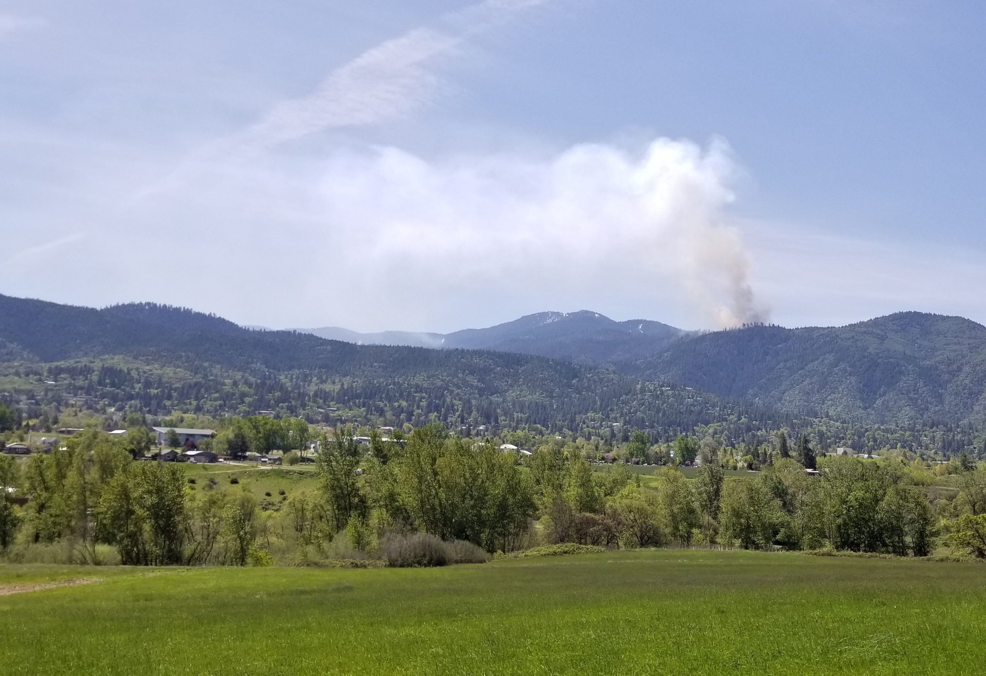
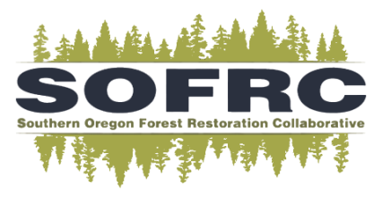

Landscape Analysis to Catalyze Project Development
11 November 2019
Kerry Metlen, Ph.D.; Forest Ecologist, The Nature Conservancy
Contact: kmetlen@tnc.org

Slide 2
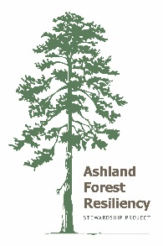
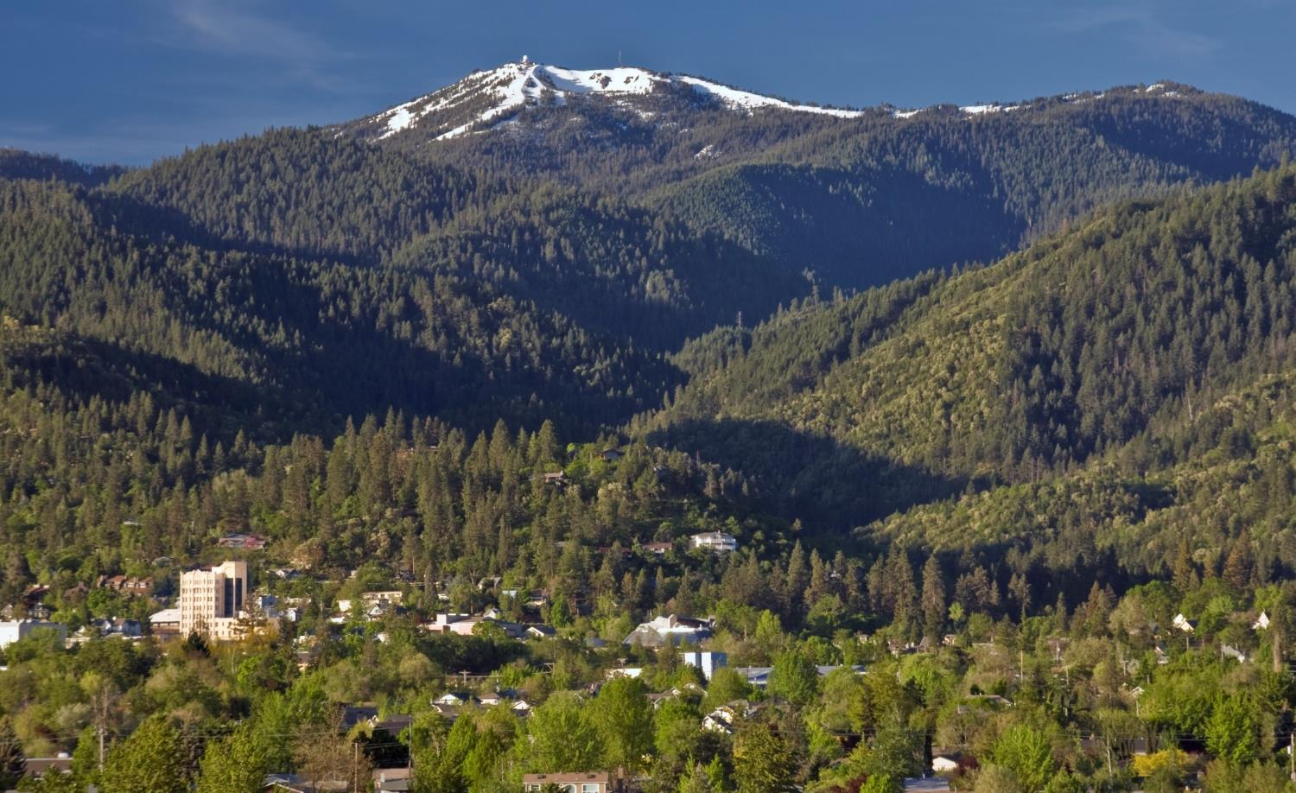

Working Together for Common Good
People and Nature are threatened by uncharacteristic fire
Integrate across objectives
Explicitly account for fire
Collaborate, all lands
Be broad-based and transparent
Si

Slide 3
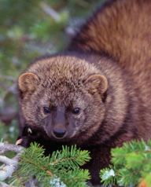
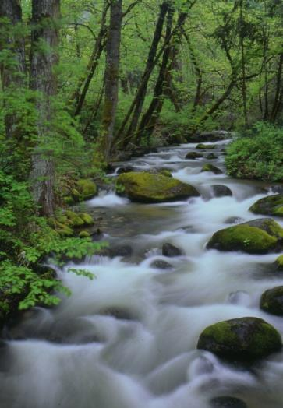
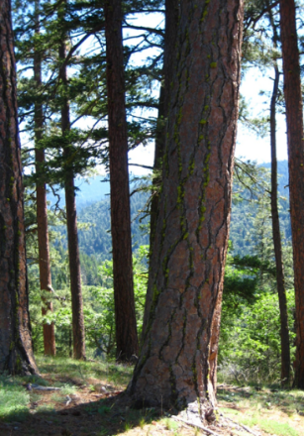
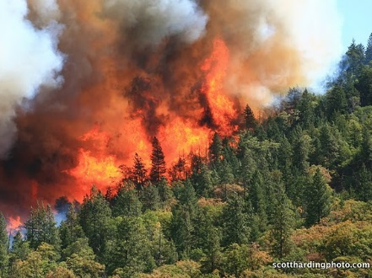
Integrated By Design
Municipal Watershed Protection
Spotted Owl Habitat Protection
Restoring Fire
Thinning
Community Protection

Slide 4
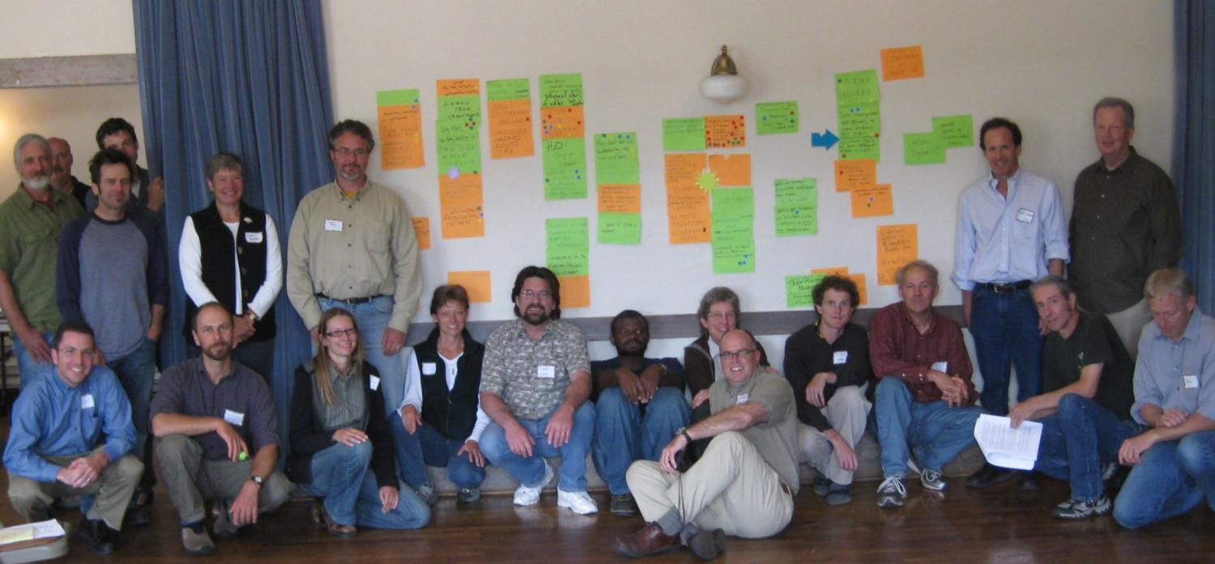
Collaboration
Developing Monitoring Priorities, June 12, 2009
Monitoring Advisory Committee
Ellen Goheen - USFS, Forest Health Program
John Alexander - Klamath Bird Observatory
John Gutrich - Southern Oregon University
Mark Shibley - Southern Oregon University
Eric Dinger- National Park Service
Dan Sarr- monitoring scientist
Dave Clayton – USFS, Rogue-Siskiyou NF
Marty Main – Contract Forester

Slide 5
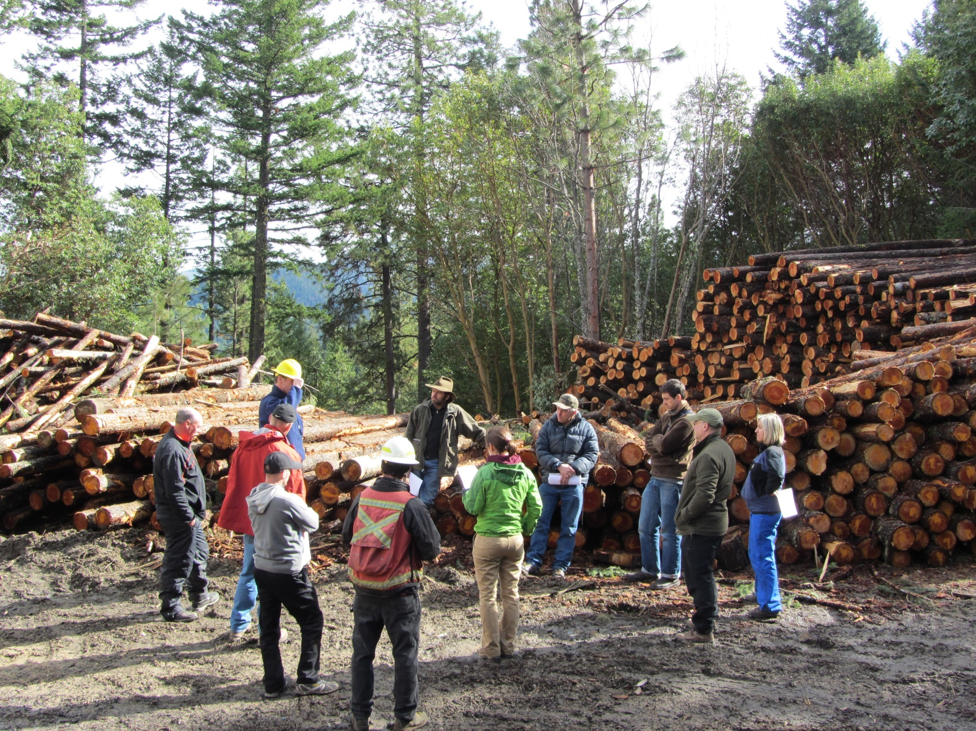


Support for Forest Restoration Growing from AFR
Large scale restoration (up 10%)
Cutting large and small trees with science backing (up 2x)
Commercial thinning (from 55% to 75%)

Slide 6
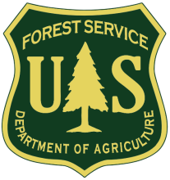
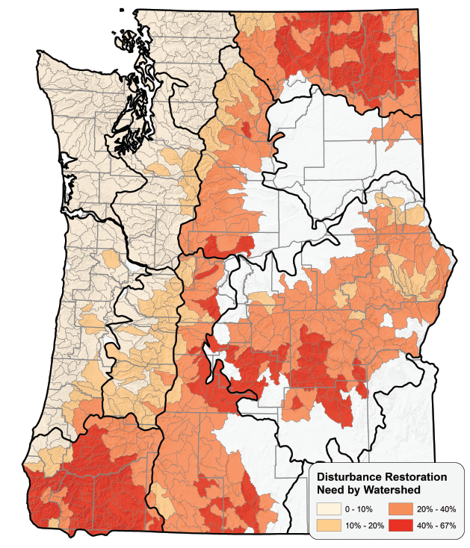
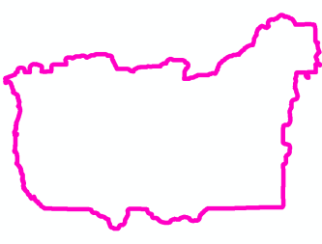
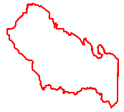
Restoration Needs in Frequent Fire Forest A collaboration of USFS R6 and TNC
Rogue Basin Forests and Woodlands
4.2 million acres
Late seral forest severely deficit
50 % overly dense
Rogue Basin
Haugo et al. 2015. A new approach to evaluate forest structure restoration needs across Oregon and Washington, USA. Forest Ecology and Management 335:37-50.
DeMeo et al. 2018. Expanding our understanding of forest structural restoration needs in the Pacific Northwest. Northwest Science 92:18-35.
Ashland Forest All Lands Restoration Initiative

Slide 7
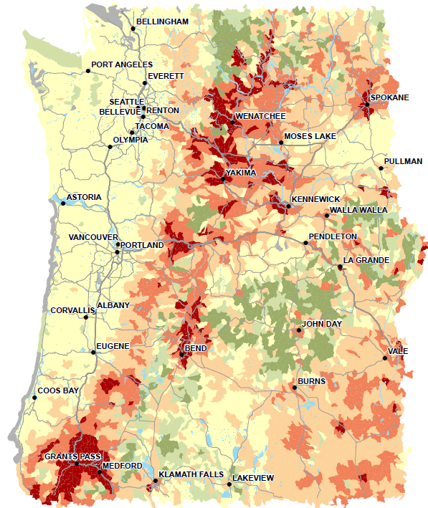
All Lands Quantitative Wildfire Risk Assessment
Rogue Basin Forests and Woodlands
Among the most at-risk in the Pacific Northwest
Smoke not evaluated
Pacific Northwest Quantitative Wildfire Risk Assessment. 2018. USFS Pacific NW & Alaska Regions/BLM State Office. Portland, OR. Project Manager: Rick Stratton; Contractor: Pyrologix.
Ashland Forest All Lands Restoration Initiative
Rogue Basin

Slide 8
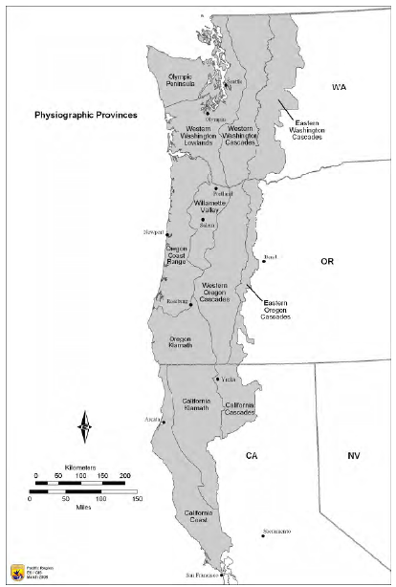
Northern Spotted Owl Recovery
Ashland Forest All Lands Restoration Initiative
Rogue Basin

Slide 9
Northern Spotted Owl Recovery Plan
Ashland Forest All Lands Restoration Initiative

Slide 10
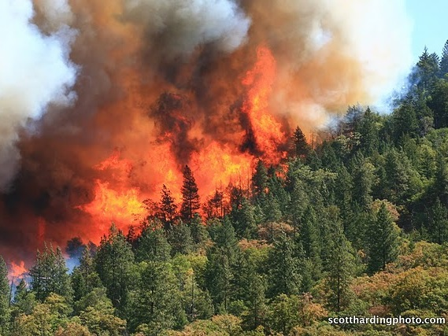
The Problems
Altered Landscapes
Elevated wildfire risk
Ecosystem Services
Water
Climate Change
Increasing temperature
Drought
Fire probability and effects
Overly dense forests and altered species mix
Endangered species
Jobs
Biodiversity
Diminished old growth
Carbon
Clean air

Slide 11
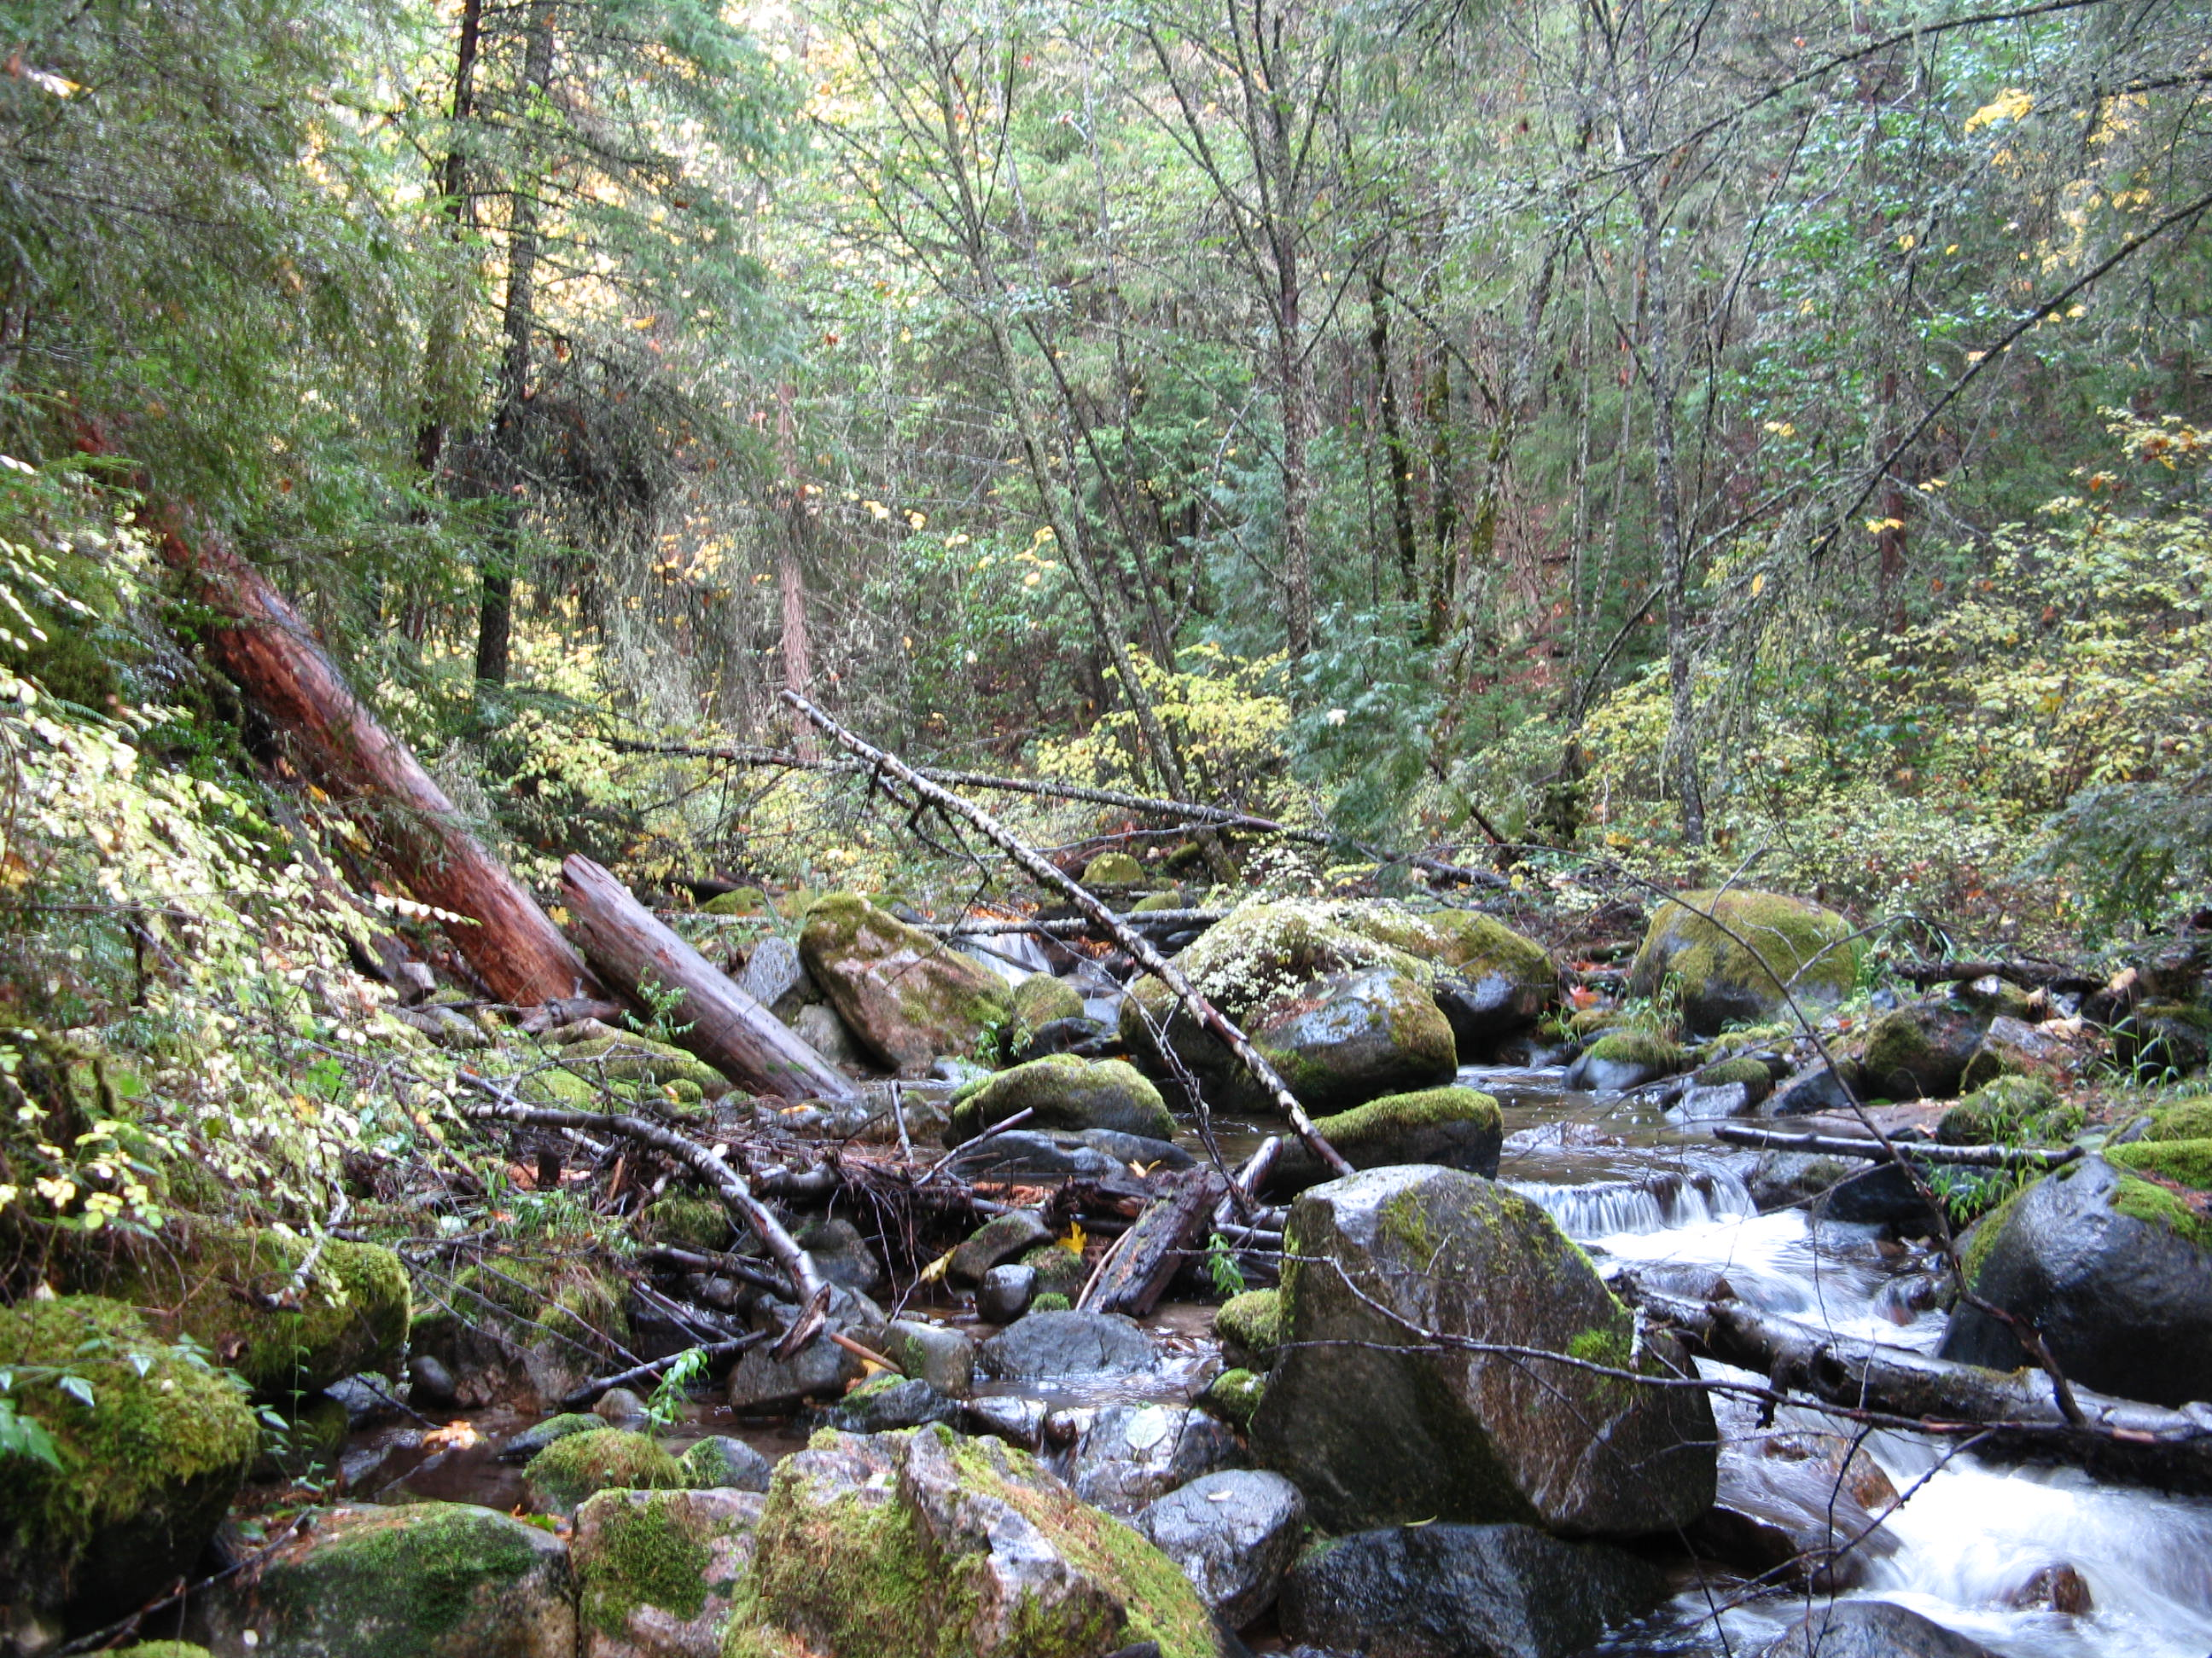
Management Options
Managed Fire
Protect communities
Proactive Ecological Thinning
Promote landscape matrix
Keep old trees
Protect and Promote Complex Forests
Protected areas
Generate revenue and support to local economies
Thinning to accelerate old growth development
Improved suppression effectiveness and safety
Adjacent fuel reduction
Integrate fire management
Restore forest process

Slide 12
Basin Strategy Increases Efficiency The Cohesive Picture
Regional Assessment
Landscape resilience
Wildfire risk
Northern Spotted Owl recovery
Climate adaptation options
Rogue Basin Strategy
Landscape-scale monitoring
Roll-up to Basin and Region
Monitoring
Adaptive Management
Watershed Project Priorities
Effectiveness monitoring
Implementation
monitoring
Local Unit Monitoring
Treated area
Treatment type
Fuel model
Seral state
Stakeholder concerns
Local opportunities
Site productivity
Species by size class
Fuel model
Successional class
Values at risk
Unit Scale Implementation

Slide 13
Efficiency by linking scales

Slide 14
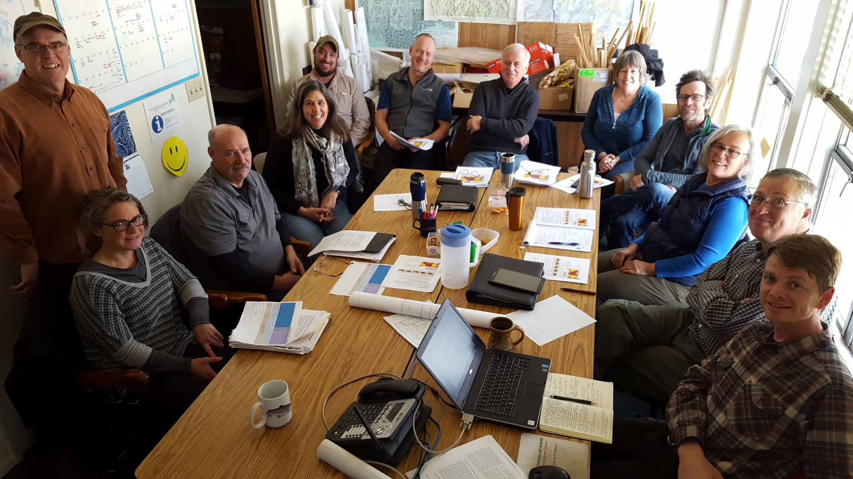
Southern Oregon Forest Restoration Collaborative sofrc.org -Technical Team-

Slide 15
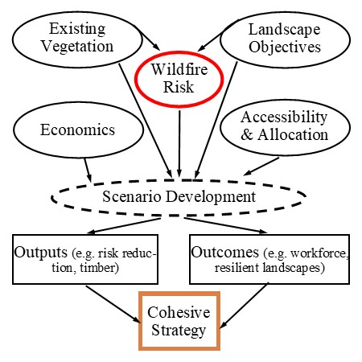

Slide 16
Cohesive Forest Restoration Addresses Why and How
Prioritized Project Areas with Explicit Objectives
Community at Risk
Resilient Landscapes
Northern Spotted Owl Recovery
Climate Resilience
Treatment Type
Accessibility and Land Allocation
Predictable Work Flow
Why
How

Slide 17
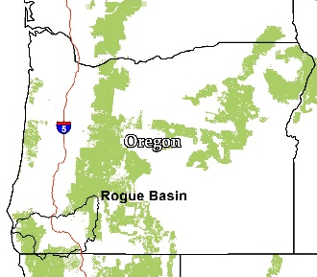
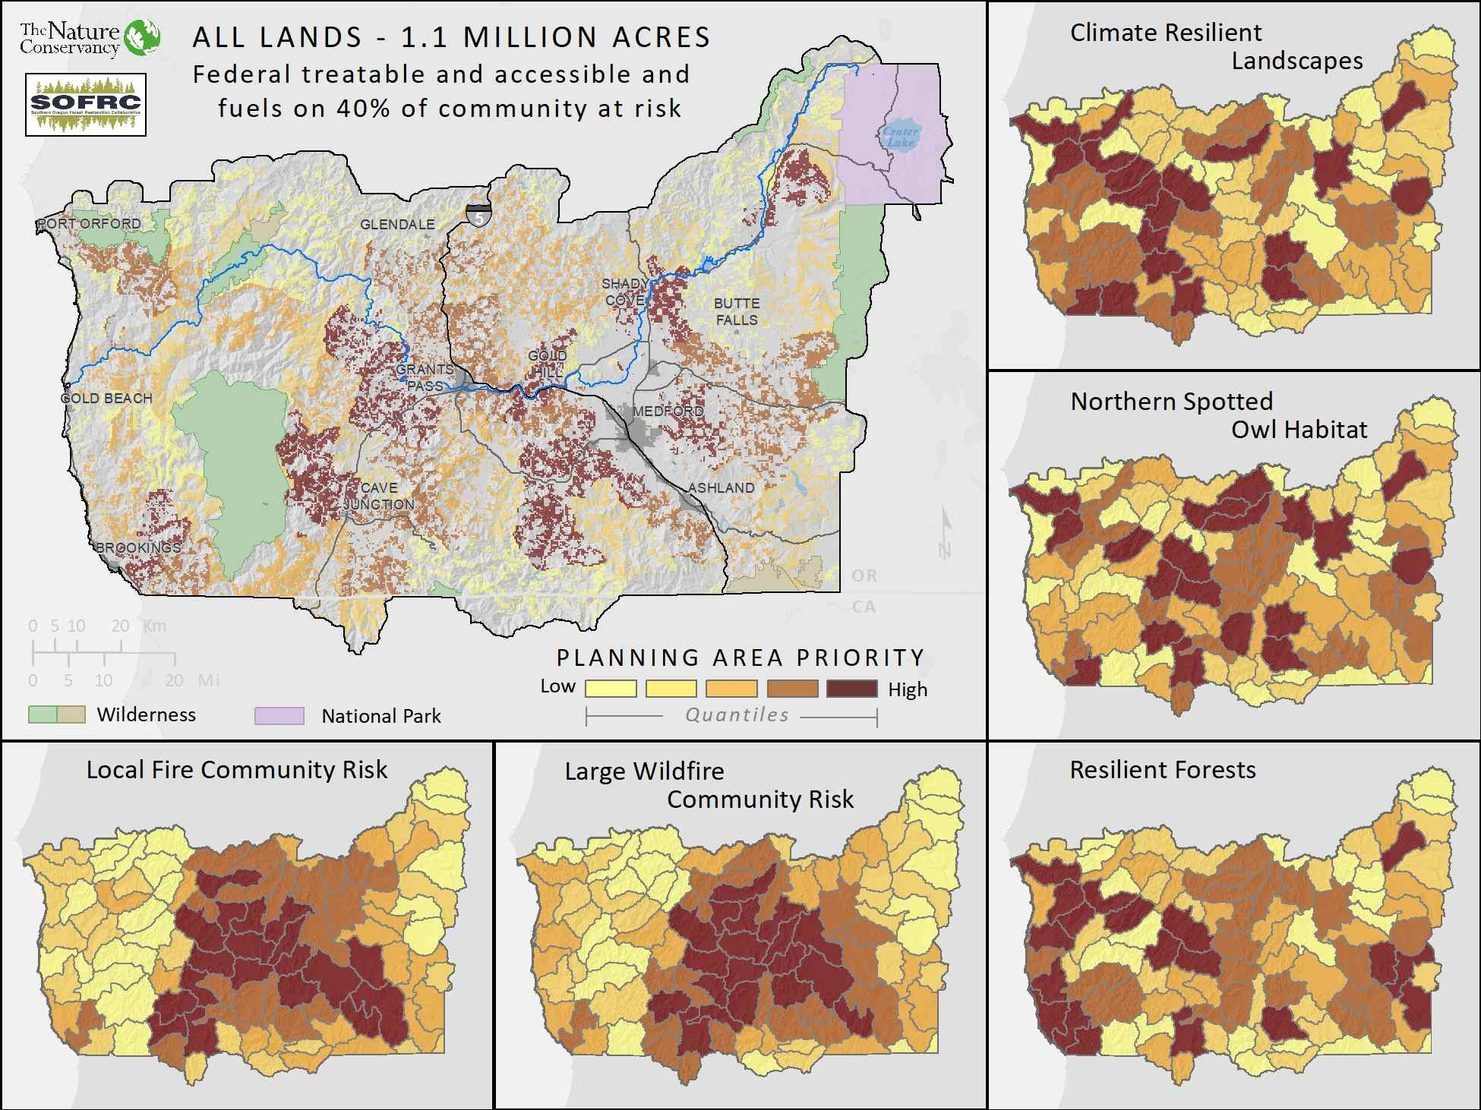
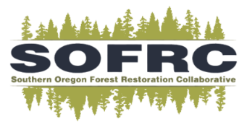
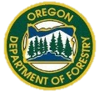
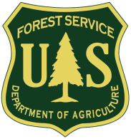
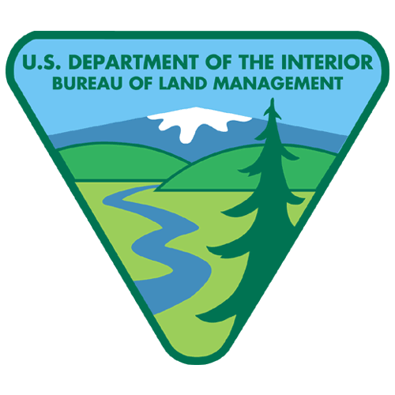

Rogue Basin Cohesive Forest Restoration Strategy Priorities and Optimization http://bit.ly/rbs-report
FUNDING SUPPORT
Ashland Forest All Lands Restoration Initiative

Slide 18
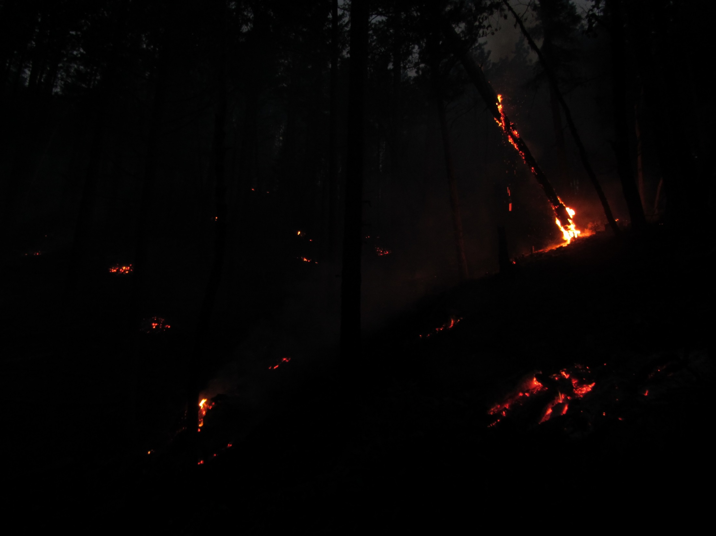

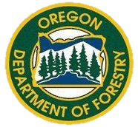

All Land Treatments on 25% of the Landscape Reduce Wildfire Risk
Reduced Overall Risk – 70%
Reduced Risk to Homes – 50%
Reduced Risk to Northern Spotted Owl core habitat – 50%

Slide 19
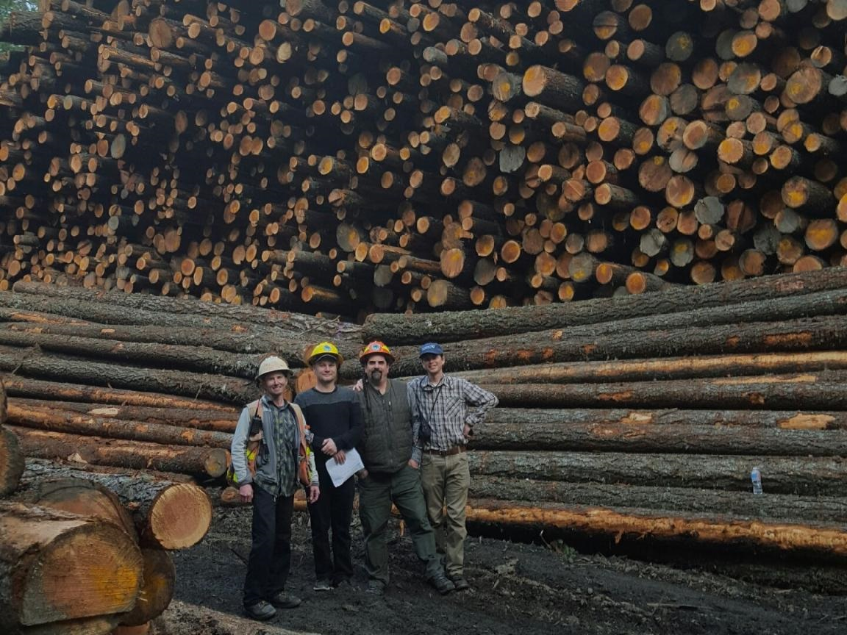
Jobs – Federal Lands 45,000 ac Annually Over 20 years
Investment of $32 million annually in mechanical fuel reduction and restoration
Harvests 66 million board feet
Generates 1,545 jobs and over $57 million in local wages
Contributes over $230 million to the local economy

Slide 20
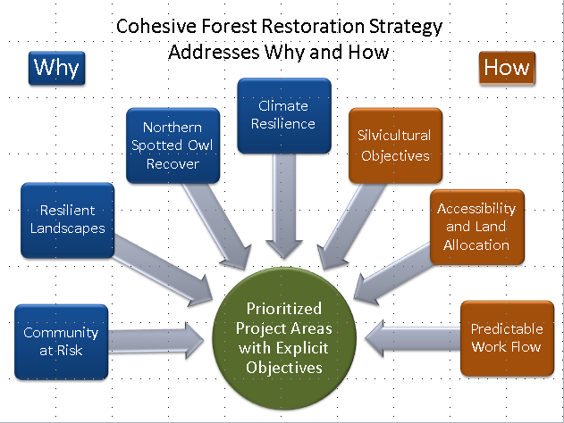
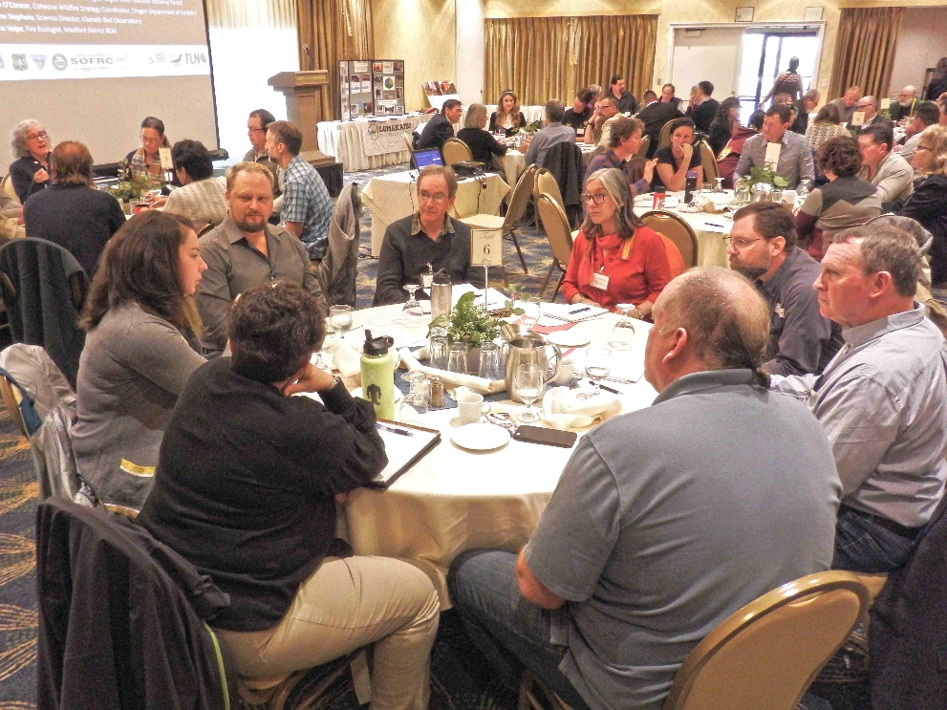
From Regional Analyses to Local Projects
Landscape objectives
Constrained by filters
Social relevance with broad collaboration
Political will
Local opportunities
Refined objectives
Spatial prioritization
Outreach, education, and engagement
Co-investment

Slide 21
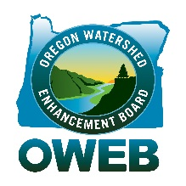
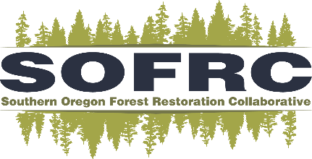
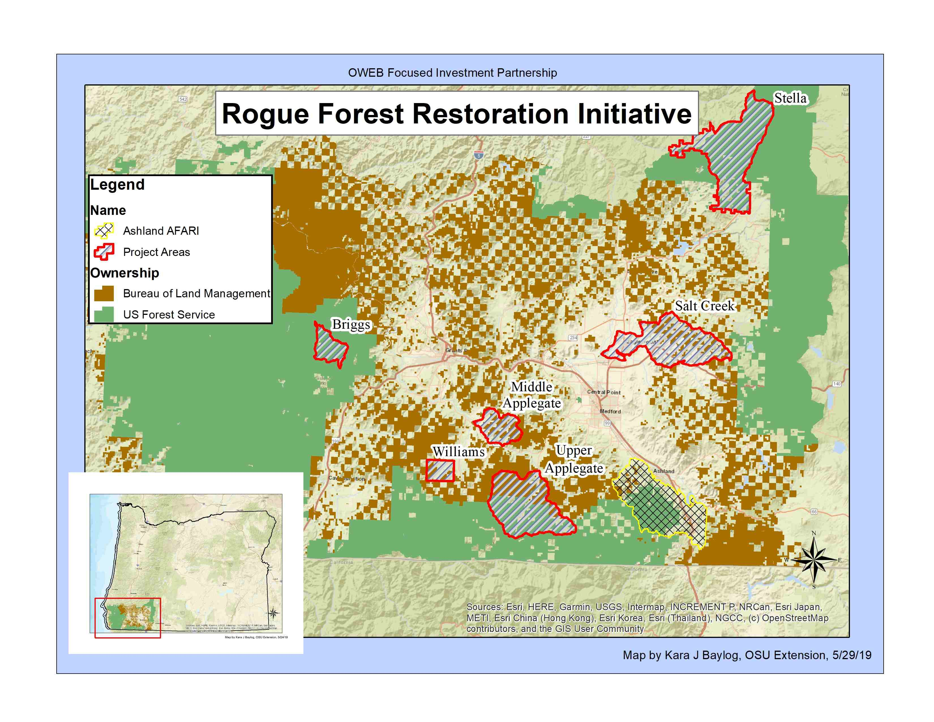

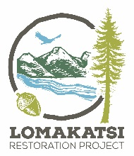
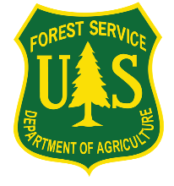
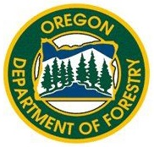
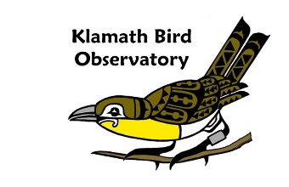

State Funding $6 million/6 years Rogue Forest Restoration Initiative

Slide 22
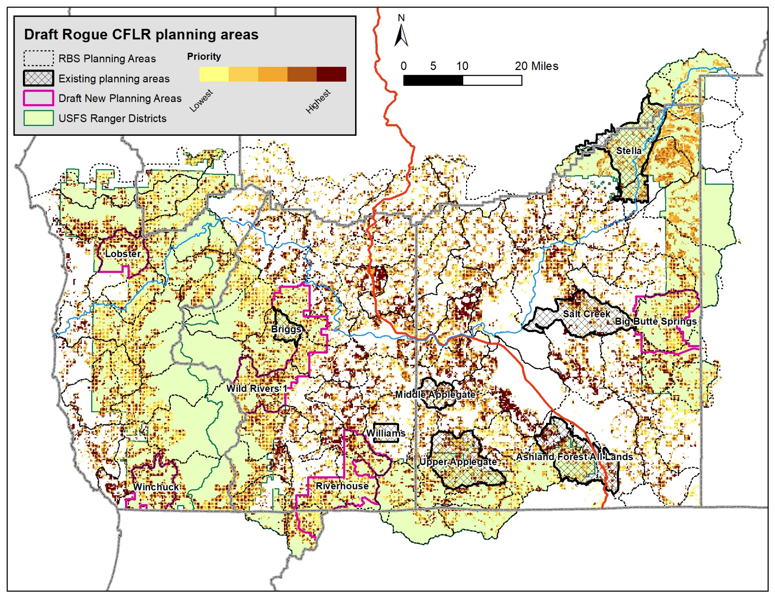
Guiding Collaborative Landscape Forest Restoration

Slide 23
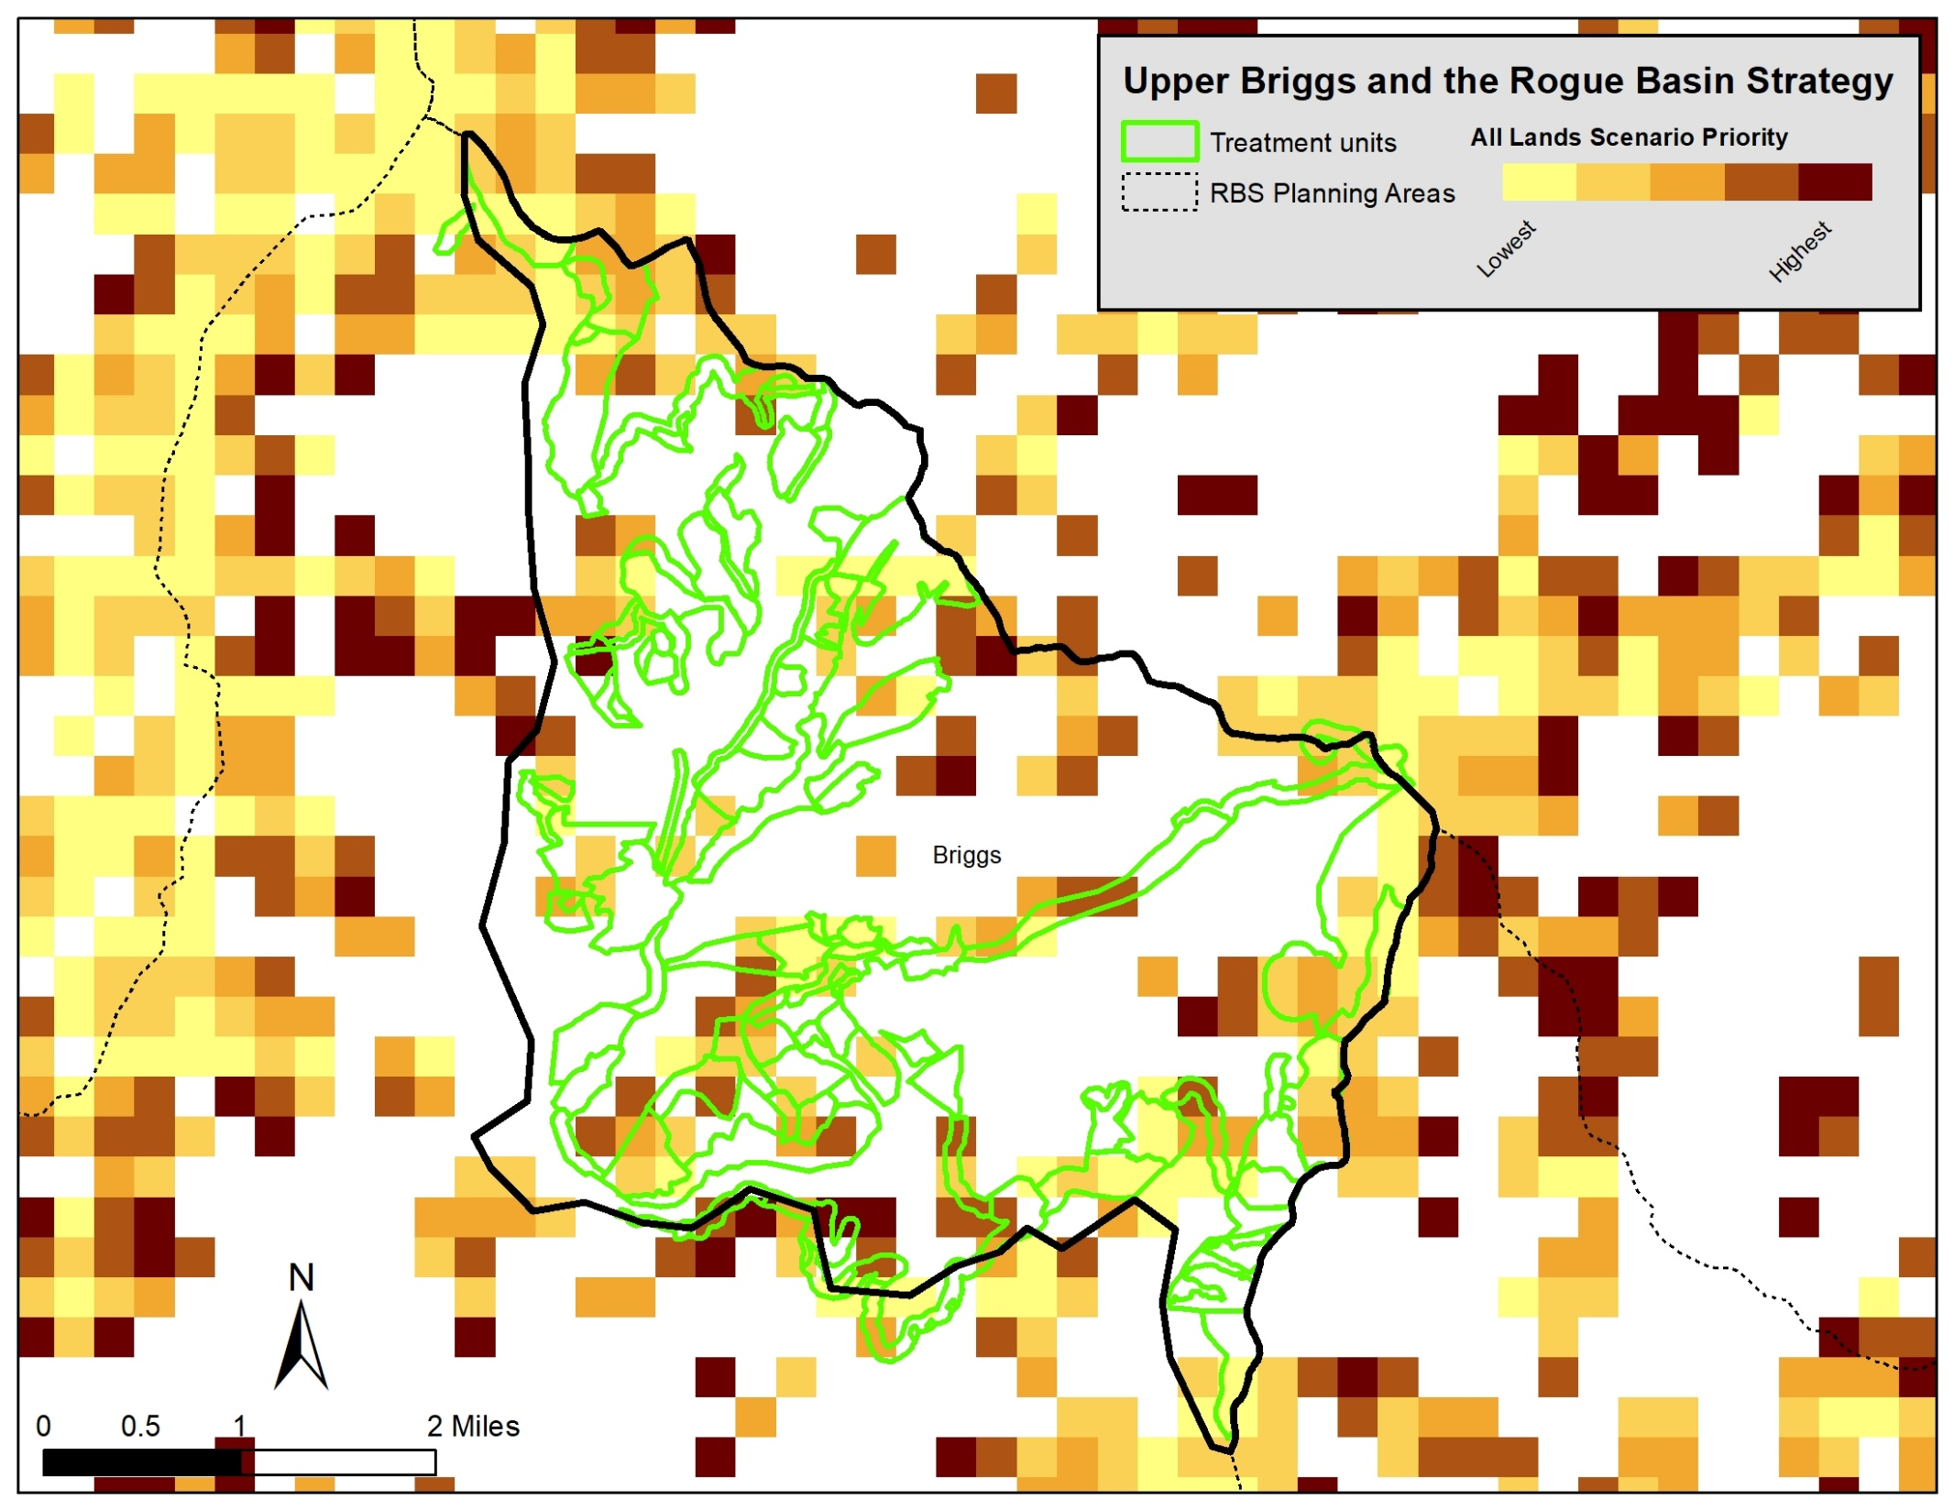
Local Project Refinement

Slide 24

Partners in Planning

Slide 25
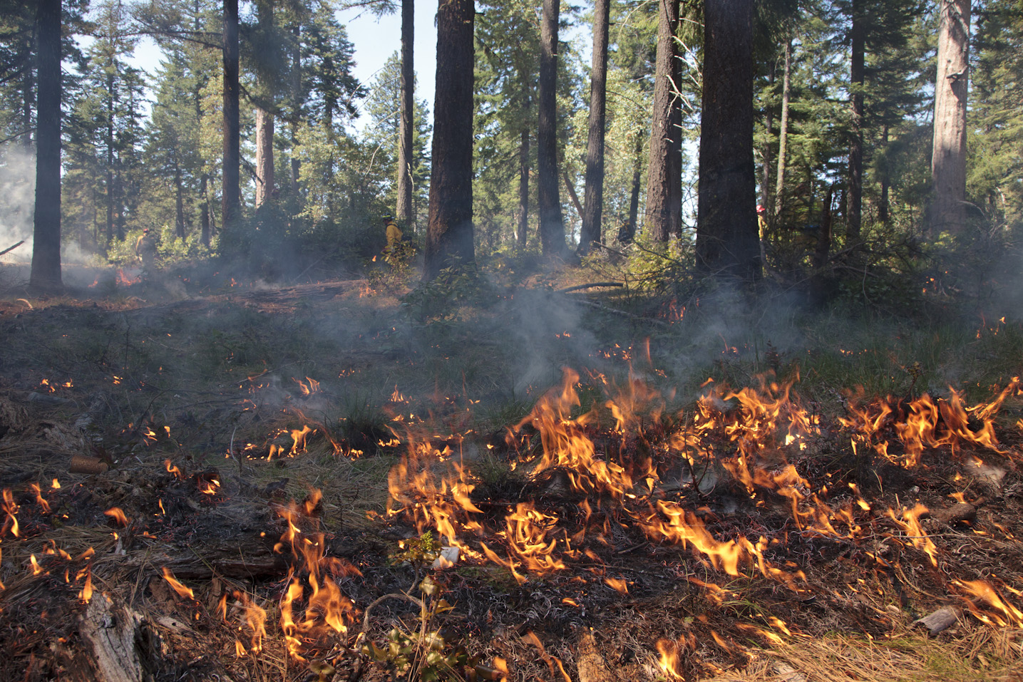
Restoring Fire for Nature and People
Metlen, K. L., D. Borgias, B. Kellogg, M. Schindel, A. Jones, G. McKinley, D. Olson, C. Zanger, M. Bennett, B. Moody, and E. Reilly. 2017. Rogue Basin Cohesive Forest Restoration Strategy: A Collaborative Vision for Resilient Landscapes and Fire Adapted Communities. The Nature Conservancy, Portland, OR. Available online at: http://bit.ly/rbs-report or SOFRC.org
Funding Support
Northwest Conservation Fund, Oregon Department of Forestry, Oregon Watershed Enhancement Board, Jackson County, Josephine County, USDA USFS Rogue River-Siskiyou National Forest, USDI Bureau of Land Management
Photo © The Nature Conservancy (Evan Barrientos)

Slide 27
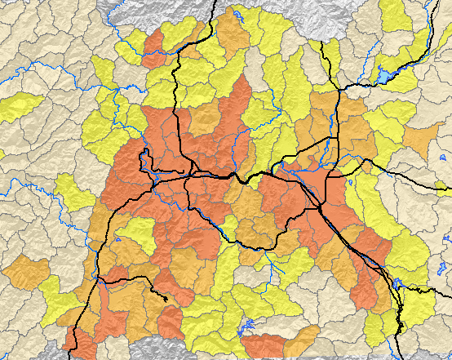
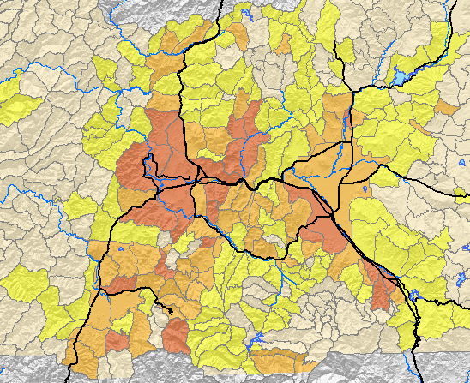

Improve Spatial Planning with Fire-relevant Boundaries
12th Field Watershed
Potential Wildfire Operational Delineations (PODs)
Strategic fuel treatment planning
Informed suppression response
Integration with other resources

Slide 28
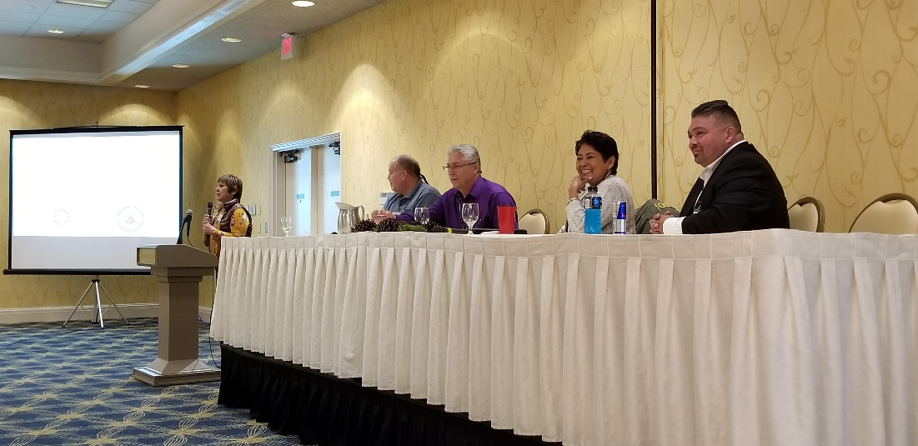
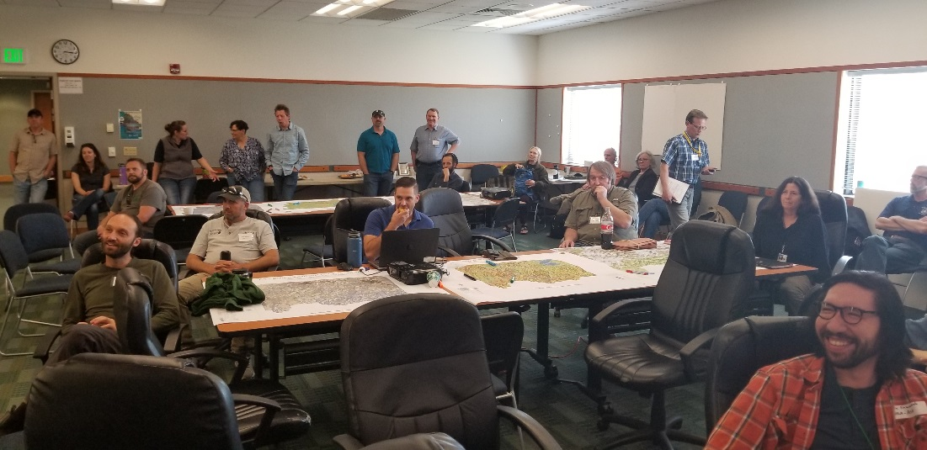
Integrate Planning and Fire with Social and Technical Process Collaboratively Proactive Fire Planning
Rogue Leadership Forum
146 leaders and partners
Federal agencies
Tribal officials
State agencies
Rural fire chiefs
Elected officials
Conservation organizations
Business
Industry
All Lands Workshops
104 specialists and partners
Agency planners
Tribal specialists
Fire specialists
Wildlife biologists
Conservation groups
State agencies
Rural fire
Industry

