Slide 1



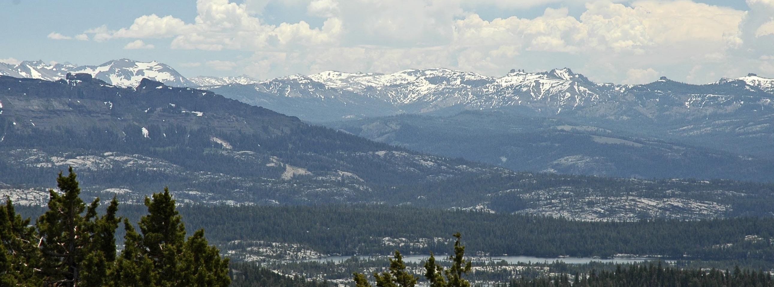
Emigrant Wilderness: A Profile
The 113,000-acre Emigrant Wilderness is entirely within the Stanislaus National Forest, on the upper western slope of the central Sierra Nevada range. Bordered on the south by Yosemite National Park and on the east by the Hoover Wilderness, this wilderness measures roughly 25 miles long and 15 miles wide and is entirely within Tuolumne County. Major watersheds drain to the Stanislaus and Tuolumne rivers and its name is derived from the emigrant parties who crossed the Sierra Nevada.
About 2.5 million years ago, glaciers started carving into the Sierra Nevada batholith, exposing granite and creating telltale U-shaped valleys. The northeastern section of the wilderness is characterized by volcanic ridgelines and peaks. The remaining sections are sparsely vegetated granite ridges, with fresh alpine lakes and lush meadows scattered between them. Elevations range from below 5,000 feet near the Cherry Reservoir to the majestic 11,750-foot Leavitt Peak. The range of elevation in the popular high use areas lies between the 7,500-foot to 9,000-foot levels.
Carson-Iceberg Wilderness: A Profile
The 160,000-acre Carson-Iceberg Wilderness straddles the crest of the central Sierra Nevada range, located in both the Stanislaus and Humboldt-Toiyabe National Forests. This area lies within portions of Tuolumne and Alpine counties, bordered on the south by Highway 108 and on the north by Highway 4. The name is derived from two geographic features: the Carson River (named for scout and explorer Kit Carson) and the distinctive granite formation known as the "Iceberg", situated on the southern boundary of the wilderness at the end of Clark Fork Road. Watersheds drain to the Stanislaus and Carson Rivers.
The Dardanelles are a prominent volcanic feature in the southwestern sector of the area. There are many streams flowing through canyons but very few lakes in comparison to the Emigrant Wilderness next door. Elevations range from 5,000 feet near Donnell Reservoir to towering 11,462-foot Sonora Peak. From some vantage points, one can simultaneously view vast deserts to the east and dense conifer forests to the west.
Welcome to the Wilderness
Emigrant and Carson-Iceberg Regulations
Climate
Precipitation averages 50 inches annually; 80 percent in the form of snow. Snowpack typically lingers into June, and even later after a very wet winter. Summers are generally dry and mild, but afternoon thunderstorms occur periodically and night temperatures can dip below freezing. Always be prepared for cold and wet weather!
Ecology
Mixed forests of ponderosa and Jeffrey pines, white fir, and oak exist at mid-mountain elevations (3,000-6,000 feet). At around 7,000 feet lodgepole pine and western juniper grows and golden-mantled ground squirrels, dusky grouse, and pine martens appear. In the subalpine zone (9,000-10,500 feet) whitebark pine and Clark's nutcracker are common. Several trout species live in the subalpine lakes. Watch out for mosquitoes and other bugs in the wet summer months.
History
Many Native American tribes (among them the Mi-Wuk) have populated this area for thousands of years, spending the summer and early autumn months hunting game and gathering resources in the high country. They traded with other tribes, such as the Paiute and Washoe tribes of the Great Basin– on the eastern slope of the Sierra. In 1827, Jedediah Smith and fellow trappers crossed from west to east somewhere near Ebbetts Pass. The earliest emigrant crossing in the Carson-Iceberg area was in 1841 just north of the Sonora Pass by the Bartleson-Bidwell party.
After gold was discovered in 1848, large numbers of miners and settlers descended on the area, devastating the native population and their culture. In the fall of 1852, the Clark-Skidmore party was the first emigrant group to travel the West Walker route over Emigrant Pass. The following year, several more groups were enticed by officials in Sonora to use this route, but it was a very difficult passage. Relief Valley got its name from the assistance stranded travelers received from the Sonora area residents. The route was later abandoned, and the area fell into disuse and in 1931, the Forest Service created the Emigrant Basin Primitive Area.
Wilderness Management
The Wilderness Act of 1964 established the National Wilderness Preservation System, "to secure for the American people of present and future generations the benefits of an enduring source of wilderness". On Jan. 4, 1975, the Emigrant Basin Primitive Area was designated as the Emigrant Wilderness. The Carson-Iceberg Wilderness was created with the passage of the California Wilderness Act of 1984.
Grazing
Livestock grazing first came into the high country in the 1860s. The Wilderness Act allows grazing to continue where it was an established practice before the land was designated as wilderness. Gates and drift fences control livestock movement to prevent overgrazing and reduce conflict with wilderness visitors. Please help by keeping gates closed.
Wilderness is a treasure that must be protected by every visitor who experiences its beauty. Some mark is left each time we visit, but we can all do our part to ensure any impact is imperceptible. The Stanislaus National Forest contains the entire Emigrant Wilderness and a portion of the Carson-Iceberg Wilderness.
The Emigrant Wilderness is known for sparkling alpine lakes, vast granite basins, and craggy volcanic formations. The Stanislaus portion of the Carson-Iceberg Wilderness provides opportunities for solitude among a variety of geological features and numerous mountain streams.
Permits
A free permit is required for any overnight use of the wilderness. Obtain them in person before your trip starts at the Supervisor’s Office in Sonora or at the Calaveras, Groveland, or Summit Ranger Stations. If you are unable to obtain them in person, call a ranger station for guidance. If you are just day-hiking in the wilderness, then you do not need to obtain a permit. All types of groups, however, are limited to fifteen (15) people maximum traveling together. We encourage groups to restrict their numbers when visiting wilderness areas, which helps keep pristine resources from being damaged.
If you are planning longer distance trips that involve travel to other wilderness areas, be aware that they may have differing quotas. Contact their governing agencies for specific information.
Trailheads
Many trailheads that lead into the wilderness have limited parking and no facilities. Popular trailheads may fill up for
day hiking usage, plan ahead to make sure you are able to leave your vehicle in a safe and legal space. Please don't block forest roads and intersections.
Campsite Selection
Do your part to steward the wilderness and camp responsibly. These areas have no designated campsites. You must be able to identify campsites that follow our guidelines and Leave No Trace principles. You are required to camp at least 100 feet from any trails or water sources (if seasonal, defer to any high-water marks).
Make every effort to find legal, previously used campsites. Camping on previously used sites creates far less impact than setting up in pristine areas. If no such site exists, camp on durable surfaces, do not camp in meadows or near stream beds. You may come across campsites that are too close to water and trails, do not use them. If you wish to have a campfire, find a campsite that already has a fire ring and make sure you are below 9,000 feet in elevation. (See the next page for fire and stove regulations).
USDA is an equal opportunity provider and employer.
ROG 16-25/31 06/2024
ROG 16-23 06/2024

Slide 2
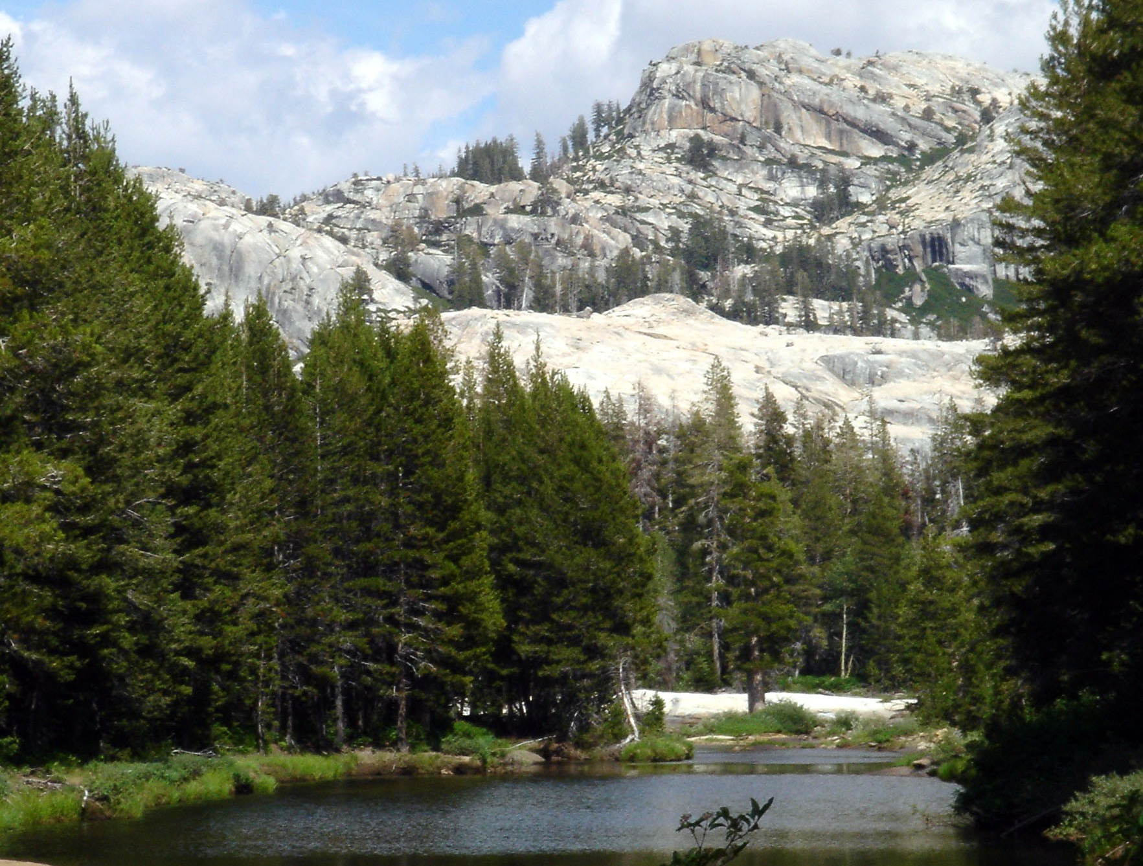
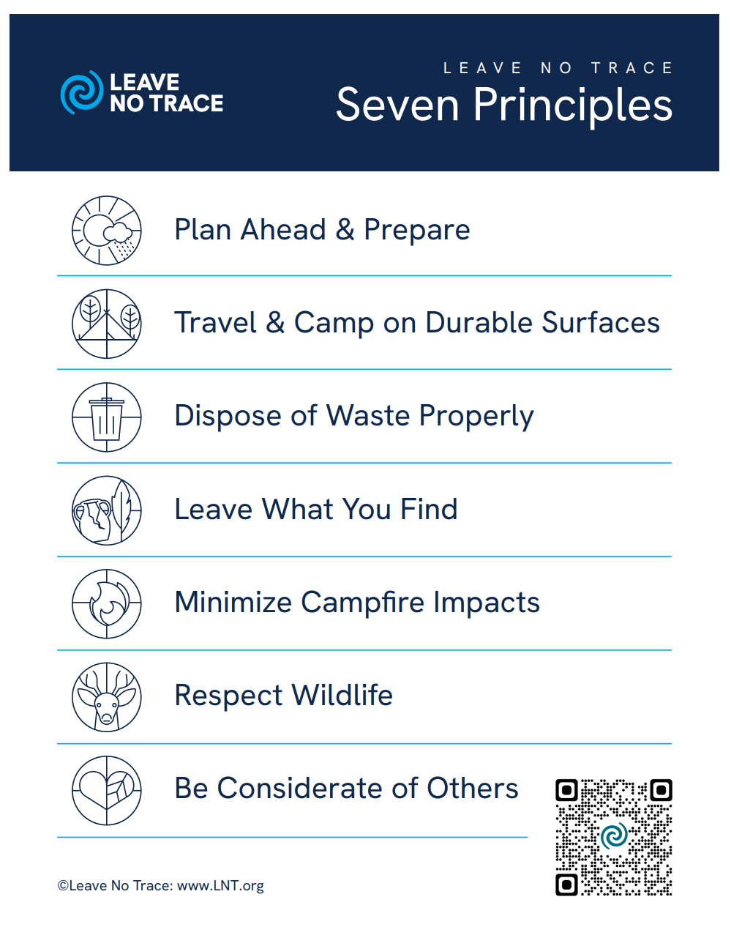
Stoves and Fires
You must obtain a free California Campfire Permit from CalFire for the use of all stoves and fires. www.readyforwildfire.org/permits/ You are legally required to know and comply with all current fire restrictions for the area.
The use of gas stoves with regulators is encouraged for fire safety and to avoid depletion of wood. If you do have a fire, use existing fire rings, please do not build new ones. Campfires are not permitted in locations above 9,000 feet. If you find a fire ring where one shouldn't be, (too close to any natural resources, above 9,000 feet, etc.), please do not use it. If you have the capability, take a GPS point or an accurate location description and contact someone at a ranger station to let them know of any problem fire rings.
Use wood found on the ground that has a diameter no greater than three inches. Keep fires small– no bonfires. Clear all flammable materials from the ground for 5 feet in all directions. Always personally supervise the campfire until it is completely extinguished. If you plan to have a campfire, carry a collapsable bucket and trowel to stir coals and water to make sure it is completely extinguished. DROWN–STIR–FEEL–REPEAT until it is out. You are legally responsible for any fire you start and may be financially liable if it escapes.
Breaking Camp– PACK IT OUT
Be sure to carry out all trash– including foil, cans, plastic, glass, cigarette butts, and cooking grills. Do not bury or burn food scraps, you must pack them out. Buried garbage attracts animals and is harmful to them. Sweep your site to make sure you picked everything up. Leave the wilderness better than you found it and carry out trash that isn’t yours!
Sanitation
Human and canine feces left unburied or close to water can spread disease and contaminate water sources. Dig a cathole six to eight inches deep to bury human and canine feces– at least 200 feet from water, trails, and campsites. Pack out toilet paper and any other refuse (tampons, pads, diapers, wipes, etc.). Clean fish far from water and camp sites, at least 200 feet. Remember, all foreign substances are pollutants. Sunscreen, bug spray, etc.– even biodegradable soaps are a shock to fragile and pristine aquatic ecosystems. If swimming or wading, please wipe anything off before entering the water and do not bathe in waterways. If you must wash dishes, use a bucket at least 200 feet away from any water source, campsite, or trail and dispose of the dirty water in a cathole.
Water Quality
Lakes and streams can be contaminated even though they look and taste pure. The surest method of treatment to make water safe for drinking is to boil it for five minutes. Other methods involve filtering or using chemical disinfectants (such as iodine or chlorine tablets and drops). A 0.5-micron filter can remove most harmful bacteria and protozoa– including giardia. Although not designed to kill giardia, these filters work well against most waterborne, disease-causing bacteria and viruses. For increased safety, you can treat filtered water with chemical disinfectants.
On the Trail
Cutting across trail switchbacks causes soil erosion and damages trails. Staying on trail is safer, easier and saves trail maintenance costs. Do not leave trail markers of any kind. For both your and their safety, always give stock/horses the right of way by moving well off the trail on the downhill side. Please verbally communicate with the horse user and follow their instructions if necessary. If you are bringing a dog, you must pick up and dispose of their waste, make sure you know and adhere to leash laws for the county you are in. Dogs accompanying stock groups may be under voice control.
Solitude
Perhaps the most important aspect of the wilderness experience is the quality of solitude– freedom from the intrusion of human sights, sounds, and odors. Help preserve this aspect for everyone who visits by observing a few considerations for your wilderness neighbor. While hiking or camping, groups should be separate as much as possible to minimize adverse impact on resources. Avoid acting boisterous or playing music. Using drones in wilderness areas is prohibited. Mechanized (includes anything with wheels) and motorized equipment are prohibited, (see Regulations).
Food Storage and Bear Safety
Anything that goes in your body or on your body should be secured at all times. This means that those items should be either in your pack that is on your back, in a bear resistant food container, or properly hung. Never leave a pack with food or scented items unattended.
You must store your food, trash, and any other scented items such that they are inaccessible to wildlife. A bear resistant food container (see the Interagency Grizzly Bear Council’s website for a list of tested products) is the most effective method, given that it is appropriately used and kept the proper distance away and downwind from your campsite. Bear canisters are required in Yosemite National Park and the Hoover Wilderness. A proper bear hang is permissible on the Stanislaus but can be an unreliable method. It leaves room for human error and bears sniff out any mistake a person makes. If you are planning to hang your food, practice your technique before you leave home and make sure you are confident in your skill and equipment. Note that in alpine areas adequate trees to hang may not always be available, and if they are, you must take extra care not to damage them as organisms in these low nutrient environments can take years to recover.
Contact someone at a ranger station to report any concerning bear behavior or if a bear obtains a food reward.
Regulations and Guidelines
To ensure that you have a true wilderness experience, we ask that you follow these guidelines. This will make certain that future generations will find the wilderness just as wild and free as it is for your visit.
Obtain a free wilderness permit for overnight trips.
Do not camp, travel, or gather in groups of more than 15 persons.
Campsites must be at least 100 feet from any water source or trails.
Do not use any soap in lakes or streams. Wash dishes using a bucket at least 200 feet from surface water.
Dispose of bodily waste and wash water at least 200 feet from any water source, trail, or campsite. Use cat holes six to eight inches deep, pack out toilet paper and other sanitary products.
Pack out trash– including food scraps. Do not burn or bury.
Your food and other scented items (including trash) must be secured and inaccessible to animals at all times.
Mechanized and motorized vehicles and equipment, including bicycles, strollers, hangliders, game carts, and chainsaws are prohibited. Non-motorized mobility devices may be utilized.
Drone usage is prohibited in wilderness areas.
Constructing items such as rock walls, structures, tables, or permanent improvements of any kind is prohibited.
Do not cut standing trees or deface them in any way.
Campfires are prohibited in locations above 9,000 feet.
Please do not build new fire rings– use only existing ones in legal locations.
You are prohibited from leaving any property, including camping gear, food, or other provisions, unattended for longer than 24 hours.
Do not take shortcuts at trail switchbacks.
Discharging firearms is permitted only for licensed hunters taking game during appropriate hunting seasons.
Dogs must be under direct control at all times.
  Tuolumne County maintains a leash ordinance. The Emigrant and portions of the Carson-Iceberg are within the Tuolumne County jurisdictions.
One night per trip camping limits are in effect in the Emigrant Wilderness at: Grouse, Camp, Bear, Powell, and Waterhouse lakes.
Contact Us:
Supervisor's Office Stanislaus National Forest
19777 Greenley Road
Sonora, CA 95370
(209) 532-3671
Summit Mi-Wok District Highway 108 Corridor
1 Pinecrest Lake Rd
Pinecrest, CA 95364
(209) 965-3434
Groveland Ranger District Highway 120 Corridor
24545 Highway 120
Groveland, CA 95321
(209) 962-7825
Calaveras Ranger District Highway 4 Corridor
5519 Highway 4
Hathaway Pines, CA 95223
(209) 795-1381
Most offices are open Monday through Friday, call or visit https://www.fs.usda.gov/stanislaus for current hours.

