Slide 2
Alternative Slides in the deck
Slide 3 & Slide 4 – are Alternate title slides; Slide #3 has the cover of the Gov Guide as the background; Slide #4 just has the picture with slightly different wording
Slide 10 & Slide 11 – slide #10 is a map with all the NFs across the US; Slide #11 is a blank template to insert your local NF map
Slides 26, 27, 28, and 29 – Provided as alternatives; notes on slide 25 have same language
Slide 34 – Provided as additional information
Notes:
This slide shows the alternate slides in the deck; users can customize the deck to suite their needs

Slide 3
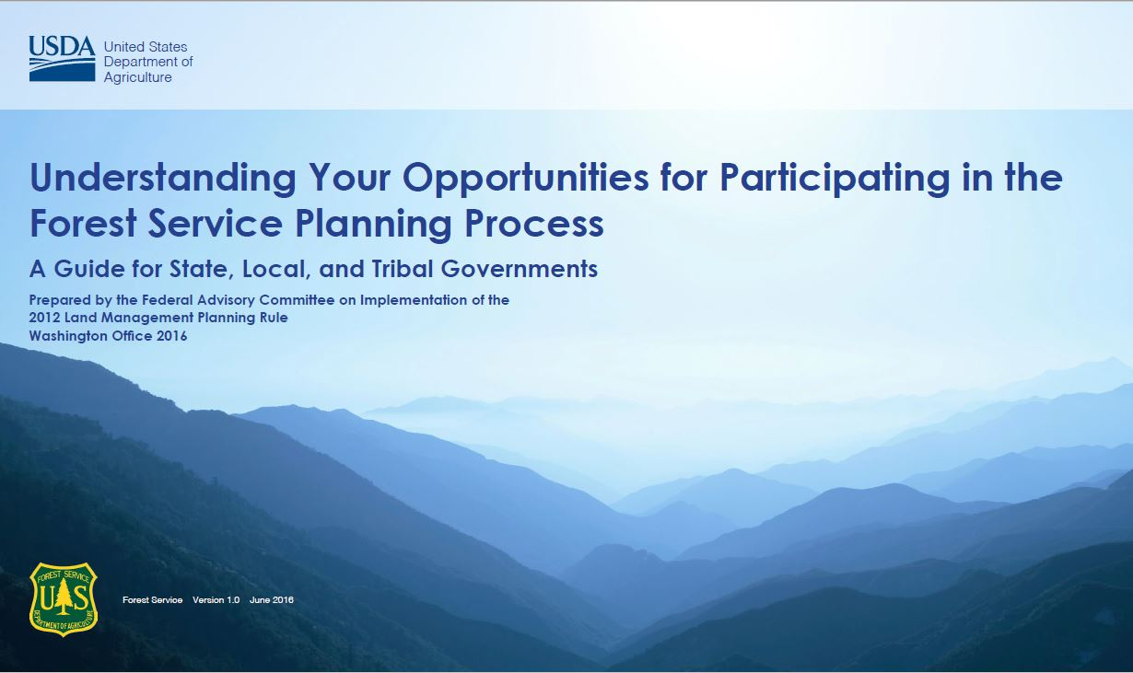
NATIONAL FOREST Planning
USDA Forest Service
[Your name] [your email]@fs.fed.us
[Your city & state], [current date]

Slide 4

NATIONAL FOREST Planning
USDA Forest Service
Understanding the opportunities for state, local, and tribal governments to participate in the forest service planning process
[Your name] [your email]@fs.fed.us
[Your city & state], [current date]

Slide 5
INTRODUCTION
Forest Plans guide the stewardship of national forests and grasslands - an important part of our National Forest System
This presentation will:
  Clarify the difference between forest plans and project/activity planning;
  Help you understand the forest plan revision process; and
  Identify your opportunities for working with the Forest Service to help determine the future of this important national legacy of stewardship
Notes:
In 2012, the Forest Service, an agency of the U.S. Department of Agriculture, adopted an innovative new rule to guide land management planning in the National Forest System.
The Planning Rule is a significant advance in citizen-based land management planning intended to benefit communities, and to protect national important landscapes and resources.

Slide 6
WHY OUR NATIONAL
FORESTS ARE MPORTANT
National forest and grasslands provide resources that we use, including timber, fish, forage, wildlife, minerals, recreation, water and many specialty products.
Healthy forest ecosystems purify the air; provide clean water; reduce the effects of drought and floods; store carbon; generate fertile soils; provide wildlife habitat; maintain biodiversity; and provide a variety of outdoor recreational experiences.
Notes:
Resources provided by national forests include timber used for wood products, forage for livestock and wildlife, mineral resources used in manufacturing and energy production, and many specialty products such as mushrooms, berries, and traditional medicines.
Healthy forest ecosystems purify the air we breathe; provide clean water for our cities, homes, and irrigation; reduce the effects of drought and floods; store carbon; generate fertile soils; provide wildlife habitat; maintain biodiversity; and provide aesthetic, spiritual, cultural values, and a wide variety of outdoor recreational experiences

Slide 7
What Is a Forest Plan and
Why Is It Important?
Forest plans set the overall management direction and guidance for each of our national forests.
Forest plans do not provide site-specific direction, but instead guide management activities at a forest-wide scale.
Forest plans guide the direction of specific projects or activities on the ground.
Forest plans must meet the requirements of the National Forest Management Act and its implementing federal regulations known as the planning rule.

Slide 8
Planning Rule and Public Involvement
Key Points of the 2012 Planning Rule
The Planning Rule establishes the process for how forest plans are developed, revised, or amended.
Provides a collaborative and science-based framework for land management planning.
Emphasizes balancing economic and social values with ecological integrity.
Recognizes the importance of working with State, local, and tribal agencies in creating plans.
Notes:
Provides a collaborative and science-based framework for land management planning in order to sustain and restore ecosystems and watersheds, protect wildlife, respond to a changing climate, and connect people to National Forest System lands.
Emphasizes balancing economic and social values with ecological integrity by supporting sustainable recreation and rural job opportunities.
Recognizes the importance of working with State, local, and tribal agencies in creating plans that meet a wide range of community needs.

Slide 9
Planning Rule and Public Involvement
Requires reaching out to partners.
Strengthens the role of public involvement in the planning process.
Establishes a pre-decisional administrative review process.
Notes:
Requires reaching out to partners to look for opportunities to meet joint objectives and build efficiencies in planning, implementation, and monitoring.
Strengthens the role of public involvement in the planning process and provides numerous opportunities for public participation and dialogue.
Includes a strong emphasis on protecting and enhancing water resources.
Establishes a pre-decisional administrative review process to provide individuals and groups an opportunity to resolve concerns before final approval of a plan amendment or plan revision.

Slide 10
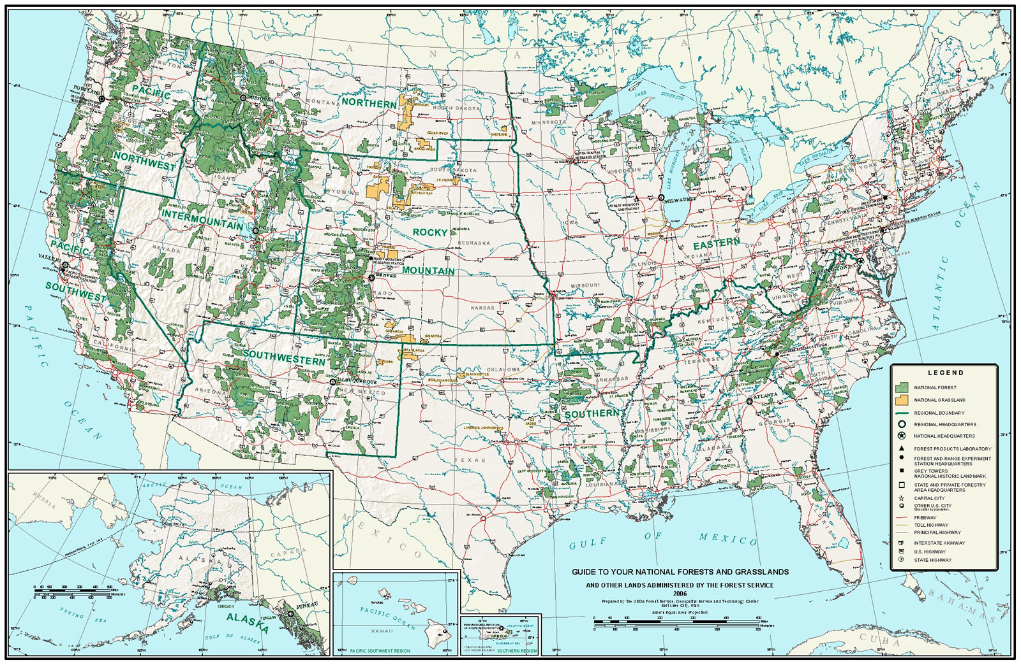


National Forest System
Notes:
This map shows the National Forest System Lands. All of the green areas are national forests and the yellow areas are national grasslands. Note also the two national forests in Alaska which are not of the same scale, as well as small units in Hawaii and Puerto Rico. You can notice that most of the lands are in the West that were reserved by the federal government from distribution to private individuals when the National Forests were created in the late 1800’s. Most of the national forests in the East were purchased from private landowners after they had been initially harvested for timber under the Weeks Act in the 1900’s. All of these national forests and grasslands must have land management plans. These are federal lands and with some exceptions, are not available for permanent occupancy or development by people of the United States.

Slide 11
[MY NF] National Forest
[INSERT A MAP OF YOUR NF HERE]

Slide 12
Hierarchy from Law to Projects
National Forest Management Act
Forest Service Planning Rule
Land Management Plans (Forests/Grasslands)
Project or Activity
Notes:
The Forest Service uses a basic hierarchical structure for governance in planning. This begins with the National Forest Management Act, a law that provides a basic requirement that the Department of Agriculture must provide regulations for the content of plans and the process for developing, amending and revising them and that each national forest and grassland must have a land management plan. The plans are developed, amended and revised by the individual unit with participation of both local and national interests. The plans in turn provide direction for individual projects such as where timber can or cannot be harvested, what lands are to be preserved as wilderness, or what lands are available for different forms of recreation. The projects must be consistent with the land management plan direction.

Slide 13
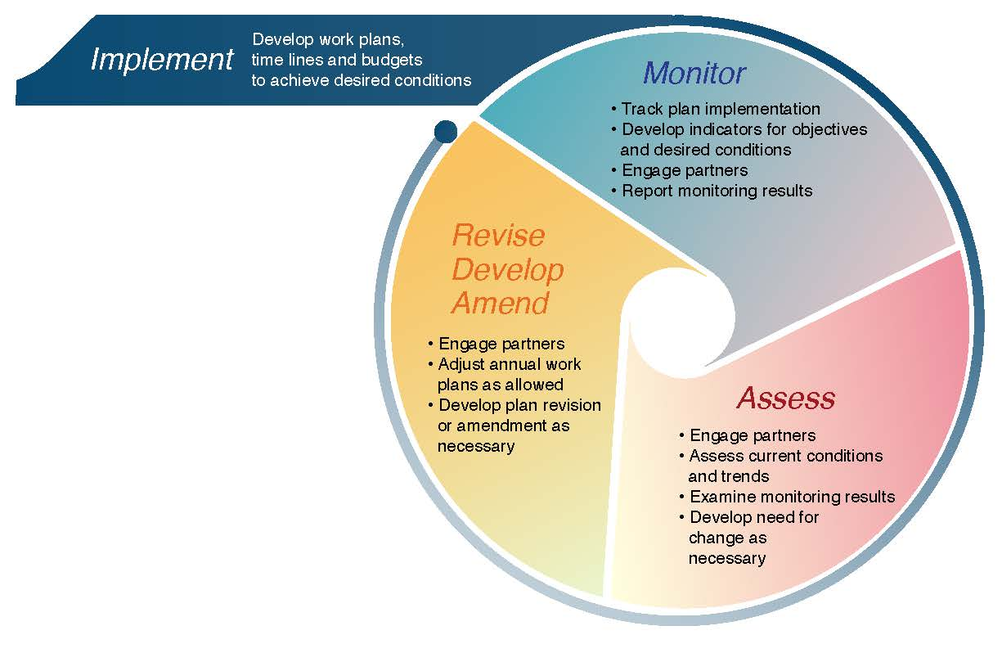
The Planning Process
Notes:
Under the 2012 Planning Rule, the planning process consists of three major phases:
Assessment. During assessment, the Forest Service and partners identify and evaluate existing economic, social, and ecological conditions in and around the national forest undergoing forest plan revision.
Plan development. This phase uses the information from the assessment, with input from the public, to revise a forest plan. Once the forest plan is approved, it will guide project-level decisions, like how and where to plan restoration or rehabilitation activities.
Monitoring. Studying conditions on the ground helps determine whether the forest plan is actually achieving its intended desired conditions and objectives. Monitoring information helps managers determine whether they need to propose amending or revising the forest plan.
The 2012 Planning Rule emphasizes public involvement through every step of the planning process and also specifies working with State, local, and Tribal Governments.

Slide 14
Key themes of the Planning Rule
Plan Components and Plan Content
Science
Collaboration and Public Involvement
Assessments
Determine Need to Change
Diversity and Sustainability
Objections
Monitoring
Notes:
These are the key themes in forest planning under the 2012 Planning Rule. While all of these are important, we will focus on the first theme around collaboration and public involvement.

Slide 15
Plan Components
Desired conditions
Objectives
Standards
Guidelines
Goals
Suitability of Lands
Notes:
Desired conditions – These are descriptions of specific social, economic, or ecological characteristics of the plan area, or a portion of the plan area, toward which management of the land and resources should be directed
Objectives – These are conscious, measurable, and time-specific statements of a desired rate of progress toward a desired condition or conditions, based on reasonably foreseeable budgets.
Standards – These are mandatory constraints on project and activity decision-making, established to help achieve or maintain the desired condition or conditions, to avoid or mitigate undesirable effects, or to meet applicable legal requirements.
Guidelines – These are mandatory constraints on project and activity decision-making that provide flexibility for different situations so long as the purpose of the guideline is met.
Goals – These are broad statements of intent, other than desired conditions, that are usually related to process or interactions with the public.
Suitability of Lands – These plan components identify areas of land as suitable or not suitable for specific uses (such as timber or range production), based on the applicable desired conditions.

Slide 16
Plan Components
Notes:
Desired conditions – These are descriptions of specific social, economic, or ecological characteristics of the plan area, or a portion of the plan area, toward which management of the land and resources should be directed
Objectives – These are conscious, measurable, and time-specific statements of a desired rate of progress toward a desired condition or conditions, based on reasonably foreseeable budgets.
Standards – These are mandatory constraints on project and activity decision-making, established to help achieve or maintain the desired condition or conditions, to avoid or mitigate undesirable effects, or to meet applicable legal requirements.
Guidelines – These are mandatory constraints on project and activity decision-making that provide flexibility for different situations so long as the purpose of the guideline is met.
Goals – These are broad statements of intent, other than desired conditions, that are usually related to process or interactions with the public.
Suitability of Lands – These plan components identify areas of land as suitable or not suitable for specific uses (such as timber or range production), based on the applicable desired conditions.

Slide 17
Purpose
Help State, local, and tribal governments better understand their opportunities for being effectively involved in the Forest Service’s land management planning process.
To promote Intergovernmental participation with a mutual respect for the rights and responsibilities of each government producing a more robust land management plan that would meet the needs of those governments.
To more effectively coordinate the best use of limited resources, staffs, and budgets, while cooperatively managing forest resources across multiple jurisdictions.

Slide 18
What Defines a State, Local or
Tribal Government?
State, local, or tribal governments must be recognized as a governmental entity applicable by State laws.
Tribal entities are determined by Federal and Tribal Law.

Slide 19
NEPA and Planning
Notes:
As the Forest Service engages with the public, stakeholders, and government partners to develop plan components, it will begin the environmental analysis and review process required by NEPA, its implementing regulations, and Forest Service NEPA procedures. This is commonly referred to as “the NEPA process.” The Forest Service will alert the public when it is about to begin the NEPA process and will seek comments and input at regular intervals during the process. You will be able to participate in collaborative or other engagement opportunities with the Forest Service and others during the planning process, and you will have an opportunity to provide formal comments to the Forest Service during the NEPA process.
The first step in the NEPA process, known as the “scoping” period, is when you can comment on the Forest Service’s preliminary proposal and say what you think are important issues for the agency to consider. After that, the Forest Service will develop a proposed plan, analyze the environmental effects of the proposed plan, as well as alternatives, in a detailed document called an environmental impact statement (EIS). The Forest Service will make the proposed plan and the draft EIS available for public review and comment. You will have at least 90 days to comment on the proposed plan and draft EIS for a plan revision.

Slide 20
Roles and Responsibilities of Participating Governments
  The Planning Rule requires that responsible officials identify and consider relevant existing governmental information, such as State Forest assessments and strategies, State wildlife data, relevant land management plans, local knowledge, etc.

Slide 21
State, Local and Tribal Governments Requirements
Provide all information believed relevant to inform planning or the context for planning in the assessment phase.
Identify and consider relevant existing governmental information, such as State forest assessments and strategies, State wildlife data, relevant land management plans, local knowledge, etc.
Determine individual need for participation.
Demonstrate willingness to make an investment of time to build and cultivate relationships.
Attend meetings, read planning documents, and develop an understanding of the planning and environmental analysis process.

Slide 22
Forest Service Requirements
Identify opportunities to contribute to mutual objectives, resolve or reduce conflicts, and achieve mutually agreeable outcomes.
Communicate with water management, emergency management services, and travel management planning.
Optimize collaborative potential of intergovernmental relationships with outreach to other Federal agencies, interested State, local and tribal governments as well as Alaska Native Corporations.
Review relevant planning and land use policies of other government entities.

Slide 23
Forest Service Requirements
Engage State, local, and tribal governments in land management planning.
Develop a formal Memorandum of Understanding outlining the terms of the cooperation.
Engaging State, local, and tribal representatives well in advance of formally initiating the planning process.
Attend meetings when participating entities request Forest Service presence.

Slide 24
Participating Agencies
Responsibilities
Assess water management, emergency management services, and travel management planning to provide important social, cultural, and economic opportunities for affected communities.
Foster collaborative community involvement and develop input that represents broad community consensus.
Facilitate efforts to increase public support, understanding, and mutually beneficial outcomes.

Slide 25
Methods of Engagement
  There are four key methods of engagement governments can choose to be involved with Forest Service land management planning:
Collaboration
Cooperation
Coordination
Cooperating Agency Status
Notes:
Collaboration is essentially people with diverse interests and ideas working together to achieve shared goals and to contribute to a broader understanding of the roles and contributions of a national forest as well as possible solutions to existing challenges
Cooperation is achieved when partners work together to collect and share data. A Memorandum of Understanding is utilized to define the roles and responsibilities that foster cooperative relationships related to the planning process creates a primary point of contact to collect and share data
Coordination:
National Forest Management Act (NFMA), “the Secretary of Agriculture shall develop, maintain and, as appropriate, revise land and resource management plans for units of the National Forest System, coordinated with the land and resource management planning processes of State and local governments and other Federal agencies,” [16 USC 1604(a)].
Federal Land Policy and Management Act (FLPMA), “[I]n the development and revision of land use plans, the Secretary of Agriculture shall coordinate land use plans for lands in the National Forests with the land use planning and management programs of and for Indian tribes by, among other things, considering the policies of approved tribal land resource management programs” [43 USC 1712(b)]
Cooperating Agency Status is made available to State, local, and tribal governments (as well as other Federal agencies) under the National Environmental Policy Act (NEPA). Applies only to that portion of the planning process that occurs during the environmental analysis process (also referred to as the NEPA process)

Slide 26
Collaboration
  Collaboration is essentially people with diverse interests and ideas working together to achieve shared goals and to contribute to a broader understanding of the roles and contributions of a national forest as well as possible solutions to existing challenges.

Slide 27
Cooperation
  Cooperation is achieved when partners work together to collect and share data. A Memorandum of Understanding is utilized to define the roles and responsibilities that foster cooperative relationships related to the planning process creates a primary point of contact to collect and share data.

Slide 28
Coordination
  National Forest Management Act (NFMA), “the Secretary of Agriculture shall develop, maintain and, as appropriate, revise land and resource management plans for units of the National Forest System, coordinated with the land and resource management planning processes of State and local governments and other Federal agencies,” [16 USC 1604(a)].
  Federal Land Policy and Management Act (FLPMA), “[I]n the development and revision of land use plans, the Secretary of Agriculture shall coordinate land use plans for lands in the National Forests with the land use planning and management programs of and for Indian tribes by, among other things, considering the policies of approved tribal land resource management programs” [43 USC 1712(b)].

Slide 29
Cooperating Agency Status
  Cooperating Agency Status is made available to State, local, and tribal governments (as well as other Federal agencies) under the National Environmental Policy Act (NEPA).
  Applies only to that portion of the planning process that occurs during the environmental analysis process (also referred to as the NEPA process).

Slide 30
Conflict Resolution
  OBJECTION PROCESS:
  The intent of the objection process is to allow the public and governmental entities the opportunity to review final plans and documents, and to work with the Forest Service to resolve any outstanding conflicts before a plan is approved.
  Plans processed under the 2012 Planning Rule are governed by the pre-decisional administrative review process.
Notes:
The steps of the objection process are generally as follows:
Following public notice by the Forest Service that the plan, environmental impact statement, and draft record of decision are available, there is a formal time period, normally 60 days, for the filing of an objection. Generally, only those parties who have submitted substantive formal comments on the plan are eligible to file an objection. Filed objections must relate to matters addressed in the comment. An exception to the requirement for a prior substantive formal comment is when the objection concerns an issue that arose after the opportunities for formal comment.
Within 10 days of the close of the objection filing period, the Responsible Official must post a list of all objections and provide information as to how an “interested person” can participate in the objection resolution process. An interested person may not want to object but may want to be involved in resolution of the conflict. An interested person must have previously submitted substantive formal comments on the proposed plan to participate.
The Planning Rule directives outline special provisions applicable to governmental entities in the objection process. The Forest Service must directly notify tribal governments and cooperating agencies of objections that have been filed and provide them the opportunity to participate in the objection process as interested parties. State and local governments that are not cooperating agencies but who participated in the planning process are to be informed of objections and provided the opportunity to file for interested person status.
Once revision of a land management plan is complete, the Forest Service will begin managing the national forest or grassland consistent with the direction contained in the new plan. All projects, such as timber sales, motorized trail development, or wildlife habitat improvement, must be consistent with direction in the revised plan.
The Forest Service will continue to work with the public, other stakeholders, and government partners to develop these projects.

Slide 31
Objections Process
1
Notice of a Plan Subject to Objection
2
Objection
3
Objections Resolution
4
Written Response
5
Issue Plan Decision
Filing Period
Closes
60 Days (EIS)
90 Days
(may be extended by reviewing officer)
10 Days
10 Days
Reviewing officer meets with objectors and interested persons
Responsible Official issues decisions after the reviewing officer’s written response, as long as the decision is consistent with the response
Forest Service accepts request to participate from interested persons
Forest Service publishes
& post notice of objections field

Slide 32
Monitoring and Adaptive Management
Once revision of a land management plan is complete, the Forest Service will begin managing the national forest or grassland consistent with the direction contained in the new plan.
The plan monitoring program must include monitoring questions and indicators about ecological, social, cultural, and economic impacts of plan implementation.
Helps managers determine whether to propose one or more changes to the plan through amendment or revision. The process of monitoring, evaluating, and adjusting (referred to as adaptive management) is central to the Forest Service’s ability to respond to changing conditions over time.

Slide 33
Monitoring and Adaptive Management, cont.
During the life of the plan, the Forest Service and its partners must work together to monitor the effectiveness of the revised plan.
Monitoring provides feedback by testing assumptions, tracking relevant conditions over time, and measuring management effectiveness.

Slide 34
Monitoring and Adaptive Management
  Relationship of plan monitoring program and broader scale monitoring program:
Plan Monitoring Program: The plan monitoring program is designed to test whether assumptions made during planning were accurate and to track progress towards meeting the desired conditions set out in the revised plan. Information from the plan monitoring program informs the Forest Service and the public as to whether changes to the plan are necessary.
Broad-Scale Monitoring Strategy: The Forest Service is required to design and implement a broad-scale monitoring strategy to support plan monitoring IF there is a need to answer a plan monitoring question at a scale larger than the plan area. This monitoring program will be developed by the Regional Forester with input from the Forest Supervisors. It is designed to ask and answer socioeconomic and ecological questions in the plan monitoring programs that are best answered at a larger geographic scale (for example, whether and how climate change is affecting water availability across an ecosystem such as the Great Basin).
The Forest Service must produce a biennial monitoring report for forest plans.

Slide 35
The Planning Process
Notes:
Under the 2012 Planning Rule, the planning process consists of three major phases:
Assessment. During assessment, the Forest Service and partners identify and evaluate existing economic, social, and ecological conditions in and around the national forest undergoing forest plan revision.
Plan development. This phase uses the information from the assessment, with input from the public, to revise a forest plan. Once the forest plan is approved, it will guide project-level decisions, like how and where to plan restoration or rehabilitation activities.
Monitoring. Studying conditions on the ground helps determine whether the forest plan is actually achieving its intended desired conditions and objectives. Monitoring information helps managers determine whether they need to propose amending or revising the forest plan.
The 2012 Planning Rule emphasizes public involvement through every step of the planning process and also specifies working with State, local, and Tribal Governments.

Slide 36
QUESTIONS?

