Slide 1
Botany / Wildlife Fieldwork and Reporting
Dakota Prairie Grasslands
U.S. Forest Service

Slide 2

Botany/Wildlife Staff
Medora District
  JJ Nelson (Biologist)
  Jack Dahl (Botanist)
  Kail Larsen (Biologist)
McKenzie District
  Lisa McDonald (Botanist)
  Sarah Bickerdyke (Biologist)
Sheyenne District
  Jamie Kienzle (Range/Wildlife)
  Stacy Swenson (Range PM)
Grand River District
  Dave Hodgson (Range/Botany)
  Greg Schonert (Zone Biologist)
Supervisors Office
  Greg Schonert (PM)

Slide 3
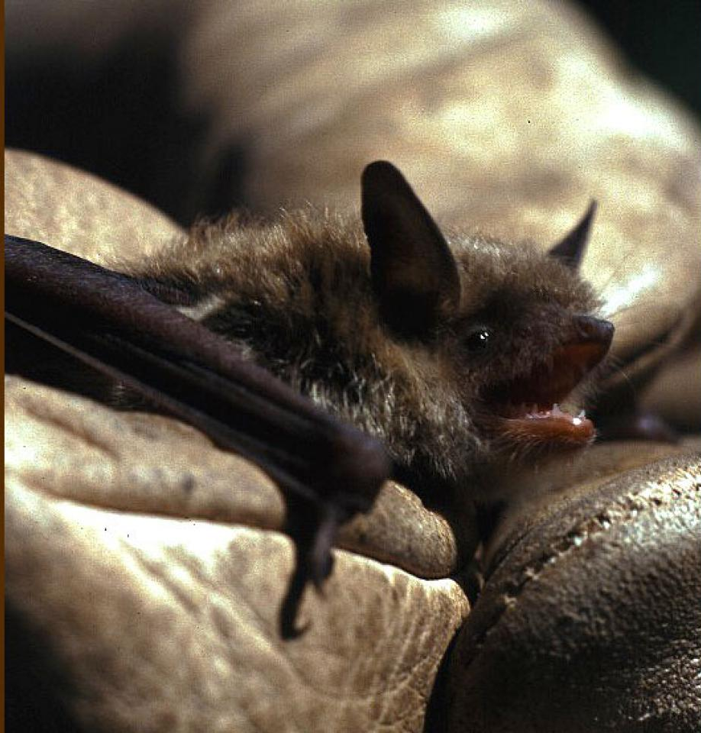

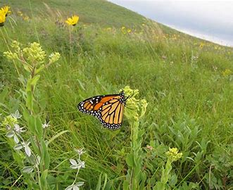
Updates to the Regional Foresters Sensitive Species List (Nov. 2023)
  New Additions (official):
    Interior Least Tern
    Swift Fox
    Little Brown Bat
    Townsend's Big-eared Bat
    Long-Eared Myotis (NOT NLEB)
  Removals:
    Loggerhead Shrike
    Bald Eagle
    Peregrine Falcon
    Broad-Winged Skipper
    Dion Skipper
    Mulberry Wing
    Arogos Skipper
    Red-Bellied Dace
    Monarch (Proposed)
    Regal Fritillary (Proposed)

Slide 4
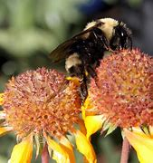
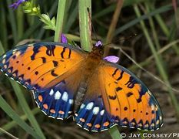
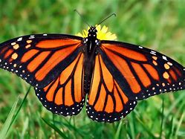
Proposed Species
Regal Fritillary: Aug. 2024 – proposed threatened
Monarch Buttefly: Dec. 2024 – proposed threatened
Suckley’s Cuckoo Bumblebee: Dec. 2024 – proposed endangered - https://www.bumblebeewatch.org/

Slide 5
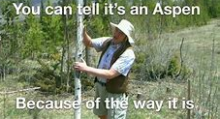
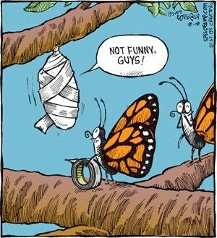
Proposed Species Analysis
Once a species is proposed, a year-long review period commences at the end of which the Service will make a final listing determination.
Upon final listing - Section 7 consultation requirements apply.
During proposed status ESA conferencing regulations apply
  Any agency action that is likely to jeopardize the continued existence (Pop. level, not species level)
  FS actions not expected to reach a level that would constitute jeopardy

Slide 6
Biological Assessment/Evaluation
For combined BA/BE:
Include table of summary of findings
  Known occurrences in the action area
  Habitat in the action area
  Effects to individuals or habitat anticipated
  Effects determination (No Effect, Not Likely to Jeopardize)
Rationale for No Effect Determination
Narrative Effects – based on context of findings in proposed rule
Cumulative Effects
Relevant Design Features

Slide 7
Biological Assessment
If separate Biological Assessment Prepared:
  Same information as above slide should be included in the BA
The Forest Service will not be conferencing with FWS or requesting any kind of response for proposed species analysis
If proposed listings become final, standard Section 7 requirements will apply

Slide 8
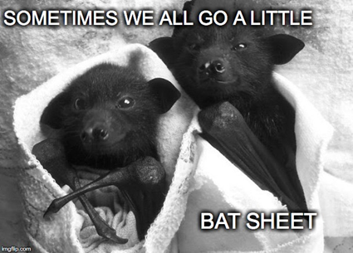
NLEB Status Change
March 31, 2023 - NLEB reclassified as Endangered
Final tools and guidance from FWS released on October 23, 2024
Work through the IPaC website for project specific analysis.
If suitable habitat present: No trees 3 DBH or greater will be removed during the Northern Long-eared Bat summer roosting season (April 15 – October 31) to minimize the potential for direct impacts to the species during their active season. (Northern Long-eared Bat, little brown myotis, long-eared myotis, Townsend’s big-eared bat)

Slide 9
Monarch/Regal Habitat Assessment
Rolled Monarch out previously (Appendix E)
Regal Fritillary for 2025 (Appendix F)
Identify and delineate monarch/regal habitat
Objective is to begin to identify high value habitat on the LMNG and to aid in BE analysis
High value vs low value
  Intense grazed pasture or dominated by invasives
  If milkweed or violets abundant – please still document these areas as suitable habitat

Slide 10
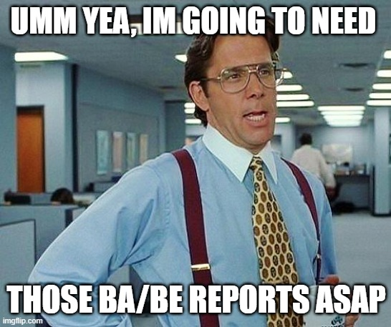
Biological Assessment/Biological Evaluation (BA/BE)
2672.4 - Biological Evaluations. Review all Forest Service programs and activities for possible effects on endangered, threatened, proposed, or sensitive species.
  The biological evaluation is the means of conducting the review and of documenting the findings. Seven components (2672.42)
  The biological evaluation may be used or modified to satisfy consultation requirements for a biological assessment
    If no effect for all T/E species – one document
    Please title Biological Assessment/Biological Evaluation
    If “may affect” for one or more spp., - BA needed
    Reference consultation/concurrence in BE
  When do they need to be updated?
    Survey data: 3-5 years (at USFS discretion)
  Which projects do / do not require a BE or BA? Ask!
  Template under development for 2025 – Stay Tuned!
    Streamline document prep, review, and approval
    Ensure FSM standards are met

Slide 11
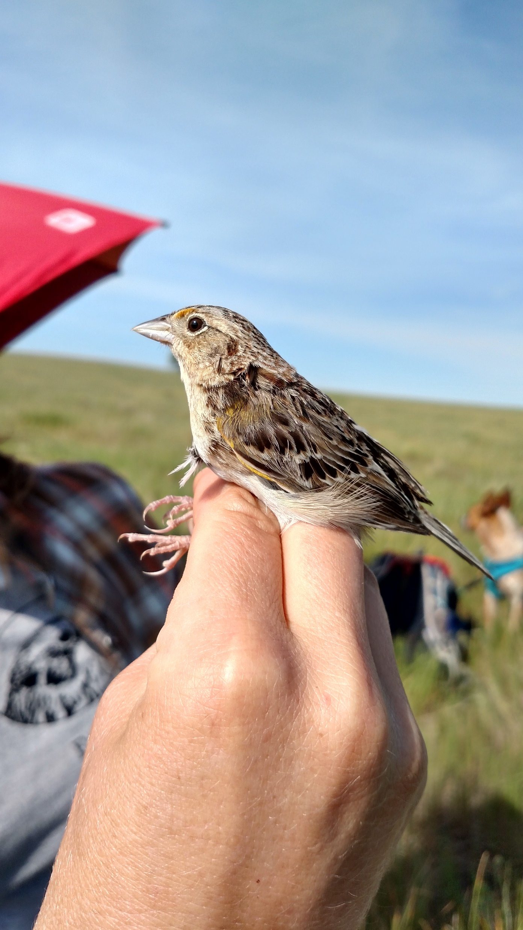
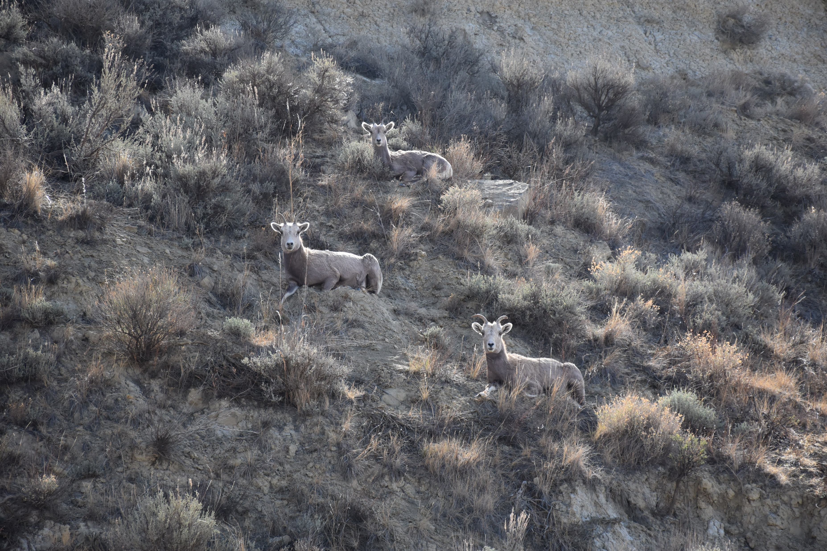
Biological Assessment/Biological Evaluation (BA/BE) Continued
Contents – More is not better!
  Clear and Concise
Appendices –
  Biology Letter – Can be referenced, do not include as attachment
  Maps
    Project Location Maps
    Wildlife/Botany
    Don’t go overboard – include what is necessary to support determinations
  Field Photos
    Habitat Conditions – document changes
      Support your rationale
    Species / Nests
Action Area / Analysis Area
  Dependent on species and project

Slide 12
Communication Continued
Have information prepared prior to making a call or sending an email –
  What is the project? Where is the project? Which District(s)? Maps?
  Who is the lead or project proponent? Has one been identified?
  When is the proposed work anticipated to occur?
  Never hesitate to reach out and ask questions or to talk things through
Email Subject Lines – Be Specific!
Prior to conducting fieldwork
  Notify District Biologist/Botanist and cc Program Manager

Slide 13

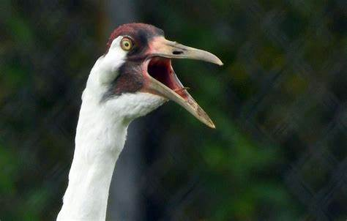
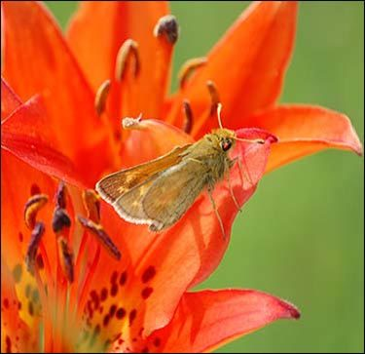
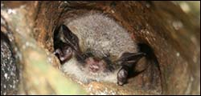
Communication with USFWS
U.S. FISH AND WILDLIFE SERVICE
  District Biologists and Biology PM – Direct Correspondence
  USFS is the lead Federal Agency and is responsible for Section 7 Consultations – Consultation history needs to be tracked (all phone calls, emails, meetings, etc.)
IPaC Website
  https://ipac.ecosphere.fws.gov/
  Species Lists
    Pay attention to species and critical habitat!

Slide 14
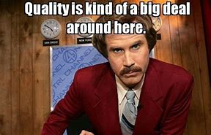
Quality Assurance/Quality Control
  Length of documents / Level of documentation
    Complex vs simple project
    Again – more is not better!
  Leftover language from previous document/project
  Ensure all species/critical habitat are adequately addressed
  Support your determinations!
  Be consistent in determinations (field forms, various sections of reports).
Be consistent in use of terms –
  Proposed Action vs Proposed Project
  Action Area, Analysis Area, Project Area
  Thorough review
    Another set of eyes
    Word search – read backwards

Slide 15
Wildlife Fieldwork / Reporting
QUALIFICATIONS
  Combination of education, training, and/or experience in conducting surveys of wildlife and habitats.
    New hires – If little to no experience should not be field lead– need close supervision
    Dakota Skipper Habitat Assessments – Botany experience
      Presence/absence surveys - 10(a)(1)(A) permitted surveyor
    Northern Long-Eared Bat – Specialized experience for acoustical monitoring/mist netting
DAKOTA SKIPPER HABITAT AND PRESENCE/ABSENCE SURVEYS
  Follow most current USFWS protocol – updated for 2024
EXPECTATIONS FOR RAPTOR SURVEYS
  Existing Data/Historical Nests
  Ground-based – potential nesting habitat and pre-identified points to assess presence
  Aerial – contact us
  Active nest discovery – notify within 7 days – Document with Photos!

Slide 16
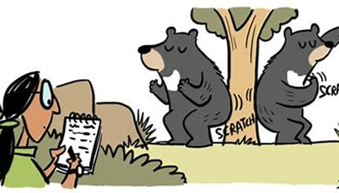
Wildlife Fieldwork / Reporting
LIST OF ENV. COMMITMENTS / DESIGN FEATURES
  Include Design Features in Separate Section of BE
  Need to be discussed/agreed upon by project proponent, and ensure included in COA’s
  Consistent with Land and Resource Management Plan
  USFWS Consultation Concurrence / Biological Opinion
SENSITIVE WILDLIFE SPECIES DETERMINATIONS
    Population Level Analysis
MIS / RAPTOR SPECIES DETERMINATIONS
    Individual Level Analysis
    Bald and Golden Eagle Protection Act
USFS REGION 1 SENSITIVE SPECIES LIST
    In effect as of November 2023

Slide 17
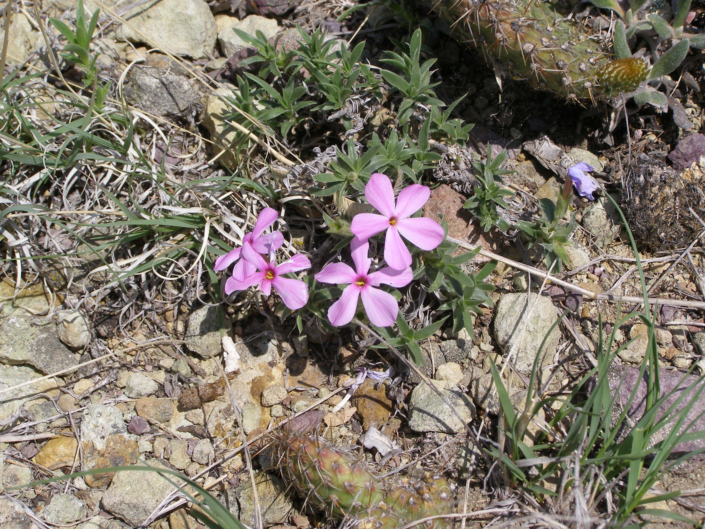
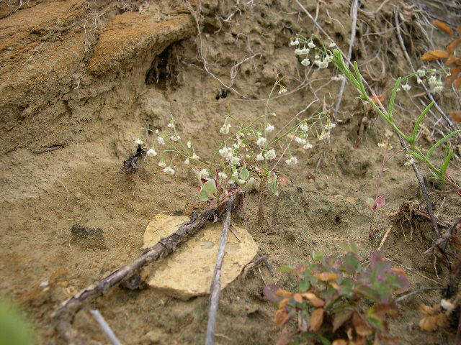
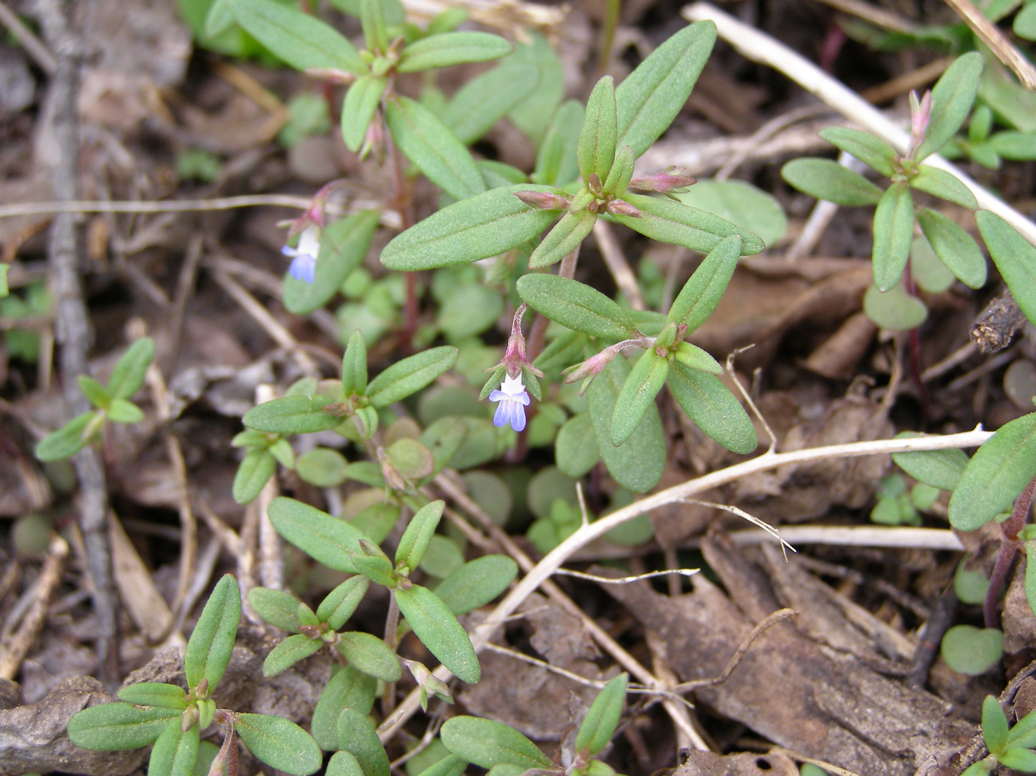
Botany Fieldwork/Reporting
Botany Survey information pages 4-6 of the Biology letter
Qualifications
  Degree in Botany or Plant Ecology
Survey dates April 15 through May 31
  Townsendia species, viola spp. and Sand lily
June 1st – September 15th
  All other RFSS plants and Asclepias spp.
Survey areas Best to call us
  125 ft from the centerline
    Roadways, pipelines, and utility lines
  50 ft from the centerline
    Electric lines, fiber optic cable, other utilities
10 Acres around single well pad
May require larger survey area for EA/EIS level projects

Slide 18
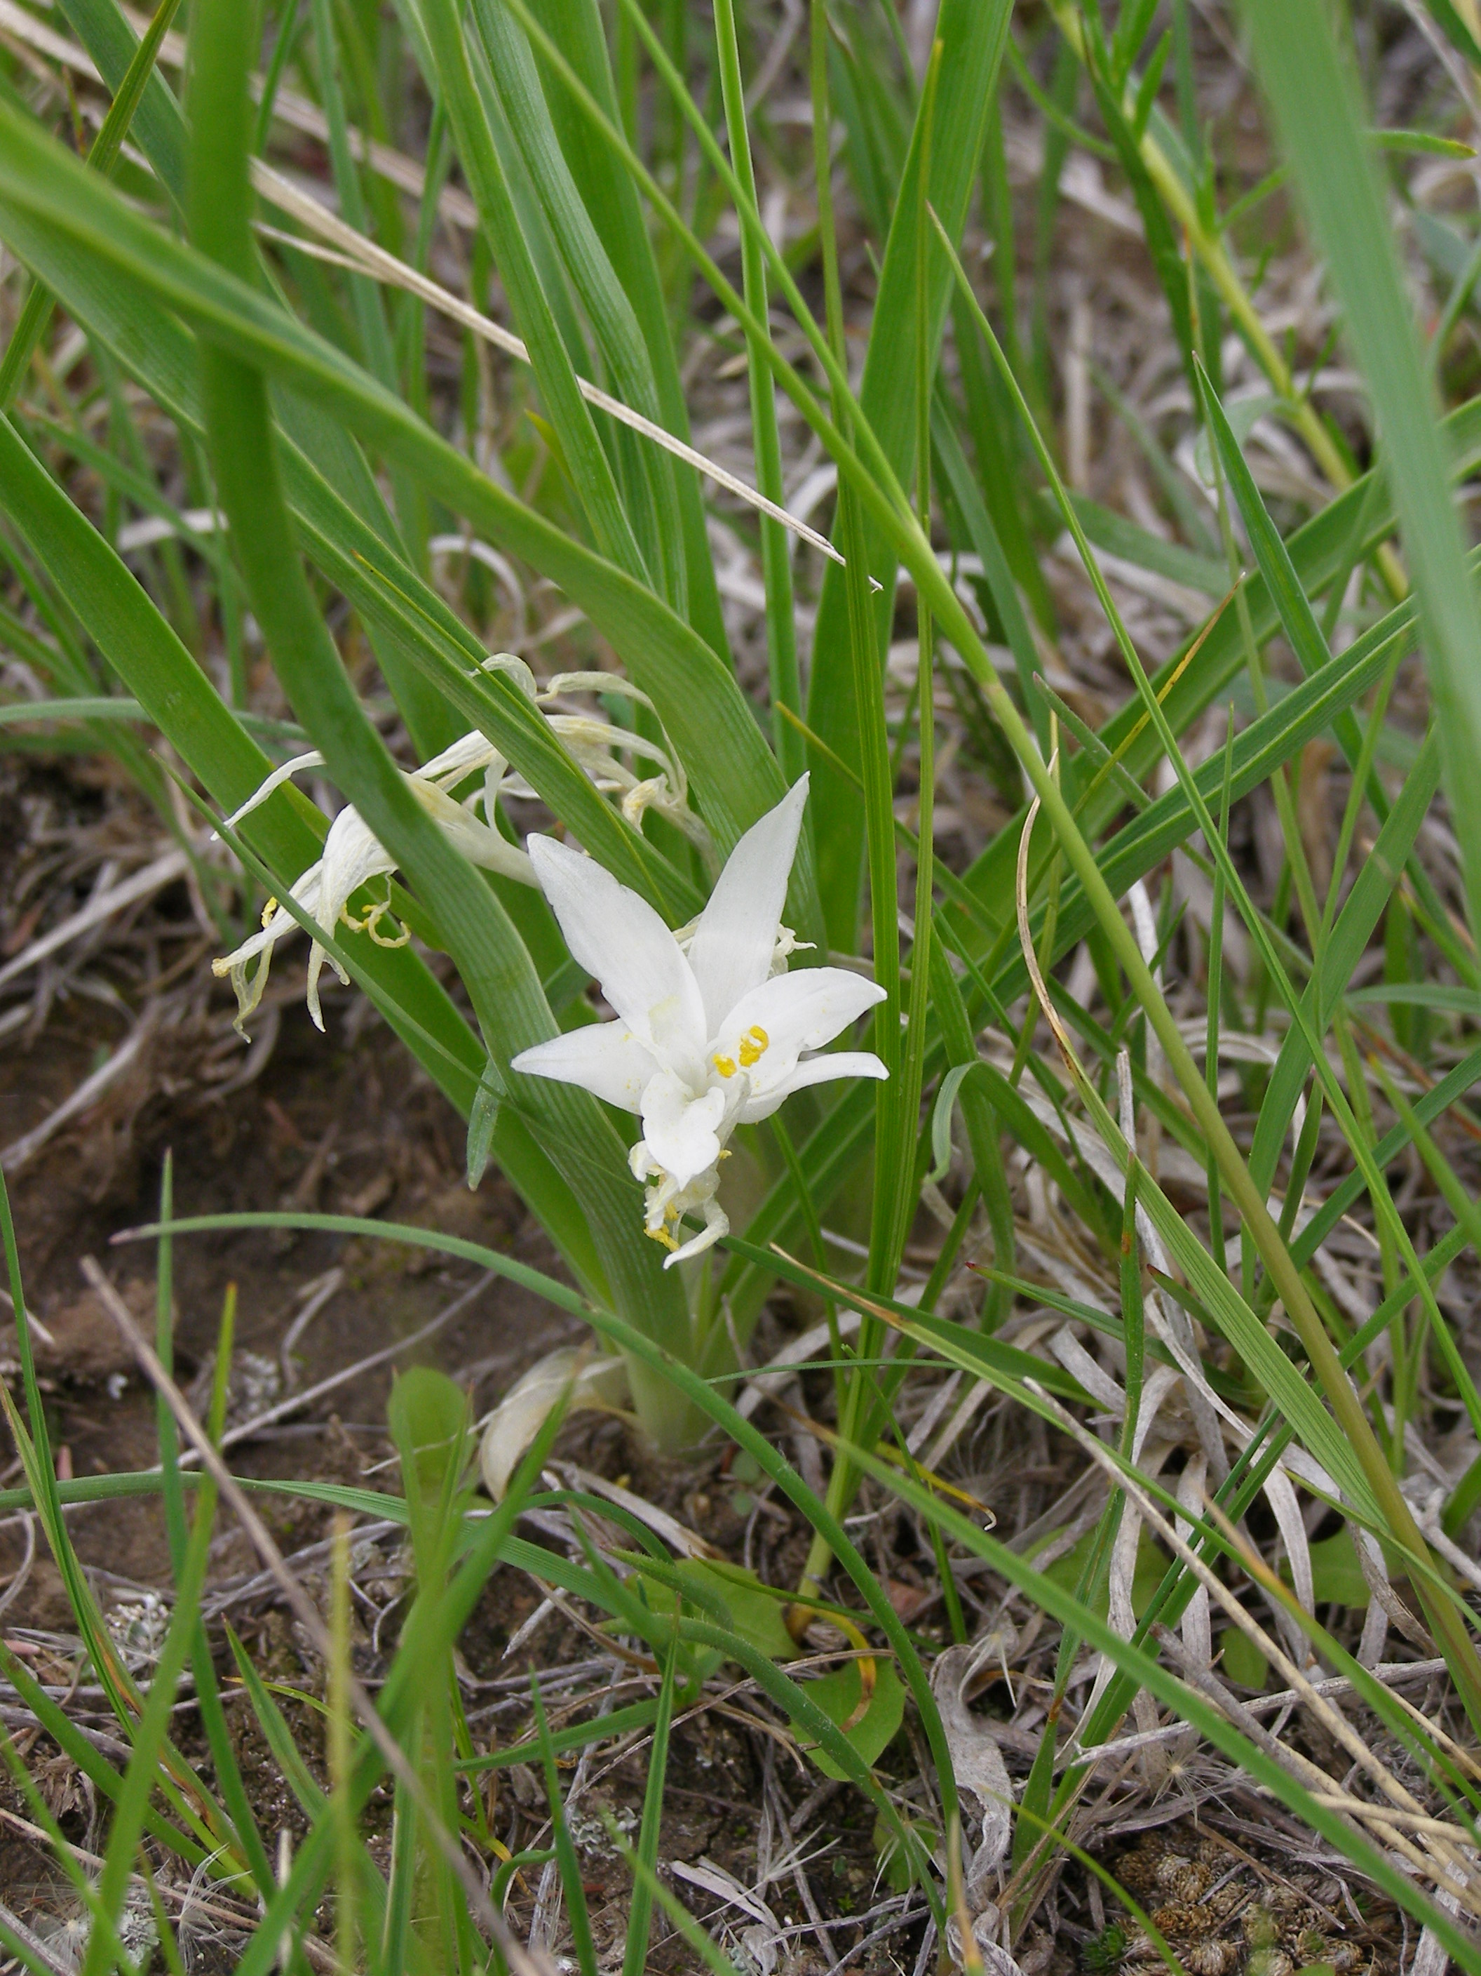
Botany Fieldwork/Reporting
Plant Survey Field Form and Sensitive Plant Field Form
Sensitive species
  If an occurrence occurs FS need to be contacted within 7 days.
Shapefiles
  Need to be sent with the BE. We will not move on the BE

Slide 19
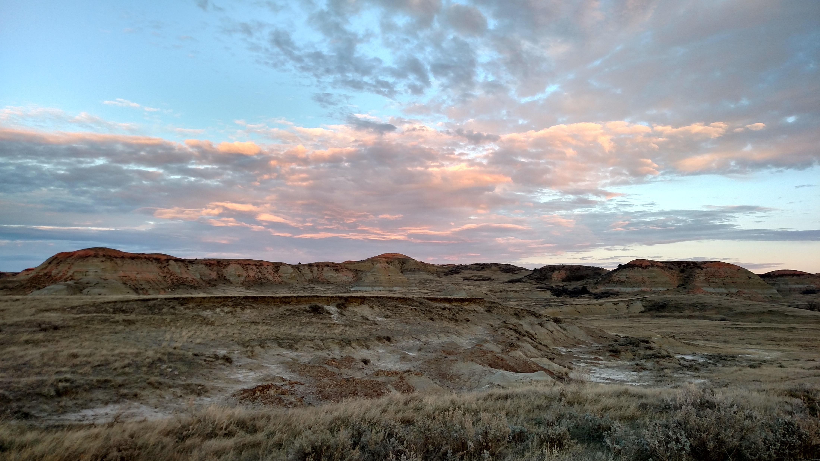
Reference Materials
Land and Resource Management Plan for Dakota Prairie Grasslands
Dakota Prairie Grassland - Land & Resources Management (usda.gov)
Biological Survey and Reporting Guidelines
  (https://www.fs.usda.gov/Internet/FSE_DOCUMENTS/fseprd923162.pdfHeading 1) (usda.gov)
  Will be available soon, no significant changes
  Be on lookout for BA/BE Template
Forest Service Manual (FSM)
  FSM - Series 2000

Slide 20
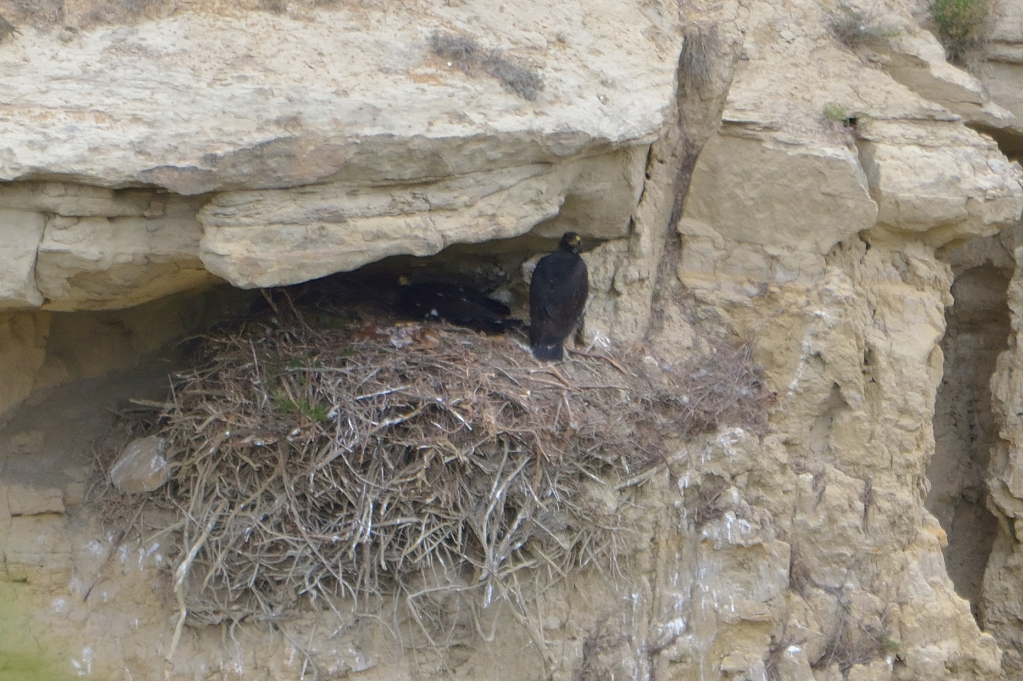

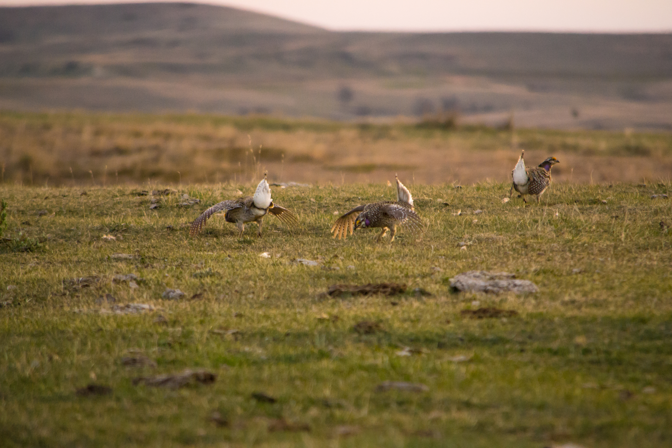
Conclusion
Thank you!
Communicate early and often
Refer to reference materials
Ask Questions

