Slide 1
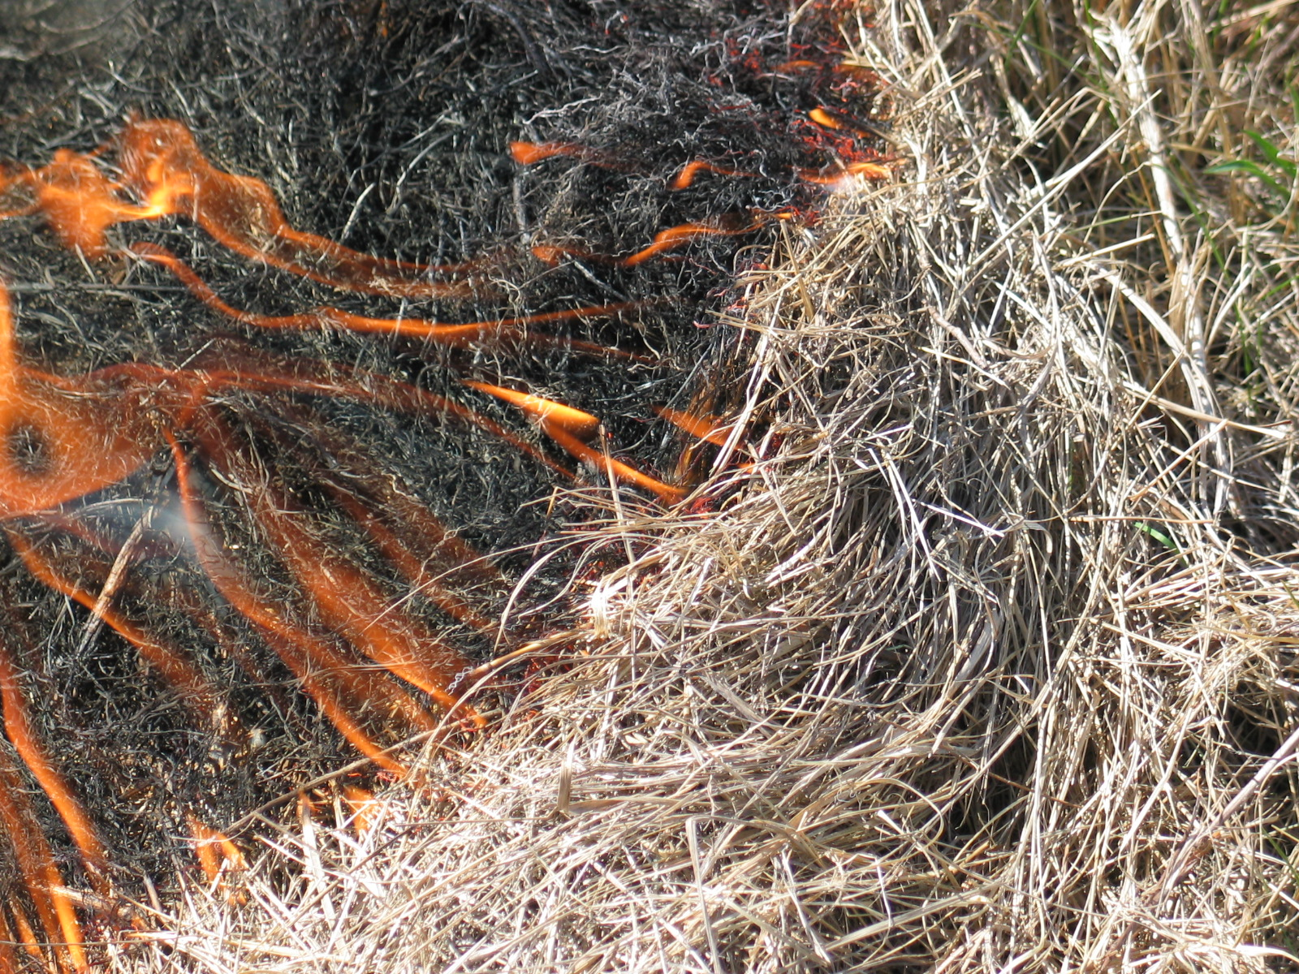
Four Forest
Restoration Initiative
(4FRI)
1st DRAFT Proposed Action (Fire)
January 20, 2010
Mary Lata
Fire Ecologist – 4FRI Core Team
“Man has possessed fire so long that the inquiry as to whether it is a human characteristic has some point.”
-Walter Hough

Slide 2
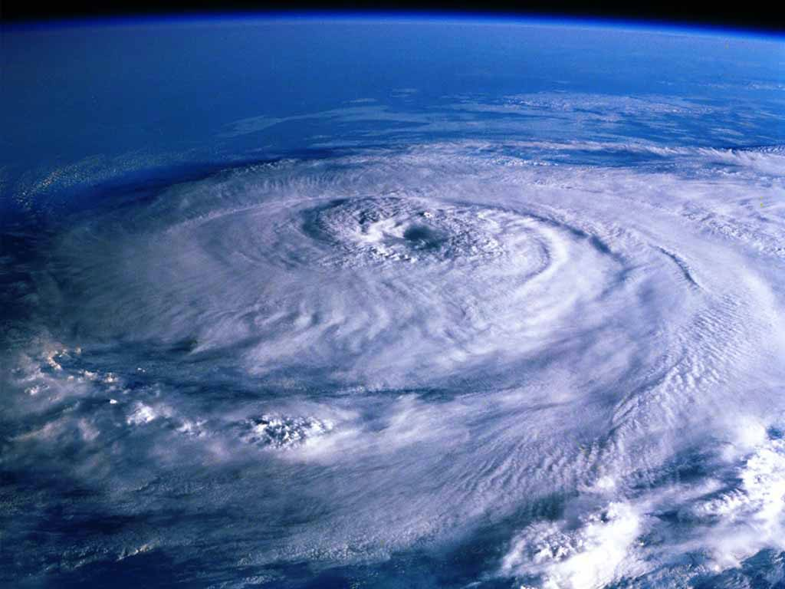
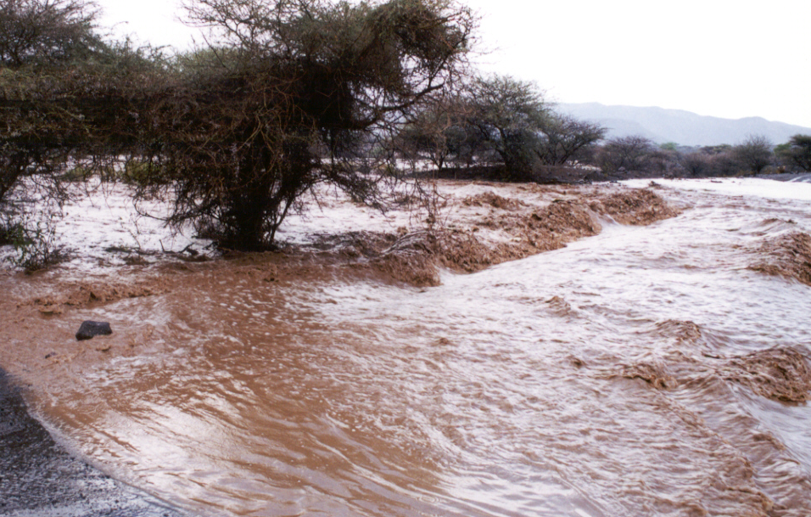
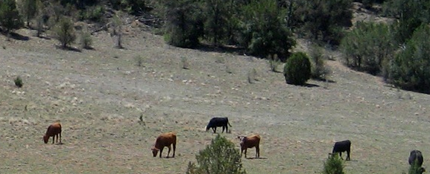
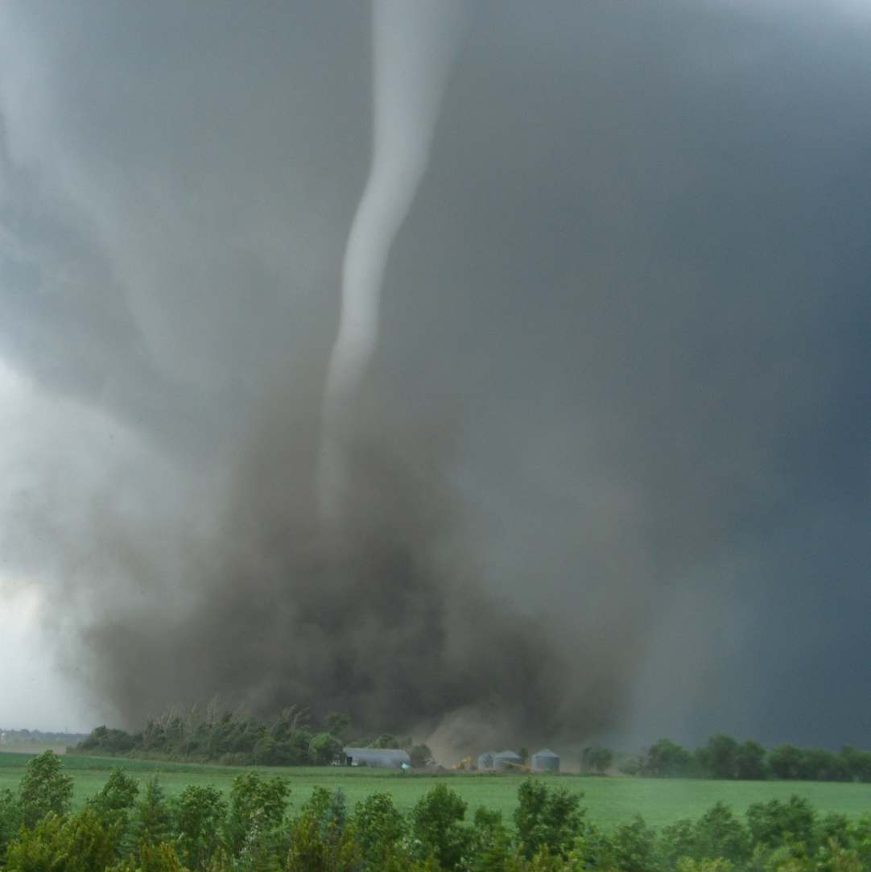
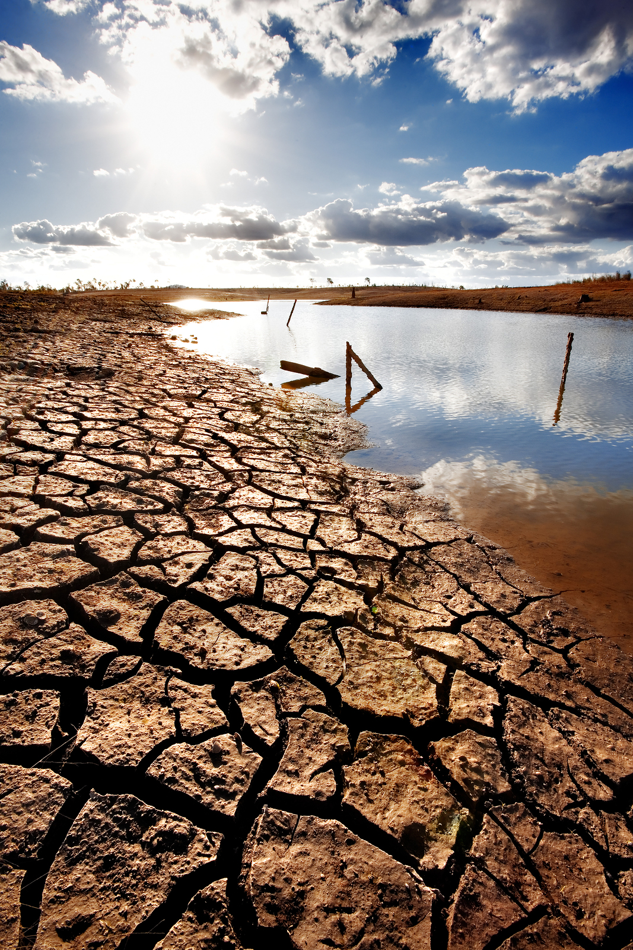
Disturbance: (in ecology) a temporary interruption of the average environmental conditions that caused a pronounced change in an ecosystem

Slide 3
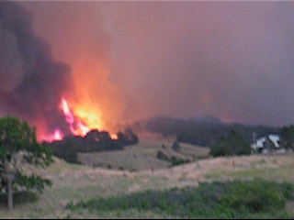
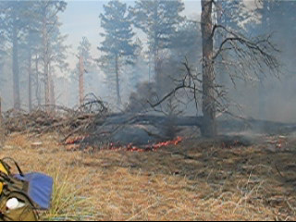
Good fire (characteristic of an ecosystem)
Bad fire (NOT characteristic of an ecosystem)

Slide 4
Fire Regime
A set of recurring conditions that characterize an ecosystem within an historic, natural or human induced context, within a given climate. The set of recurring conditions includes a specific range of attributes including:
intensity
severity
fire type
frequency
size
seasonality
spatial complexity

Slide 5
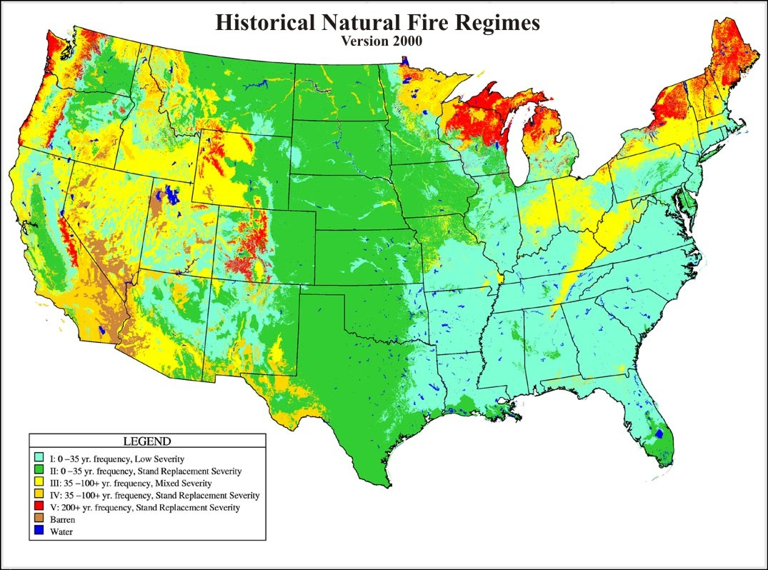
Understanding historic fire regimes and what has changed helps us understand what to do next and what to expect.
1 – 0-35 year frequency and mostly low severity (less than 75% of the dominant overstory vegetation replaced) (tree dominated, herbaceous understory)
2 – 0-35 year frequency and high severity (greater than 75% of the dominant overstory vegetation replaced – stand replacement) (grass dominated)
3 – 35-100+ year frequency and mixed severity (less than 75% of the dominant overstory vegetation replaced) (some shrub systems, mixed conifer, eastern deciduous forest)
4 – 35-100+ year frequency and high (stand replacement) severity
(greater than 75% of the dominant overstory vegetation replaced) (chaparral, Jack Pine)
5 – 200+ year frequency and high (stand replacement) severity (cooler, wetter environments)

Slide 6
Intensity = QUANTITATIVE
A measure of fire behavior
The rate of heat produced by a fire
A property of the fire itself
Indicators:
        Flame Length
        Peak Temperature
        Residence Time

Slide 7
Severity = QUALITATIVE
A measure of the immediate effects of a fire
A Classification , of fire effect/s
Indicators:
        Percent of fuel cover consumed
        Leaf or needle scorch
        Duff consumption
        Char height and depth
        Mortality

Slide 8
INTENSITY
Qualitative
Fire behavior
Rate of energy release
Measurement
SEVERITY
Quantitative
Fire effects
Degree of change (before/after)
Classification

Slide 9
Current Condition
Initial Analyses
Fire Regime/Condition Class
Fire Return Interval
Fire Type
Ignition Densities

Slide 10
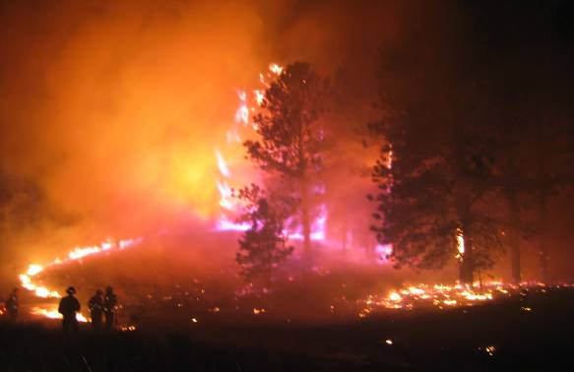
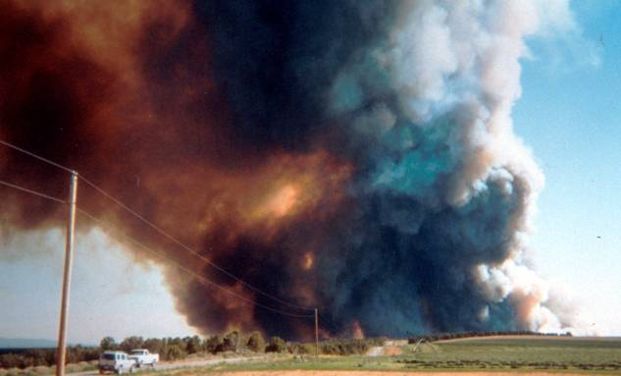
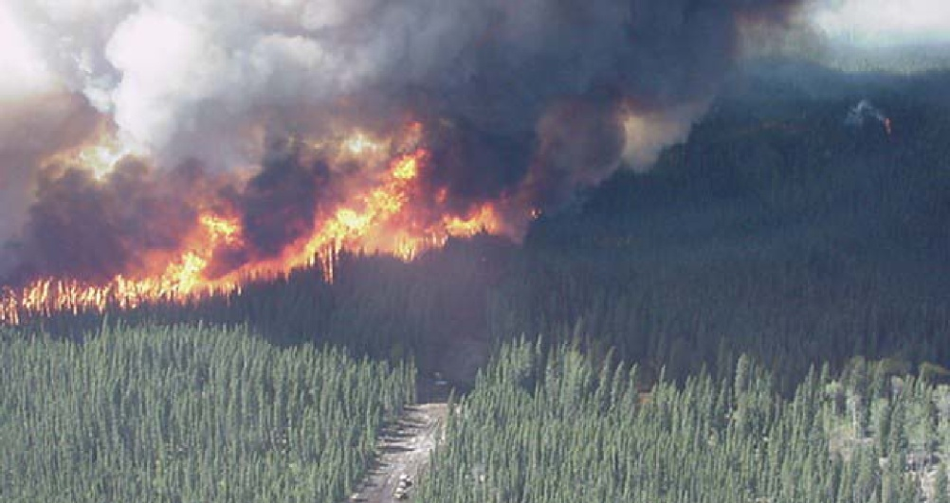
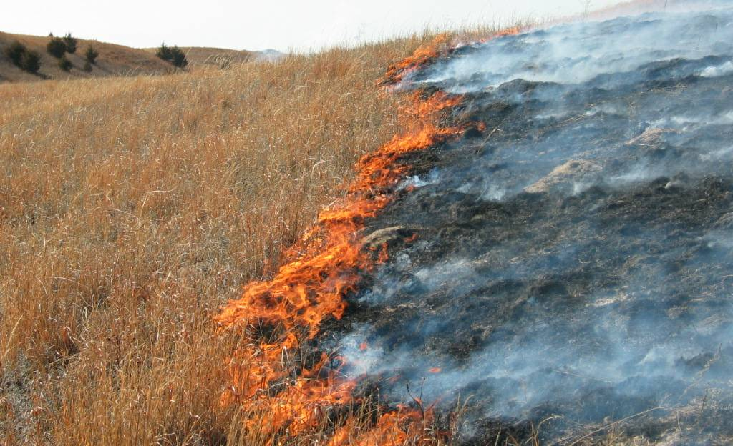
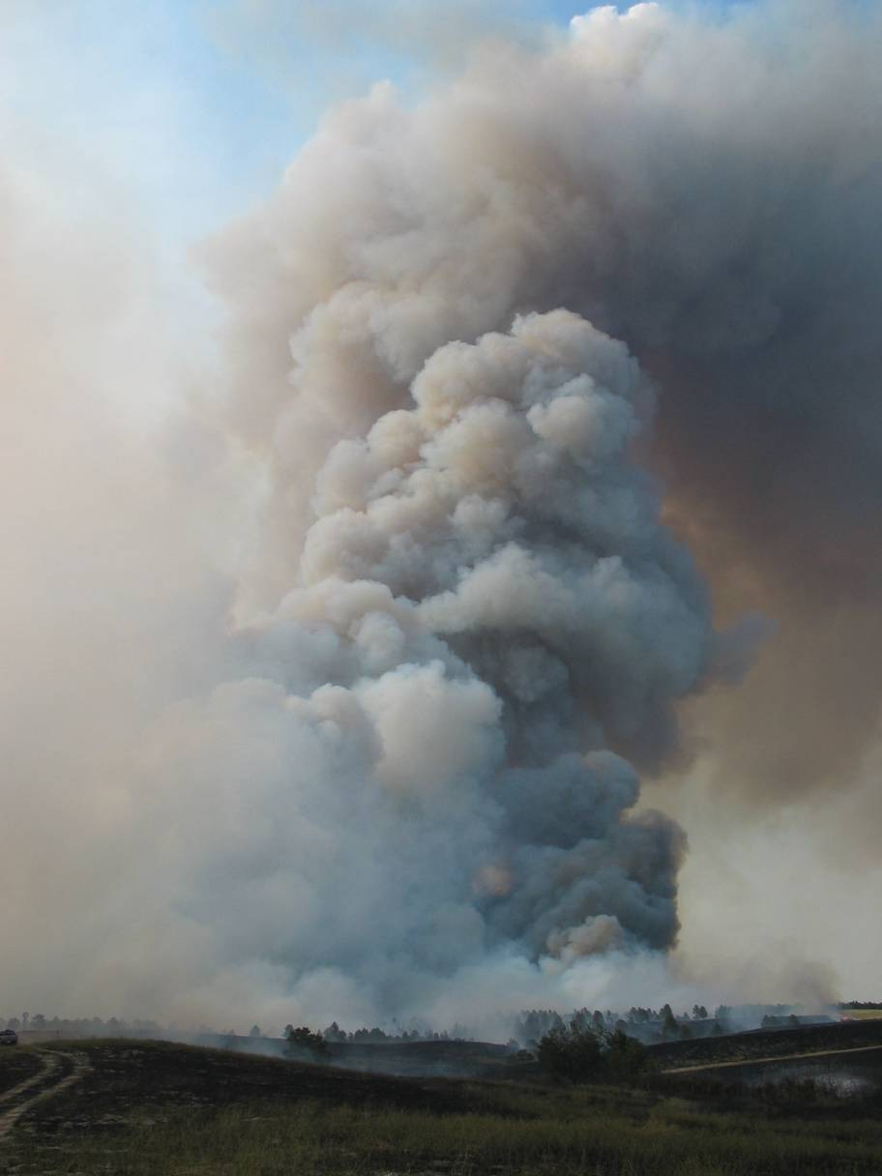
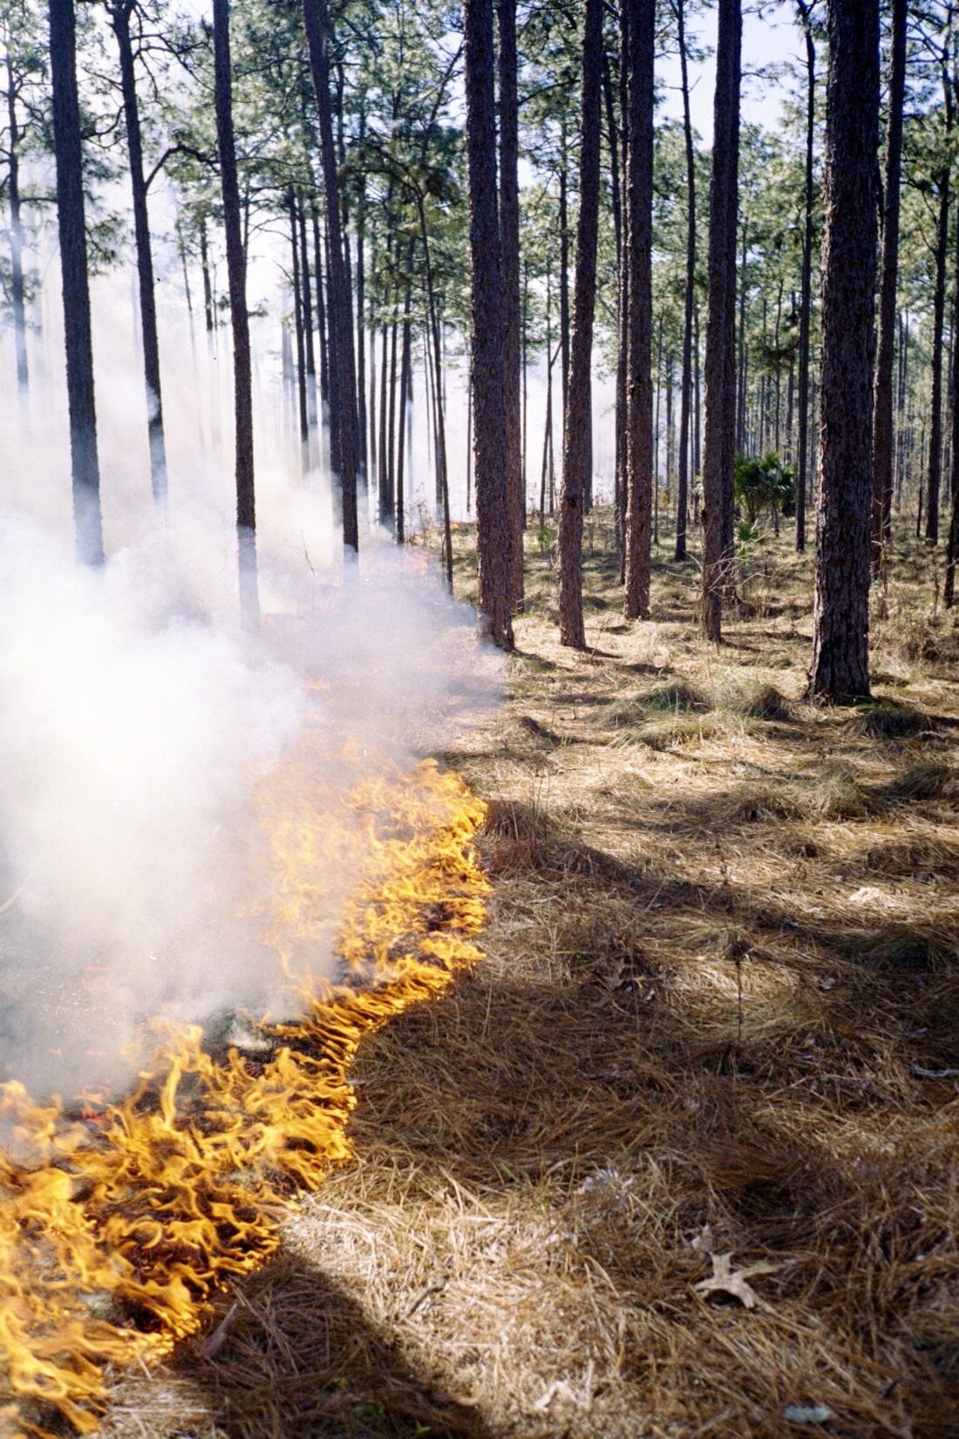
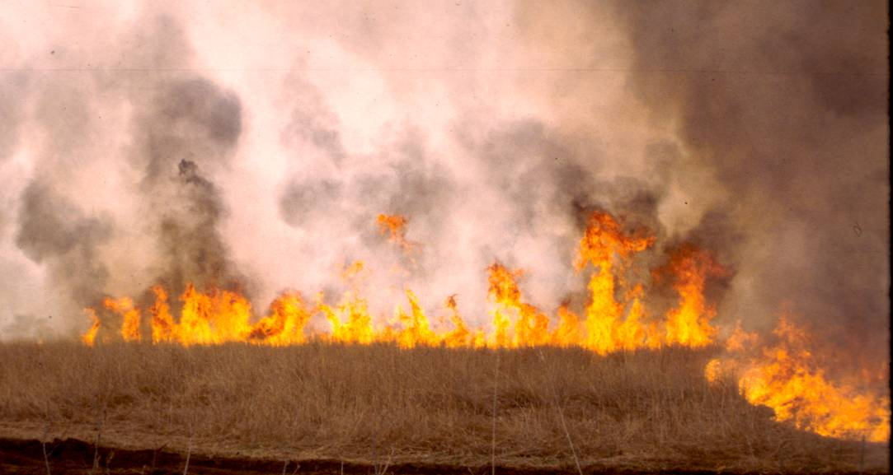
Passive Crown Fire
Fire Type
Crown Fire
Surface Fire
Notes:
Crown (active, independent), torching, group torching, surface, ground, smoldering, head, backing…

Slide 11
Strategic Placement of Treatments (SPOTS)
Define problem fire – Schultz and…Oak Creek Canyon?
Identify assets and protection targets (LSWG, other specialists, other publics – part of why we’re here today)
Define analysis area on a map (pipo analysis area)
Design treatment patterns to mitigate the problem fire and meet a range of objectives (collaborative effort in progress).
Test treatment patterns with FARSITE or FlamMap; adjust, re-test (working on it)
Display trade-offs
Follow-up w/monitoring and AM mgmt

Slide 12
”models and their results are often not meant to give “the answer”, but to provide insight, understanding, and knowledge regarding complex phenomena.”
“all models need to be validated and calibrated to some past or current documented and observed condition.”

Slide 13
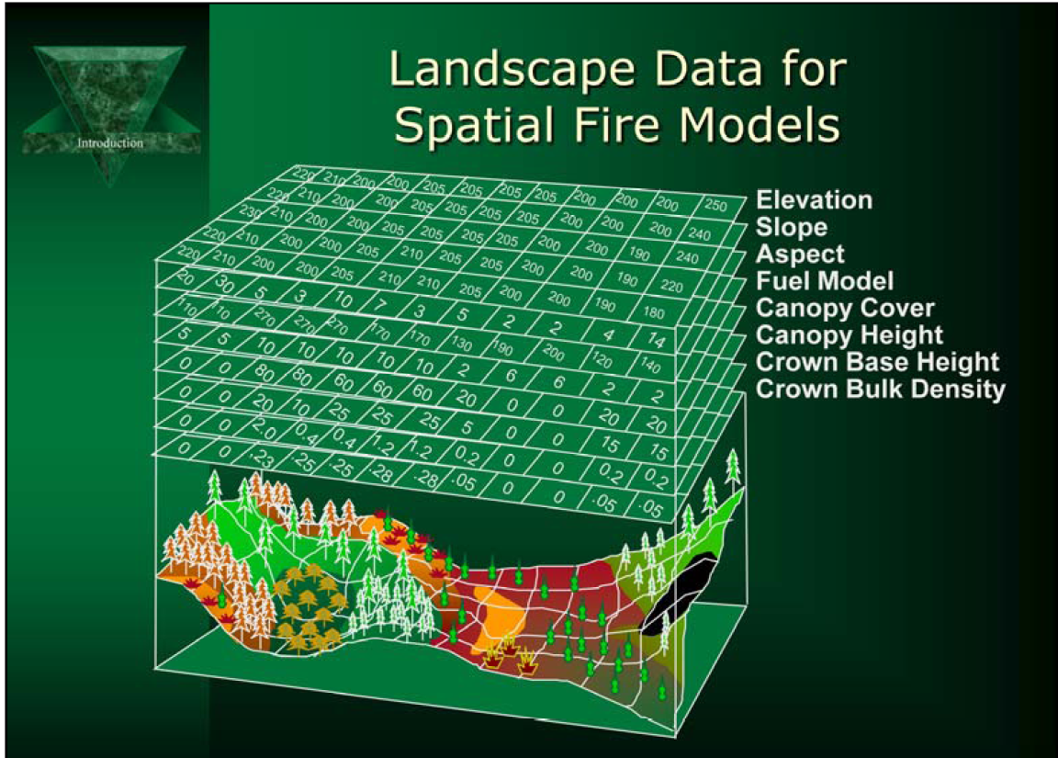
Fire Behavior Modeling Data

Slide 14
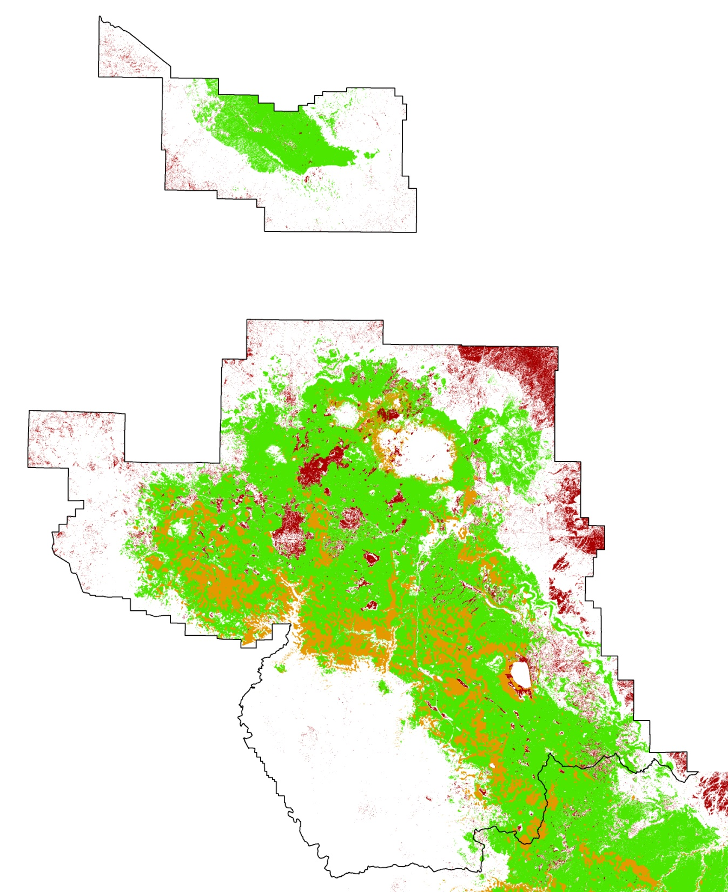
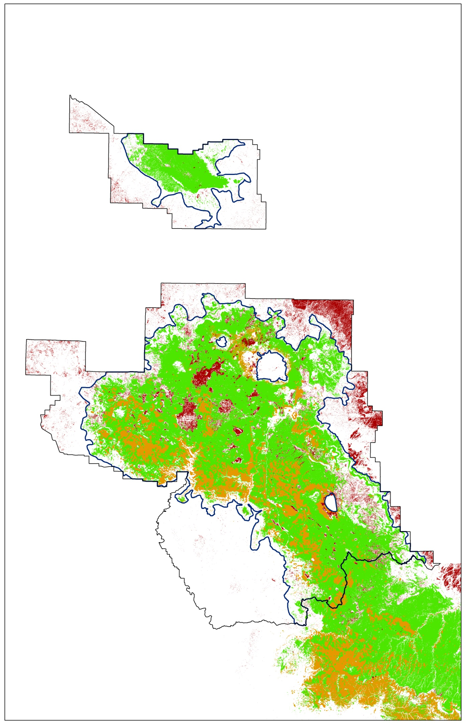
Major vegetation types
6
4
5
3
Grassland
1
Ponderosa Pine/Oak
Ponderosa Pine
Other
2

Slide 15
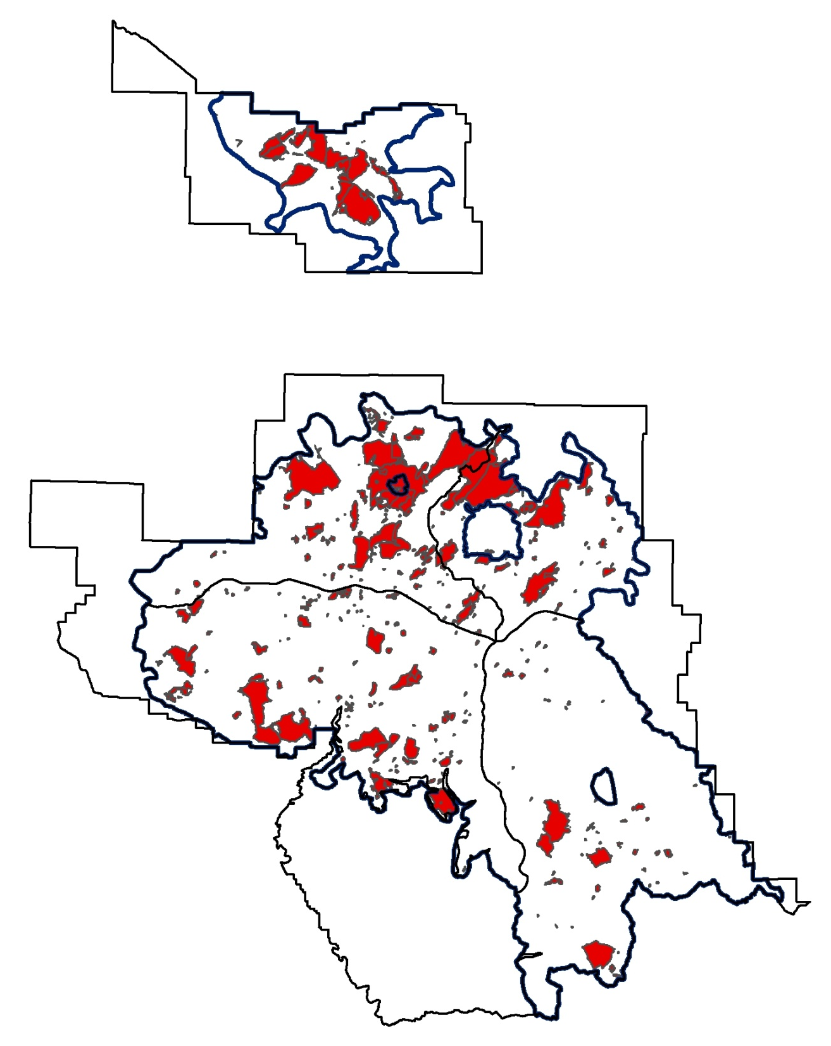
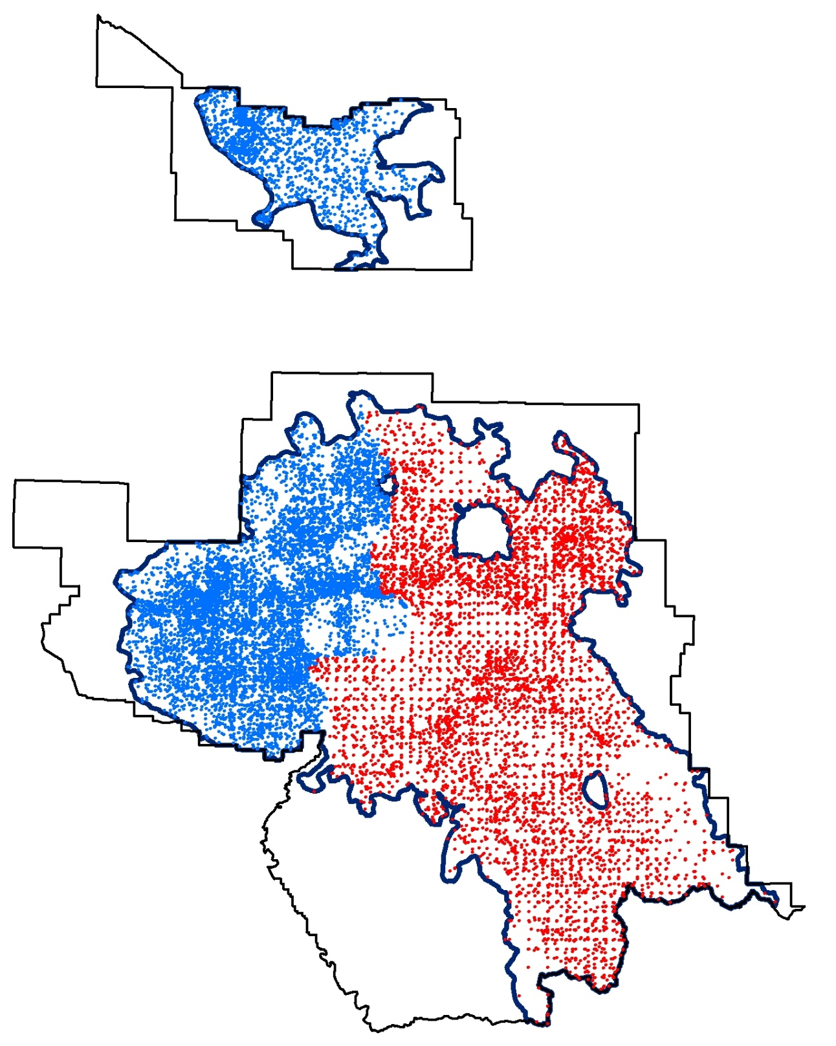
Fire Return Interval
6
Historic FRI for analysis area
=~ 2 – 20
Current FRI for analysis area
= ~43
4
5
3
1
2

Slide 16
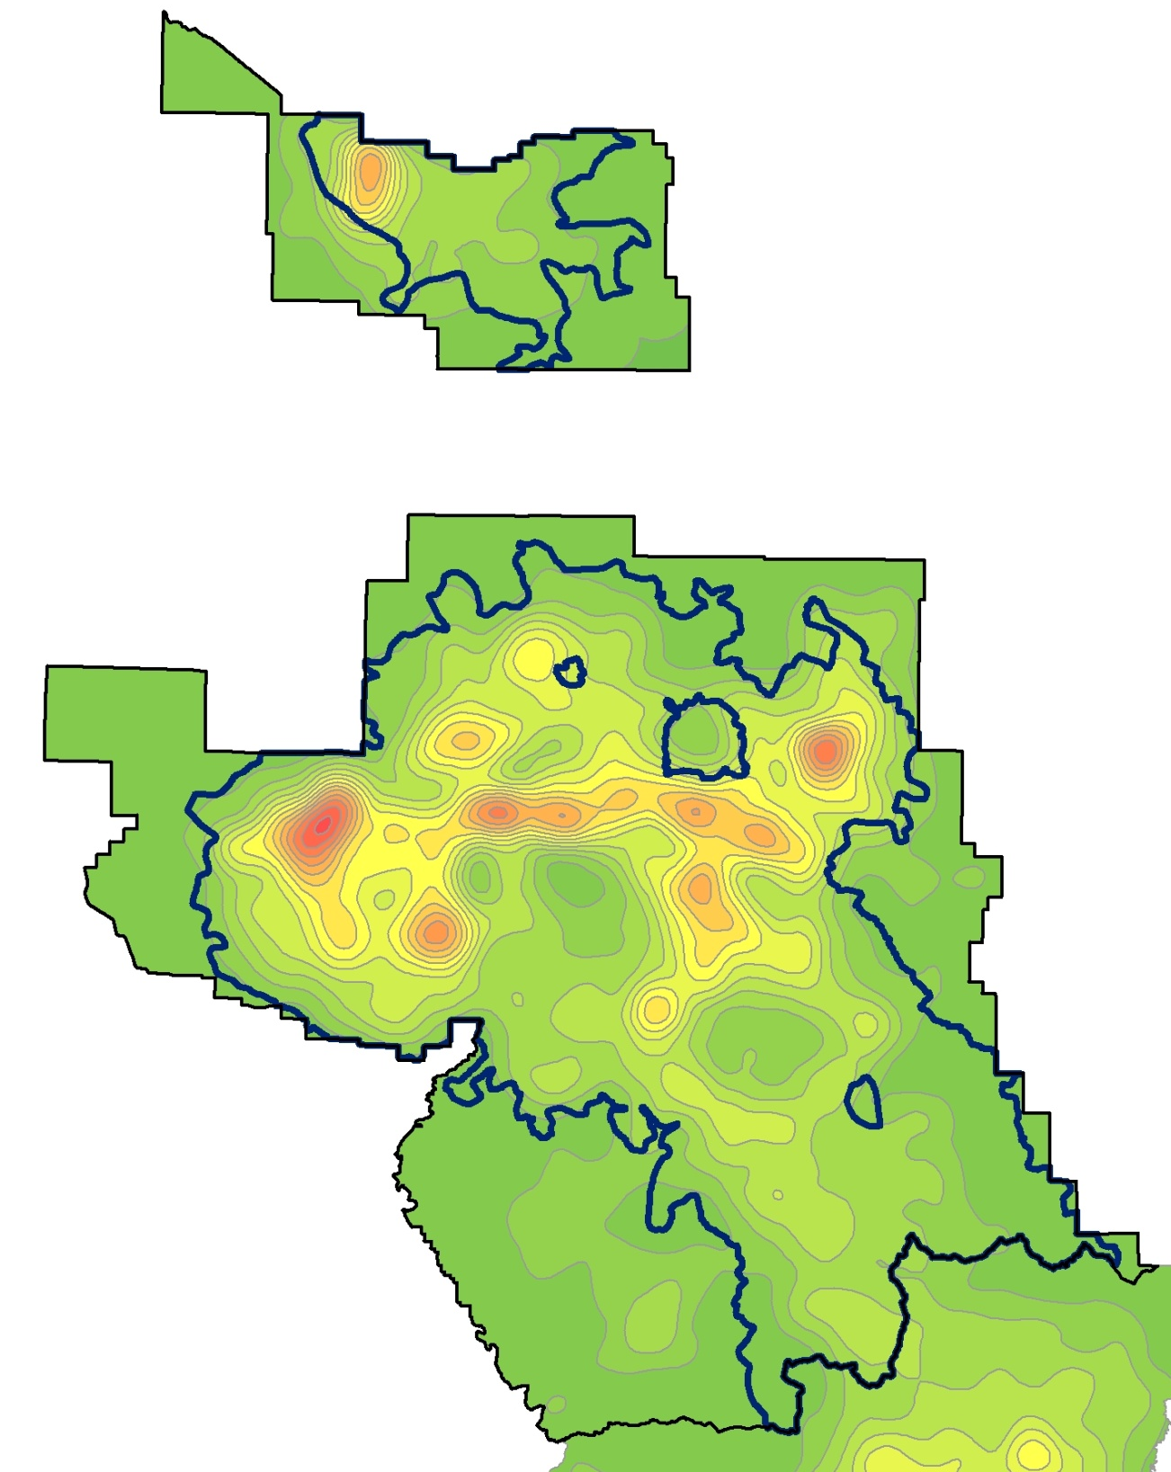
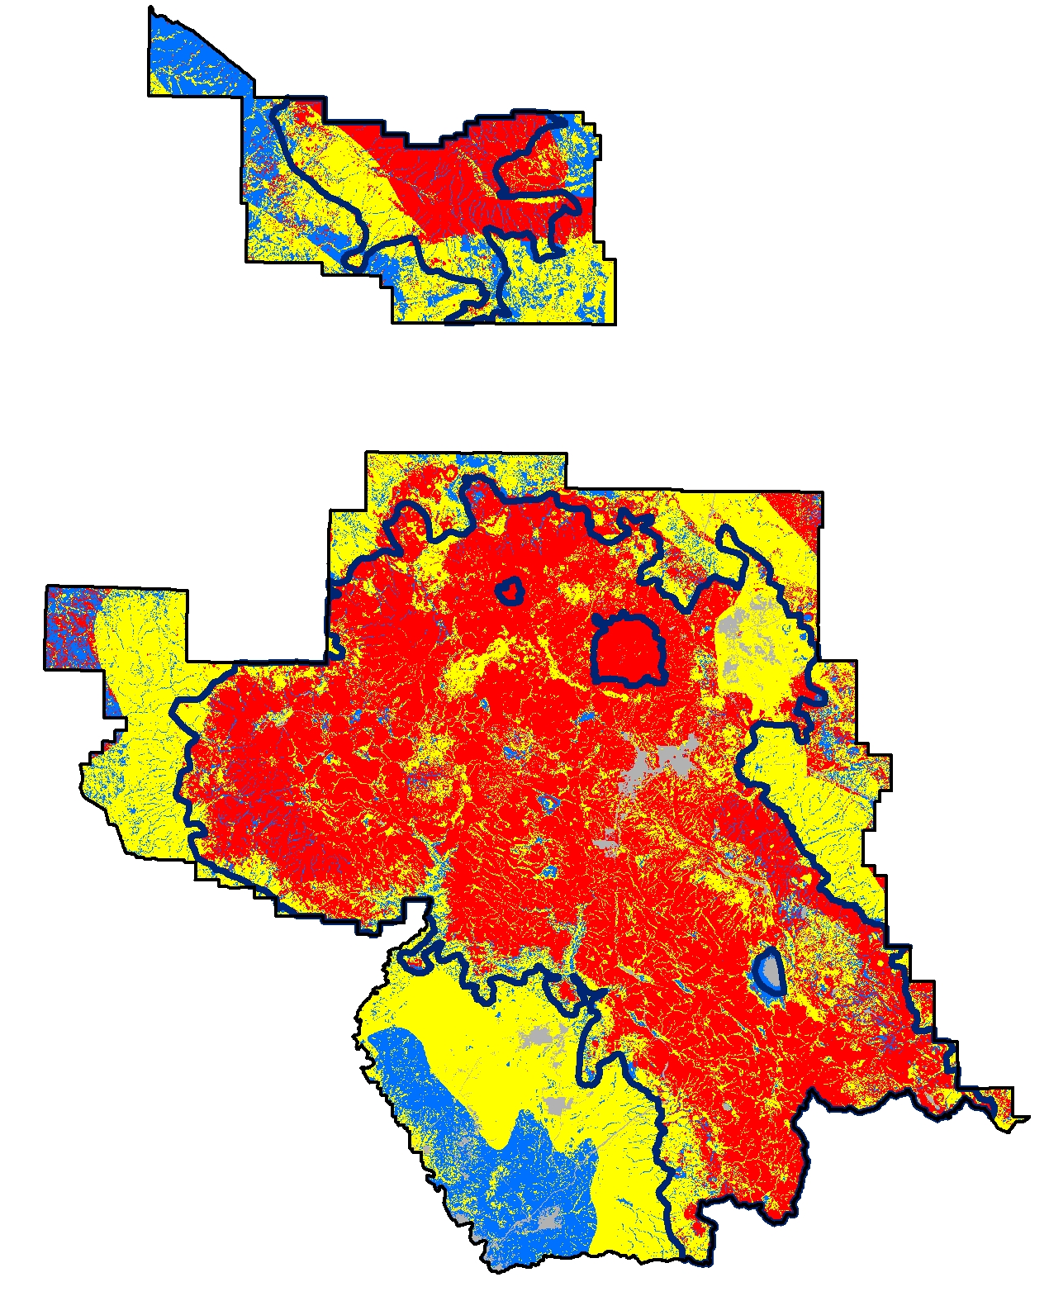
Ignition Density (starts per acre)
6
13 - 14
12 - 13
11 - 12
4
5
10 - 11
9 - 10
8 - 9
3
7 - 8
6 - 7
1
5 - 6
4 - 5
3 - 4
2
2 - 3
1 - 2
0 - 1

Slide 17
Fire Regime / Condition Class (FRCC)
6
4
5
3
Condition Class 3
1
Condition Class 2
Condition Class 1
Other
2

Slide 18
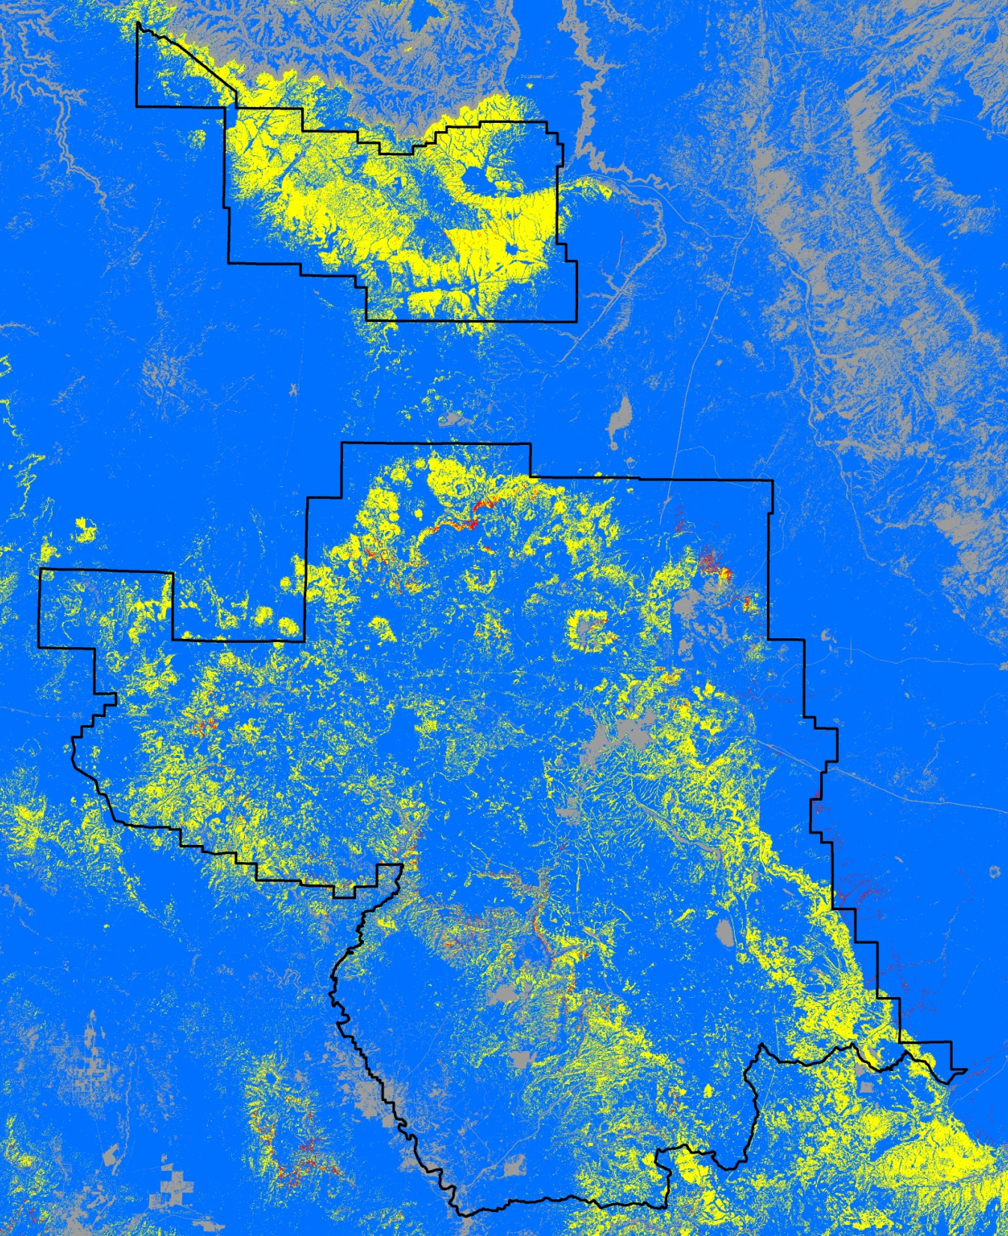
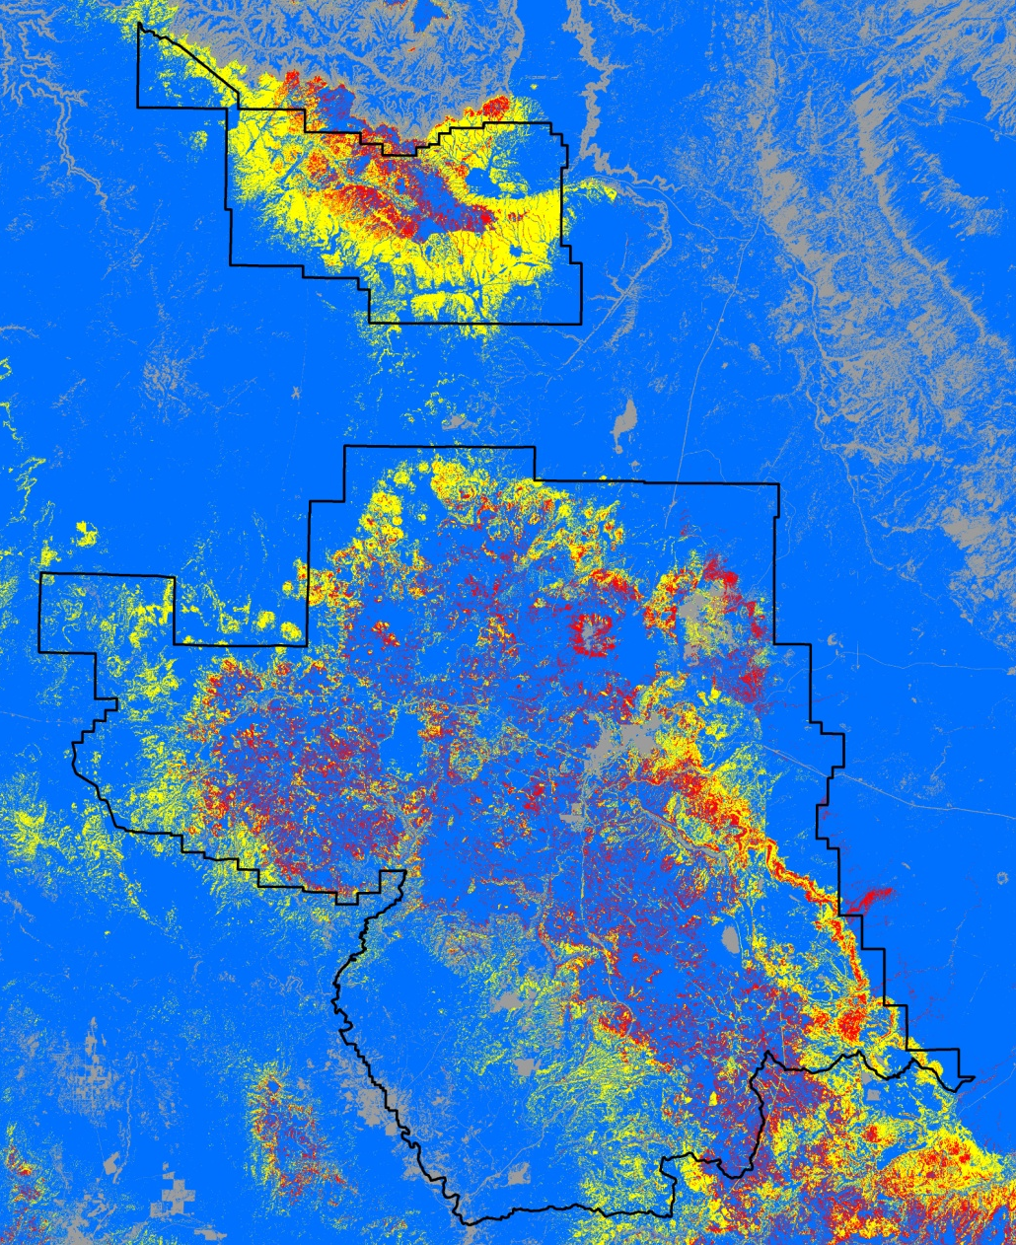
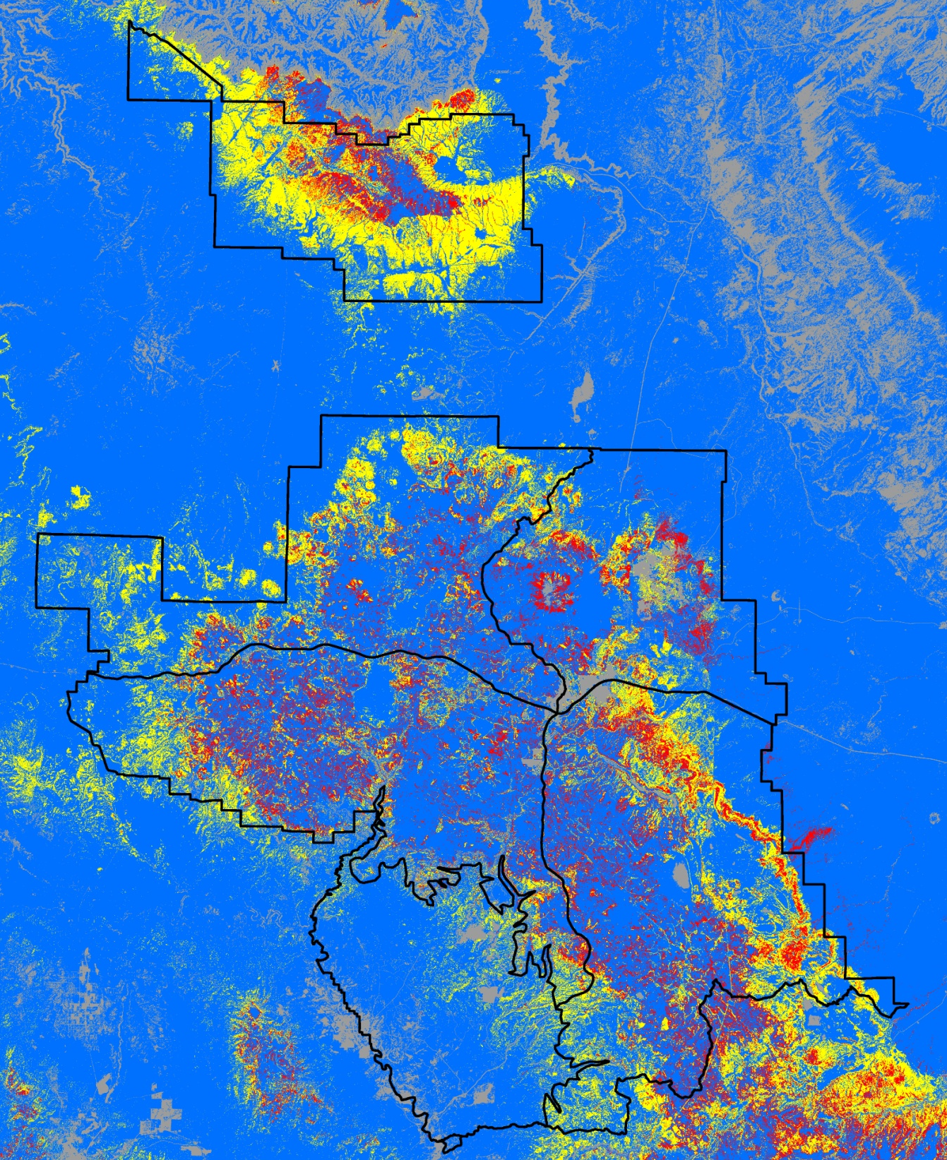
Fire
Behavior
Potential
Maximum Temp = 77°
Minimum RH = 11
Avg Wind Speed = 13
1 hr fuel moisture = 2%
10 hr fuel moisture = 5 %
100 hr fuel moisture = 7 %
Maximum Temp = 89°
Minimum RH = 6
Avg Wind Speed = 13
1 hr fuel moisture = 3 %
10 hr fuel moisture = 3%
100 hr fuel moisture = 6 %
6
95th weather percentile
4
5
Schultz wx parameters
3
Active crown fire
1
Passive crown fire
Surface fire
No fire
2

Slide 19
Current Condition
Initial Analyses
Fire Return Interval
Fire Type
Fire Regime/Condition Class
Ignition Densities
Extended Analyses
Fire Paths (risk/probability to given areas)
Fireline Intensity (fire effects)
Heat per unit area (fire effects)
Treatment Optimization Model Simulation (TOM), or similar method of optimizing proposed treatments

Slide 20
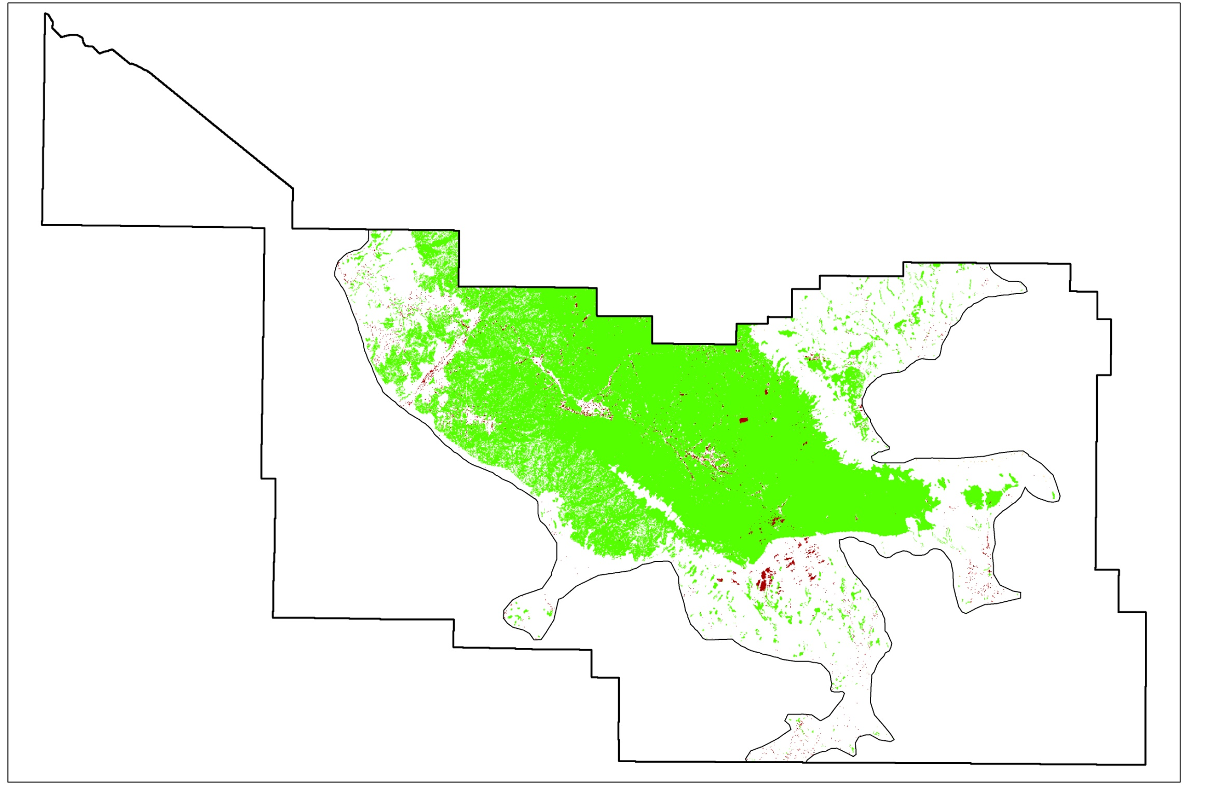
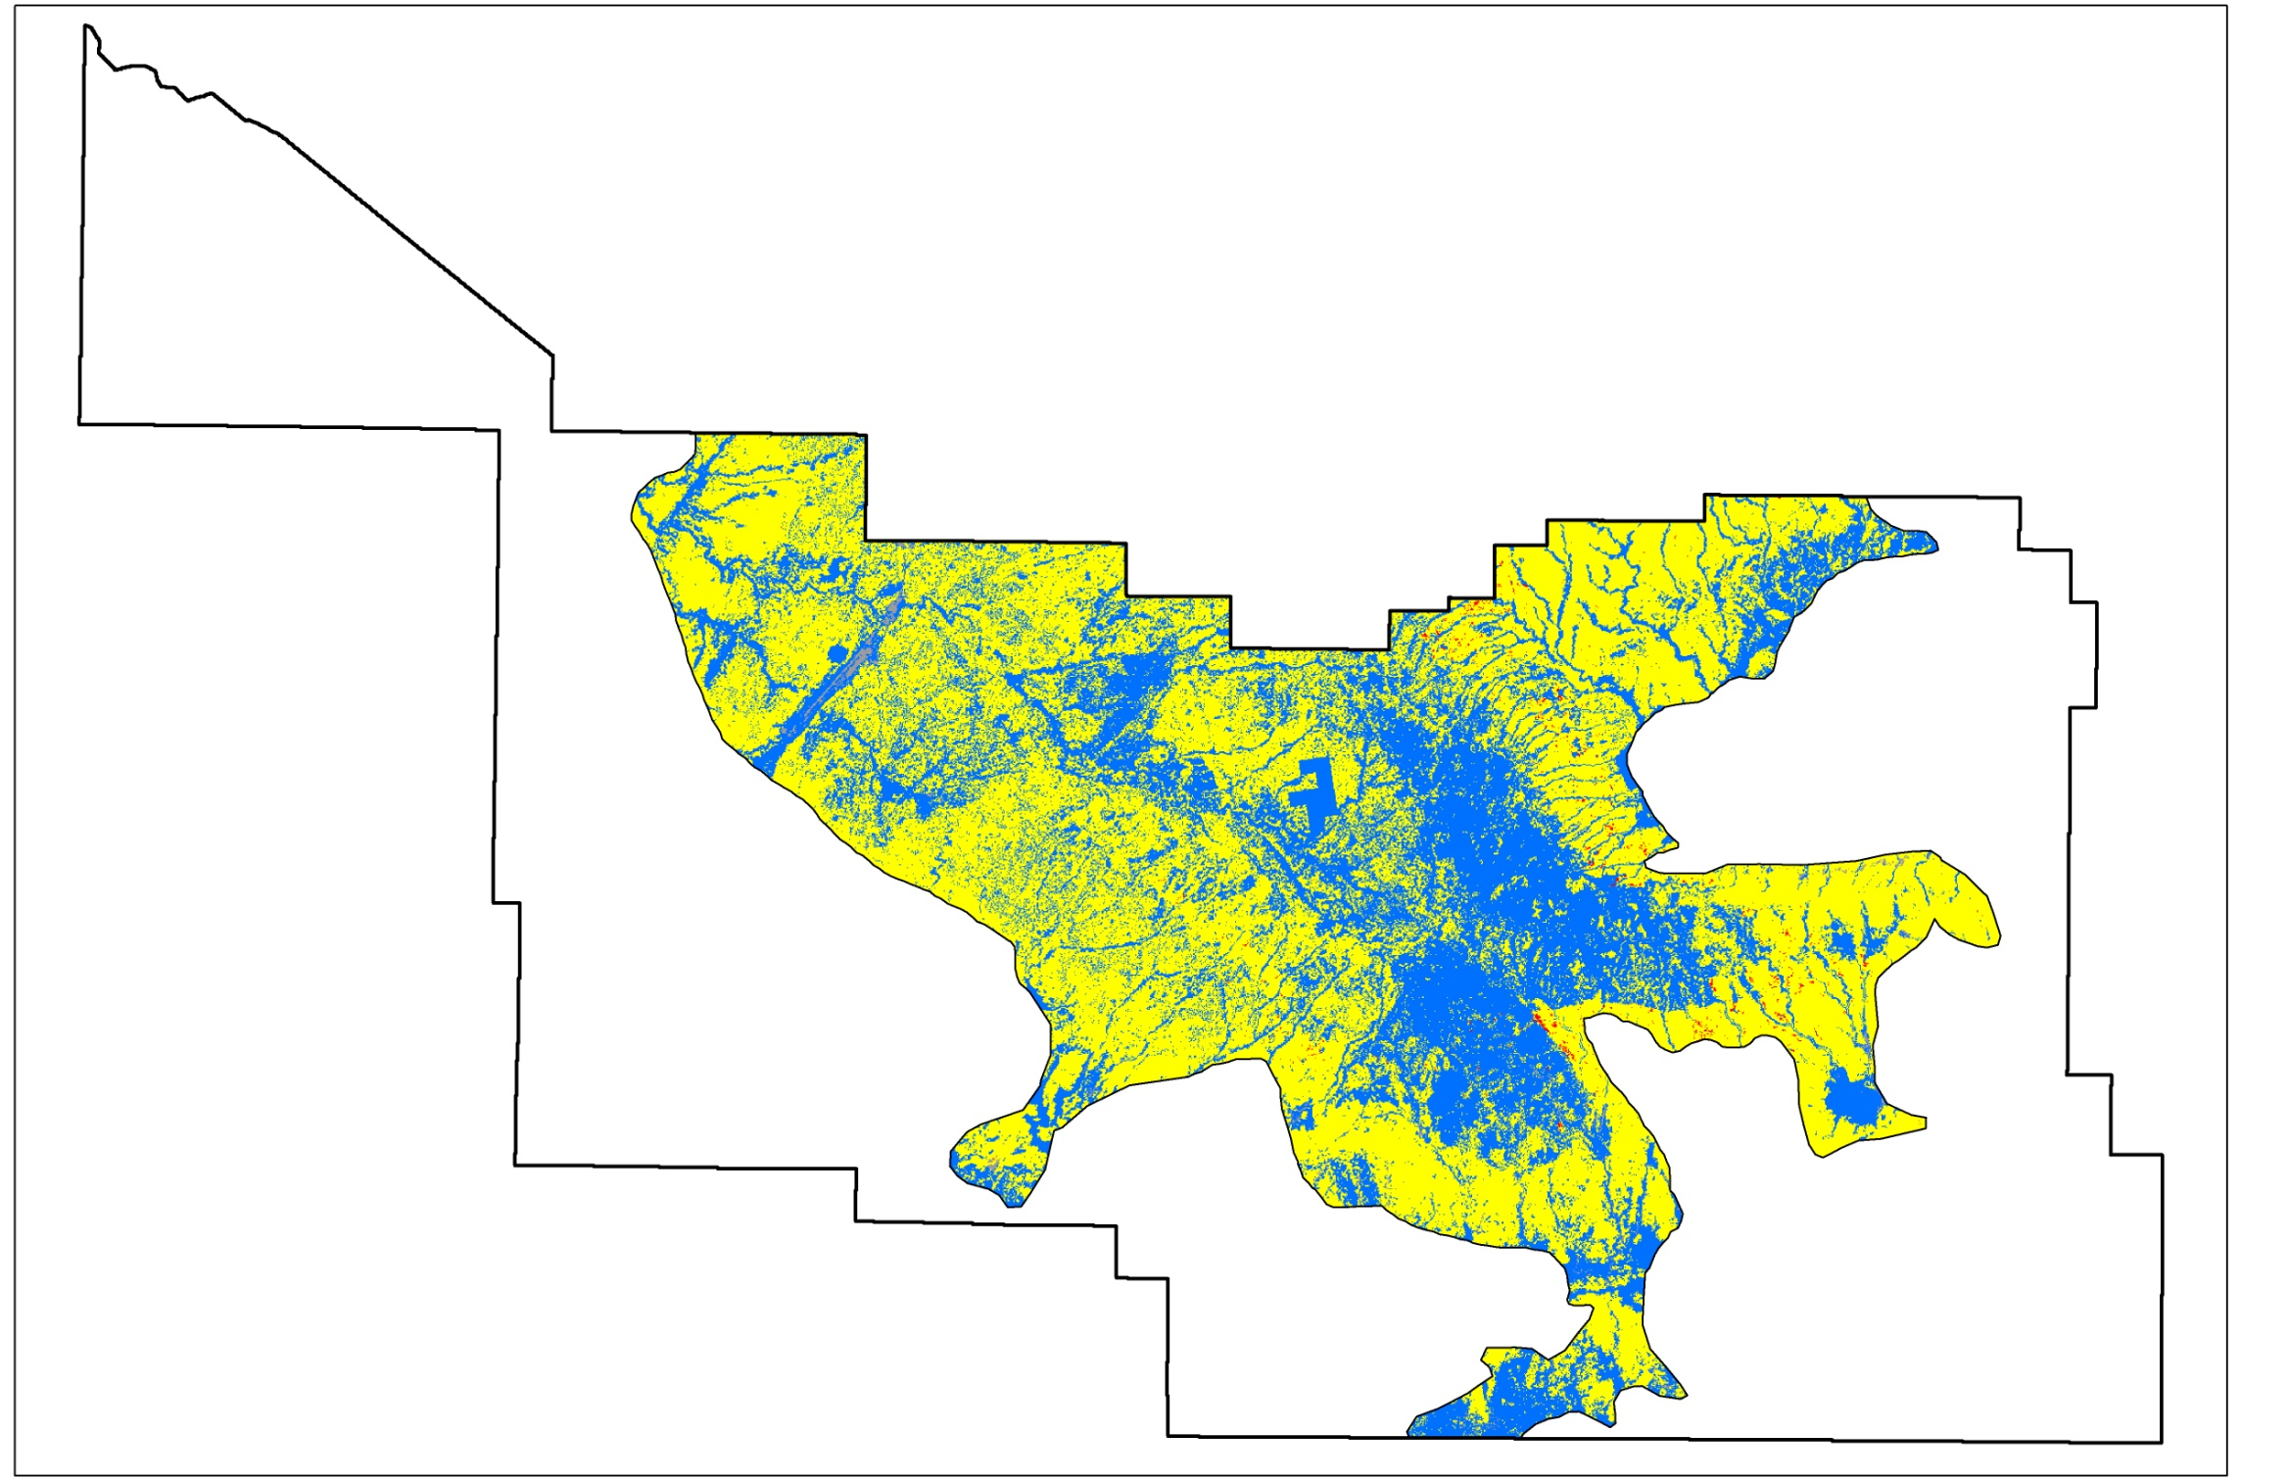
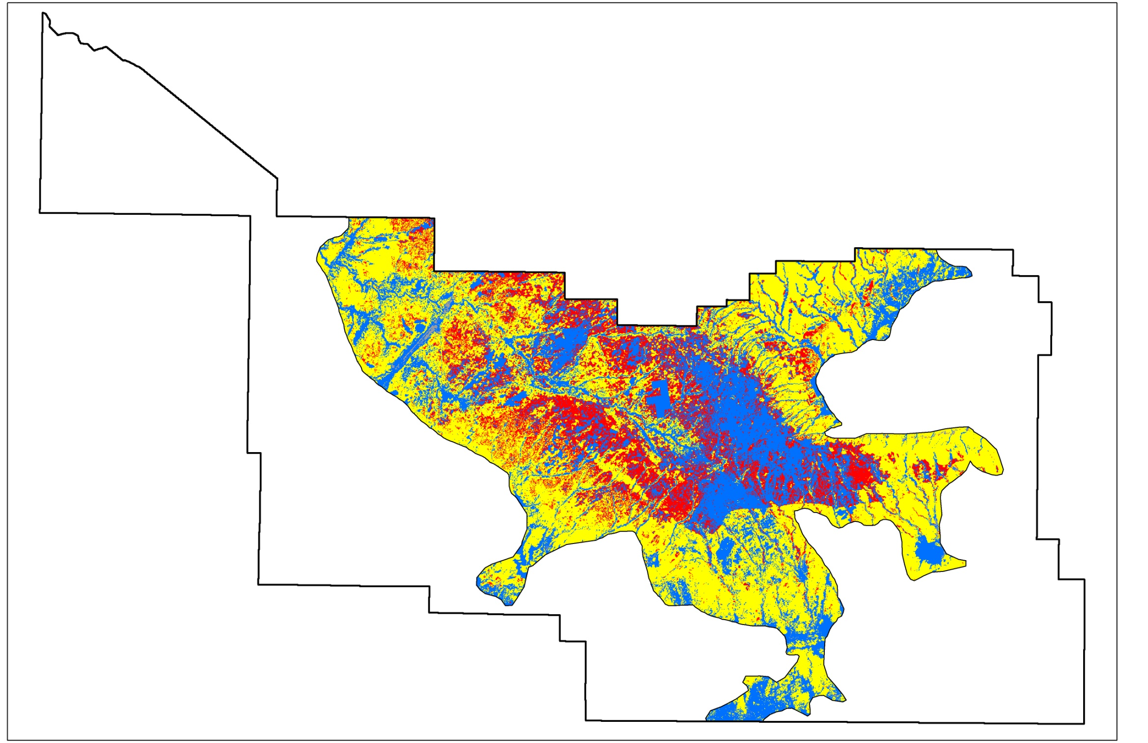
Fire Behavior Potential – Firescape 6
Schultz wx/fuel parameters
95th wx percentile
Grassland
Active crown fire
Active crown fire
Ponderosa Pine/Oak
Passive crown fire
Passive crown fire
Ponderosa Pine
Surface fire
Surface fire
Other
No fire
No fire

Slide 21
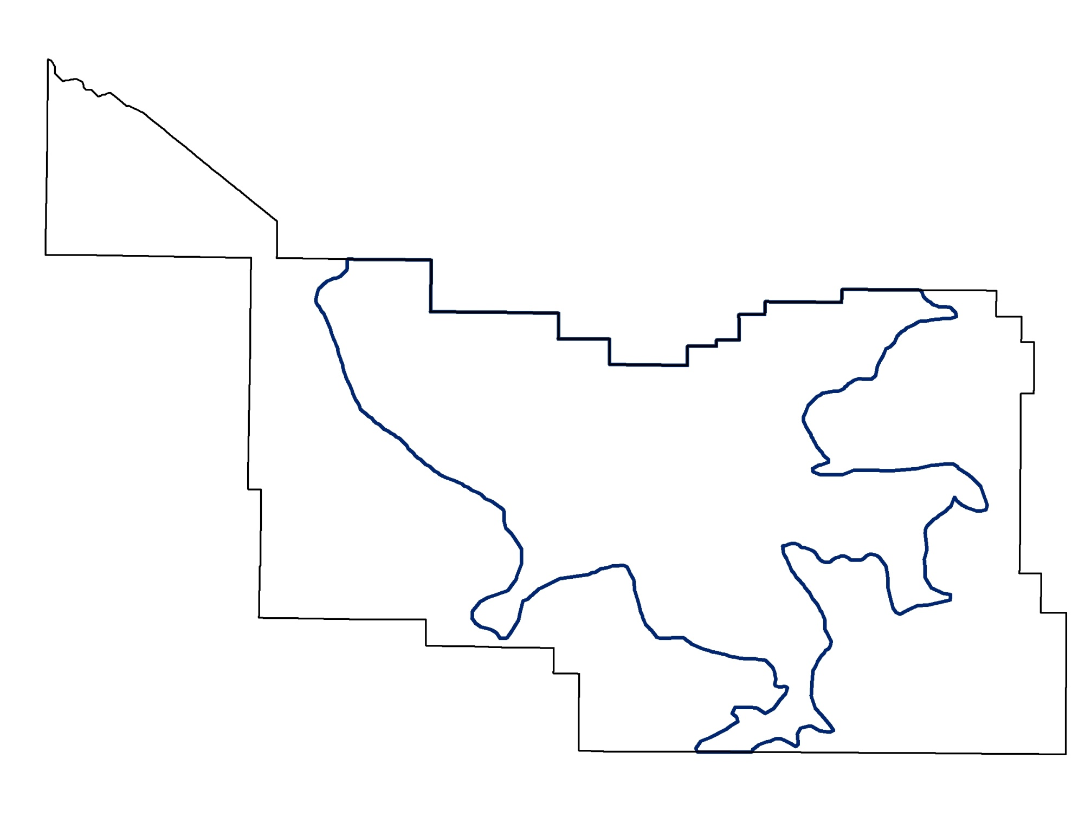
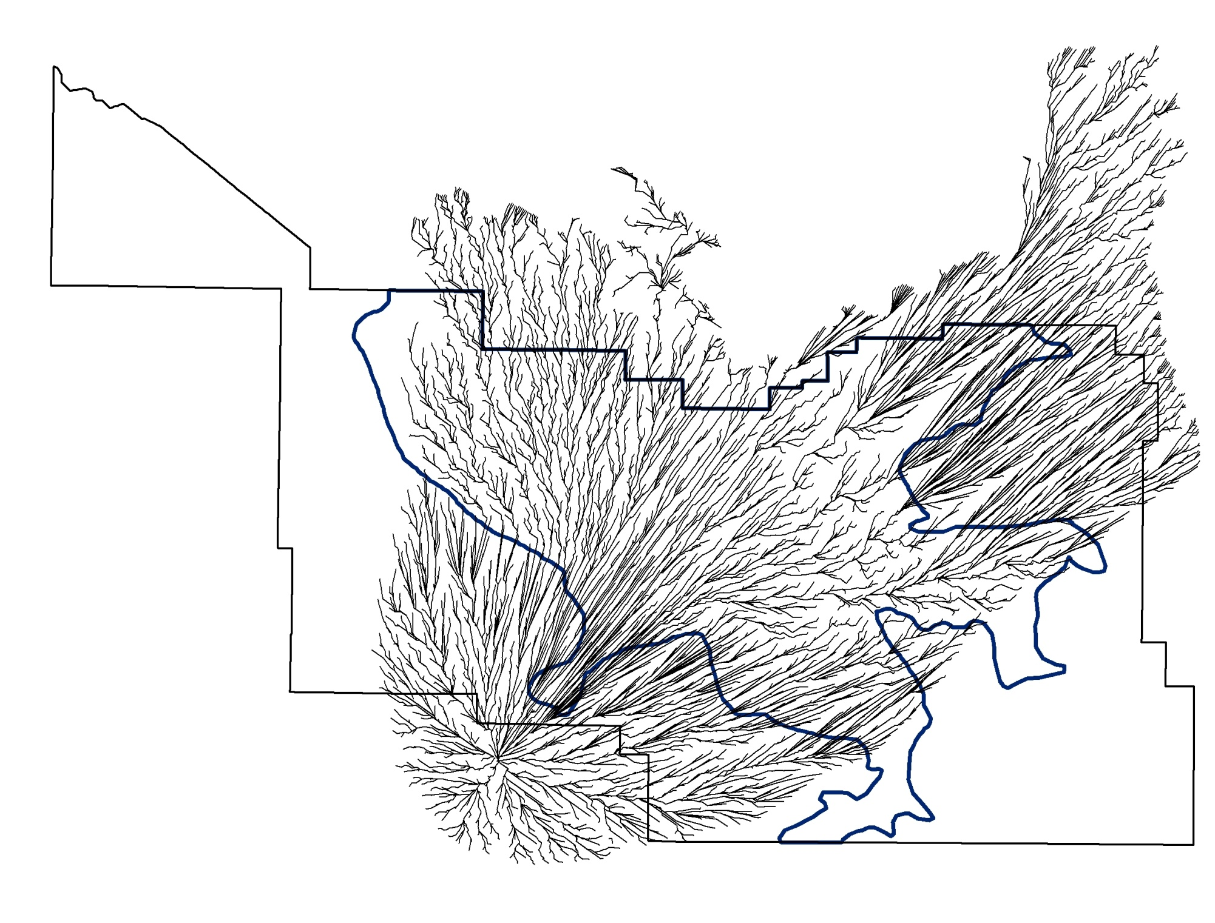
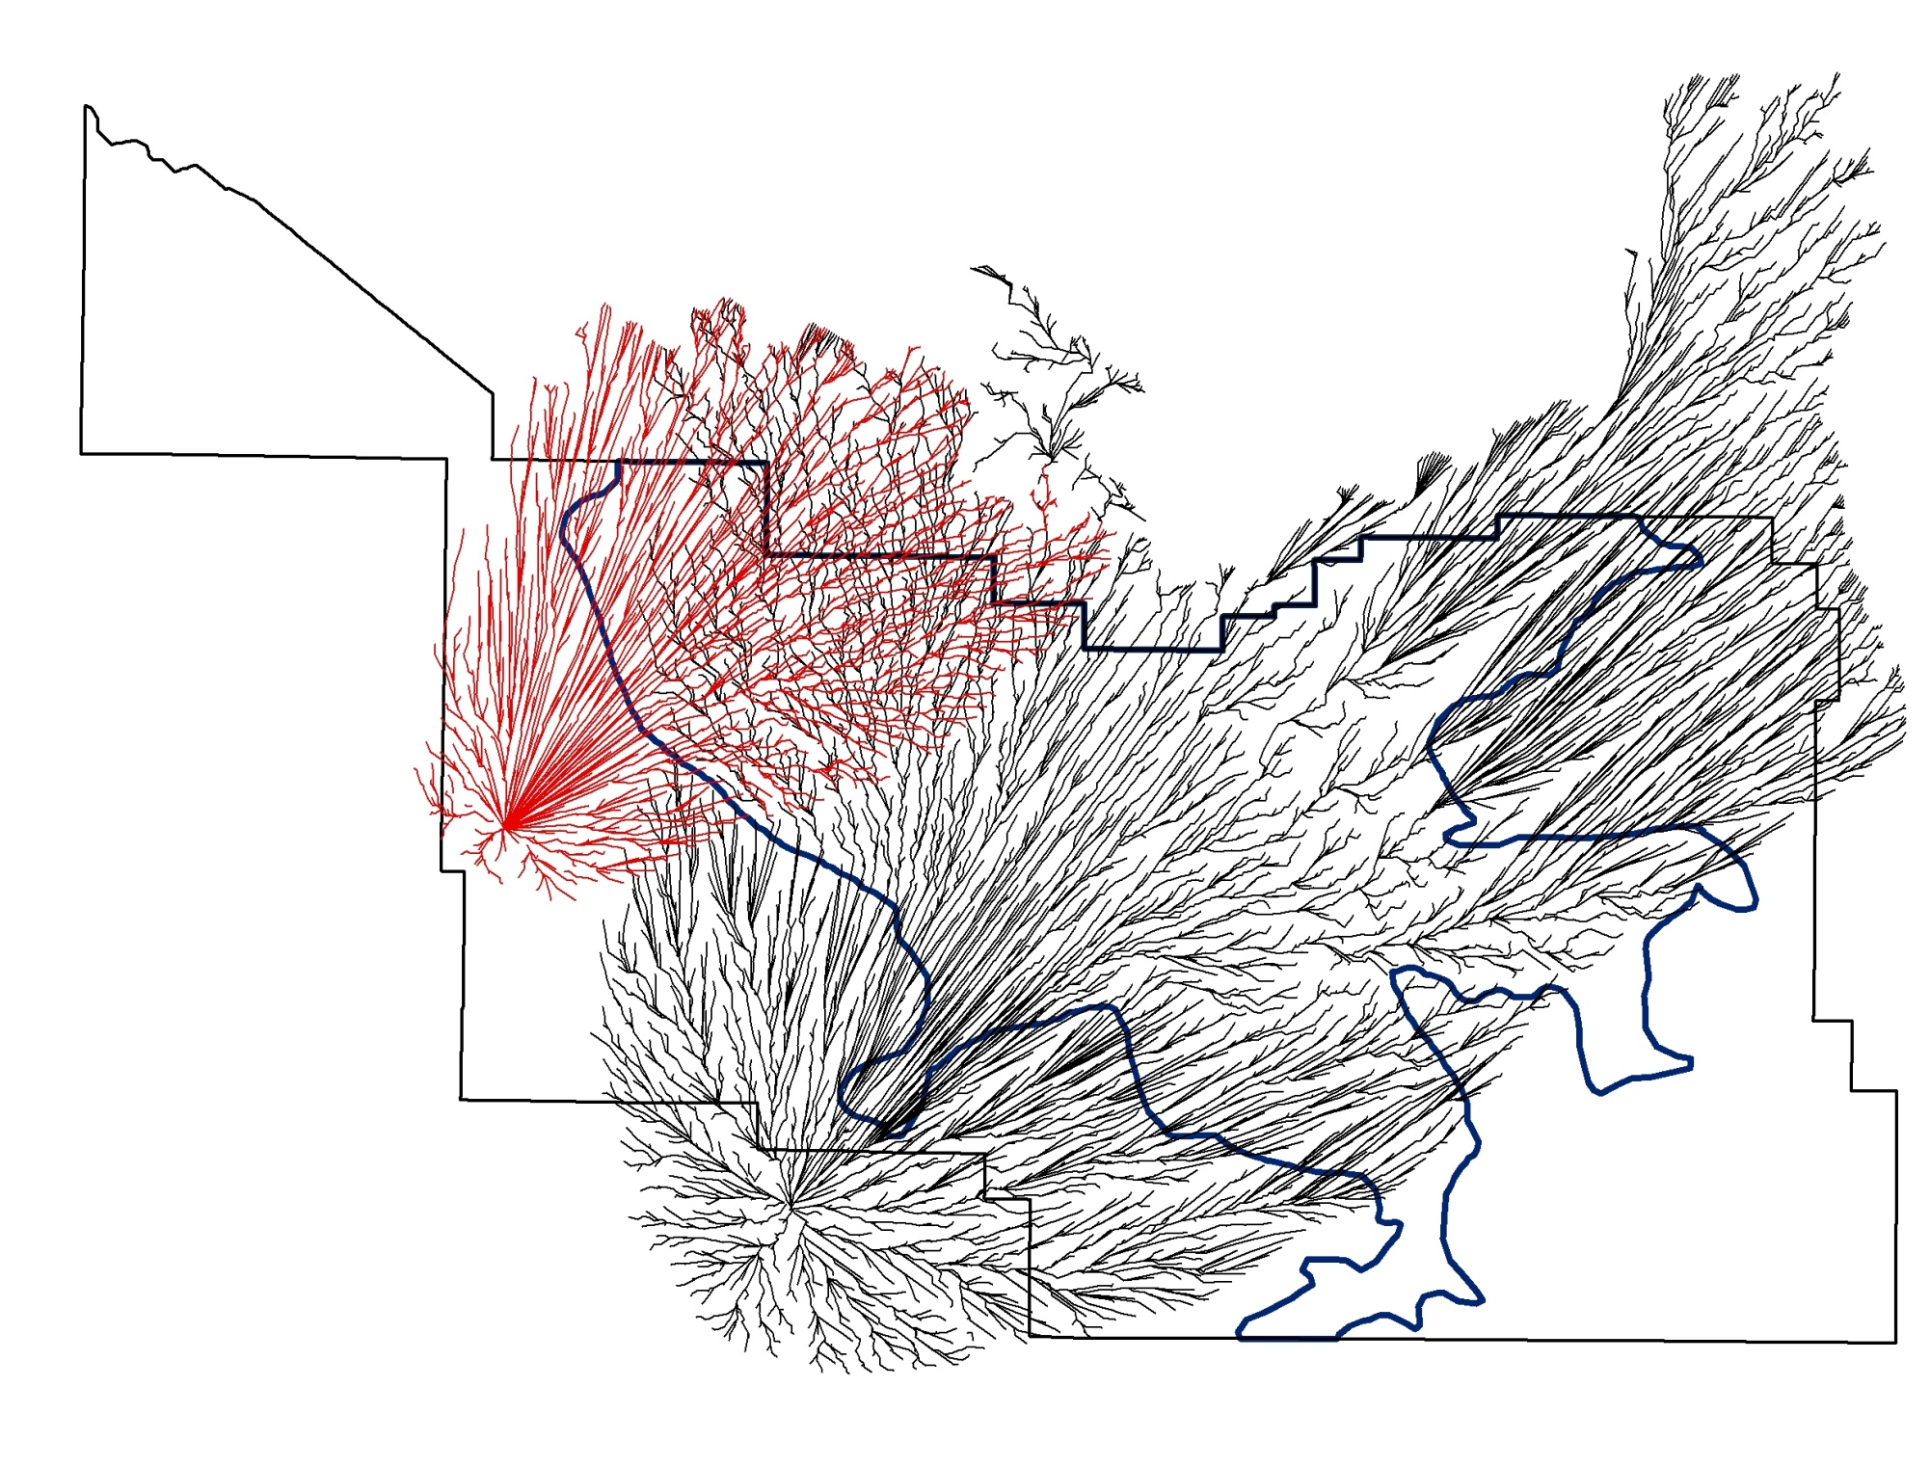
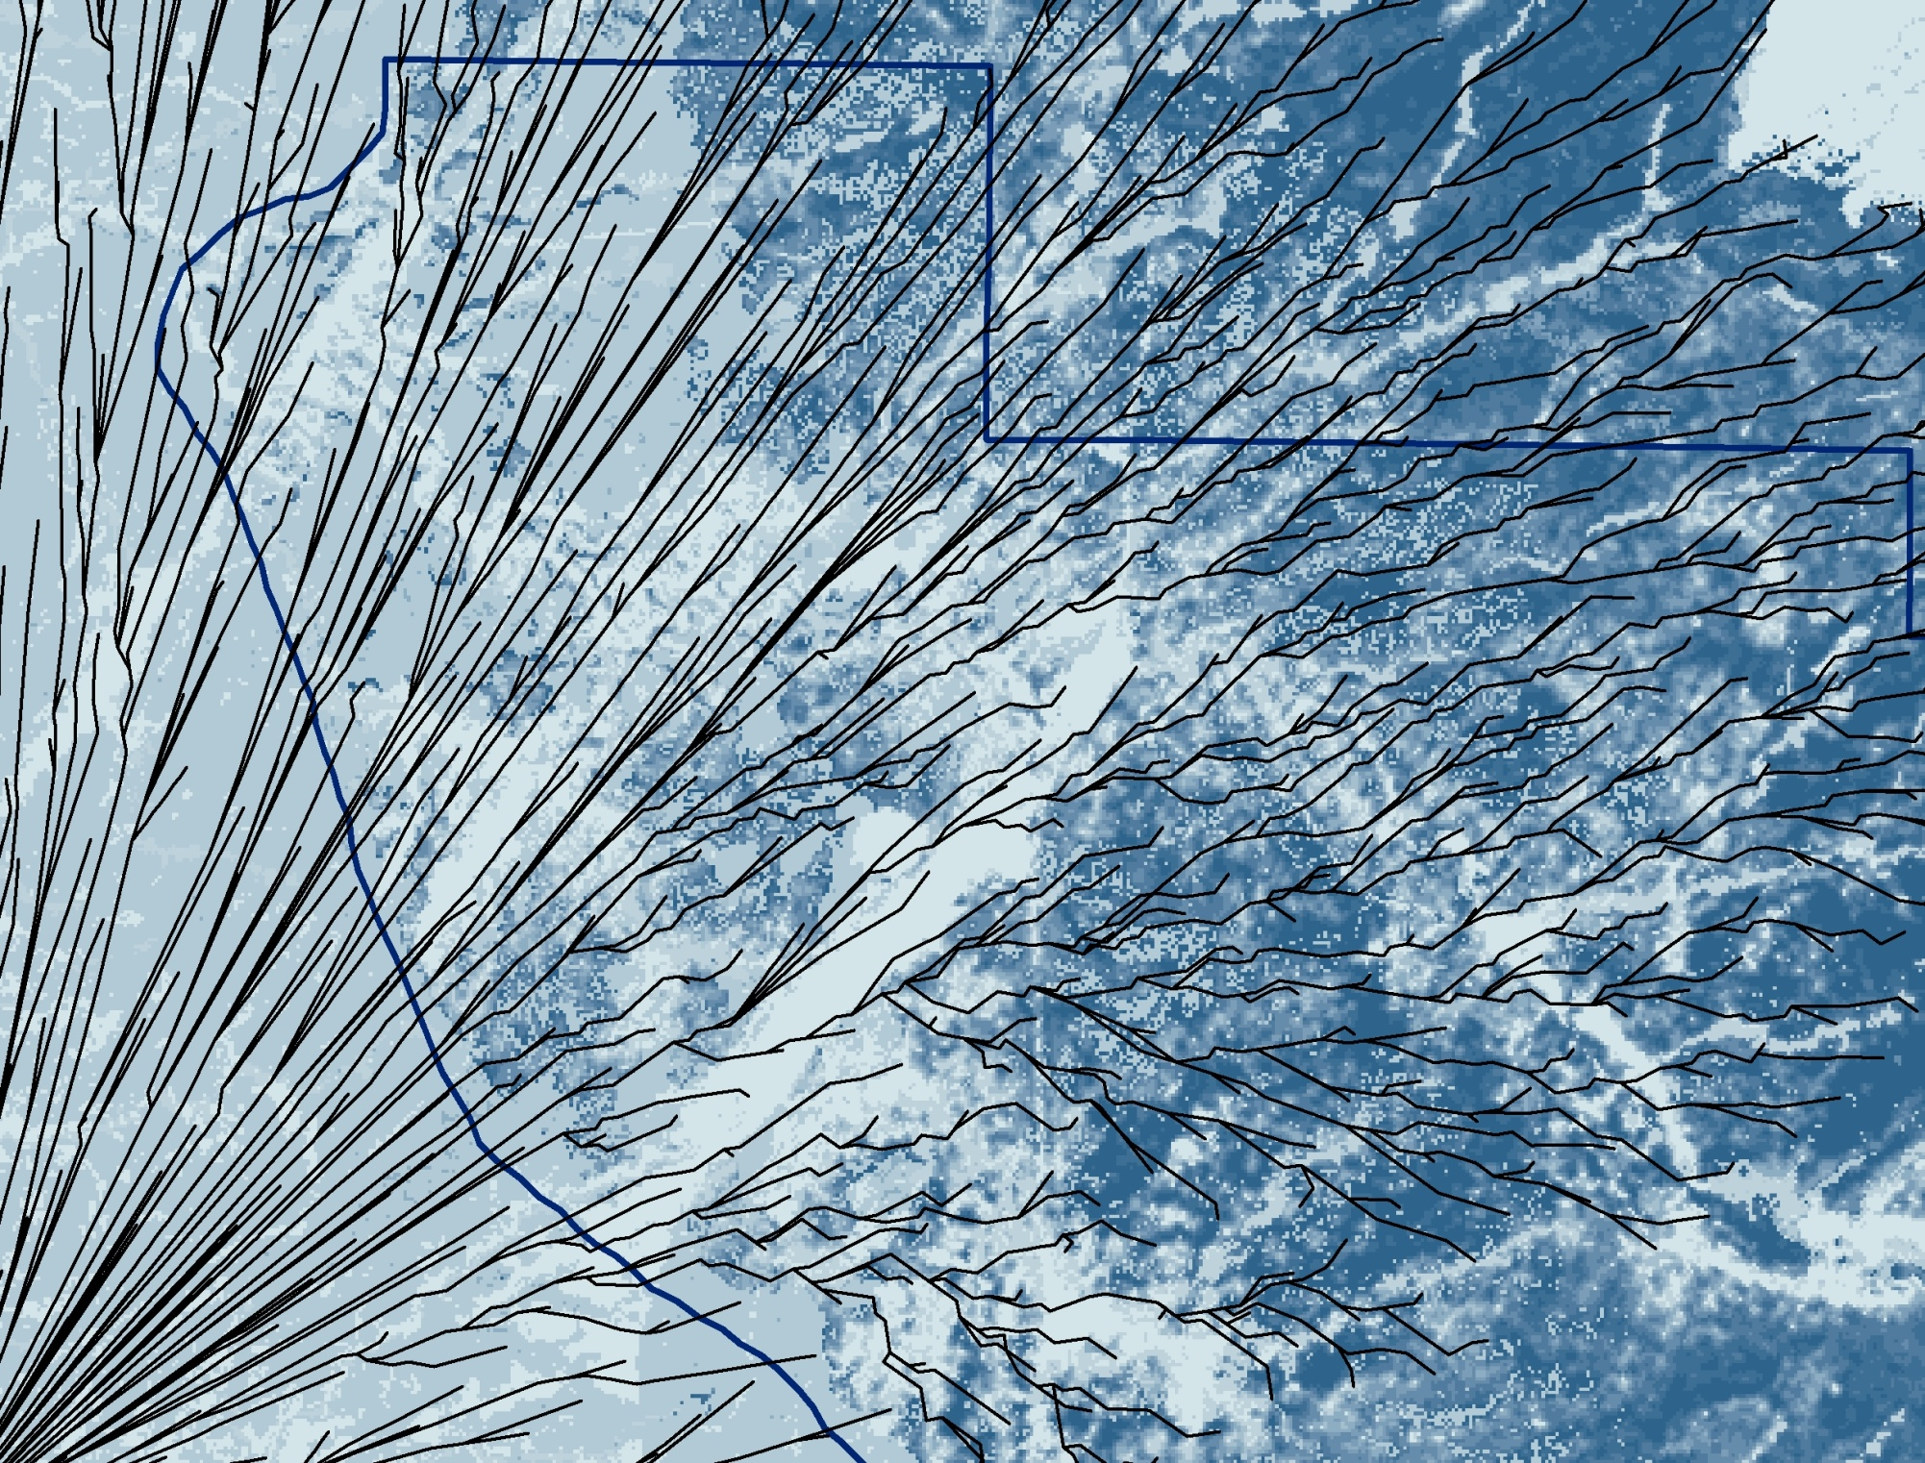
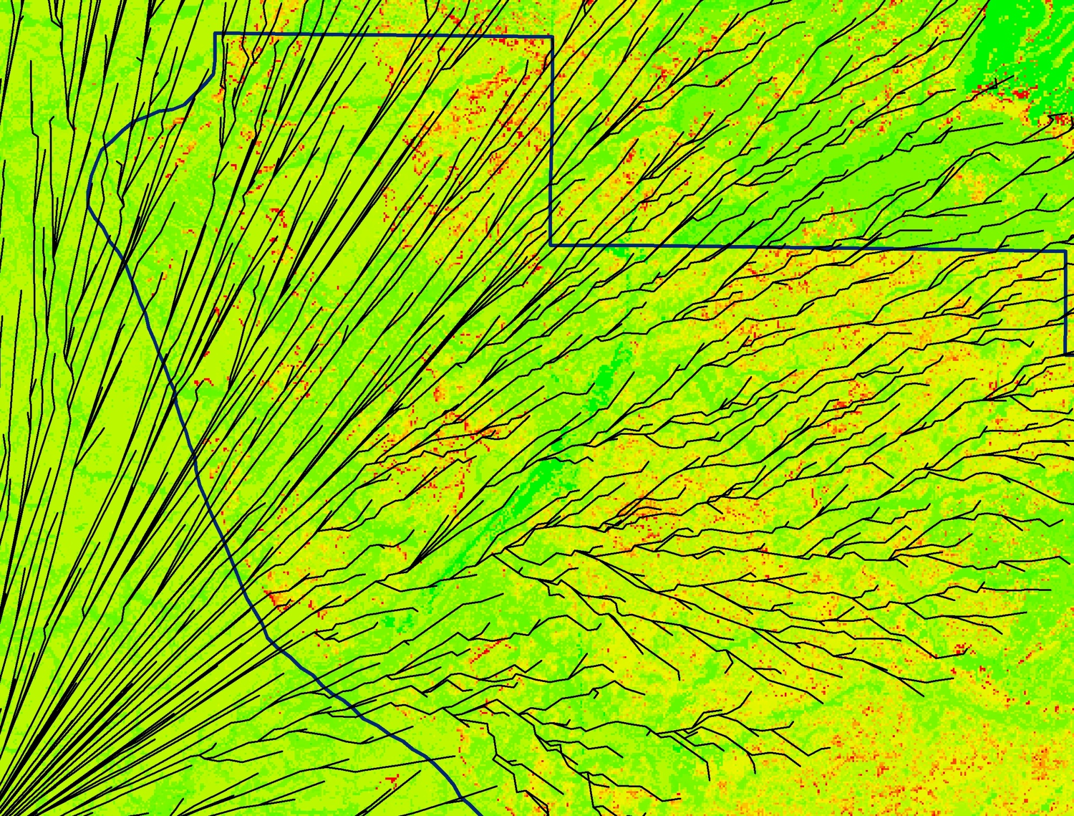
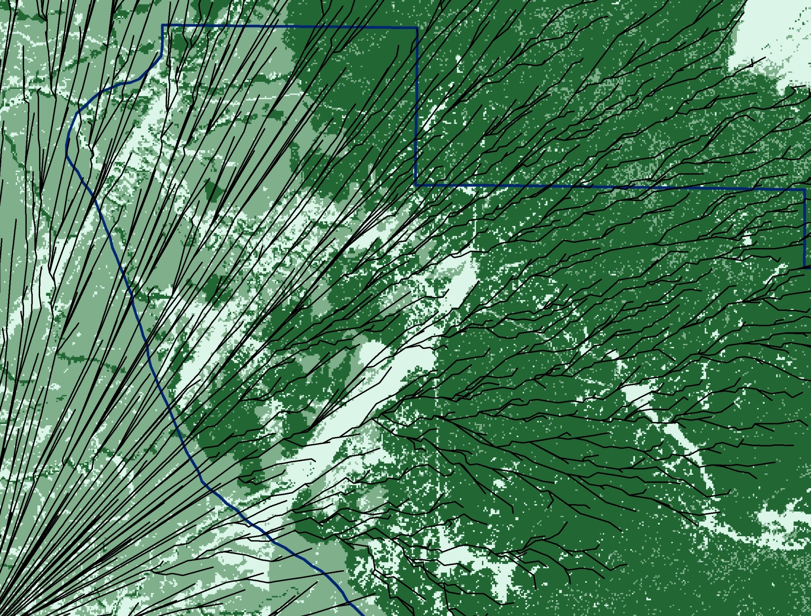
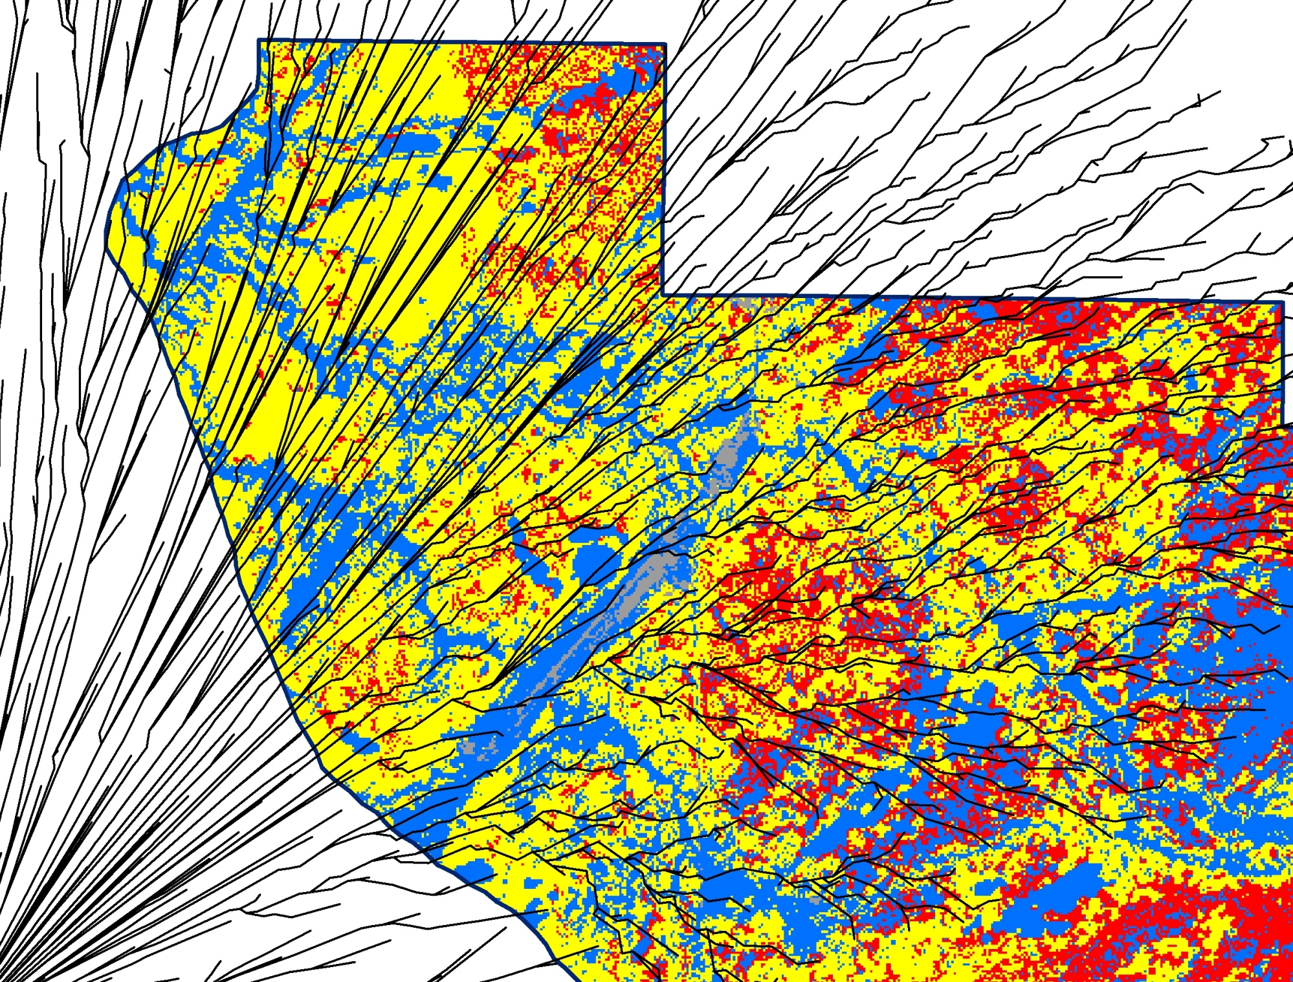
Fire Behavior Potential – Firescape 6
Fire Paths
+
Fire type potential
Fire Paths
+
Crown Bulk Density
Fire Paths
+
Heat per unit area
Fire Paths
Fire Paths
+
Stand height
Planning for prescribed fire:
Where can fire be used safely and effectively?
Can we produce the effects we want?
Is pre-treatment needed?
Maintenance burn or ‘treatment’?

Slide 22
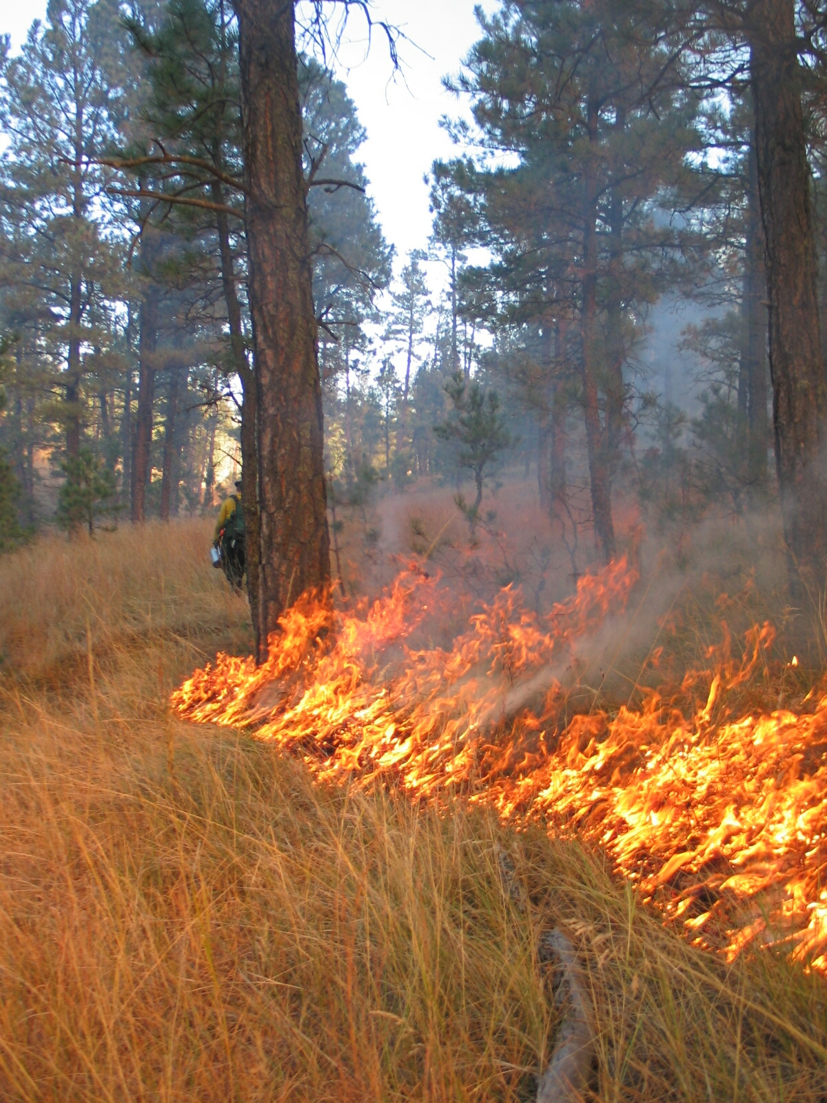
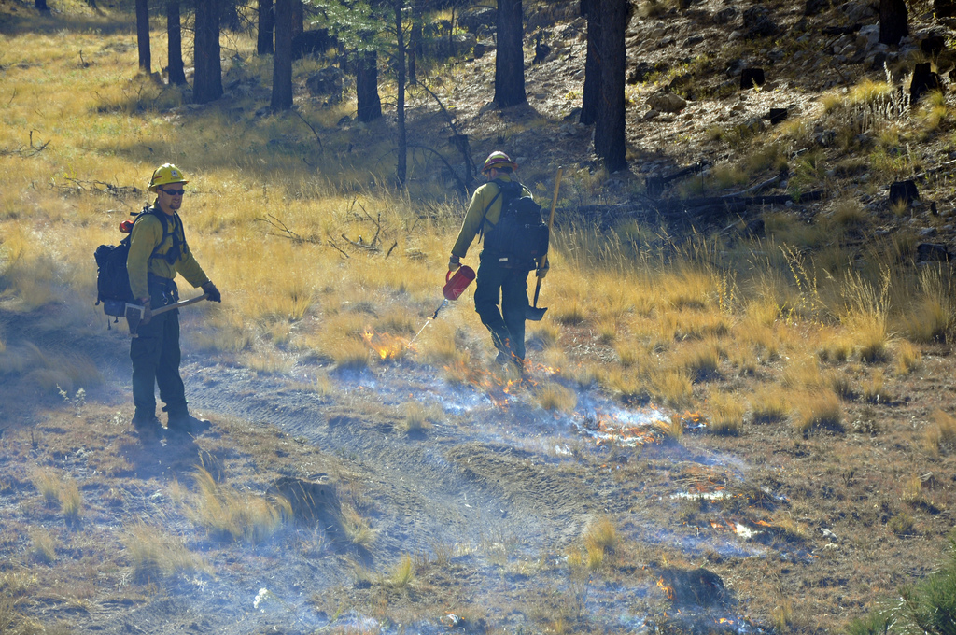
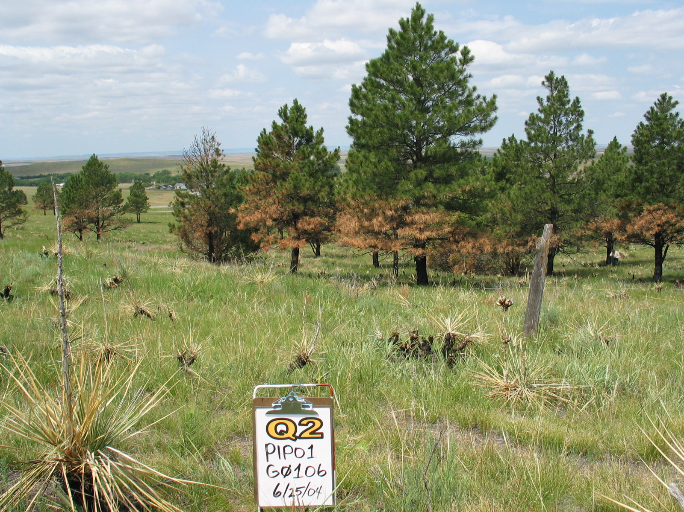
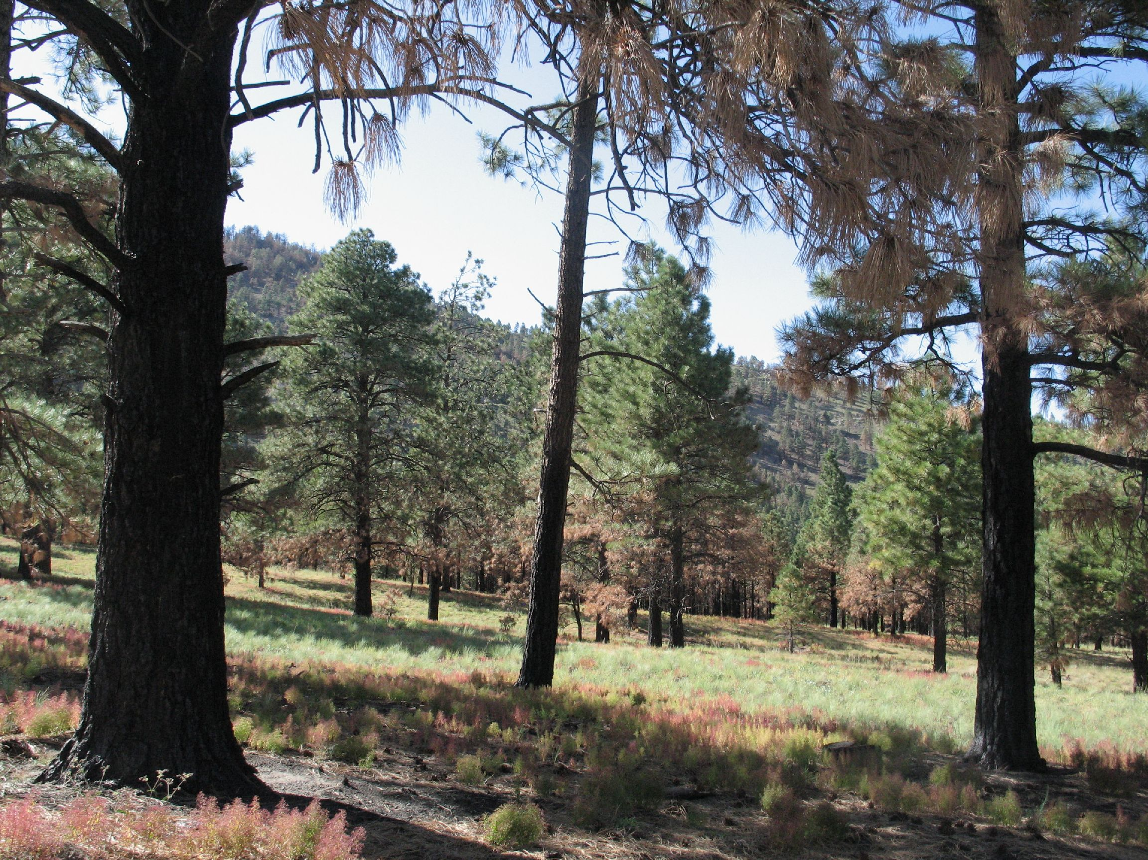
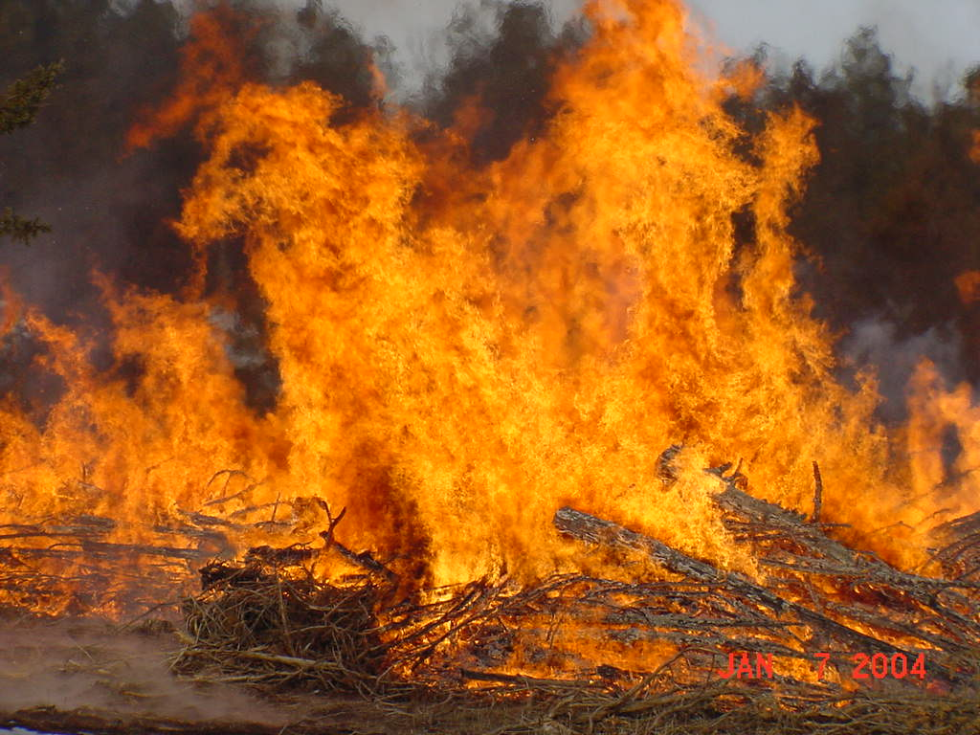
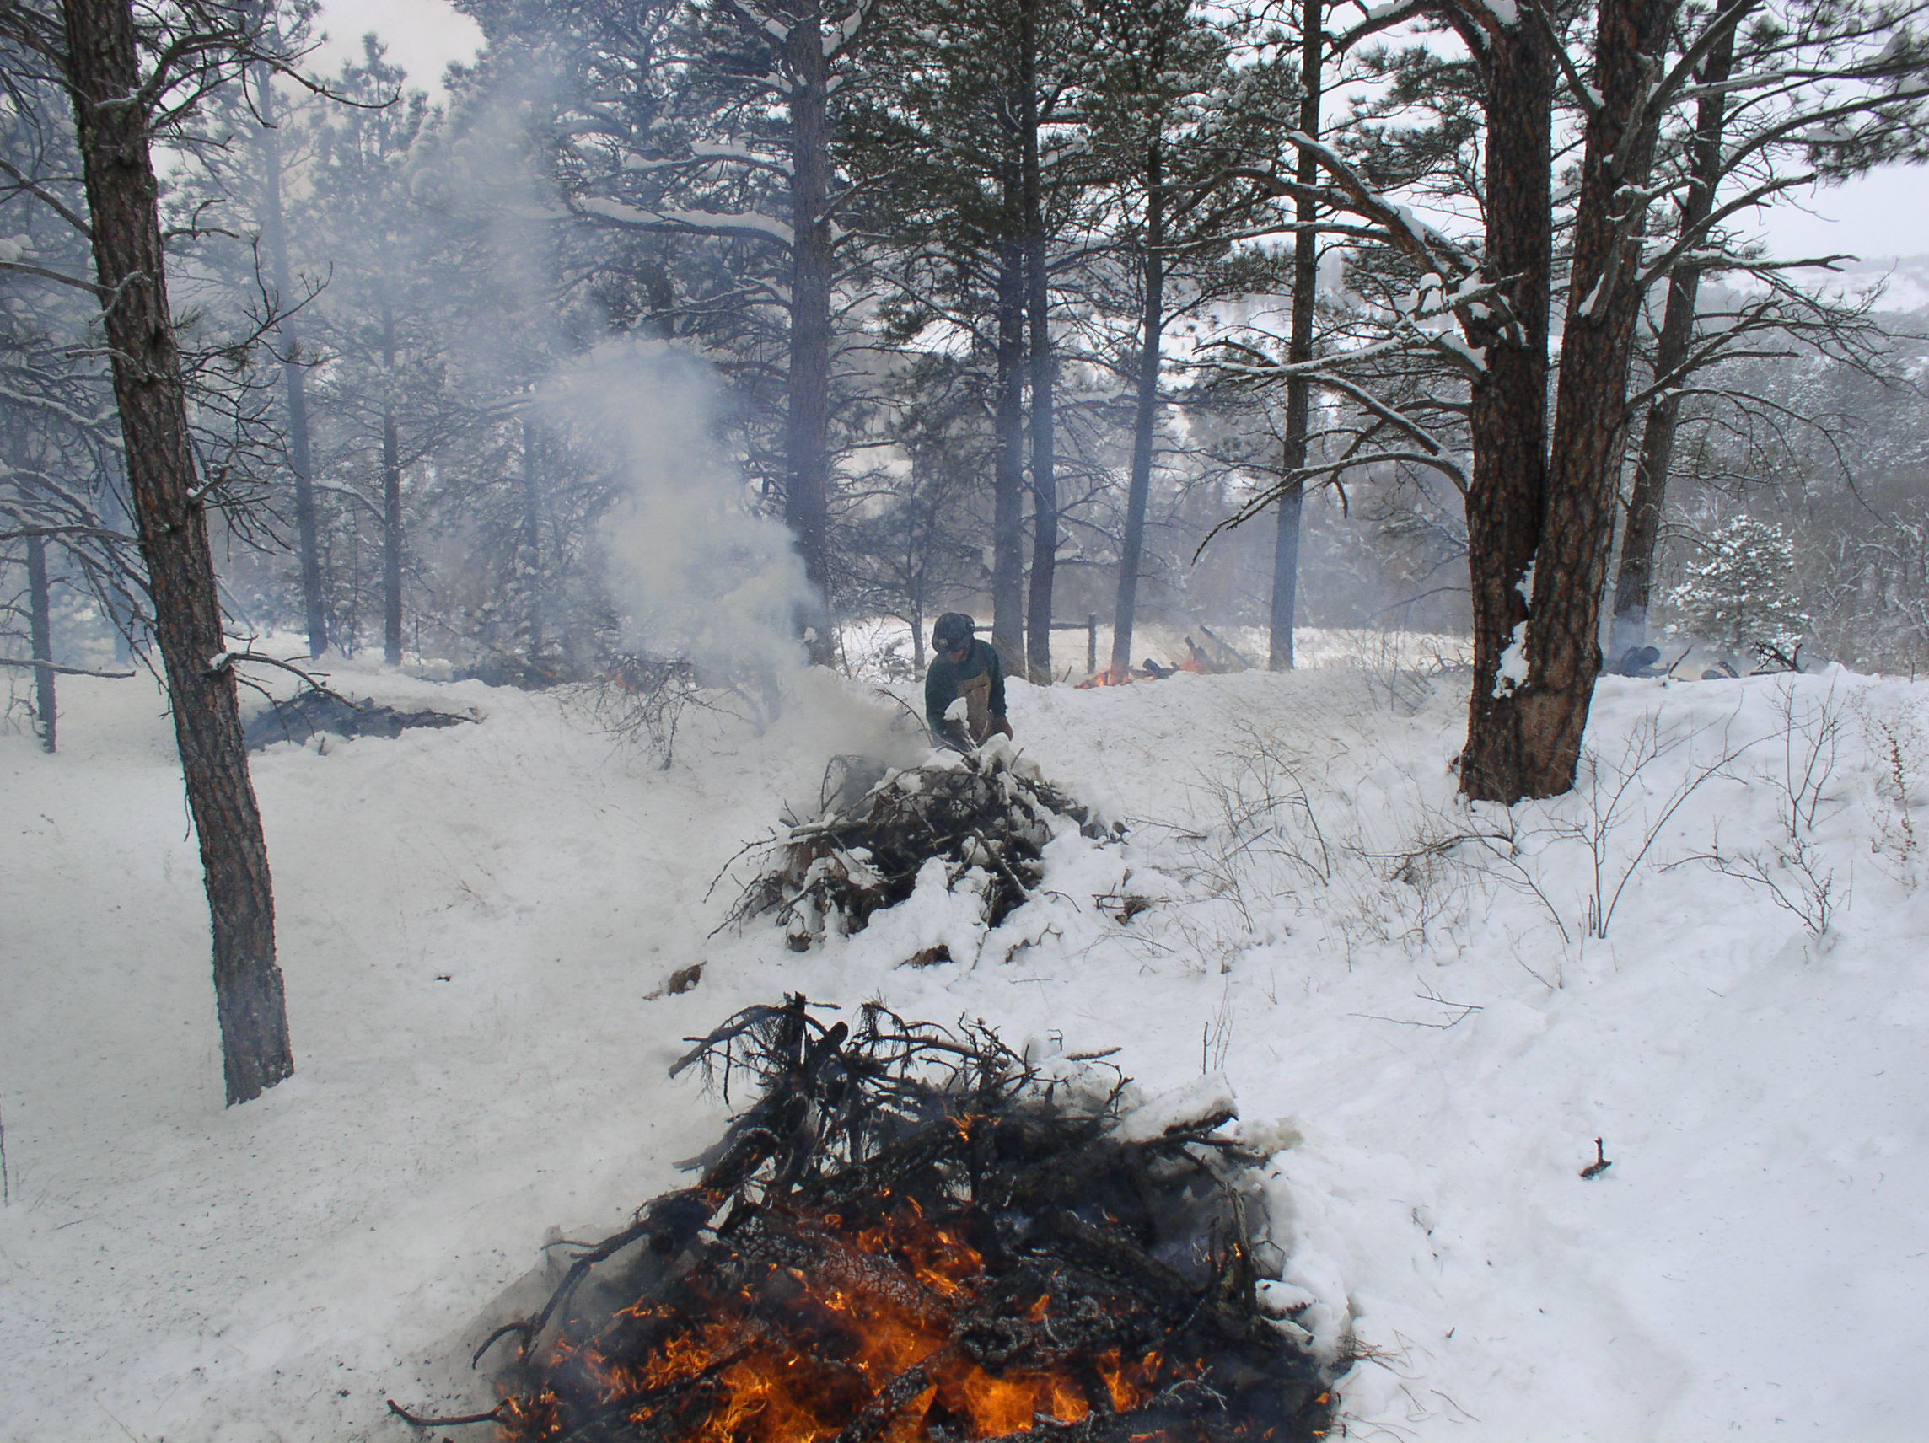
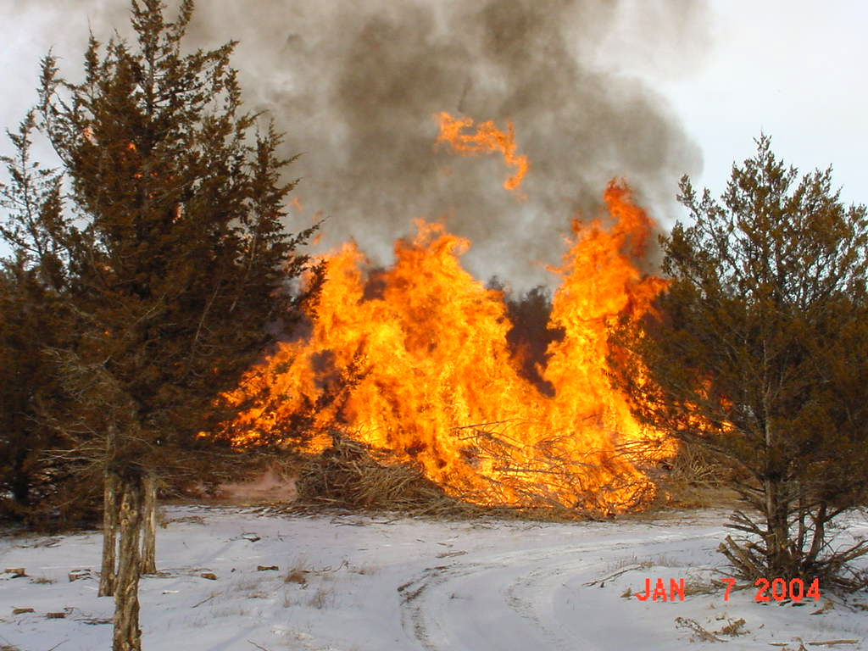
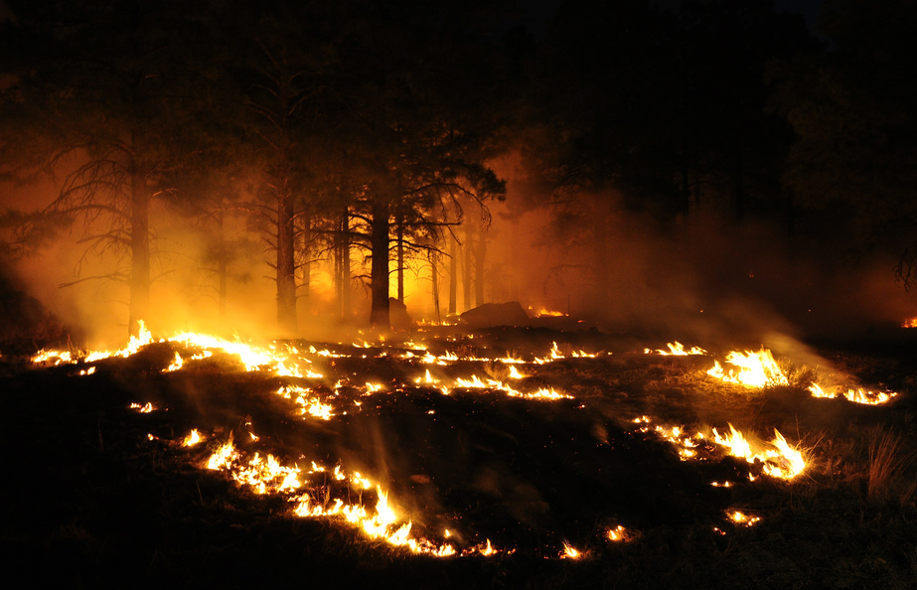
Prescribed Fire
Pile burning
Broadcast Burning
Hand Piles
Machine piles

Slide 23
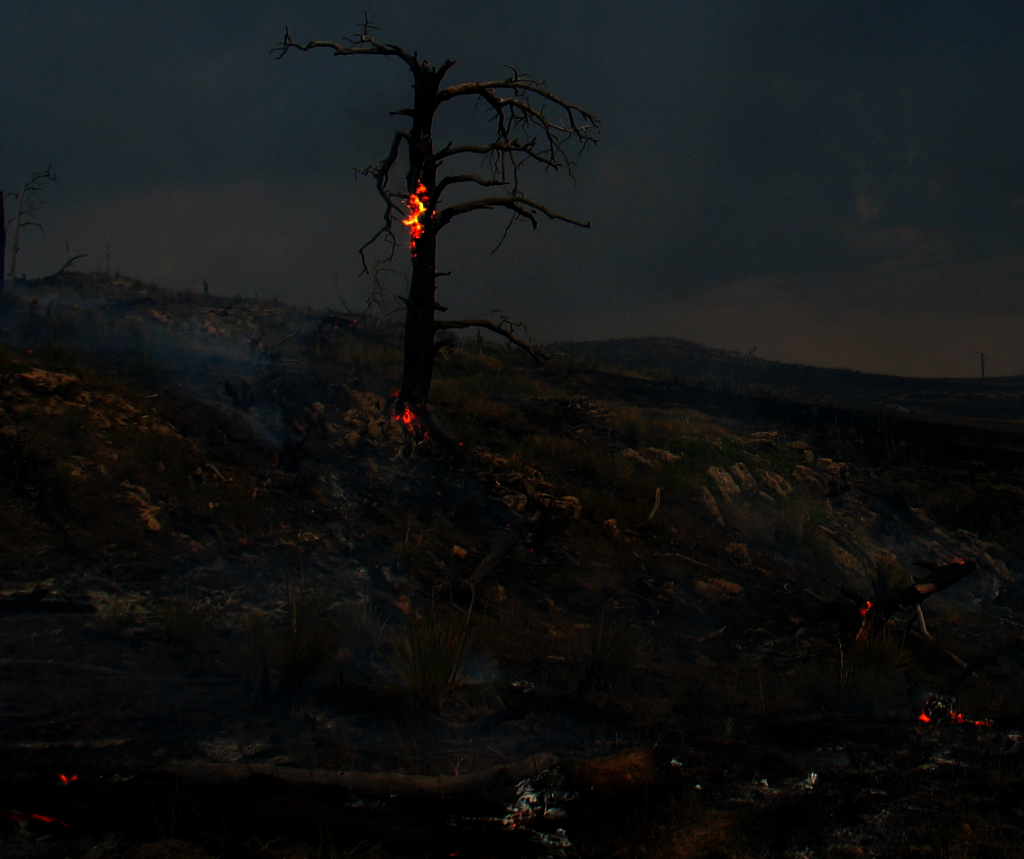
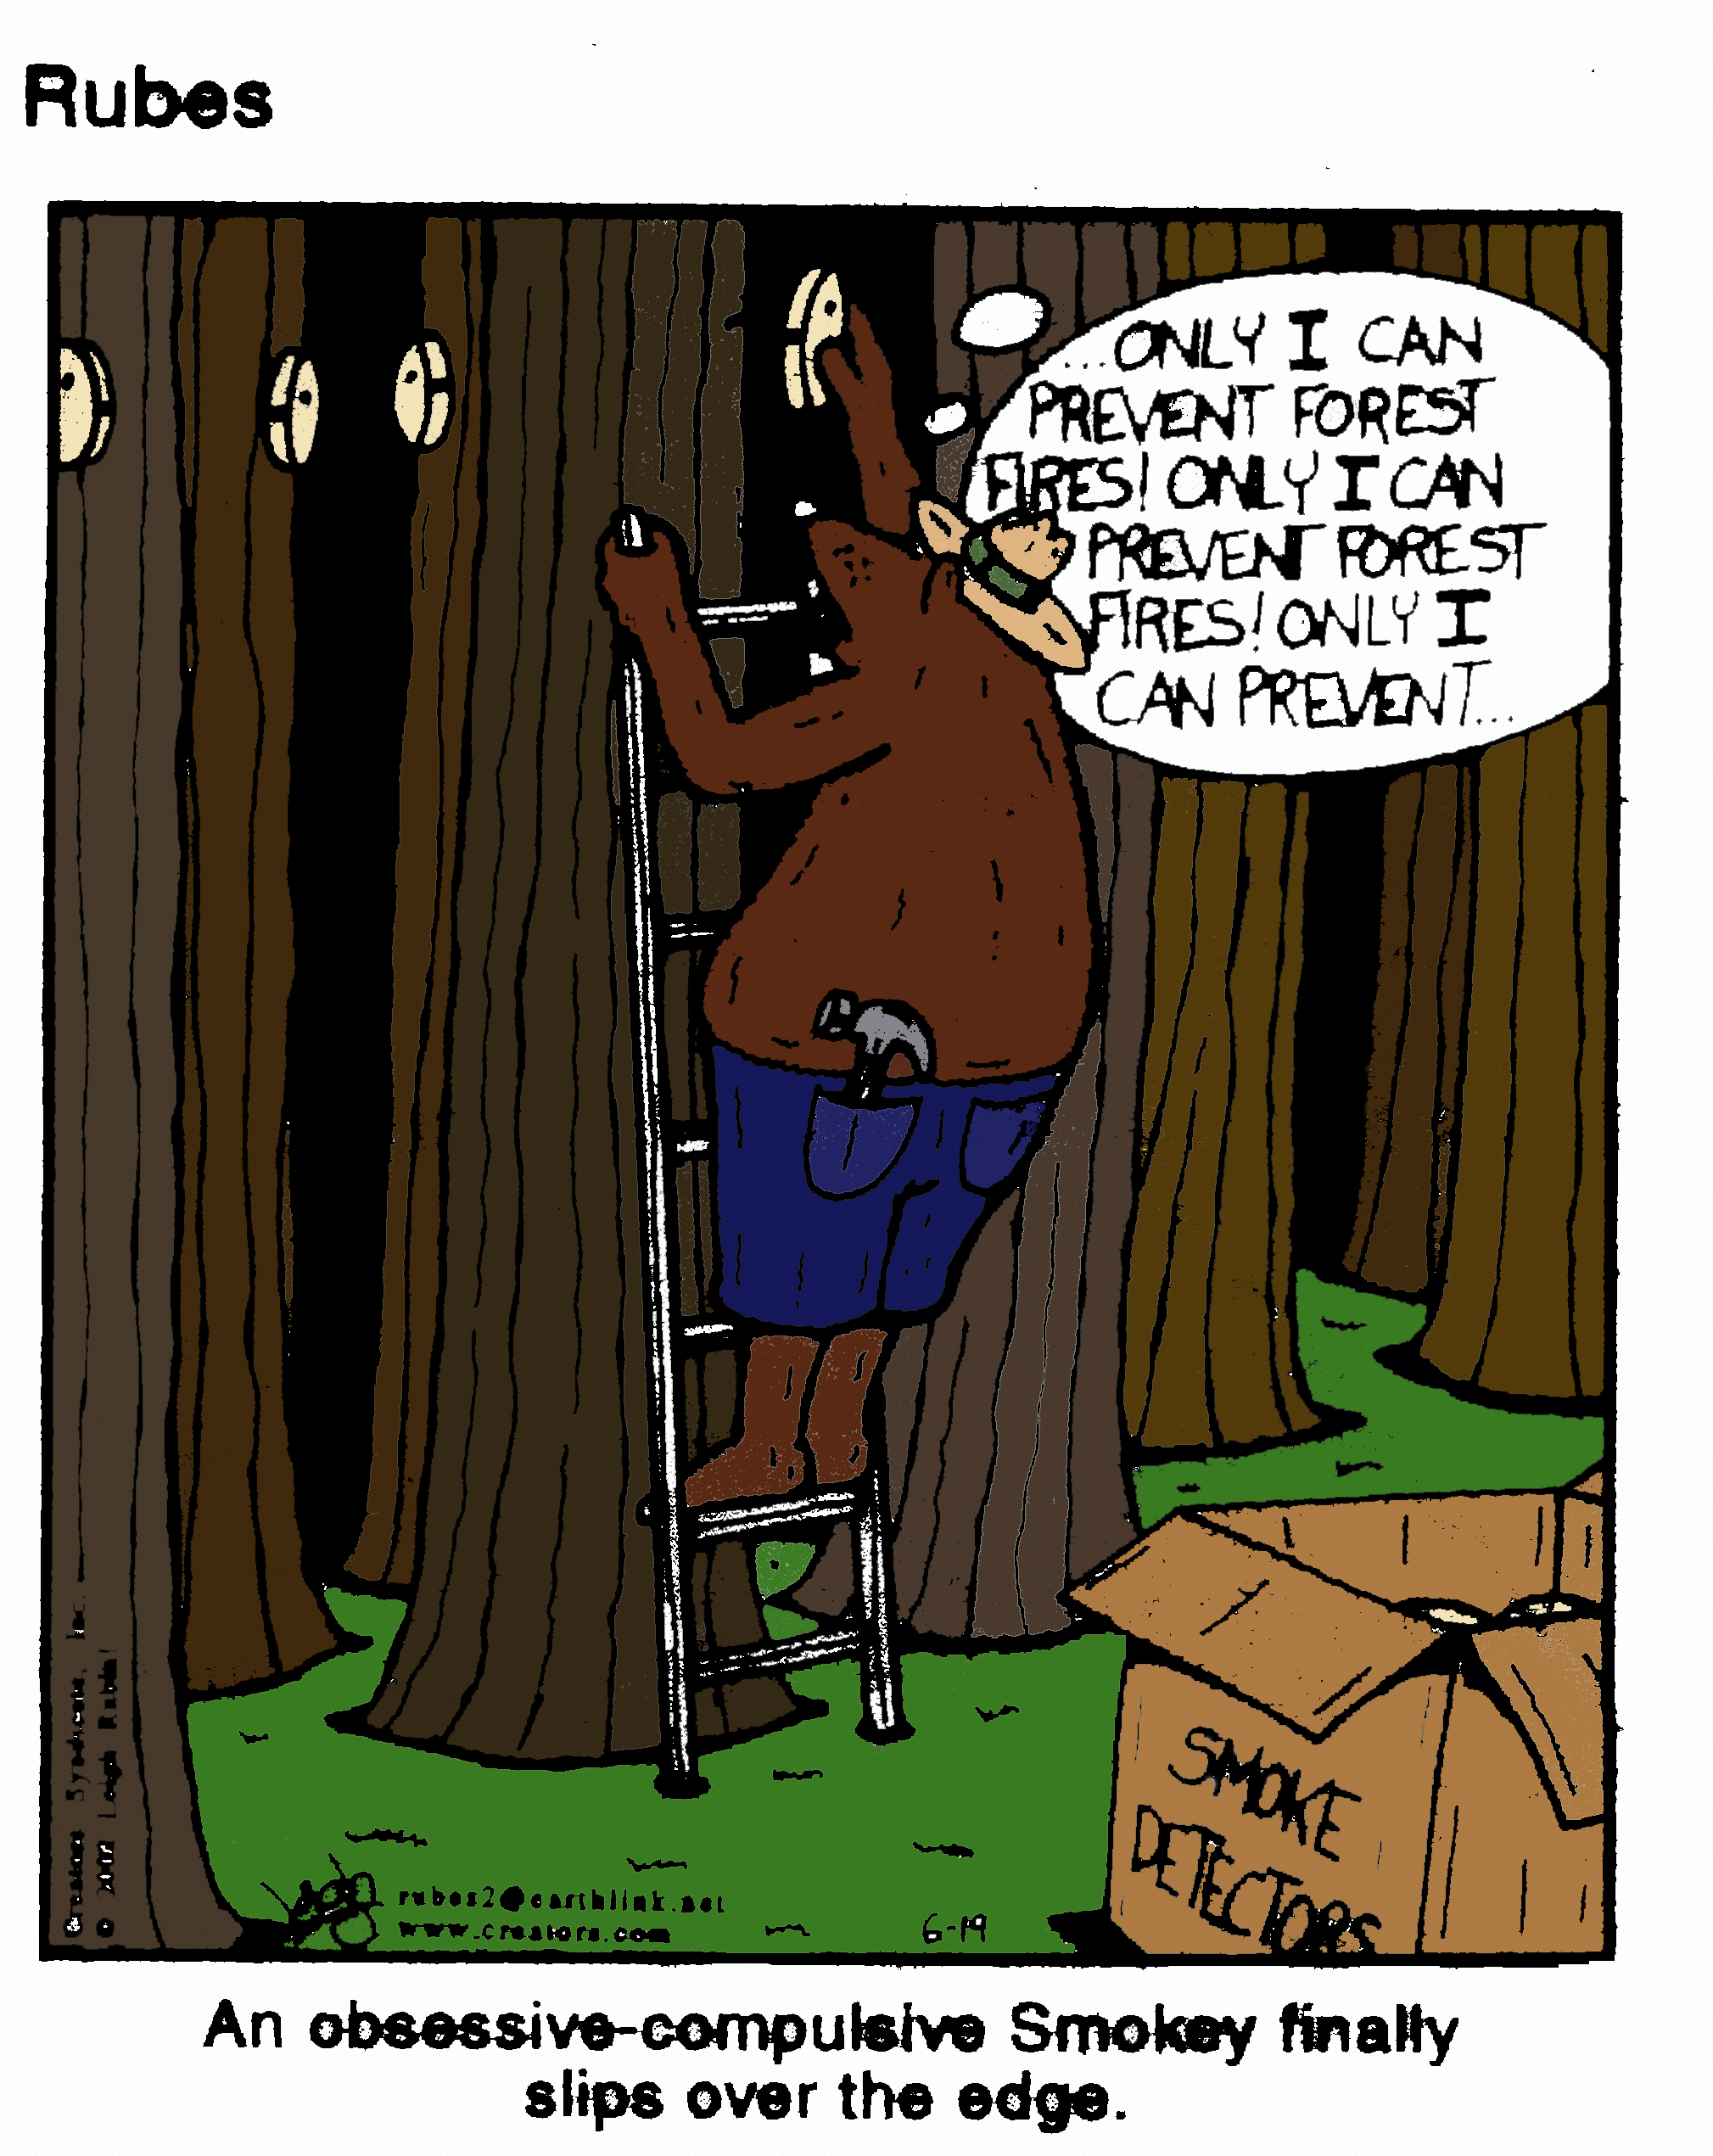
Thank you for your attention!
Questions??
Mary Lata
Fire Ecologist
Four Forest Restoration Initiative - CoreTeam

Slide 24
Include slide 21 from Unit 1, lesson 1 – McHugh diagram on modeling process
What IS the Modeling objective????
  Fuel treatments at a stand level vs landscape level analysis?
  Temporal and spatial questions
  Do we want to estimate where and when the fire might spread over a short period of time using forecasted wx? Or a specific weather scenario?
  Do we want a longer-range view to estimate the probability that fire maight affect a point of concern given climatology?

