Slide 1
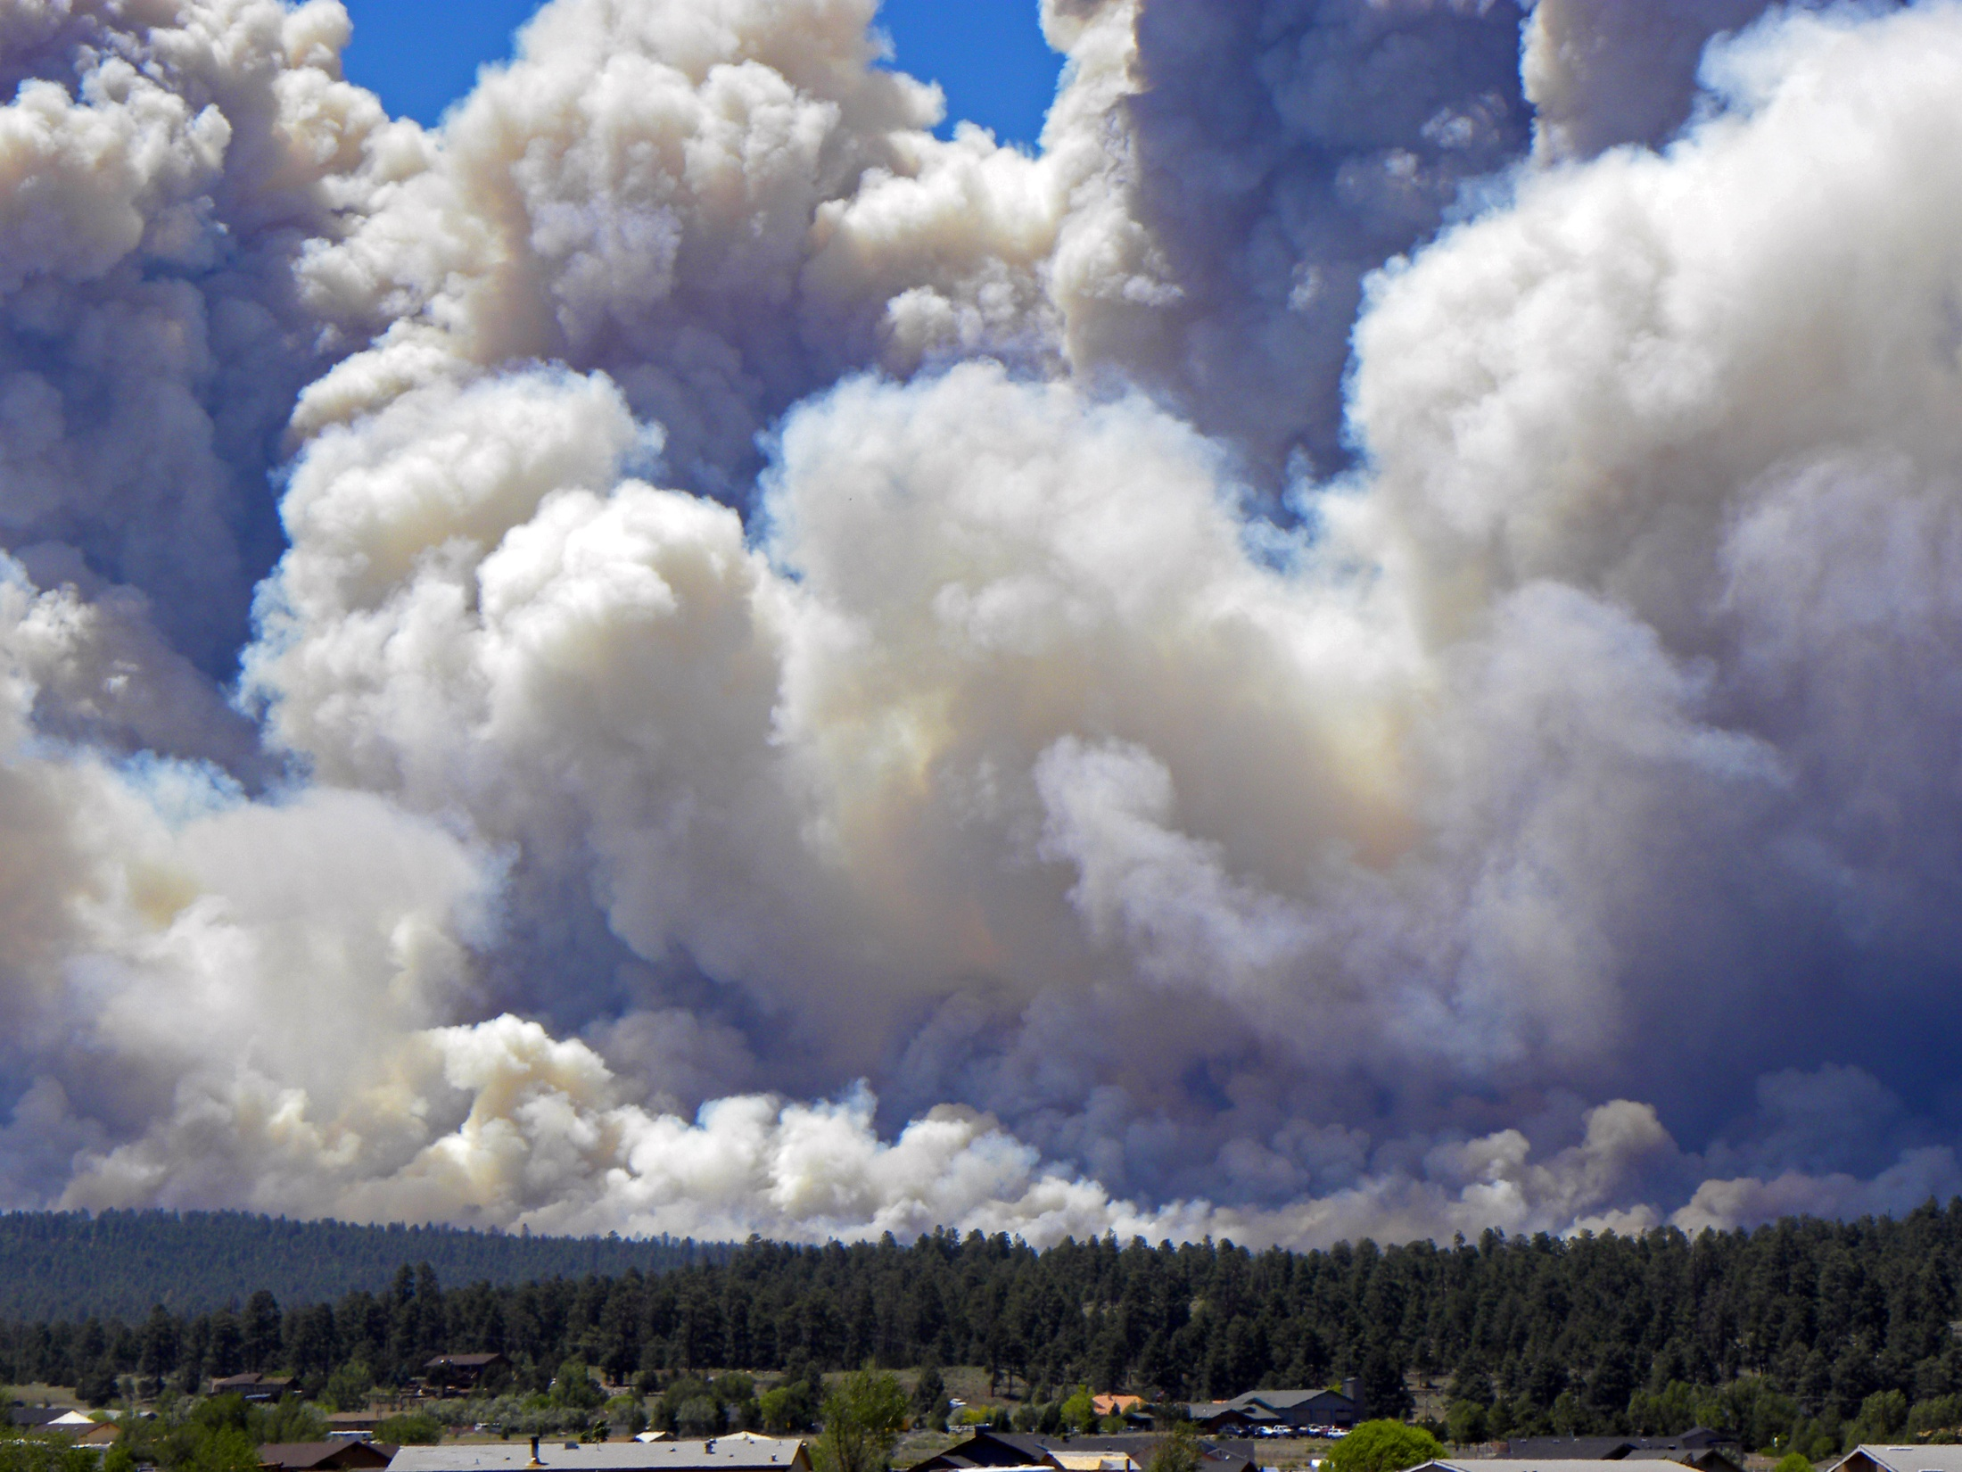

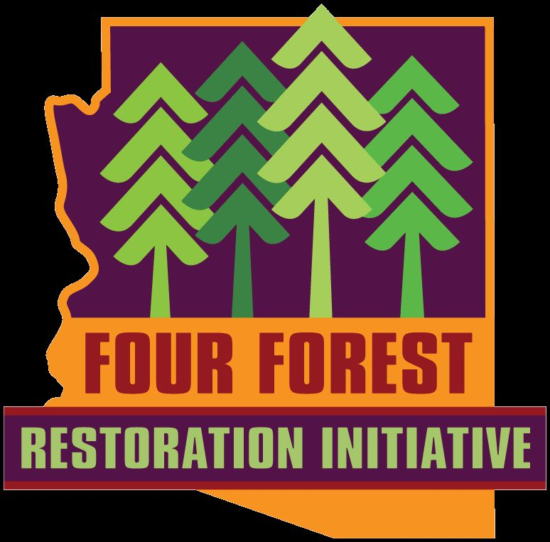
Photo credit: Dan Greenspan
Because…
Why do we need
Forest Restoration?

Slide 2
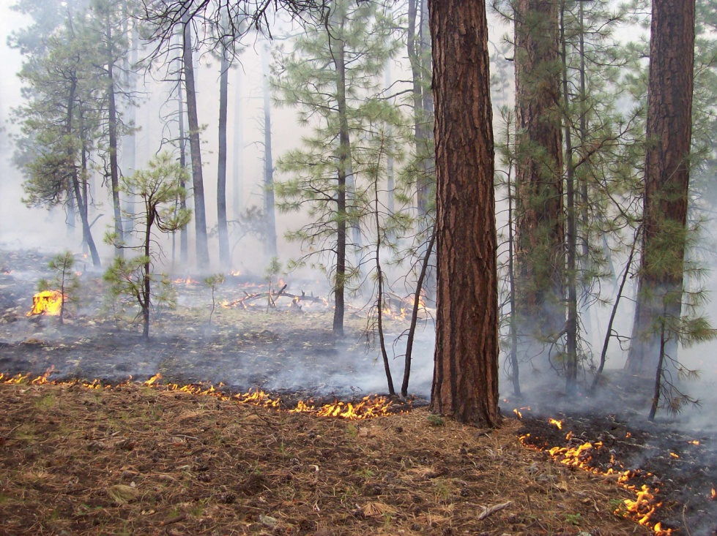
Fires that once burned like this…
Notes:
A generalized description of the changed effect of fire in a woody dominated ecosystem goes something like this…

Slide 3

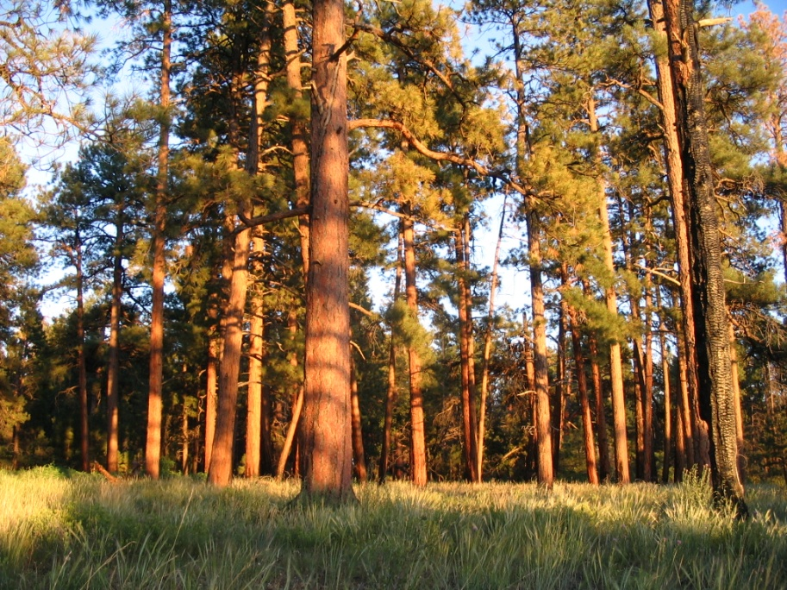
…and produced effects like this

Slide 4

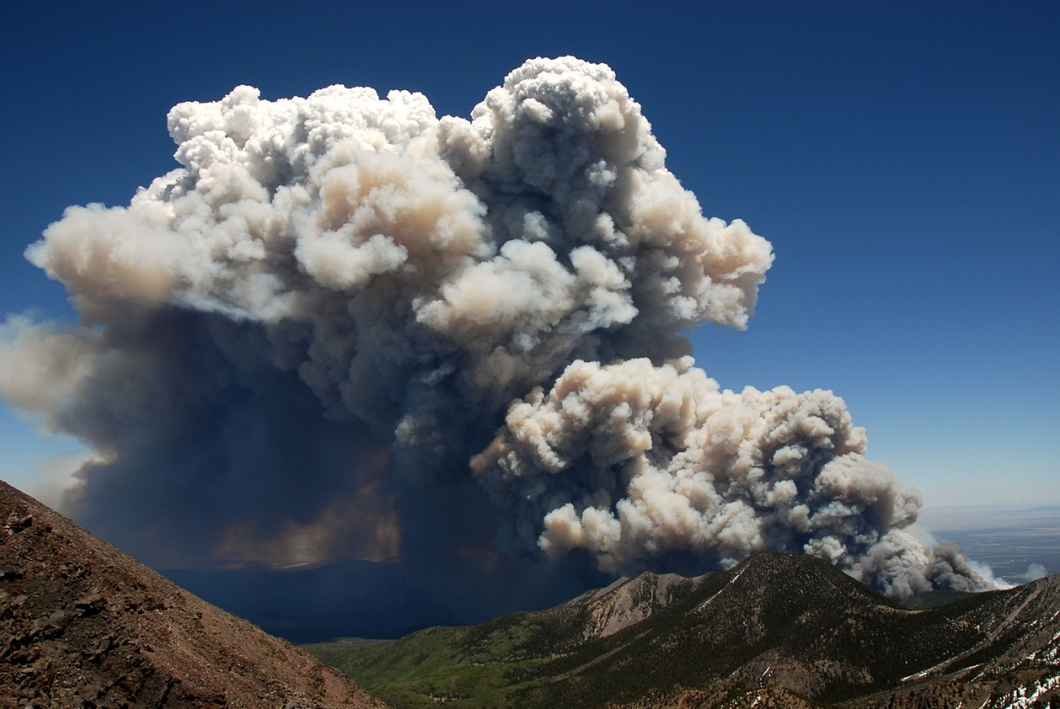
…and produced effects like this
Now burn like this…
Photo credit: Dan Greenspan

Slide 5
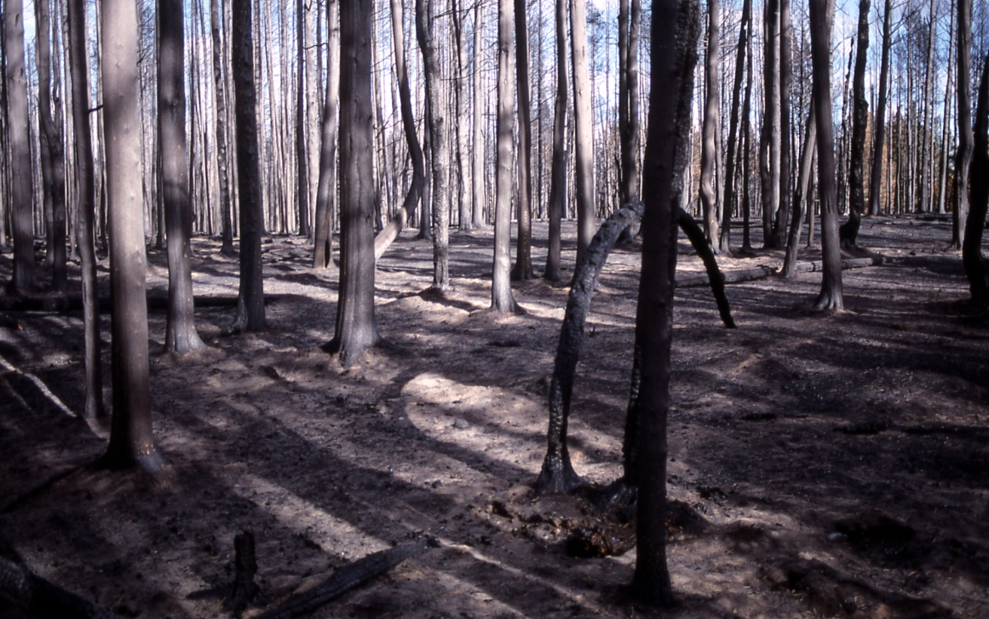
…and produced effects like this
…and produce effects like this
Photo credit: Dan Greenspan
Notes:
…departure from it’s natural fire regime puts key ecosystem components at risk.

Slide 6
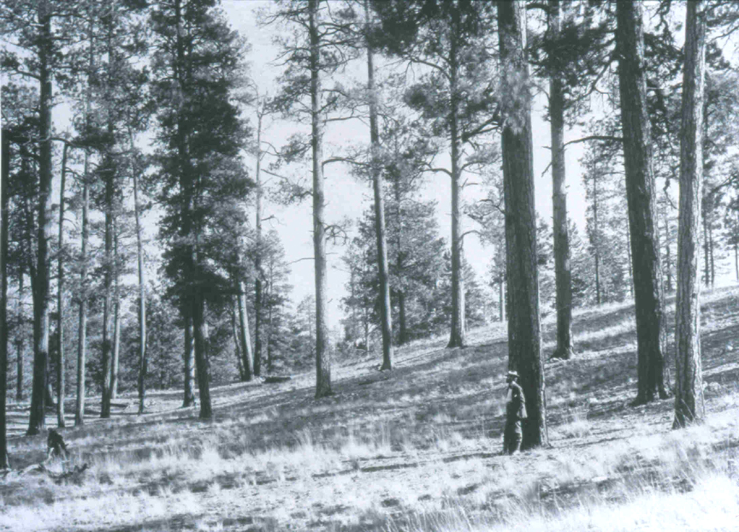
Because ecosystems that once looked like this…

Slide 7
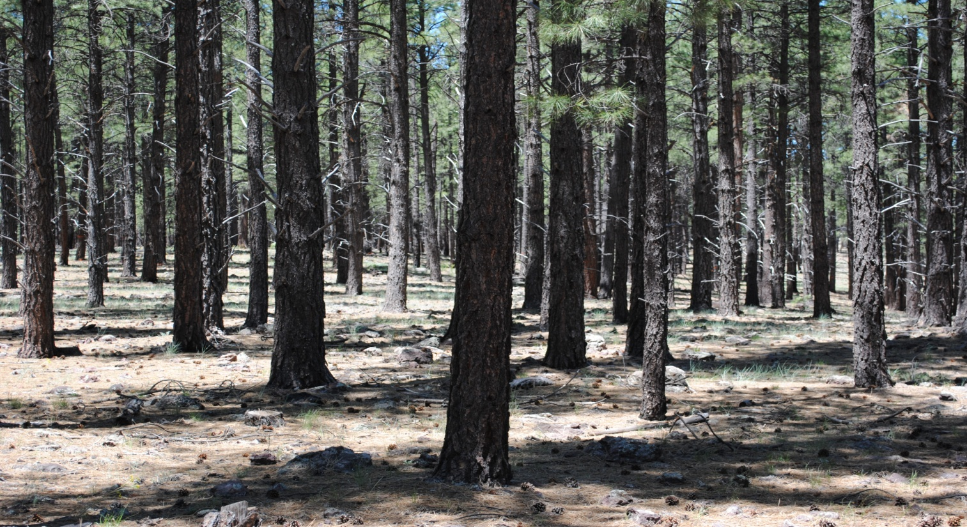
Now look like this
Because ecosystems that once looked like this…
What’s at risk?

Slide 8
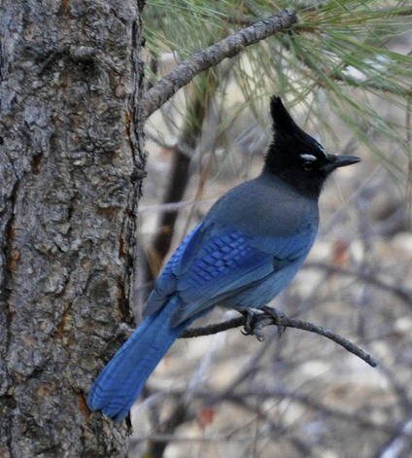
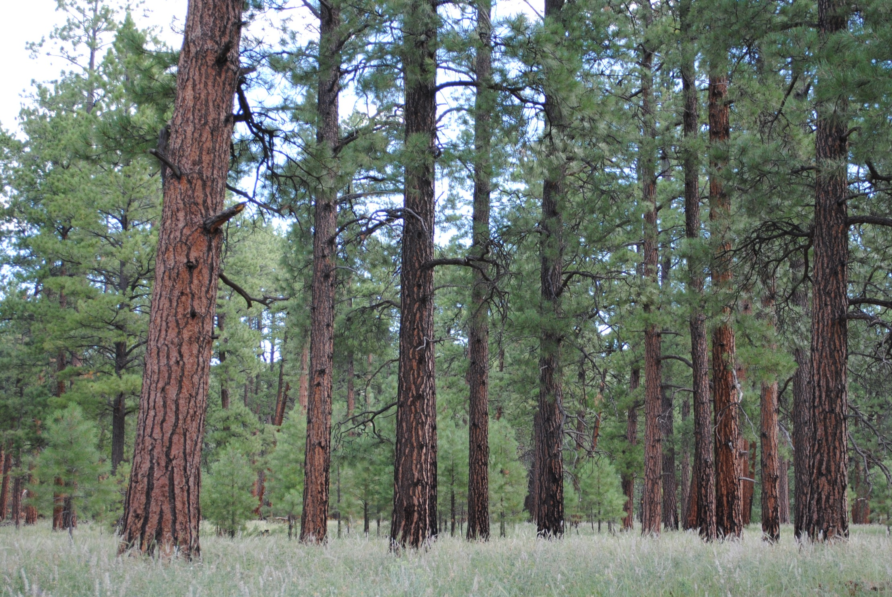
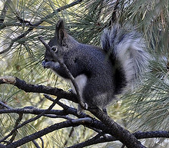
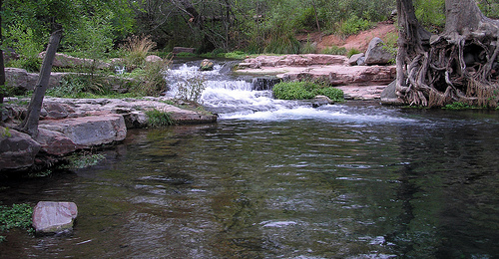
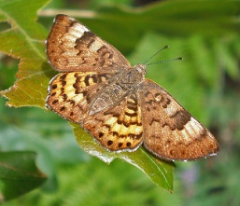
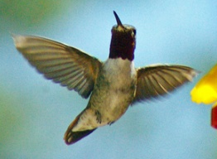
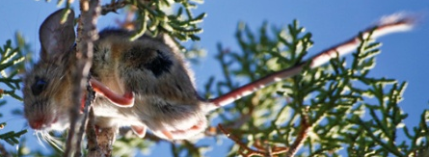
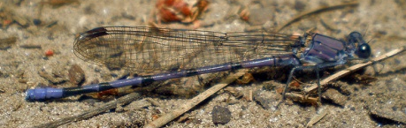
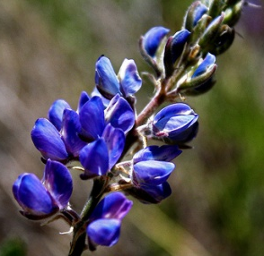
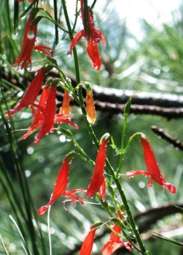
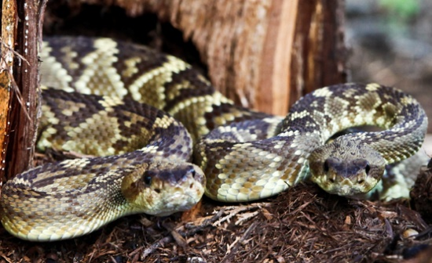
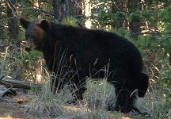
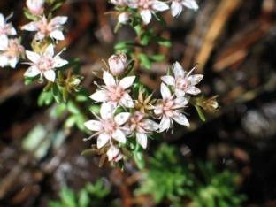
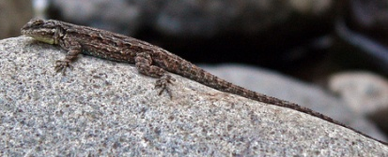
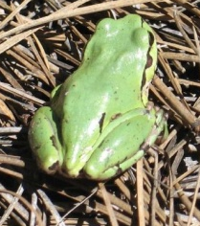
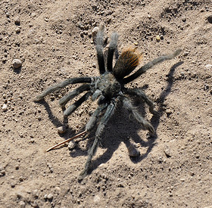
What’s at risk?

Slide 9
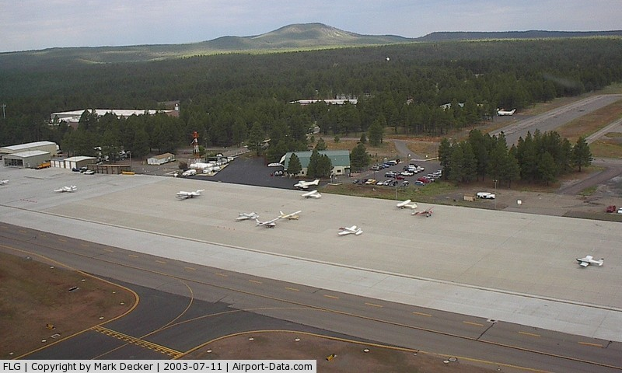
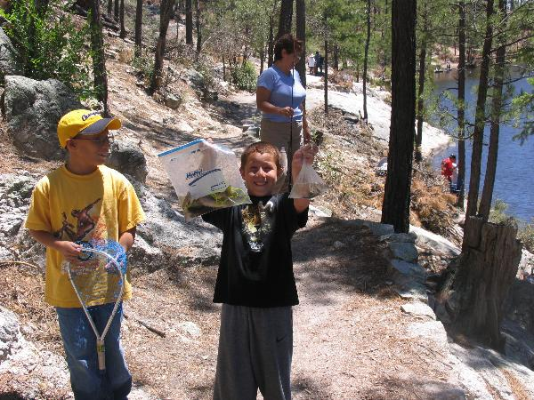
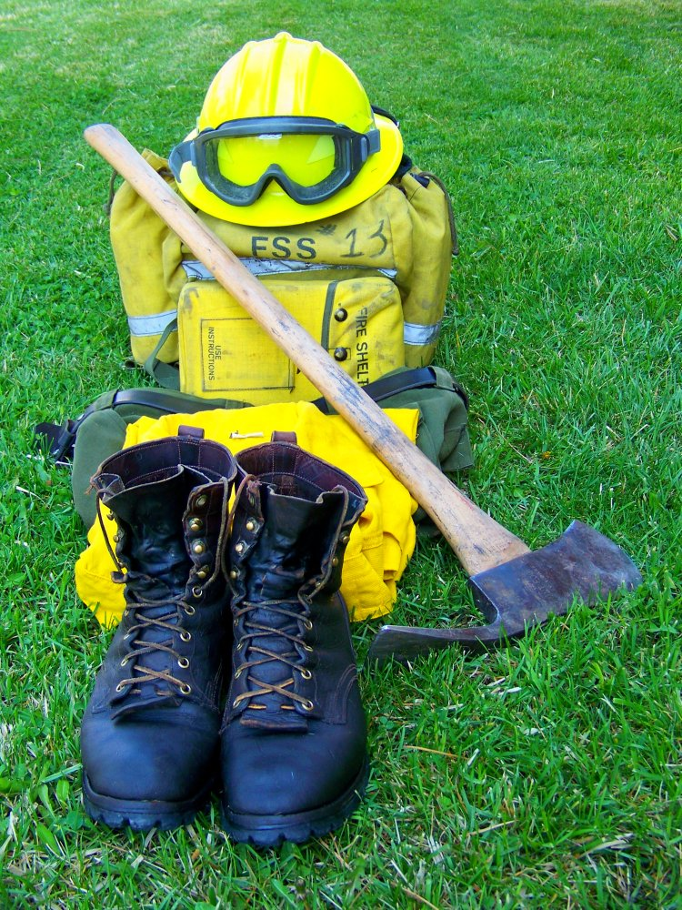
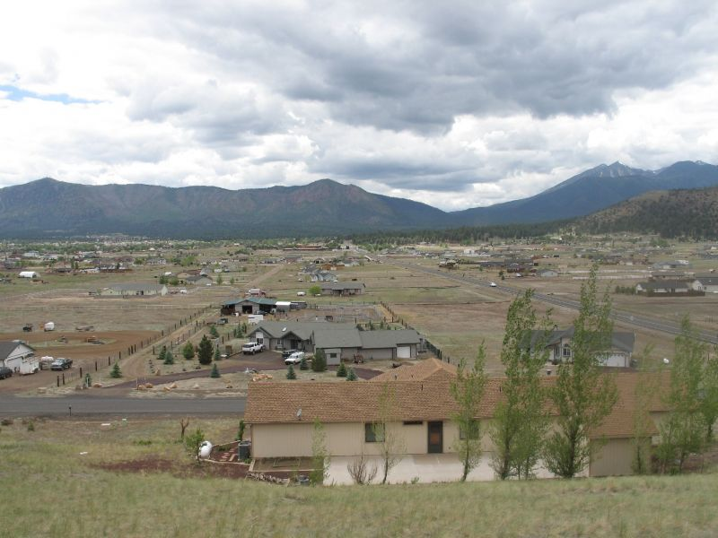
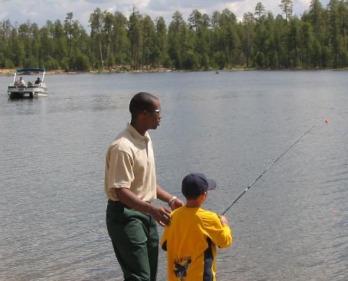
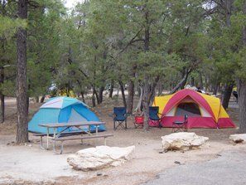
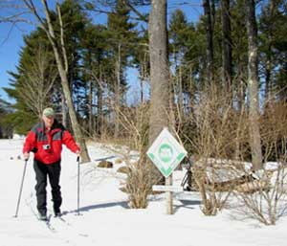
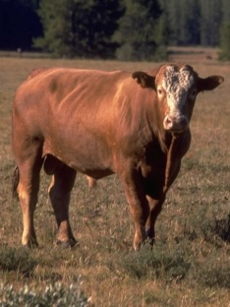
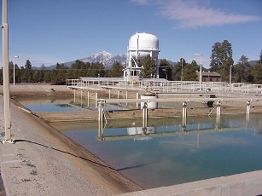
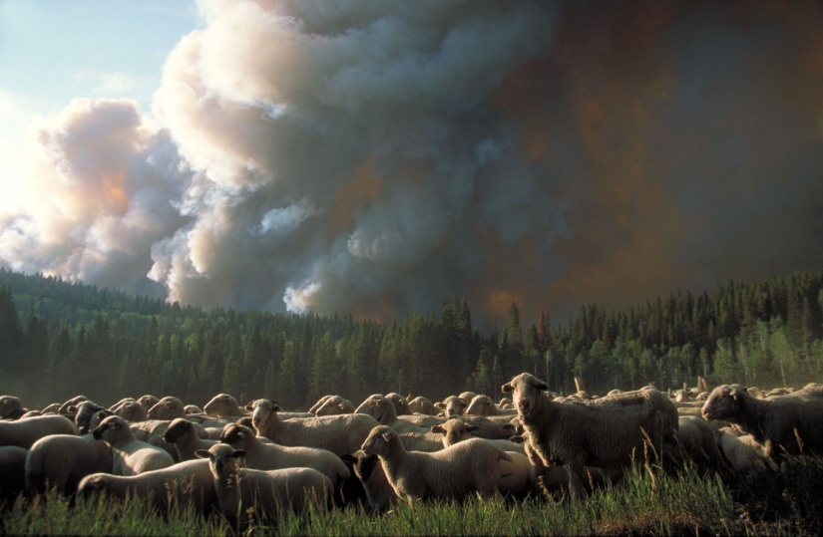
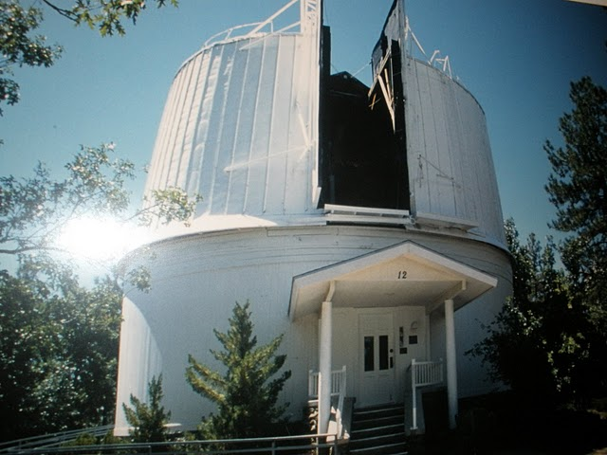
What could we lose?

Slide 10
What are we doing about it?
Four Forest
Restoration Initiative
(4FRI)

Slide 11
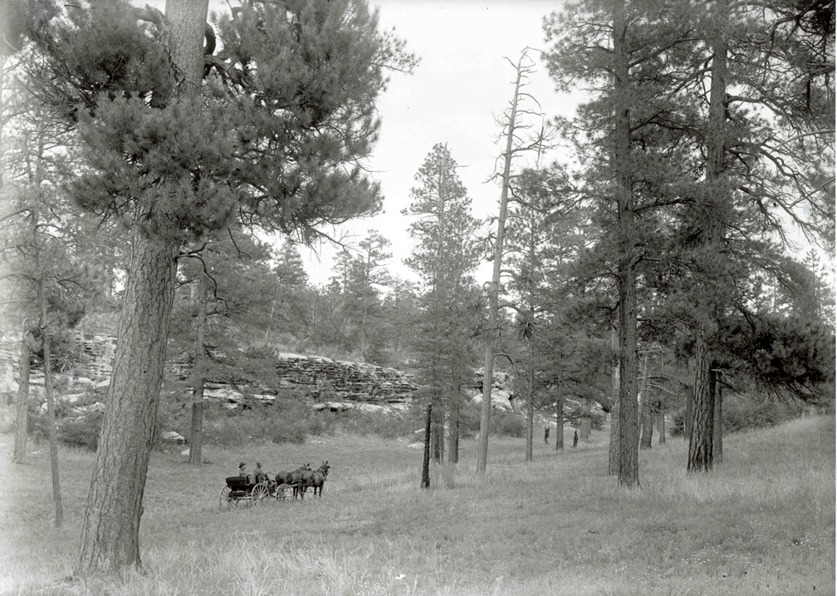
4FRI Objective:
Restore ecological resilience and function across 2.4 million acres of northern Arizona’s ponderosa pine forest and to attract appropriately sized industry to the region

Slide 12
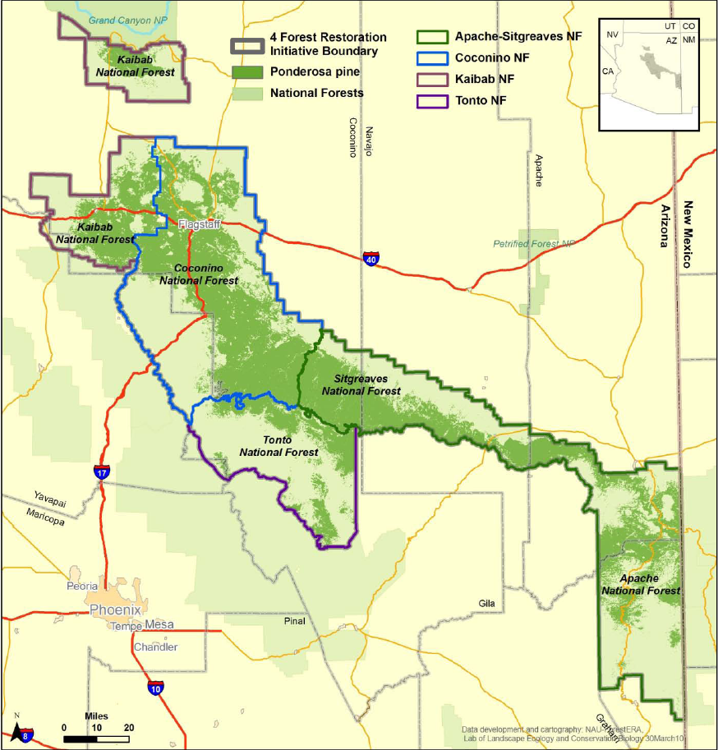
2.4 million acre analysis area
Notes:
724

Slide 13
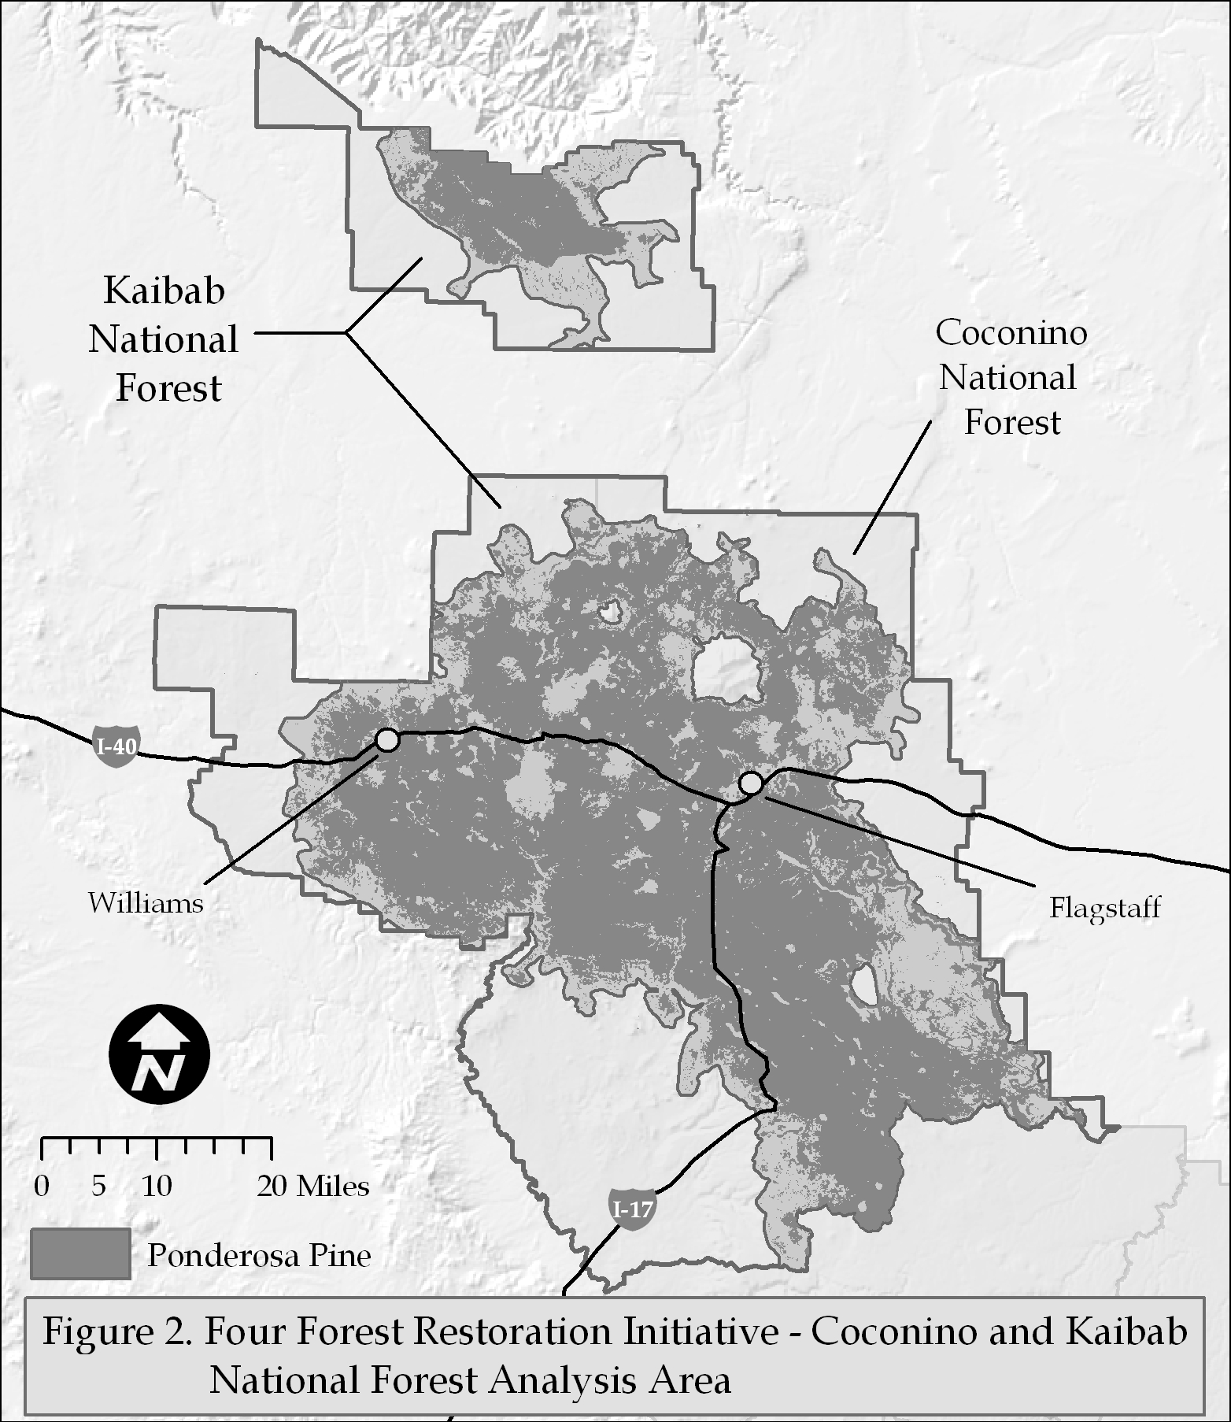
4FRI Coconino & Kaibab
724,000 Acres
Built on 5th Code Watersheds

Slide 14
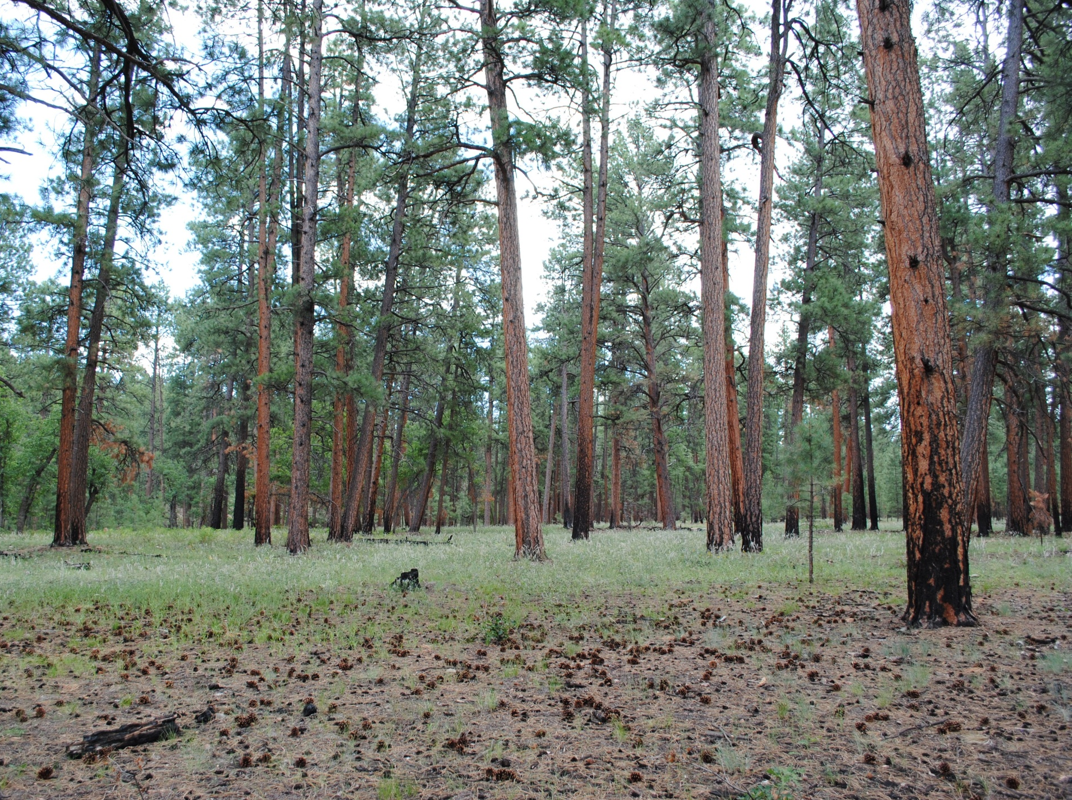
Ecological Restoration
Restoration focuses on establishing the composition, structure, pattern and ecological process necessary to make terrestrial and aquatic ecosystems sustainable, resilient and healthy under current and future conditions.” FSM 2020.5

Slide 15
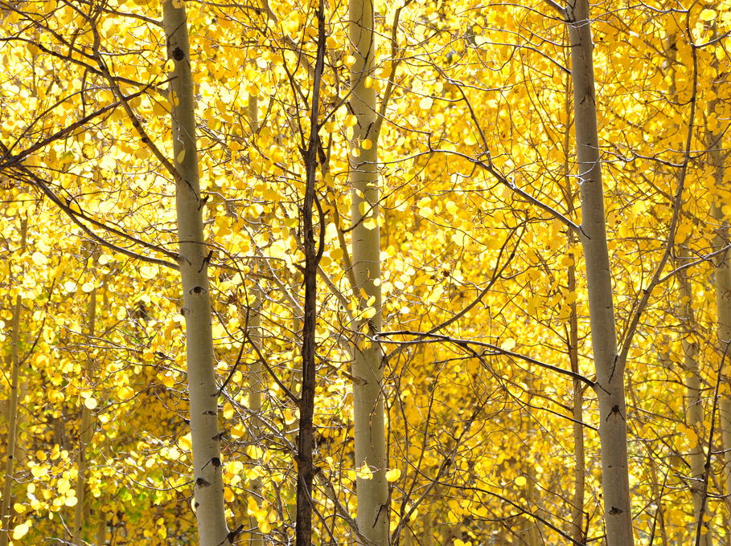
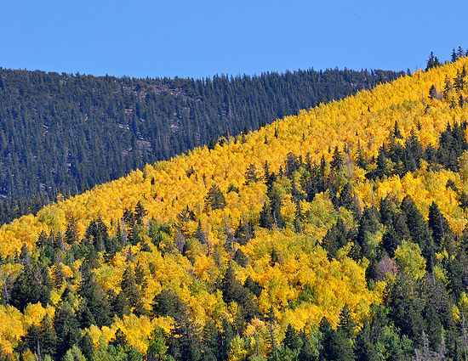
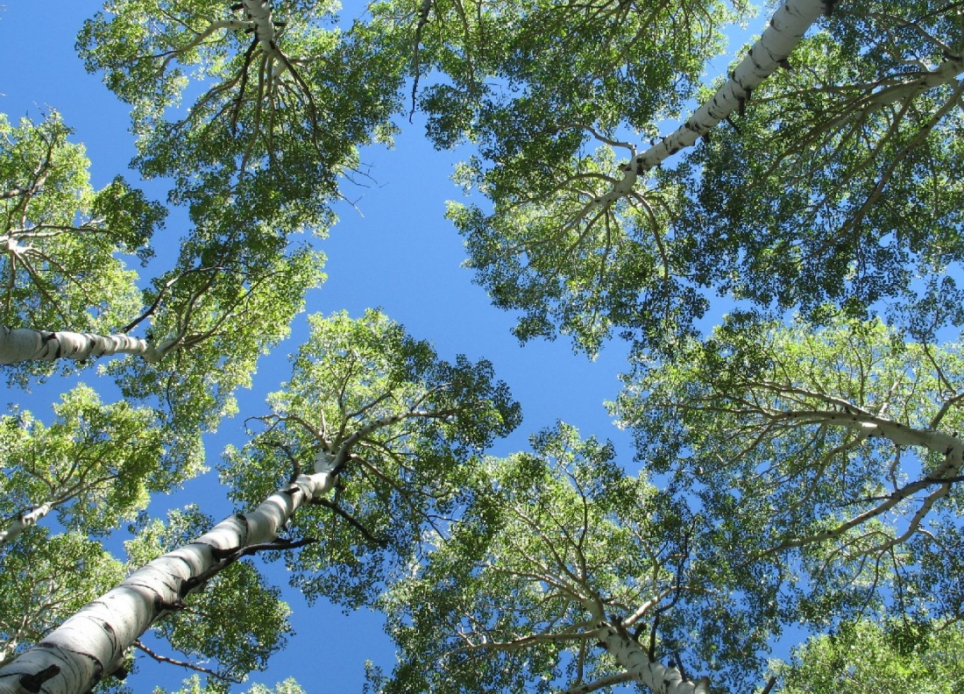
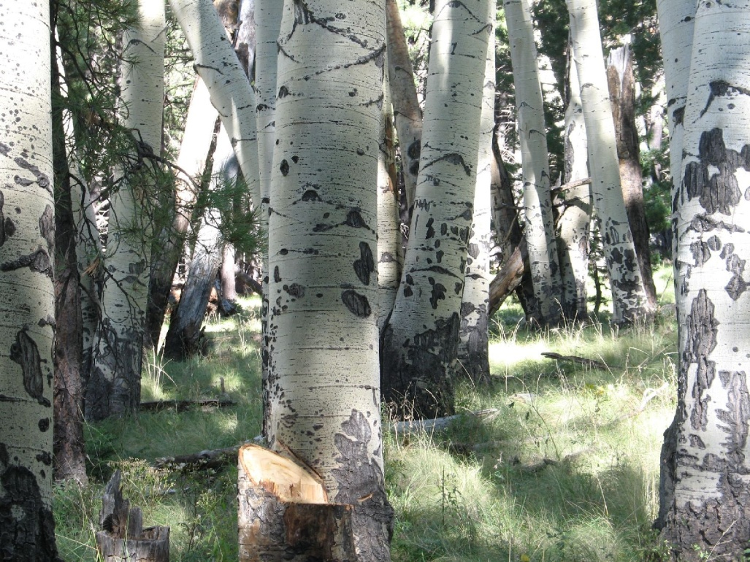
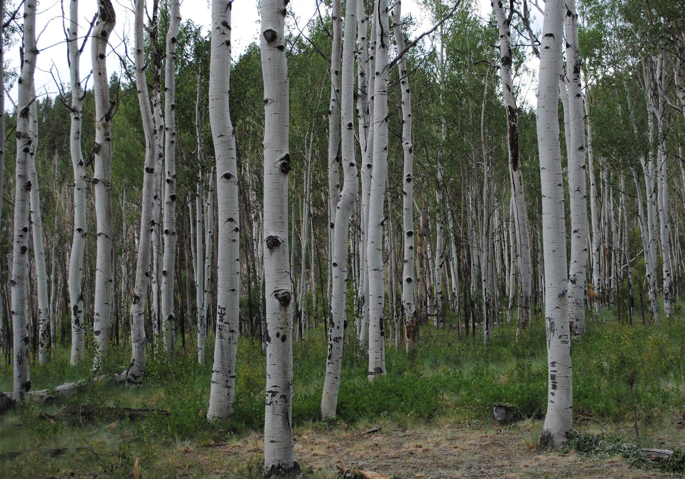
Components of 4FRI Restoration
Restore the structure and patter of our ponderosa pine system through the treatment of ~1million acres over ~20 years
Obliteration of unauthorized roadbeds
Restore function to ephemeral channels
Restore and enhance aspen, oak, springs and meadow habitat
Attract sustainable forest industry to help offset the costs of restoration and create jobs

Slide 16
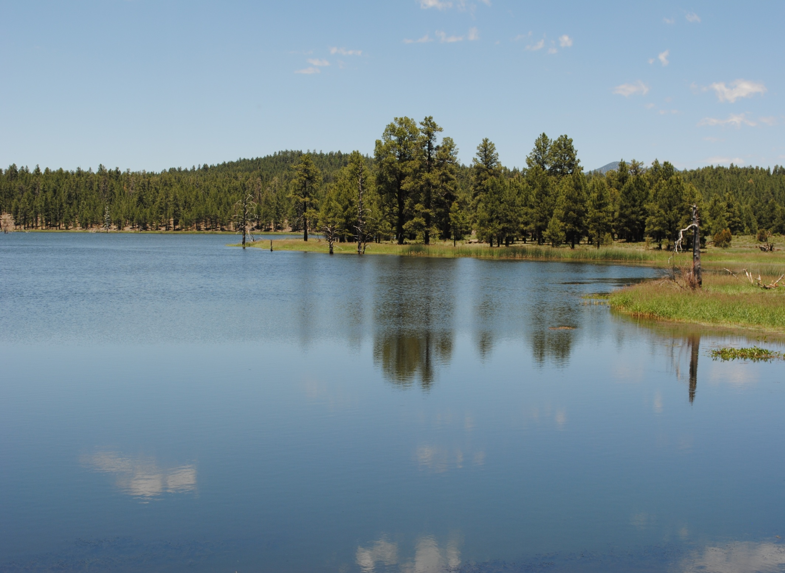
Watershed Benefits
Restored ephemeral channels reduce sediment loads and downstream effects
A recent study by the Ecological Restoration Institute indicated that restoration treatments had a positive effect on water yield
Healthy watersheds provide for a diversity of flora and fauna needs
Healthy watersheds significantly reduce the potential for catastrophic events such as the Dude, Four Peaks, Rodeo/Chediski, Cave Creek and Schultz wildfires

Slide 17
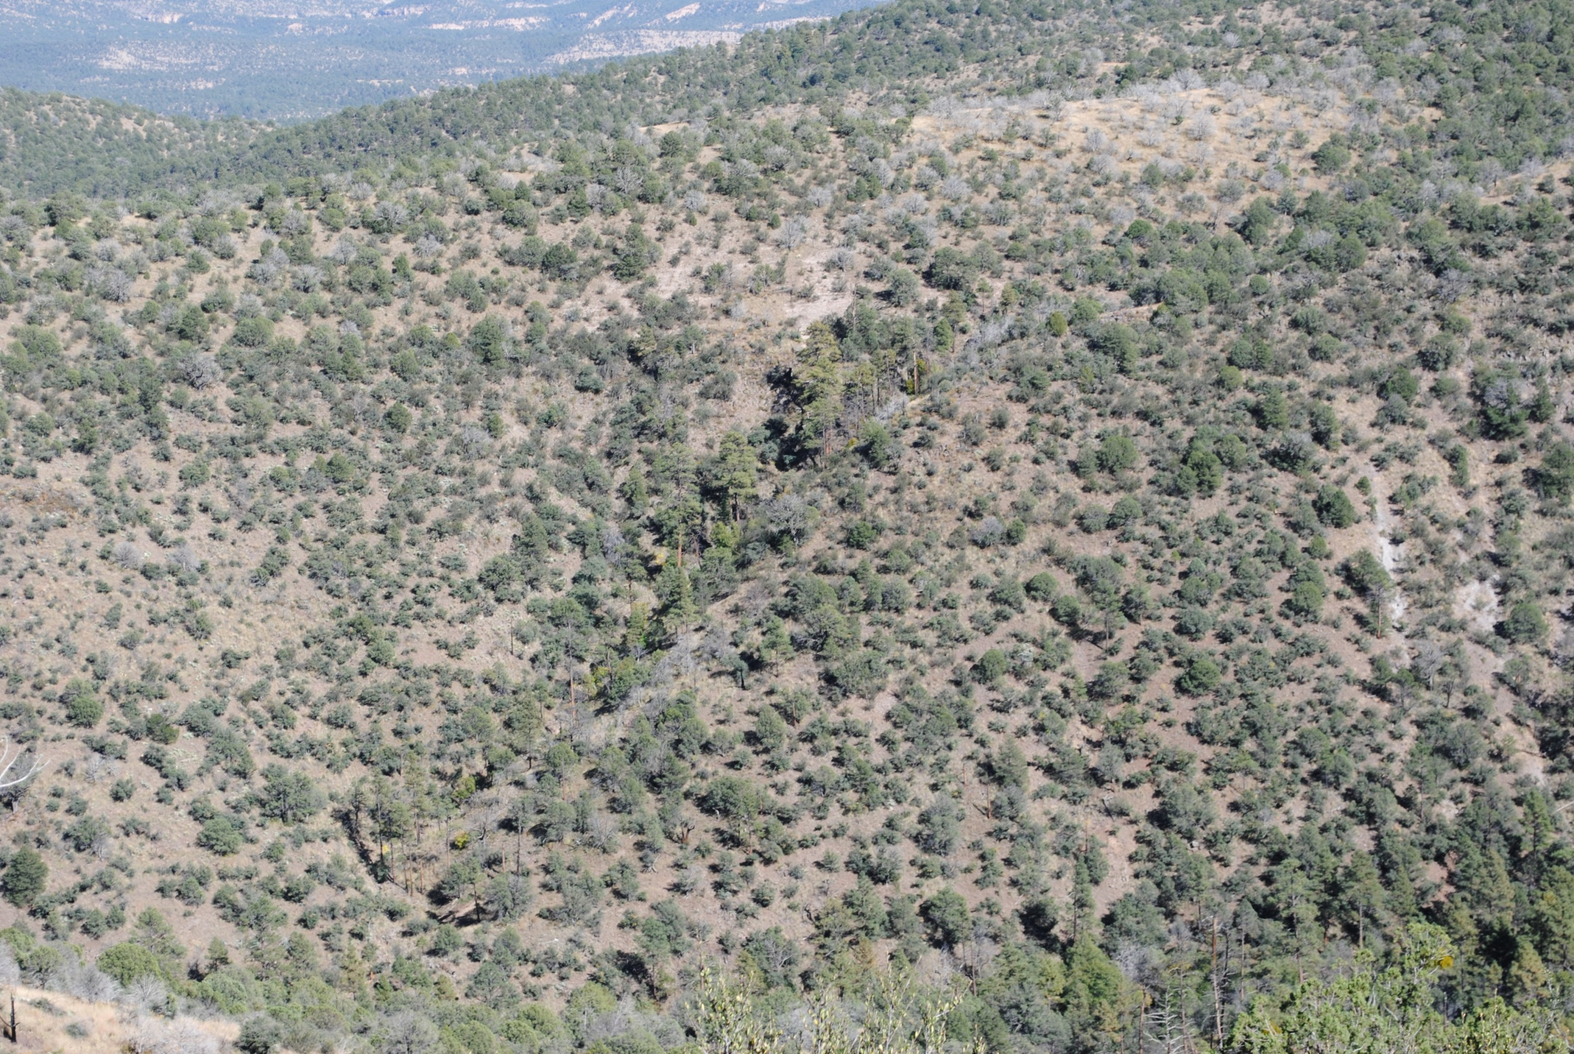
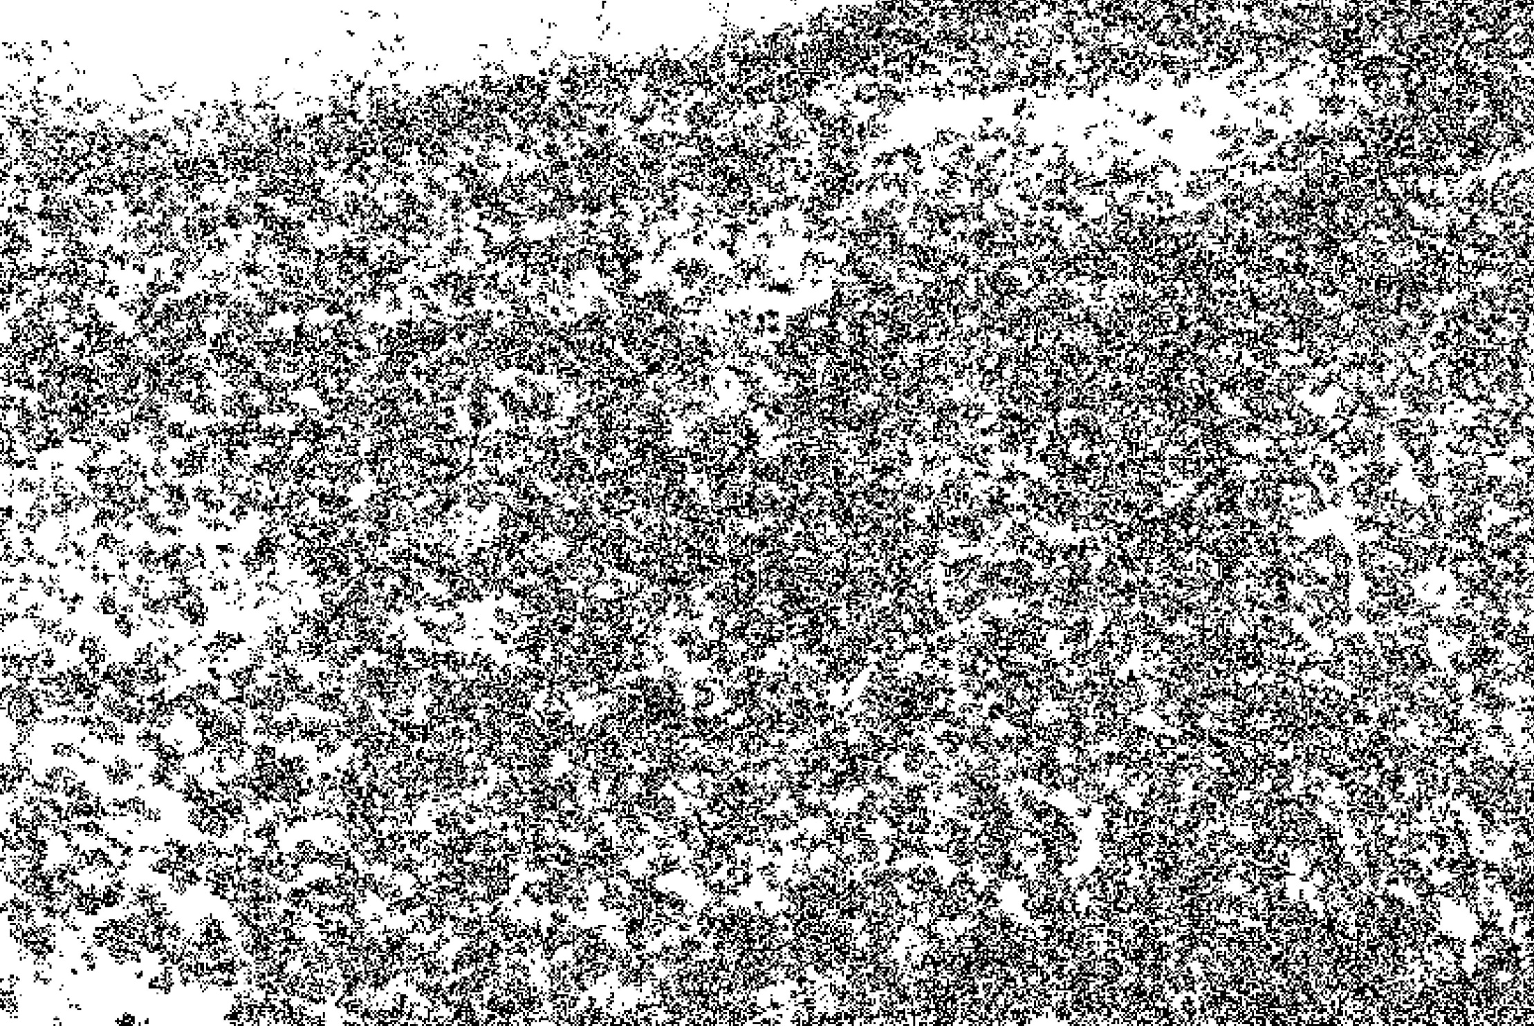
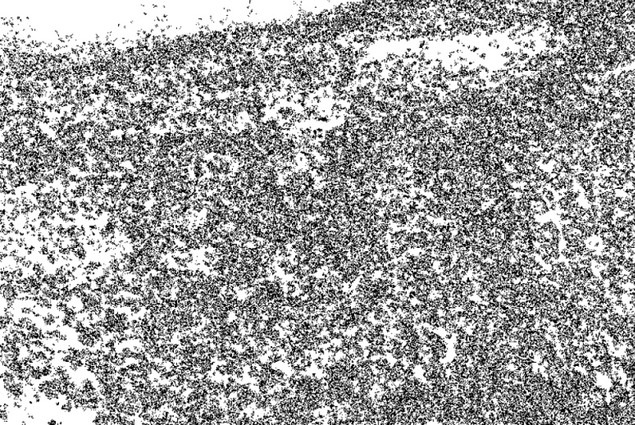
Restoration
Pattern

Slide 18
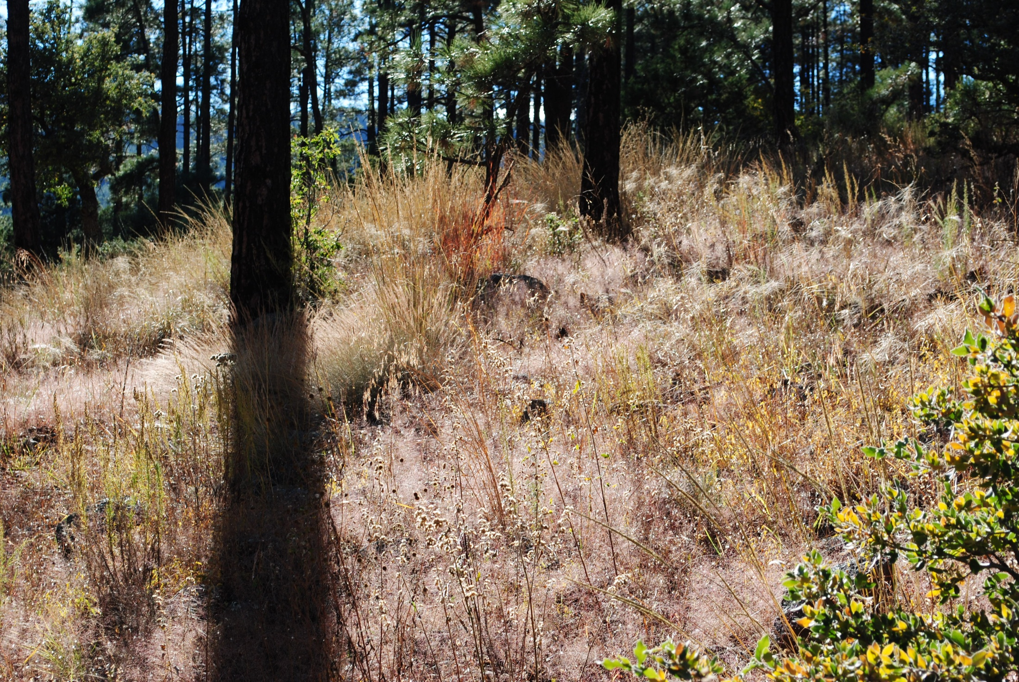
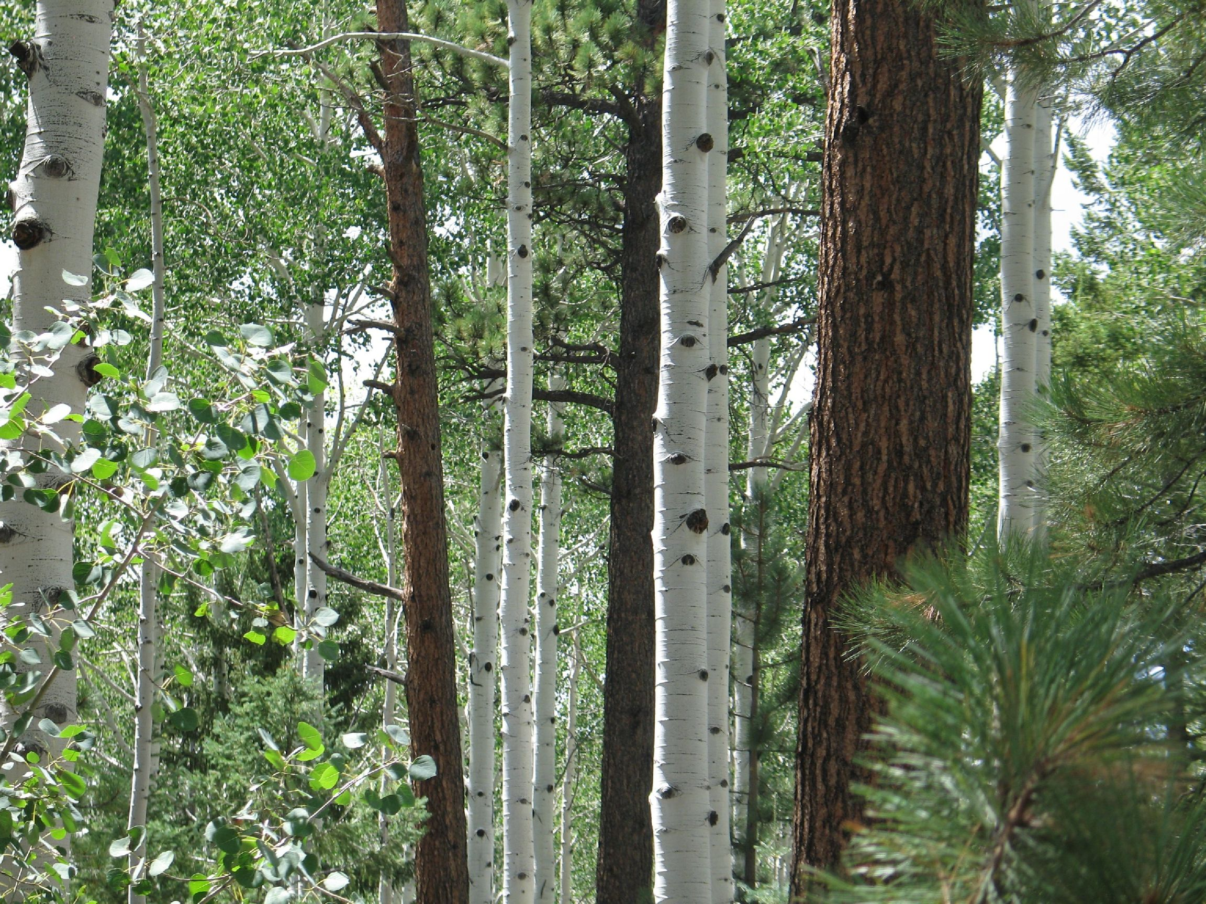


Restoration
Structure
Composition
Ecological Processes
Pattern

Slide 19

Timeline
  Collaboration and data collection began fall of 2009
  NEPA Begins January 2011
  Request For Proposals completed winter 2011
  First contract/s issued summer 2011
  First task order/s fall 2011
  ROD for first EIS covering 724,000 acres in 2012
  Full implementation of first 4FRI EIS in 2014/15

Slide 20

Thank you for your attention!
Schultz Fire Photos from Dan Greenspan http://spleen-me.com/blog/
“Tamarak Pines”, George Winston; Forest, 1994

