Slide 1
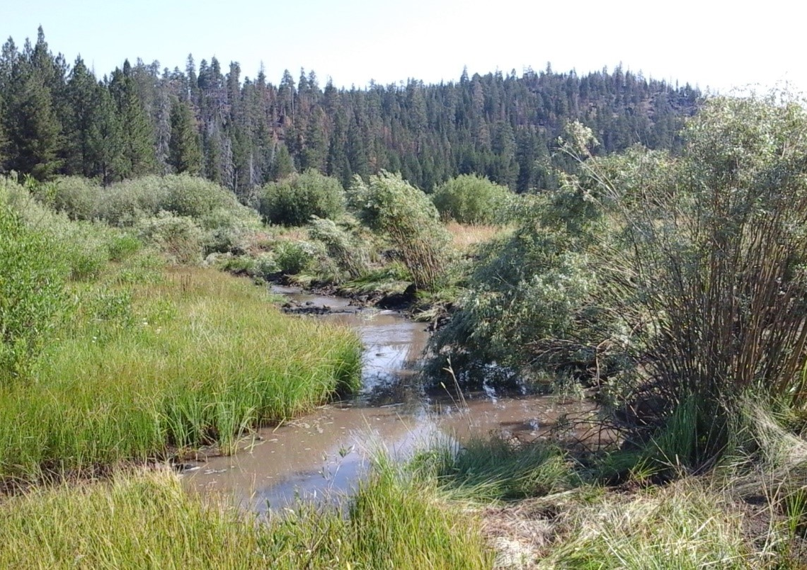
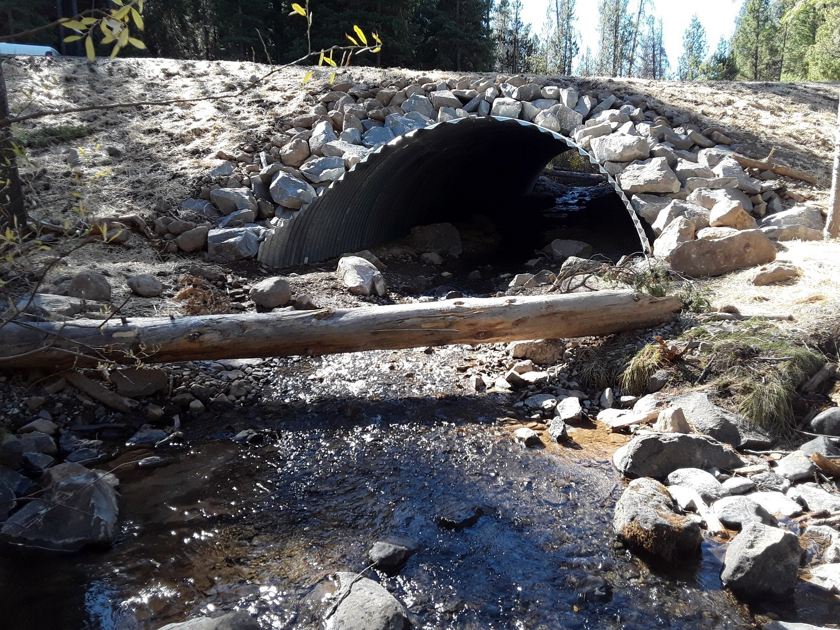
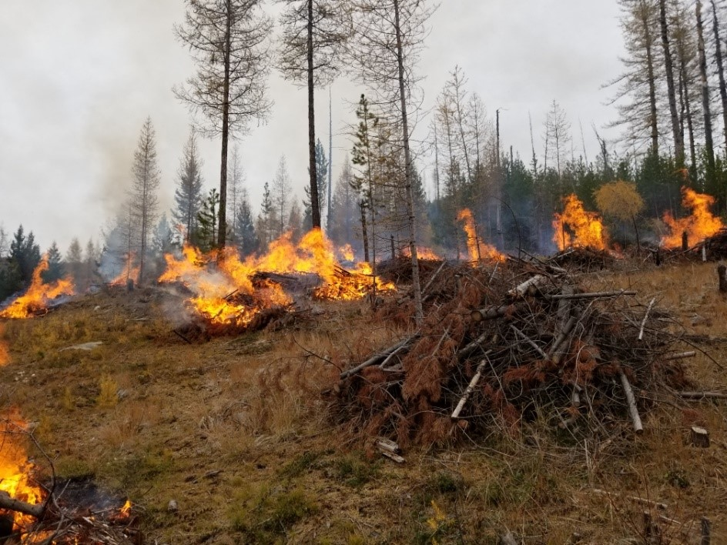
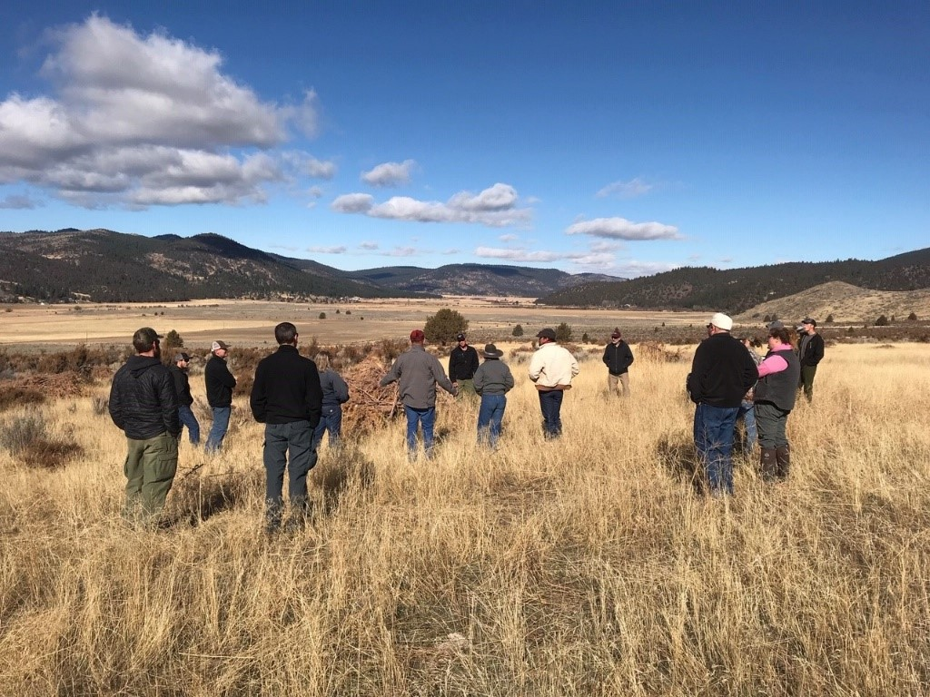
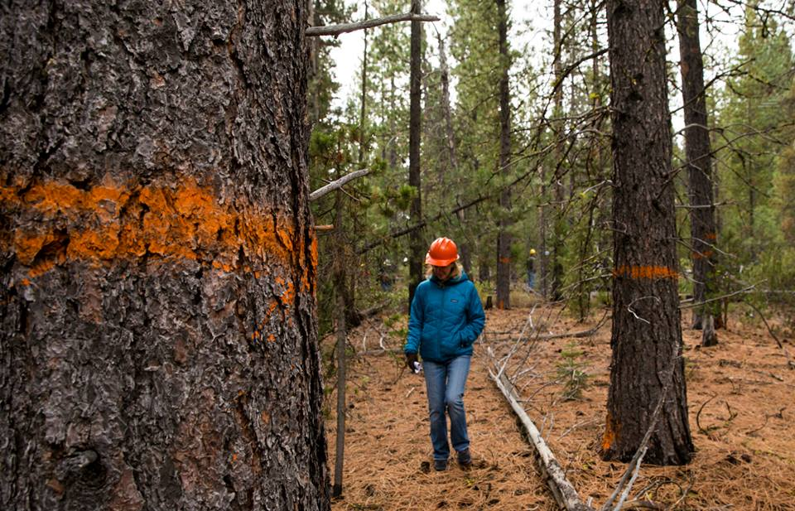
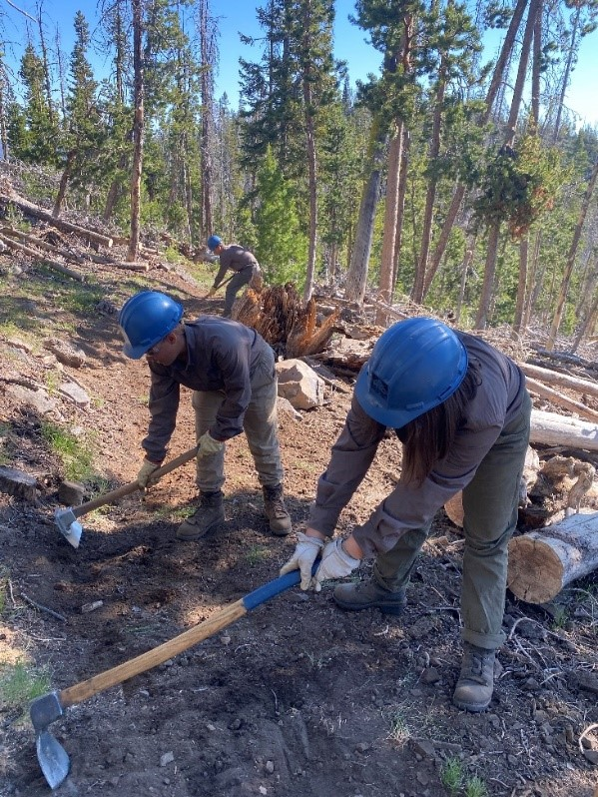
Collaborative Forest Landscape Restoration Program (CFLRP) – R6 Highlights
Notes:
Long-standing, high-impact Program – with broad, ongoing support – that advances our multiple use mission

Slide 2
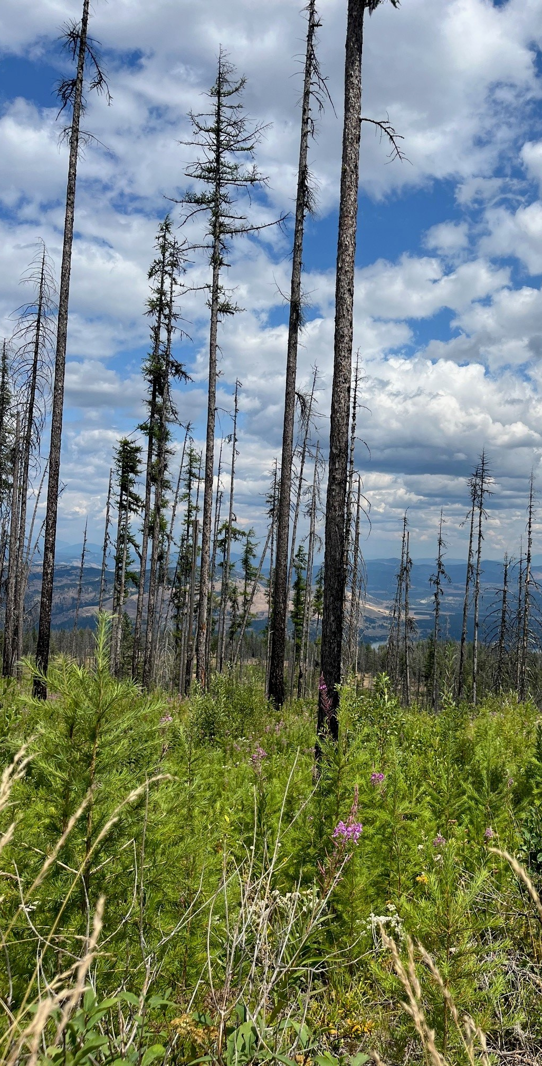
What is CFLRP?
Statutory Authority: First authorized in 2009 omnibus, reauthorized in 2018 Farm Bill, with continued partner support
Active management planned and executed with local partners in alignment with multiple-use Agency goals that benefit Americans:
Reduced wildfire risk, increased safety for wildfire response and communities
Training & jobs in rural communities
Wood product utilization
Improved fish and wildlife habitat
Road and trail maintenance
Increased water quality and quantity

Slide 3
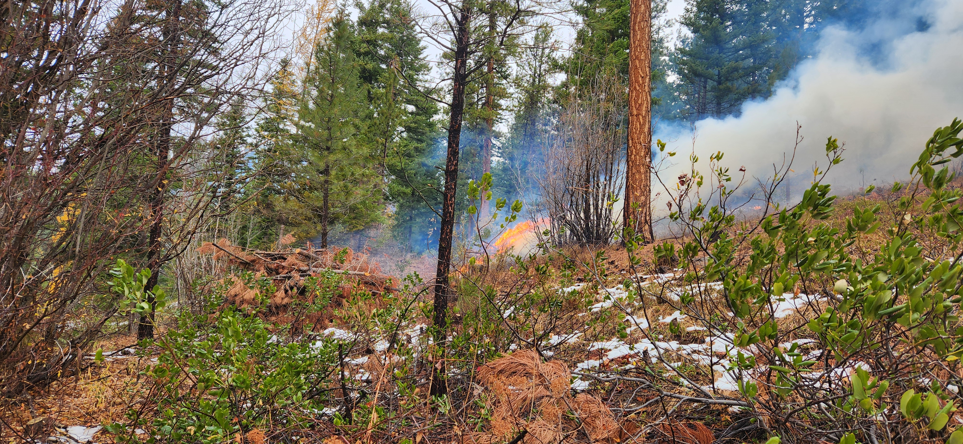
Competitive, 10-Year Funding
CFLRP Project Initiation:
Selected by the Secretary after Advisory Committee review for 10 years of funding
Potential one-time extension
Basic Requirements:
Must be at least 50,000 acres
Funds cover up to 50% of the costs of implementation and multiparty monitoring on NFS lands
Must have NEPA complete

Slide 4
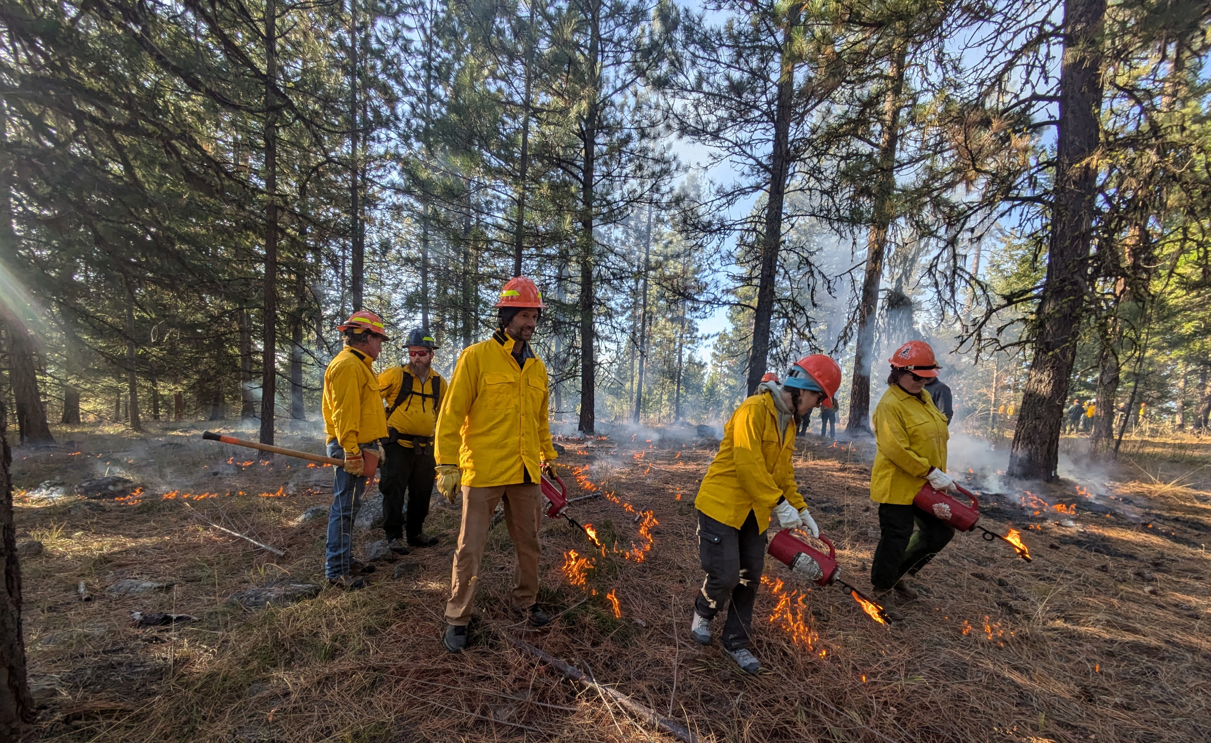
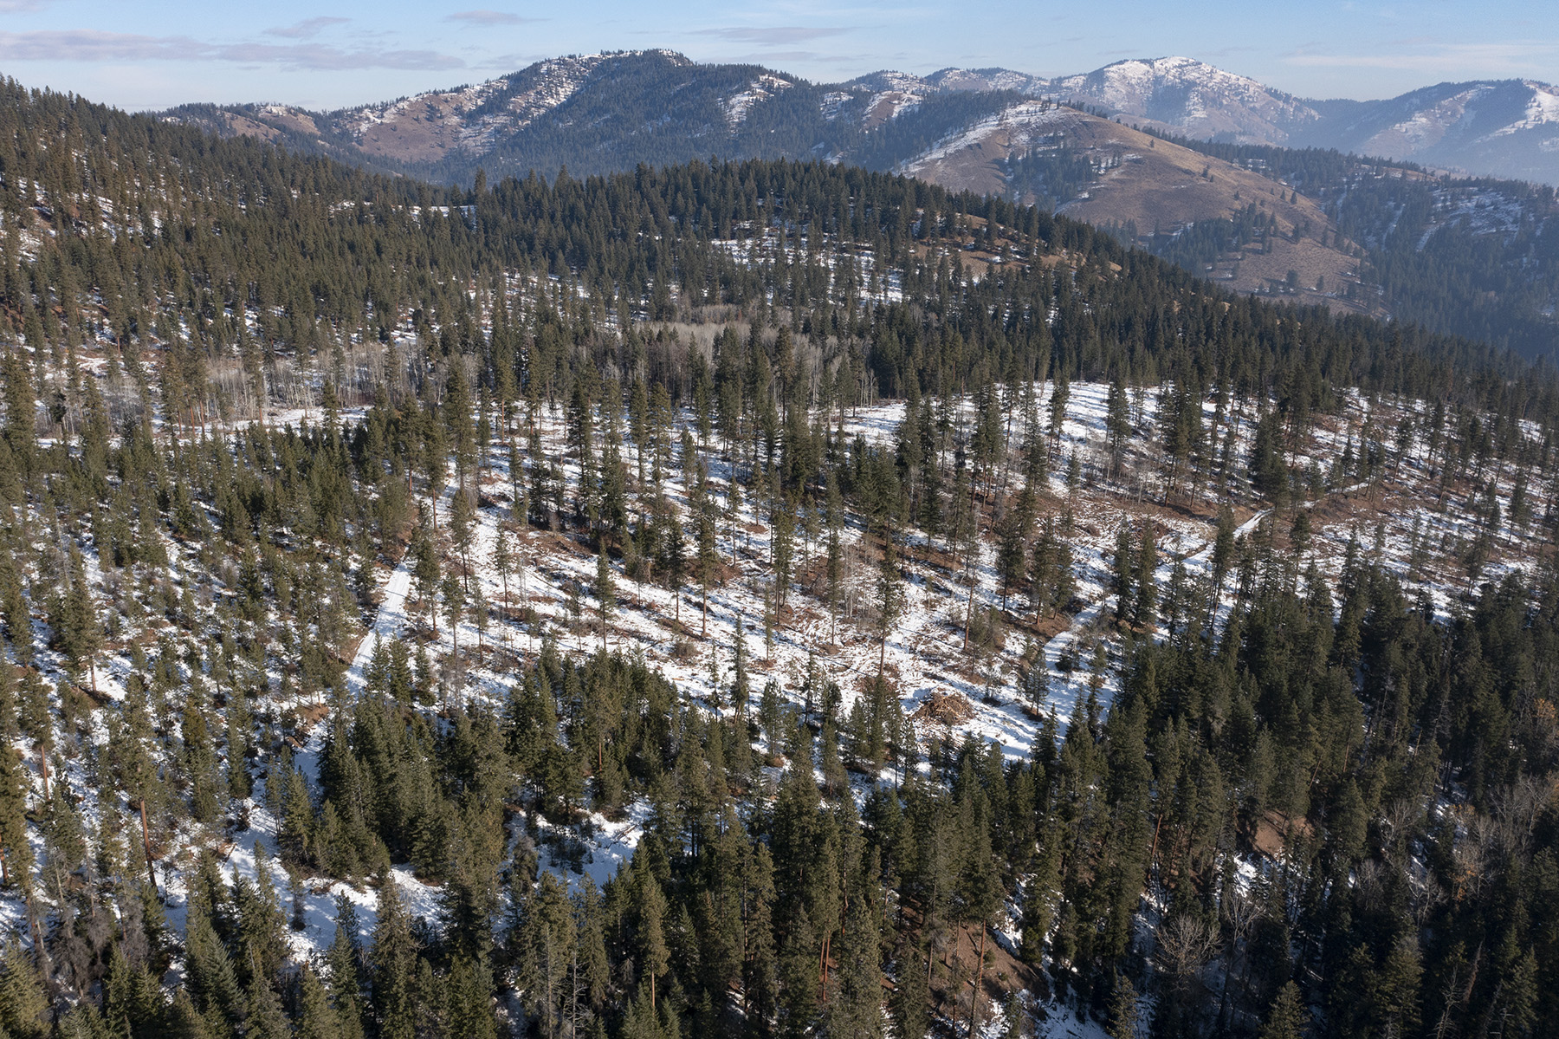
National Program Impacts
Over 6.7M acres of active management
Includes 5.3M acres to reduce wildfire risk
83% of the time local fire suppression staff observed CFLRP treatments helped control or moderate fire behavior
Outsized Impact
7% agency restoration spending -- produced 11% of timber volume, 13% hazardous fuels treatments, 14% Rx fire
9 of top 20 NFs for timber volume awarded in FY24

Slide 5
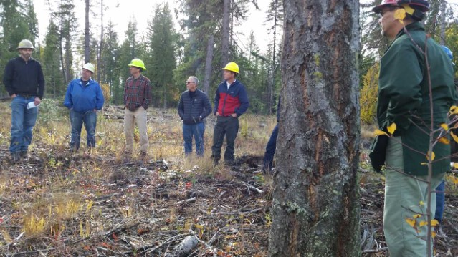
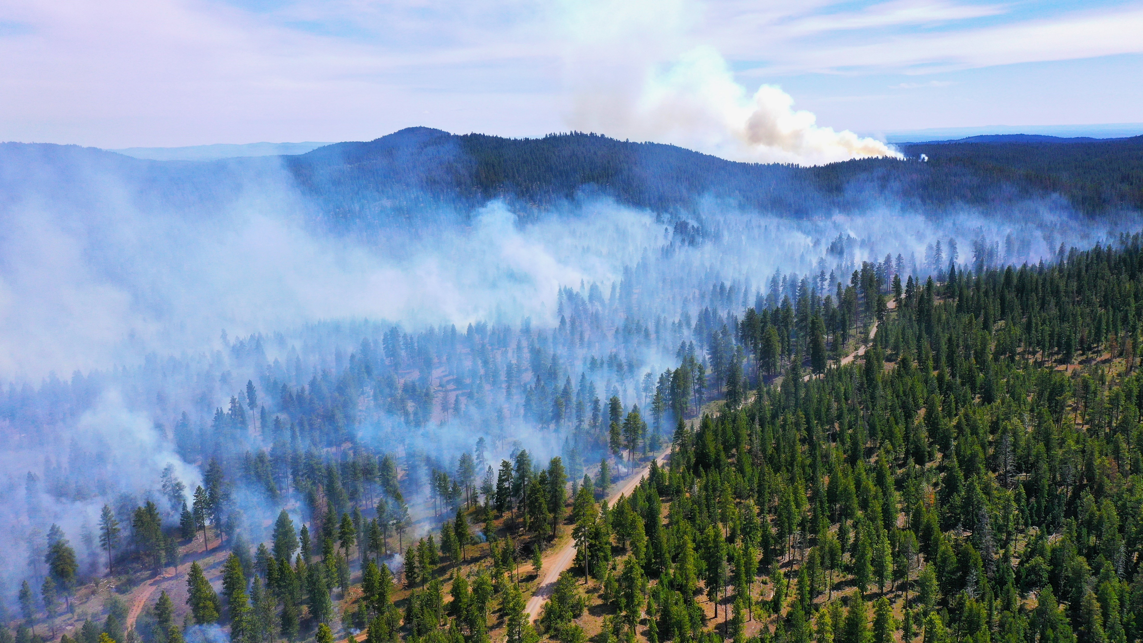
National Program Impacts
Implementation benefits communities
Average of 4,860 jobs annually, 78% in timber harvest & processing
Average of $216 M in local labor income annually
Enables industry investment in new infrastructure, stabilizes local businesses, creates new business partnerships
Attracts significant partner investments
Over 720 partners and organizations
$661 M ($1 invested attracts $1.64)

Slide 6
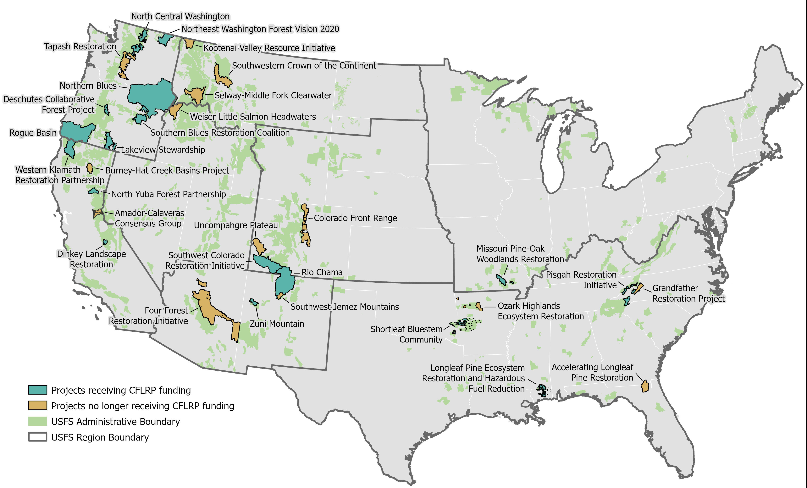
31 CFLRP Projects Funded To-Date

Slide 7
National CFLRP Project Status
17 Active CFLRP Projects
4 Proposals up for Secretary decision
14 Alumni CFLRP Projects
7 Proposals approved and not yet funded
Notes:
7 proposals approved and not funded are in Idaho (3 of 7), Washington, Arkansas, Montana, and Colorado
4 proposals awaiting a Secretarial decision in Arkansas, California, Utah (noting the Advisory Committee recommends 2 of the 4 - Sequoia in R5 and Ouachita in R8 - for potential funding)

Slide 8
Region 6 CFLRP Projects
CFLRP Project | Status | Scale | Forests
North Central Washington | Active, Funded 2022 | 1.1 M acres | Okanogan-Wenatchee
Rogue Basin Landscape Restoration | Active, Funded 2022 | 4.6 M acres | Rogue River-Siskiyou
Lakeview Stewardship | Active, First Funded 2012, Extended 2022 | 859,000 acres | Fremont-Winema
Southern Blues Restoration Coalition | Active, First Funded 2012, Extended 2022 | 1 M acres | Malheur
Northeast Washington Forest Vision 2020 | Active, First Funded 2012, Extended 2022 | 916,000 acres | Colville
Northern Blues | Active, Funded 2021 | 10 M acres | Umatilla and Wallowa-Whitman
Deschutes Collaborative Forest Project | Active, First Funded 2010, Extended 2021 | 257,000 acres | Deschutes
Tapash | Alumni, Funded 2010-2019 | 1.6 M acres | Okanogan-Wenatchee
Northeast Washington Selkirks | Approved by Secretary, awaiting funding | 339,000 acres | Colville

Slide 9
Region 6 Program Impacts
$123M in CFLRP Funding and $204M in partner investments since 2010
Over 1.2 M acres of hazardous fuels treatments since 2010
1.4 B board feet of timber volume sold since 2010
For every $1 investment, partners contributed $1.65
In FY24, 5 of the top 10 NFs for timber volume awarded in R6 were past or present CFLRP projects
670,000 acres of wildlife habitat and 755 miles of streams

Slide 10
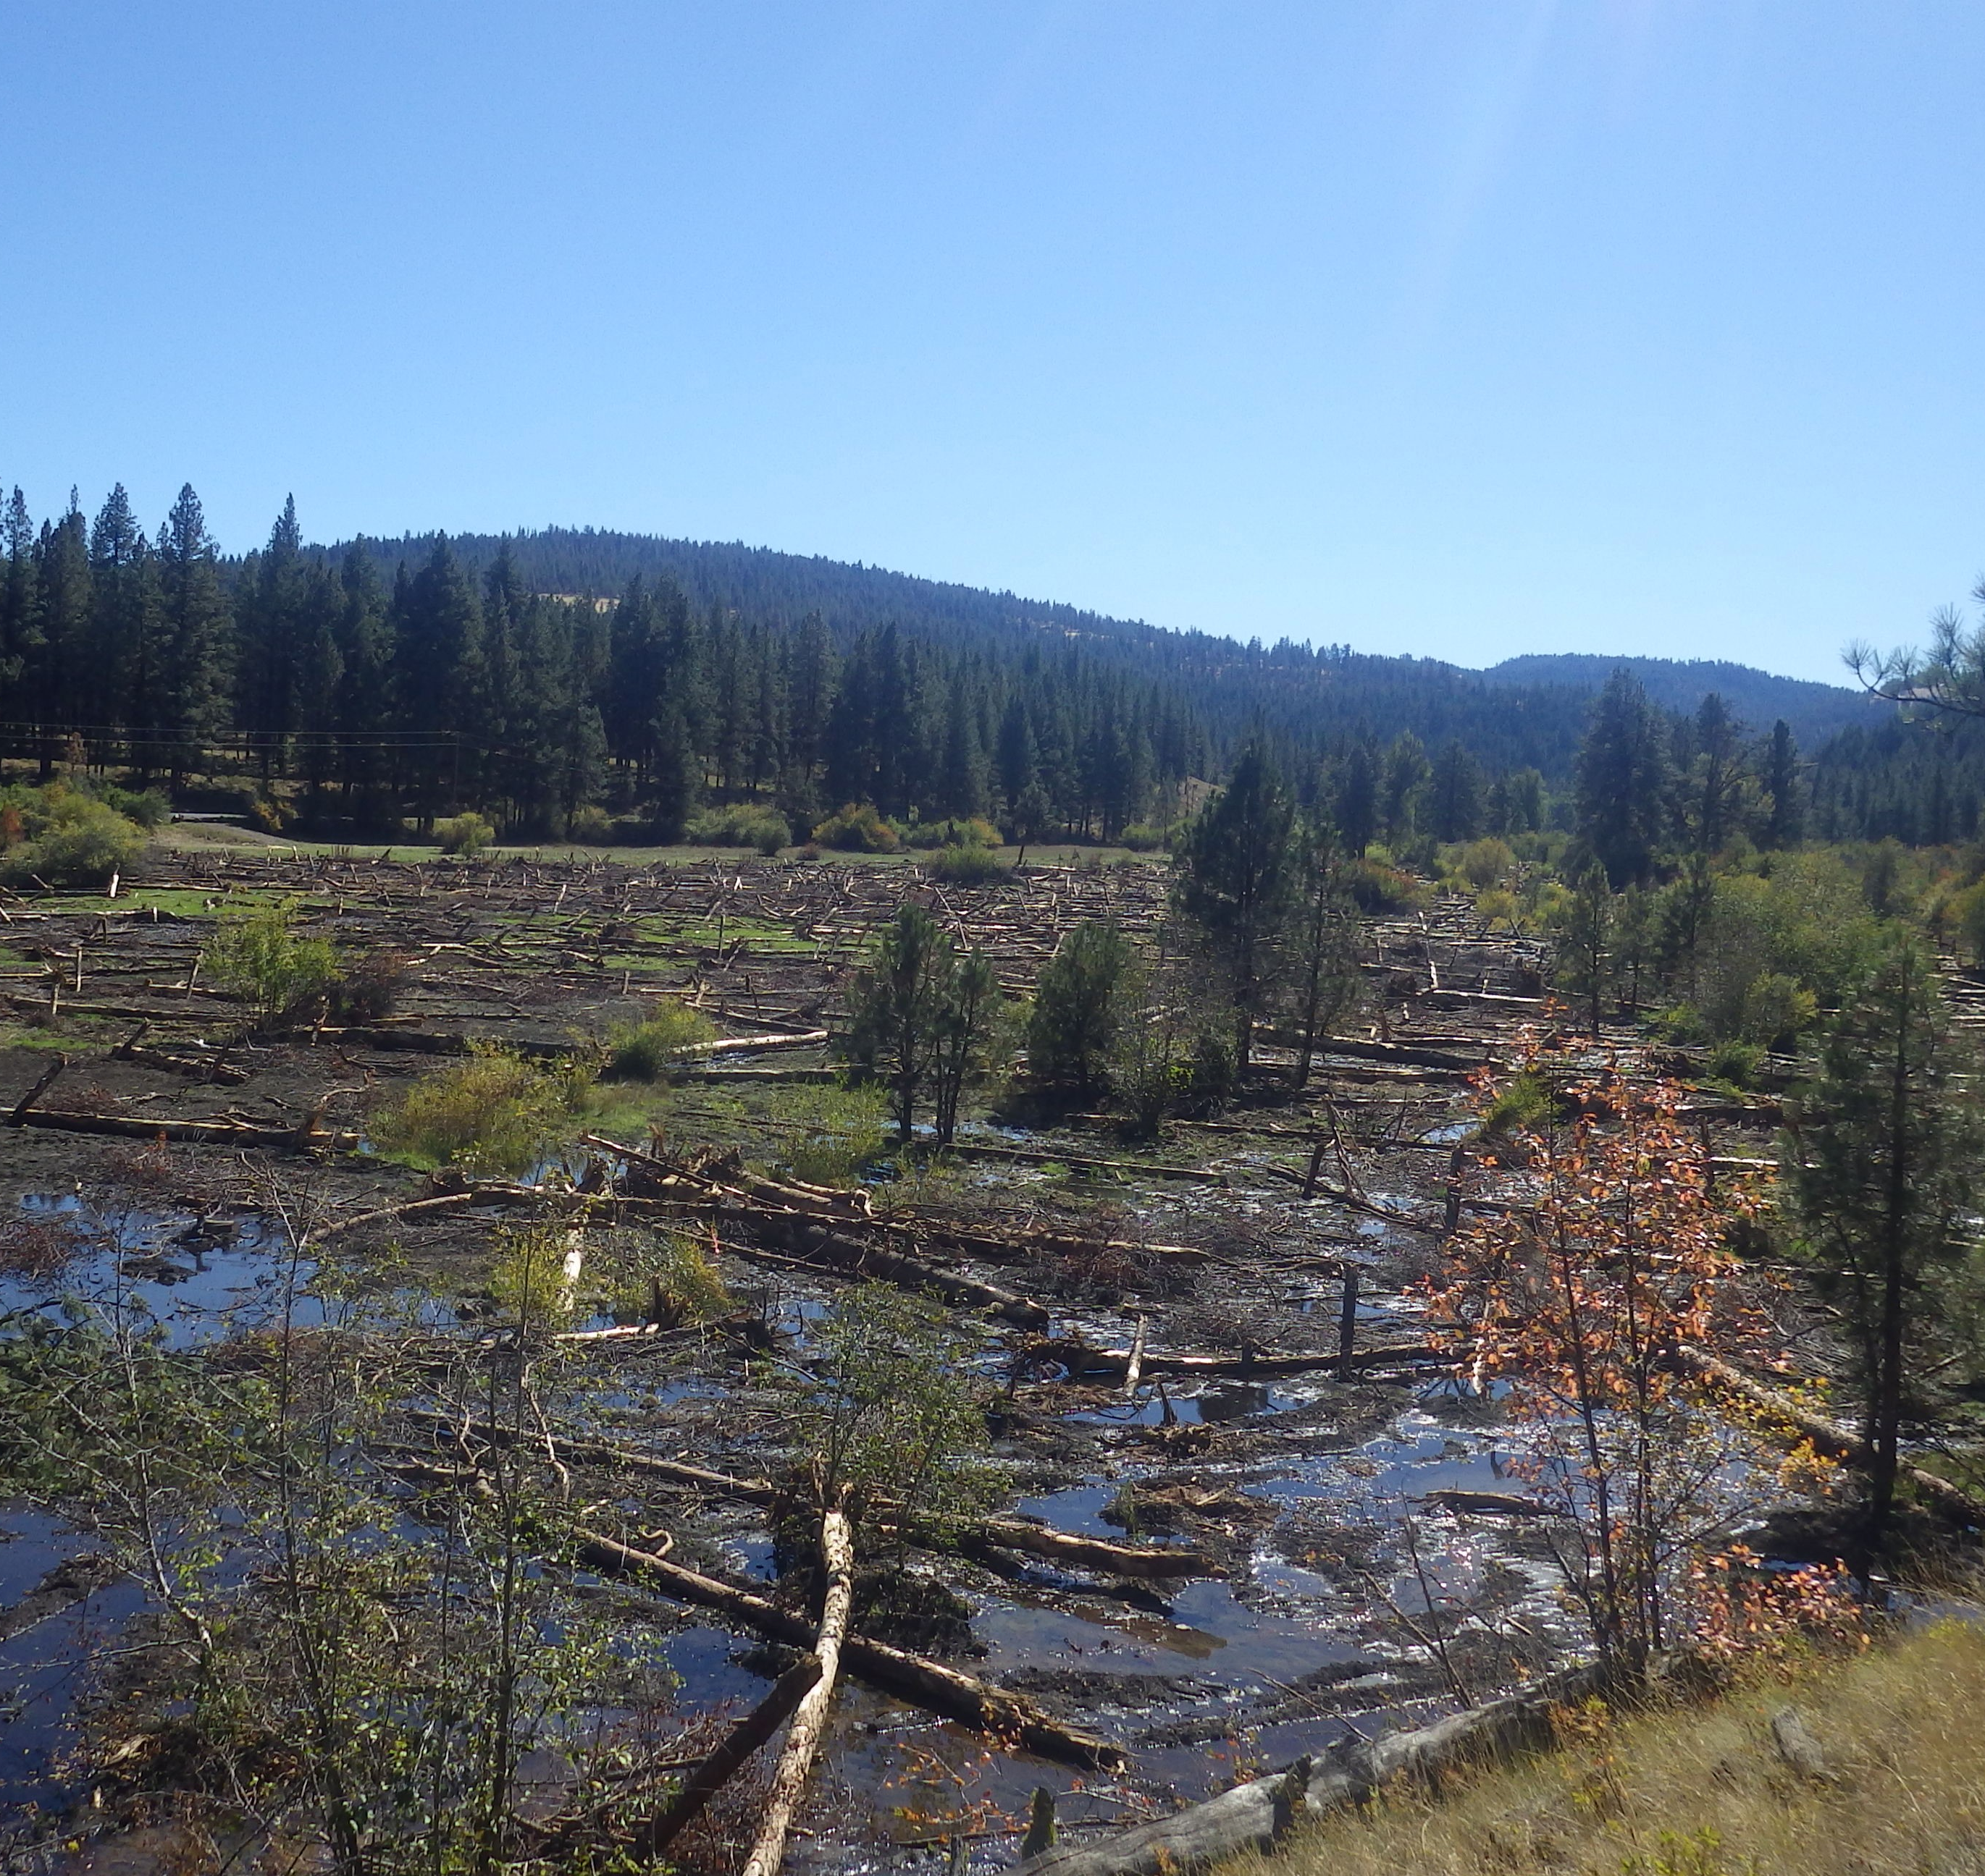
Southern Blues Restoration Coalition
The Southern Blues Restoration Coalition in Oregon has led local wood processing companies to invest heavily in upgrades and new infrastructure to utilize small diameter wood, supporting new jobs in the community. These companies have leveraged CFLRP funds and Forest Service contracting approaches that focus on local benefits to help secure investments.
Emphasis is placed on benefit to local communities with the expectation that the primary contractors hire employees locally when their projects are funded with CFLRP.
Notes:
EXAMPLE – Consider brief story demonstrating impact and/or statistics demonstrating the scale of impact

Slide 11
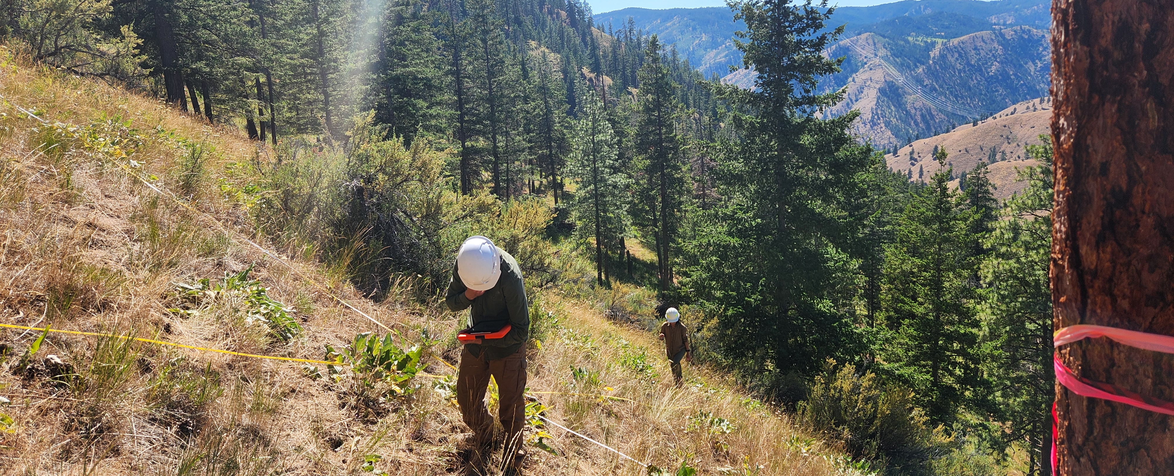
North Central Washington
Total investment: $29.9 million, including $14.5 million in partner investments
31,849 acres of hazardous fuels treated
85,389 cubic feet of timber volume sold (45.4 MMBF)
Estimated 80 jobs supported per year (avg)
27 miles of stream and 32,646 acres of terrestrial habitat restored
Notes:
EXAMPLE – Consider brief story demonstrating impact and/or statistics demonstrating the scale of impact

Slide 12
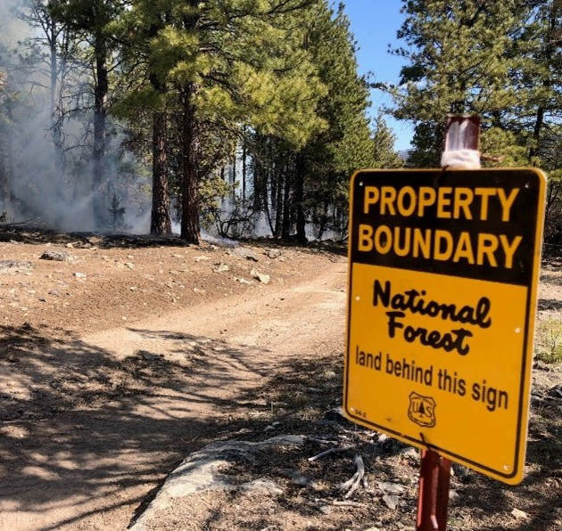
Lakeview Stewardship
The Lakeview Stewardship Landscape in Oregon found that prescribed fire treatments helped reduce the difficulty of suppression operations on the northern and eastern flanks of the 2023 Morgan fire.
Fewer resources were needed to effectively control that portion of the fire, allowing managers to concentrate on areas with a higher suppression difficulty.
Notes:
EXAMPLE – Consider brief story demonstrating impact and/or statistics demonstrating the scale of impact

Slide 13
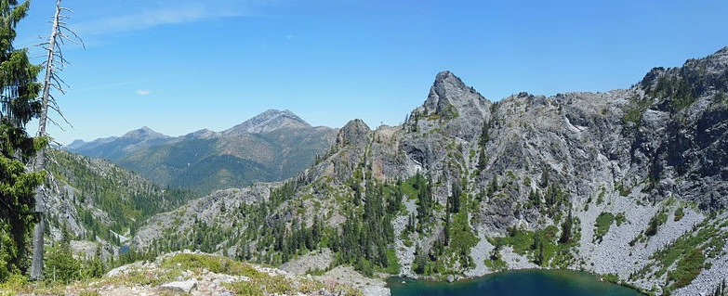
Rogue Basin Landscape Restoration
Total investment: $35.3 million, including $20.9 million in partner investments
22,627 acres of hazardous fuels treated
56,925 cubic feet of timber volume sold (30.2 MMBF)
Estimated 270 jobs supported per year (avg)
Enhanced over 30,000 of terrestrial habitat
Notes:
EXAMPLE – Consider brief story demonstrating impact and/or statistics demonstrating the scale of impact

Slide 14
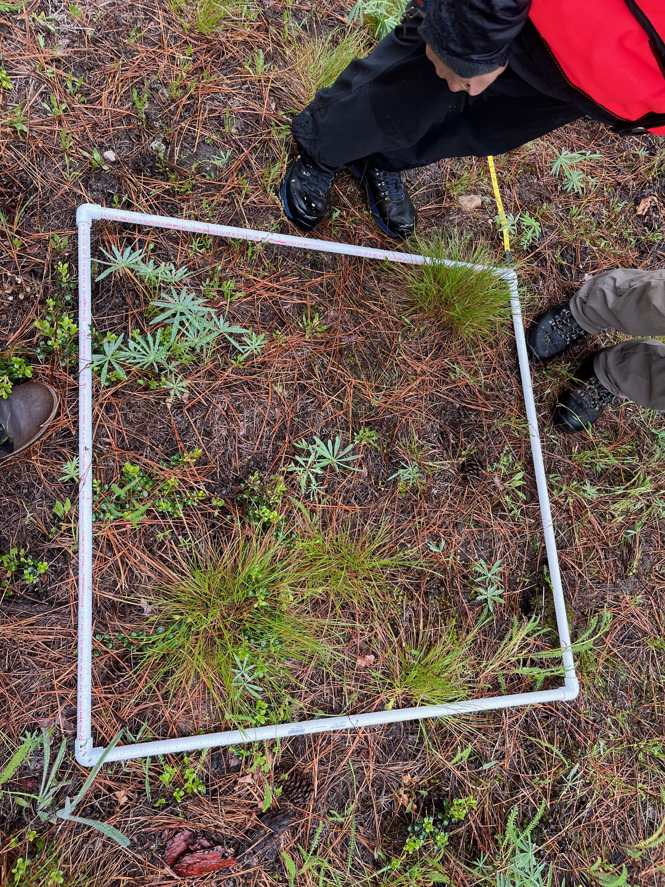
Northeast Washington Vision 2020
Total investment: $83.3 million, including $24.4 million in partner investments
146,730 acres of hazardous fuels treated
518996 cubic feet of timber volume sold (approx. 259.5 MMBF)
Estimated 345 jobs supported per year (avg)
Over 80 miles of stream restored
Notes:
EXAMPLE – Consider brief story demonstrating impact and/or statistics demonstrating the scale of impact

Slide 15
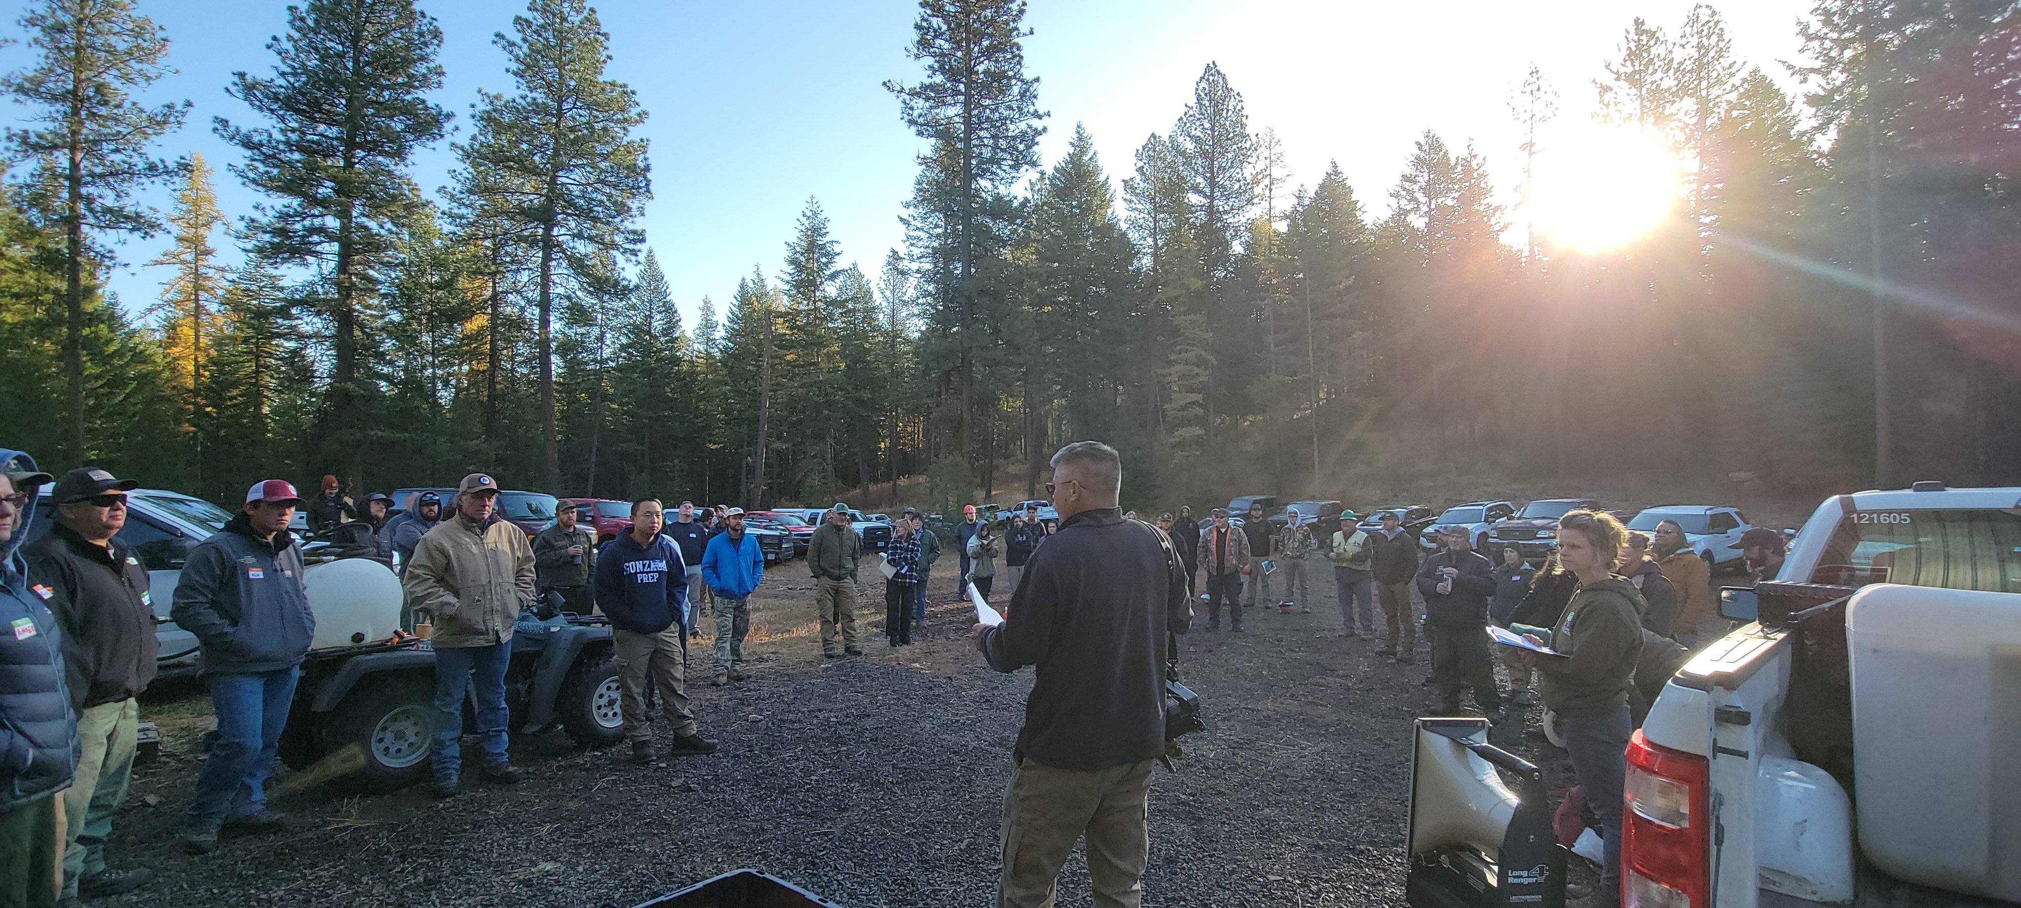
Northern Blues
Restoration efforts help preserve existing forest industry and contractor jobs while creating new opportunities in treatment contracting, monitoring, research, and supporting services. Reducing fire risks to property and lives is another key outcome, particularly in the Project Area, where private property and structures closely border the National Forests.
Four years into the project, partners have successfully retained $60,548,970 in restoration funding for contractors working in the Northern Blues.
Notes:
EXAMPLE – Consider brief story demonstrating impact and/or statistics demonstrating the scale of impact

Slide 16
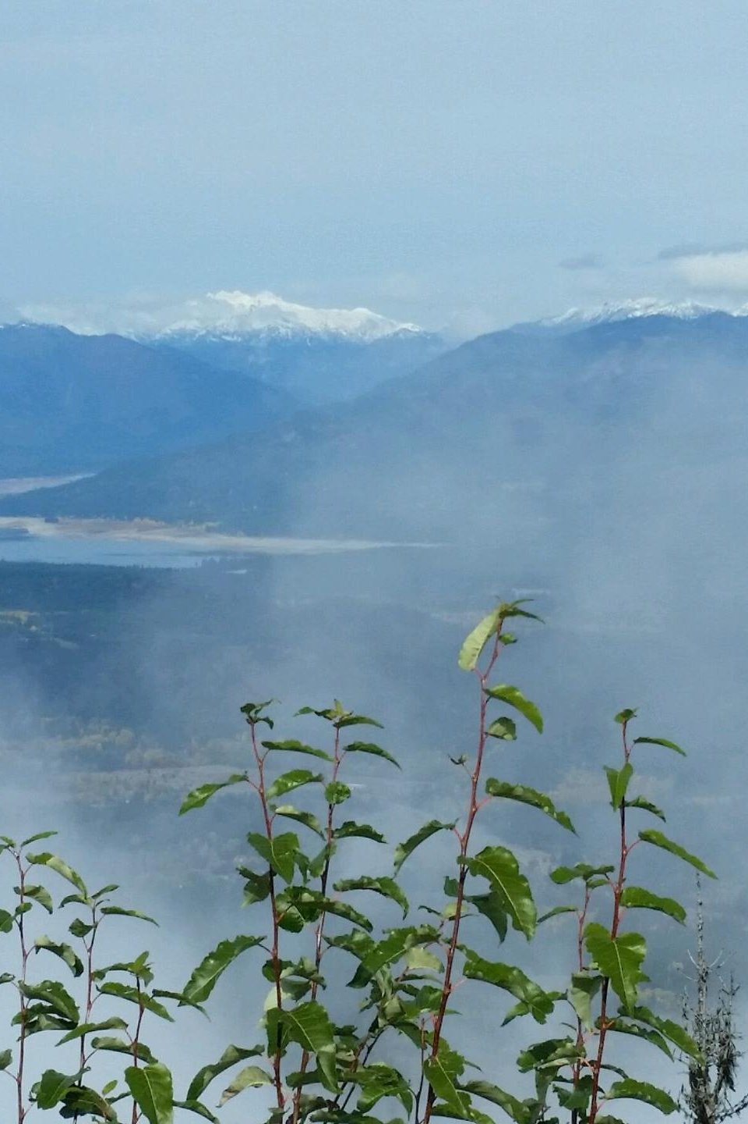
Tapash (Funded 2010-2019)
Total investment: $48.3 million, including $21.8 million in partner investments
29,946 acres of hazardous fuels treated
175,990 cubic feet of timber volume sold (approx. 88 MMBF)
Estimated 120 jobs supported per year (avg)
Nearly 30 miles of stream restored and over 100,000 acres of terrestrial habitat enhanced
Notes:
EXAMPLE – Consider brief story demonstrating impact and/or statistics demonstrating the scale of impact

Slide 17
Deschutes Collaborative Forest Project
There are 23 wildfires in the Fuels Treatment Effectiveness Monitoring database that indicate interactions with previous fuel treatment activity in the CFLR landscape. All of these wildfires were determined to exhibit reduced fire behavior due to the previous fuel treatments, inevitably leading to successful initial attack suppression and control of the unplanned wildfire.
The strategic approach to hazardous fuel treatment within the CFLR landscape has been to focus activities in close proximity to neighborhoods and communities. This approach has resulted in a more historic fuel composition around Bend and Sisters. The resulting fire behavior observed in these treatment areas prior to suppression actions is commonly low intensity ground fire.
Notes:
EXAMPLE – Consider brief story demonstrating impact and/or statistics demonstrating the scale of impact

Slide 18
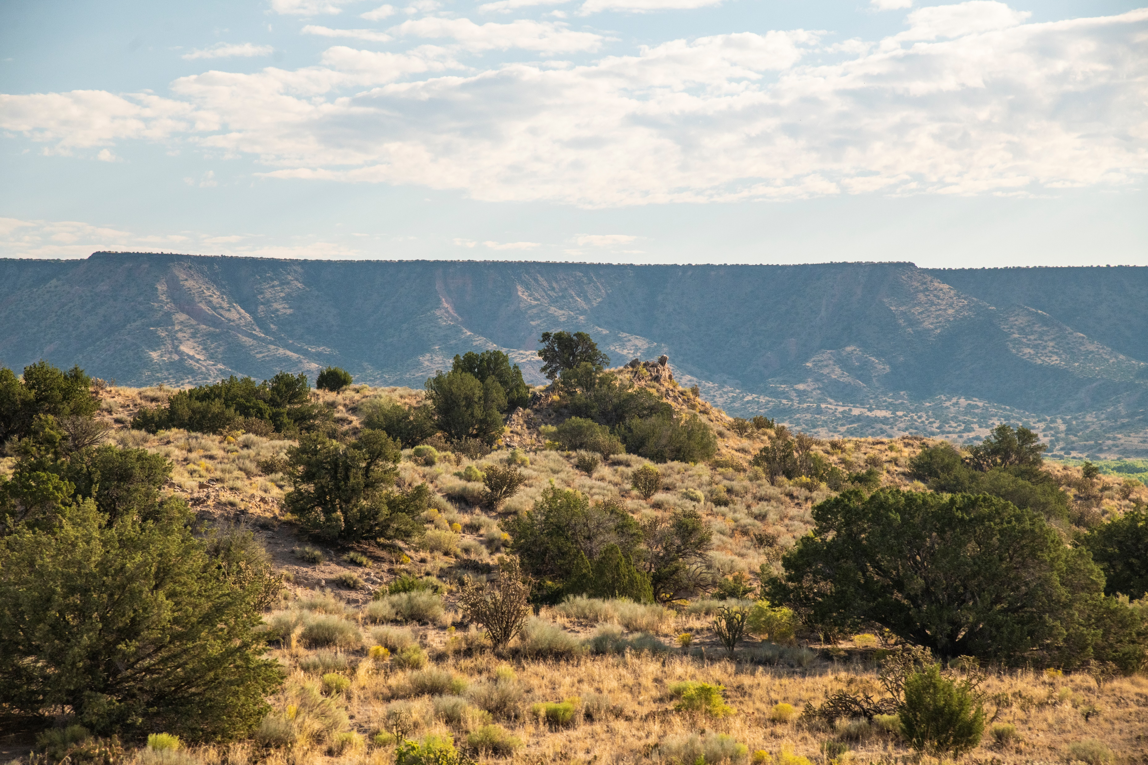
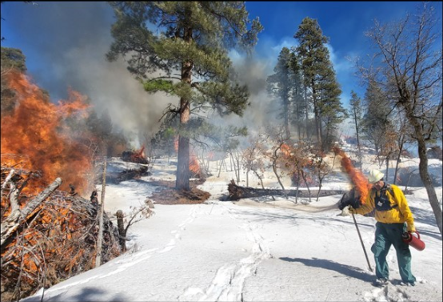
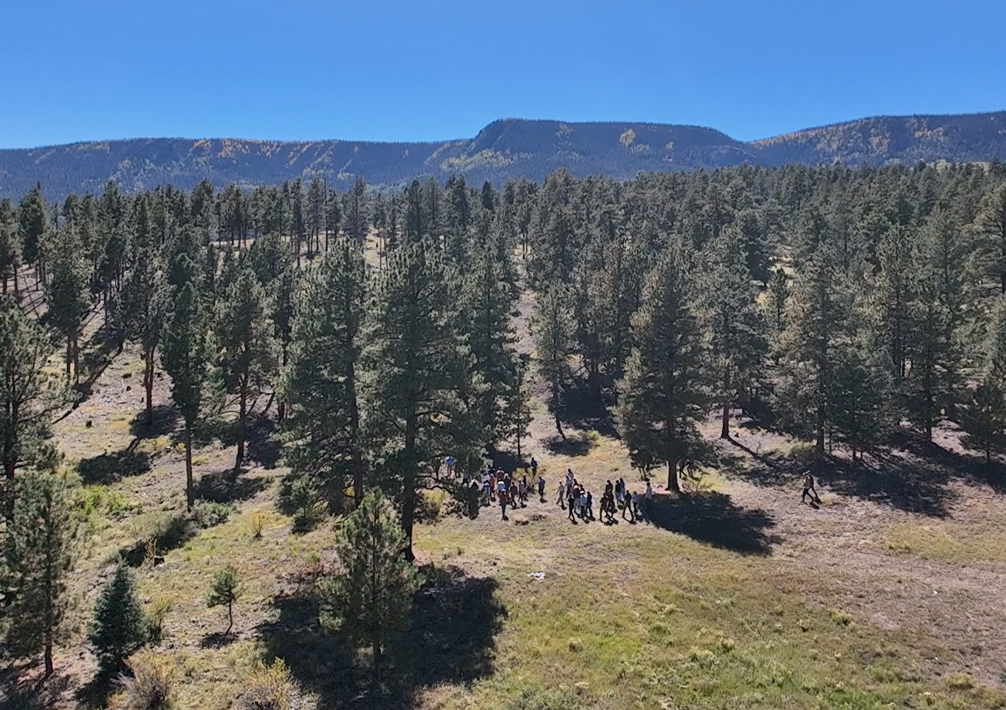
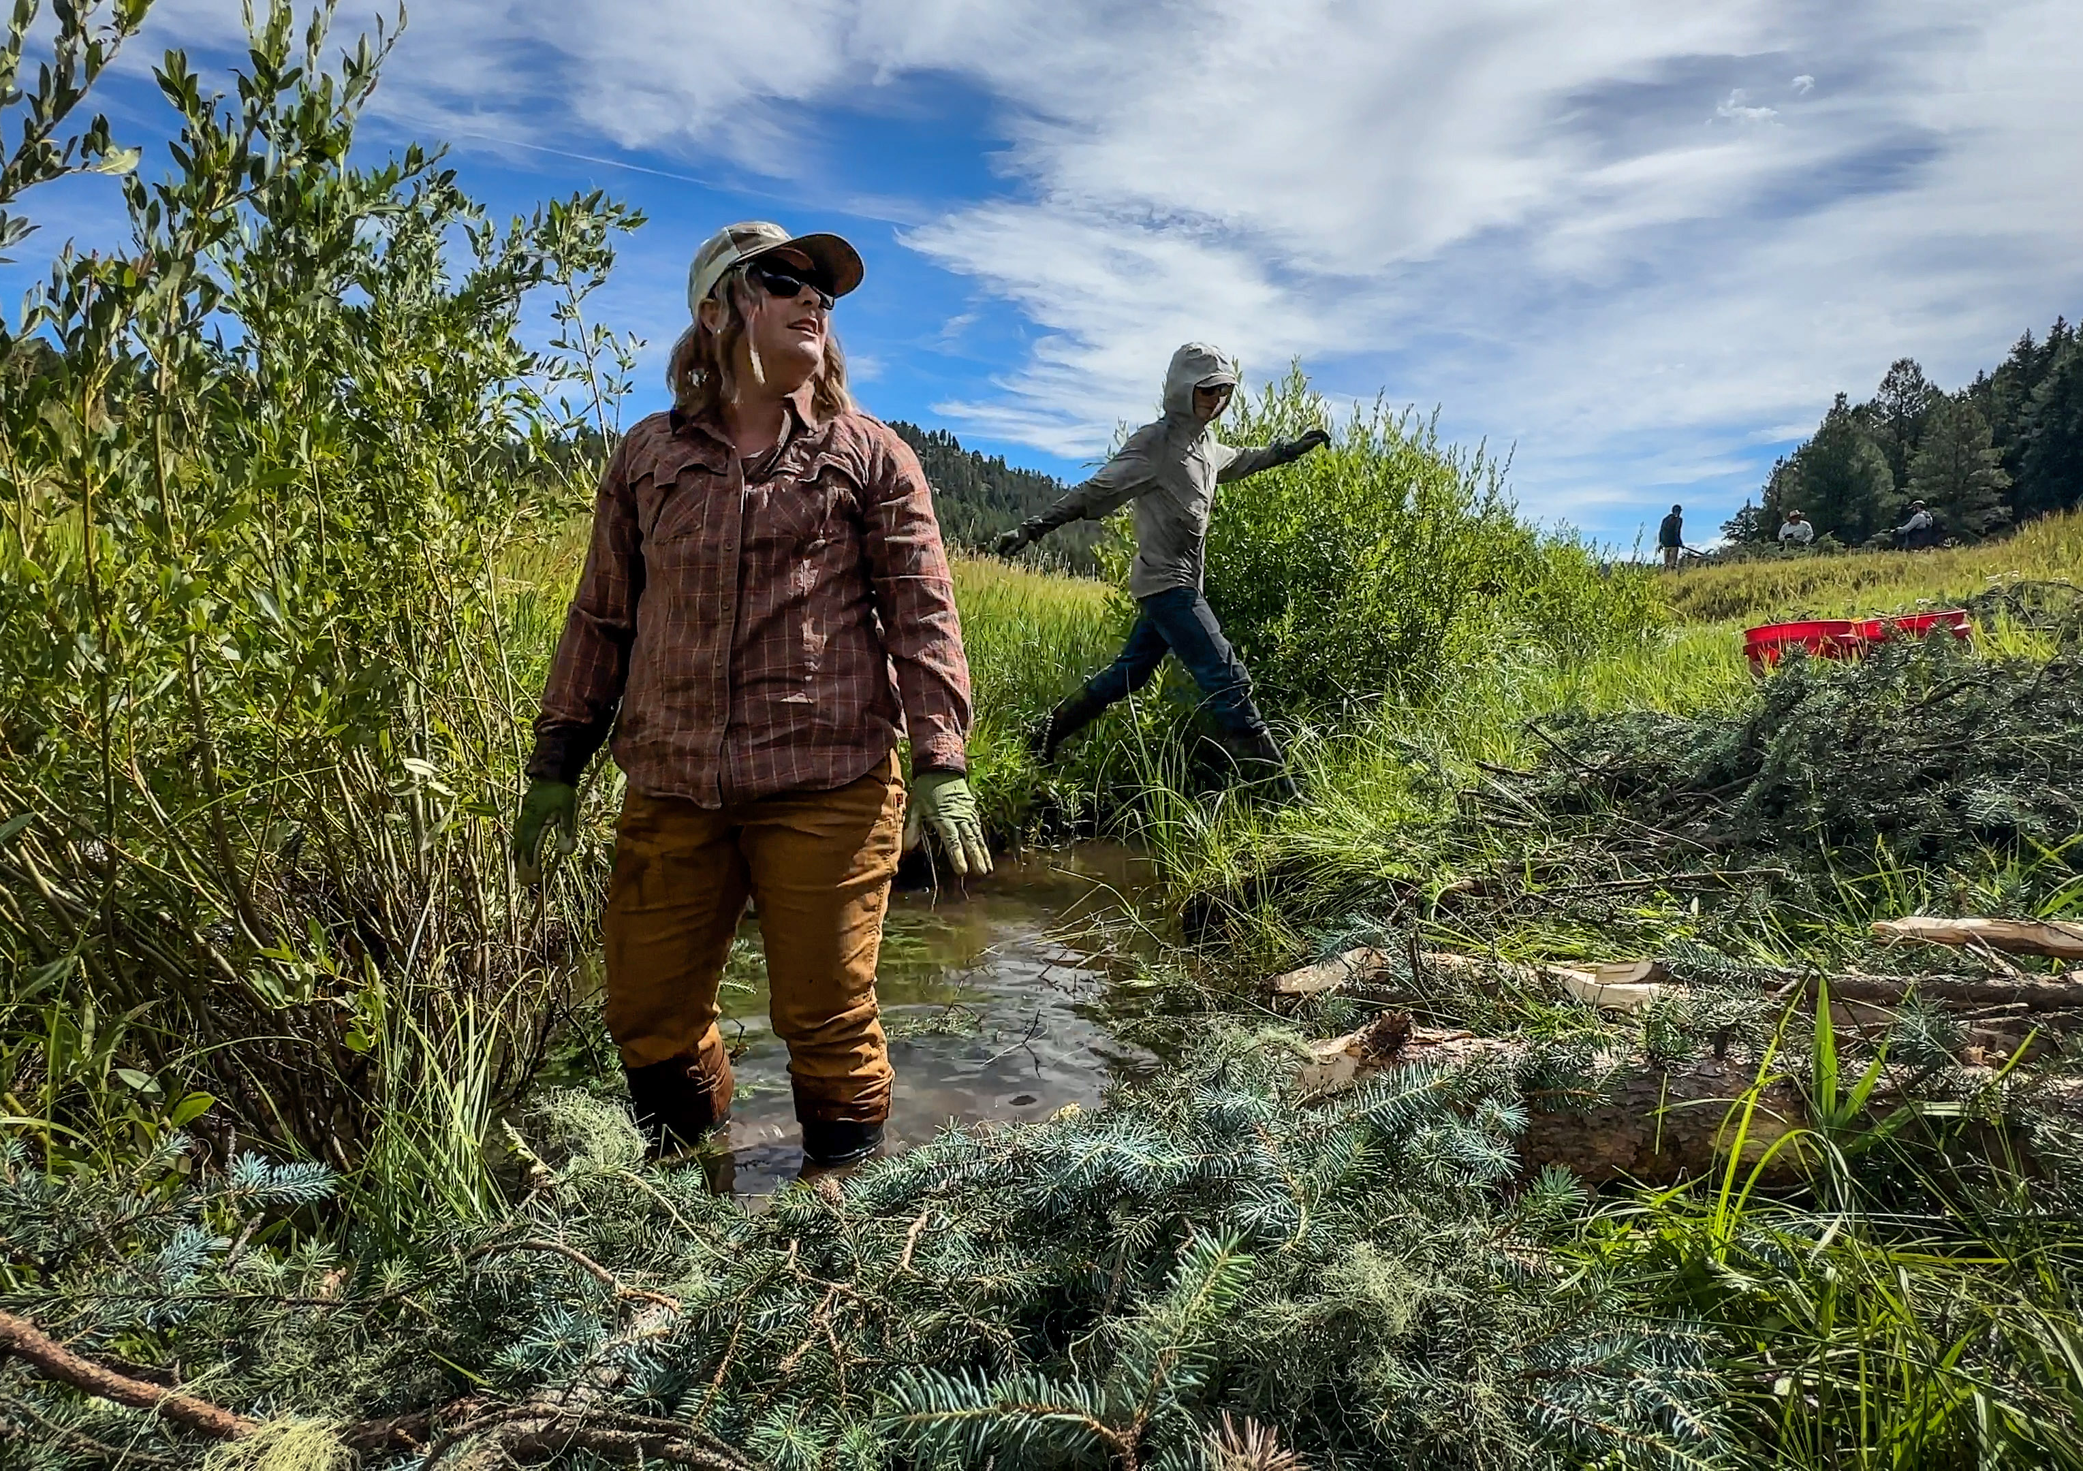
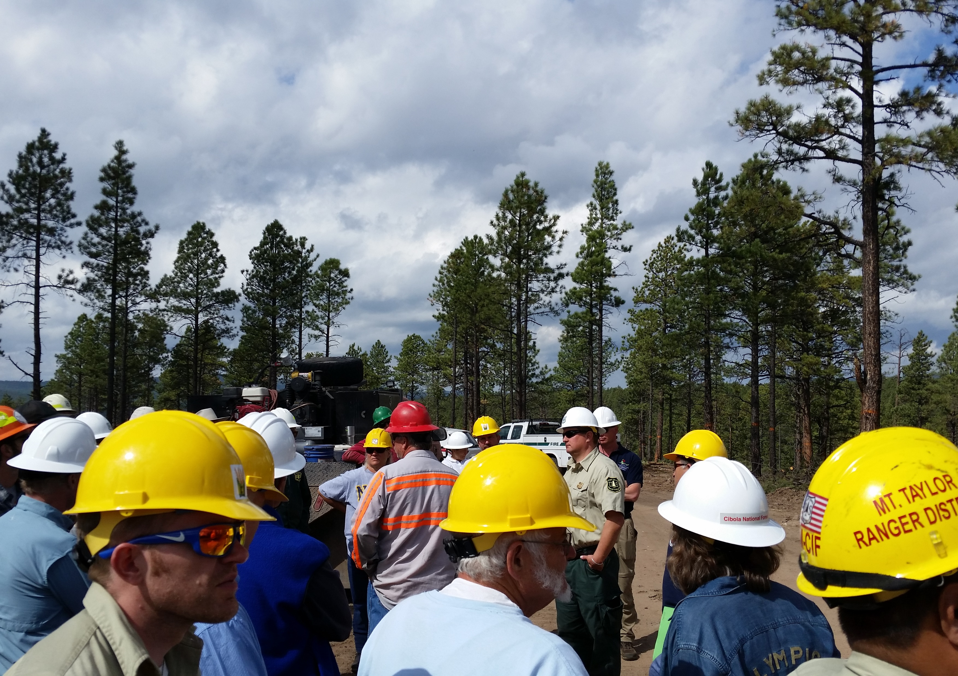
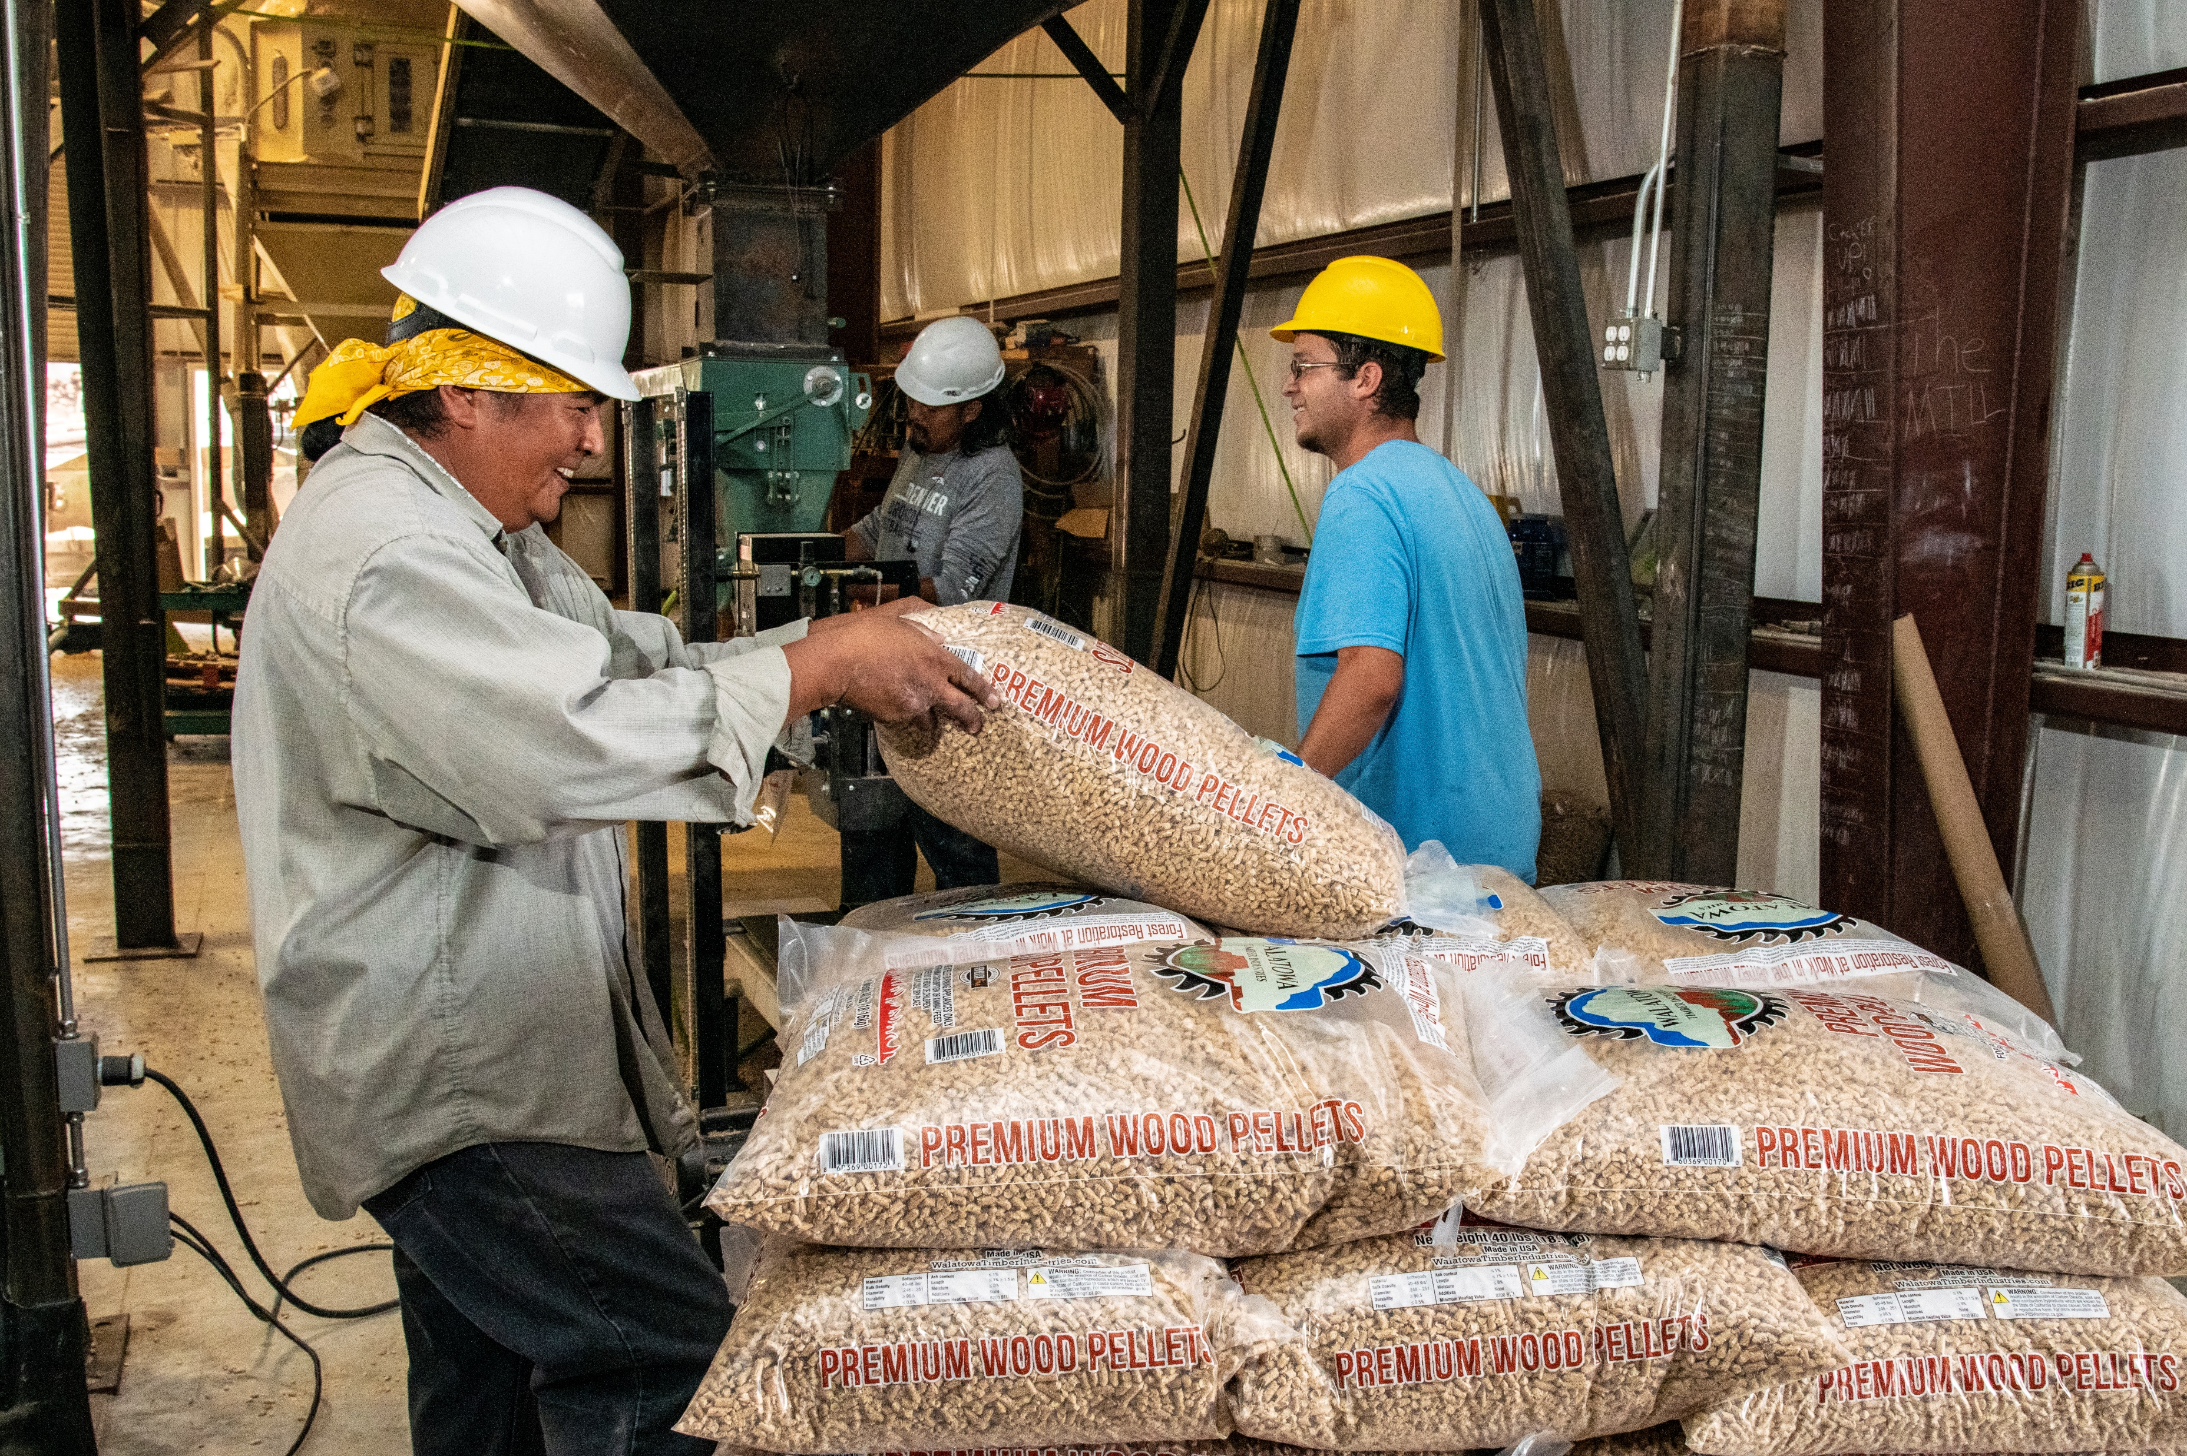

Thank you!

