Slide 1
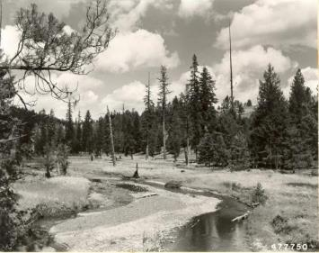
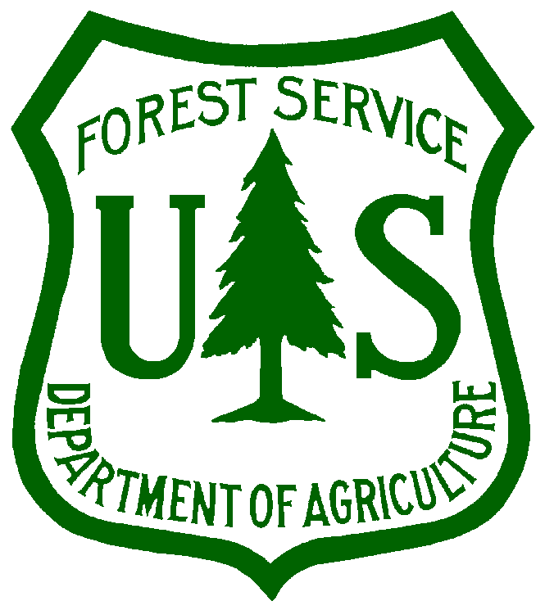



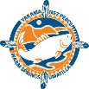



Integration of Grazing Approaches with Salmonid Restoration:
Meadow Creek Experiment
Mike Wisdom & Mary Rowland, PNW Research Station
2 November 2016 Region 6 Ecologists’ Meeting

Slide 2
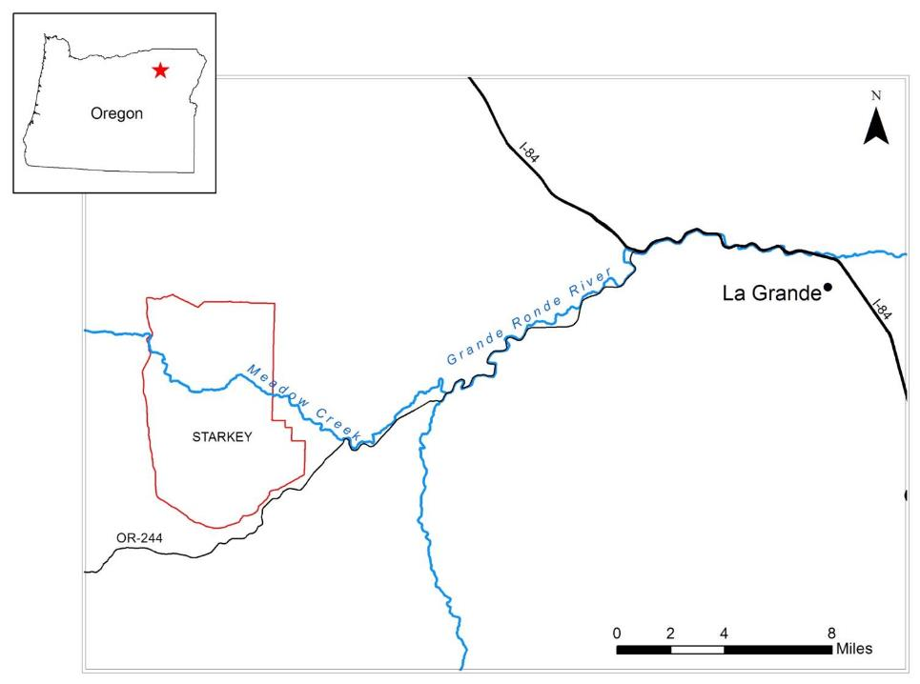
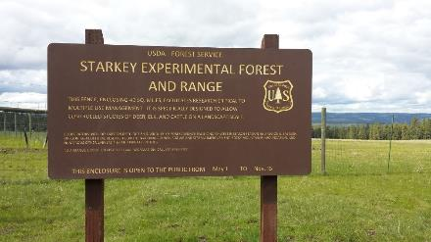

Slide 3
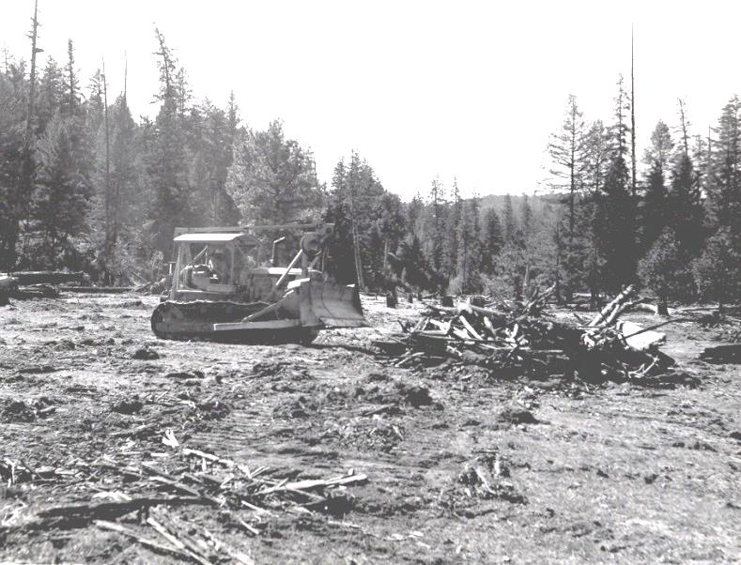
Background
Stream systems like Meadow Creek have legacy effects from splash-dam logging, railroad logging, roads, livestock grazing, and conversion of native vegetation to exotic livestock forages, leading to dramatic changes in riparian systems.
1953 livestock forage conversion on Meadow Creek

Slide 4
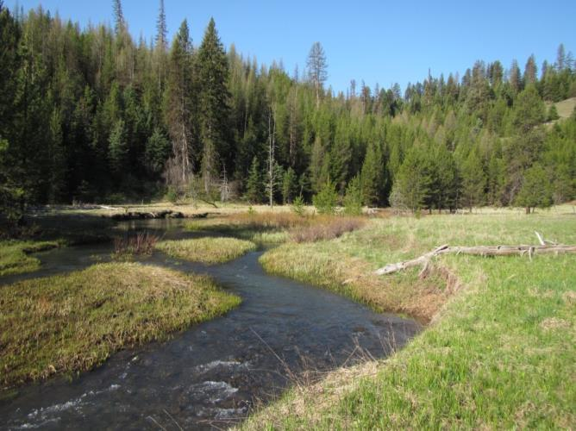
Meadow Creek before restoration in 2012. Scouring from splash-dam logging more than 100 years ago removed most in-stream structures, which are critical for spawning and rearing of salmonids.

Slide 5
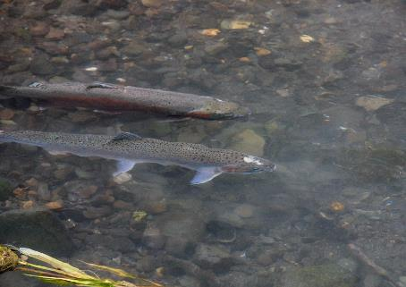
ESA-Threatened Salmonids
Snake River Steelhead--spawning and juvenile rearing in Meadow Creek
Snake River Spring/Summer Chinook Salmon--functionally extirpated from Meadow Creek but some juvenile rearing

Slide 6
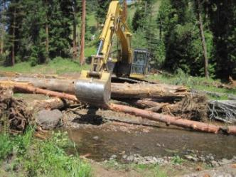
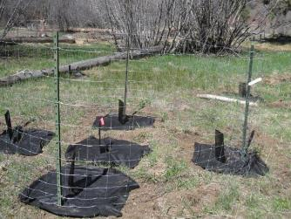
Restoration Objectives
Restore in-stream structures (boulders, large woody debris) important for salmonid spawning and juvenile rearing.
Restore riparian woody vegetation important for stream shading to mediate lethal summer stream temperatures.
Restore channel, floodplain, and riparian function.

Slide 7
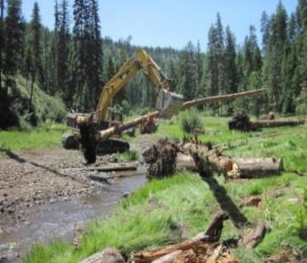
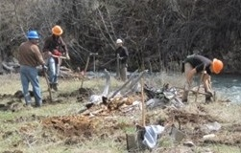
Restoration Activities: 2012-2014
In-Stream: ~60 clusters of boulders and large woody debris across 7.5 miles of Meadow Creek (600 large wood pieces, 285 boulders)
Riparian: 50,000 seedlings planted (deciduous shrubs and conifers)

Slide 8
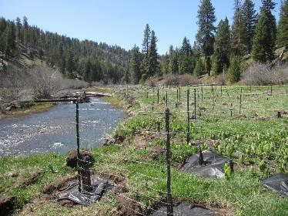
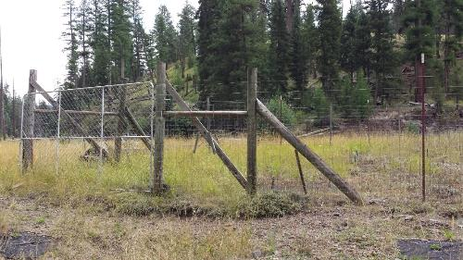
Restoration Activities: 2012-2014
3.5 miles of new livestock fencing constructed
9 large ungulate exclosures constructed, each ~2.5 acres
6 upland water sources constructed for cattle
1,800 small exclosures (“pods”) constructed to protect deciduous plantings; ~50% left unprotected to understand herbivory effects

Slide 9
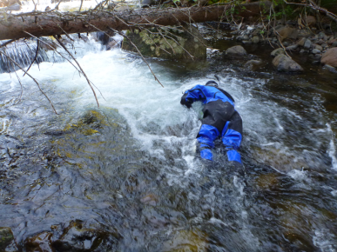
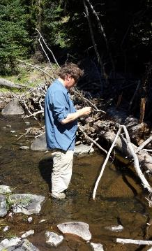
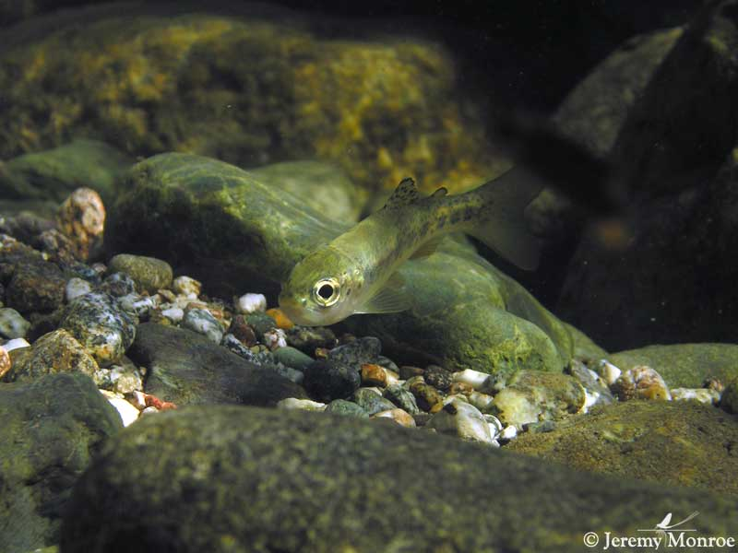
Restoration Monitoring
Salmonid habitat responses (Columbia Habitat Monitoring Program – CHaMP)
Adult spawning and juvenile rearing responses (redd counts in spring, snorkel surveys late summer)

Slide 10
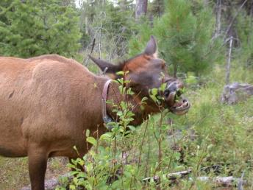
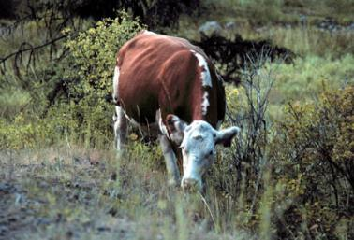
Grazing Effects Monitoring
Document effects of wild vs. domestic ungulate herbivory on riparian restoration of woody vegetation.
Evaluate new cattle grazing practices designed to be compatible with in-stream and riparian restoration for salmonids.

Slide 11
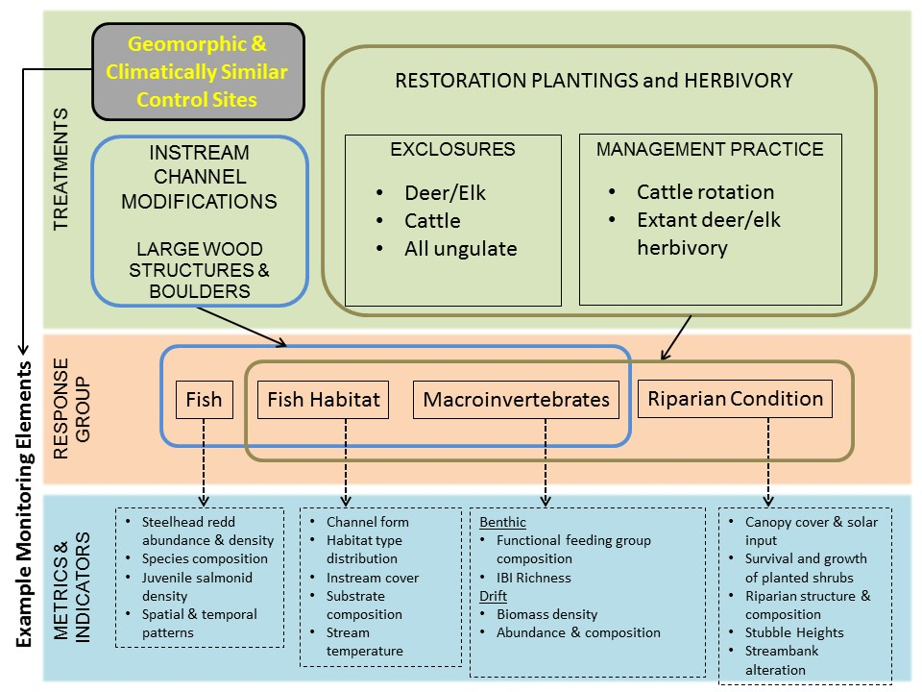

Slide 12
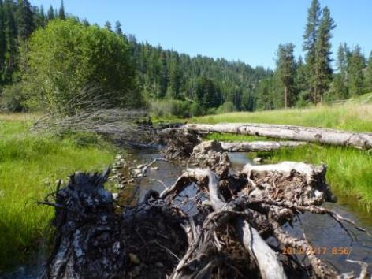
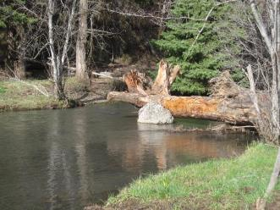
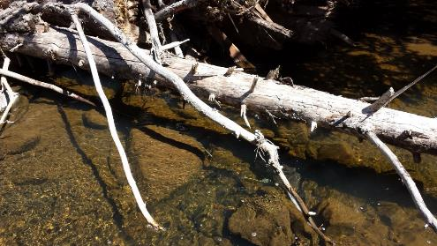
Meadow Creek
In-Stream Restoration – Initial Results

Slide 13
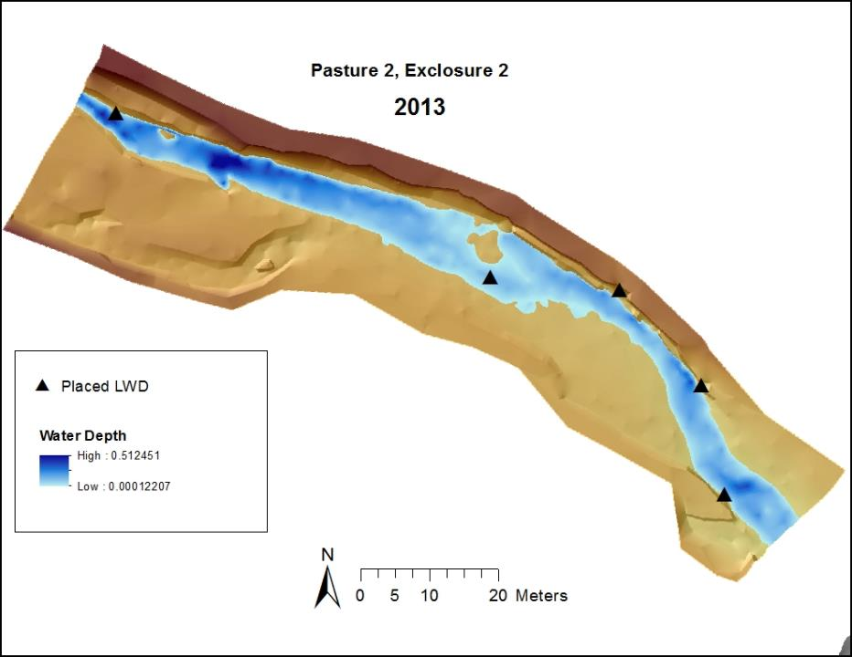
Deep pools
pre-wood placement
Future LWD
placements

Slide 14
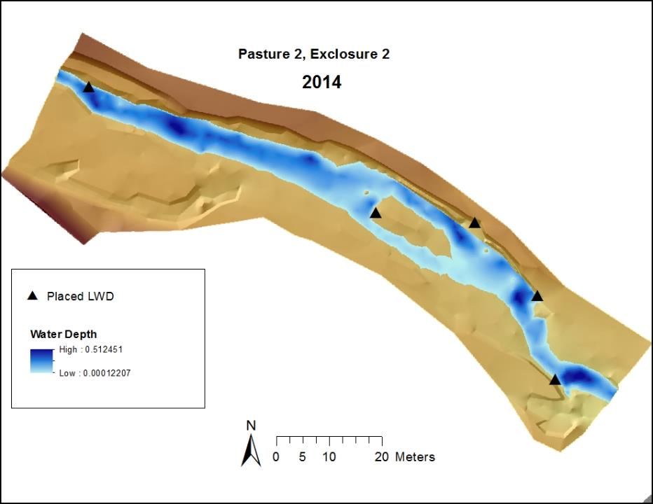
Deep pools
Overall stream channel is deeper
Dispersion of sediment,
Redistribution of gravel

Slide 15
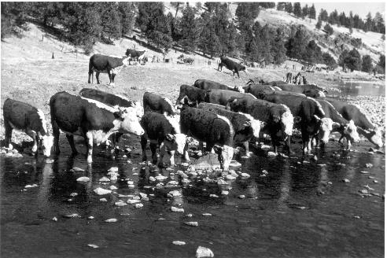
Grazing System Objectives
Design and integrate new cattle grazing practices compatible with salmonid restoration, and evaluate effects on restoration.
Guiding Principle: GRAZING PRACTICES SHOULD RESULT IN REDISTRIBUTING CATTLE FROM RIPARIAN AREAS TO UPLANDS

Slide 16
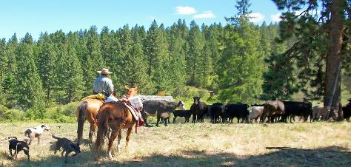
Begins 2017, following post-restoration grazing rest
Deferred rotation across small pastures
Short grazing periods per pasture (high intensity - short duration)
Earlier spring turnout of cattle
Compressed period of late-season grazing
Well-distributed upland water and nutritional supplementation
Systematic, regular herding to upland water
“Real-time” utilization monitoring of key forages in riparian and uplands to guide herding and pasture rotation
Meadow Creek Grazing System and Practices

Slide 17
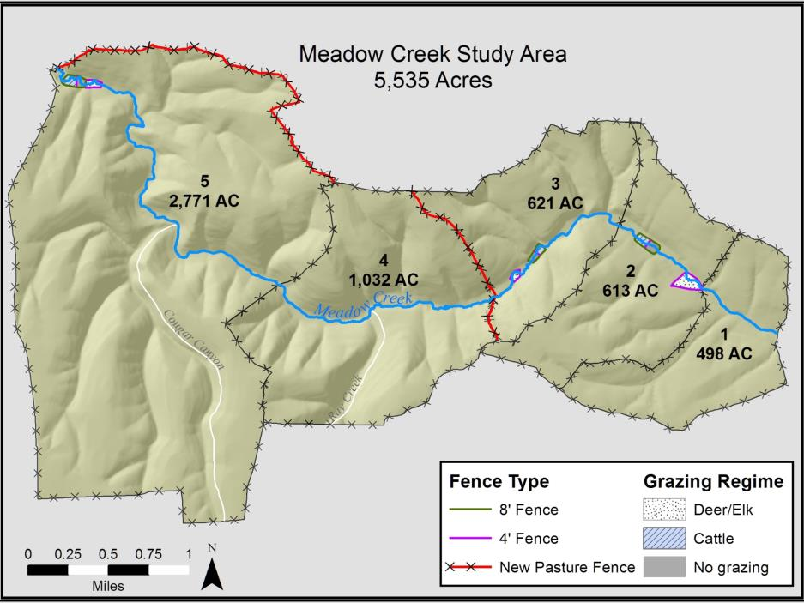

Slide 18
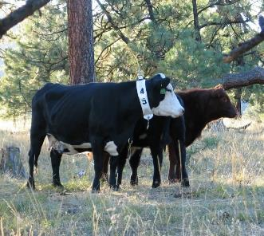
60 cow-calf pairs (Oregon State University cattle)
June 1-October 1 (120 days) under deferred rotation
—rotate from pastures 1 through 5 in 2017
—rotate from pastures 5 through 1 in 2018
60 days in Pasture 5, 15 days each in Pastures 1 to 4
Stocking rates moderate for first year (initial test)
Regular monitoring of herd locations and forage utilization
Regular maintenance of fences and upland water
Grazing System

Slide 19

Herd Management Approach
Move cattle to upland water sources upon first entry to a pasture.
Number of cow-calf pairs assigned to an area near upland water based on cattle watering and forage capacities of the upland (“local stocking rate”).
Regular monitoring of the riparian zone for cattle presence (e.g., ~2-3 days)

Slide 20
Herd Management Approach
Monitor greenline stubble heights and riparian forage utilization when cattle show up in riparian area.
Move cattle back to upland areas when utilization warrants.
Monitor upland forage utilization, especially near water and supplementation sites.
Move to next pasture based on move date - or earlier if utilization warrants.

Slide 21
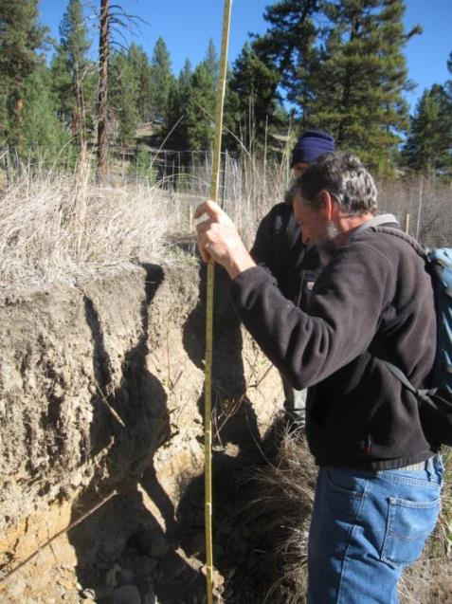
Stubble Height Monitoring – Salmonid Recovery Metric
Monitor greenline stubble heights during grazing in each pasture.
Monitor stubble heights mid-season (post-grazing) and end of grazing season.
Compliance with new terms and conditions for recovery of salmonids (6-8 inches herbaceous greenline stubble height)

Slide 22
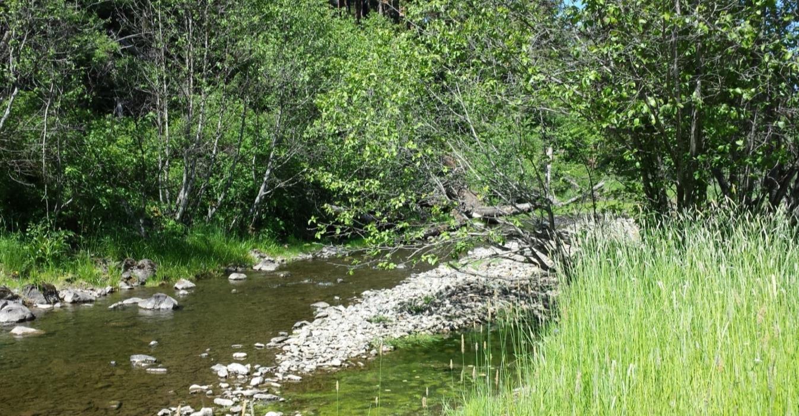
Stubble Height Monitoring – Salmonid Recovery Metric
Willingness of NOAA/FWS to allow lower stubble heights in some sites in light of benefits of research to grazing management in salmonid streams
Effectiveness of stubble height as an indicator of stream and riparian health for salmonids
Relate stubble heights to CHaMP and MIM metrics and vegetation monitoring such as streambank alteration, riparian shrub
recovery, wild vs. domestic ungulate effects, etc.

Slide 23
Monitoring the Grazing System, Practices, and Success
Range rider will carry GPS unit
30-40 of the 60 cows will wear GPS collars
Document time spent by cattle:
  --in uplands versus riparian areas
--in areas near versus far from water and supplementation sites
--in relation to a suite of other environmental conditions affecting
cattle distributions and herd management.

Slide 24
Monitoring the Grazing System, Practices, and Success
Cattle weighed and body condition scores recorded at start and end of grazing season.
Data analyzed for beef production in relation to labor and infrastructure costs to estimate time needed to recoup investments in grazing practices to make them economically viable.

Slide 25
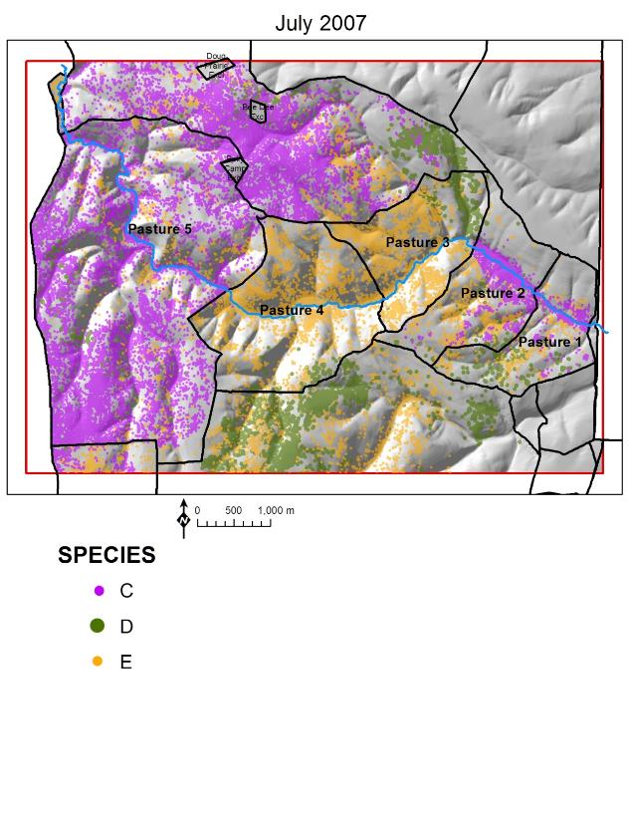
Example telemetry locations of cattle (C), mule deer (D),
and elk (E) at Starkey’s Meadow Creek pastures under past
grazing management with ample upland water (Pasture 5)
in contrast to limited upland water (Pastures 1 and 2).
Pastures 3 and 4 were not grazed by cattle.

Slide 26
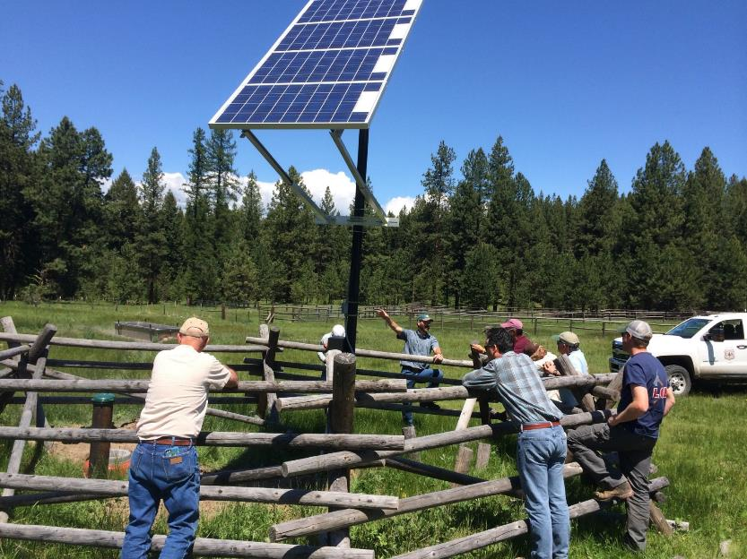
Upland (Off-Stream) Water is Key!

Slide 27
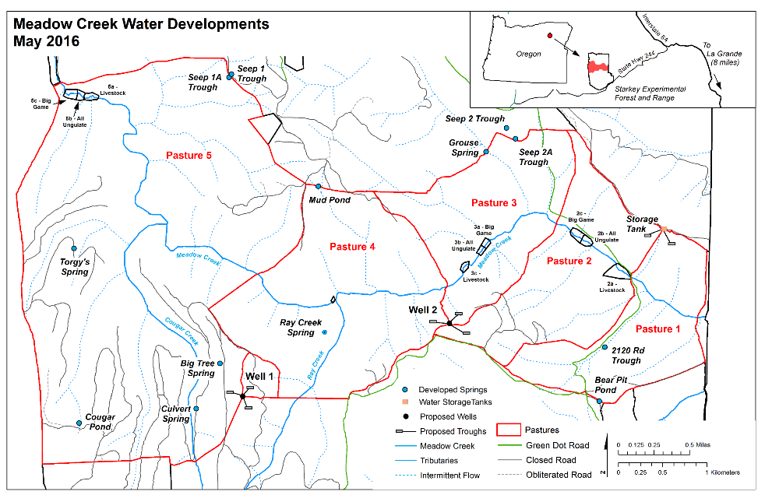

Slide 28
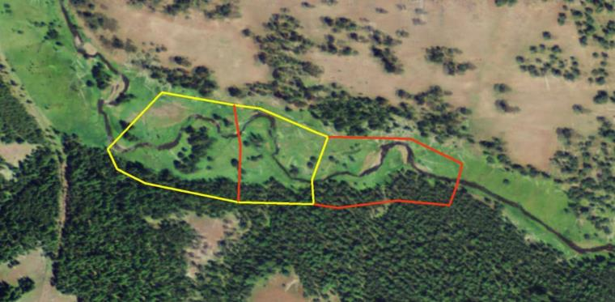
4 Treatment Levels of Herbivory
Deer and Elk Effect (Cattle Exclusion)
Cattle Effect (Deer and Elk Exclusion)
No Ungulate Effect (Cattle, Deer, and Elk Exclusion)
Cattle, Deer, and Elk Effect (Extant Grazing—includes new
cattle grazing system)
4
3
2
1

Slide 29
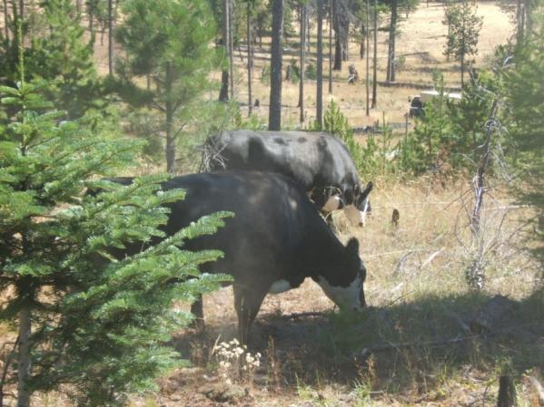
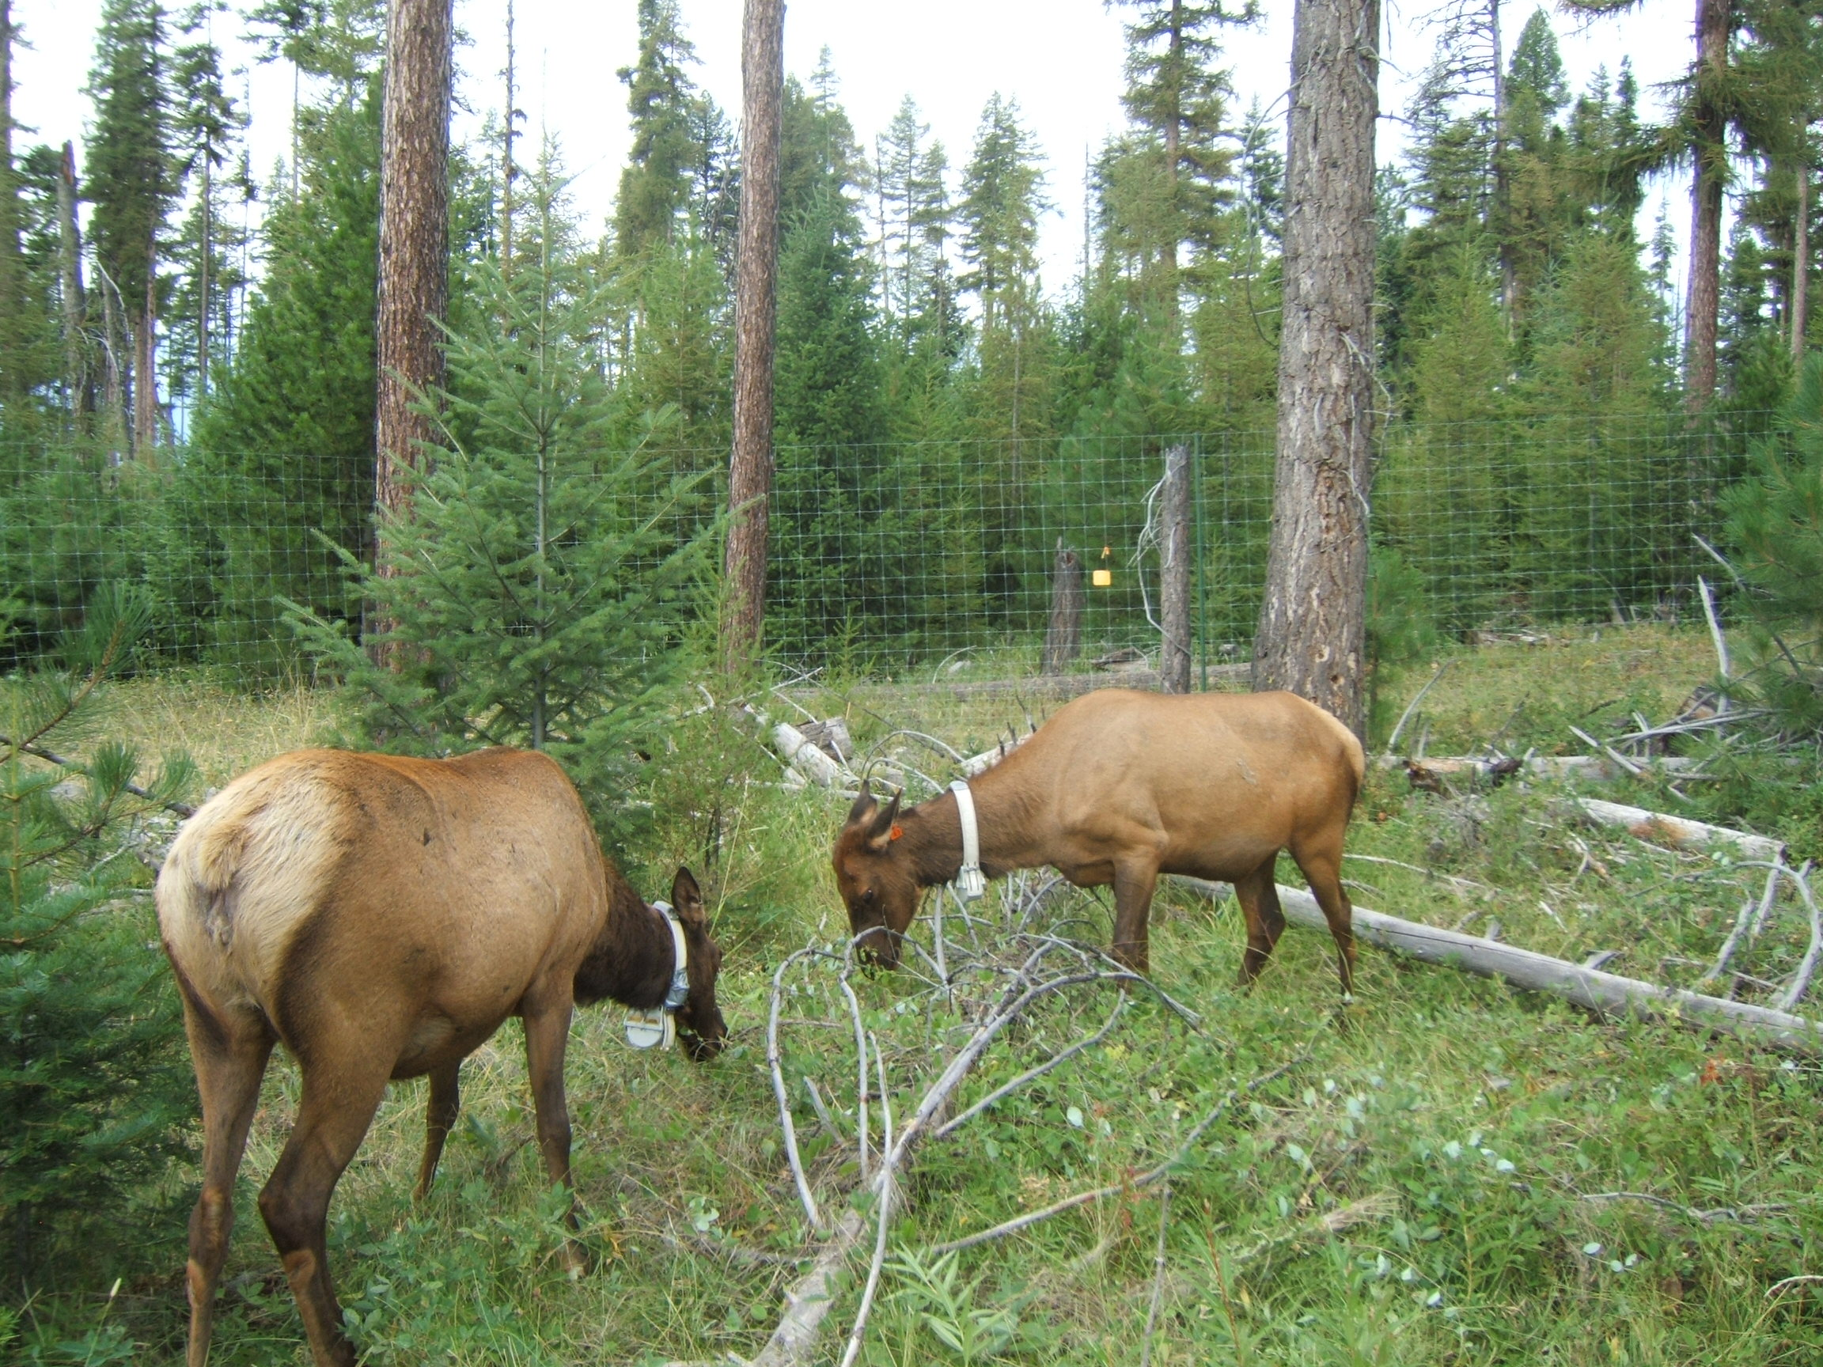
Relating Grazing Effects to Multiple Responses:
CHaMP salmonid habitat surveys
--over 100 stream & riparian metrics
Multiple Indicator Monitoring (MIM) surveys
  --greenline monitoring of stubble heights, streambank alteration
Vegetation transects
--herbivory effects on riparian plantings and on long-term vegetation

Slide 30
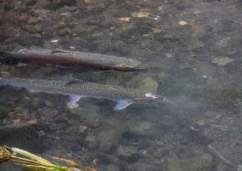
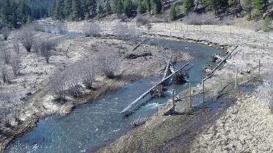


“While many of these changes in grazing management may seem impractical, their practicality and benefits remain untested across large landscapes at operational scales of livestock management.”

Slide 31
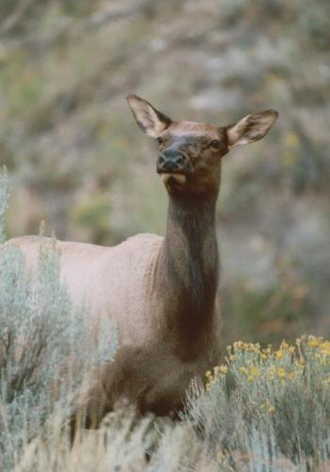
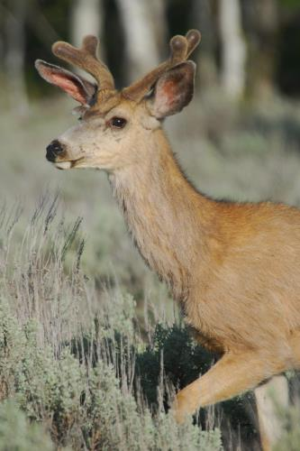
Survival of deciduous shrubs
Percentage (%)

Slide 32
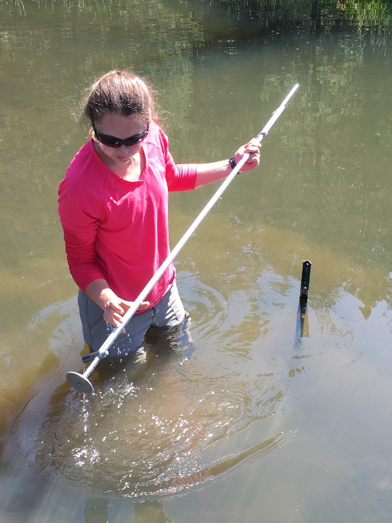
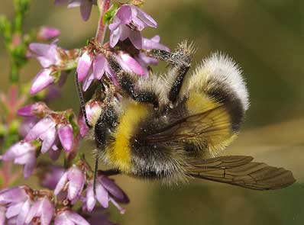
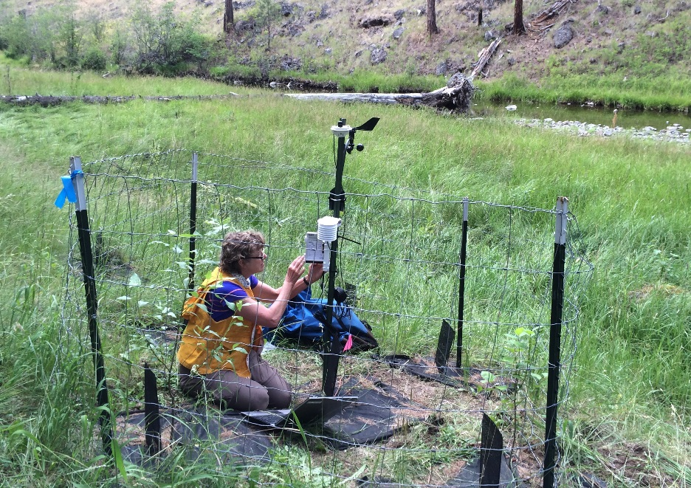
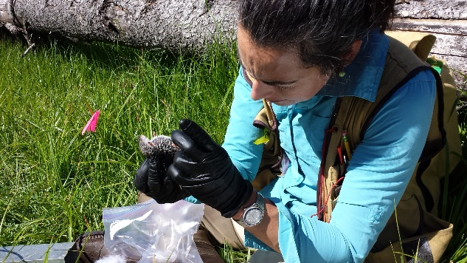
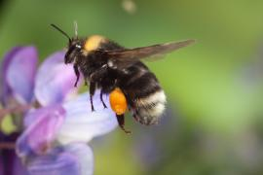
Additional Responses to Restoration
Native bee and small mammal abundance & diversity
Hydrologic regime
Stream temperature-climate change-restoration interactions
  Build on Wondzell work in Middle Fork John Day

Slide 33
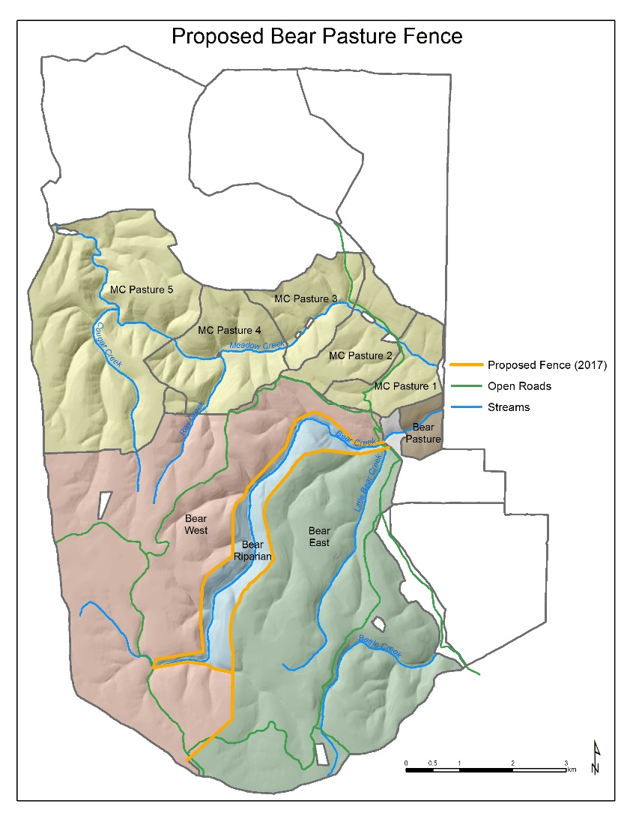
Bear Creek Riparian Fencing Proposal:
Address terms & conditions for recovery of threatened steelhead
Part of deferred rotational grazing system in Starkey Allotment
Partition large Bear pasture into east and west portions
Add riparian pasture with gates
Allow for strategic seasonal use of riparian area as appropriate
Meet new stubble height standards
Different riparian grazing approach for testing in contrast to Meadow Creek approach

Slide 34

Meadow Creek Timeline
Deferred Rotation
Grazing →
v
Wild Ungulate Grazing Research →
Small Mammal, Pollinators, other Terrestrial Research →
Riparian Monitoring (Browsing, Plant Survival) →
Juvenile and Adult Steelhead Monitoring →
Stream Habitat Monitoring (CHaMP)
Stream Assessment
Restoration (LWD, Fencing, Planting)
2011
2013
2014
2015
2016
2017+
2012

Slide 35
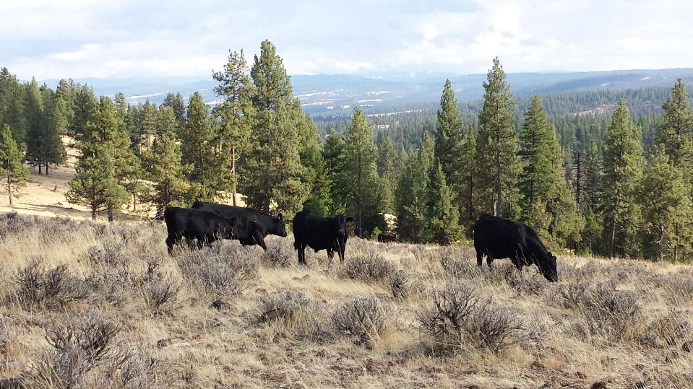
Questions?

Slide 36
Partners in Meadow Creek Restoration Experiment
Forest Service Pacific Northwest Research Station—coordinate overall development and implementation of restoration experiment among partners.
Wallowa-Whitman National Forest, La Grande Ranger District—designed and implemented the stream and riparian restoration activities.
Bonneville Power Administration--funded stream and riparian restoration activities, including livestock fencing ad upland water developments.
Grande Ronde Model Watershed—coordinated the programs of funding and multi-partner implementation of restoration work.
Oregon Department of Fish and Wildlife—measuring long-term salmonid habitat and population responses with Columbia Habitat Monitoring (CHaMP) surveys, spawning counts, and snorkeling surveys for juveniles.
Oregon Watershed Enhancement Board--funded upland water developments and upland water monitoring.

Slide 37
Oregon State University (OSU) Eastern Oregon Agricultural Research Center—design, implementation, monitoring, and research of cattle grazing practices using OSU cattle.
OSU Dept. of Animal and Range Sciences—measuring vegetation and cattle performance responses to restoration treatments.
OSU Dept. of Fisheries and Wildlife—measuring juvenile salmonid food responses and insect pollinator responses to restoration treatments.
Utah State University—empirical stream temperature dynamics and modeling in relation to stream shading under existing and projected restoration.
Forest Service National Stream and Aquatic Ecology Center--design of cattle grazing practices and their integration with salmonid restoration activities.
Columbia River Inter-Tribal Fish Commission—stream temperature changes under long-term scenarios of climate and riparian changes.
Partners in Meadow Creek Restoration Experiment

Slide 38
