Slide 1
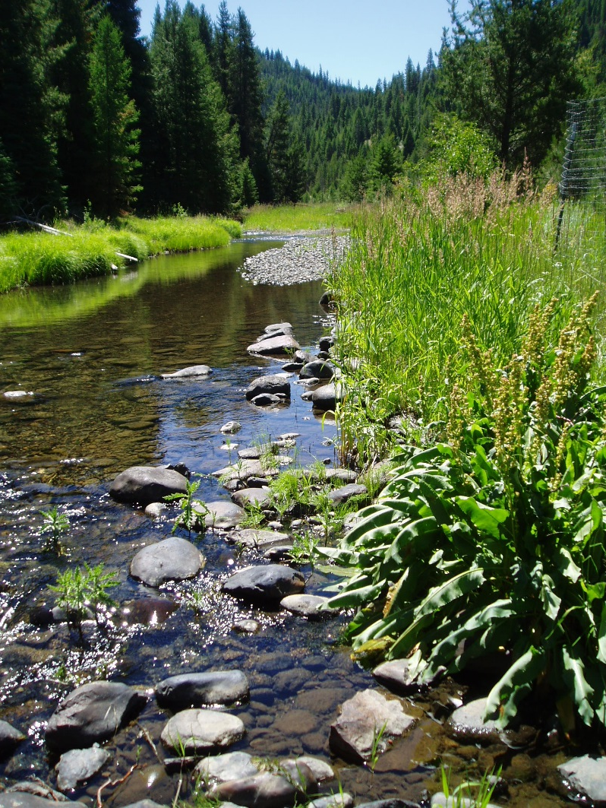
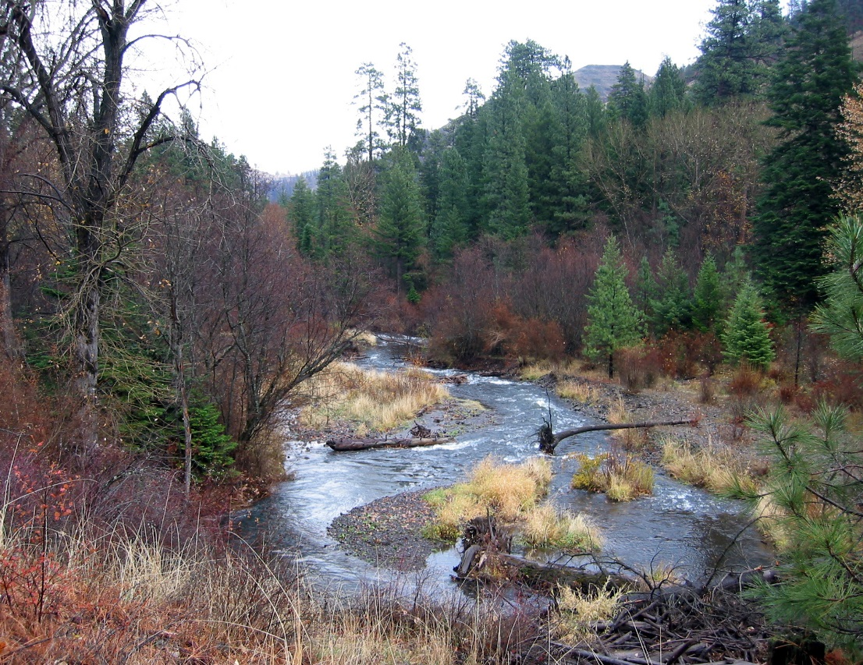
Riparian Management
(Successes/Challenges in ESA Consultation)

Slide 2
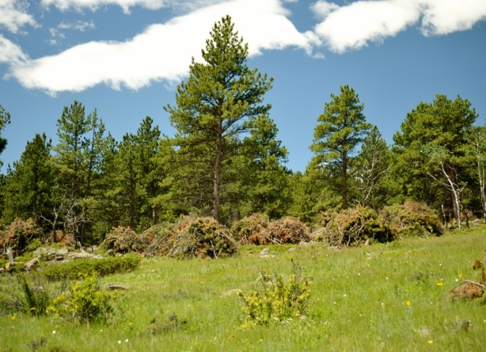
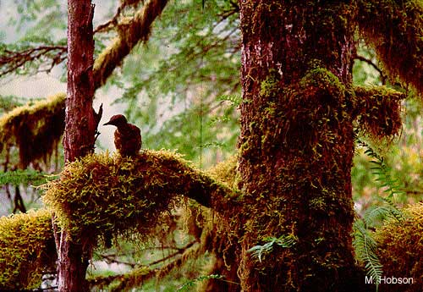
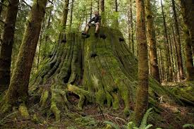
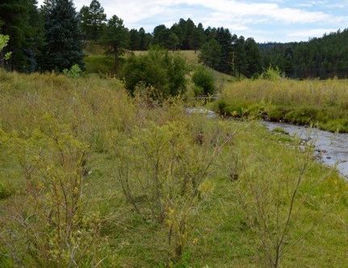
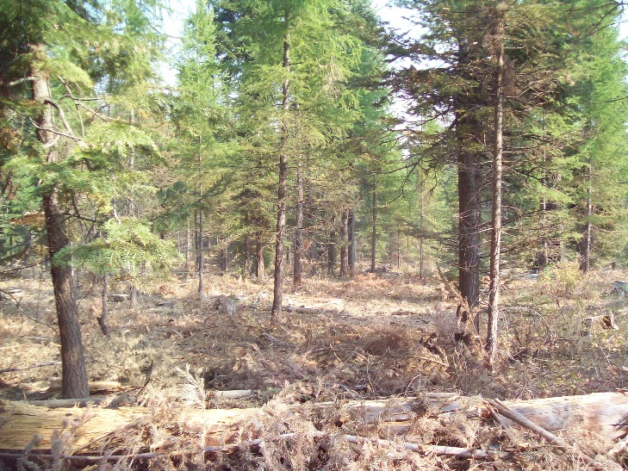
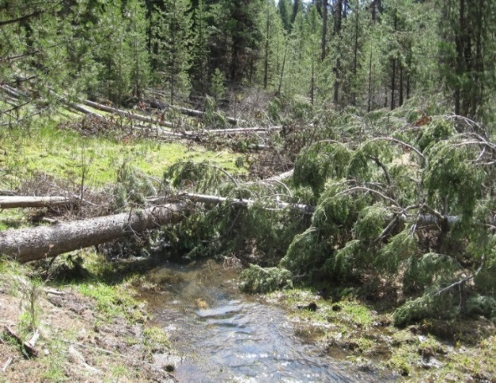
Desired Outcomes
Meadow Conifer Encroachment
Increase Larger Conifers
  Canopy for MAMU/NSO Habitat
Increase Instream Wood
Restore Hardwoods
Reduce Fuel Loading

Slide 3
Let’s Get to Work!
Budget and Staffing Constraints
ESA Consultation
Department and Agency Policies
Conservation Strategies
Reduce Fuel Loading
Public Desires
NEPA

Slide 4
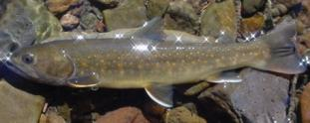
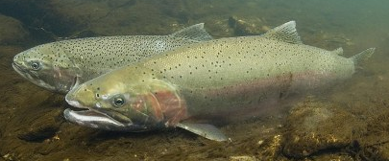
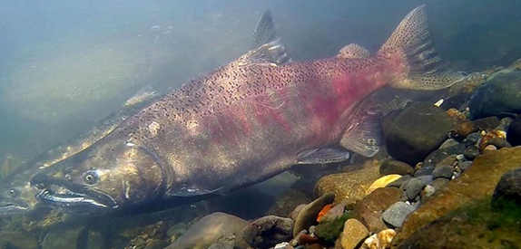
Endangered Species Act
  Section 9 – prohibits taking of listed fish and wildlife species.
    “Take” - “to harass, harm, pursue, hunt, shoot, wound, kill, trap, capture, or collect or to attempt to engage in any such conduct”.
    “Harm” - any action that “significantly modifies or degrades habitat that results in the death or injury of a listed species by significantly impairing essential behavior including breeding, feeding or sheltering.”
  Section 10 - provides exceptions to section 9 take prohibitions.
  Section 7 - Federal agencies must consult whenever an authorized action is likely to affect a listed species or its critical habitat. Consultations provide incidental take (e.g. not the purpose of carrying out lawful activity) permits.
  Biological Opinions includes reasonable and prudent measures, with non-discretionary terms & conditions to minimize take.

Slide 5


Streamlined ESA Consultation
Enhance interagency cooperation for conserving listed/proposed species and their habitat.
Improve efficiency of consultation process through early Level 1 discussions on proposed action, and preliminary effects.
Reduce conflicts between listed species and proposed actions.
Complete consultation within reasonable timeframes.
Resolve technical and policy issues using an interagency approach.

Slide 6
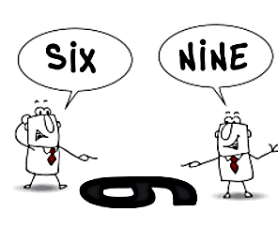
NW Oregon Riparian Reserve Tree Thinning Elevation
2010 - Disagreement on best available science on the effects of riparian thinning on wood recruitment and stream temperature to listed fish.
This was elevated to the Regional Executive Team.

Slide 7
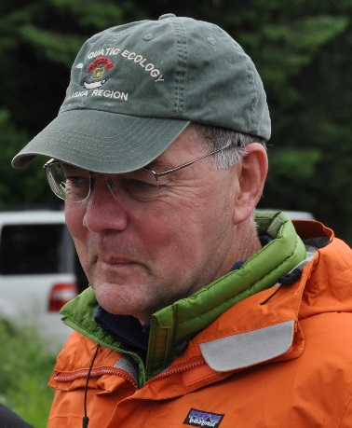

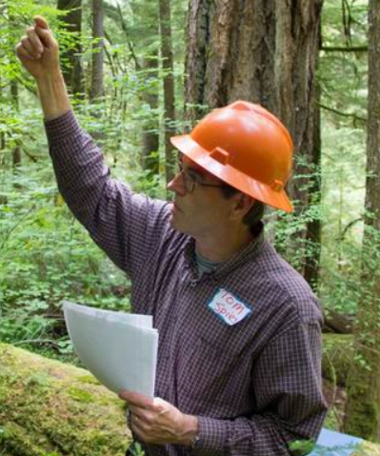
Science Review Team
  Dr. Michael Pollock and Dr. Tim Beechie, NMFS
  Dr. Gordie Reeves and Dr. Tom Spies, USFS PNW lab
  Dr. Christian Torgersen, USGS
  George McFadden, BLM
  Dr. Peter Leinenbach, EPA
  Dr. Robert Anthony, FWS
  Information Sources
  Published information
  Unpublished data/model results
  New data interpretation
  Best professional judgment

Slide 8
Key Findings
Thinning is most beneficial in dense young stands <80 years and less clear in older stands.
Thinning accelerates the development of older forest structure (e.g. large trees, spatial structural, etc.).
95% of wood recruitment comes from within 82-148’ of a stream. Distance varies with forest conditions and geomorphology.
Thinning must be placed in a watershed context.
Riparian management practices need to address ecological stream functions.
Thinning variation is essential to mimic natural forest conditions.

Slide 9
Lower Joseph Creek Restoration Project
Intermittent Streams - Thinning to reduce stocking densities and disease/insect risks, and produce larger trees for stream shade and recruitment.
25’ variable no treatment buffer. Slash piled by hand and burned. Backing prescribed fire to reduce fire intensity and fuel loading.
Swamp Creek (fish bearing) - Remove meadow conifer encroachment and retaining trees over 15” dbh for shade.
Intermittent Stream Effects
Streams dry by mid-June and no overstory trees removed within RHCAs so no summer stream temperature increase.
Low fire intensity having little effect on riparian stream shade.
Sediment yield very low due to minimal ground disturbance.

Slide 10
Lower Joseph Creek Restoration Project
(NMFS Conclusions)
Thinning and smaller riparian buffers will impact snowpack accumulation causing faster snow melt leading to increased water temperatures from increased runoff and decreased groundwater.
Buffer widths of ≥66 feet are sufficient to keep stream temperatures within 2°C of fully forested watersheds; but widths of 100 feet or more are needed to prevent temperature increases.
LWD is important for maintaining transient storage for hyporheic flow to perennial streams for cold water steelhead refugia. Any LWD reduction will lead to increased downstream water temperatures.
Terms and Conditions
150-foot no-entry buffer to protect stream temperature and LWD recruitment in Swamp Cr.
50-foot no-entry buffer and retain a minimum of 40% canopy between 50-100’ to minimize steelhead effects from water temperature and LWD.

Slide 11
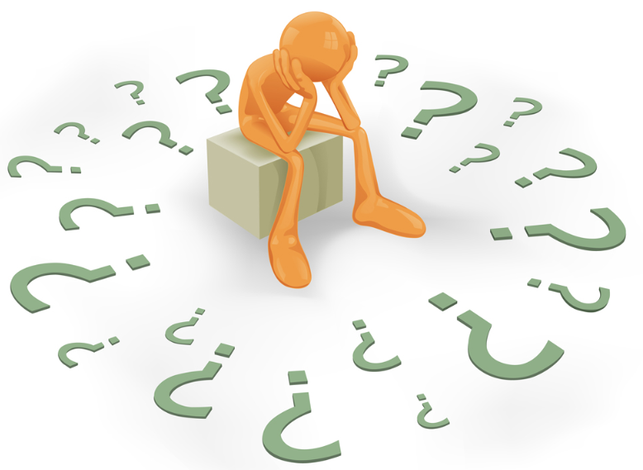
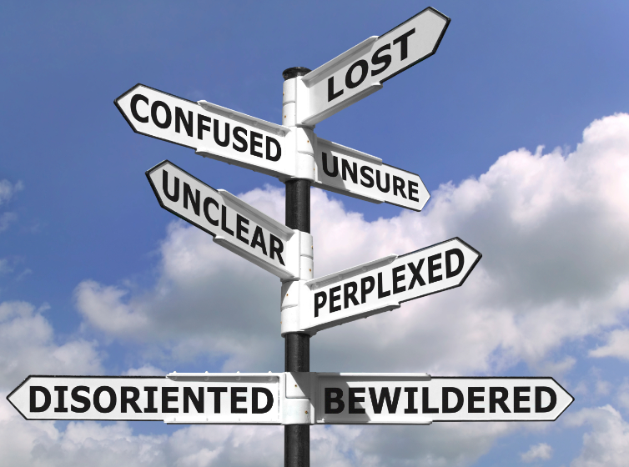
Lower Joseph Creek Restoration Project
NMFS BO Conclusion - Action will increase stream temperatures and decrease LWD reducing juvenile steelhead carrying capacity, fitness and increased downstream mortality.
Draft BA submitted to NMFS on July 21, 2015 and final BO received on June 15, 2016.

Slide 12

Consultation Challenges
Project-level analysis continues to increase even though most projects are designed to minimize effects to listed species and their habitat.
NMFS takes 6-10 months to return letters of concurrence or biological opinions due to internal review, reduced staff, and science disagreements.
Line officers sometimes either:
Design a “No Effect” project to eliminate consultation.
Design an “NLAA” project by enlarging no treatment riparian buffers.
Key Questions
How can we design projects to minimize listed species effects and still achieve restoration objectives?
How can we come to agreement on fundamental science early in the consultation process?
How can we ensure that terms & conditions do not limit our ability to meet the project’s primary purpose?

Slide 13
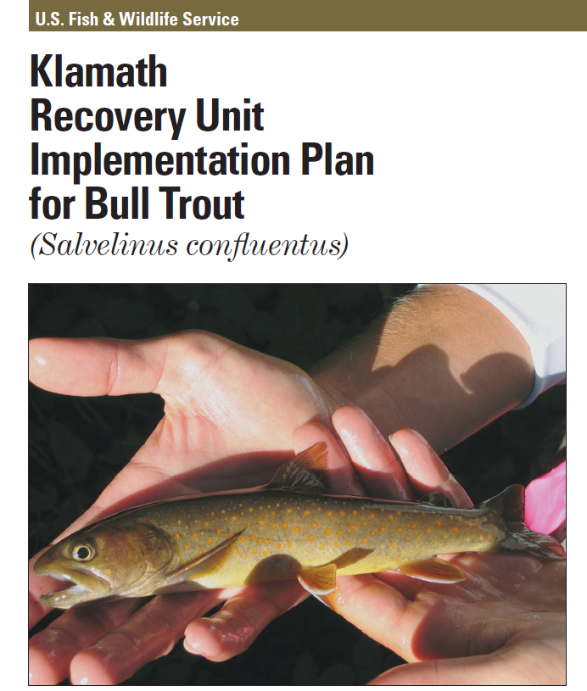
Forest Service Responsibilities
Section 7 (a)(1) - All Federal agencies shall use their authorities by carrying out programs for the conservation of threatened and endangered species.
2672.2 - Management must include actions that protects or contributes to the recovery of federally listed species.
Road map for species recovery. Outlines species threats (high water temperatures, sedimentation) and actions (restore shade, riparian cover) to address them.
No ESA requirements to implement strategy or specific actions. Guidance, not regulatory documents.
Provide context for project development and 7(a)(2) consultations.
Key Questions
How can we best design riparian treatments to recover and conserve TEPS species and their habitat?
How can we ensure treatments intended to move toward ecological desired conditions are not in conflict with recovery plan objectives?

Slide 14
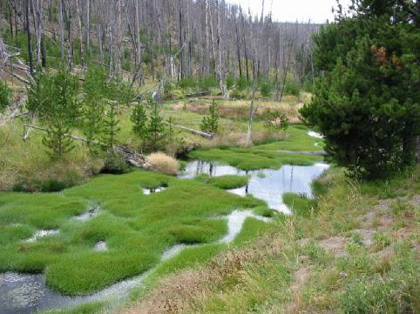
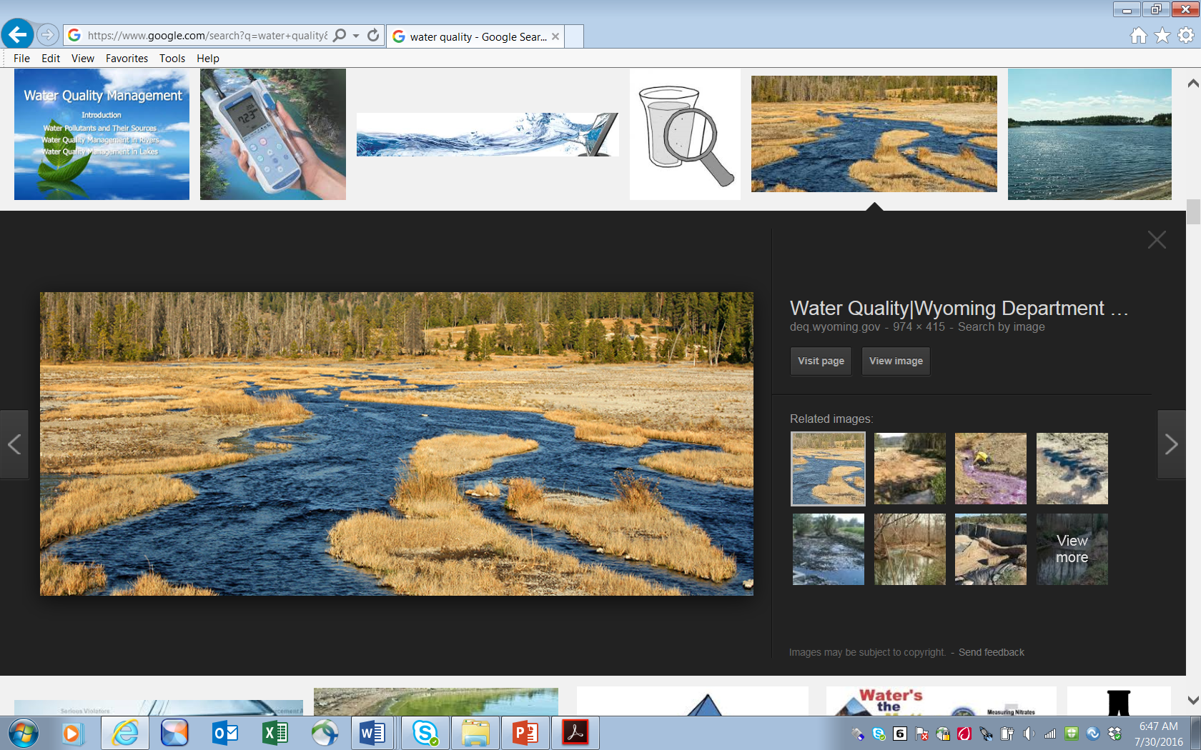
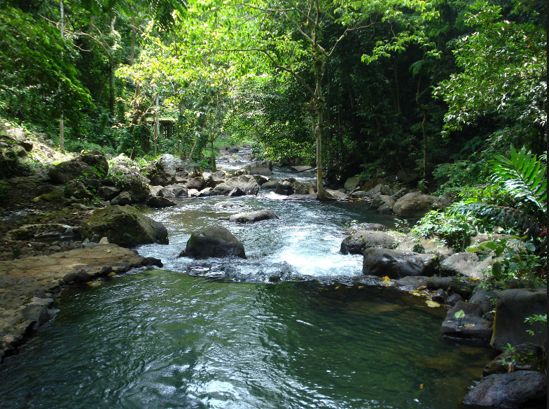
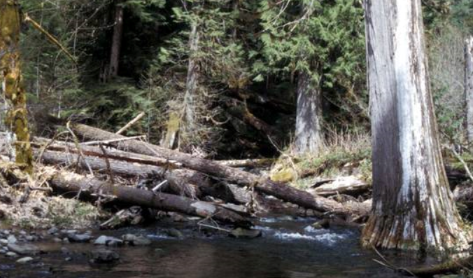
Infish and Pacfish Strategies
RHCAs are areas where riparian-dependent resources receive primary emphasis and management activities are subject to specific standards and guidelines.
Goals establish characteristics of healthy, functioning watersheds, riparian areas, and associated fish habitats. Goals are to maintain or restore:
Water Quality/Instream Flows
Water Table/Plant Communities
Water Temperature
Channel Integrity
Large Wood Debris

Slide 15
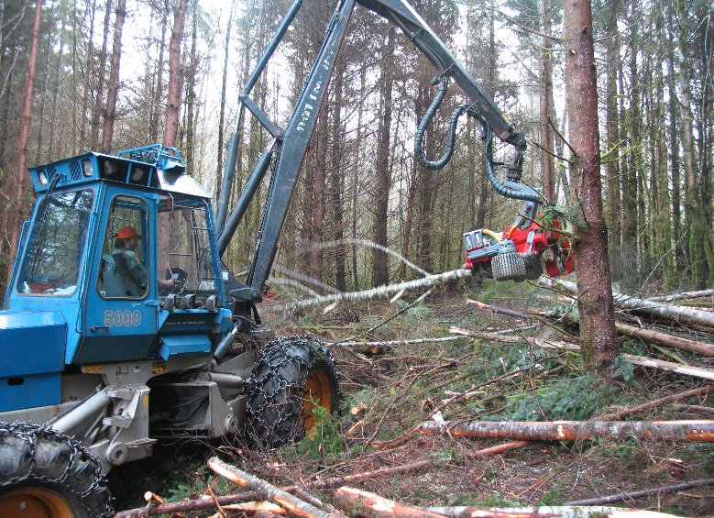
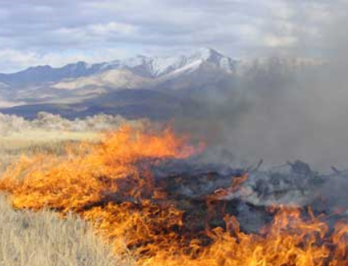
Standards and Guidelines
TM-1 - Prohibit timber harvest, including fuelwood cutting, in RHCAs except:
b. Apply silvicultural practices for RHCAs to acquire desired vegetation characteristics where needed to attain RMOs. Apply silvicultural practices in a manner that does not retard attainment of RMOs and that avoids adverse effects on fish.
FM-1 - Design fuel treatment and fire suppression strategies, practices, and actions so as not to prevent attainment of RMOs and to minimize disturbance of riparian ground cover and vegetation.

Slide 16
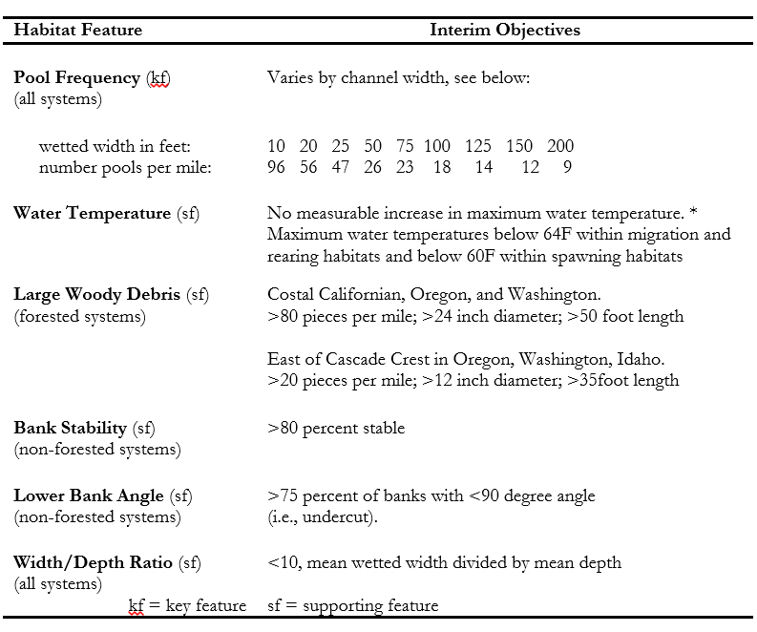
Riparian Management Objectives
RMOs provide criteria against which attainment or progress toward riparian goals are measured.
RMOs provide a benchmark to ensure that management actions maintain or restore habitat conditions.
RMOs provide conditions which land managers strive to achieve as they conduct management activities across the landscape in absence of Watershed Analysis.
Key Questions:
How are we incorporating riparian goals and RMOs into treatment development?
How will and in what timeframe can treatments achieve goals and RMOs?

Slide 17

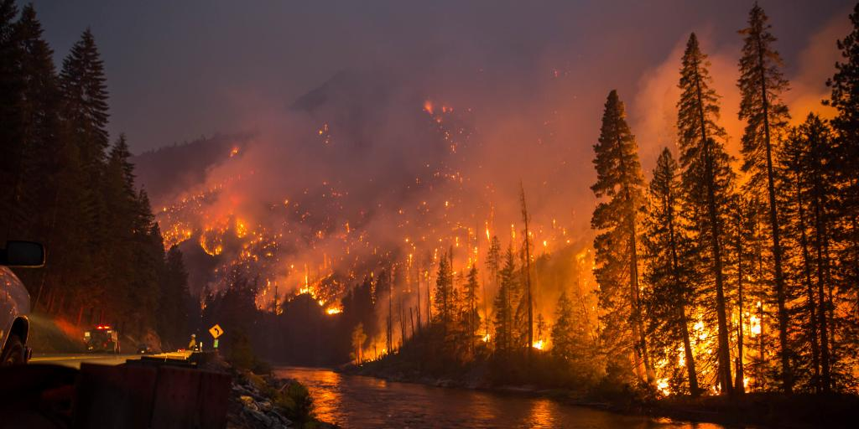
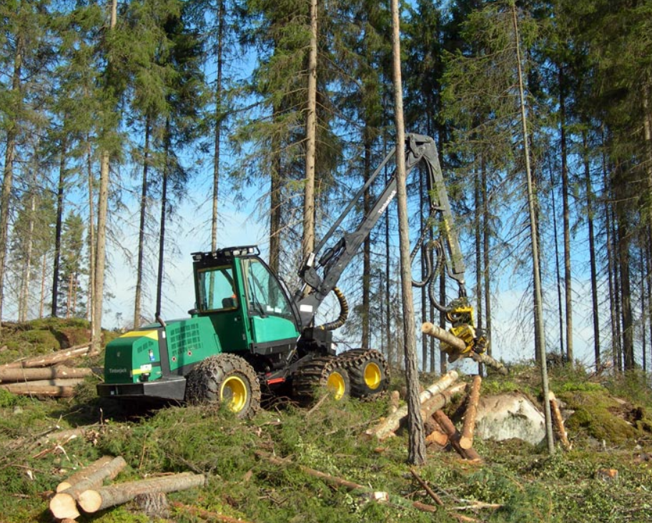
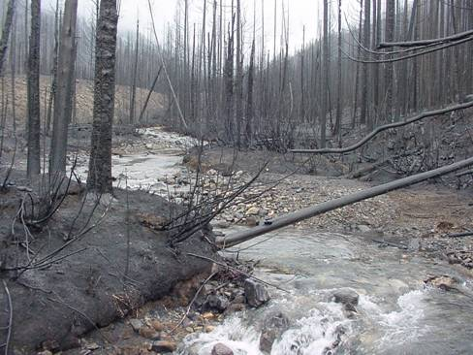
To Manage or Not To Manage?
Key Question - What are the consequences of not treating certain areas and are these consequences acceptable and will these help achieve recovery of listed species?

Slide 18
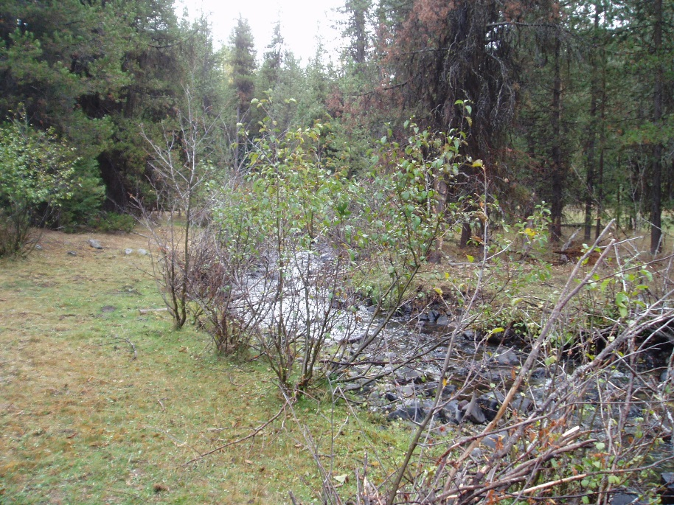
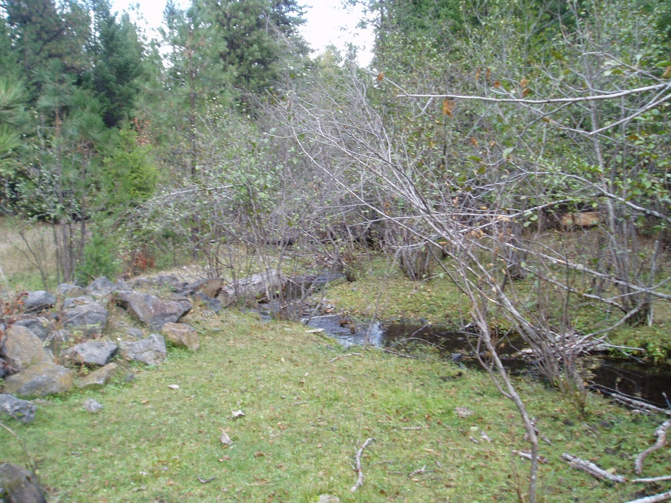
Achieving Desired Outcomes?
Key Questions
What is environmental baseline in relation to riparian goals?
Can treatments achieve desired outcomes in reasonable timeframes?
What monitoring is in place to track our progress?

Slide 19
Conclusions
Project must be designed to:
Consider threats and recovery actions identified in recovery plans.
Contribute to the recovery of listed species.
Manage habitat to maintain viability of native/desired nonnative species.
Ensure riparian-dependent resources receive primary emphasis.
Ensure riparian goals are implemented so watersheds, riparian areas, and fish habitats can be restored.
Ecological conditions and process are considered at multiple scales.
We need to work collaboratively to develop common understandings of best available science, evaluate treatment and non-treatment risks, and develop adaptive management strategies to evaluate projects proposed in RHCAs.

Slide 20
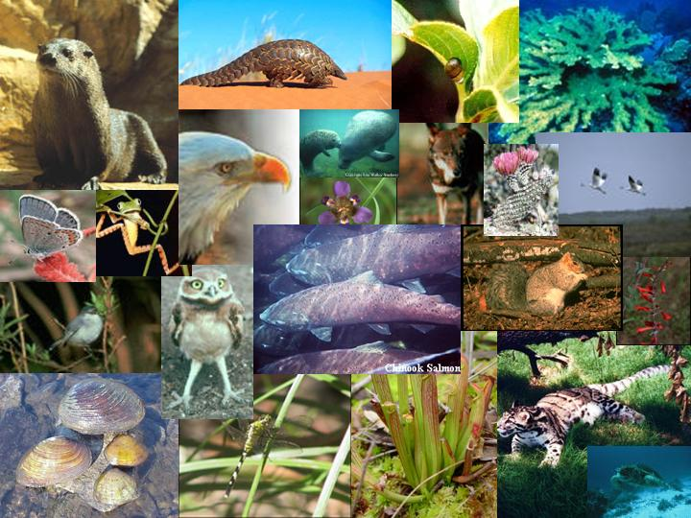
Questions?

