Slide 1
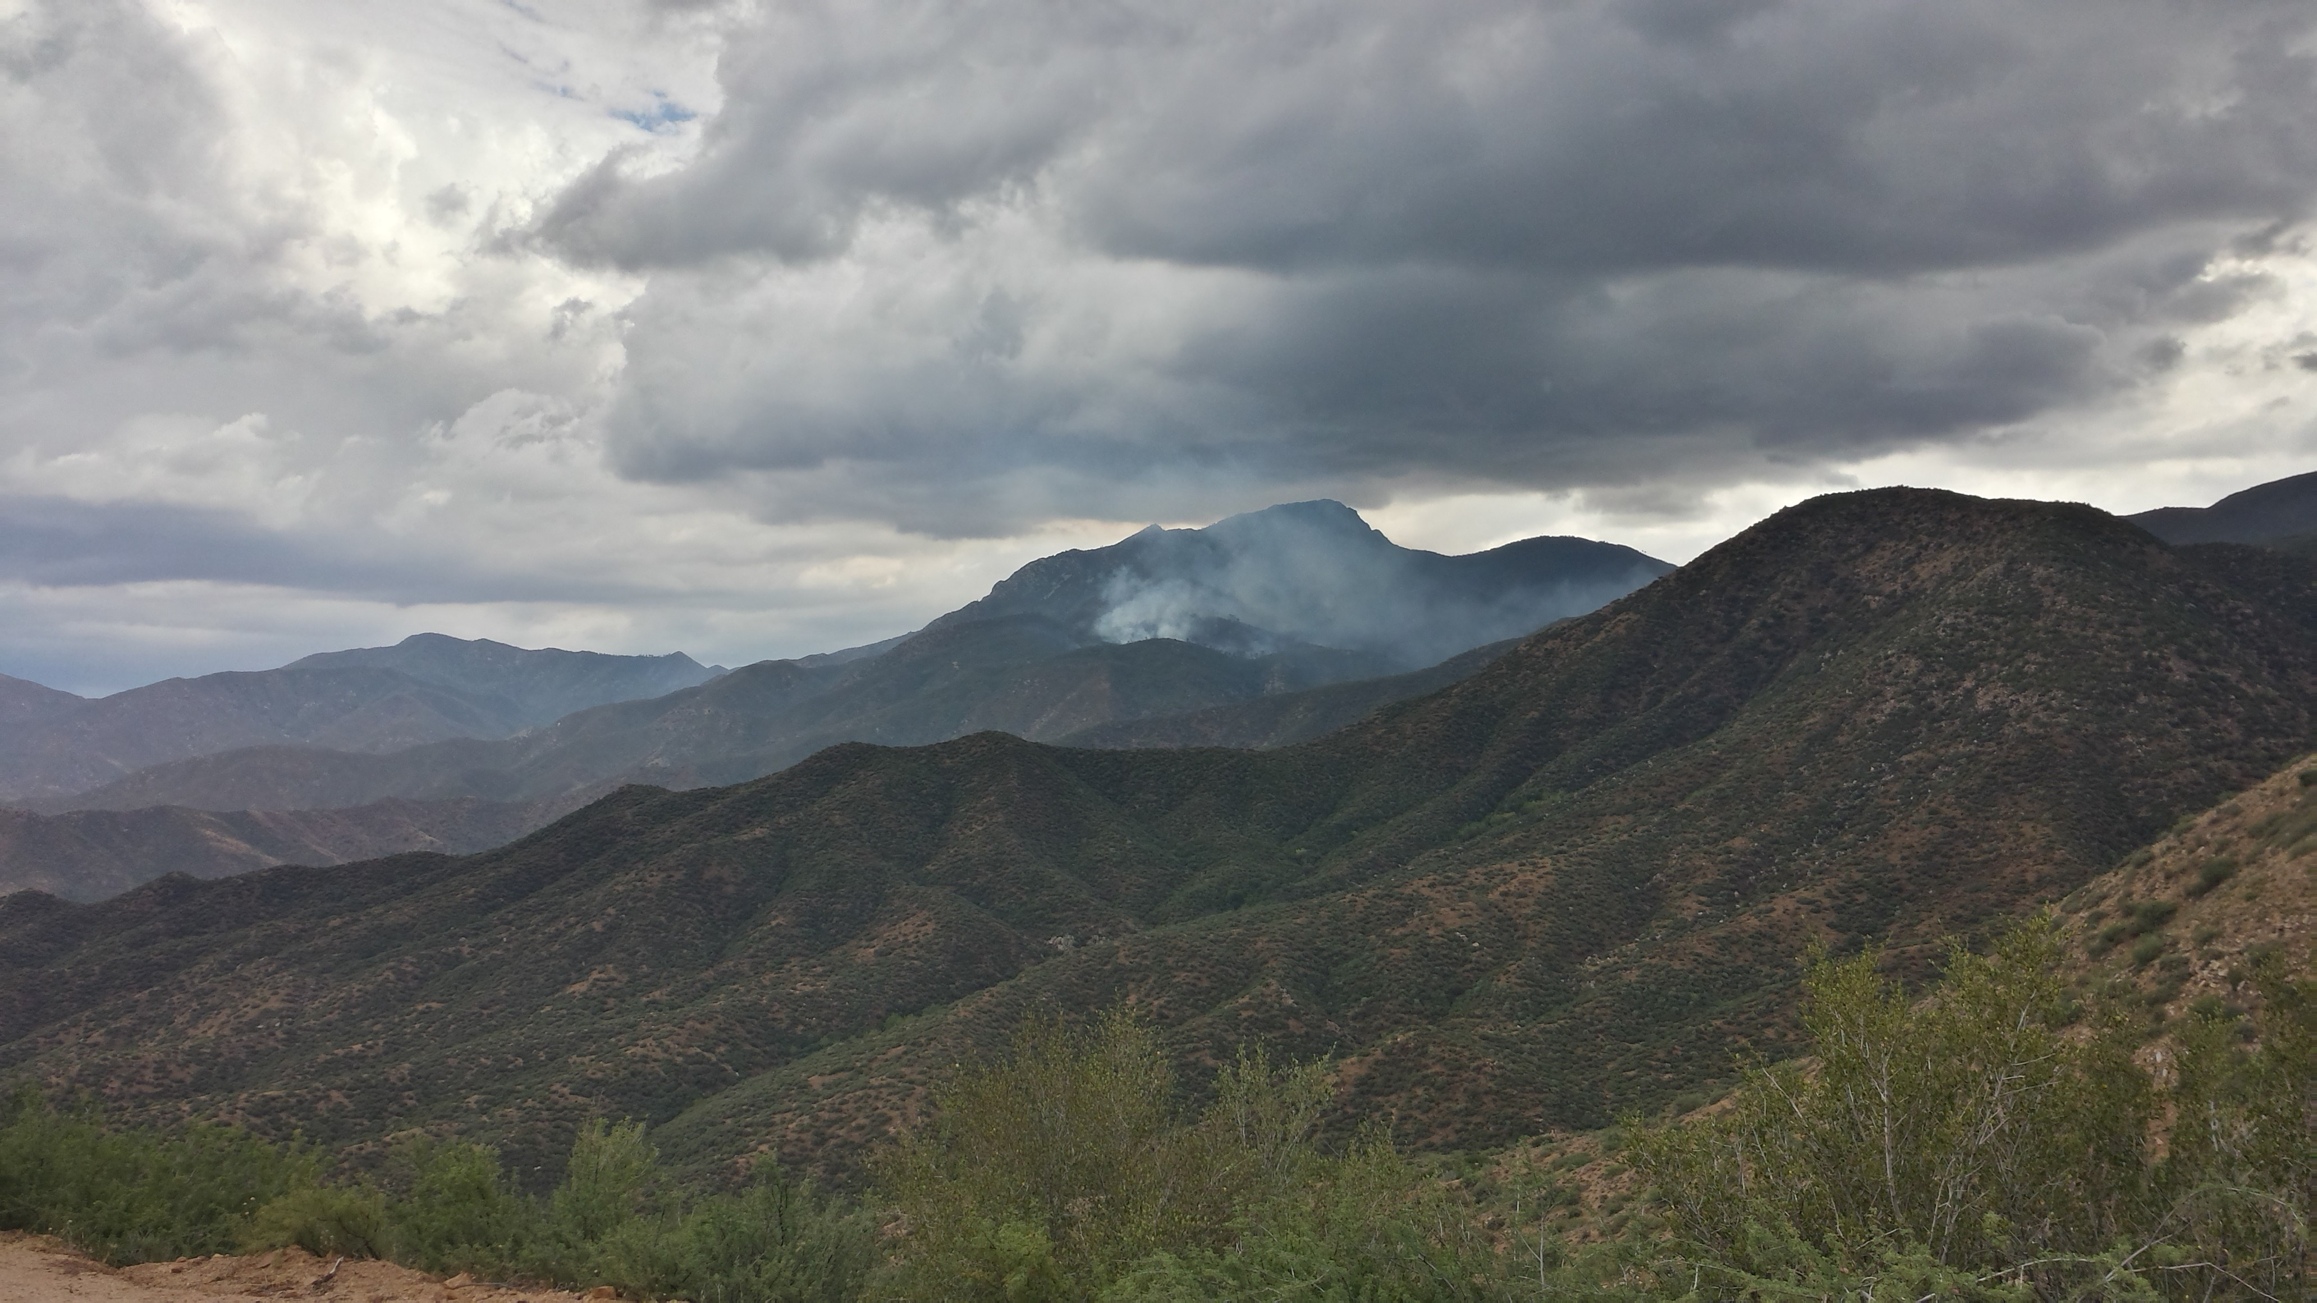
Fire Hazard Index Version 3.0
An easily updatable index to spatially classify the ecological vulnerability to wildland fire
The Fire Hazard Index is not intended to identify risks to infrastructure, structures, cultural sites, recreation values, WUI, or other non-ecological values

Slide 2
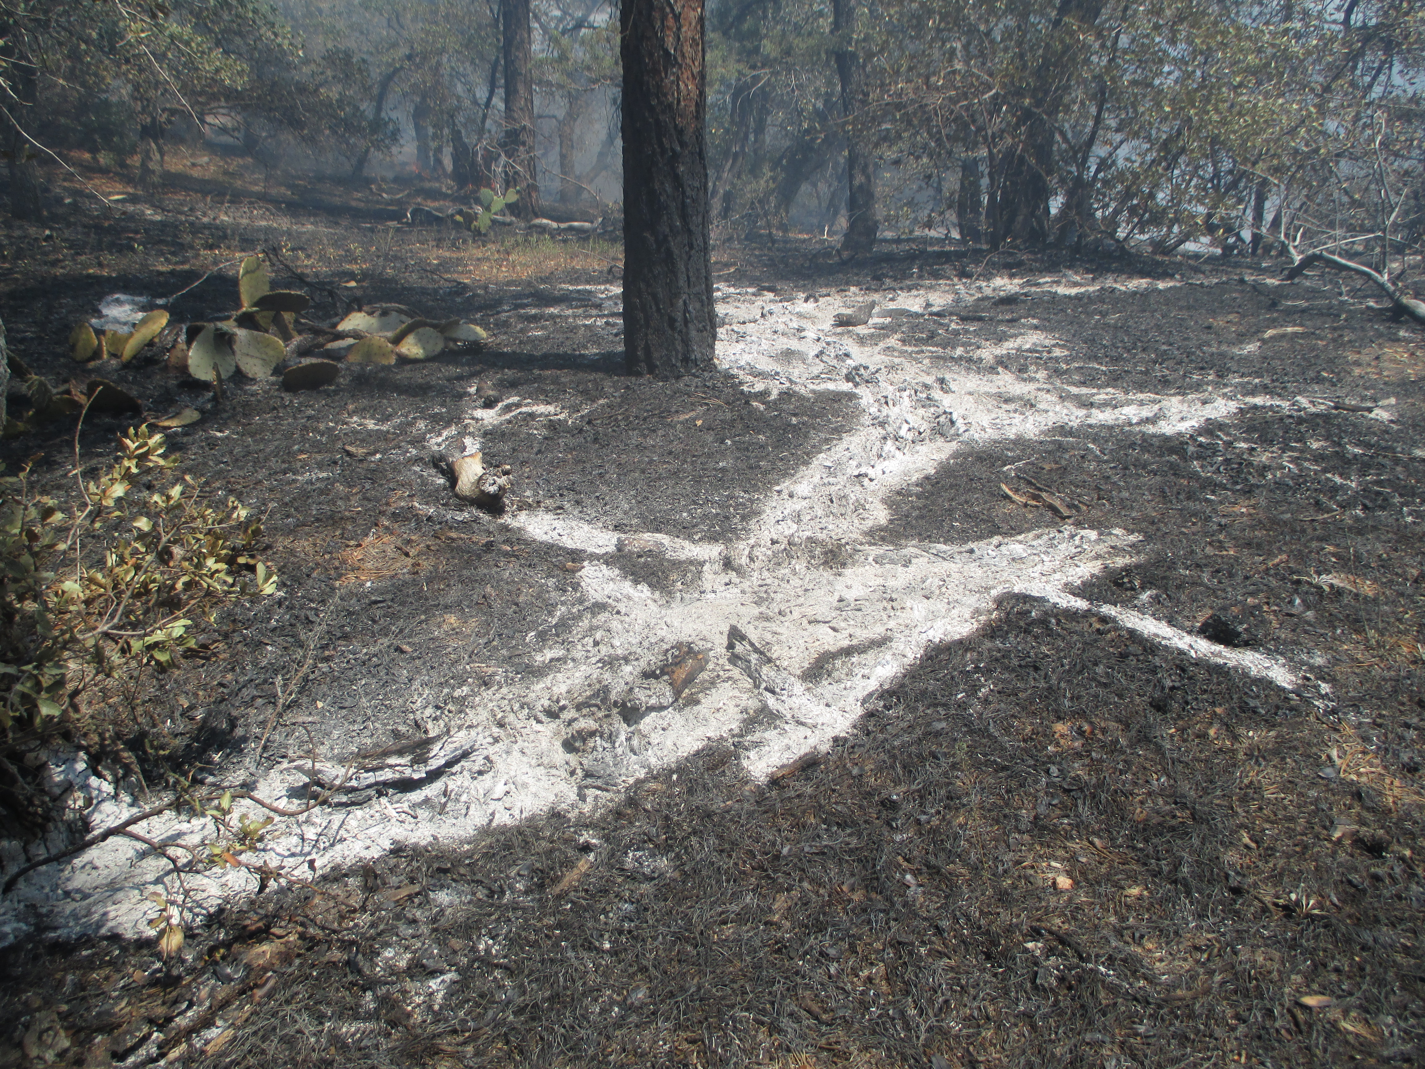
Why?
Need for spatial data to identify ecological vulnerability
Originally the FHI was developed to help assess the risk to PACs in 4FRI
Watershed Restoration Action Plan uses the Watershed Condition Framework (WCF) which, at the time, recommended FRCC…which at that time was actively discouraged and not supported by fire/fuels at the WO
Fire is one of 12 indicators of condition within the WCF
Little Green Valley, East Verde, and Camp Creek
Notes:
The QWRA includes non-ecological values, such as infrastructure, rec, etc.

Slide 3
Why?
Fire Regime / Condition Class (FRCC): original process not supported by the WO, though it did have the benefit of being able to be updated at the forest level
National and Regional Fire Regime / Condition Class layers are sufficiently outdated as to be irrelevant
A Quantitative Wildfire Risk Assessment (QWRA) was done for the TNF in 2016 – 2017, hadn’t been updated though >800,000 acres have burned since then (rx and wf)
QWRA that is a critical component of Potential Operational Delineations (PODS), but the TNF is not a high priority in the region for getting the QWRA revised
QWRA can not be updated at the forest level
Notes:
The QWRA includes non-ecological values, such as infrastructure, rec, etc.

Slide 4
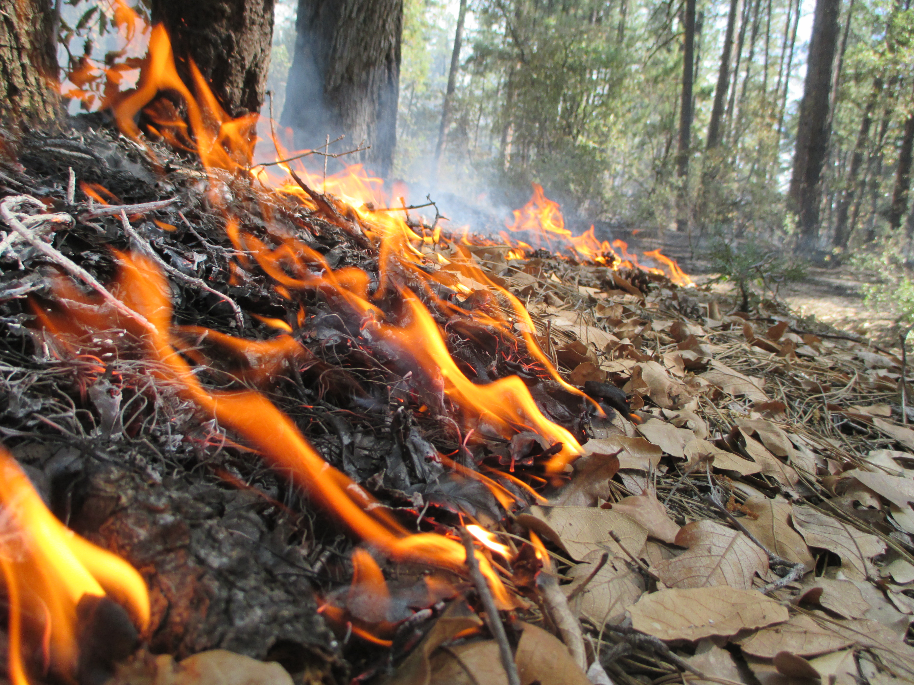
What is the FHI based on?
Focused on soil as a critical and key feature of ecosystems
Focused on the potential effects to soils from the types of fires that are likely to occur in the Southwest in late June.
Metrics facilitate the evaluation of fire effects to soil and to vegetation because:
The potential for soil to erode when vegetation or ground cover decreases or is removed increases (water, wind)
Soil stability or productivity is likely to be adversely affected by first or second order fire effects (heat)

Slide 5
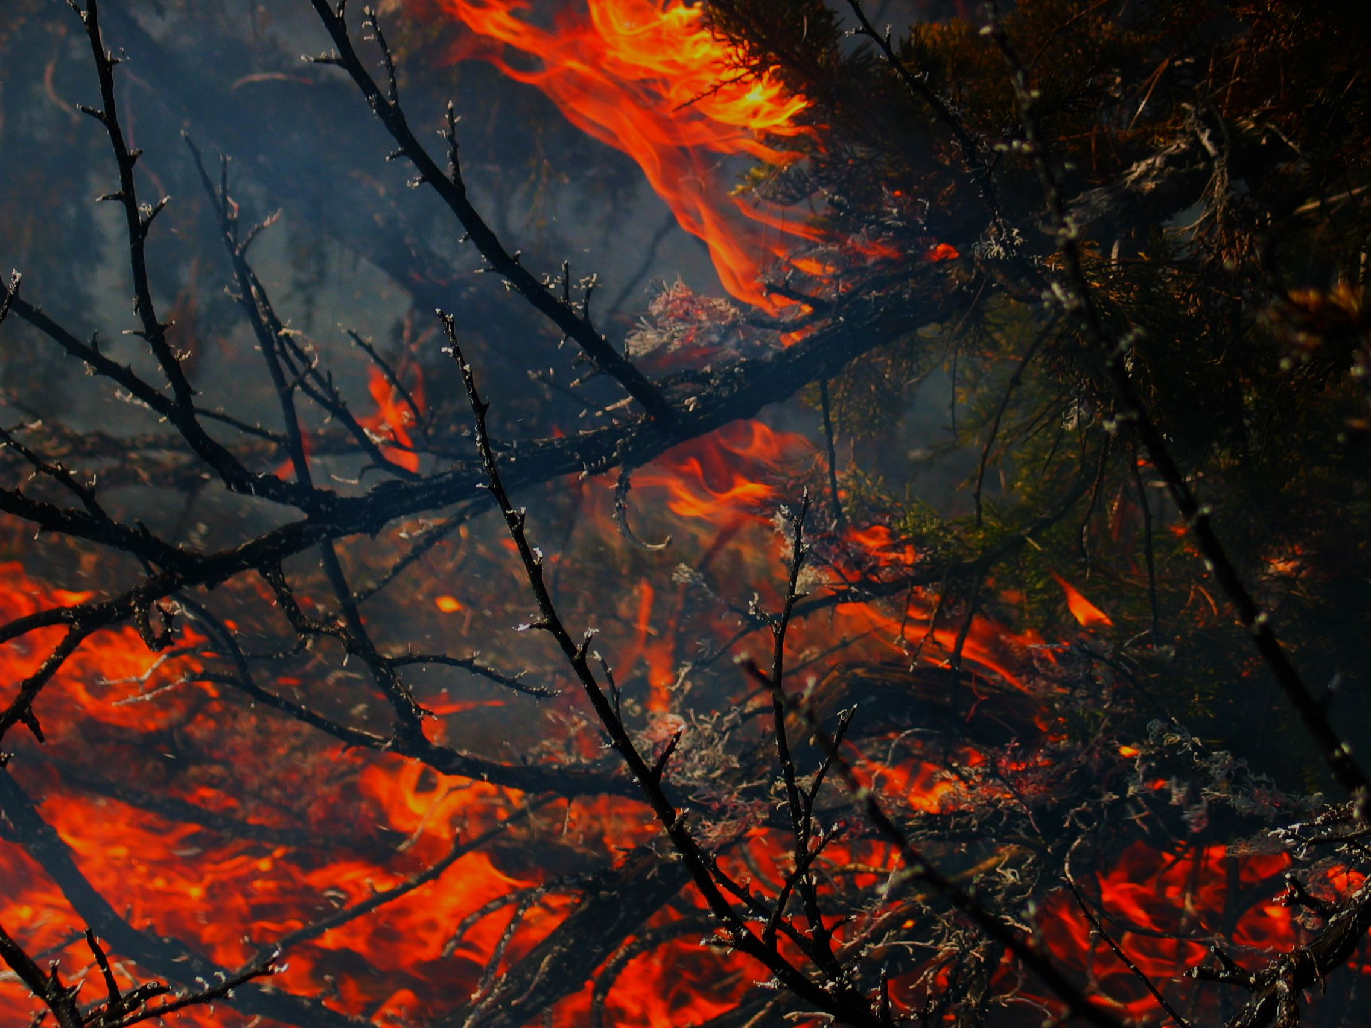
First Order Fire Effects
For the most part, the amount and size of plants and soil biota killed or top-killed by fire increases with:
an increase in the rate of heat energy released (fire intensity which is reflected in flame length)
AND/OR
the or total amount of heat energy released (heat/unit/area).
Notes:
Estimates of the rate and amount of this heat release are thus important descriptors of fire behavior (Wade 2013, Rothermel and Deeming 1980), so two measures of energy were used and are described below.

Slide 6
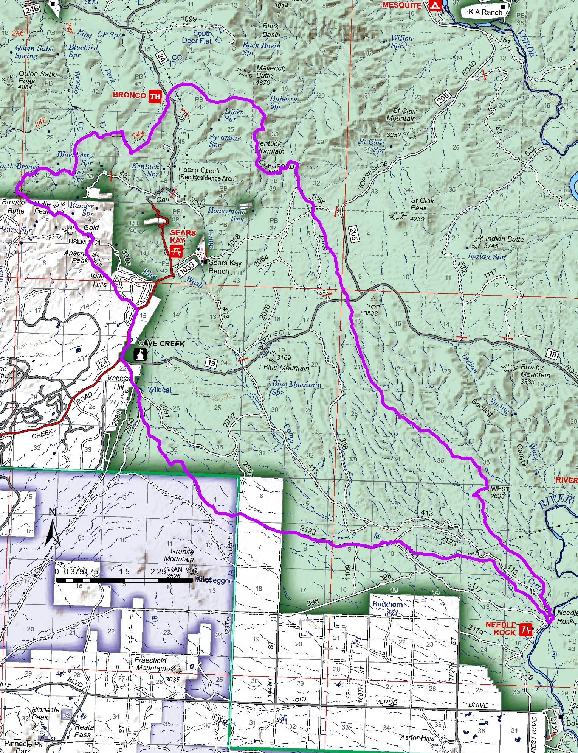
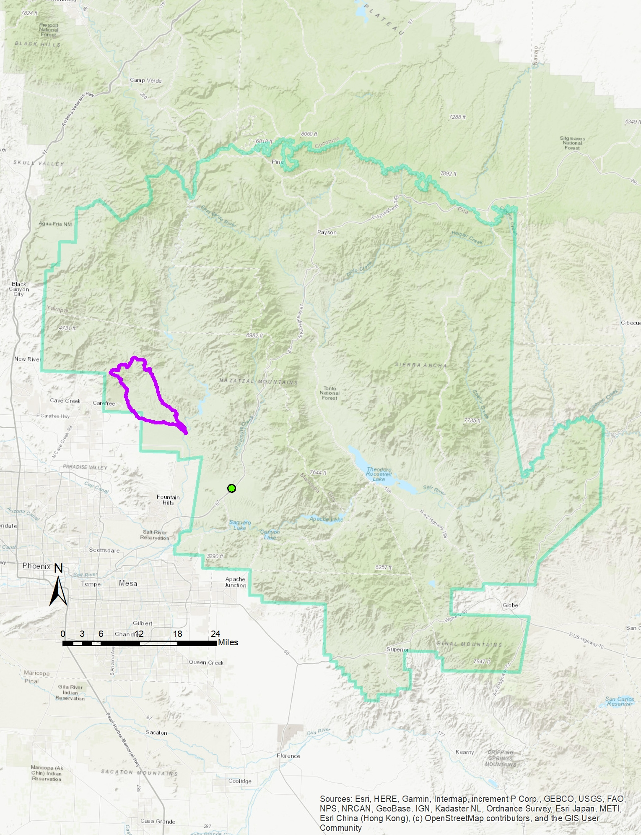
Camp Creek Watershed

Slide 7
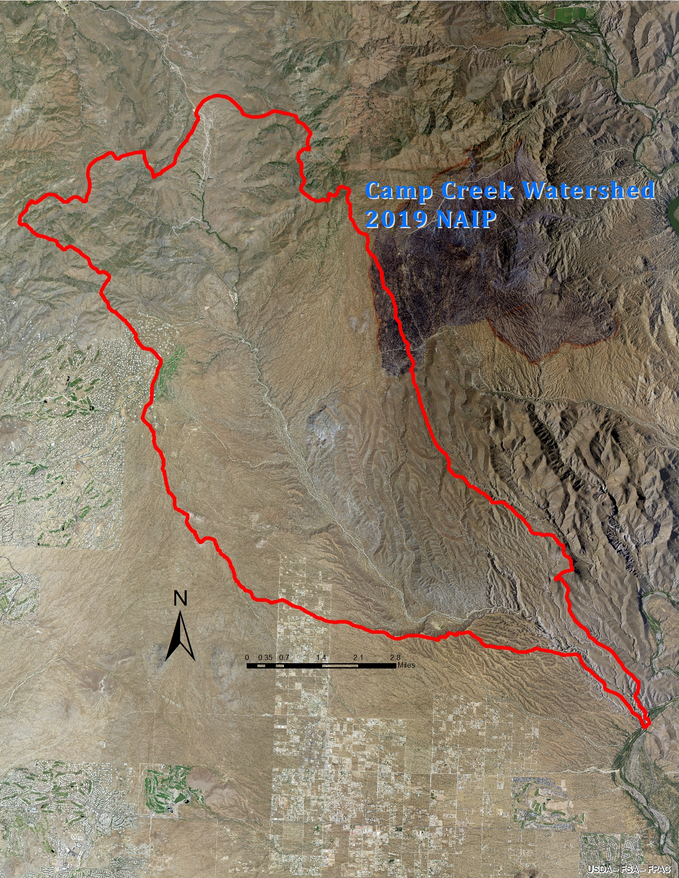
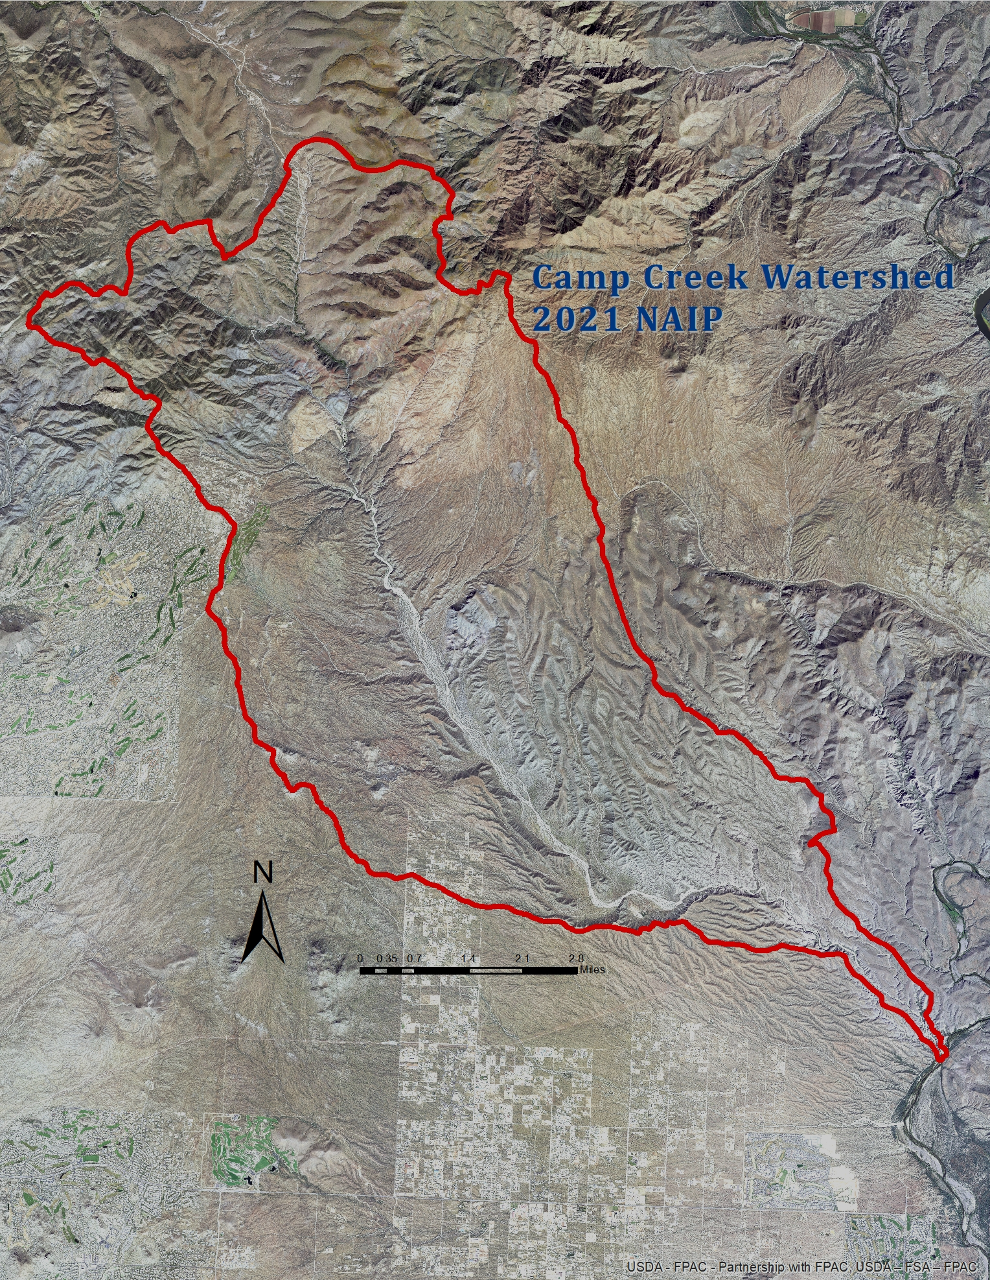
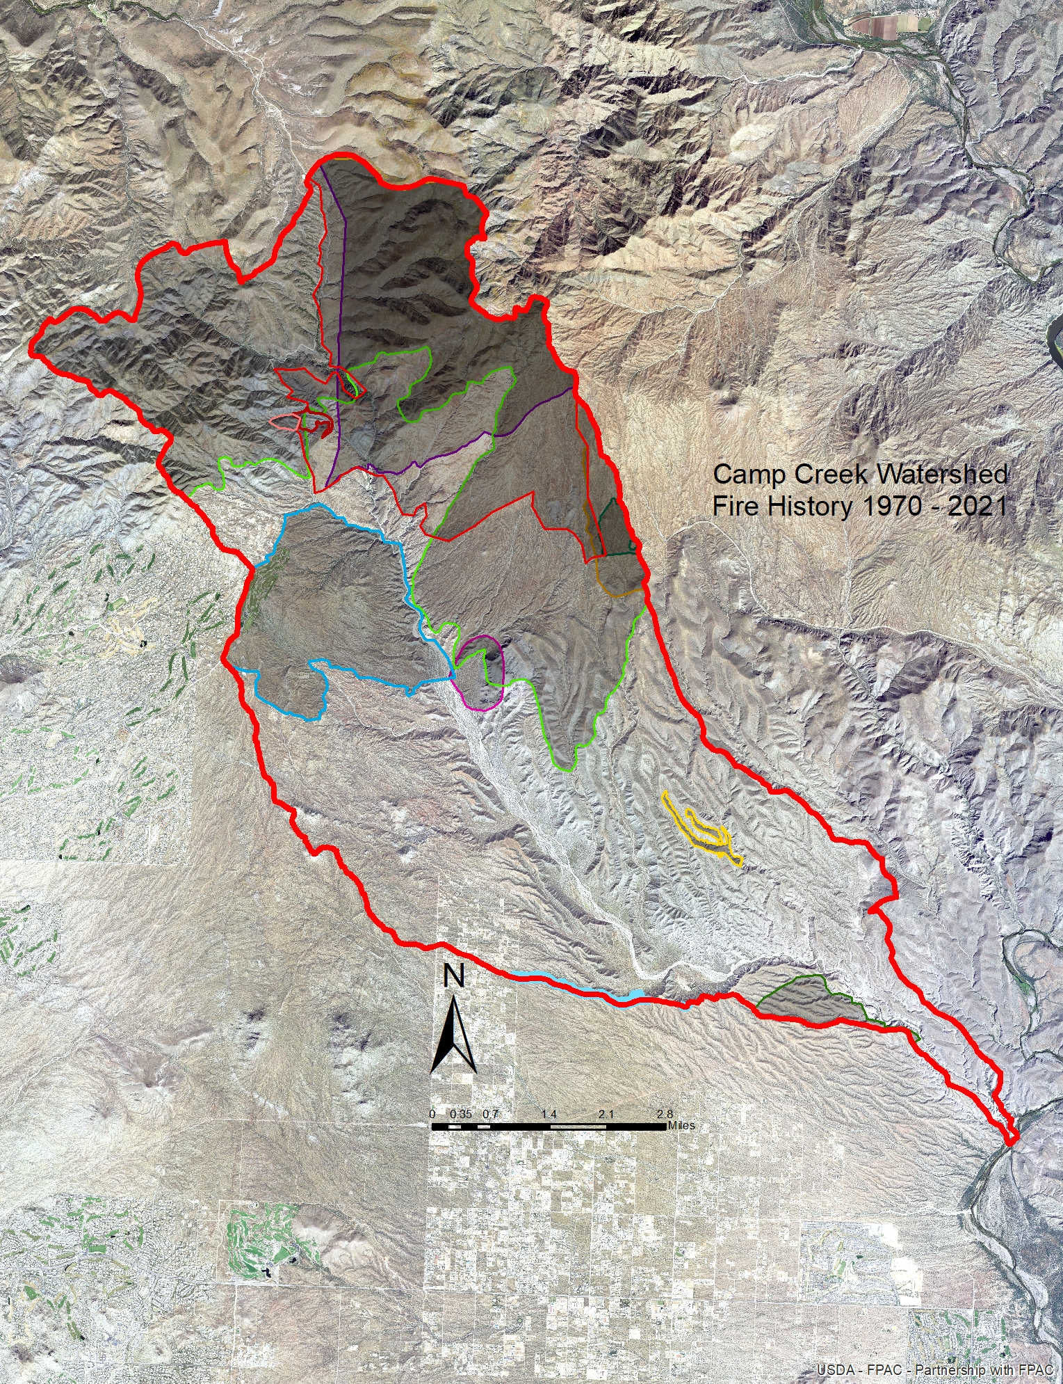
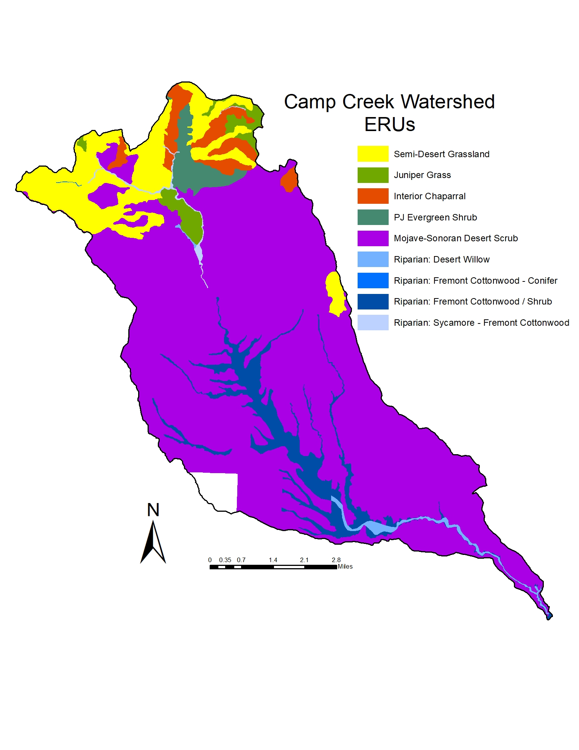
Fire Modeling
Notes:
RAVG, fire history, SBS, INREV, imagery…

Slide 8
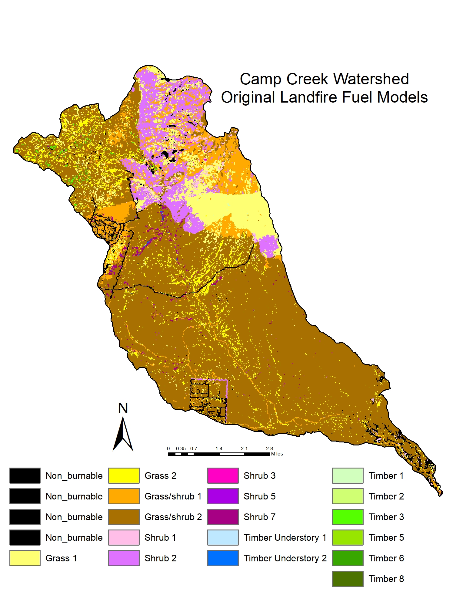
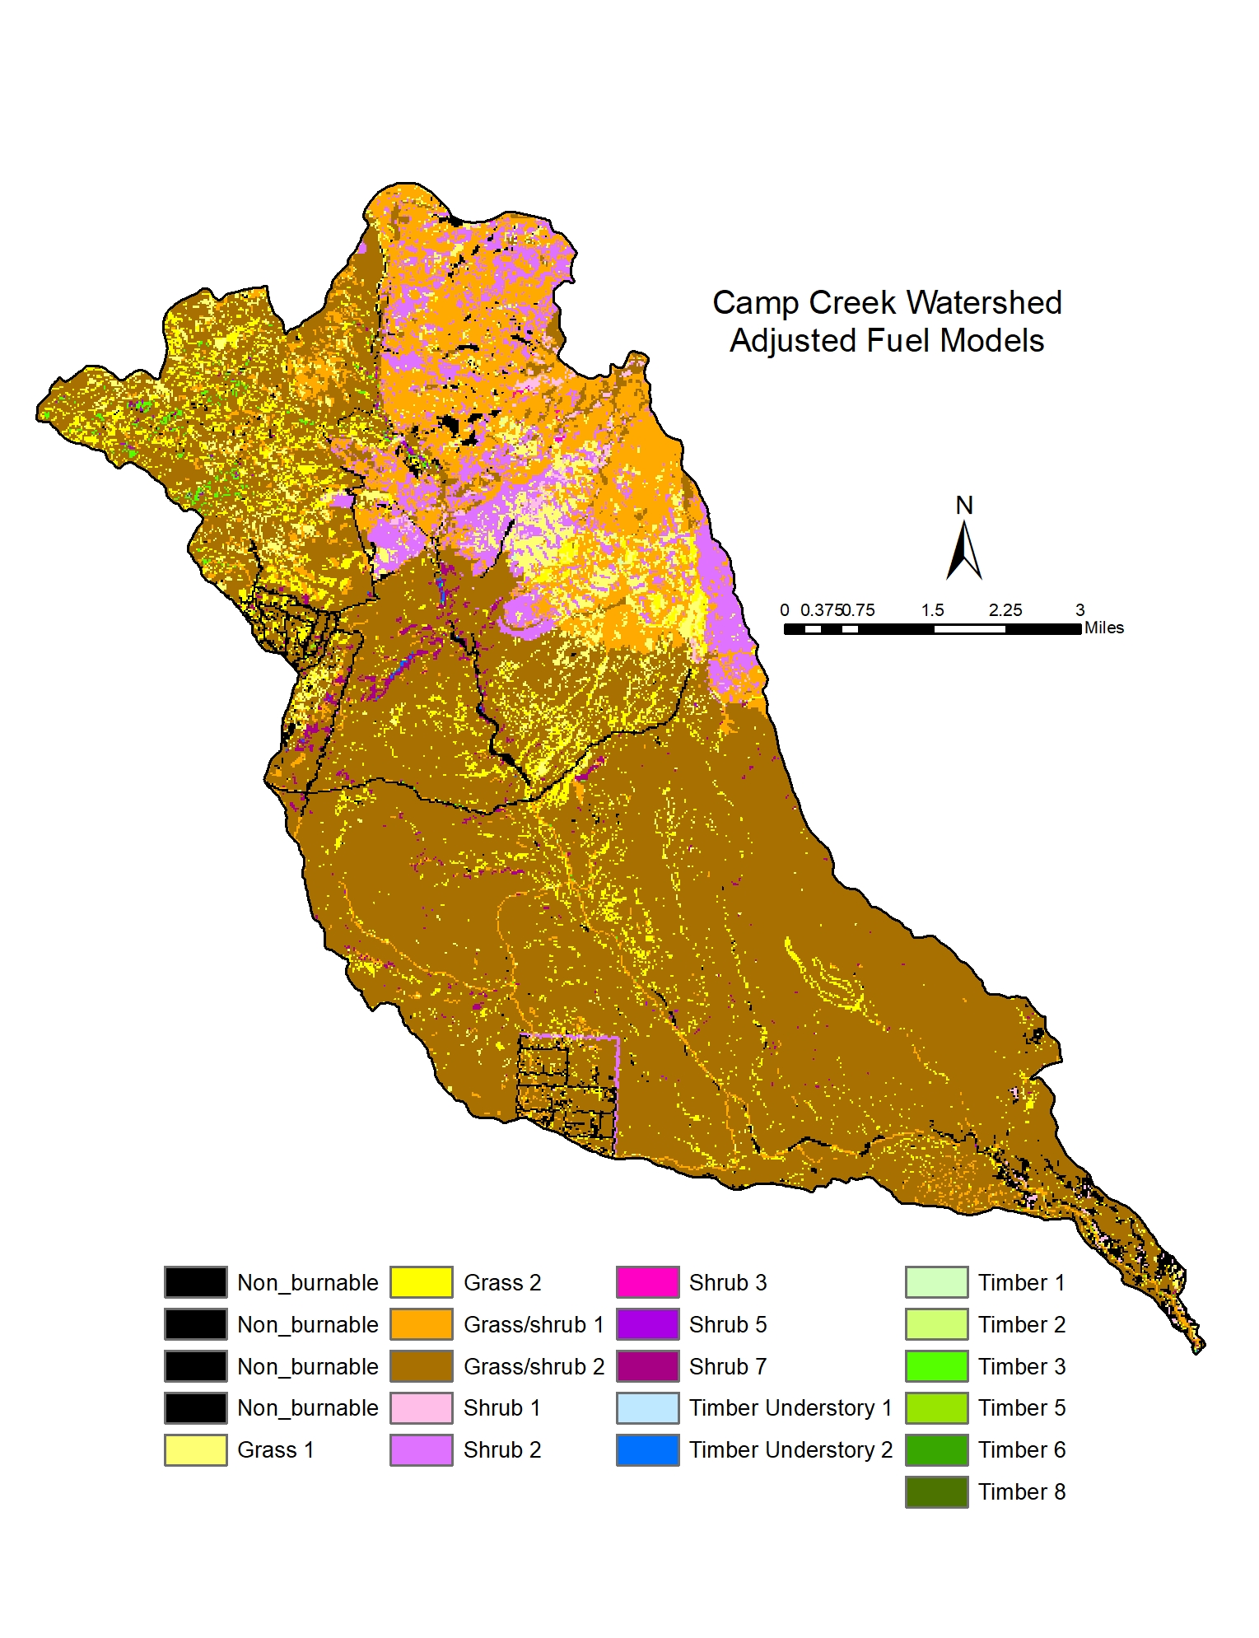
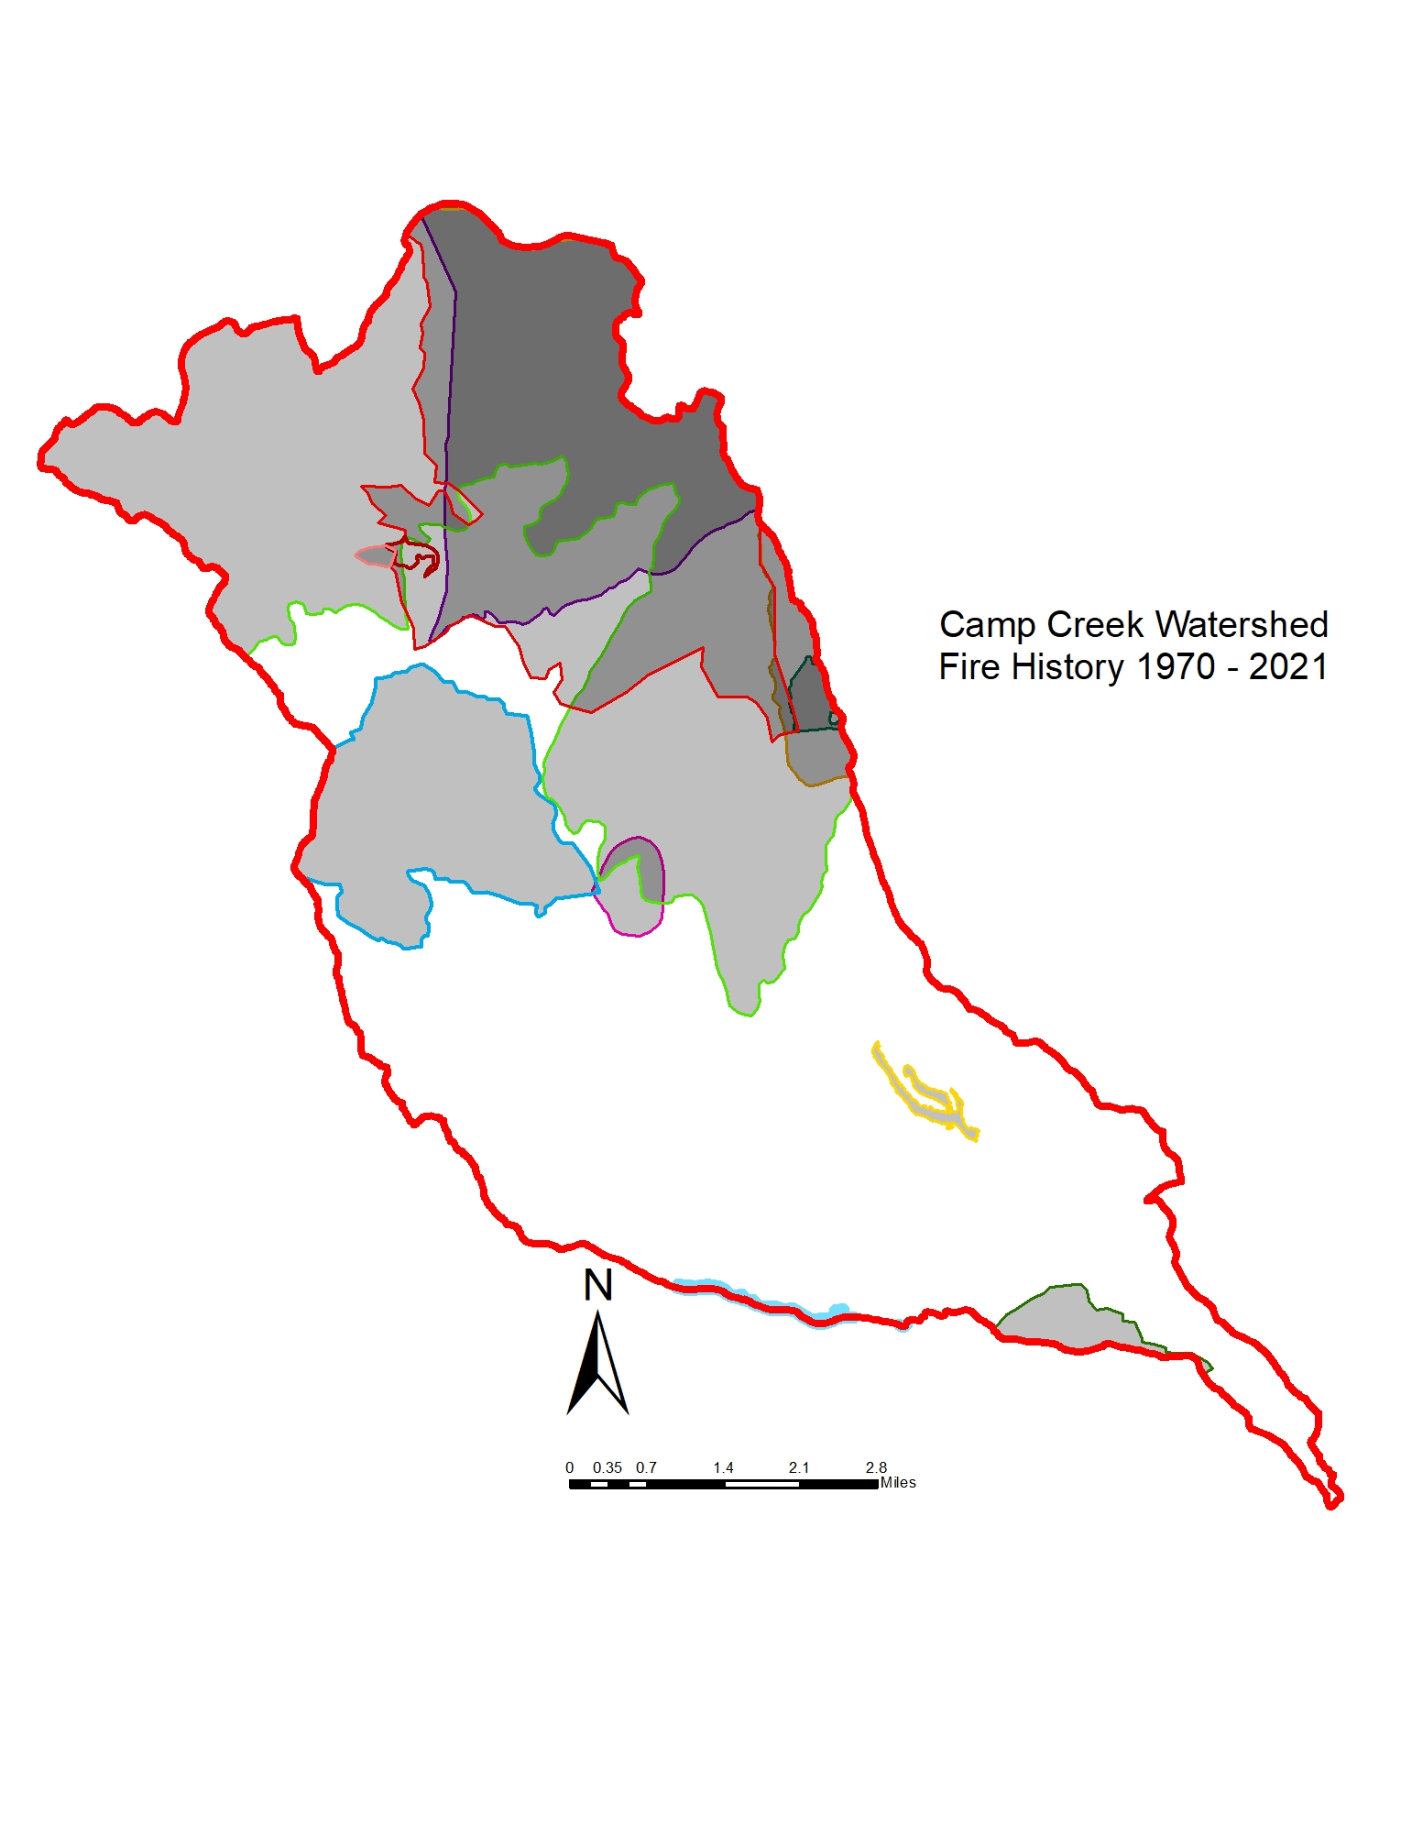
Fire Modeling
Notes:
RAVG, fire history, SBS, INREV, imagery…

Slide 9
Inputs
Six datasets were used to identify the potential for various levels of fire severity on soil and vegetation and for fire behavior.
Crownfire potential

Slide 10
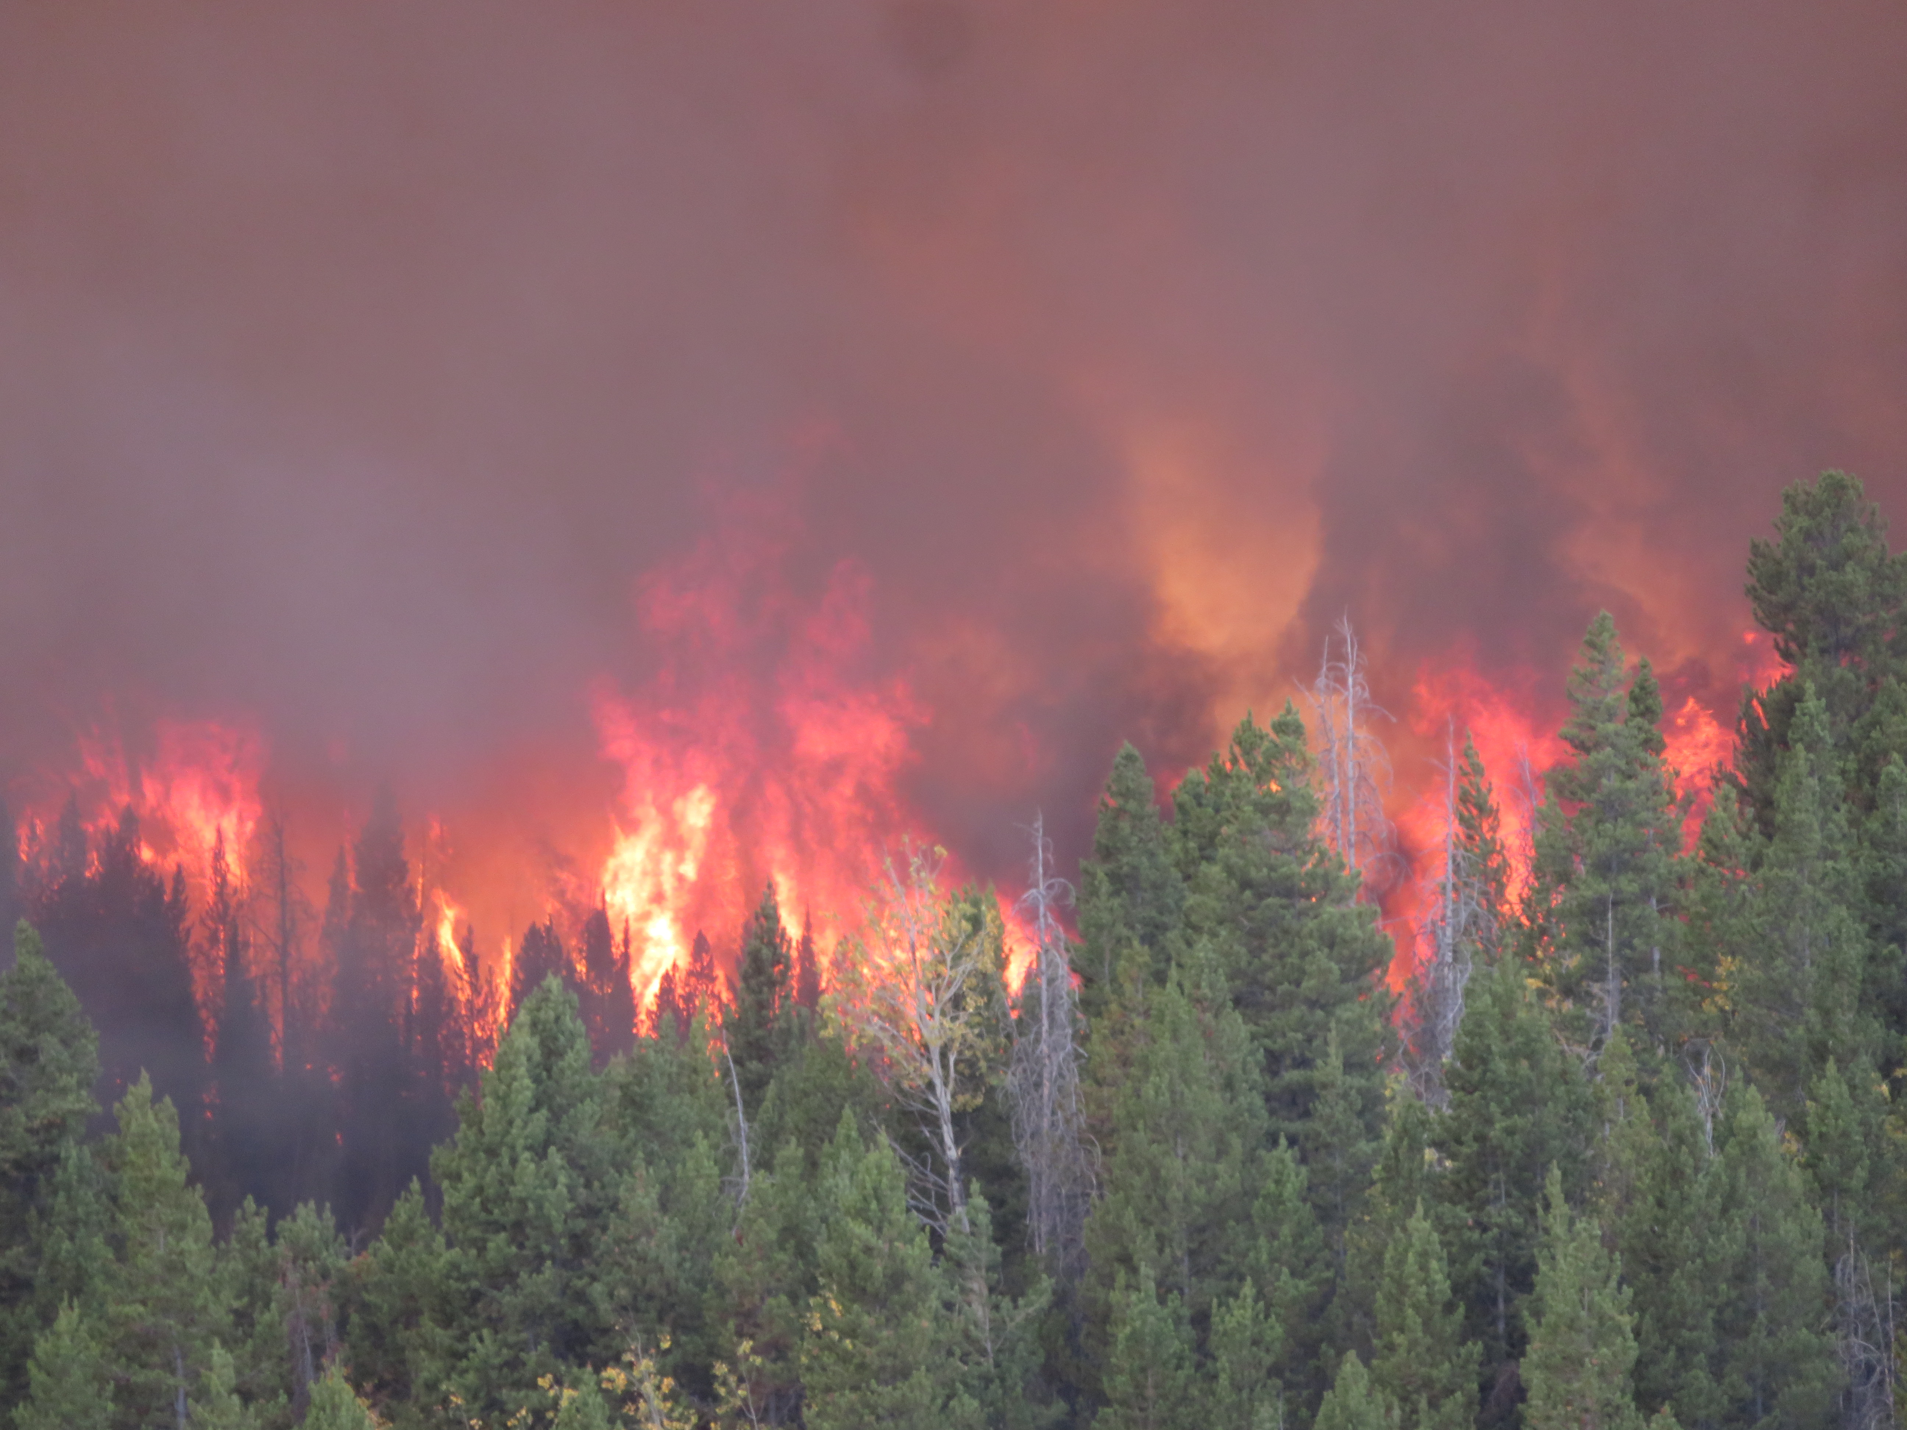
Crownfire Potential
Crownfire = when a fire burns in the crowns of trees and/or the canopies of stands of trees or shrubs
Active Crownfire:
Causes 100% mortality in conifers on the Tonto NF (except for Alligator Juniper (Juniper depeanna) and Chihuahua Pine (Pinus leiophylla))
Difficult to control since direct attack is not possible, and spotting is common
Doesn’t always result in high soil burn severity, but removes most canopy cover
Passive Crownfire:
At some level is a normal part of the fire ecology in most forested and woodland ecosystems
In proximity to active crownfire, or if there are large areas with potential, small wind shifts may cause it to transition to active crownfire or result in spotting, effectively increasing ROS and fire intensity. (SIZE MATTERS!)
The level of concern for passive crownfire is directly related to the size and continuity of the area.

Slide 11
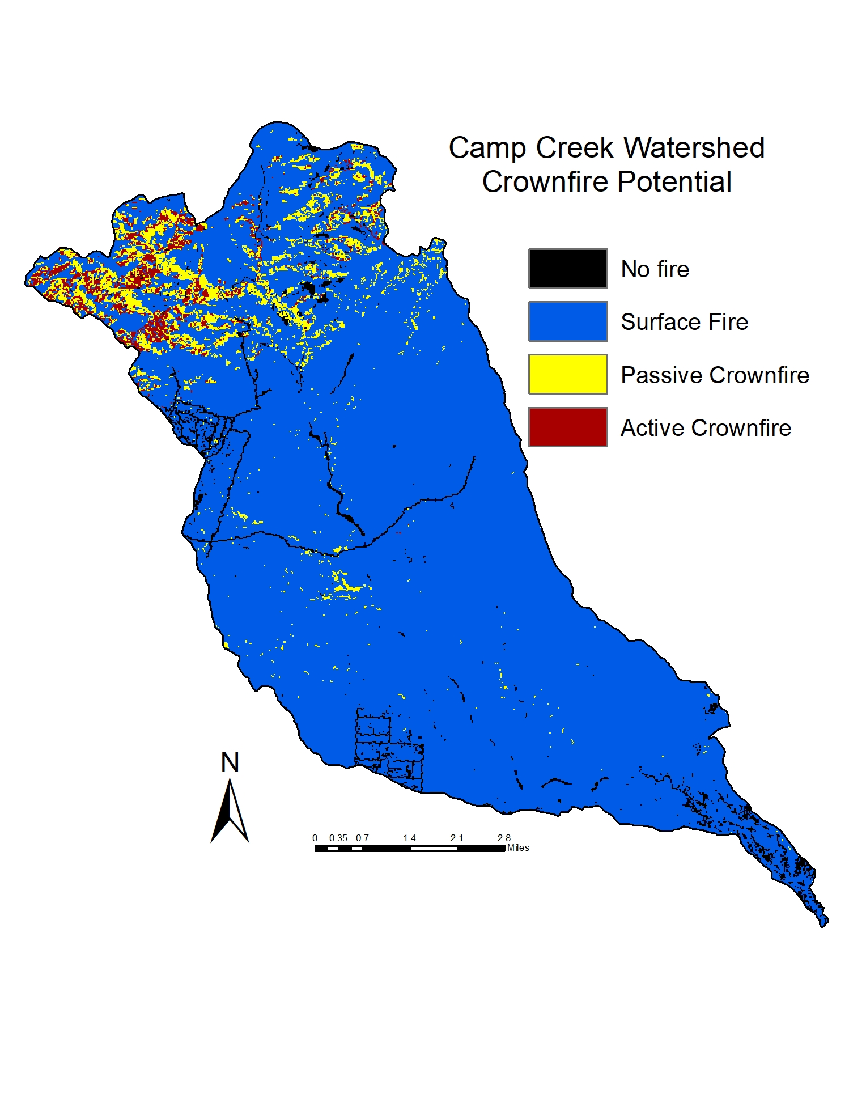
Crownfire Potential

Slide 12
Inputs
Six datasets were used to identify the potential for various levels of fire severity on soil and vegetation and for fire behavior.
Crownfire potential
Heat per unit area

Slide 13
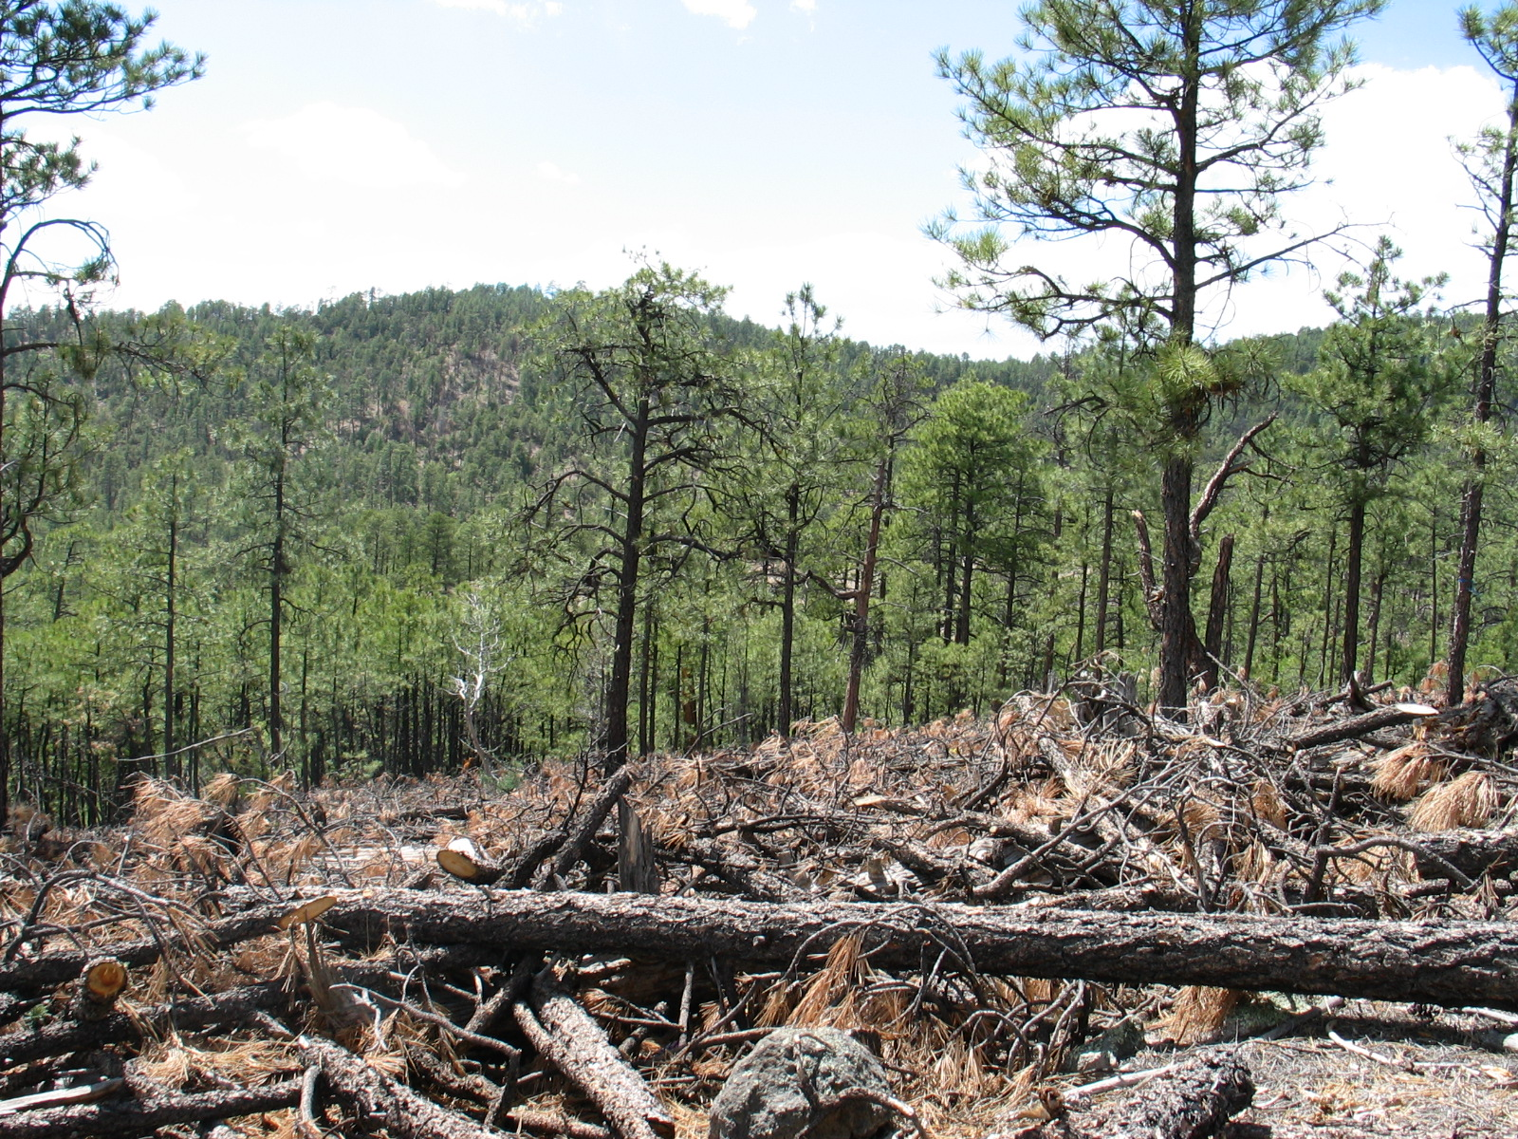
Heat per Unit Area (HUA)
Heat per unit area (hua) = a measure of the intensity of a fire that represents a portion of the total amount of heat produced on a given area.
Better estimate of soil burn severity than fireline intensity because it is the sum of the amount of heat produced by a stage of combustion
It is a proxy for residence time which is a critical component of fire effects

Slide 14
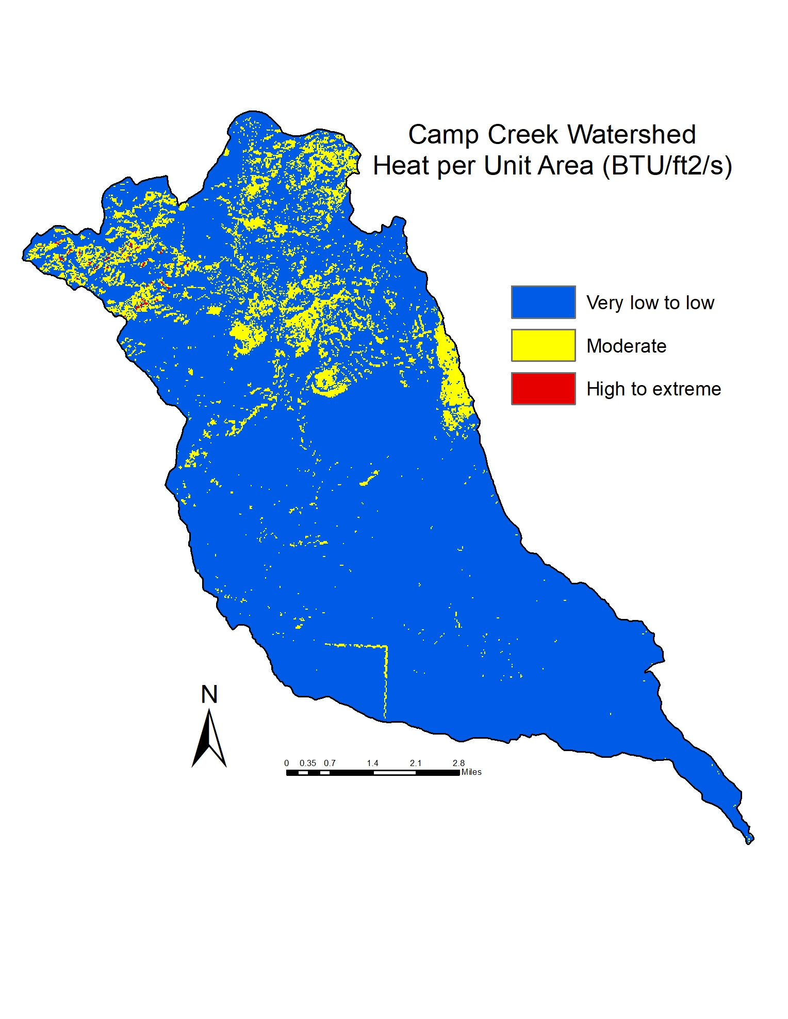
Heat per unit area (HUA)

Slide 15
Inputs
Six datasets were used to identify the potential for various levels of fire severity on soil and vegetation and for fire behavior.
Crownfire potential
Heat per unit area
Flame Length (Fireline intensity)

Slide 16
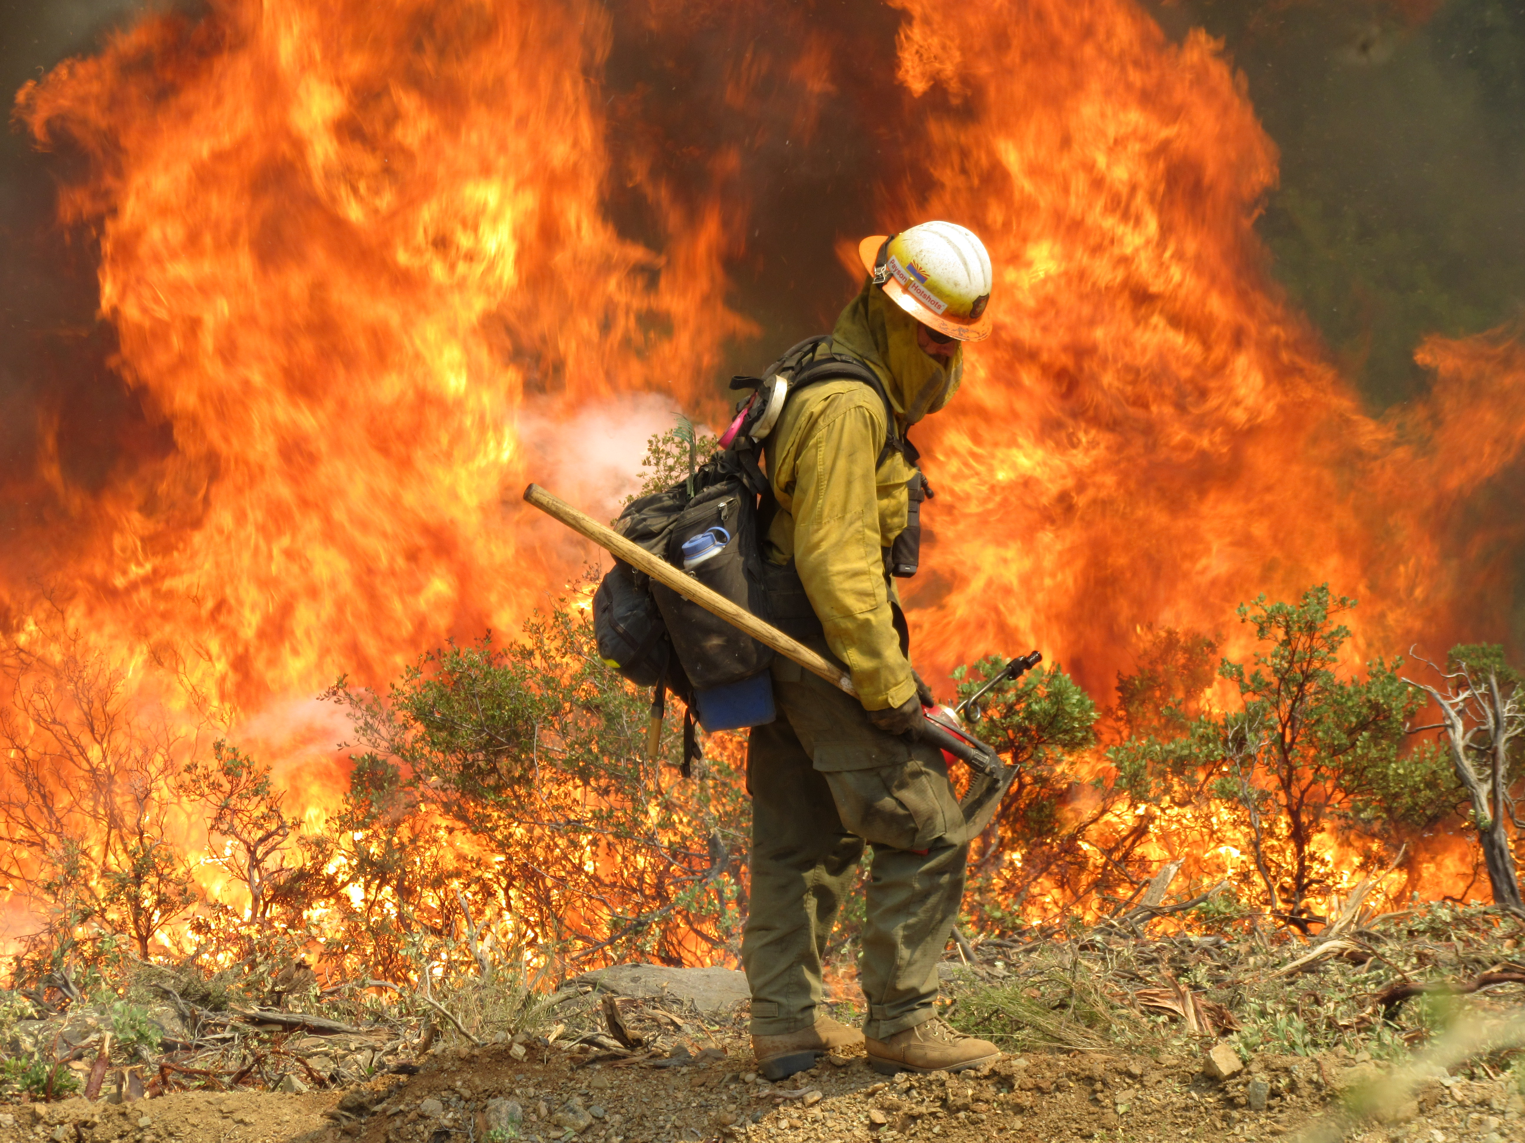
Flame Length (fireline intensity)
Flame Length:
Represents Fireline intensity (fli), which is the rate of energy or heat release per unit time per unit length of fire front.
Used to approximate fire severity on vegetation.
Thresholds for the expected fire severity on vegetation were initially based on fireline intensity levels from in a case study on the Coconino NF. They were adjusted to account for a broader range of vegetation types, more recent information, and observations in the field.
*Adapted from Alexander and Cruz 2019, Alexander and Cruz 2011, Stratton 2009, Andrews and Rothermal 1982, and Campbell et al. 1977

Slide 17
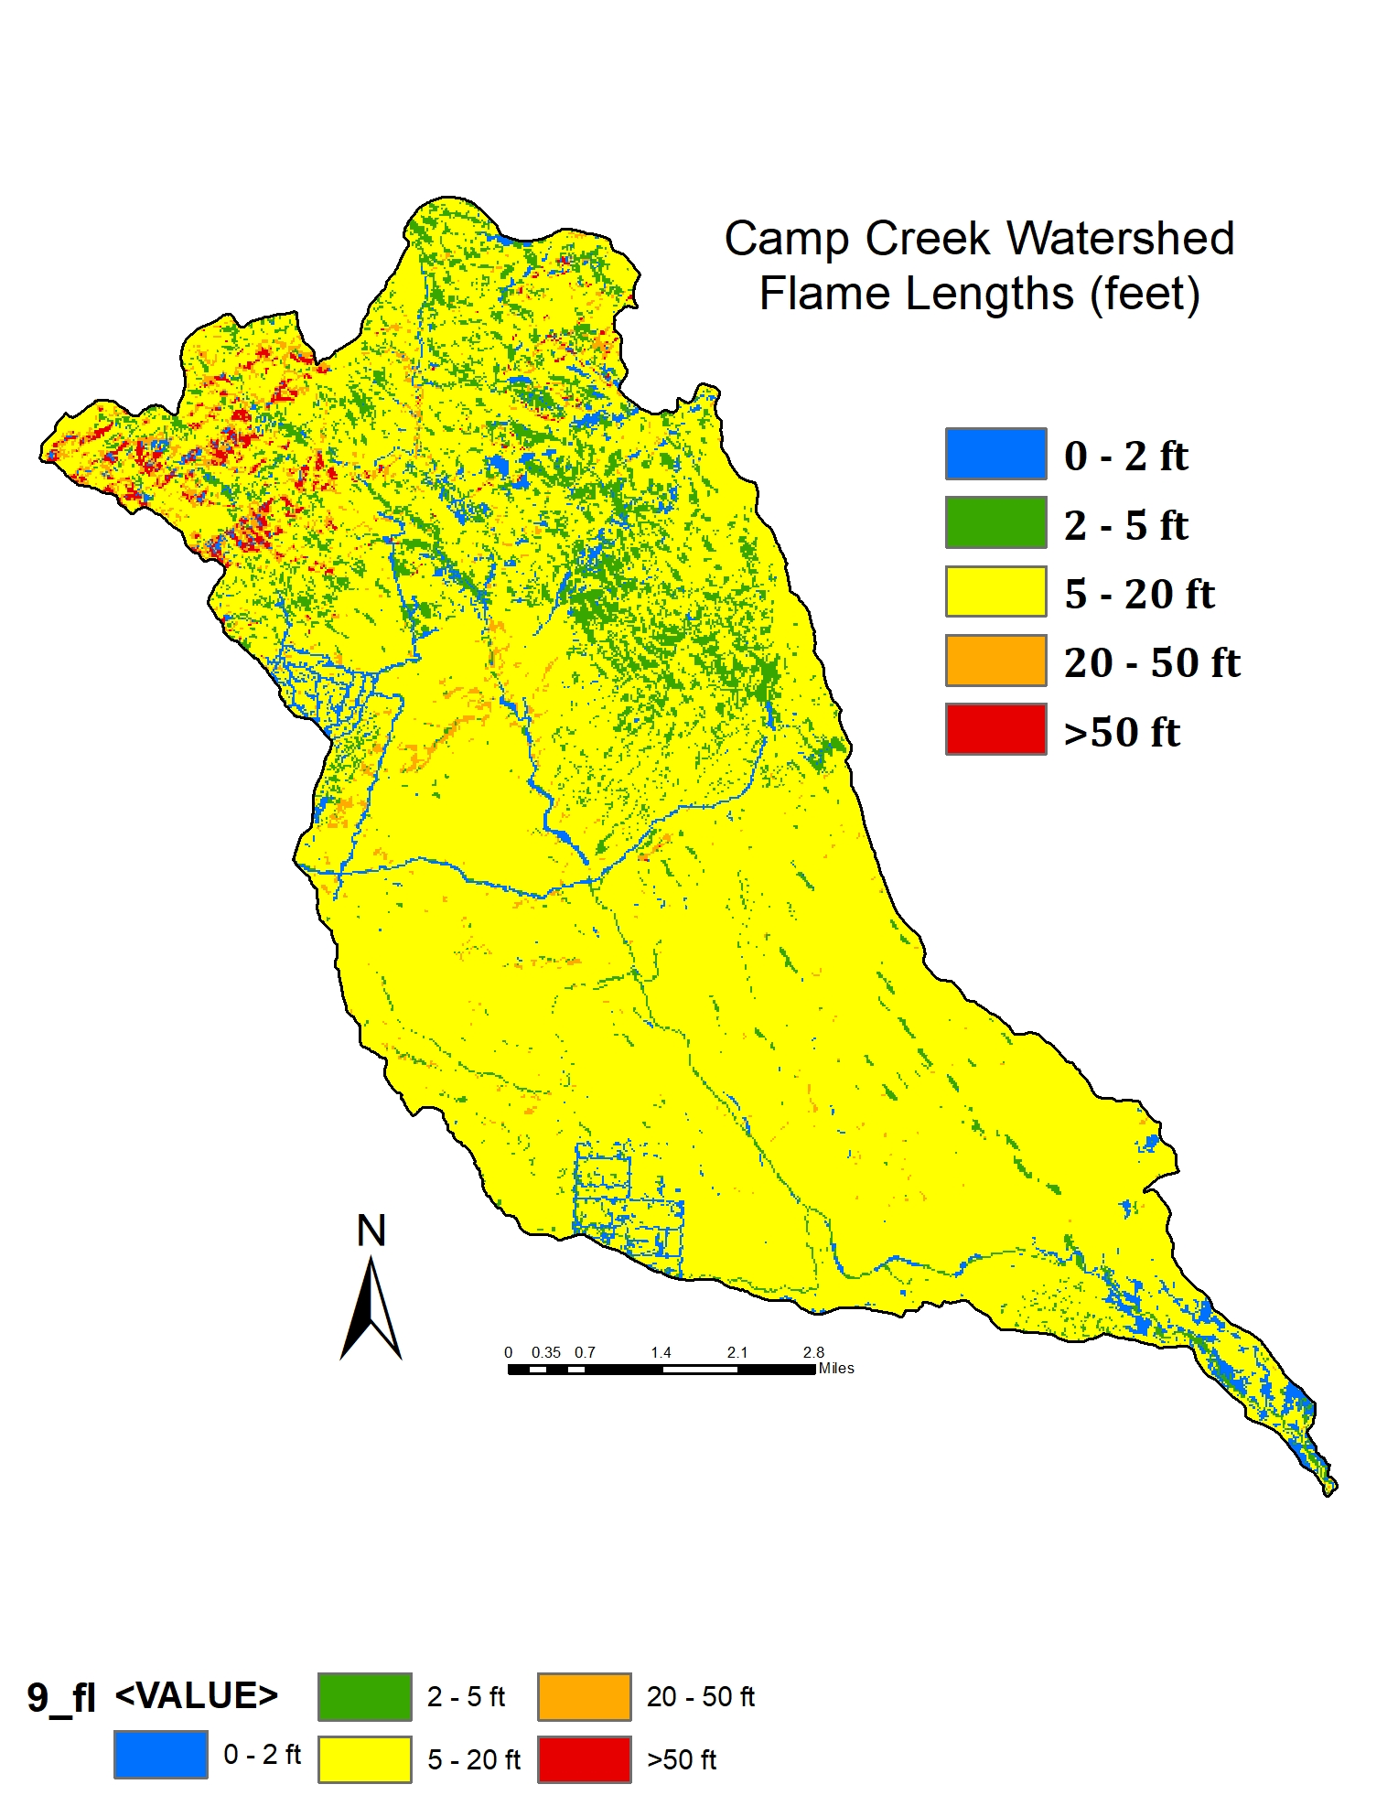
Flame Length (fireline intensity)
*Adapted from Alexander and Cruz 2019, Alexander and Cruz 2011, Stratton 2009, Andrews and Rothermal 1982, and Campbell et al. 1977

Slide 18
Inputs
Six datasets were used to identify the potential for various levels of fire severity on soil and vegetation and for fire behavior.
Crownfire potential
Heat per unit area
Flame Length (Fireline intensity)
Fire adapted (based on ERUs)

Slide 19
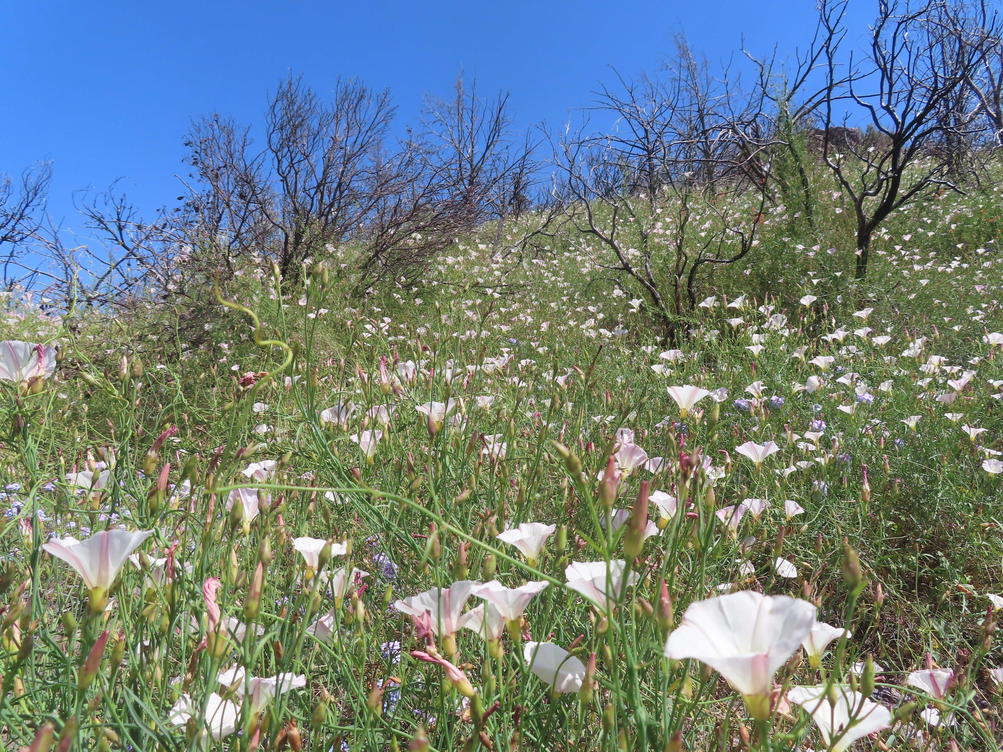
Fire-Adapted
Mapped by Ecological Response Units (ERUs – technical groupings of Terrestrial Ecological Units) as mapped by Region 3
Although many individual species in the Sonoran Desert are adapted to fire, in general, Sonoran Desert ERUs are poorly adapted to fire
Riparian areas associated with the Sonoran Desert are likely to have even fewer adaptations to first order fire effects
They may have some adaptations to second order fire effects, particularly flooding and sediment movement coming from fires upstream in ERUs that are well adapted to fire of one kind or another.

Slide 20
Inputs
Six datasets were used to identify the potential for various levels of fire severity on soil and vegetation and for fire behavior.
Crownfire potential
Heat per unit area
Flame Length (Fireline intensity)
Fire-adapted (based on ERUs)
Soil Erosion Hazard (water) – TEUI Interpretation
Soil Erosion Hazard (wind) – TEUI Interpretation

Slide 21
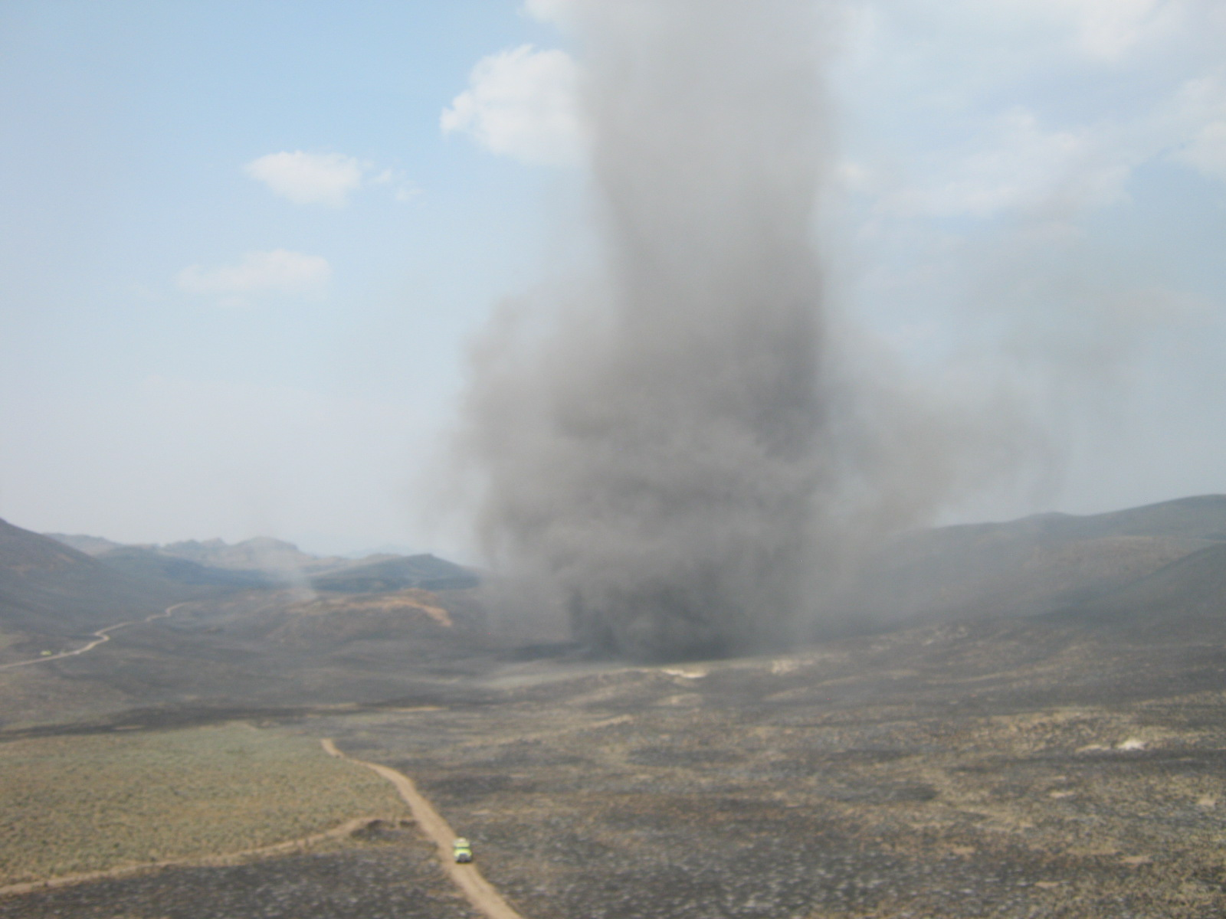
Soil Erosion Hazard (water and wind) – TEUI Interpretations
Soil erosion by water or wind can produce effects that are considered permanent since soil formation in dry climates is very slow.
Changing climate, invasive species, changing fire regimes, and other human impacts, introduce significant uncertainty in future soil-forming processes
Soil is a primary ecological characteristic that defines the potential of a site
There is a symbiotic relationship between soil and the flora and fauna that inhabit an ecosystem
Removal of ground cover leaves soil exposed to erosion by both water and wind
If too much heat is transferred to soil, organic matter that contributes significantly to soil structure and cohesion can be incinerated leaving it much more vulnerable to wind and water erosion
In the southwest where there is a hot/dry/windy season followed by monsoon, these factors can significantly impact soil, so both water and wind erosion are included as variables contributing to the ratings below.

Slide 22
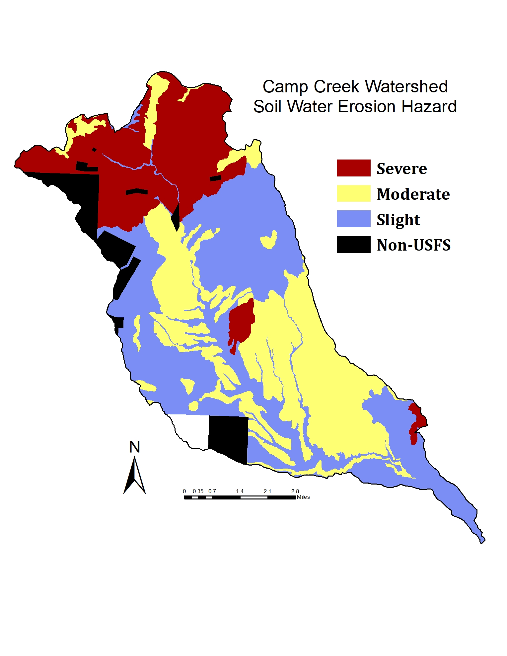
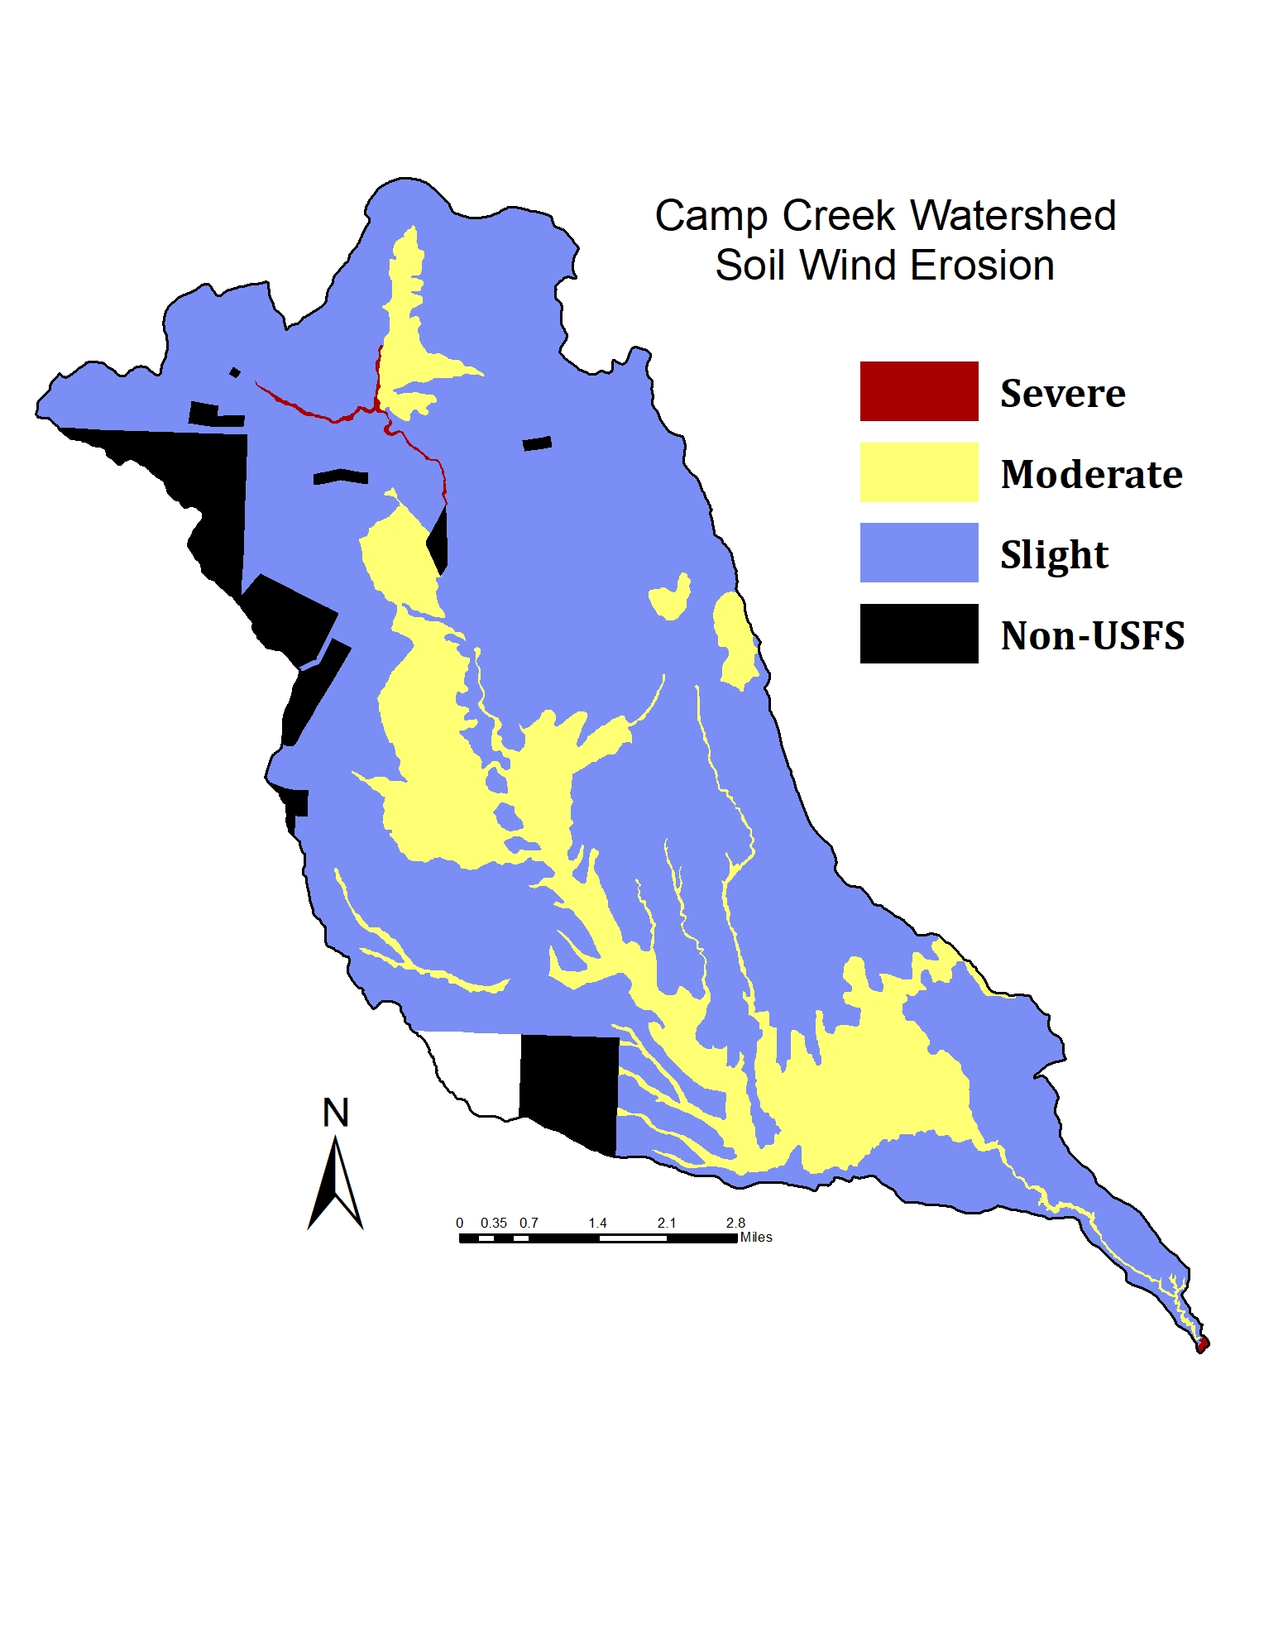
Soil Erosion Hazard (water and wind) – TEUI Interpretations
Water erosion: Mostly snowmelt and monsoon (winter and July/August)
Wind erosion: Mostly late May until monsoon

Slide 24
Indexing: Step 1
Metric |  | Points | Thresholds | Description
Crown Fire | af = active crownfire | 3 | Active | Estimate of fire effects to vegetation
 | pf = passive crownfire | 1 | Passive
Heat per unit area (kJ/m2) | hhua = high hua | 3 | High >60,500 | Estimate of fire effects to soil
 | mhua = moderate hua | 2 | Moderate 8,700 - 60,499
Flame Lengths (ft) | flvh = very high fl | 4 | >50 ft | Estimate of fire effects on vegetation.
 | flh = high fl | 3 | 20 – 50 ft
 | flm = moderate fl | 2 | 5 – 20 ft
 | fll = low fl | 1 | 2 – 5 ft
Fire Adapted | lfa = least fire adaptation | 2 | Sonoran Desert | Account for fire adaptations
 | pfa = poor fire adaptation | 1 | Desert riparian
Soil Erosion Hazard – water (TEUI rating) | swtr = severe water erosion risk | 2 | Severe | Estimate of long-term effects to the ecosystem
 | mwtr = moderate water erosion risk | 1 | Moderate
Soil Erosion Hazard - wind (TEUI rating) | swnd = severe wind erosion risk | 2 | Severe
 | mwnd = moderate wind erosion risk | 1 | Moderate

Slide 25
Indexing: Step 2
Score from Table 5 | Risk of long-term adverse ecological effects | Discussion
1, 2 | 1 – Lowest | The only combinations for this rating that include fire measures are passive crownfire, moderate hua, or moderate flame lengths, but with no points at all from fire adaptation or soil erosion. Soil that is rated as being at ‘severe’ risk of erosion by wind OR by water qualify as a ‘2’, without any effects from fire. Since these areas do not have both a severe erosion hazard and any risk of adverse fire effects, they are rated at the lowest risk of long-term adverse ecological effects from fire.
3, 4, 5 | 2 – Moderate | For this rating, of the fire effects measures, only the highest hua, active crownfire, or high flame lengths could be applied to a soil with a high erosion hazard, and not where fire adaptation is a concern. Though there would be benefits to evaluating these areas for treatment needs, the need would be only moderate compared with higher risk levels.
6, 7, 8, 9, 10, 11, 12 | 3 – High | The lowest ratings in this classification allow for moderate fire effects to multiple ecological metrics (wind/water erosion and fire adaptation). The higher ratings allow for the highest ratings of more than one of the fire behavior metrics, or a high and a moderate severity combined with a high rating for wind or water soil erosion hazard. These areas are at a high risk of long-term adverse ecological effects from fire.
13, 14 | 4 – Very high | This rating indicates where at least four of the six metrics have the highest rating. In some cases, fire effects to soil could be severe enough to significantly degrade ecological function through, for example, burning out all the organics in the surface layer/s and/or changing the cation exchange capacity so that it is difficult for seeds to successfully colonize these burned areas. Where the areas represented here are greater than a few acres and/or in a critical location, they should be considered for some type of mitigation or treatment. Additional consideration should be given to those adjacent/downstream areas that could be affected by second order fire effects originating from these acres.
15, 16 | 5 – Extreme | This rating represents the highest rating for at least five of the six metrics, including at least one of the erosion metrics. If these areas burn under the worst conditions, the effects on soils could be permanent and could change site potential for the foreseeable future. Where the areas represented here are greater than a few acres and/or in a critical location, they should be considered for some type of mitigation or treatment. Additional consideration should be given to those adjacent/downstream areas that could be affected by second order fire effects originating from these acres.

Slide 26
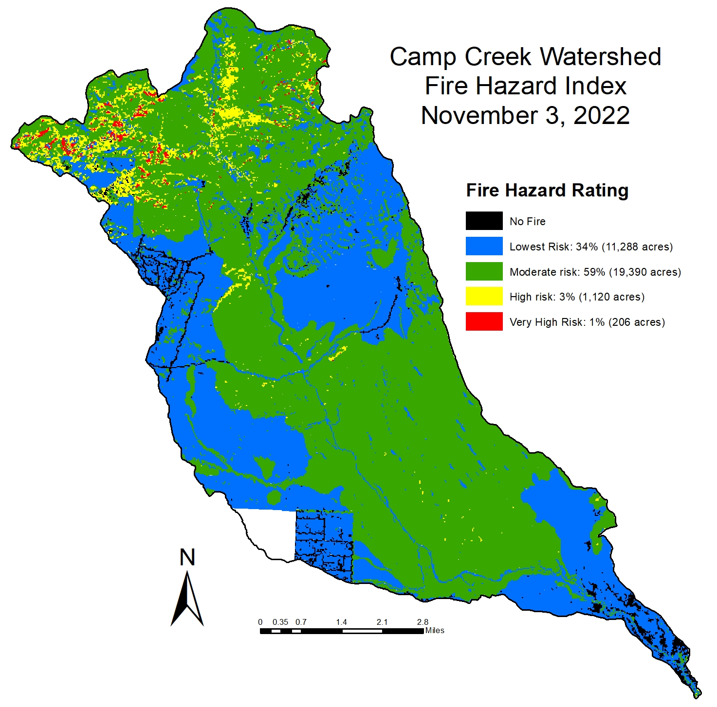
Fire Hazard Index

Slide 27

Questions? Comments? Observations? Discussion?

