Slide 1




Planning for National
Scenic & Historic
Trails
10/18/2017
Notes:
The content of this presentation reflects agreements (a meeting of the minds) between National EMC and Recreation Directors. Many discussions, including dialogue with Chief Tidwell, informed the guidance we’ll be presenting. Our intent is to simply clarify requirements and also share some examples and tools to facilitate consistent and defensible approaches…hopefully creating some efficiencies for individual units as they embark on their specific revision efforts.

Slide 2
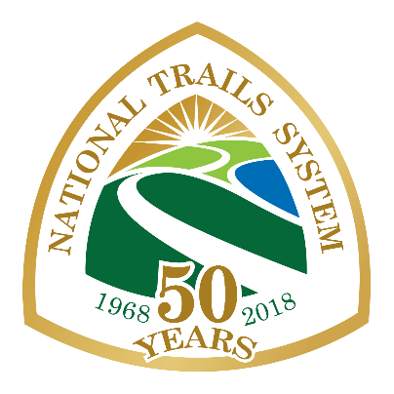
Overview
WHAT are NSHTs?
WHY are they important?
WHERE are they?
WHO is responsible?
HOW do we plan for them?
  Key Concepts
  Connecting Direction and Resulting “Plans”
  Types of Plans
Notes:
Handout !
Law & Policy Framework (NTSA, EO 13195, Comp Plans, FSM 2350)
Other guiding docs (IA MOU, Trails Stewardship Act, Sust Trails Strategy, High Five)
FS Planning Rules & Policy
Handout 2
Recommended plan components to address scenery, fire, timber, etc

Slide 3
WHAT are
National Scenic & Historic Trails?
Congressionally-designated
  National Scenic Trails (NSTs) : long-distance trails that provide unique opportunities to hike or ride through areas of outstanding scenic beauty.
  National Historic Trails: long-distance trails that follow original trails or routes of travel of national historical significance."
Notes:
Recreation trails are different…

Slide 4
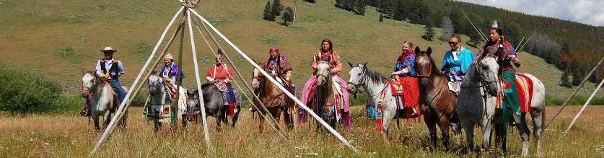
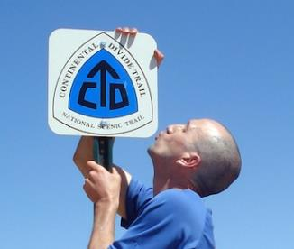
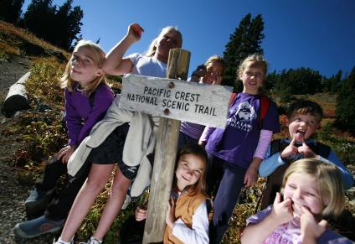
WHY are NSHTs important?
Showcase America’s rich natural and cultural heritage
Inspire citizen stewardship
Connect people to their public lands
Notes:
NSHTs represent some of our nation’s most iconic treasures

Slide 5
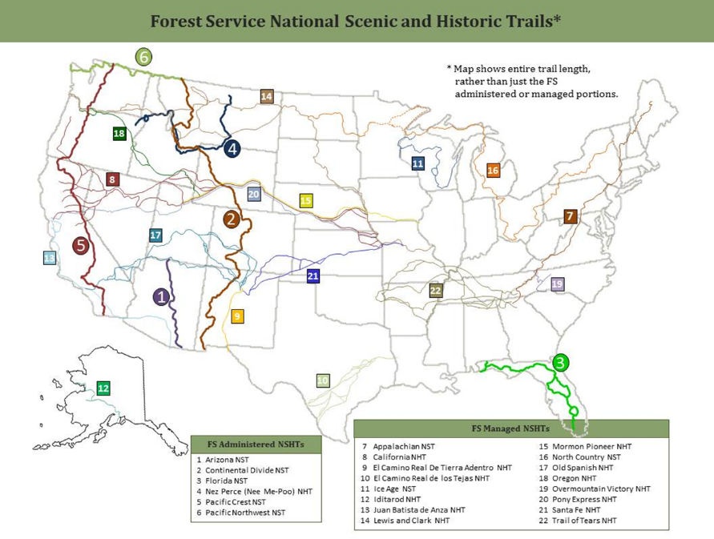
WHERE…
Notes:
All Regions of the Forest Service have at least one NSHT. The Forest Service is the lead administrator for six trails (5 NST and 1 NHT) and 16 are managed by the Forest Service leaving only 8 within the system that are not on national forest system lands.

Slide 6
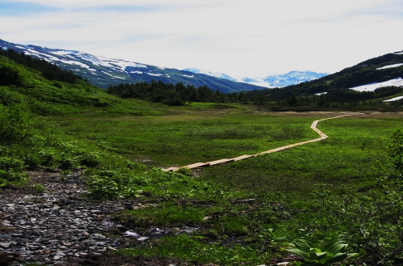
Some Stats…
30 NSHTs
Totaling 55,000 miles,
Crossing all 9 FS regions, and
90 Forests & Grasslands

Slide 7




6 NSHTs administered by the FS…
WHO’s responsible…
NSHT | Lead | Regions
Arizona National Scenic Trail | R3 | R3
Continental Divide National Scenic Trail | R2 | R1, R3, R4
Florida National Scenic Trail | R8 | R8
Pacific Crest National Scenic Trail | R5 | R4, R6
Pacific Northwest National Scenic | R6 | R1
Nez Perce National Historic Trail | R1 | R2, R4, R6
8
Notes:
Administering these trails means: trail-wide coordination, guidance, technical assistance and consultation.
Newest Trails are the Arizona and PNT designated in 2009. The Pacific Crest and Appalachian Trails are sister trails that are celebrating their 50th anniversary in 2018.
FYI – The Arizona, Pacific NW and Nez Perce Comprehensive Trail Plans are currently being worked on – we’ll talk more about what’s in these plans later in the presentation…

Slide 8
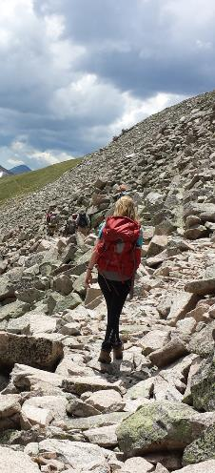
16 Additional NSHTs managed by the FS
WHO’s responsible…
NSHT | Lead | FS Regions
California National Historic Trail | NPS | R4, R5, R6
El Camino Real de los Tejas NHT | NPS | R8
Juan Bautista de Anza NHT | NPS | R5
Lewis and Clark National Historic Trail | NPS | R1, R6, R9
Mormon Pioneer National Historic Trail | NPS | R4
Oregon National Historic Trail | NPS | R4, R6
Pony Express National Historic Trail | NPS | R4, R5
Appalachian National Scenic Trail | NPS | R8, R9
North Country National Scenic Trail | NPS | R1, R9
Santa Fe National Historic Trail | NPS | R2, R3
Trail of Tears National Historic Trail | NPS | R8, R9
Overmountain Victory NHT | NPS | R8
Ice Age National Scenic Trail | NPS | R9
El Camino Real de Tierra Adentro NHT | BLM & NPS | R3
Old Spanish National Historic Trail | BLM & NPS | R2, R3, R4, R5
Iditarod National Historic Trail | BLM & NPS | R10
9
Notes:
The managing agency is the agency, landowner or interest with the responsibility for decision making for lands under its jurisdiction. Responsibilities are for decisions and action on FS lands.
NOTE: THIS SLIDE CAN BE CHANGED OUT FOR MORE LOCAL PRESENTATIONS – WHAT DOES THE REGION/FOREST HAVE WITHIN THIS PLANNING AREAS.

Slide 9
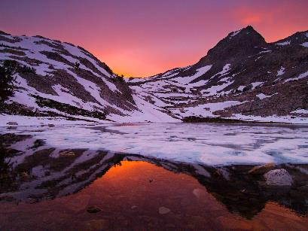
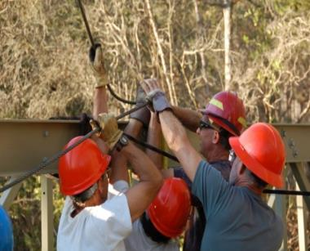
Key Concepts To Keep in Mind
(regardless of the planning level)
HOW do we Plan for them?
  Seamless management
  Collaboration
  Trail experience
Photo: Florida National Scenic Trail- volunteers building a bridge.
Notes:
The laws and policies governing NSHT management and administration can be summed up by the following key concepts:
1. Leadership intent is for seamless management across unit and agency jurisdictions.
2. Collaboration with volunteers and partners in the planning, maintenance, and management, as appropriate, is the cornerstone of the NTSA.
3. These trails were congressionally designated based on specific values and attributes that extend beyond the trail tread and create the trail experience.
We’ll talk more about the corridor in a little bit…

Slide 10

We’re not just managing this…
Notes:
Not just the trail tread

Slide 11
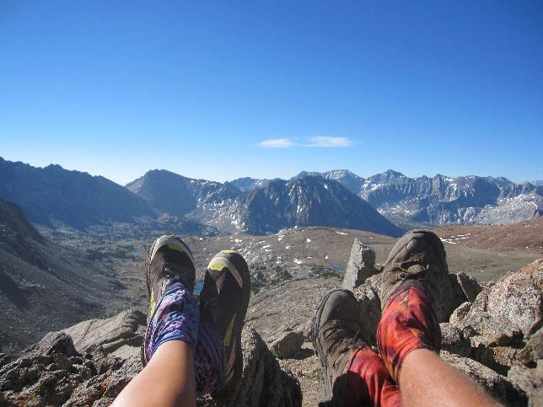
We’re managing for this
Notes:
We’re managing for the overall recreation setting and experience. Recreationists are inspired not just with what is below their feet but what they see while walking and riding, and in this case resting, on and by the trail. Outstanding scenery is key feature of national scenic trails. For national historic trails, management includes protection of nationally significant routes, trails, and sites that had a far reaching effect on broad patterns of American culture.

Slide 12
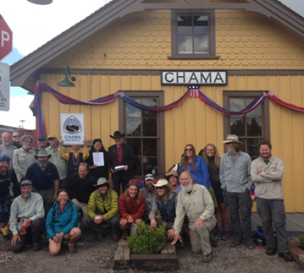
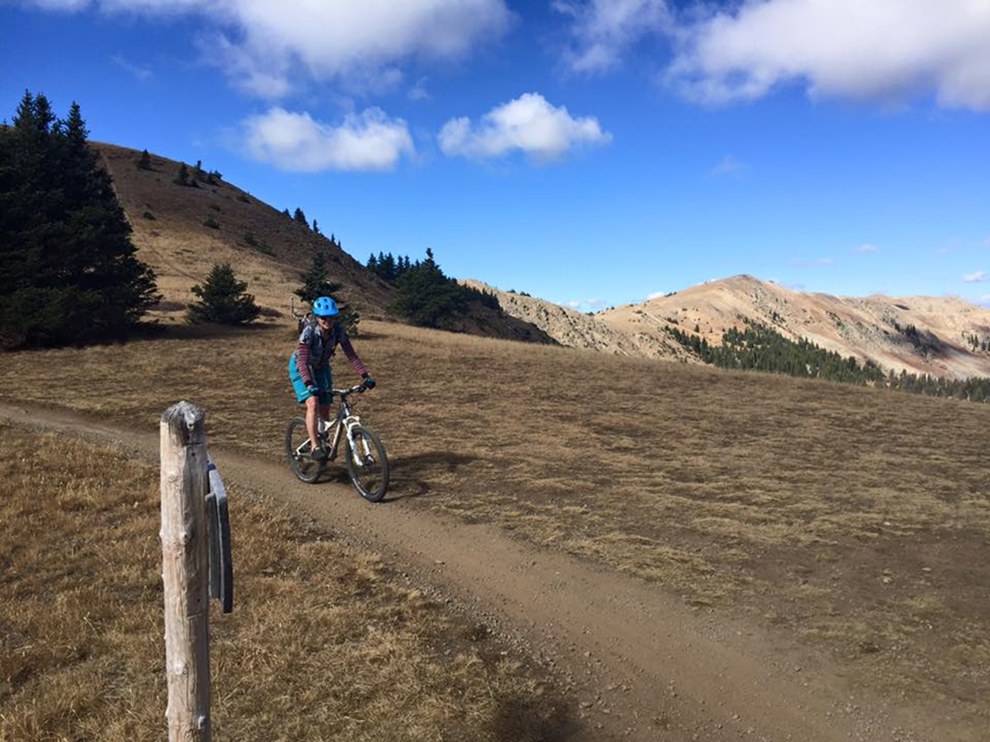
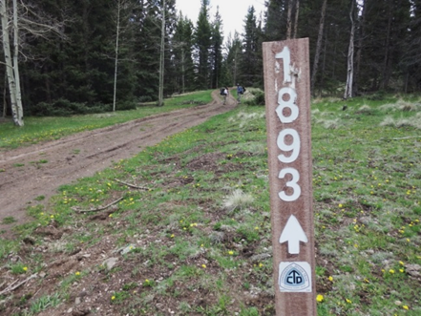

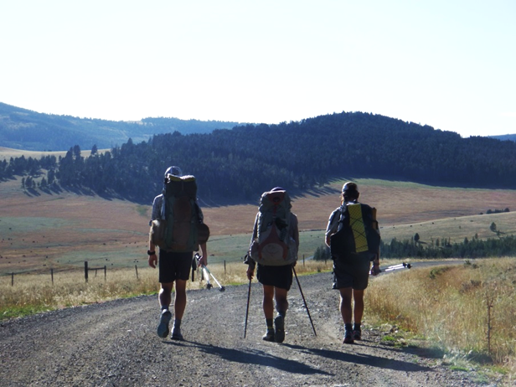
NSHT are NOT defacto Wilderness
Key concepts - continued
and traverse many settings
Notes:
These long distance trails cross a range of settings. The trail alignment is sometimes along existing roads, passes through communities, and cross a variety of settings.
Except where the trails are located within designated wilderness, the trails are not to be managed as wilderness.
Most management activities can continue to occur (veg treatments, range permits, etc), they just need to be done in a way that is sensitive to the purposes for which the NSHT was established- for NSTs- to provide high quality recreational opportunities in scenic settings.

Slide 13
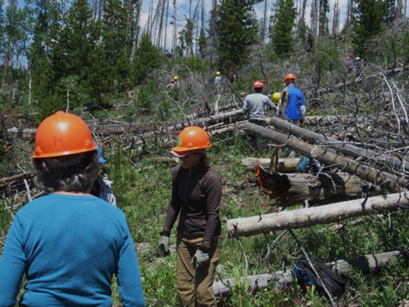
Unlike Wilderness…
Other multiple uses are not automatically prohibited or restricted along the trail.
Management activities are designed to harmonize with the resource values and purposes for which the trails were established.

Slide 14
Connecting Direction and Plans
National Forest Management Act
National Trails System Act
Designated Areas
Planning Rule
Executive Order 13195
FSM1920 FSH1909.12
FSM 2350
Land Management Plans
Comprehensive Trail Plans
Compatibility
Project Plans
Notes:
Laws: National Trails ACT & NFMA, as well as, trail-specific legislation – Regulations: 2012 Planning Rule – Policy and Direction: 1900 and 2350 Directives – (decisions) LMPs/CTPs/Project level NEPA - Result in 3 different plans –

Slide 15
Differences among the 3 Plans
Land Management Plans (LMP) address management of the land (including land around the trail) within the FS unit.
Comprehensive Trail Plans (CTP) address management of the entire trail (across jurisdictions).
Project Plans address specific projects or activities that support/implement the direction contained in the both the LMP and CTP.

Slide 16
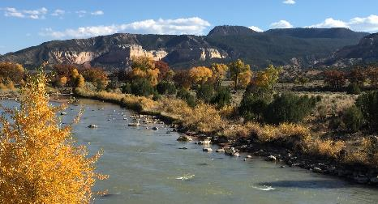
Direction and Guidance on LMP side
National Forest Management Act
2012 Planning Rule
FSM1920 FSH1909.12
Land Management Plans
Notes:
Lets start with what the requirements are for NSHTs in an LMP context

Slide 17
2012 Planning Rule
Designated Areas
Assessments are required to identify and evaluate existing information about existing designated areas
36 CFR 219.6(b)(15).
Plans must identify existing designated areas
36 CFR 219.7(c)(2)(vii)
Plans must have plan components including standards and guidelines to provide for appropriate management of other designated areas in the plan area.
36 CFR 219.10(b)(vi)).
Notes:
The 2012 Rule speaks to “designated areas”…. NHSTs are one of the many “designated areas” addressed in LMP-ing

Slide 18
Expectations in the Planning Directives
FSH 1909.12, Sec. 24.1 & 24.43
Identify and map NSHT corridors in the plan 24.1, 2 and 24.43 1(c) and 2(e);
Develop plan components that provide for the nature and purposes of the trail 24.43, 1(f); and
Coordinate planning efforts and management direction across neighboring jurisdictions to facilitate compatible management approaches for NSHTs 24.23, 1(d).
Notes:
THESE represent CONSENSUS between EMC and RHVR DIRECTORS in interpreting direction and guidance contained in the implementing directives:
FSH 1909.12 Chapter 20 (Land Management Plan ):
Sec. 24.1, 2. All designated areas that have been statutorily designated or recommended to be statutorily designated must be shown on a map in the plan, unless it is necessary not to do so, to protect resources in the designated area.
Sec. 24.43(1)(c). The Interdisciplinary Team shall use the national scenic and historic trails rights-of-way maps required by 16 U.S.C. 1246(a)(2) to map the location of the trails. Where national trail rights-of-way have not yet been selected, the Interdisciplinary Team shall reference the establishing legislation (16 U.S.C. 1244(a)) as the primary source for identifying and mapping the national scenic and historic trails right-of-way. If the right-of-way has not been selected, either through legislation or publication in the Federal Register, the Interdisciplinary Team should use other information to delineate a national scenic and historic trails corridor that protects the resource values for which the trail was designated or is being proposed for designation (16 U.S.C 1244(b)).
Sec. 24.43(2)(e) MUST identify and map National Scenic and Historic trails per #1c above.

Slide 19
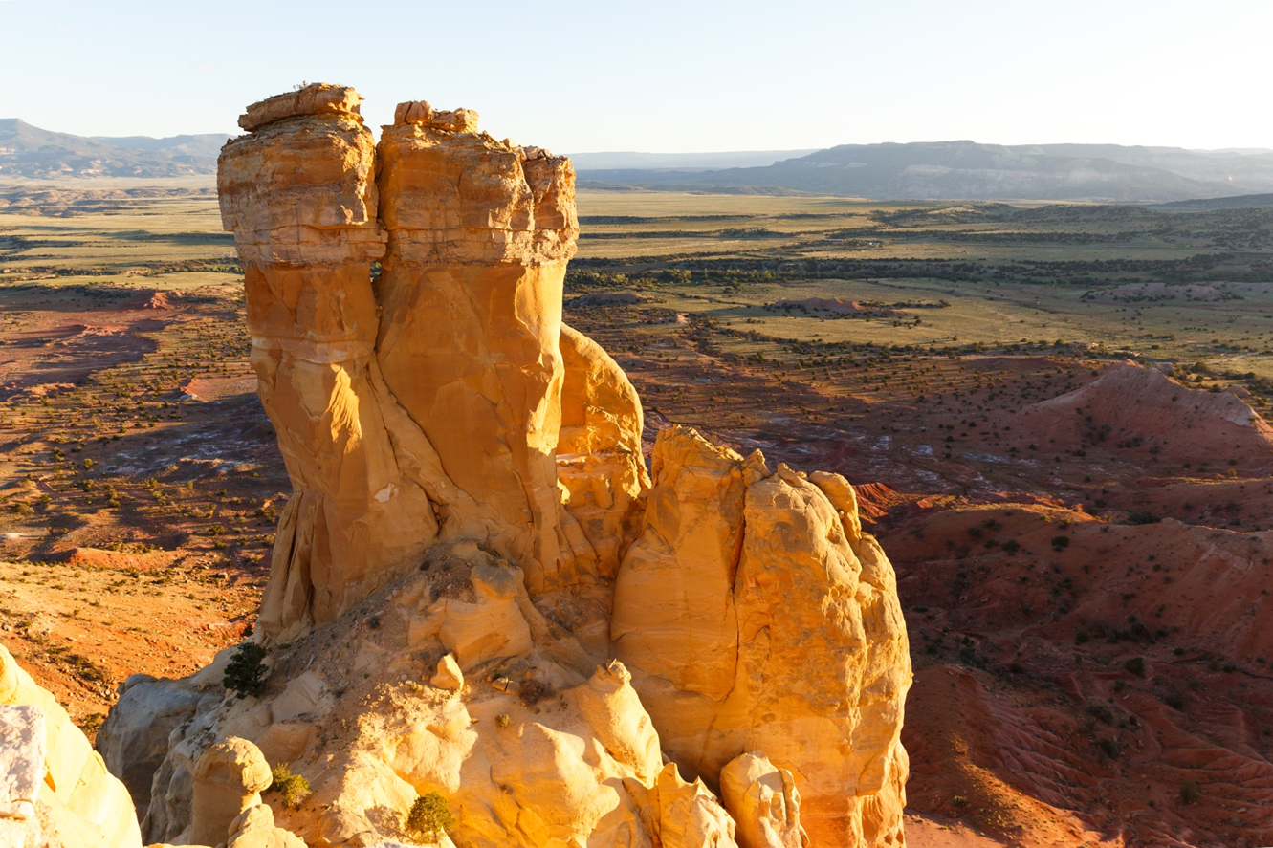
NSHT Corridors should be wide enough to encompass the resource values for which the trail was designated
Key features and destinations (scenic vistas, water features, campsites, cultural sites, etc.) along the trail.
Desired Recreation Opportunity Spectrum (ROS) settings.
Scenery Integrity Objectives (SIOs) – especially for National Scenic Trails
Historic sites and cultural landscapes – especially for National Historic Trails

Slide 20
Additional FSH 1909.12 Guidance for Plan Components
Plan should include desired conditions that describe the NSHTs and the recreational, scenic, historic and other resource values for which the trail was designated.
May include objectives related to NSHTs
May include standards or guidelines to place limits or conditions on projects to protect trails and associated resource values.
May include suitable uses to identify uses that are to be allowed or prohibited along the trail.
Notes:
NSHT direction contained in Land Management Plans must be consistent with legislation associated with each NSHT and compatible with applicable trail comprehensive management plans.

Slide 21
Consider other resource values and multiple uses when developing plan components for trails:
  Scenery (using SMS)
  Recreation settings, activities, and experiences (using ROS)
  Vegetation treatments and timber production
  Grazing activity
  Road construction, maintenance, relocation or decommissioning
  Special Uses (communication sites and utility corridors)
  Recreation Special Uses, services, and events
  Mineral Uses within agency authorities
Notes:
Consider how these other uses and activities will harmonize with trail management. Consider if specific plan components are needed to manage these uses in the vicinity of the trail.

Slide 22
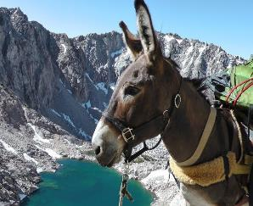
Useful starting point for IDT discussions and public engagement
Available tools and references…
A Menu of Plan Components for NSHTs
Based on coordinated CDT effort and several LMP examples
Summary of relevant Laws and Direction
Notes:
Provide as Handouts…

Slide 23
Note - LMPs under the 1982 Planning Rule….
Although 1982 Rule direction for designated areas is limited to Wilderness,
the National Historic and Trails Act does note that agencies must identify NSHTs in their respective general management plans.

Slide 24
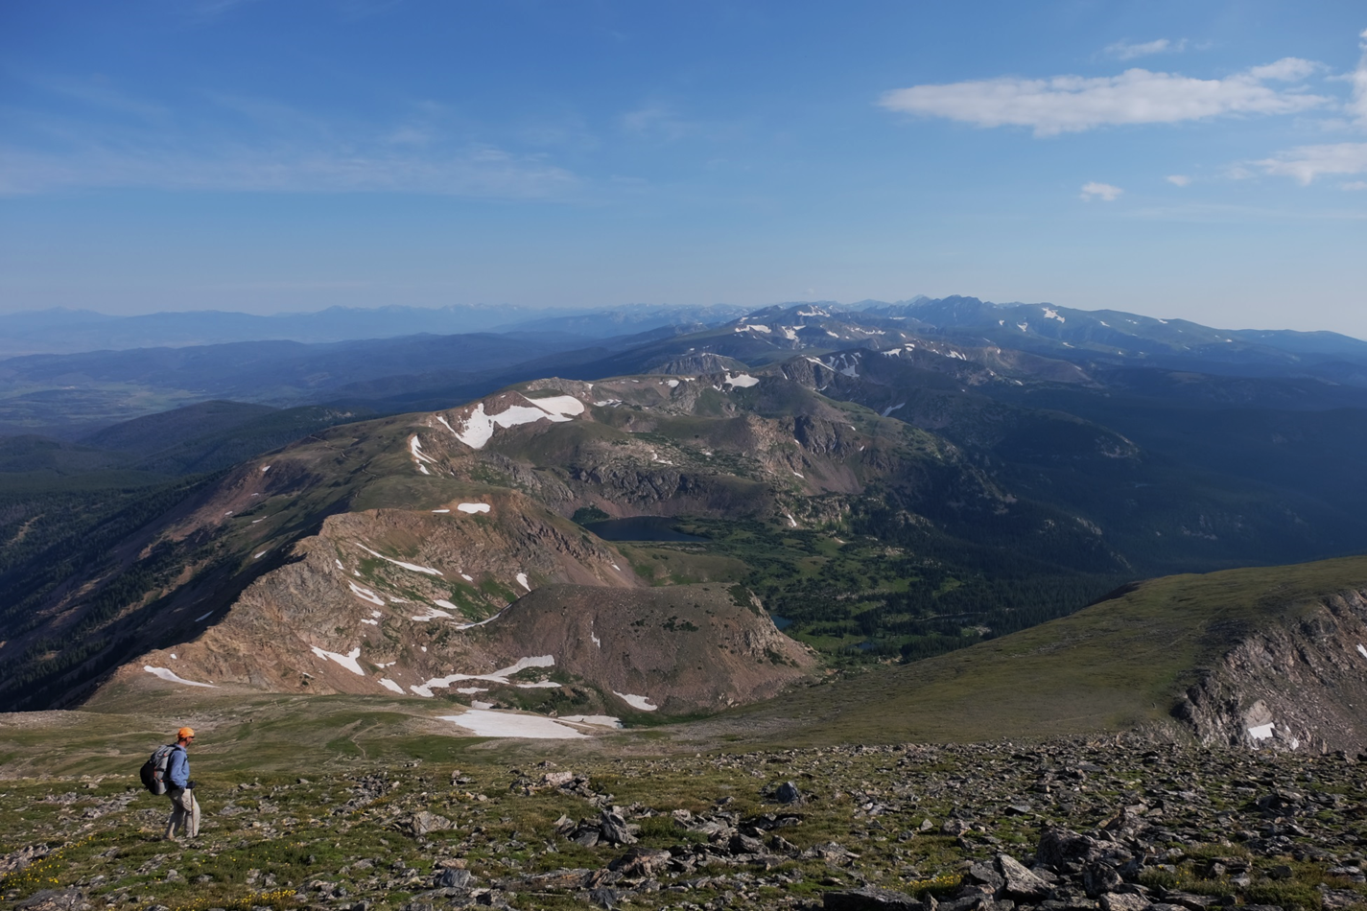
Direction and Guidance on the CP side
National Trails System Act
Executive Order 13195
FSM 2350
Comprehensive Trail Plans
Notes:
On the comprehensive Trail Plan side

Slide 25
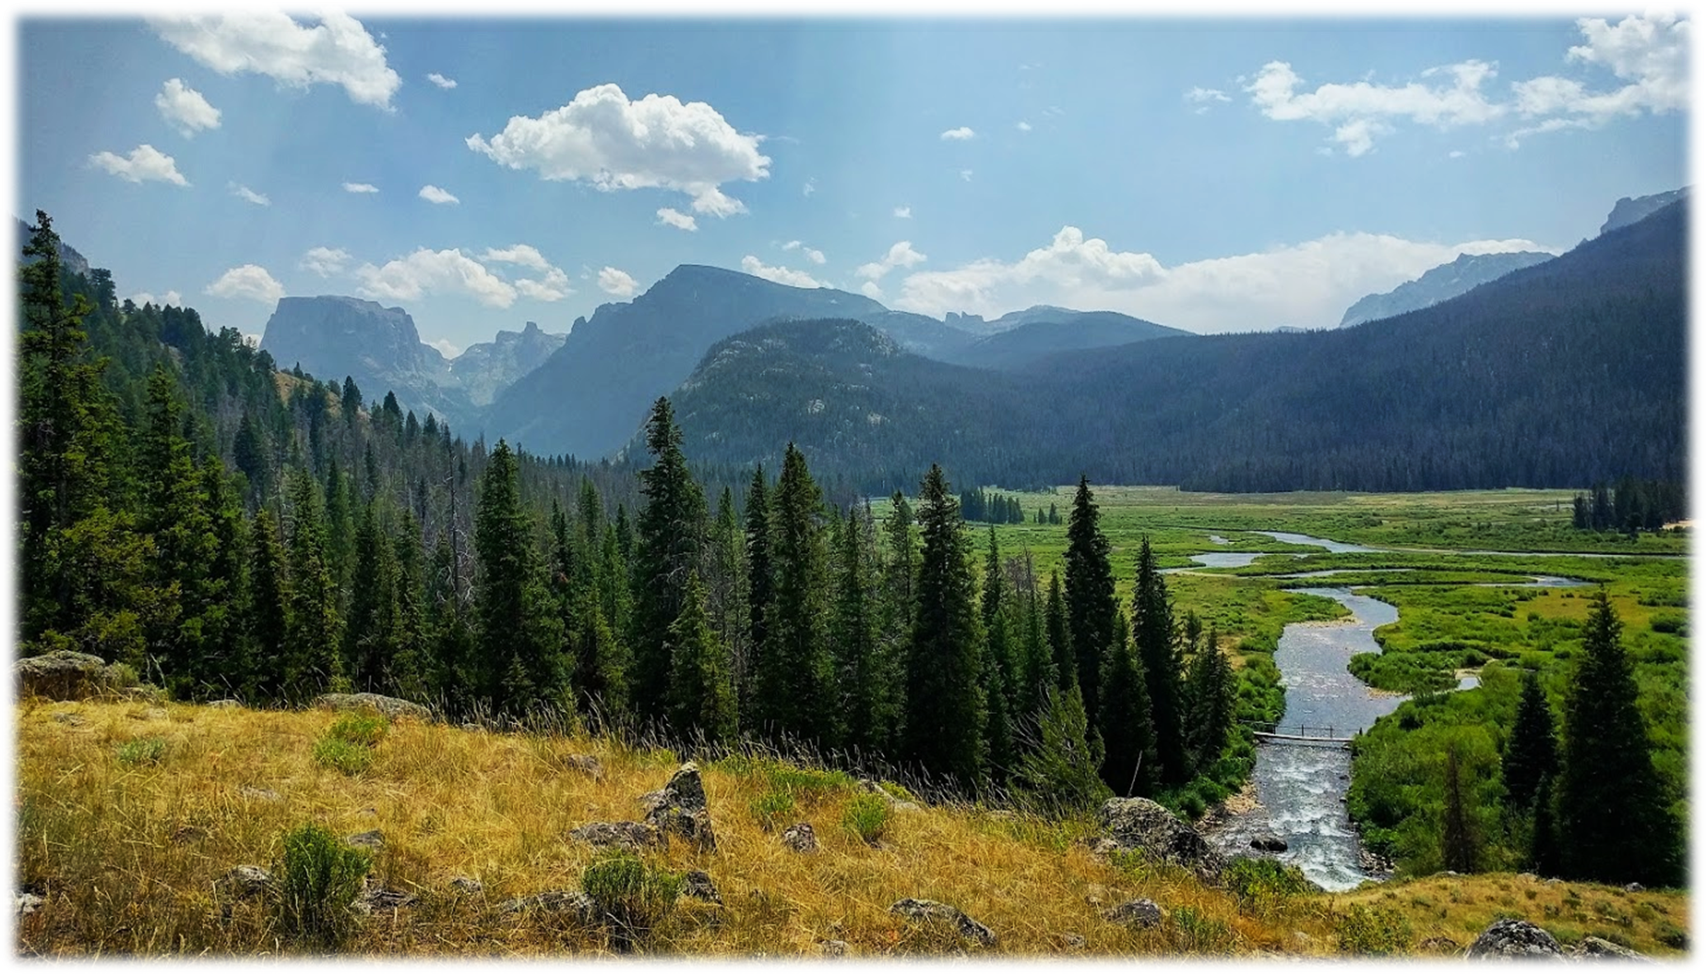
National Trails System Act
P.L. 90-543, Oct. 2, 1968
Law…
Requires:
  Establishment of trail right-of-ways
  Non-motorized (with a few exceptions)
  Comprehensive Plan requirement
  Coordination across jurisdictions
  Engagement of partners and volunteers
Notes:
Establishes Federal recognition and protection for long-distance trails with nationally-significant recreation and scenic potential and historical significance.

Slide 26
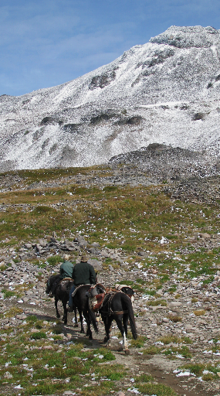
Executive Order 13195
Trails for America in the 21st Century, 2001:
  “Federal agencies will… protect, connect, promote, and assist trails of all types…
  This will be accomplished by… protecting the trail corridors associated with National Scenic Trails… to the degrees necessary to ensure that the values for which each trail was established remain intact.”

Slide 27
FSM 2350
(November 2009)
Needs to be updated to better align with:
The Planning Rule and implementing directives
The Trail Stewardship Act
The National Strategy for a Sustainable Trail
System
The National Trails System Interagency MOU
Notes:
Planning and management of NSHTs should align with the Agency’s leadership intent of strengthening and deepening connections with the public through outdoor recreation experiences. These expectations are further underscored by the National Trails System Interagency MOU, signed by the Chief of the Forest Service in January of 2017. Central to the MOU, and recently emphasized by partners to the Chief, is the objective to promote and facilitate consistent and seamless planning, development, administration, maintenance, and operation of NSHTs across jurisdictional boundaries. In addition, the Forest Service recently completed its National Strategy for a Sustainable Trail System, which also emphasizes the need for shared leader intent and cross-program integration to meet trail management, restoration, and stewardship objectives.

Slide 28
Comprehensive Trail Plans
Are for the acquisition, management, development and use of the trail including:
Objectives and practices to be observed in the management of the trail, including the identification of all significant natural, historical and cultural resources to be preserved.
Agreements to be consummated with other entities, and
An identified carrying capacity of the trail and plan for its implementation.
Acquisition/protection plan for lands to be acquired
General and site specific development plans (including costs).

Slide 29
The last type of plan…
Project Plans
Support and implement LMP and CP direction
Example Project Plans:
Realign a section of trail to reduce resource impacts
Construction of a new parking area to improve access
Treat vegetation to enhance views
Land Management Plans
Comprehensive Trail Plans
Compatibility
Project Plans

Slide 30

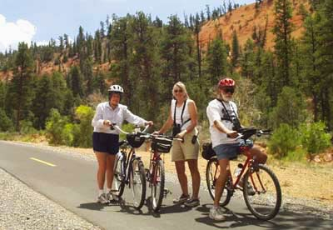
National Recreation Trails
One last thing….
Administratively-designated
Secretary of Interior or the Secretary of Agriculture may designate
NRTs provide for numerous outdoor recreation activities in a variety of urban, rural, and remote areas.
Red Canyon NRT, Dixie NF, Utah
Over 1,000 trails in all 50 states.
Ranging from < 1 mile to 485 miles in length.
Designated on federal, state, municipal, and privately owned lands.
Notes:
Part of the original National Trails System design in 1968, NRT designation for the Forest Service has been delegated from the Secretary of Agriculture to the Regional Forester(s). These trails may include motorized trails and should not be established if they exist entirely within a wilderness area. Regional Foresters should avoid overlapping a National Recreation Trail with a National Scenic Trail or National Historic Trail.
LMPs must identify these trails…through a narrative or a map.
Plan components are not required for each specific recreation trail IF other plan components adequately protect the values and purposes for which the National Recreation Trail was designated.

Slide 31
To Recap:
  NSHTs are congressionally designated areas but are not managed as defacto Wilderness;
  LMPs must Identify and map NSHT corridors in the plan;
  LMPs Must have plan components for NSHTs;
  Planning efforts and management direction must be coordinated across neighboring jurisdictions ;
  LMPs and Comprehensive Plans must be compatible
    LMPs address management of the land (including land around the trail) within the FS unit.
    Comprehensive Trail Plans address management of the entire trail (across jurisdictions).

Slide 32
Contacts:
National Trails Program Manager: Jaime Schmidt, (208)665-0138
National Recreation Planner: Lis Novak, (406)493-8819
WO Planning Specialist: Bill Connelly, (202)205-0962.
NSHT Administrators:
Arizona National Scenic Trail: Laura White (R3), 520-388-832
Continental Divide National Scenic Trail: Brenda Yankoviak (R2),
303-275-5322
Florida National Scenic Trail: Shawn Thomas (R8), 850-523-8586
Nez Perce National Historic Trail: Sandra Bronchaeu-Mcfarland
(R1), 208-476-8334
Pacific Crest National Scenic Trail: Beth Boyst (R5), 707-562-8881
Pacific Northwest Trail: Matt McGrath (R6), 928-348-1974

