Slide 1
The Central Washington Landscape Assessment (CWLA) project update and discussion

Slide 2
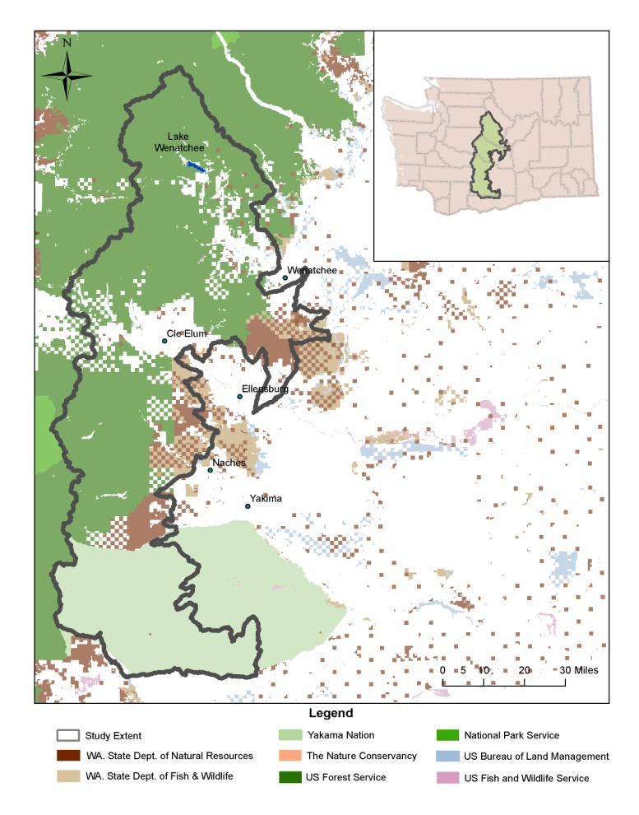
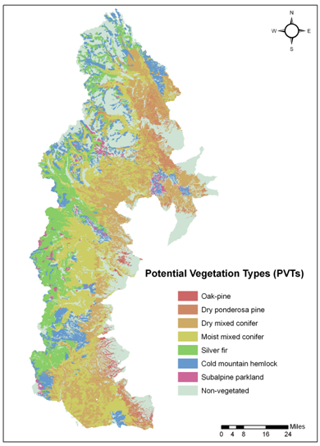
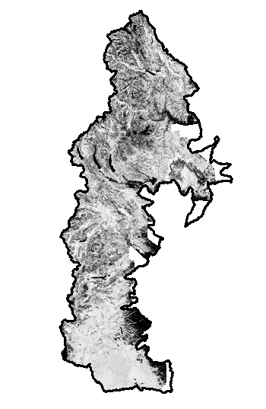
Project Objectives – Create Consistent GIS Data
Existing vegetation

Slide 3
Project Objectives – Create Consistent GIS Data
Existing vegetation
Potential vegetation

Slide 4
Project Objectives – Create Consistent GIS Data
Existing vegetation
Potential vegetation
Ownership/allocation

Slide 5
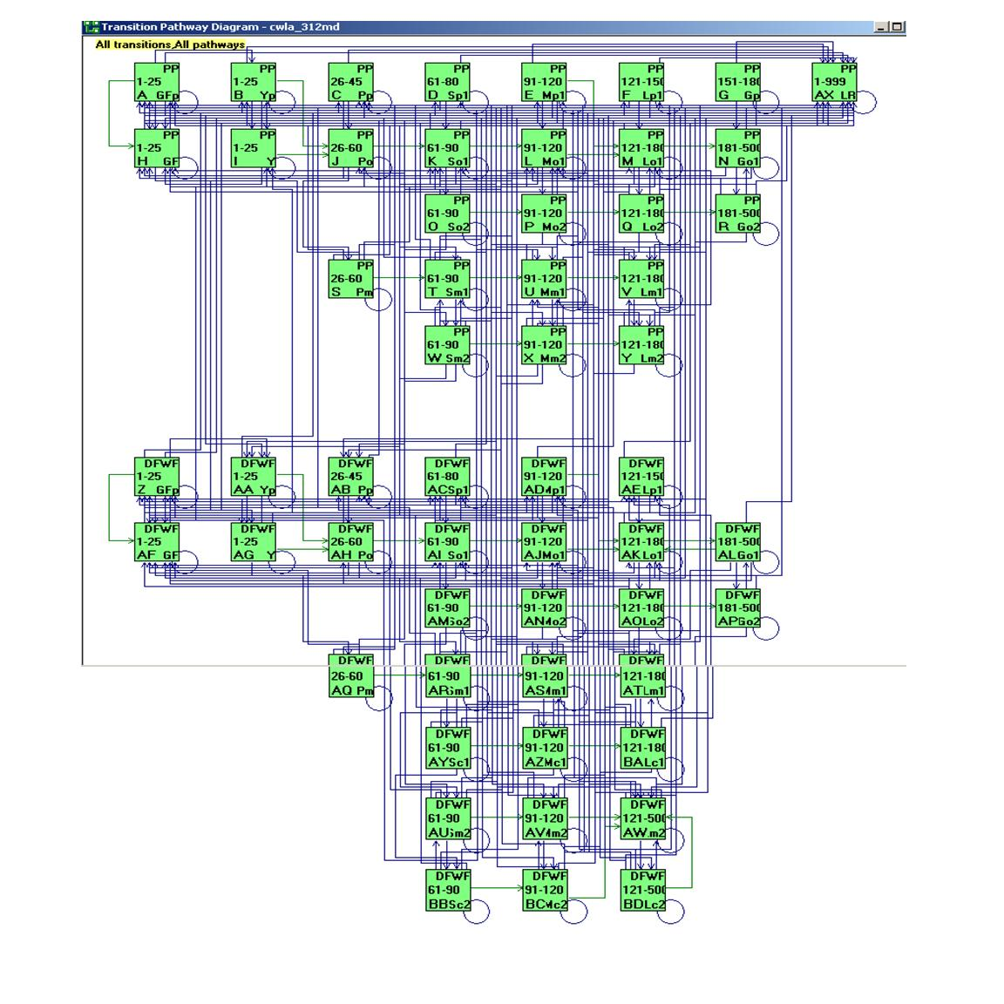
Project Objectives – Model Development
Vegetation Dynamics
Development Tool
(VDDT)

Slide 6
Project Objectives – Model Development
Vegetation Dynamics
Development Tool
(VDDT)
Created seven VDDT
models for all forested
environments in CWLA

Slide 7
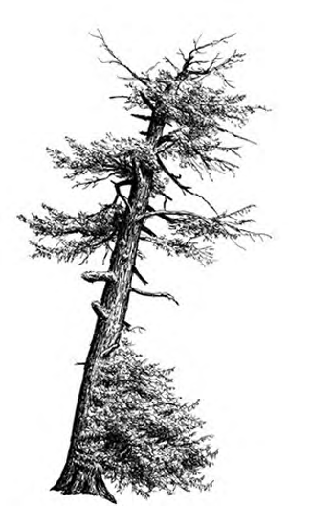
Project Objectives – Run Multiple Scenarios
Historic
Current Management
No management other
than fire suppression

Slide 8
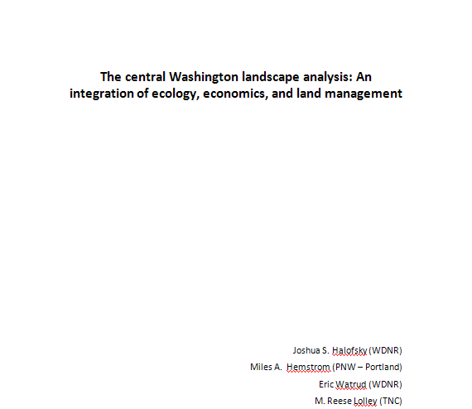
Project Objectives – Write Report
Please view the rest of this document
as example output!

Slide 9
Topics Addressed in Report – Trends in large Ponderosa pine trees

Slide 10
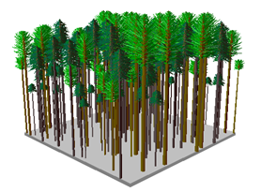
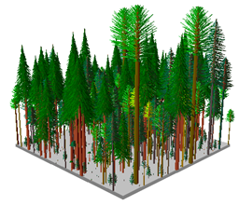
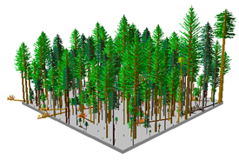
Topics Addressed in Report – Trends in potential northern spotted owl habitat
Dry mixed conifer PVT, High density, Multi-storied, Douglas-fir/Grand fir cover type
Moist mixed conifer PVT, High density, Single storied, Grand fir cover type
Moist mixed conifer PVT, High density, Multistoried, Grand fir cover type

Slide 11
Topics Addressed in Report – Trends in potential northern spotted owl habitat

Slide 12
Topics Addressed in Report – Trends in timber volume

Slide 13
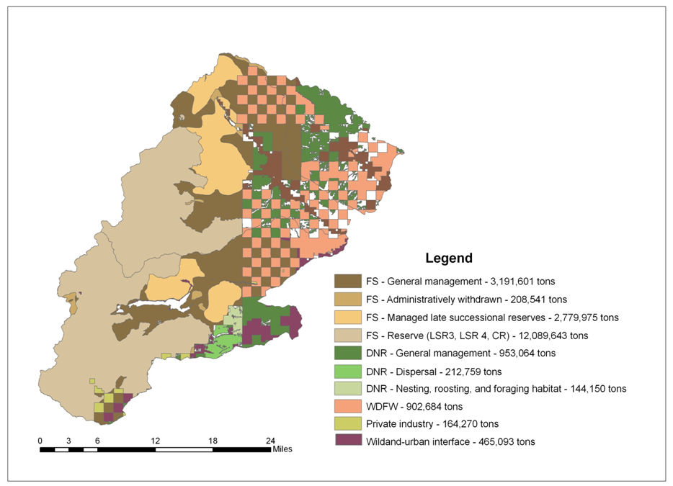
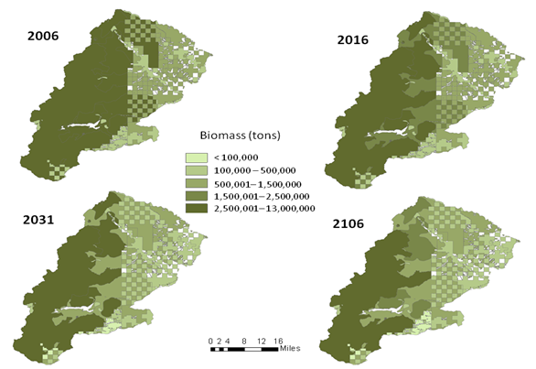
Topics Addressed in Report – Trends in biomass

Slide 14
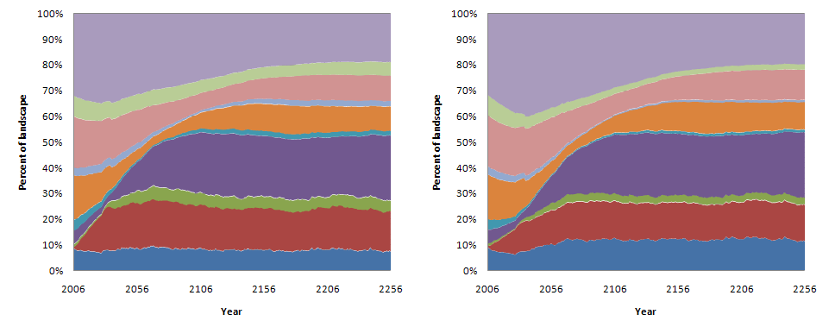
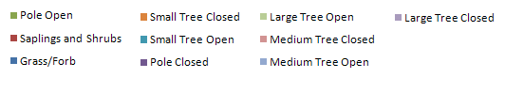
Topics Addressed in Report– Multiple Scenarios, Forest Service
Current Management
No Management

Slide 15
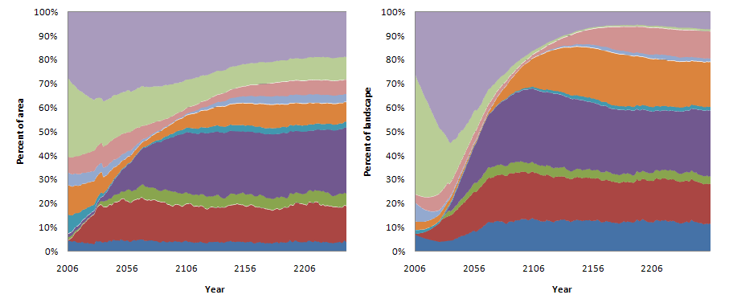
Topics Addressed in Report– Multiple Scenarios, Yakama Nation
Current Management
No Management

Slide 16
Summary of Findings
Today’s east-side forests are structurally and compositionally different than forests were historically.

Slide 17
Summary of Findings
Today’s east-side forests are structurally and compositionally different than forests were historically.
Northern spotted owl habitat in drier forest types is more abundant today than in the past but can current levels of habitat be maintained?

Slide 18
Summary of Findings
Current management does not greatly influence the impact of natural disturbances on forest structure.

Slide 19
Summary of Findings
Current management does not greatly influence the impact of natural disturbances on forest structure.
There is a potential opportunity cost if current management continues.

