Slide 1
Humans as ecosystem modifiers:
Influences on the forest landscape over time
& NEPA Analysis Applications
Michelle Steen-Adams, Ph.D.
Landscape Ecology and NEPA Planning Training
5 November, 2019

Slide 2
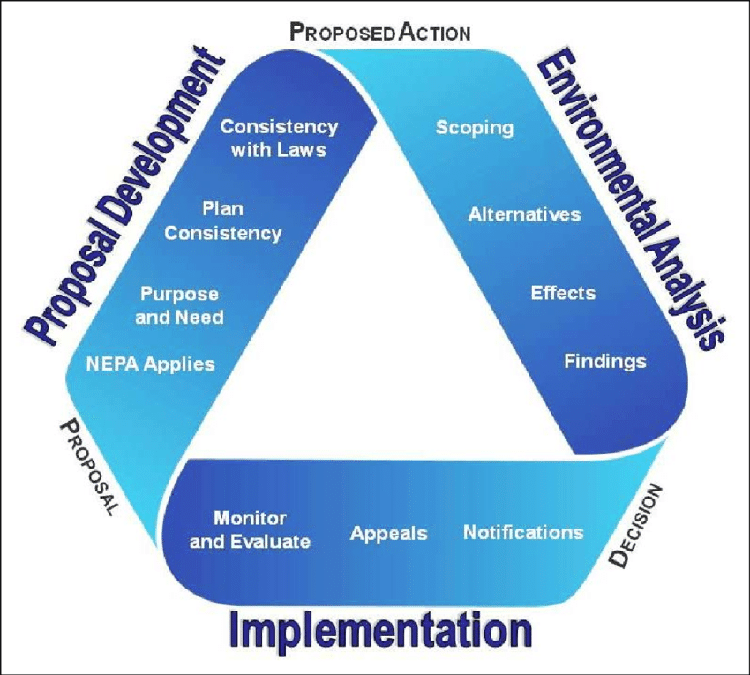
Key question
What approaches can be employed to integrate socio-cultural processes into a landscape ecology framework to NEPA decision-making?
Outcome: strengthen NEPA decisions

Slide 3
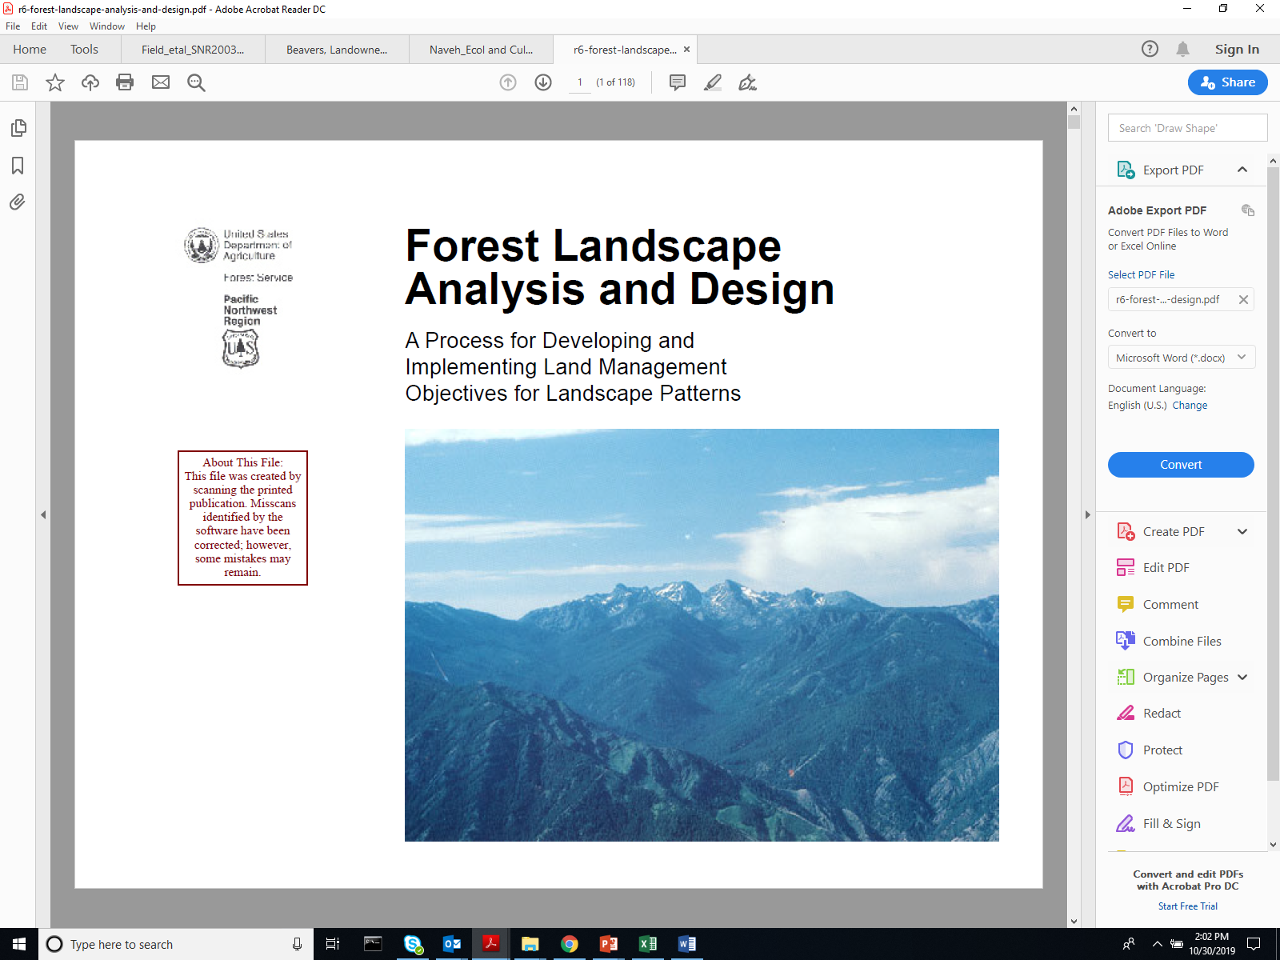
Diaz and Apostol, 1992

Slide 4
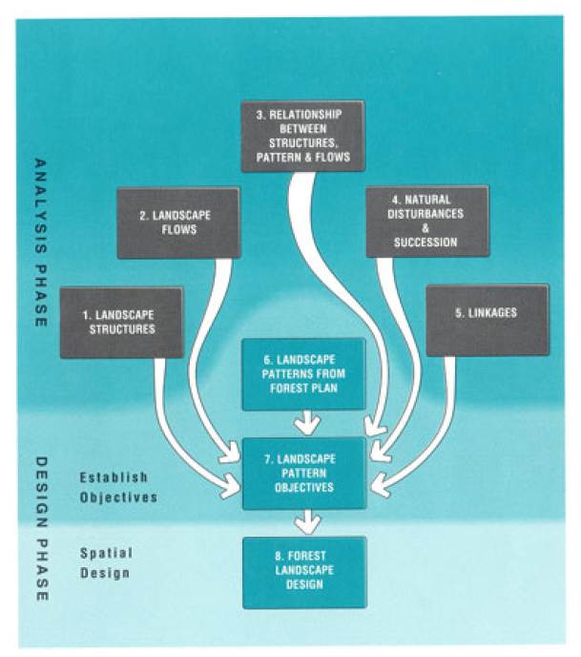
Landscape Analysis and Design Framework
ANALYSIS PHASE
Landscape Structure
Landscape Flows
Interactions
Natural disturbances and succession
Linkages/ Landscape context

Slide 5
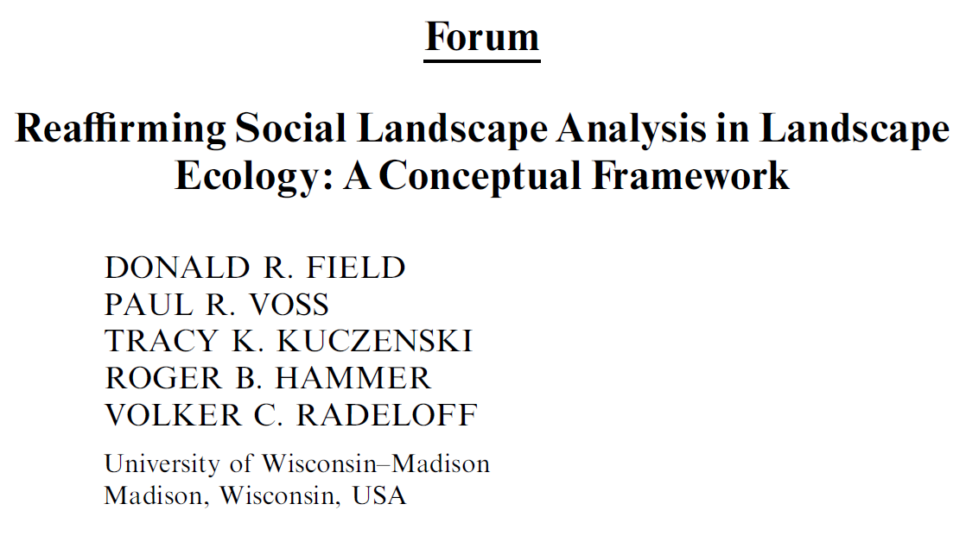
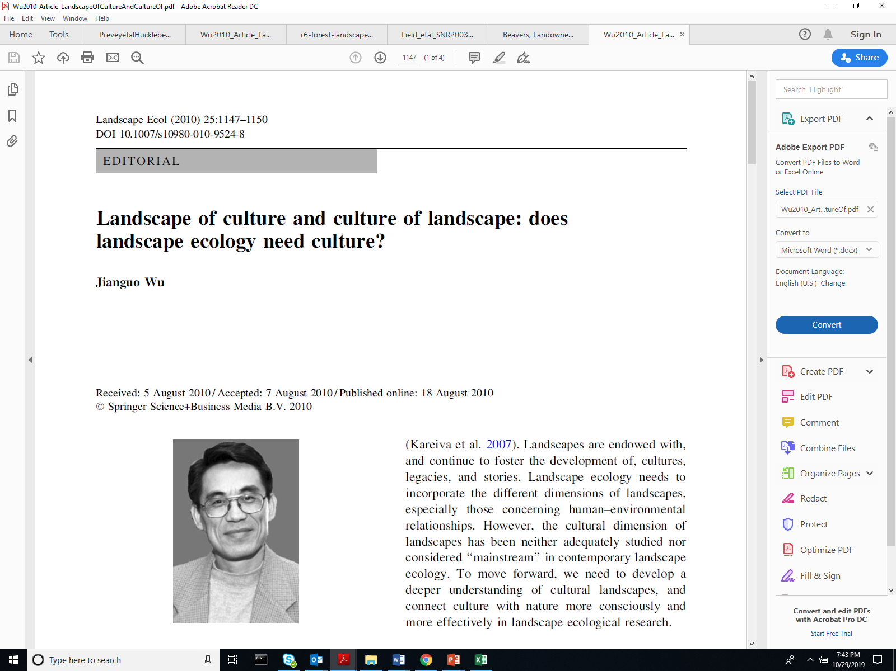
State of the science: Inherent challenges
In general, landscape ecologists have paid much more attention to the biophysical than cultural aspects of landscapes (Wu, 2010).
Need attention to the cultural landscape
Need attention to the “human actor” (Field et al., 2003)

Slide 6

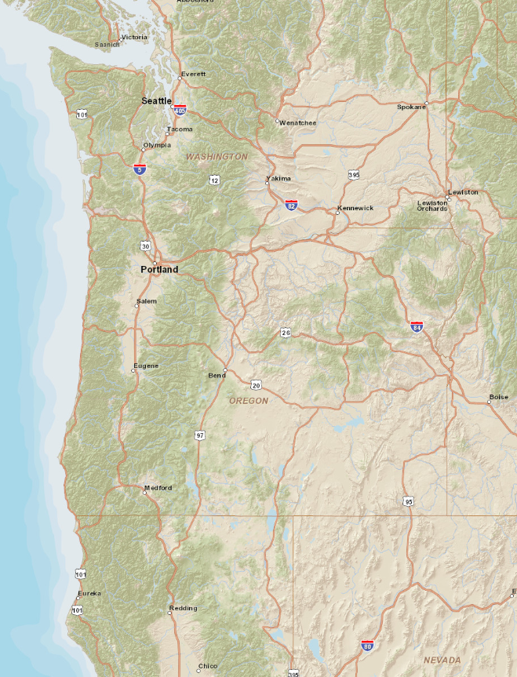
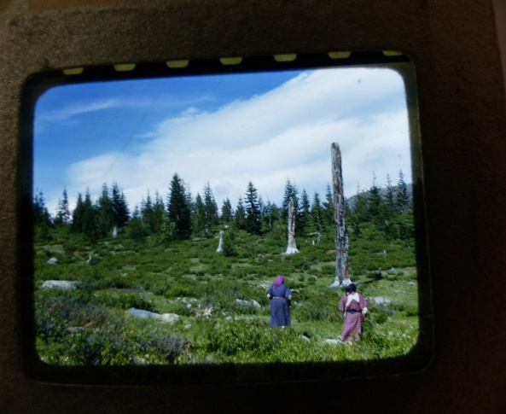
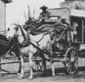
3 approaches to human dimensions of landscape ecology
Approach | Focus/ concept | Example
Cultural landscape analysis | Cultural fire regime | Eastside Cascades of Oregon
Multi-level analysis | Heritage feature: multiple levels | Santiam Wagon Road, Willamette NF
Social landscape analysis | Social influences on adoption of Beaver Related Restoration (BRR) of wetland systems | (3a) Triple Creek project, Okanogan Highlands, WA (3b) Scott River Basin, CA

Slide 7
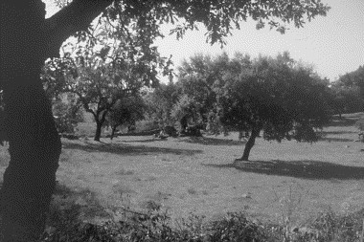
(1) Cultural Landscape Analysis
Focus: cultural processes
Relevance:
  Maintenance /influence on landscape structure
  Biodiversity
  Resilience
Agro-Silvi-Pastoral landscape, “Montado”, Portugal
Pinto-Correia, 2000, Landscape and Urban Planning

Slide 8
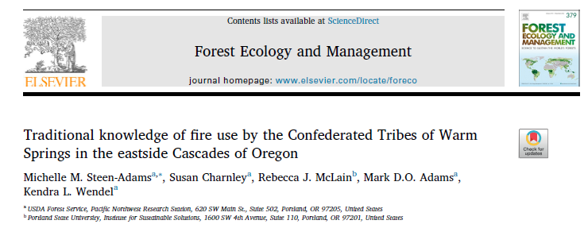
Cultural landscape analysis example:
Traditional fire use, Eastside Cascades of Oregon
What is the traditional knowledge of fire use by the CTWS peoples?
How did the CTWS peoples traditionally use fire in the Moist Mixed Conifer (MMC), Dry Mixed Conifer (DMC), and Shrub-Grassland (SG) zones, and thereby maintain cultural fire regimes (CFRs)?

Slide 9
Cultural Fire Regime
A group’s pattern of managing fuels and ignitions of a particular ecological community to promote desired resources and ecological conditions
(1) Traditional knowledge
(3) Historical fire regime
  Fire frequency
  Severity
  Burn patch size
  Extent
  -Culture
→Practices
(2) Cultural fire regime
  Fire frequency
  Severity
  Burn patch size
  Extent

Slide 10
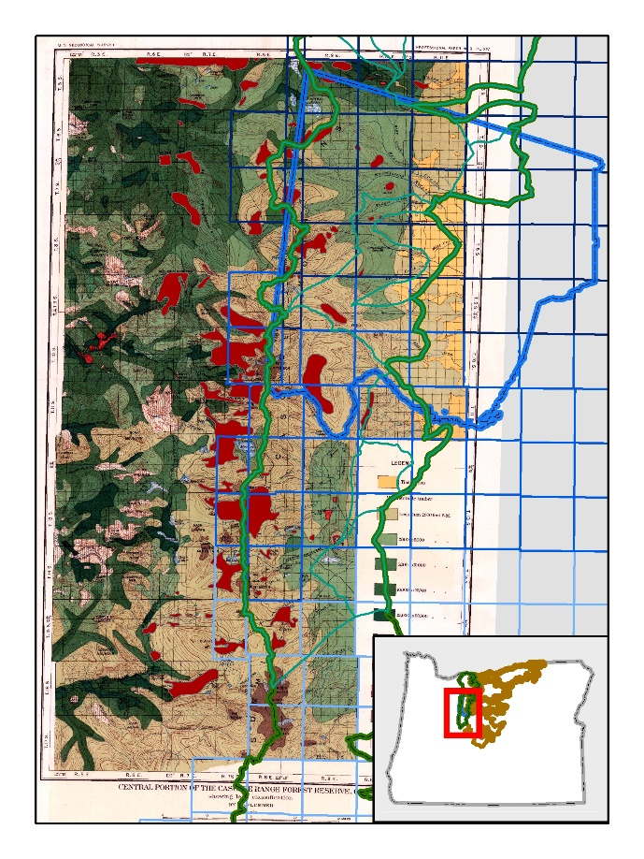
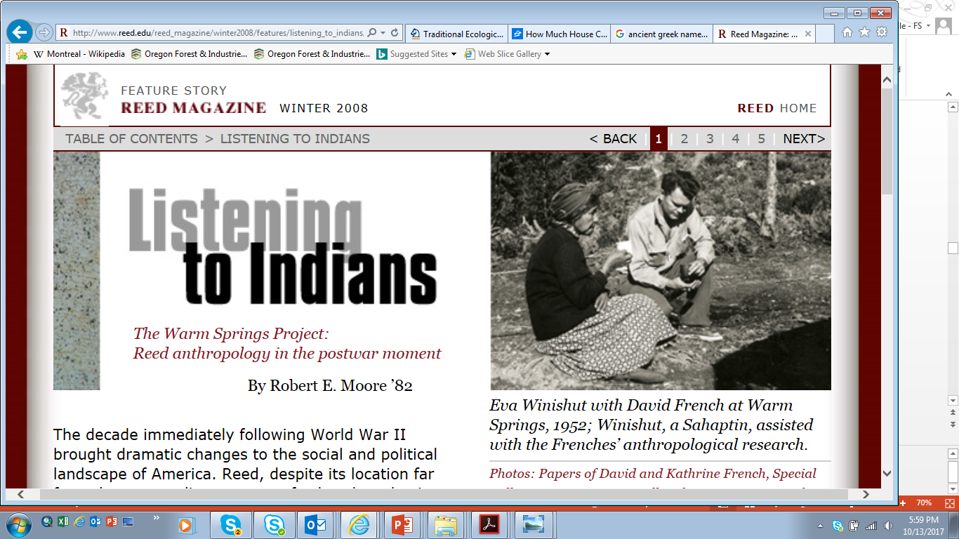
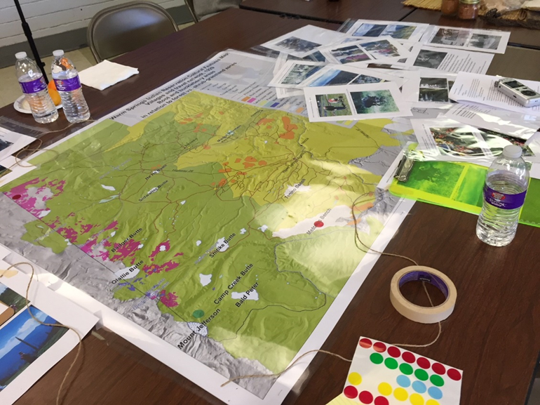

Methods & Materials
Ethnohistorical records
Oral history interviews and Participatory GIS data
Historical ecological records
R. McLain

Slide 11
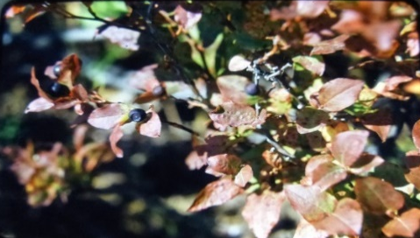
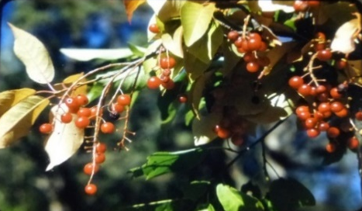
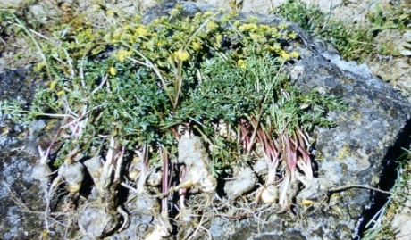
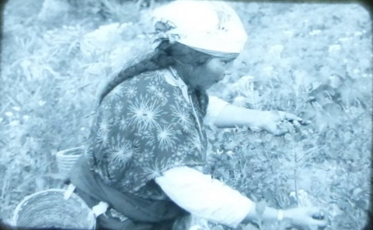
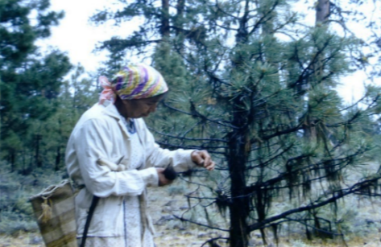
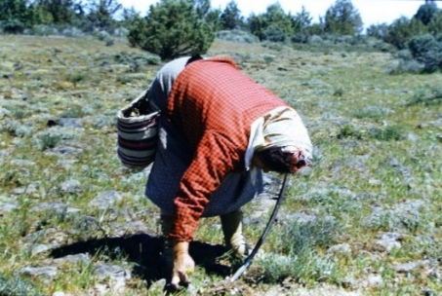
Results
 | MMC | DMC | SG
Key resc. | -Big leaf huckleberry -Mountain ash (and others) | -Chokecherry -Black lichen (and others) | -Biscuitroot -Bitterroot (and others)
CFR | Low severity, frequent fire use | Fire use not reported | Fire use not reported; natural fire perceived as beneficial
Warm Springs tribes developed traditional knowledge to promote distinct culturally-important resources in MMC, DMC, and SG zones
Cultural fire regime in MMC zone
  Severity: low
  Frequency: ~7 years
  Patch: 1-4 ha
  Pattern: rotational
  Extent: ~220,000 ha
  24 resource sites
    Mt. Hood
    Mt. Jefferson
    buttes
D. French, University of Washington Special Collections

Slide 12
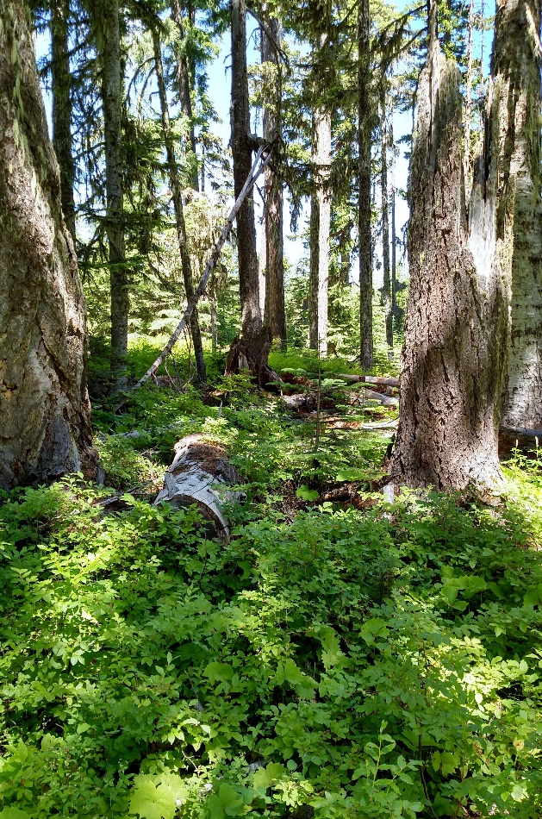
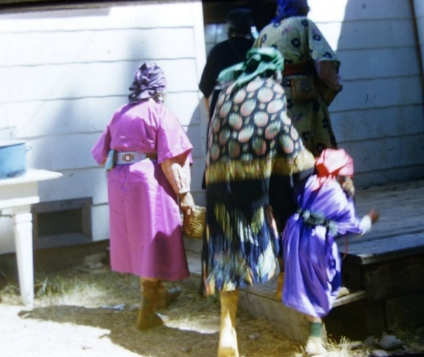
Restoration applications
Landscape-level, cross-ownership approach
Big-leaf Huckleberry (Vaccinium membranaceum)
Community engagement
USFS
CTWS
M. Jimenez, Confederated Tribes of Warm Springs
D. French, University of Washington Special Collections

Slide 13
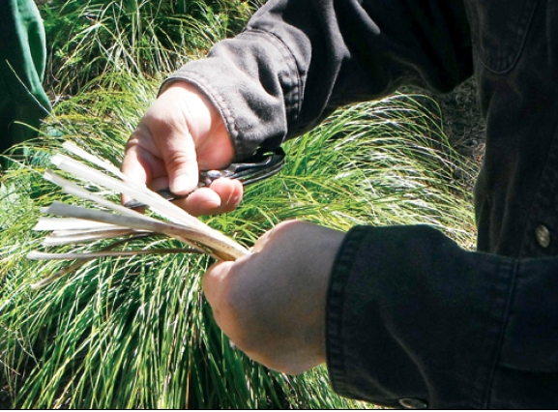
Cultural landscape analysis application to LAD Framework
LAD Framework modification
Cultural process → Historical disturbance regime
Applications
Historical landscape structure
Restore Culturally-important species
Cultural processes
D. French, University of Washington Special Collections
B. Gervais

Slide 14
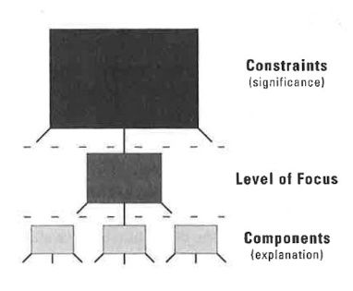
(2) Multi-level Analysis
Hypothetical example elements
Climatic & topographic factors
What is the effect of tree stand density on avian diversity?
Nesting sites
Foraging sites
Turner et al., 2001. Adapted from O’Neill et al.; 1986; Allen and Star, 1982.

Slide 15
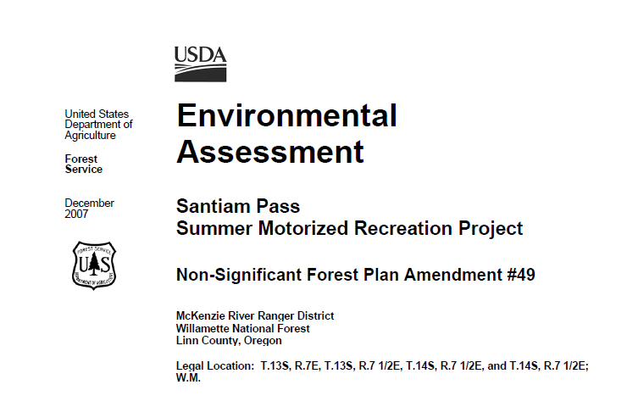
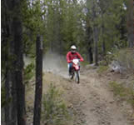
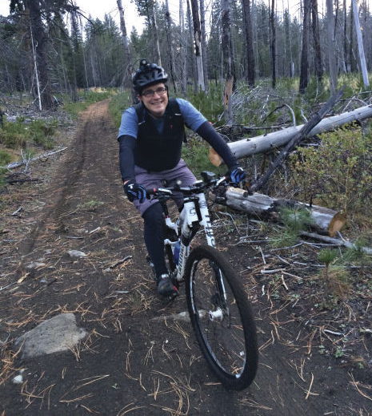
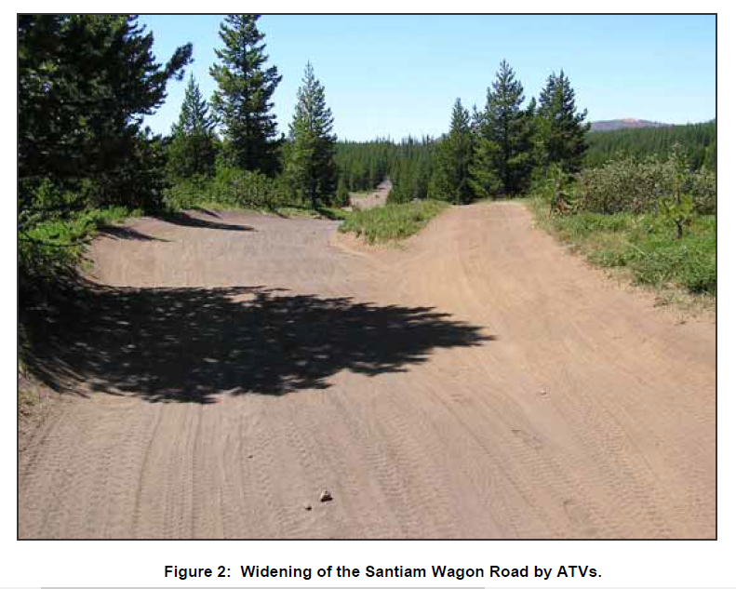
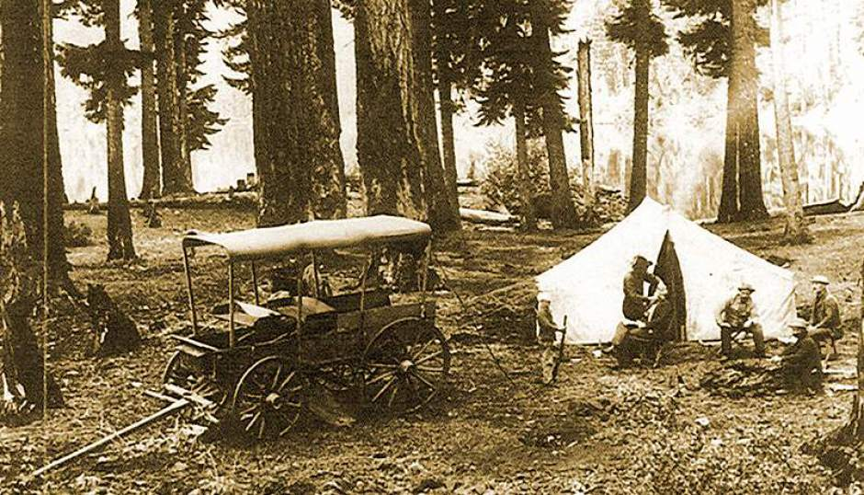
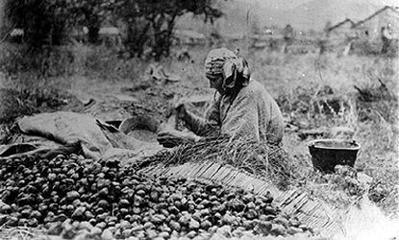
Santiam Wagon Road Special Interest Area,
Santiam Pass, Summer Motorized Recreation Project
Use Considerations
Heritage Resource Considerations

Slide 16
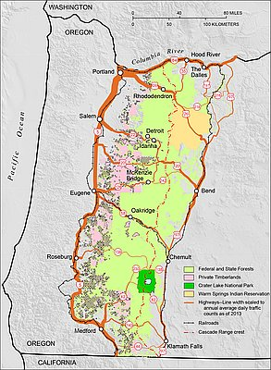
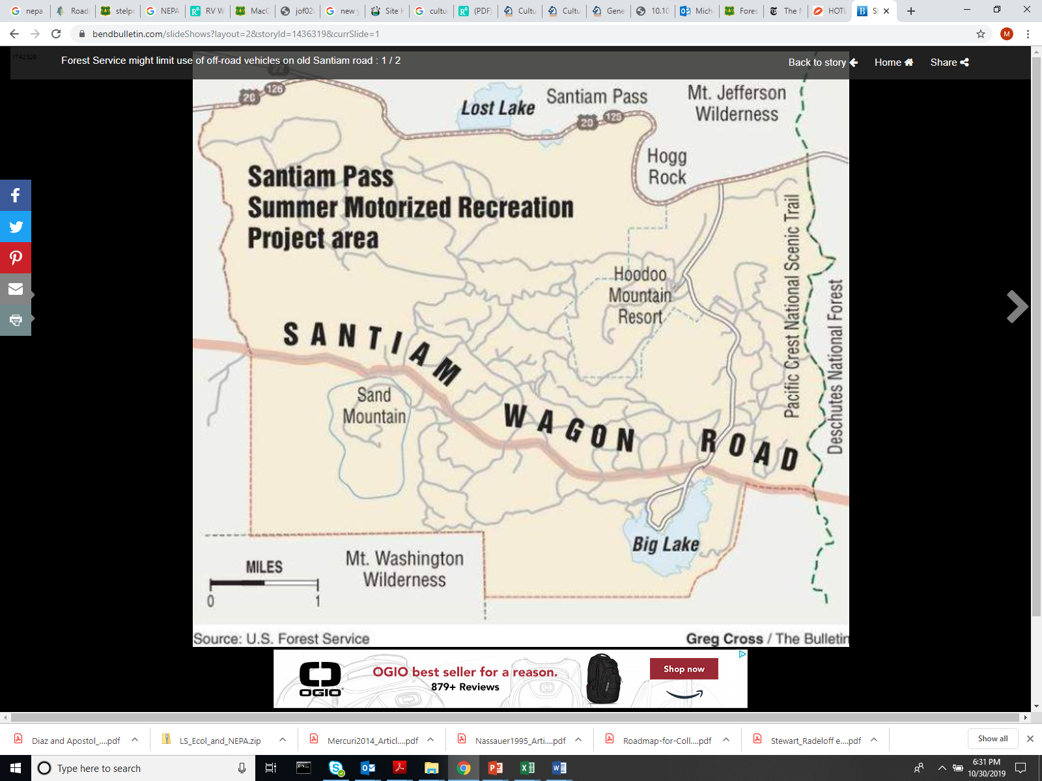
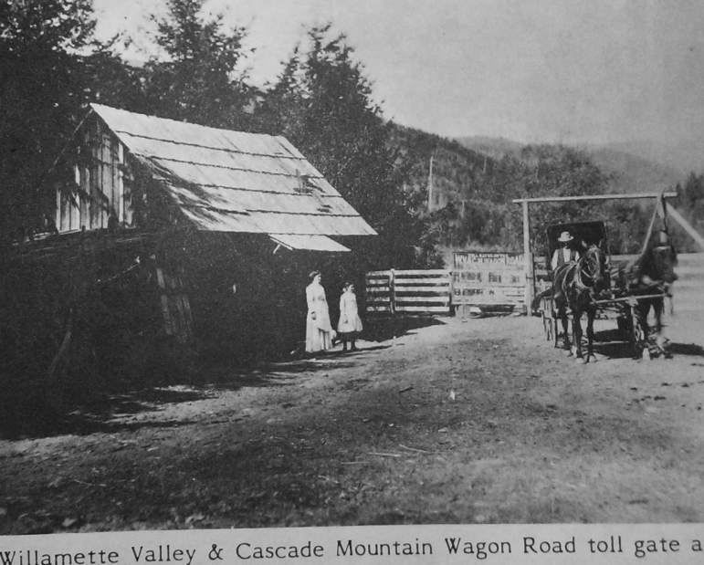
Multi-level analysis:
Application to Santiam Wagon Road SIA
Landscape context-level
Focal level:
SIA feature
Site-level
Turner et al., 2001. Adapted from O’Neill et al.; 1986; Allen and Star, 1982.

Slide 17
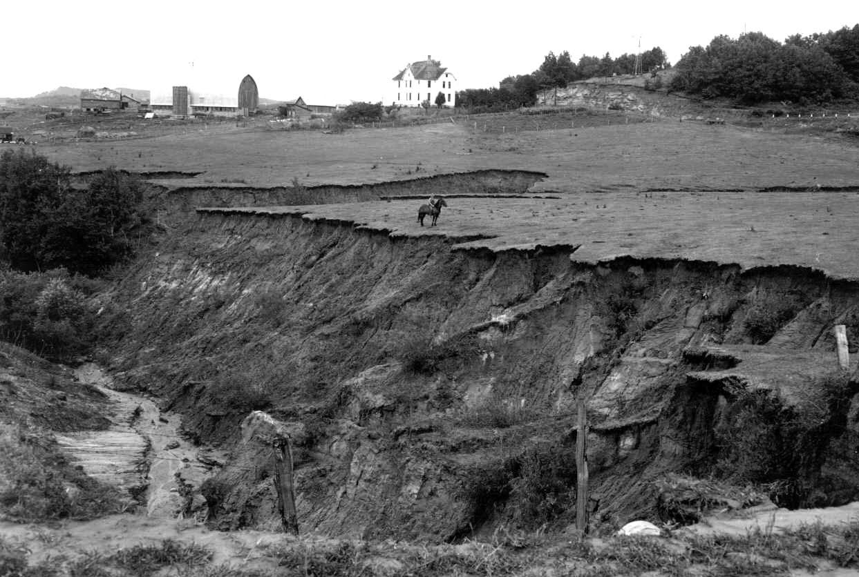
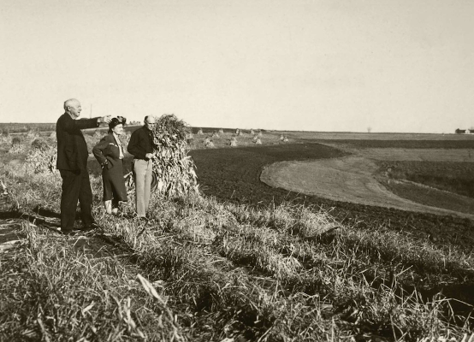
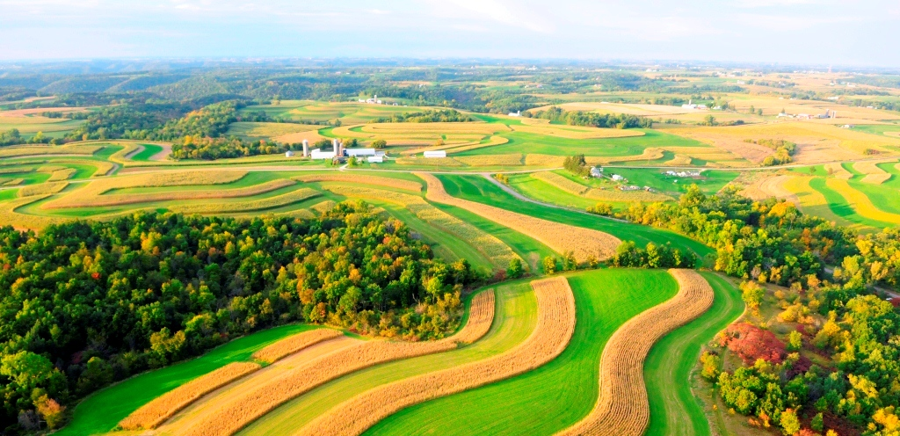
(3) Social landscape analysis
Objective expand the scope of landscape ecology: social organizational structure, human behavior, and social relations to the land (Field et al., 2003).
Origin:
USDA Natural Resc. Conserv. Service
J. Luhning

Slide 18
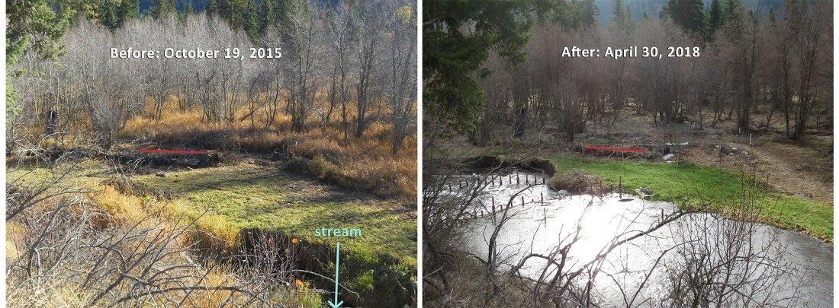
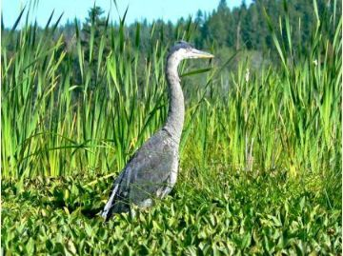
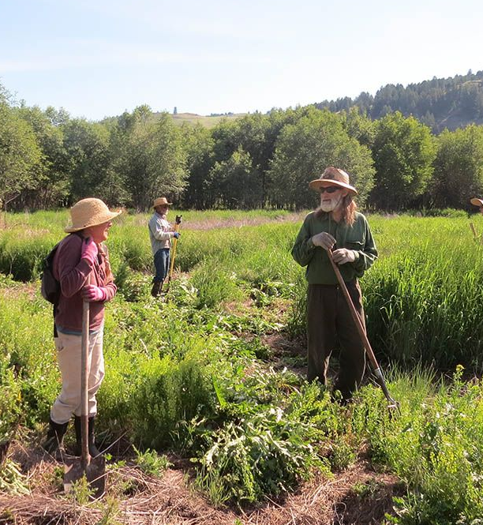
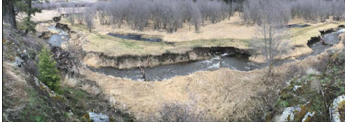
Example (3a): Wetland restoration
Triple Creek project, Okanogan Highlands
Problem: Stream incision
Significance
Social context
D. Dufour
Floodplain function
Wetland vegetation
-Avian community
Okanogan Highlands Alliance

Slide 19
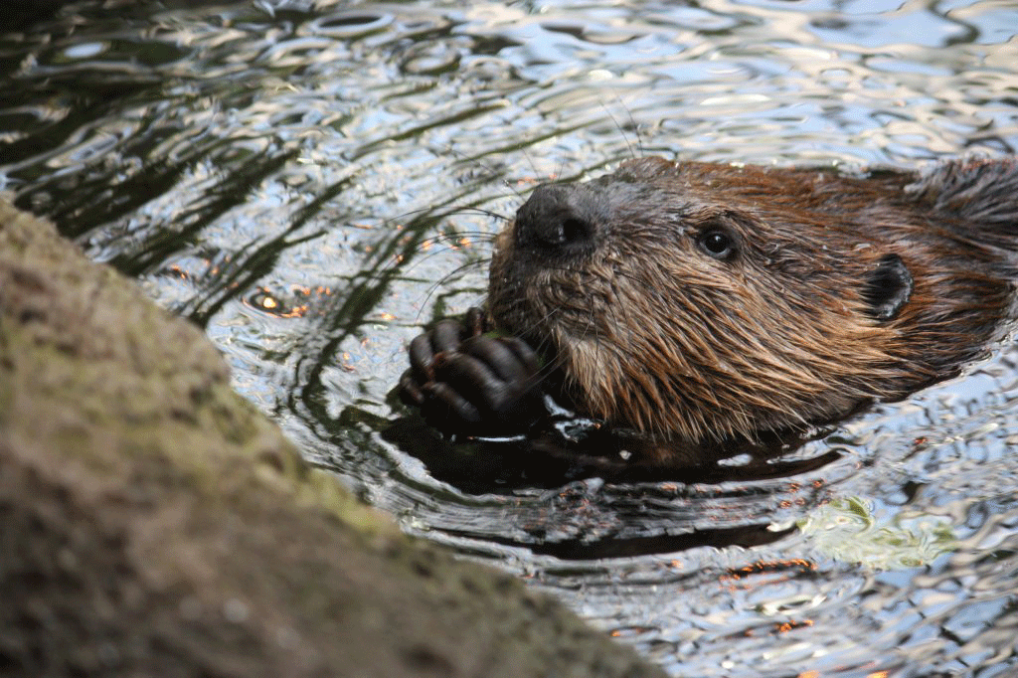
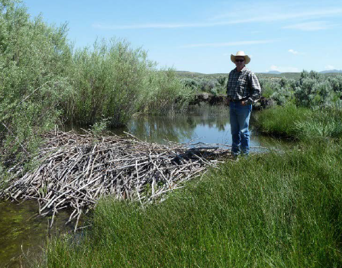
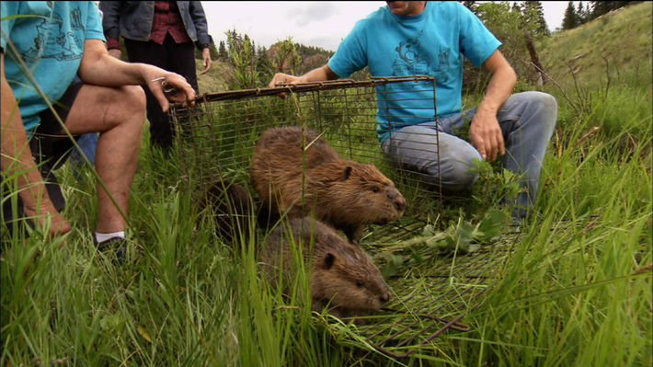
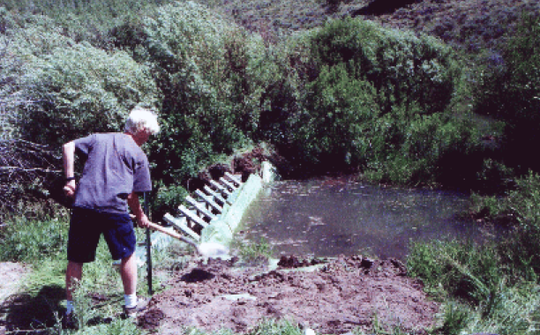
Potential solution:
Beaver related restoration (BRR)
Beaver translocation
The use of beavers or artificial structures that mimic beaver dams
as a tool in restoration practice

Slide 20



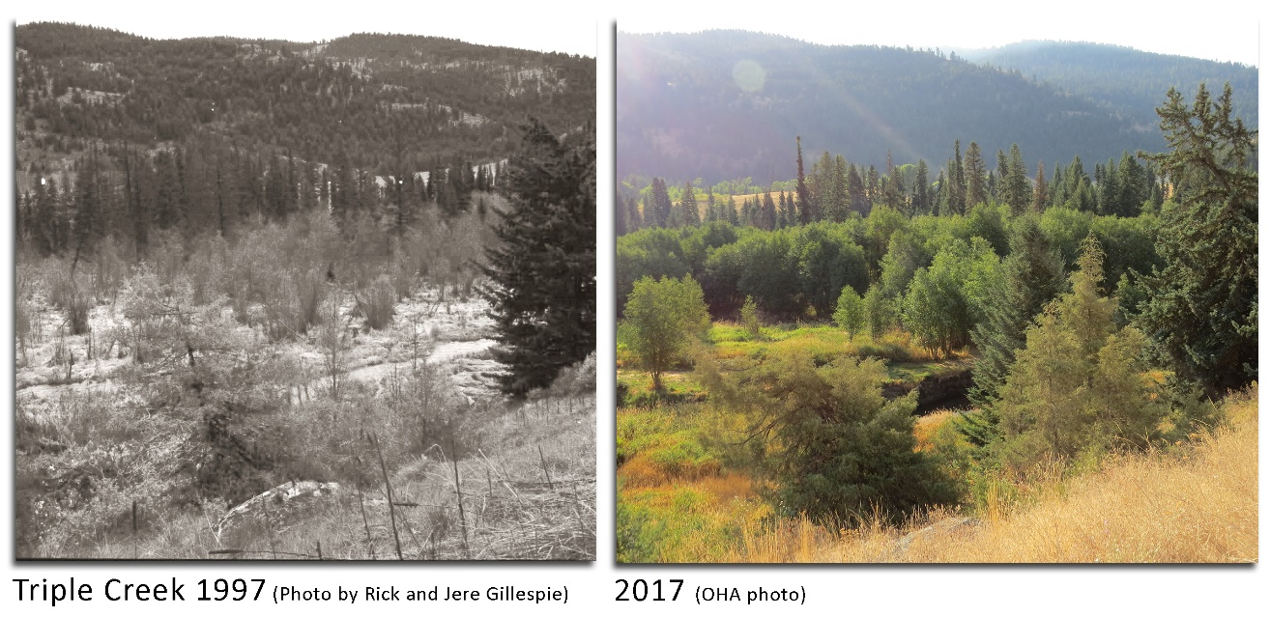
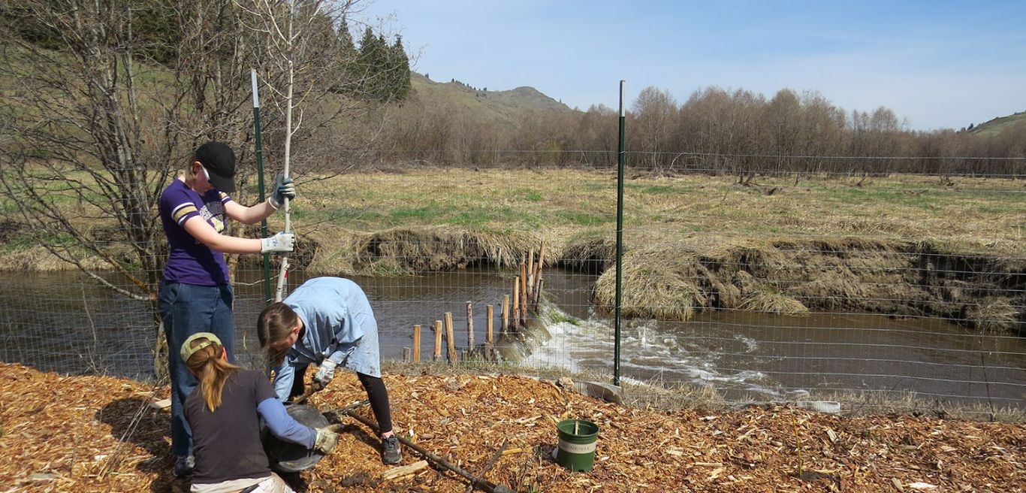
Triple Creek Project collaboration
d
Triple Creek Landowners

Slide 21
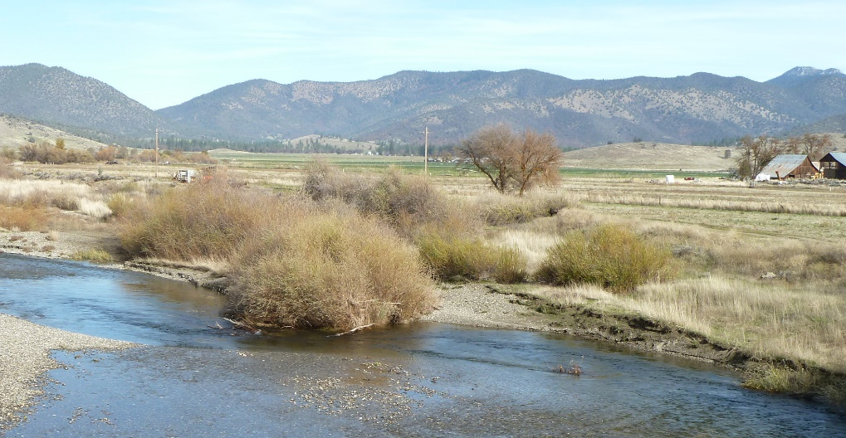
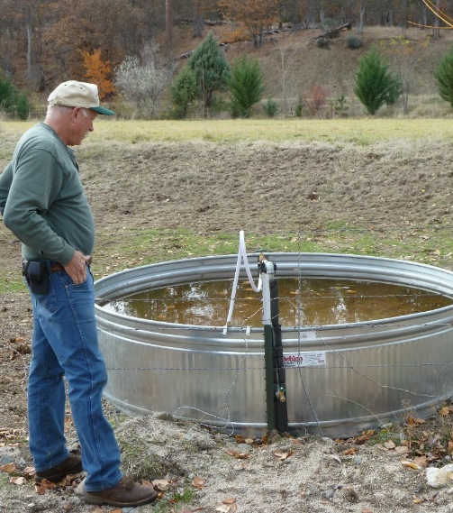
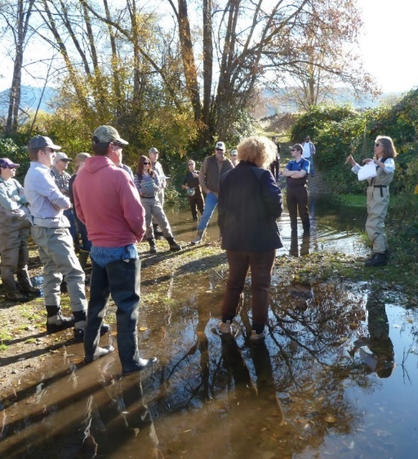
Example (3b): Scott River Basin, California
Perceived Benefits | Perceived Costs
More water available for irrigation | Beavers plug irrigation infrastructure
Increase forage production | Beavers eat alfalfa
More surface water later into dry season | Beavers cut down trees
Create habitat for fish & wildlife | Dams can cause flooding, damaging property
Land ownership context
S. Charnley
Social Context
Charnley, 2018.
Notes:
1 - SONCC coho: Southern Oregon Northern California Coast coho salmon – Oncorhynchus kisutch
SONCC coho first listed as threatened under the federal ESA in 1997, and as threatened under the CA ESA in 2002. According to the NMFS, the SONCC is likely to become endangered.
The Scott River is the most important spawning and rearing stream for SONCC coho in the Klamath River Basin
The SONCC recovery plan identifies increasing beaver abundance in the Scott River basin as a high priority action to promote fish population recovery
2 - The Scott River Basin has also been an important agricultural area for over a century; thus water is important for both fish and agriculture
3 – Stream incision caused by a history of land & water use and management decisions is a problem in some places

Slide 22

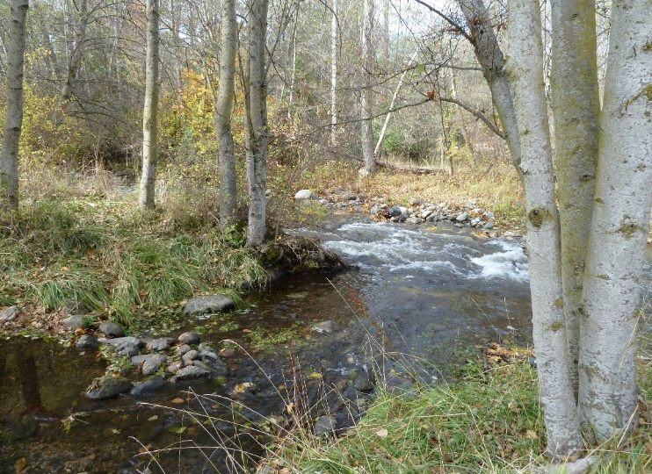


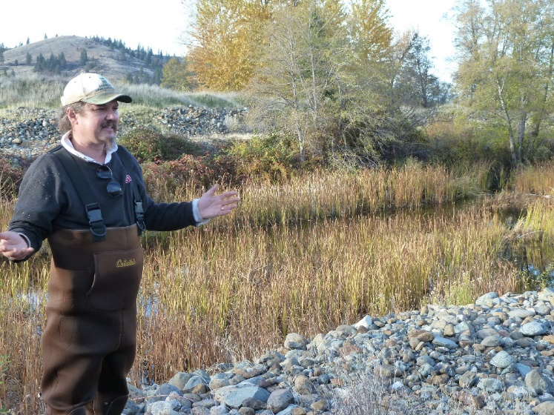



Social analysis:
Enabling factors for beaver related restoration
(Selected examples, Charnley, 2018)
Proponents/innovators/partnerships
Compatible grazing management
Supportive regulatory environment

Slide 23
Social landscape analysis application to LAD framework
Social drivers – Framework addition
  Influences on human behavior
    Example: Enabling factors of BRR
  Social influences on LAD elements:
    Wildlife (Landscape flows)
    Landscape structure
    Interactions
    Disturbances
Social drivers

Slide 24




Conclusions: Human dimensions into LAD framework
(1) Cultural Landscape Analysis:
  Cultural processes: Cultural Fire Regime
(2) Multi-level analysis
(3) Social Landscape Analysis:
  Social drivers/ social organization
Social drivers
Cultural processes

Slide 25
Acknowledgements
Confederated Tribes of Warm Springs
Reconstructing Historical Fire Regimes using Ecological and Anthropological Data Resources project team
Okanogan Highlands Alliance
Beavers, Landowners, and Watershed Restoration in the Scott River Basin, CA project team
Project funding
Pacific Northwest Research Station, USDA FS

Slide 26
References-selected
Allen, T.F. and Starr, T.B., 2017 (1982). Hierarchy: perspectives for ecological complexity. University of Chicago Press.
Charnley, S. 2018. Beavers, Landowners, and Watershed
Restoration: Experimenting with beaver dam analogues in the Scott River Basin, California, USDA Forest Service Research Paper PNW-RP-613.
Diaz, Nancy; Apostol, Dean. 1992. Forest landscape analysis and design: a process for developing and implementing land management objectives for landscape patterns. R6 ECO-TP-043-92. Portland, OR: U.S. Department of Agriculture, Forest Service, Pacific Northwest Region.
Minang, P. A., Duguma, L. A., Alemagi, D., & van Noordwijk, M. (2015). Scale considerations in landscape approaches. In Minang, P. A., van Noordwijk, M., Freeman, O. E., Mbow, C., de Leeuw, J., & Catacutan, D. (Eds.) Climate-Smart Landscapes: Multifunctionality in Practice, 121-133. Nairobi, Kenya: World Agroforestry Centre (ICRAF)
O’Neil, R.V., DeAngelis, D.L., Waide, J.B., and Allen, T.F.H., 1986. A Hierarchical Concept of Ecosystems, Princeton University Press, New Jersey, USA.
Steen-Adams, M.M., Charnley, S., McLain, R.J., Adams, M.D. and Wendel, K.L., 2019. Traditional knowledge of fire use by the Confederated Tribes of Warm Springs in the eastside Cascades of Oregon. Forest Ecology and Management, 450, p.117405.
Turner, M.G., Gardner, R.H., and O'Neill, R.V., 2001. Landscape ecology in theory and practice (Vol. 401). New York: Springer.

Slide 27

Questions

Slide 28
Q & A Slides

Slide 29

Human influences on the PNW landscape over time: 3 aspects
Keystone species – wetland interactions: Beaver related restoration
Historical Trail/
Road influences
Cultural fire regime influence
Pre-Euro American settlement period
Euro-American settlement period
Early 20th Century
Post-WWII- present

Slide 30



Cultural Landscape Typology,
World Heritage Convention, UNESCO
Clearly defined landscapes designed and created intentionally by humans
2. “Organically evolved landscapes” – resulting from successive interactions between local people and their natural environments
3. Associative cultural landscapes: places of powerful religious, cultural, or spiritual associations with natural environment
Adi Siminov
Head-Smashed-In Buffalo Jump World Heritage Site, Alberta.
© Parks Canada / Jazhart Studios

Slide 31
(3) Social landscape analysis
Objective expand the scope of landscape ecology: social organizational structure, human behavior, and social relations to the land (Field et al., 2003).
Origin:
USDA Natural Resc. Conserv. Service
J. Luhning
Scale Equivalence Examples:
Spatial hierarchy | Social landscape | Biophysical landscape
Individual site | Neighborhood | Stand, patch, stream
Landscape | Community, Local NGO, Conservation district | Watershed, local biome
Physiographic region | State, Census region | North Pacific Region

