Slide 1
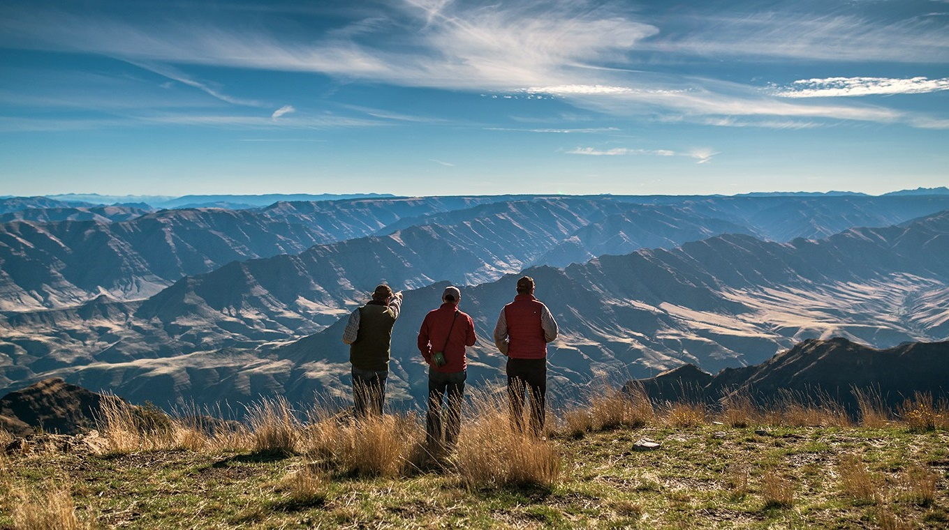
Practical Application of Natural Range of Variation Concepts to Support Planning
Landscape Ecology and NEPA Planning
Oregon State University, Corvallis
5 November 2019

Slide 2
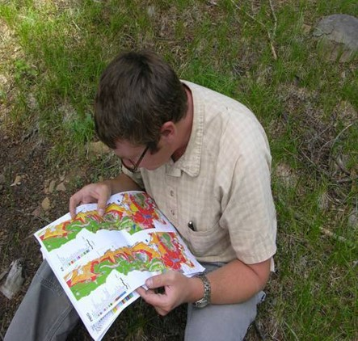
“Show me how it all fits together”

Slide 3
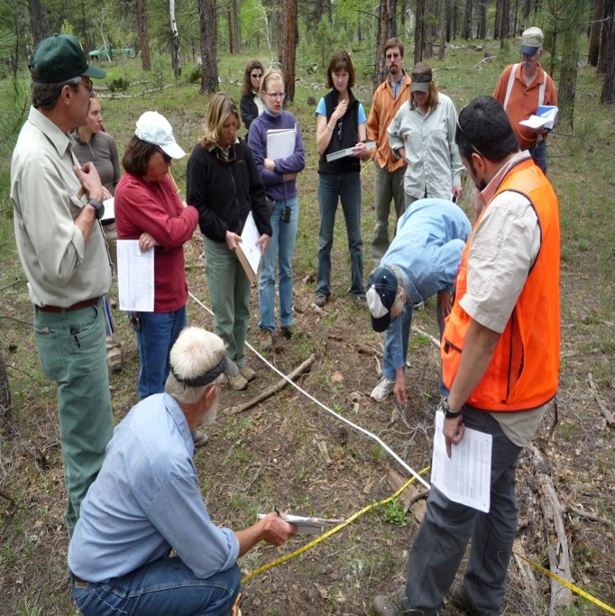
How it all fits together
The legacy and building blocks
The need for a set of departure estimates covering the Region
Development of these estimates
Refinement and expansion of these estimates to meet planning needs

Slide 4
Potential vegetation plant association legacy
In response to National Forest Management Act reforestation requirement
Match the species to the site—local scale
1980-1995
More or less covered all forested areas of the Region

Slide 5
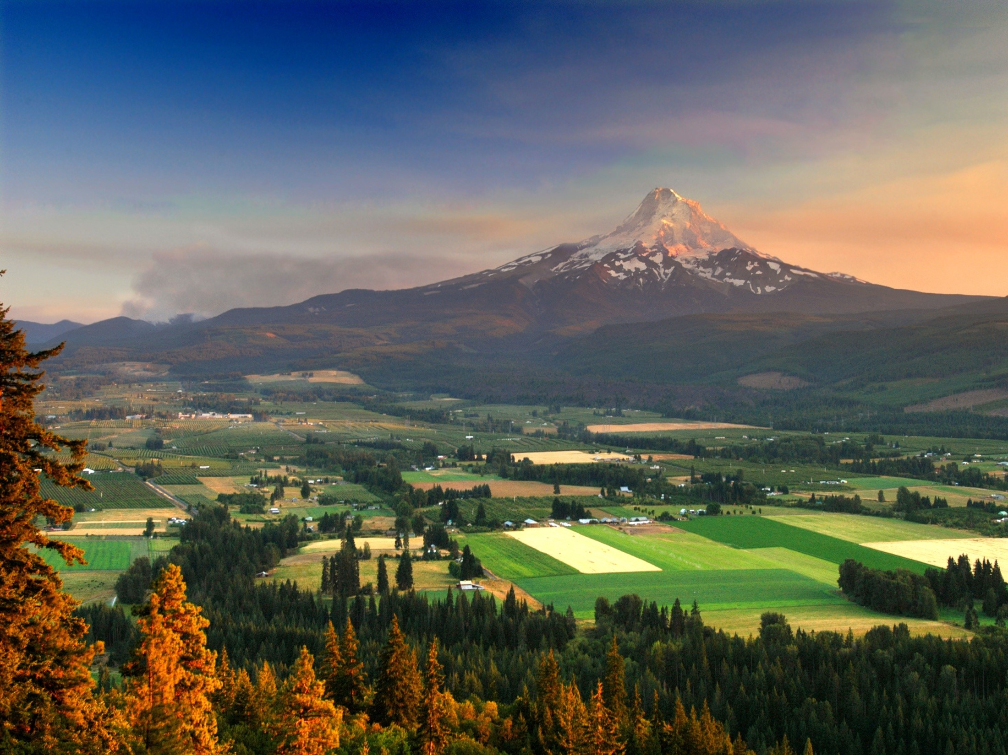
Landscape scale
Around 1985 was emerging as a major thrust of investigation in the Region
Franklin and Forman 1987
Heavily influenced Northwest Plan and
Interior Columbia Basin Assessment

Slide 6
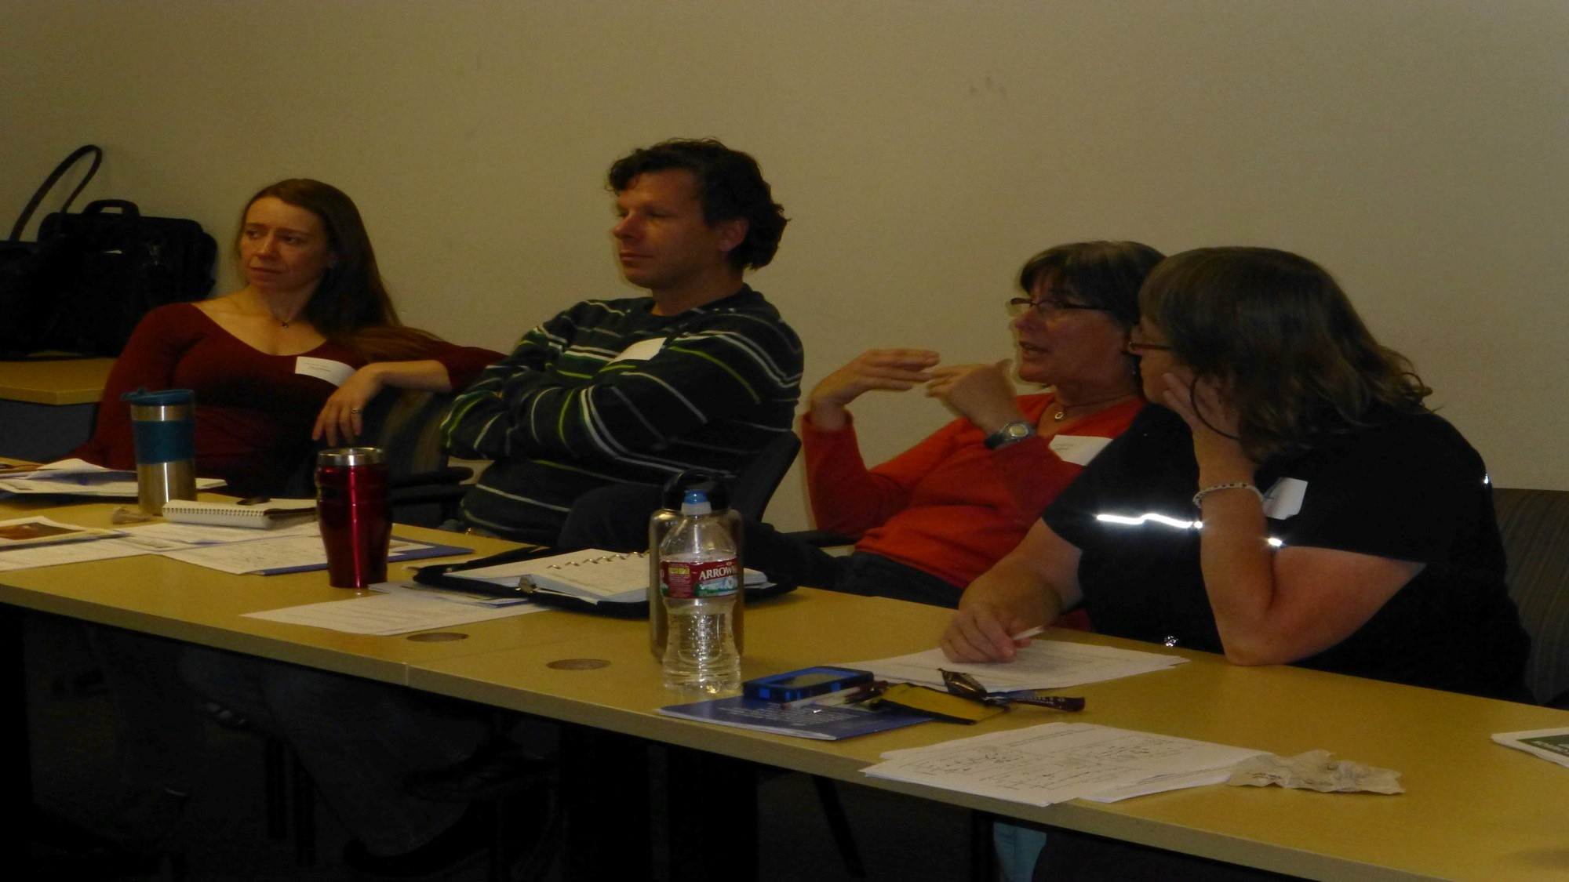
State and transition modeling
Use to understand the range of variation
Can model how seral stages change over time, and how they change with disturbance
Can run multiple iterations to see relatively stable patterns

Slide 7
State and transition modeling
Implemented as a forest planning tool in the 1990s
Vegetation Dynamics Development Tool (VDDT)
Became Path and then ST Sim
Ecology program, with partners, collating and revamping models

Slide 8
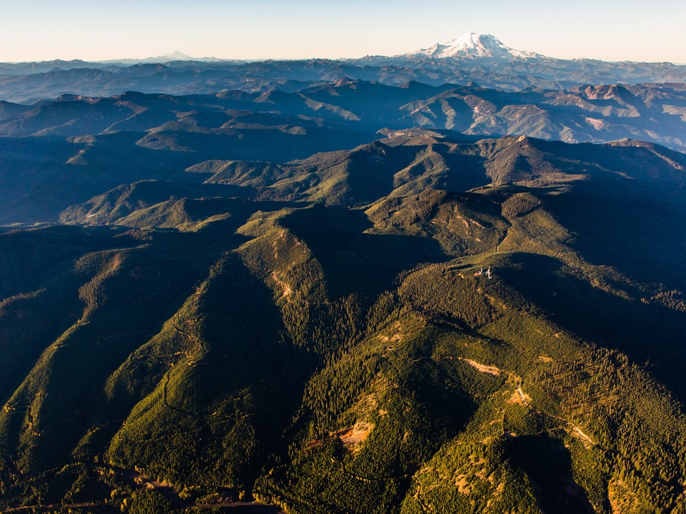
Transition
1994 Northwest Plan
1996 Eastside Screens

Slide 9
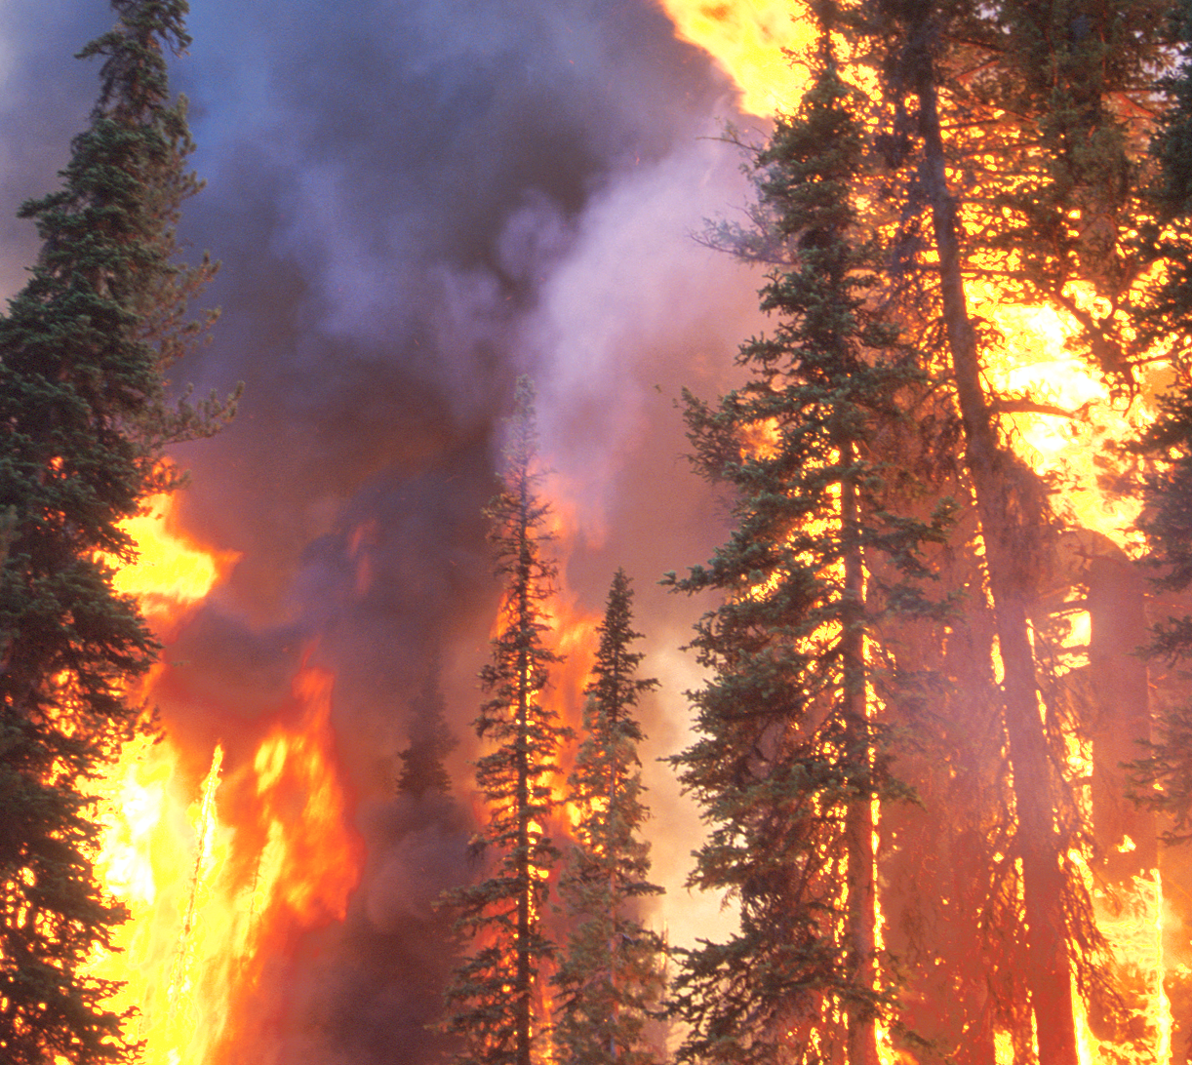
The need for an assessment tool

Slide 10
The need for an ecological metric
Departure from the natural range of variation
Measure of how far you are from sustainable, resilient conditions
Assumption that pre-settlement landscapes had all their components and were functioning

Slide 11
How do we describe the natural range of variation (NRV)?
Potential vegetation is used as a framework for fire regimes
The set of pre-settlement conditions can be modeled, and is referred to as the reference conditions

Slide 12
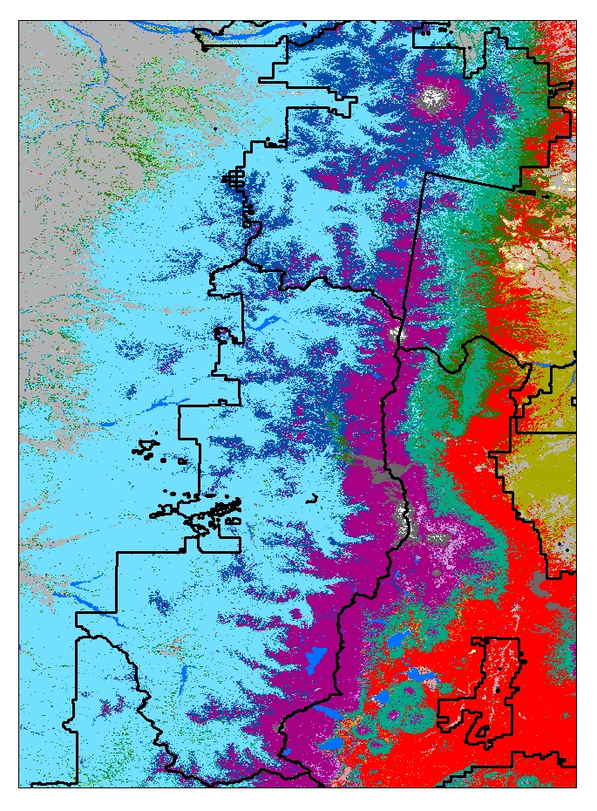
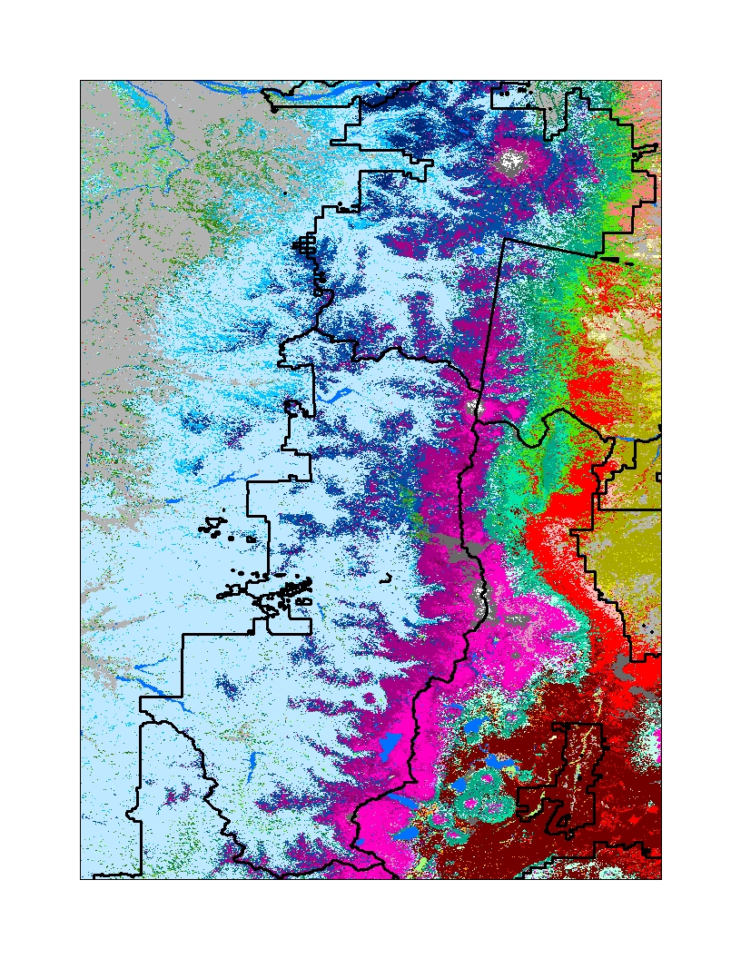
Potential vegetation can be mapped at broad scale too
Vegetation zone
Vegetation subzone

Slide 13
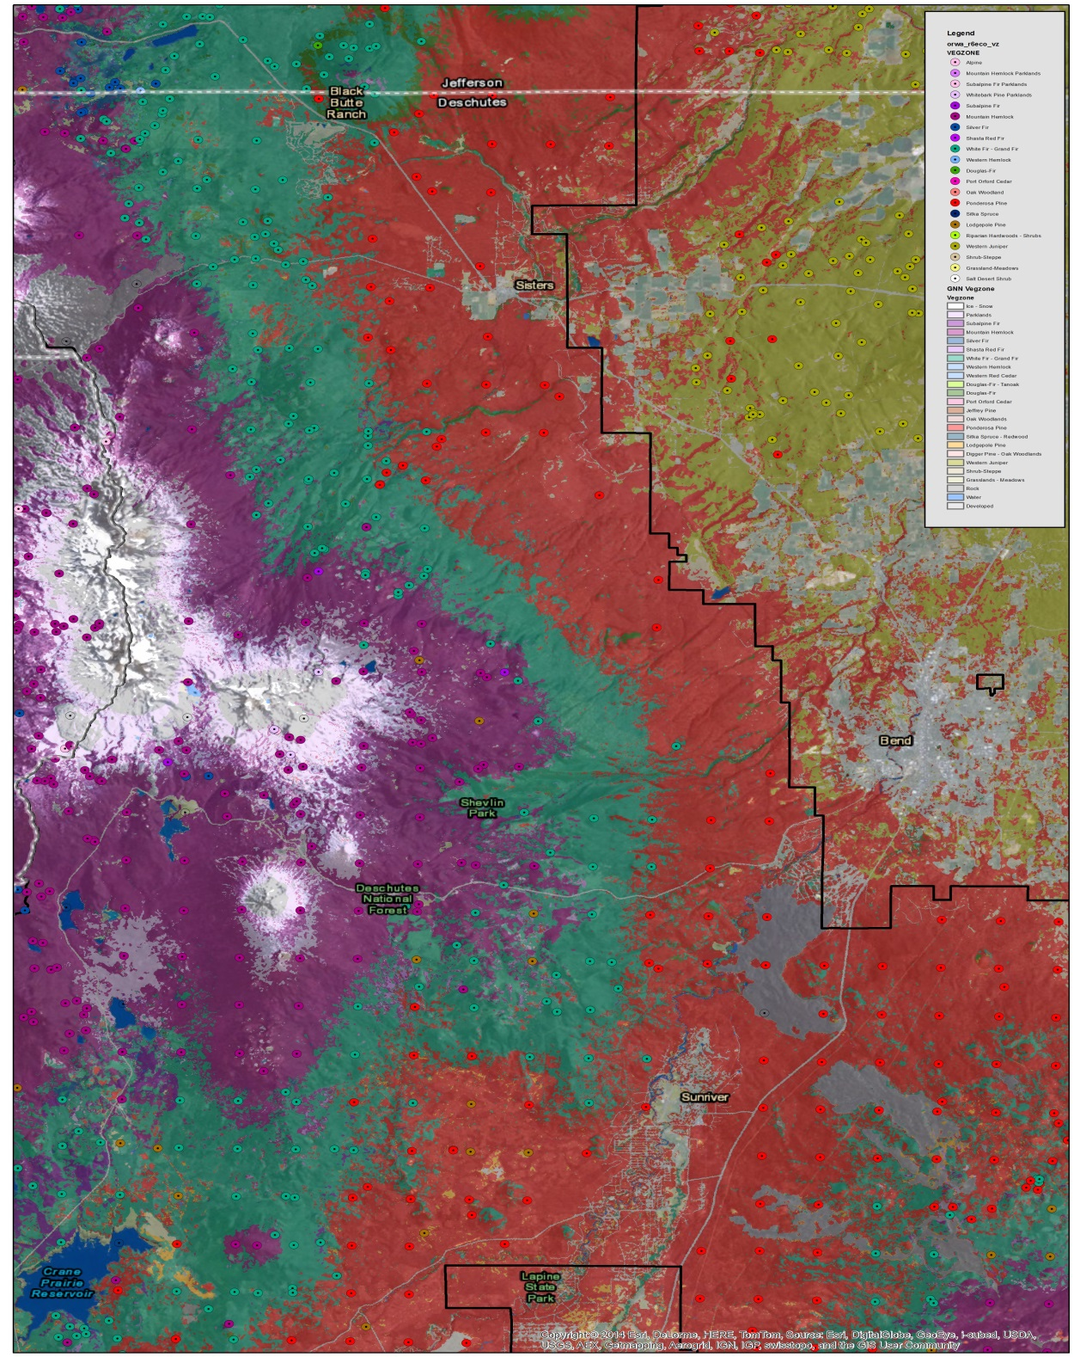
…and provides the framework for mapping fire regimes

Slide 14
Examples of potential vegetation and association fire regimes
Ponderosa pine Frequent low intensity fire every 3 to 5 years
Grasslands Frequent high intensity fire every 2 years
Grand fir Mixed severity and frequency (every 25-65 years)
Lodgepole pine Infrequent high severity (every 100-200 years)
Sitka spruce Very infrequent high severity (every 300-500 years)

Slide 15
Fire regime reference conditions
Vegetation
Set of seral stages and their historic abundance by potential vegetation type
Disturbance
Characteristic frequency and severity

Slide 16
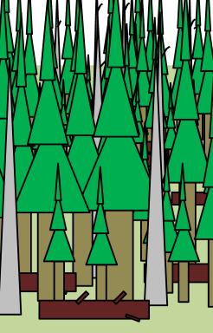
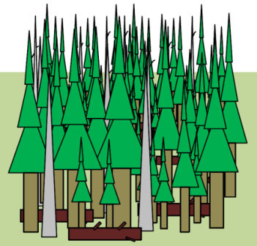
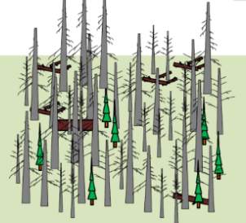
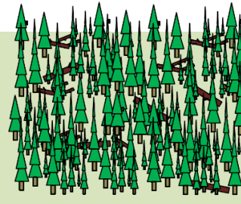
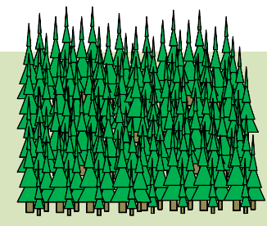
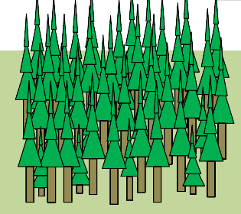

Stand Development Stages
Oliver and Larson (1990)
Stand initiation
Stem exclusion
Understory re-initiation
Old-growth
Biomass accum./ competitive exclusion
Franklin et al. (2002)
Disturbance and legacy
creation
Cohort establishment
Canopy closure
Maturation
Vertical and horizontal diversification
Age
(yrs) 0 20 30 80 150 300 800
From Franklin et al. 2002 Forest Ecology and Management
Notes:
Various efforts have classified forest development progression into discreet “stages” to better to describe the range of stand conditions occurring through time. Simple 4 stage to more complex. More or less follows a linear progression

Slide 19
Let’s Recap: What do we need for departure estimates?
Potential vegetation map, broad scale, to frame fire regimes
Potential vegetation maps at broad scale
Existing vegetation map, so we can classify it into seral stages
Gradient nearest neighbor layer, can be classified into seral stages
Some kind of landscape delineation
Use HUCs, size appropriate to the fire regime
Estimate of historic (natural) range of variation—
Reference Conditions, from state and transition models

Slide 20
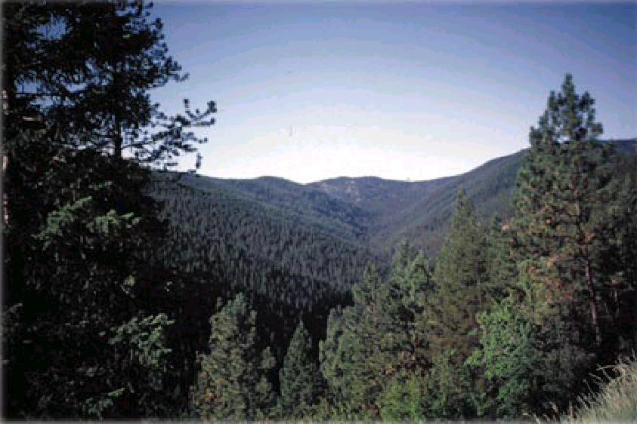
Fire Regime Condition Class (FRCC)/LANDFIRE
Class | Ref | Cur | Sim
Early Seral | 15 | 0 | 0
Mid Closed | 10 | 45 | 10
Mid Open | 25 | 0 | 0
Late Open | 40 | 0 | 0
Late Closed | 10 | 15 | 10
Uncharacteristic | 0 | 40 | 0
Sum | 100 | 100 | 20
Departure = 100 – 20 = 80; Veg-Fuel CC = 3
(CC1 – 0-33; CC2 – 34-66; CC3 – 67-100)
Ponderosa Pine – Douglas-fir
Fire Regime Group I – Frequent Surface & Mixed

Slide 22
2013 Assessment at Request of
Regional Forester
Used to help justify Eastside restoration

Slide 23
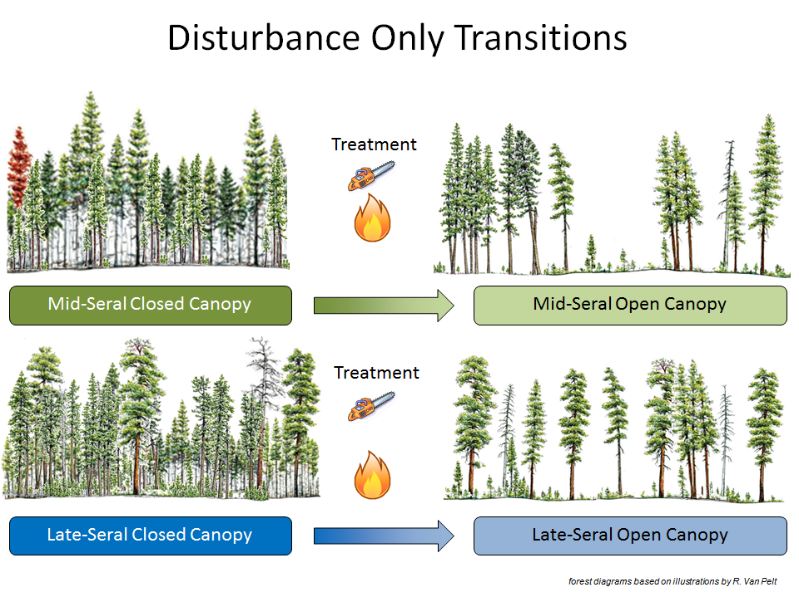
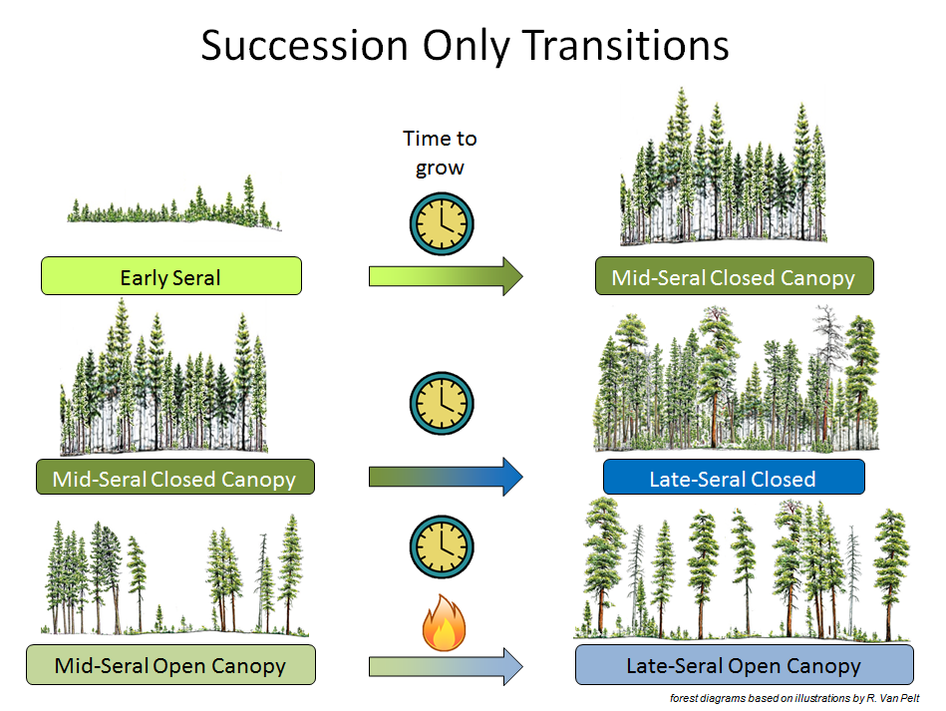
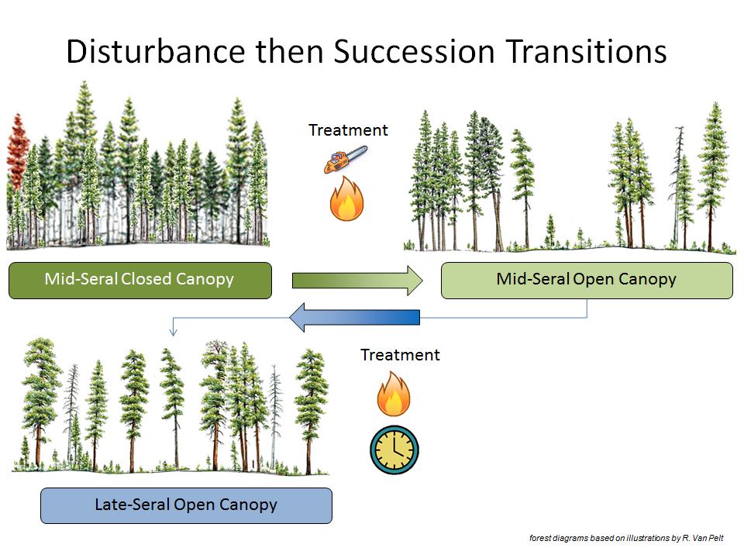

Slide 24
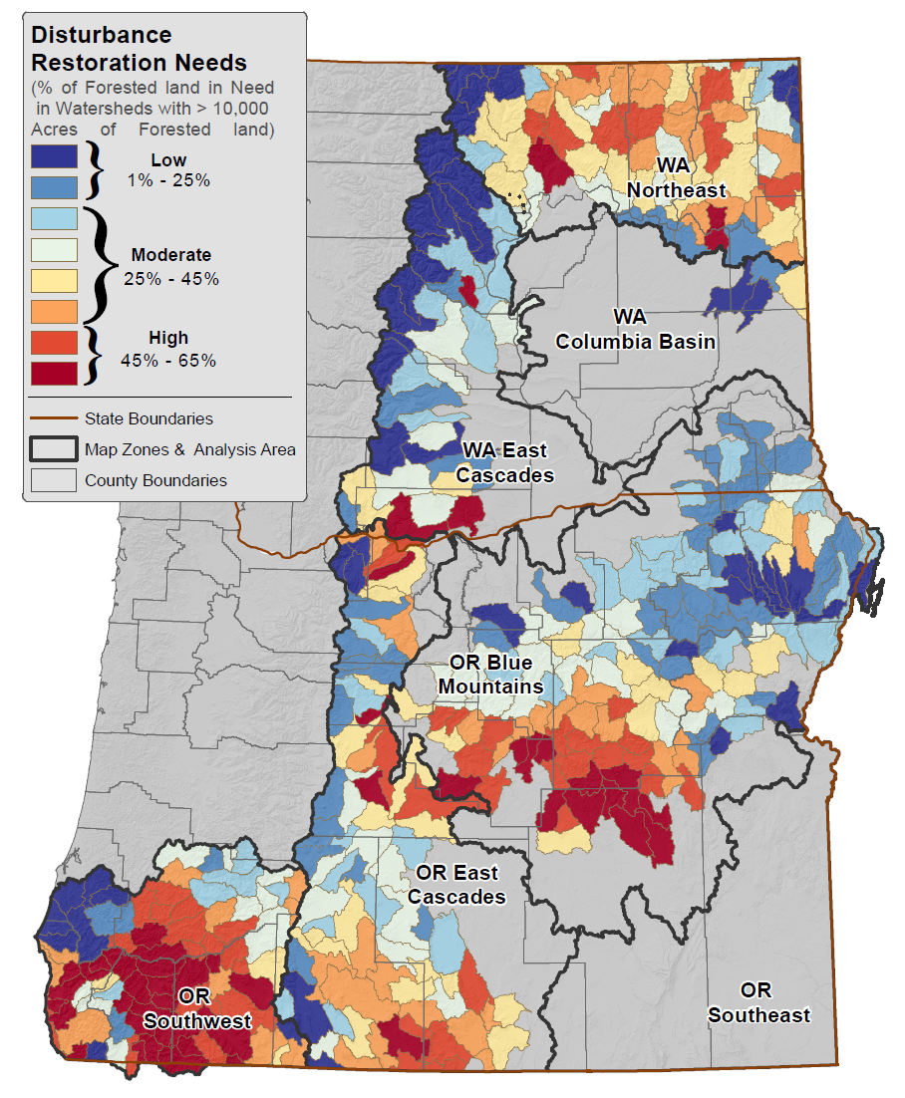
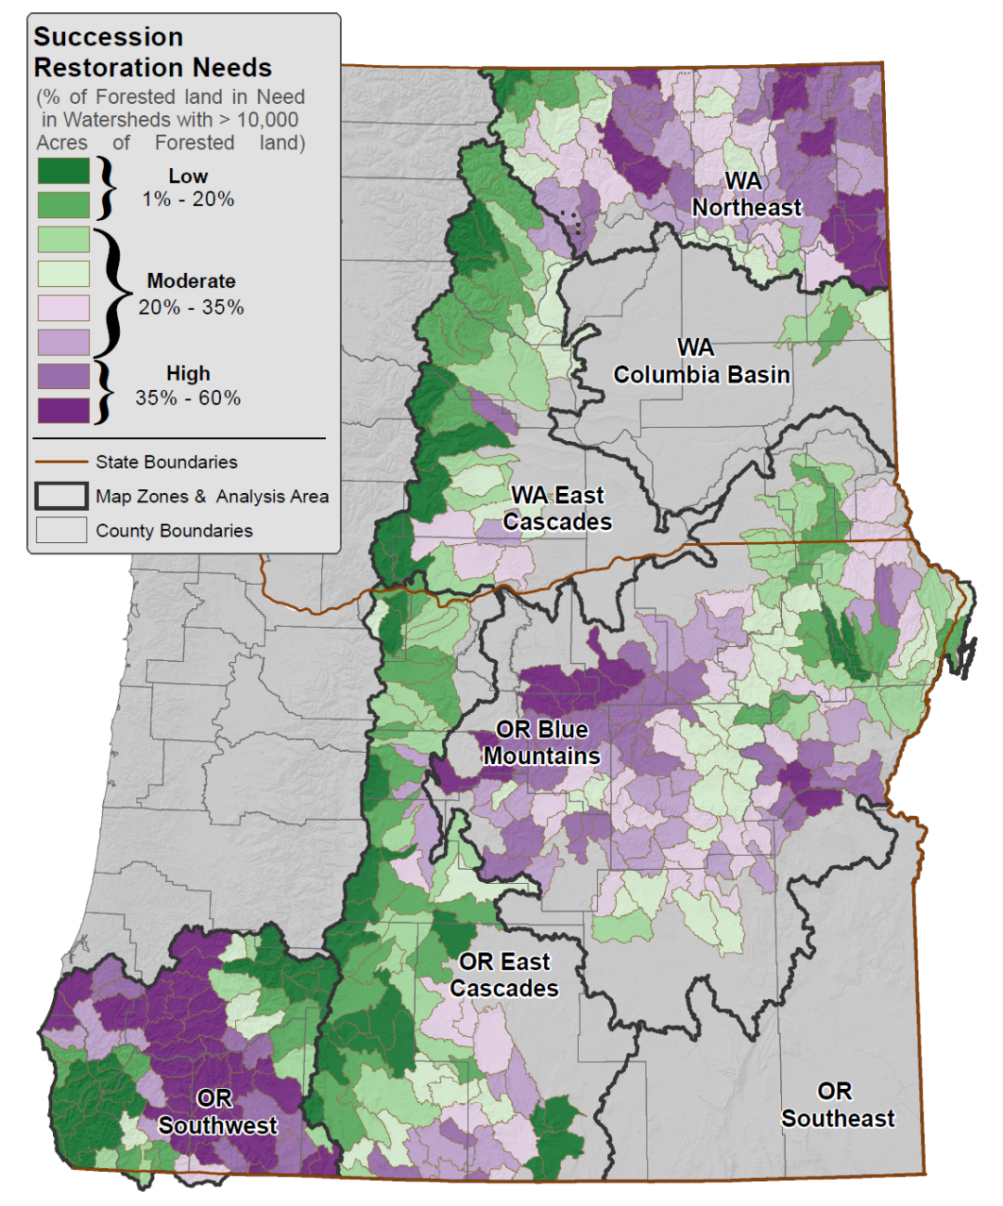

Slide 25
Notes:
Disturbance restoration need (left). This is the need for treatment through thinning, prescribed burning, wildland fire use, etc. Succession restoration need (right). The need to let seral stages grow into older ones. Note disturbance followed by succession is also commonly needed.

Slide 27
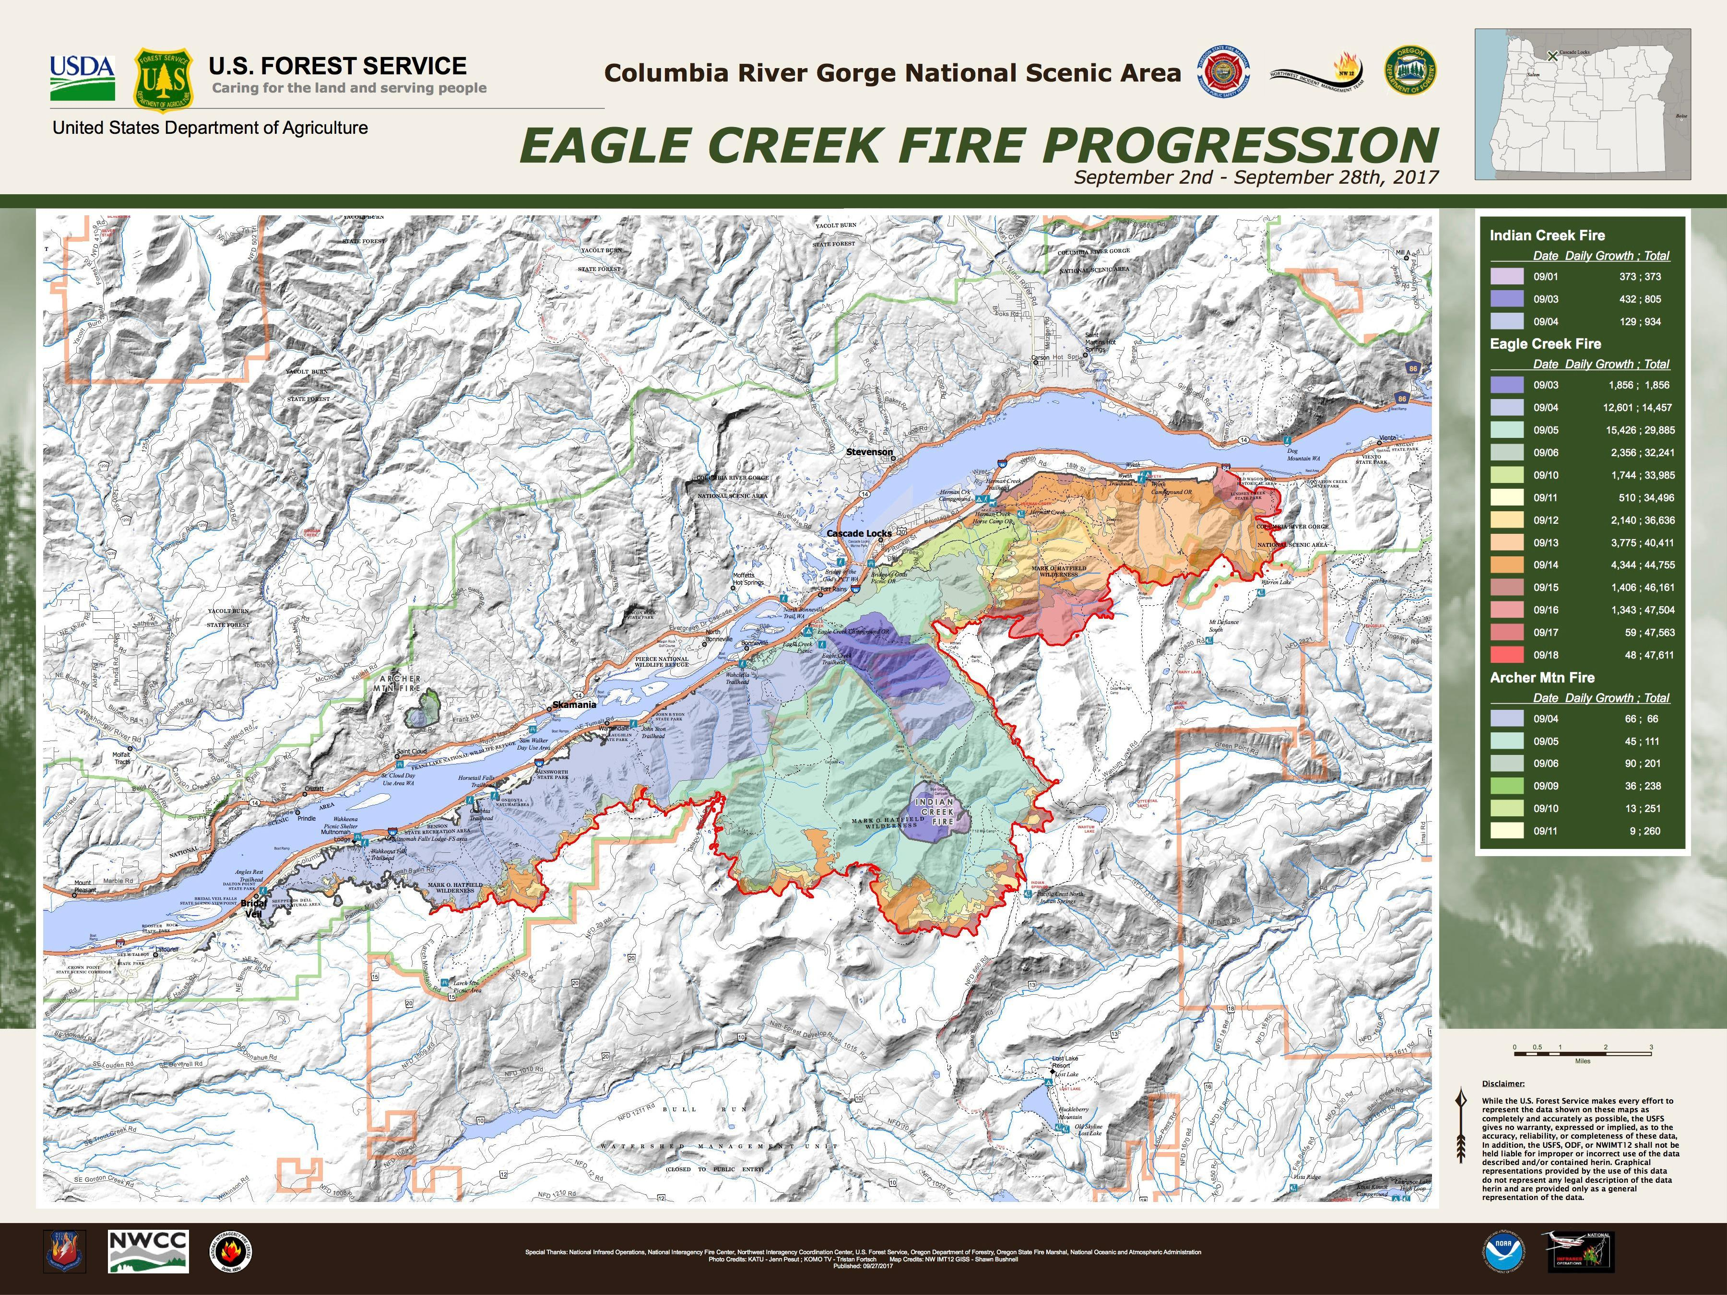
Summary– Use of departure estimates as a planning tool
Can identify acres in need of treatment or succession by HUC 5, by PNV type, by seral stage, and the order of treatment
Can use to set restoration priorities– identify and defend the why here why now
Integrated landscape concept– coarse filter– if the landscape is functioning its parts are functioning

Slide 28
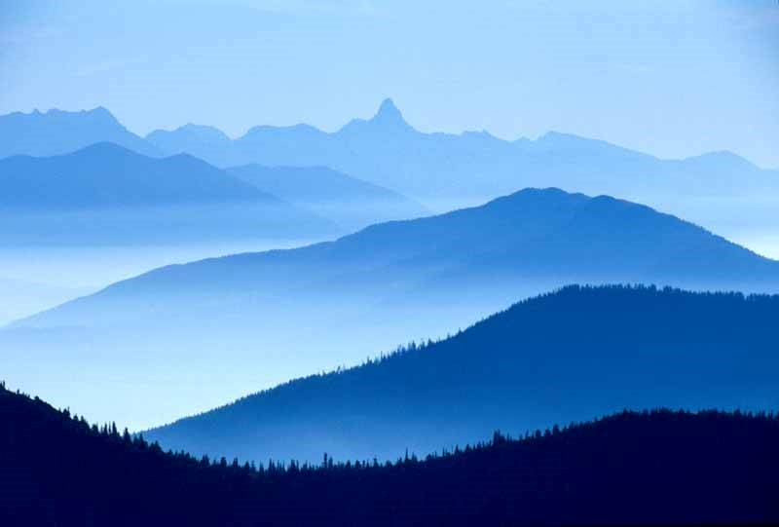
Guiding principles (Trammell et al. 2018)
Use landscape sustainability as an overarching goal
Use a broad ecosystem services framework
Explore landscape history more comprehensively

Slide 29
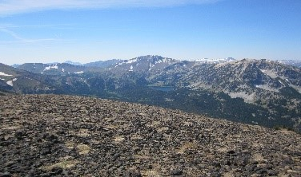
Guiding principles (Trammell et al. 2018)
4. Consider climate change effects
5. Use landscape models to support planning decisions
6. Promote a greater presence of landscape ecologists within agencies

Slide 30

Lessons Learned
Work with partners to get on the same page
Landscape assessments are successive refinements
Allow different approaches and methods—where you end up in your assessment is more important than how you got there

Slide 31
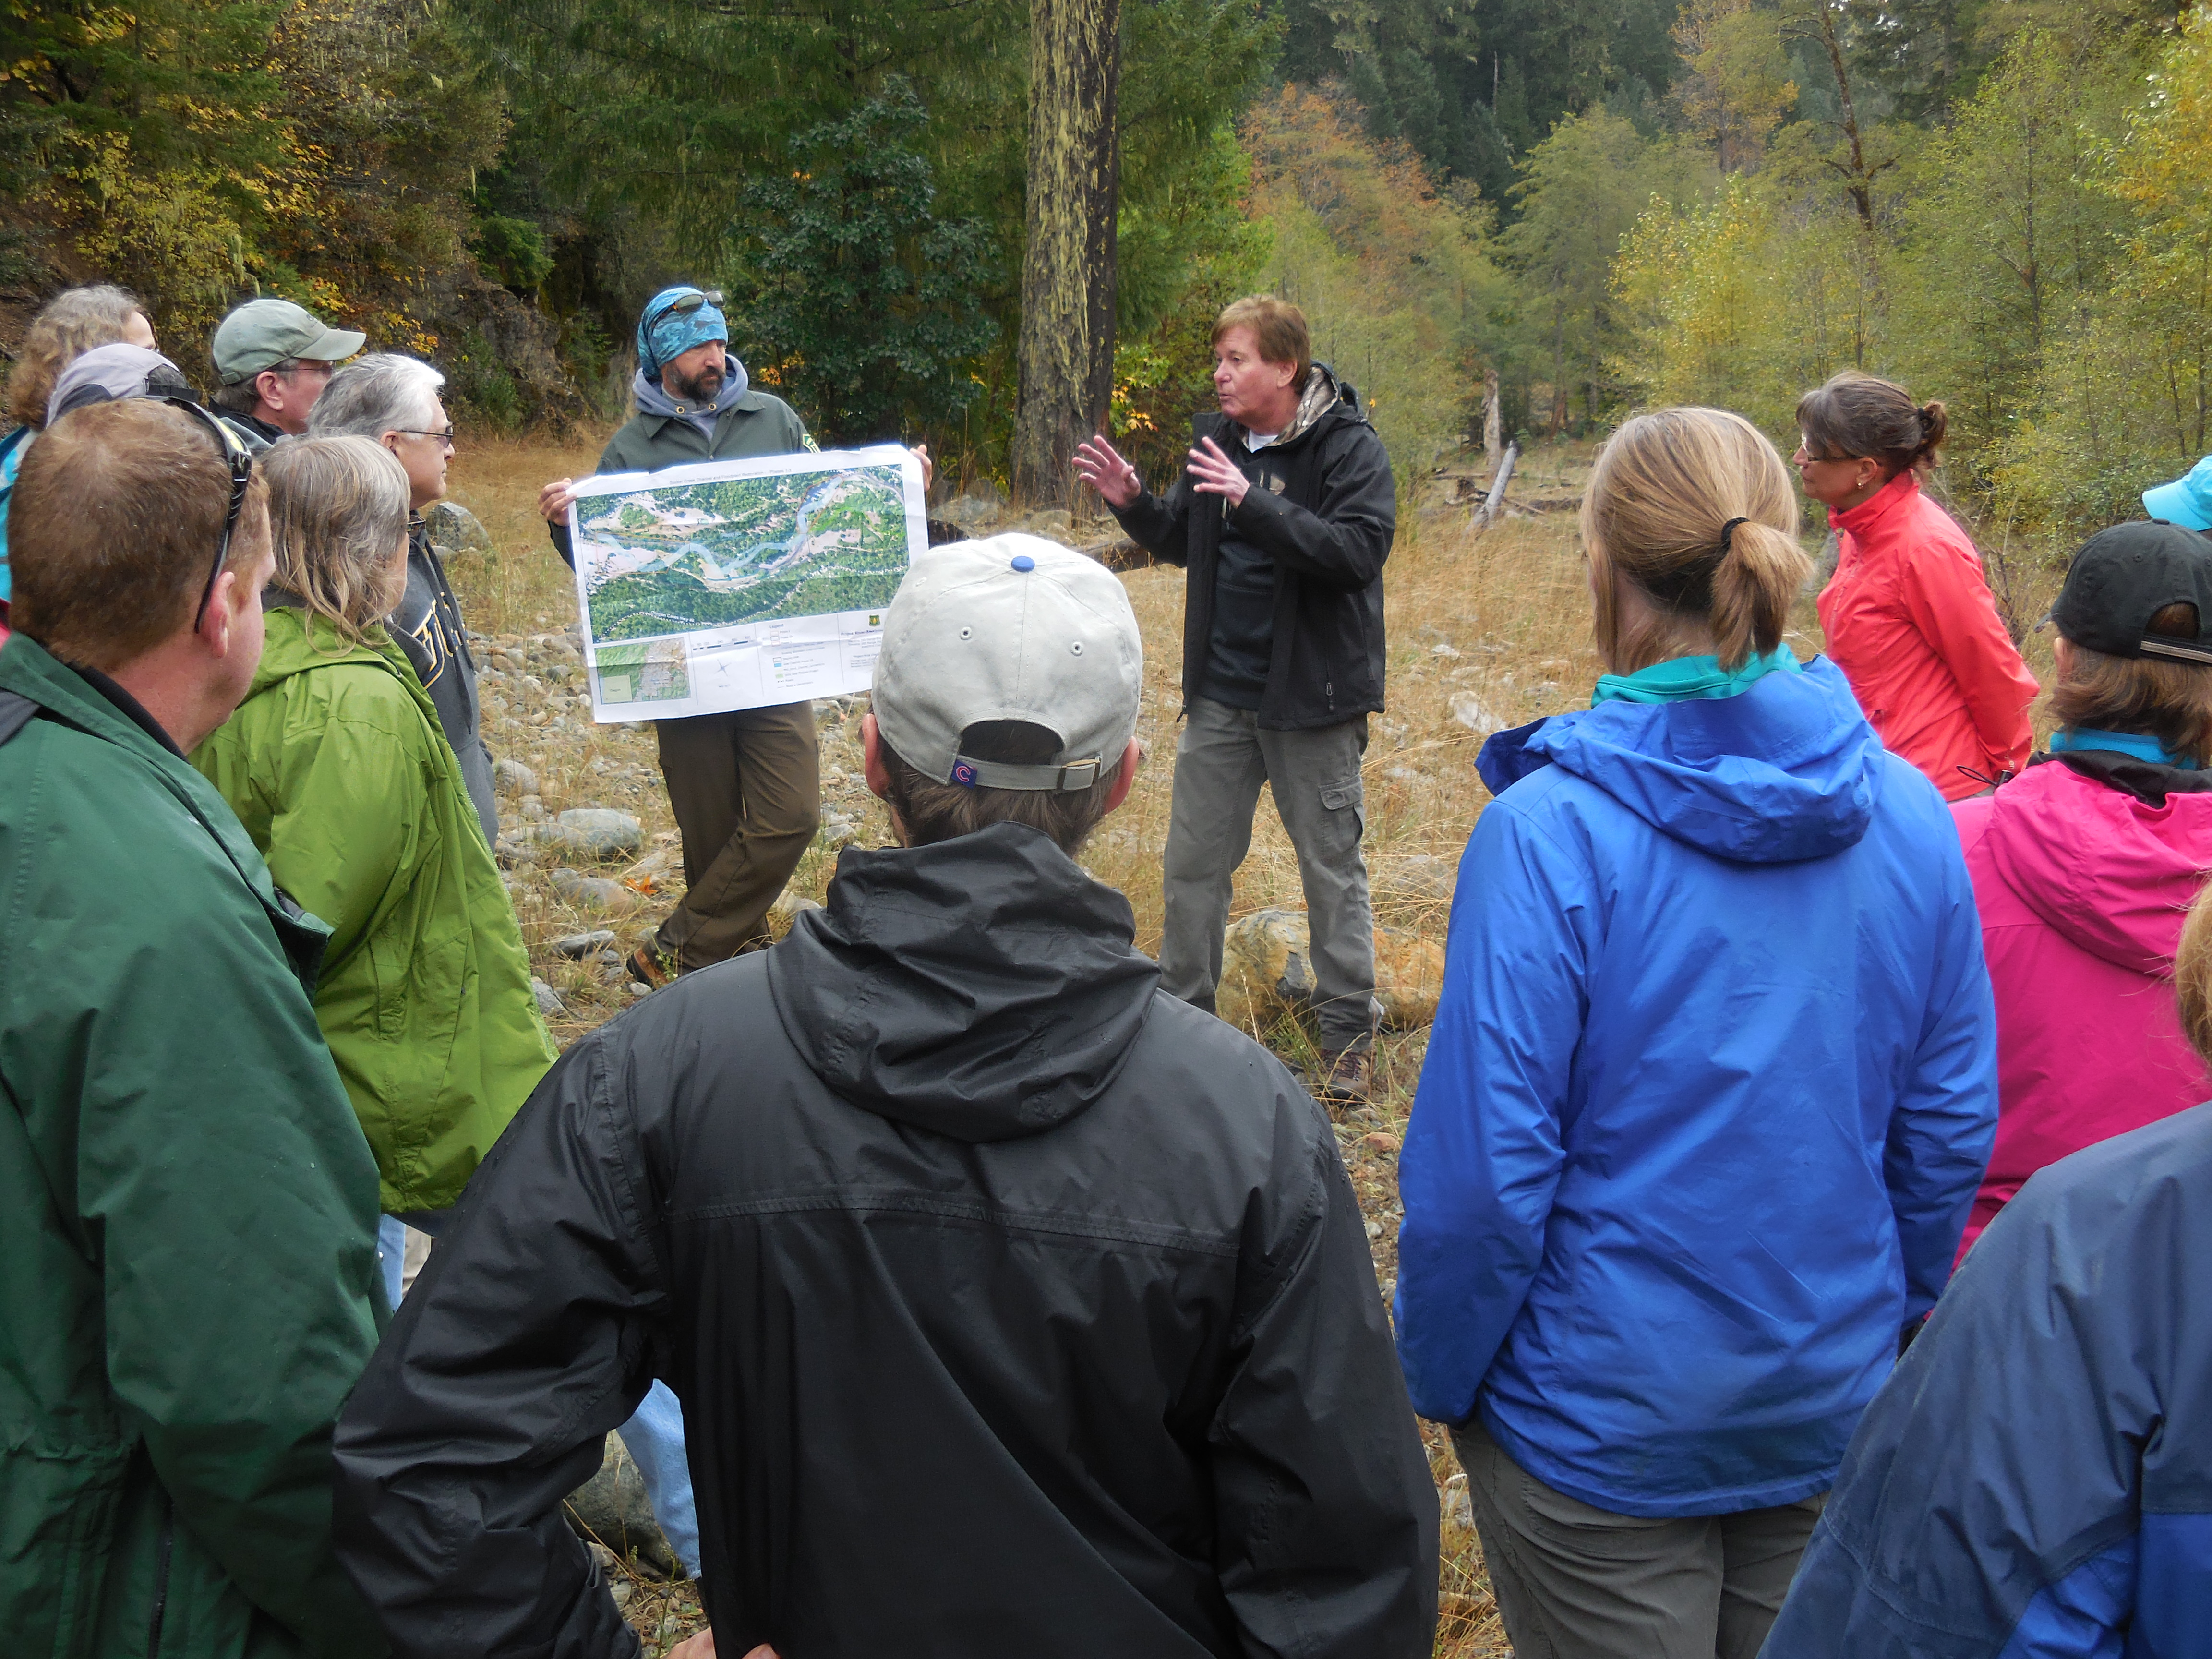
Suggestions for Planning Teams
Be clear on your objectives
--Reducing departure?
--Reducing fire risk?
--Maintaining a species?
--Reducing invasive species?
Use the many tools available– avoid reinventing the wheel—match the tool to the need
Show clearly how your actions will further the objectives
A landscape strategy is not just yarding up a set of treatments

