Slide 1
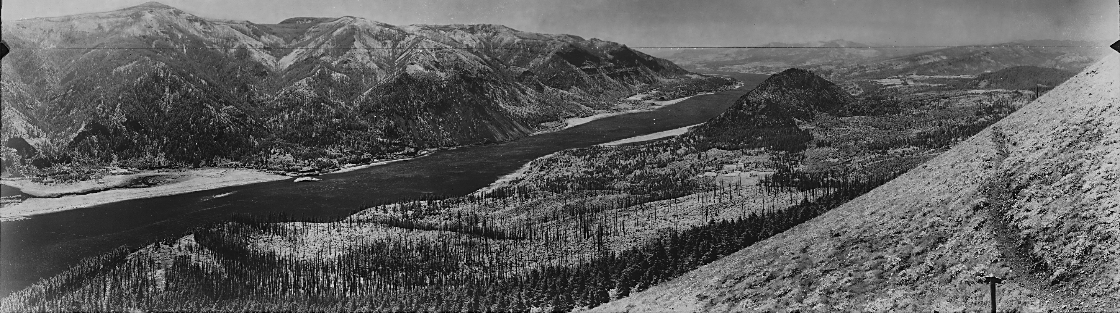
Eagle Creek area from Dog Mtn, WA
1937
Climate, Environment, and Disturbance History Govern Resilience of Pacific Northwest Forests
Paul Hessburg, Nicholas Povak, & Brion Salter
USDA-FS, Pacific Northwest Research Station
2018
John Marshall Photography ©2018

Slide 2
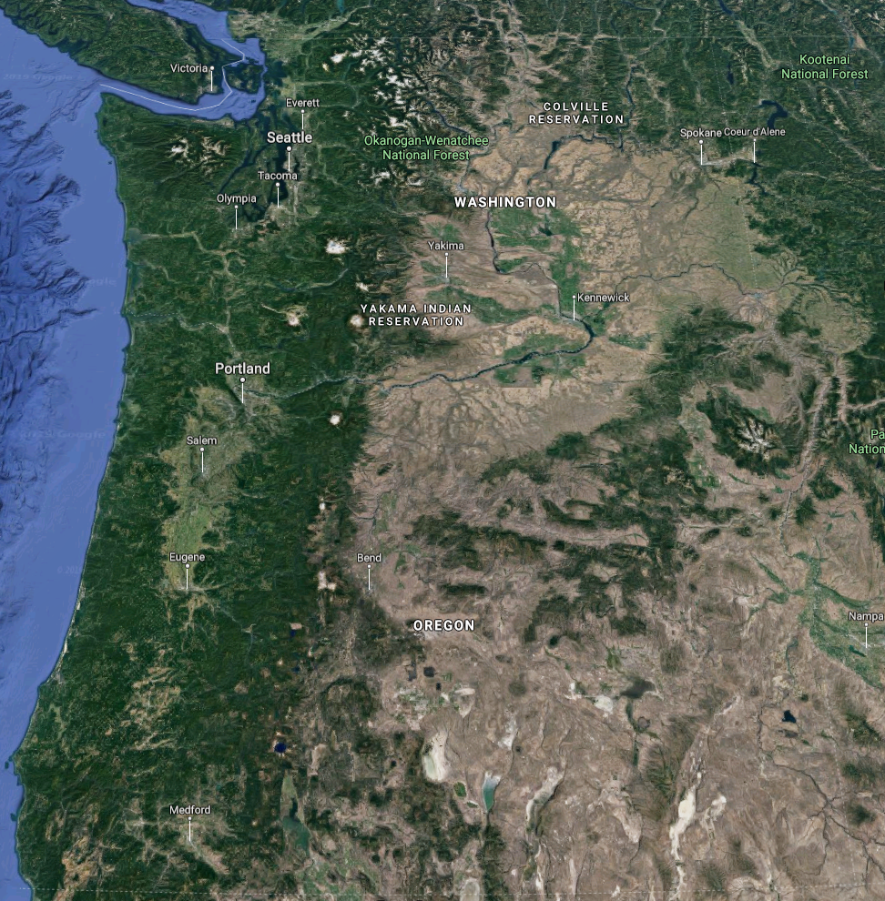
The pacific northwest:
A region of great biotic, cultural, & environmental diversity
…but its forests and ranges are greatly changed over the last 150 yrs

Slide 3
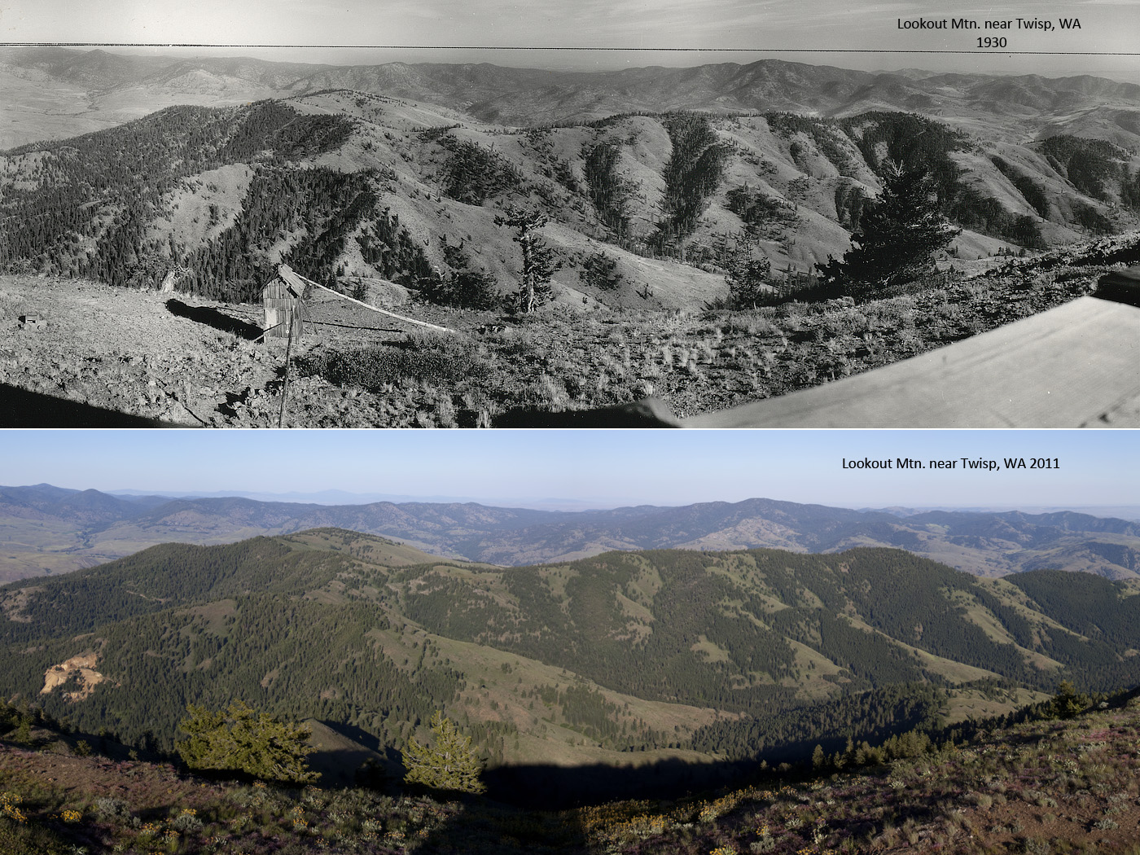
Inland forests
Grasslands & sparse woodlands decreased…
…forests encroached

Slide 4
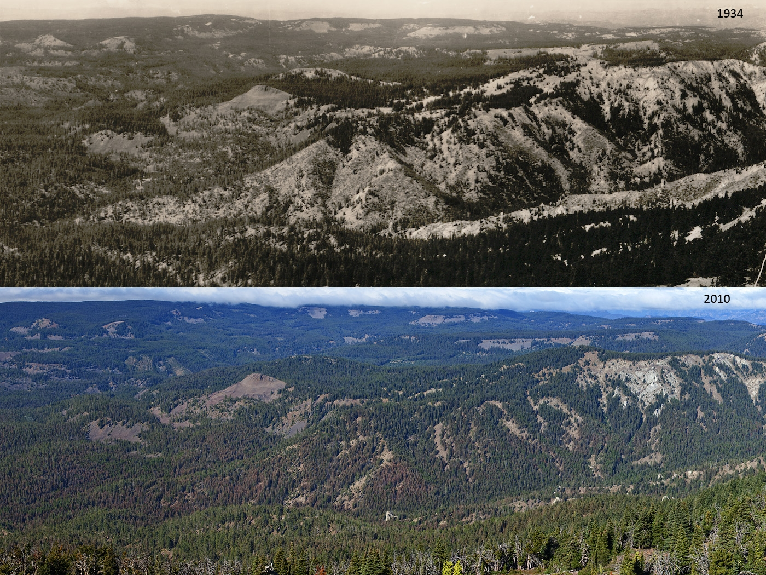
Inland forests
Dry south slopes and ridgetops…
…filled in with trees

Slide 5
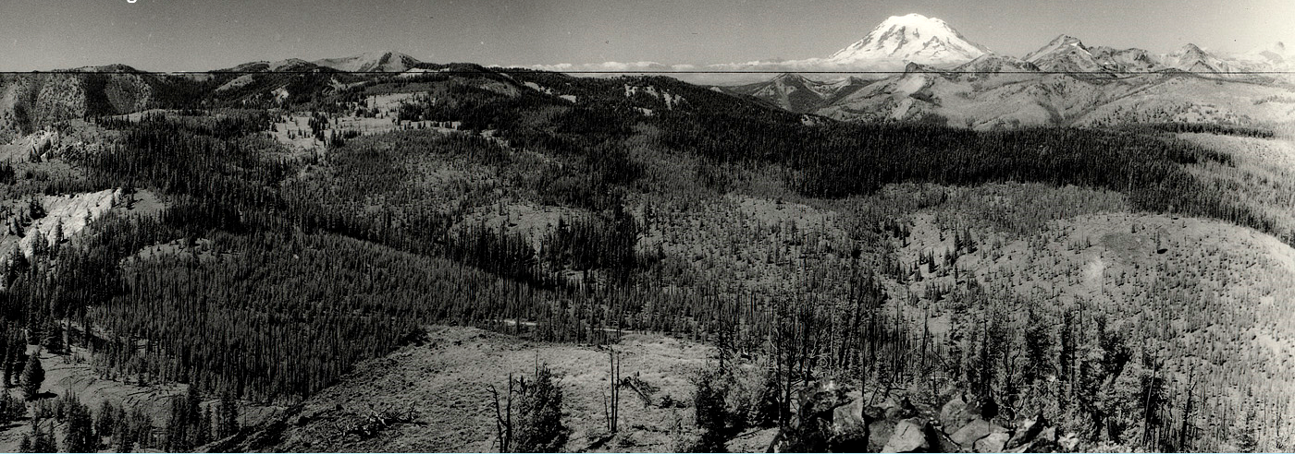
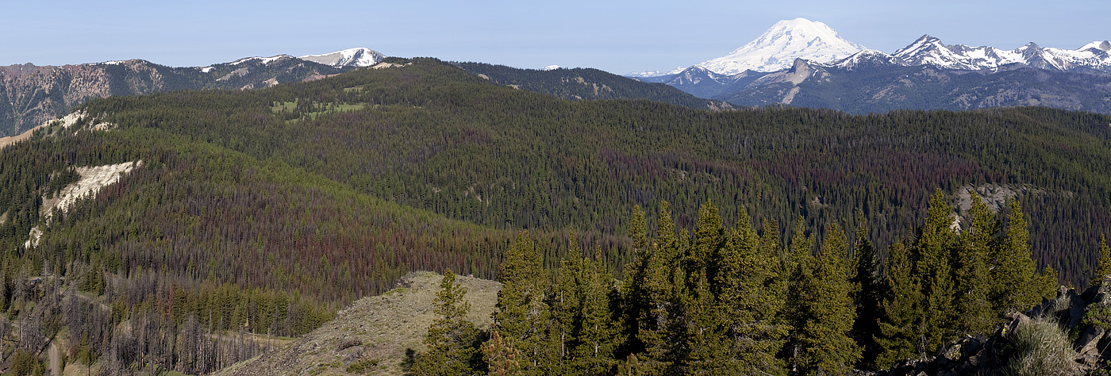
Inland forests
Complex forest successional patchworks…
…became uniform

Slide 6
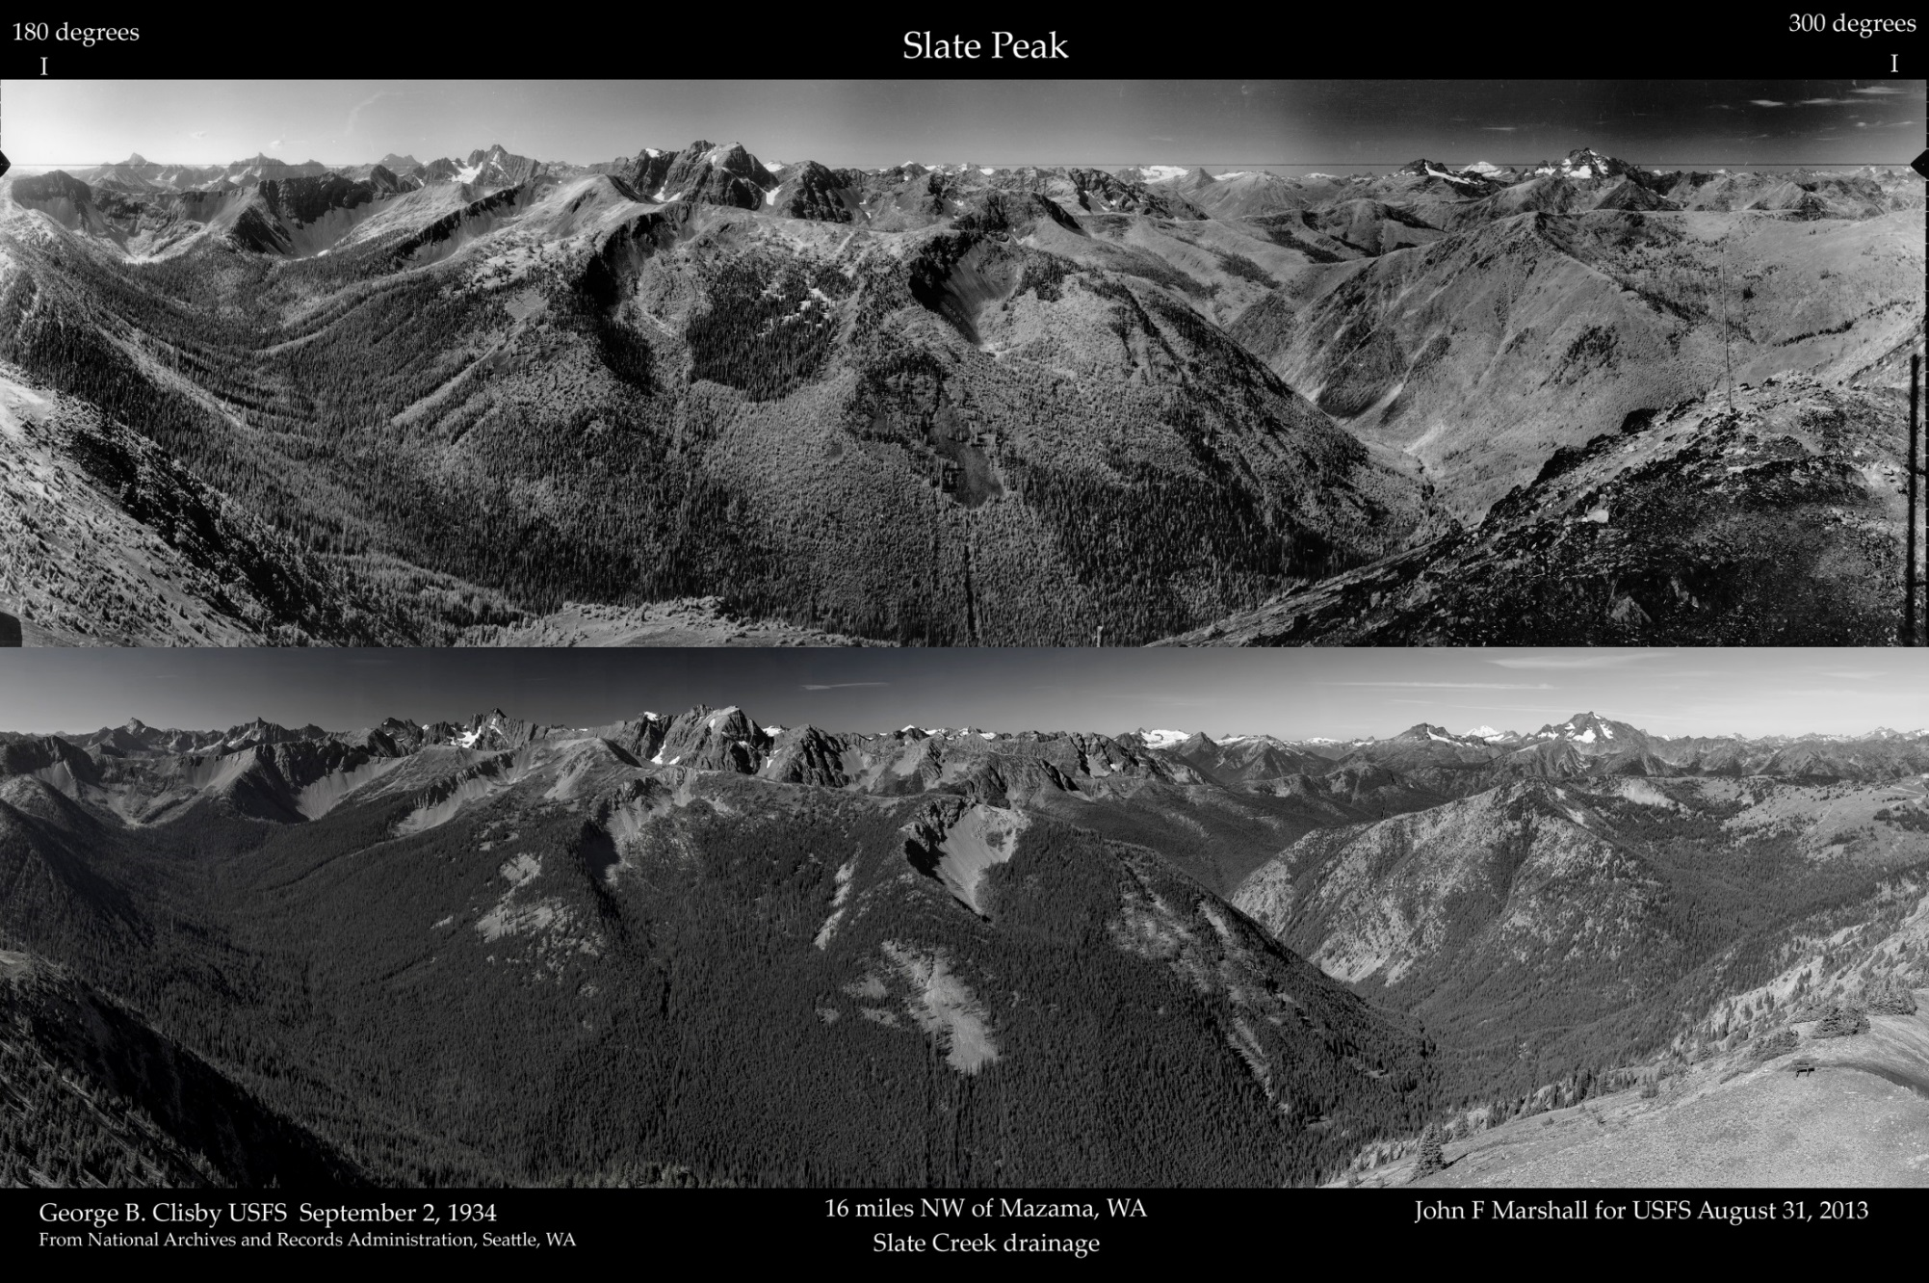
Inland forests
Patchworks of burned and recovering forest…
…gave way to continuous forest

Slide 7
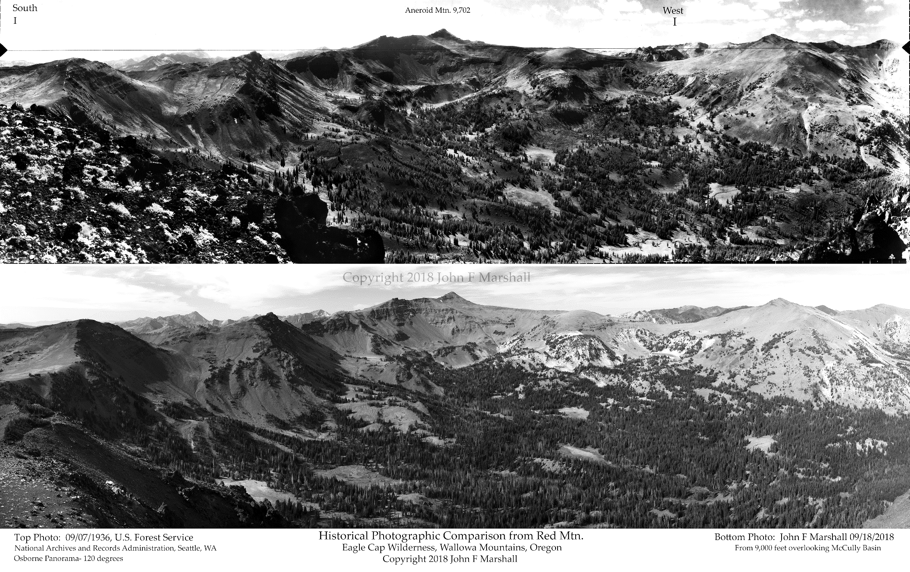
Inland forests
Abundant meadows…
…gave way to dense forest

Slide 8
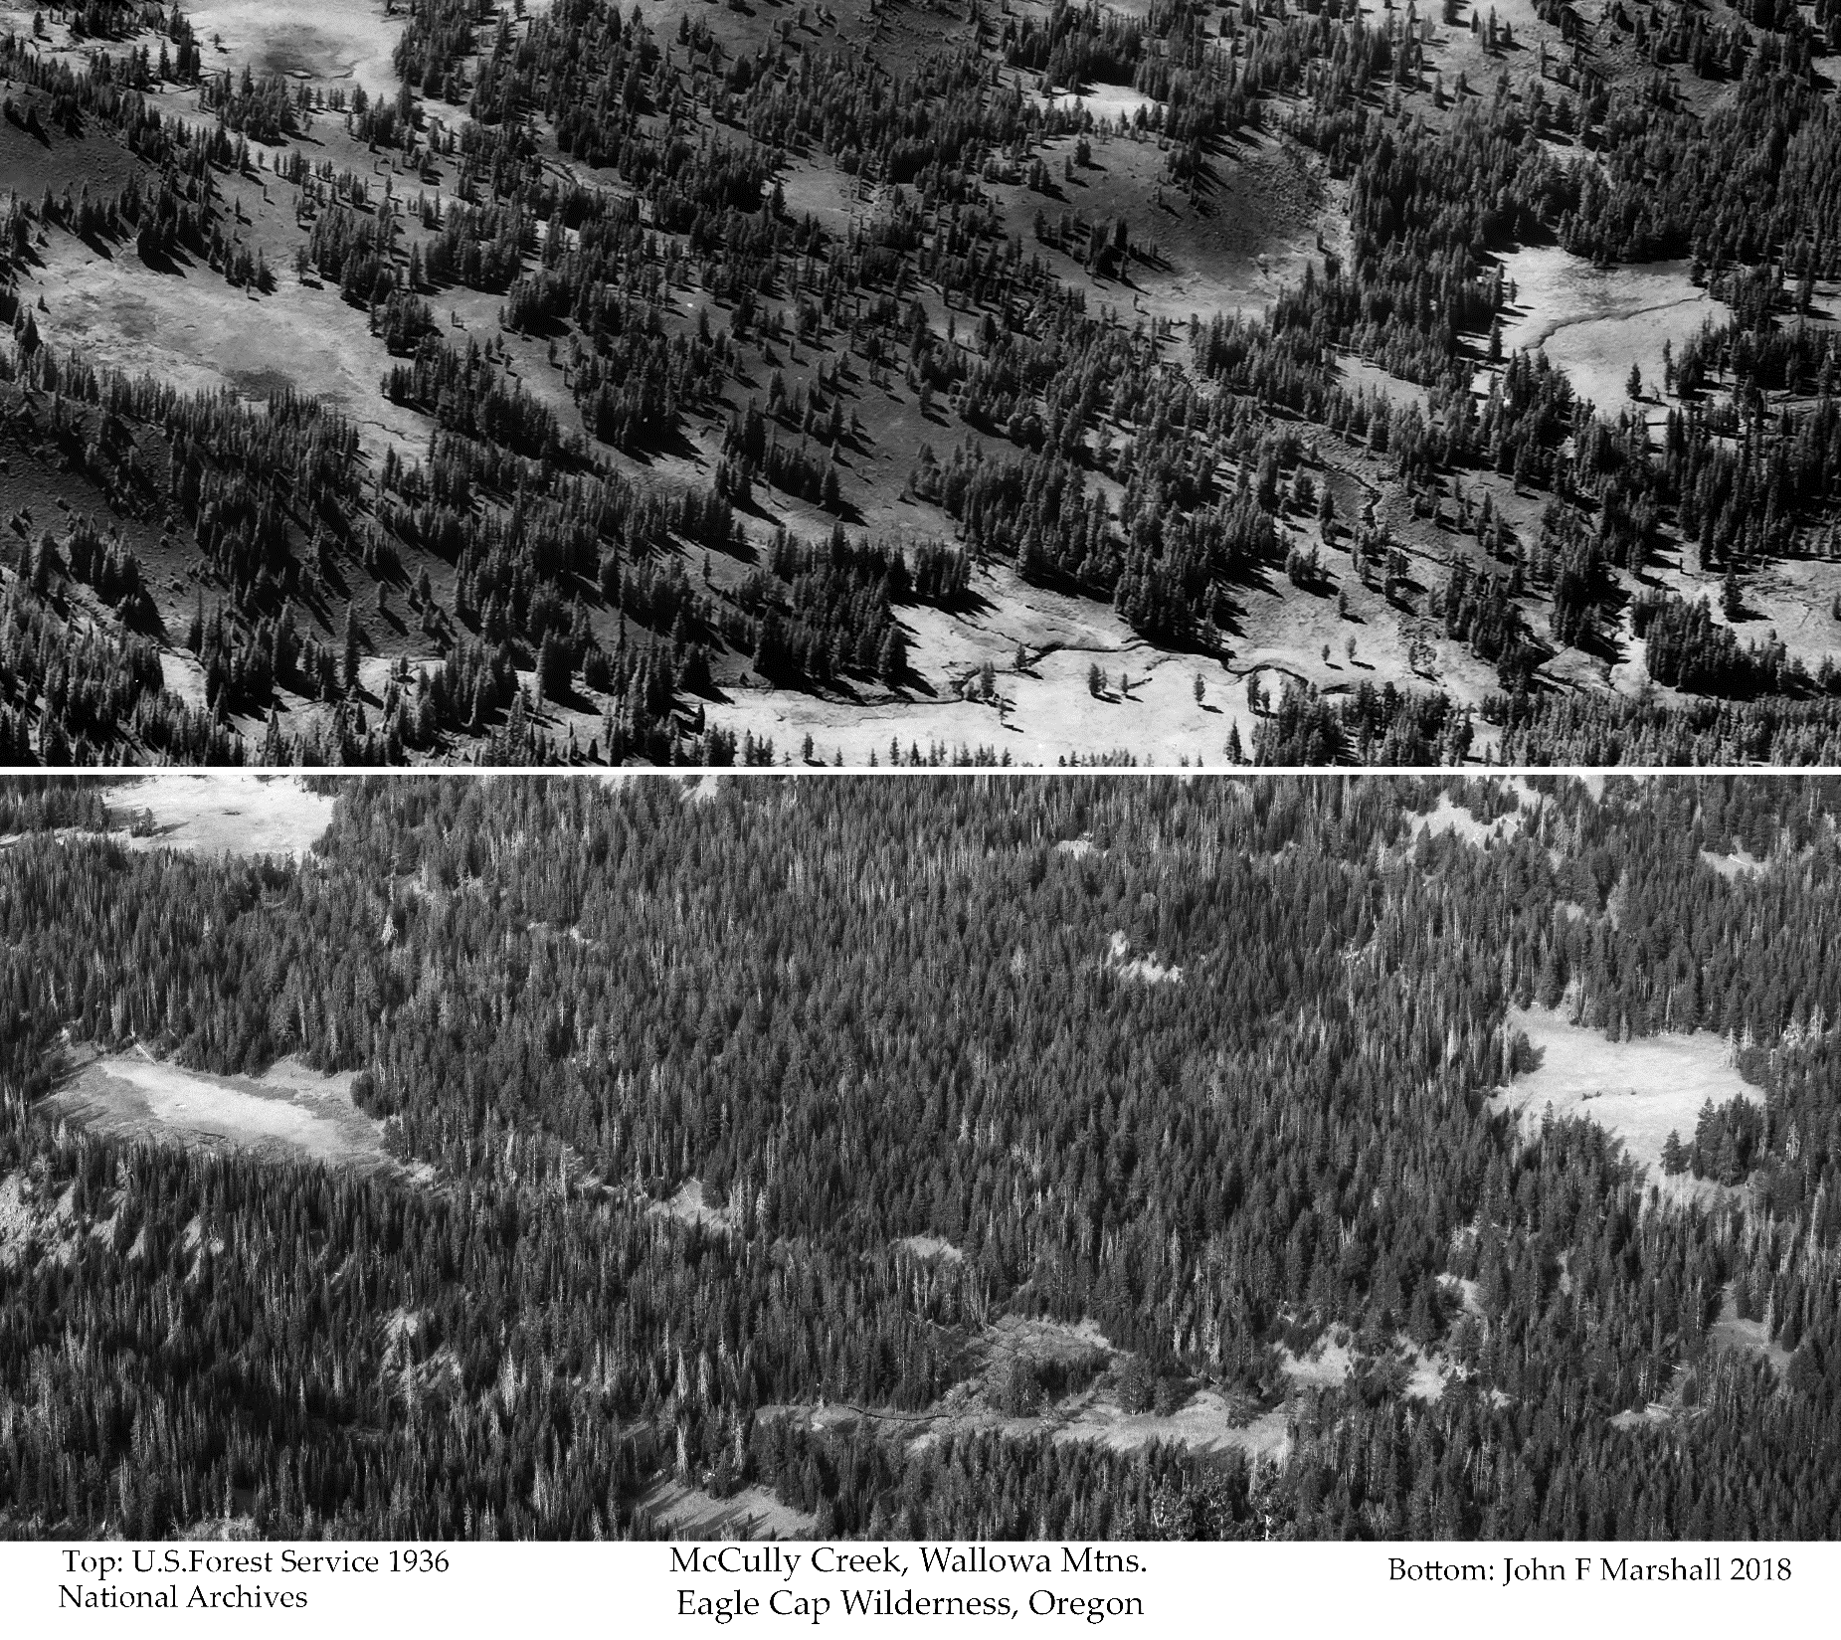
Not just in dry forests
Notice the loss of wet and dry meadows
And the 10- to 100-fold increase in tree stocking

Slide 9
Many changes
many agents
Change Agents: Cultural/aboriginal burning
Roads and railroads
Subdividing by ownership Clearcutting
Selection cutting Domestic livestock grazing Fire suppression Urban/rural development Agriculture Climate change
Key Changes:
Loss of cultural fire regimes
Created a vast fuelbreak network
Fragmented forests by varied management plans
Cut older forests; Removed large trees; left small trees; increased vulnerability to fire, I&Ds
Livestock ate the grasses, excluding frequent fires
Widely increased forest area and density
Excluded fires, promoted aggressive fire suppression
Eliminated grasslands/shrublands, excluded fires
Larger and more severe fires

Slide 10


Eagle Creek area from Dog Mtn, WA
1937
2018
John Marshall Photography ©2018
True of many west-side forests as well

Slide 11
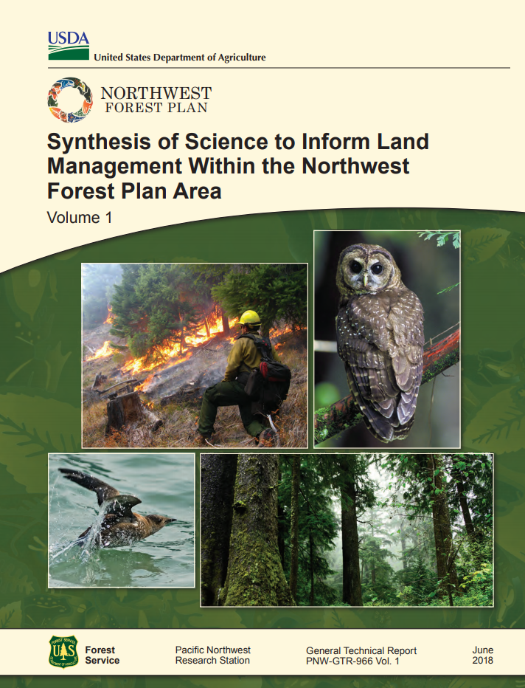
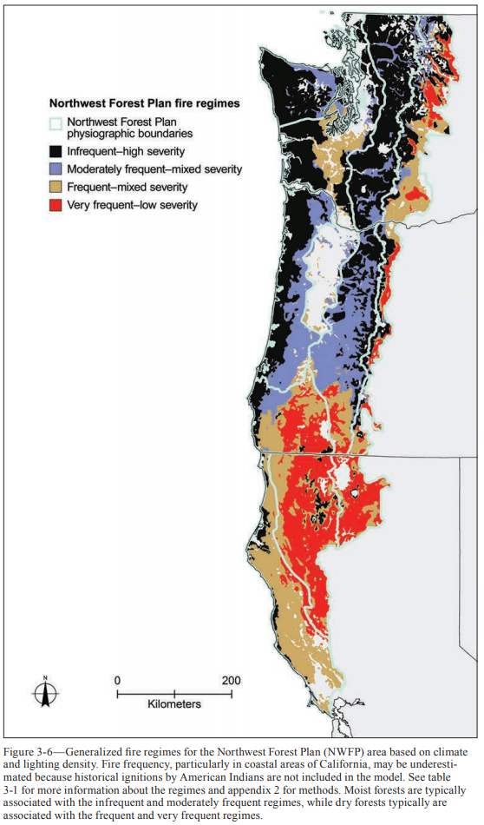
West-side forests
Spies, T.A., et al. 2018. Old growth, disturbance, forest succession, and management in the area of the Northwest Forest Plan. Chapter 3, In: Gen. Tech. Rep. PNW-GTR-966: 95-243.
Notes:
We recently revised the historical fire régime of the west-side in the NWFP sci synth. Under a steadily warming climate, these regimes are yet in flux.

Slide 12
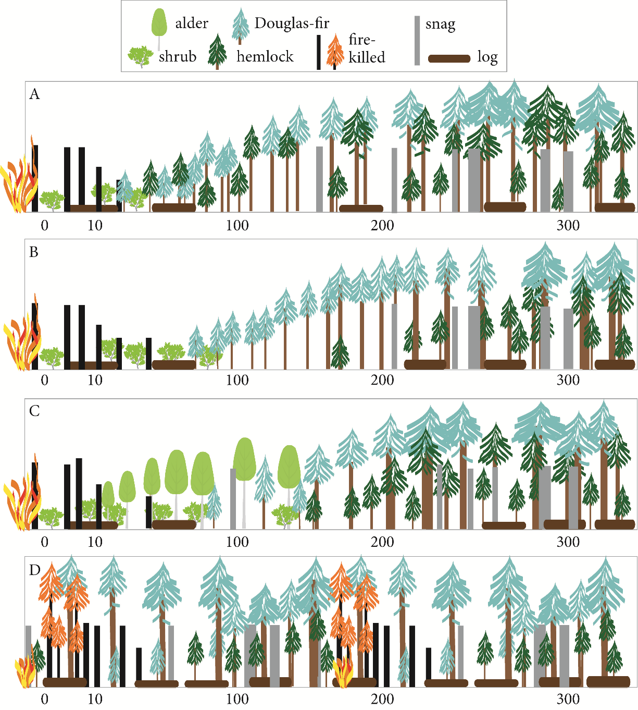
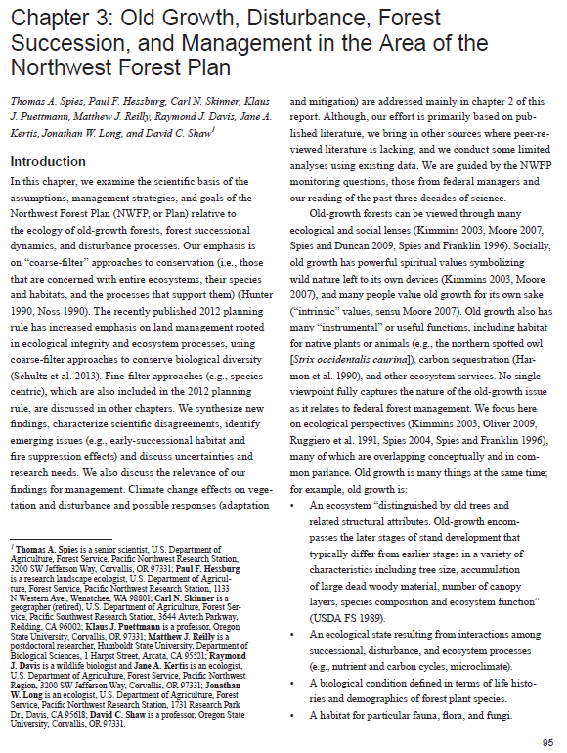
Path A: HSF, 50 yrs of grass/shrub→SECC mixed DF/WH @ age 50;
Path B: HSF, 50-100 yr grass/shrub→SECC DF @age 50-100; 100-200yr DF→DF/WH mix
Path C: HSF, 10-20 yr grass/shrub→20-120 yr alder/DF mix→DF/WH mix
Path D: MSF, periodic, → patchy/gappy DF with DF/WH islands

Slide 13
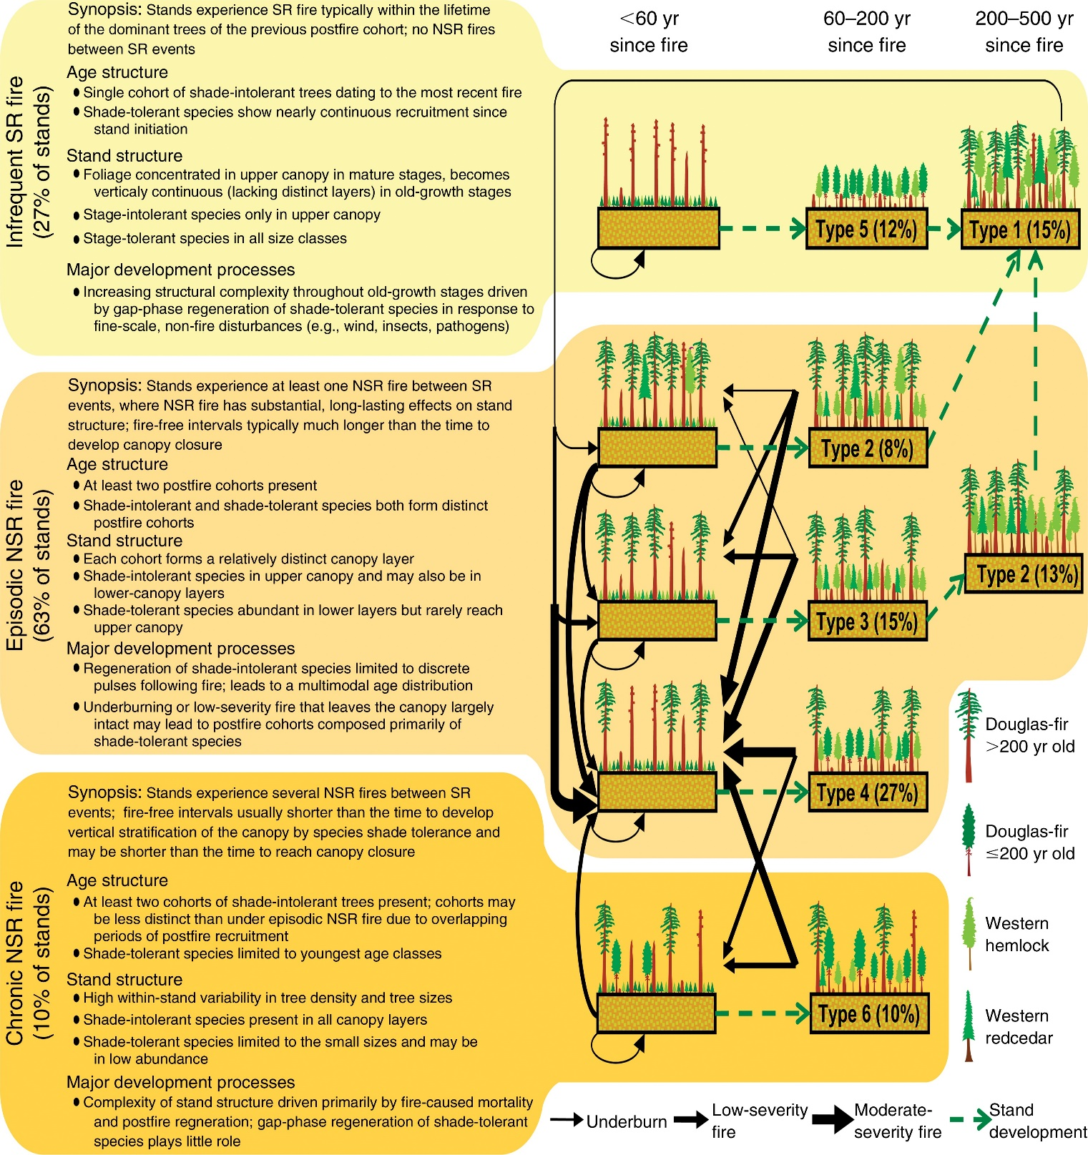
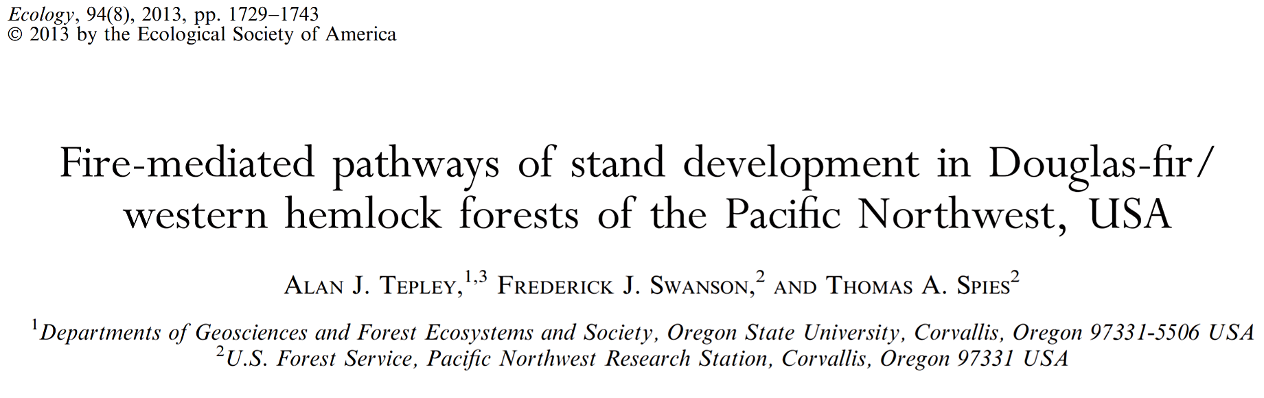
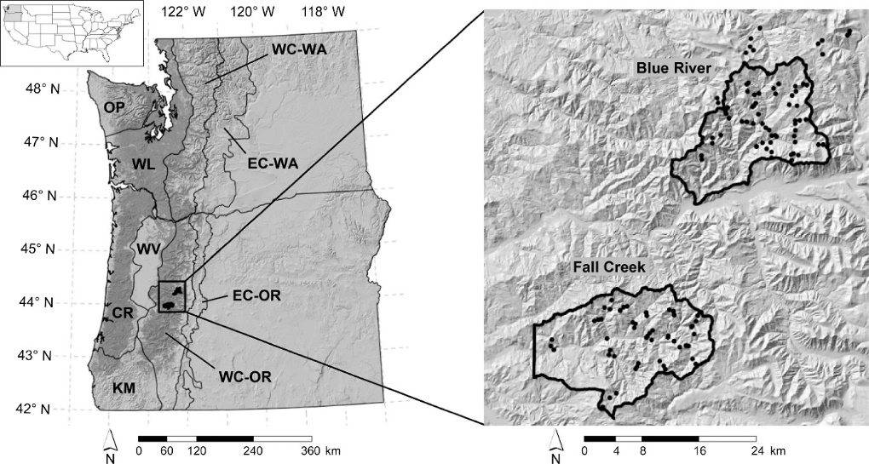
Tepley et al. 2013. Ecology, 94(8), 1729-1743.
In the interval btw SRFs, three-quarters of the historical MSF regime area was undergoing episodic disturbance, creating highly varied successional conditions
The west-side was a fire-prone region with MSF & HSF dominating
Wildfire was a essential disturbance process
Notes:
John Tepley’s work in the MSF regime zone—that brown and blue zone I just showed you—reveals that in the interval btw SRFs, ¾ of that area is undergoing episodic disturbance, creating an abundance of varied successional conditions. These conditions both reinforced and were an outward expression of the variability in MSF regimes.

Slide 14
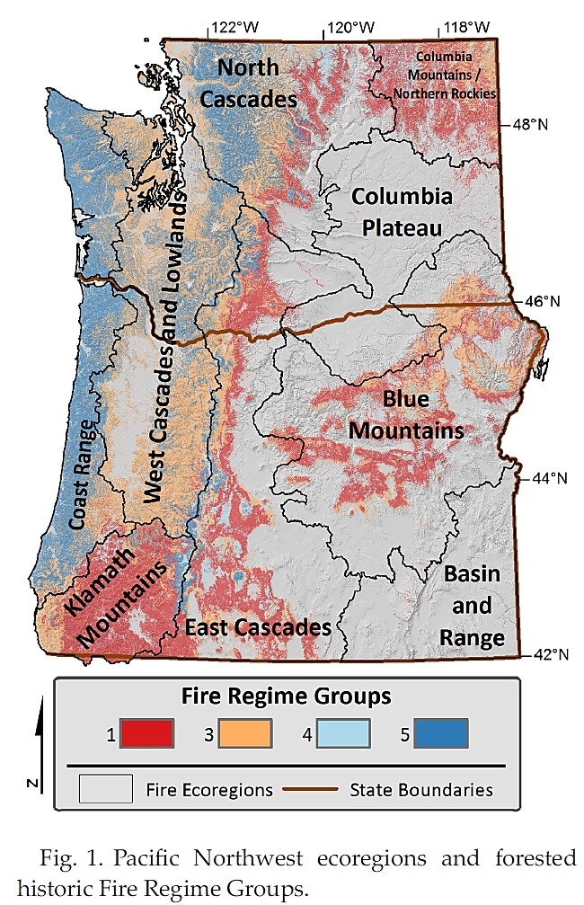
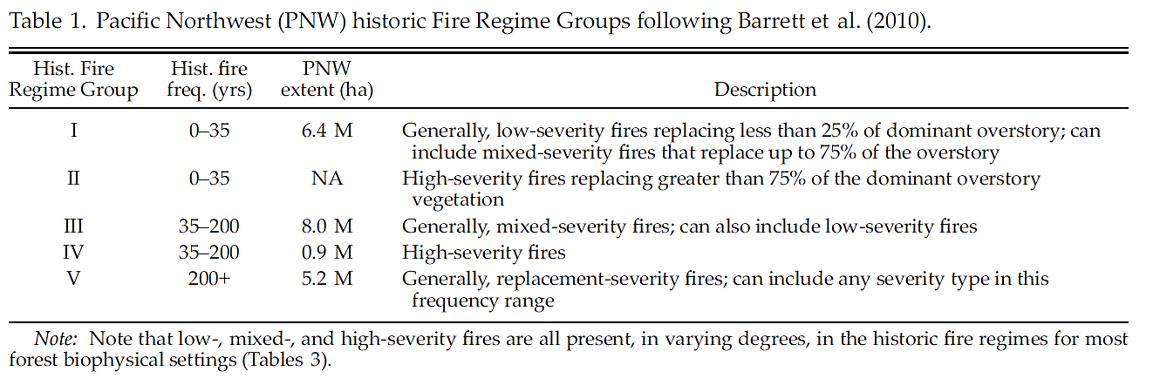
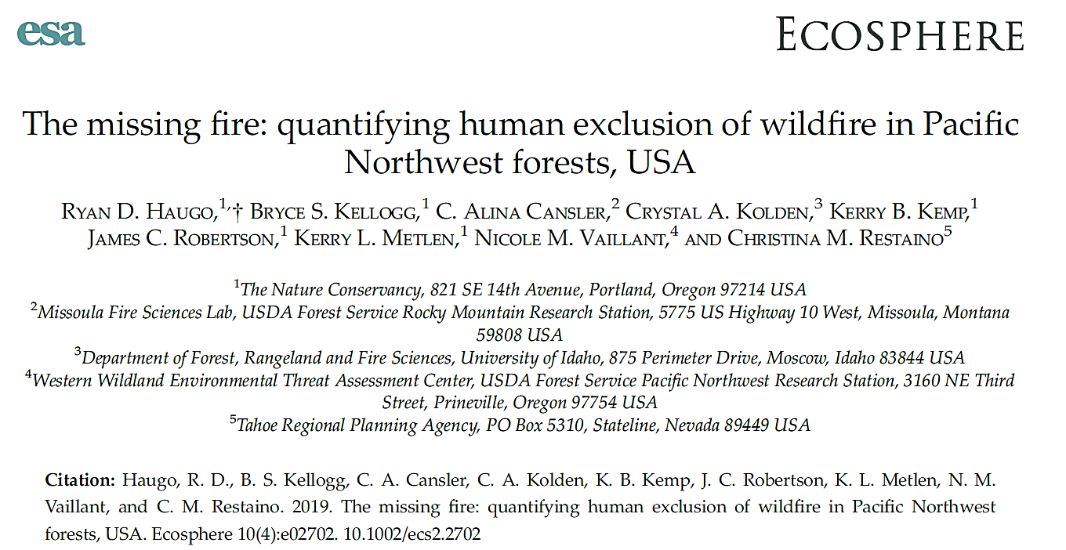
Pacific Northwest forests have experienced an order of magnitude less fire over the period of the MTBS record than occurred prior 150 yrs
Notes:
In work published this year, TNC, FS, and university scientists quantify the effects of fire exclusion. They compare MTBS burned area from 1984-2015 to modeled historical fire regimes for broad ecoregions and fire regime groups. And they show that Pacific Northwest forests have experienced an order of magnitude less fire over the period of the MTBS record than expected under historic fire regimes.

Slide 15
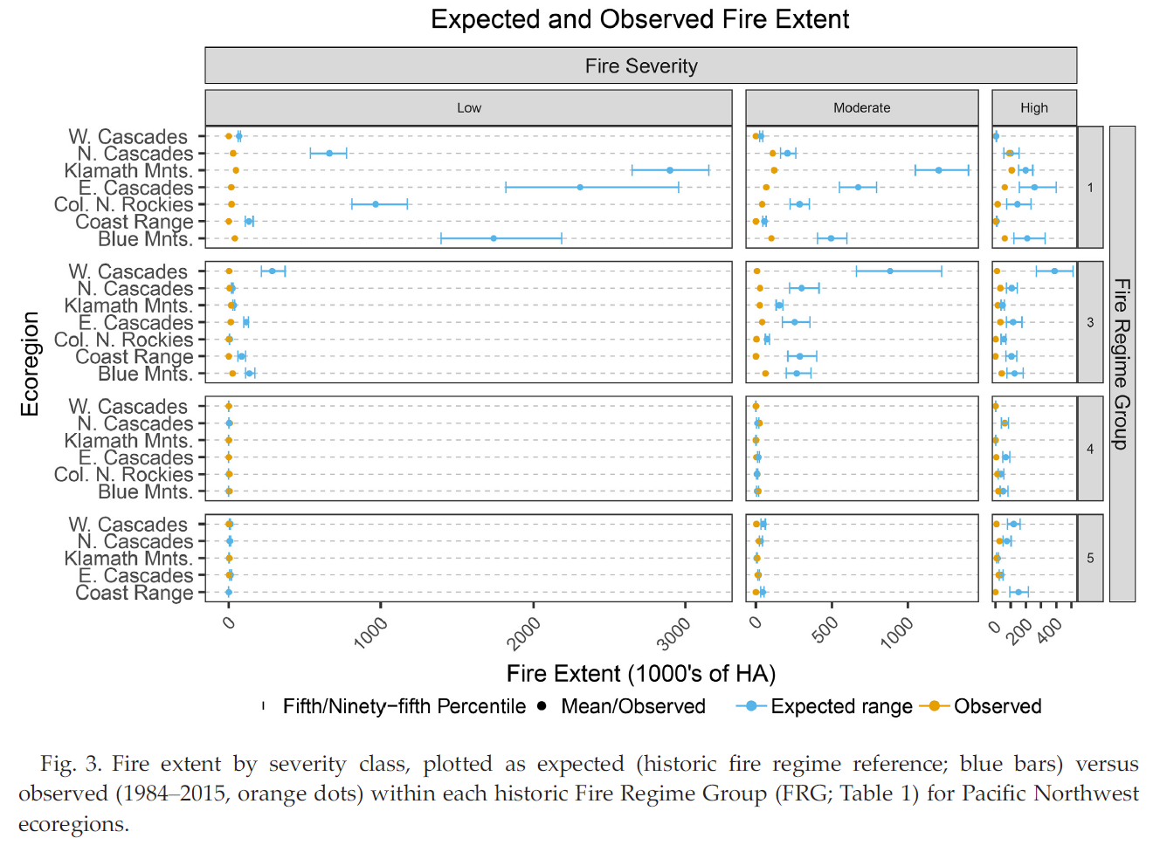
More historically
More currently
There was much more burned area
at any time
of all types, historically
Notes:
When they compared the observed versus expected fire extent, there was much more fire of all types historically

Slide 16
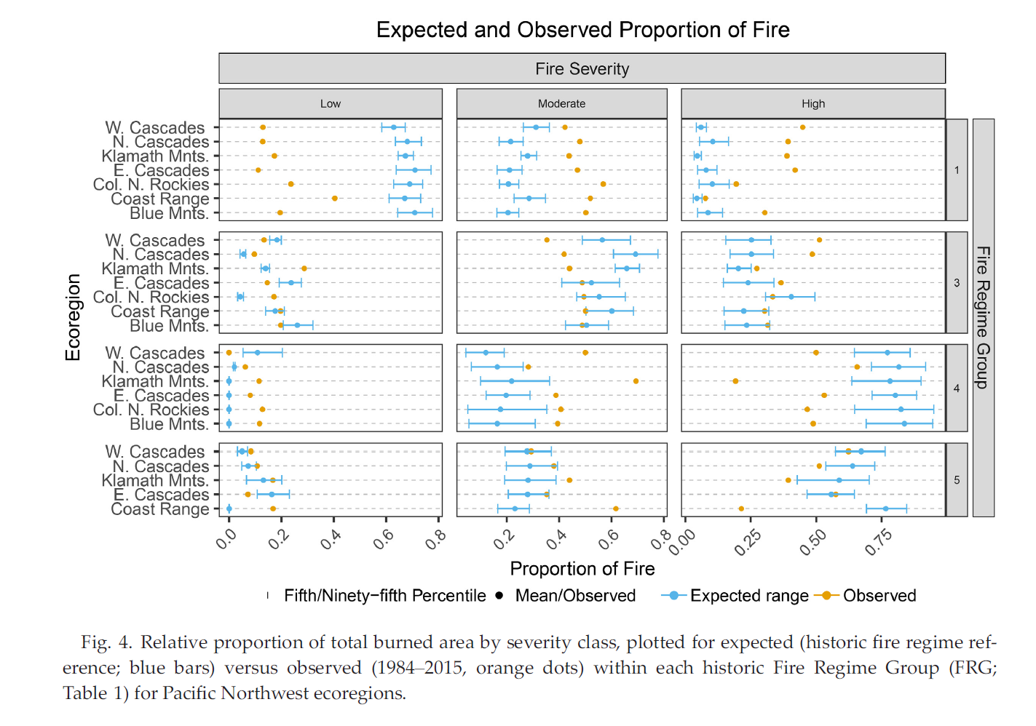
More historically
More currently
There is currently <LSF & >MSF/HSF in FRGs 1&3
More LSF & MSF, & less HSF than would be expected for FRGs 4&5
Notes:
When they compared the observed versus expected proportion of area burned, there was less LSF and MSF and more HSF than would be expected for L and MSF regime groups.
There was also more LSF and MSF and less HSF than would be expected for the HSF regime groups. So, modern wildfires were not doing the job we had hoped for.

Slide 17
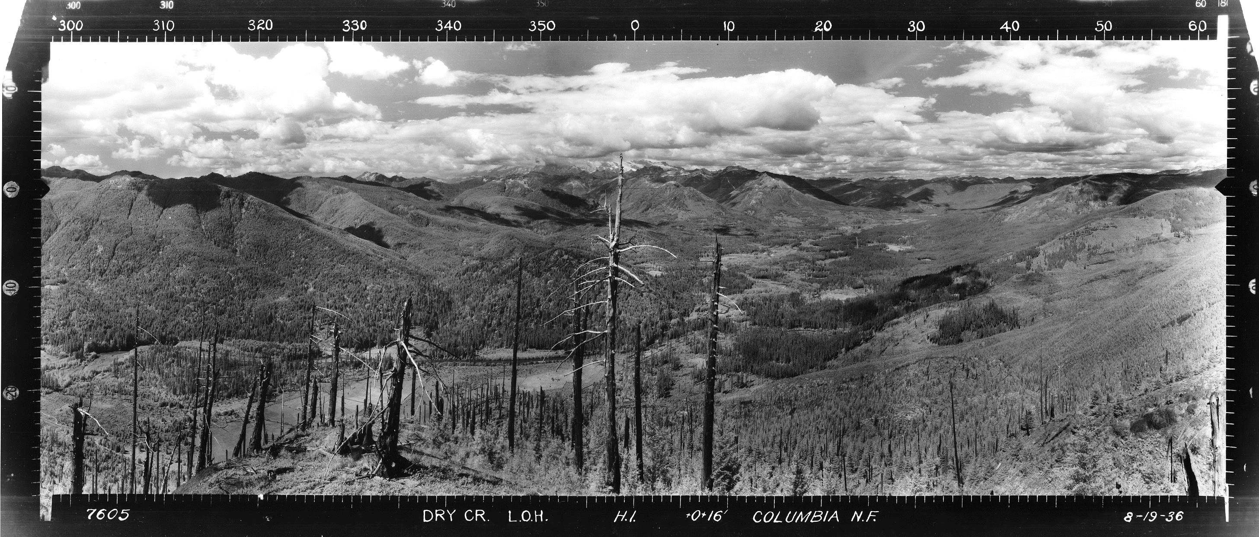
Looking N from Dry Creek Lookout on the GIP NF, notice the older burn scars and the resulting successional patterns
Mt. Rainier
Those are comparisons with historical fire regimes.
Our goal is to wildfire & CC adapt E and W-side forests.
What does CC hold?

Slide 18
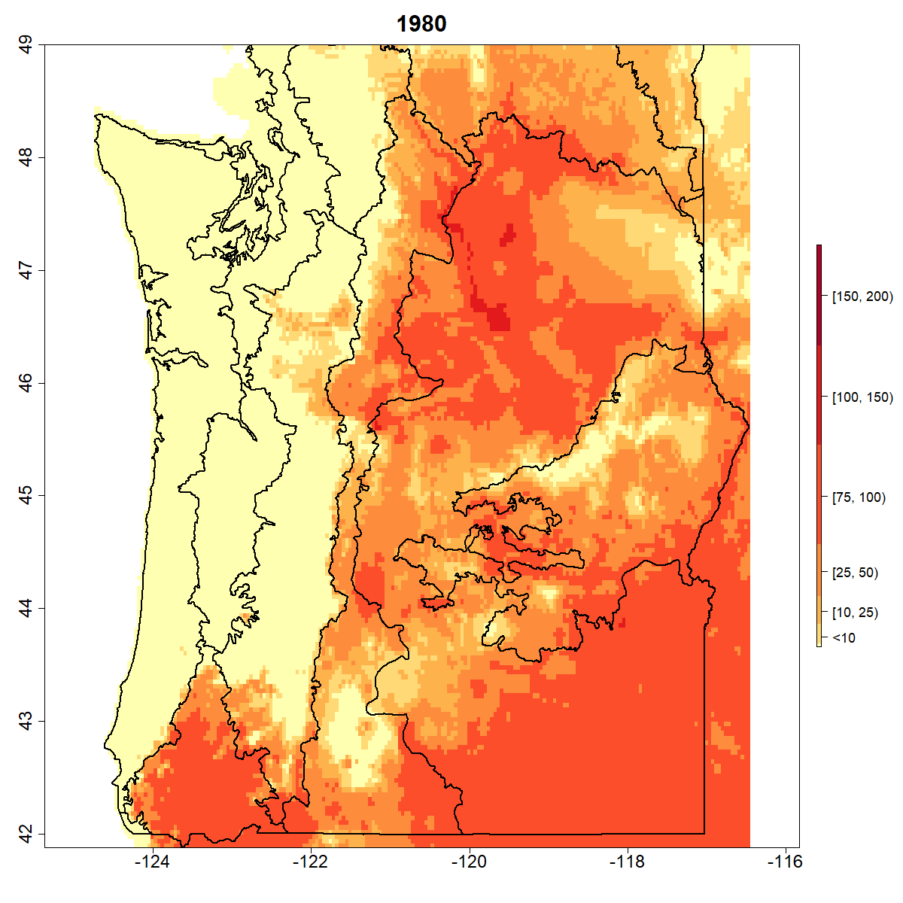
Energy Release Component (ERC) 55+ days
Weather years 1980-2018
Days/yr when wildfires are able to ignite
Predicted for a standardized fuel bed G: Short needle forest w/ heavy fuels

Slide 19
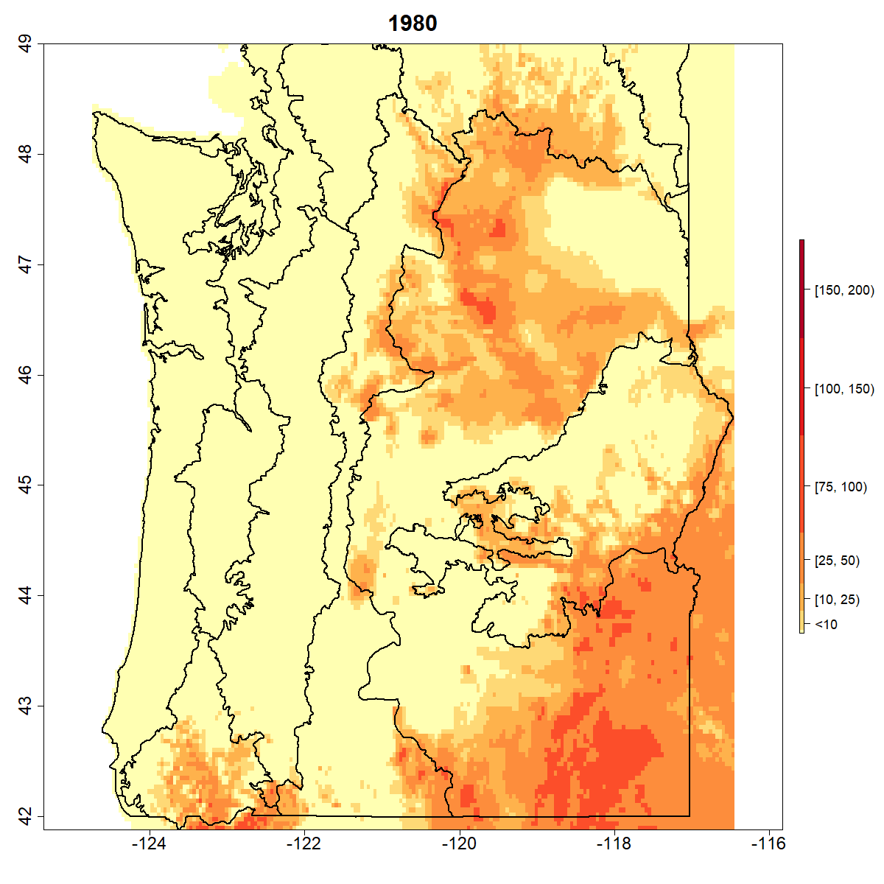
Energy Release Component (ERC) 67+ days
Weather years 1980-2018
Days/yr when wildfires will most likely become problem fires, ≥ 1,000 ac, escaping initial attack

Slide 20
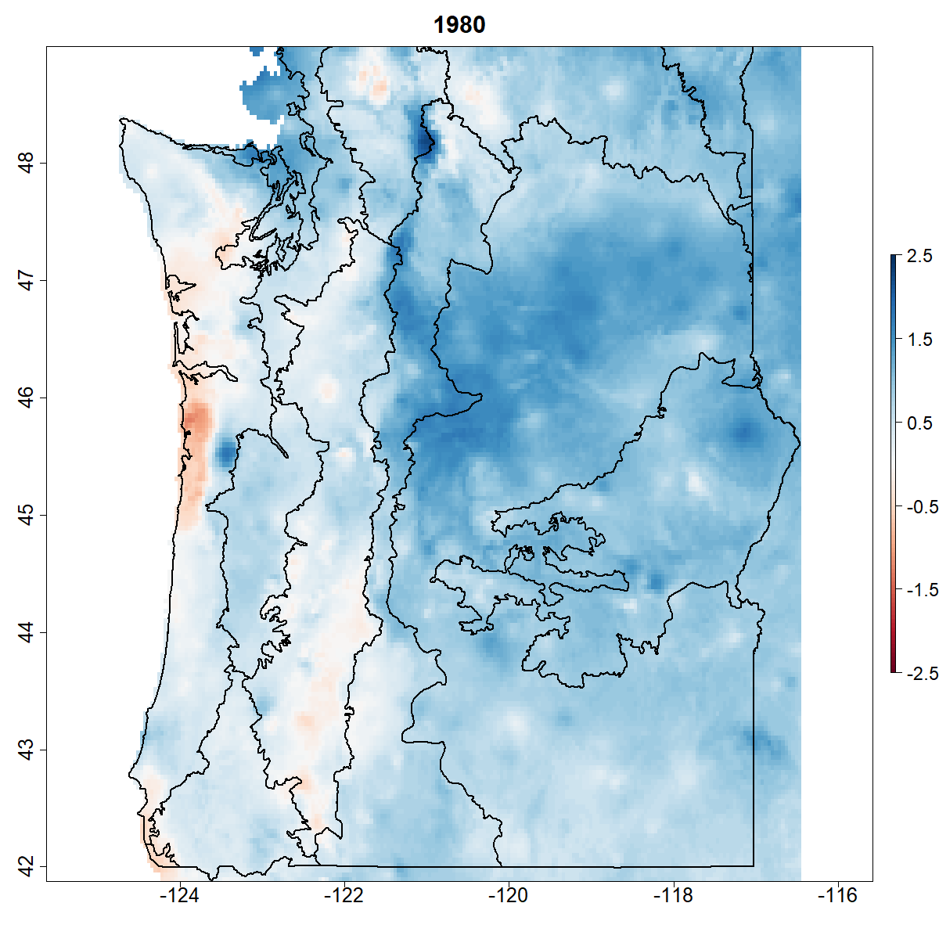
Annual standardized precipitation-evapo-transpiration index (SPEI) for JUN to AUG, 1980-2018 weather years
Accounts for both cumulative PPT & PET
Captures short term drought events
Shows winner in the annual tug-o-war btw PCP or PET
Useful to explaining tree die off events & flash droughts

Slide 21
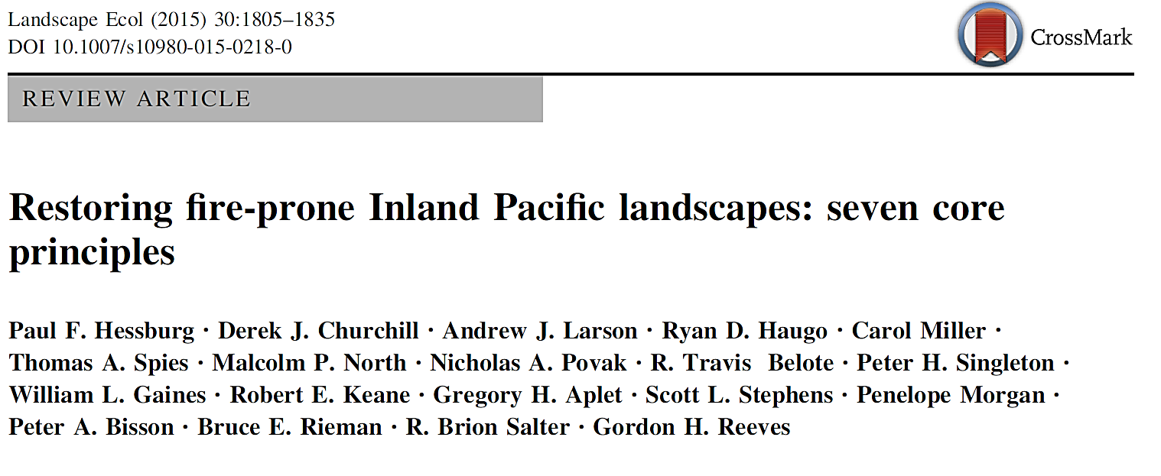
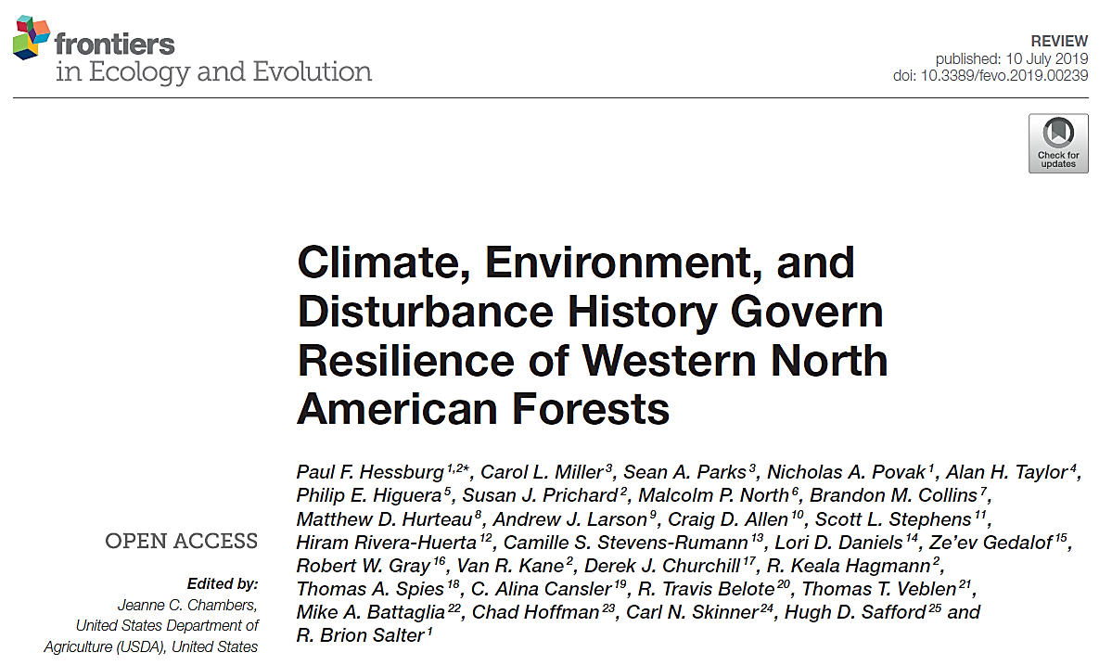

Slide 22
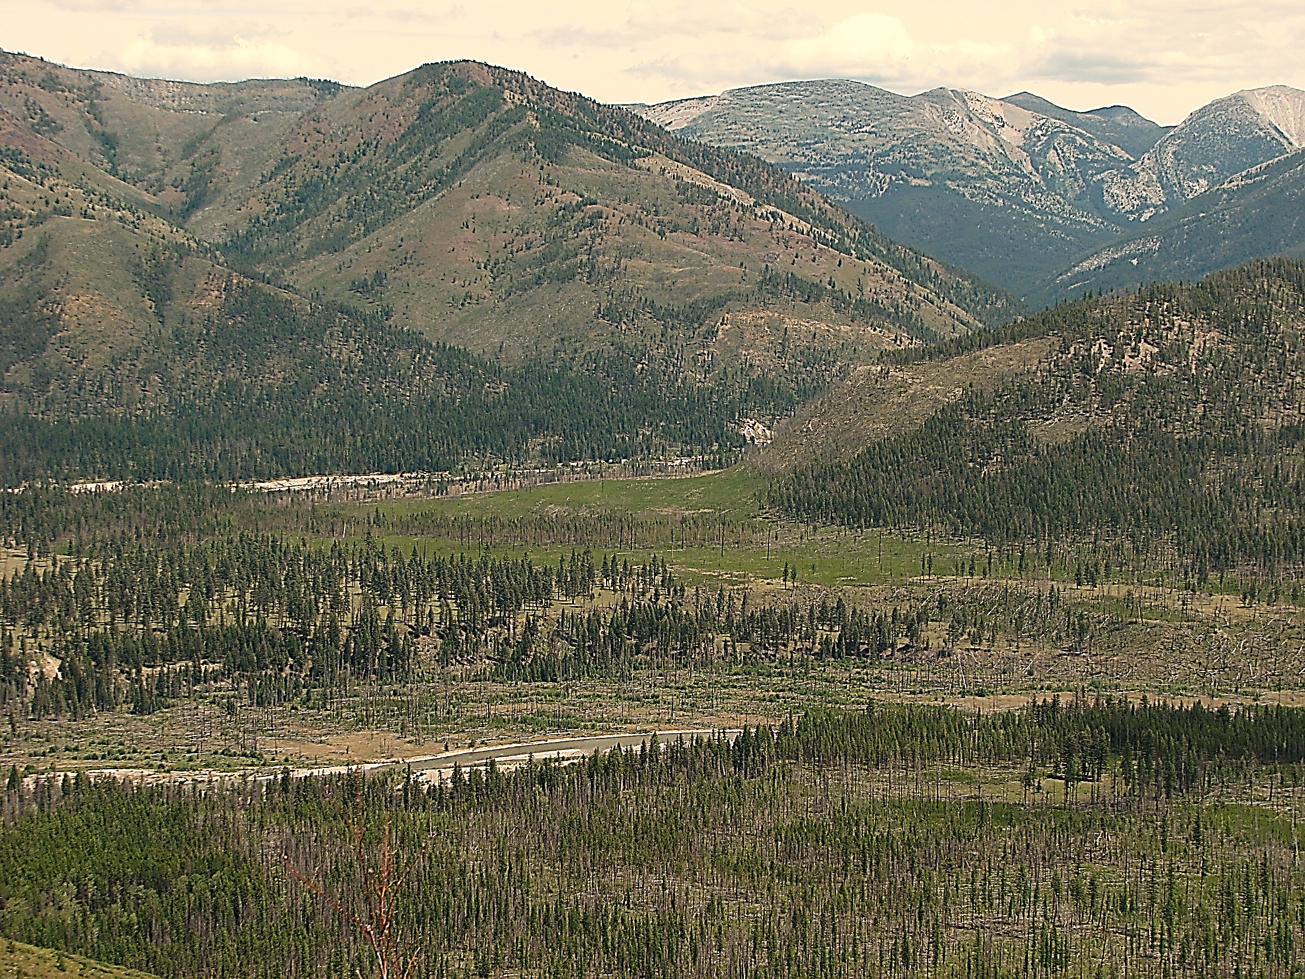
Synthesis
E & W-side forests are wildfire systems; patterns were historically sculpted by wildfires
Fire exclusion & management have drastically changed forest successional conditions, E & W-side
Fire exclusion more E, management more W-side, both influences key
There is strong cross-talk btw patterns of succession & fuel conditions & wildfire, E and W-side
Opportunity to CC and wildfire adapt existing conditions
Resilience & resistance are hierarchically structured in fire-prone E- and W-side landscapes
At fine-scales, patches w/ clumped/gapped or continuous trees
These nest w/ in meso-scale forest successional landscapes
These nest w/ in broad-scale patchworks of nonforest and preforest
Wildfires maintain patchworks of burned & recovering vegetation
Some burn scars spatially interrupted fire flow, others facilitated it
Reburns create non-forest & preforest → decoupling forest and surface fuel succession
These feedbacks influence frequency, size, severity of future fires
How extensive were these conditions? What was their role?
How often did/will future conditions remain in alternative stable states?
These co-extensive nonforest/preforest/forest patterns are an outgrowth of the fire ecology
We need to learn much more about them in W-side landscapes for the coming climate
Wildfire will primarily alter forest successional conditions going forward w/o adaptation treatments

Slide 23
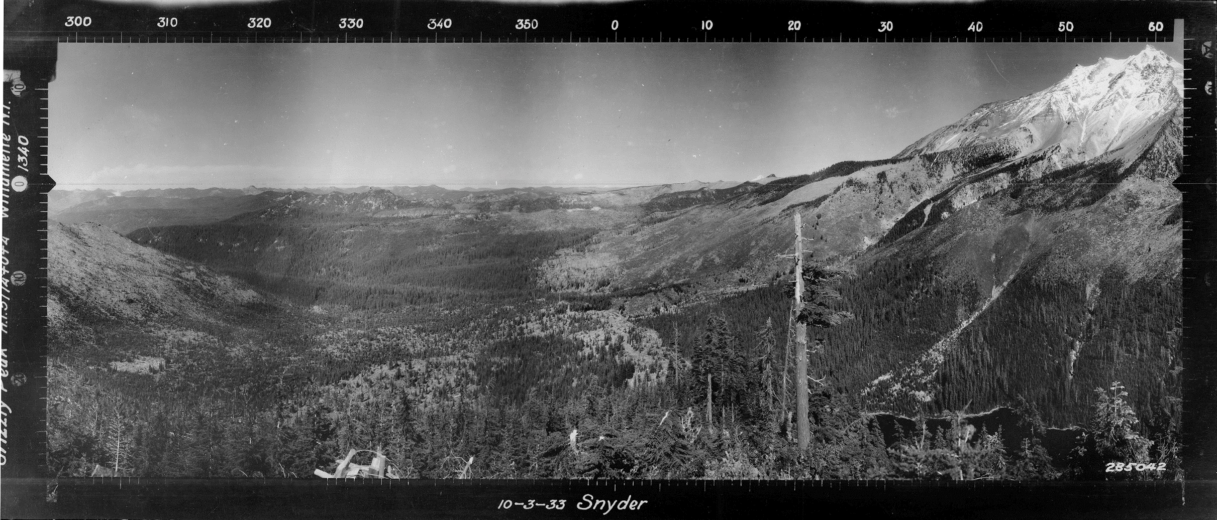
Nonforest conditions provide vital context to forests
Nonforest nearly as abundant as forest in many E-side provinces
What about W-side provinces?
Interplay w/ ignition frequency, fire weather, forest area w/ high canopy cover
Tug-o-war btw factors growing forests & those removing forest → nonforest
Provinces vary in how much potential energy they can store as forest
Nonforest -- a benign fire delivery system once reburning has occurred
In flux with changes in the climate & fire weather
Interplay btw forest – nonforest gives clues to what we can expect w/ CC
Warmer/drier climate -- less forested area and lower canopy cover
Cooler/moister climate -- more forested area and higher canopy cover
Regardless, natural carrying capacity of forests seldom realized
On science, planning, and management sides, we have work to do in partnership
Mt Jefferson, OR Cascades
Grizzly Peak looking North, Willamette NF

Slide 24
Thank you
E-mail: paul.hessburg@usda.gov
pfhess@uw.edu
Time for questions?

