Slide 1
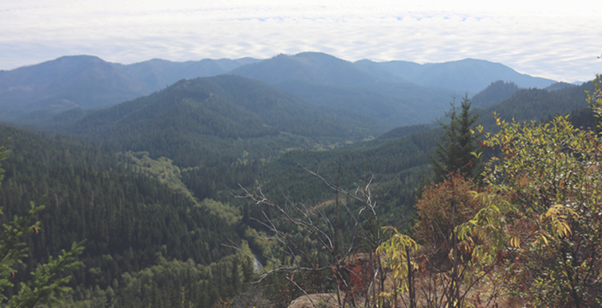
Rigdon Landscape Analysis and Design
A Collaborative Approach to Planning and Project Implementation
Jane Kertis
Ecologist, NW Oregon Ecology Program
Allen Hambrick
Planner, Willamette National Forest

Slide 2
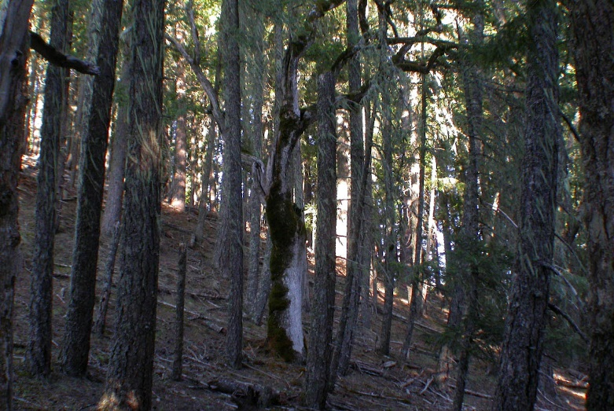
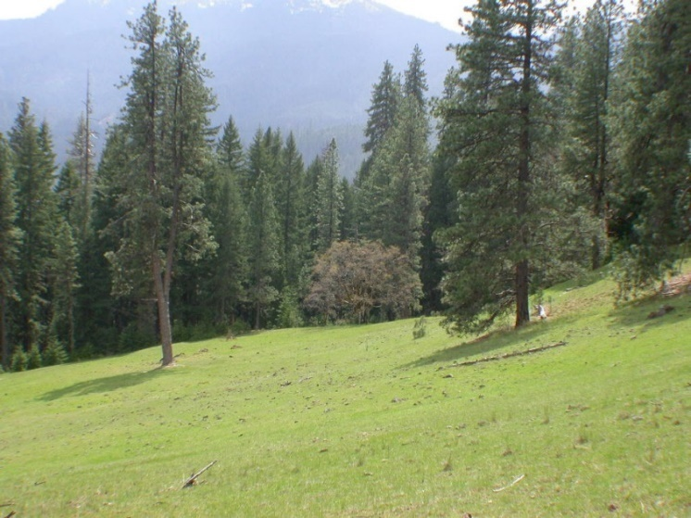
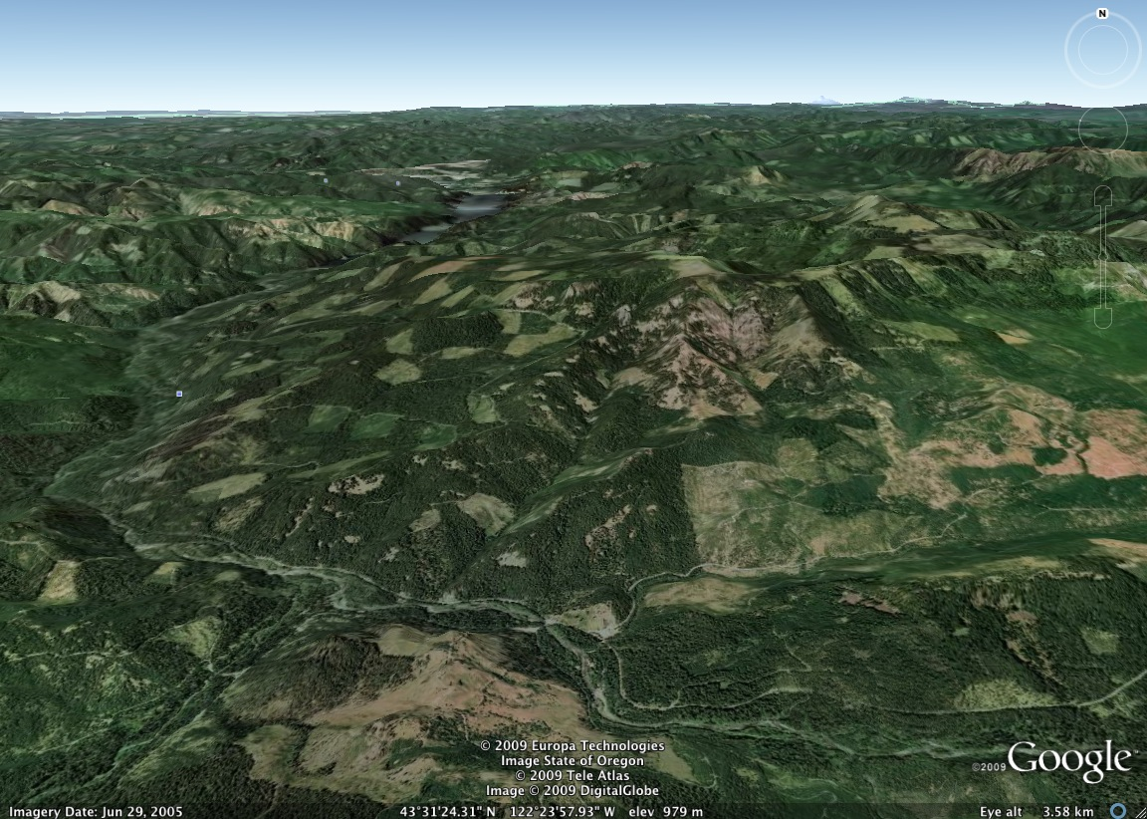
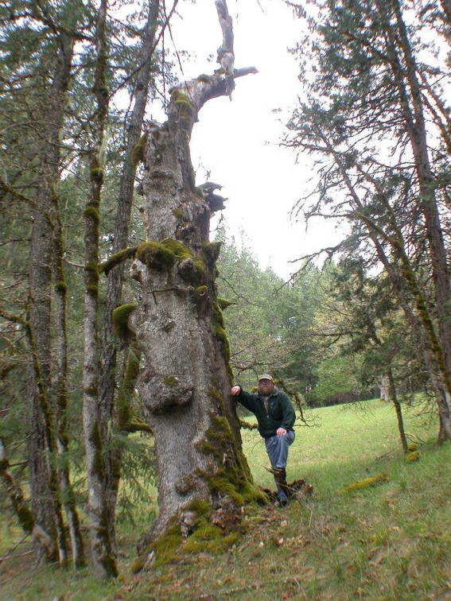
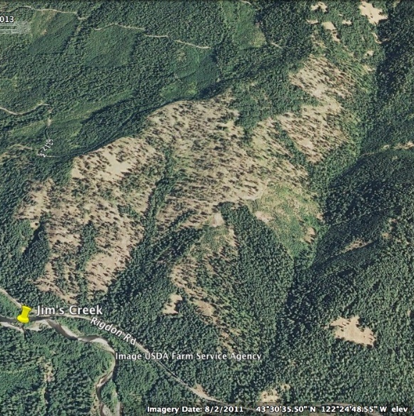
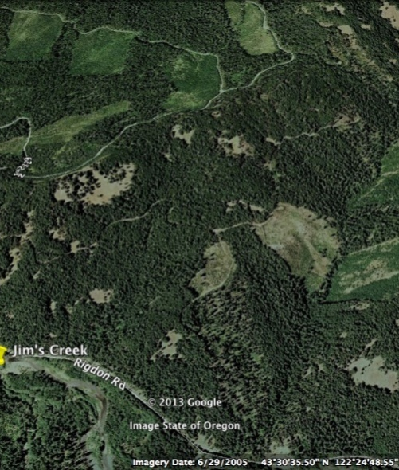
It All Started with Jim’s Creek 2001
Oregon white oak snags and live trees in mixed conifer forest and meadows
Large live ponderosa pine (cultural trees), sugar pine
Encroached meadows
Collaborative process
Oakridge
Jim’s Creek (~700 acres)

Slide 3
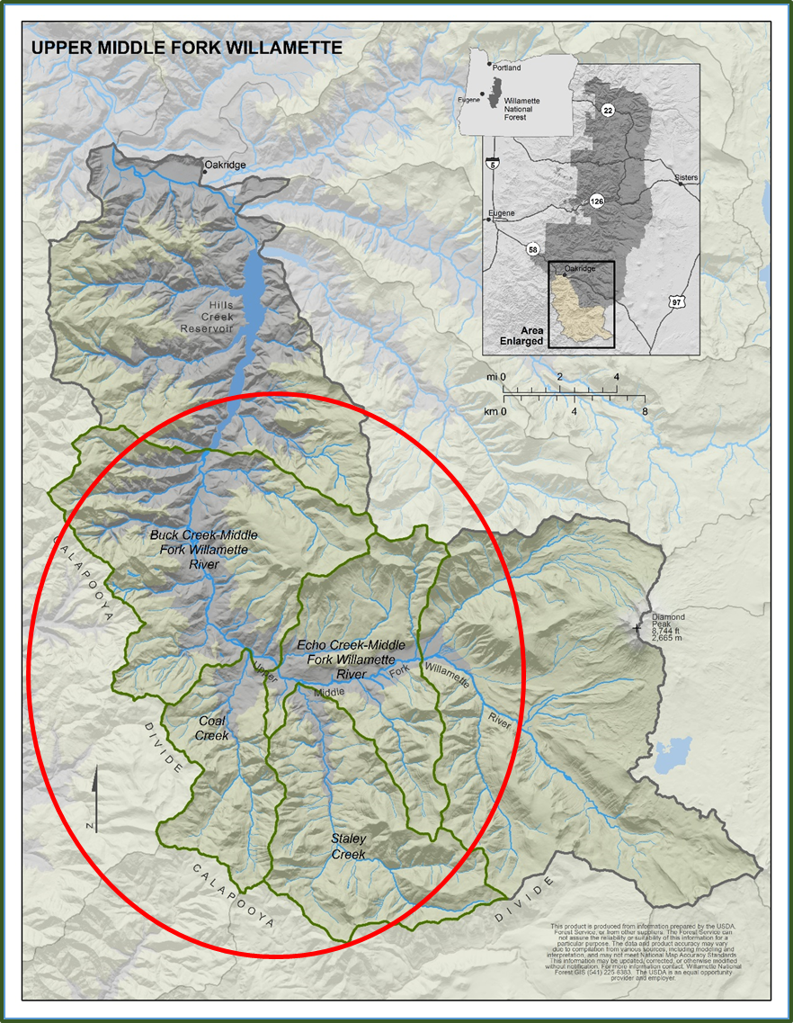
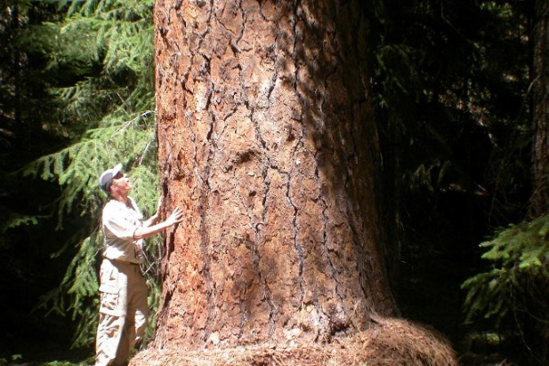
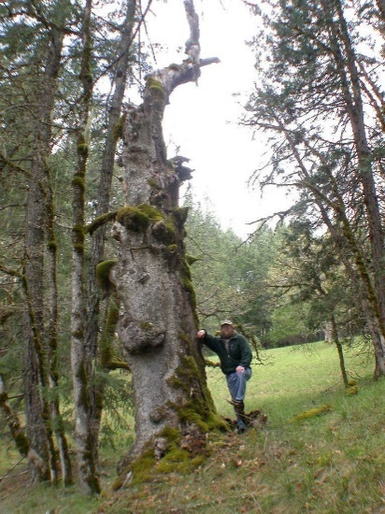
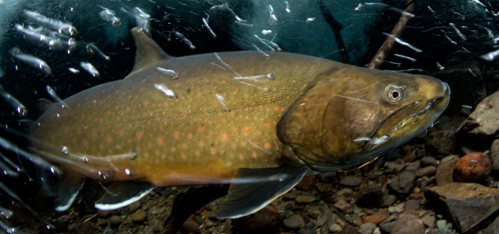
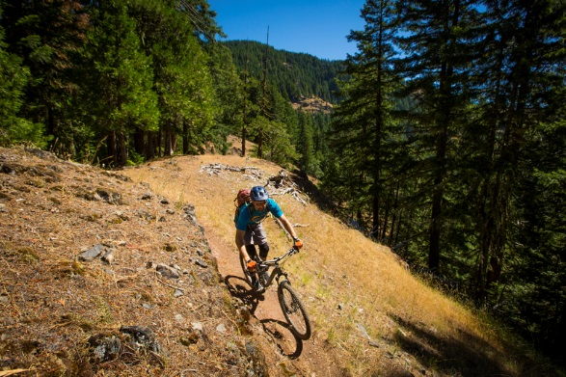
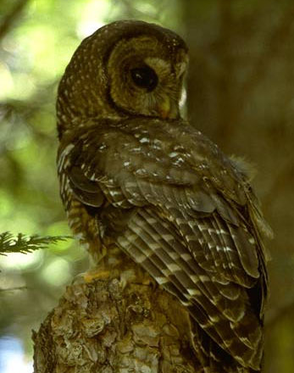
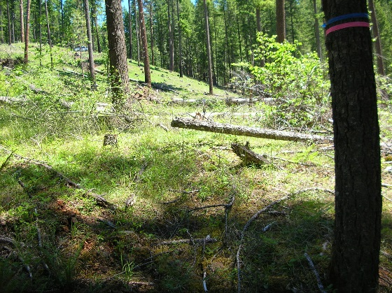
Rigdon Landscape: Working Environment
104,000 acres
4 subwatersheds
Transition zone:
Northernmost contiguous mixed conifer forest
Northern spotted owl, elk and deer habitat , many other species
Aquatic habitat for spring chinook and bull trout
Provide human services such as recreation, economic supply

Slide 4
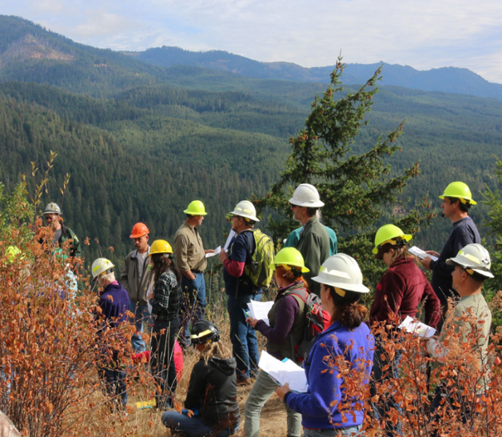
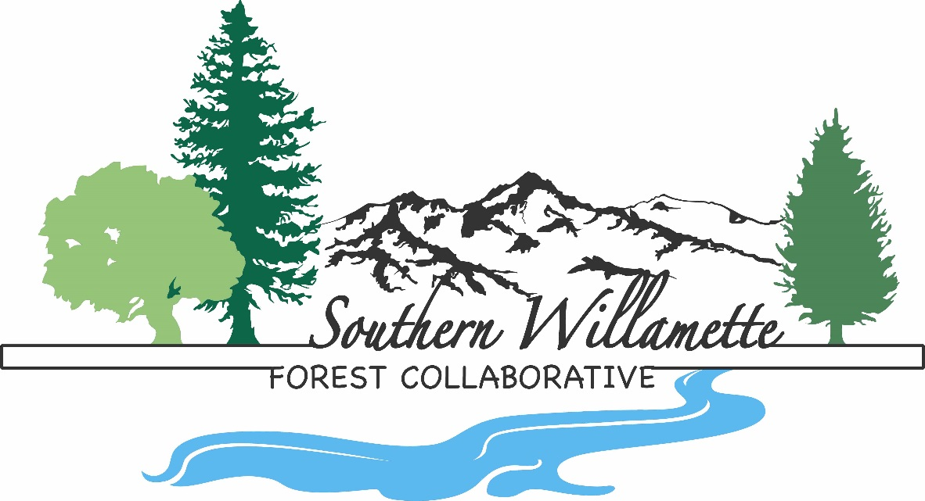
Interested Stakeholders
Southern Willamette Forest Collaborative
“Coming together for healthy forests and communities”
> 70 Stakeholders :
Agencies
elected officials
community members
interest groups
small businesses
industry
universities

Slide 5
Forest Landscape Analysis and Design
(Diaz and Apostle, 1992)
Explore landscape elements , flows and barriers, processes, functions through time (1-5)
Collaborative
Input
3.
Relationship
Between
Elements &
Flows
4.
Disturbances
And
Succession
2.
Landscape
flows
Consider direction from Plans (6)
7.
Landscape
Pattern
Objectives
5.
Linkages
Develop landscape pattern objectives (7)
1.
Landscape
Elements
6.
Landscape
Patterns from
Forest Plan
Collaborative
Input
8.
Forest
Landscape
Design
Collaborative
Input
Apply to project landscape (8)

Slide 6
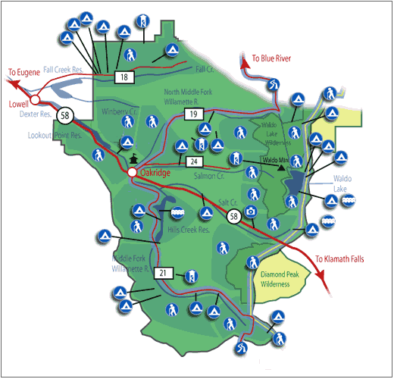
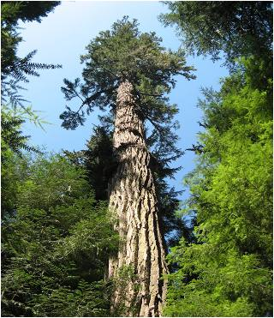
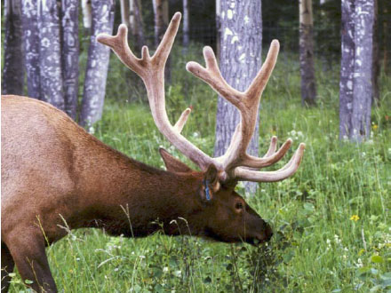
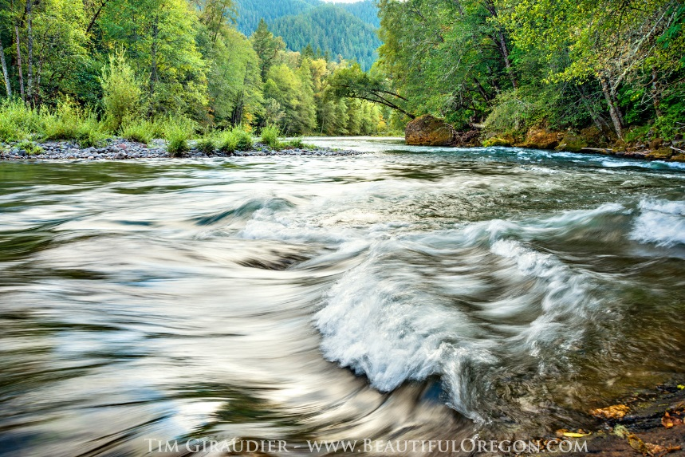
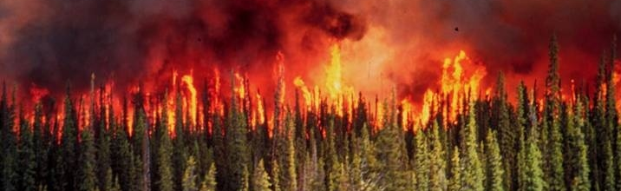
Collaborative Landscape Themes
Vegetation
Wildlife Habitat
Aquatics
Physical Environment
Humans
Fire

Slide 7
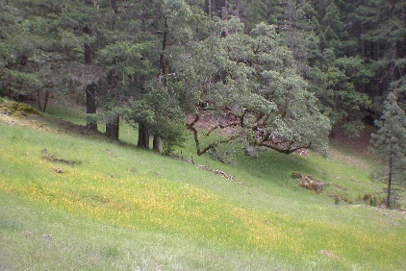
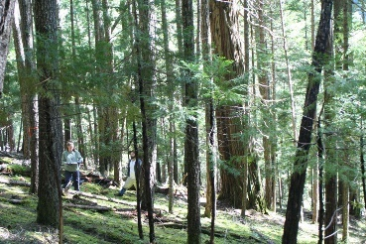
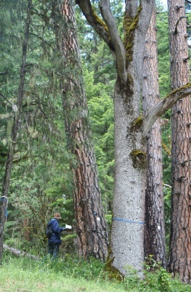
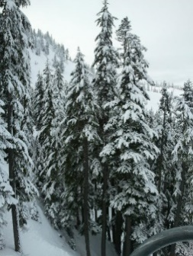
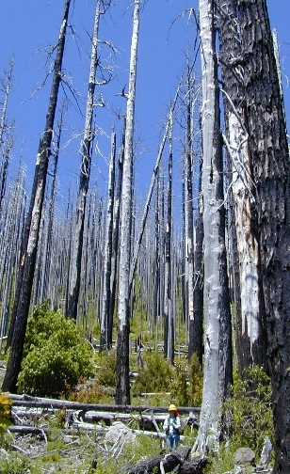
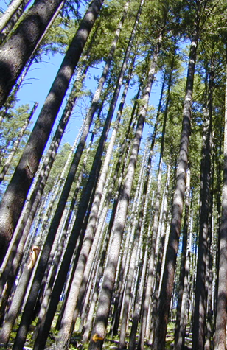
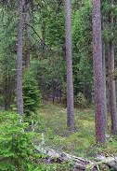
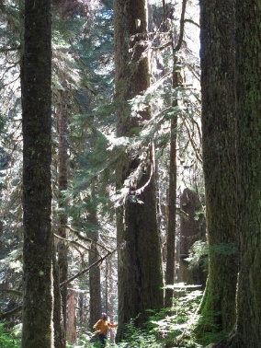
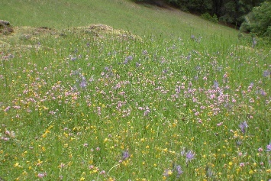
Vegetation: Key Elements
Key elements:
Biophysical Environments —Potential vegetation types
Forested: Seral stages (composition and structure)
Non-forested— meadow types

Slide 8
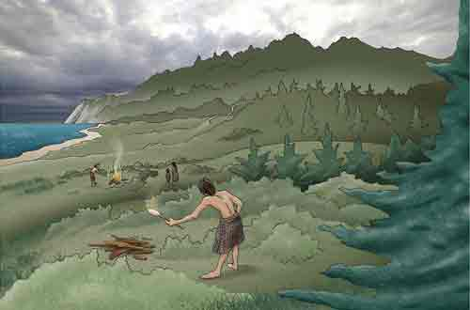
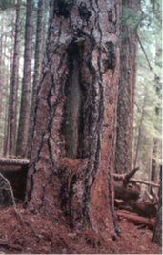
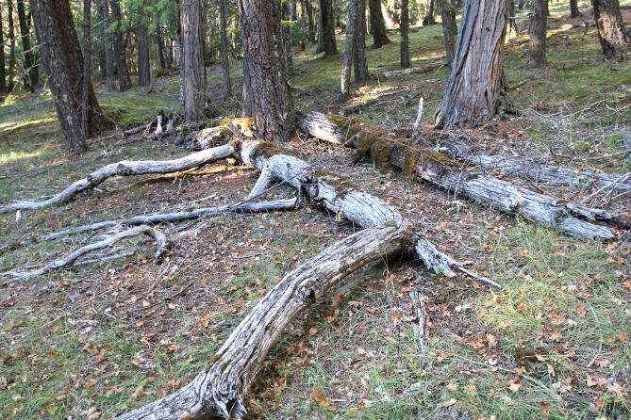

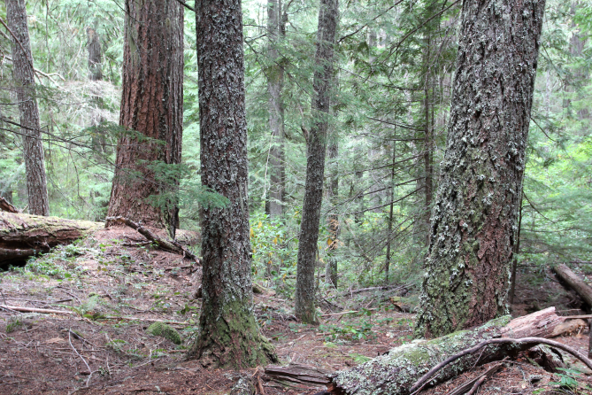
Vegetation: Driving forces
Fire History
James Johnston, OSU unpubl. data
Fire
Wind
Insects and Pathogens
People
Historical range of frequencies (5-200 MFRI)
Potential influence of indigenous people
Strong link to potential vegetation type
High frequency, low severity in mixed conifer
Mixed severity regime in western hemlock, Pacific silver fir
Dry pine with oak
Douglas-fir/western hemlock
Pacific silver fir
MFRI: 5 years
MFRI: 55 years
MFRI: 190 years

Slide 9
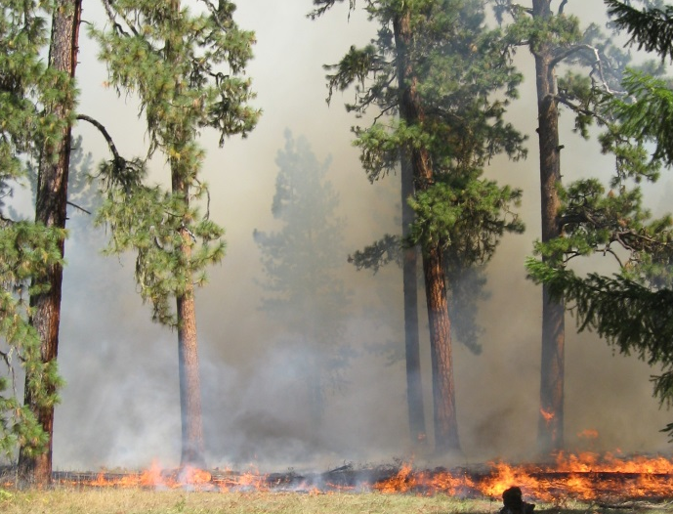
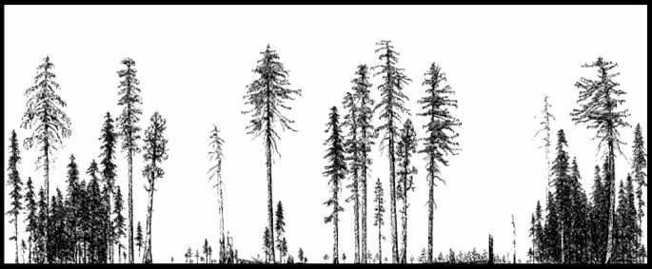
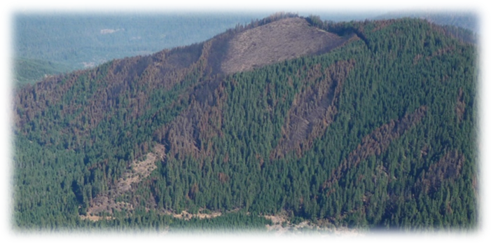
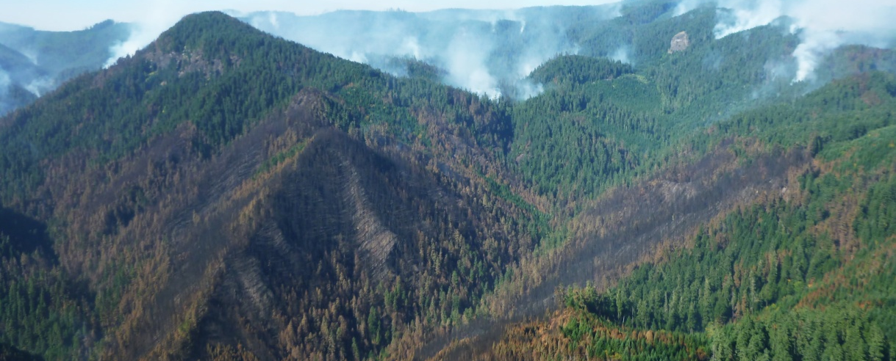
Vegetation Patterns, Flows and Functions
Pattern:
Mixed conifer: Open forest , fine scale variability
Moist/cool forests :Moderate-closed forest, late seral fabric, with fine-moderate grained variability
Functions:
Produced carbon, vegetation heterogeneity, wildlife habitat diversity, CWD/LWD, first foods (e.g. camas, huckleberry)
Stored carbon
Cycled nutrients, sediment, wildlife, water
Output CWD, sediment, certain wildlife species

Slide 10
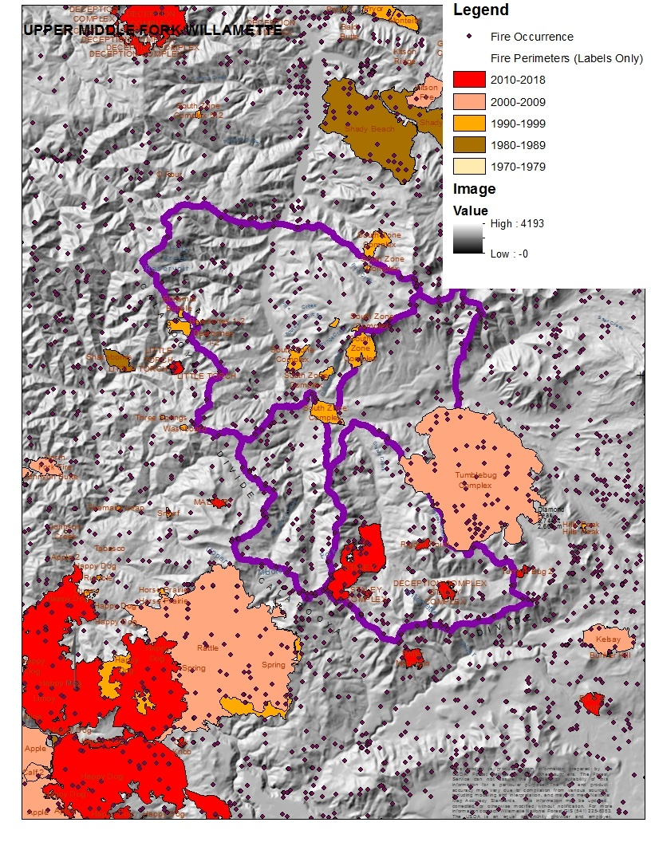
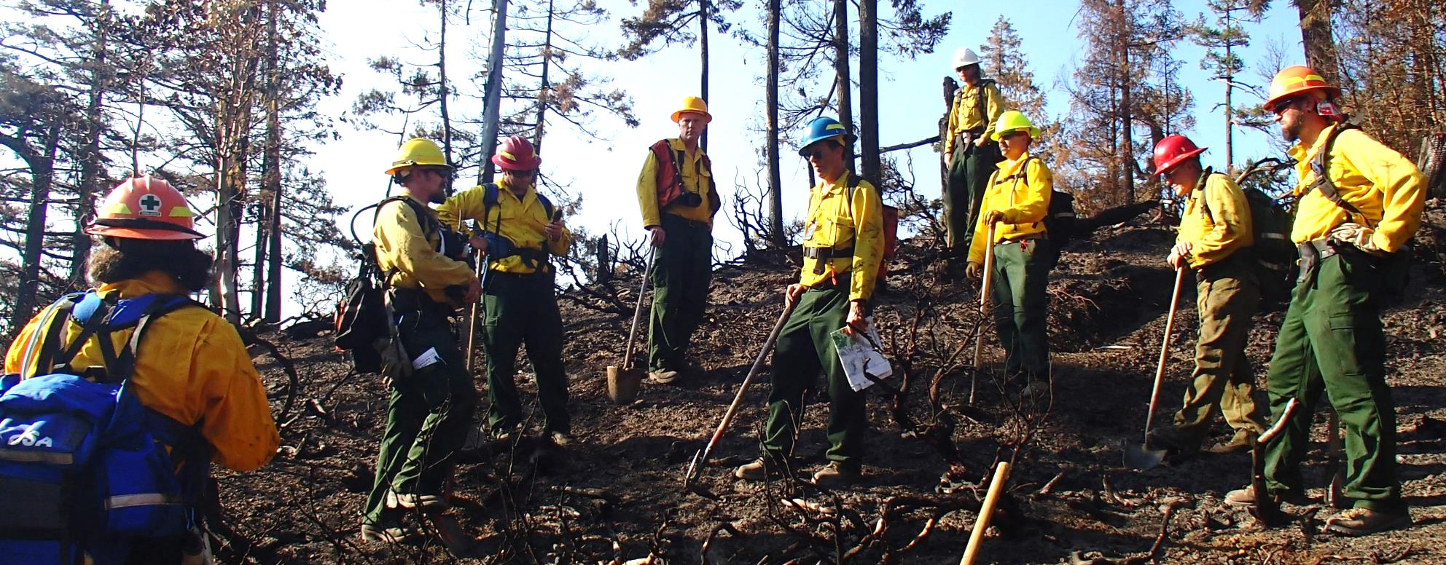
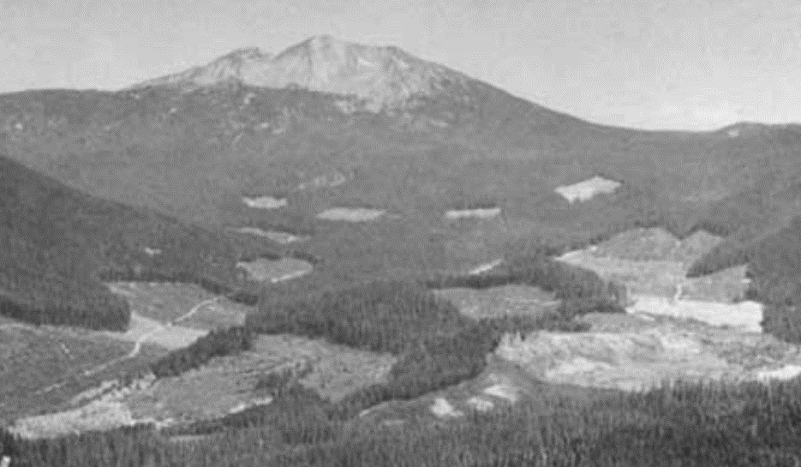
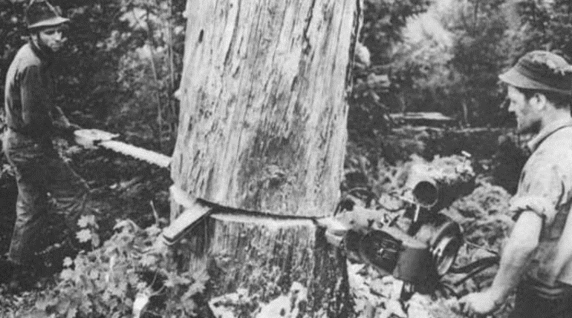
Vegetation: Changing Driving forces
Fire :
Removal of Indigenous People
Suppression
Timber Management

Slide 11
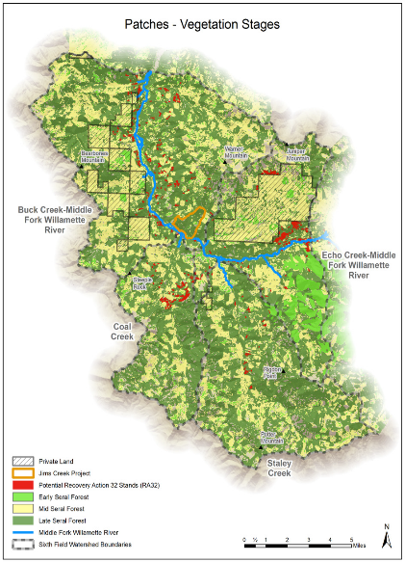
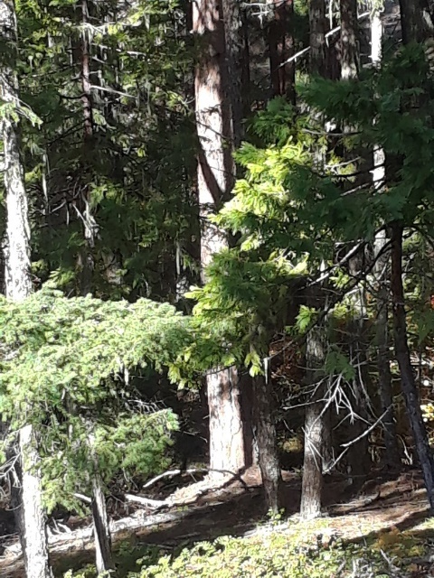
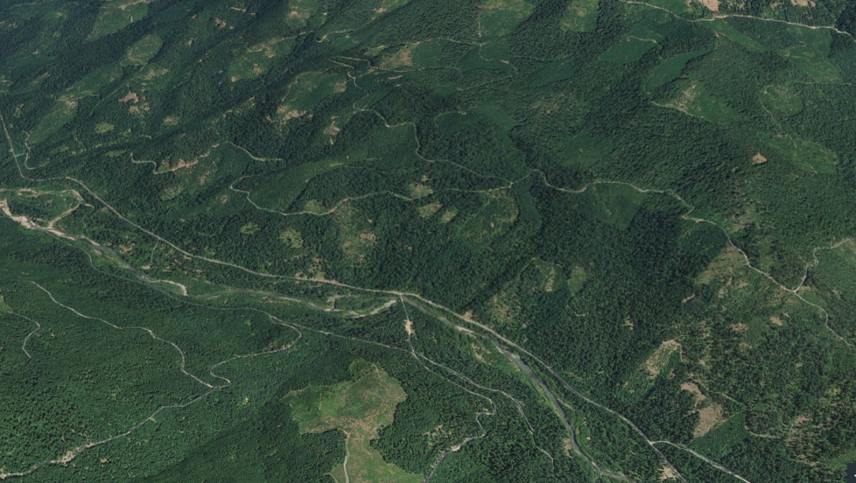
Vegetation: Changing Pattern and Functions
Current Vegetation Pattern
Mixed conifer: closed canopy forest fabric, unhealthy ponderosa, sugar pine
Moist/cool forests: Seral stage distribution, ownership patterns

Slide 12
Relationships : Late Seral Stage Element
Fuel buildup in NSO and red tree vole patches may promote fire flow.
Wildlife
Red tree vole utilize late seral riparian corridors.
Aquatics
Vegetation
Late seral closed forest beneficial to water quality and aquatic flows--provide shade, contribute large woody material, filter overland sediment, maintain high water quality.
Trails/roads may inhibit aquatic flow
Human Uses
Fire
Administrative sites increase human ignition source flows.

Slide 13
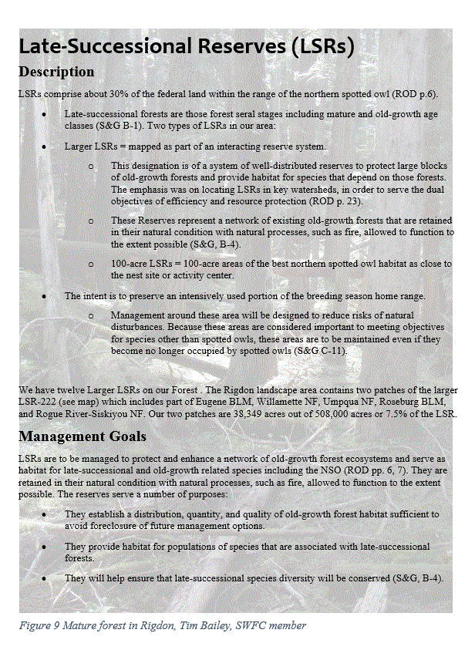
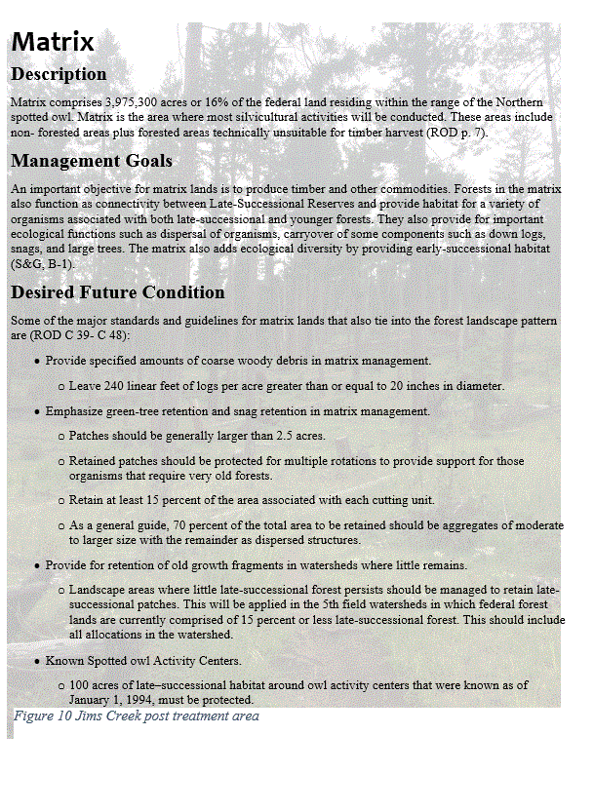
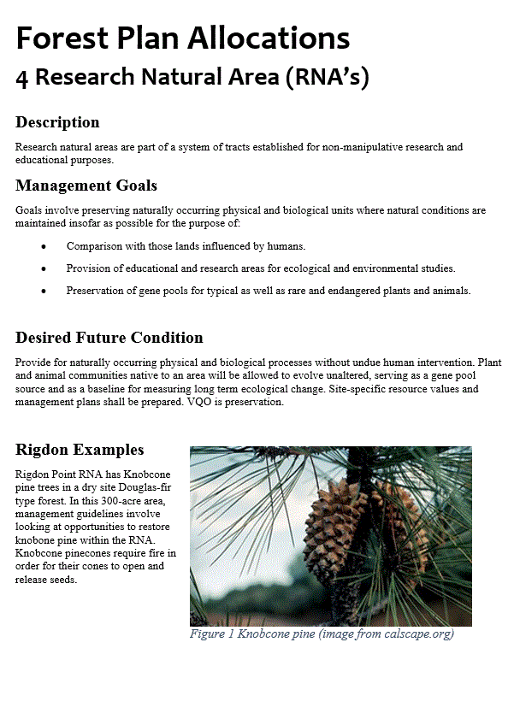
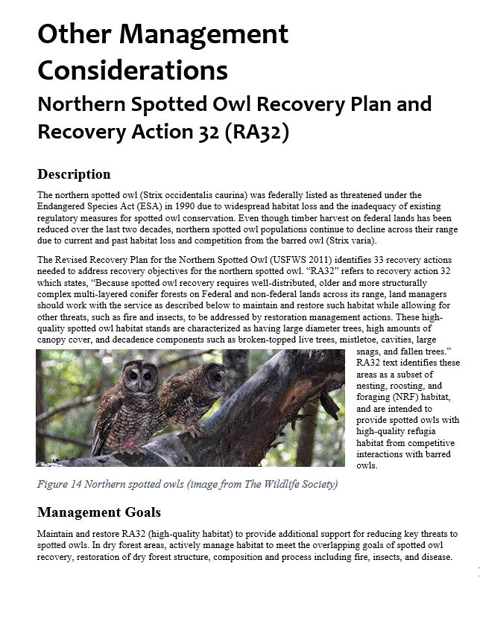
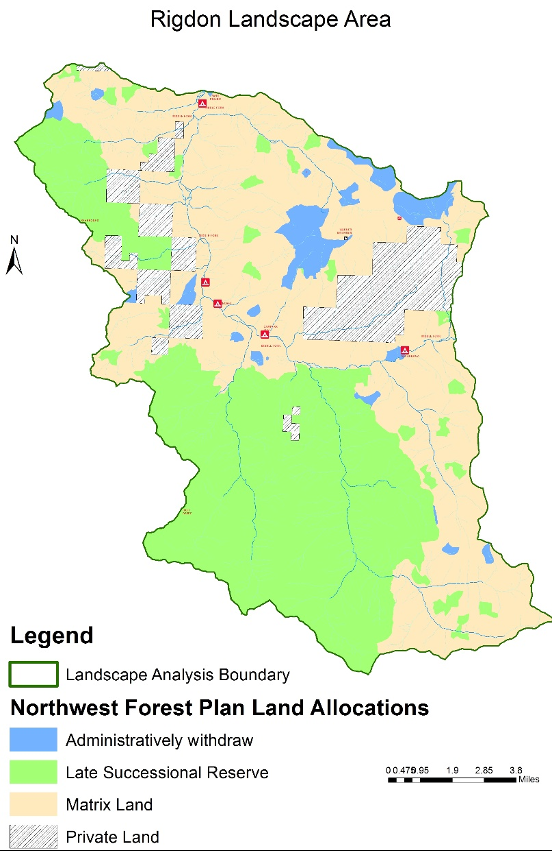


Plan Direction
Desired Future Condition
Stand desired characteristics include multispecies and multilayered assemblages of trees, moderate-to-high accumulations of large logs and snags, moderate-to-high canopy closure, moderate-to-high numbers of trees with physical imperfections such as cavities, broken tops, and large deformed limbs and moderate-to-high accumulations of fungi, lichens, and bryophytes.
Landscape desired characteristics include
Vegetation structure and pattern are diverse: Patch size, plant species composition, and other late successional characteristics meet the habitat requirements for late successional associated species
Habitat for early/mid successional species is maintained: Habitat is maintained in these stages when LSR populations of those species are important for viability of the species over a broader geographic area, or if any of those species should be locally endemic to these LSRs.
Connectivity exists between and within watersheds: Late seral vegetation provides connected and resilient watershed processes within and between watersheds. Within watersheds, the terrestrial, riparian, and aquatic systems are connected.
Wet area habitats maintain high levels of source populations: Aquatic and terrestrial habitats of native species dependent on wet areas are restored and maintained.
Managing fire risk: no more than 28 percent of the LSR acres are in high fire risk condition at any one time. Wildfires are low to moderate intensity over about 75% of the area and features of the natural disturbance regime operate at levels that maintain species, habitat diversity, and encompass less than natural levels of stand replacement events.
Since the goal in LSRs is to protect late seral conditions, management should move in the direction of lowing risk that has increased since the advent of fire control, where possible to be more consistent with natural fuel levels.

Slide 14


Target Landscape Goals and Patterns:
Target Landscape Patterns
Forest structure and composition pattern varies across landscape:
Mixed conifer forest – Dominated by open late seral forest, with scattered patches of other seral stages (including connected closed forest).
Moist upland forest – Dominated by connected closed canopy late seral forest, with scattered patches of other seral stages.
Patches of drier forest, such as those with knob cone pine, occur in the southern area along north/south ridges.
Goals and Objectives
Provide healthy, diverse resilient forests that sustain plant, wildlife and aquatic habitats by:
Allowing natural processes to flow where possible.
Restoring and promoting seral stage distribution to reflect
natural disturbance patterns.

Slide 15


RLA to Project Planning
This RL analysis will be used for the current project, Youngs Rock Rigdon, and future projects. The district can continue to use this analysis as a guide.
Use landscape goals/objective and target patterns developed for the large landscape
Develop the P&N
Evaluate current condition
Design to meet appropriate goals and patterns—1st project design beginning NOW
Can use results for the next 3-4 projects in this area. Or almost any project within the area.
~33,000 Acres in YRR of the ~100,000 Acre landscape area

Slide 16
Youngs Rock Rigdon EIS P&N taken directly from the RLA Goals and Objectives
Purpose and Need
P&N cont.
Improve stand landscape diversity, structure, and resiliency
Increase diversity and structure in mixed conifer
Increase diversity and structure in moister forests
Meadow and oak savannah restoration
Floodplain and aquatic restoration
Control stocking and improve structural complexity and diversity of riparian vegetation and complexity needed to attain Aquatic Conservation Strategy Objectives
Strategically Reduce Hazardous Fuels
Sustainably manage existing trail system and dispersed recreation while minimizing impacts to natural resources
Identify a sustainable road system needed for safe and efficient travel and for administration utilization, and protection of National Forest System Lands.
Provide a sustainable supply of forest products
Notes:
LA-Gave a full description of the landscape historically and currently and then we decided on the P&N using a portion of the landscape. Projects will use what is appropriate from the RLA and may or may not include everything listed. Needs to be appropriate by site.

Slide 17



Increase diversity and structure in mixed conifer
Notes:
Map and landscape pattern that this project is producing. You can see the pattern starting to unfold of how the area can look in the future. Fits the pattern of the RLA.
creating more late seral open forest by thinning in 3,000 acres of older natural stands
Treatments would be primarily through timber harvesting but also includes using non-commercial methods such as underburning, fall and leave, and fall and remove for aquatic habitat restoration activities.

Slide 18


Jim’s Creek Project-Pine Release Inside the RLA area
Notes:
Project within the RLA that helped with development-Finished product that happened to fit right in.

Slide 19


Increase diversity and structure in upland managed stands
Notes:
Focused in the 40 to 60 year old plantations.
Thinnings with gaps and riparian reserves.
Variable density thinning would include skips and gaps .
accelerating the development of late seral patch connectivity by thinning in 500 acres of younger managed stands and
creating more complex early seral habitat by regeneration harvesting in 500 acres of younger managed stands.
Regeneration harvest includes retaining at least 15% unthinned in clumps and scattered trees.

Slide 20


Meadow and Oak Savannah Restoration
Meadow Conifer Encroachment
Opening Oak Savannahs
Notes:
Part of the pattern is Meadow restoration and enhancement
Oak Savannah restoration and improvement

Slide 21


Aquatics
Flood Plain and Aquatic Restoration
Control stocking and improve structural complexity and diversity of riparian vegetation and complexity restoration needed to attain Aquatic Conservation Strategy Objectives
Notes:
Finished zero stage floodplain project that fits in with the RLA and is also within the RLA area. There are proposals for another ~700acres in the YRR project that are similar.
Read the rr stuff in the slide.

Slide 22

Strategically Reduce Hazardous Fuels including roadside fuel breaks
Notes:
Understory, and roadside fuel breaks.
Help with resiliency and safety for the future.

Slide 23


Sustainably manage existing trail system and dispersed recreation while minimizing impacts to natural resources Fostering human use-Supporting economic sustainability-Historical education opportunities
Notes:
Restoring and maintaining the trails system and telling the history of the area.

Slide 24

Roads and Forest Products
Sustainable Road System
Sustainable Supply of Forest Products
.

Slide 25
The rest of Rigdon and future projects using the RLA
Potential Future Projects Using the RLA
Steeple Rock and Dome Rock-EAs (Tree density reduction & structural diversity)
Floodplain Restoration/Watershed-EA or CE
Trail Maintenance-Reroutes/Dispersed Camping/Developed Campsites-EA or CE
Historical Education Opportunities-Can fit inside other appropriate projects

Slide 26

Questions?

Slide 27





Understand Landscape Pattern, Flow, Function
What are the key elements in each theme/resource?
What have been the driving forces that shaped the landscape?
What patterns and flows resulted from these forces? How did this influence landscape function?
How have things changed through time?

