Slide 1
Using Traditional Ecological Knowledge for Restoration:
Insights from project with Confederated Tribes of Warm Springs
Michelle Steen-Adams
Portland Forest Sciences Lab
With S. Charnley, P. Hessburg, K. Hagmann, B. Salter, R. McLain, and K. Wendel
Notes:
Two main ideas of today’s talk:
Traditional ecological knowledge, as well as Local Ecological Knowledge, is a valuable data resource for scientists and projects focused on ecological restoration, as well as biodiversity conservation. The argument that we’ll be making is based on over 20 years of knowledge advancements, primarily by anthropologists, beginning with papers published in the mid-1990s (Hunn, 1993; Berkes et al., 1995; also Turner). I’ll illustrate our argument with a project, conducted an interdisciplinary team of ecologists and social scientists, in collaboration with the CTWS, that focuses on the east Cascades ecoregion system.
TEK projects can present some unique challenges for forest scientists: Crafting and managing TEK projects to fulfill proposal deliverables requires (a) engagement with collaborator community—specifically, responsiveness to cultural norms, management/ administrative organizations, and governance rules; (b) resourcefulness to identify and ADAPT the project’s research design to emergent data resources and cultural norms; (c ) a relatively long-term project time-line, given these two caveats. TEK projects can deliver unique, valuable insights for restoration. This said, an insight of our project experience is that it’s important to candidly assess these constraints for fit with project objectives and resources from the outset.

Slide 2
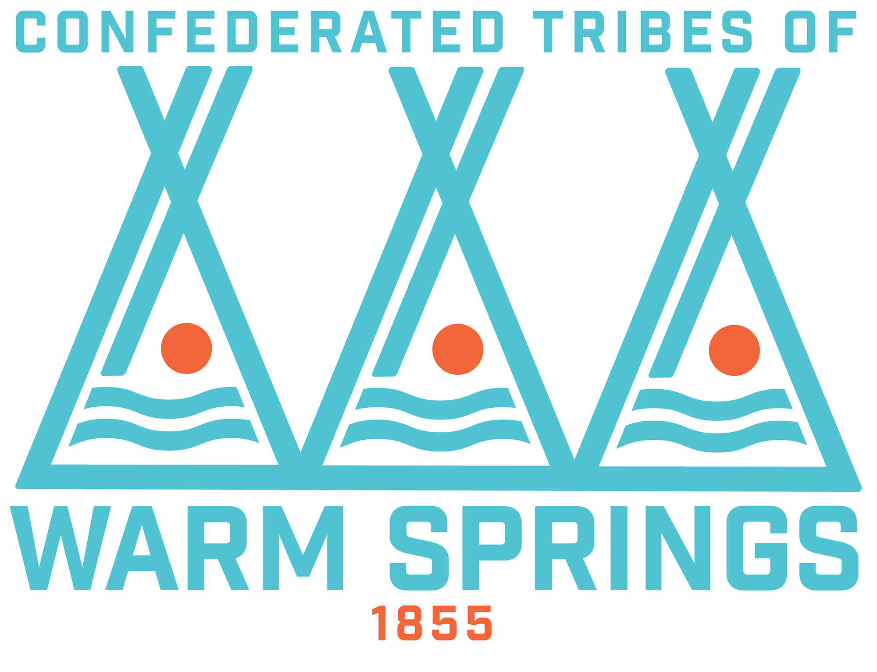
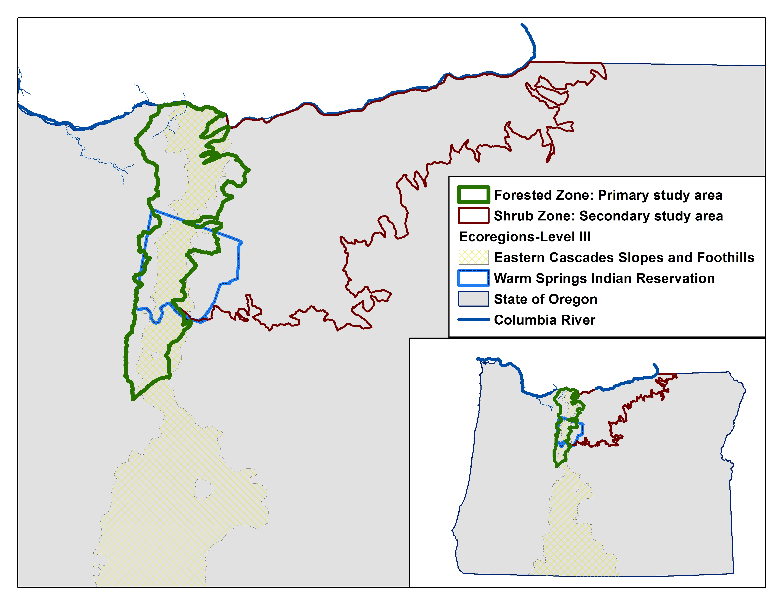
Outline
Big picture questions
Illustrating example
  Reconstructing fire regimes and vegetation conditions on tribal lands in eastern Oregon using ecological and anthropological data resources (Hessburg, Hagmann, Steen-Adams, Charnley, et al.)
  TEK Approach
  Preliminary Results
Big picture questions - Response
Notes:
I’ve structured today’s talk in three parts:
First, I’ll introduce some big picture questions that some of you may have regarding applying a TEK approach to your work.
Second, I’ll present a TEK project example, based on an interdisciplinary team of social scientists and ecologists. The proj. is called Reconstructing historical fire regimes and vegetation conditions on tribal lands using ecological and anthropological data resources . We’re carrying this out with the CTWS. The primary study area is the Forested Zone, in green. We subsequently added a secondary study area, the shrub zone, in response to emergent data and the community’s request.
In this section, I’ll first want to share our research design, as an example of a TEK approach – specifically insights we’ve gained regarding adaptations to the collaborator community and data resources. Next, I’ll present some preliminary results.
Three, in the wrap-up, I’ll circle back to respond to the Big Picture questions introduced in Part I.

Slide 3
I. Big picture questions regarding TEK/ LEK approach
Why employ a TEK/ LEK approach in restoration projects?
How to employ a TEK approach?: Research methods
Anticipating and navigating challenges
Notes:
To help you evaluate whether employing a TEK approach is a fit for your research projects, I want to start by framing this talk with some big-picture questions.
Why employ a TEK/ LEK approach?
How to employ a TEK/ LEK approach?
What challenges should you anticipate?; how can you successfully navigate them?
I will illustrate responses to these questions with the example of our current project with the CTWS.
A heads-up that there are specific project research questions that I’ll present. In this talk, the research questions are nested within the big picture questions.

Slide 4
Definitions:
Knowledge systems
A. Traditional Ecological Knowledge (TEK):
  cumulative body of knowledge and beliefs,
  handed down through generations by cultural transmission,
  relationship of living beings… with one another and their environment (ECOLOGICAL) [Berkes, 1993; Berkes et al. 1995]
Three categories (Turner et al., 2000):
  philosophy and worldview
  communication of knowledge
  practices and strategies
    Ways of tending vegetative resources to promote productivity
Turner et al., 2000
Notes:
Three categories:
Philosophy/ worldview: a group’s spirituality
Communication of knowledge: Ceremonies, traditions
Practices and strategies for sustainable living, e.g., ways to tend vegetation to promote productivity

Slide 5
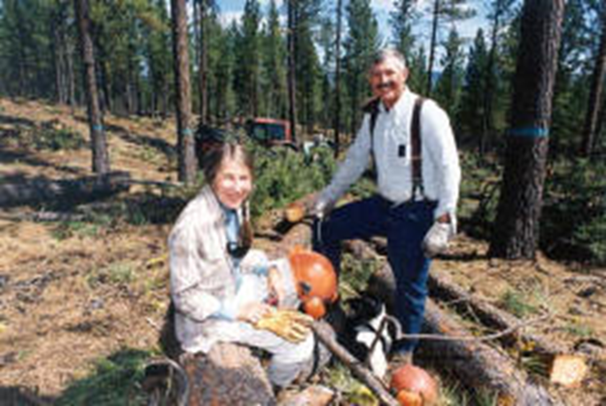
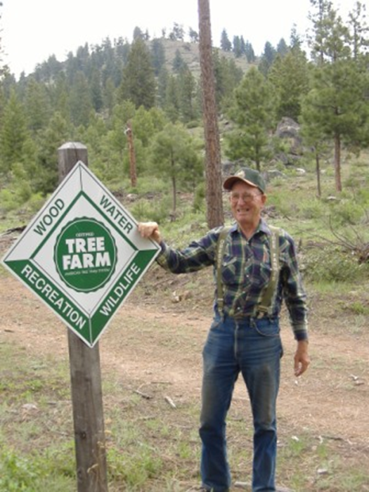
Definitions:
Knowledge systems
B. Local Ecological Knowledge (LEK)
  Knowledge, practices, and beliefs regarding ecological relationships … gained through extensive personal observation of and interaction with local ecosystems, and shared among local resource users (Charnley et al. 2007).
    Family Forest Owners, e.g., Oregon Small Woodland Owners Ass’n
    Watershed Councils (Rickenbach and Reed)
C. Modern Scientific Knowledge
  Contrasted with TEK/ LEK (Hunn 1993)
Notes:
TEK and LEK can be contrasted with Modern Scientific Knowledge, which can be characterized as a framework to assess theories through the scientific method.
Indigenous Knowledge
local knowledge held by indigenous peoples or local knowledge unique to a given culture or society

Slide 6
II. Example: East Cascades Ecoregion Project
Main objective: Guide managers regarding restoration of frequent-fire forest landscapes, including cultural resources
ANTHROPOLOGICAL SUB-STUDY
-Assess role of TEK, particularly historical fire-use on landscape structure and fire regime
-Guide cultural resource restoration
ECOLOGICAL SUB-STUDY
Inform how/where to distribute patch sizes of distinct forest structure, density, and species composition to restore resilience to frequent fire
Notes:
Ecological Applications
Huckleberry fields: restore productivity
Forest landscapes: restore resilience
Huckleberry Restoration by Gifford Pinchot NF/ Yakima Tribe , http://www.columbian.com/news/2011/oct/05/huckleberry-fields-benefit-from-flames/

Slide 7
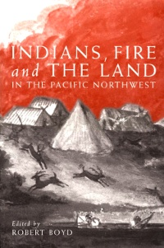
Research Questions:
TEK sub-study
How did Sahaptin and Wasco tribes historically tend and harvest cultural resources?
  Did tribes deploy fire as a management tool, and if so how?
How did TEK practices influence the fire regime and forest landscape pattern?
  H: Human fire-use influenced fire regime in frequent-fire zone
Motivations: Why did the Sahaptin and Wasco tribes deploy TEK practices, particularly those associated with fire-use?
  H: combination of cultural and socio-economic factors, organized as a seasonal round
Notes:
We developed three main questions. However, I’m going to focus on only Qu. 1 and 2 for this talk.

Slide 8
TEK approach and methods

Slide 9
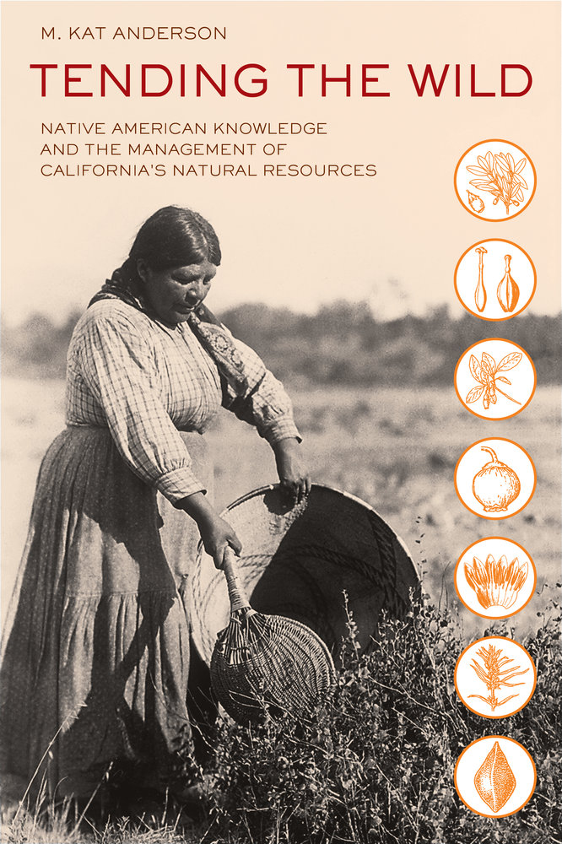
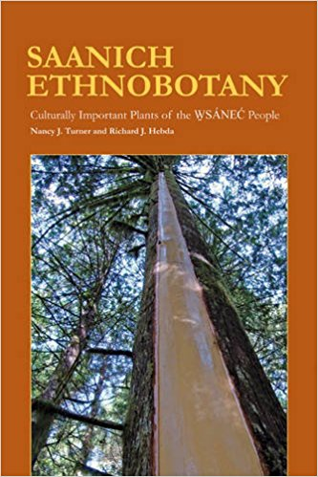
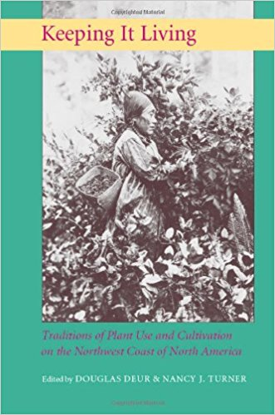
TEK Approach
Underlying precept
Ecological communities, landscape structure, and processes have co-evolved with social systems
Notes:
Ecological communities, landscape structure, and processes have co-evolved with social systems
Social systems include social-economic systems, which provide subsistence, and culture/ knowledge systems.

Slide 10
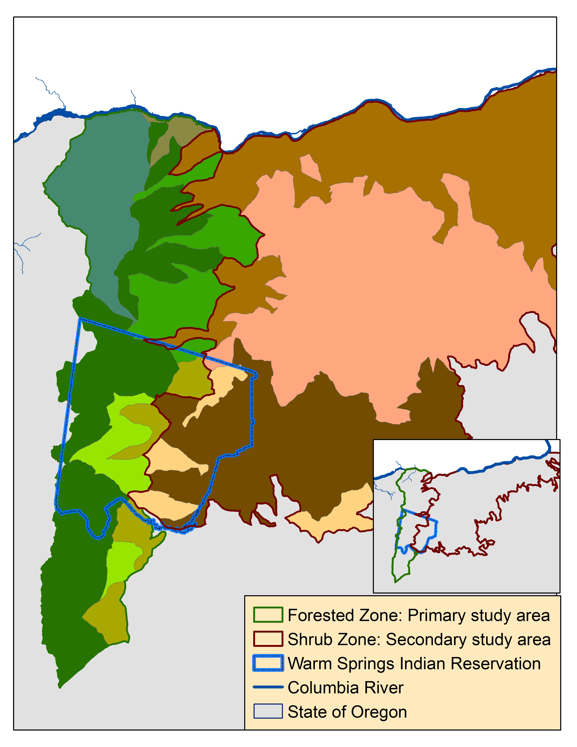
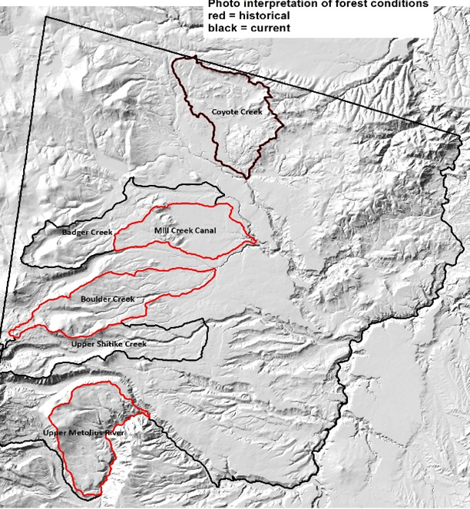
Methods: Study area definition
Coordinate ecological and TEK sub-studies
Ecological sub-study
TEK sub-study
Notes:
Defining the study area required a Process of coordinating ecological and TEK & ecological sub-studies:
First, the ecologists defined their study area, based on a spatial extent that was appropriate to their data, historical aerial photographs and a forest inventory.
Our TEK group began by adopting a similarly fine-scale study area.
However, our literature review and oral history interviews ultimately revealed that the spatial extent needed to be expanded to detect the social processes of interest. So, we developed an expanded study area.
Second, we learned that organizing the geography into two main zones--a forest zone and a shrub zone –would best position our study to understand the community’s cultural resource practices.

Slide 11
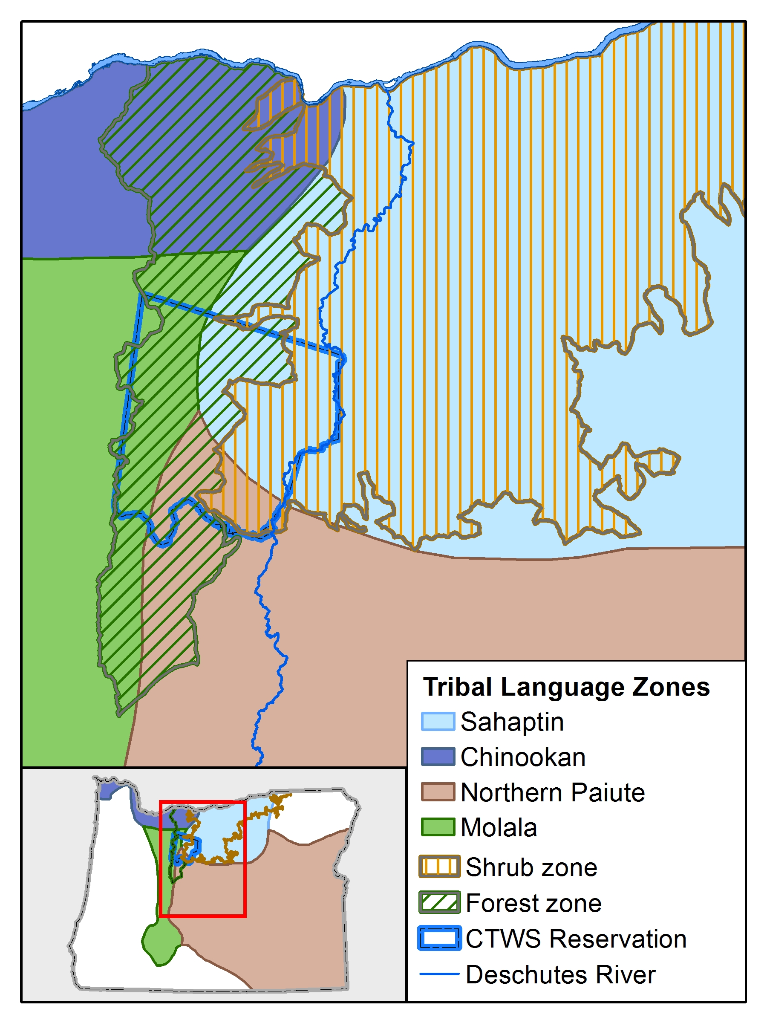
Methods: Study area definition
Coordinate ecological and anthropological geographies
Ecological geography
Anthropological geography
Notes:
Within the TEK sub-study, we coordinated two interrelated geographies:
Ecological zones
Anthropological zones: specifically, to identify the areas where the tribes who are generally thought to have deployed fire –the Sahaptin and Chinookan-speaking peoples—historically inhabited. We found that language zones are a well-documented anthropological technique to delineate inhabitation area. This said, such zones should be understood as an approximation, not a hard-and-fast delineation of tribal inhabitation area.

Slide 12
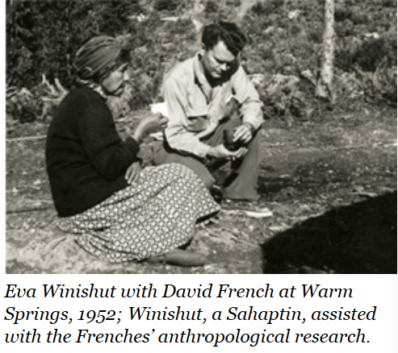
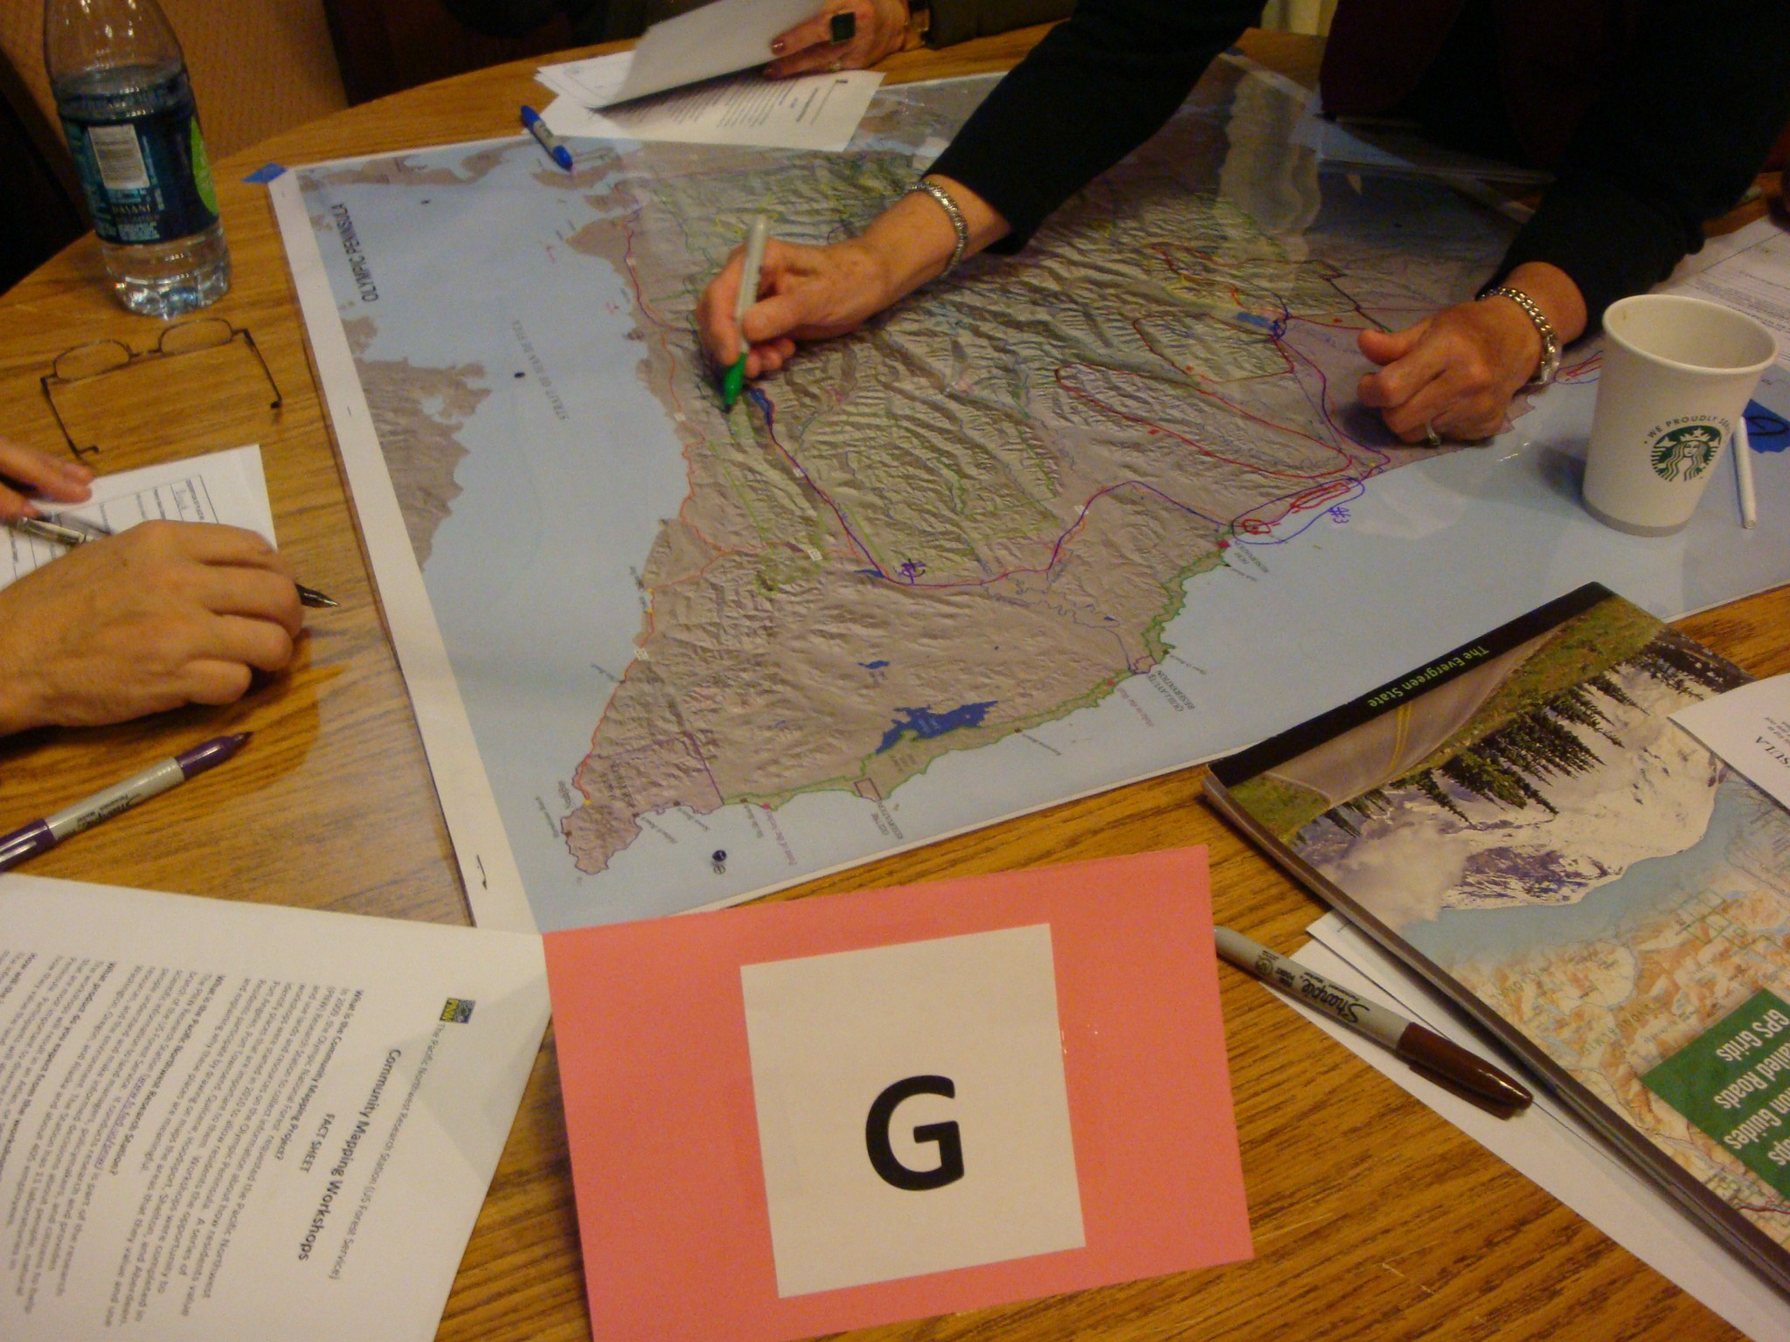
Data
community-engaged data
non-community engaged / Archival data
Oral history interviews
  Semi-structured interviews
    10 interviews, 2014
  Cross-walk instruments
Participatory GIS (PGIS)
  Method of developing spatial data that represents stake-holder knowledge
    Pilot, March 2017
Ethnohistorical data
  D. and K. French Collection
    Anthropologists, Reed College
    “Warm Springs Project”: 1950-56; continued thereafter
Historical ecological data
  Cascade Range Forest Reserve Inventory, 1903
Image credit: R. McLain
Notes:
Our data fall into two categories: on the slide left-hand, Community-engaged data: We conducted oral-history interviews using a semi-structured protocol. We also developed cross-walk instruments, designed to help relate the social science data to ecological questions. I’ll describe these in a minute.
In addition, we are piloting the use of PGIS. This is a method to develop spatial data that represents stake-holder knowledge.
The second main data resource is non-community engaged or Archival data. Serindipitously, this study site was the focus of anthropologists D. and K. French in the 1950s, and thereafter. Their primary source data have been archived. In this past April and May, we visited the archives to collect records relevant to our study questions.
Finally, we used historical ecological data, including that of the Cascade Range Forest Reserve inventory.
http://www.reed.edu/reed-magazine/in-memoriam/obituaries/may1994/david-french-1939.html

Slide 13
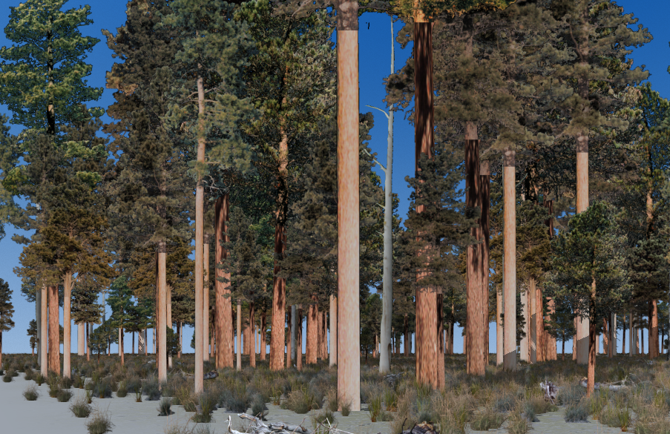
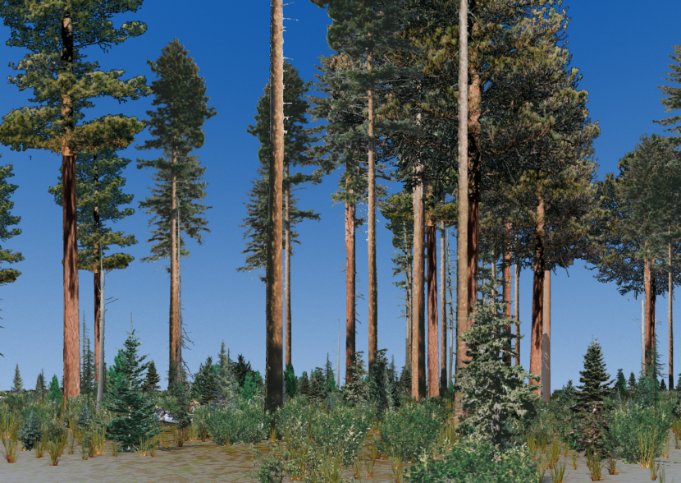
Cross-walk instrument:
Forest Structure templates
Source: Visual Nature Studio (VNS) imagery
Stand attributes:
  Forest type
  Successional Stage
Ponderosa Pine
Old Forest, Single Strata
Mixed Conifer
Old Forest, Single Strata
Notes:
The first cross-walk instrument were forest structure templates, derived from VNS software.
Stand attributes consisted of Forest type and Successional stage, for instance, Ponderosa Pine and old forest, single strata.
In the field with this particular community however, we found that tribal elders generally had difficulty connecting a particular template from an array of templates to describe landscape conditions. A factor in play may well be the relatively long period between the practices of interest and the present.
Visual Nature Studio, https://www.fs.fed.us/t-d/programs/forest_mgmt/projects/landscapesim/software.shtml

Slide 14
Cross-walk instrument:
Historical photographs
Source: Field reports, H. Weaver, 1939-1956
Focal factor: Understory cover (UC)
Low UC %
Moderate UC %
High UC %
Jefferson Creek, T. 11 S., R. 9 E. June, 1939
Metolius Unit, T. 10 S., R. 10 E. , 1939.
T. 10 S., R. 10 W., Sec. 23, 1956.
Image credit: Forest History Society
Notes:
Historical photographs were a second cross-walk instrument. Using the field reports of H. Weaver of the 1930s-1950s, we developed an array to structure the reporting of understory conditions.

Slide 15
Adapted methods for community-engaged data
Factors | Initial methodology | Adapted methodology
Interview protocol | Semi-structured structure, yet fairly linear and western scientific “What…?”; “When…?” “How…?”; “Why?” | Story-telling structure “Tell us about…”;
Interview management | Interviewer-led | -Participant /tribal elder-led -Involve & train tribal youth
Cross-walk instruments | Abstracted | Representative of recognizable place
Geographical instruments (maps) | Western worldview maps | Hybrid story-telling, supplemented with maps, as appropriate
Informed consent protocol | Standard paper document | Oral consent acceptable alternative to paper document
Notes:
In sum, a main insight to share with you is the need to adapt methods of data collection to the community.
This table reports our adaptations with regard to five factors:
1. Interview protocol: INITIAL: Semi-structured structure, yet fairly linear and western scientific:“What…?”; “When…?” “How…?”; “Why?”
ADAPTED: Story-telling structure“Tell us about…”;
4. Geographical instruments (maps): INITIAL: Western worldview cartography, structured with cardinal directions and latitude and longitude;
ADAPTED: hybrid-story telling, supplemented with more localized reference points and ecological zones, rather than specific places.

Slide 16
Preliminary Results

Slide 17
Research Questions:
TEK sub-study
How did Sahaptin and Wasco tribes historically tend and harvest cultural resources?
  Did tribes deploy fire as a management tool, and if so how?
How did TEK practices influence the fire regime and forest landscape pattern?
  H: Human fire-use influenced fire regime in frequent-fire zone
Motivations: Why did the Sahaptin and Wasco tribes deploy TEK practices…?
Notes:
We developed three main questions. However, I’m going to focus on only Qu. 1 and 2 for this talk.

Slide 18
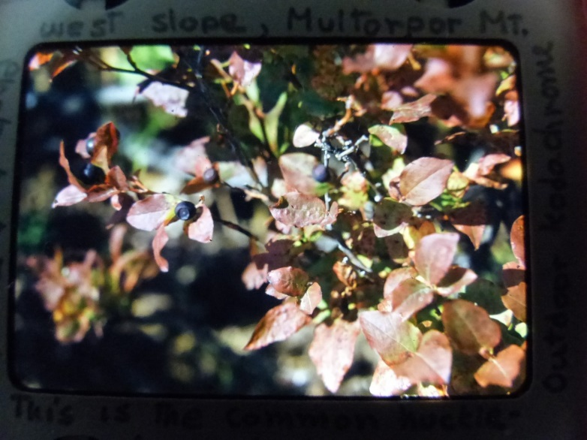
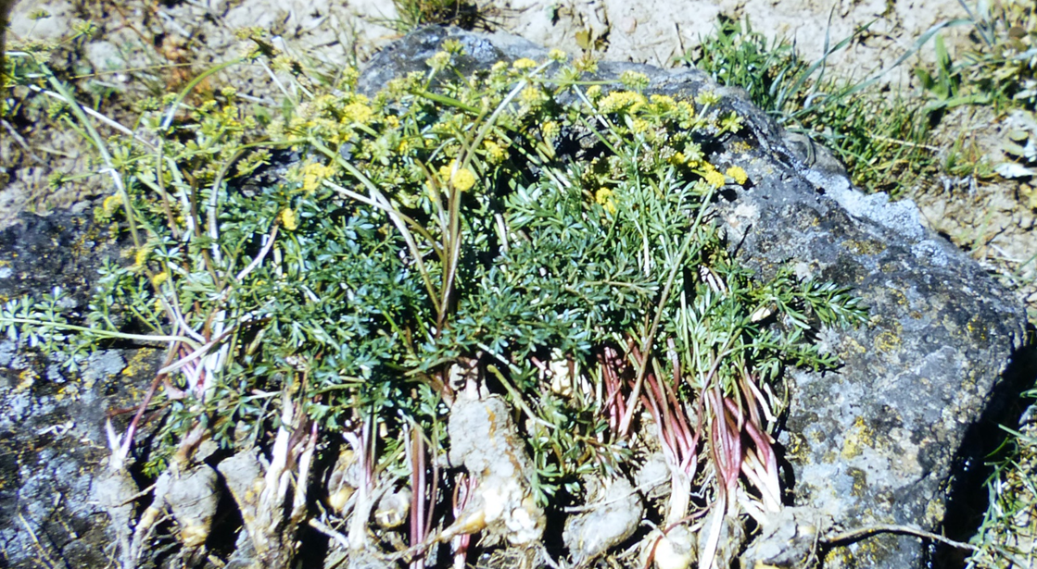
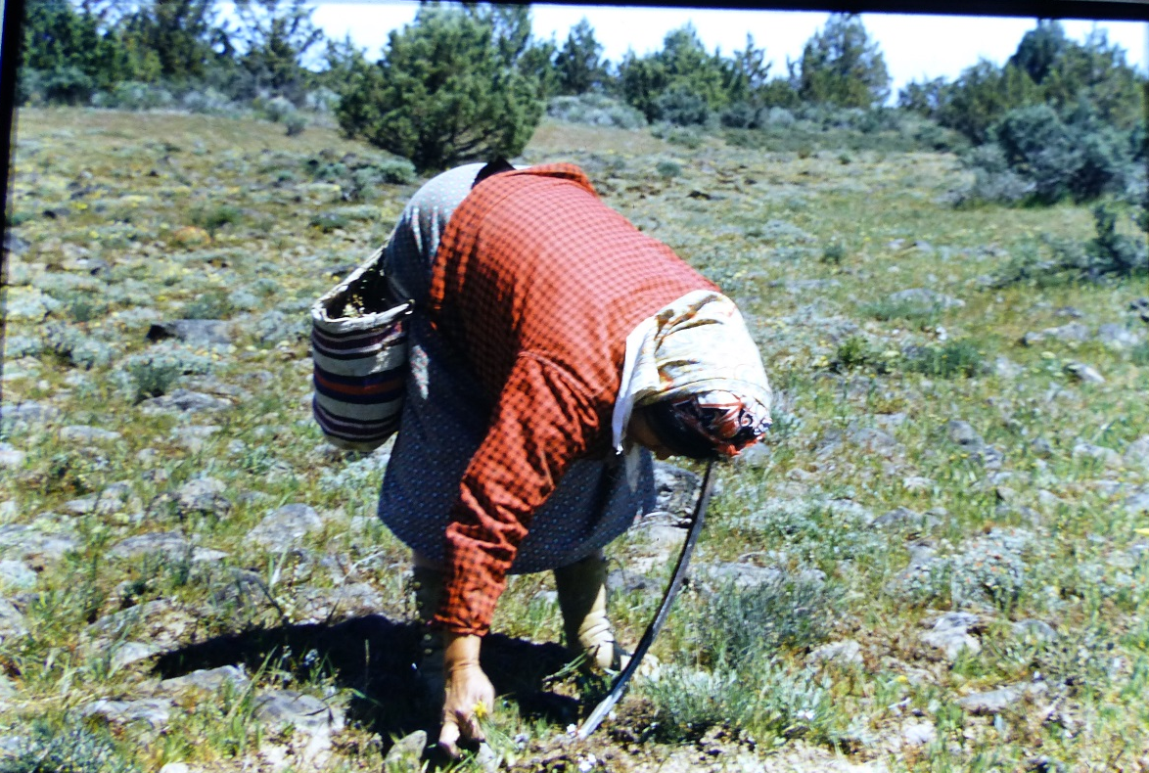
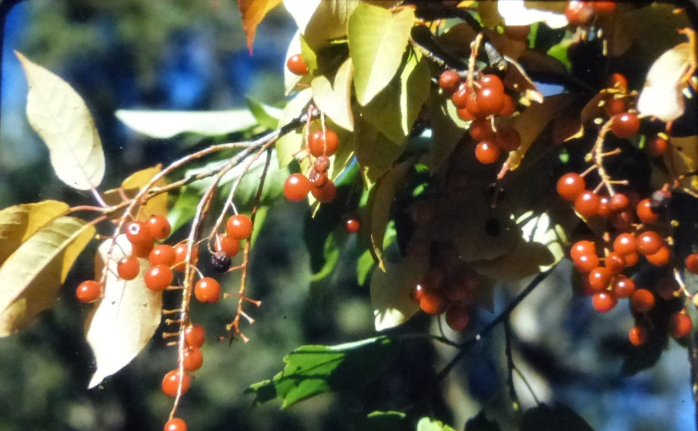
1. Social process: Seasonal round.
Diverse species, migratorily harvested across ecological zones
Berry producing shrubs in forest zone
Vaccinium spp., mixed conifer understory 9/10/52: “This is the common huckleberry in the area picked by Indians.”
Chokecherry, 9/10/52. “Growing near [name withheld] Creek. Picked and dried or canned”
Roots in shrub zone
Lomatium cous, Biscuitroot, 1953
Digging roots on flat northwest of Agency, 5/10/53.
Notes:
TEK approach insights: We anticipated that vaccinium spp. would be a key cultural resource that tribal peoples had historically tended. The TEK approach was valuable b/c it opened dialogue regarding a much broader diversity of resources than anticipated. We learned that berry-producing shrubs other than Vacc. Were historically important, for instance chokecherry. This pointed to the landscape complexity of cult resc. ecological communities, and thus, the LS complexity of restoration needs.
Furthermore, the TEK-based dialogue w/ community and research pointed to an entire ecological zone that we hadn’t previously considered: the non-forested shrub zone. Tribal communities had historically tended starchy root resources as a key dietary component.

Slide 19
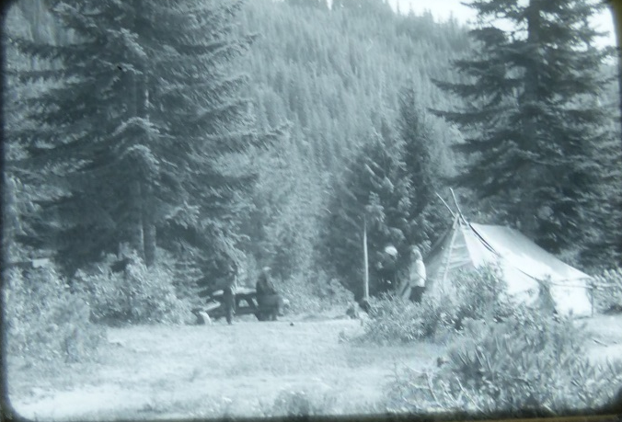
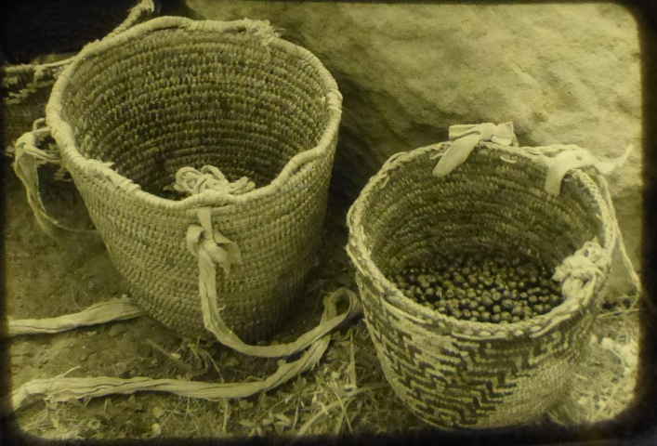
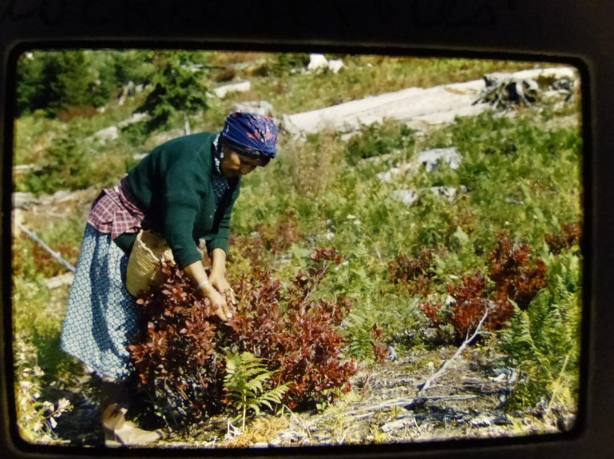
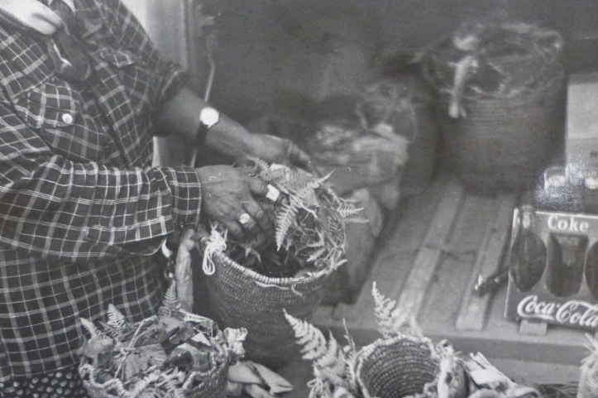
1. Practices
Fire as management tool?
Social organization
Technology
Family unit camps
Berry Baskets
Minimal, Less conclusive direct evidence:
-Some affirmative records
-Some non-commital records
However, indirect evidence exists
Harvest, Multorpor Mt.
Fern fronds
Notes:
Images are derived from slide collection and records of anthropologists D. and K. French, who conducted research at WSIR in 1950s and thereafter.
Social organization: (1) relatively dispersed harvest pattern, organized by family unit groups who established camps.
(2) Women typically carried out the harvest.
Technology: (1) berry basket, worn around the waist; (2) Cool, moist, Fern fronds to preserve the harvest until processing.

Slide 20
Research Questions:
TEK sub-study
How did Sahaptin and Wasco tribes historically tend and harvest cultural resources?
  Did tribes deploy fire as a management tool, and if so how?
How did TEK practices influence the fire regime and forest landscape pattern?
  H: Human fire-use influenced fire regime in frequent-fire zone
Motivations: Why did the Sahaptin and Wasco tribes deploy TEK practices…?
Notes:
Qu. 2: How did TEK practices influence the fire regime and forest landscape pattern?
H: Human fire-use influenced fire regime in frequent-fire zone

Slide 21
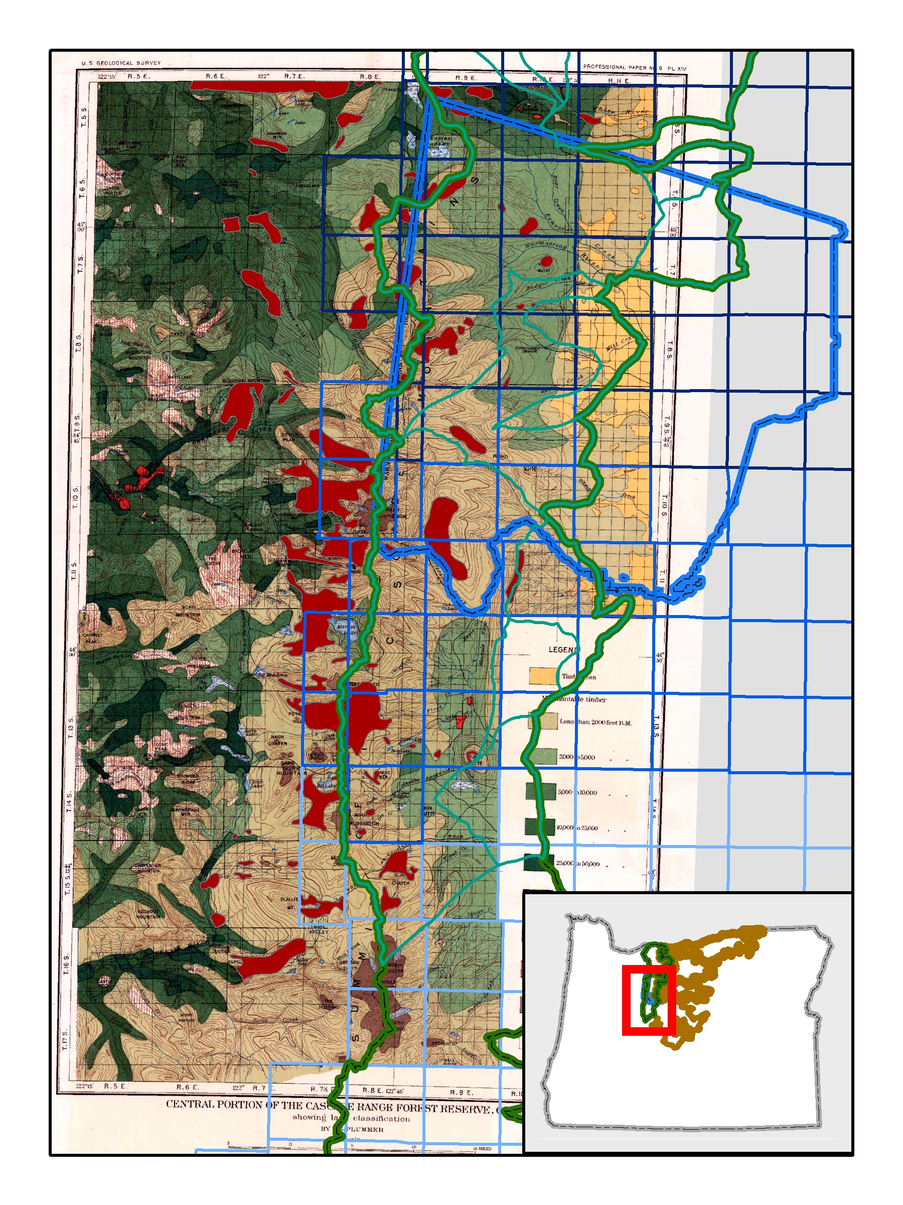
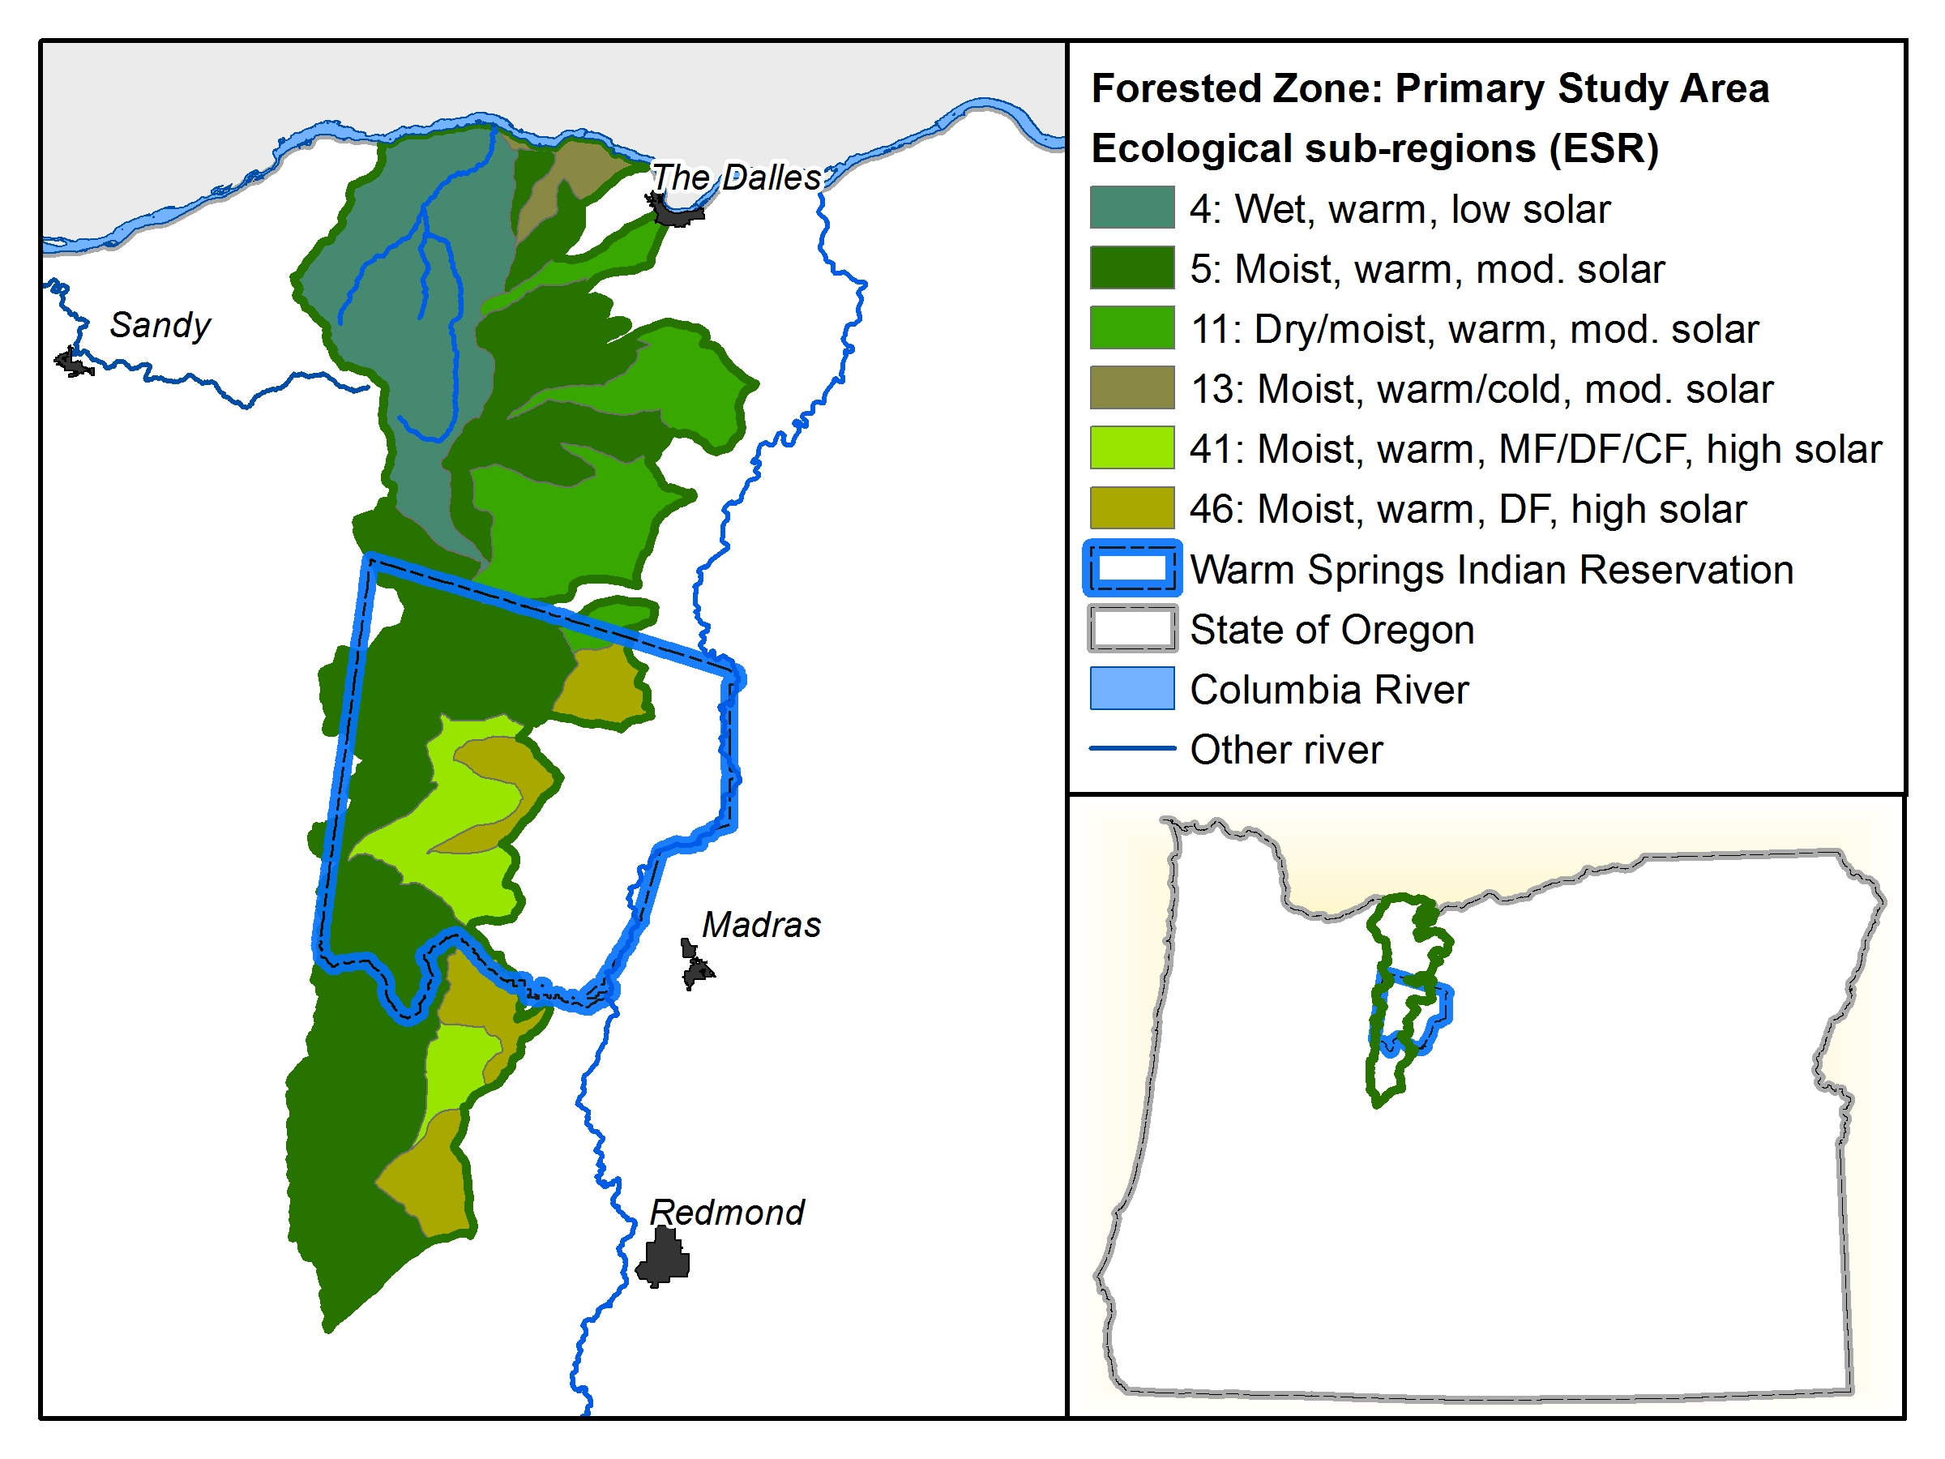
2. Historical burn land-cover pattern
Cascade Range Forest Reserve Inventory, 1903
Ecological sub-region (ESR) framework
Notes:
Although we’ve found minimal direct evidence thus far regarding historical fire-use, we have found indirect evidence that illuminates human influence on fire regime and LS structure.
First, I’ll present preliminary findings regarding the landscape pattern of the historical fire regime. We asked, “how are burn land cover polygons of the Cascade Range Forest Reserve Inventory distributed across Ecological Sub-regions. In this analysis, which focuses on the Inventory’s Central Zone, the main ESRs are ESR 5, Moist, warm, mod. solar flux, and ESR 41, moist, warm, high solar flux.

Slide 22
2. Historical burn land-cover pattern
ESR
Burn land-cover
ESR | Area (ha) | Patch area, mean (ha) | Std. Dev | Number patches | % ESR area
4 | 663.9 | 29.3 | 17.0 | 3 | 13.2
5 | 179,081.7 | 569.7 | 1,077.0 | 31 | 9.9
11 | 9,743.0 | 131.9 | 112.8 | 2 | 2.7
41 | 103,043.9 | 223.0 | 277.9 | 4 | 0.9
Notes:
We found that ESR 5, in dark green, has a comparatively large patch area (570 ha) and number of burn patches (33), as well as relatively high ESR area (9.9%). This result compares with ESR 41, in bright green, the other major ESR in the study area: mean patch size is 223 ha; burn accounts for <1% of ESR area.
Does TEK give provide some insight to this finding, and if so, how?

Slide 23
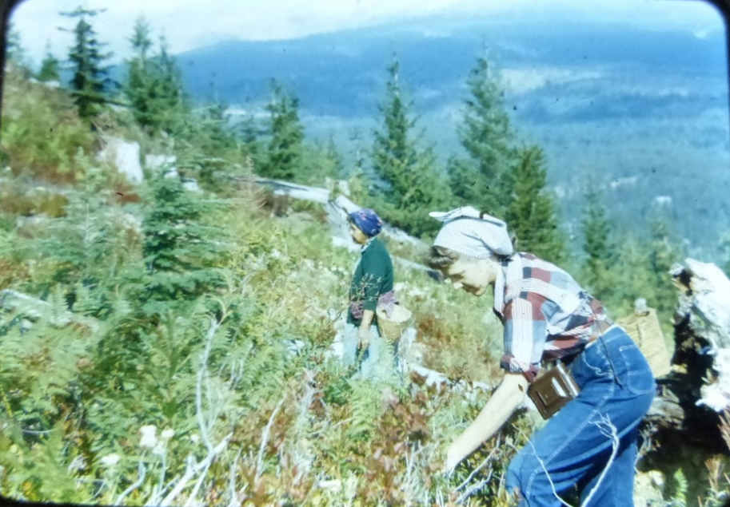
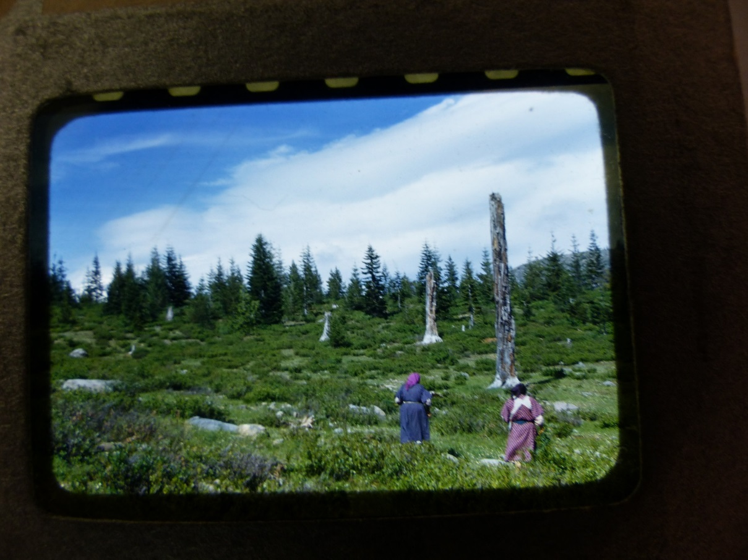
2. How did TEK practices influence landscape pattern and fire regime?
Preliminary evidence: comparatively high burn land-cover of ESR 5 maybe influenced by historical fire-use
Site Attributes of harvest patches
Forest type: moist mixed-conifer forest, e.g., mountain hemlock (Tsuga mertensiana), spruce (Picea glauca, P. engelmannii), and fir (Abies amabilis, A. grandis, A. lasiocarpa)
Topography: higher elevation, mountainous
  ?: Moderate solar flux
Landscape structure
Patch size: 100’s acres
Hypothesis Assessment
Human fire-use influenced fire regime in frequent-fire zone?
Surprising finding: Historical fire-use maybe deployed in moist, mixed conifer zone; little evidence regarding frequent-fire zone
*Mountain, 9/10/52
*name withheld
*Camp, 8/9/53
*name withheld
Notes:
Visual inspection of the ethnohistorical images indicates site attributes similar to that of ESR 5: Forest type is dominated by moist, mixed conifer forest, in keeping with the biophysical attribute, “moist”; Topography: higher elevation may be associated with the moderate solar flux of ESR 5.
Regarding LS Structure, patch size of several hundred acres corresponds w/ the characteristic size for this ESR, based on the Cascade R. Forest Reserve Inventory.
Other LS metrics: Canopy cover : relatively low (estimate: 10-15%)
cold moist conifer forest (apparently), probably including mountain hemlock (Tsuga mertensiana), spruce (white, Engelmann (Picea glauca, P. engelmannii), and fir (silver, grand, or subalpine, respectively) (Abies amabilis, A. grandis, A. lasiocarpa)

Slide 24
I. Why employ a TEK/ LEK approach in restoration projects?
  Distinct insights regarding co-evolutionary social-ecological processes and influence on landscape pattern and vegetation condition
    Role of social process—migratory seasonal round –as ecological disturbance
    Preliminary evidence of human fire-use in moist, higher elevation forest zone
  Restoration applications
    Utility of replicating / approximating TEK social processes in restoration framework
    Community and Public outreach: vehicle for dialogue re restoration practices

Slide 25
II. How to employ a TEK/ LEK approach?
Study area: Fit with social process of interest (seasonal round; fire-use), as well as ecological process (fire regime)
  Consider a nested geographical approach:
    Ecology sub-study: finer scale
    TEK sub-study: broader scale
Research design: Data resources span community-engaged data and non-community engaged data
Community-engaged data: Adapt methods to cultural norms and governance structures
  Protocol factors: Interview protocol and management; Cross-walk instrument; Maps; Informed consent
Notes:
How to employ a TEK/ LEK approach?

Slide 26
III. Anticipating & navigating challenges
Challenge to Anticipate | Navigation
Multiple, sometimes disconnected, conflicting governance structures Branch of Natural Resources -Forestry -Cultural Resources Tribal government: Culture and Heritage Committee | At project initiation stage: Meet/ discuss with key governance and management organizations Forge MOU agreements Cognizance that agreement with one organization ≠ all organizations
Community protectiveness of TEK, particularly spatial information | Data reporting in relation to an ecological zone, not spatially specific Partnership approach -Identify deliverables relevant to community
Delayed timeline, due to unforeseen community or weather events (e.g., death of tribal elder; snowstorm) | Build extra time into project Identify alternate tools (e.g., Skype); build broad collaborator base to advance project
Notes:
To help you evaluate whether employing a TEK approach is a fit for your restoration projects, it’s important to anticipate and consider prospective challenges.
TEK projects can present some unique challenges for forest scientists:
Crafting and managing TEK projects to fulfill proposal deliverables requires (a) engagement with collaborator community—specifically, responsiveness to cultural norms, management/ administrative organizations, and governance rules; (b) resourcefulness to identify and ADAPT the project’s research design to emergent data resources and cultural norms; (c ) a relatively long-term project time-line, given these two caveats. TEK projects can deliver unique, valuable insights for restoration. This said, an insight of our project experience is that it’s important to candidly assess these constraints for fit with project objectives and resources from the outset.

Slide 27
Acknowledgements
CRAG-RUCF grant
K. Wendel: Literature review and archival field work assistance
M. Adams: GIS data construction and consultation
R. McLain: PGIS collaboration
Visual Nature Studio (VNS)-image generation
Bob Gray: TEK and ecological literature

Slide 28
Key Literature
Berkes, F., Folke, C., and Gadgil, M. 1995. Traditional Ecological Knowledge, Biodiversity, Resilience, and Sustainability, pp. 281-287 in CA Perrings et al., eds. Biodiversity Conservation. Kluwer.
Charnley, S., Fischer, AP, Jones, ET, 2007. Integrating traditional and local knowledge into forest biodiversity conservation in the Pacific Northwest, Forest Ecology and Management, 246(1):14-28.
Hessburg, PF, Salter, RB, Richmond, MB, Smith, BG 2000, Ecological subregions of the Interior Columbia Basin, USA, Applied Vegetation Science 3:163-180
Hunn, E. 1993. What is traditional ecological knowledge? Pp. 13-20 in NM Williams and G Baines, Traditional Ecological Knowledge: Wisdom for Sustainable Development
Turner, NJ, Ignace, MB, and Ignace, R. 2000. Traditional Ecological Knowledge and wisdom of aboriginal peoples in British Columbia, Ecological Applications 10(5):1275-1287.

