Slide 1
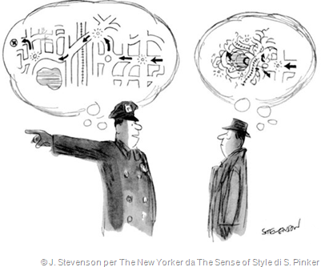
The theme is COMMUNICATION of SCIENCE

Slide 2


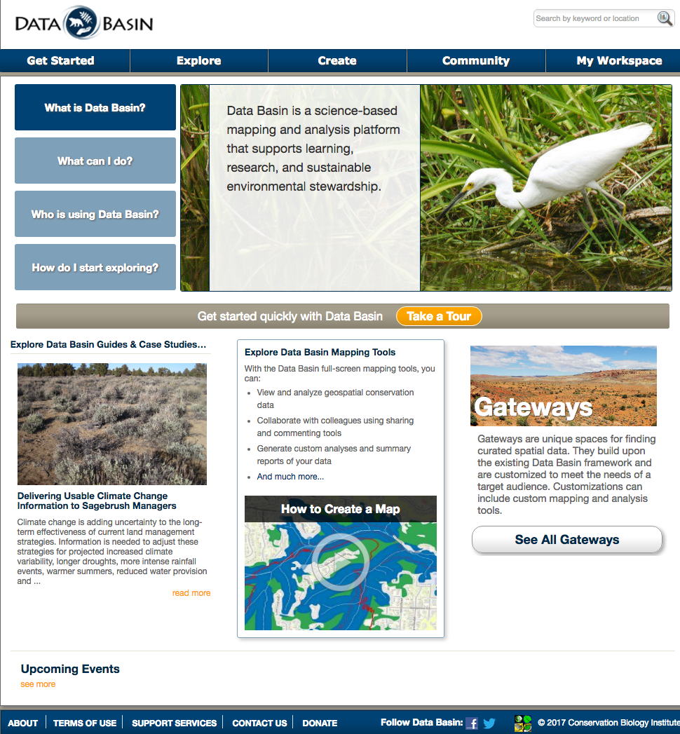
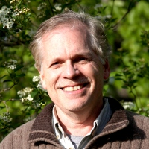
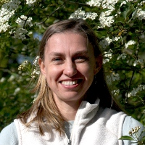

CBI’s Claim to Fame
Jim Strittholt
Tosha Comendant
Brendan Ward and his
team of programmers

Slide 3
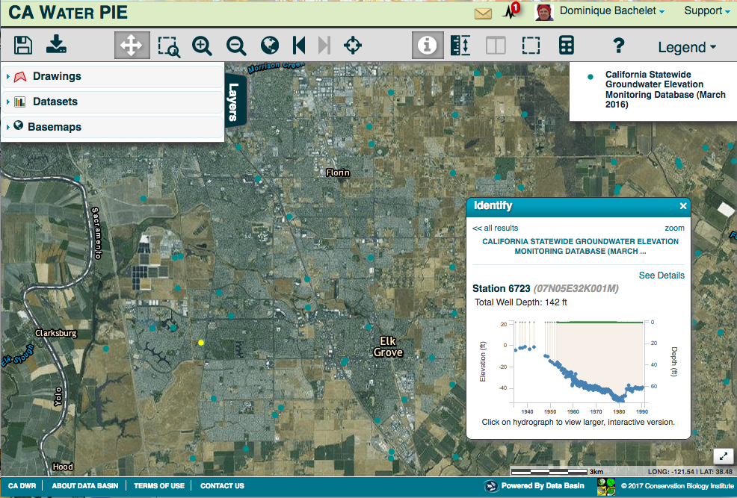
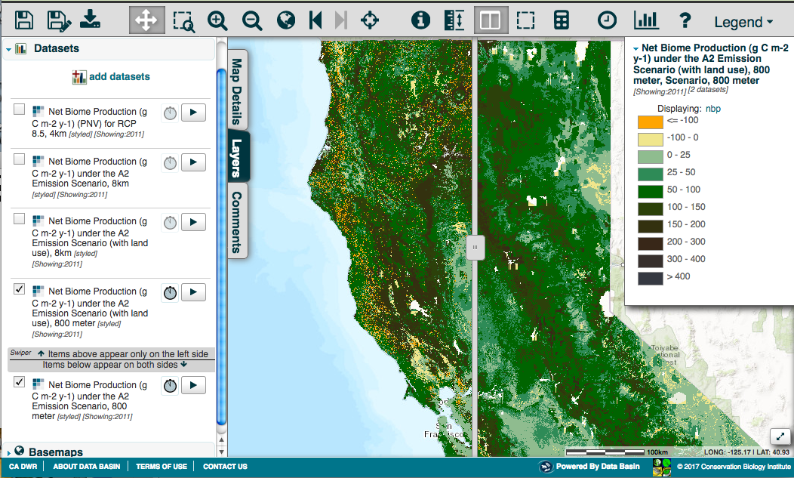
Spatial Data to Visualize & Share
Model results:
with or without fire suppression
Time series of
groundwater levels

Slide 4
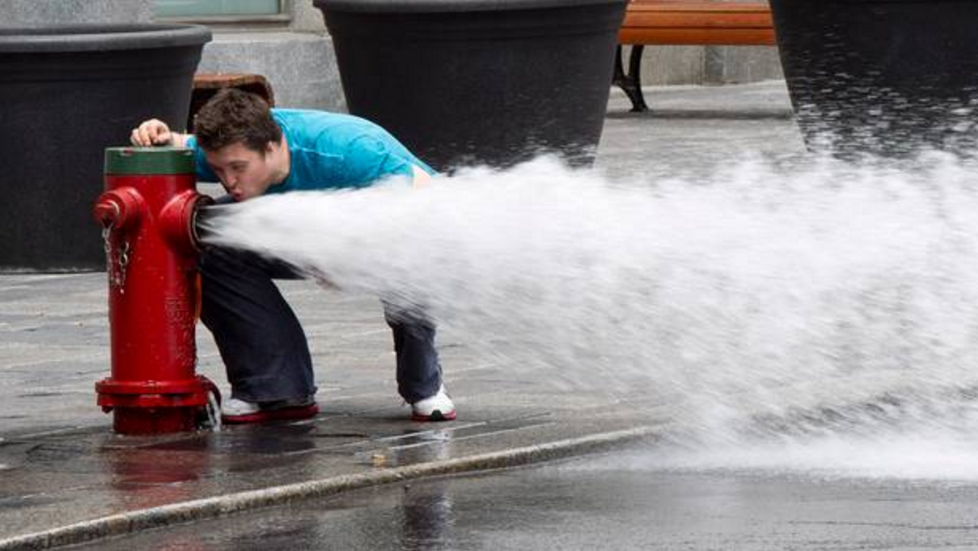
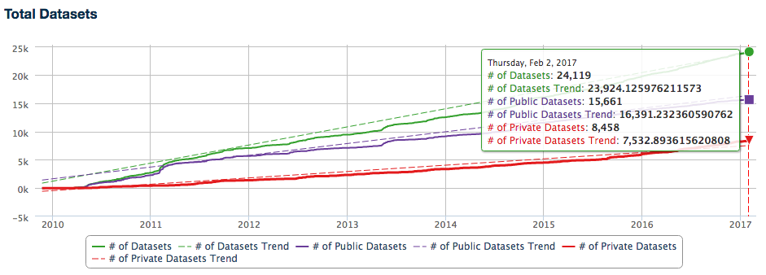
BUT almost 25,000 datasets …

Slide 5
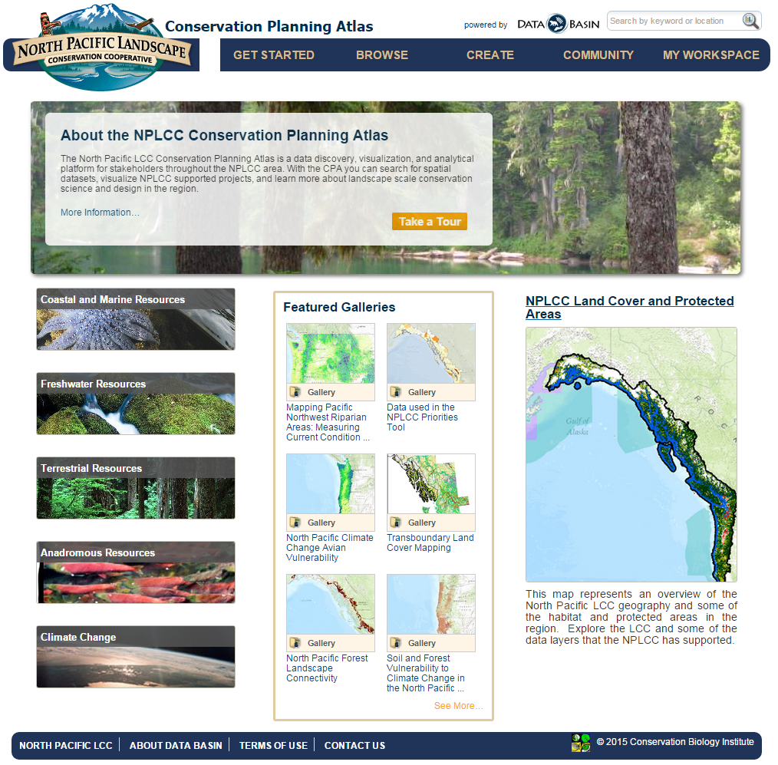
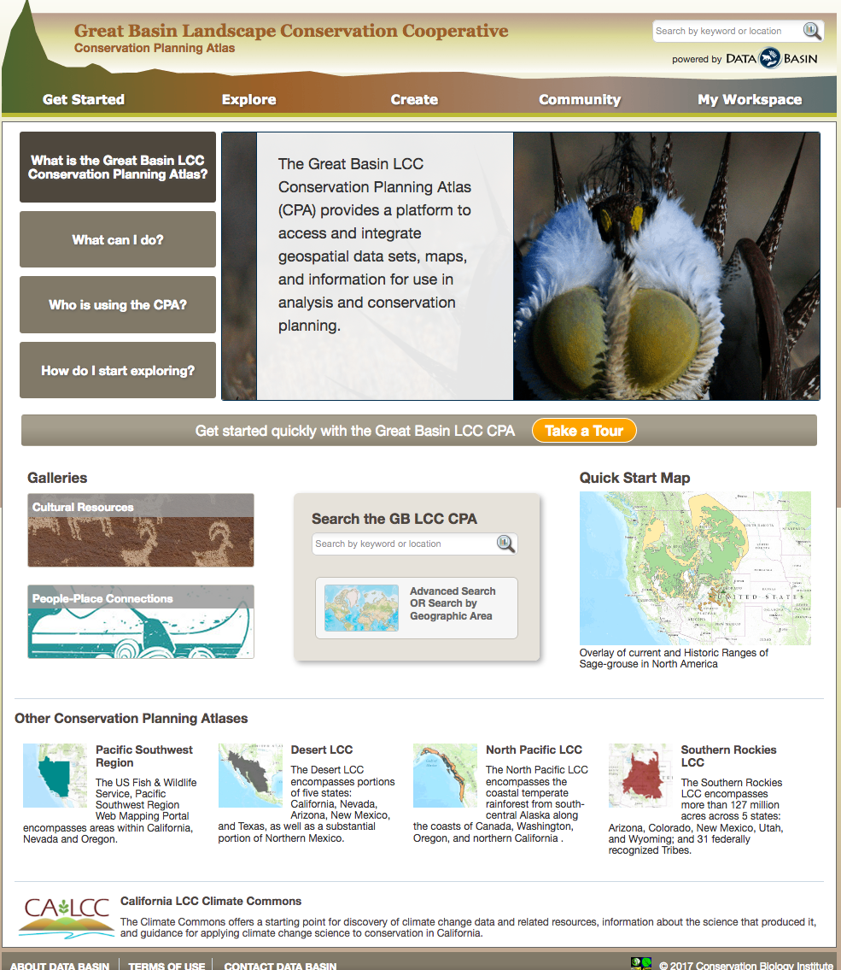
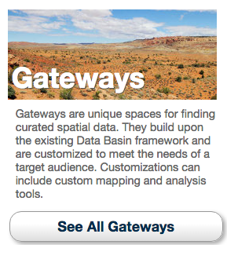
30 Gateways or CPAs – Simple, Focused, Customized

Slide 6
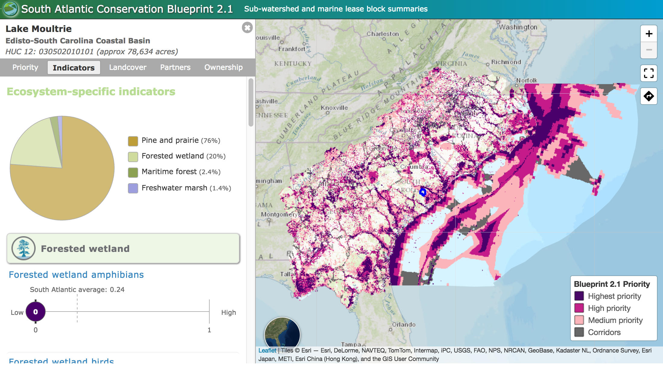
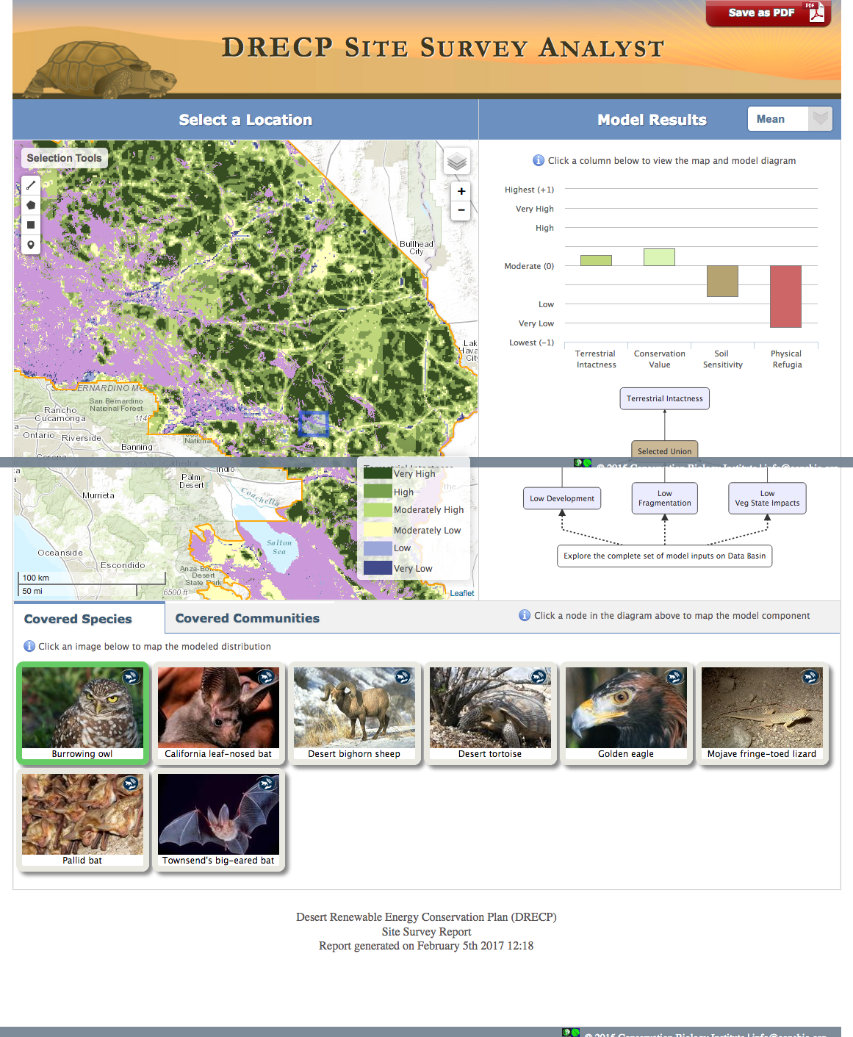
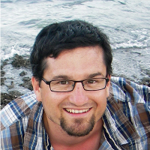
Gateway Tools – for a region
http://blueprint.southatlanticlcc.org/v2.1/index.html
Brendan Ward
Mike Gough
http://bit.ly/2lcPPHc

Slide 7
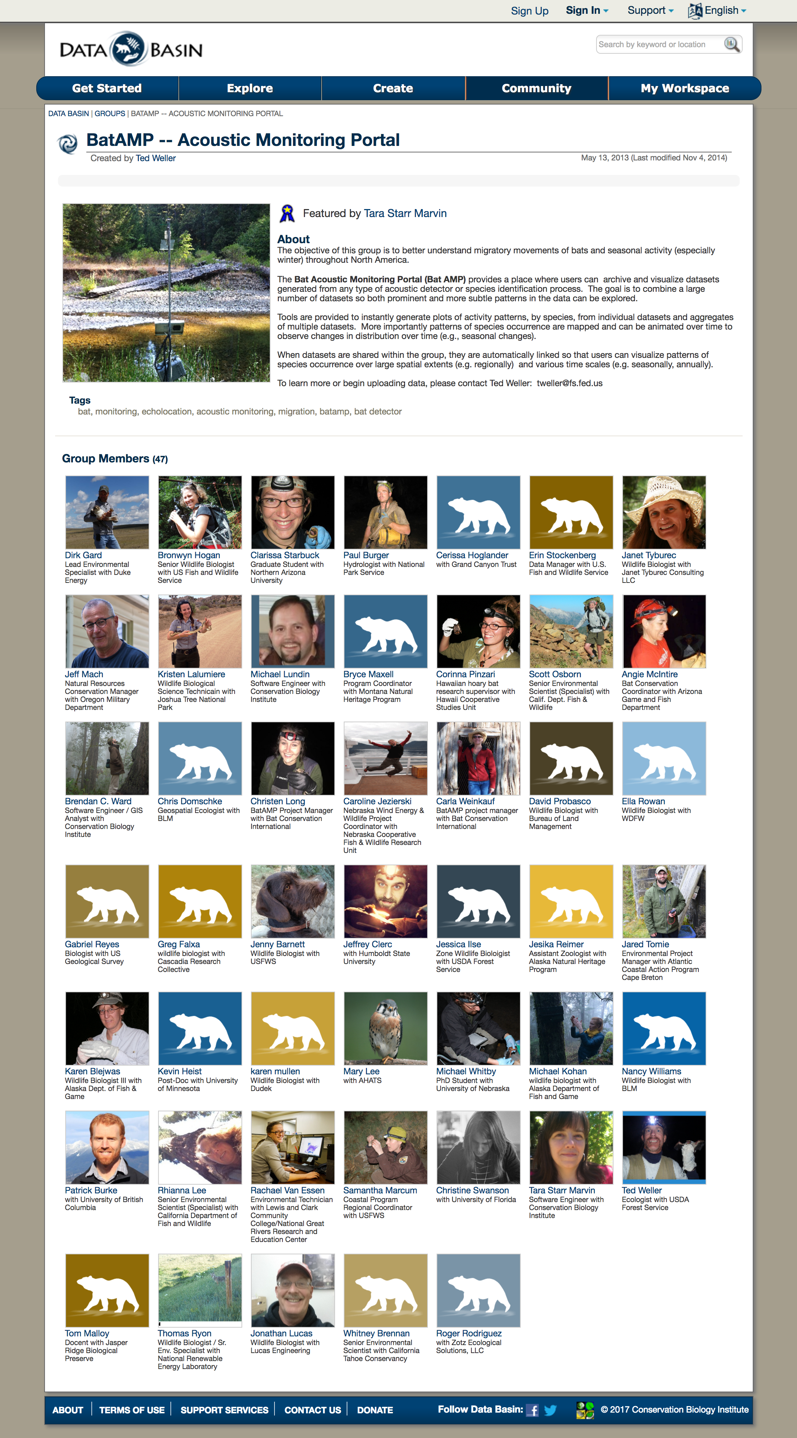
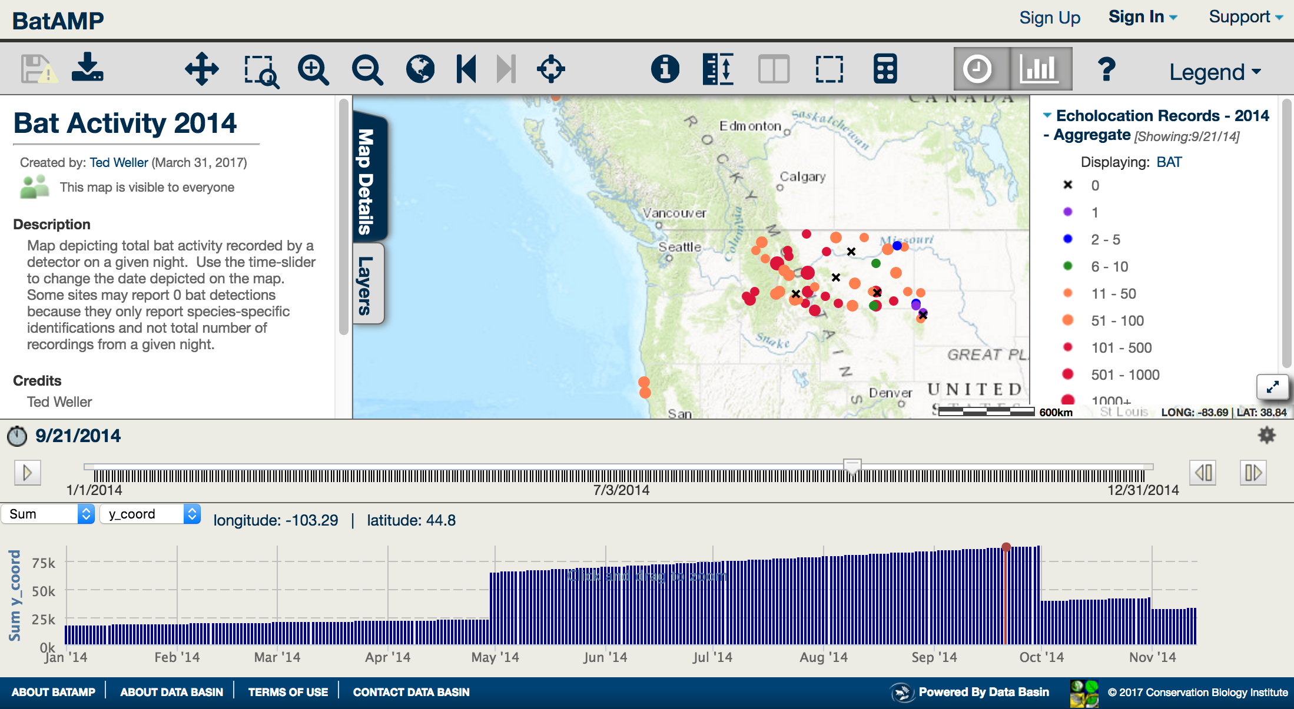
Gateway Tools – for a theme (e.g. bats)
https://batamp.databasin.org/

Slide 8
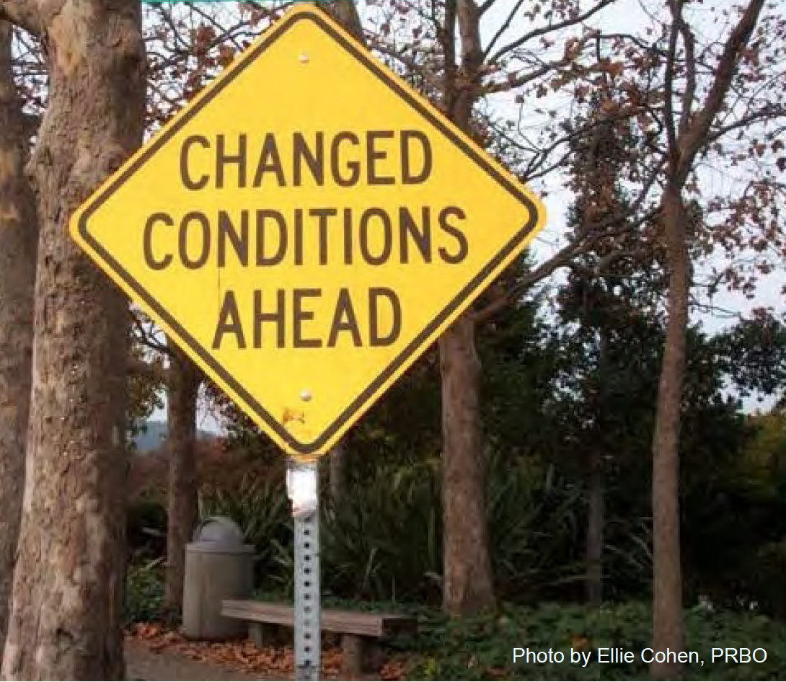

USE OUR
CLIMATE TOOLS

Slide 9

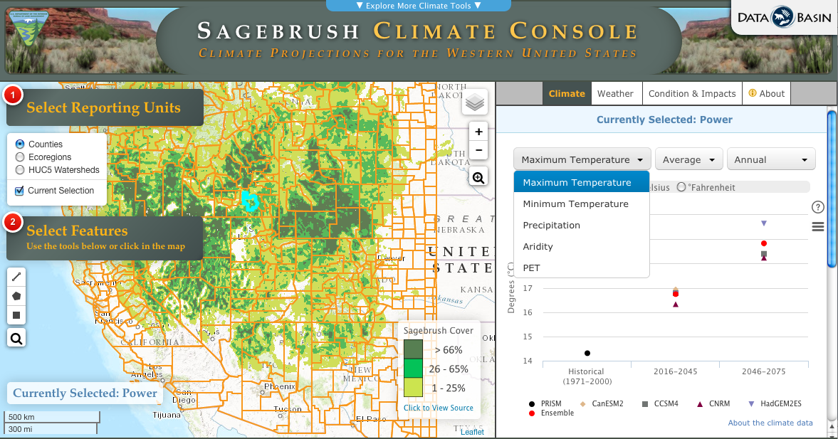

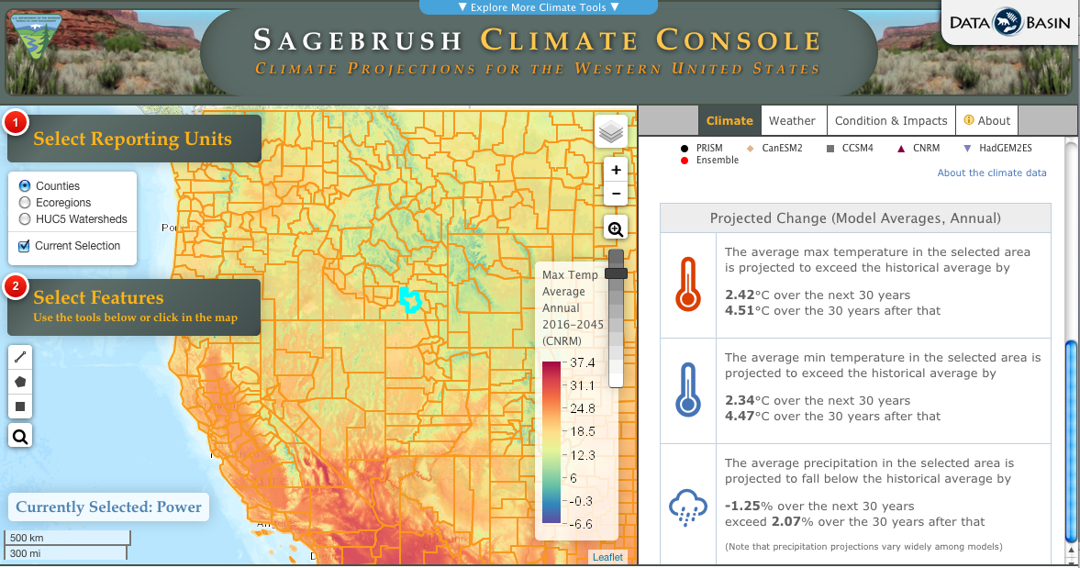
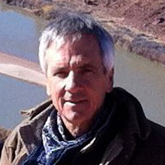

BLM
Outreach
Melanie Brown
http:/climateconsole.org/sagebrush
Mike Gough
Barry Baker
Tim Sheehan

Slide 10

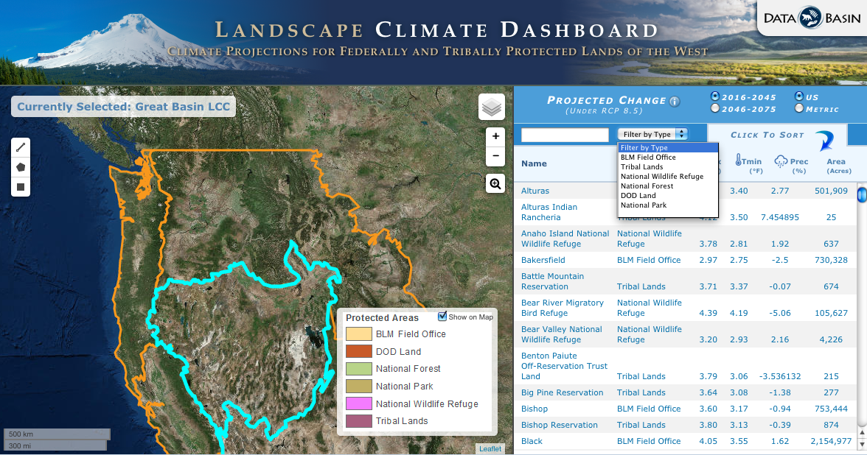
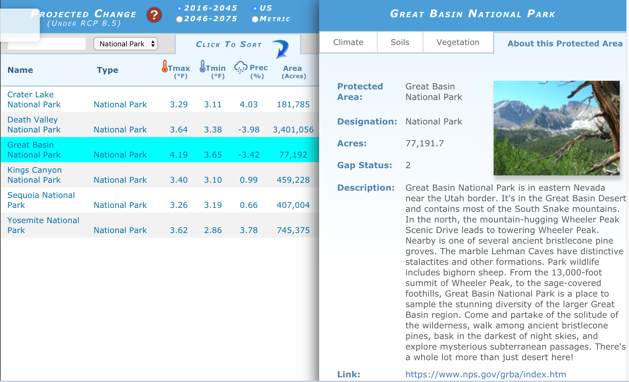
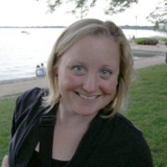
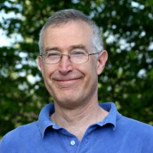
Landscape Conservation Cooperative Network
http:/climatedashboard.org
Kai Foster
Tim Sheehan
Barry Baker
Mike Gough
Ken Ferschweiler

Slide 11

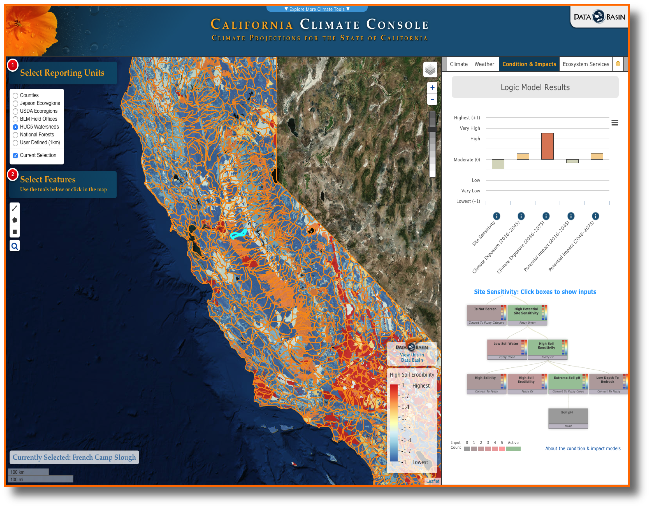
Mike Gough
Tim Sheehan

Slide 12
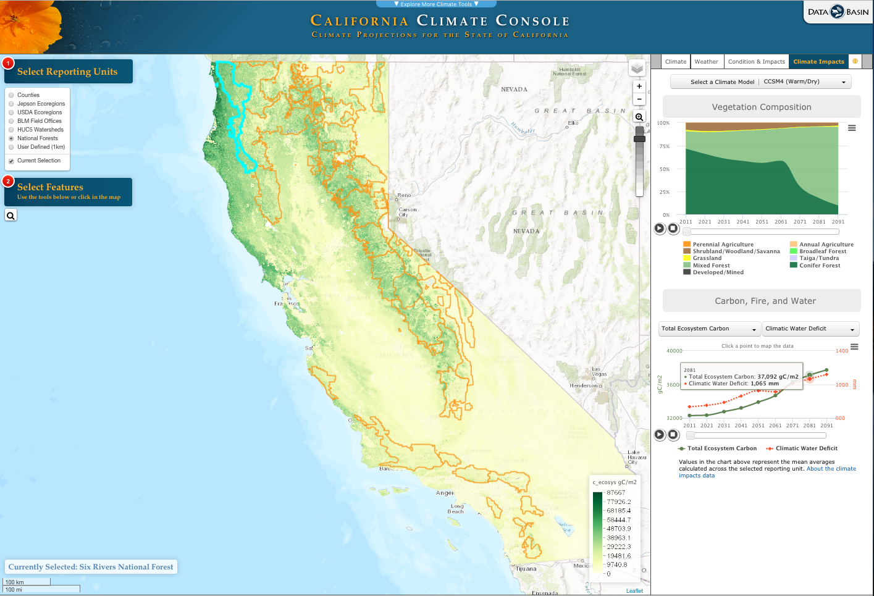
http:/climateconsole.org/
Mike Gough
Barry Baker
Tim Sheehan
Ken Ferschweiler

Slide 13
Soon? Climate Exposure Tool
BLUE PRINT
Mike Gough
Barry Baker

Slide 14
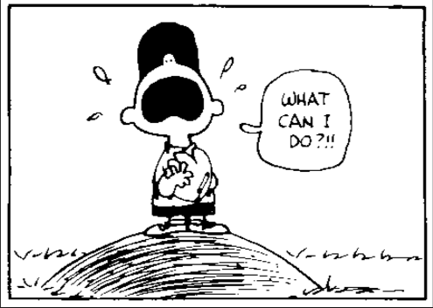
but the real question is …

Slide 15
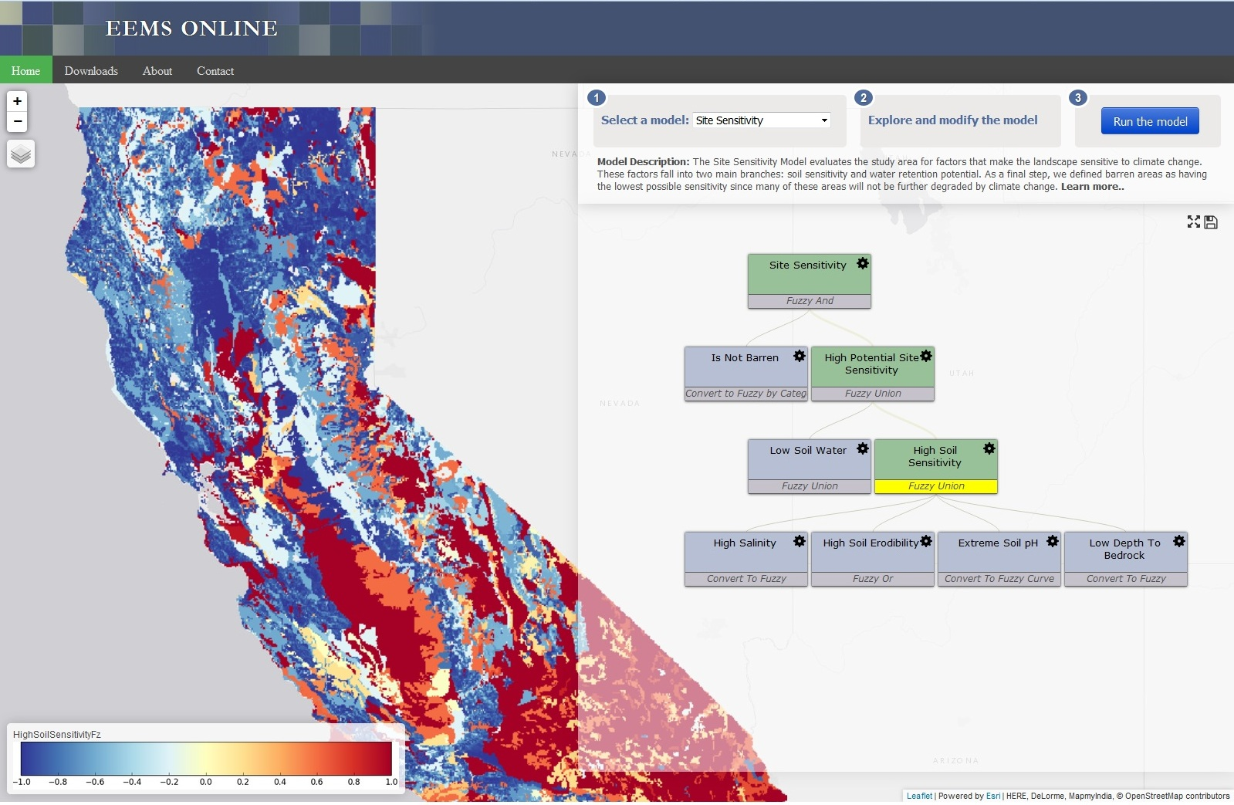
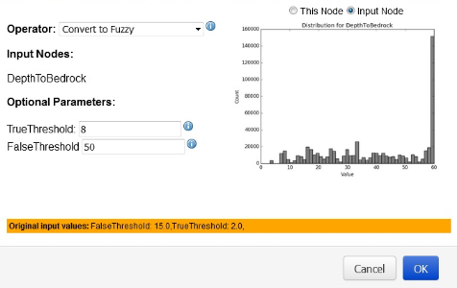
Interactive Decision Support Tool
Ecosystem Evaluation Modeling System
http://eemsonline.org
Mike
& Tim

Slide 16
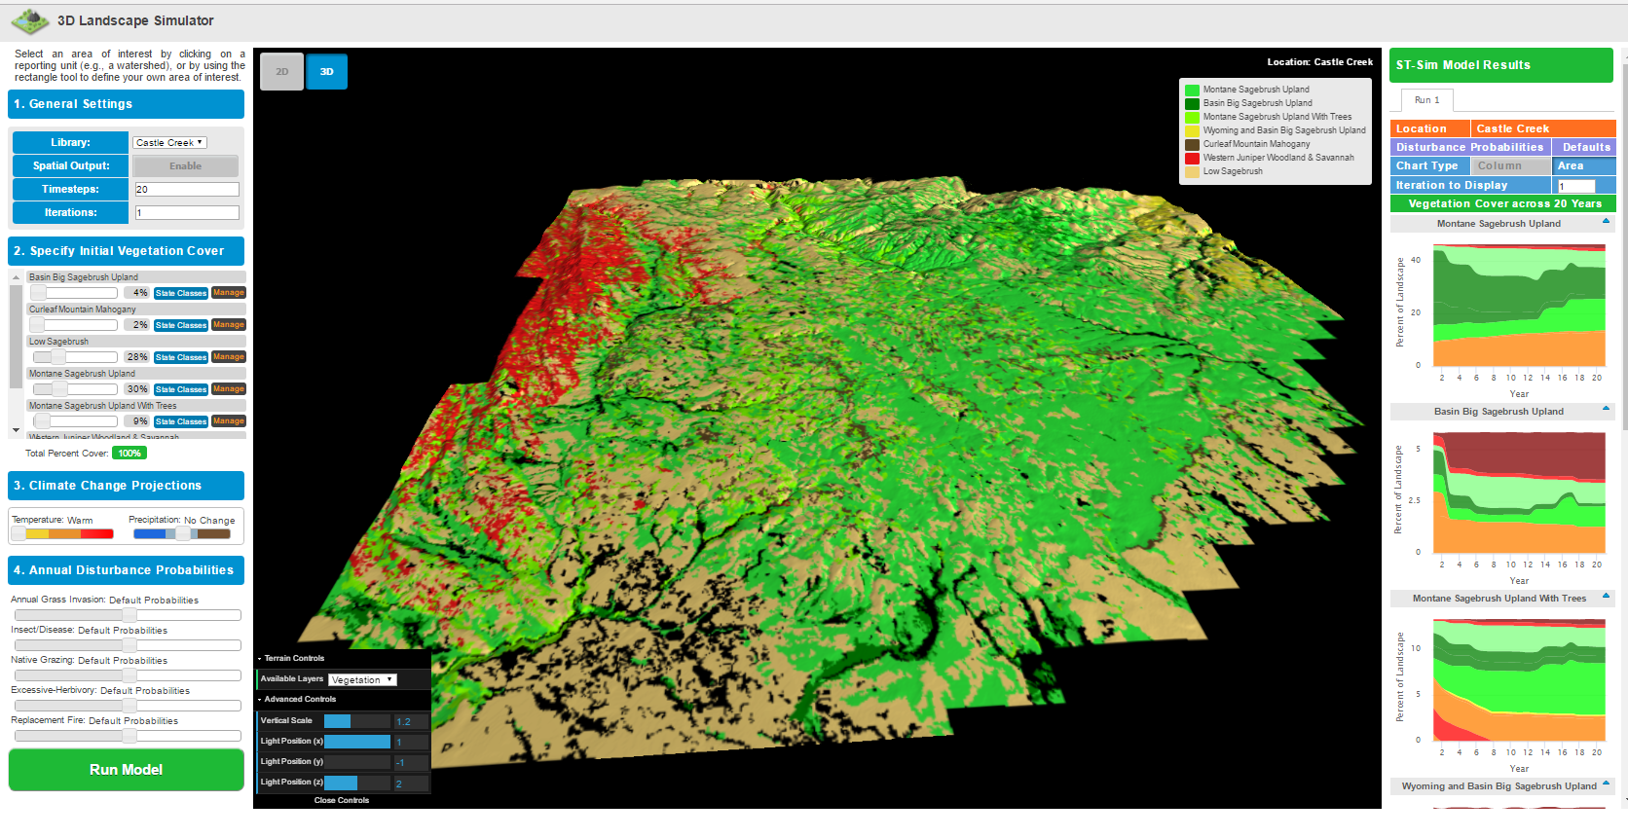
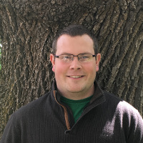

Interactive State and Transition Model Platform
http://landscapesim.org
Melanie Brown
Mike Gough
Taylor Mutch

Slide 17

NOOOOOOOOOOoooooooooooooooooooooo!!! not another model …

Slide 18

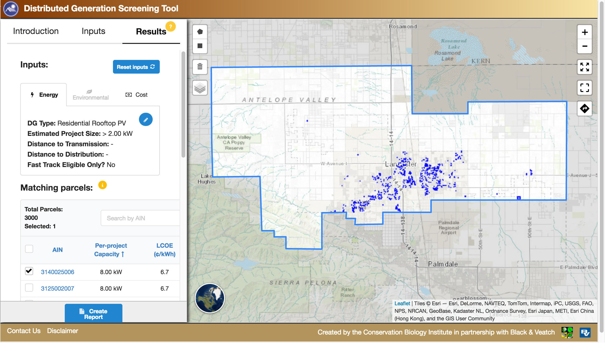
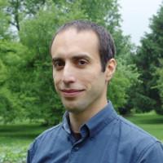
Energy Planning Assistant
http://s3-us-west-2.amazonaws.com/dg-screening/index.html
Mike Gough
Kaveh Karimi

Slide 19

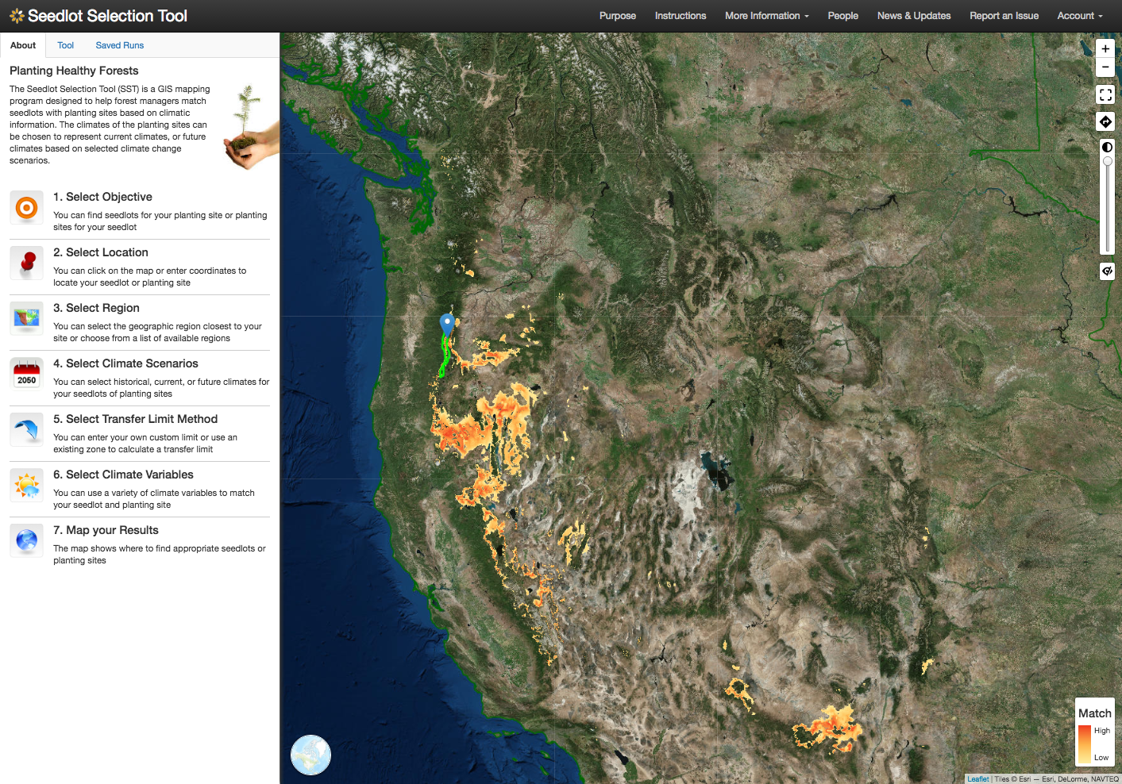

Interactive Climate Adaptation Tool
http: seedlotselectiontool.org
USA, AK, Canada and Mexico
Nik Molnar
Brendan Ward
Taylor Mutch

Slide 20

contact info: dominique@consbio.org

