Slide 1
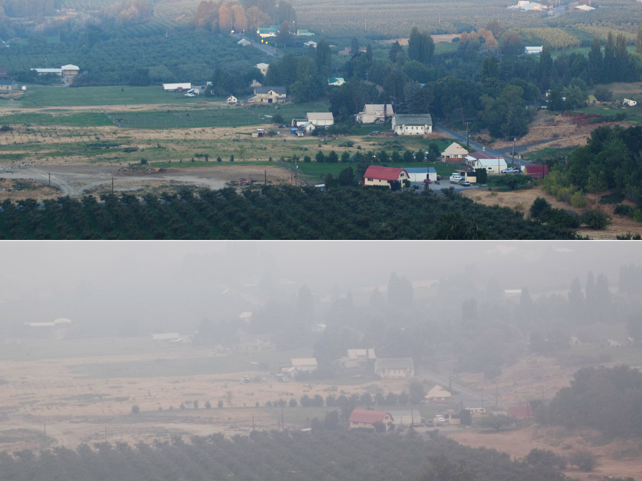
Wild & Rx Fires: Balancing Risk & Emissions
Paul Hessburg, PNW Research Station, and
Richy Harrod, Okanogan-Wenatchee NF

Slide 2
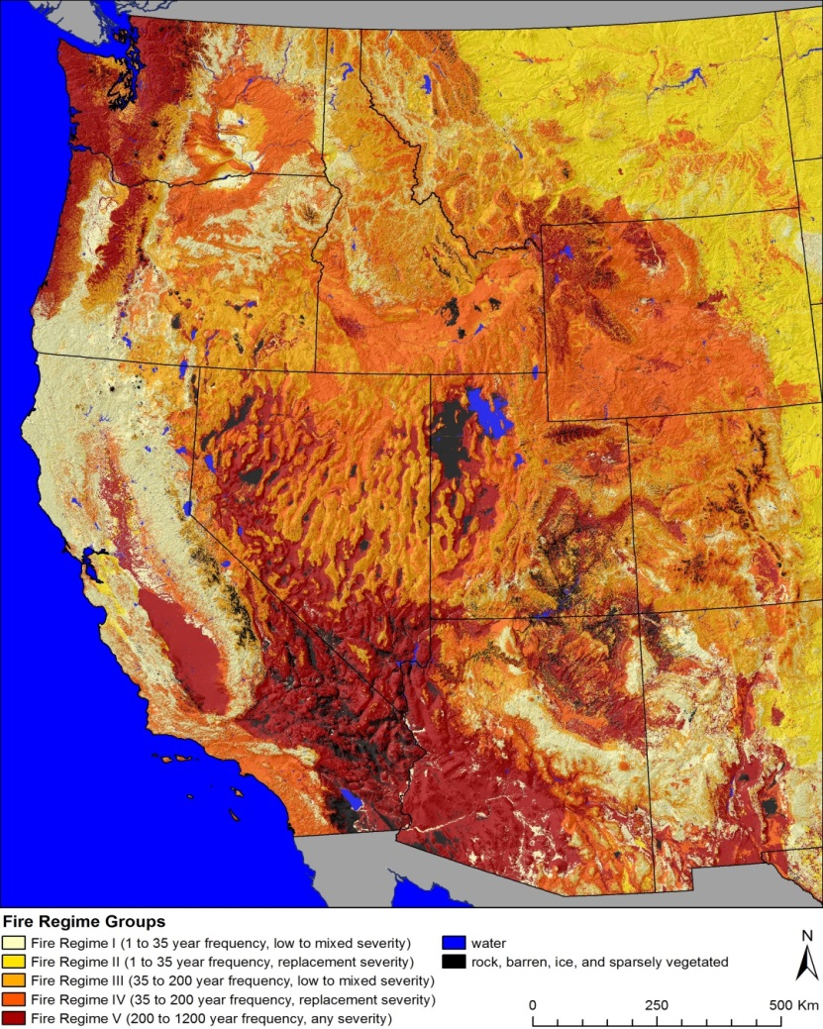
Smoke Mgmt & Rx Burning in WA: Foundations for the Future
Notice how historical fire frequency and severity are geographically zoned by climatic gradients
February 28 – March 1, 2017, Wenatchee, WA
Notes:
Historical fire regime areas (left). Land cover types (right). Notice the high degree of correspondence between the fire regime and land cover maps. Fire regime zones and land cover types are both driven by broad differences in topography, climate and lifeform zones, land surface forms, and geology. Data are from www.landfire.gov.

Slide 3
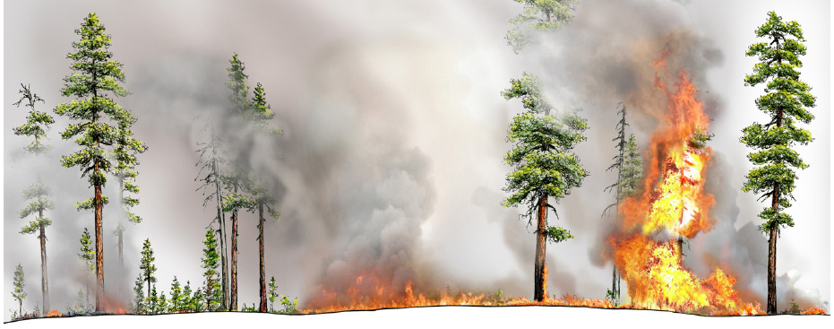
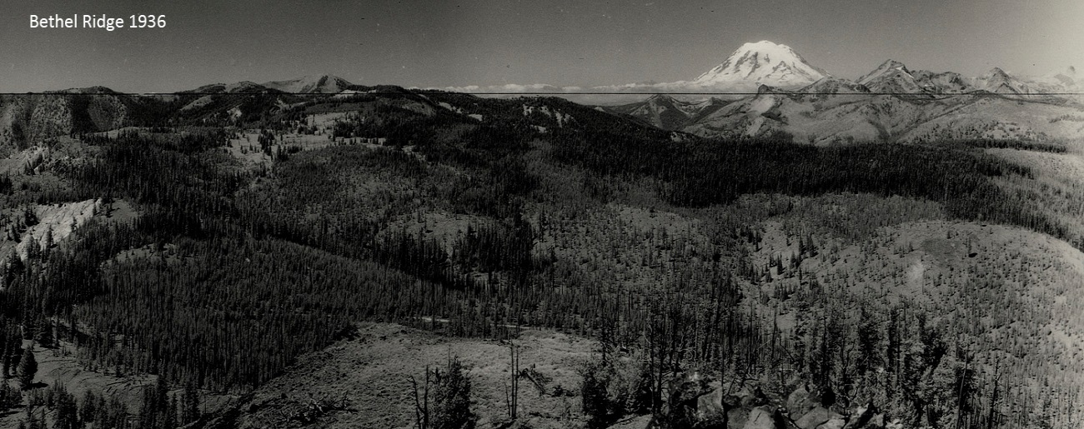
Smoke Mgmt & Rx Burning in WA: Foundations for the Future
Locally—fires continually thinned forest patches, reducing density and fuels
Regionally—fires created variable patchworks of grass, shrub, early, mid, late seral conditions, these patterns spatially controlled future fire size & severity
February 28 – March 1, 2017, Wenatchee, WA
Notes:
Distinguish fire effects by fire regime

Slide 4
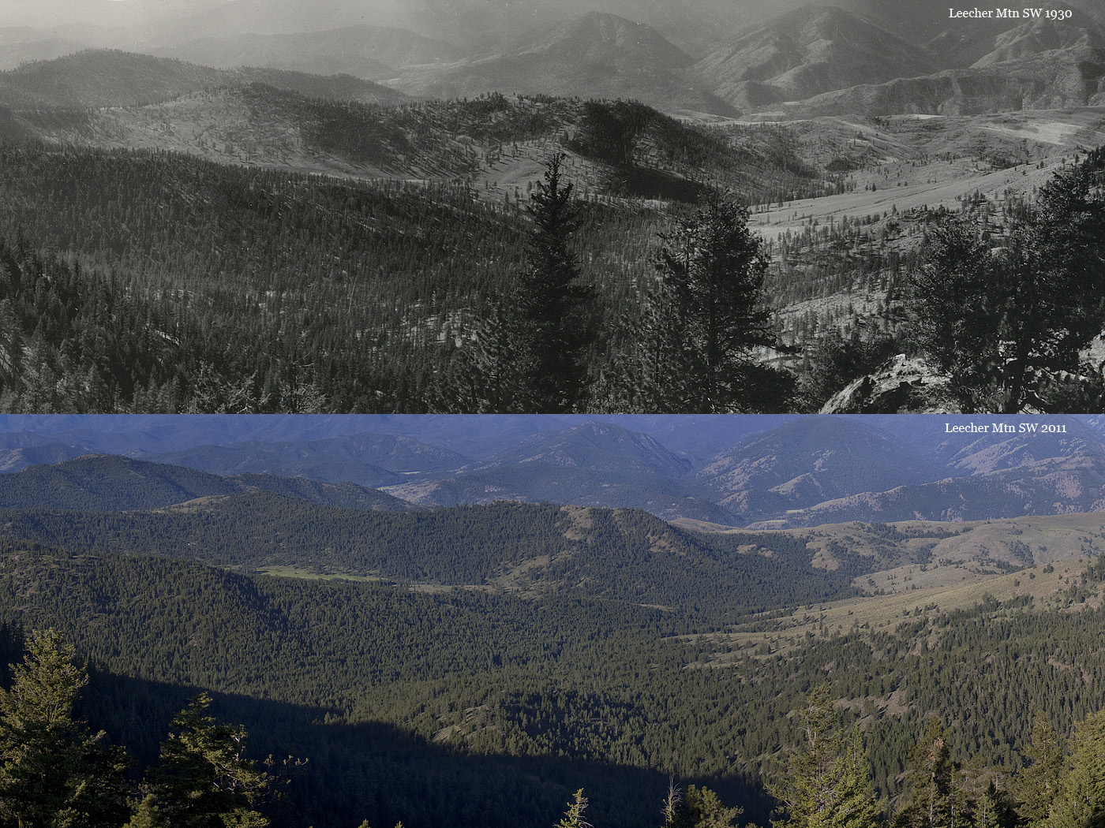
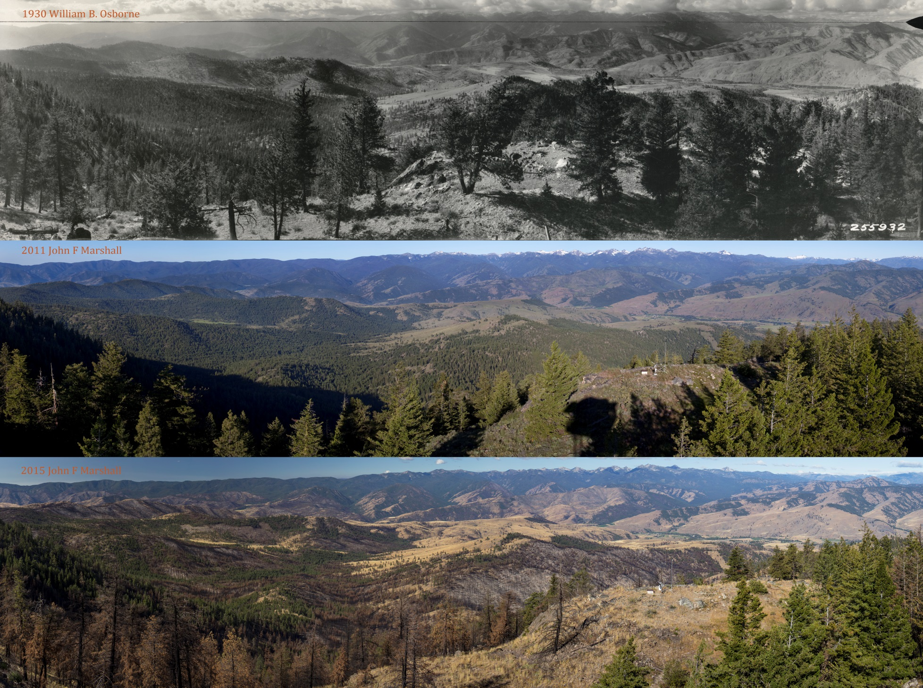
Smoke Mgmt & Rx Burning in WA: Foundations for the Future
Landscape Planning Conference, December 1-2, 2016, Lubrecht Forest, MT
February 28 – March 1, 2017, Wenatchee, WA
Notes:
These are comparison panoramas of the Leecher Mtn area, in the Methow Valley. In the B+W, we are looking at dry mixed conifer forests, regularly burned by lightning ignited fires and Native Americans until the start of the 20th century. Notice how open the canopy conditions are in top photo and how dense the forest has become in the bottom photo.

Slide 5
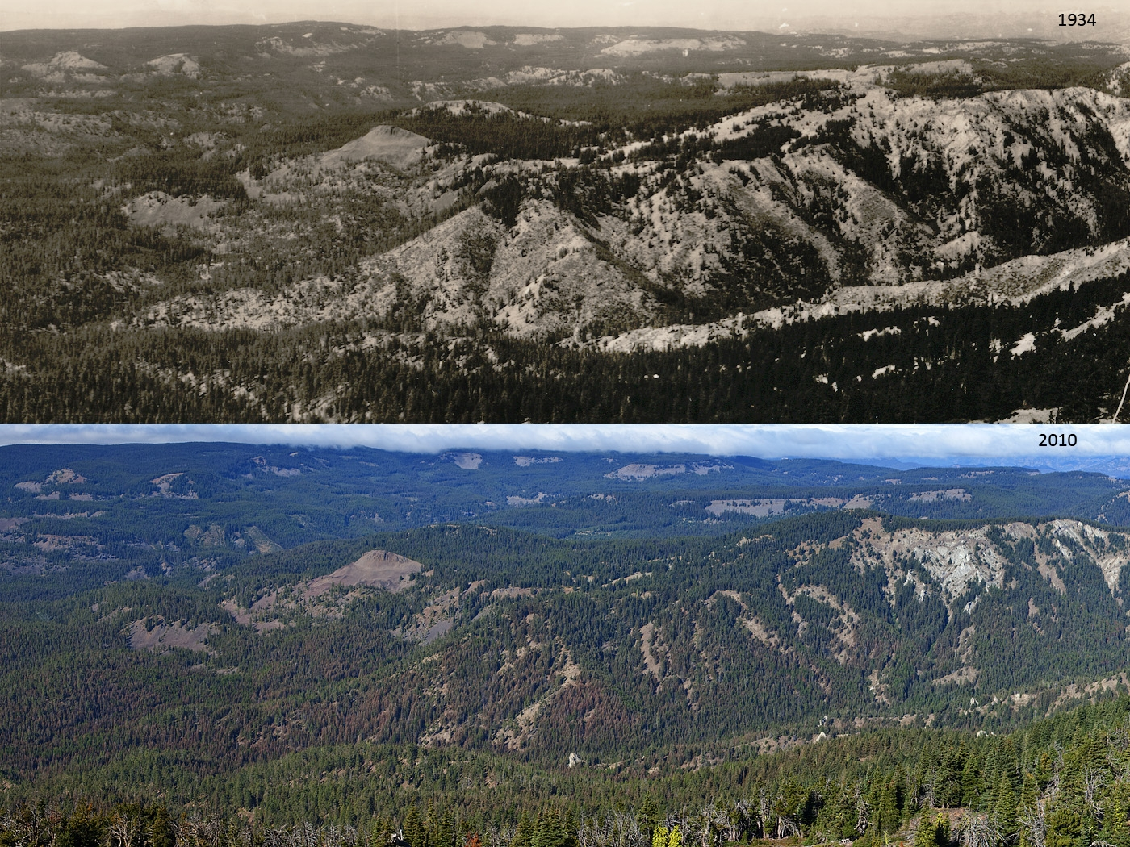
Smoke Mgmt & Rx Burning in WA: Foundations for the Future
February 28 – March 1, 2017, Wenatchee, WA
Notes:
This pair of panoramas is much closer to home. Here we are looking down the backside of Mission Peak. Note the strong control of ridgetop and S facing slopes on tree density and fire behavior. Fires were frequent on these warmer slopes and flame lengths were short. Typical south facing slopes supported open canopy forest or sparsely wooded areas. North slopes and valley bottoms were heavily wooded, this where historical old growth forests often occurred, even in fire prone forests.

Slide 6
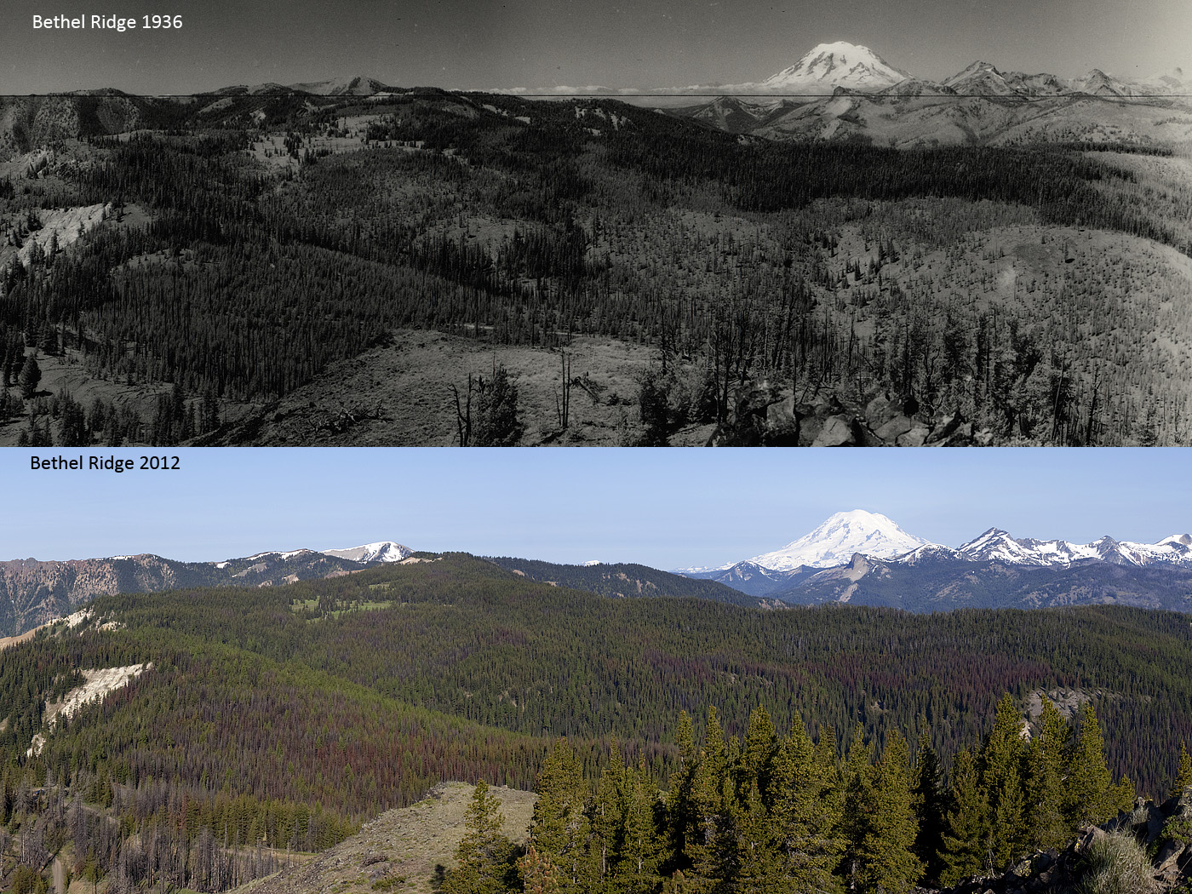
Smoke Mgmt & Rx Burning in WA: Foundations for the Future
February 28 – March 1, 2017, Wenatchee, WA
Notes:
This final pair of panoramas is from Bethel Ridge near Naches, WA, north of Rimrock Lake, and east of Mt. Rainier. These are moist mixed conifer and subalpine forests in headwaters environments. Notice the variety in lifeform cover and of recently burned area, recovering forest, early seral grasslands, new forests, patches of seedlings and saplings, intermediate and mature forests. Note also the bark beetle mortality in the current image, in the previously burned areas.

Slide 7
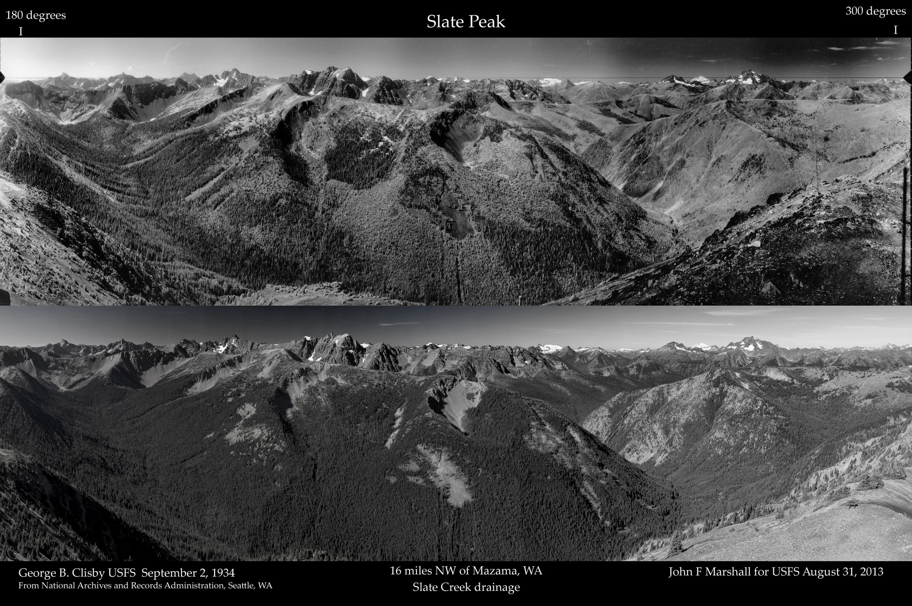
Smoke Mgmt & Rx Burning in WA: Foundations for the Future
February 28 – March 1, 2017, Wenatchee, WA
Notes:
This pair of panoramas is from Slate Peak near Mazama, WA. Notice the exceptional variety in lifeform cover and of forest successional conditions (burned area, recovering forest, early seral grasslands, new forests, patches of seedlings and saplings, intermediate and mature forests). Notice also the recent landslide and avalanche chutes, and hillslope failures in recently burned historical areas, and their relative absence in the current scene.

Slide 8
Smoke Mgmt & Rx Burning in WA: Foundations for the Future
Recap
We live in landscapes that were continuously shaped by fire.
Our nearby forests will burn. We can influence how often, how severe, how large.
High surface fuel loads, high canopy fuel contagion -- key drivers.
Reduced snowpack, longer fire seasons, hotter, drier, windier summers create more extreme wildfire conditions.
Extreme weather coupled with high fuel contagion is increasing fire size & severity in most interior forest types.
February 28 – March 1, 2017, Wenatchee, WA

Slide 9
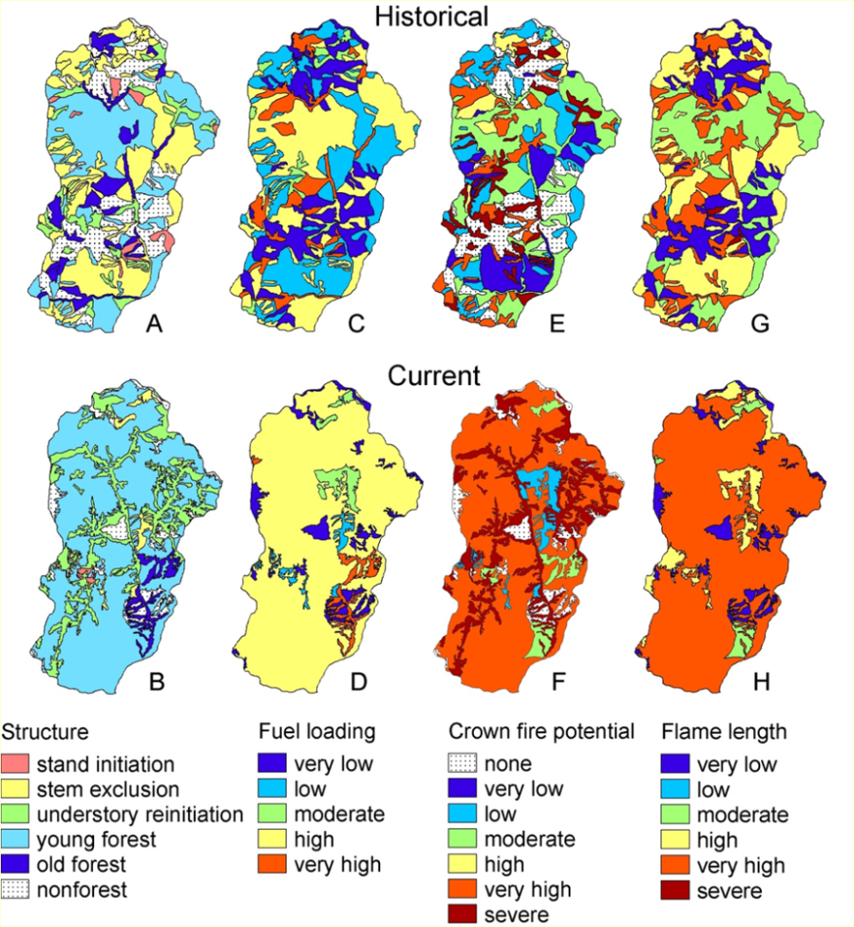
Smoke Mgmt & Rx Burning in WA: Foundations for the Future
Fire and forest succession are the engine that drives the system
Keane et al. (2009) For Ecol Manage v258
Bisson et al. (2009) Ecol & Soc v14(1)
Collins et al. 2009, Parks et al. 2015;
McGarigal & Romme 2012;
Hessburg et al. 2015. Landscape Ecology v30
February 28 – March 1, 2017, Wenatchee, WA

Slide 10
Smoke Mgmt & Rx Burning in WA: Foundations for the Future
Topics
Effectiveness of different types of fuel treatments
thinning alone
thinning + piling + Rx burning,
Rx burning alone,
thinning + piling
Implications of continuing at the current pace & scale
Implications if smoke management rules were relaxed
What else is needed to reach restoration & maintenance goals.
February 28 – March 1, 2017, Wenatchee, WA

Slide 11
Smoke Mgmt & Rx Burning in WA: Foundations for the Future
Topics
Effectiveness of different types of fuel treatments
February 28 – March 1, 2017, Wenatchee, WA

Slide 12
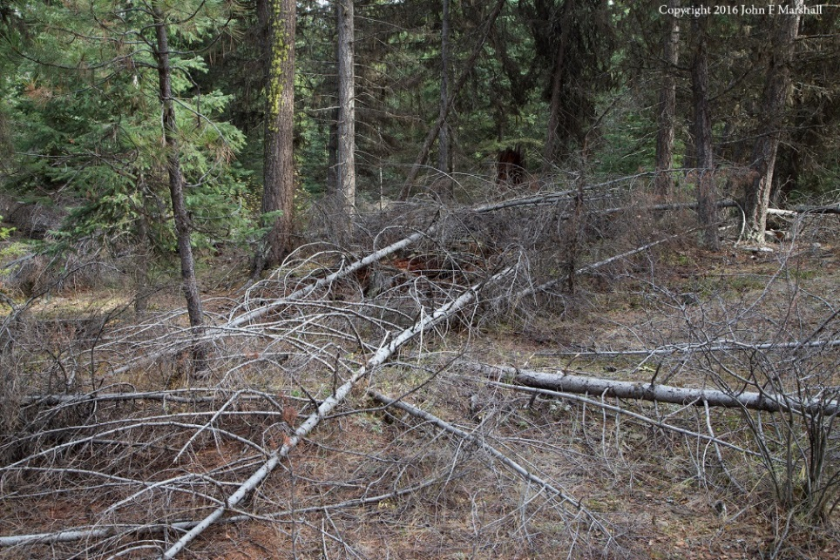
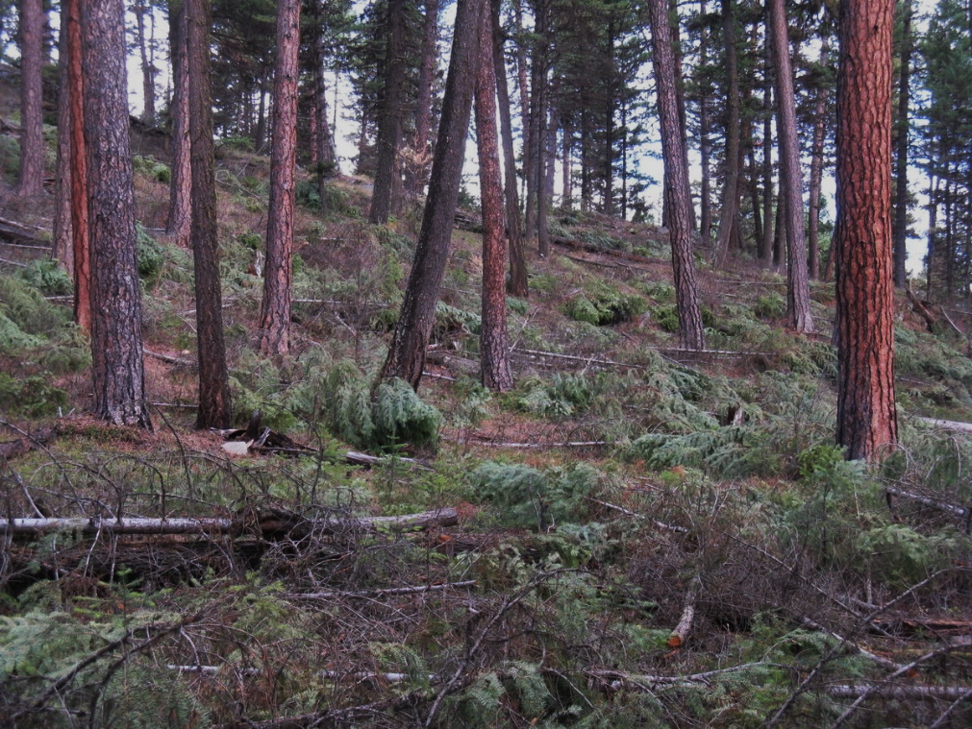
Smoke Mgmt & Rx Burning in WA: Foundations for the Future
Thinning alone
Recovers wood fiber, if commercial
Abundant slash, esp. if not commercial
Lowest cost when trees have value
Future fire effects less controlled
Future overstory, not wildfire protected
February 28 – March 1, 2017, Wenatchee, WA
Notes:
Thinning is often non-commercial because the overabundant trees are often too small. Removing commercial trees often crushes non-commercial small trees adding tremendously to the surface fuel load.

Slide 13
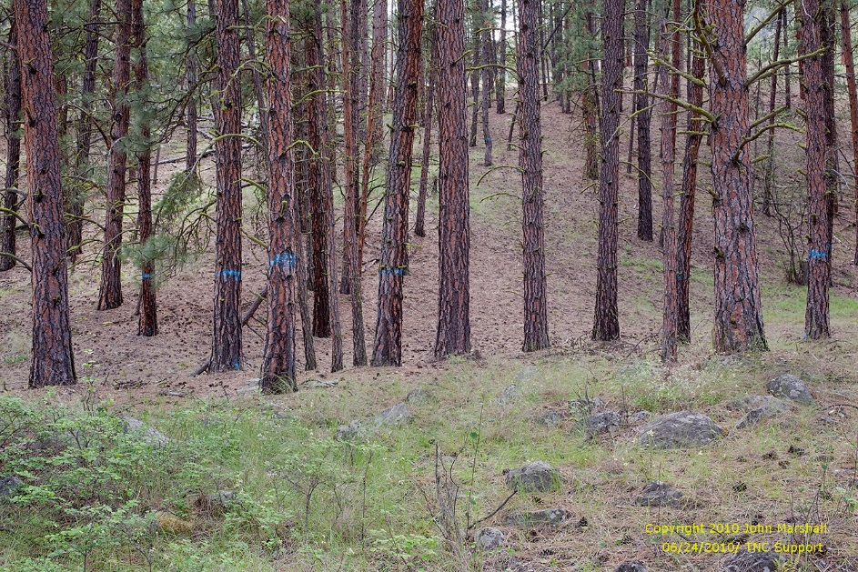
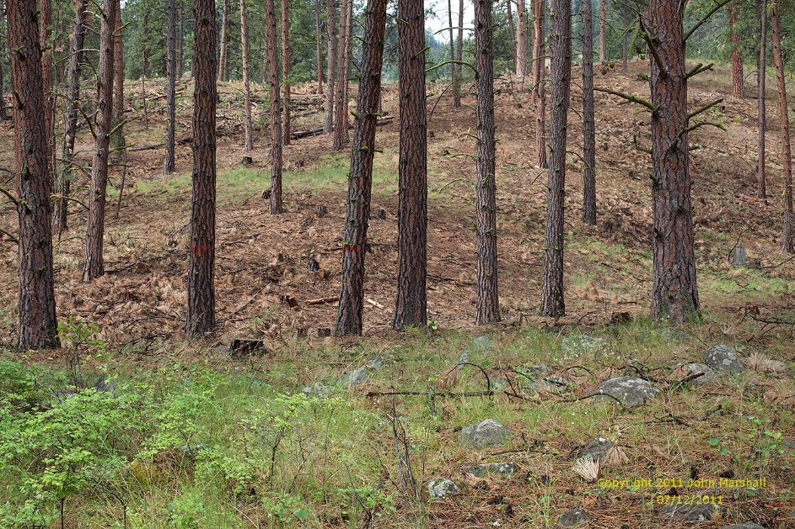
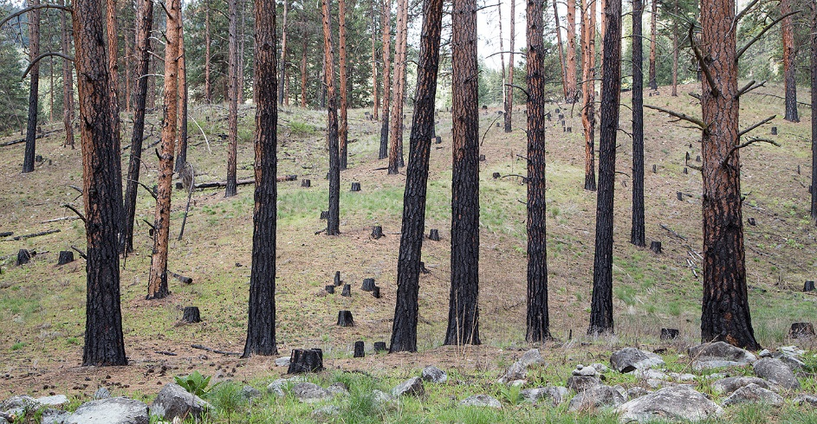
Smoke Mgmt & Rx Burning in WA: Foundations for the Future
Thinning + Piling + Rx burning
Recovers wood fiber
Abundant slash is burned
Less to hand pile, concentrations only
Broadcast burning good for the native plant community
Most effective hazardous fuel reduction
Prepares mineral soil if PP or WL are to be regenerated naturally
Spatially precise
Fire effects most controlled
Less frequent maintenance burns
February 28 – March 1, 2017, Wenatchee, WA

Slide 14
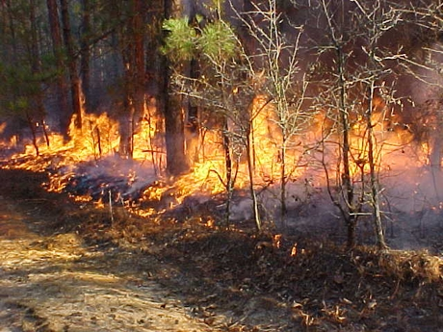
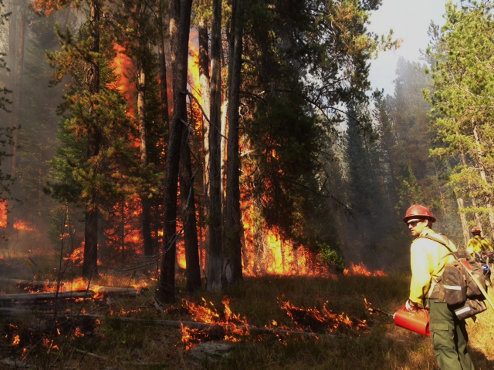
Smoke Mgmt & Rx Burning in WA: Foundations for the Future
Rx burning alone
No wood fiber recovery
No slash
Less/nothing to hand pile
Prepares mineral soil if PP or WL are naturally regenerated
Fire effects harder to control
Fire perimeter harder to control
May require more staffing/longer staffing
May get more/less mortality than desired
Maintenance burns required more often
February 28 – March 1, 2017, Wenatchee, WA

Slide 15
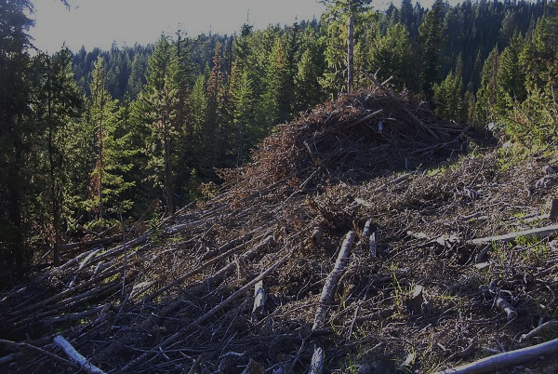
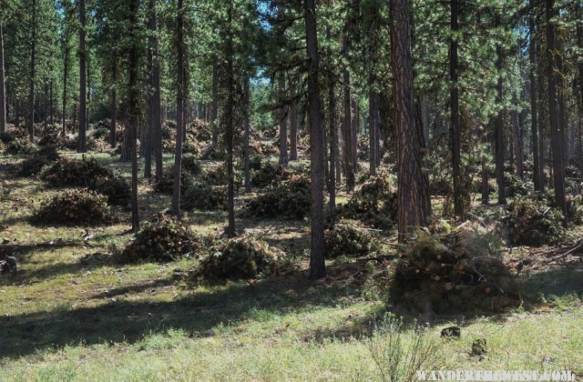
Smoke Mgmt & Rx Burning in WA: Foundations for the Future
Thinning + piling
Recovers wood fiber
Abundant slash
Most expensive to thin + hand pile
Acres treated are small, labor intensive
Can be hard on/sterilize soil if large piles are burned
Least effective at protecting the future stand
February 28 – March 1, 2017, Wenatchee, WA
Notes:
Piling burning is the least expensive on a per acre basis (no unit prep, no patrol and mop-up, no specialized equip.), but not many acres can be treated.

Slide 16
Smoke Mgmt & Rx Burning in WA: Foundations for the Future
Topics
Effectiveness of different types of fuel treatments
Implications of continuing at the current pace & scale
February 28 – March 1, 2017, Wenatchee, WA

Slide 17
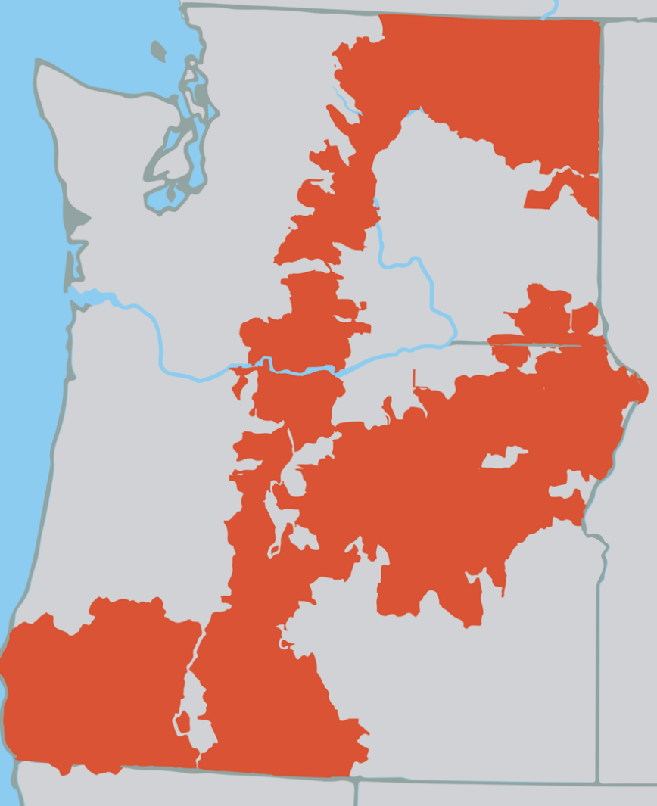
Smoke Mgmt & Rx Burning in WA: Foundations for the Future
Need for treatment is large and time is short
1/2 of the red area is in need of treatment to improve successional and/or fuel conditions,
By 2050, climate warming will 2X or 3X the area burned btw 2000-2015
More than 100 MM ac burned in the West since 2000
February 28 – March 1, 2017, Wenatchee, WA

Slide 18
Smoke Mgmt & Rx Burning in WA: Foundations for the Future
Topics
Effectiveness of different types of fuel treatments
Implications of continuing at the current pace & scale
Implications if smoke management rules were relaxed
February 28 – March 1, 2017, Wenatchee, WA

Slide 19
Smoke Mgmt & Rx Burning in WA: Foundations for the Future
Implications…
Fire managers would burn far more acres to meet forest restoration objectives
More burned acres in WUI: much safer for firefighters, citizens
More burned acres in General Forest and Wilderness:
better able to maintain critical habitats, e.g., spotted owls, WHWP
lower potential for large insect outbreaks
better able to restore successional patterns and fire regimes
But how much more is needed?
February 28 – March 1, 2017, Wenatchee, WA

Slide 20
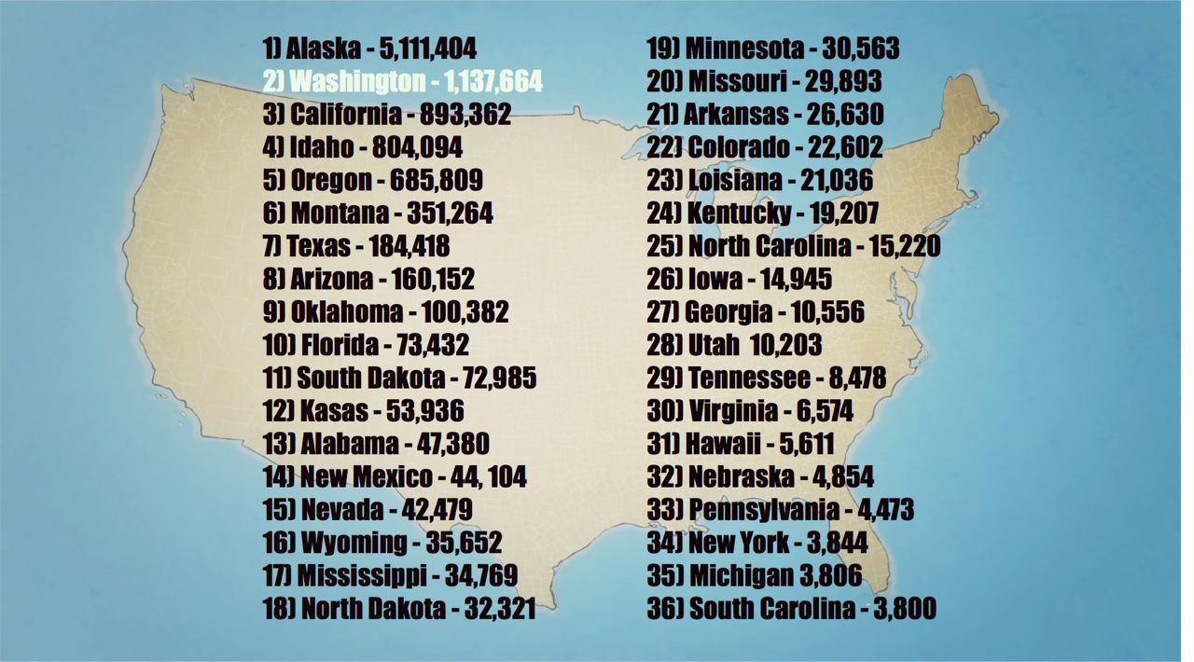
Smoke Mgmt & Rx Burning in WA: Foundations for the Future
2015 – Wildfire Acres Burned
February 28 – March 1, 2017, Wenatchee, WA

Slide 21
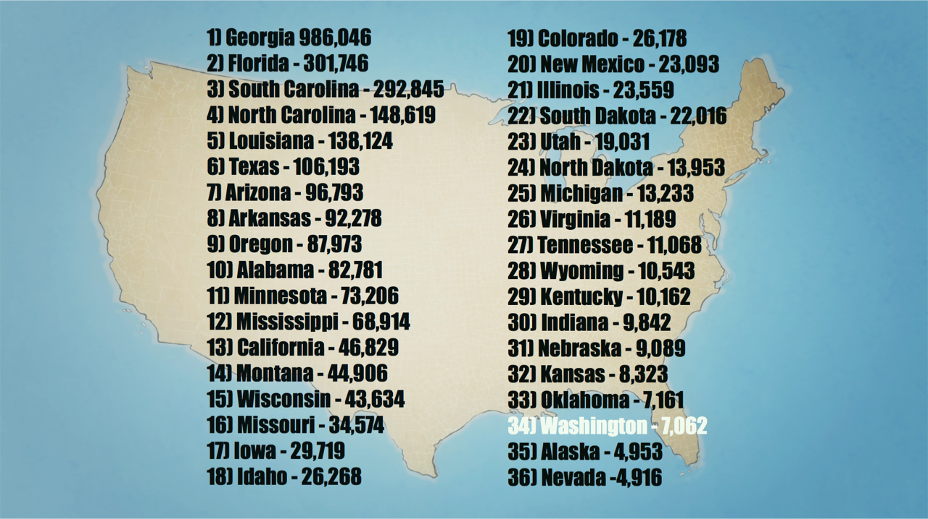
Smoke Mgmt & Rx Burning in WA: Foundations for the Future
2015 – Acres Rx Burned
February 28 – March 1, 2017, Wenatchee, WA

Slide 22
Smoke Mgmt & Rx Burning in WA: Foundations for the Future
Historical wildfire annual acres burned in the US
25- 40 MM ac / yr, under the native fire regimes
2015 annual acres burned by wildfire in the US
10 MM ac in severe wildfire scenarios, uncontainable fires
Not the fire behavior or effects we want
Wildfire suppression cost 2015 > 3 billion $$
Associated infrastructure and economic impact > 50 billion $$
Fire deficit in forests remains
Need to kick the system at the scale of the need
At smaller scales, does not move the needle…
February 28 – March 1, 2017, Wenatchee, WA

Slide 23
Smoke Mgmt & Rx Burning in WA: Foundations for the Future
4. What else is needed to reach restoration & maintenance goals?
Social license to burn
Trust in land managers to do the right thing, in the right places
Improved understanding of the ecological importance of fire
Better able to protect human communities and natural resources we value
Better understanding of the scale of burning needed
A clear understanding of wild vs Rx fire smoke tradeoffs
February 28 – March 1, 2017, Wenatchee, WA

Slide 24
Smoke Mgmt & Rx Burning in WA: Foundations for the Future
Simulation design
20 subwatersheds on the OWNF that are the focus of current mgt
Compared emissions for Wild & Rx burn scenarios
Simulated emissions for Dry, Moist, & Cold Forests separately
Separated PM2.5, PM10, & Total emissions for comparison
Assumed 95th percentile fire weather conditions
Used CONSUME 3.0 to simulate emissions:
Used DAYMET climate data for 95th percentile fire weather
Calculated ERCs, fuel consumption, emissions
Graphed emissions trade-offs, below
February 28 – March 1, 2017, Wenatchee, WA
Notes:
Need to explain the scenarios, maybe need another slide.

Slide 25
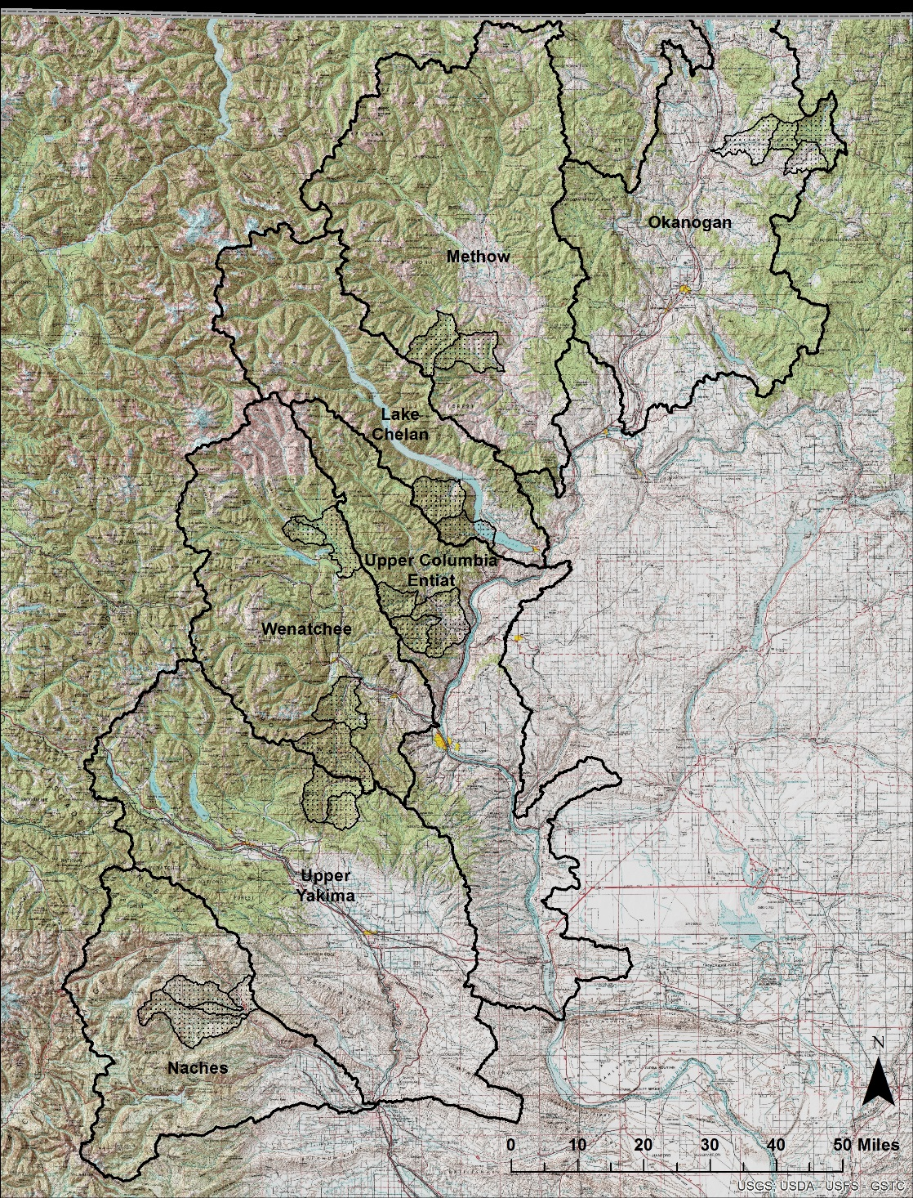
Smoke Mgmt & Rx Burning in WA: Foundations for the Future
February 28 – March 1, 2017, Wenatchee, WA

Slide 26
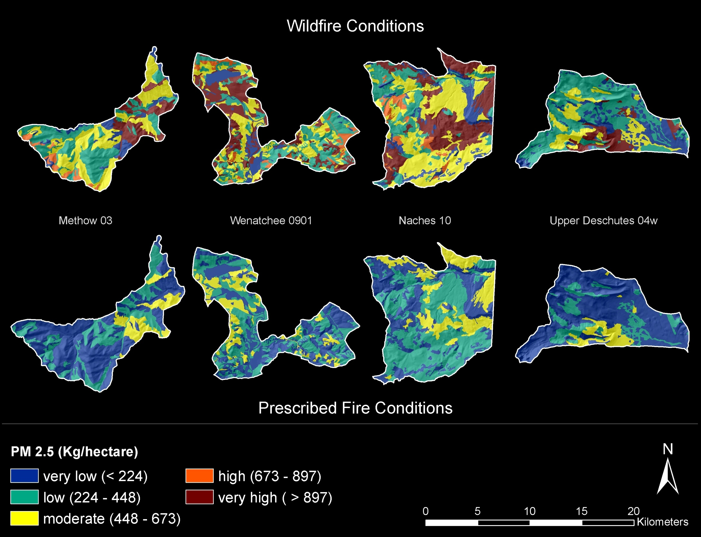
Smoke Mgmt & Rx Burning in WA: Foundations for the Future
February 28 – March 1, 2017, Wenatchee, WA

Slide 27
Smoke Mgmt & Rx Burning in WA: Foundations for the Future
February 28 – March 1, 2017, Wenatchee, WA
Notes:
Each cluster of bars represents a watershed

Slide 28
Smoke Mgmt & Rx Burning in WA: Foundations for the Future
February 28 – March 1, 2017, Wenatchee, WA
Notes:
Average for all watersheds

Slide 29
Smoke Mgmt & Rx Burning in WA: Foundations for the Future
February 28 – March 1, 2017, Wenatchee, WA

Slide 30
Smoke Mgmt & Rx Burning in WA: Foundations for the Future
February 28 – March 1, 2017, Wenatchee, WA

Slide 31
Smoke Mgmt & Rx Burning in WA: Foundations for the Future
February 28 – March 1, 2017, Wenatchee, WA

Slide 32
Smoke Mgmt & Rx Burning in WA: Foundations for the Future
February 28 – March 1, 2017, Wenatchee, WA

Slide 33
Smoke Mgmt & Rx Burning in WA: Foundations for the Future
February 28 – March 1, 2017, Wenatchee, WA

Slide 34
Smoke Mgmt & Rx Burning in WA: Foundations for the Future
February 28 – March 1, 2017, Wenatchee, WA

Slide 35
Smoke Mgmt & Rx Burning in WA: Foundations for the Future
Emissions summary
Trade-off analysis is one snapshot in time
Rx burning esp. reduces PM2.5 emissions: 50-65% < wildfire, regardless of PVG
Dry, Moist, & Cold Forest PVGs benefit about equally in the proportion reduced
Greatest smoke savings is in dry PP & MC forests, where most WUI is
Rx burning consumes fine fuels, not the coarse fuels
Wild vs Rx difference in PM2.5 is in smoldering combustion avoided, duff, litter, and large logs
February 28 – March 1, 2017, Wenatchee, WA

Slide 36
Smoke Mgmt & Rx Burning in WA: Foundations for the Future
Uncertainties
When & where wildfires occur: will treated areas experience wildfires?
How much Rx & managed wildfire burning is realistic, possible?
How much is needed to create a significant shift in landscape-level fire behavior?
Long-term emission tradeoff analyses are lacking, needed. Initial estimates are 18-25% long-term reduction with CO_{2,} correlate pretty well with emissions, in some forest types ≥ 50%
Life cycle analysis lacking: what are PM2.5 emissions after biomass utilization?
What are total smoke impacts vs. emissions impacts?
February 28 – March 1, 2017, Wenatchee, WA

Slide 37
Smoke Mgmt & Rx Burning in WA: Foundations for the Future
Conclusions
Rx fires (incl. managed wildfires) effectively mitigate wildfire effects
Reduce flame length & fireline intensity
Reduce crownfire initiation & spread potential
Create needed variability in fire sizes
Create defensible spaces & anchor points for firefighters
Reduce wildfire smoke
Prescribed burning programs enhance ecosystem resiliency
Reduce density + canopy layers, restore fire tolerant spp
Improve resilience to climate change
Reduce susceptibility to large insect outbreaks
Restore habitats for a wider variety of plant & animal species
Reducing smoke impacts to communities is a shared goal
February 28 – March 1, 2017, Wenatchee, WA

Slide 38
Smoke Mgmt & Rx Burning in WA: Foundations for the Future
Regulations and Tradeoffs
Air quality is but one barrier to Rx burning programs (Quinn-Davidson 2012), also cost, staffing, ongoing maintenance + commitment, others…
Rx burning, including managed wildfires, is our most effective option at mitigating future wildfire smoke
Large potential benefits of a smoke-is-smoke policy *
Incentivizes Rx burning programs
Creates due diligence of least smoke trade-off analysis
Better aligns objectives btw regulators & fire managers
* K. H. Engel. 2013. Perverse Incentives: The Case of Wildfire Smoke Regulation, vol. 40, Ecology Law Quarterly. Available at: http://dx.doi.org/doi:10.15779/Z38PG4W
February 28 – March 1, 2017, Wenatchee, WA

Slide 39
Smoke Mgmt & Rx Burning in WA: Foundations for the Future
Discussion Questions
After 100 yrs+ of fire exclusion, can wildfires still be considered natural events?
If Rx fires are used to restore fire regimes to fire-excluded landscapes, should they be considered anthropogenic in origin?
Should unplanned wildfire smoke still get a free pass in state air quality compliance?
February 28 – March 1, 2017, Wenatchee, WA

