Slide 1
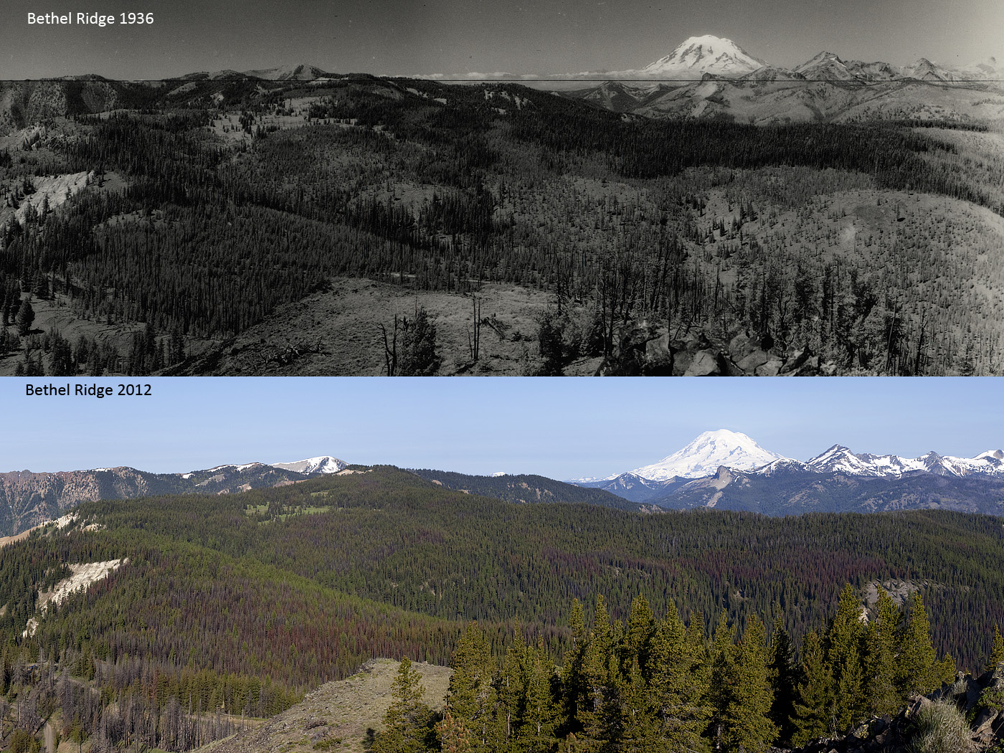
Evaluating Landscape Spatial Pattern Changes Using EMDS
Paul Hessburg & Keith Reynolds, PNW Research Station,
Wenatchee & Corvallis Forestry Sciences Laboratories

Slide 2
Hessburg, P.F.; Reynolds, K.M.; Salter, R.B.; Dickinson, J.D.; Gaines, W.L.; Harrod, R.J. 2013. Landscape Evaluation for Restoration Planning on the Okanogan-Wenatchee National Forest, USA. Sustainability 5(3): 805-840.

Slide 3

Reynolds, K.M., P.F. Hessburg, and P.S. Bourgeron (eds). 2014. Making Transparent Environmental Management Decisions: Applications of the Ecosystem Management Decision Support System. DOI: 10.1007/978-3-642-32000-2_7, Springer-Verlag, Berlin, Heidelberg.
For a complete list of current published applications in EMDS: https://en.wikipedia.org/wiki/Ecosystem_Management_Decision_Support

Slide 4
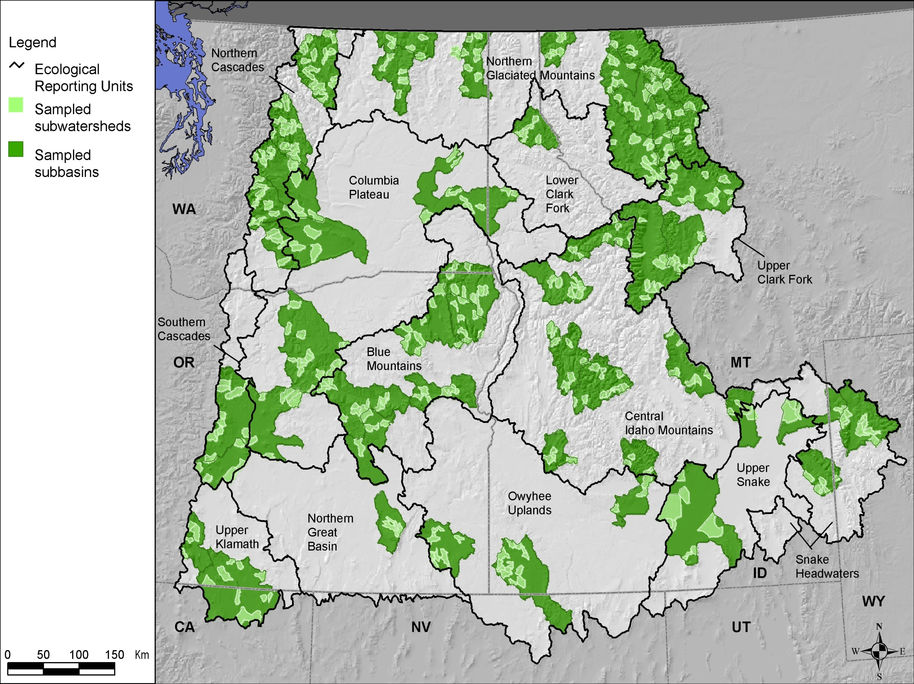
Hessburg, et al. 2000. Forest Ecology and Management. 136: 53-83.
Hessburg & Agee. 2003. Forest Ecology and Management 178:23-59.
Hessburg, Agee, & Franklin. 2005. Forest Ecology and Management 211(1): 117-139.
Hessburg, et al. 1999. PNW-GTR-458. Portland, OR: USDA-FS. 357 p.
Hessburg, et al. 1999. PNW Res. Pap. PNW-RP-514. 65 p.
Hessburg, et al. 1999. Ecological Applications. 9(4): 1232-1252.

Slide 5
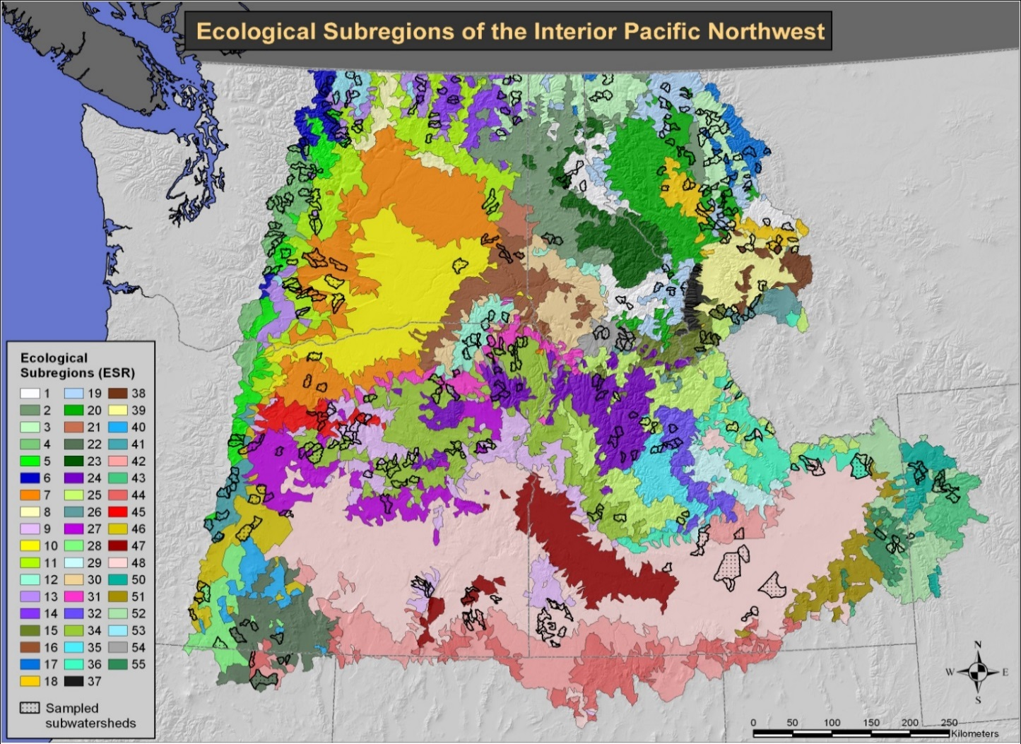
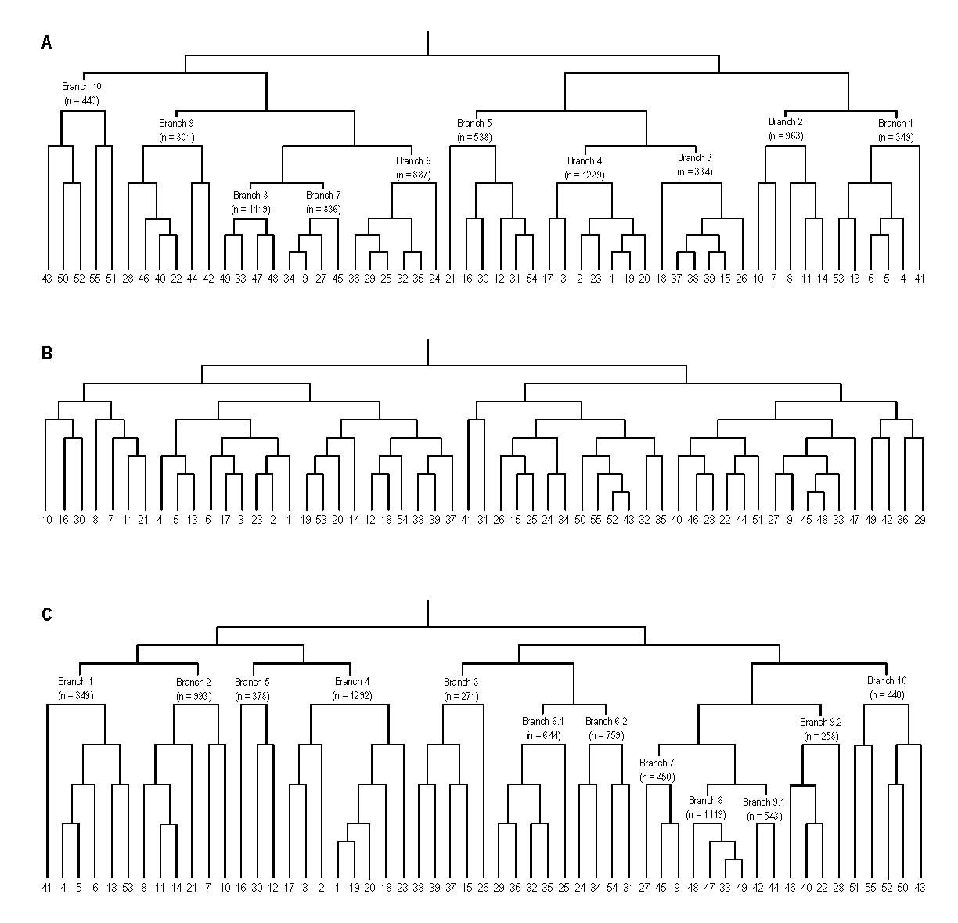
Hessburg et al. 2000. Ecological Subregions of the Interior Columbia Basin, USA. Applied Vegetation Science. 3(2): 163-180.

Slide 6
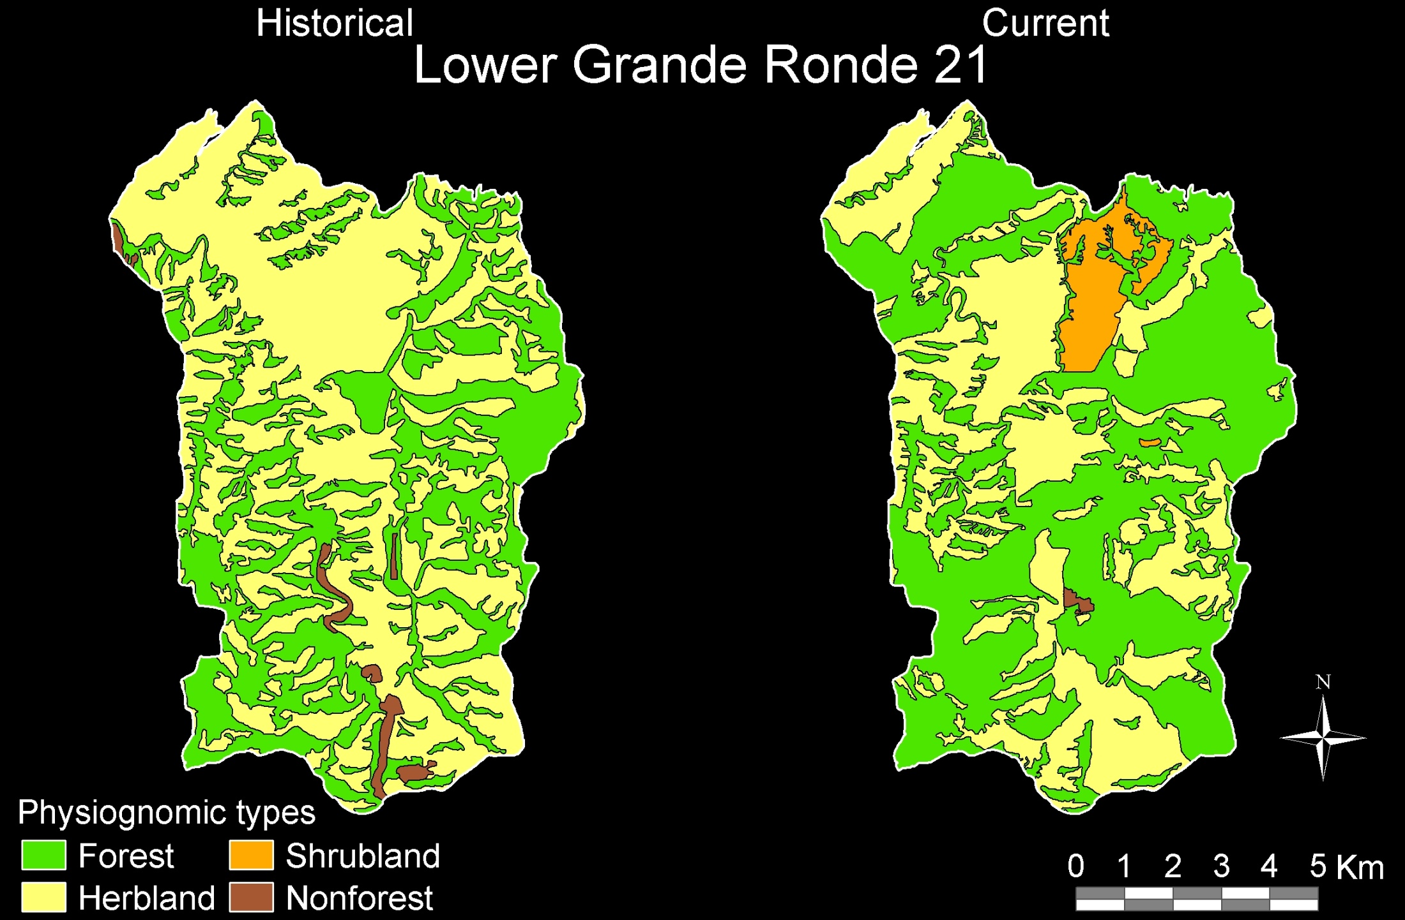

Slide 7
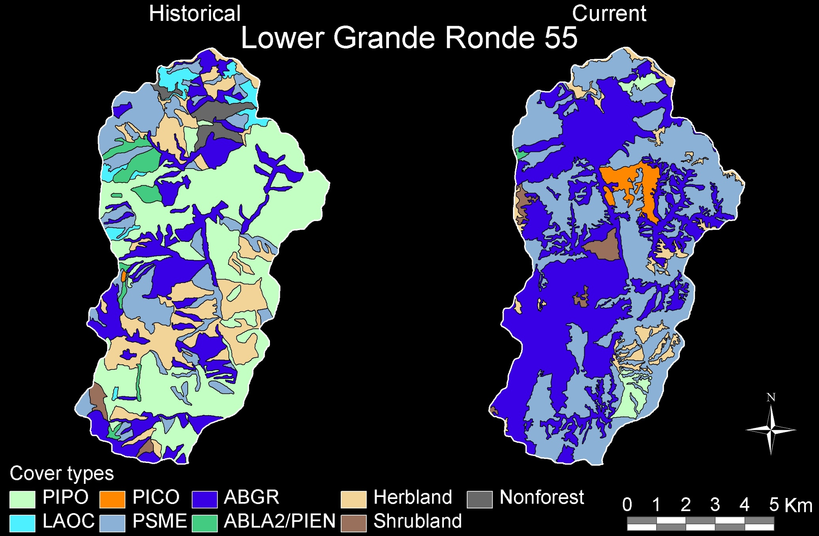

Slide 8
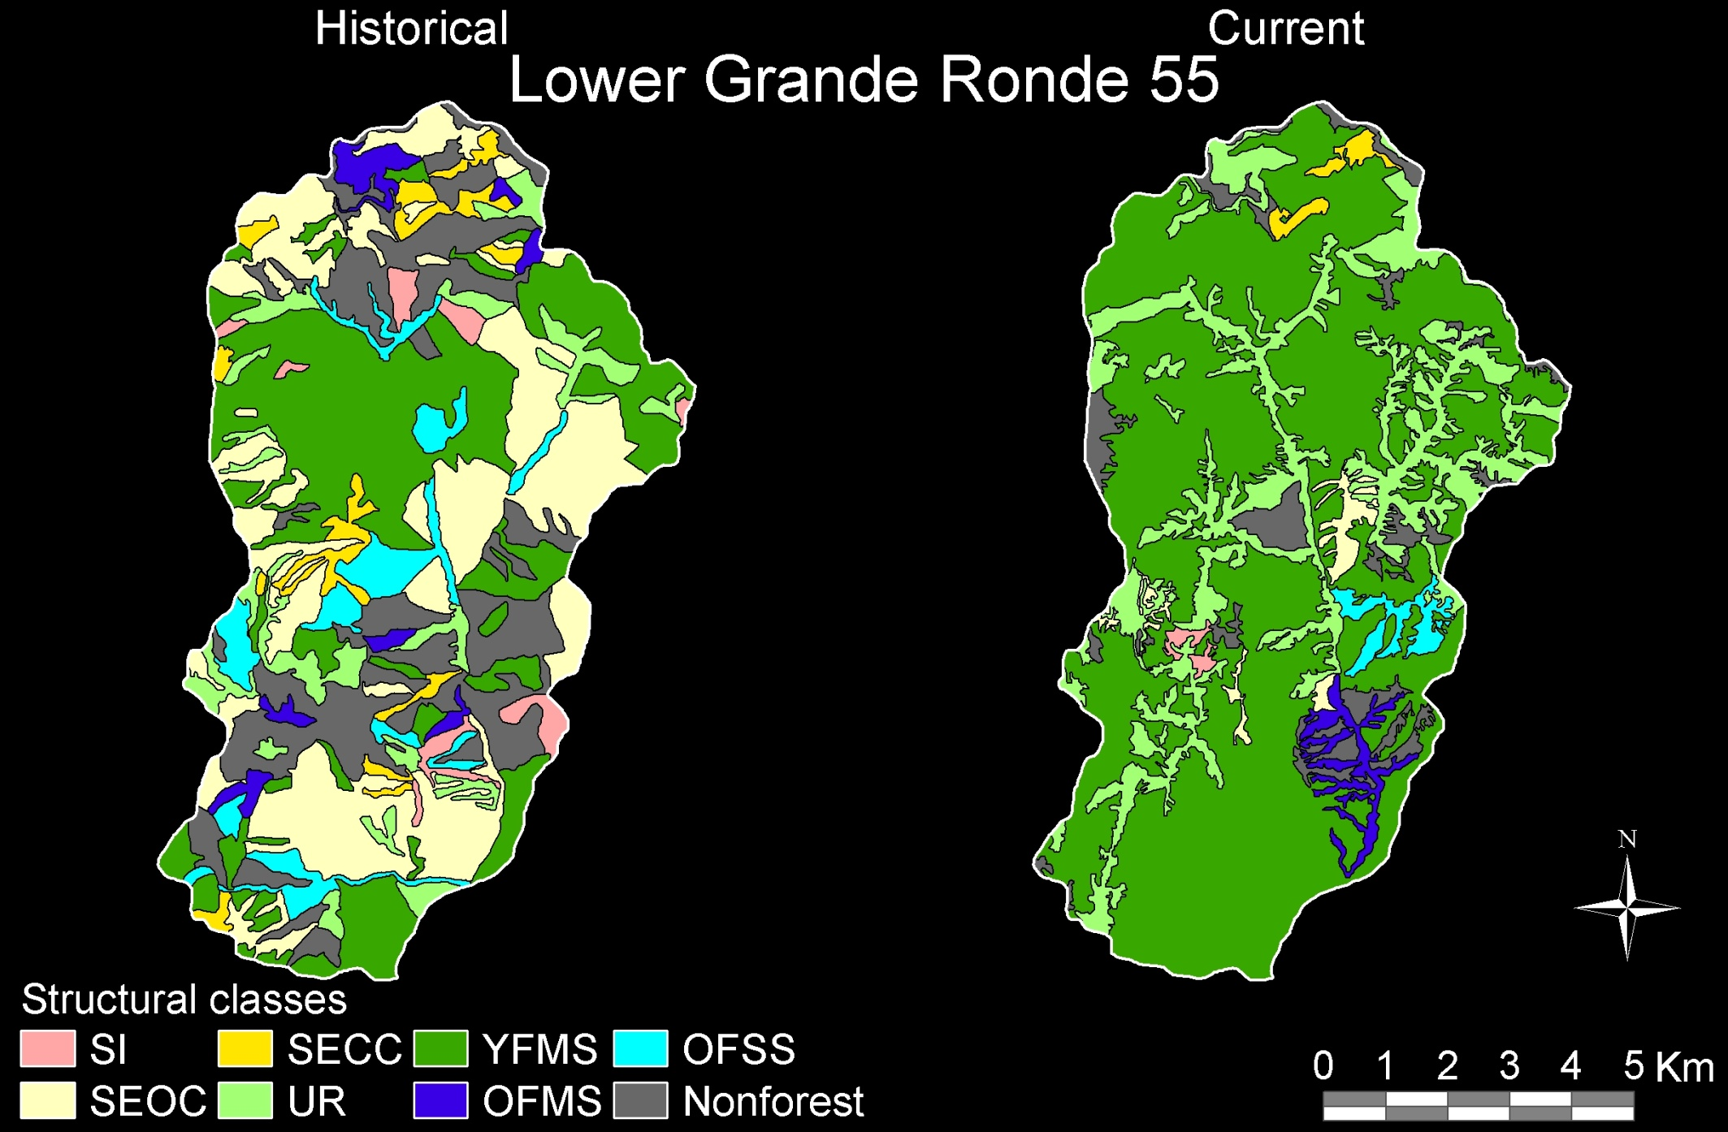

Slide 9
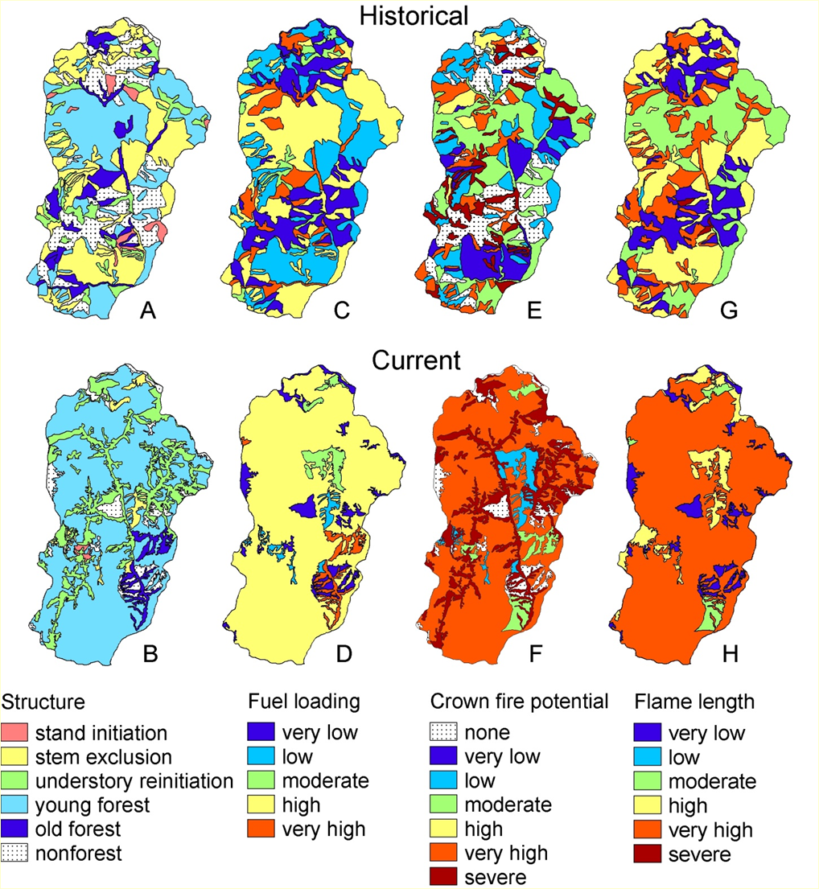

Slide 10
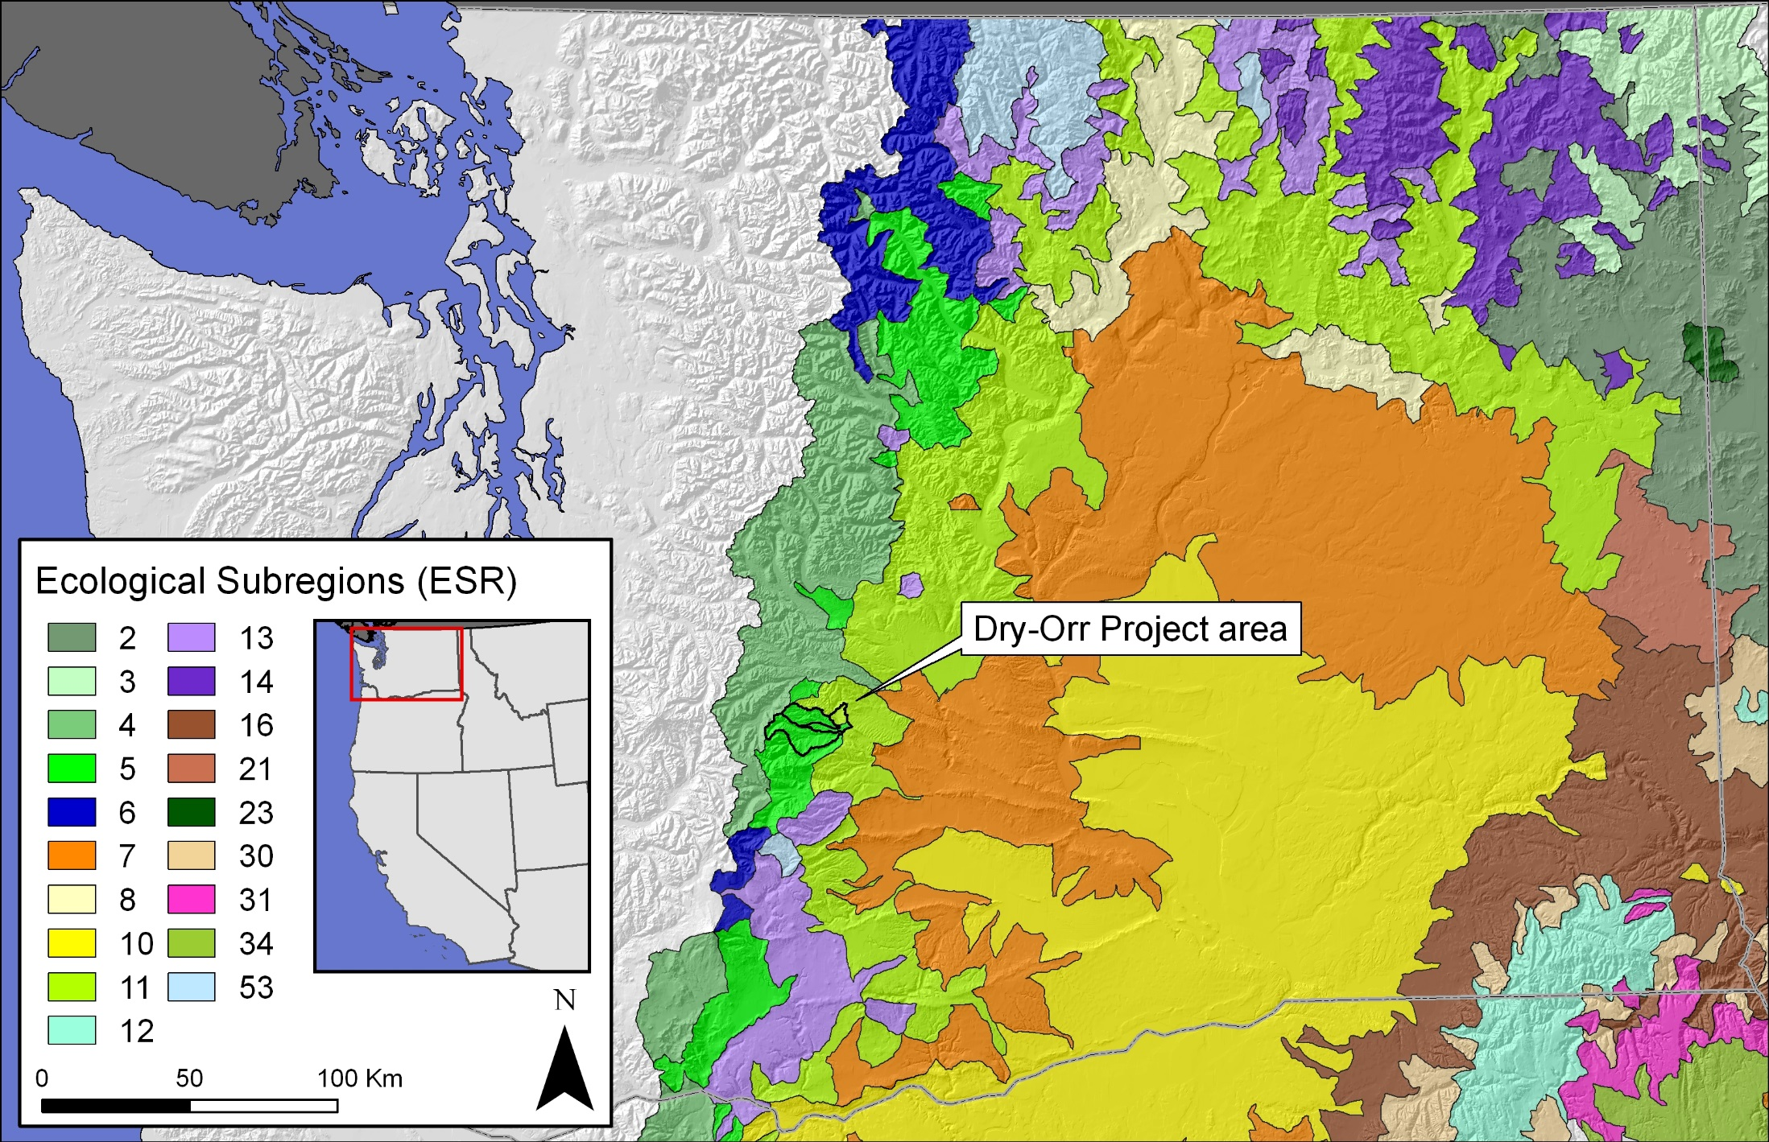

Slide 11
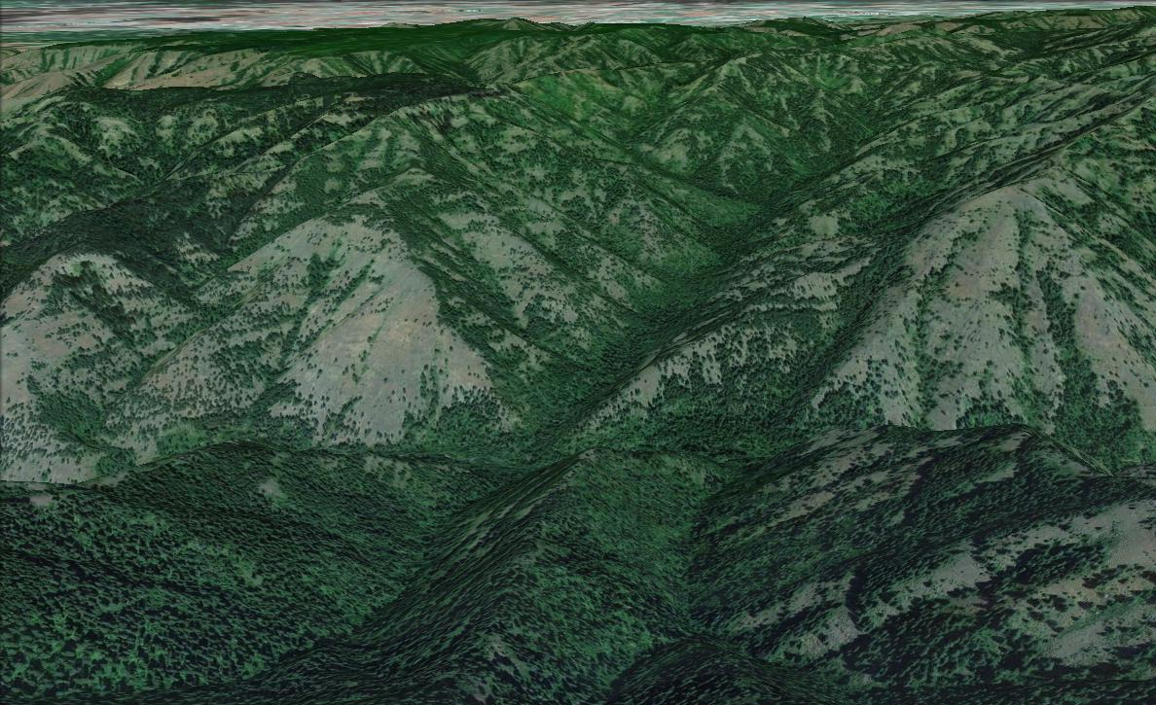

Slide 12
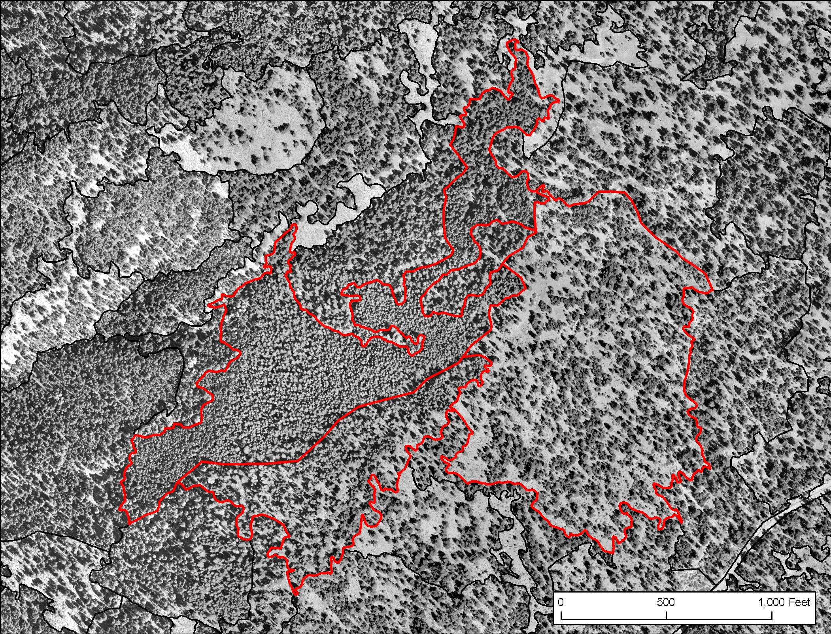

Slide 13
Raw PI-ed Vegetation attributes:
1) Canopy Cover: TOTL_CC, OS_CC, US_CC, all decile classes
2) Clumpiness: CLMP_DENS, CLMP_SIZE, by visual template
3) Degree of crown differentiation: L, M, H, by visual template
4) Canopy layers: 1, 2, >2
5) Is a riparian or wetland patch?
6) Is in a non-forested condition, numerous classes
7) Has been logged, logging type, HCC, HSH, HTH, HSL
8) Density of the overstory
9) Density of the understory
10) Size class of the OS: SS, PT, SmT, MedT, LgT
11) Size class of the US: SS, PT, SmT, MedT
12) SPP_OS: numerous SAF, and SRM species mixes
13) SPP_US: numerous SAF, and SRM species mixes
14) dead tree and snag abundance: quantile classes
15) ELEV_BELT
16) ELEVATION
17) ASPECT
18) SLOPE
19) NON_FRST-SPP_OS
20) NON_FRST-Tree_CC
Generated in a GIS

Slide 14
Data derived by classification from the raw attributes:
1) COVER type: SAF and SRM defined, dozens
2) Potential vegetation type: PVT, dozens
3) STRUCTURE class: O’Hara 7 classes
4) Is an LSOF patch? using Forsman, Sovern, Buchanan, Everett NSO_NRF descriptions
5) PHYS TYPE: Forest, Shrubland, woodland, grassland, non-forest/non-range
6-27) I&D vulnerability scores to major DMs, RDiseases, BBeetles, Defoliators
28) Fuel loading: 155 fuel beds
29-36) 90th % wildfire ROS, RCF, FL, FLI, ERC, CONS, PM10, PM2.5 emissions
37-44) Rx fire ROS, RCF, FL, FLI, ERC, CONS, PM10, PM2.5 emissions
45-… WL habitats: White-headed woodpecker, American marten, NSO NRF, No. Goshawk…

Slide 17
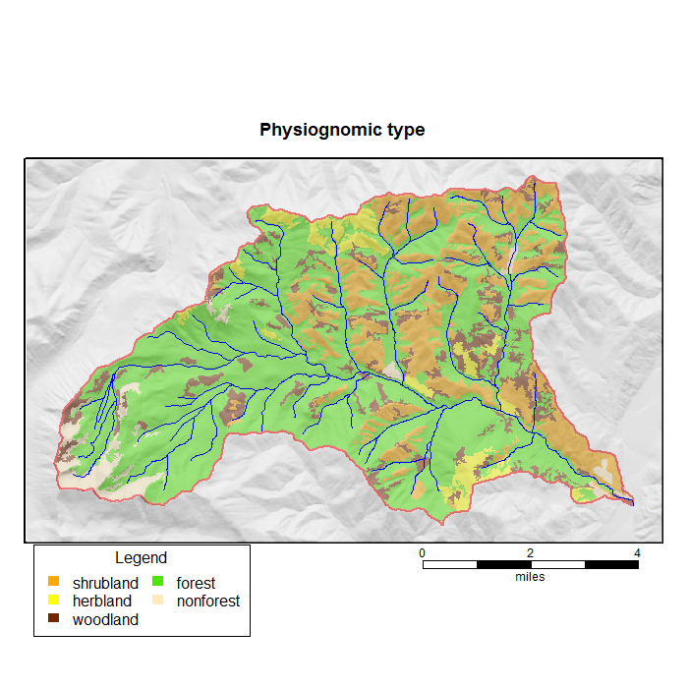

Slide 18
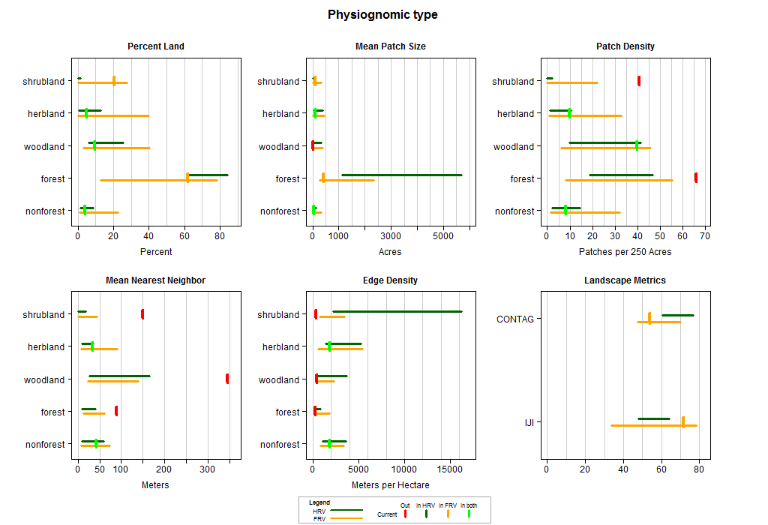

Slide 19
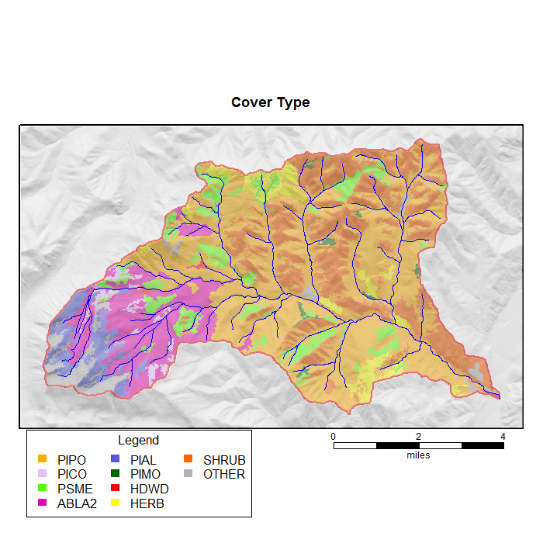

Slide 20
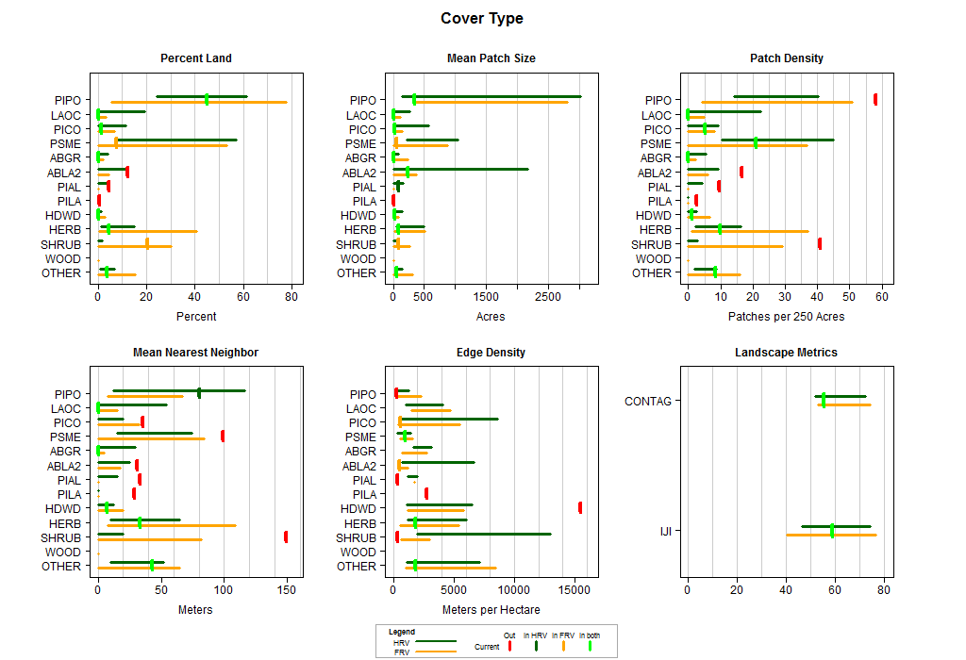

Slide 21
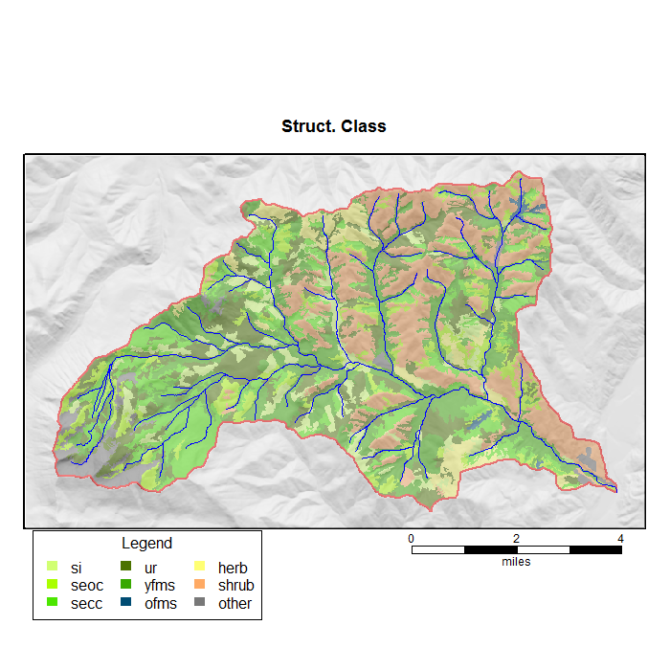

Slide 22
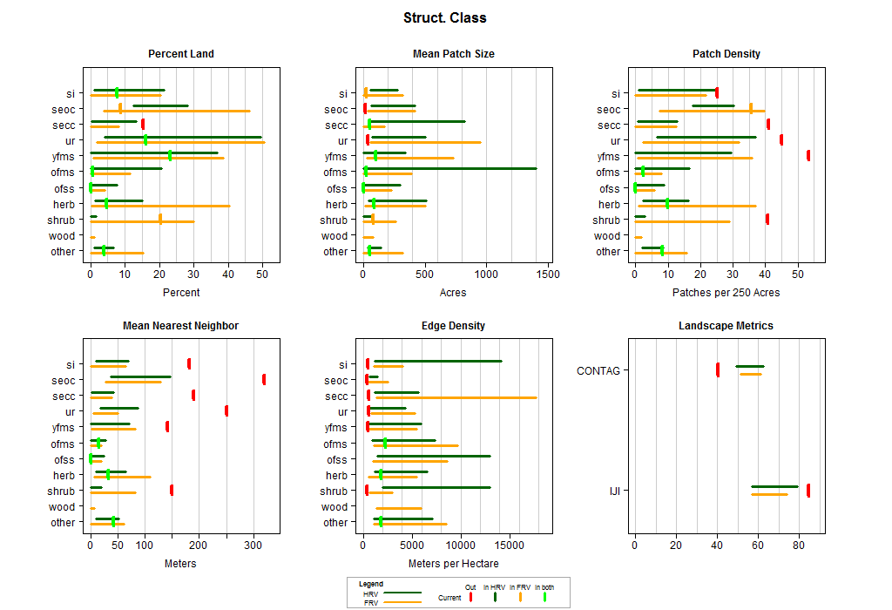

Slide 23
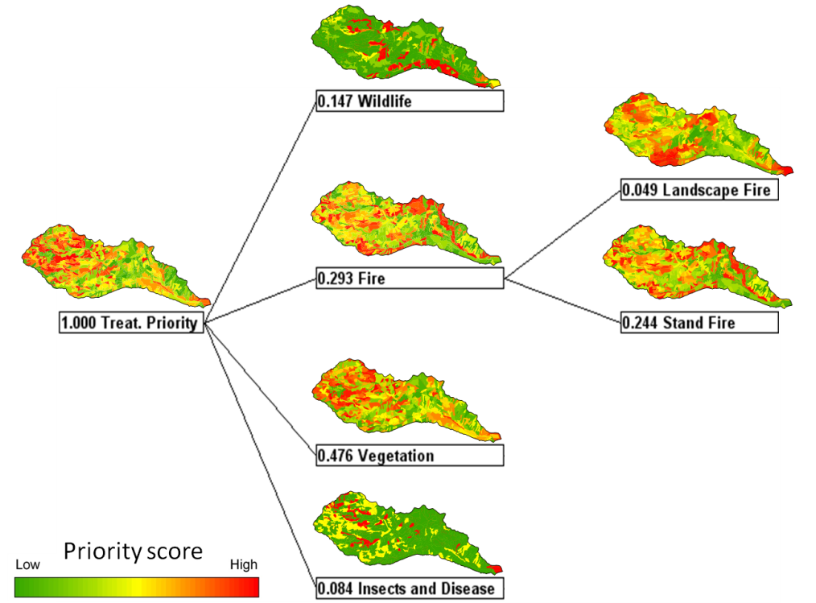
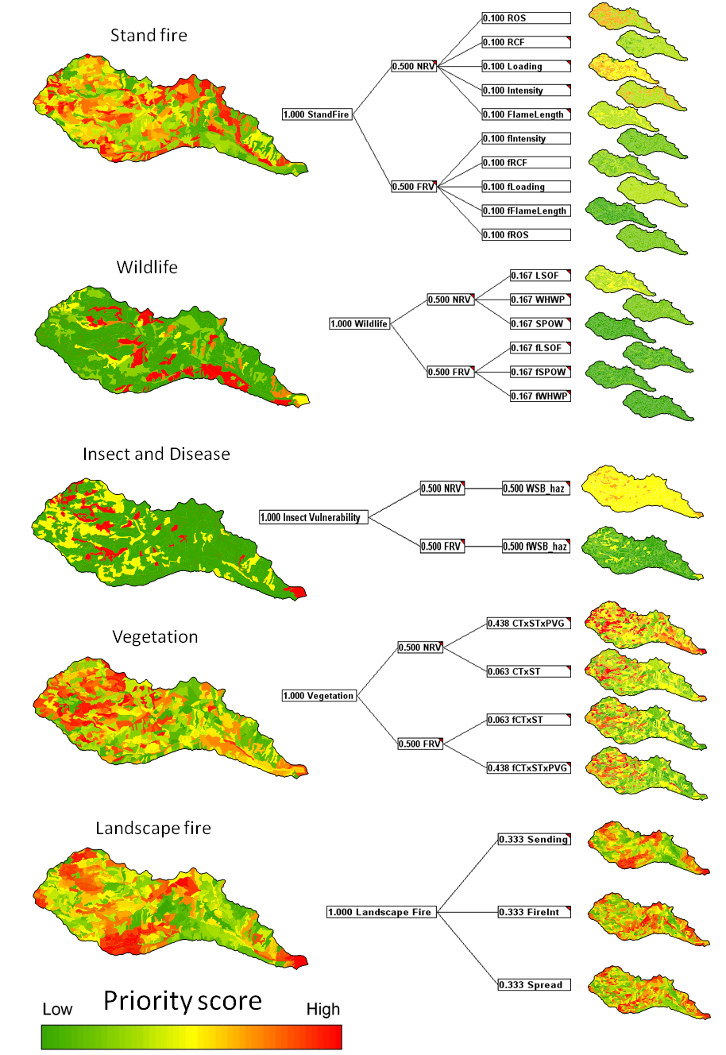
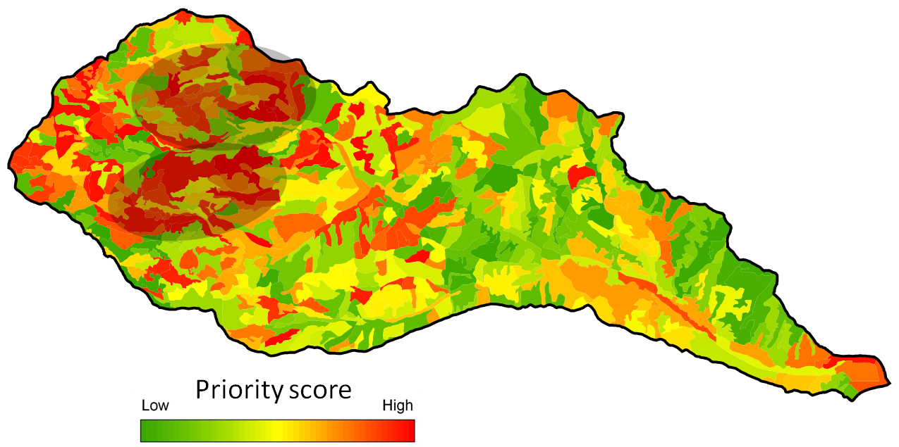
OKA-WEN restoration planning model (EMDS)

Slide 24
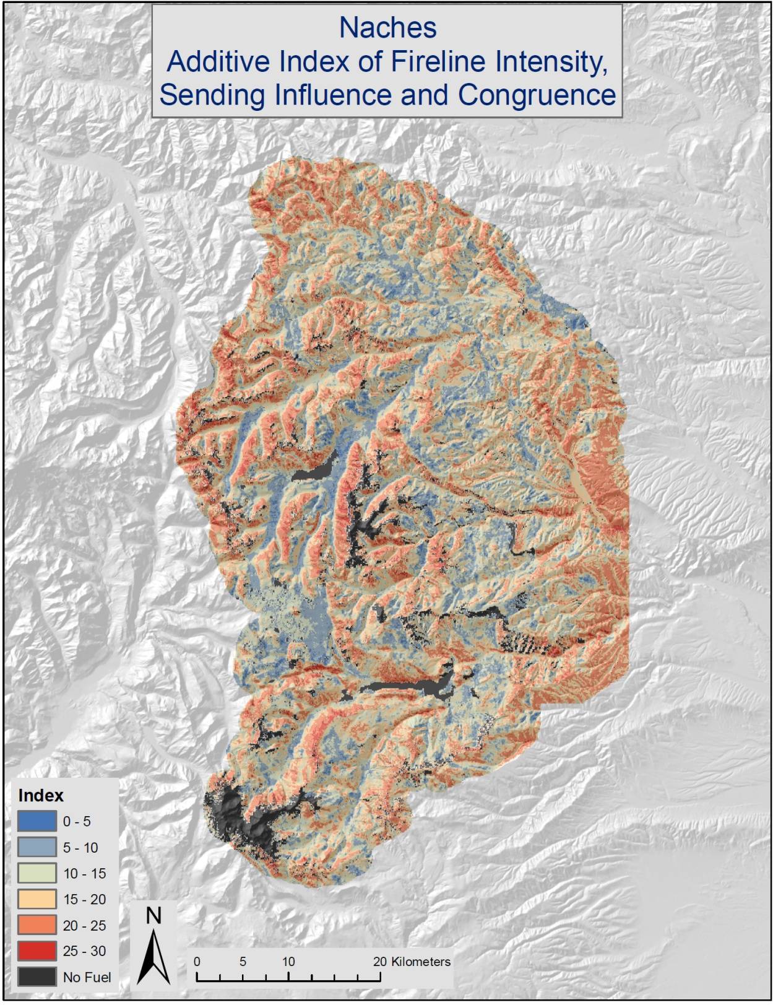

Slide 26


