Slide 1
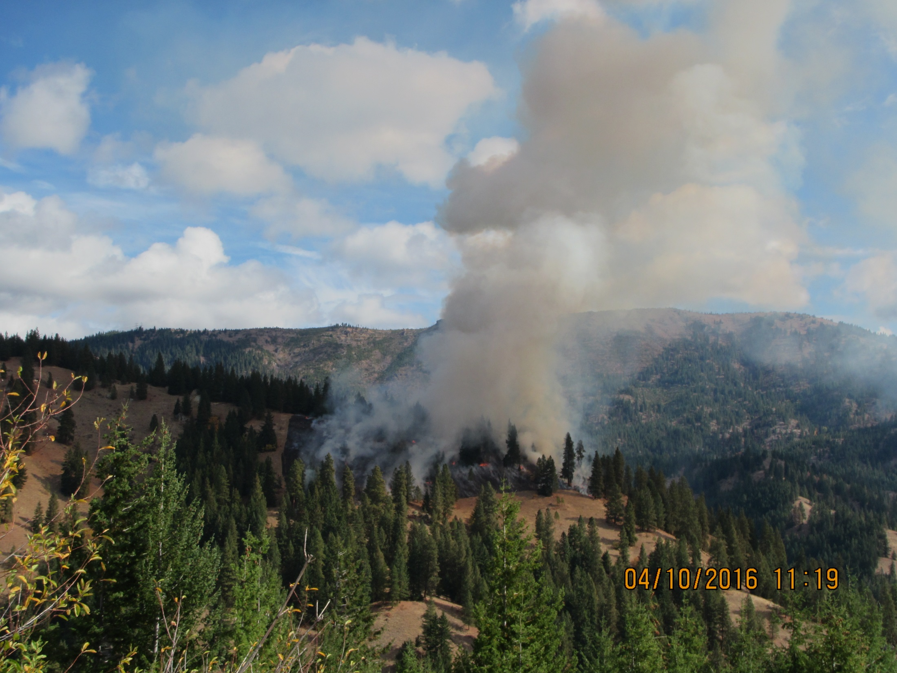


Management, Regulators and Research Working Together to Increase Burning Opportunities
Roger Ottmar
Pacific Wildland Fire Science Laboratory
Seattle, WA

Slide 2
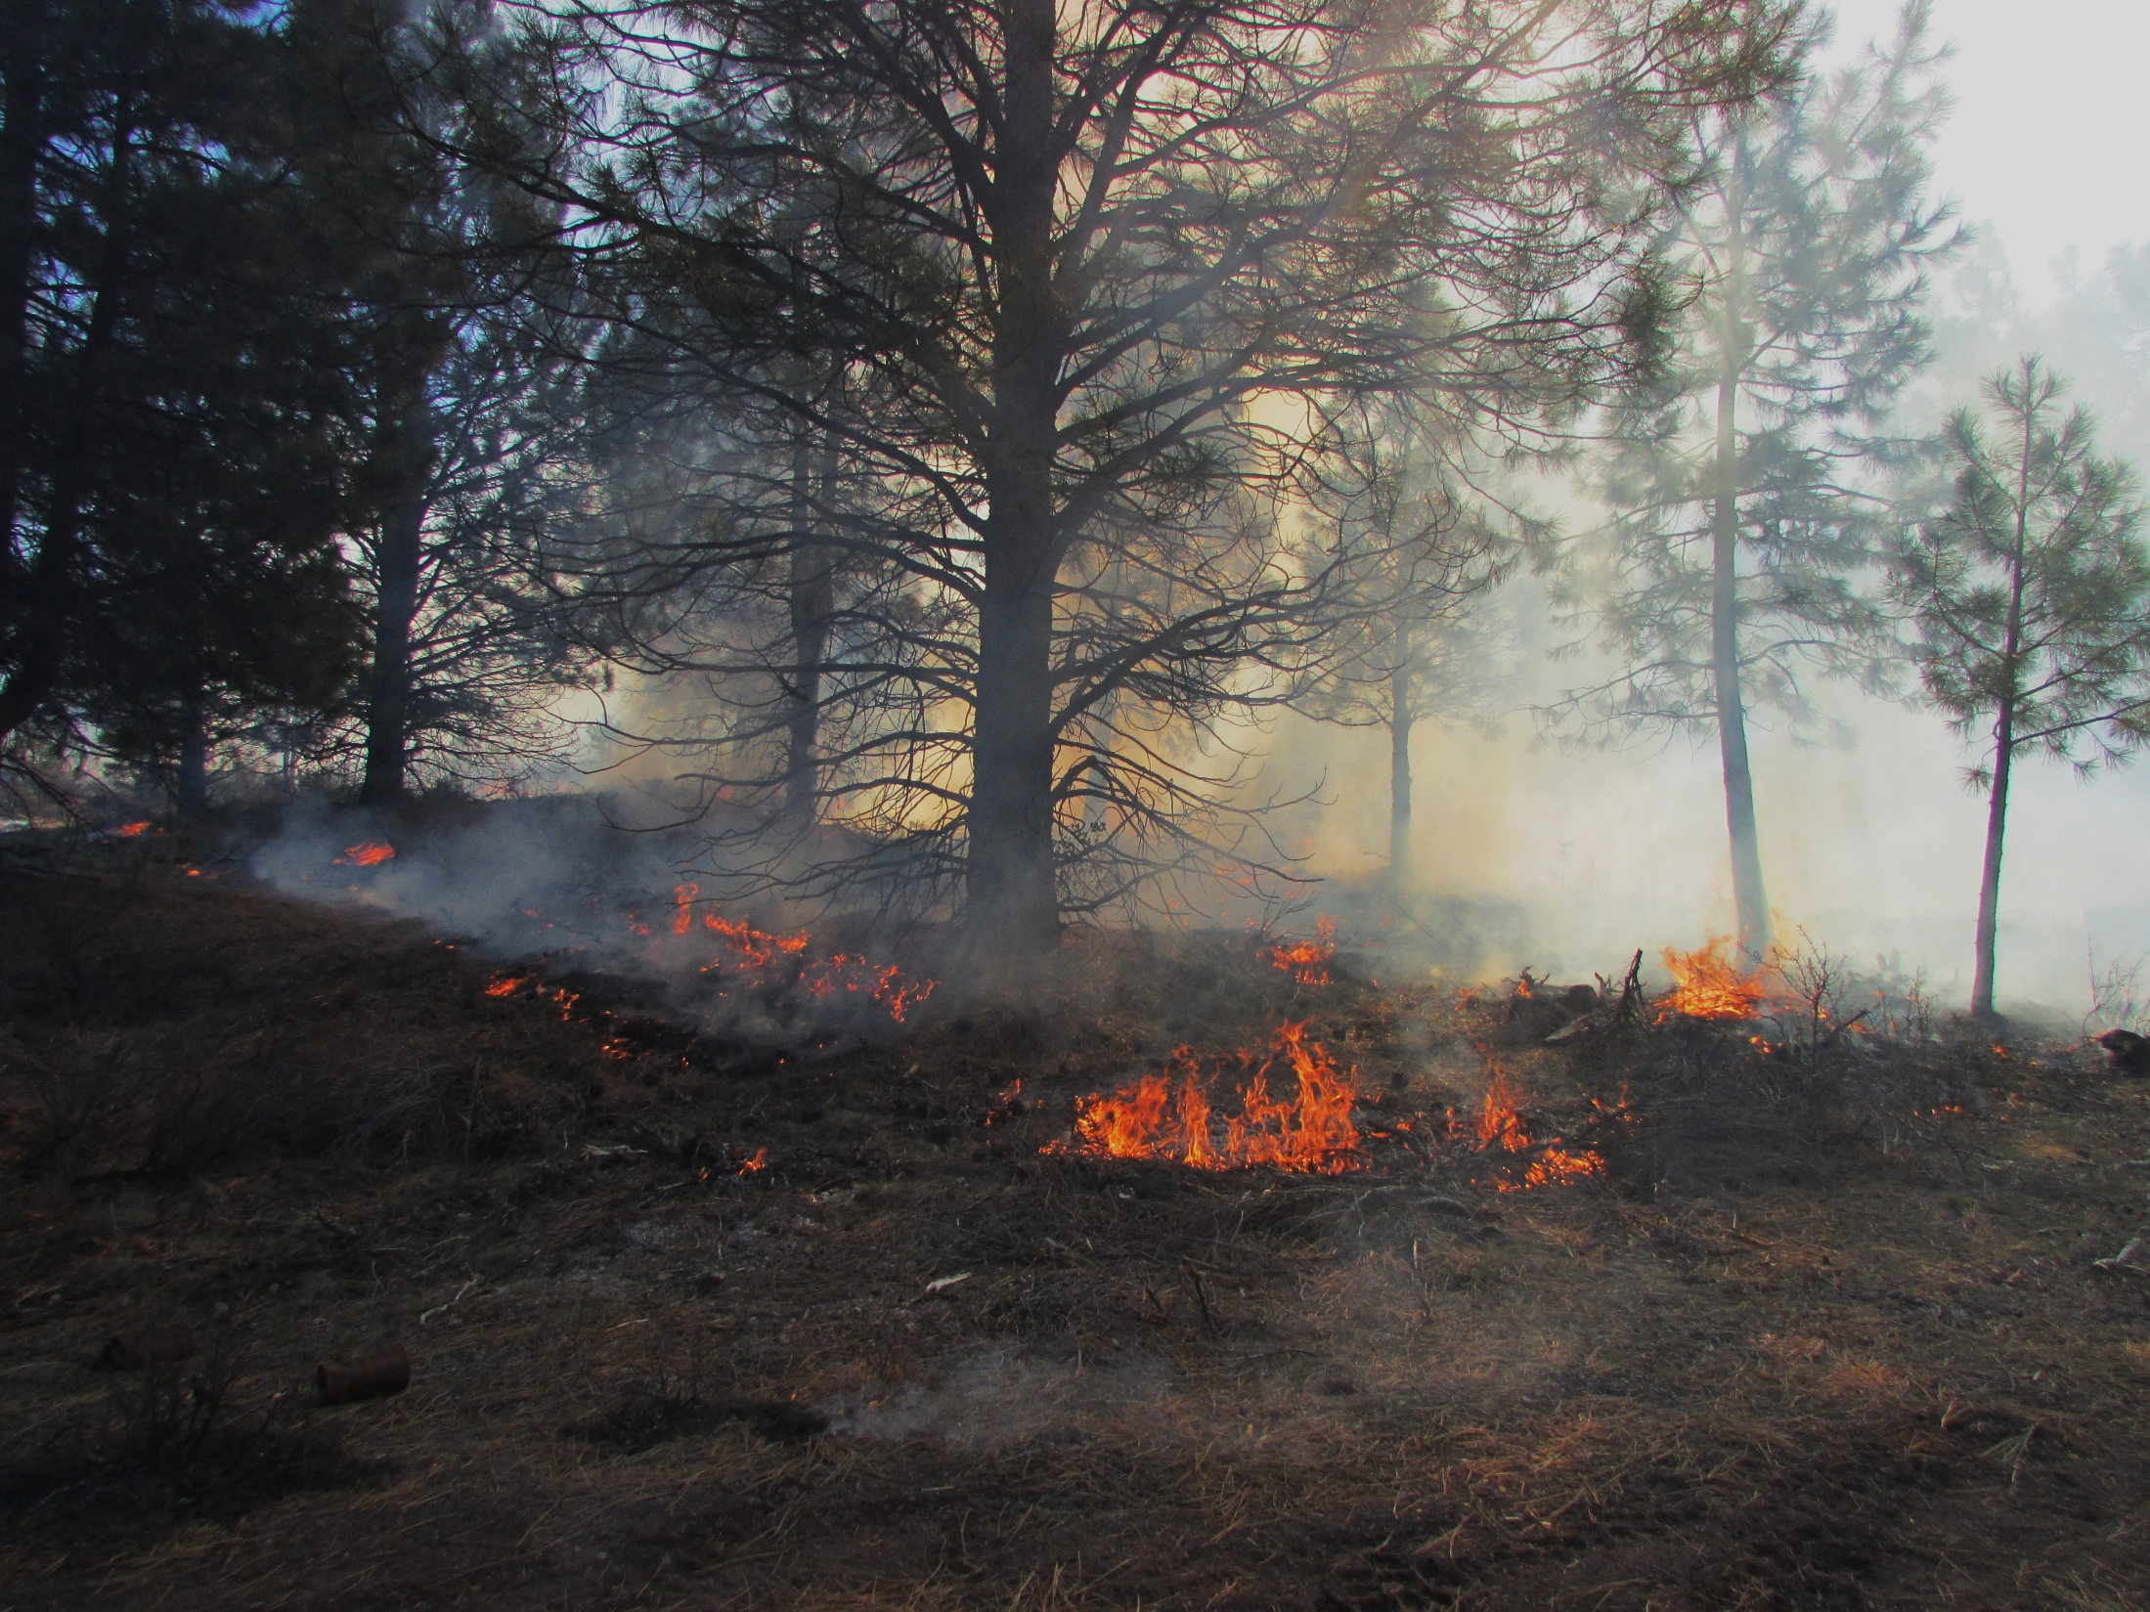
Outline
Early smoke management cooperation
Recent smoke management cooperation
Planning tools
Evaluation
Knowledge transfer

Slide 3
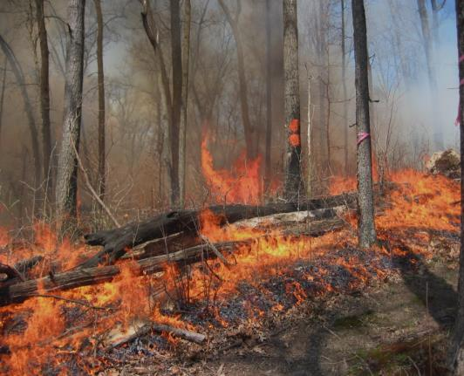
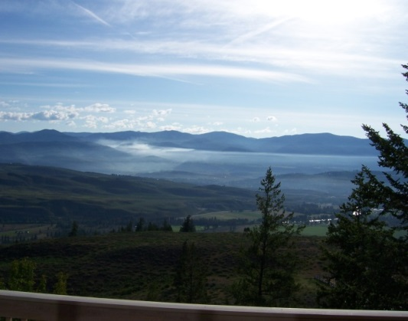
Emissions Inventory/Impacts
Area Burned
Fuel
Largest error
Fuel Consumed
Fire Effects/Fuel Treatment Effectiveness
Emissions Factors
Emissions Production
Meteorology
Dispersion
Impacts

Slide 4
Early Management, Regulator and Research Cooperation
Regulations: Washington State Implementation Plan: reduction in Rx smoke by 20% by acres
Research suggested reduction could be obtained by Rx emission reduction techniques
EPA and State: prove it
Research developed:
Fuel characteristics (PS, FCCS)
Fuel consumption models (Consume)
Emission factors (tables)

Slide 5
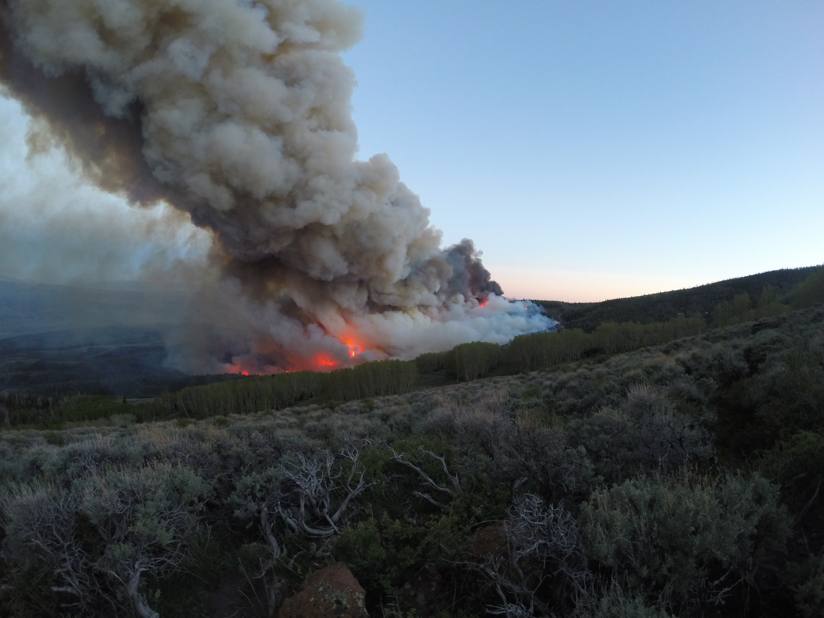
More Recent Management, Regulator and Research Cooperation
DNR Forest Resiliency Burning Pilot
Smoldering smoke and intrusions
Pile burning
Firefighter smoke exposure and health

Slide 6
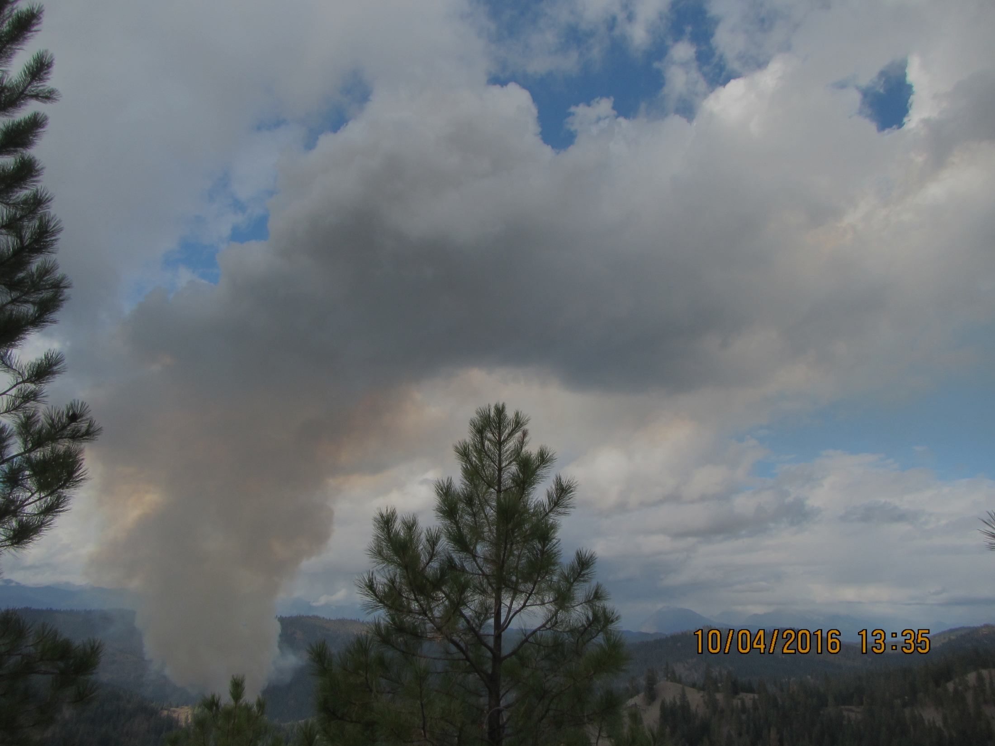
Forest Resiliency Burning Pilot
Pre- and post-burn fuel characterization
and tree mortality assessment

Slide 7
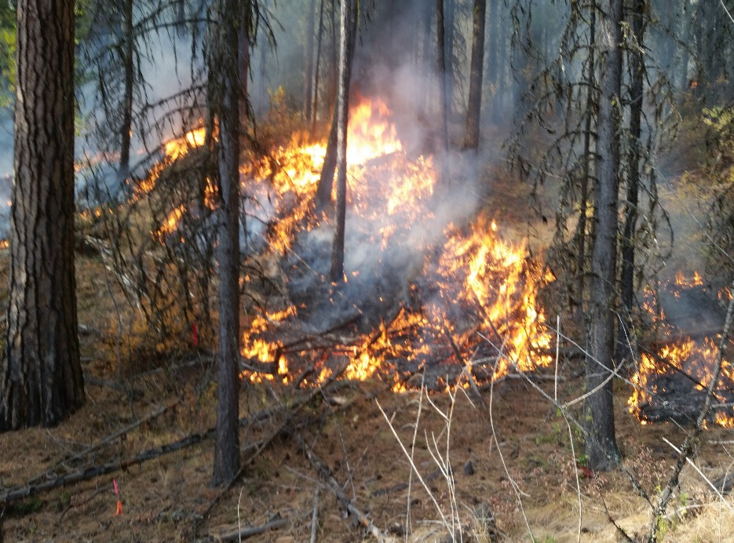
Goal: Monitor and evaluate the benefits of forest resiliency burning and the impacts on ambient air quality
Objectives:
Characterize pre- and post-fire fuels and consumption
Document environmental conditions
Provide an initial assessment of the predictive capability of Consume v. 2.1 and Consume v. 4.2
Assess pre- and post-fire tree damage

Slide 8
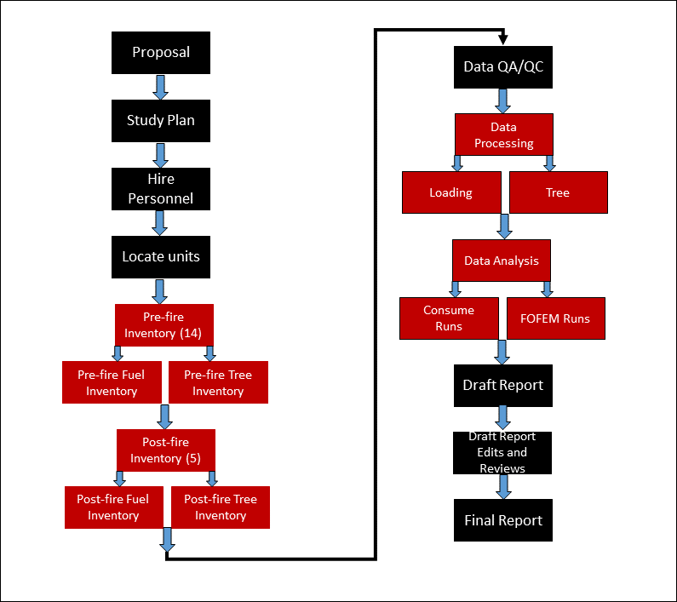
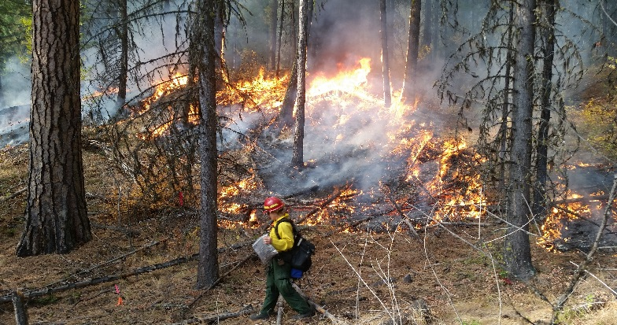
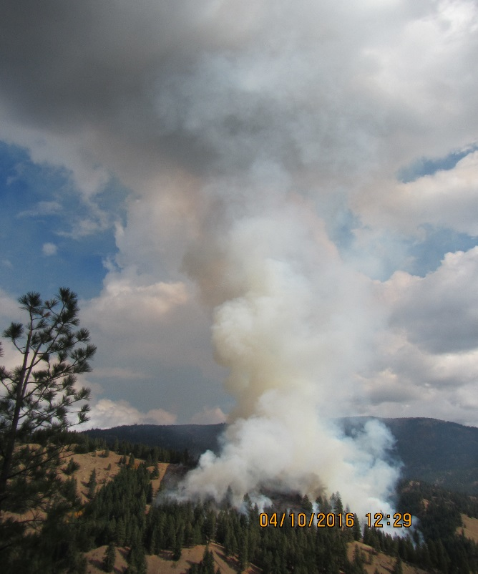
Process

Slide 9
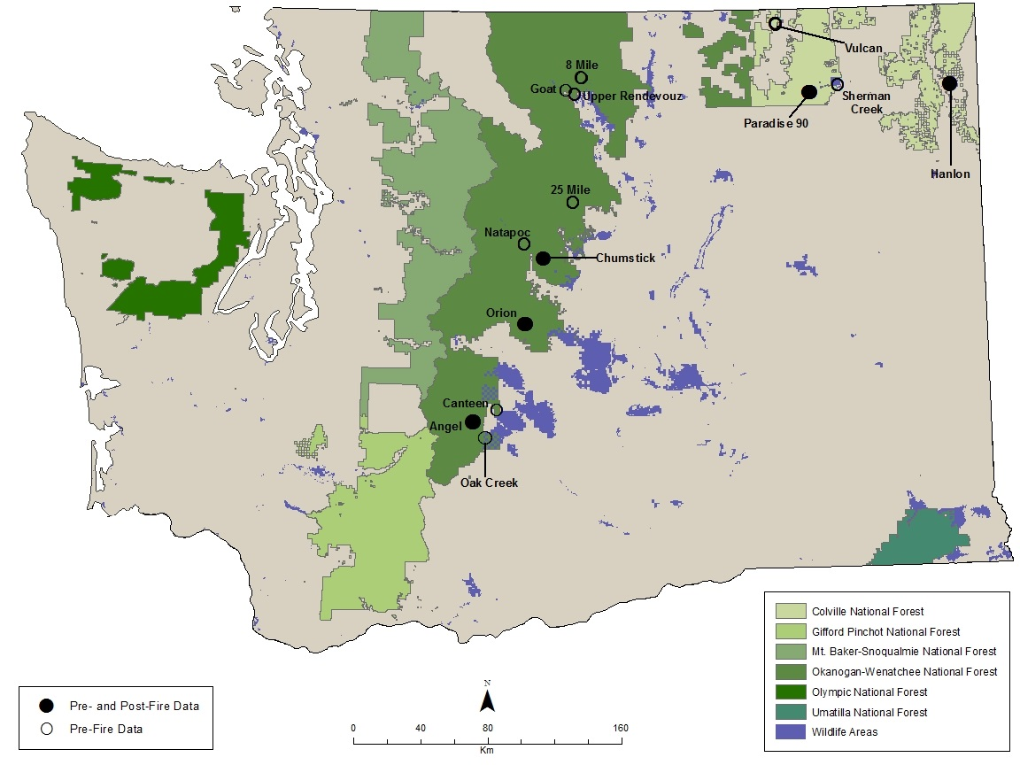
Site Locations
Pre-fire data
Pre- and post-fire data
National Forest
State Wildlife Area

Slide 10
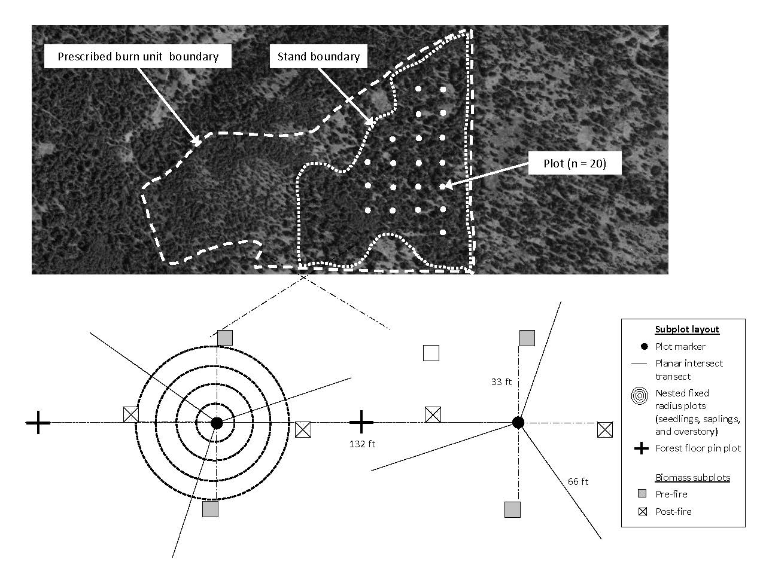
Methodology

Slide 11
Results– Pre-Fire Fuels

Slide 12
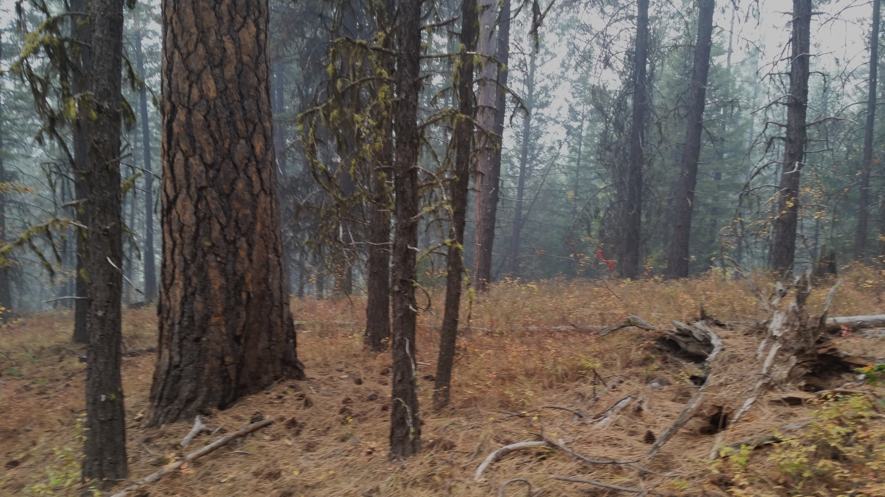
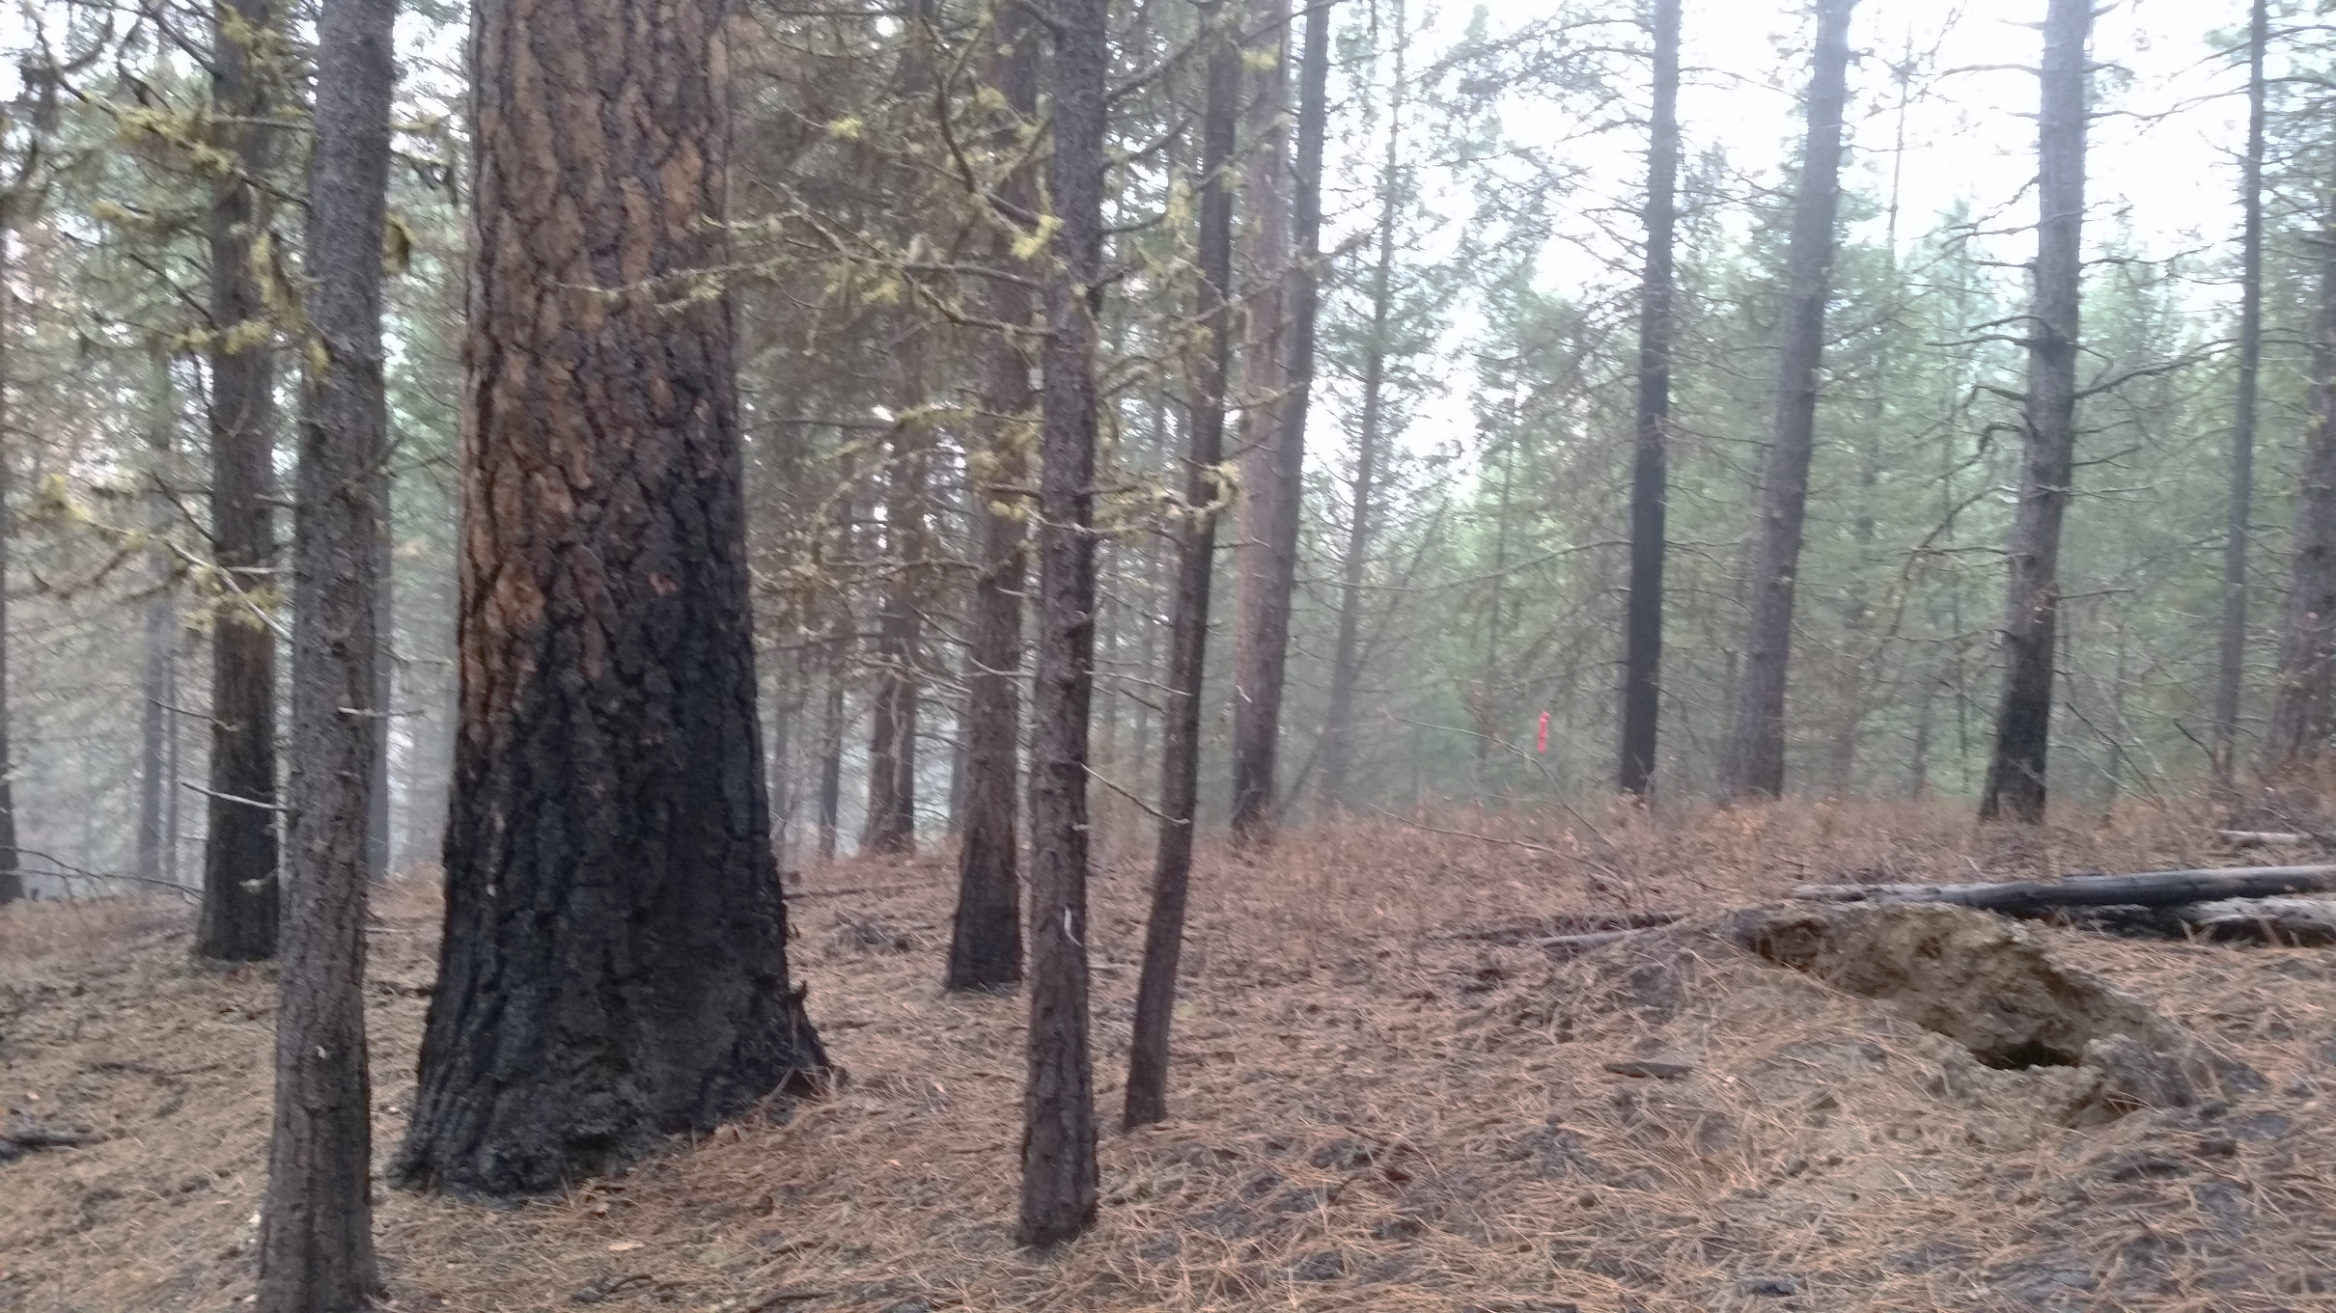
Surface Fuel Consumption

Slide 13
Results-Surface Fuel Consumption

Slide 14













Fuelbed Organization
Stratum Category
Canopy
Trees
Snags
Ladder fuels
Shrub
The fuelbed was designed to include all fuelbed components that could burn. It allows users to include, combine or exclude as much detail as needed for an application
Primary
Secondary
Herbaceous
Primary
Secondary
Woody
Sound
Rotten
Stumps
Piles
Litter-lichen-moss
Litter-lichen-moss
Ground fuels
Duff
Basal accumulations
Squirrel middens

Slide 15
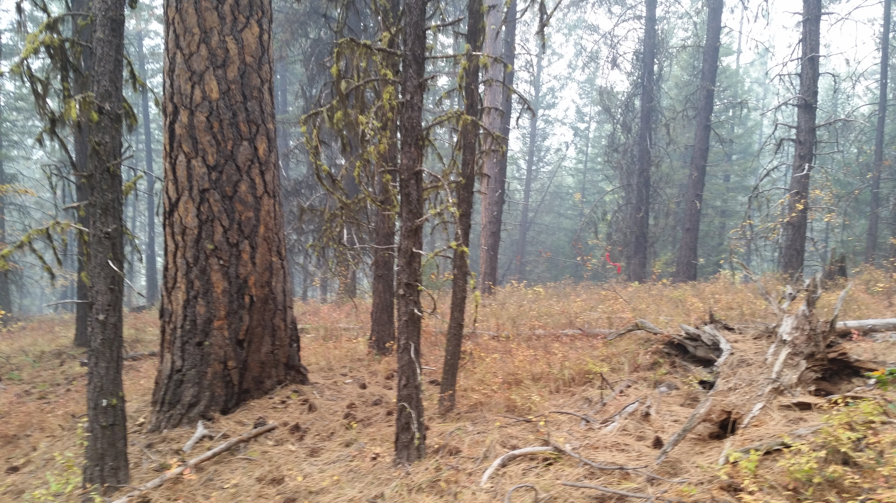
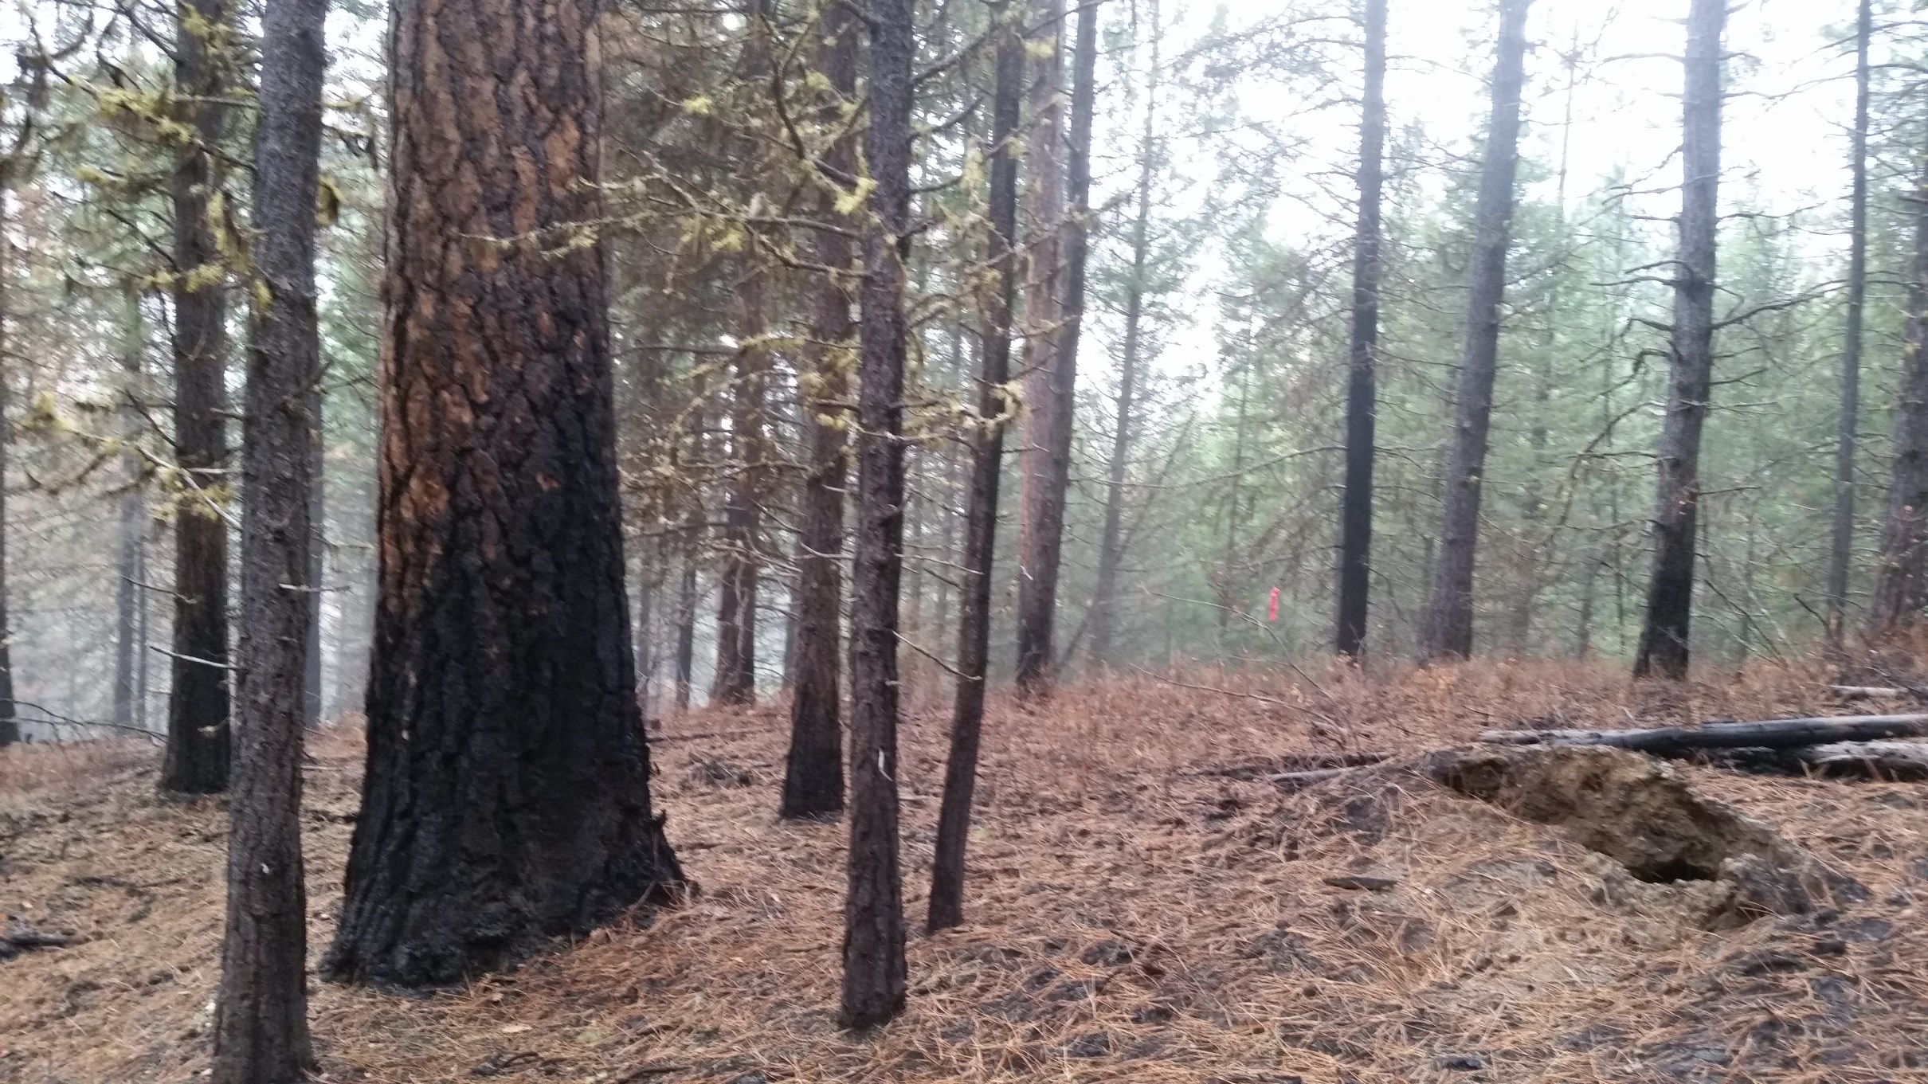

Slide 16
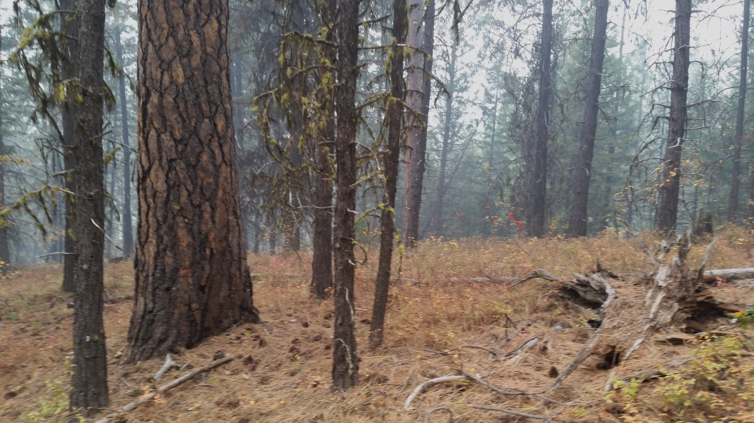
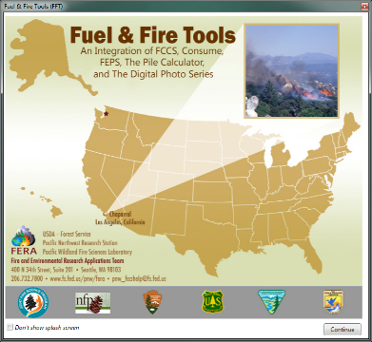
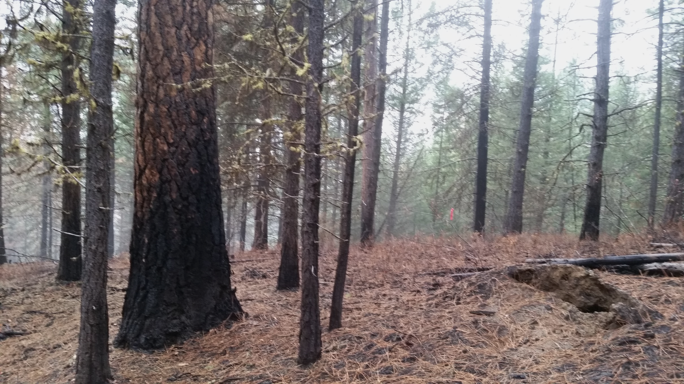
Predicted surface fuel consumption
Consume v 2.1: Under-predicted by 18-36%
Consume v 4.2: Under-predicted by 16-45%

Slide 17
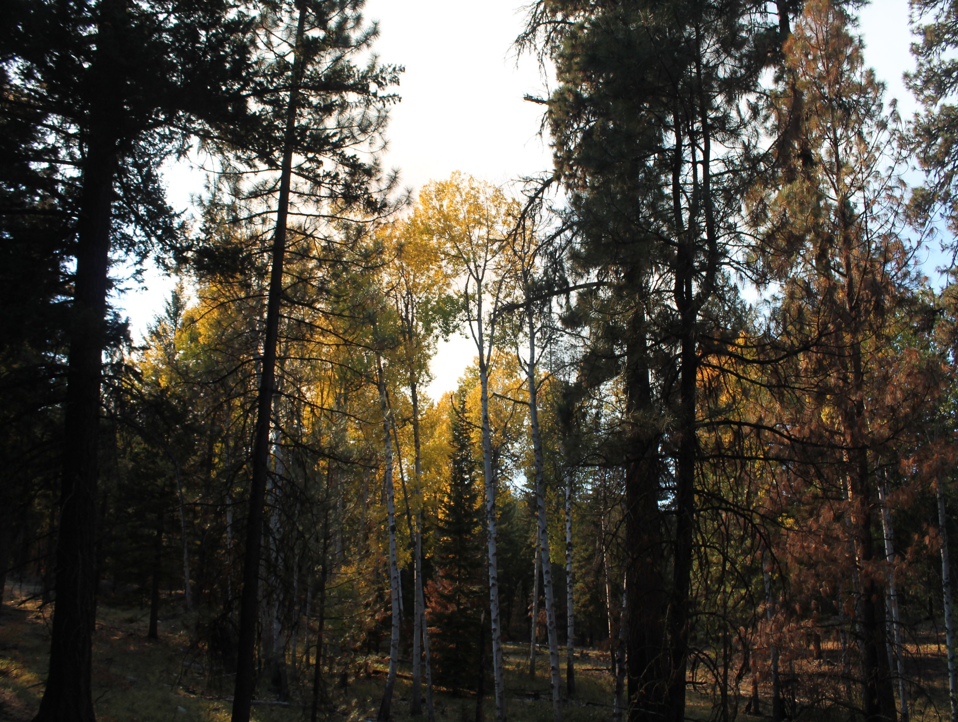
Predicted overstory mortality – FOFEM v6.3.1
23
16
9
7
Orion 2 (Wenatchee)
Paradise 90
(Colville)
Chumstick
(Wenatchee)
Angel
(Wenatchee)

Slide 18
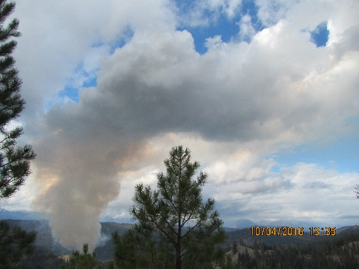
What have we learn?
Pre-fire fuel loadings were typical of burns on east side of the Cascades ranging from 15 to 52 t/ac; duff contributed 33-66% of fuels
Consumption was also typical of eastside burns and ranged from 9 to 28 t/ac. Duff consumption contributed 30 to 67% of total fuel consumed.
Consume v. 4.2 performed better at predicting litter and woody fuel than Consume v. 2.1; both models underestimated duff consumption.
High percent small tree mortality; low mortality in mature trees. Prescribed burns were successful in reducing forest fuels with limited impacts to the overstory.

Slide 19
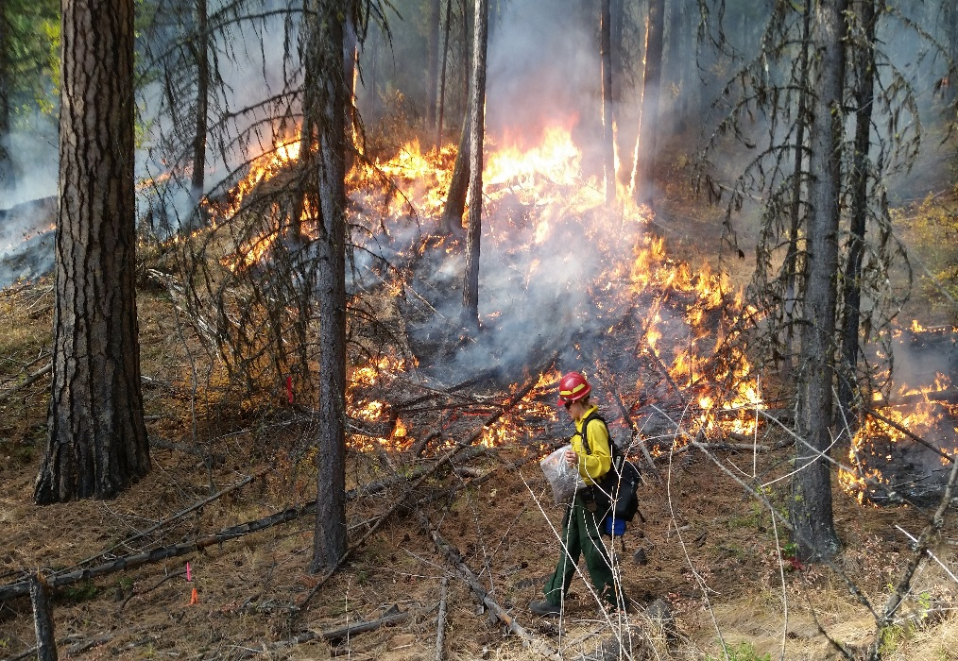
What’s next?
Spring burns
Tree mortality
Evaluate and modify Fuel and Fire Tools
Duff/rotten logs
Crowns
Piles

Slide 20
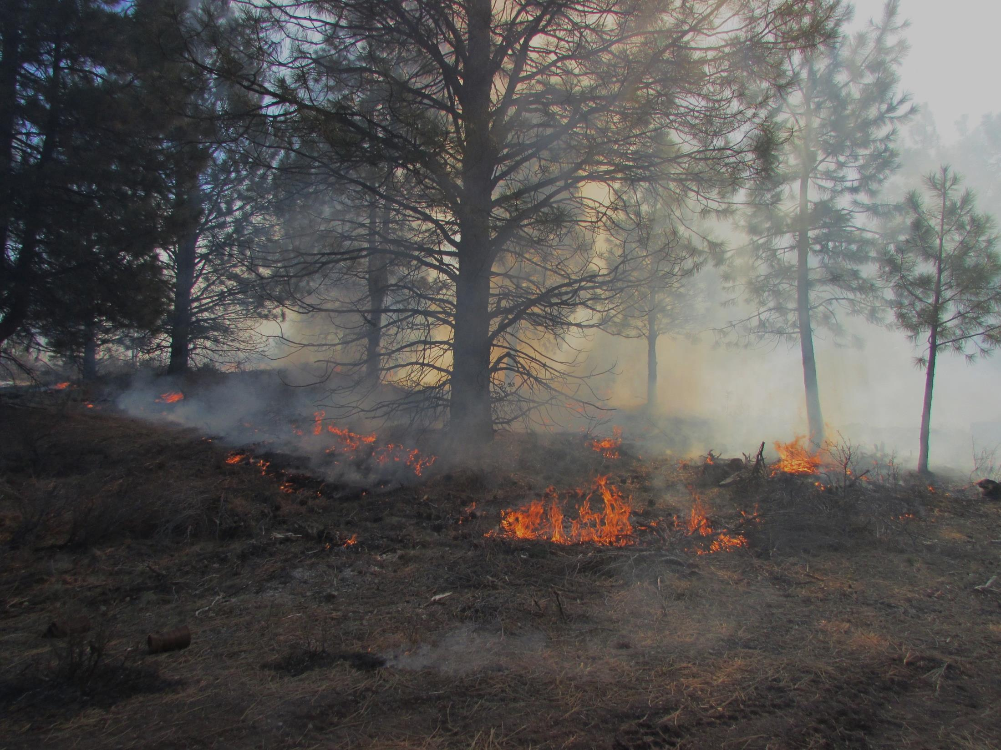
Smoke Management and RxFire
fuel bed components that contribute to smoldering smoke and evening intrusions

Slide 21

Background
Rx Fire near Bend:
reduce fire hazard
enhance forage, habitat
protect valuable resources
provide ecological process to restore and maintain functional ecosystems
Smoke from wildland fire is a critical management issue
public and firefighter health
keep smoke from sensitive receptor areas
encourage reduction of smoke and intrusions
comply with state/federal air quality/visibility requirements

Slide 22
Oregon Smoke Management Plan
Federal Forest Restoration Burning
Land managers discussed accelerated restoration within Oregon SMP.
Recognize need to increase restoration while minimizing smoke intrusions.
Maximize opportunities while avoiding intrusions through enhanced communication, applied research, and site-specific experience.
End of season review to determine progress, successes, and potential modifications.

Slide 23
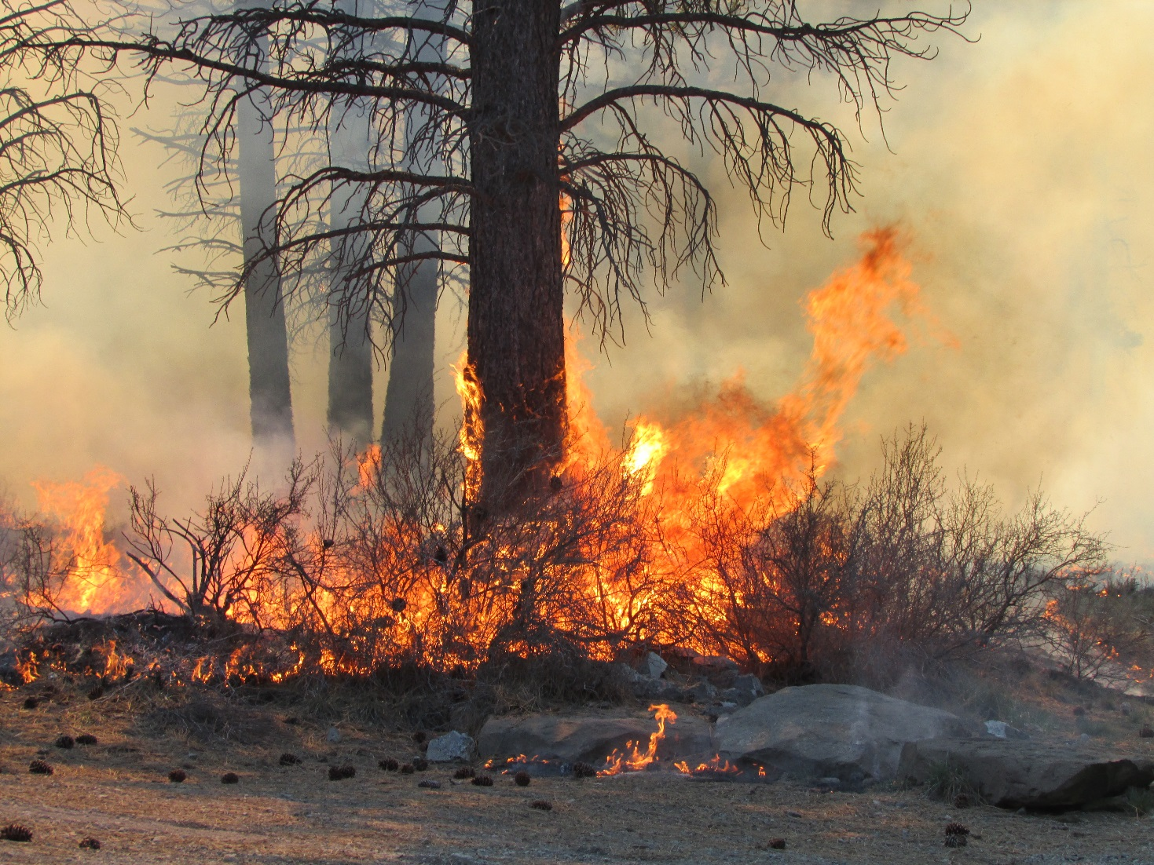
West Bend Unit Ignition
Saturday, April 12, 2014
West Bend
Courtesy: USFS

Slide 24
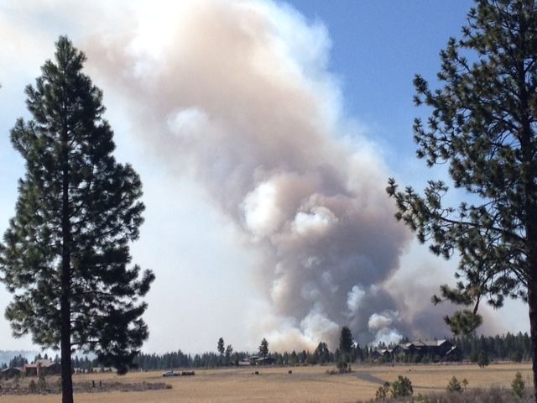
West Bend Unit Active Column
Saturday, April 12, 2014
West Bend
Courtesy: USFS

Slide 25
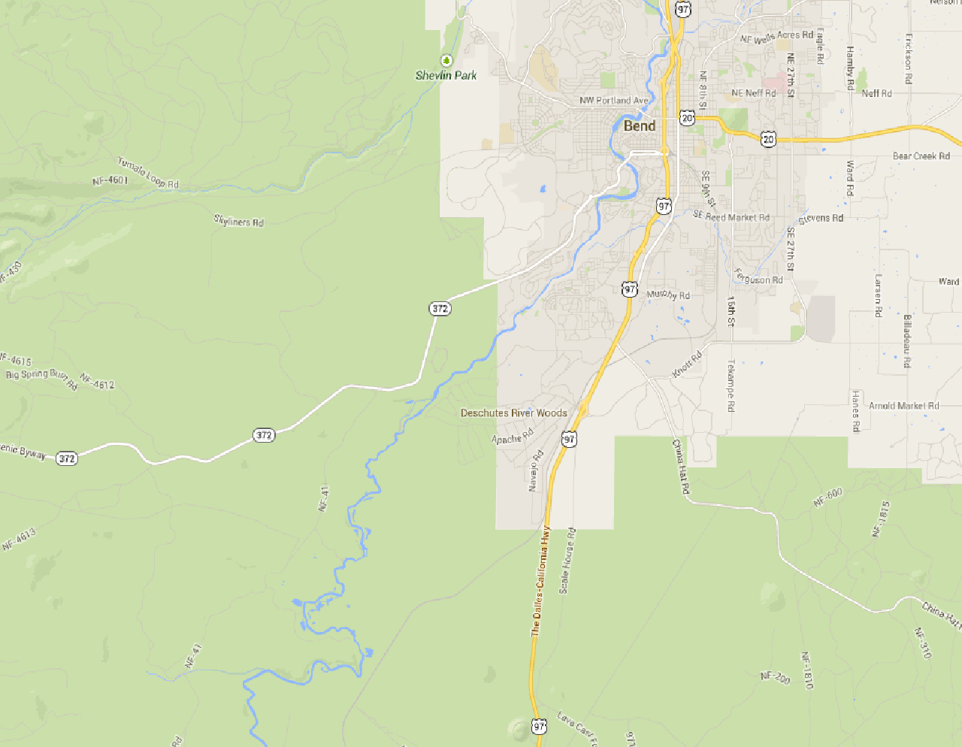

Ignition, West Bend Saturday, April 12
0950 – 1350 PDT
≈ 1 mile W of Bend SSRA
Main Smoke Plume
Courtesy:
ODF

Slide 26
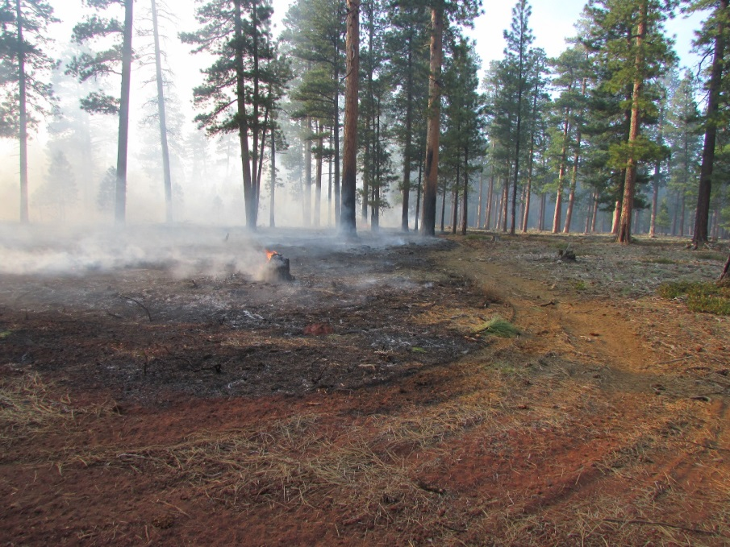
West Bend Unit Smoldering
Saturday, April 12, 2014
Basal accumulation
Rotten stumps
Rotten logs
West Bend
Courtesy: USFS
West Bend
Courtesy: USFS

Slide 27
Intrusion 14-02-- Bend April 13-14th
Smoldering smoke
Overnight
Drainage Winds
Courtesy:
ODF

Slide 28
Heavy
Moderate
Light

Slide 29
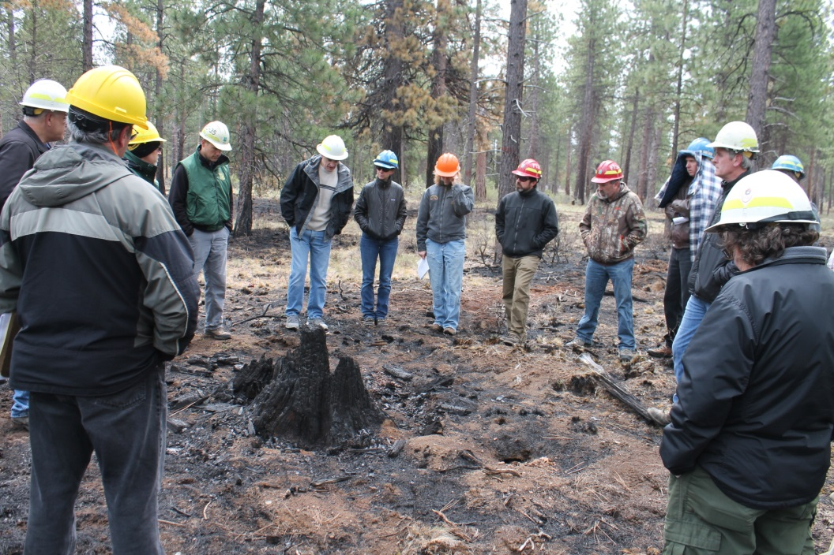
Meeting following West Bend and Glaze Meadow intrusions—April 23, 2014
USFS/BLM/ODF/ODEQ
West Bend prescribed burn
Weather/topography
Fuel bed components
Definition of an intrusion
Go-no-go decision process
Mitigation techniques
Retrospective study

Slide 30
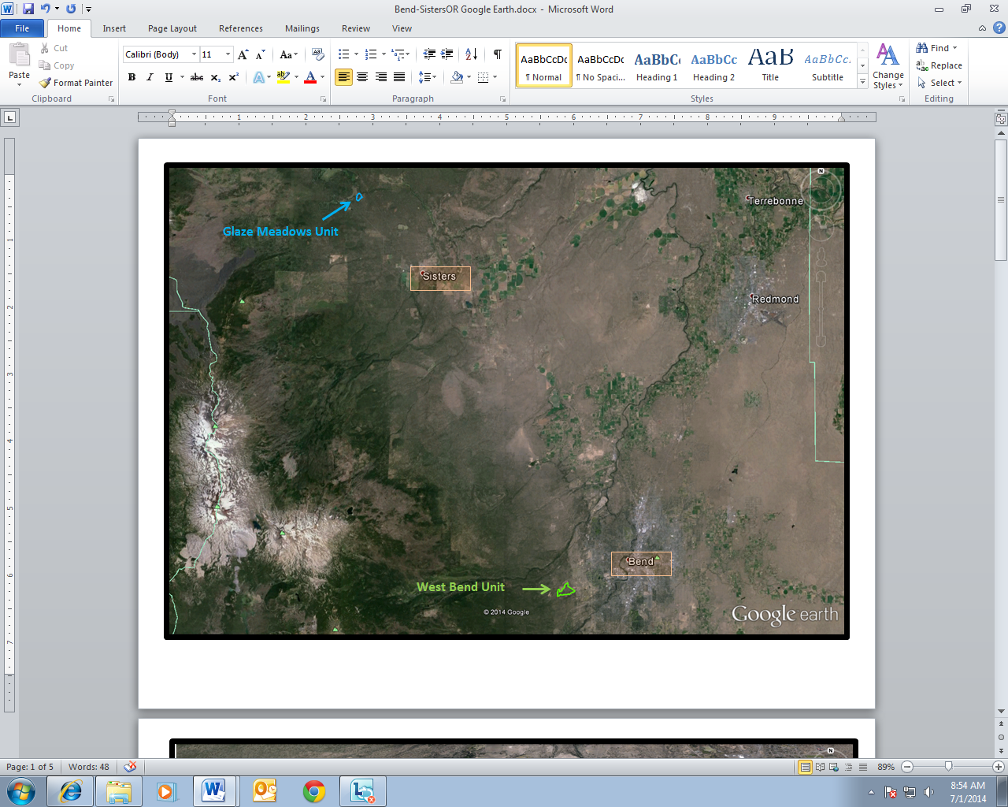
Retrospective Study of smoldering smoke
Plume dominated intrusion
Units
Better understand what fuel bed components contributed to the intrusion and by how much
Smoldering smoke dominated intrusion

Slide 31
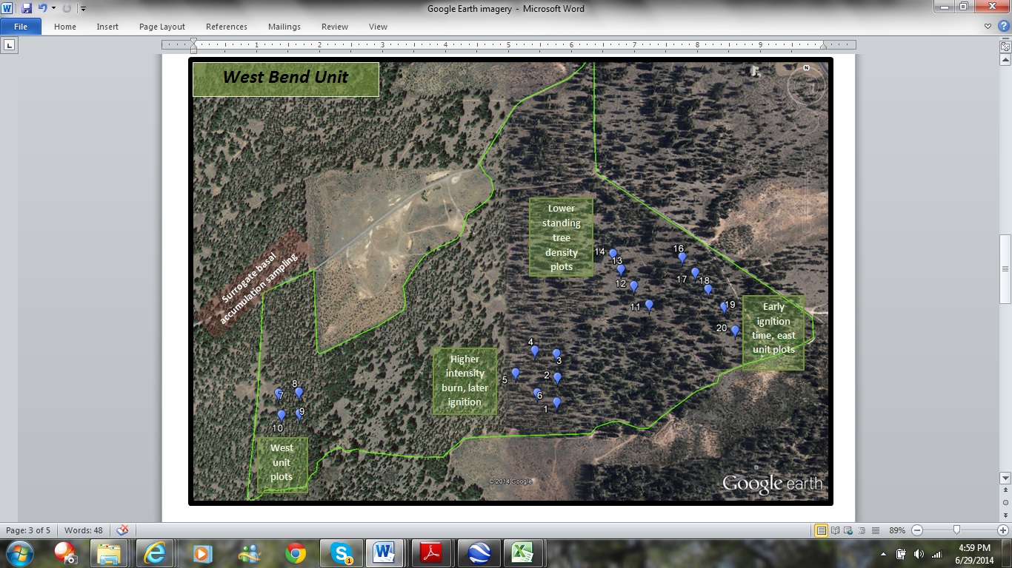
Plot Layout

Slide 32
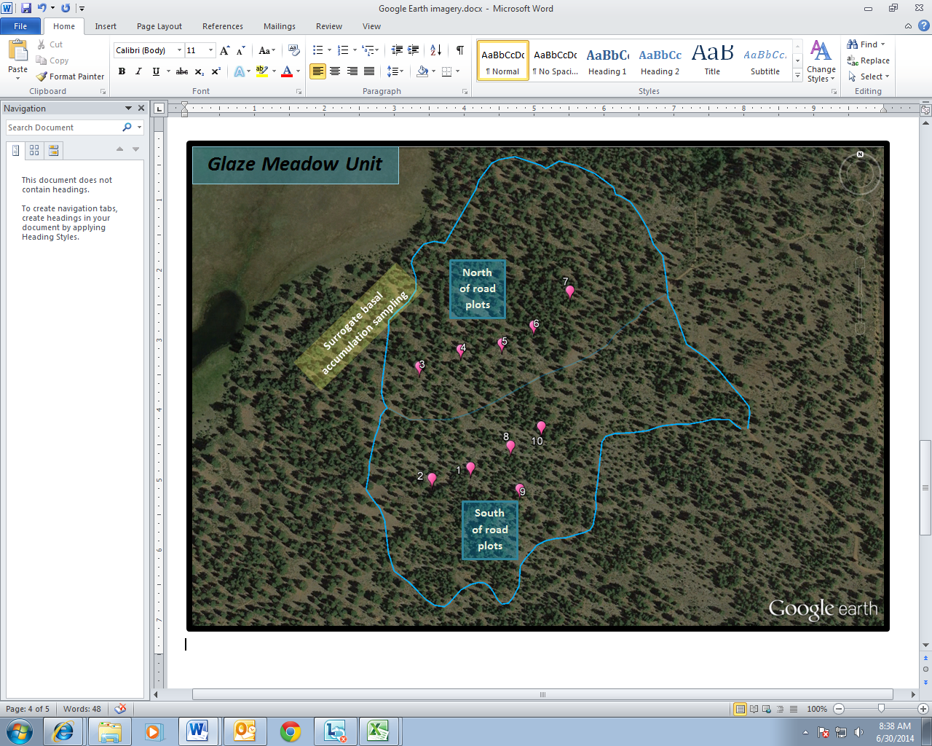
Plot Layout

Slide 33
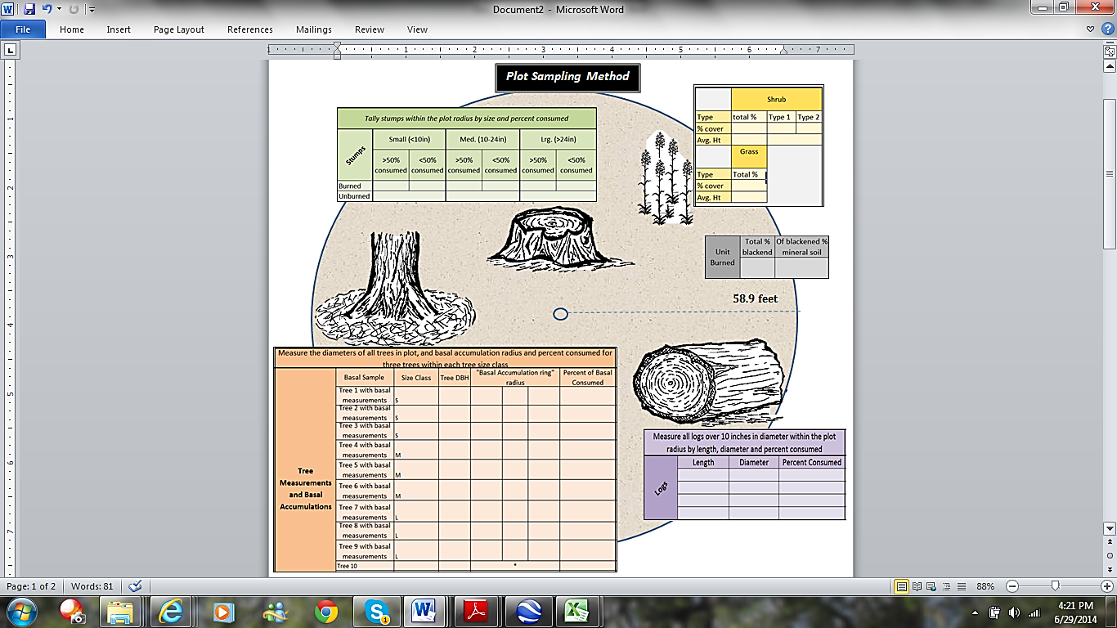

Slide 34
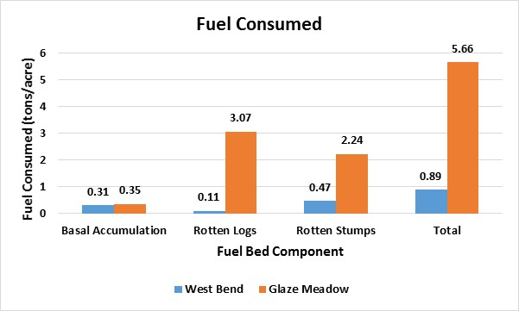
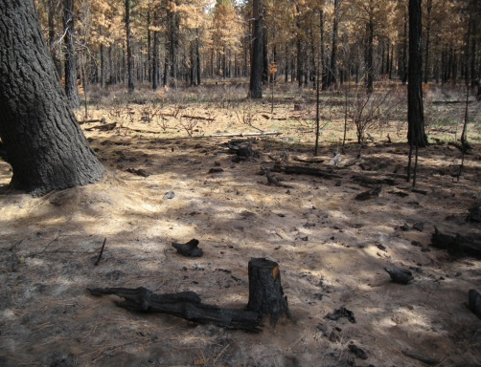
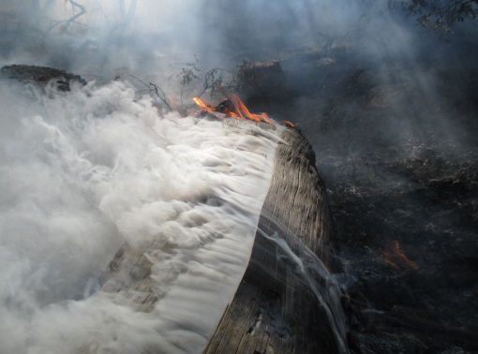
Result
Basal accumulation
Rotten logs
Rotten stumps

Slide 35
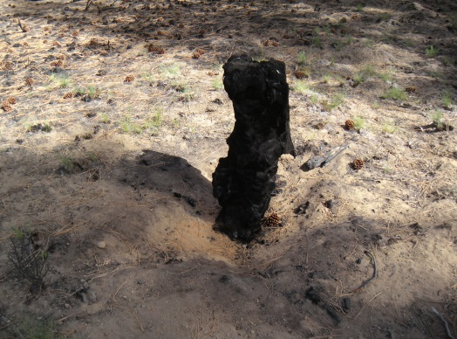
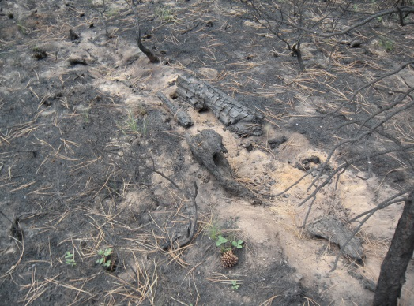
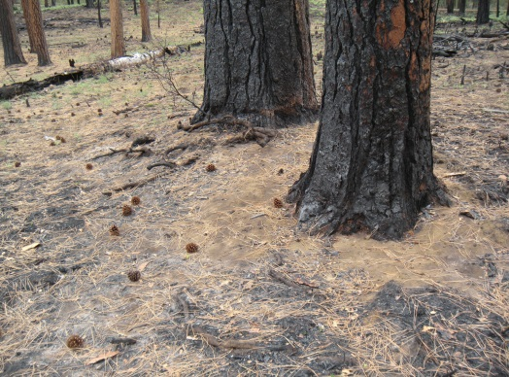
Retrospective Study Discussion
West Bend
Small amount of fuel consumed
Close to Bend, near drainages
Two evening/morning intrusions
Glaze Meadow
More fuel consumed
Early plume directed away from Bend
Wind shift not predicted
Intrusion

Slide 36
Retrospective Study Discussion (Con’t)
Plume and smoldering Intrusions occurred during acceptable burn windows
Smoldering intrusion in part caused by small amount of consumption of:
Rotten stumps
Rotten logs
Basal accumulation
Retrospective study:
Low degree of certainty
No timing and duration of smoldering could be determined
can’t say definitively they caused the intrusion
can say these smoldering fuels consumed

Slide 37
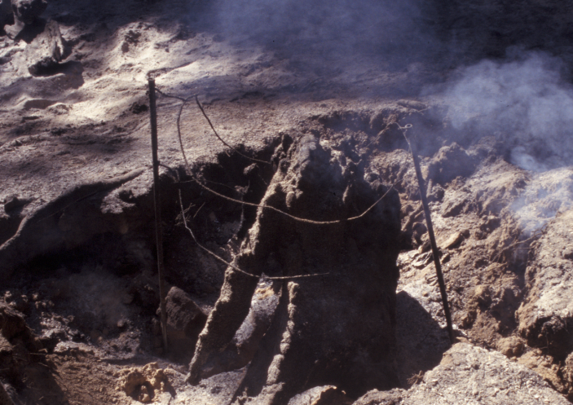
Mitigating Techniques
Alternatives to burning
Burn on good dispersion days
Clear around or do not light fuel bed components that are likely to smolder
Apply appropriate tools (BlueSky Playground)
Pile burning/jack pot burning??
Mop-up (exposure??)
Burn under high FM??
Others??

Slide 38
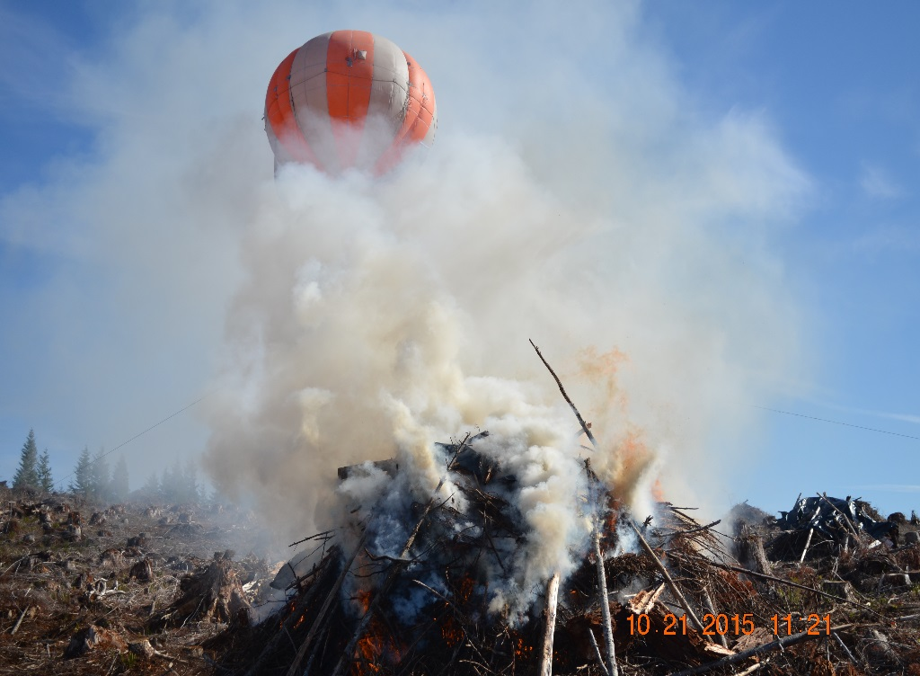
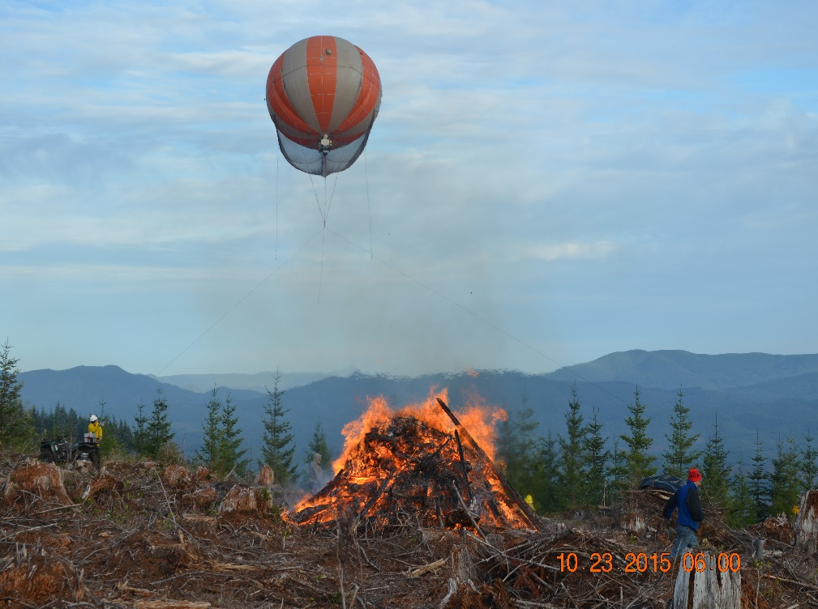
Dry versus wet piles (ODF and EPA)
Plastic keeps center dry, less smoke
No toxics detected from combustion of plastic

Slide 39
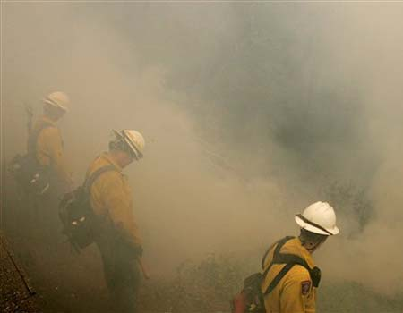
Firefighter Exposure and Health
Safety and welfare of workers
OSHA occupational standards/NWCG standards
Research
Exposure assessment
Health impacts
Risk management strategies
Recommendations provided

Slide 40

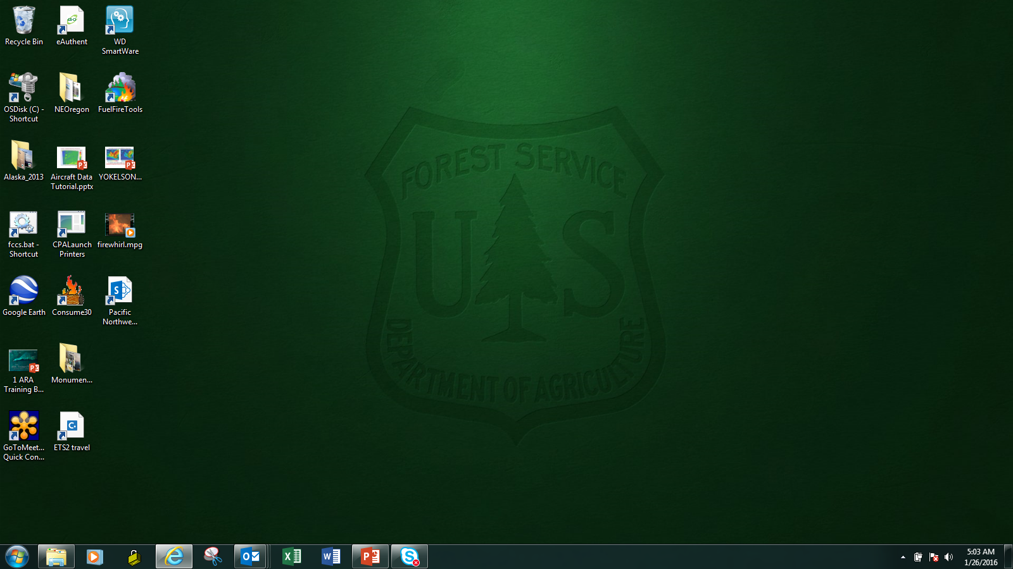
http://www.fs.fed.us/pnw/fera/fft

Slide 41
FFT System Diagram
Digital Photo Series
Fuel characteristics
(Fuel loading, cover, depth, carbon)
(Reaction intensity / reaction potential,
rate of spread / spread potential,
flame length / flame length potential)
Custom Fuelbed Data
FCCS
Surface fire behavior and potentials
FCCS Fuelbeds
Crown fire potentials
(Indexed potential for crown fire
initiation and spread)
Available fuel potentials
(Indexed potential of available fuel
for consumption under dry conditions)
Fuel consumption
(Total fuel consumption by stratum
and category)
CONSUME
& Pile Calculator
Environmental Variables
Pollutant emissions
(Total emissions by pollutant species)
Heat release
(Total heat release)
FEPS
Hourly fuel consumption
(Hourly fuel consumption)
Fire area and weather info
Hourly emissions
(Hourly emissions by pollutant species)
Plume rise
(Predicted plume rise)

Slide 42
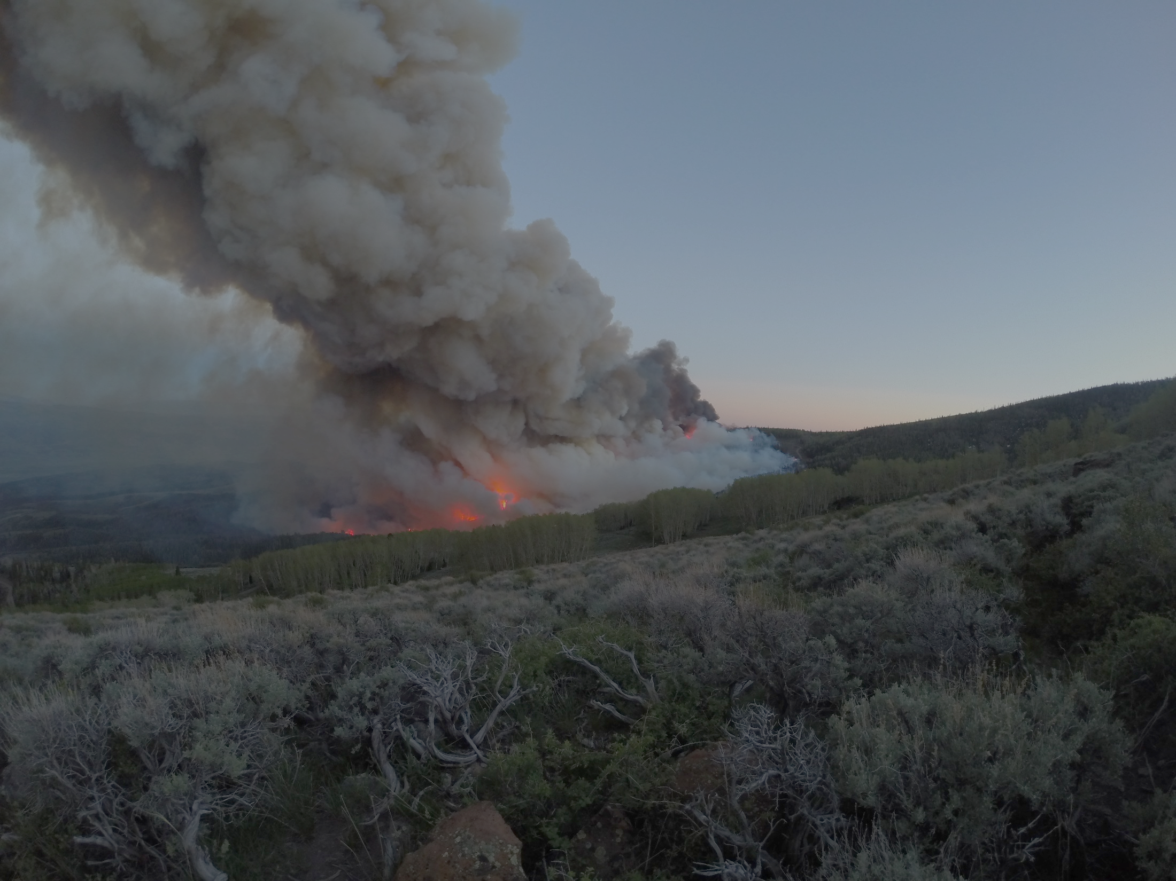









Fire And Smoke Model Evaluation Experiment (FASMEE)
A Large Integrated Multiagency Fire Study
http://fasmee.net

Slide 43
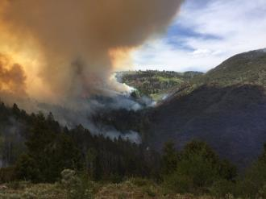
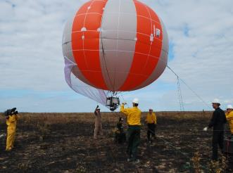
FASMEE Science Question and Goal
Goal: To use innovative and efficient measurement techniques to collect critical observational data necessary to evaluate and advance operationally used fire and smoke modeling systems.

Slide 44
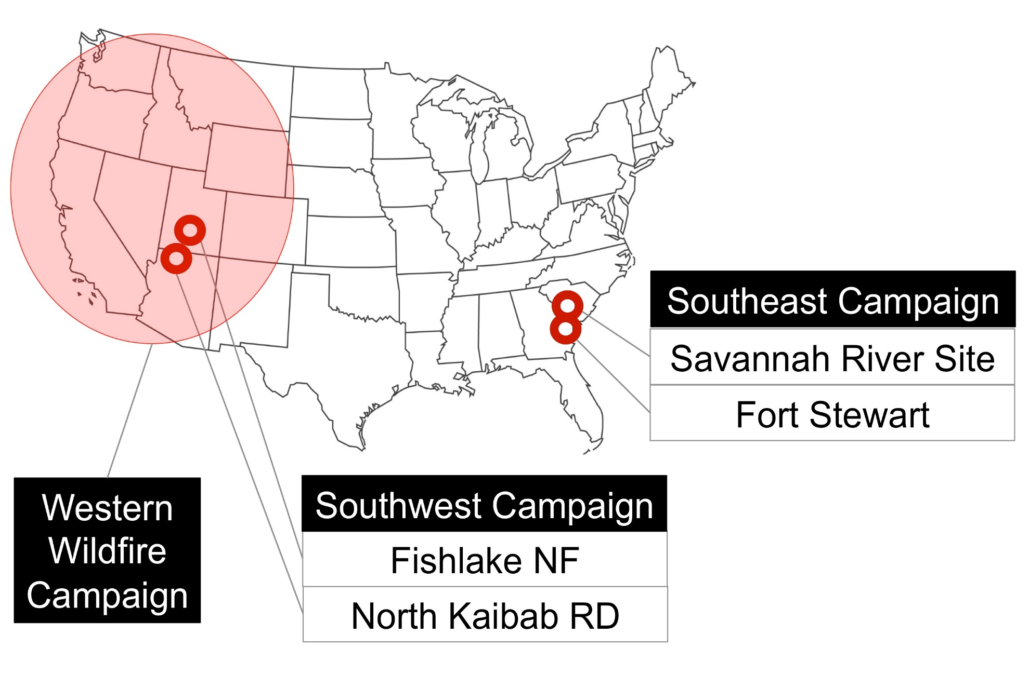
FASMEE Campaigns

Slide 45
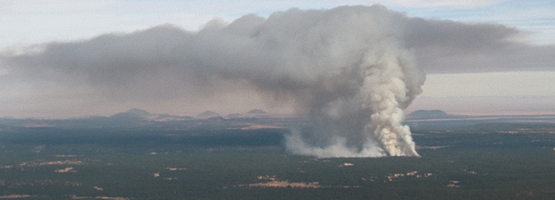
Key model improvements and evaluation
Plume and meteorology
Mixing and entrainment
parameterizations
Identification of dynamic
regimes and parameters
Multiple core interactions
Smoke and chemistry
Flaming and smoldering emission factors
Smoke evolution and aging
UAS, lidar, towers
Airborne platform, towers
Fire behavior and energy
Characterize spatial and
temporal heat flux density
Fuels and consumption
Multi-scale characterization
Airborne, ground and satellite platforms
Ground sampling
Air and ground Lidar
UAS mapping

Slide 46
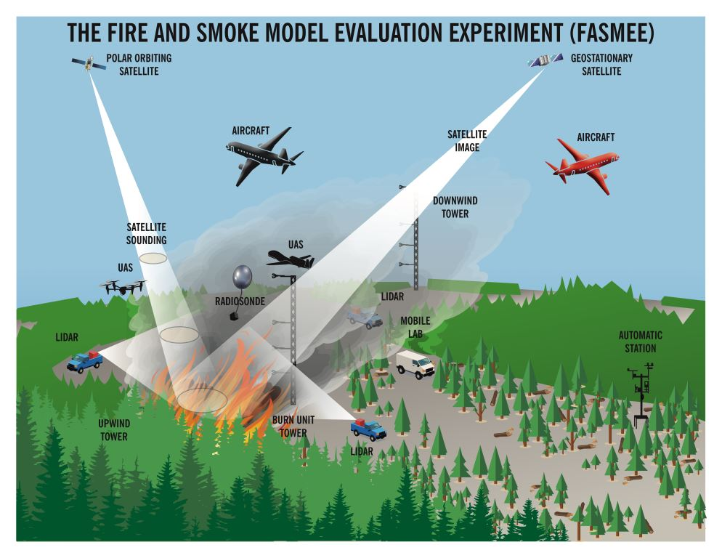
Integrated experiment with sharing of resources

Slide 47
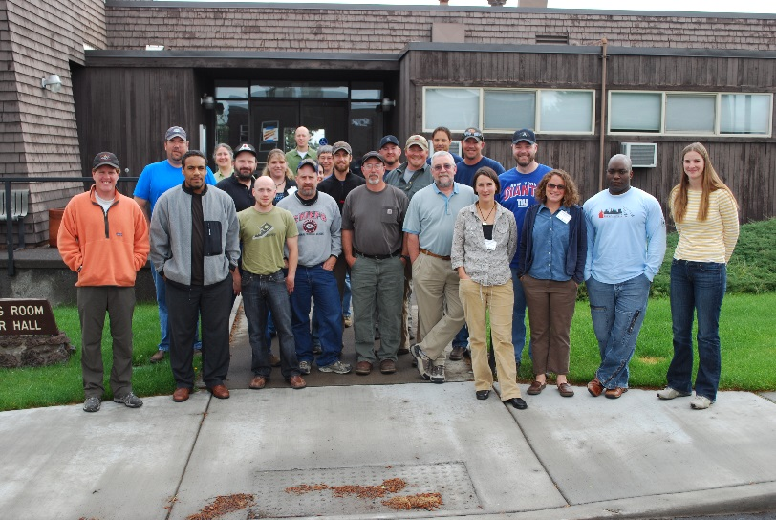
Knowledge Transfer Open communication
Training (Rx410/Rx310)
Workshops and field trips
Meetings, conferences and symposiums
R6 semi-annual meetings
Discussions with National and State regulators
Assist in updating State smoke management plans

Slide 48
Questions?

