Slide 1

Why we need to integrate social science into natural resource planning: My experience as a guy who crossed over from research to management
John Laurence
Who at one time worked for, but doesn’t any longer
US Forest Service
Region 6 and PNW Research Station

Slide 2
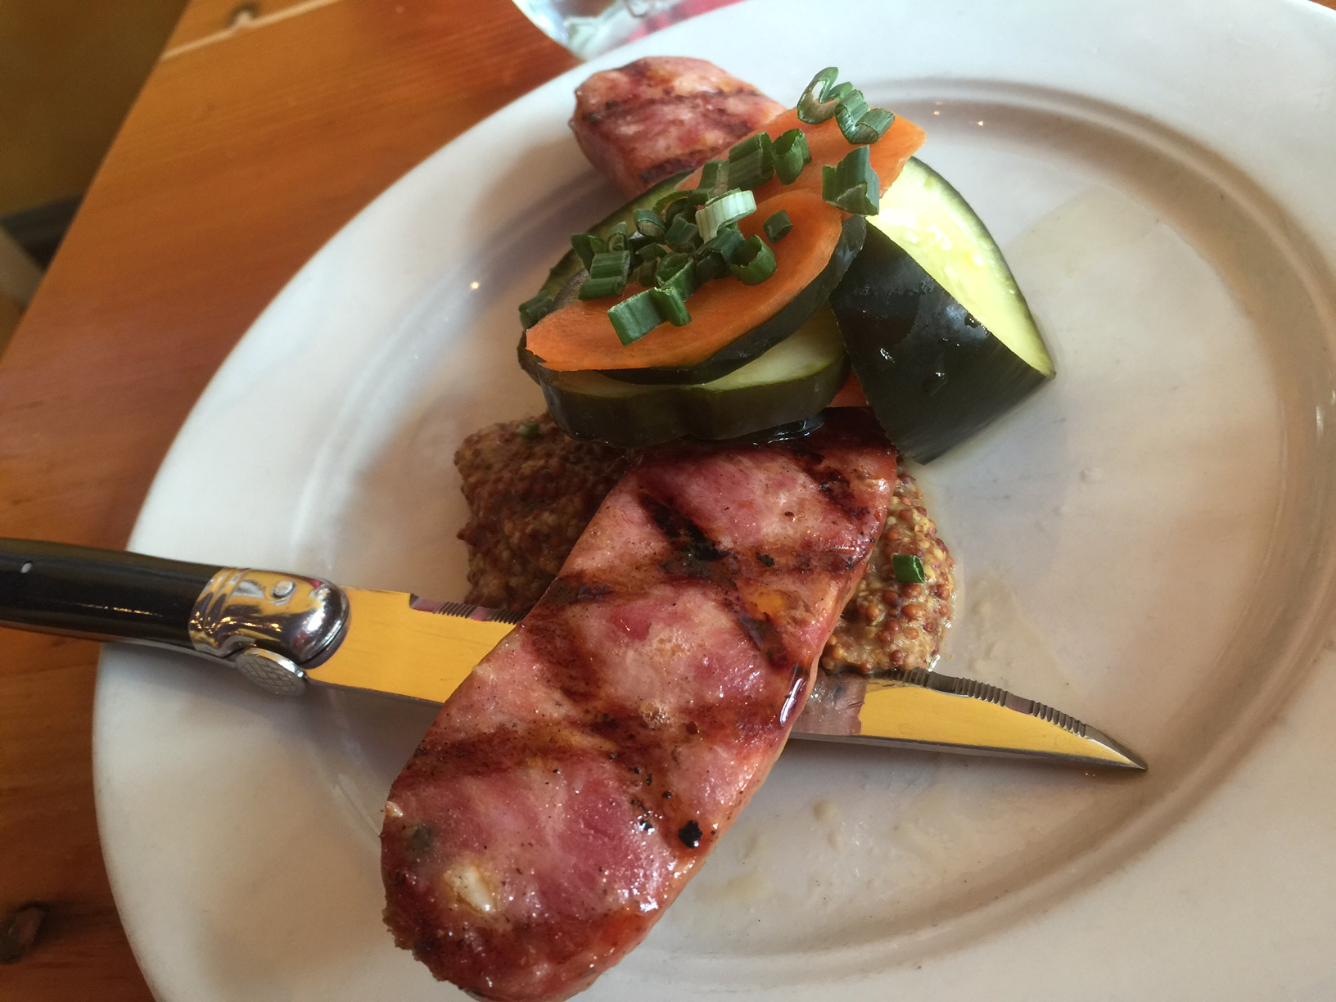


Slide 3
Why we need to integrate social science into natural resource planning: My experience as a guy who crossed over from research to management
…or
John Laurence
Who at one time worked for, but doesn’t any longer
US Forest Service
Region 6 and PNW Research Station

Slide 4
How the light clicked on once I left the Coniferous Tower
John Laurence
Who at one time worked for, but doesn’t any longer
US Forest Service
Region 6 and PNW Research Station

Slide 5
How I see the importance of Social Science
Bob’s story of teaching math as it relates to my move from academic research to agency research to management
Notes:
Bob’s story of teaching math as it relates to my move from academic research to agency research to management

Slide 6

How I see the importance of Social Science
The likelihood of a successful project
0-100
Given:
The project is a priority on the unit and within regional or national direction
Budget is sufficient
We don’t define success as wining in court

Slide 7


How I see the importance of Social Science
The likelihood of a successful project
0-100
Given:
The project is a priority on the unit and within regional or national direction
Budget is sufficient
We don’t define success as wining in court
Science is research that answers critical questions and is ready for application
0 to 10

Slide 8

How I see the importance of Social Science
The likelihood of a successful project
0-100
Given:
The project is a priority on the unit and within regional or national direction
Budget is sufficient
The likelihood of a successful project
0-100
Given:
The project is a priority on the unit and within regional or national direction
Budget is sufficient
We don’t define success as wining in court
Science is research that answers critical questions and is ready for application
0 to 10
Unit Capacity is the ability to receive and apply science
0 to 10

Slide 9

How I see the importance of Social Science
The likelihood of a successful project
0-100
Given:
The project is a priority on the unit and within regional or national direction
Budget is sufficient
The likelihood of a successful project
0-100
Given:
The project is a priority on the unit and within regional or national direction
Budget is sufficient
We don’t define success as wining in court
Science is research that answers critical questions and is ready for application
0 to 10
Unit Capacity is the ability to receive and apply science
0 to 10
S is social success, a measure of our relationship with the public
1 to -1

Slide 10





How I see the importance of Social Science
The likelihood of a successful project
0-100
Given:
The project is a priority on the unit and within regional or national direction
Budget is sufficient
We don’t define success as winning in court
Science is research that answers critical questions and is ready for application
0 to 10
Unit Capacity is the ability to receive and apply science
0 to 10
S is social success, a measure of our relationship with the public
1 to -1

Slide 11
How I see the importance of Social Science

Slide 12
What’s the upshot?
Scientists and managers need to work together to identify the questions that need to be answered

Slide 13
What’s the upshot?
Scientists and managers need to work together to identify the questions that need to be answered
Research organizations need to match their investment (in people and operating funds) to meet priorities, including clearly identifying the investment in mission-driven research versus fundamental and basic science—this means developing new flexibility in organization

Slide 14
What’s the upshot?
Scientists and managers need to work together to identify the questions that need to be answered
Research organizations need to match their investment (in people and operating funds) to meet priorities, including clearly identifying the investment in mission-driven research versus fundamental and basic science—this means developing new flexibility in organization
Management agencies need to invest to increase the capacity of units to receive and apply science

Slide 15
What’s the upshot?
Scientists and managers need to work together to identify the questions that need to be answered
Research organizations need to match their investment (in people and operating funds) to meet priorities, including clearly identifying the investment in mission-driven research versus fundamental and basic science—this means developing new flexibility in organization
Management agencies need to invest to increase the capacity of units to receive and apply science
Appropriate investments will pay off by increasing S

Slide 16
Today you will hear from John Allen and Stanley Asah about success on a forest that has unit capacity, public support, and a long history of working with researchers.
You will hear from Cass about methods that are available to increase our understanding of public opinion—the research capacity
You will hear from Michael, Troy, and Nikola about the questions that need to be addressed
You will hear from Bruce and Emily Jane about what the public expects—what will drive S higher
You will hear from Lee about application of some of the tools, and I think, the need for increases in capacity at the unit level
You’ll have a chance to identify and maybe prioritize some of the questions that need to be answered
And finally, Katherine will make sense of the day and tell you how you are going to pull this all off.
I’ll be an interested bystander as I read about your successes in the future.

