Slide 1

Bruce Shindler, Professor Emeritus Dept. of Forest Ecosystems & Society
Public Expectations of
Natural Resource Managers:
Building Trust through
Collaborative Efforts

Slide 2





Agency-Stakeholder Trust in Communities at risk of wildfire in Australia, Canada, and the U.S.
Bruce Shindler & Christine Olsen—Oregon State University, U.S.
Sarah McCaffrey, US Forest Service, Northern Research Station, U.S. Tara McGee, University of Alberta, Canada
Bonita McFarlane & Amy Christianson, NR Canada, Alberta, Canada
Allan Curtis & Emily Sharp, Charles Sturt University, NSW, Australia

Slide 3
***We’re talking Trust***
Why should natural resource managers be interested in trust and trust-building?

Slide 4
These days… little trust in big government, big business, or bureaucracies.

Slide 5
The single biggest problem with communication is the illusion that it has taken place.
- George Bernard Shaw

Slide 6
Trust as a factor in resource management…
Stakeholder trust in natural resource agencies is one of the most significant factors influencing support or opposition to management activities. Our co-workers and the public are not likely to listen to us unless they view us as credible and trustworthy.

Slide 7
For us in the NR professions, it is often about public expectations and relationships…
Relationships based on trust contribute to effective management programs—particularly at the local level.

Slide 8
Where trust exists:
Agencies and field personnel have the respect of stakeholders
Information sharing is encouraged
Shared values and common problems become the focus
Trust serves as an indicator that people feel field managers are effective land stewards
Capacity to respond is built within communities

Slide 9
Citizen –Agency Interactions
Lack of trust… or skepticism… is usually the starting point.

Slide 10
Citizen – Agency Interactions
Parties need to be able to trust each other just enough (healthy skepticism) to allow them to begin work together.

Slide 11
Trust Building Loop
Reinforce trusting attitudes
Build foundation for more ambitious plans and projects
Aim for realistic (initially modest) but successful outcomes
Form expectations about the future of the relationship based on reputation or past behaviors
Have enough trust, be willing to take a risk, and initiate a cooperative effort

Slide 12
Recognize the context of the issue
Agencies and field personnel regularly encounter a range of conditions, projects, and interested stakeholders.
Small scale management activities
Often informal, routine interactions where trust is built through mutual experience and successful implementation of low-risk activities.

Slide 13
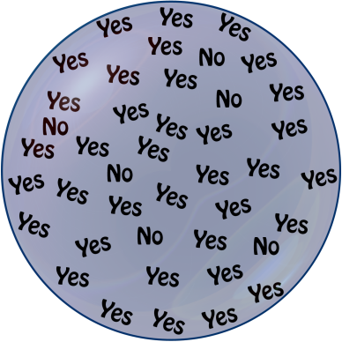
Small Scale Activities
Trust evolves over time as participants interact and move gradually toward modest local projects.
Small Wins

Slide 14
… the context of the issue
Large-scale activities or landscape level projects
Involve multiple agencies, organizations, and stakeholders—often to meet the requirements of a government initiative.

Slide 15

Large scale projects
Often involve formation of a “collaborative” or “partnership.” These are complex projects that require coordination and deliberate action to maintain a balance of trust.
High stakes

Slide 16
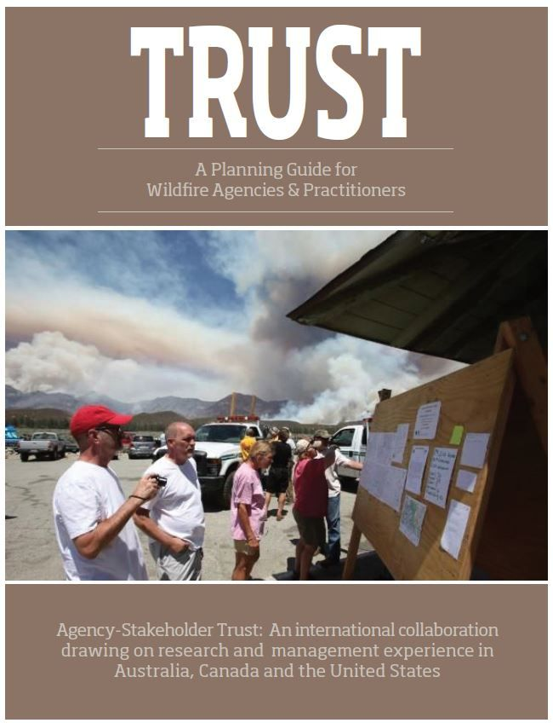

Slide 17
Public Expectations
Trustworthy qualities are often measured by:
Ability
Belief in manager’s ability to make good decisions and effectively implement practices.
Fairness and Equity
Belief personnel are sincere and genuinely engage citizens about plans/decisions… that individuals will act in the best interest of the community.

Slide 18
Public Expectations
also by:
Integrity
Belief the agency and its personnel are acting in accord with a set of values and norms shared by the community. Doing what you say you will do… building up credibility over time through promise-keeping.

Slide 19
Contributory Actions >>> Desired Outcomes
Trust is built with specific actions that contribute to desired outcomes. This happens at two levels:
Agency level actions
Individual actions
The following examples are intended as an evaluation tool. Collectively, these actions influence the ability of stakeholders to work cooperatively and are at the heart of the trust-building process.

Slide 20
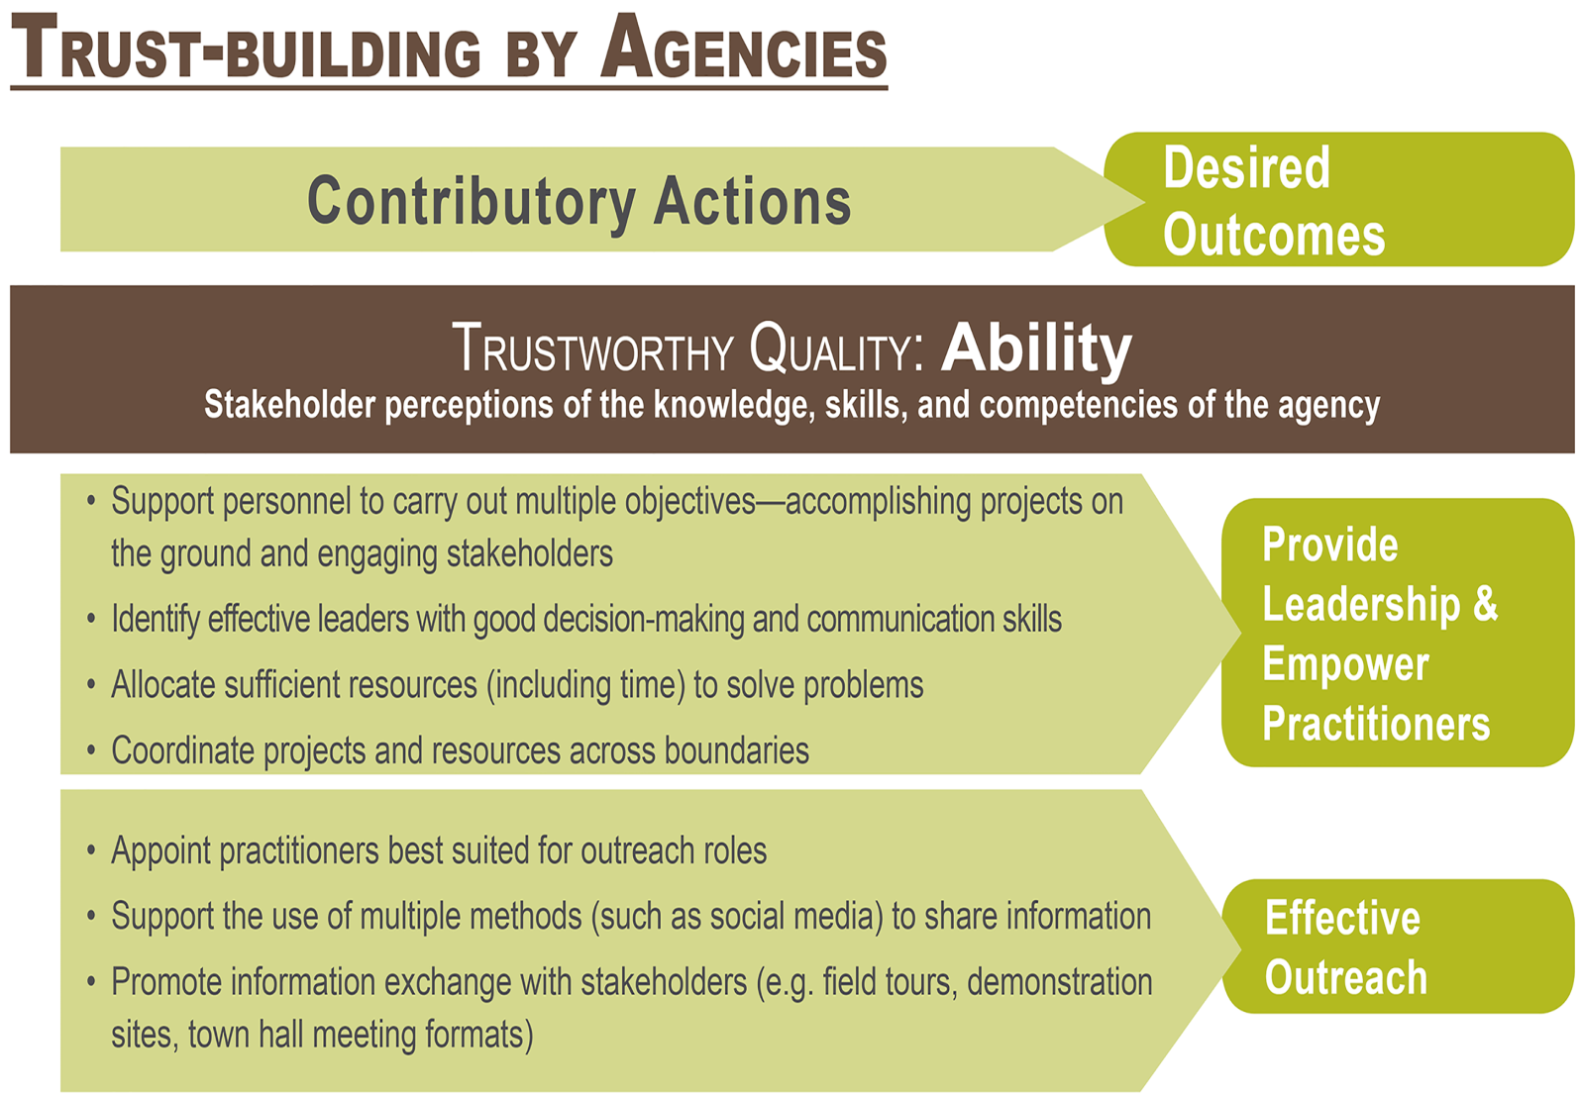

Slide 21
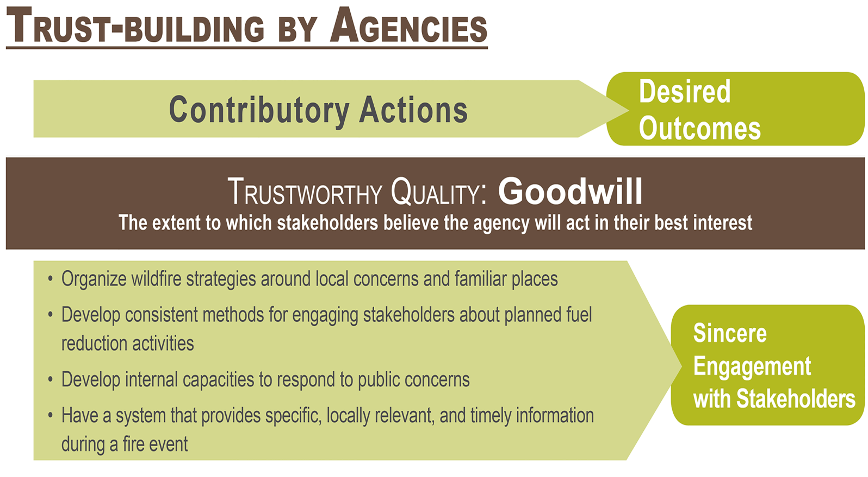

Slide 22
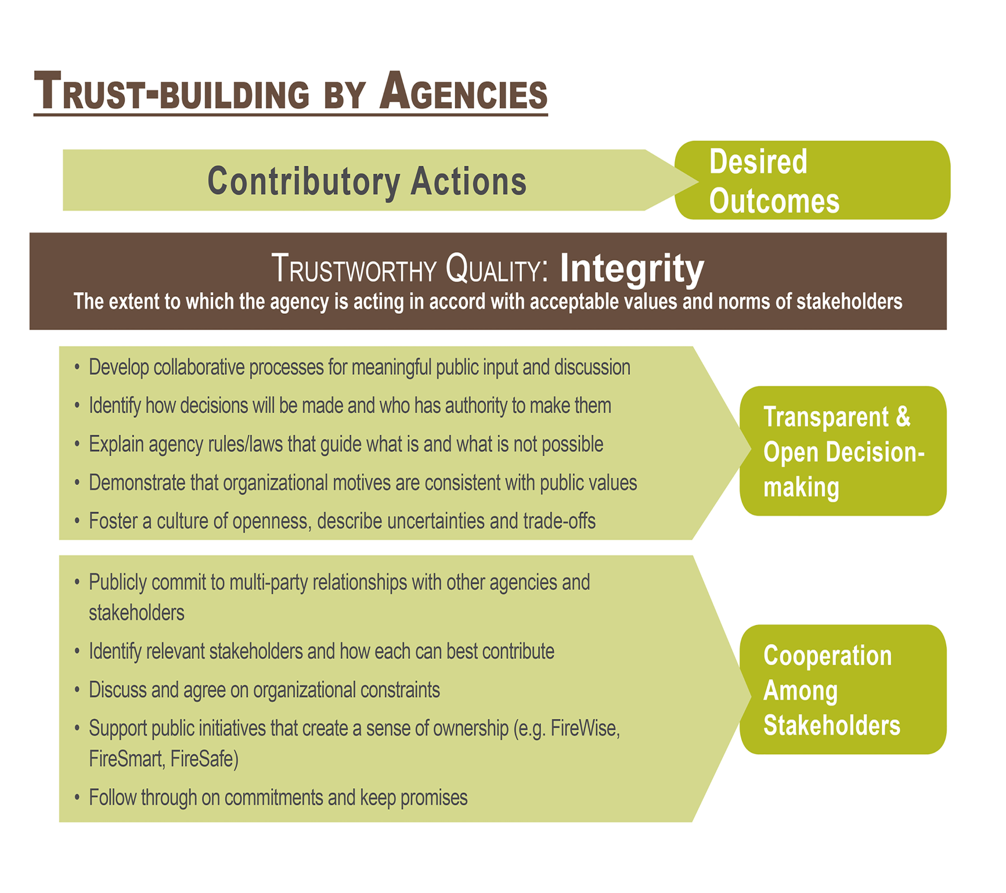

Slide 23
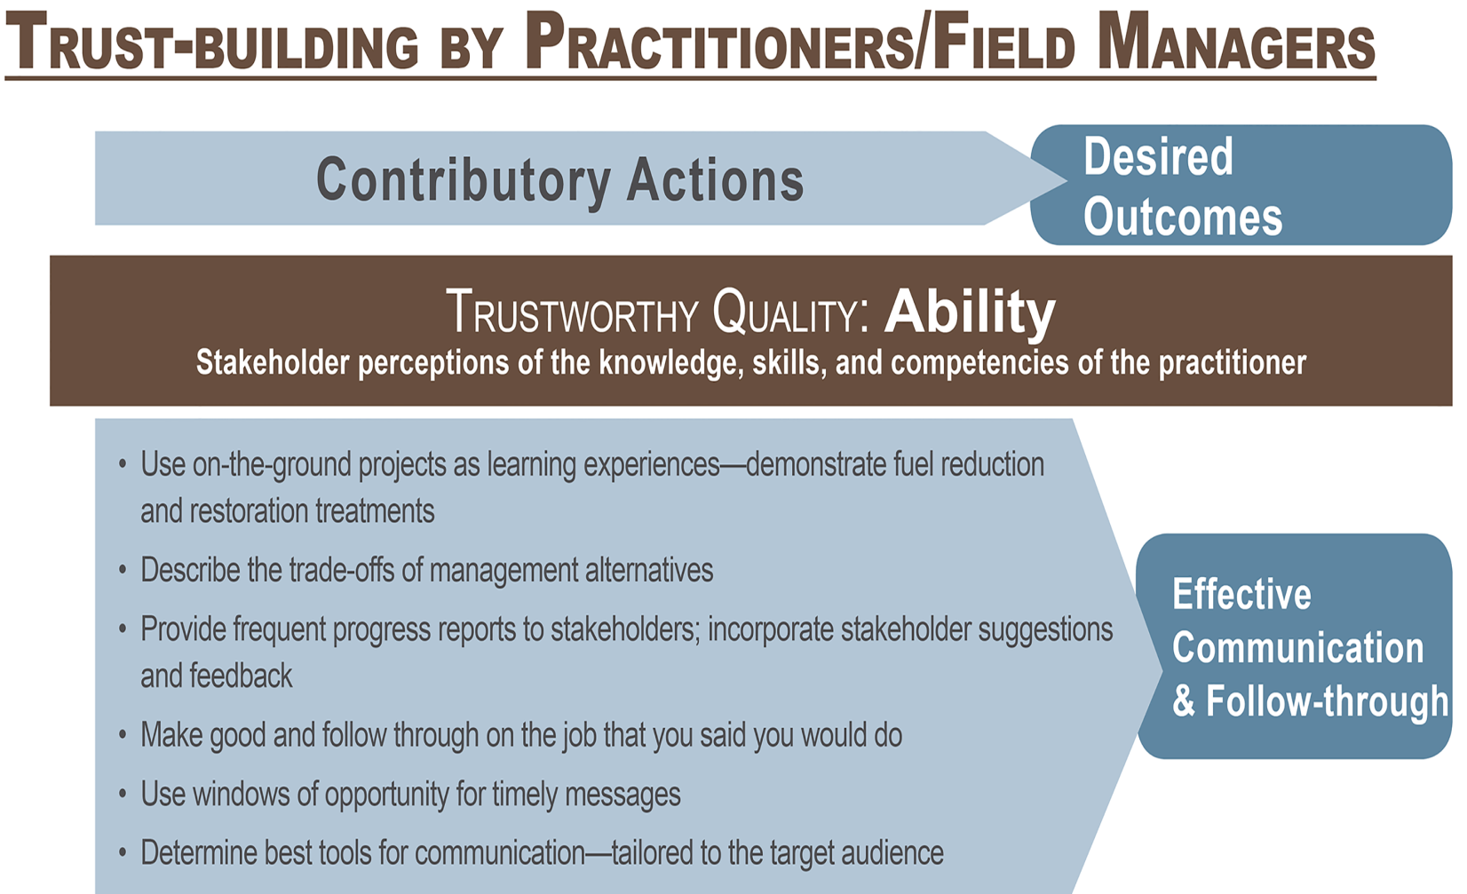

Slide 24
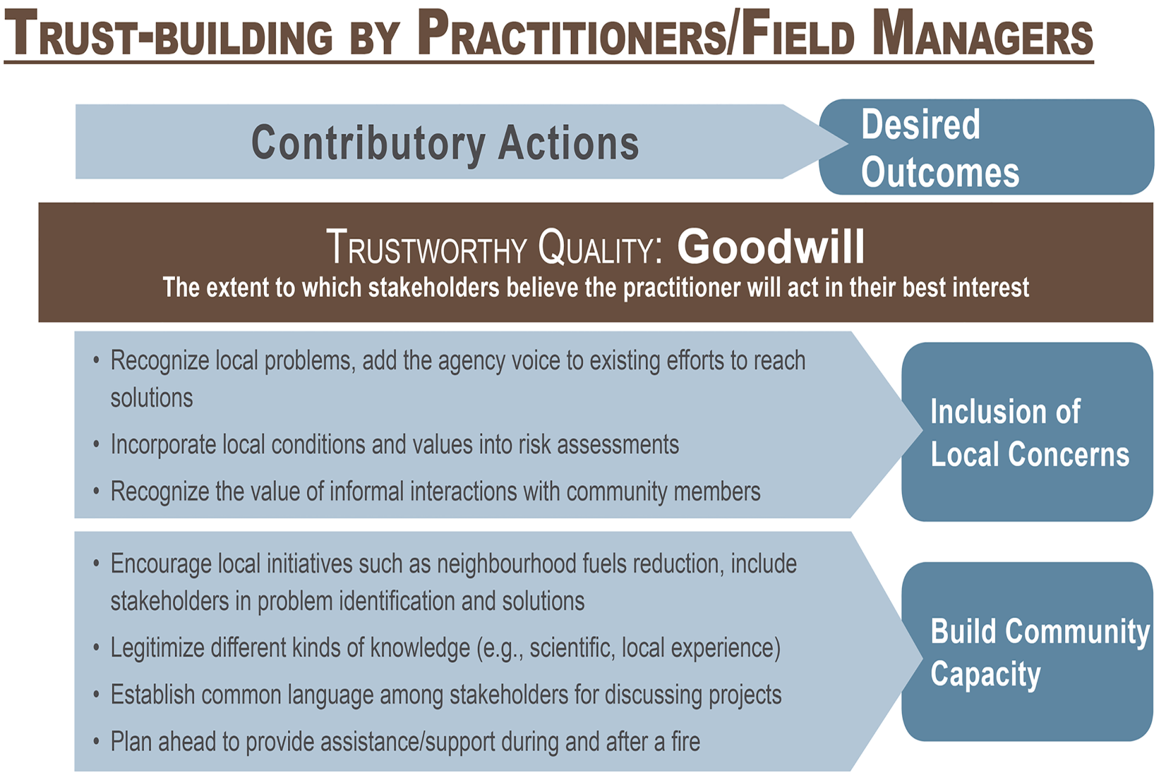

Slide 25
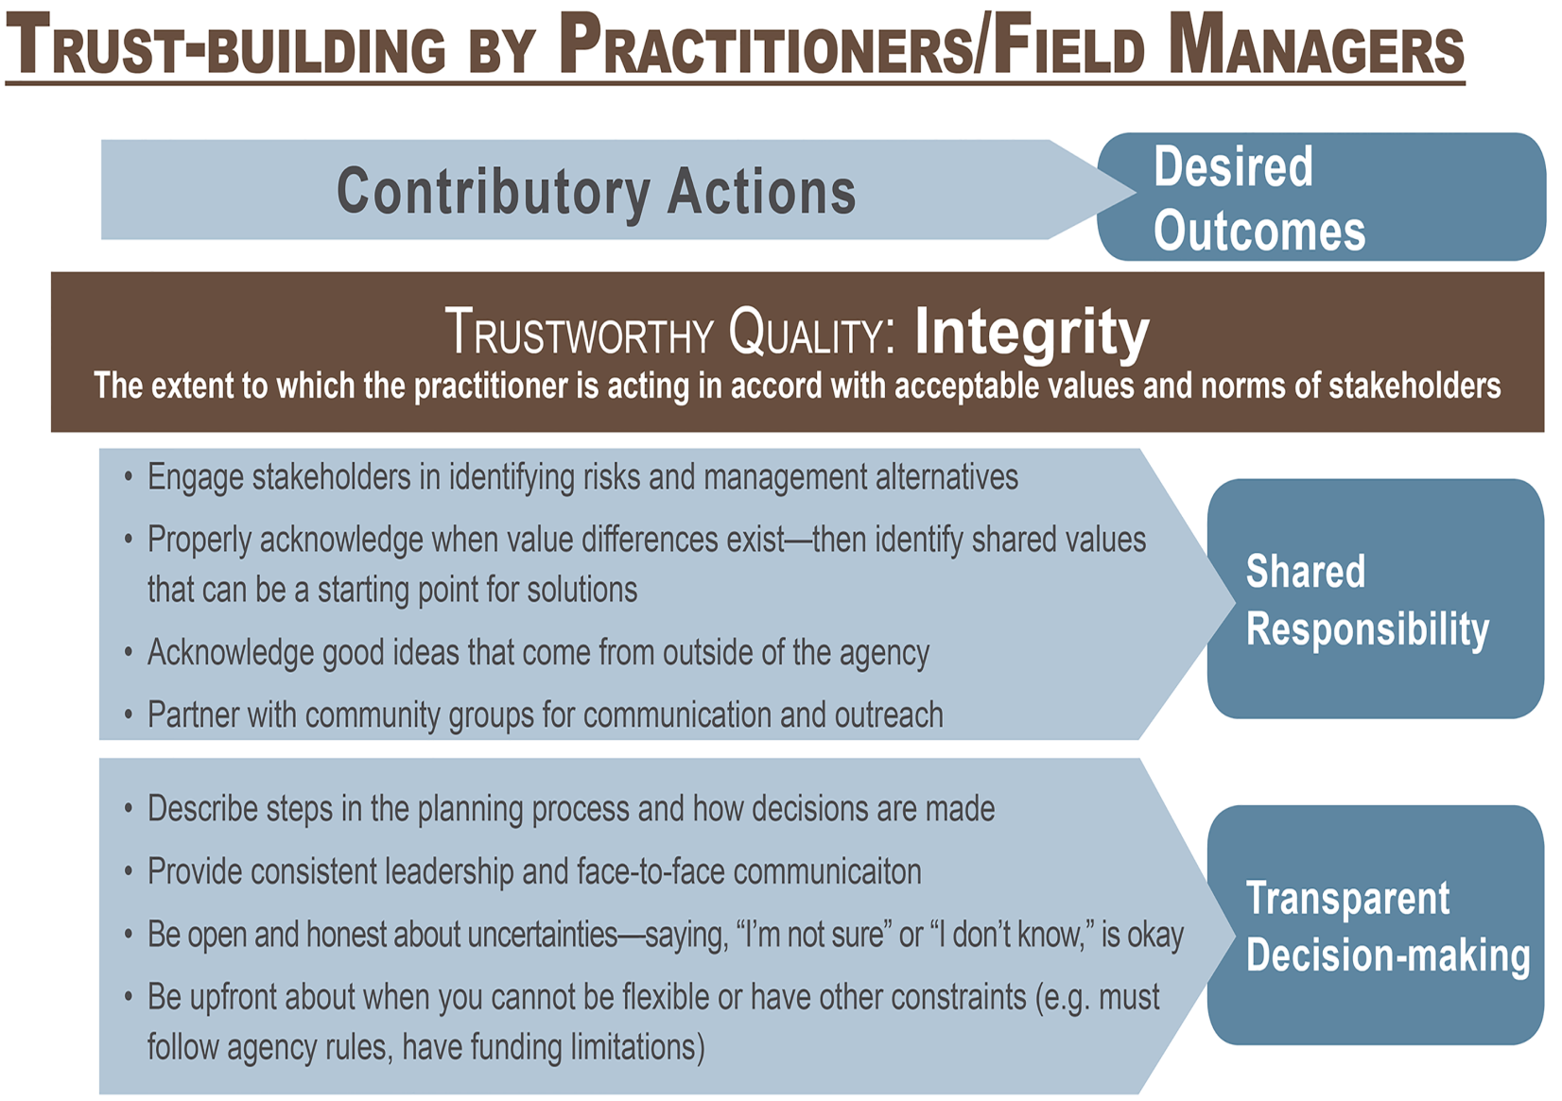

Slide 26
Take advantage of existing resources in the community…
Utilize individuals and organizations that can carry your message to a broader audience.
Recognize the good work already being accomplished outside the agency and piggy-back on these efforts.
Engage the entire community affected by the issues… WUI or landscape level.
Use a variety of strategies to get your message across.

Slide 27
A few quotes from our workshop participants…
In order to build trust, the emphasis from the beginning should be for agency personnel to listen first, then address specific concerns. Often, all people need is to be heard and to have their fears and concerns acknowledged.
Trust also comes when citizens believe managers share the values of the broader community, the planning processes are fair and equitable, and that managers will follow through on their commitments.

Slide 28
Quotes…
Cooperation is made possible by personal relationships. If you had to go through the bureaucracy, it would be impossible.
Drop the lingo—speak English. Respect the knowledge people have, even if they don’t have formal expertise. A good communicator is someone who listens.
It is most effective to get people out on the ground, meet face-to-face, learn about problems together.

Slide 29
The single biggest problem with communication is the illusion that it has taken place.
-- George Bernard Shaw

