Slide 1
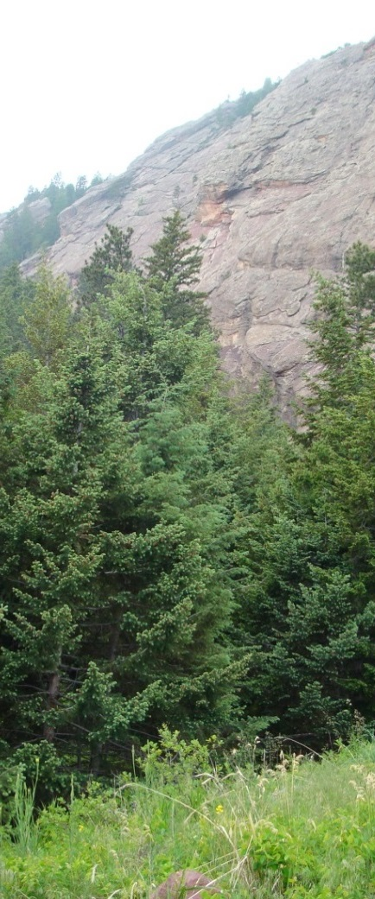
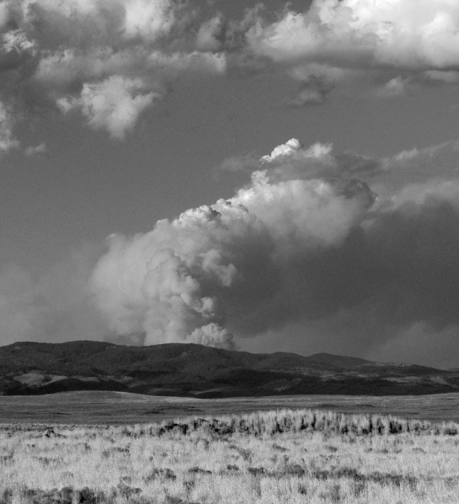
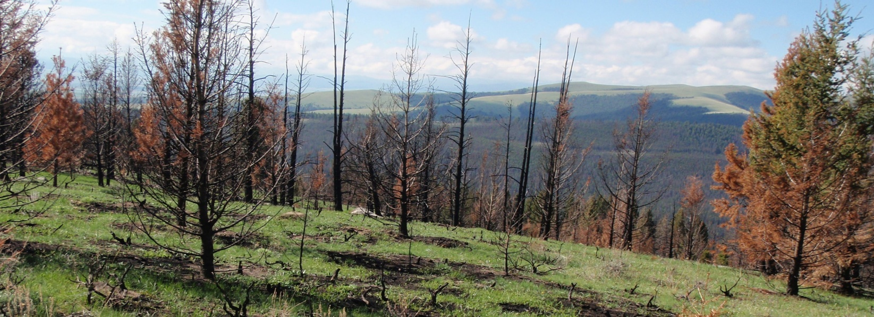
A wildfire risk assessment framework for land and resource management
Joe H. Scott, Pyrologix LLC
Portland, Oregon
June 28, 2016
Notes:
Joe H. Scott
Pyrologix LLC
406-549-2340
joe.scott@pyrologix.com
www.pyrologix.com

Slide 2
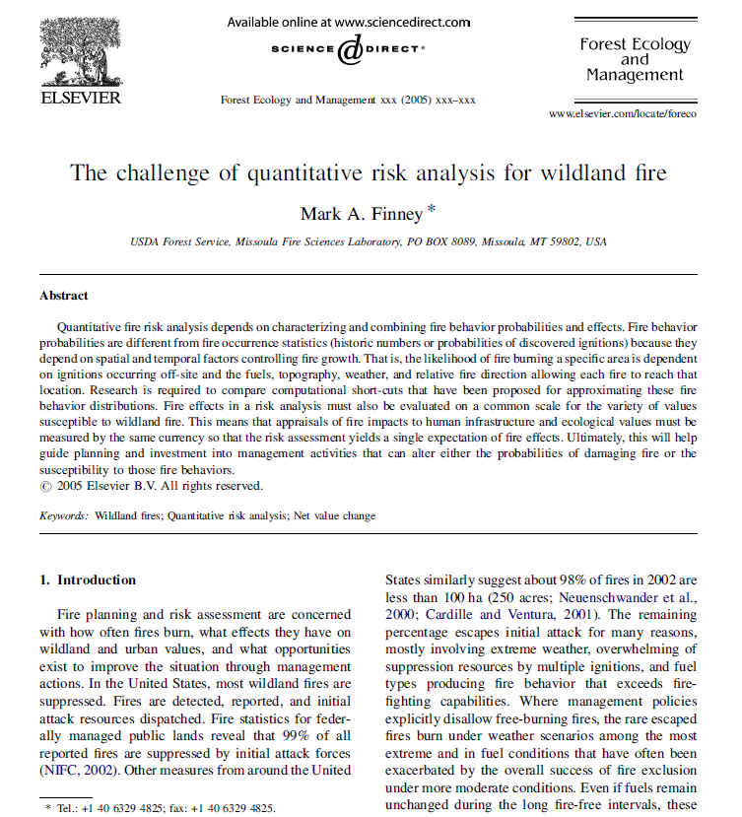
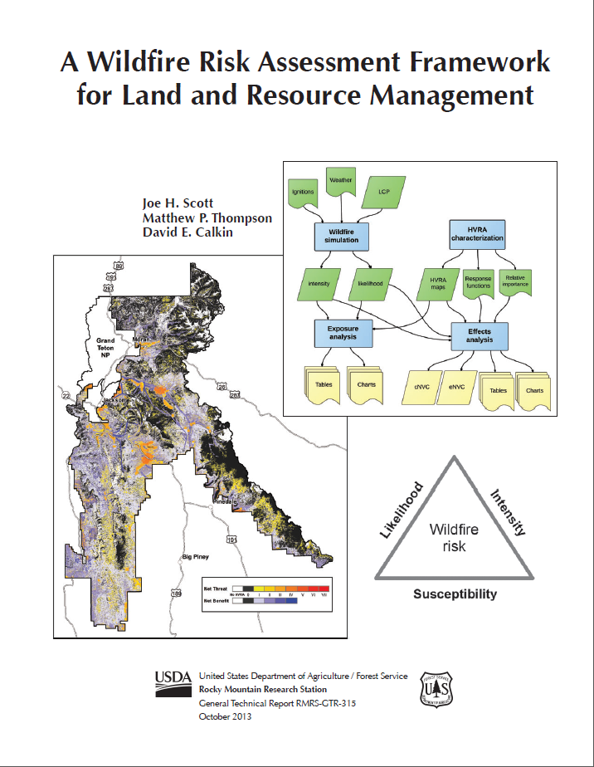
2005-2013

Slide 3
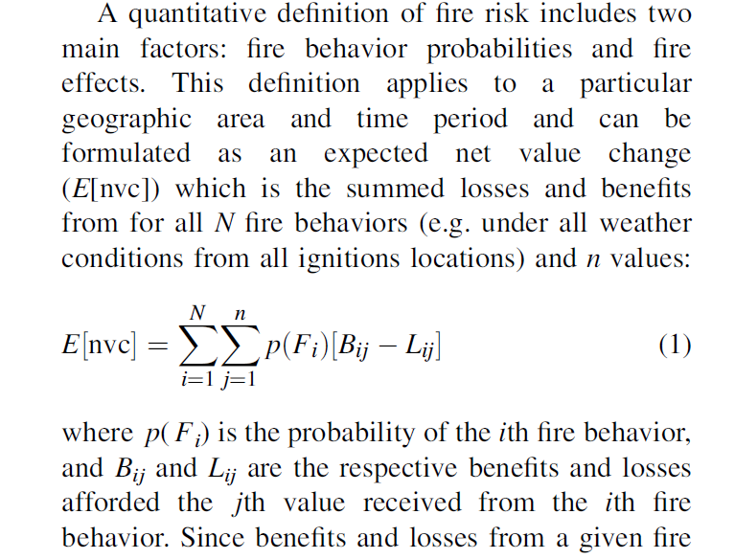
eNVC, a quantitative measure of ‘risk’
From Finney (2005)

Slide 4
Risk framework concepts
HAZARD
X
VULNERABILITY
PROBABILITY
INTENSITY
EXPOSURE
SUSCEPTIBILITY
RISK

Slide 5

Risk framework concepts
$$eNVC=BP∗\sum_{j}{\sum_{i}{\left({FLP}_{i}∗{RF}_{ij}\right)}}$$
Wildfire risk
Likelihood
Intensity
Susceptibility

Slide 6
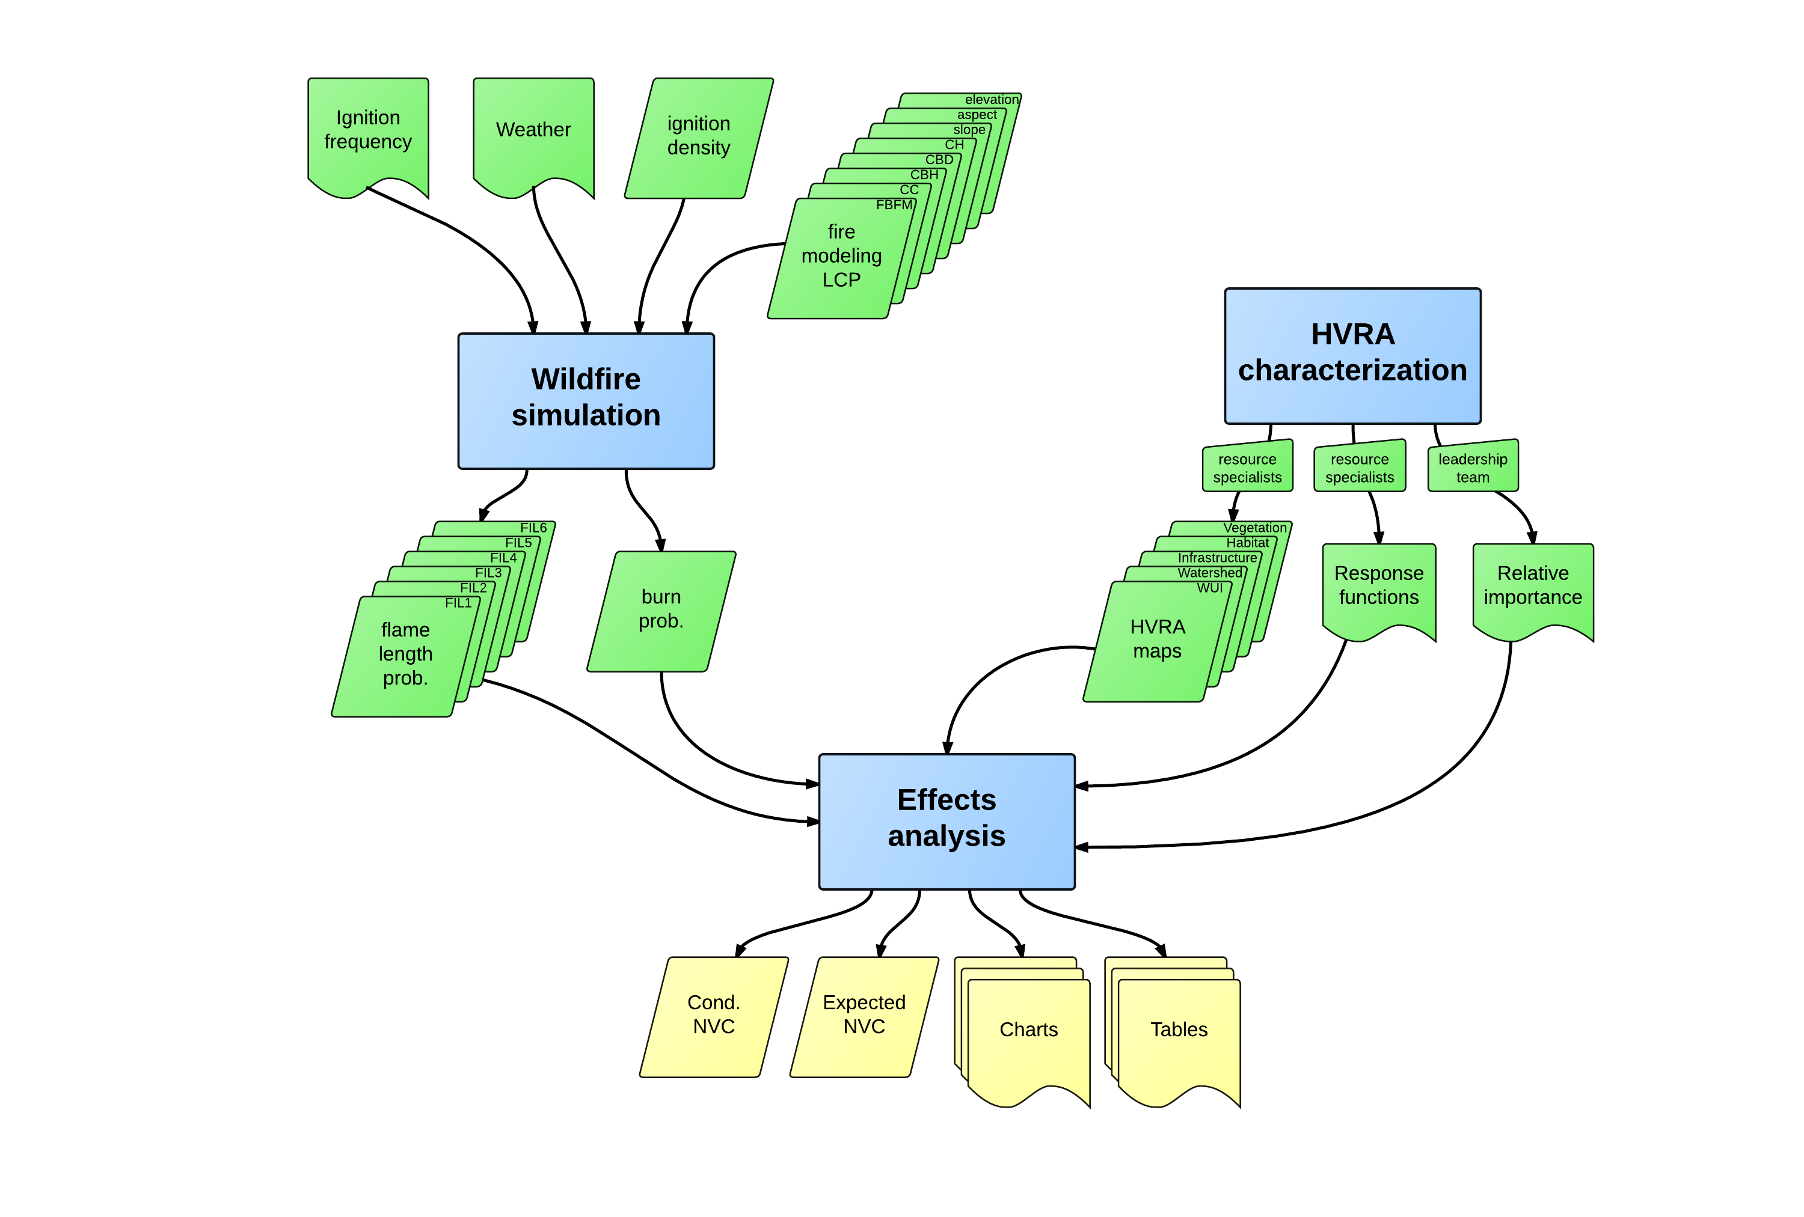
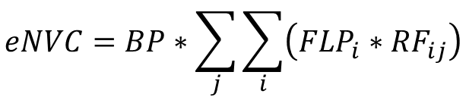
Risk framework concepts
$$eNVC=BP∗\sum_{j}{\sum_{i}{\left({FLP}_{i}∗{RF}_{ij}\right)}}$$

Slide 7
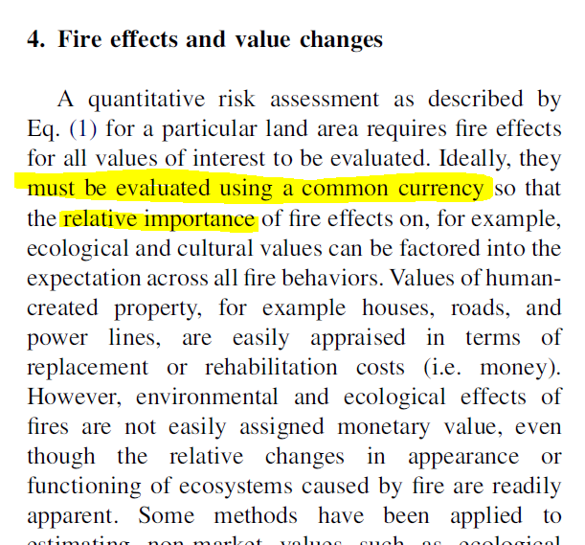
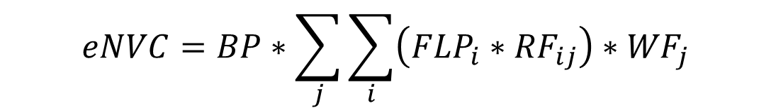
Risk framework concepts
$$eNVC=BP∗\sum_{j}{\sum_{i}{\left({FLP}_{i}∗{RF}_{ij}\right)}∗{WF}_{j}}$$
If you choose not to decide You still have made a choice
-Rush (Freewill)
From Finney (2005)

Slide 8
Risk framework concepts
HAZARD
X
VULNERABILITY
PROBABILITY
INTENSITY
EXPOSURE
SUSCEPTIBILITY
Prevention
Preparedness
Large-fire suppression
Landscape-scale fuel modification
Evacuation
Land use regulation
Fuel modification
Defensible space
Point protection
Point protection
Asset hardening

Slide 9
Fireshed analysis, central Sierra

Slide 10
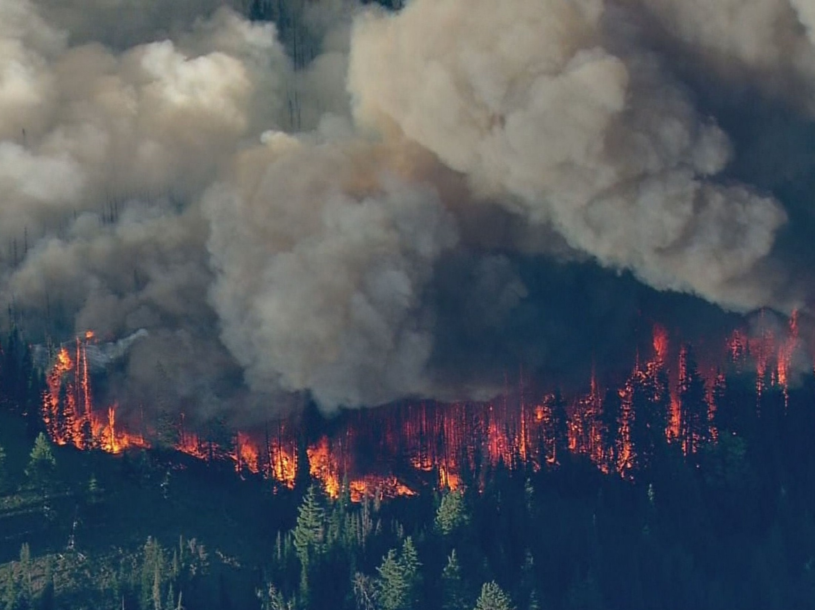
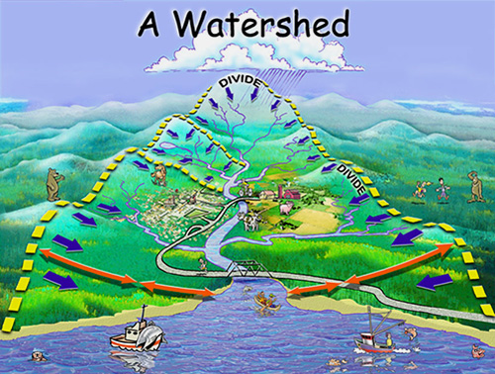
Fireshed analysis
Watershed—the land area where surface water drains to a given point or line.

Slide 11
Fireshed analysis
Watershed—the land area where surface water drains to a given point or line.
Fireshed—the land area from which a fire can start and eventually reach a given point, line or area¹ ¹in a designated period of time (days, weeks, or whole season).

Slide 12
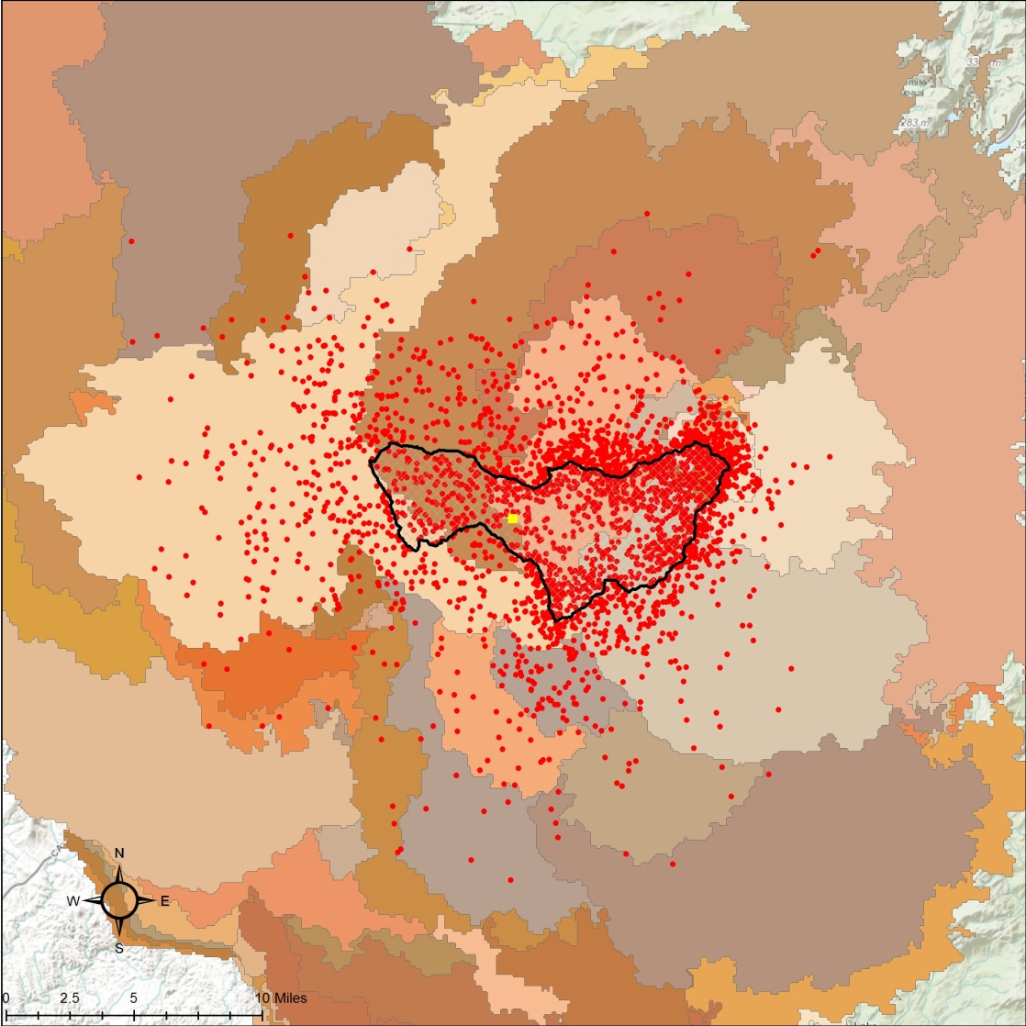

Slide 13
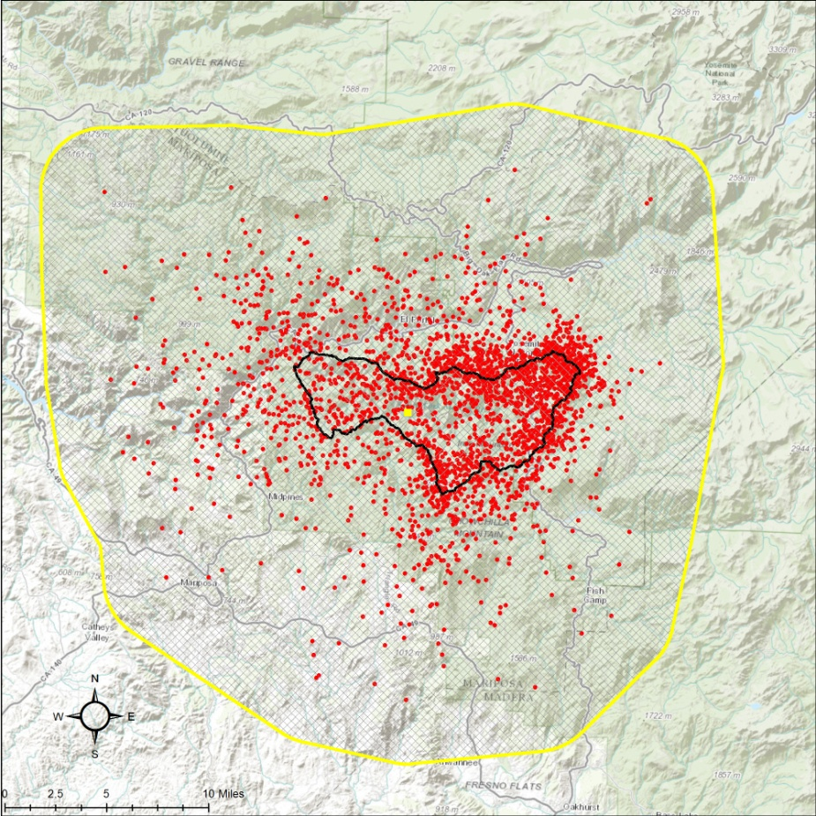

Slide 14
Fireshed analysis, Pawnee Montane Skipper habitat

Slide 15
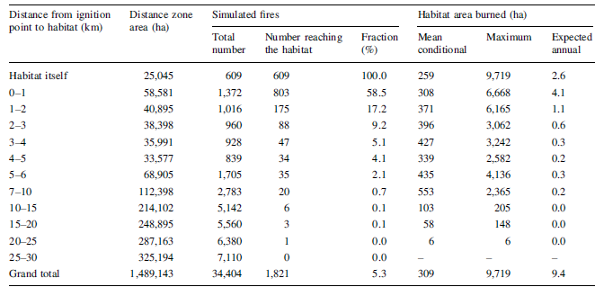
Fireshed analysis

Slide 16
Fireshed analysis, Island Park, Idaho

Slide 19
Distance from structure to ignition (km) | Distance zone area (ha x 1000) | Fraction of large fires reaching at least one structure | Expected annual structures exposed | Proportion exposed (%) | Cumulative proportion exposed (%)
0-1 | 32 | 81.4 | 2.15 | 34.7 | 34.7
1-3 | 52 | 42.2 | 2.20 | 35.5 | 70.2
3-5 | 39 | 15.9 | 1.00 | 16.1 | 86.3
5-7 | 37 | 6.69 | 0.42 | 6.72 | 93.0
7-10 | 56 | 5.06 | 0.35 | 5.70 | 98.7
10-15 | 93 | 1.13 | 0.07 | 1.19 | 99.9
15+ | 73 | 0.36 | 0.005 | 0.08 | 100.0
TOTAL | 381 |  | 6.20

Slide 20
risk = eNVC

Slide 21
5.4% annual chance of exposing at least one structure to fire
1-in-10,000 annual chance of exposing at least 2,000 structures to fire

Slide 22
1-in-100 annual chance of exposing at least 171 structures to fire
171

Slide 23
Risk assessment for incident management

Slide 24
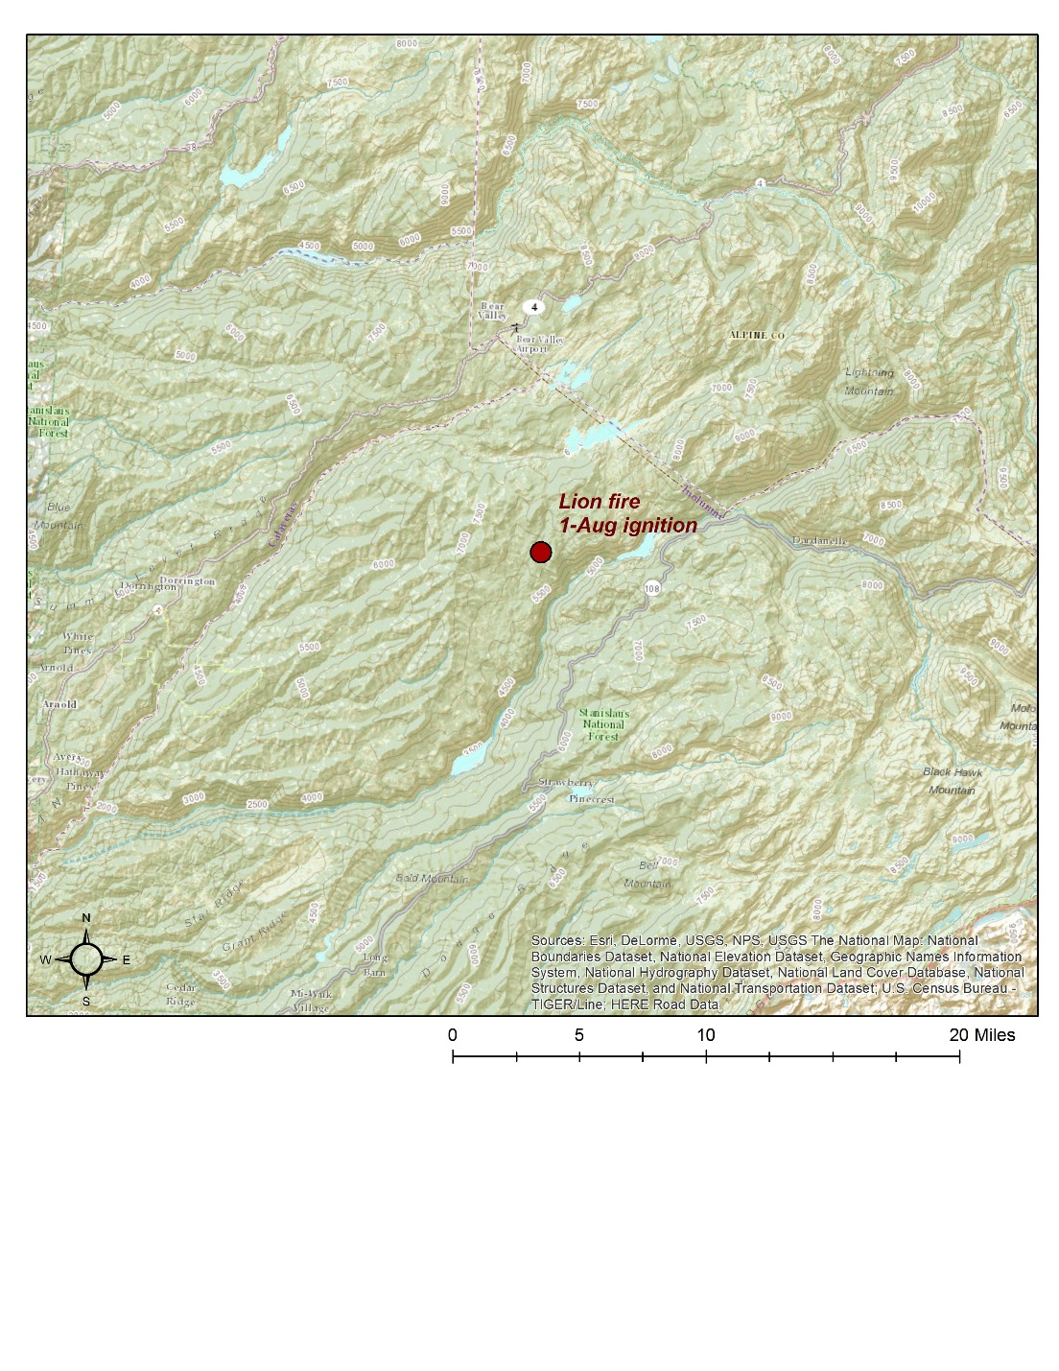

Fire start: 8/1

Slide 25
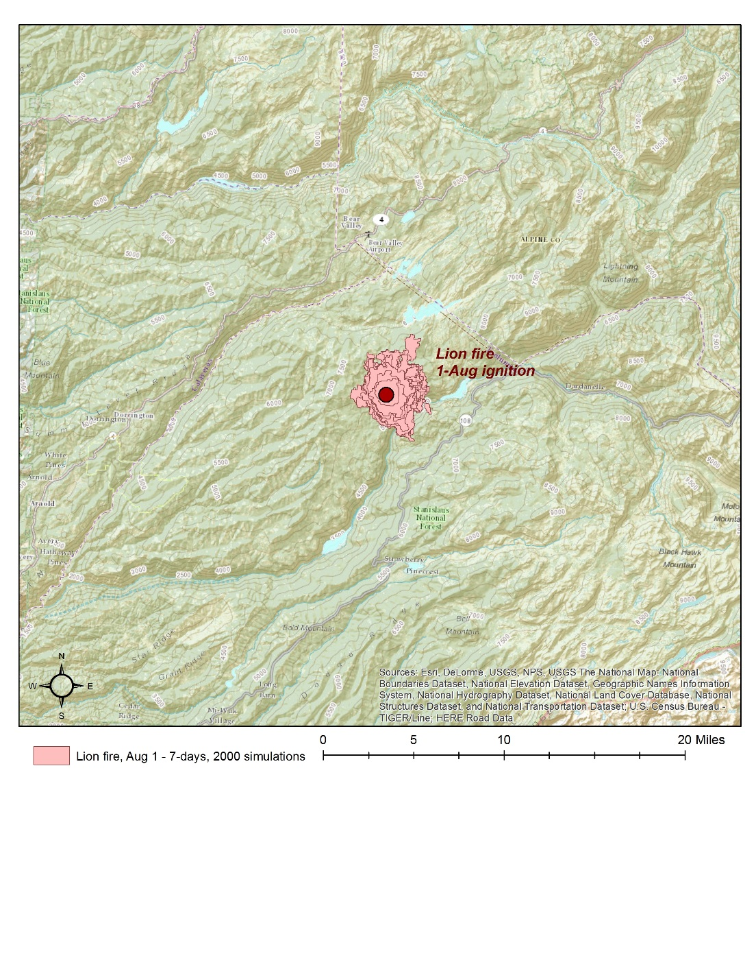
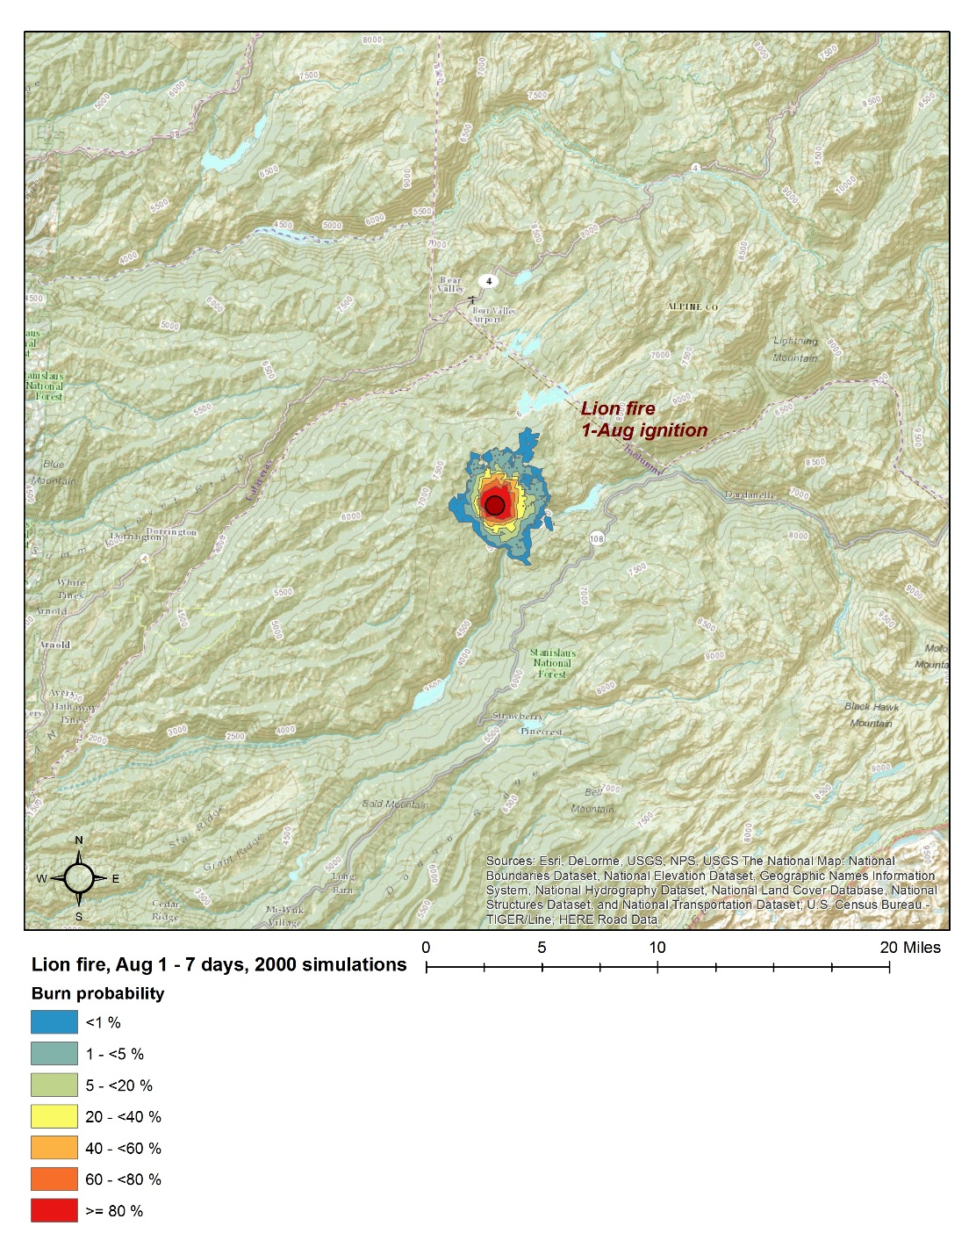
7-day outlook

Slide 26
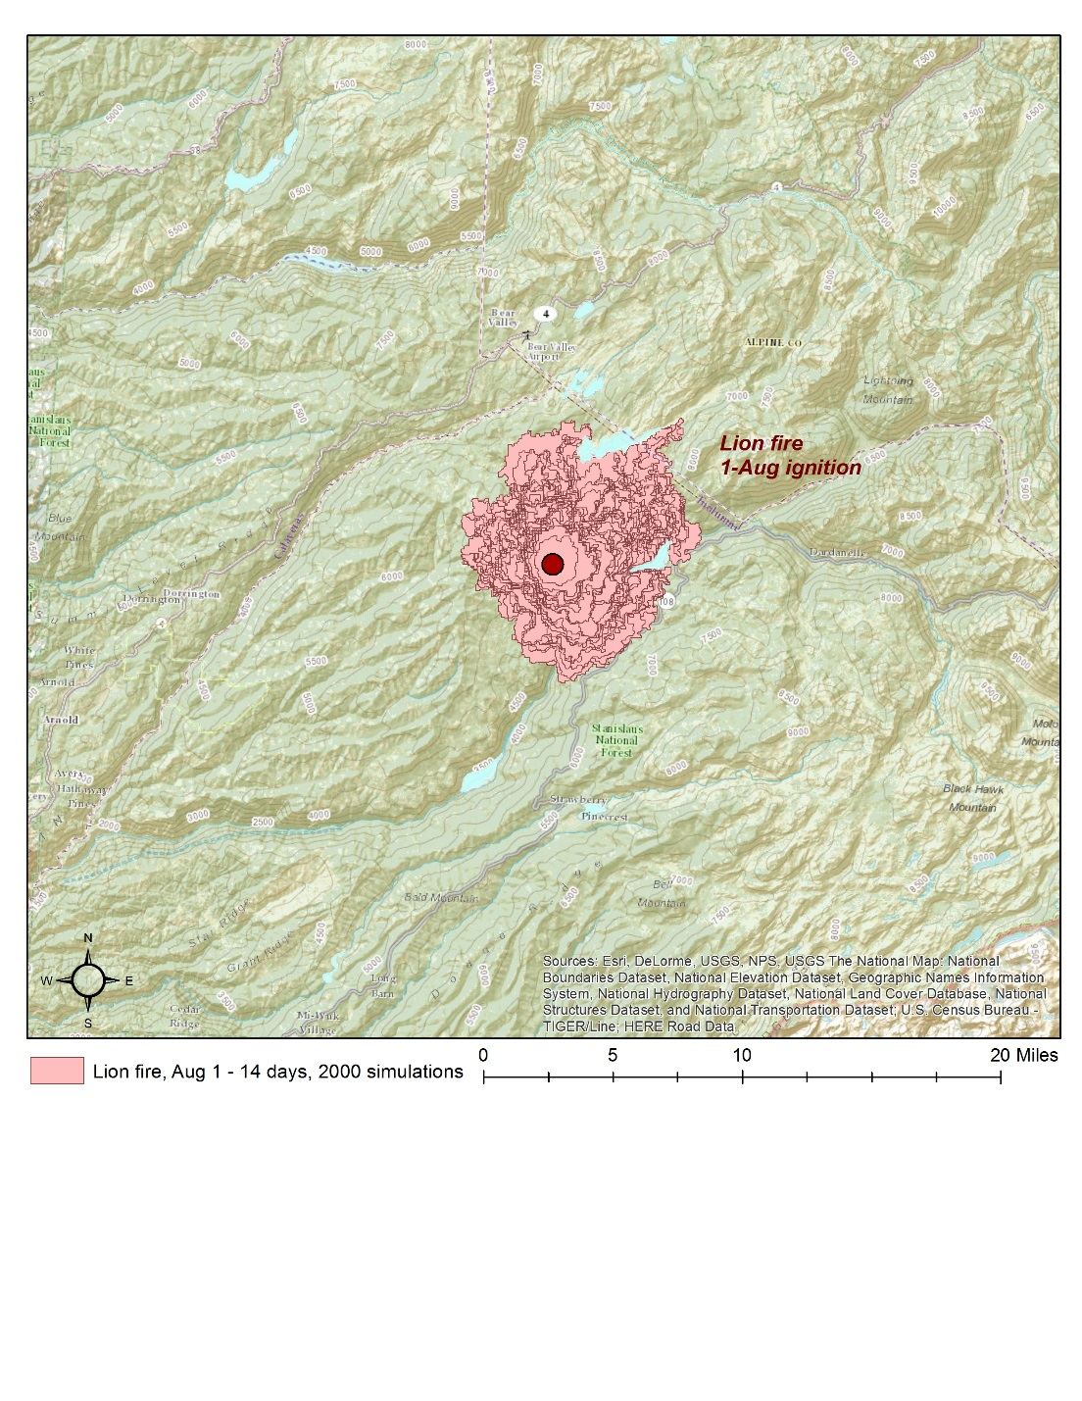
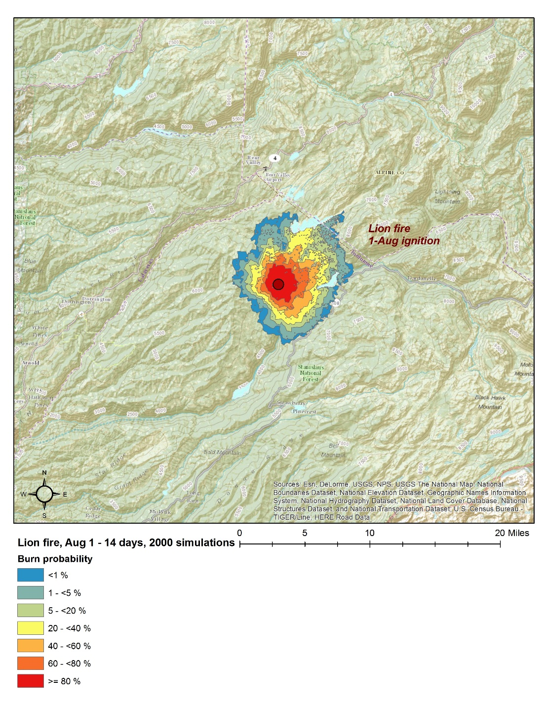
14-day outlook

Slide 27
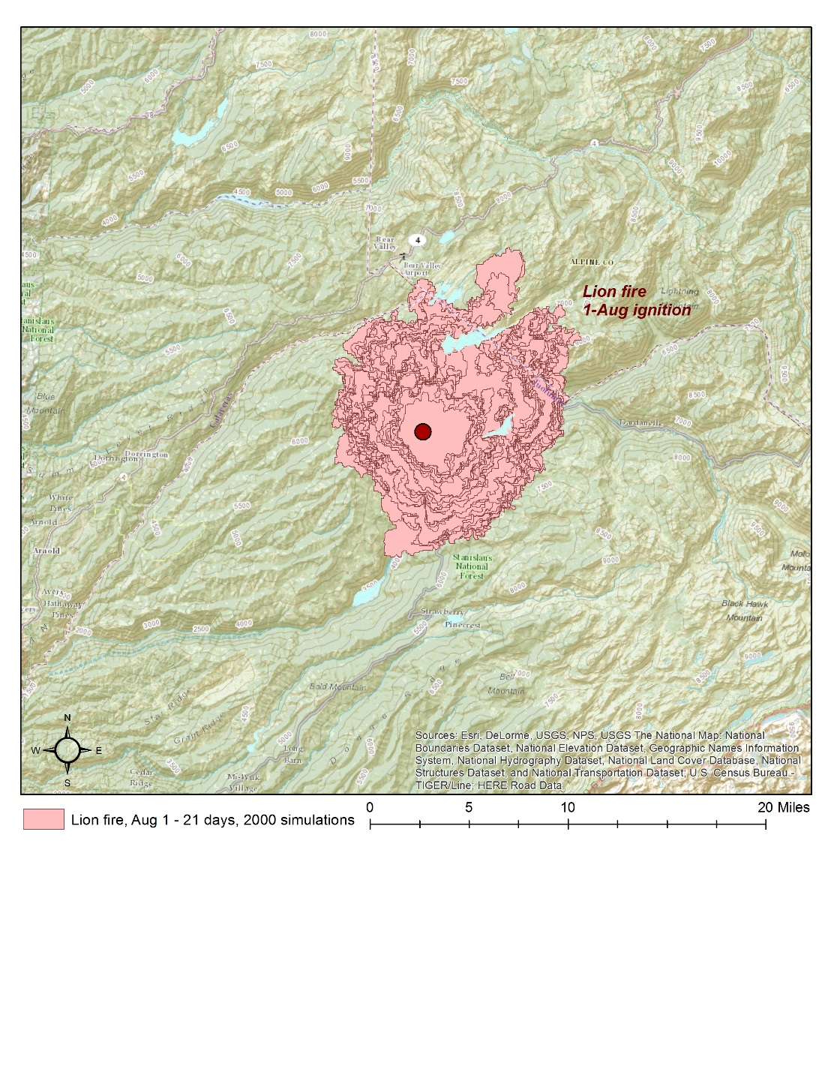
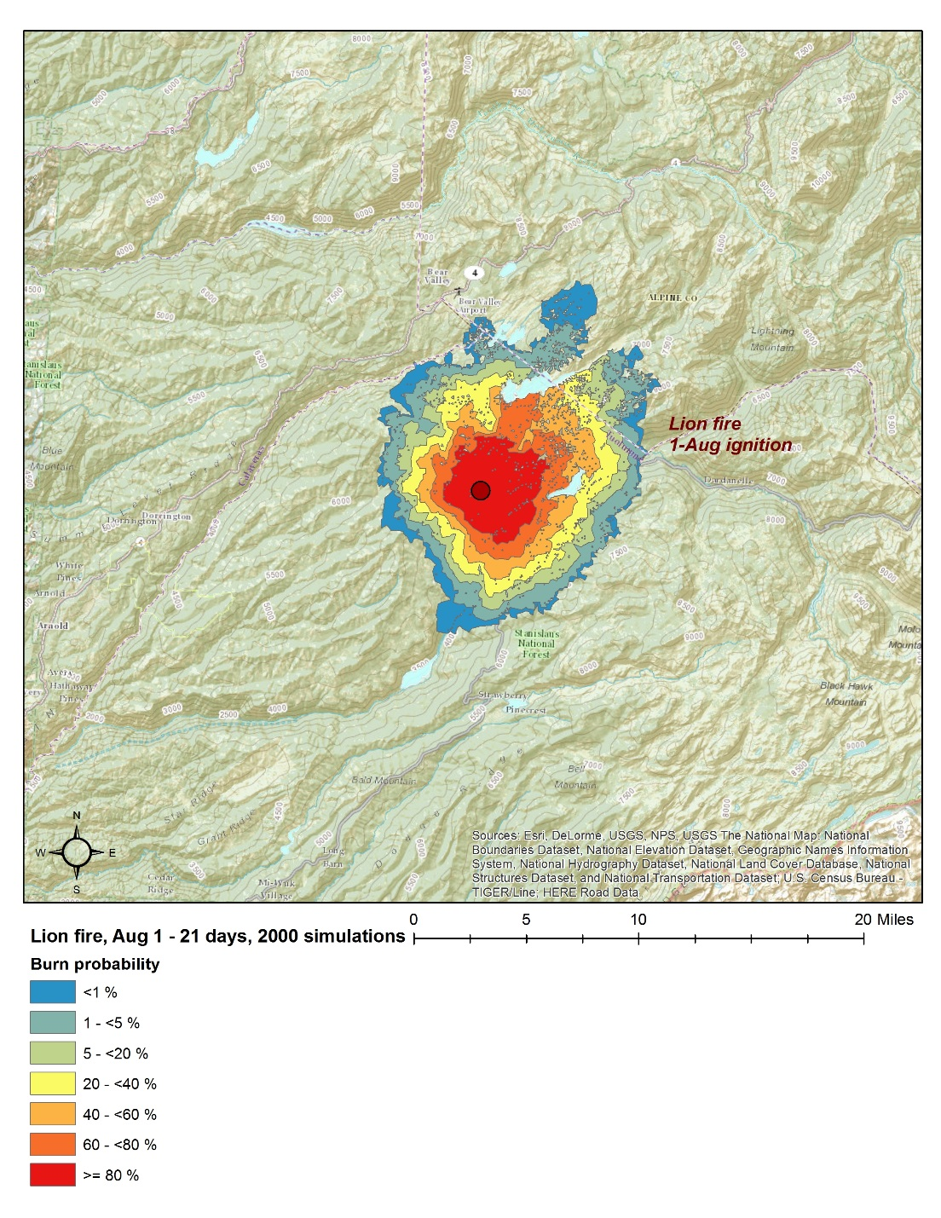
21-day outlook

Slide 28
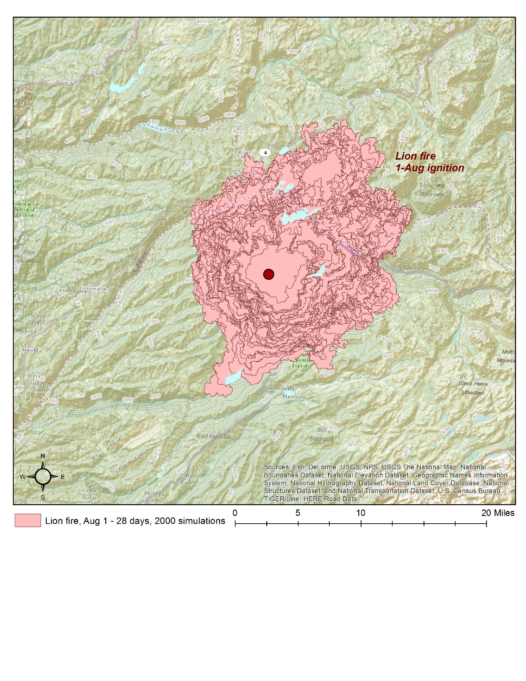
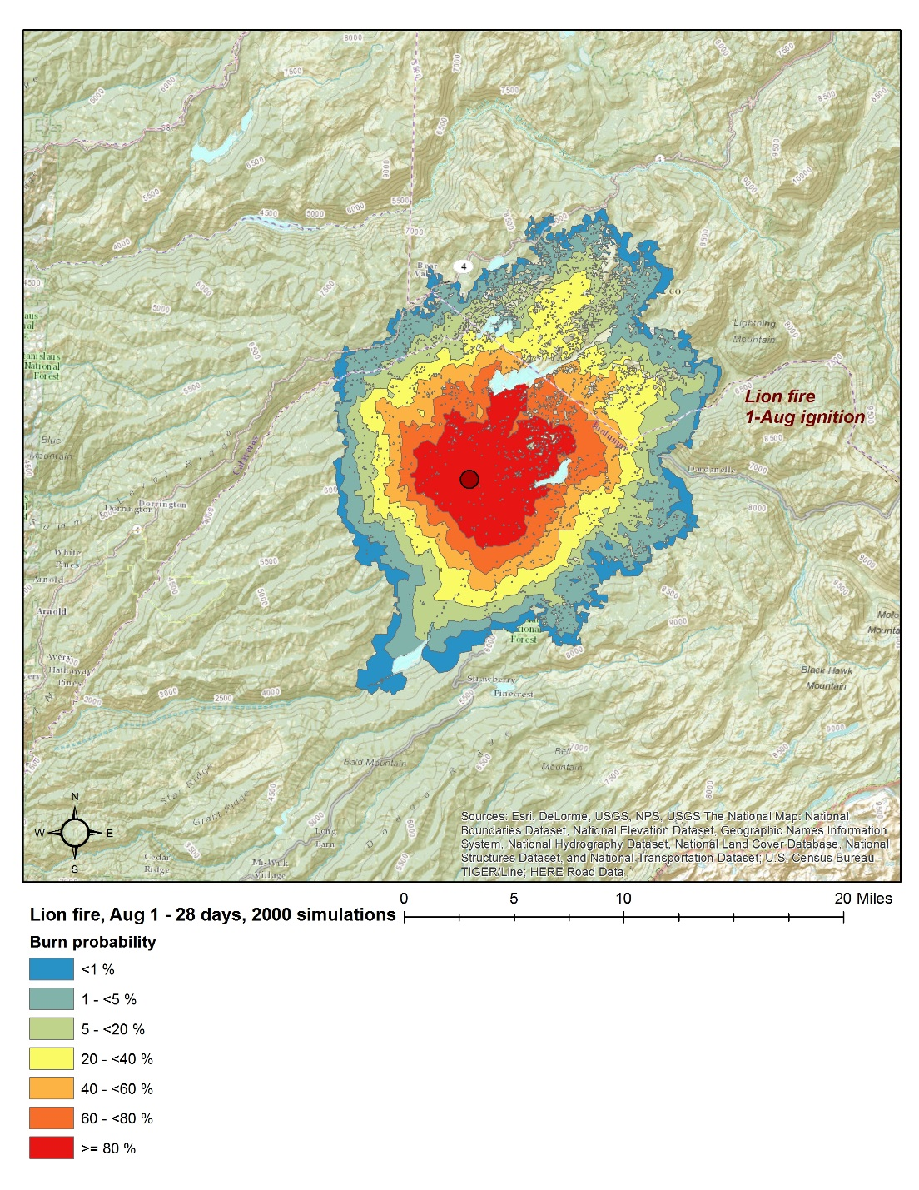
28-day outlook

Slide 29
Add slides here
EP curve for fire size

Slide 30
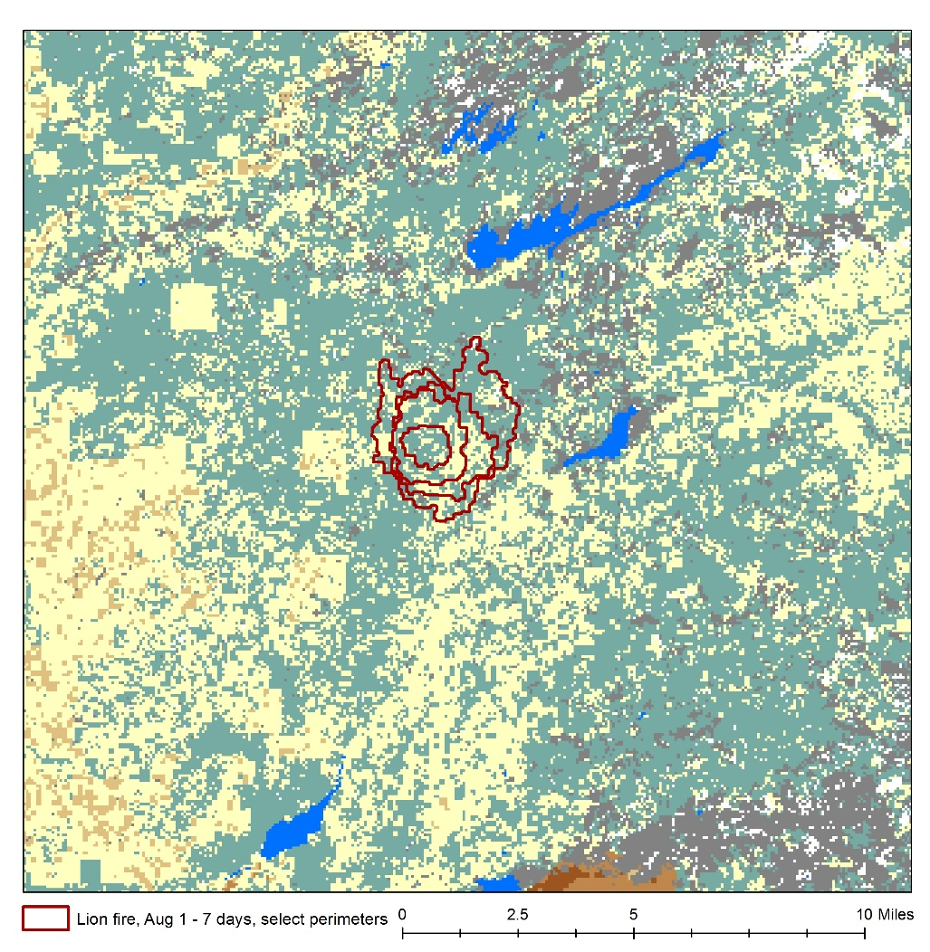
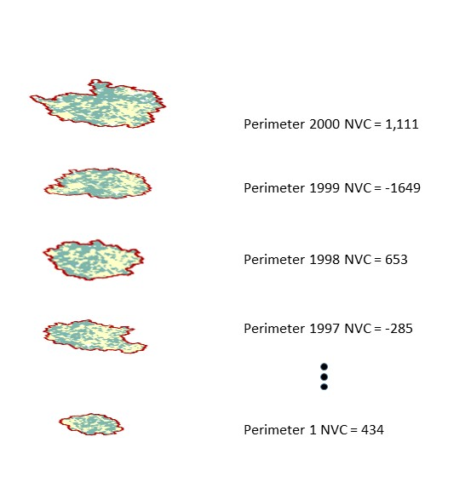
Fire-level NVC (sum of cNVC)

Slide 38
Incident comparison
Basin fire
Lion fire

Slide 39
Incident comparison

Slide 40
Risk assessment for fire management planning

Slide 41
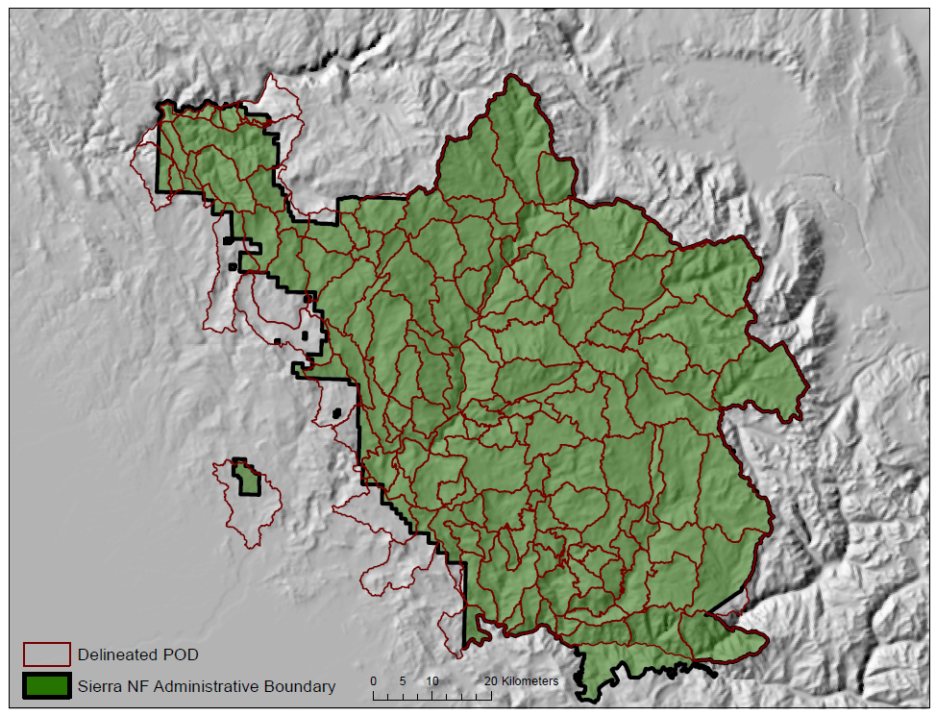
Potential wildland fire Operations Delineations (PODs)

Slide 42
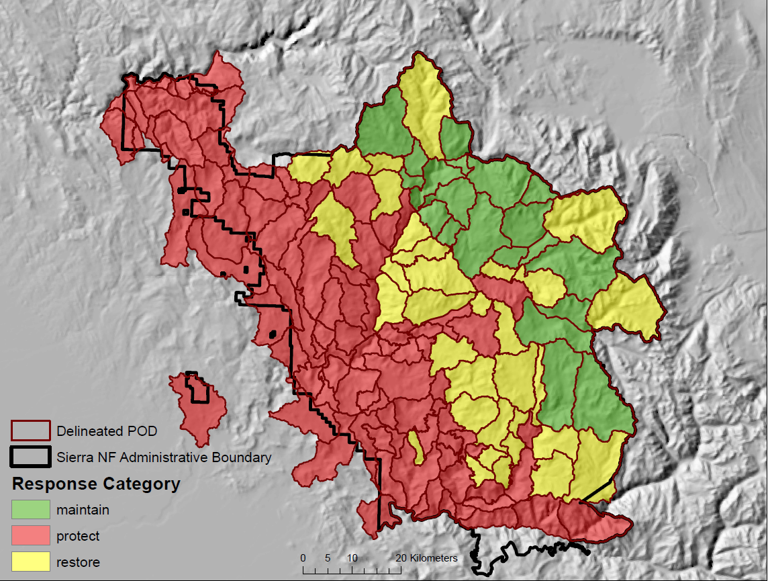
POD categorization

Slide 43
Phil Bowden et al.

Slide 44
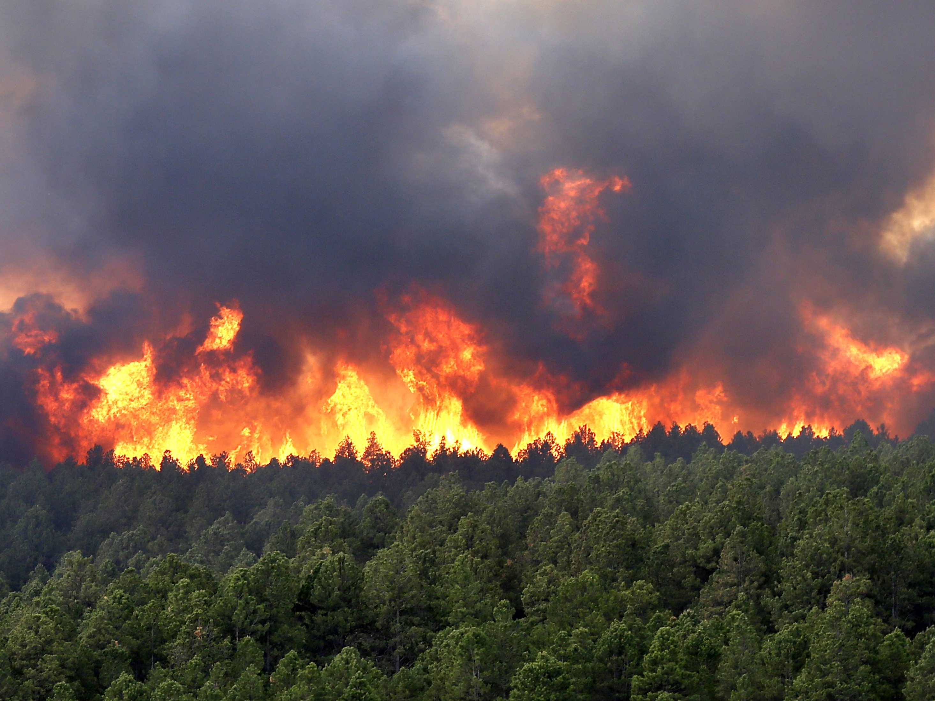
Joe H. Scott
Pyrologix LLC
406-549-2340
joe.scott@pyrologix.com
www.pyrologix.com

