Slide 1
Social science to inform Resource management
Troy Hall
Forest Ecosystems & Society
March 8, 2016

Slide 2
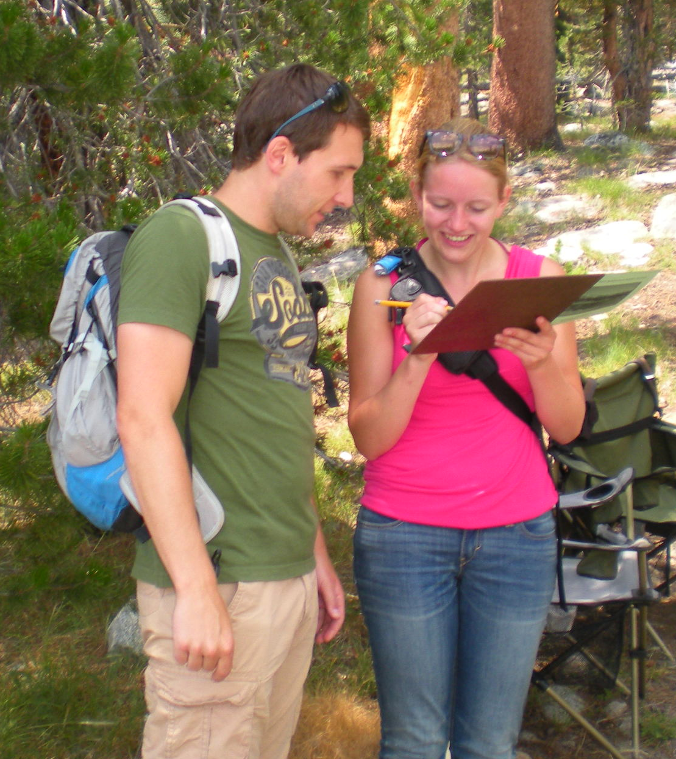
Our task…
Discuss researchable questions & tools to answer them
Describe how information can be used
Provide examples
Notes:
Assumptions about audience level of knowledge

Slide 3
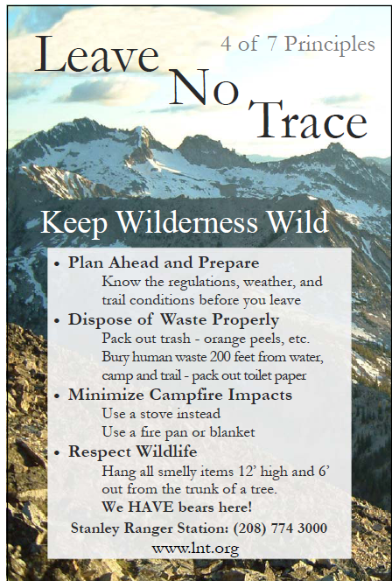
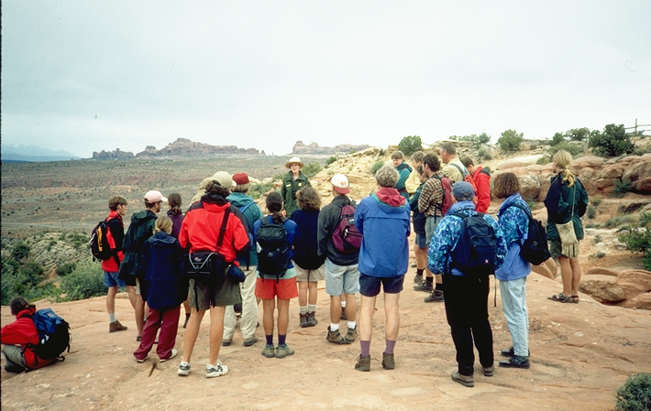
My orientation
Social psychology – beliefs, attitudes, values
Communication
Notes:
Lots of studies of public understanding and attitudes, including for the USFS;
Focus on development of communication and evaluation of effectiveness

Slide 4
Overview
Three themes:
  Social science to describe recreation use and impacts
  Social science to describe and quantify public sentiments
  Social science to develop effective programs
Conclusions: value of social science to resource planning and management

Slide 5
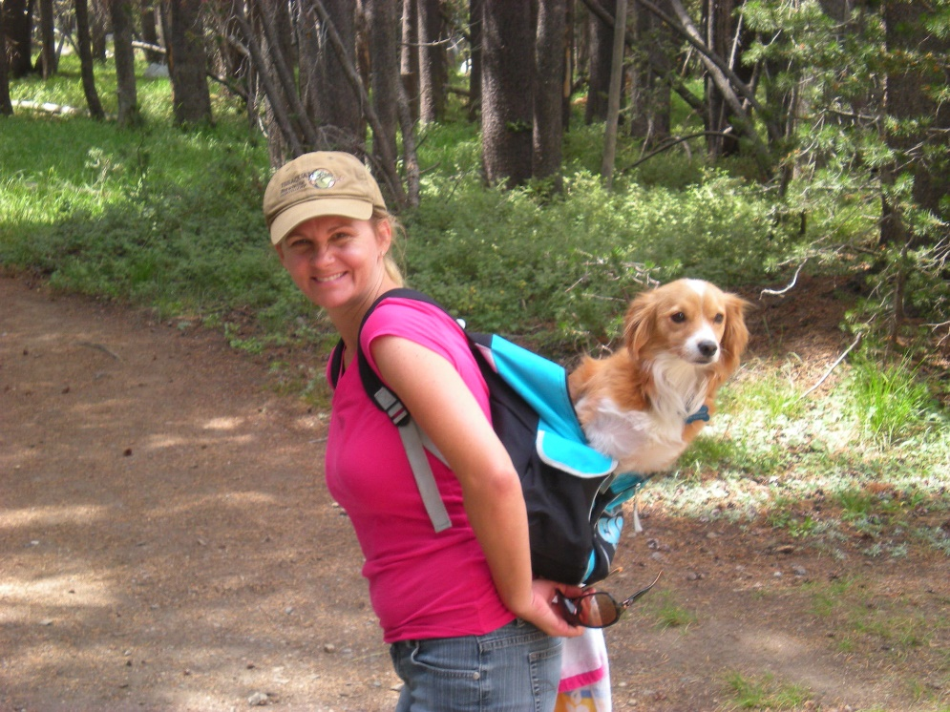
1. Social science to describe recreation use and impacts
Why?
  Protect experiences and resources
  Required monitoring
  Develop effective management strategies
Notes:
Experience quality and access to recreation is sometimes in tension with resource protection mandates.
Forest plans and other plans require monitoring of some indicators
Understanding recreation use trends and impacts can help lead to effective and acceptable management policies

Slide 6
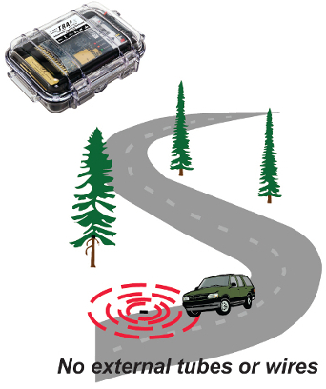
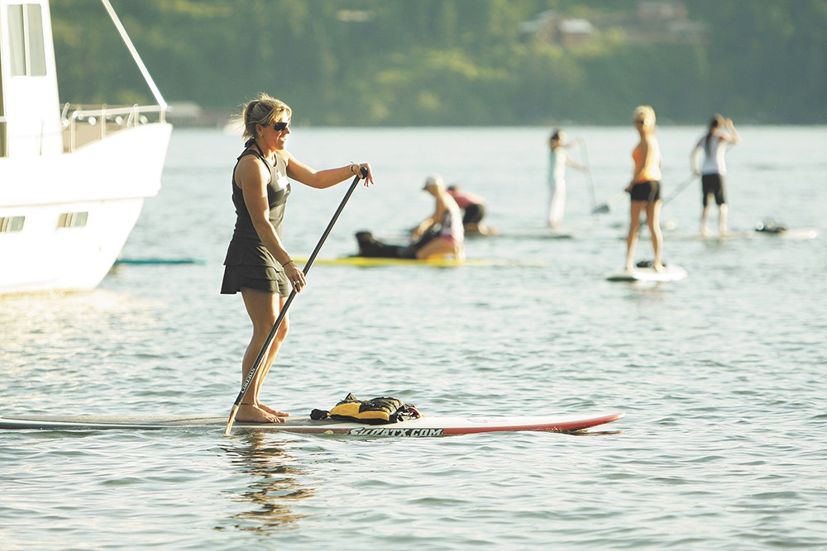
1. Social science to describe recreation use and impacts
  Develop efficient, defensible protocols to monitor trends in recreation (amounts, types)
TRAF-X
www.inlander.com
Notes:
Recreation is dynamic and responds to many different factors – the economy, marketing/publicity, changes in leisure time and interests. To plan for the future, managers need information about trends – in activities, in user segments, in space and time
Social science can develop efficient protocols for monitoring these trends at different spatial scales.

Slide 7
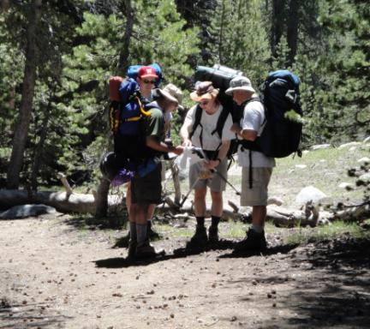
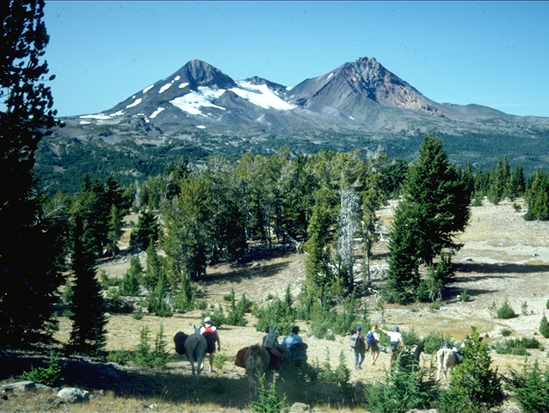
1. Social science to describe recreation use and impacts
Example: monitoring solitude opportunities in wilderness
  Purpose
  Sampling
  Data collection & analysis
Notes:
National initiative to monitor wilderness character. As part of that, I developed a protocol for use across the wilderness system to track outstanding opportunities for solitude.
Worked with Willamette and Deschutes to identify sampling areas, establish a sampling strategy, collect and analyze data in 2014.
Added value in that we had data collected in the early 1990s and could use this to track trends over time.

Slide 8
1. Social science to describe recreation use and impacts
Notes:
A number of things stand out:
Green lakes – holy cow
Some locations were quite constant (no change)
Pamelia decreased – use limits?
Marion lake – fire?

Slide 9
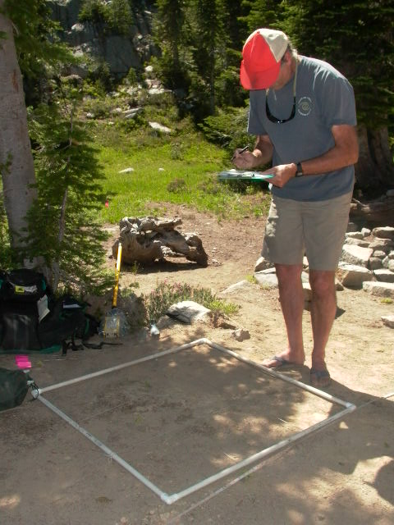
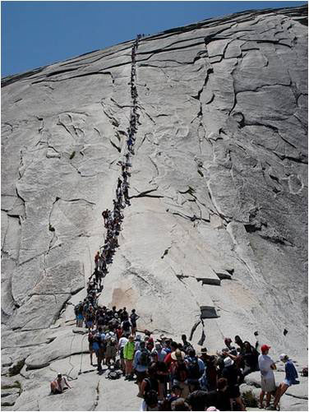
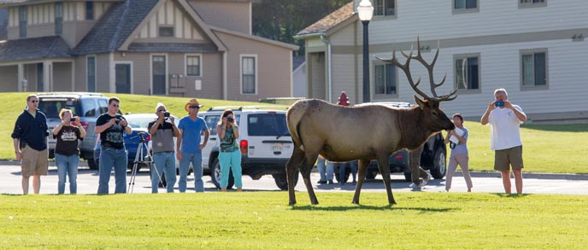
1. Social science to describe recreation use and impacts
  Understand relationships between recreation use and impacts (e.g., vegetation, wildlife, visitor conflict)
Photo: NPS
Photo: Wilderness Watch

Slide 10
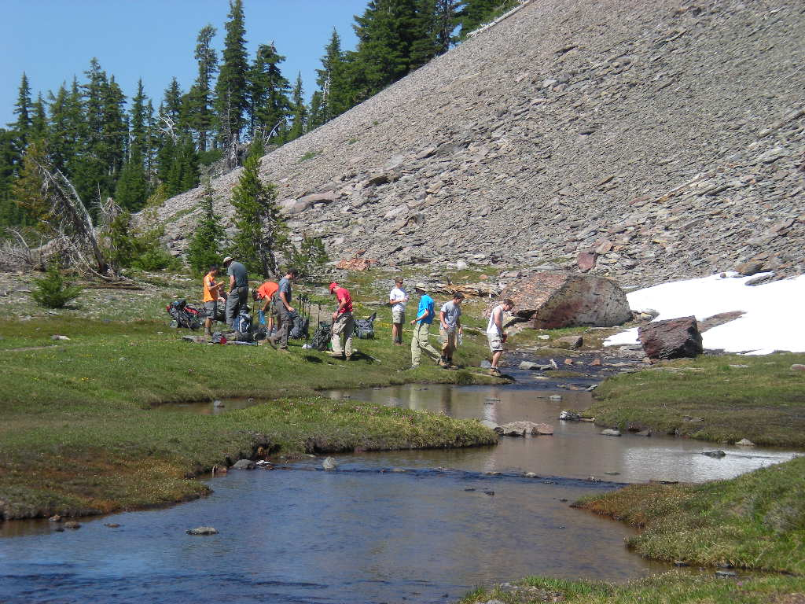
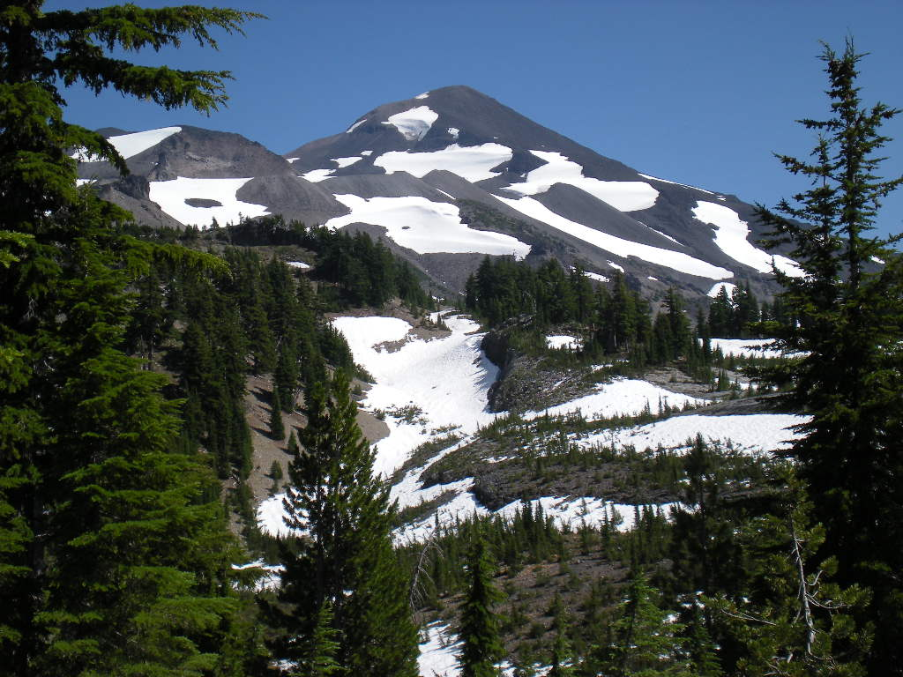
1. Social science to describe recreation use and impacts
  Example: Obsidian Falls (Three Sisters Wilderness)
    Concerns
    Need for data
Notes:
Use was increasing in wilderness. Popular areas like Obsidian were feared to be exceeding forest plan standards for conditions

Slide 11
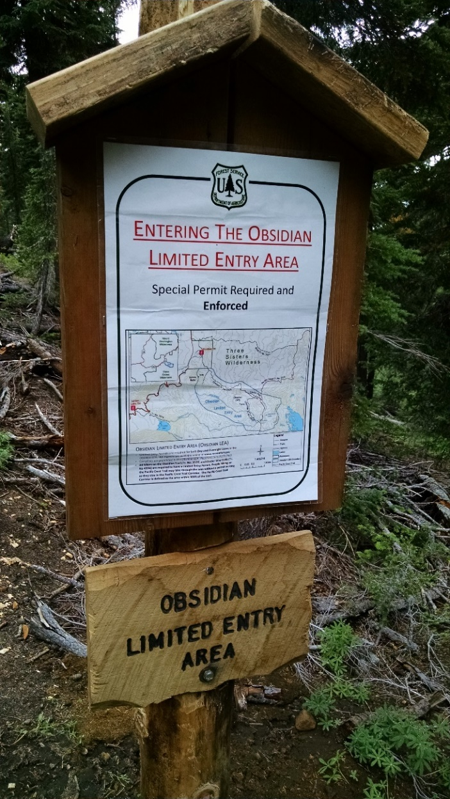
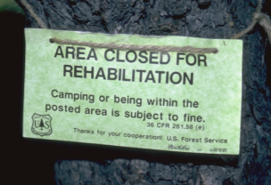
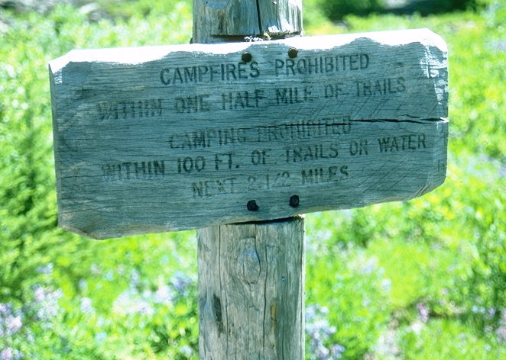
1. Social science to describe recreation use and impacts
  Example: Obsidian Falls Limited Entry Area
2moremiles.com
Notes:
Managers wanted to take action to address recreation impacts at Obsidian – campsites, fires, crowding. Needed to understand the relationship between visitation (the thing you can control) and the impacts.
We were able to use encounter data and data on visitation (from self-issue permits) to quantify relationships. The permitted establishment of a use limit that would ensure conditions stay within forest plan standards.
We also established long-term plots to monitor changes at wilderness campsites (after a fire ban). Found that the campfire ban was successful, but site rehab was not.

Slide 12
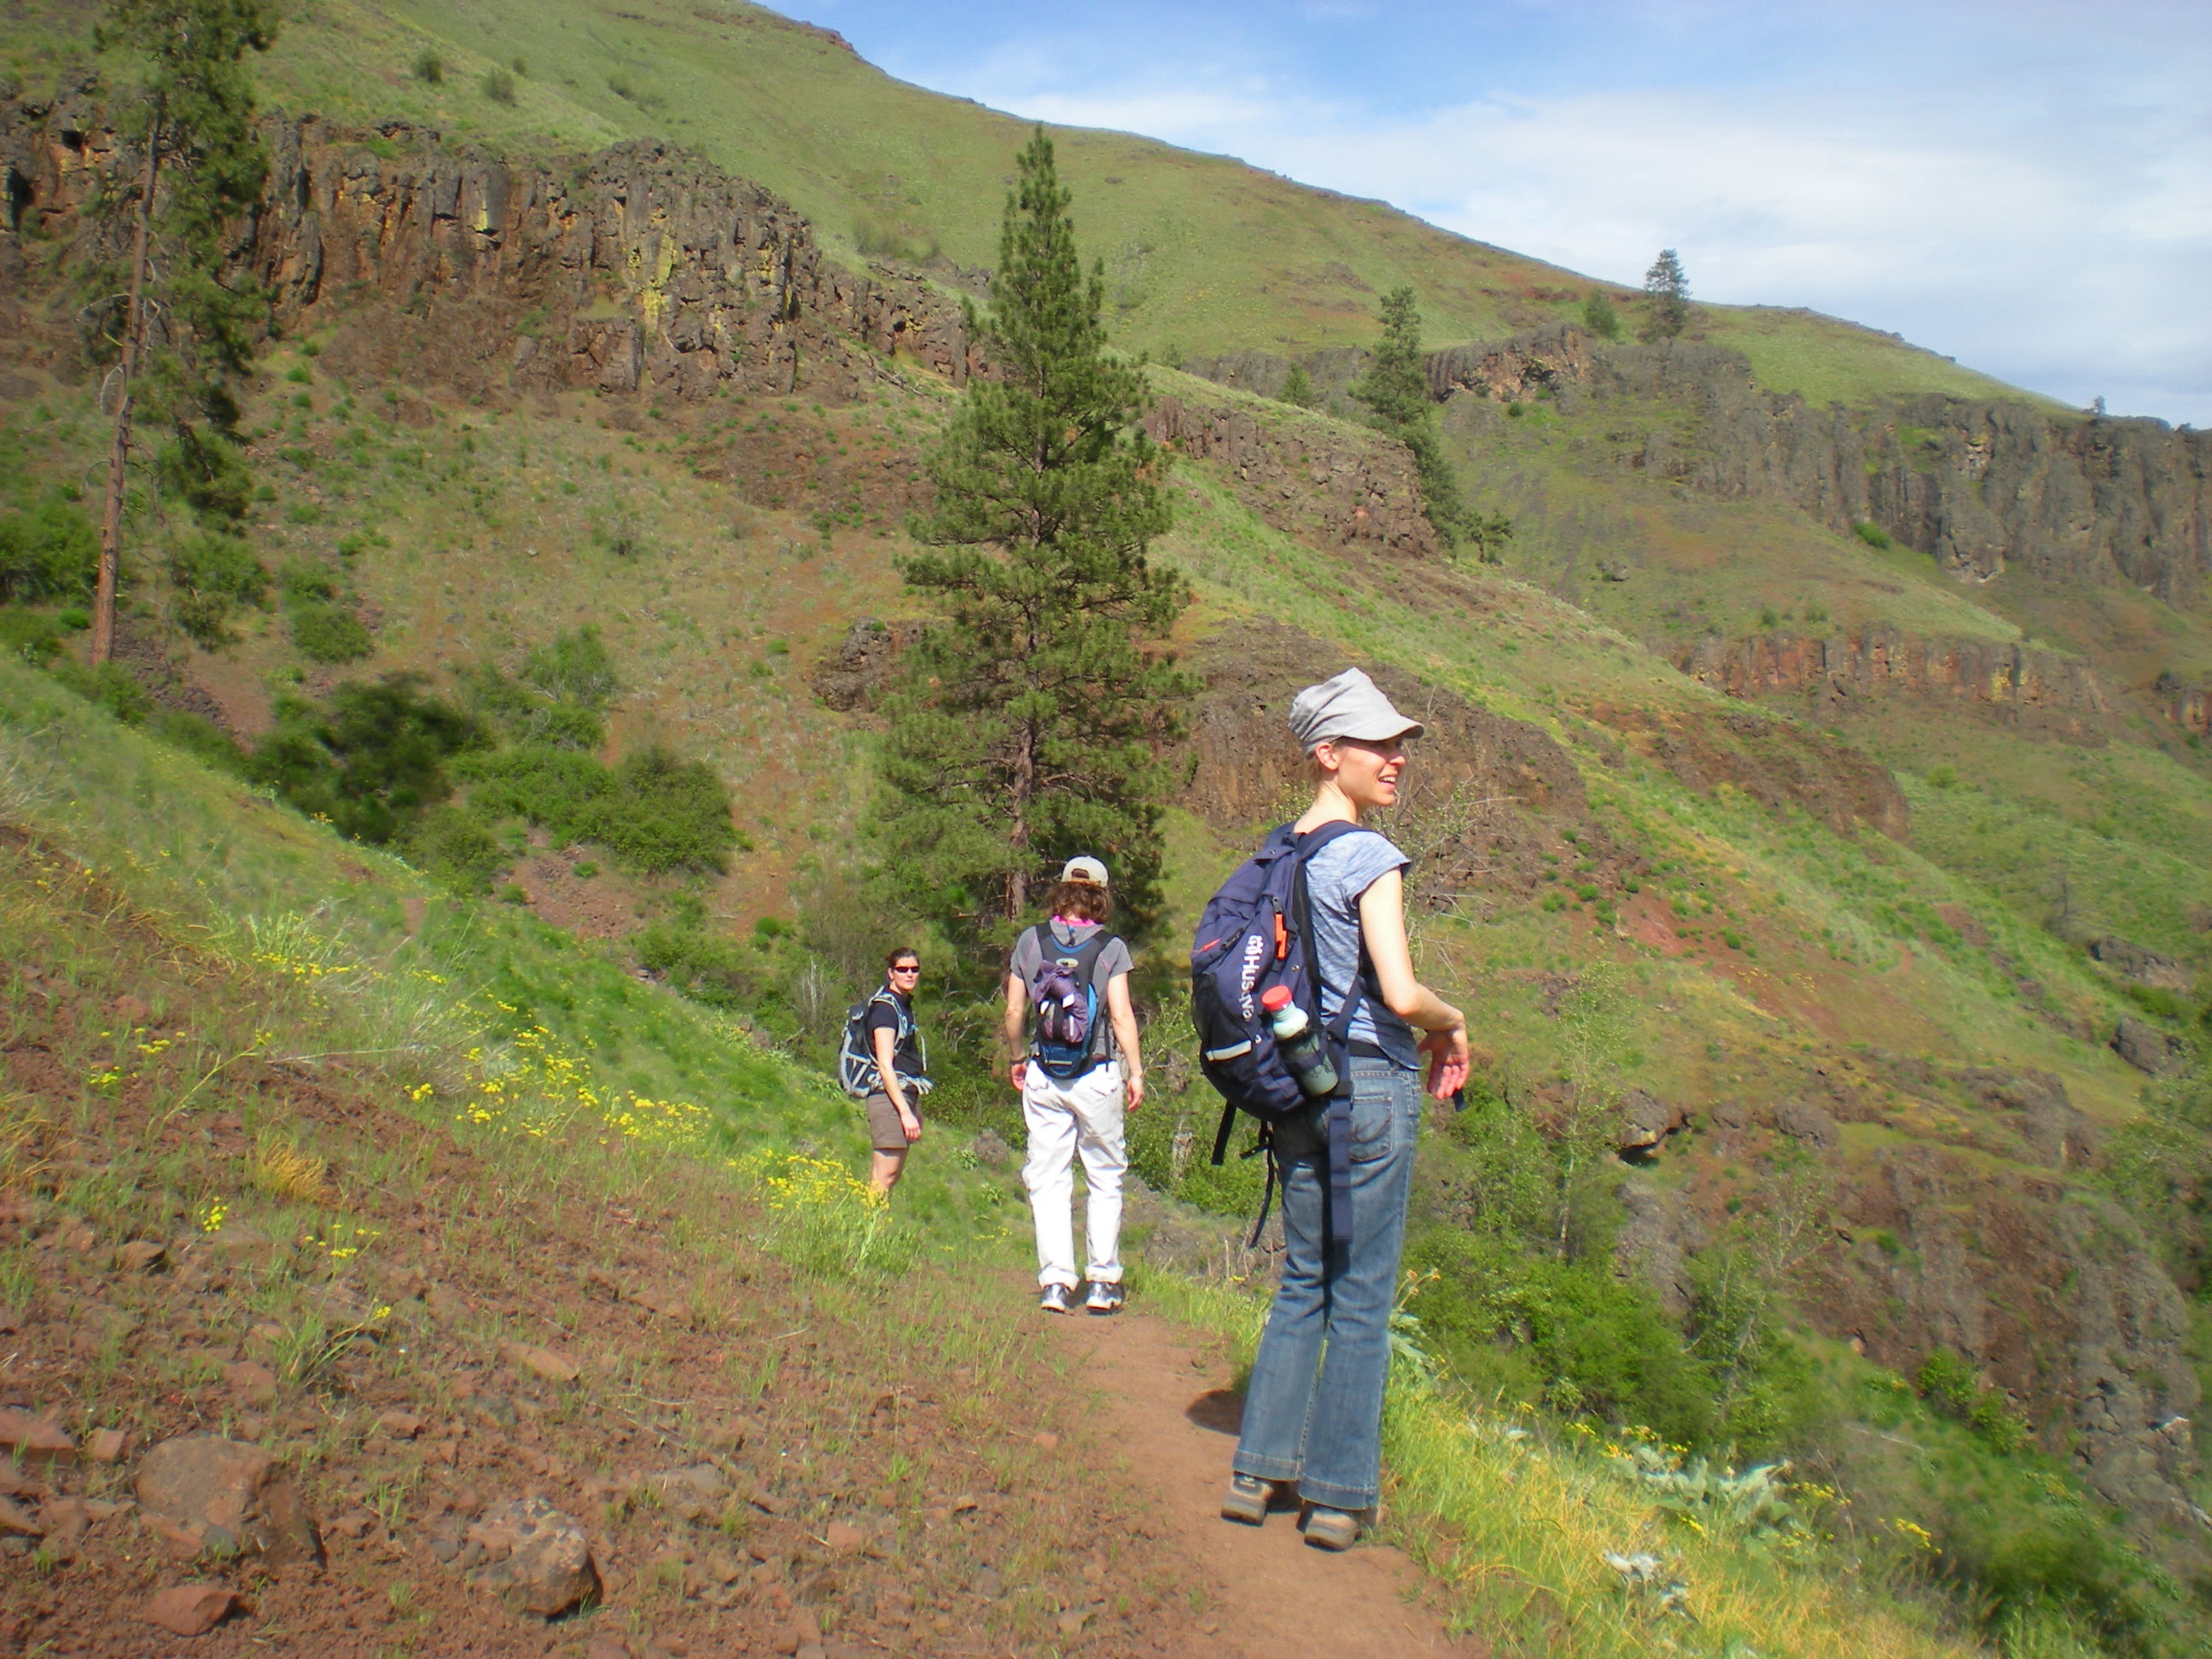
2. Describe and quantify public sentiment
  Why?
    Provide high quality experiences
    Develop defensible actions using representative, objective data

Slide 13
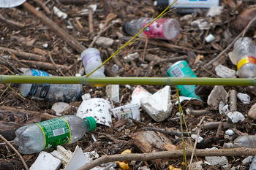
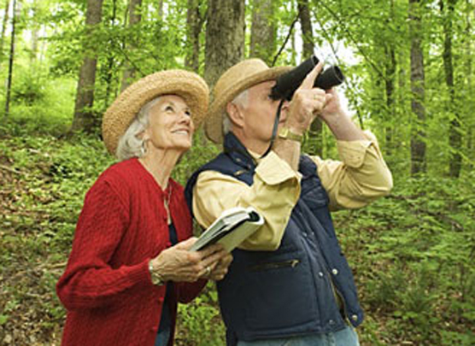
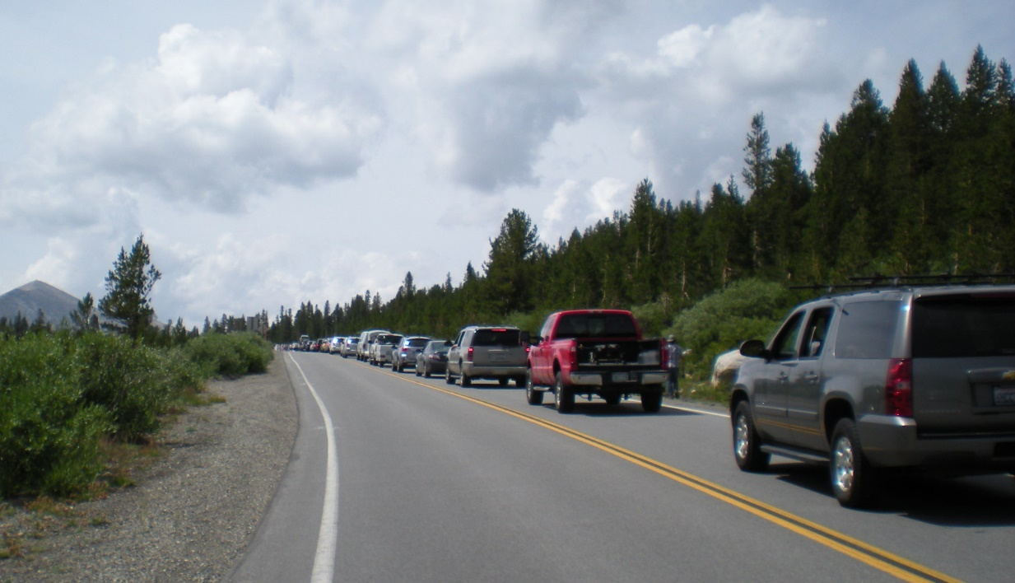
2. Describe and quantify public sentiment
  Identify factors that influence experience quality
Voicesofyouth.org
Nps.gov
Notes:
A major thrust in human dimensions work has been on the benefits people get from outdoor recreation and understanding the factors that influence experience quality.
This research has helped prioritize policies and programming, identify indicators and standards used in plans, and ensure best practices in recreation and tourism provisioning

Slide 14
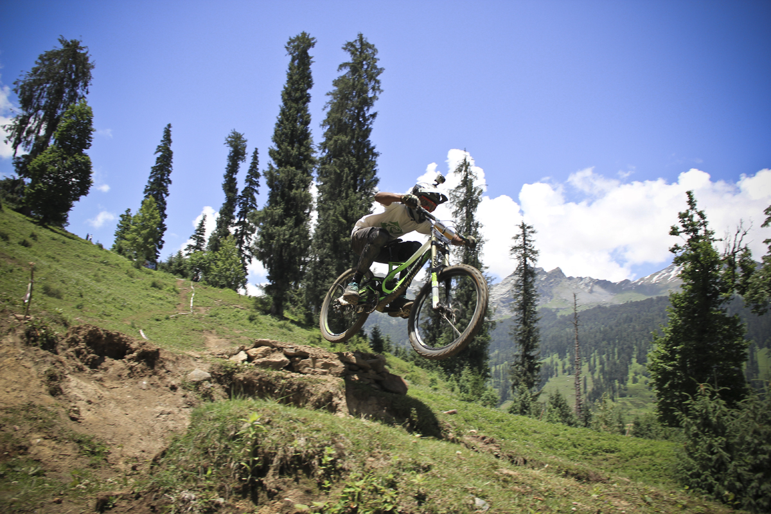
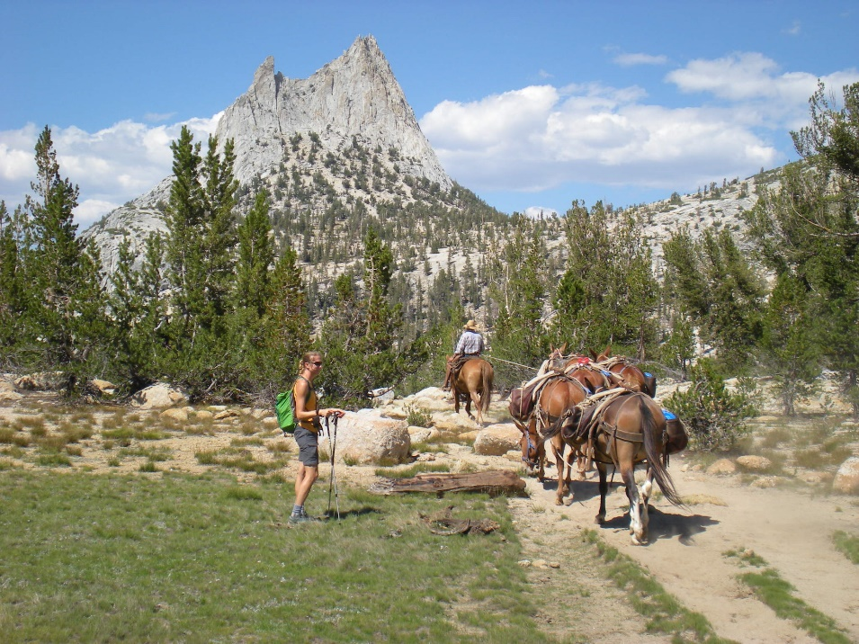
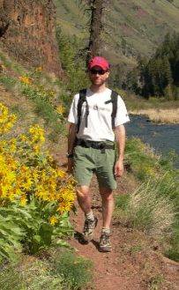
2. Describe and quantify public sentiment
    Understand variations across stakeholder segments
Wikipedia.org

Slide 15
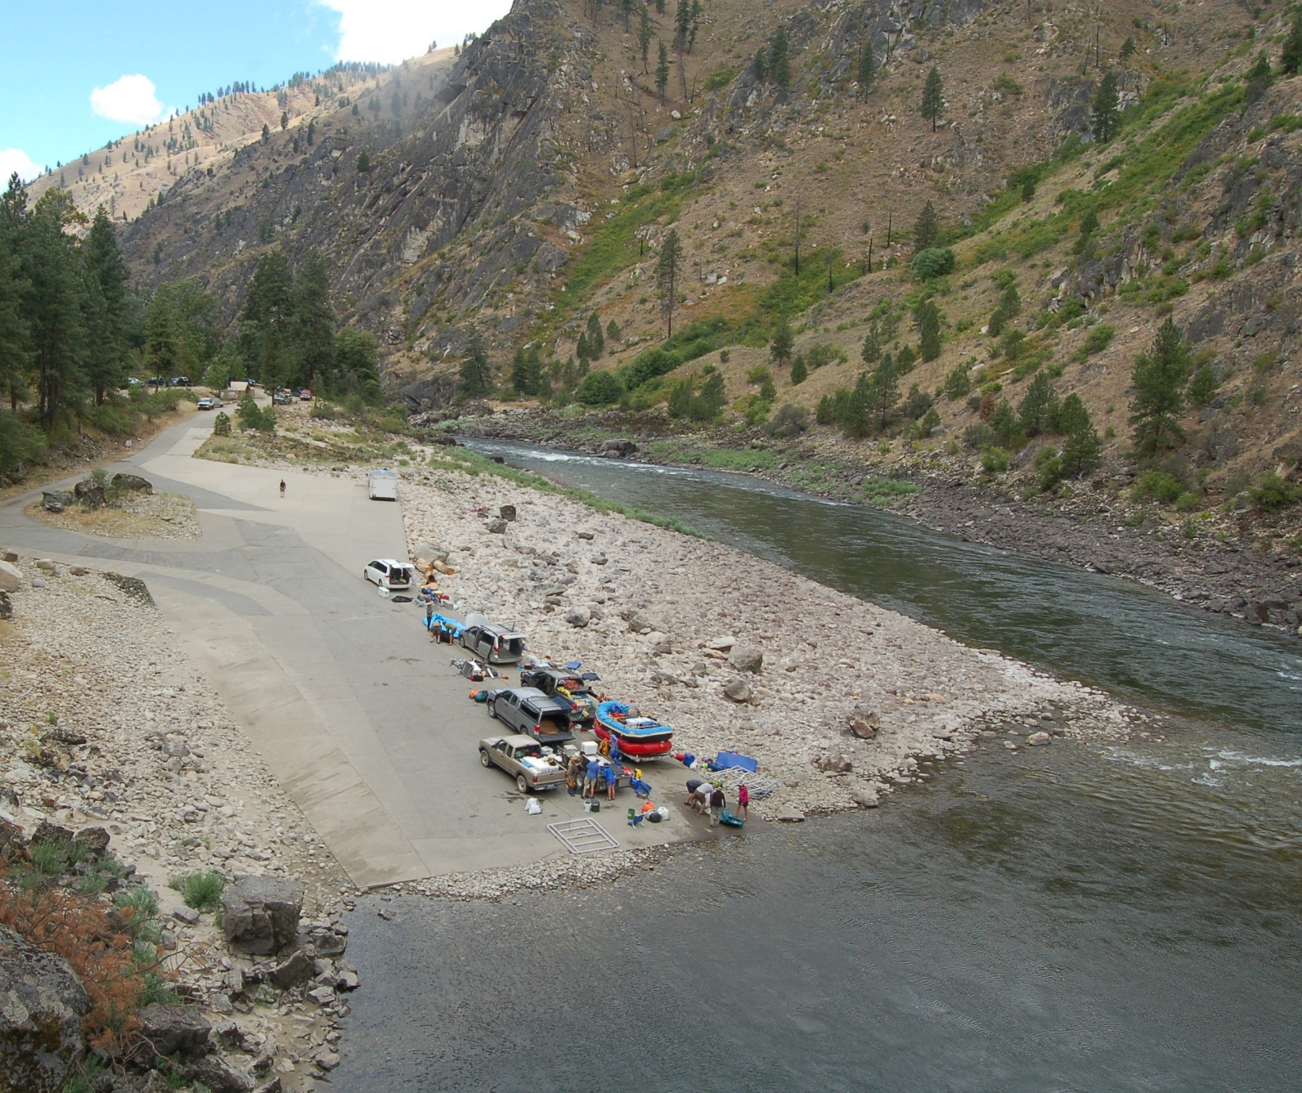
2. Describe and quantify public sentiment
  Example: Boating in Hells Canyon
    How have experiences changed?
    How to deal with assertions about experience quality?
Blackadarboating.com
Notes:
Added motor-free times in the wild stretch. Did not add float-free times. Assertions by stakeholders that “everyone” feels one way or another

Slide 16
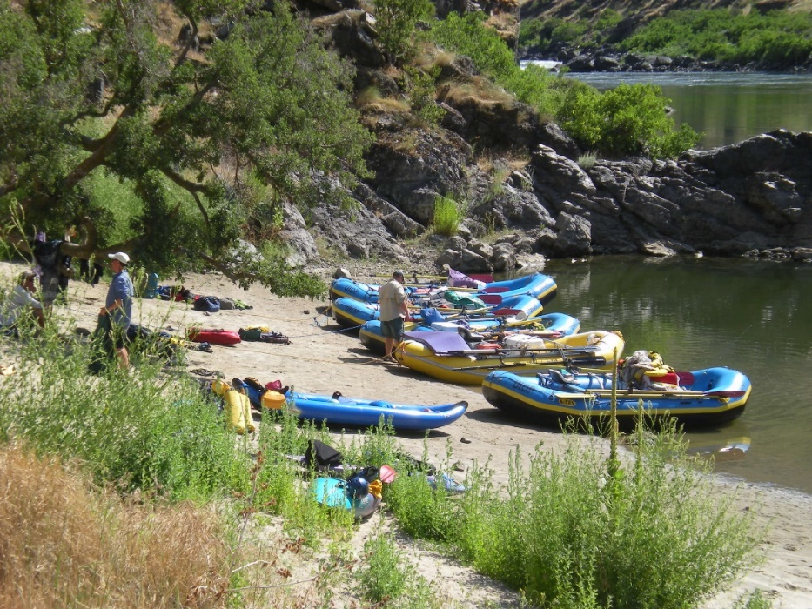
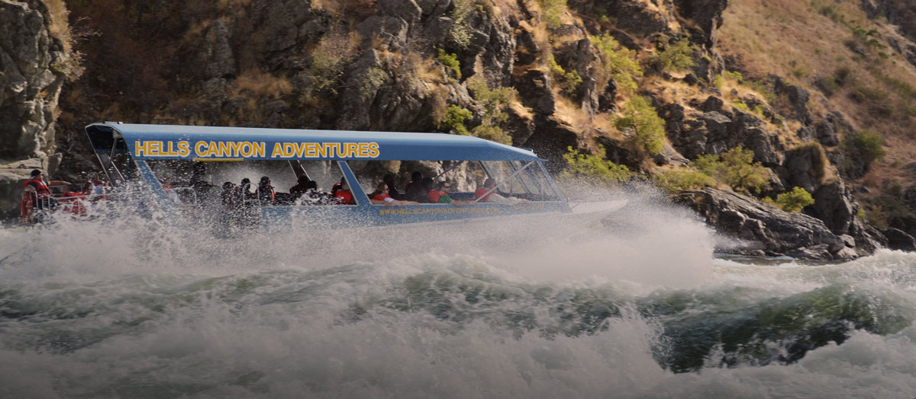
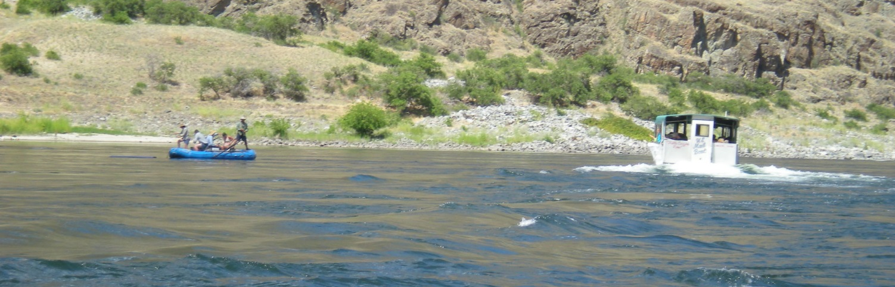
2. Describe and quantify public sentiment
  Approach
18summers.us
Notes:
Approach:
Segment the population and sample to obtain representative samples of each
On site surveys
Developed questions in consultation with stakeholders

Slide 17
Notes:
Determined that many of the factors were not “major” issues for a majority of the public. Some factors (e.g, camping in sight) had been anticipated to be issues; but turned out not to be.
Highlights concern among private floaters about power boaters → support for maintaining motor-free window. Encountering float boaters was positive → no need for “float free” window

Slide 18
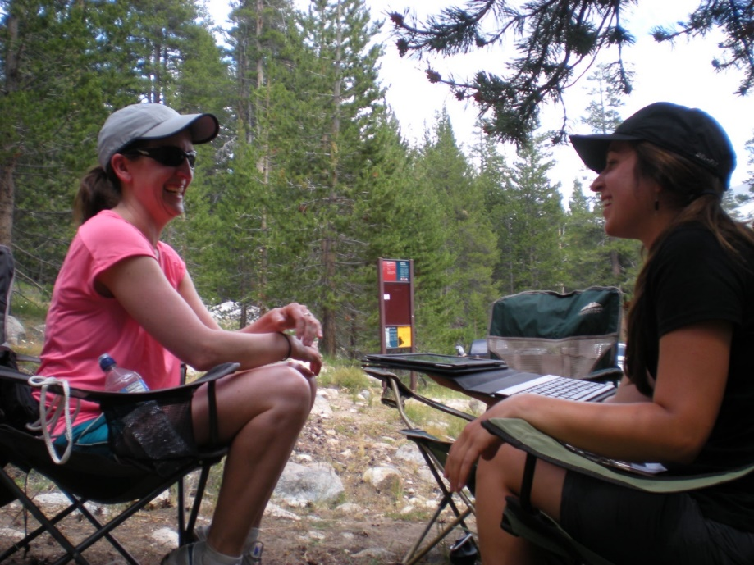
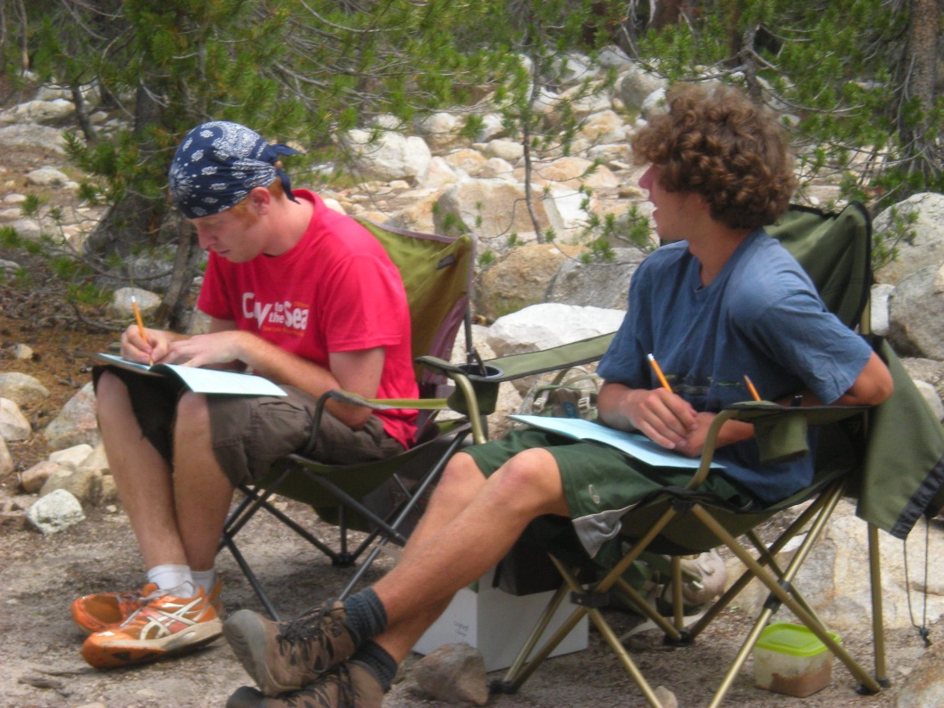
2. Describe and quantify public sentiment
  Assess public support for policies and practices

Slide 19
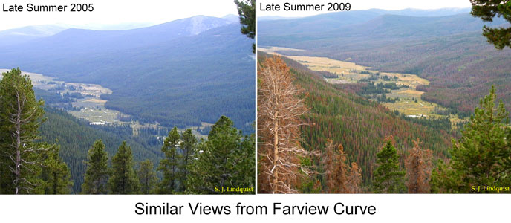
2. Describe and quantify public sentiment
  Attitudes toward forest management in Grand County
    Purpose & approach
NPS
Notes:
MPB 1995-2008 – 3 million acres in county
234 questionnaires

Slide 20
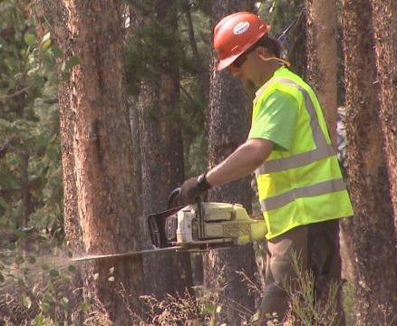
Denver.cbslocal.com

Slide 21
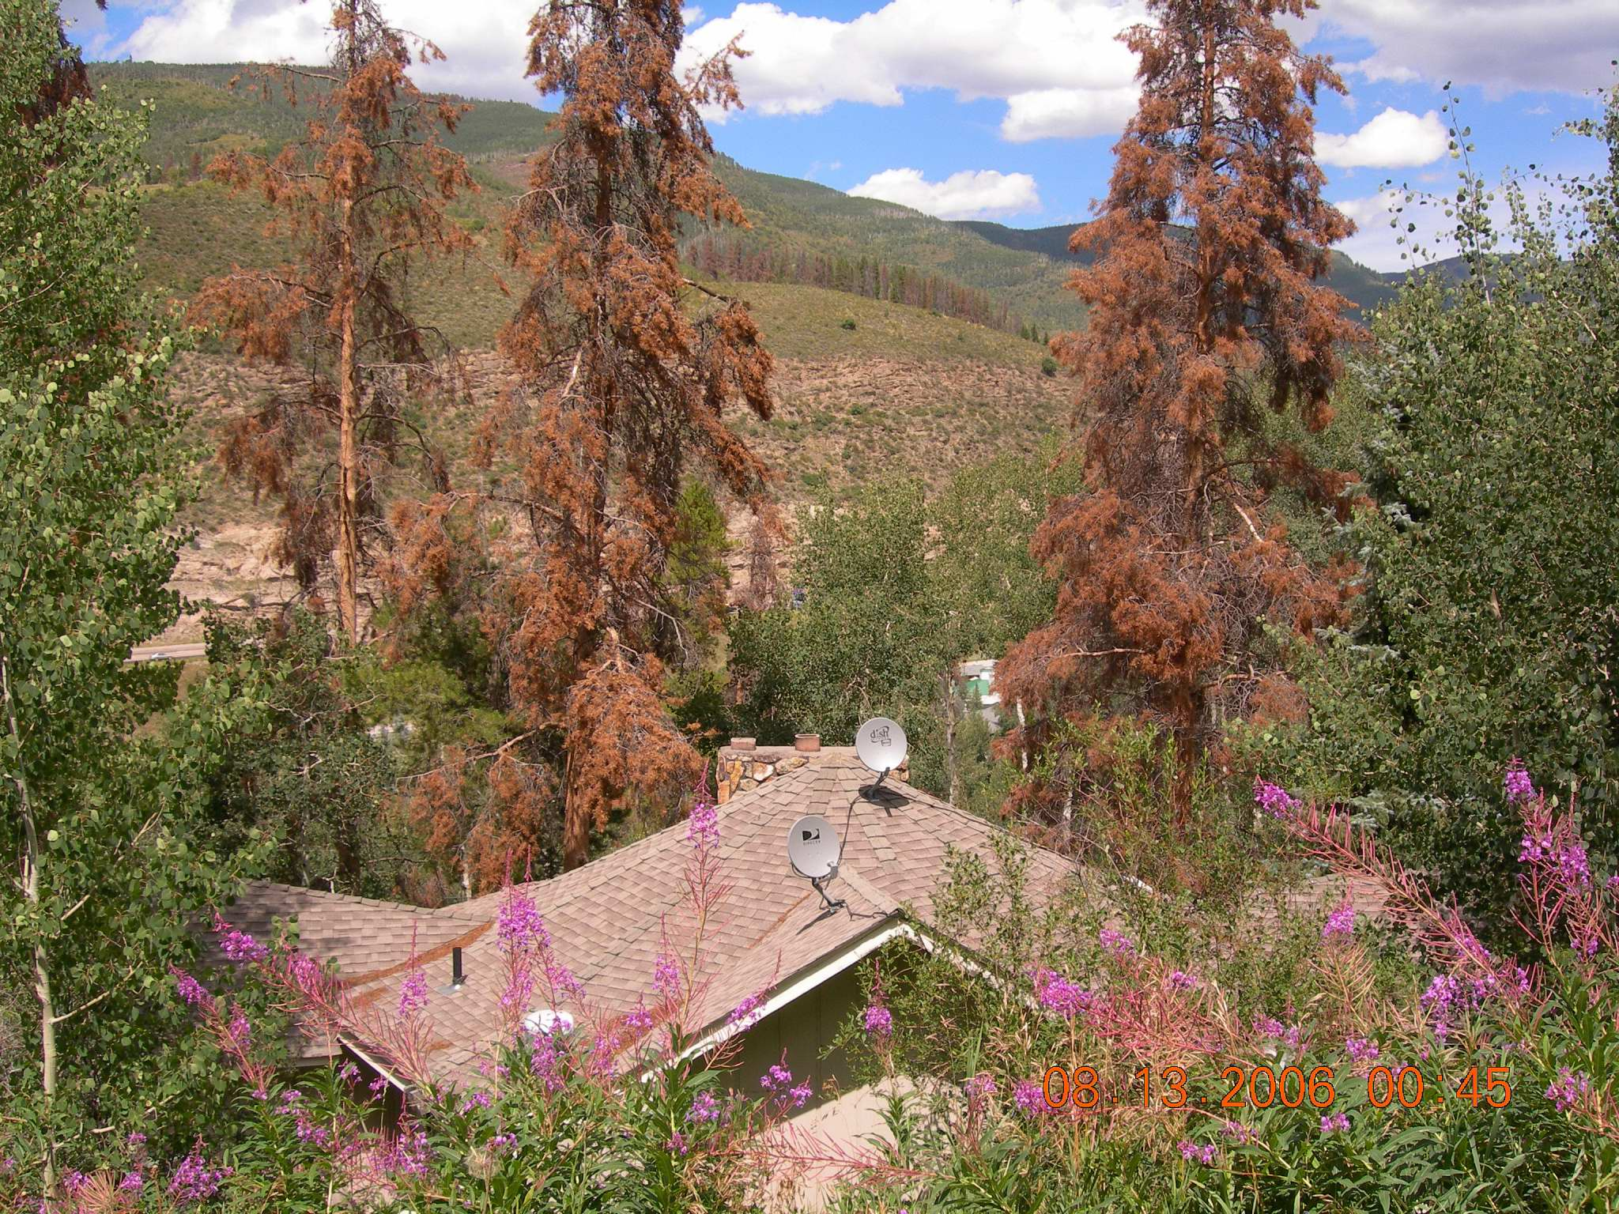
Support for selective removal
  Largely unrelated to sociodemographic factors (age, gender, education, income, political orientation)
  Positively related to ecological risk perceptions (wildlife habitat, water quality, invasive species)
  Positively related to social risk perceptions (safety, revenue loss, scenic effects, fire risk, property values)
Mountaintownnews.net

Slide 22
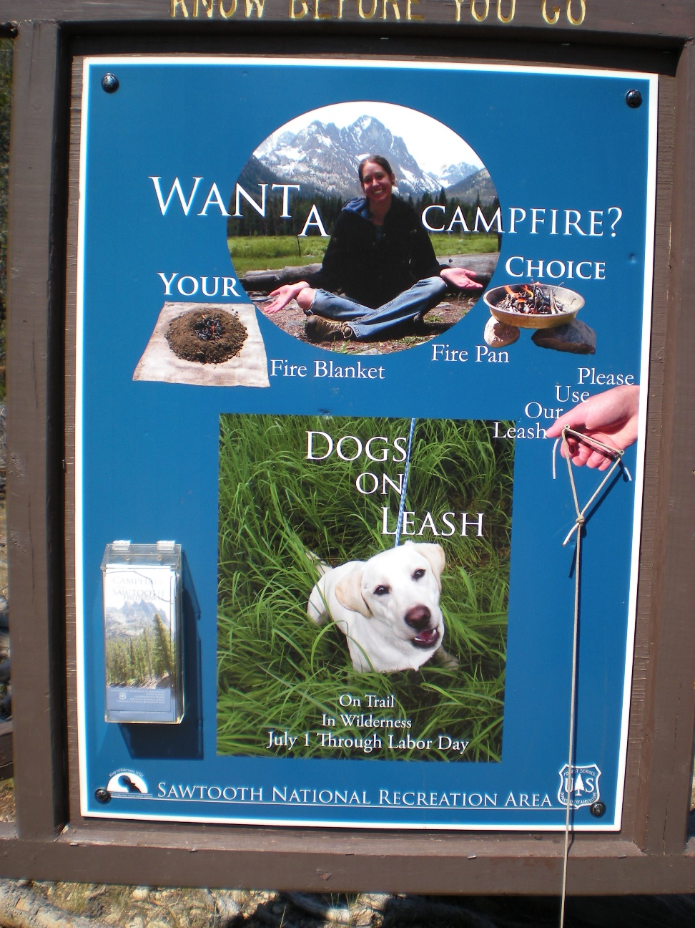
3. Develop and evaluate programs
  Why?
    Ensure that acceptable and effective policies are implemented
    Learn and adapt

Slide 23
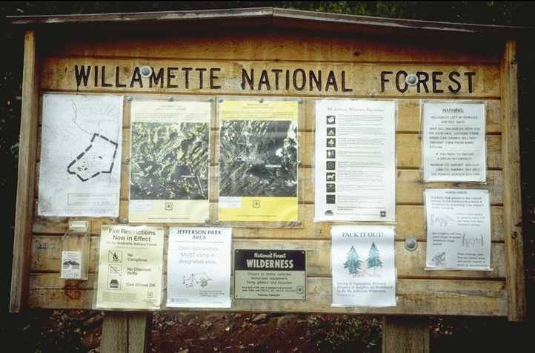
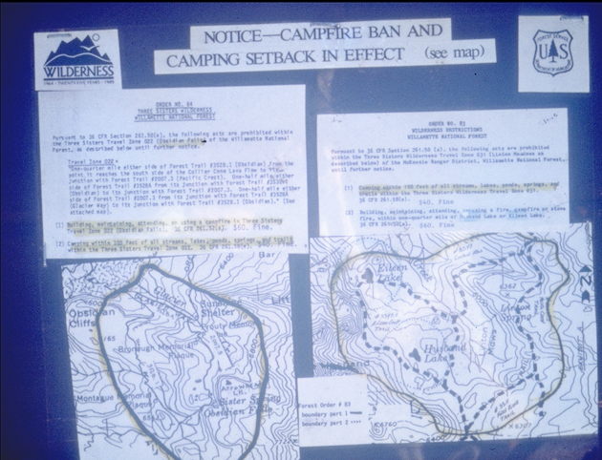
3. Develop effective programs
  Example: Where and why do regulations and communication (not) work?
Notes:
Education is often the approach most endorsed for everything. If people aren’t complying – educate! If they object to resource mgt plans – educate!
It turns out that education is often not the right answer. And social science has helped us understand why. And how to do education right.
Take these wilderness communications (from a couple decades ago). As a communication researcher there are so many things I could point out about why these won’t work – they don’t capture attention, they can’t be remembered, they don’t convice people that they are worth following.

Slide 24
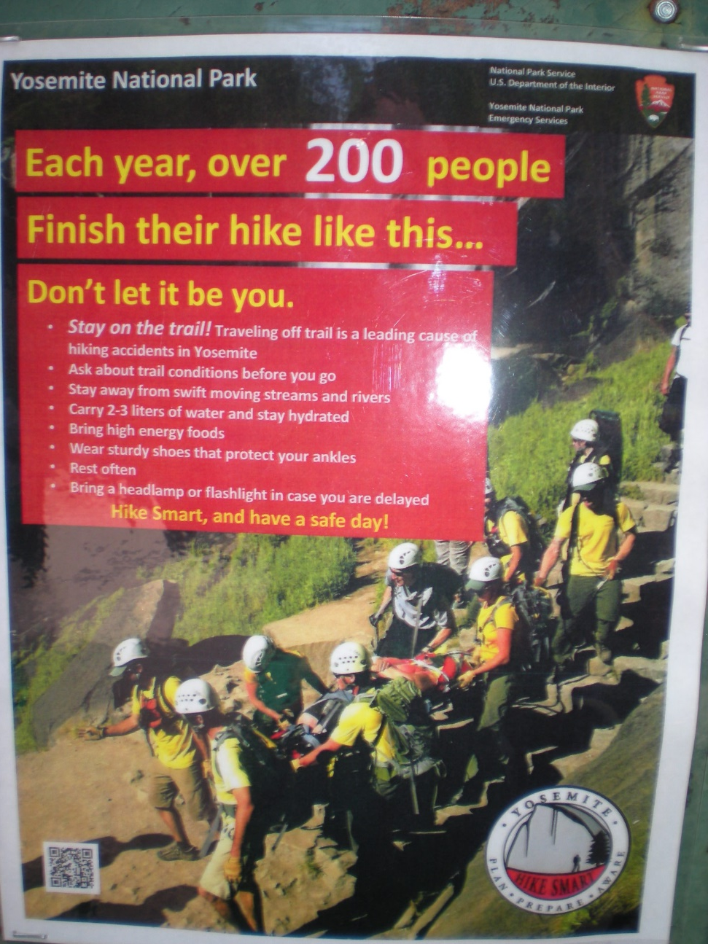
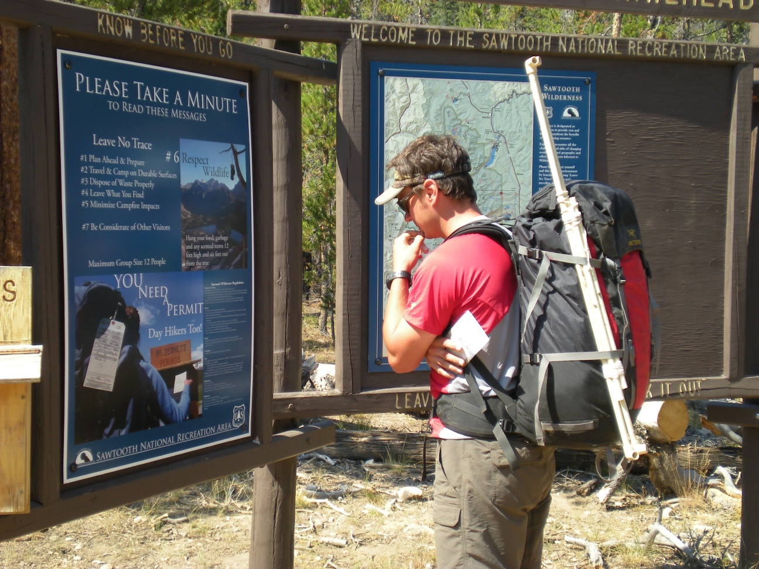
3. Develop effective programs
  Communication programs
Notes:
Communication research has helped develop much more effective campaigns – ones that draw the reader in (recognizing his/her interest), that are easy to process, and that contain compelling messages.

Slide 25
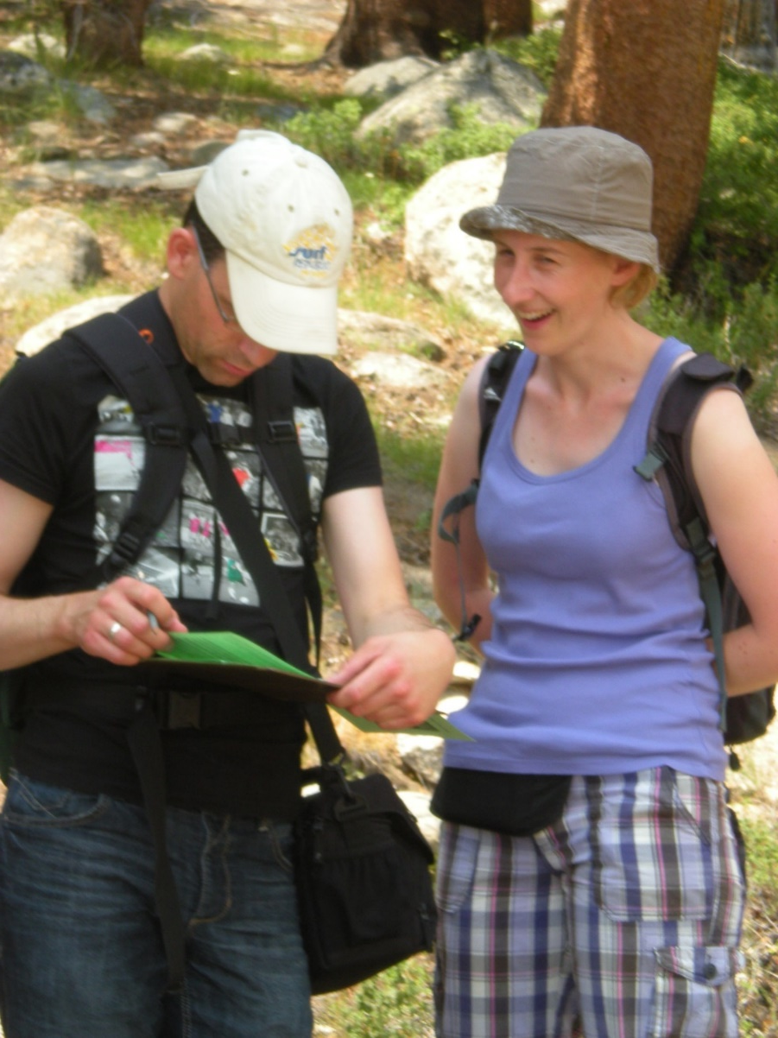
Conclusions
These are just a few examples…
Social science helps:
  Set priorities
  Collect valid data with appropriate rigor
  Anticipate public support or opposition
  Identify and shape effective actions
Notes:
Set priorities – focus on issues that matter to people; choose among alternative actions
Collect valid data – defensible in terms of representativeness (important!), arrive at the appropriate level of precision
Identify issues that are hot buttons for the public (and be able to use data about representative publics)
Shape policies to recognize human tendencies, dispositions, interests, and concerns.

Slide 26
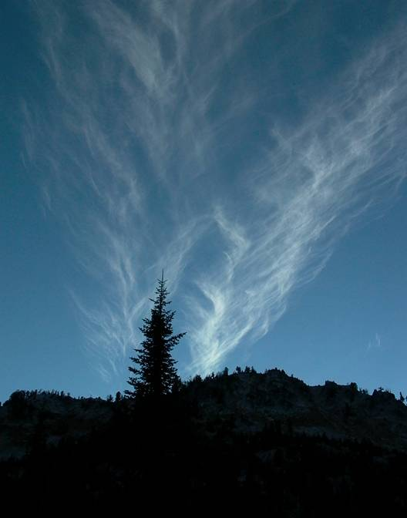
Questions?
troy.hall@oregonstate.edu

