Slide 1
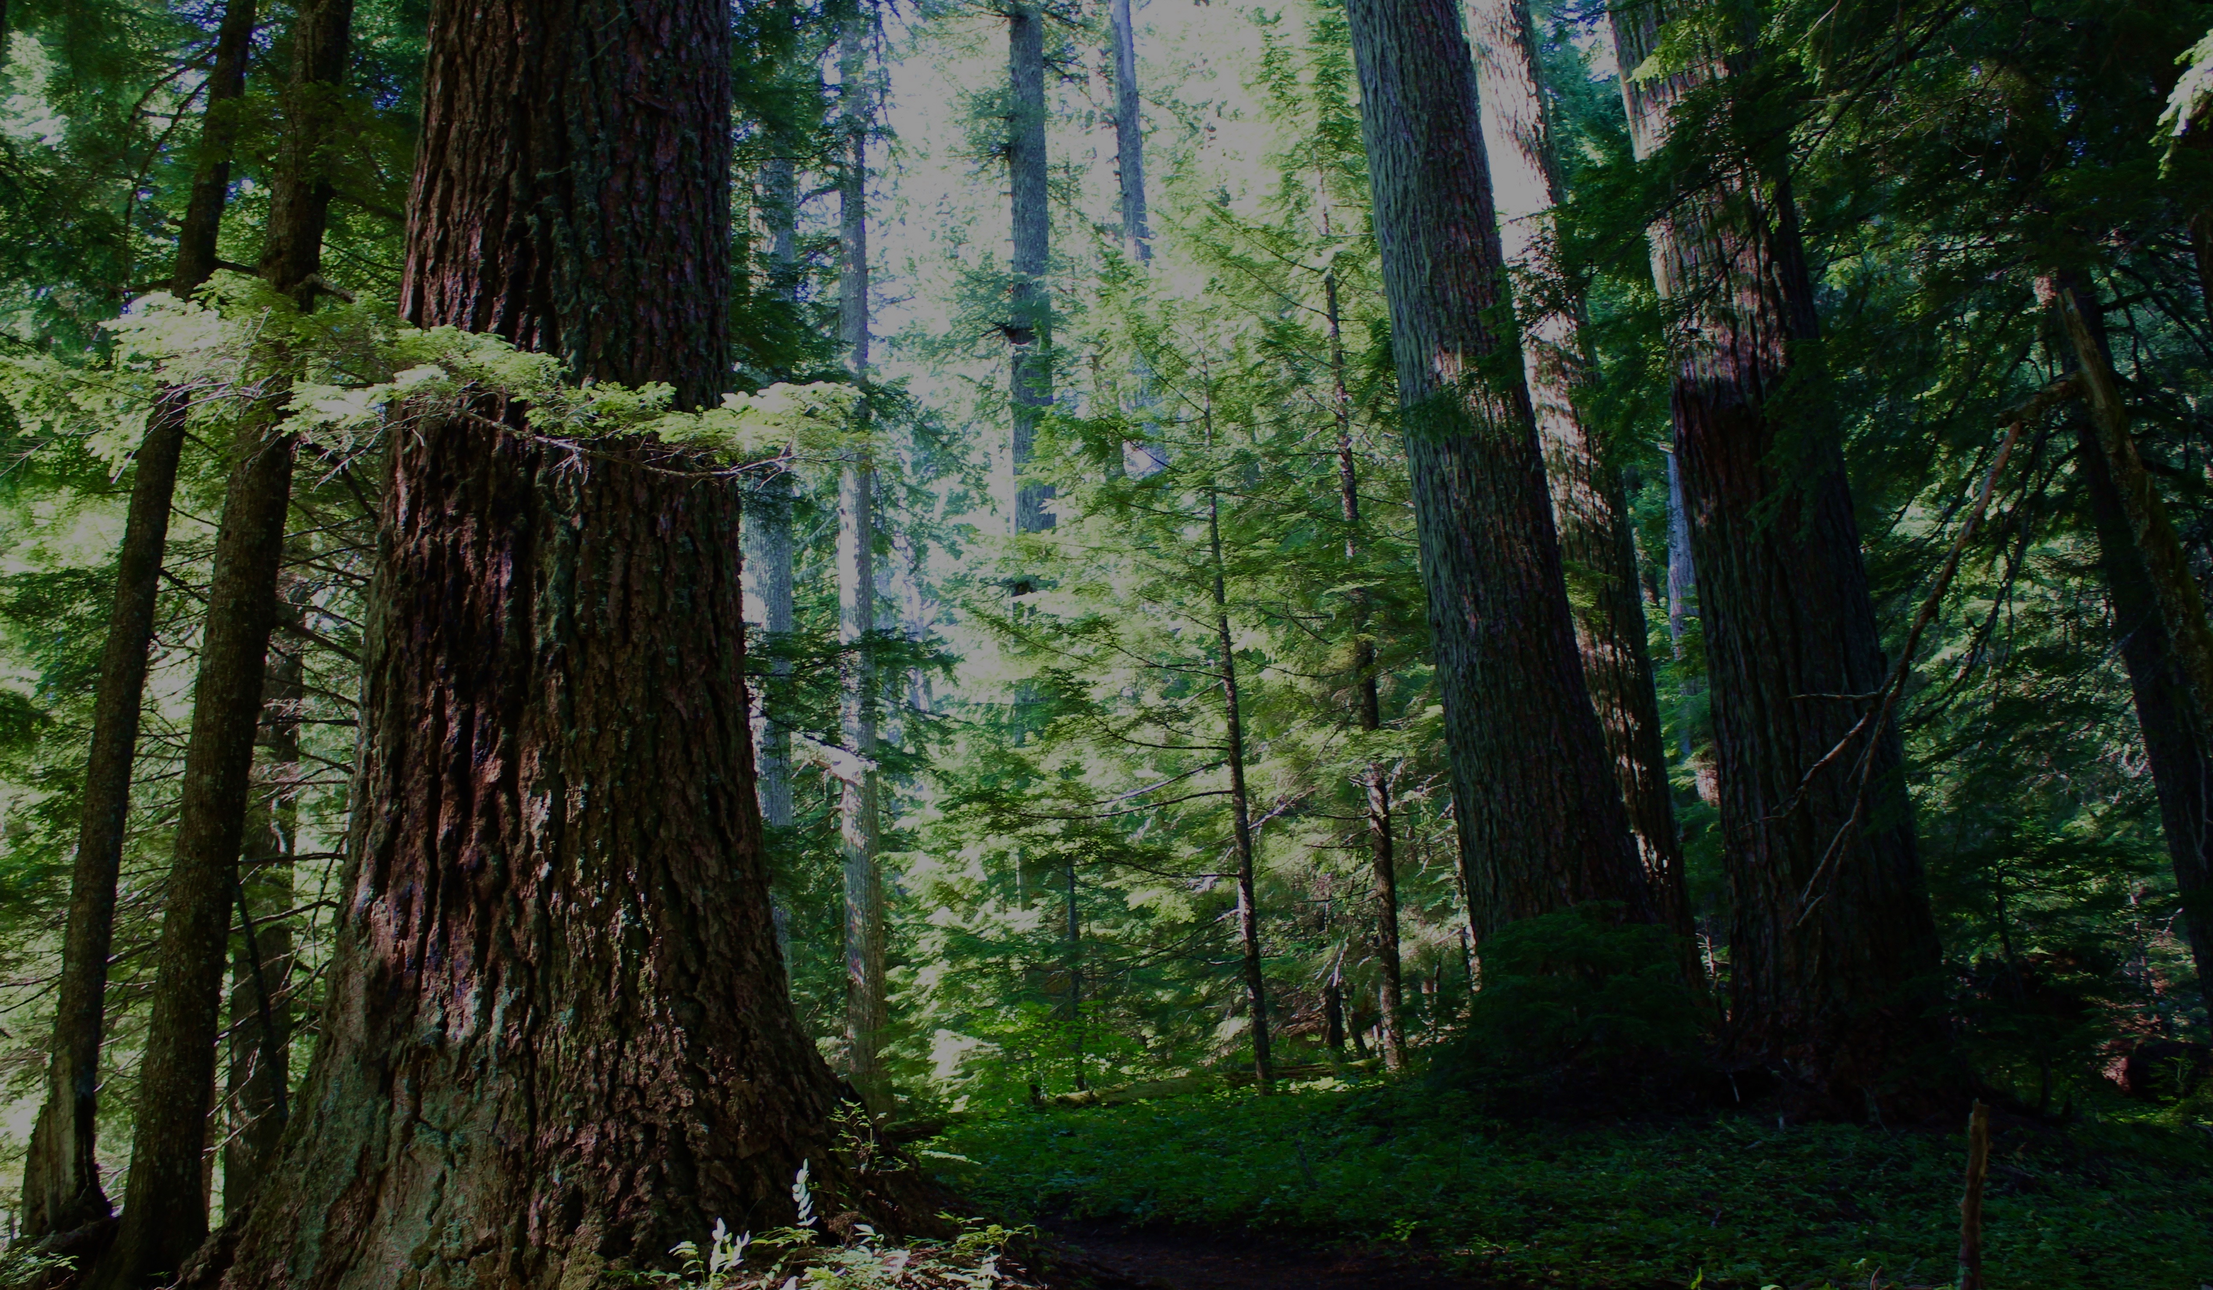

STUDYING COLLABORATION
Emily Jane Davis
Assistant Professor
Extension Specialist

Slide 2
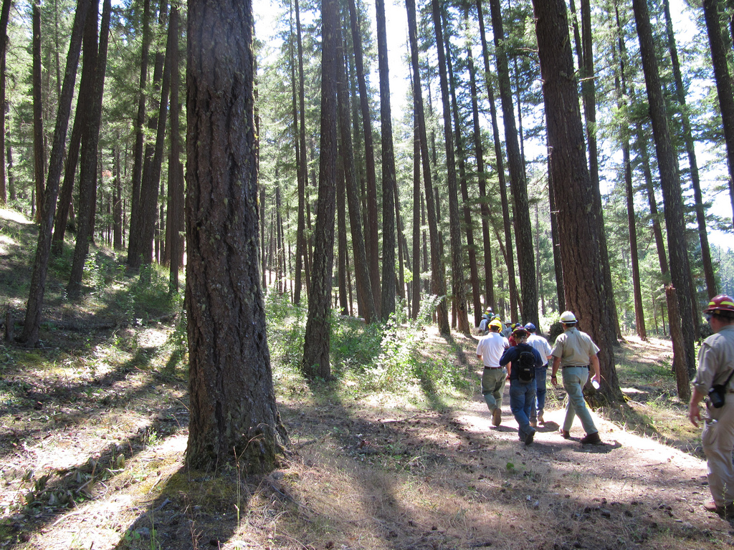
Overview
What is collaboration?
How is collaboration studied?
Examples from our study
Mixed methods focus on collaborative governance
Potential management and policy implications
Notes:
My goals today are to share with you how we study collaboration in the social sciences, since it is a topic of such importance in natural resource management.
I’ll talk a bit about what collaboration and collaborative means, describe the ways that collaboration has been studied, and give examples of some current research on collaboration using mixed methods from a study that myself and colleagues from the PNW are undertaking.

Slide 3
Do you collaborate?
Notes:
First, let’s talk about how ubiquitous collaboration has become.
If you think that you collaborate with stakeholders or external partners in your work, please raise your hand

Slide 4
Do you collaborate?
Do you collaborate with an organized forest collaborative group?
Notes:
Now, if you think that you are collaborating with a forest collaborative group, keep your hand up.
Your first thought might have been---well, what does she mean by a forest collaborative group? How do I qualify that?
In large part, that is what I am here to talk about.

Slide 5
adj. “produced or conducted by two or more parties working together.”
Notes:
I like to say that we’ve moved the word “collaborative” from an adjective to a noun over time.
As early as the 1990s, there was collaboration. There were partnerships. There were community efforts to respond to the effects of the Northwest Forest Plan, and so on.
“Collaborative” historically has been an adjective, meaning in its simplest sense, produced or conducted by two parties working together.

Slide 6
adj. “produced or conducted by two or more parties working together.”
Working Group
Community-based organization
CFLRP
Fire Learning Network
Watershed council
CWPP
AMA
Friends groups
To name a few…
Notes:
And your efforts to be collaborative took and still take some of these forms, or many others, from partnering to accomplish watershed restoration with a watershed council, or recreation work with a Friends group, or working with the community and other agencies to develop a wildfire protection plan.

Slide 7
Defining collaboratives
n. A group that collaborates (freq. ref. to with agency)
Defined group
Specific landscape
Public lands
Ongoing
relationships
“Triple bottom line”
“To develop and promote balanced solutions from a diverse group of stakeholders to improve and sustain ecological resiliency and local community socioeconomic health in and near the National Forest.”
Notes:
But when we use “collaborative” now, it’s much more often a noun, not an adjective. It has come to mean some kind of organized group, focused on an area of public and maybe other lands, and with enduring relationships between stakeholders. It’s not a one-off public involvement process. It’s an ongoing venue for dialogue, and it’s also a kind of organization. It requires resources, strategy, leadership, and support.
Some common activities that we see in collaboratives in Oregon include:
Building agreement on public lands management actions
Monitoring, learning, trust
Stewardship contracting
Supporting or coordinating planned activities across ownerships.

Slide 8
Public participation
Bilateral communication
Collaboration
Multilateral communication
Land manager
Land manager
Notes:
And I think it’s important to distinguish this from public participation. It’s that ongoing relationships and interaction among stakeholders component. In traditional public participation, stakeholders interacted in a bilateral way with the agency, and did not have to interact with each other. Maybe they saw each other at a public meeting, but they were not necessarily part of a process that built relationships and created enduring cooperation amongst them.
Collaboration is distinct because all these different stakeholders work within the collaborative venue to combine their values, goals, and knowledge, and make some kind of collective statement to managers. As such, we study some of the same things we might study with public participation, but we focus a good deal more on understanding interaction and those dynamics between stakeholders, not just between stakeholders and the agency.

Slide 9
Collaborative governance
Collective action
Collaborative conservation
Citizen science
Cross-boundary management
Participatory democracy
Co-management
Grassroots ecosystem-based management
Collaborative management
Networked governance
Devolution and decentralization
Community forestry
Hybrid arrangements
Participatory politics
Polycentric governance
Collaborative multi-level governance
Notes:
I’m going to spend the next few minutes talking about research on collaboration in general.
Collaboration is a cross cutting object of study. It is not a traditional social science discipline unto itself. There is no one home for it or one stop shop you can find.
The different forms of collaboration and then the different terms we use to characterize it are really endless too. It really depends on what tradition or discipline you are coming from, what you are trying to understand, and how you see it.
For example, I once read a book chapter on the Forest Service’s attempts to collaborate locally in one area in New Mexico, and its intent was to try to understand how that process worked and didn’t work for both the locals and the agency and to offer some general insights.
I also read another book about the same exact area and process, but it was a critical, cultural politics perspective that focused on the history of how the presence of the Forest Service alienated local Latinos from their own place and subsistence practices. Same place, similar objects of study, but from very different theoretical backgrounds and trying to explore very different facets.

Slide 10

“Collaboration”→3,580,000 articles
“The untidy character of the literature reflects the way it has bubbled up from many local experiments…” (Ansell and Gash, 2008)
Notes:
So as you might imagine, research on collaboration is a messy world and it is far, far bigger than our current obsession with these forest collaborative groups. This in large part is precisely because of how collaboration has happened. It’s popped up in hundreds of different locations and instances, proliferating at the local scale.
If you google scholar collaboration, you get over three million and half hits.

Slide 11
“Collaboration”→3,580,000 articles
“Natural resource collaboration”→1,960,000 articles
“Forest Service” collaboration→44,600 articles
“The untidy character of the literature reflects the way it has bubbled up from many local experiments…” (Ansell and Gash, 2008)
Notes:
If you try to get more precise, you still get nearly 2 million hits on natural resource collaboration, and nearly 45,000 on Forest Service collaboration.
Now, this is probably something of a statement on the inefficacy of Google Scholar’s filtering algorithims, but my point stands that there is so much out there that it can be hard to make sense of it.
MOREOVER,
to additionally complicate it, collaboration also has generated a good deal of non-academic material that you may see floating around. There are tons of how-to guides, stories, tips, etc. It’s a movement in the business and non-profit sectors.
In fact, if came to me and said that you wanted to know “how to collaborate” or get some actionable tips, I’d probably send you to a website like the National Forest Foundation’s before I’d send you many articles, or at least in addition to sending you to academic articles. That’s because these kinds of materials represent distillations of research that have been made more directly usable to you, or aren’t even really derived from research but rather experience, and they are targeted to be applicable, to help you in your practice.

Slide 12
Expert opinions
Observational studies
Experimental studies
Notes:
Research is the process of systematically producing knowledge. Simplified and broadly speaking, there are three ways you might classify research.
Expert opinion and “white papers” - draws on knowledge, experience and the literature—so if you come ask me a question, I try to give you an expert opinion based on what is available out there and what I know.
Observational studies, such as case studies, surveys and focus groups –which are designed, systematic ways to collect data/information when the scientific question precludes an experimental approach
And then Experimental studies – for when the question can be answered with a experiment that excludes extraneous factors and utilize replication to test a hypothesis.
And as you might suspect, it’s usually the first two that apply to the study of collaboration. It is pretty difficult to control variables and create replicable experiments when you are trying to study a human, social phenomenon with countless manifestations.

Slide 13
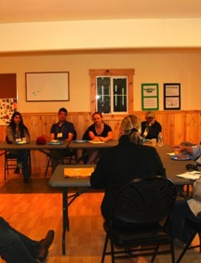
We tend to:
Conduct case studies; often just one or two
Notes:
It is also worth noting that those of us who study natural resource collaboration have some tendencies. And I am as guilty as anyone of possessing them.
First, we tend to use case studies. A case study is an in-depth analysis of a fairly small number of objects of study—sometimes just one, or two.
Case studies are great for providing detailed, contextualized information and a long look under the hood to see how everything is arranged. They can also be useful in comparison, when a number of case studies are purposively selected for their similarities or differences and then factors.
We have these handfuls of well-documented examples of collaboration. But as a result, we have sometimes a limited sense of the whole scope of collaboration. Lee and colleagues and I are publishing a paper just now that does something somewhat uncommon. It documents how many collaboratives there are in Oregon, when they were started, and basic characteristics. There are few papers like this that stocktake and account for the bounds of a phenomenon. Without those bounds, though, we don’t necessarily have a place to situate our case studies. We don’t know the context they sit in. You may think we should be asking more sophisticated questions, but honestly, we don’t ask ourselves enough these basic questions of: What exactly is this? How much of it is it? Where is it? How does it vary and why? We also need to be doing more meta-analysis across case studies.

Slide 14
We tend to:
Conduct case studies; often just one or two
Examine process
Notes:
Second, we tend to love process. We like to study examples of collaborative processes and ask questions about how equitable, or fair, it was. Or just even to do a kind of detailed history or accounting of a process that is fairly descriptive. When we evaluate collaboration, we are often evaluating a process—and we are not always evaluating what it accomplished. We’re sort of doing an after action review on how it went.

Slide 15
We tend to:
Conduct case studies; often just one or two
Examine process
Attempt to evaluate outcomes or “success”
Conley A, Moote MA. Evaluating collaborative natural resource management. Society & Natural Resources. 2003 May 1;16(5) 371-86.
Recommended reading:
Notes:
That brings me to a third tendency—which is that we have challenges in evaluating collaboration outcomes or success.
Notions of success depend on the particular goals of the participants in a given process, and collaborative efforts exist for a variety of reasons. And produce a variety of different outcomes. Is success the completion of some project or process? Is it the achievement of some agreement that everyone can accept? Is it the achievement of the eventual downstream outcomes?
Also, the variation in the structure, function, goals, context and terminology of collaborative processes makes it difficult to operationalize and measure collaboration and collaborative performance, and there is little agreement about what constitutes success.
Finally, what may help one studied process “succeed” may not be a key factor or relevant issue in another instance. So there can be a lack of ready transferrability.

Slide 16
Shared concern, critical threat, perceptions of an issue
Organizational capacity to convene people, facilitate hard conversations, and keep momentum
Agency capacity and leadership
Genuine community leadership
Selection of issues and projects that are well-linked to the shared concern
Creation of procedures, ground rules, and institutional memory
Relationships and formation of trust among participants
Achieving outcomes
Notes:
After just having disappointed you because I’m not bringing you a magical list of keys to successful collaboration, I will offer this.
This is just to show you some of the conclusions that researchers have drawn from studies of Forest Service-community stakeholder collaboration. This is not to say that these have been uniformly tested in a rigourous way across places, with the same study design, or that they will be factors in success all the time in any location or instance.
But these are some aspects that have been identified as possible factors of importance. Note that they include what you might think of as organizational qualities about how the collaboration is structured, as well as human or social qualities.

Slide 17
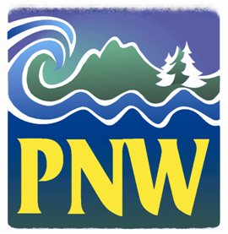
EJ Davis, Meagan Nuss, Don Ulrich—Oregon State University
Lee Cerveny, David Seesholtz, Eric White—PNW Research Station
What organizational models for forest collaboratives appear to be achieving their desired goals? How important are these relative to other social attributes such as trust and relationships?
Notes:
For the rest of my time here, I’ll quickly go through examples of research on forest collaboratives that I am undertaking with these great colleagues from OSU and the PNW. This research focuses specifically on forest collaborative groups, attempts to characterize how they are organized and operate, and tries to explore what, if anything, about how groups are organized is linked to perceptions of success.

Slide 18
Rapid assessment
1
1
1
1
Key informants
1
1
1
1
1
1
1
1
1
1
1
1
Notes:
We designed a multi part study. The design of a study and how many different methods used in it is often a facet of funding and our own capacity. Not all studies can do everything or be everything.
First we did a Rapid assessment to get a handle on what the organizational features of the collaboratives even are. We developed a current list of all collaboratives and ensured we had a selection logic for what a forest collaborative is. We collected basic information about their age, mission, and other features as well.
The rapid assessment is completed by key informants, those being the facilitators or leaders of each collaborative. The point was to gather what should be somewhat objective information about how a group is organized from the expert on it.

Slide 19
Rapid assessment
1
1
1
1
Key informants
1
1
1
1
1
1
1
1
1
1
1
1
Survey
Population of collaborative participants
Notes:
Then we did a survey to collect data about perceptions of forest collab success, motivations to participate—and do actually get some basic information about who is collaborating, demographically, professionally, etc.
The survey was targeted to reach the population of people who participate in any collaboratives across Oregon.

Slide 20
Rapid assessment
1
1
1
1
Key informants
1
1
1
1
1
1
1
1
1
1
1
1
Survey
Population of collaborative participants
Case studies
10
10
Key informants in selected collaboratives
10
10
Notes:
And we matched this with case studies to gain in-depth understanding of how specific collaboratives work. We chose four case studies that were similar in terms of organizational features, and all more than 6 years old in order to choose groups with some previous experience to learn from. Within each case study, we targeted interviewing about ten people who were active participants in the collaborative representing a range of views.
Now what I’m going to do is share just a few findings from the assessment and survey. Our case study analysis is not done yet. We have many findings, but I’m just pulling in a few examples here to show you how we might use this research to inform management and policy.

Slide 21
In 2015, there were at least 41 forest collaboratives active
Half have emerged in the last decade (40% since 2011)
Notes:
One simple but important finding is that we now have at least 41 of these groups across three states. So the reality is that we have a lot of collaboratives.
The finding is also that we have a lot of new collaboratives. 40% of these groups have emerged in the past five years.
What this means is that broadly speaking, a lot of being expected from groups that are relatively new and may lack experience and time spent building trust. So the implication is perhaps an expectation check.

Slide 22
“Formality scores” for Northwest forest collaboratives, 2015
Notes:
We also compiled information on how many groups had these different more structured organizational features, and assigned them scores. Higher scores of 10 to 8 mean a group is more formally organized, and these lower scores mean it is less formally organized. This is not intended to say that one approach is better or worse than the other, but simply to find a way to classify collaborative organization. We looked at presence of operational charters, mission statements, ground rules, frequency of meetings, and dedicated facilitation.
18 groups across the Northwest OR 44% of these groups have an 8 or higher, meaning they are more formal, or have more structure. So 8 is a pretty common model, especially in Oregon.

Slide 23
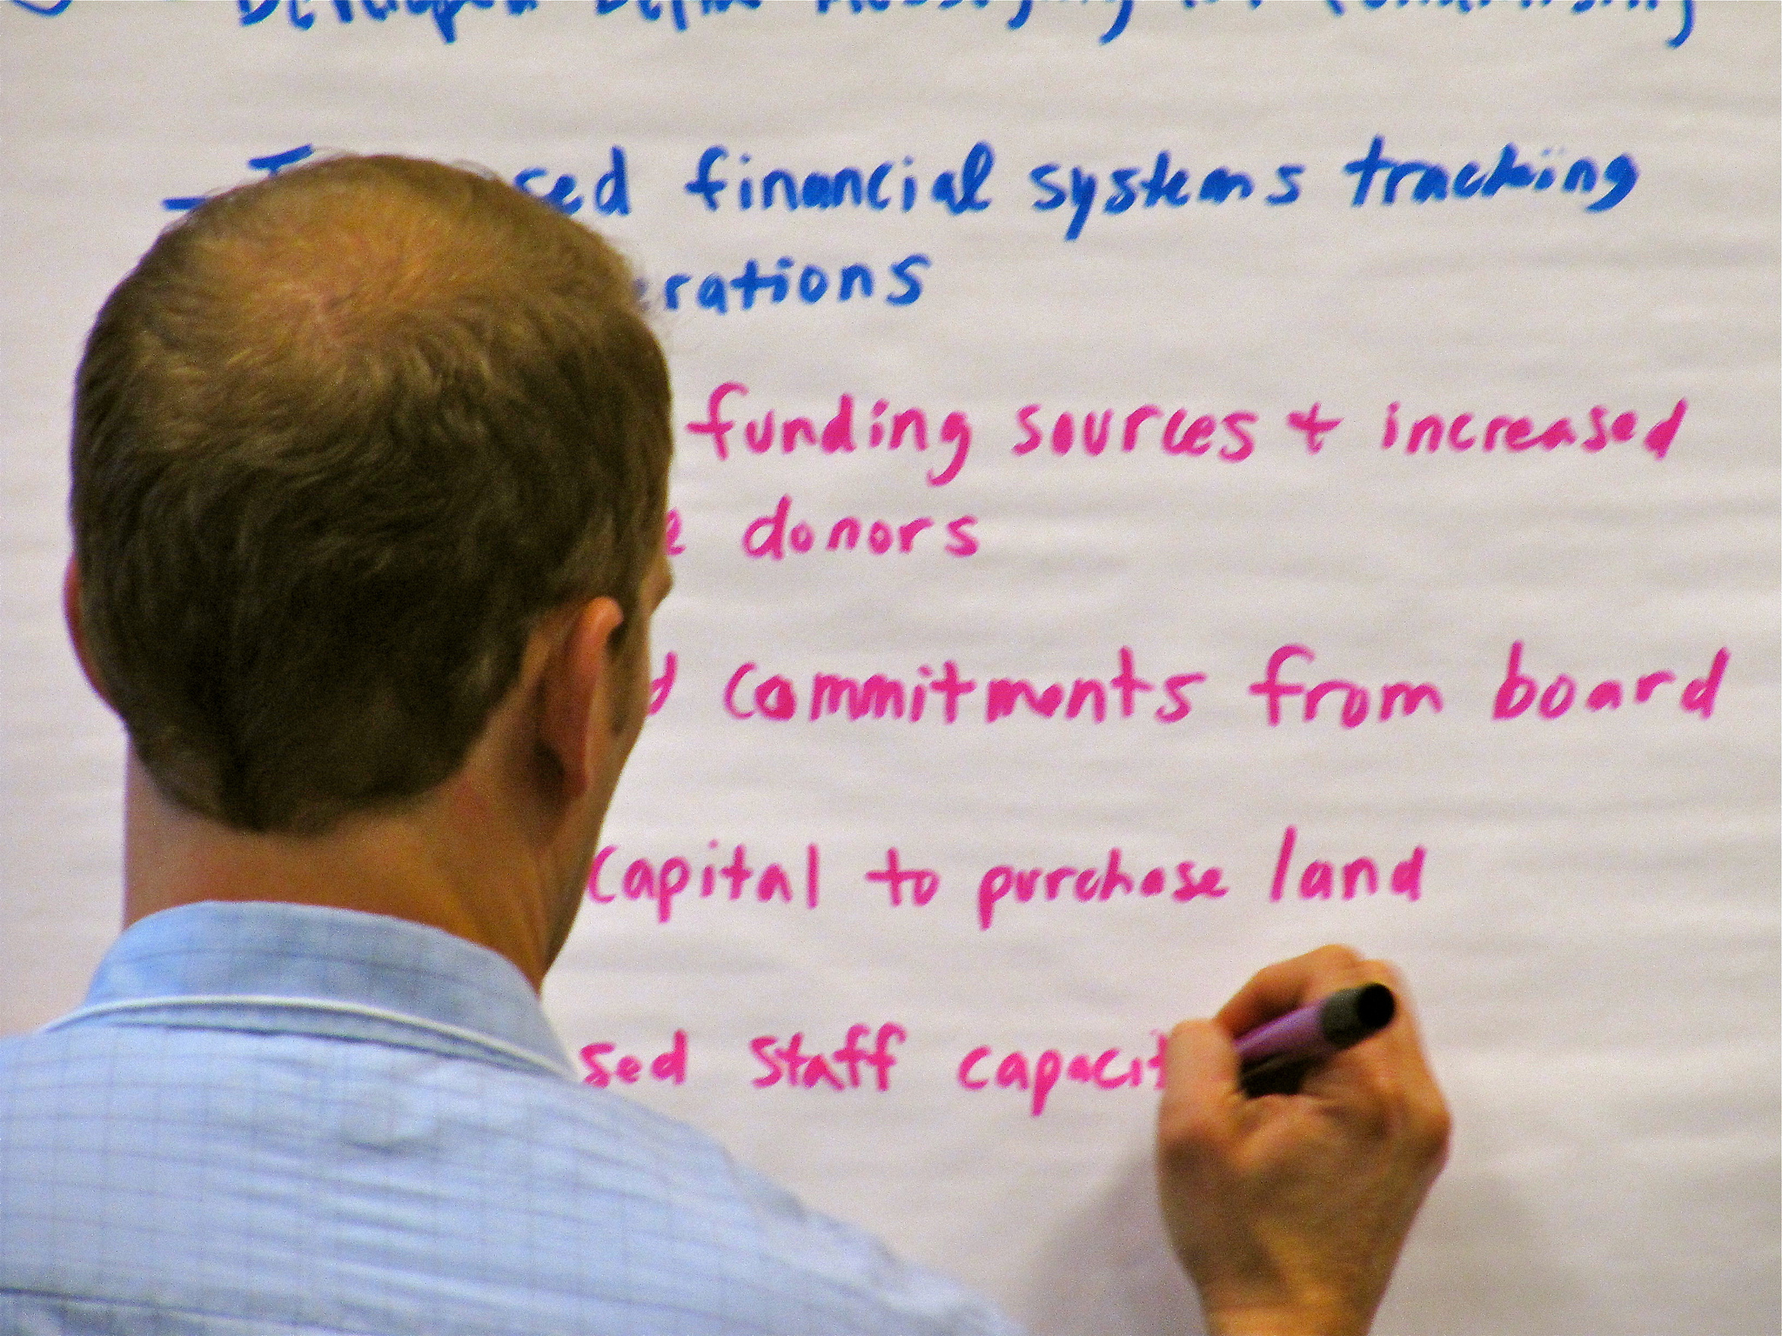
How satisfied are you with the
ability of your collaborative to
achieve its desired outcomes?
44% satisfied; 21% very satisfied
Most dissatisfaction: funding availability, outreach efforts
Most satisfaction: trust, relationships, commitment of participants, leadership stability, facilitation quality, transparency, agency participation
Notes:
One way to look at how successful collaboration is is to ask for perceptions of success. This is not a flawless method. It’s perceptions reported by respondents, rather than some other more arms-length way of trying to measure success. But it is still a common practice for research on collaboration.
So we are talking now about the survey results. The survey so far has just been done for Oregon and we had 215 responses.
We found that overall satisfaction was very high. 65 percent of our respondents are satisfied or very satisfied. When we asked them to rank satisfaction with specific facets, it was high for a number of them, and rarely was there much dissatisfaction.

Slide 24
How satisfied are you with the ability of your collaborative to achieve its desired outcomes?
Participants in collaborative groups with formality scores of 8 are more likely to be dissatisfied and less likely to be very satisfied.
Notes:
And here’s an example of one way that we can look at relating the organizational features of a collaborative from the rapid assessment to perceived success from the survey. We broke out and analyzed perceptions of success by the formality of the groups that respondents were from—that formality score that I just showed.
Again, as you just saw, general satisfaction was high amongst collaborative groups across all formality scores and that is an important takehome. However, digging deeper, we found that participants in collaborative groups with a formality score of 8 are statistically more likely to report being dissatisfied or very dissatisfied and less likely to report being very satisfied than others. More than ¼ of respondents in formality group 8 report being dissatisfied or very dissatisfied overall.

Slide 25
How satisfied are you with the ability of your collaborative to achieve its desired outcomes?
Participants in collaborative groups with formality scores of 8 are more likely to be dissatisfied and less likely to be very satisfied.
Notes:
So we then have to ask, is the common model deficient somehow? Or is there something else that these groups may have in common that could be leading to this greater likelihood of dissatisfaction? This shows something we need to ask more questions about.

Slide 26
High importance
Ecological outcomes (61%)
Implementation (50%)
Implementation (40%)
Collab. trust (39%)
High performance
Low performance
Innovation (53%)
Public support (50%)
Low importance
Notes:
Finally, we also got at success by examining a number of possible outcomes of collaboration too, and asked respondents to rate how important those were to them, and then how well they thought their collaborative was performing on them. This allowed us to see where importance and performance were aligned, where things are going well, and where they may be out of line. In this diagram, I display the top two for each combination of importance and performance.
High importance and high performance: implementation, level of trust in collaborative (so these are important and going well)
High importance and low performance: ecological outcomes, and implementation (so there are two camps of opinion about how well implementation is going, but agreement that it’s important)
Low importance and high performance, so where things are going well but it’s not necessarily as important, is use of innovative tools and approaches in the agencies, and then public support and awareness of the collaborative.
Finally, there were not any items that were low importance and low performance.

Slide 27
High importance
Implementation (40%)
Collab. trust (39%)
Ecological outcomes (61%)
Implementation (50%)
High performance
Low performance
Perhaps where to focus efforts to improve collaborative outcomes…
Innovation (53%)
Public support (50%)
Low importance
Notes:
At its most simple, these kinds of findings about importance crossed with perceived performance can help managers and policy makers think about where their efforts in collaboration can keep up the good work (where importance and performance are both already high), and where they may want to focus in particular on improvements in these areas with high importance but low performance.

Slide 28
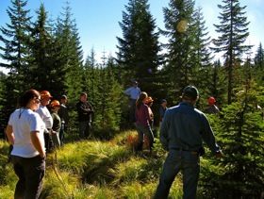
“The scientist is not a
person who gives the
right answers, [she's] one
who asks the right
questions.”
--Claude Lévi-Strauss
“It’s a campfire, not a
crystal ball.”
--disputed, likely Tom Spies
Challenges abound but satisfaction is relatively high

Slide 29
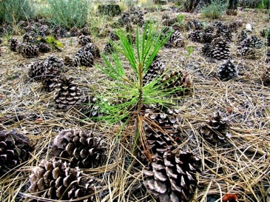
THANK YOU!
Emily Jane Davis
Assistant Professor/Extension Specialist
College of Forestry
Oregon State University
EmilyJane.Davis@Oregonstate.edu
541-520-2688

