Slide 1
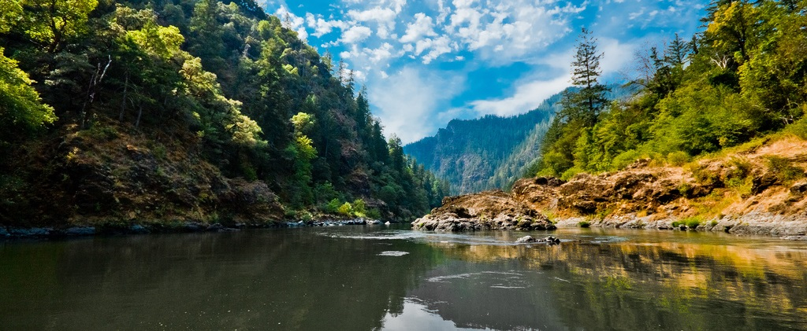
Valuing natural resources: Evolving USFS mission from dominant use to ecosystem services
Robert Deal
Research Forester and Ecosystem Services Team Leader
Pacific Northwest Research Station
Nikola Smith
Ecologist and Ecosystem Services Specialist
Pacific Northwest Region

Slide 2
Overview
Evolving USFS mission and associated values/valuation.
Dominant use (timber, water reserves, fire suppression).
Multiple Use (MUSYA ,1960).
Ecosystem Management (e.g. green forestry, new perspectives).
Ecosystem Services (Planning Rule, Presidents memo, NESST).
Forest values, ecosystem services examples & projects.
Kline et. al, 2013
Agric. Res. Econ.
Notes:
outline of my presentation

Slide 3
USFS Mission - Dominant Use
USFS beginnings (e.g. Forest Reserve Act 1891, Organic Act 1897 until 1960s.
Clear mission: Commodity production and sustainable forestry.
Timber production, & Sustained Yield.
Valuation: optimal rotation, Faustmann valuation, traditional timber production values, board feet and $$, timber targets).
Water reserves (quantity of water, flood protection).
Rangeland for cattle and sheep, fire suppression.
Notes:
outline of my presentation

Slide 4
USFS Mission - Multiple Use
MUSYA, 1960: 1960-1980s. Also ESA, NFMA, other leg.
Five major uses (timber, water, range, recreation, fish & wildlife), No use greater than any other use.
Valuation: FORPLAN, IMPLAN, optimization values.
Recreation use, multi-resource models and non-market valuation Bowes & Krutilla, Peterson & Randall.
Lawsuits and litigation, unhappy public.
Notes:
outline of my presentation

Slide 5
USFS Mission - Ecosystem Management
1980s thru 2000s.
Public dissatisfaction with continuing emphasis on timber.
Green forestry, New perspectives, Ecosystem Mgmt.
Valuation: public preferences, tradeoff analyses.
Desire to reduce conflicts, best “ecosystems” for fish and wildlife habitat, old-growth, timber, water, wetlands etc.
But forgot to include people in the equation…
Notes:
outline of my presentation

Slide 6
USFS Mission - Ecosystem Services
Ecosystem services: Most recently 2012 Planning Rule.
Ecosystem services are “the benefits people obtain from ecosystems” (Millennium Ecosystem Assessment-2005).
Ecosystem services means different things for different people (e.g. Daily,1997; Costanza et al. 1997).
Valuation: Direct vs. supporting benefits (e.g. FEGS,) quantitative vs descriptive, some are difficult to quantify.
Planning Rule, Presidential Directive, NESST
Notes:
outline of my presentation

Slide 7
USFS Planning Rule
E.S. mentioned more than 60 times in Planning Rule.
Ecosystem services and multiple uses “considering a full range of resources, uses and benefits”
MUSYA- timber, water, recreation, range, wildlife & fish.
E.S. follows MEA definitions including provisioning, regulating, supporting and cultural services.
E.S. also includes cultural heritage values, other services not included in multiple use.
Notes:
Some of the already developed markets for ESM

Slide 8
USFS Planning Rule
Early adopter forests are using Planning Rule for forest plan revisions and assessments.
Difficult for N.F. to include and value all E.S.
2015 Directives state the N.F. should include “key ecosystem services” in forest plan revisions.
Allows flexibility and helps N.F. focus on most important ecosystem services for their forest plans.
Notes:
Some of the already developed markets for ESM

Slide 9
Incorporating Ecosystem Services into Federal Decision Making
October, 2015 –CEQ, OMB Directive.
Directs agencies to develop and institutionalize policies for ecosystem services in planning, investment and regulatory context.
Each agency developing work plan due March, 2016.
Implementation guidance, CEQ convening subject matter experts for “community of practice” concept.
Notes:
Some of the already developed markets for ESM

Slide 10
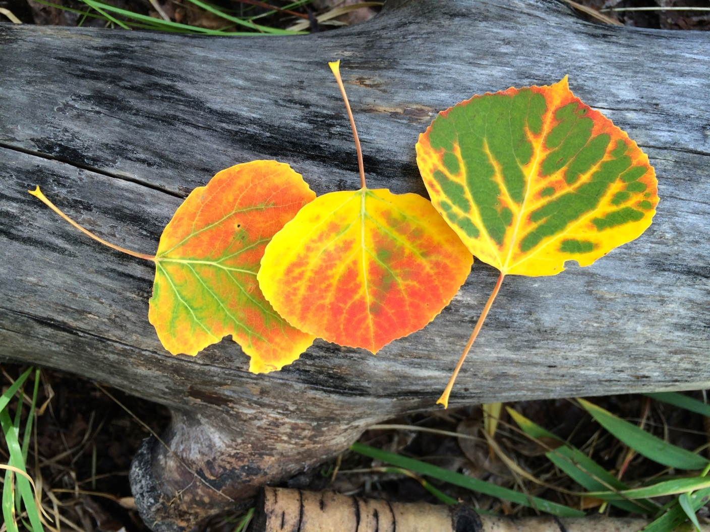
NESST
“The National Ecosystem Services Strategy Team (NESST) is established to collaboratively develop national strategy and policy around ecosystem services and integrate it into Forest Service programs and operations.”
GTR: Integrating Ecosystem Services into National Forest Service Programs and Operations

Slide 11
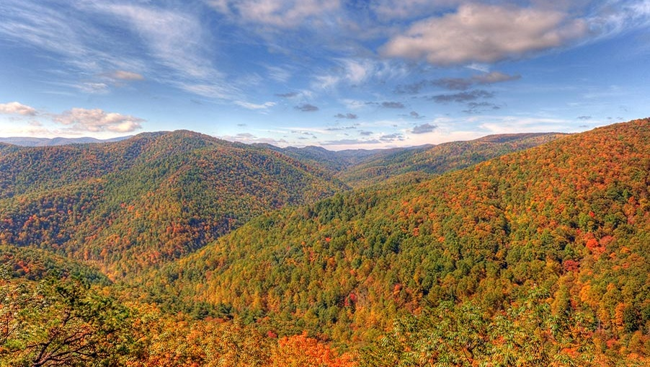
Why are forests important?
How do we define their value?

Slide 12
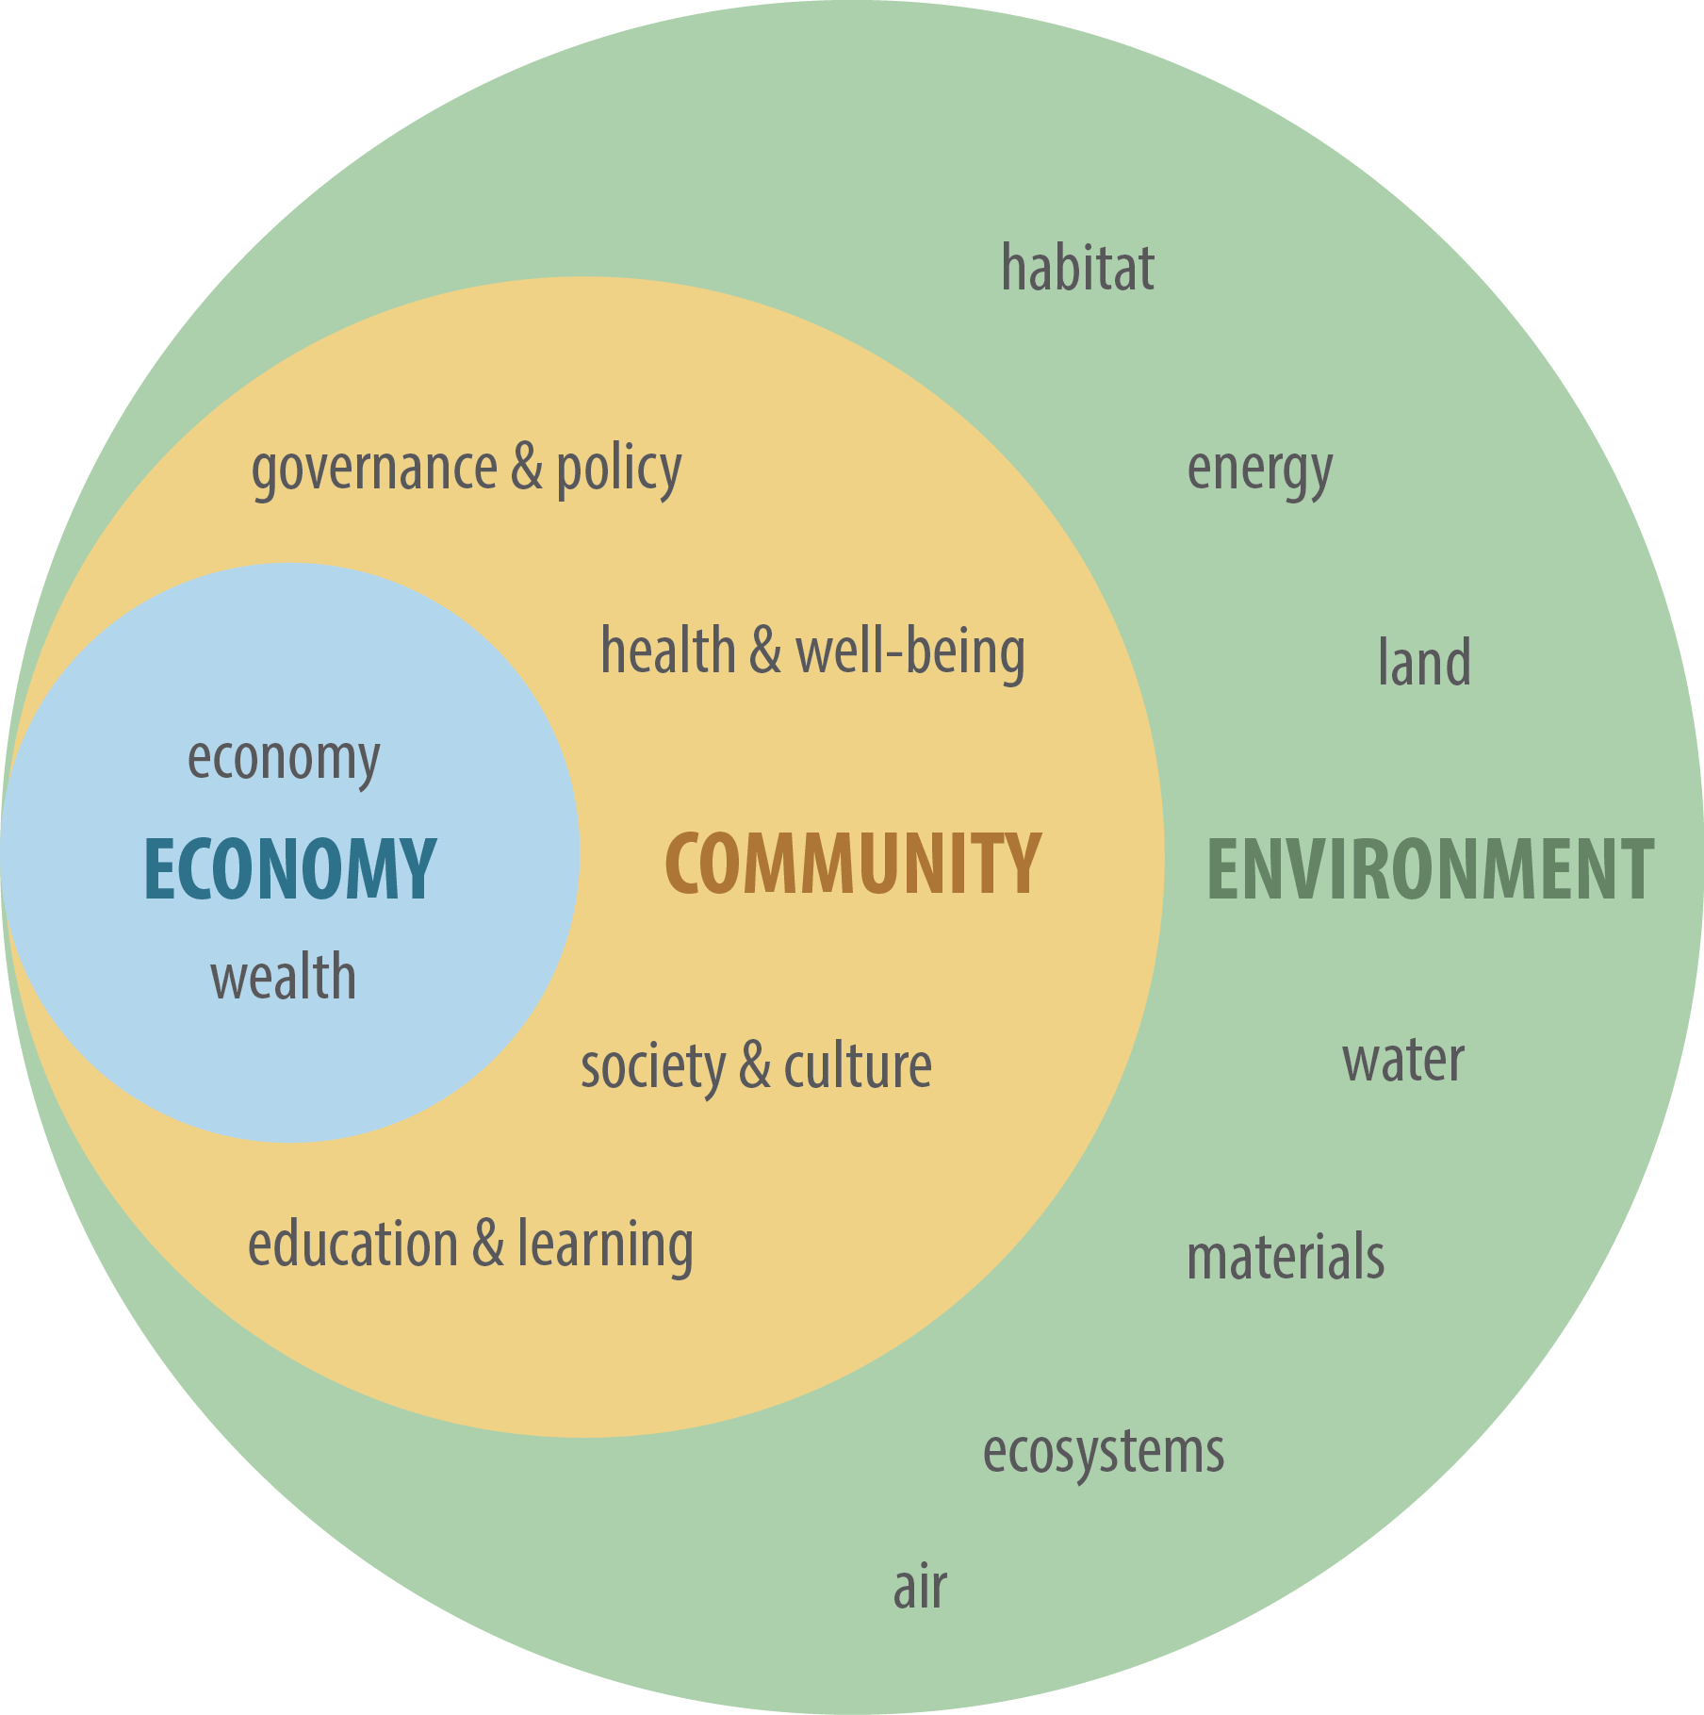
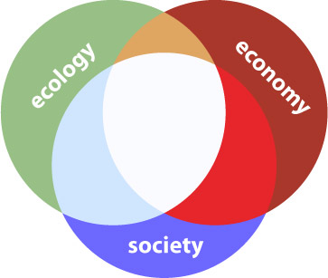
Figure from Sustainability Solutions Group

Slide 13
$
$
$
$
Timber
Fuel
Reduction
Watershed
Restoration
Recreation
Board Feet
Acres
Acres or Miles
Miles or Visits

Slide 14
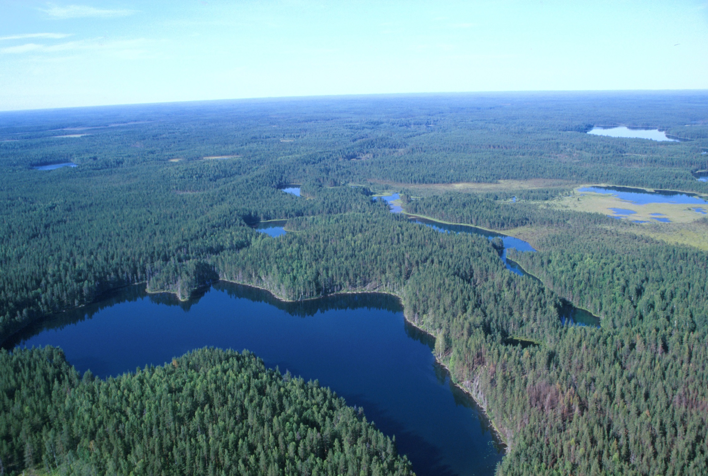
Describing Outcomes in addition to reporting Outputs
Acres treated
Miles restored
Number of visits
Board feet sold
Healthy watersheds
Resilient, functioning ecosystems
Benefits for communities

Slide 15
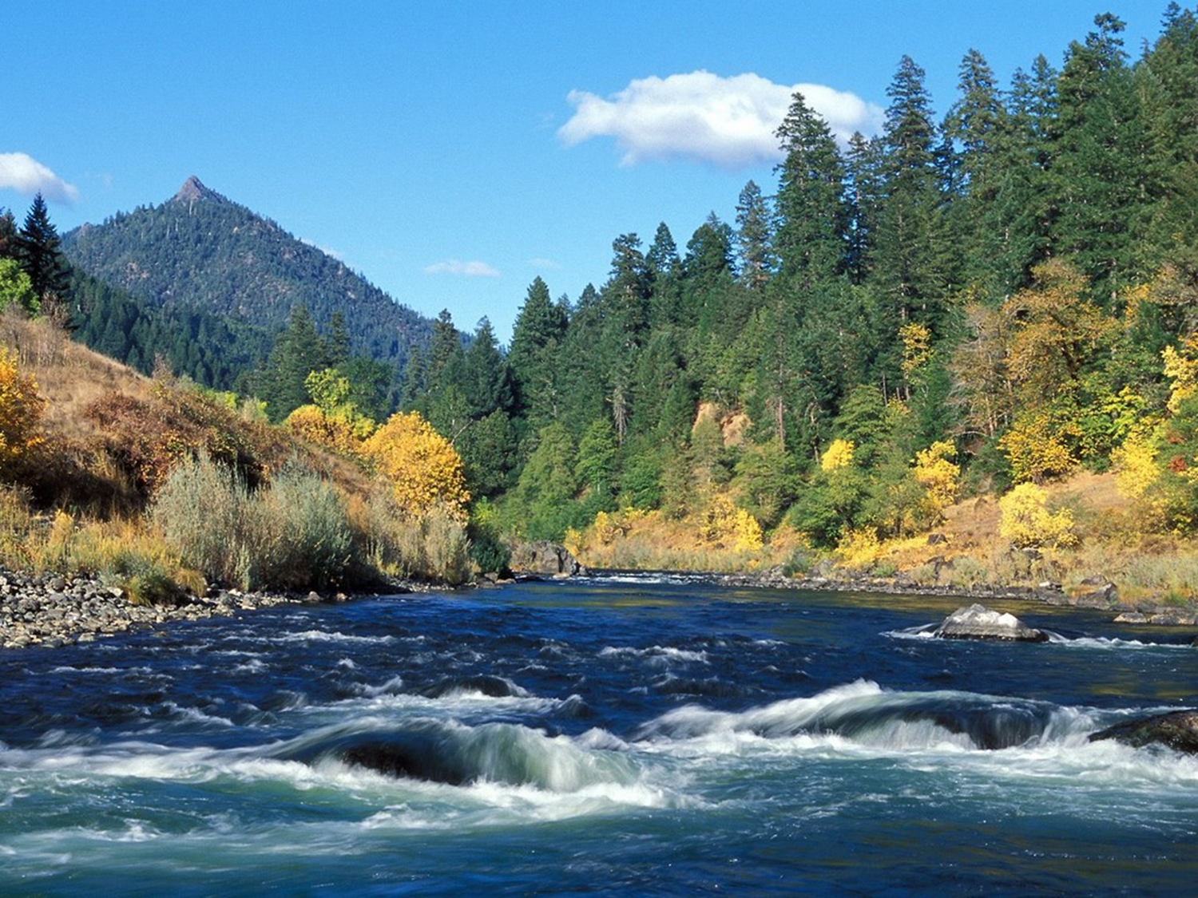
Articulating the Value of Forests and Forest Management:
Language Matters
Resonance and Relevance

Slide 16
Ecological, Social and Economic Outcomes
Recreation
Fuels Treatment
Forest Products
Watershed Restoration
Habitat Restoration
Cultural Resources

Slide 17
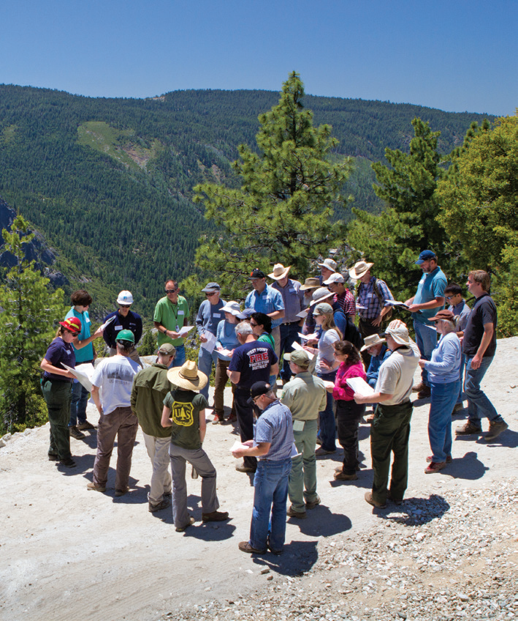
How Do Forests Contribute to Communities?

Slide 18
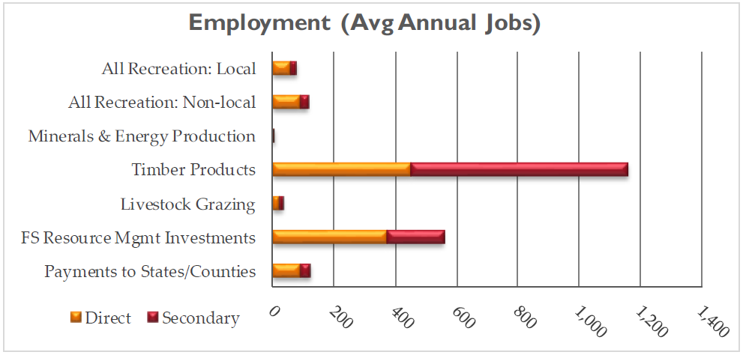
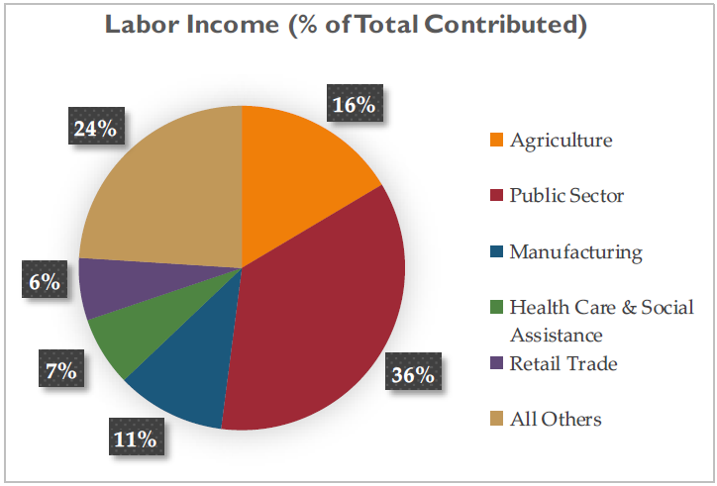

Slide 19
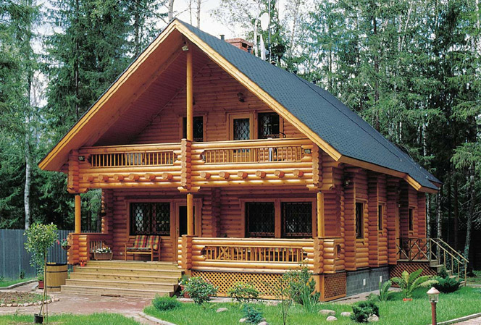

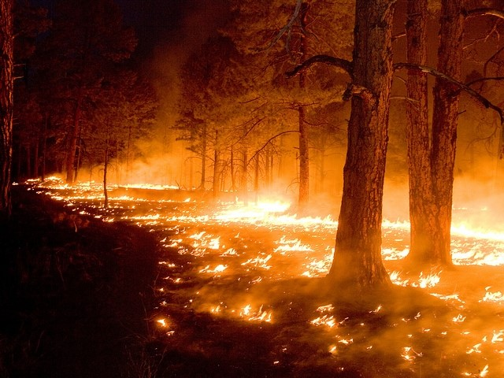
timber
biomass
grazing

Slide 20
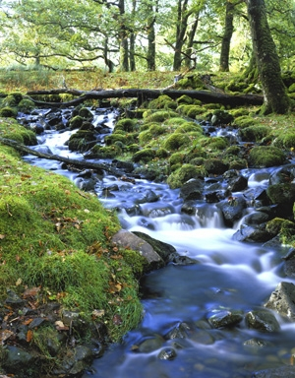

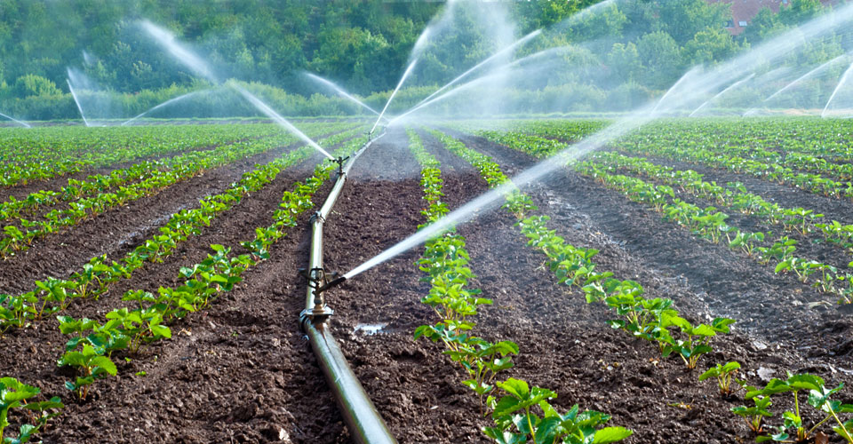
% stream flow
# water rights
hydropower

Slide 21
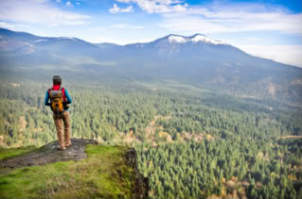

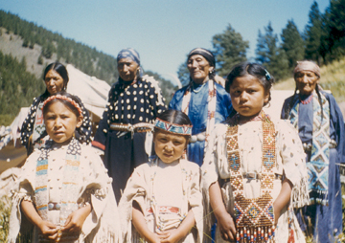
Cultural Connections with Nature
spiritual practice, heritage and identity, sense of place, recreation, learning and discovery
“Perhaps the rebuilding of the body and spirit is the greatest service derivable from our forests, for what worth are material things if we lose the character and quality of people that are the soul of America.”
~ Arthur Carhart, U.S. Forest Service Landscape Architect, 1919

Slide 22

Nature is Good for Us – Physically and Mentally
Reduces stress and anxiety
Increases attention capacity and creativity
Enhances ability to connect with others
~ Jill Suttie, Greater Good, 2016
“Ecosystem services are being incorporated into decision making at all levels of public policy, land use planning and urban design, and it’s very important to be sure to incorporate empirical finds from psychology into these decisions.”
~ Gregory Bratman, Stanford University

Slide 23
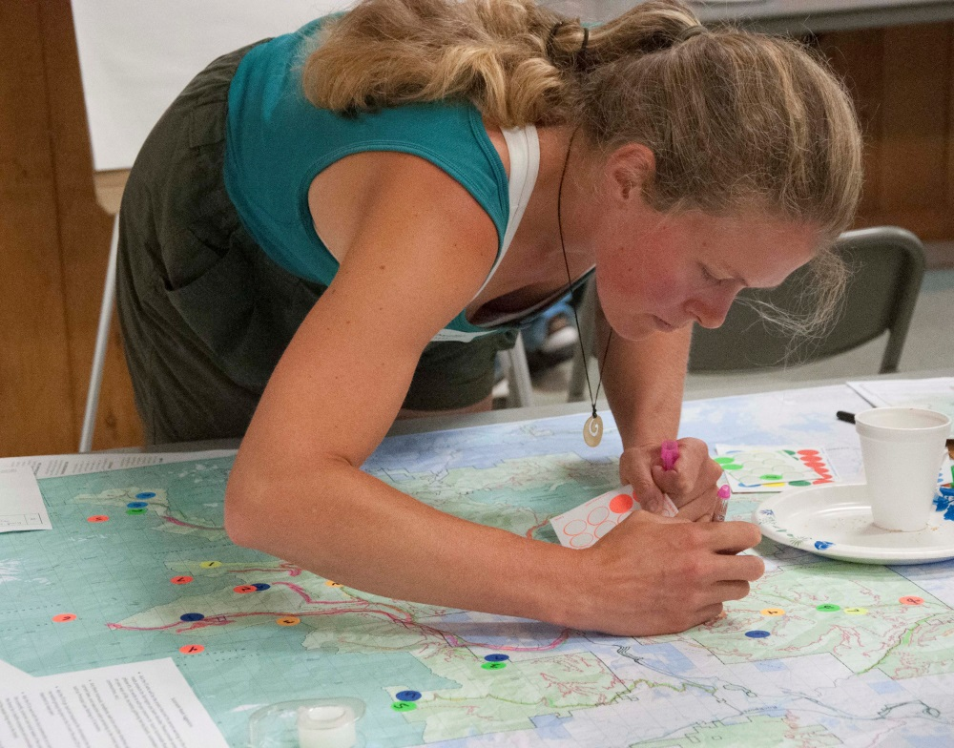
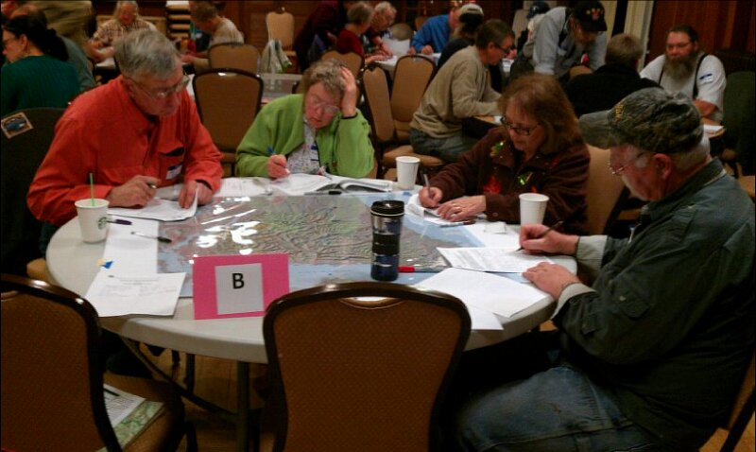



HUMAN ECOLOGY MAPPING: A tool for incorporating social, ecological, and economic information in forest planning
Lis Grinspoon, USFS Pacific Northwest Region
Lee Cerveny, USFS PNW Research Station
Rebecca McLain and Diane Besser, PSU

Slide 24
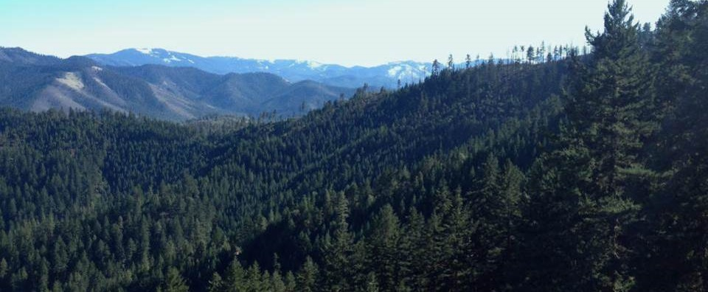
Applying ecological, social and economic values to forest management projects
Gold Beach Ranger District, Rogue River-Siskiyou National Forest
Shasta-Agness Planning Area

Slide 25
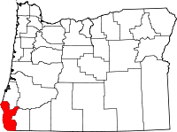


The Value of Federal Forests in Curry County, Oregon
Notes:
Payments to states and counties from the Forest Service support schools, maintain roads, as well as contribute to stewardship projects and county government operations.

Slide 26
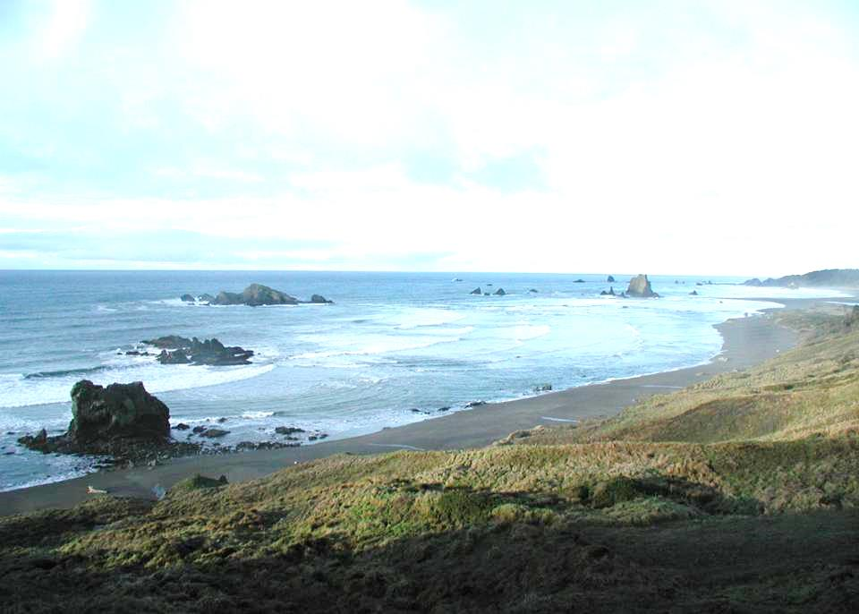
Wild Rivers Coast Forest Collaborative
Enhance an ecologically sound and healthy landscape, including functioning riparian areas, restored oak and meadow habitat and protection of rare and endemic species, all while providing opportunities for economic development

Slide 27
Biodiversity
Pollination
Recreation
Water Quality
Timber
Cultural Resources

Slide 28
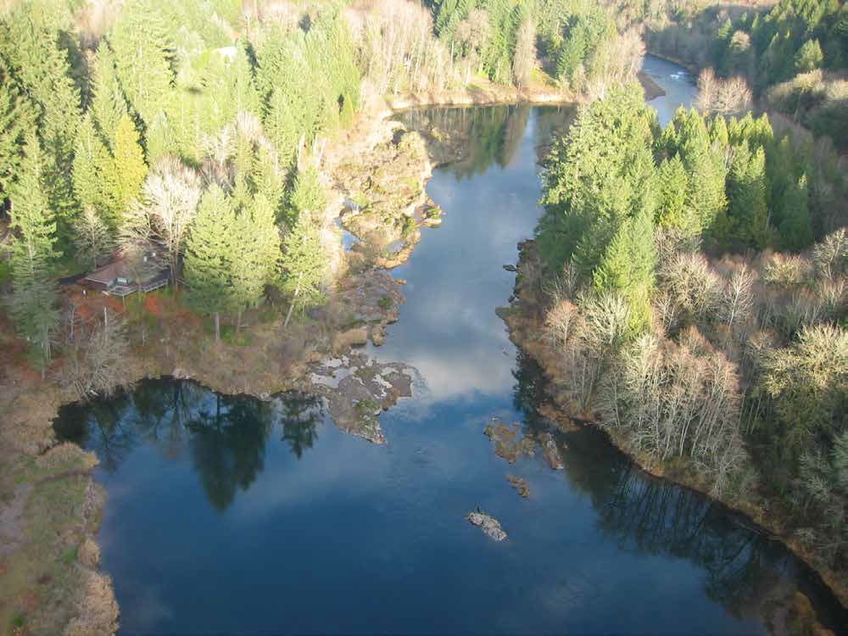

Watershed Protection:
Investing in Natural Capital
Eugene Water & Electric Board ~ Eugene, Oregon

Slide 29







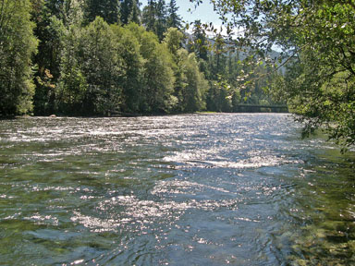
Eugene Water and Electric Board (EWEB)
Collaborative Source Water Protection
valuation of ecosystem services provided by forest lands
payments to private landowners to maintain high quality riparian areas
partnerships with NGOs, the Willamette NF and the private sector

Slide 30

Diverse approaches to understanding “value”
help us see the bigger picture

Slide 31
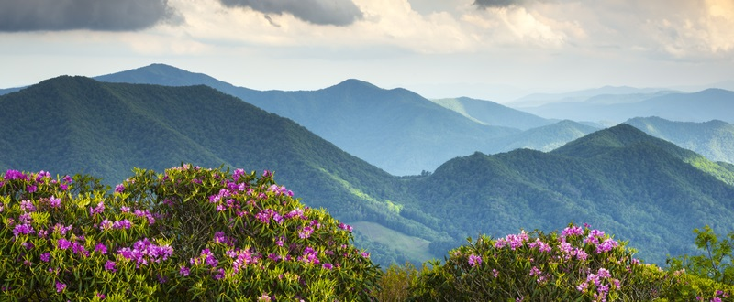
Thank you!
Questions and Discussion

