Slide 1
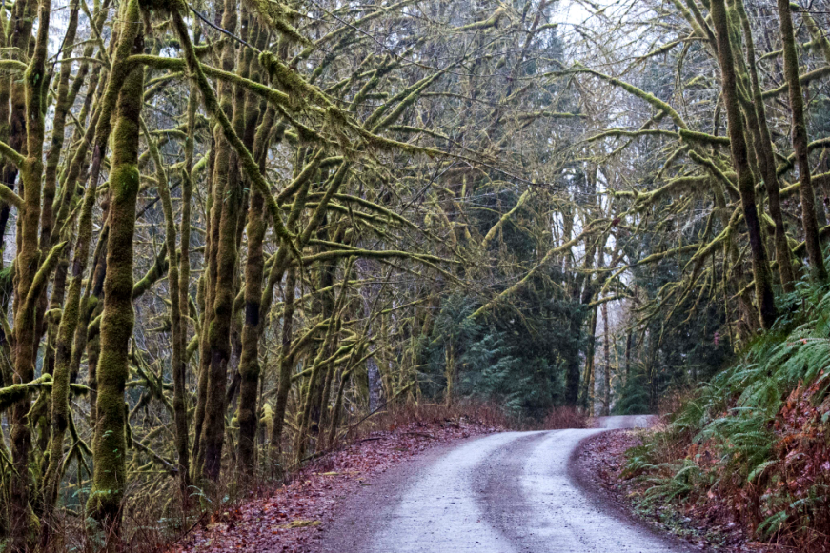



Mapping human values to guide landscape management decisions
Lee Cerveny, PNW Research Station
Mike Schlafmann, Mt. Baker-Snoqualmie National Forest

Slide 2
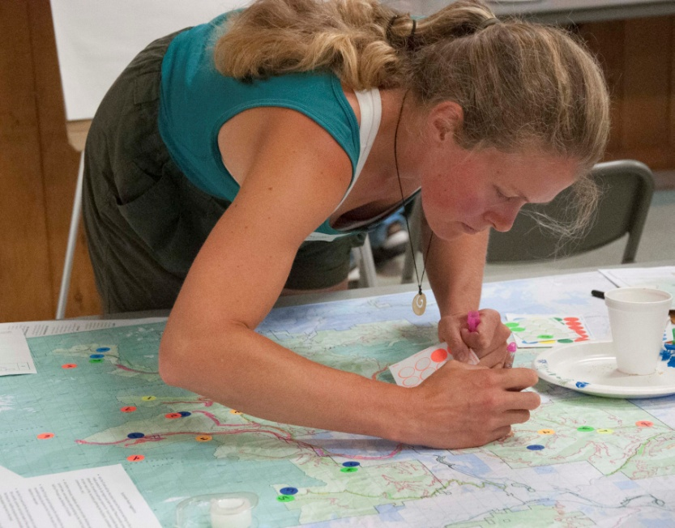
OUTLINE
Human ecology mapping overview
Human ecology mapping for sustainable roads
Building social capacity
Discussion
Notes:
Total 30 min. 20 min presentation; 10 min Q&A
Session: 1:15-1:45

Slide 3

CONCEPTUALIZING “PLACE”
Place Attachment – people develop connections to a place based on repeated experiences and in-depth knowledge of that place
Place Dependence – people have places they rely on to provide services & products that sustain their livelihoods or lifestyles or provide desired experiences.
Place Identity – people have places with deep symbolic meaning (cultural, historical, spiritual) that are important to defining who they are in the world.

Slide 4
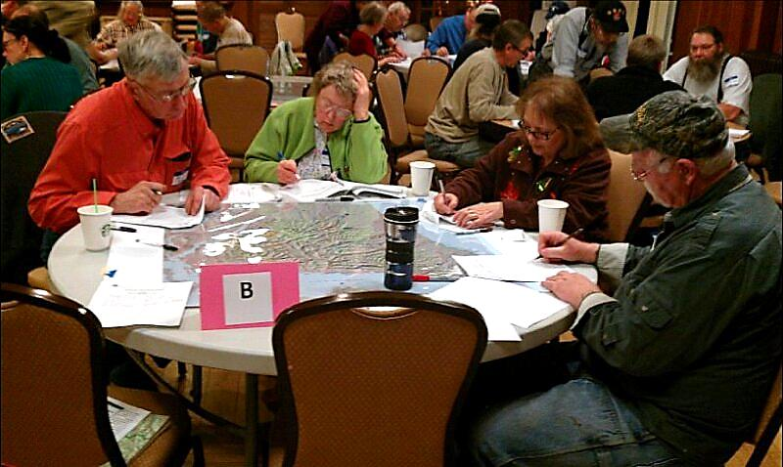
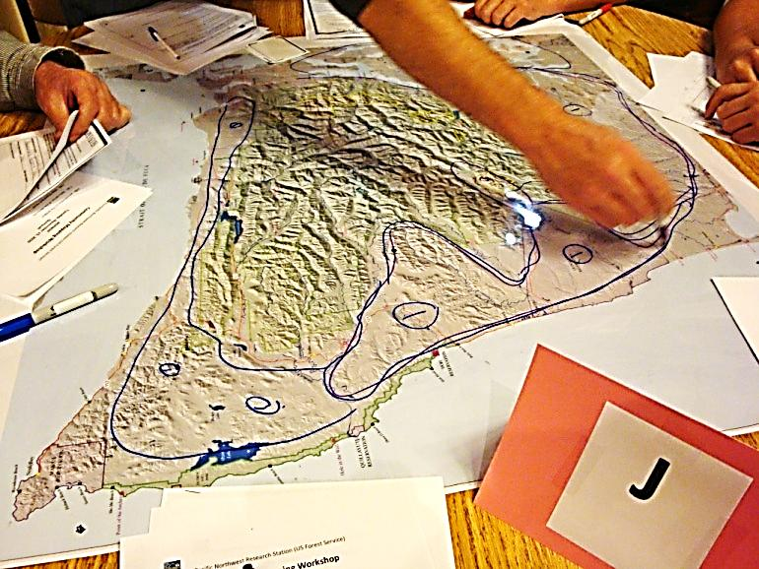
WHAT IS HUMAN ECOLOGY MAPPING?
Human ecology mapping uses maps and other geo-spatial tools to understand people’s relationships with a landscape.
Special places
Social values
Resources they use
Ecosystem benefits
Participatory mapping is a way to strengthen relationships, grow mutual understanding and create new opportunities.
Notes:
Human ecology mapping gathers information about social values, human uses, and resource interactions using maps and other geo-spatial tools.
HEM is a tool developed by social scientists and GIS specialists. HEM can be used to gather information from communities, stakeholders, tribes, landowners, public agencies, and special populations.

Slide 5
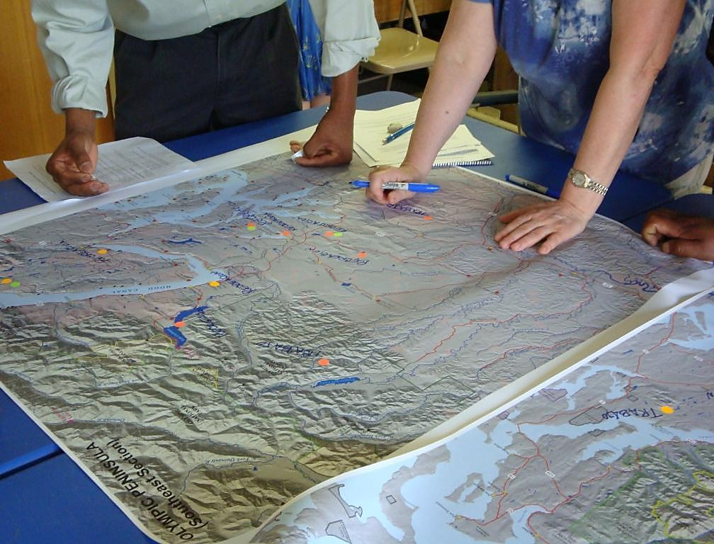
MANY WAYS OF MAPPING
Participants draw their own maps of their landscape
Draw pictures or write narratives on existing maps
Use maps to tell stories (oral histories)
Use dots to indicate critical sites
Use points, lines, polygons to designate meaningful places
McLain, R. (2013) Making Sense of Human Ecology Mapping. Human Ecology

Slide 6
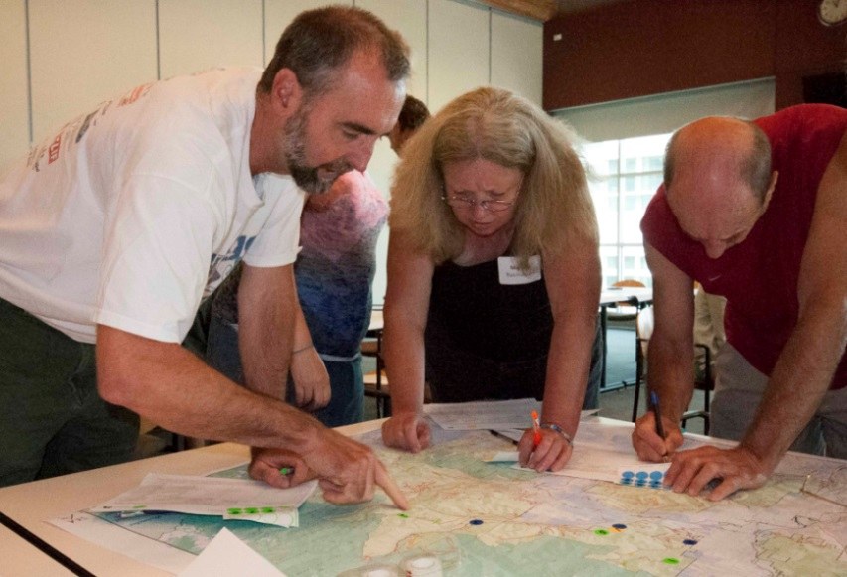
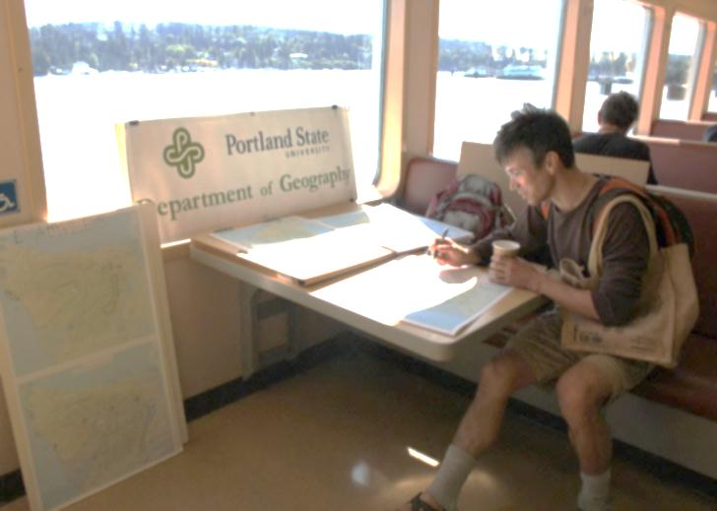
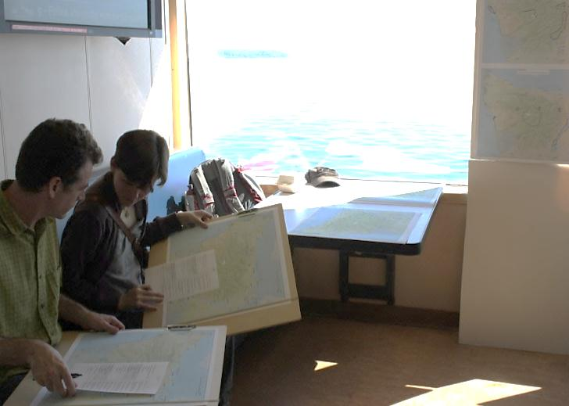
HUMAN ECOLOGY MAPPING IS FLEXIBLE
Multiple Approaches
Public meetings
Websites/on-line mapping
Targeted user groups
On-site (visitor centers, trailheads)
Events (fairs, farmer’s markets)
Public meeting for sustainable roads
Visitor mapping, WA state ferry
Notes:
HEM is a tool developed by social scientists and GIS specialists that can be adapted for use in landscape-scale restoration. HEM can be used to gather information from communities, stakeholders, landowners, public agencies, and special populations.

Slide 7

The map is not the territory. The territory lives in our hearts and minds. The map helps us find our way.
Alfred Korzybski

Slide 8
SUSTAINABLE ROADS:
MT. BAKER-SNOQUALMIE NATIONAL FOREST
GOALS
Engage the public about the importance of forest roads
Gather information from the public about places that matter and roads they use
Produce socio-spatial data for forest planning team

Slide 9
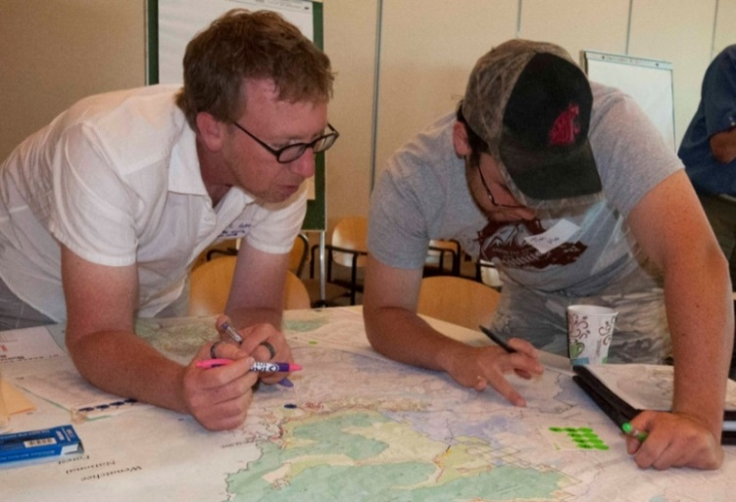
SUSTAINABLE ROADS PROCESS
Partners involved in multiple project phases
Variety of communities: rural, urban, virtual
Well supported by USFS officials
Multiple ways to engage:
Public meetings (284)
On-line survey (1700)
Blog-site commentary (200+)

Slide 10





SUSTAINABLE ROADS CADRE “SRC”
Planning public meeting approach & schedule
Web host for blog (TWS)
Web host for survey (WTA)
Identifying meeting sites
Hosting meetings (food)
Recruitment
Facilitators
Ongoing communications
Interpreting results
The Sustainable Roads Cadre now includes more than 45 partner groups and a core planning team of 5 partners.

Slide 11
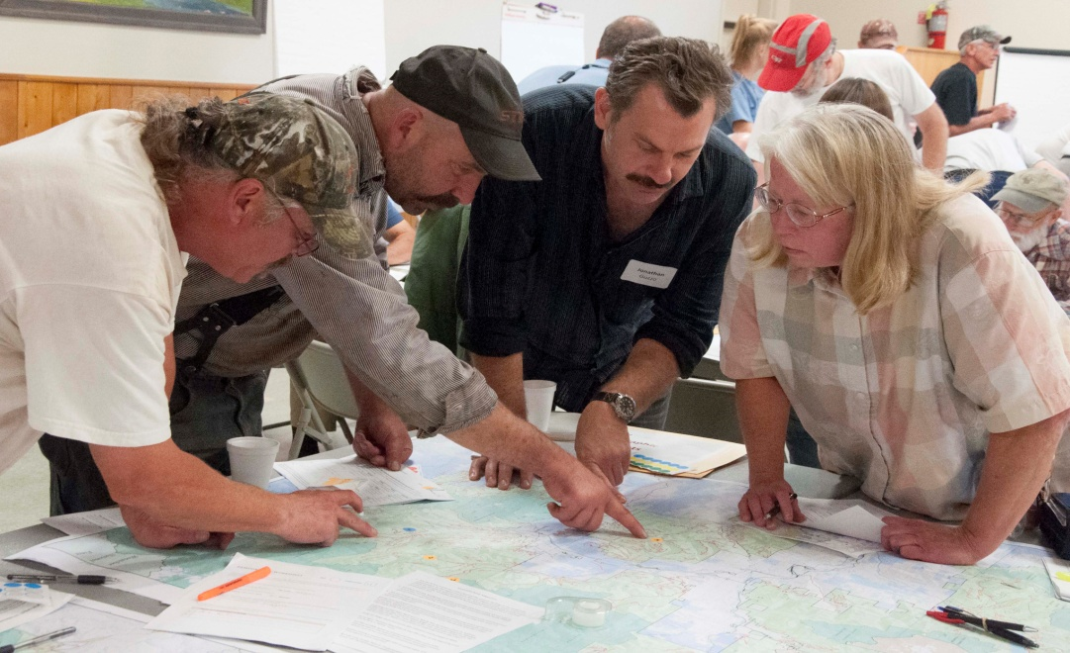
PART A. FOREST DESTINATIONS
Destination Mapping
Identify 8 forest destinations
Why destination is important to you
Activities you do there
Frequency of visits
Vehicle used
Access route
ON THE MAP: Place a dot on the map for each destination. Use a highlighter pen to trace the route you travel to reach that destination.
6-7 participants and 2 volunteer facilitators per table.

Slide 12

PART B: GROUP DIALOGUE
What are the consequences of a reduced road system?
What criteria should the USFS use to decide which roads to prioritize?
What strategies, ideas, or opportunities could help adapt to changes?

Slide 13
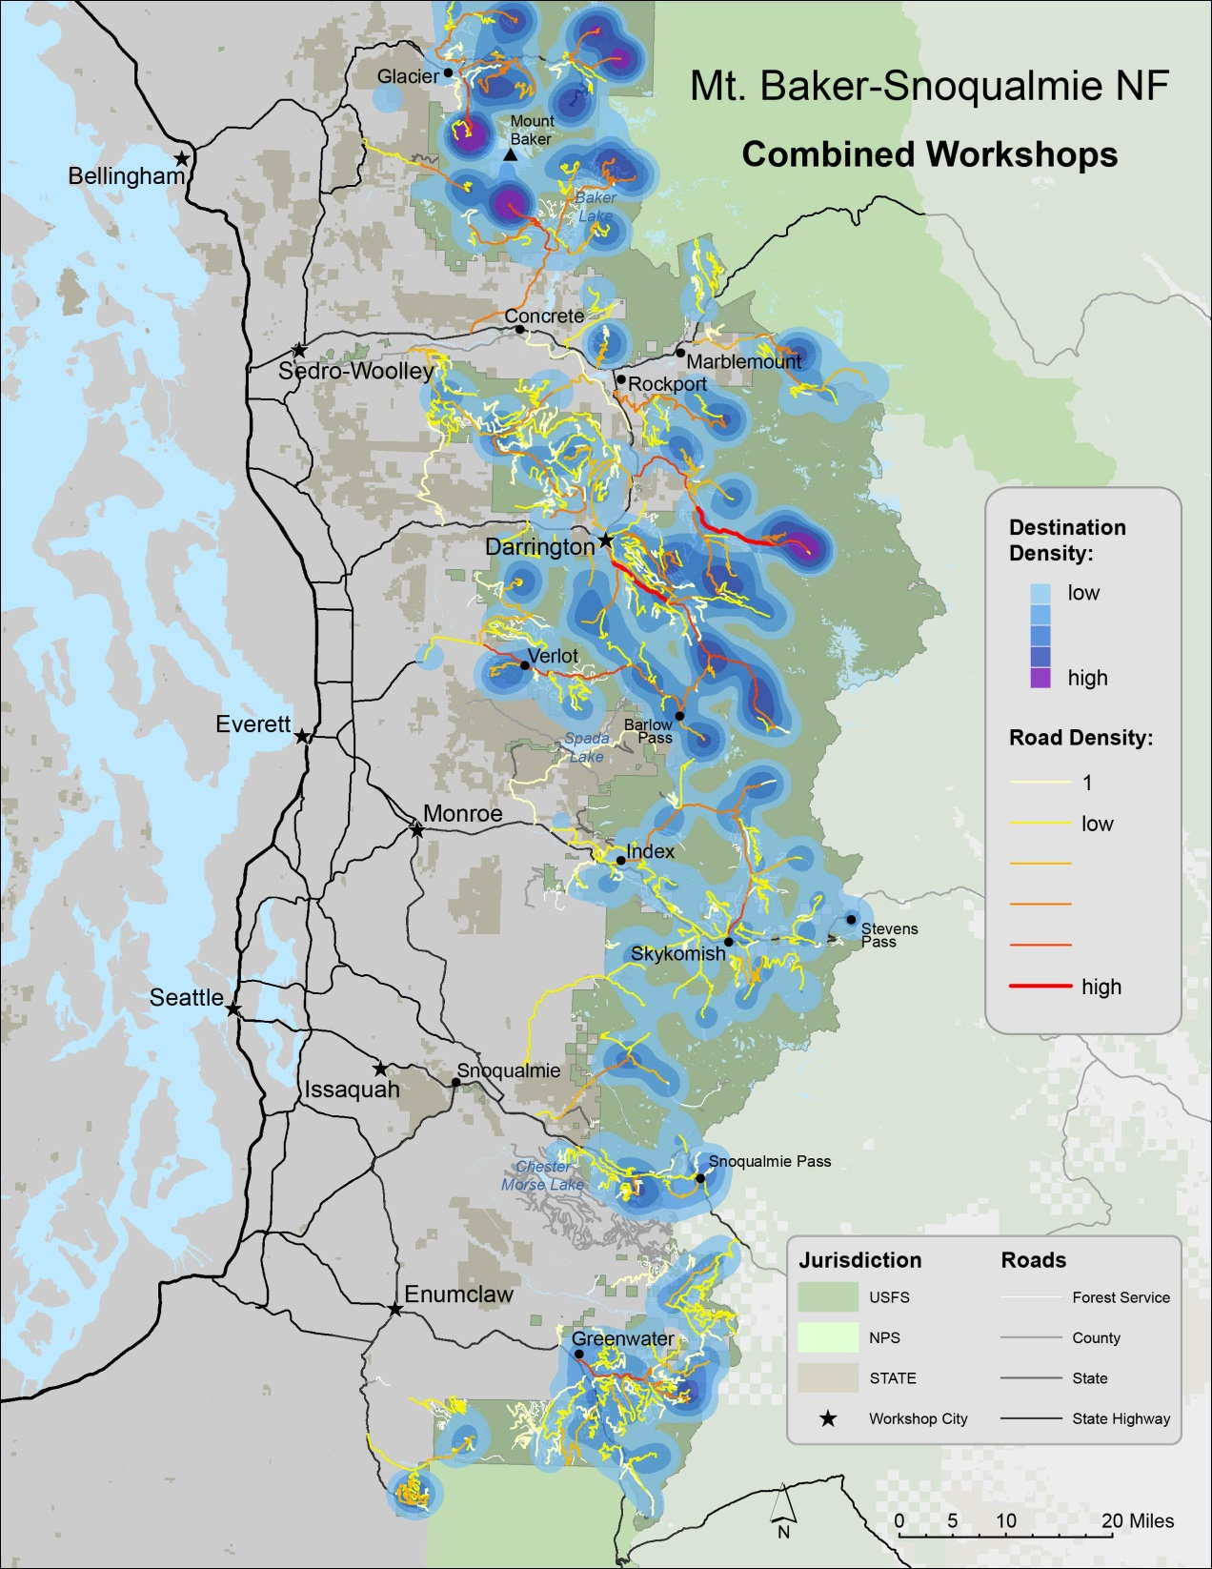
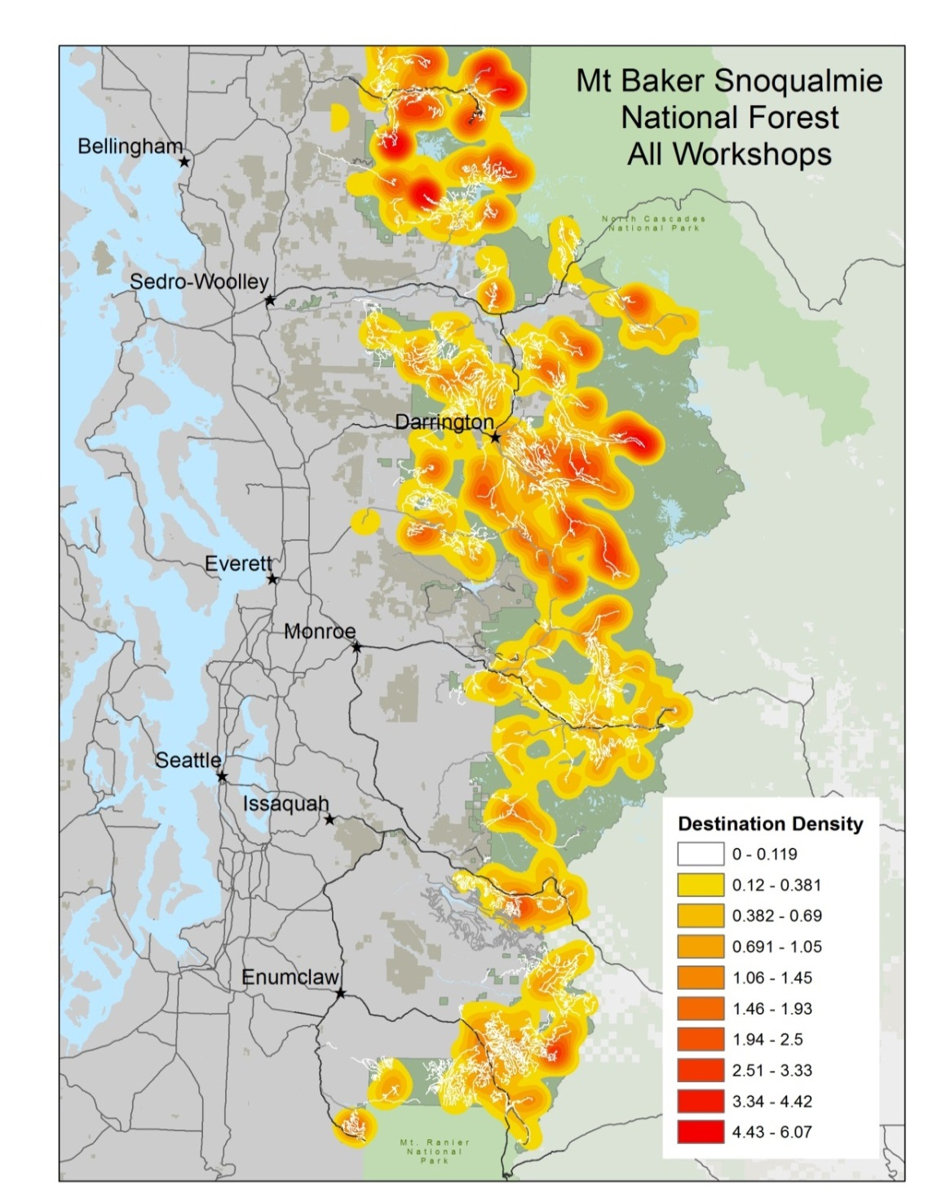
FOREST DESTINATIONS AND ROADS

Slide 14
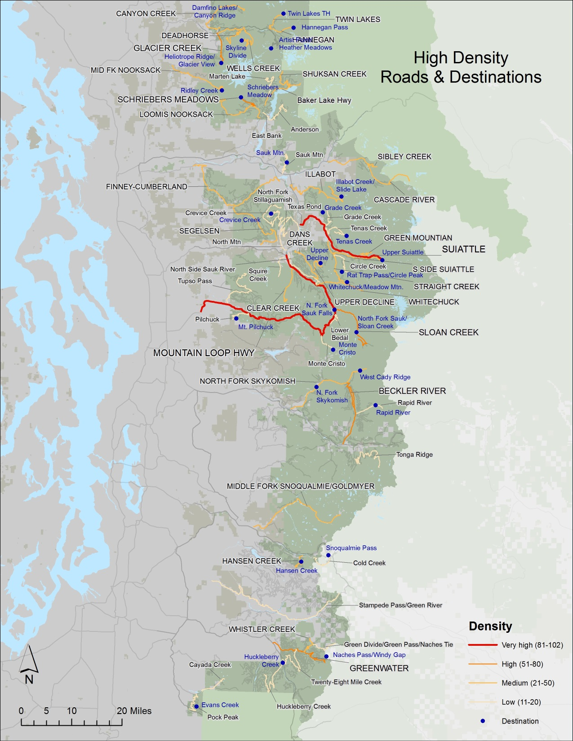
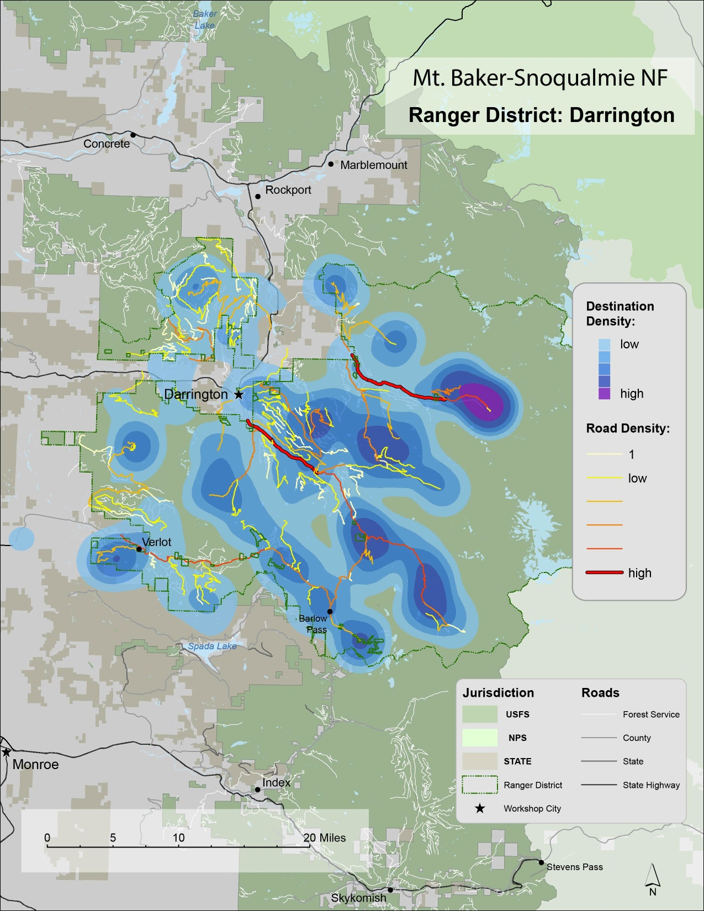
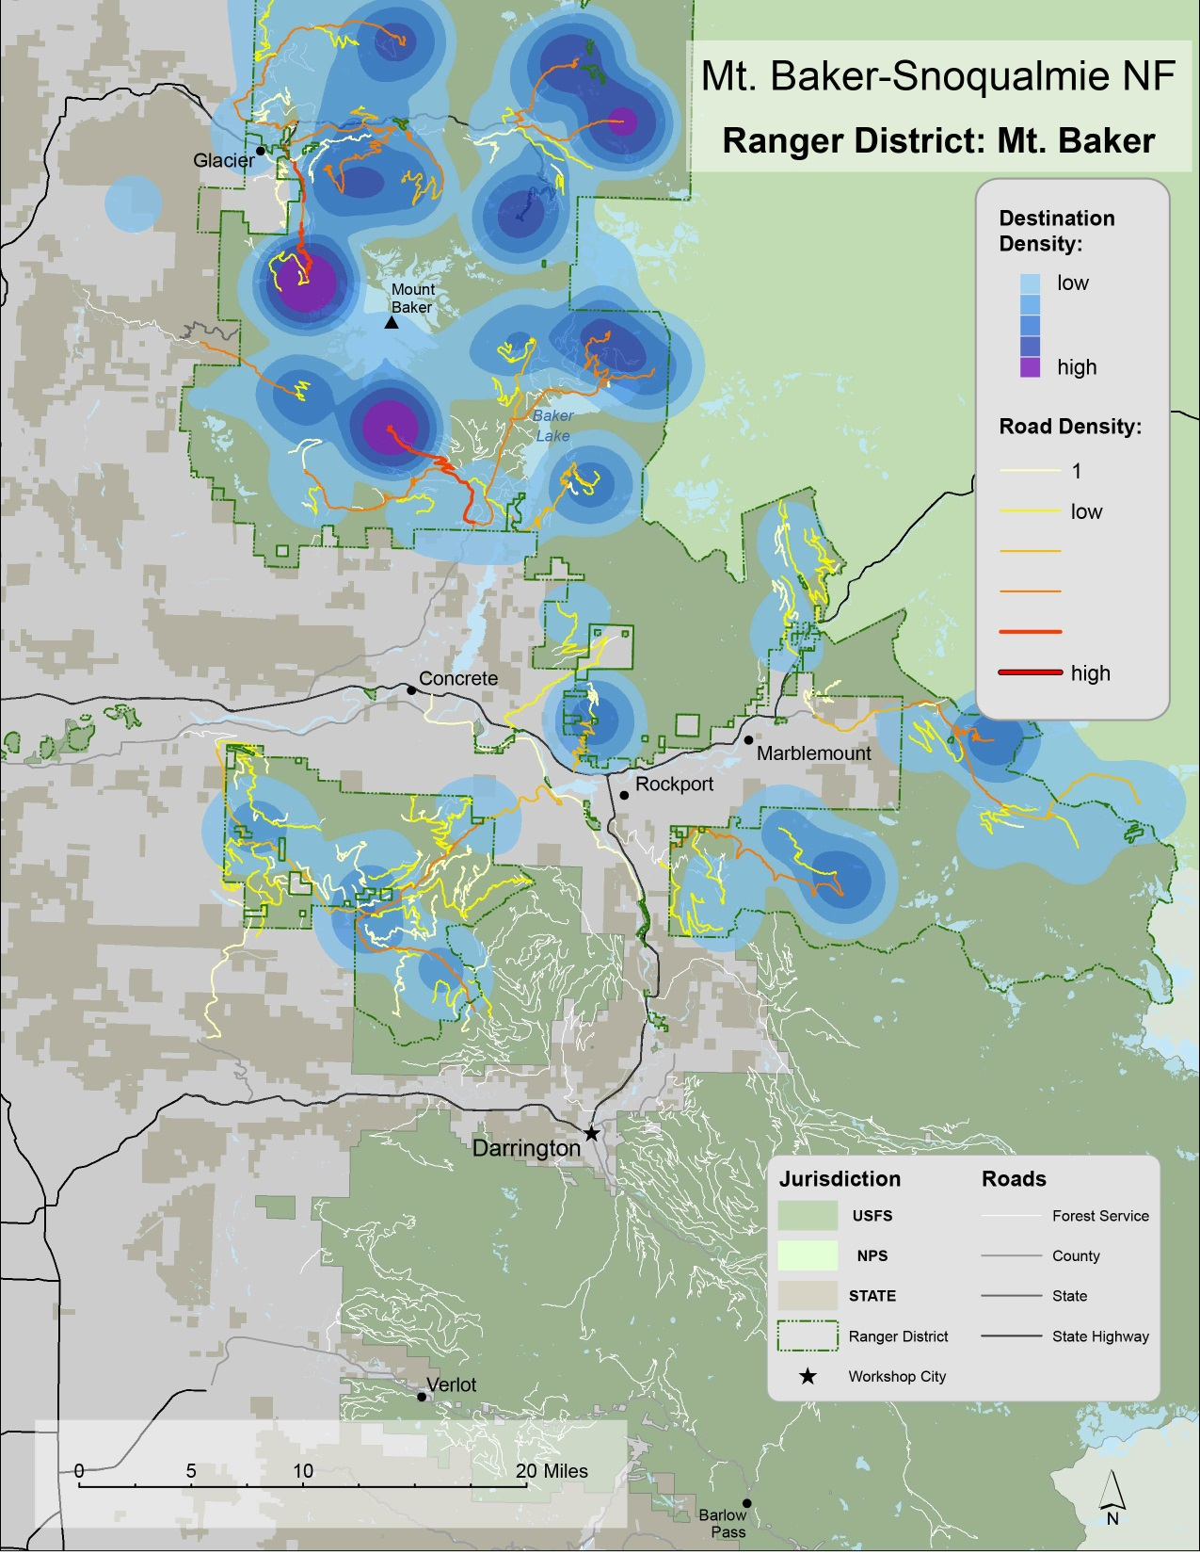

Slide 15
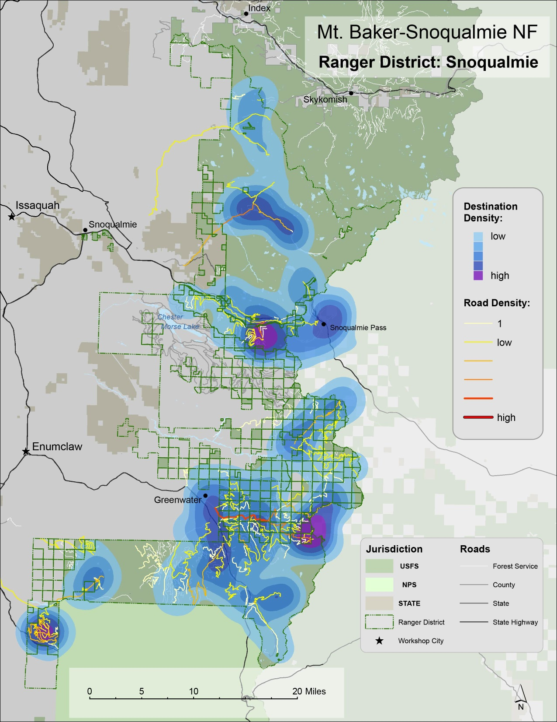

Slide 16
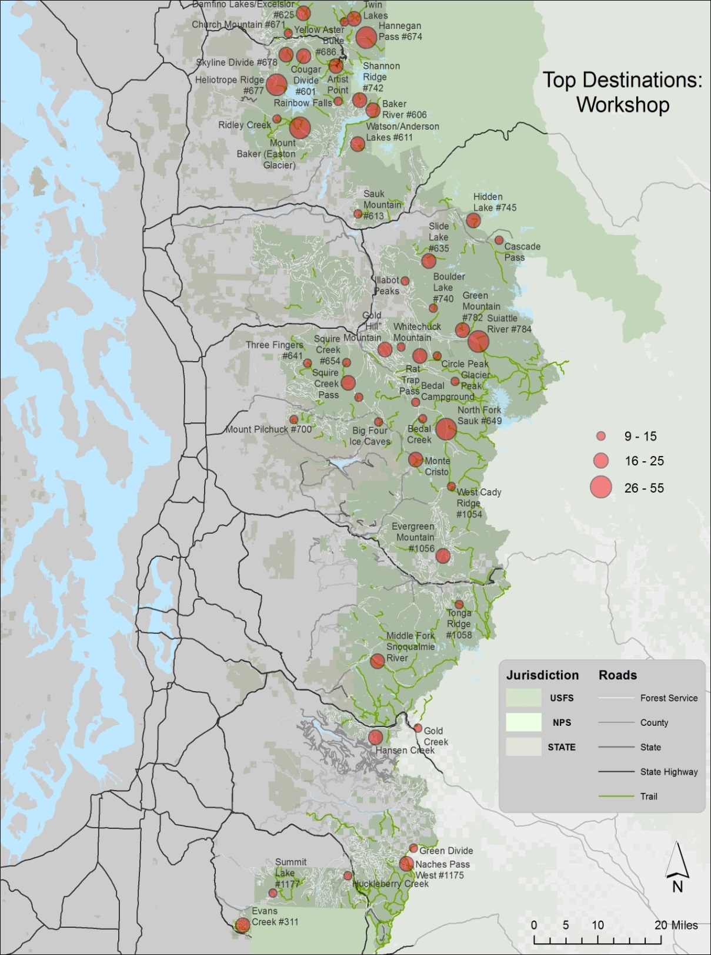
Top Destinations

Slide 17
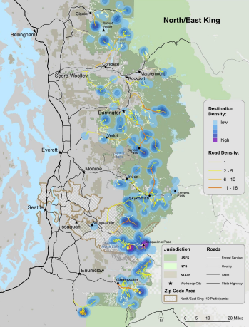
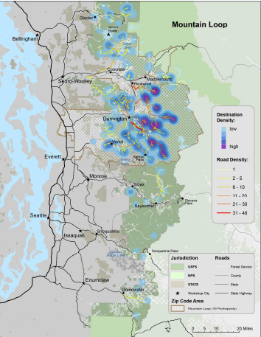
DIFFERENCES BY ZIP CODE
DIFFERENCES BETWEEN URBAN AND RURAL RESIDENTS
Seattle Area
Mountain Loop

Slide 18
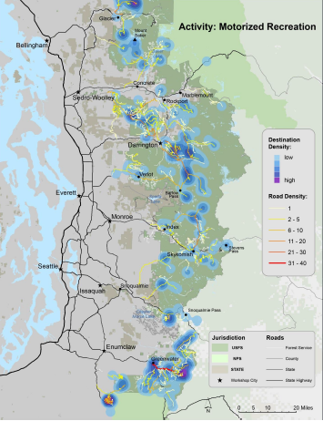
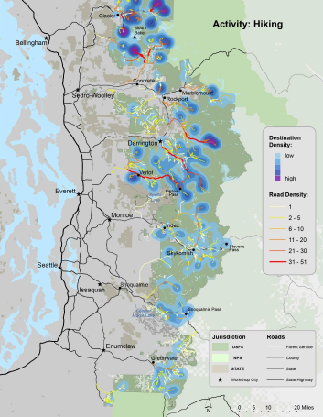
DIFFERENCES BY USER GROUP
Motorized Recreation
Hiking

Slide 19

CRITERIA FOR DECIDING ROAD STATUS
Diversity of activities a road may support
Volume of public use
Cost to maintain road
Effect on local industries
Ecological health
Potential for connectivity and loops

Slide 20

STRATEGIES AND OPPORTUNITIES
Volunteer brigades for roads maintenance (adopt-a-road)
NW Forest Road Pass Program
People for Public Access

Slide 21
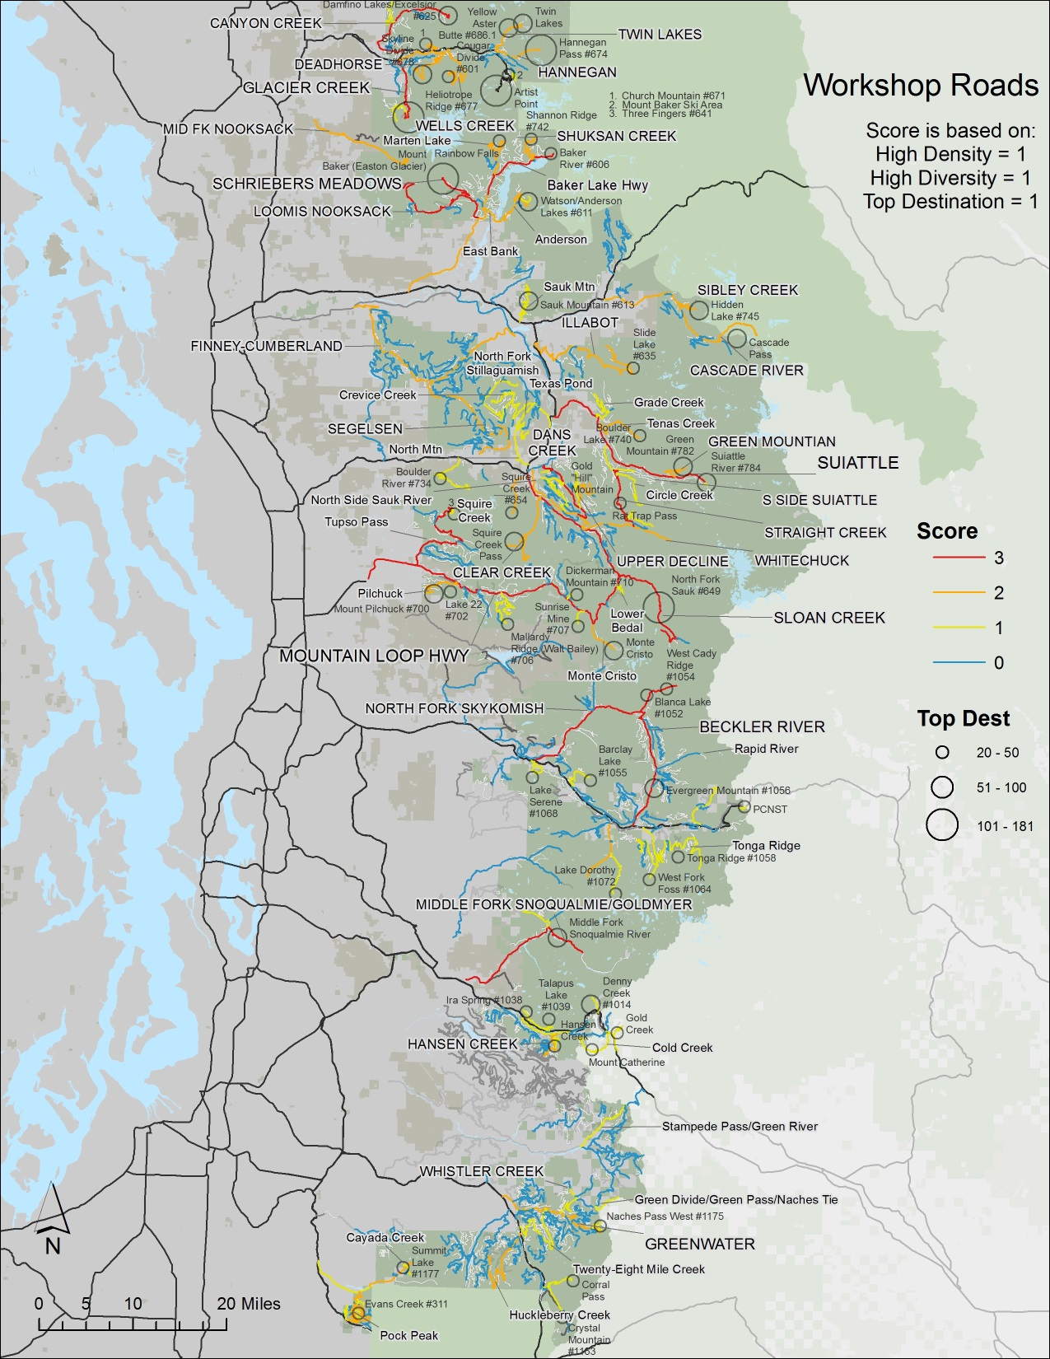
Top Roads

Slide 22
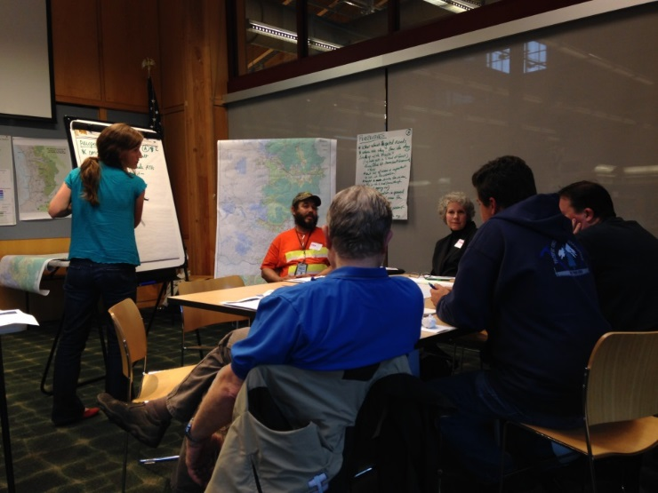
LOOPING BACK
Bringing maps back to the communities
Opportunity to show what we found
Confirmation, questions, interpretations
Seeing themselves in the data
Maintaining momentum

Slide 23
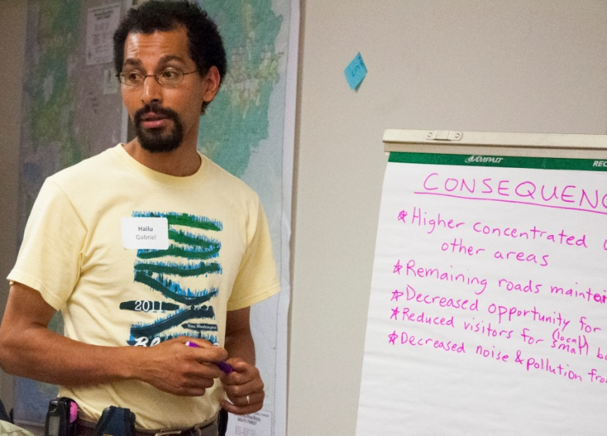

Do you see yourself in the maps?
I do indeed.

Slide 24
PLANNING & DECISION OUTCOMES: Nooksack Watershed ATM
Sustainable Roads Collaborative Proposed Action
Participants are better able to make sense of the social, ecologic and economic landscape
Participants are more accepting of tradeoffs

Slide 25
OTHER OUTCOMES
Strong Cadre of Partners and Public Engage Directly in Developing, Facilitating and Leading Efforts
Development of Monitoring Strategy and Stewardship Plan for Climbers on Mt. Baker
Stillaguamish Sauk Region Sustainable Tourism Strategy
Skykomish Region Sustainable Tourism Strategy
Snoqualmie Valley Sustainable Recreation Strategy
Notes:
Total 30 min. 20 min presentation; 10 min Q&A
Session: 1:15-1:45

Slide 26
WHAT WE LEARNED
Engaging partners early fundamentally changed the process and generated enduring momentum.
Maps get people thinking about what is important to them about a place.
Maps provide a vehicle for people to share stories about how they connect to a place which seems to diffuse conflict.
Importance of letting go the need for control.

Slide 27
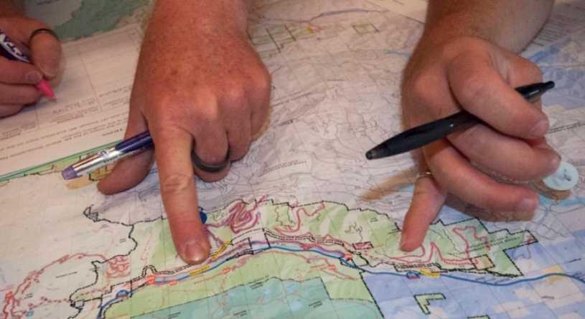
HUMAN ECOLOGY MAPPING: DESCHUTES & OCHOCO NF (2016)
Important Forest Places
Benefits/Values
Uses/Activities
Features
Threats
Management strategies
Strategies:
Online survey
Public events (I-pads)
Targeted workshops
Partners:
Deschutes & Ochoco NFs
Discover Your Forest
Portland State University
USFS Pacific NW Region (R6)
Pacific NW Research Station

Slide 28
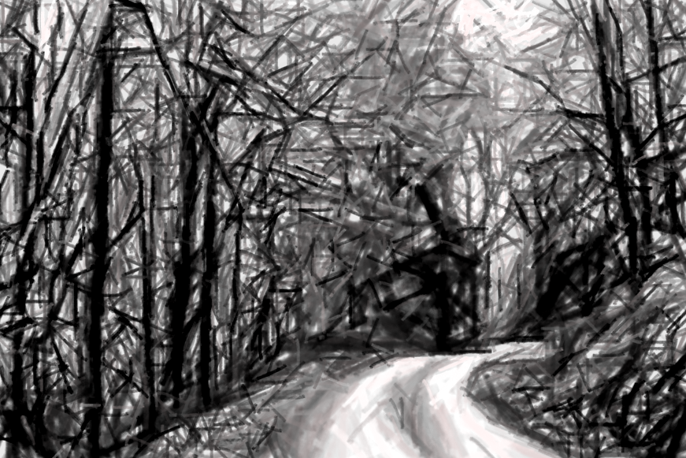

DISCUSSION

Slide 29
ONLINE SURVEY
Gender: 71% male; 29% female
Avg. years in area: 32
Average age: 51 years
Percent attending as official representative: 4%
Percent who drive on USFS roads for work: 38%
OVERVIEW
1,776 responded
1,510 valid entries
898 provided at least one forest destination
More than 45% of survey respondents were from urban King County

Slide 30
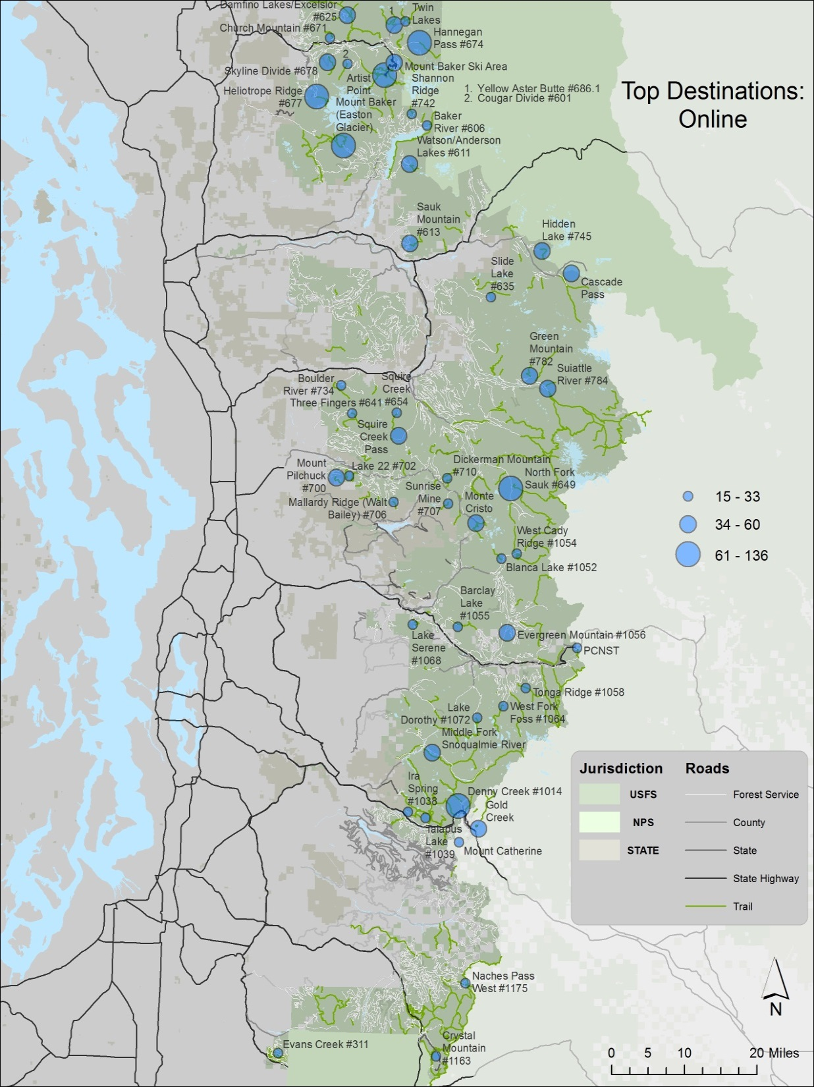

Slide 31
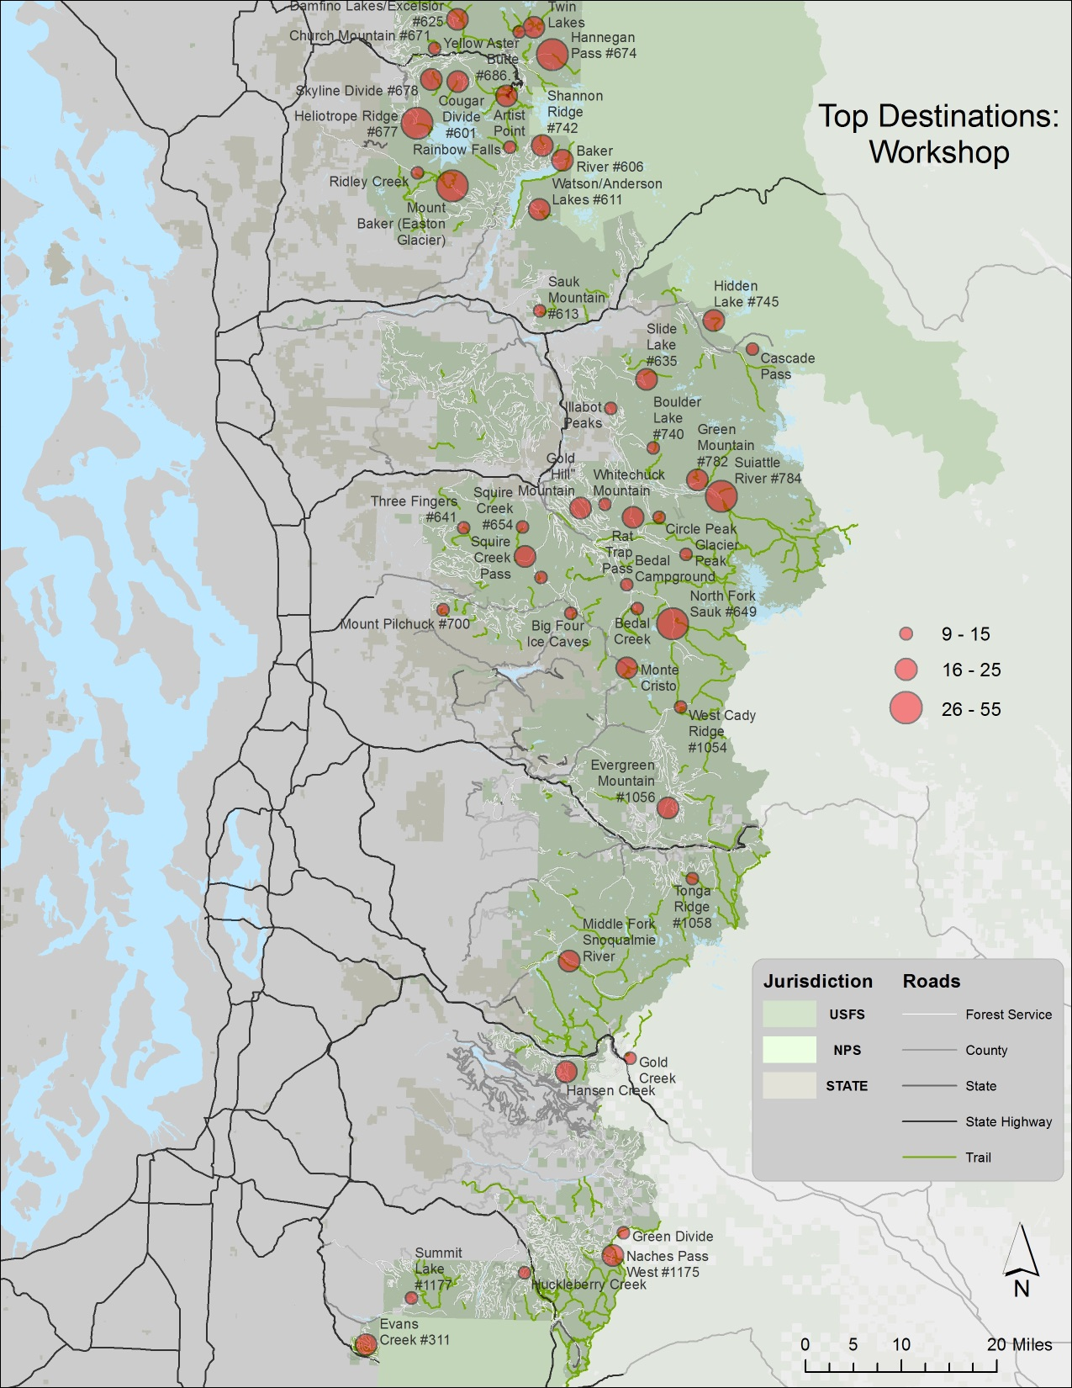

Slide 32
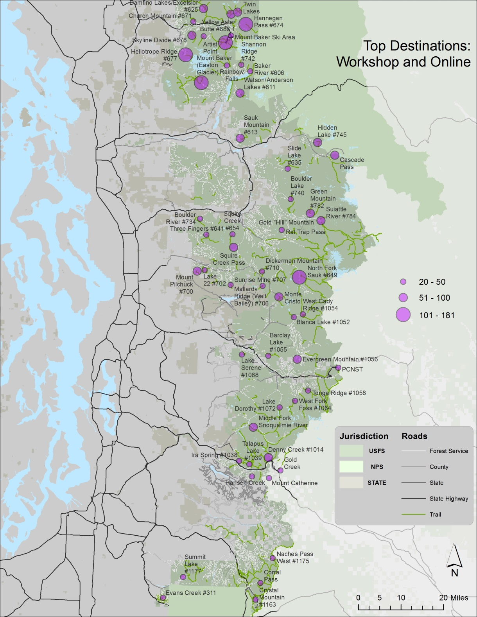

Slide 33
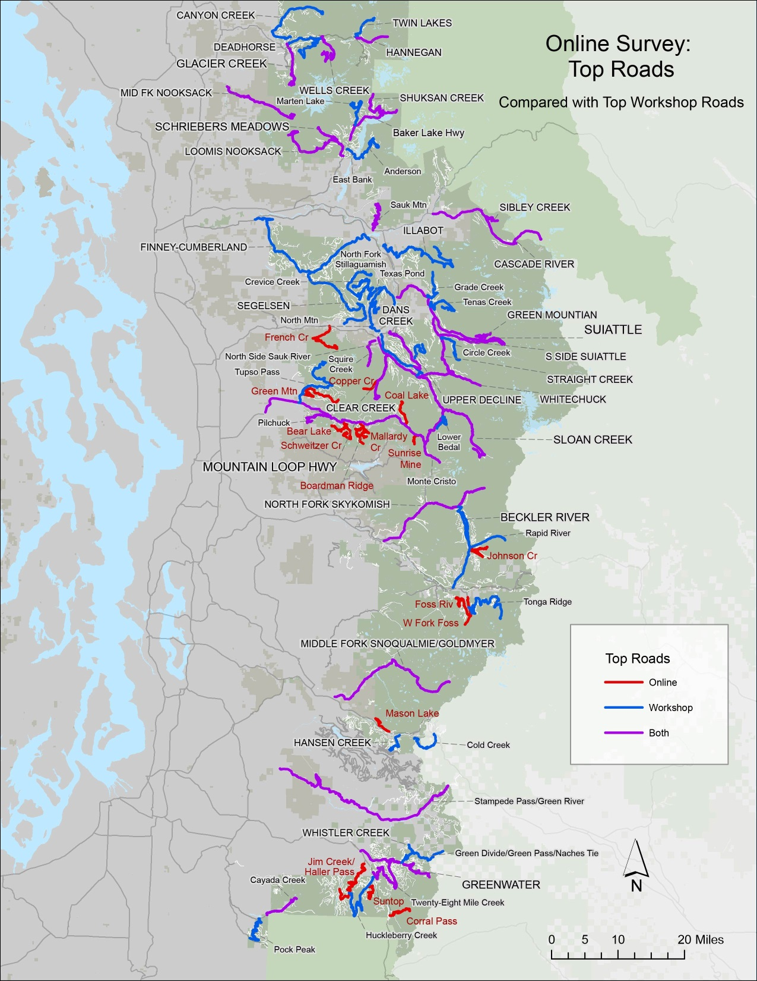

Slide 34
DEMOGRAPHIC SUMMARY
Average attendance: 31
Gender: 74% male; 26% female
Avg. years in area: 37 years
Average age: 54 years
Percent attending as official representative: 48%
Percent who drive on USFS roads for work: 58%

Slide 35
VISITS TO THE NATIONAL FOREST

