Slide 1
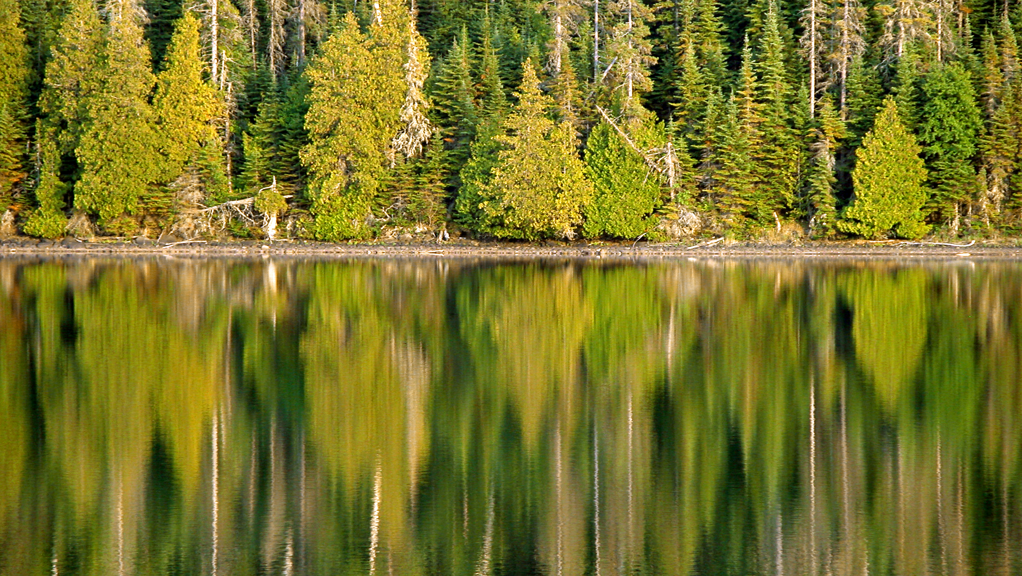
Studying the ethical dilemmas of natural resource management
USFS Region 6 Social Science Forum, March 2016
Michael Paul Nelson, Oregon State University

Slide 2


Slide 3
The Practical Syllogism
P1. Descriptive, empirical This is the way the world is.
P2. Normative, ethical This is what we value,
This is what we believe is right,
This is how the world ought to be.
___________________________________________________
Conclusion This is what we ought to do.

Slide 4

Example 1
Intrinsic Value

Slide 5
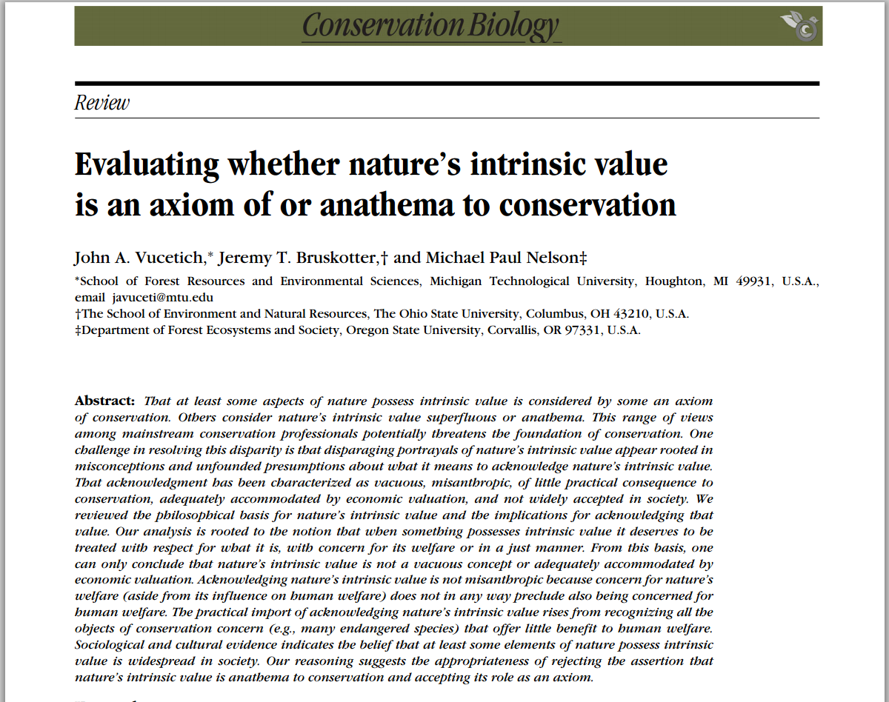
Conservation Biology,
29(2) pp. 321–332, April 2015.

Slide 6
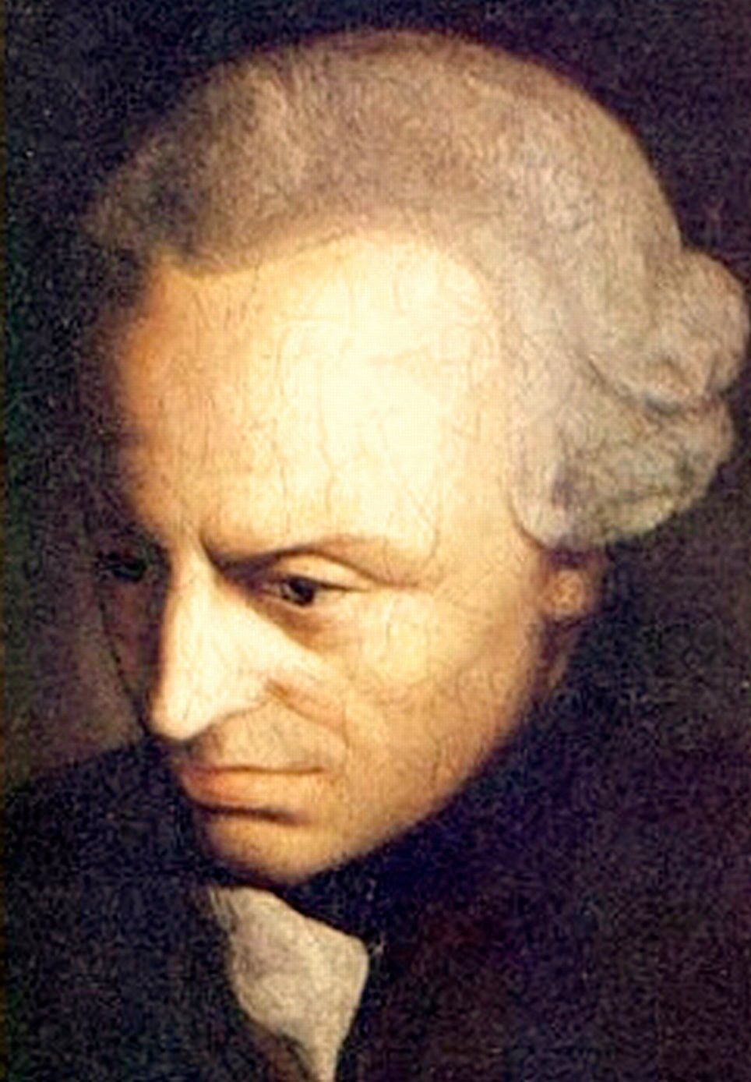
WHAT IS INTRINSIC VALUE?
...everything has either a price or a dignity. What has a price can be replaced by an equivalent; by contrast, that which is elevated above all price... has a dignity…
Each human being necessarily represents his own existence in this way.
Immanuel Kant (1870)

Slide 7
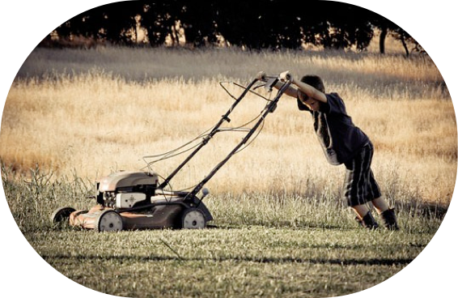
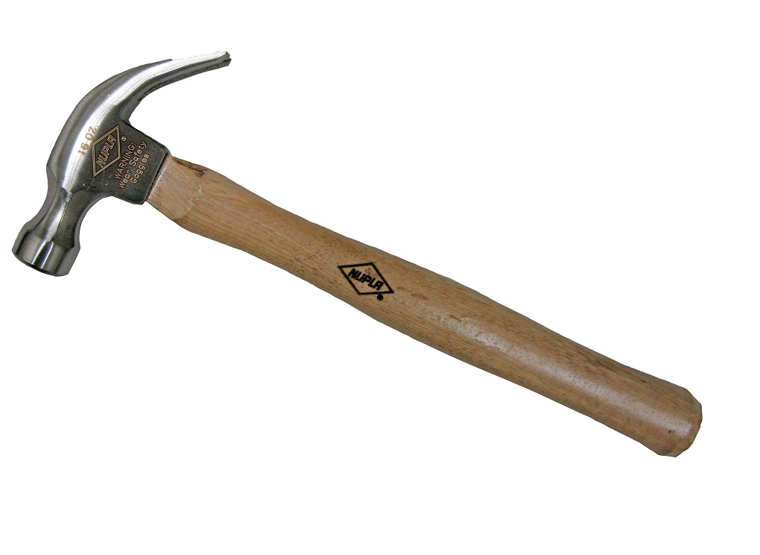
WHAT IS INTRINSIC VALUE?
function
replaceable
useful for what it does
for its own sake
for what it is, not
what it does
irreplaceable

Slide 8
QUESTIONS ABOUT NATURE’S INTRINSIC VALUE?
arbitrary?
misanthropic?
infinite?
subject to economic valuation?
moot?
widely acknowledged?
influence on behaviors and decisions?

Slide 9
Sometimes Conceptual
P1. Many of those who oppose hunting wolves attribute IV to wolves
P2. The attribution of IV is arbitrary
P3. We shouldn’t seriously consider positions that are based on arbitrary beliefs
C. Therefore, we shouldn’t seriously consider positions held by those who oppose hunting wolves

Slide 10
Is it ARBITRARY to acknowledge nature’s intrinsic value?
What about humans imbues us with IV? What trait?
One answer is, certain interests, e.g., interest to avoid pain.
Mammals and birds possess IV because they possess that trait.
Anything with that trait would possess IV.
Fish might possess IV because they might possess that trait.
Plants and insects do not possess IV because they
do not possess that trait.

Slide 11
Is it ARBITRARY to acknowledge nature’s intrinsic value?
What about humans imbues us with IV? What trait?
One answer is, certain interests, e.g., interest to avoid pain.
being alive
All living things possess IV.
Anything with that trait would have IV.

Slide 12
Sometimes Conceptual
?
P1. Many of those who oppose hunting wolves attribute IV to wolves
P2. The attribution of IV is arbitrary
P3. We shouldn’t seriously consider positions that are based on arbitrary beliefs
C. Therefore, we shouldn’t seriously consider positions held by those who oppose hunting wolves

Slide 13
QUESTIONS ABOUT NATURE’S INTRINSIC VALUE?
arbitrary?
misanthropic?
infinite?
subject to economic valuation?
moot?
widely acknowledged?
influence on behaviors and decisions?

Slide 14
Sometimes Empirical
P1. We should only adopt management policies
reflecting the values of the majority of humans since only those will be effective
P2. The majority of humans only view nature as
instrumentally (not intrinsically) valuable
Therefore, we should only adopt management
policies based on the instrumental value of nature
since only those will be effective

Slide 15
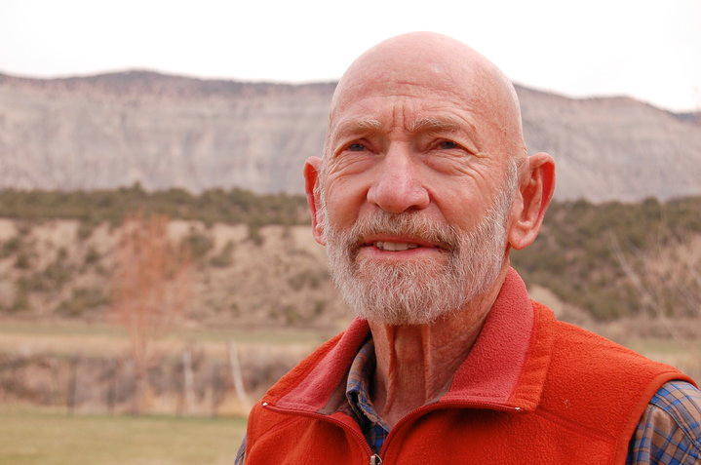



Conservation Biology emerges from the notion that “biotic diversity has intrinsic value, irrespective of its instrumental or utilitarian value”
Michael Soule
Peter Kareiva
Conservation should be motivated by
the benefits that nature provides to humans.
,

Slide 16
Reported Belief in Intrinsic Value - Ohio
2 Statements:
1. Wildlife are only valuable if people get to utilize them
in some way.
N = ~2740
2. Wildlife have inherent value, above and beyond their
utility to people.
N = ~2730
Notes:
How would you answer this question?
How do you think ~3k Ohioans answered this question?
Note the difference.

Slide 17
Reported Belief in Intrinsic Value
(-0.04)
(0.01)
(-0.04)
(0.16)
Vucetich et al., Conservation Biology, 2015

Slide 18
Reported Belief in Intrinsic Value
Vucetich et al., Conservation Biology, 2015

Slide 19
Reported Belief in Intrinsic Value
Vucetich et al., Conservation Biology, 2015

Slide 20
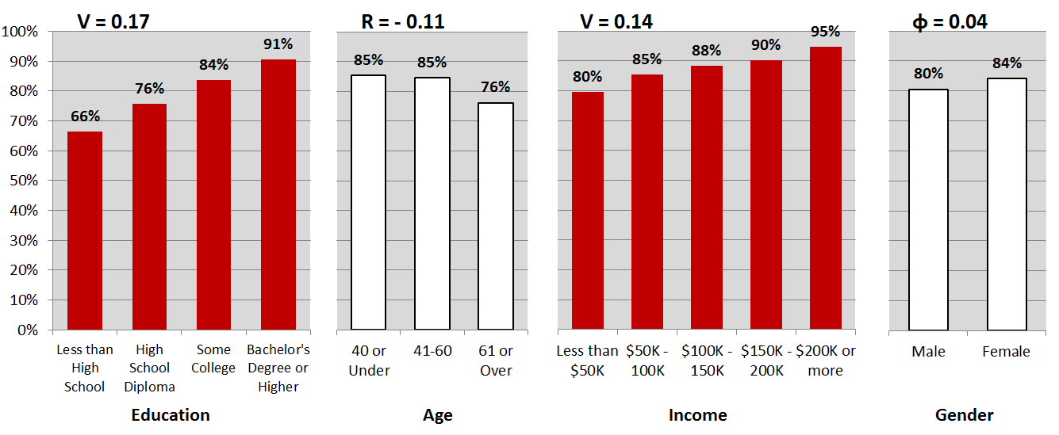
Reported Belief in Intrinsic Value
Vucetich et al., Conservation Biology, 2015
Notes:
Education the biggest predictor – why, do you learn to acknowledge nature’s IV in college?

Slide 21
Sometimes Empirical
P1. We should only adopt management policies
reflecting the values of the majority of humans since only those will be effective
P2. The majority of humans only view nature as
instrumentally (not intrinsically) valuable
Therefore, we should only adopt management
policies based on the instrumental value of nature
since only those will be effective
?

Slide 22
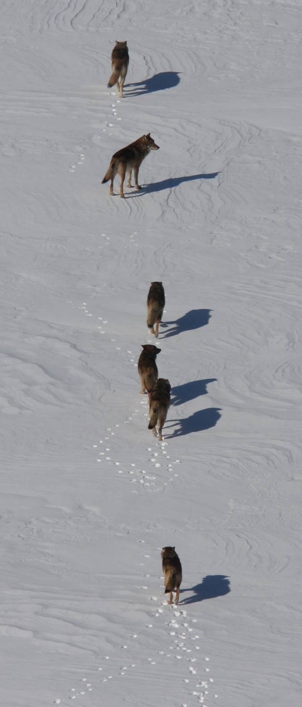
Example II
The Wolves of
Isle Royale

Slide 23
Consider:
P1. In the face of climate change, we will have to
intervene at times to secure land health.
P2. The public will not support intervention
(mistrust, health=non-intervention, etc.).
C. Therefore, we will not be allowed to intervene,we will not be able to secure land health, land will
become increasingly unhealthy.

Slide 24
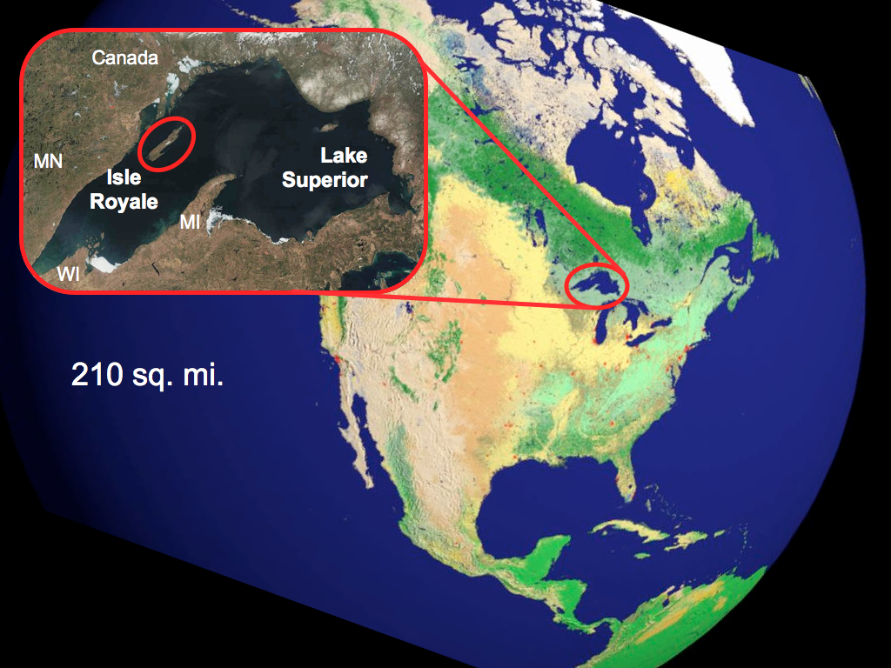
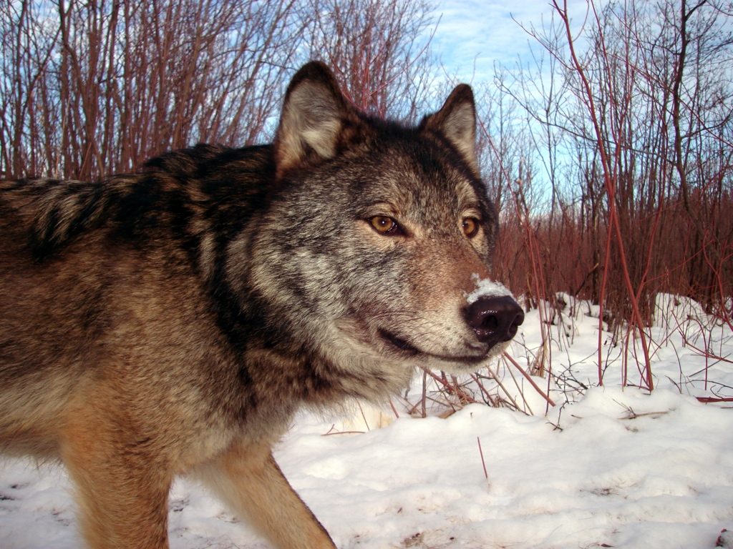
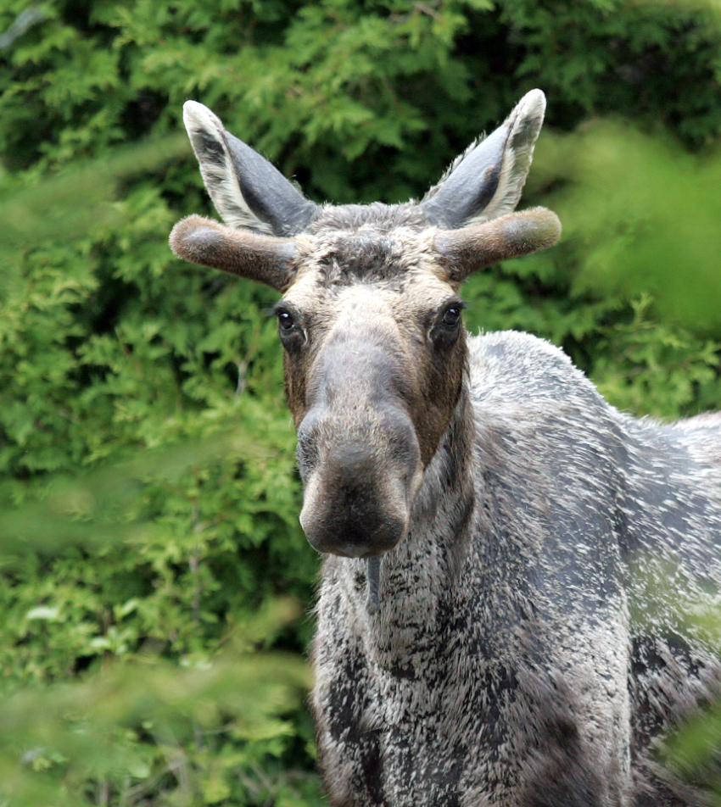

Slide 25
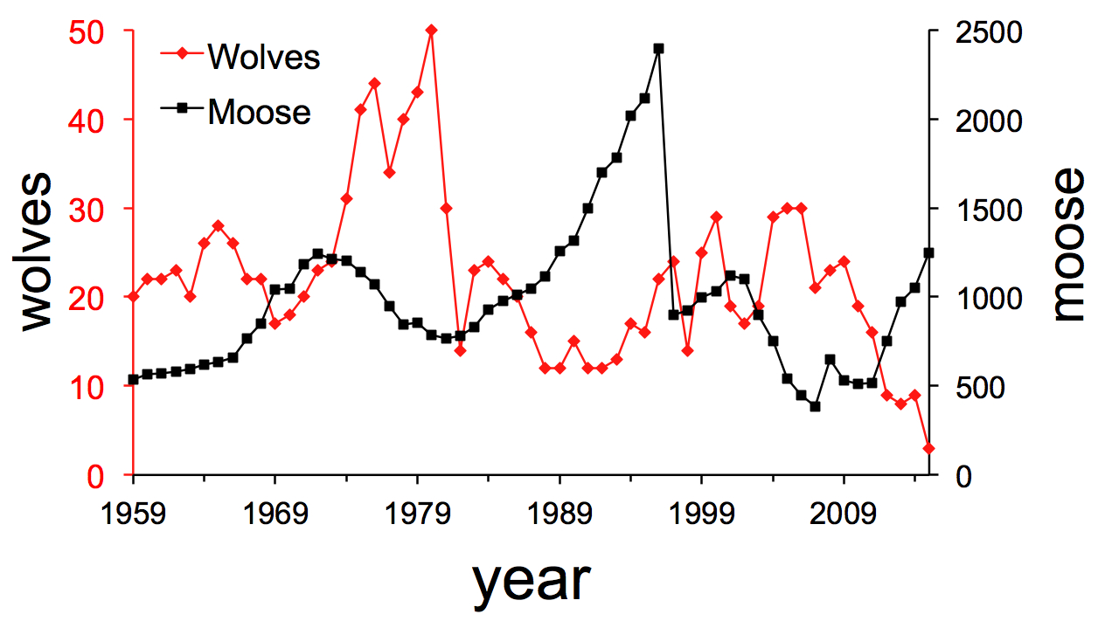

Slide 26
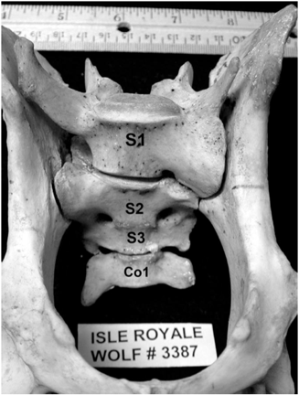
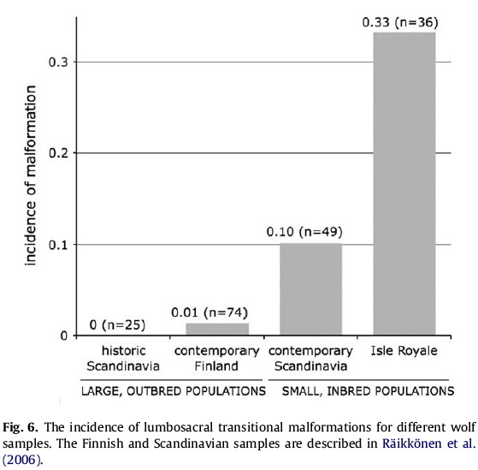
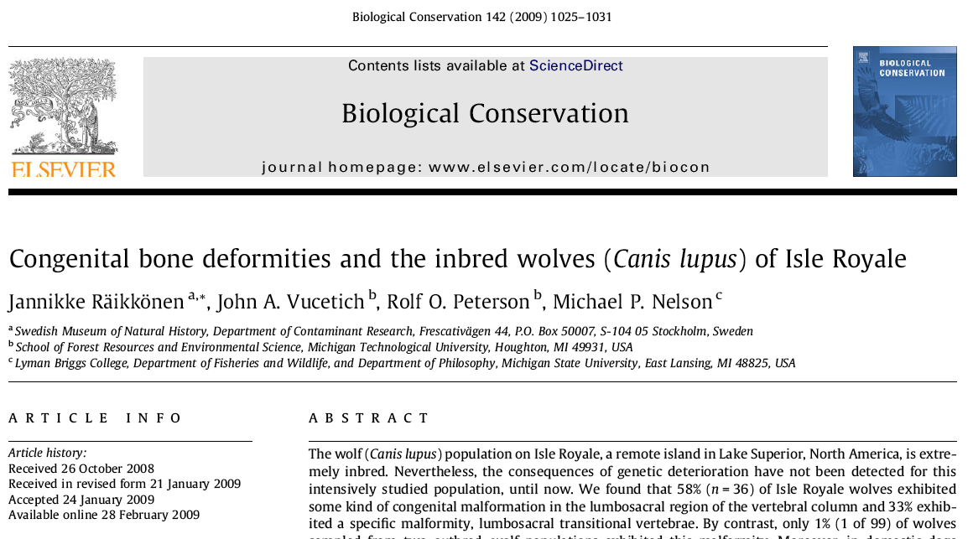
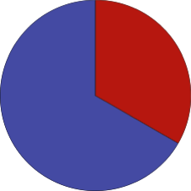
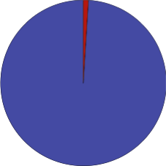
Bone Deformities in Wolves
long been present, only discovered in 2009
33%
incidence in Isle Royale wolves.
1%
incidence in
normal populations.

Slide 27
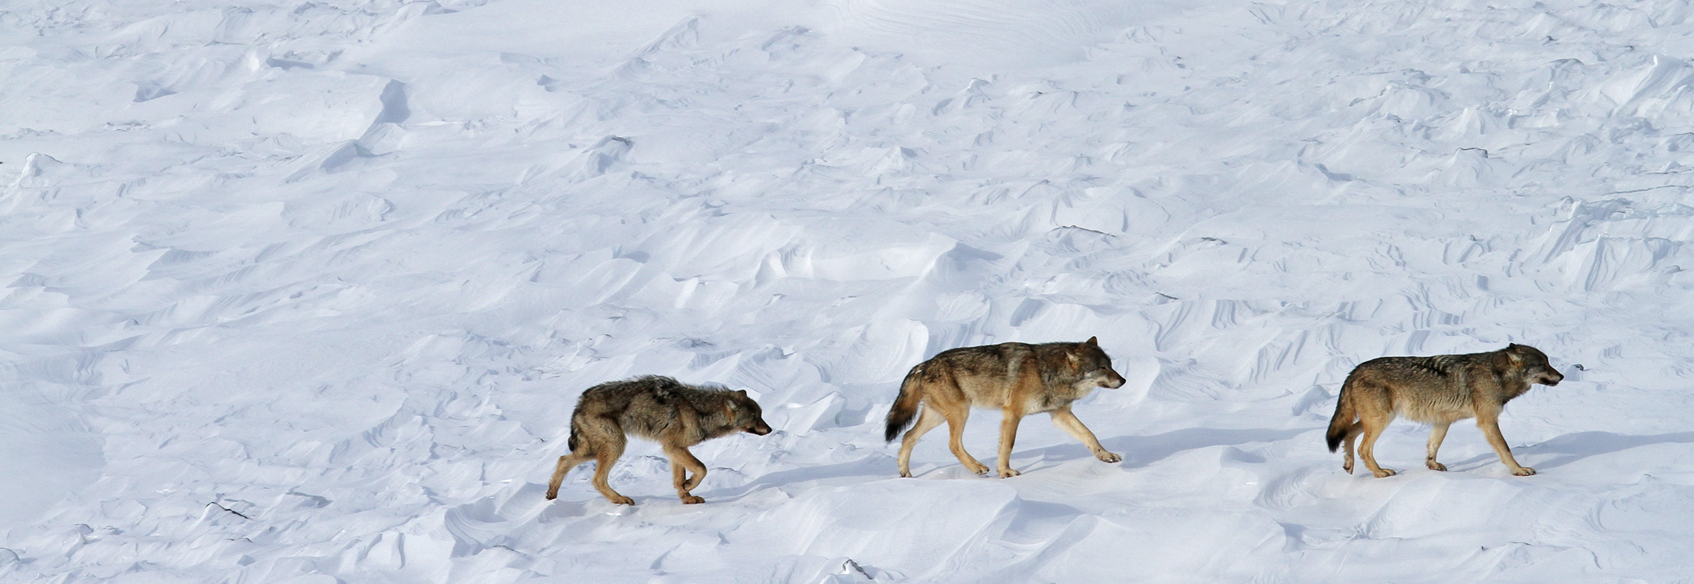
2/15/15

Slide 28
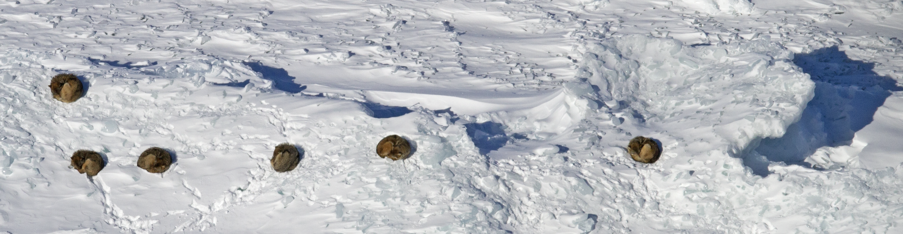
WS 2012
M = 750
W = 9
WS 2013
M = 975
W = 8
WS 2014
M = 1050
W = 9
WS 2015
M = 1250
W = 3
WS 2016
M = ?
W = ?
~End
2017
9/12
4/14
5/15
N=~930
N=359
N=?

Slide 29

Policy Preference
isleroyale_wildlife@nps.gov
3 options, and why
Do nothing, now or ever
Let them go extinct, then reintroduce
Genetic rescue now
4. Do nothing now, but don’t rule out the possibility of genetic rescue later

Slide 30
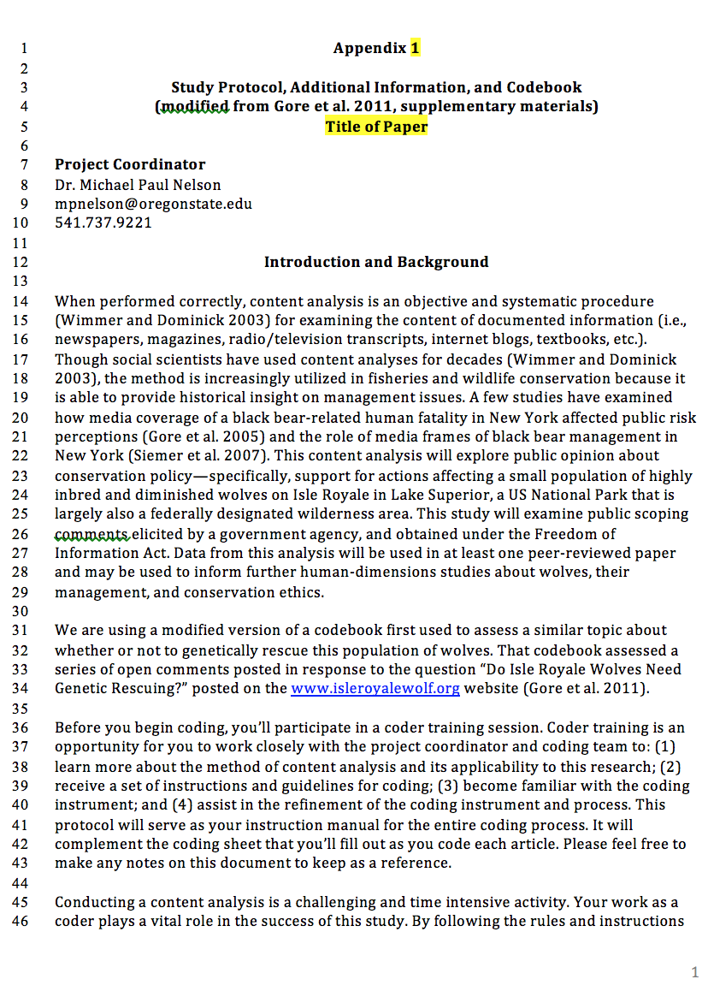

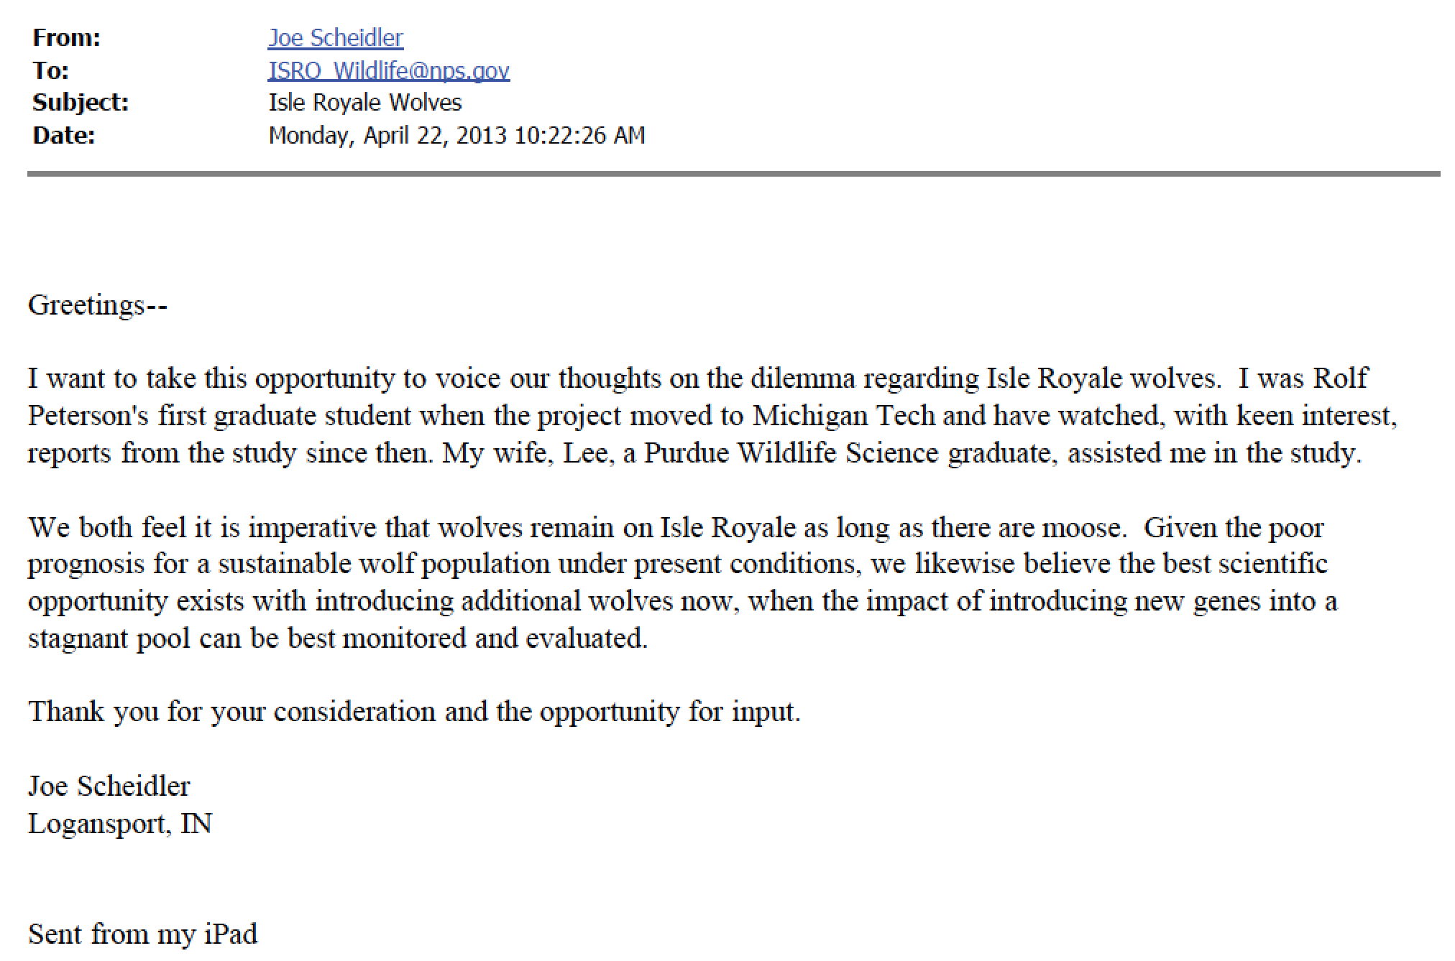
Methods
Total N = 930
We analyzed ~50% = 466,
selected at random
2 Independent Coders
Intercoder reliability = low 90% ave. across the board

Slide 31
Policy Preference
N = 428
Removed those where we couldn’t tell or off topic=5%
Interventionist = 88% Non-Interventionist = 12%

Slide 32
Moral Grounding – our specific ethical theory
External Authority
Divine Command
Natural Law
Human Authority
Consequences
Motives
Appeals to Rights
Individual or Collective Suffering/Benefit
What should be done about ISRO wolves?
Appeals to Virtue
Benefits to Science

Slide 33
Moral Grounding
“Dominant” Ethical Framework
19%
13%
66%
2%

Slide 34
Moral Grounding
Utilitarianism
27%
Utilitarianism
73%

Slide 35
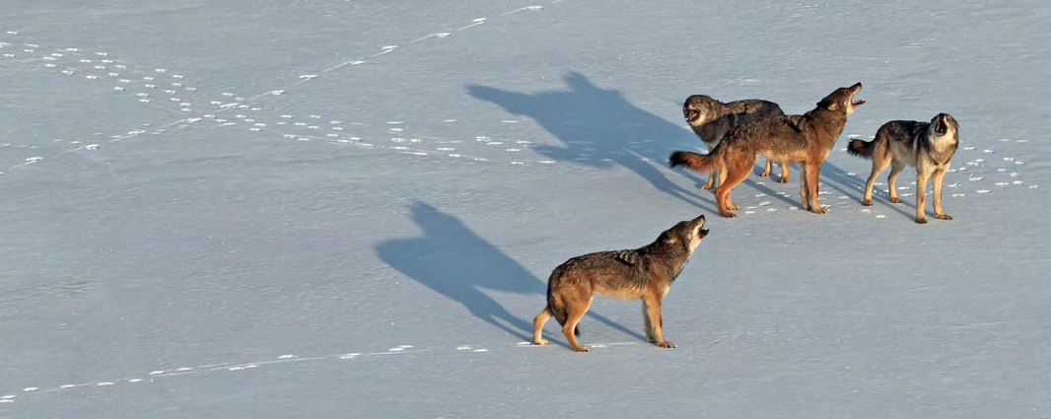
Moral Grounding
Justice Frame:
Mainly restorative, we broke it, we should fix it
18% of total appealed to justice
All of them were interventionists

Slide 36
Consider:
?
P1. In the face of climate change, we will have to
intervene at times to secure land health.
P2. The public will not support intervention
(mistrust, health=non-intervention, etc.).
C. Therefore, we will not be allowed to intervene,we will not be able to secure land health, land will
become increasingly unhealthy.

Slide 37
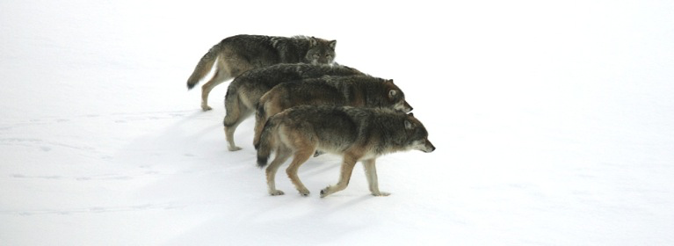
The End?

