Slide 1

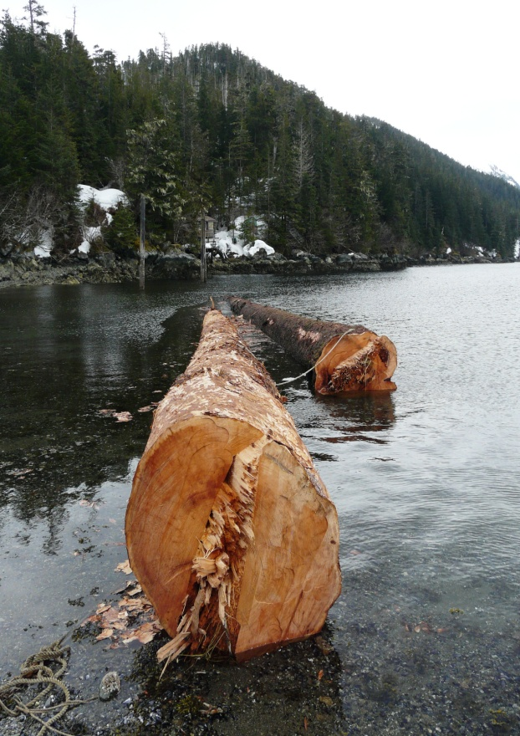

Integrating Social Sciences into Tongass National Forest Planning and Projects
Nicole Grewe, PhD, Regional Economist
Ecosystem Planning and Budget
USFS, Alaska Region
Jean Daniels, PhD, Research Forester
Portland Forestry Sciences Lab
USFS, PNW Research Station
USFS Region 6 Social Science Forum
Corvallis, Oregon
March 8, 2016

Slide 2
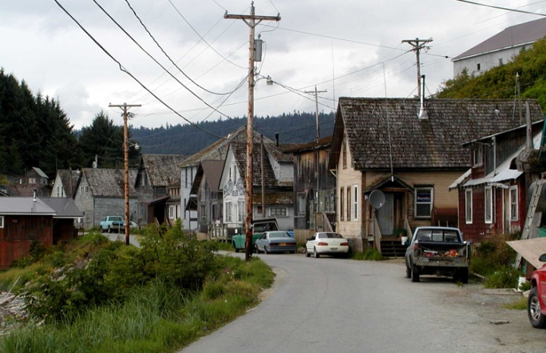
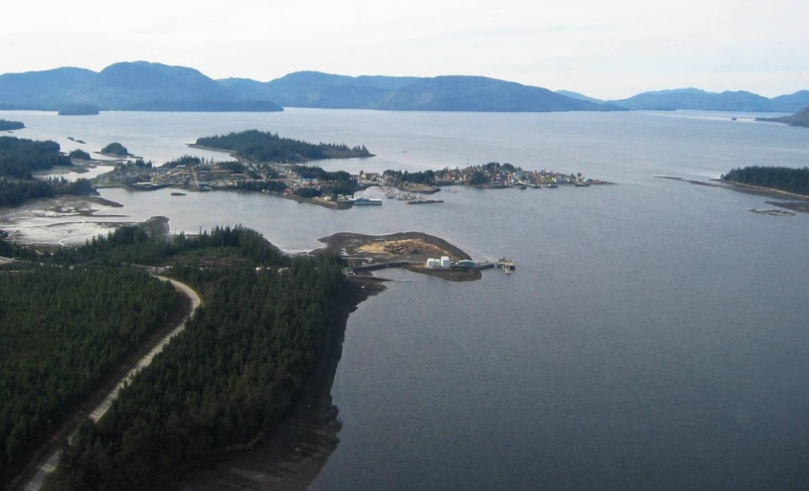
Presentation Outline
Region 10 Background
Planning
Projects
Collaborations
Transition
Research Example
PNW Research Station Value
Acknowledgement:
Sue Howle, Planning Manager, Tongass National Forest
Jay Anderson, Deputy Forest Supervisor, Tongass National Forest
Linda Kruger, Social Scientist, PNW Research Station
Tongass Advisory Committee
Tongass Collaborative Stewardship Group

Slide 3
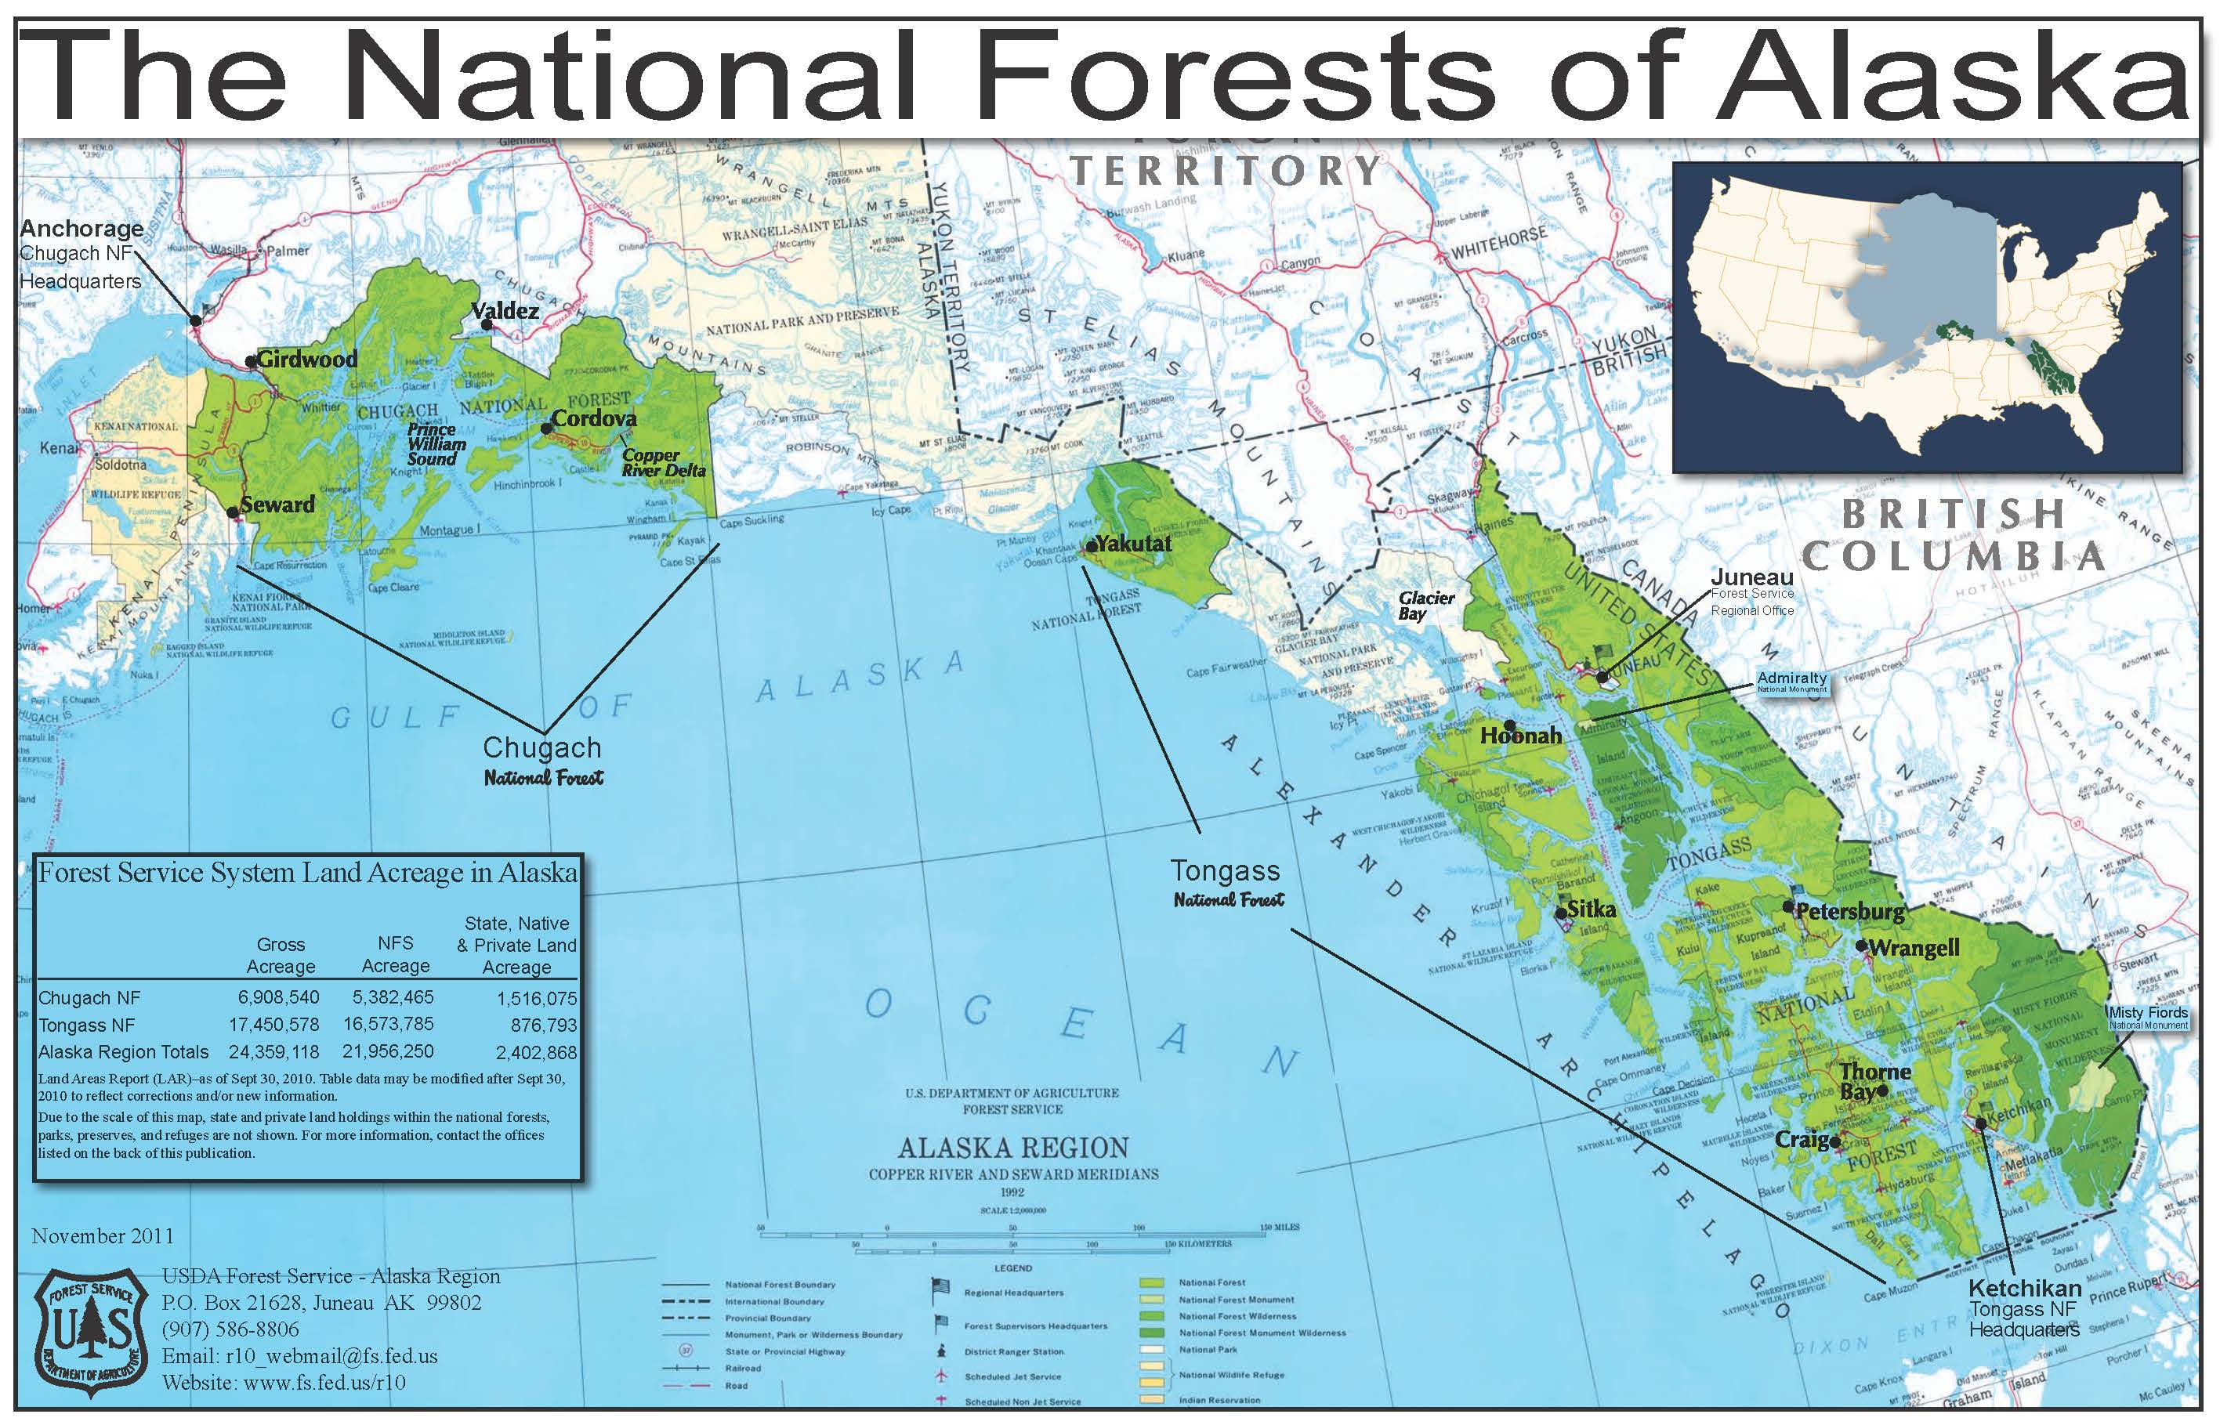

Slide 4
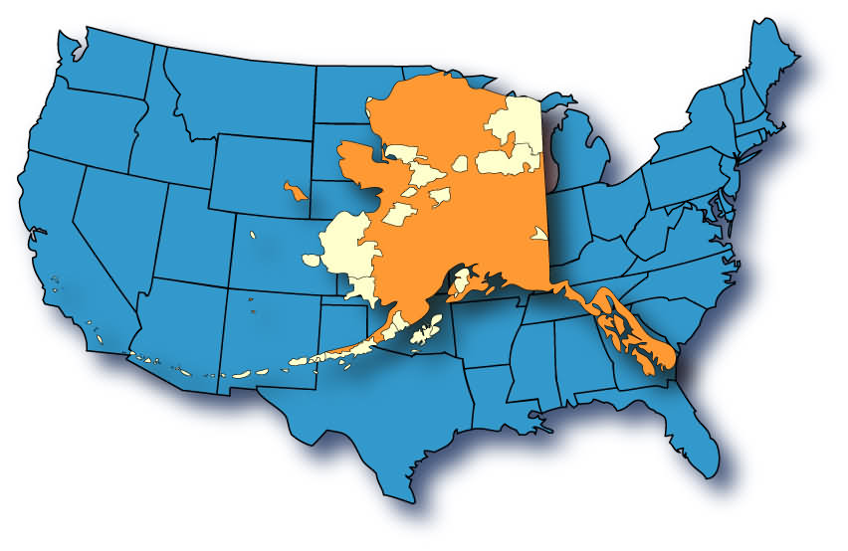

Where is the Tongass National Forest?
Tongass N.F.
Source: pbworks.com

Slide 5
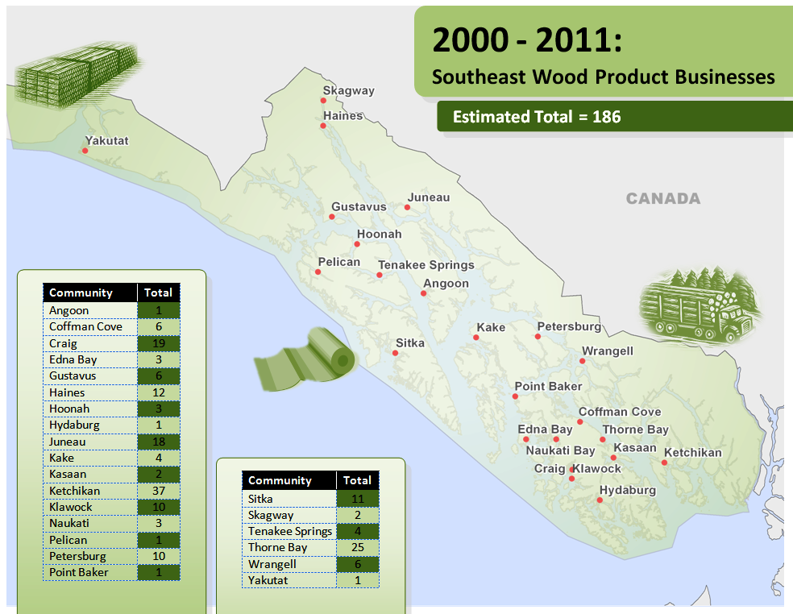


Slide 6
1990 – 2013: Southeast Community Conditions
Community | Timber Business | 1990 Pop | 2000 Pop | 2010 Pop | 2013 Pop | 1990 – 2010 Percent Change 20 Year | 2000 – 2010 Percent Change 10 Year | 2010 – 2013 Percent Change 2 Year
Angoon | √ | 638 | 572 | 459 | 456 | -28% | -20% | -1%
Coffman Cove | √ | 186 | 199 | 176 | 181 | -5% | -12% | 3%
Craig | √ | 1,260 | 1,397 | 1,201 | 1,243 | -5% | -14% | 3%
Edna Bay | √ | 86 | 49 | 42 | 39 | -51% | -14% | -8%
Elfin Cove |  | 57 | 32 | 20 | 39 | -65% | -38% | 49%
Haines | √ | 1,238 | 1,811 | 1,713 | 1,832 | 38% | -5% | 6%
Hollis |  | 111 | 139 | 112 | 109 | 1% | -19% | -3%
Hoonah | √ | 795 | 860 | 760 | 777 | -4% | -12% | 2%
Hydaburg | √ | 384 | 382 | 376 | 367 | -2% | -2% | -2%
Hyder |  | 99 | 97 | 87 | 98 | -12% | -10% | 11%
Kake | √ | 700 | 710 | 557 | 598 | -20% | -22% | 7%
Ketchikan | √ | 13,828 | 14,070 | 13,447 | 13,938 | -3% | -4% | 4%
Klawock | √ | 722 | 854 | 755 | 799 | 5% | -12% | 6%
Klukwan | √ | 129 | 139 | 95 | 93 | -26% | -32% | -2%
Naukati | √ | 93 | 135 | 113 | 115 | 22% | -16% | 21%
Pelican | √ | 222 | 163 | 88 | 82 | -60% | -46% | -7%
Petersburg | √ | 3,207 | 3,224 | 2,948 | 3,269 | -8% | -9% | 10%
Point Baker | √ | 39 | 35 | 15 | 16 | -62% | -57% | 6%
Port Alexander |  | 119 | 81 | 52 | 66 | -56% | -36% | 21%
Port Protection |  | 62 | 63 | 48 | 42 | -23% | -24% | -14%
Saxman |  | 369 | 431 | 411 | 432 | 11% | -5% | 5%
Thorne Bay | √ | 569 | 557 | 471 | 508 | -17% | -15% | 7%
Whale Pass | √ | 75 | 58 | 31 | 39 | -59% | -47% | 21%
Yakutat | √ | 534 | 808 | 662 | 622 | 24% | -18% | -6%
Average (N = 25) |  |  |  |  |  | -7% | -12% | 6%

Slide 7
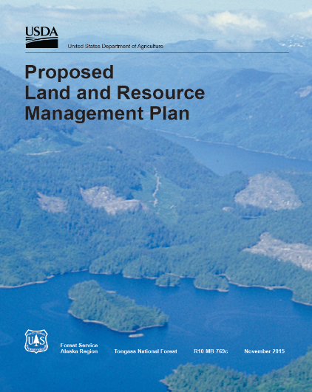
Planning and Social Science:
Tongass National Forest,
Land Management Plan Amendment
2013 USDA Secretary Vilsack memo directing to transition from old-growth to young-growth timber harvest while maintaining a viable timber industry.
Public comment closed February 2016.
On schedule for late 2016 plan adoption.
Social Science Contributions:
Core Interdisciplinary Team Member
Community Profiles – community, economy, and culture
Preferred Alternative (5)
Long-Term Timber Demand Projections
Effects Analysis
Appendix G

Slide 8
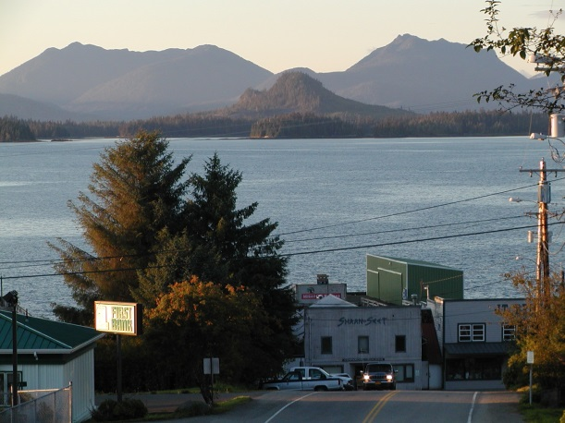
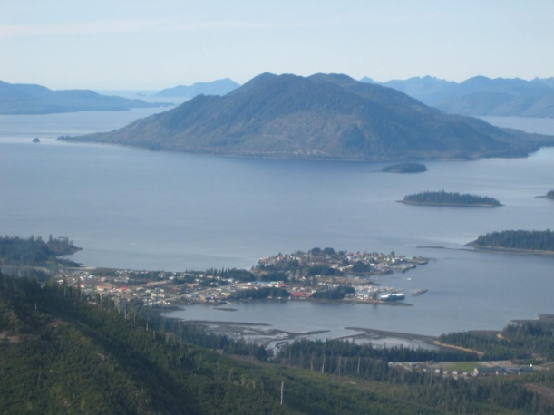
Projects and Social Science:
Tongass National Forest
Saddle Lakes Timber Sale
Sitka Young Growth
Wrangell Island Timber Sale
Navy Timber Sale
Big Thorne Timber Sale
Shoreline II Outfitter/Guide Management Plan
State of Alaska and USFS Land Exchange

Slide 9
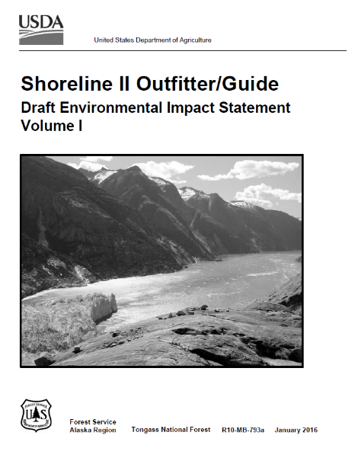
Projects and Social Science:
Tongass National Forest,
Shoreline II Outfitter/Guide EIS
Shoreline II Outfitter and Guide Management Plan Environmental Impact Statement
A project to determine recreation use levels for saltwater-based outfitters and guides on Admiralty National Monument, Hoonah, Juneau, and Sitka Ranger Districts.
Proposed action developed to allocate service days for commercial outfitter and guide use.
Timeline – Draft EIS Completed Spring 2015. Final decision released winter 2016.

Slide 10
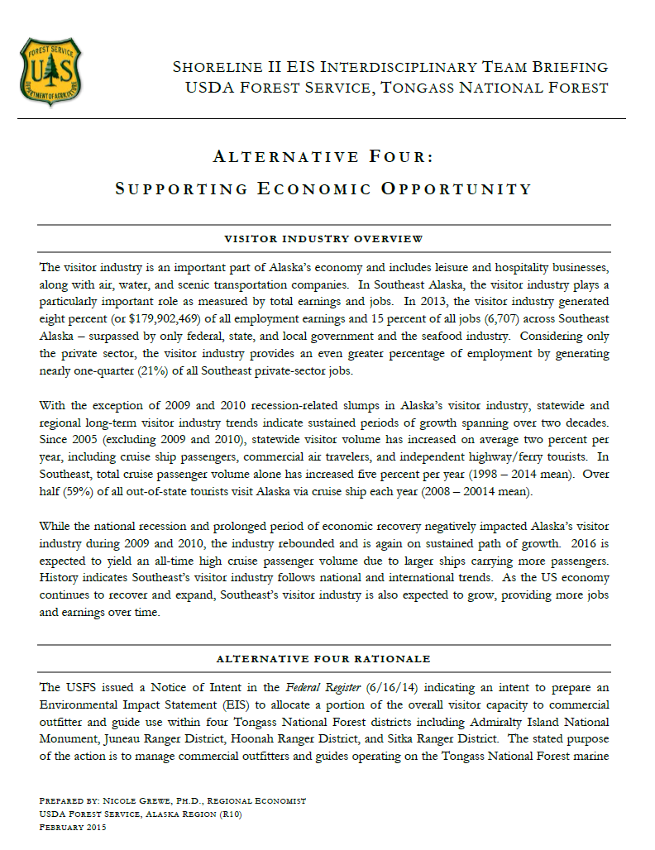
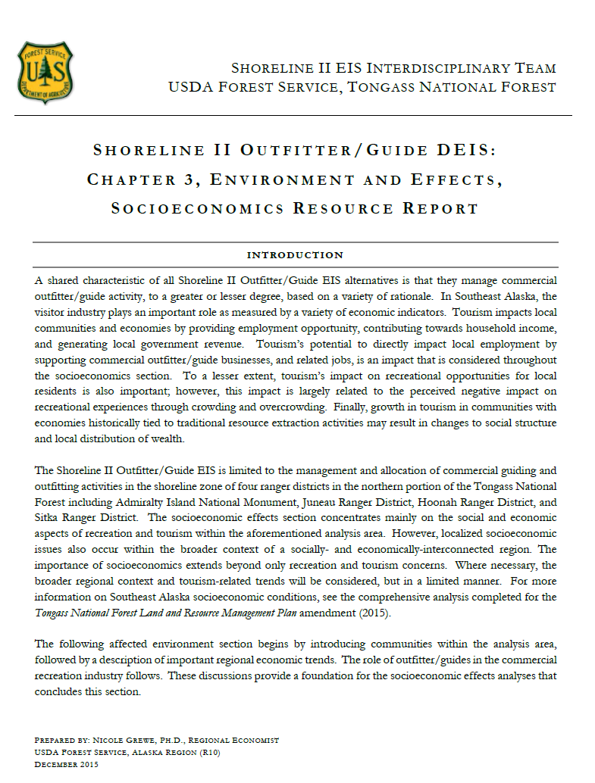
Projects and Social Science:
Tongass National Forest,
Shoreline II Outfitter/Guide EIS
Alternative 4 – Supporting Economic Opportunity
Statewide Tourism Trends
Southeast Tourism Trends
Port Community Visitor Volume
Small Cruise Capacity
Guided Client Use
Recommended increase in outfitter/guide use.
Socioeconomics Resource Report
Community Profiles
Regional Profile
Tourism Industry Trends
Projects impacts of preferred alternative non-commercial users, industry, and community.

Slide 11
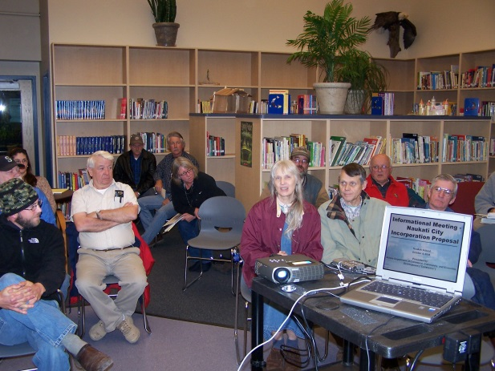
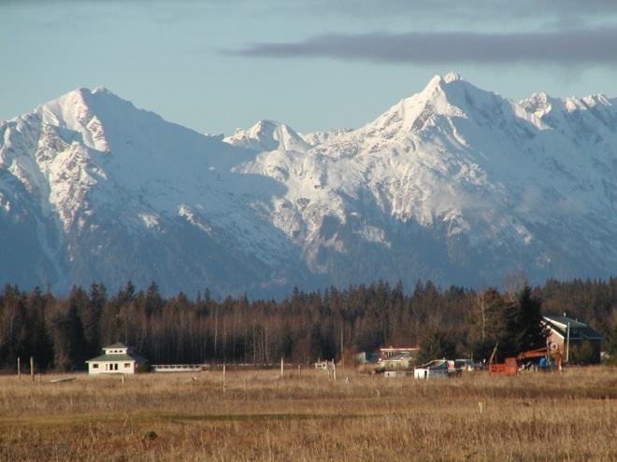
Collaborations and Social Science: Tongass National Forest
Tongass Advisory Committee
Tongass Transition Collaborative
Tongass Collaborative Stewardship Group
Southeast Conference
Juneau Economic Development Council
USDA Interagency Economic Diversification Team
National Forest Foundation

Slide 12
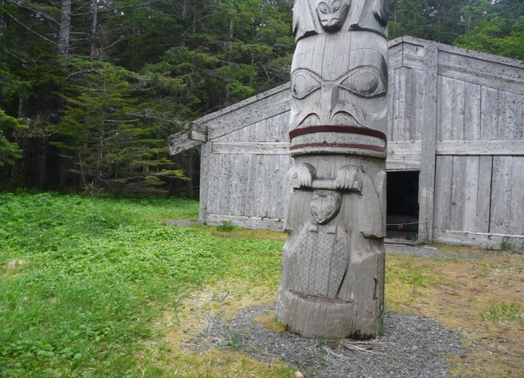
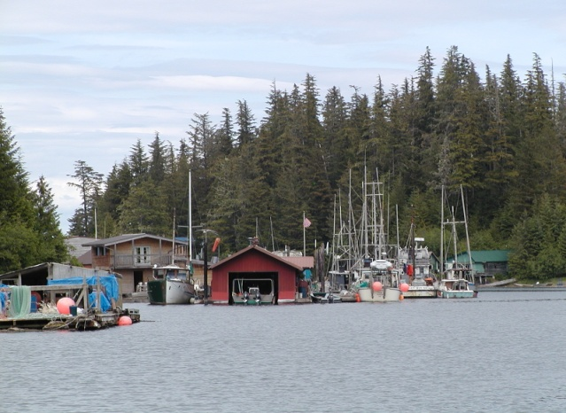
Collaborations and Social Science:
Tongass Advisory Committee,
Tongass Transition Collaborative
Annual Southeast Sawmill Survey – USFS Alaska Region
Forest Products Business Retention and Expansion Survey – State of Alaska, Division of Economic Development
Long-Term Timber Demand Projections – USFS, PNW Research Station
Five-Year Forest Products Industry Survey - University of Montana, Bureau of Business and Economic Research
Committed to robust and active monitoring

Slide 13
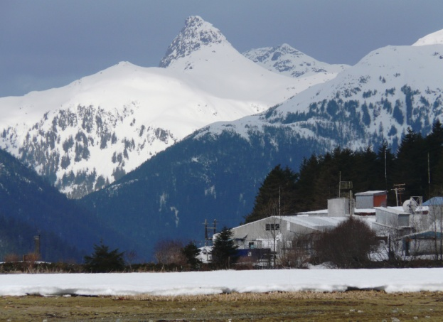
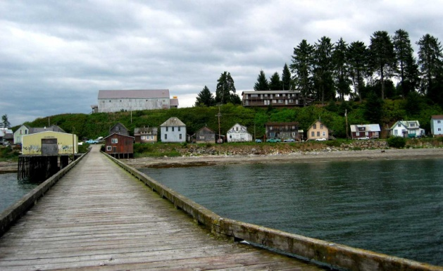
Collaborations and Social Science:
Tongass National Forest Transition
Purpose:
Transition from old-growth to young-growth timber harvest while maintaining a viable timber industry.
Facilitate renewable energy development
Support regional economic diversification
Social Science Role:
Current forest products industry research
Future timber demand projections
Community and regional socioeconomic conditions
Guides investments in regional economic diversification
Informs federal advisory committee
Informs USDA’s Interagency Economic Diversification Team
Guides young growth industry investment decisions

Slide 14
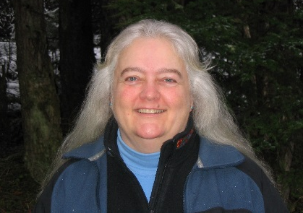
Notes:
Sue is the Segway!

Slide 15
The Tongass Timber Reform Act (1990)
Mandates that the Secretary of Agriculture will “…seek to provide a supply of timber from the Tongass National Forest which (1) meets the annual market demand for timber from such forest and (2) meets the market demand for timber from such forest for each planning cycle.”
“seek to meet market demand”
Requirement is unique to the Tongass
Long term timber demand estimates = best available science
PNW Research Station

Slide 16
Past PNW Tongass demand estimates

Slide 17
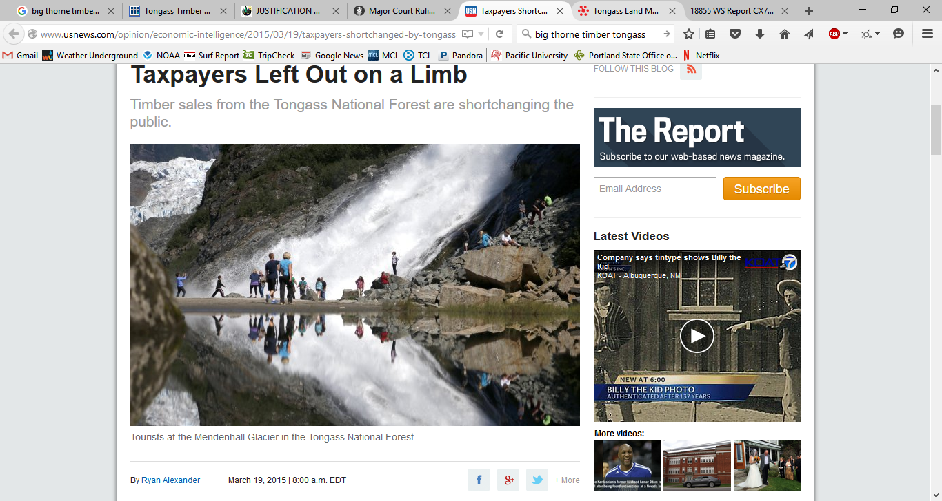
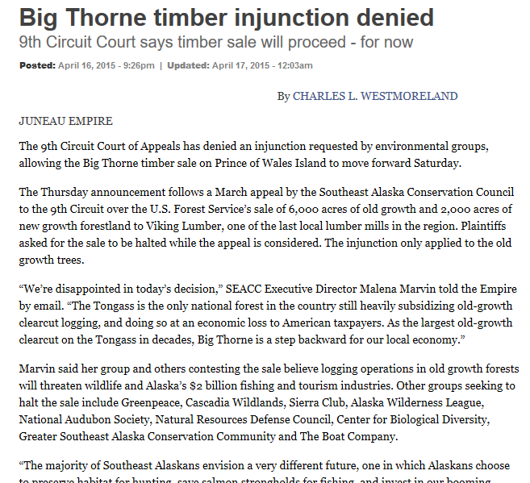
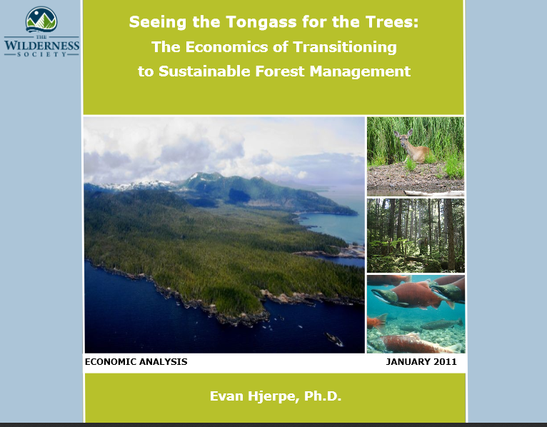
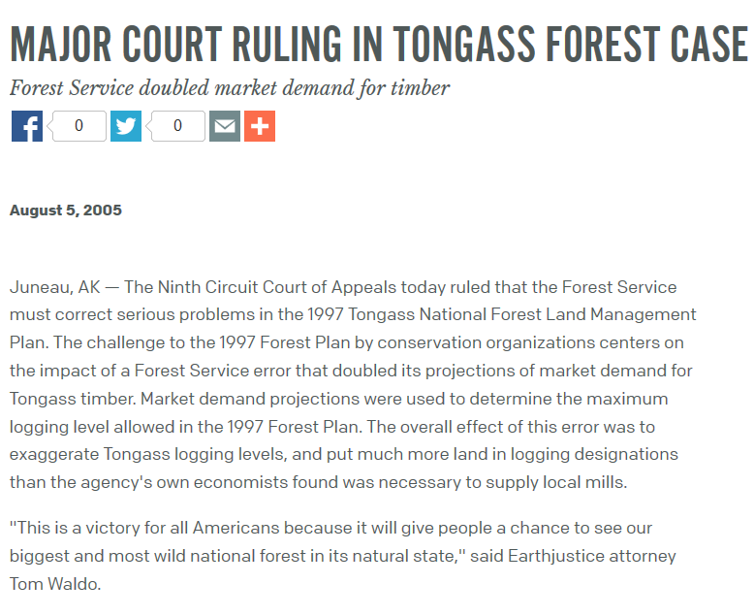


Slide 18
Demand study goals:
Estimate demand for Tongass timber
Develop market model that is:
Transparent
Conservative
Replicable
Material balanced
Easy to use and understand today
Easy to use and understand for future analyses
The best available science for TLMP amendment
Follow Station process for Highly Influential Science

Slide 19
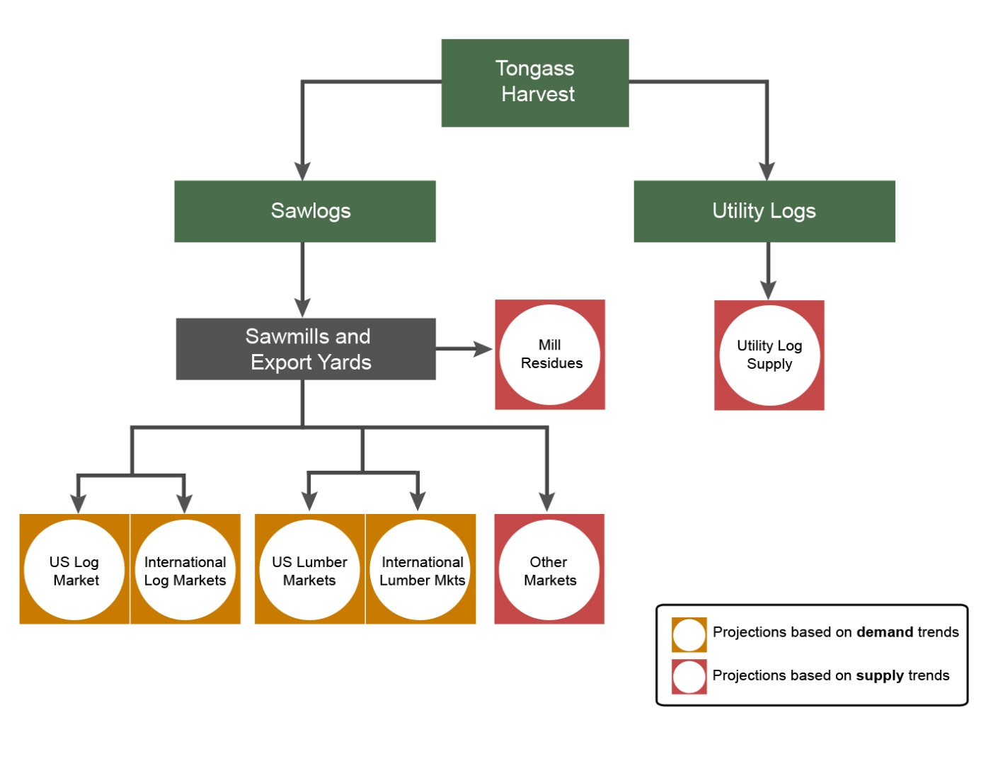
Roundwood log exports Domestic processors Residue
1. Define Tongass timber product markets
2. Estimate product demand
3. Estimate harvest equivalent to meet demand

Slide 20
Daniels et al. Tongass harvest results

Slide 21






Stakeholder meetings
Trip 1
Juneau, Ketchikan, Sitka
Met with R10 and Tongass staff, NGOs, economic development agencies, State of Alaska DNR
June, 2014

Slide 22
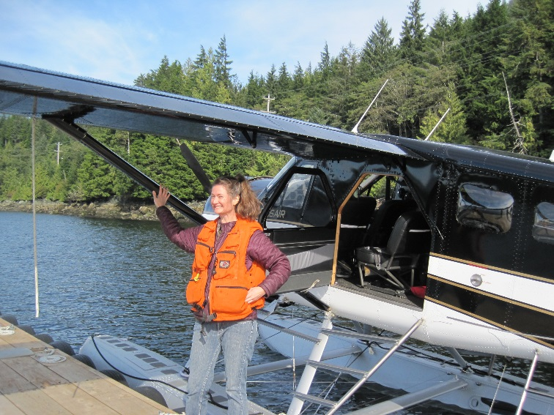

Stakeholder meetings
Trip 2
Juneau, Ketchikan, Prince of Wales Island
Progress report to R10 staff
Toured mills and met forest industry representatives
September, 2014
Alcan Forest Products, Ketchikan
Good Faith Lumber, Thorne Bay
Thuja Plicata, Thorne Bay

Slide 23
Stakeholder meetings
Trip 3
Juneau
Presented findings from Tongass demand study in meeting with internal staff
VTC
Representatives from:
R10
Tongass National Forest
Office of General Council
October, 2015

Slide 24




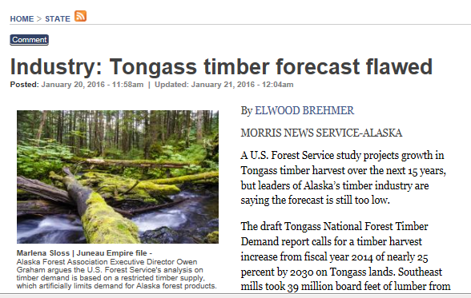
Other noteworthy meetups
Portland-area stakeholders
Political representatives
Consultants
Other agencies
Media
Public comments (?)

Slide 25
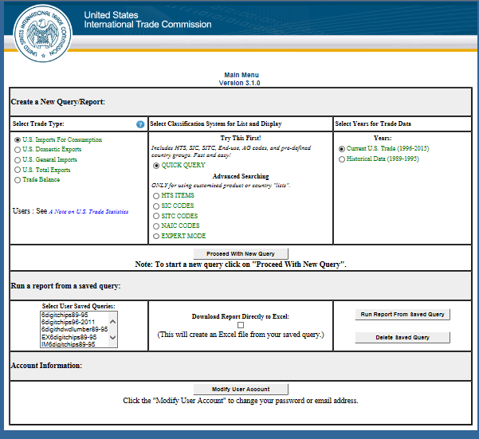
Other noteworthy findings: softwood log trade data discrepancies
Year | AK log exports, USITC MMBF | SEAK harvest, MMBF
2005 | 213.5 | 196.3
2006 | 249.7 | 158.9
2007 | 197.6 | 113.3
2008 | 187.9 | 92.2
2009 | 204.9 | 93.7
2010 | 280.9 | 112.3
2011 | 275.9 | 112.0
2012 | 292.1 | 84.4
2013 | 276.9 | 99.4

Slide 26
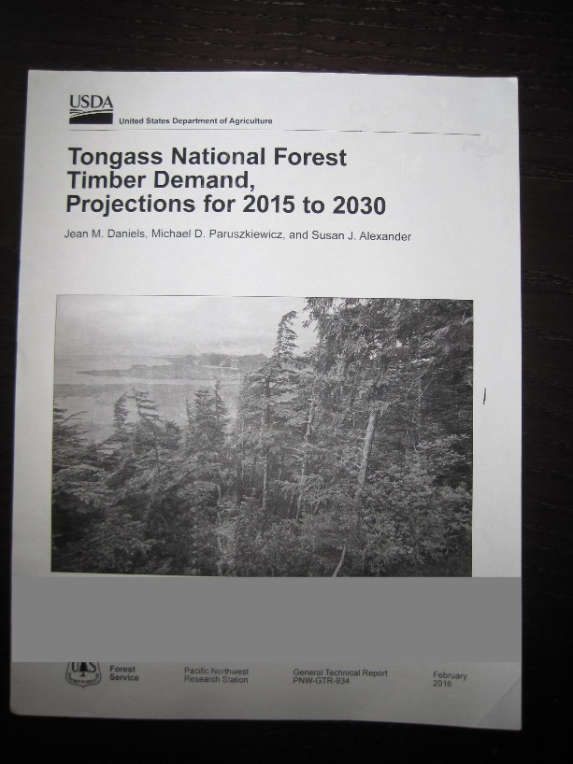
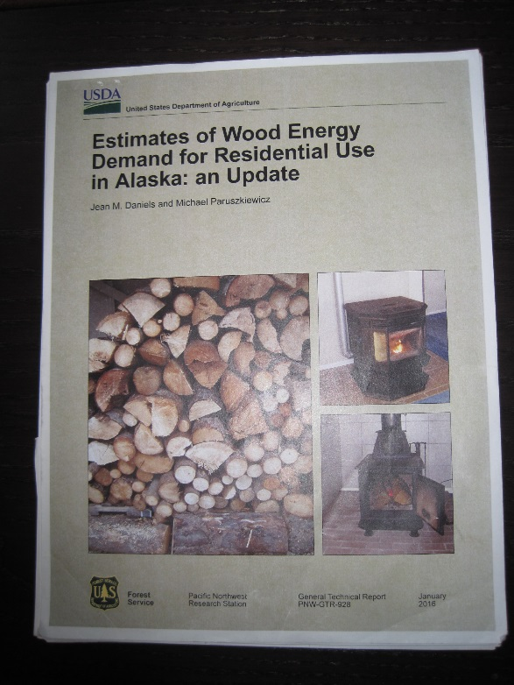
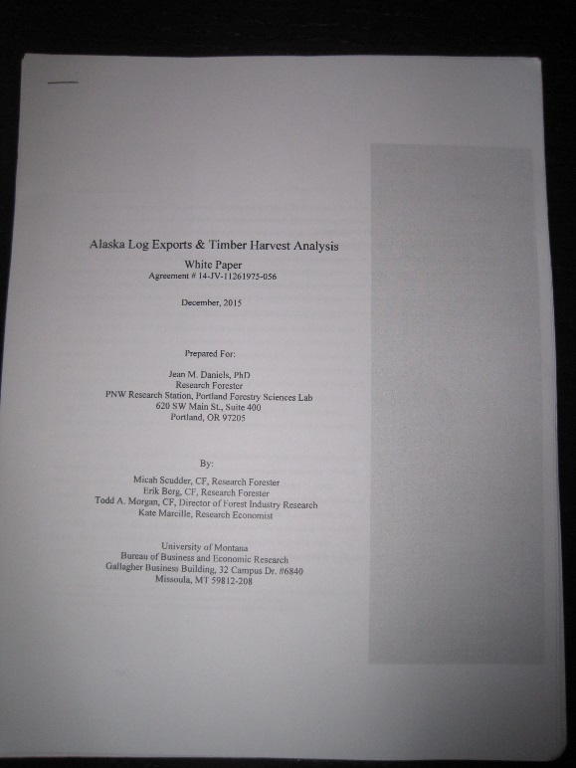



Publications
Tongass demand analysis
Background for wood energy scenario (S2)
AK log export trade data discrepancies
Publishable results

Slide 27
Presentations: past
Pacific Northwest Regional Economics Conference
April 2015; Bellingham, WA
Western Forest Economists
June 2015; Vancouver BC
PNW Research Station Executive Management Team
September 2015; Portland, OR
FIA Annual Science Symposium
December 2015; Portland, OR

Slide 28
Presentations: upcoming
Timber Measurements Society
April 3; Coeur d’Alene, ID
Tongass young growth timber summit
April 17-20; Prince of Wales Island, AK
Western Forest Economists
May 4; Seattle, WA

Slide 29



R10 $
Key elements for success
Student assistant
Research cooperators,
Data
Funding,
Data,
Cooperation,
Memorandum of Cooperation
Mentorship
FIA
Airplanes

Slide 30
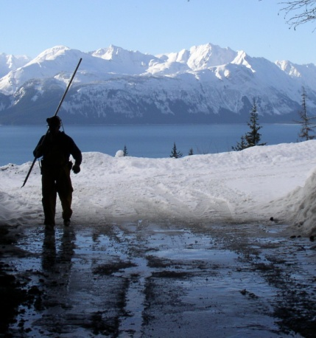
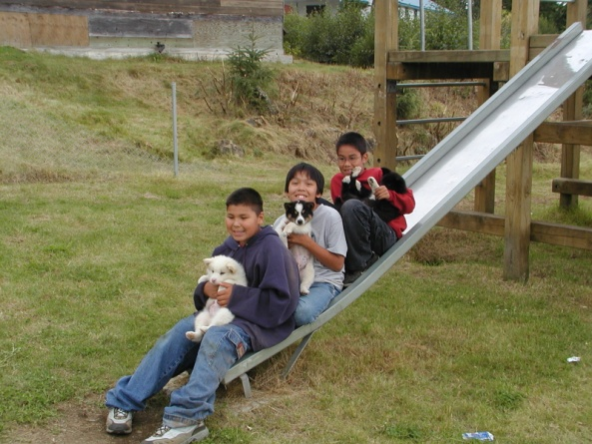
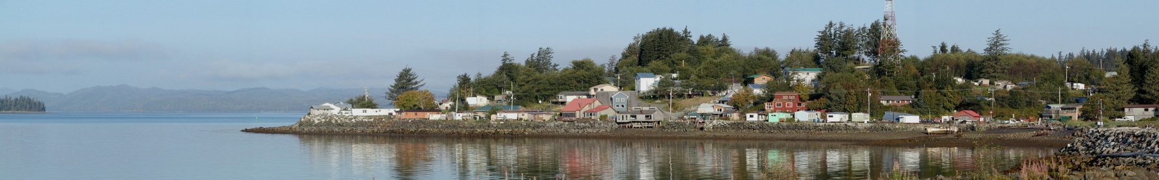
Questions or Comments
Nicole Grewe, PhD, Regional Economist
Alaska Region
Email: nicolergrewe@fs.fed.us
Direct: (907) 586-8809
Juneau, Alaska
Jean Daniels, PhD, Research Forester
PNW Research Station
Email: jdaniels@fs.fed.us
Direct: (503) 808-2004
Portland, Oregon

