Slide 1
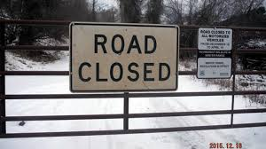
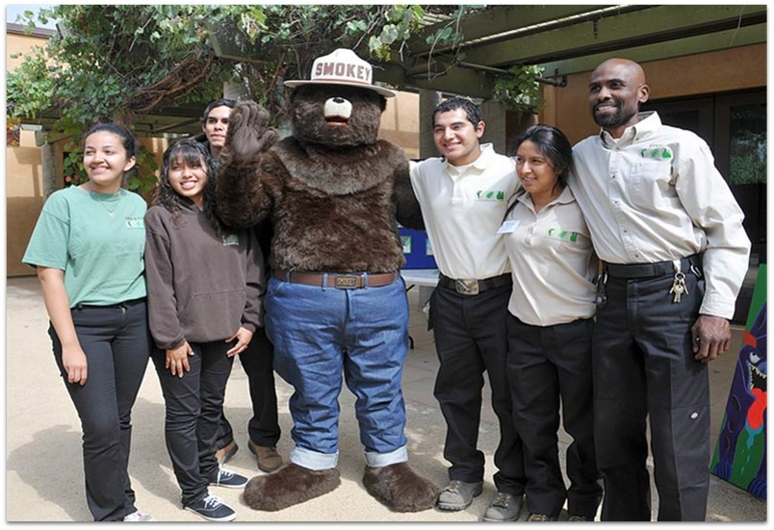
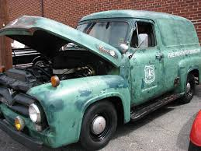
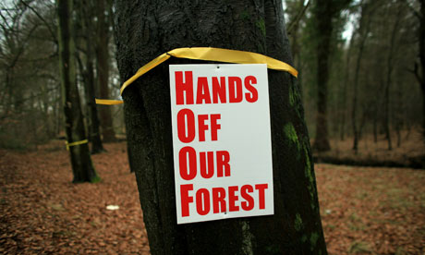
Where to from here?
Region 6 Social Science Forum
Transforming barriers into opportunities
Notes:
Introduction (who I am and why I’m here)
PNW, but representing USFS mission - Look at this presentation as an opportunity to talk broadly about the opportunities to achieve the “better serve (and engage) the people” part of the USFS mission.
Not a social scientist, but a champion - In my less than two years in the region, I’ve seen remarkable integration between our social scientists and managers; but hear the concern surrounding resources/capacity from both scientists and managers. Focus here on the immediate to long term opportunities to rise to the challenge of caring for the land and SERVING the PEOPLE
Most important thing to know about me – is that I plan to be brief
Thanks to organizers
Refer back to goals of the meeting (AS APPROPRIATE BASED ON DAYS PRESENTATIONS & DISCUSSION)
Managers learn how socials science is conducted, its uses and limitations
Scientists increase awareness of high priority needs
Set research agenda to inform future landscape planning efforts, including plan revisions
Cover how we did?
The sheer number of people attending this meeting shows that many in our agency have already recognized the importance of social science. We are here because we want to find ways to provide better social science and economic analysis and research to support improved forest management and better communication with our stakeholders.

Slide 2
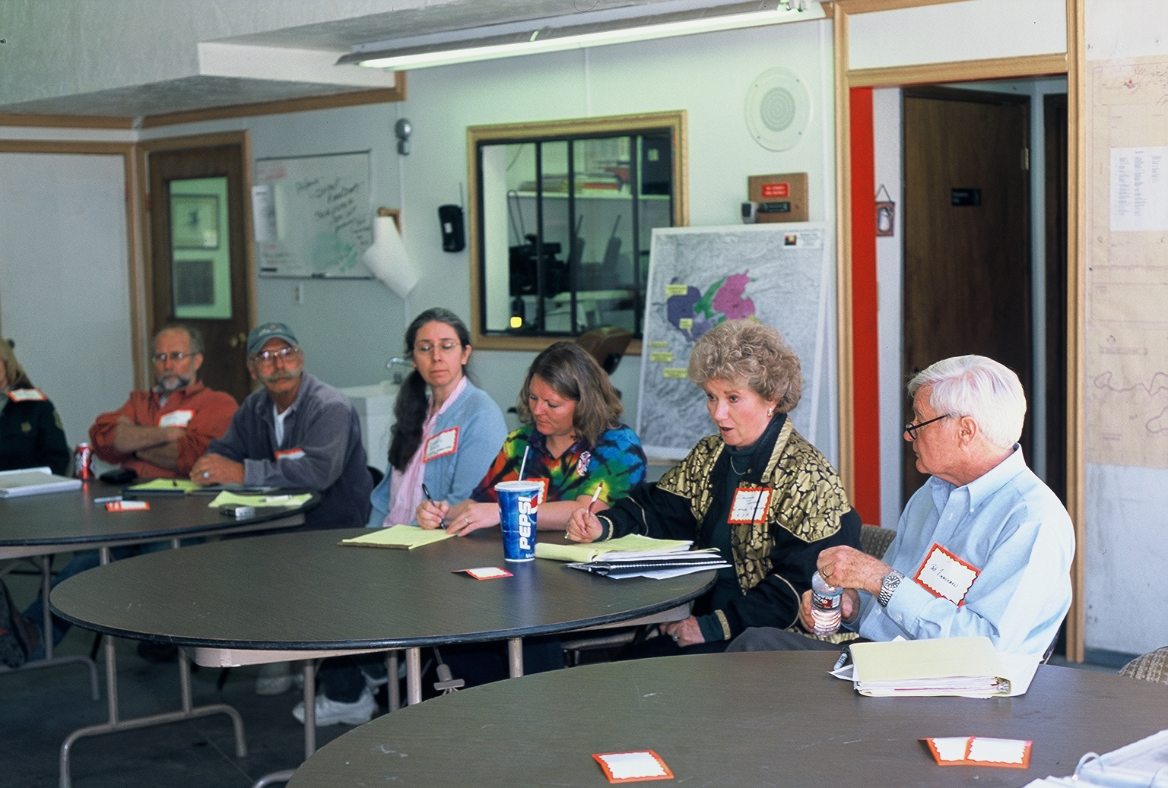
USFS has recognized that people and values are central to today’s challenges
Notes:
The USFS has recognized that people and values are central to today’s challenges.
we’ve know that …
It’s a time of rapid social, economic political, and ecological change
Changing role and perception (and even size) of government
And that we need to:
Better engage the public (e.g., planning rule)
Understand and be responsive to demographic changes (e.g., urban)
Demonstrate value of public lands to a traditional audiences & engage nontraditional audiences (WO & regional foresters effort)
For example, the RF wants to change the relationship with our stakeholders by giving them detailed information about the social and economic contributions of the National Forests to surrounding communities.
To communicate and collaborate with stakeholders, we need good information on social and economic contributions as well as values, attitudes, and beliefs. We also need all of this information for good forest management.
Public is asking for more social science
22% of questions at the Monitoring Forum in June 2015 were on social and economic topics
The public is asking for better information about social and economics trends. For example, the public raised concern over NWFP social and economic monitoring used for the 15-year and 20-year reports at the Monitoring Forum. These 15-year and 20-year reports used more course scale county level data, whereas the 10-year report used finer scale community level data. Communities want to see their social and economic conditions reflected in Forest Service research reports and management projects. Finer scale data usually requires more time, money, and people to collect. We may also be able to take advantage of new geospatial data available through ESRI, for example, too.

Slide 3
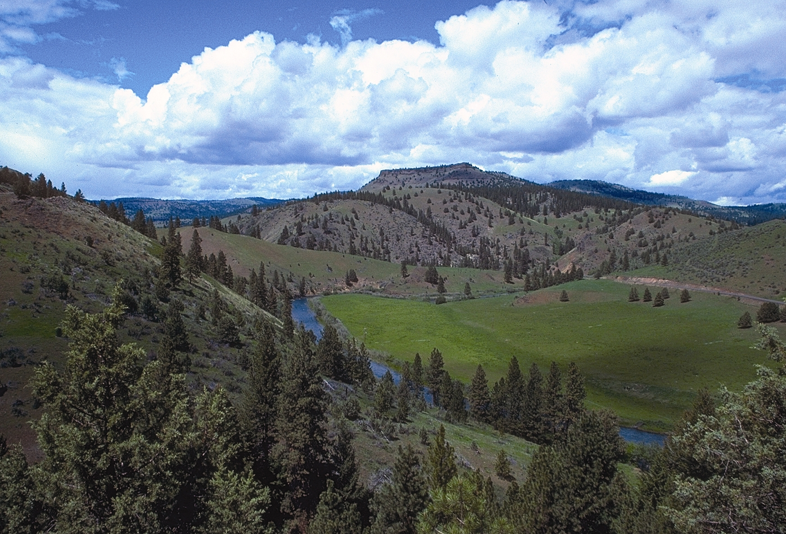
USFS mission: Caring for the land and serving the people
We are collectively learning how to achieve a new vision of serving the people.
The public is not the problem, but they can be part of the solution. Planning processes that employ a truly collaborative process right from the start (drawing on published best practices) tend to be more productive and less contentious and, surprisingly, quicker too. You need to know what your publics need and want from the forest and you need to recognize that it may not be what you think (or where you think it is). Your choices are defendable as long as you show that you gathered data from your publics and you used it to make decisions.
Notes:
We see that focus on serving the people in new policies, programs and management approaches that call for or demonstrate effective engagement & incorporation of values in land management decisions.
Planning rule
Collaborative approaches (note quote above)
Urban field stations & partnerships
We’ve seen a rapid shift in policies and programs – and commitment to serving the people
However, our resources have traditionally been allocated toward caring for the land – and we are still building our capacity to serve the people (in a time when it is very challenging to build capacity)

Slide 4
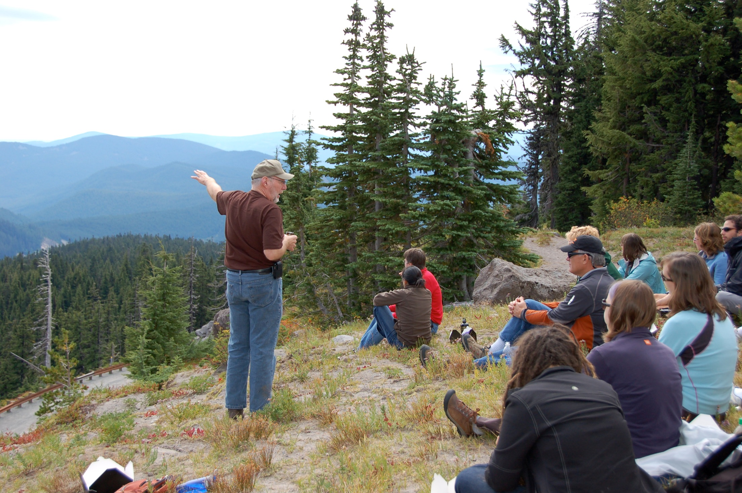
So, how do we rise to the challenge?

Slide 5
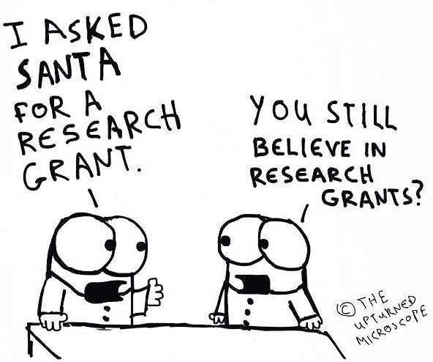
First, Acknowledge the challenges are real and big
Compliments of Dale Blahna
Notes:
First, we need to acknowledge that the challenges are real and big.
We have innovative ideas, and great talent, but challenges in resources.
Funding (thanks to dale for cartoon – a statement on hunting for external funds)
Staffing (both research & management side)
Capacity to develop, execute, deliver and “receive” science
Traditionally low staffing in social sciences on both sides. As well as science delivery and tech tran positions
Increasing workloads
Retirements
Funding
Cultural
natural resource focused
Target focused
Siloes

Slide 6
Then, Have a dialog on what we can do
Can’t do more with less
Can build & strengthen relationships
Can be creative, innovative
Can network and learn from successes
Can demonstrate value and cultivate champions (play the long game)
Some ideas……

Slide 7
Build relationships & Share innovations
Add photo from the workshop
Add Lis’s examples
Add from day’s presentations
Diane Besser might have some innovations
Notes:
REFER BACK To day’s examples of what social science can bring to the management challenges we are facing
& how well we are already doing on engaging scientists
poverty in R6. One in five children is food insecure. Horrifying poverty. School and jails are closing. Some counties lack adequate numbers of sheriffs or police to protect citizens due to budget cuts. There is great suffering in forest dependent communities in R6 related to faltering economies and poverty. Communities see their social and economic woes as directly related to federal forest management policies. This is to a certain extent a misconception. We need good data on social and economic trends as well as cause-and-effect relationships between federal and economic well-being. We need this data to have meaningful conversations with our stakeholders about how to improve the economies and well-being of our forest-dependent communities. We need this data to collaborate effectively. We need this data to plan effectively. We need social scientists and economists to work across academic, management, and research boundaries to produce this data.

Slide 8
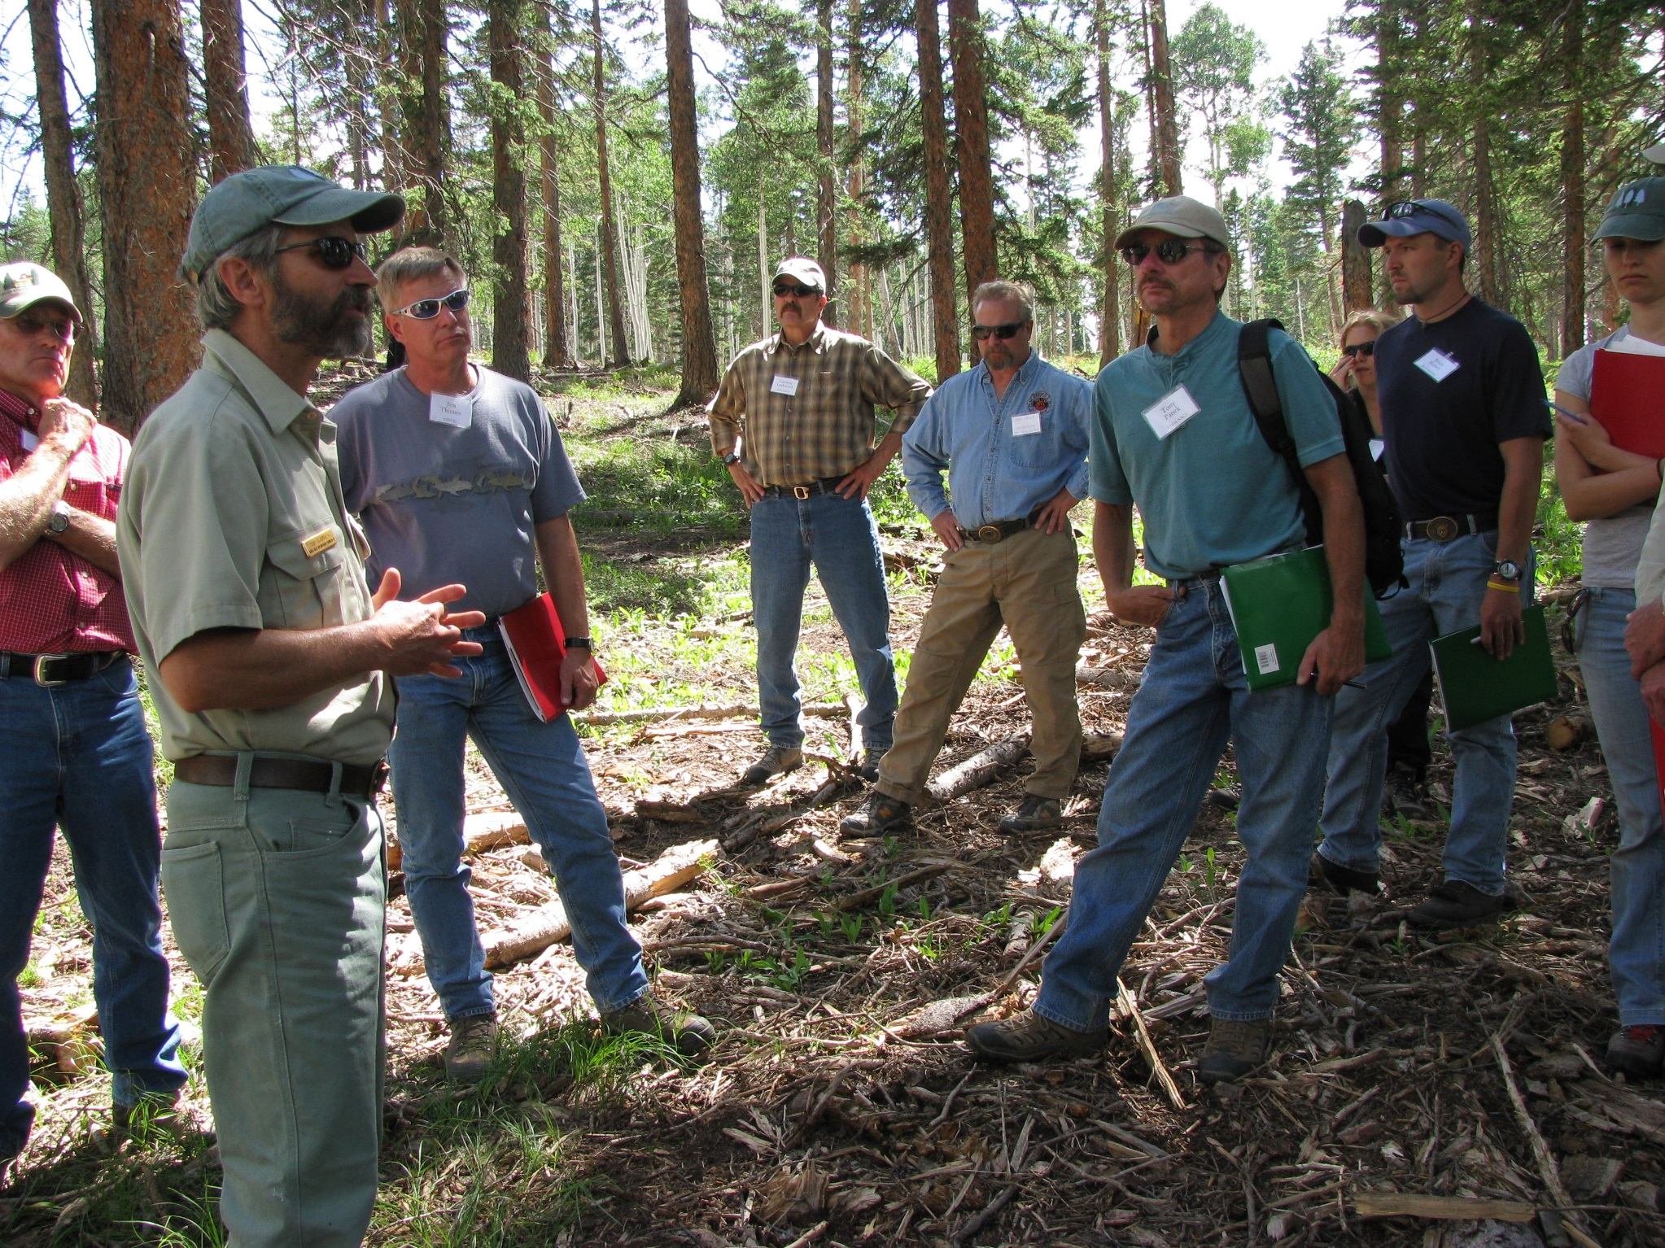
Continue to strengthen relationships with the research community - Communication - Connections - Partnerships
Notes:
But there are areas where we can strengthen relationships with the research community
Communication
Need for common language
Understanding AND RESPECT of differences in schedule, incentives and priorities (DALEs point on independent research arm)
Address disincentives where we can (Panel Guidance Underway to address disincentives for science delivery)
Building connections:
Workshops (thank Cheryl and team)
Seed Grants (beSmart, thank Lee). (Consider expanding this concept in R6 with a focus on social science and planning and/or value of public lands)
Early career mentoring (both directions)
Partnerships
Jointly discuss integration of Societal/management questions with Researchable questions
Examples
LEI
(Link to ideas from the day)

Slide 9
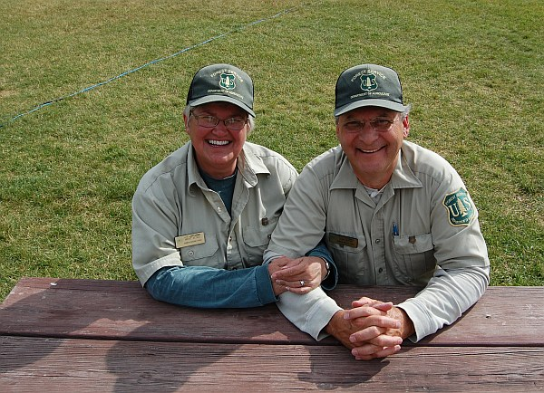
Be creative in identifying resources - Staffing -External funding -Partnerships
USFS Volunteers
Notes:
Acknowledge ever increasing need staffing/resources to develop as well as incorporate social science on mgt side
Nontraditional staffing models
Volunteers
networked approaches (e.g., planning rule guidance)
student engagement (end of year funding and student support or ORISE support)
Interdisciplinary positions
training existing staff (esp new staff who are coming in with interdisciplinary training) Toral’s example of landscape ecologist skills
External funding – this can include:
More of what we’ve been doing:
partnering with managers (administrative studies)
Partnering with universities to who have access to NSF funding (and bring additional expertise)
New ideas
R10 Meyers family foundation
Research arm working with federal funders to increase social science research funding (New national program leaders efforts)

Slide 10
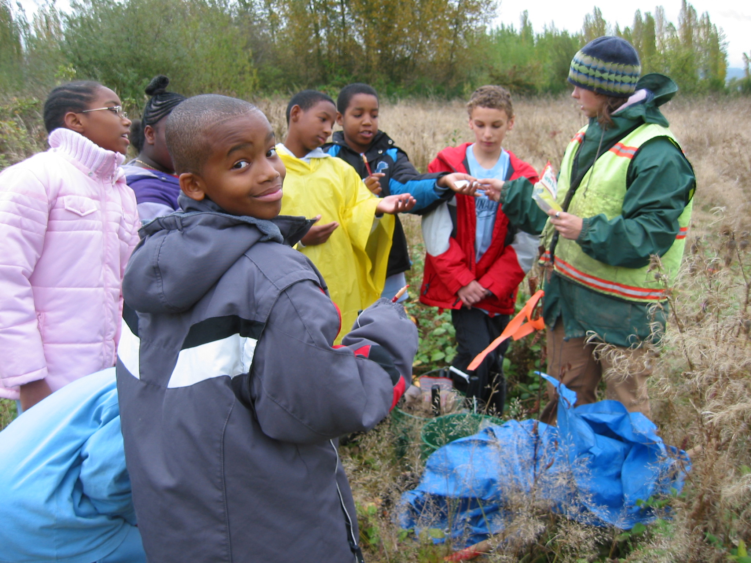
Play the long game -Tell the story -Cultivate champions
Notes:
Capture success & tell the story in terms of problems solved/averted/management improved (note RF and WO are using social science to do this)
Cultivate champions at all levels
Internal and
External
Call out the champions in the audience (and missing)
John Allen
Pena and mangold
Kenli Kim & Ashley Goldhor-Wilcock. Economics center of excellence

Slide 11
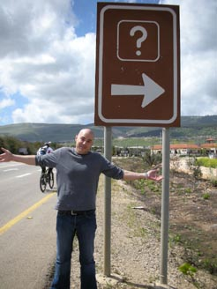
Find opportunity in change -Social landscape -Management drivers -Agency culture
Notes:
The changes we are seeing inside and outside the agency, create the demand and an opportunity to grow the resources we need to address the challenges.
Changing world
Rapid ecological change
Demographic changes
Need to reach new audiences
Expectation of engagement
New Management Approaches & Drivers
Planning Rule
Collaborative approaches
All lands
Need to work better with public
Engagement
Communication
Demonstrating value of public lands
Agency Culture
Recognition that issues are inherently social
Still a natural resources culture; and fairly siloed
Retirements
New staffing & new skills

Slide 12
Thanks!
Cheryl Friesen & the Forum Planning Team
Lee Cerveny & BeSmart Concept Team
Kenlie Kim, Simon Kihia, Rachel White, and PNW Goods Services and Values Program
Diane Besser, Lis Grinspoon, Toral Patel Weynand, Jim Pena, Rob Mangold, Kent Connaughton
Speakers
John Laurence
John Allen
Cass Moseley
Michael Nelson
Troy Hall
Bruce Shindler
Emily Jane Davis
Nikola Smith
Linda Kruger

