Slide 1
Defining Older Forests
Over 80 years
Late-successional
Old-growth
Raymond Davis
Monitoring Lead
Older Forests and Spotted Owls
(Northwest Forest Plan Area)

Slide 2
Defining Older Forests - History
Early 1900s – Relative terms like “old-growth, large second growth, and second growth”. Differentiated slower growing older forests from the faster growing younger forests. A general sense of stand age, but largely based on diameter at breast height (DBH) of the largest dominant and co-dominant live trees.
1980s – Old-growth is best perceived as, “a stage of forest development characterized by more diversity of structure and function than that found in younger successional stages.”
Chief’s Memo (1989) – Old-growth is usually distinguished by the presence of larger, older trees and structural attributes such as multiple canopy layers, decadence in the form of standing dead trees (snags), and accumulations of fallen trees (down wood).
Interim Definitions (1992, 1993) - Provided discrete classifications based on minimum amounts of old-growth elements such as snags and logs. Related these things to stand age (usu. 150 to 240 years).

Slide 3
Defining Older Forests - History
FEMAT and the Northwest Forest Plan (1993) – Mature phase of stand development begins around 80 years and is characterized by relatively large live and dead trees, although multiple canopy layers may not yet be well developed.
  Maturation stage = 80-140yr
  Transition stage = 150-250yr
Franklin and Johnson (2013) – Used three different stand ages that might be declared “old” – 80, 120, and 160 years. Part of the social dialogue and intensely debated.
BLM Western Oregon Plan Revision (2015) – Older (mature) and more structurally complex multi-layered conifer forests (80, 120, 140, 160, and 200 years).

Slide 4
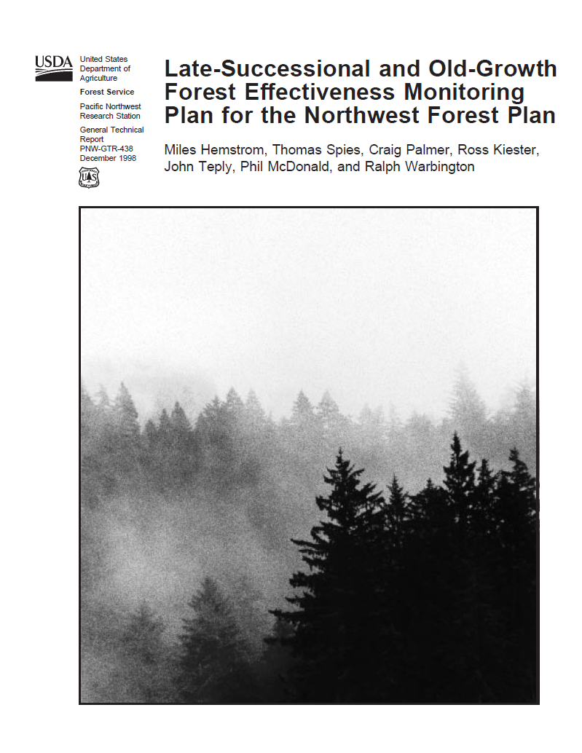
Refine Definition
for Older Forests
Page 24
Existing definitions provided black and white answers, while in the real world structure and composition differ in gradients.
Page 31
Need refined definitions or indices to assign plots and remotely sensed stands to a position along a continuum of older forest structure and composition.

Slide 5
Previous Monitoring Definition
Canopy
Cover
≥10%
+
Average
DBH ≥20in
Too simple and hard to interpret change

Slide 6
“New” Monitoring Definition
+
+
+
Large
live trees
Snags
Down wood
Diameter
diversity
Old-Growth Forest Structure Elements

Slide 7
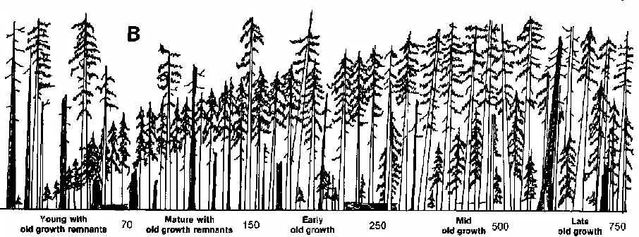
Spies and Franklin. 1988. Old growth and forest dynamics in the Douglas-fir region of western Oregon and Washington. Natural Areas Journal. 8: 190-201.
100
Old-Growth Structure Index
0
younger
Stand age
older

Slide 8
Back to the Basic Elements
100
Old-Growth Structure Index
0
younger
Stand age
older

Slide 9
Large Trees
100
Large live tree density
0
younger
Stand age
older

Slide 10
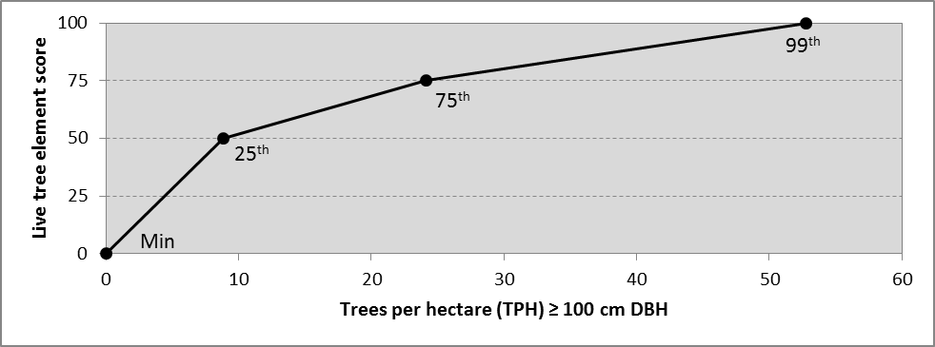
Large Trees
100
plot data
Large live tree density
0
younger
Stand age
older

Slide 11
Large Snags
100
Snag density
0
younger
Stand age
older

Slide 12
Fallen Trees
100
Dead wood cover
0
younger
Stand age
older

Slide 13
Multiple Canopy Layers
100
Diameter diversity index
0
younger
Stand age
older

Slide 14
Average Score of all Elements
100
Old-Growth Structure Index
0
younger
Stand age
older

Slide 15
Selecting Mapping Thresholds
100
Old-Growth Structure Index
OGSI 80
mapping threshold at 80yr
0
80yr
younger
Stand age
older

Slide 16
Selecting Mapping Thresholds
100
mapping threshold at 200yr
Old-Growth Structure Index
OGSI 200
0
200yr
younger
Stand age
older

Slide 17
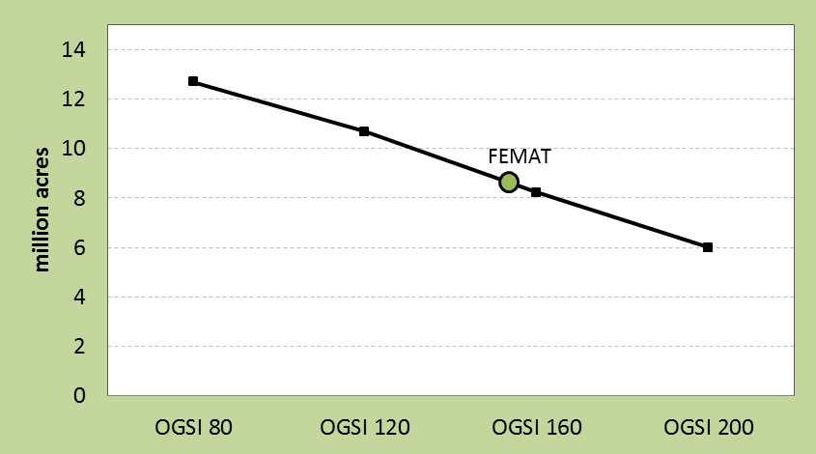
Assigned plots and remotely sensed data to a position
along a continuum of old forest structure and composition
Older forests on federally managed lands in 1993

Slide 18
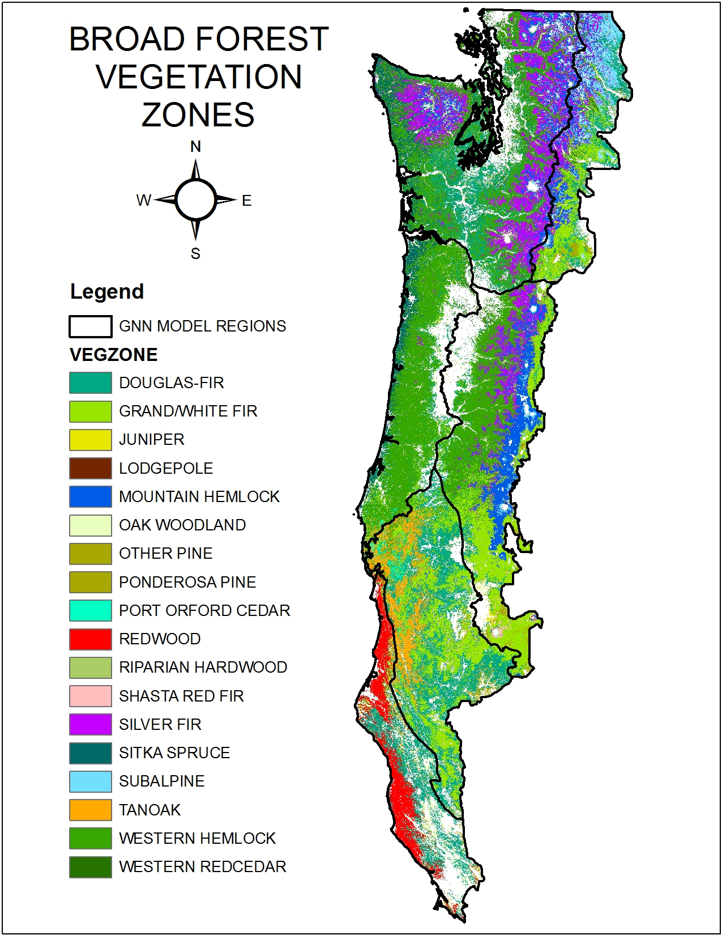
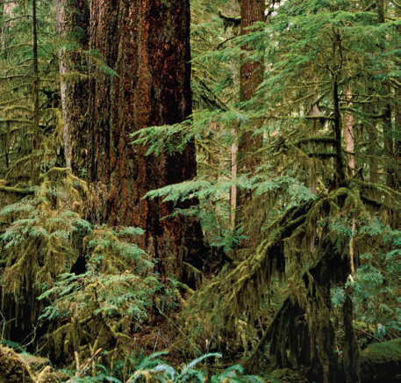
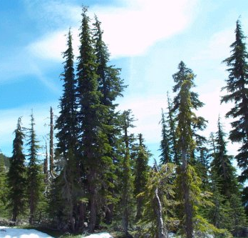
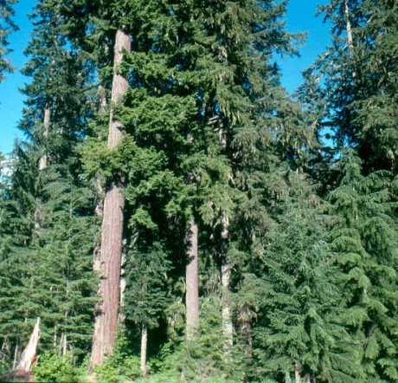
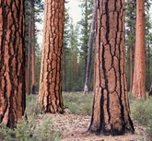
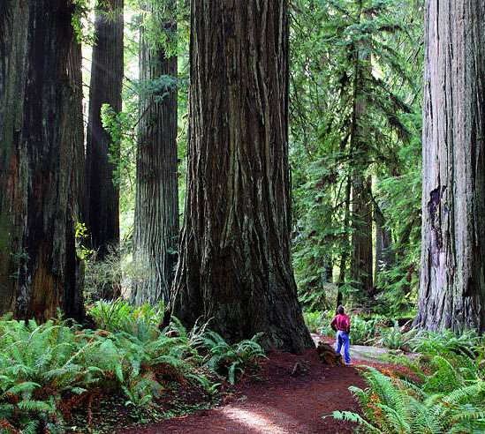
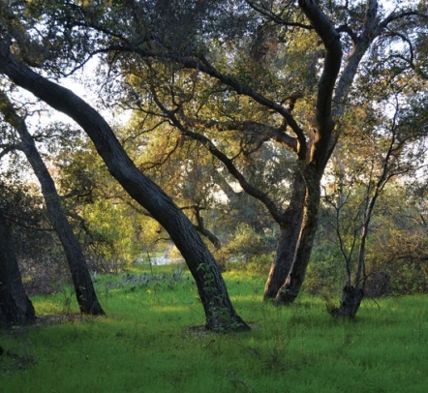

Slide 19
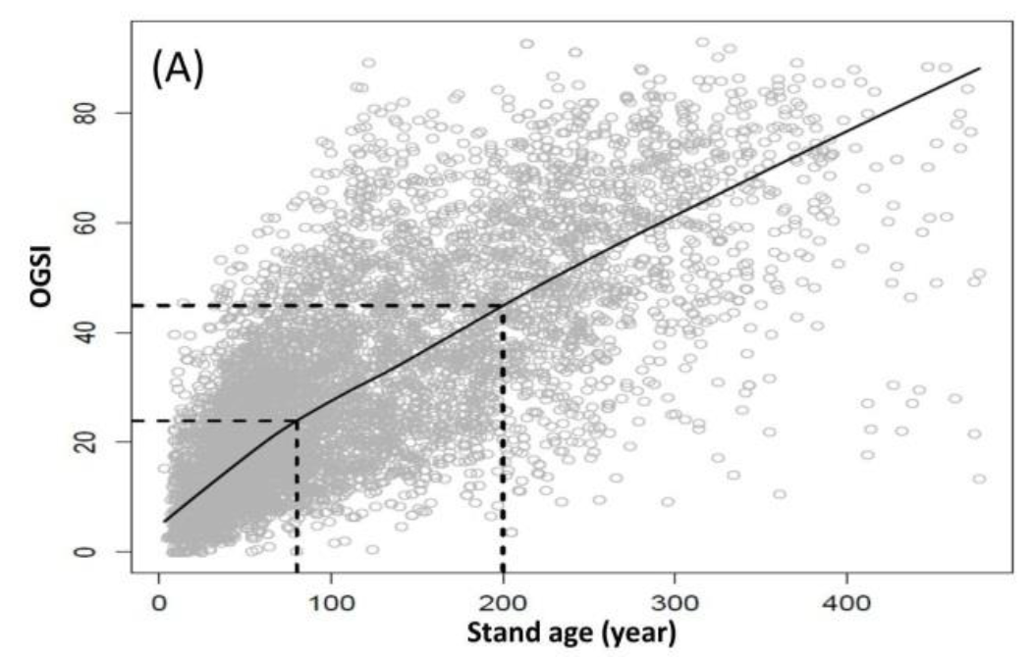
Scatter Graph of Western Hemlock Plots
OGSI vs Stand Age

Slide 20
Scatter Graph of Western Hemlock Plots
OGSI vs Stand Age
<80yr with
high OGSI

Slide 21
Scatter Graph of Western Hemlock Plots
OGSI vs Stand Age
<80yr with
high OGSI
>80yr with
low OGSI

Slide 22
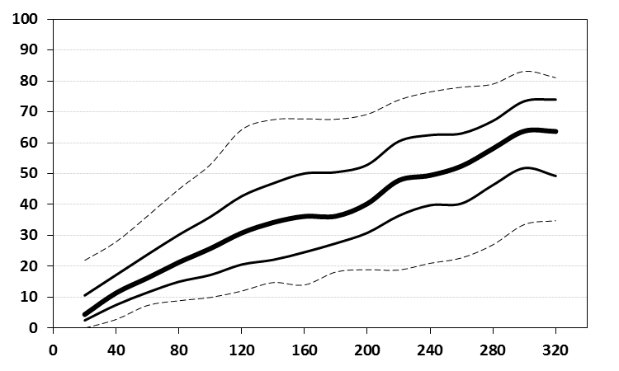
Percentiles Graph of Western Hemlock Plots
OGSI vs Stand Age
95th
75th
50th
OGSI
25th
5th
Stand Age

Slide 23
Percentiles Graph of Western Hemlock Plots
OGSI vs Stand Age
95th
75th
50th
OGSI
25th
5th
Stand Age

Slide 24
Percentiles Graph of Western Hemlock Plots
OGSI vs Stand Age
95th
75th
50th
OGSI
25th
5th
Stand Age

Slide 25
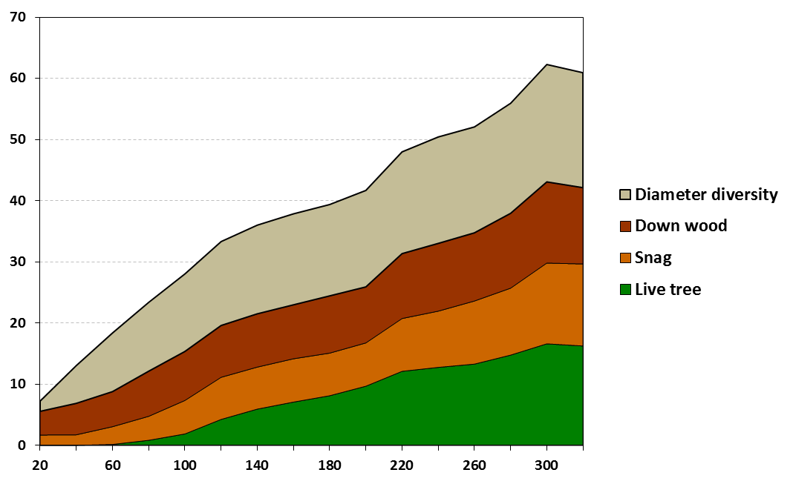
Western Hemlock
OGSI Elements vs Stand Age
80 yr
200 yr
OGSI
Stand Age

Slide 26
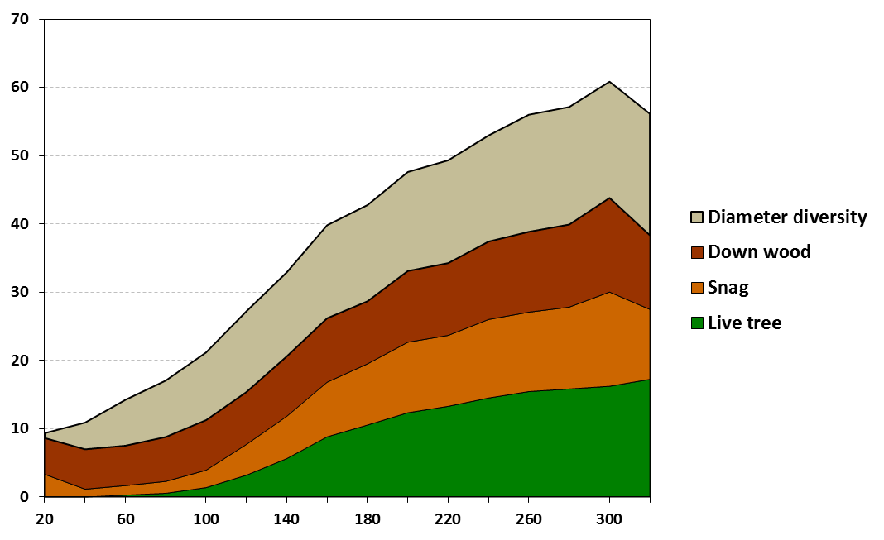
Grand Fir-White Fir
OGSI Elements vs Stand Age
80 yr
200 yr
OGSI
Stand Age

Slide 27
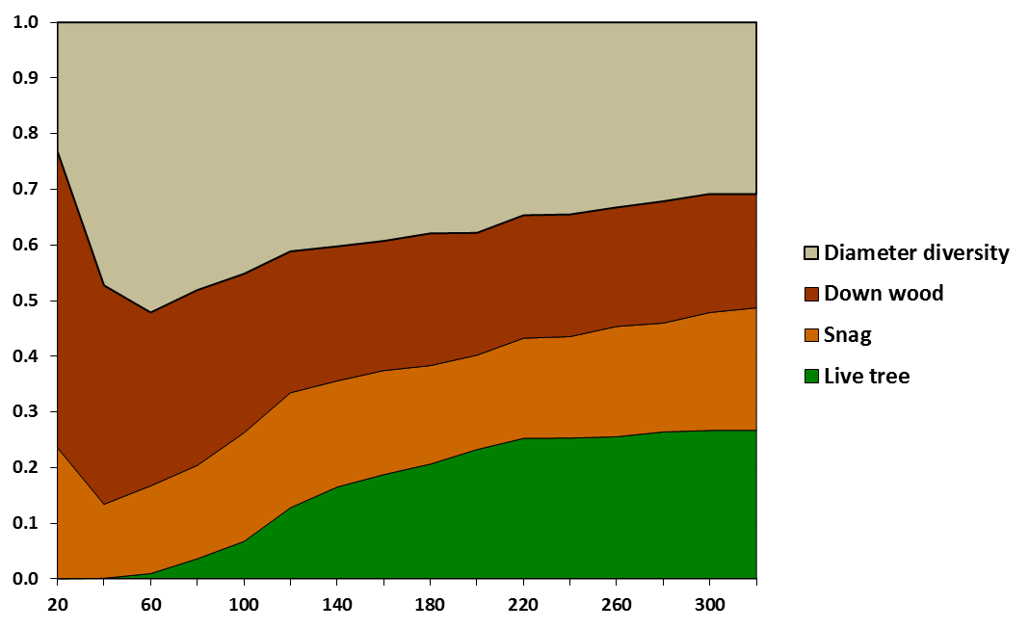
Western Hemlock
OGSI Element Proportion vs Stand Age
80 yr
200 yr
Proportion of OGSI
Stand Age

Slide 28
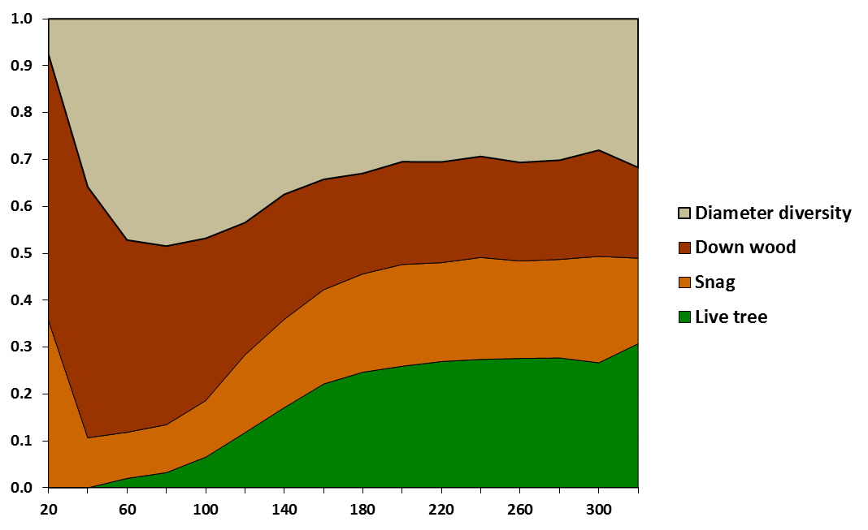
Grand Fir-White Fir
OGSI Element Proportion vs Stand Age
80 yr
200 yr
OGSI
Stand Age

Slide 29
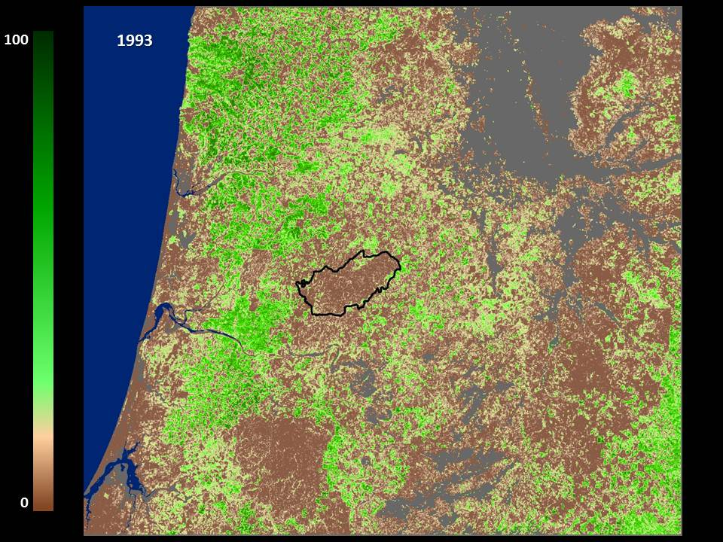
Willamette
Valley
Umpqua
Valley

Slide 30
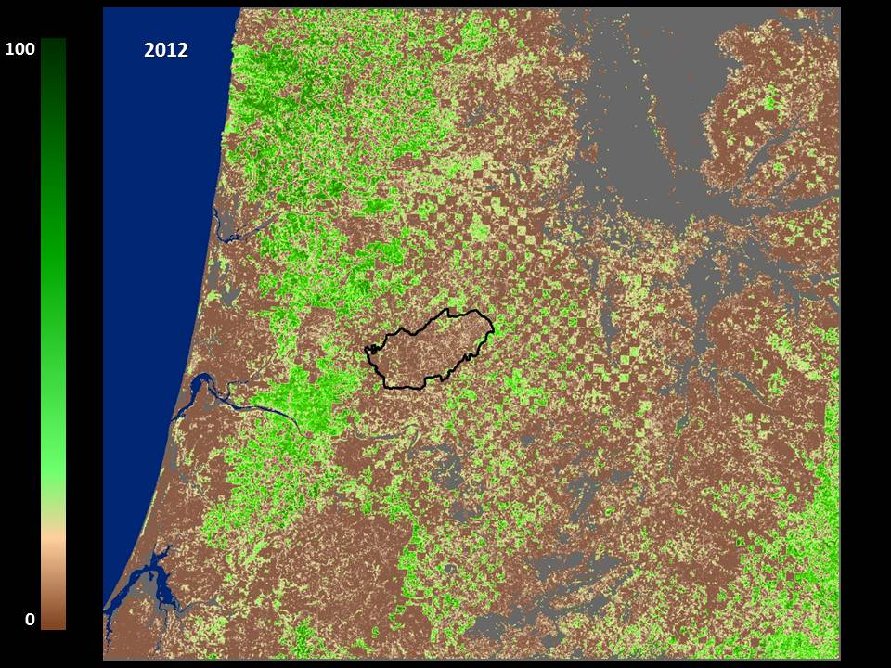
Willamette
Valley
Umpqua
Valley

Slide 31
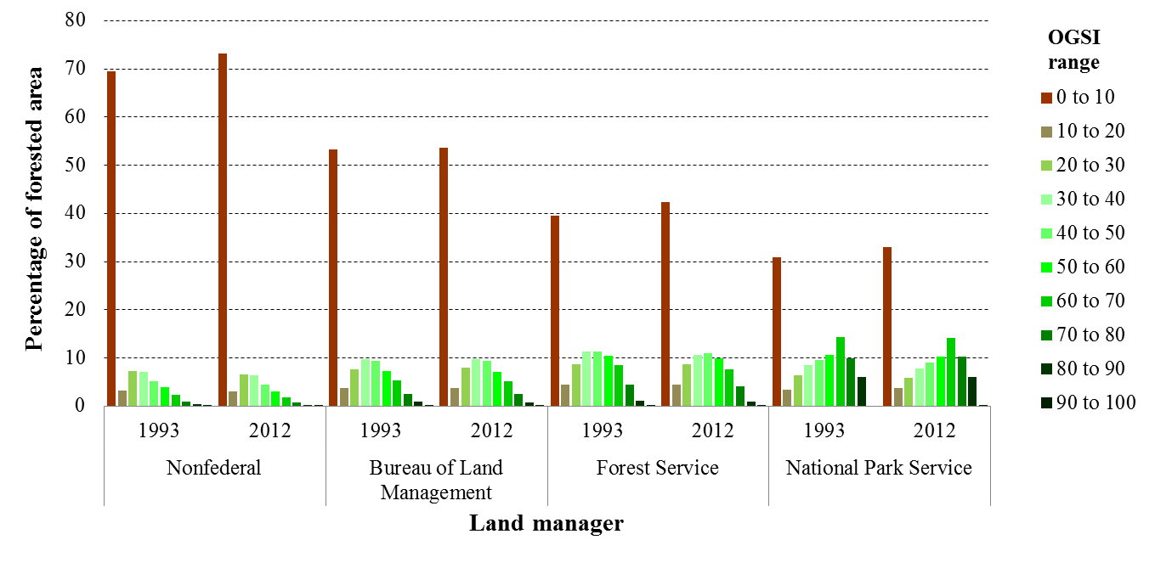
Monitoring the Continuum

Slide 32
Acknowledgements
Janet L. Ohmann, Robert E. Kennedy, Warren B. Cohen, Matthew J. Gregory, Zhiqiang Yang, Heather M. Roberts, Andrew N. Gray, and Thomas A. Spies
        Justin Braaten (OSU)
        Daniel Donato (WA DNR)
        Andrew Merschel (OSU)
        Vicente Monleon (USFS PNW)
        Rob Pabst (OSU)
        Matt Reilly (OSU)
        Mike Simpson (USFS)
        Andrew Yost (ODF)
        Harold Zald (OSU)
        Miles Hemstrom (INR)
        Ashley Steele (USFS PNW)
        Becky Gravenmier (USFS PNW)

Slide 33
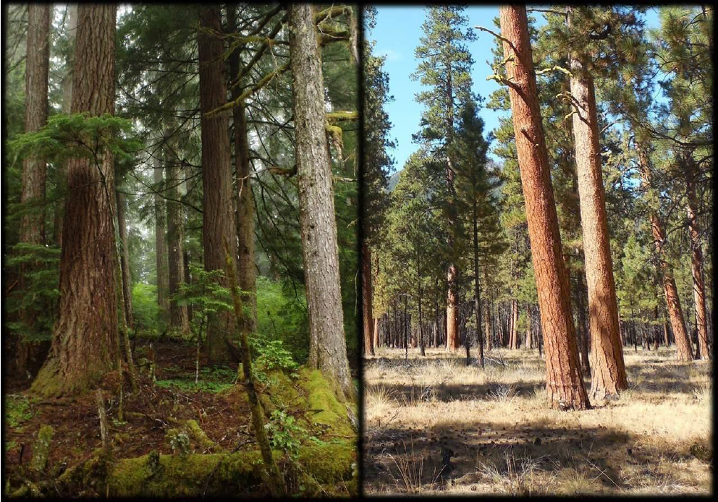
Questions?

