Slide 1
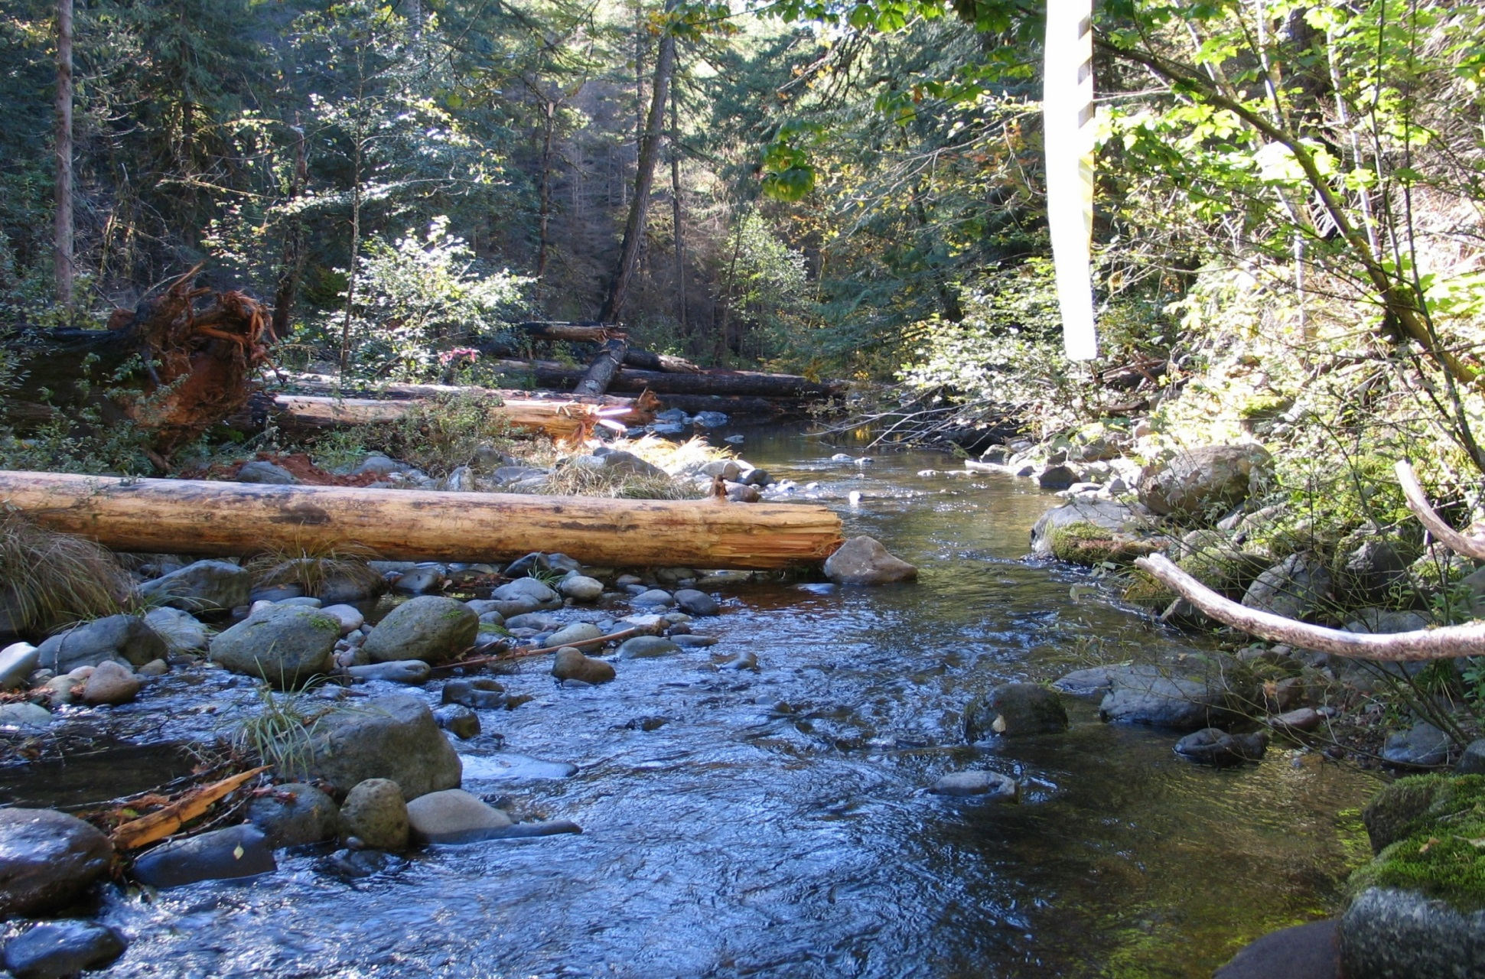
Umpqua National Forest

Slide 2
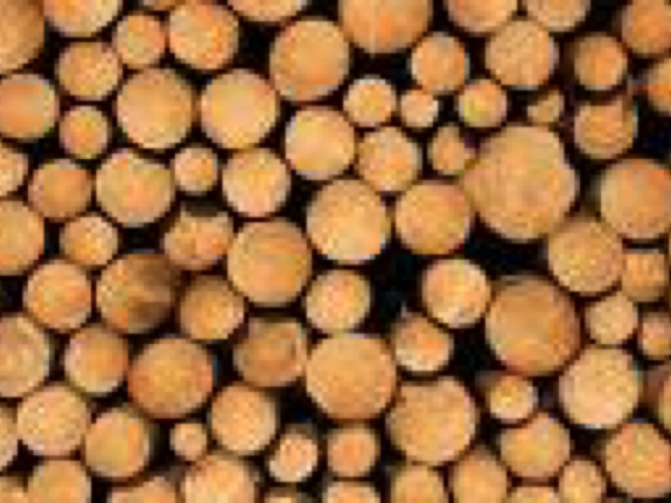
How we got here
Douglas County yesterday
Douglas County today
Notes:
Umpqua National Forest is in Lane, Jackson and Douglas County (75%).
Douglas County is 3.2 million acres with 2.8 million acres of forested land, about half is federally owned
About 25% of the employment in the county is in forest products
Roseburg is the county seat of Douglas County and the city’s motto is “timber capital of the world”
278 mills after WWII
Currently ¾ of a billion board foot per year capacity

Slide 3
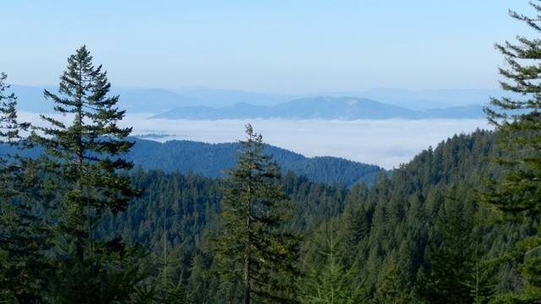
How We Got Here
Before the 90s, the Umpqua was harvesting more than 340 MBF annually
  Up to the early 1990s (pre- Forest Plan) the Umpqua principally clear cut large, old trees
The 1990 Forest Plan ASQ was 334 MBF annually
  After the mid 90’s, the Umpqua primarily commercial thinned previously managed stands of <80 year old predominately Douglas fir
Notes:
The Umpqua is just under 1 million acres with 600,000 available for timber
The Umpqua’s Forest plan was implemented October 129, 1990
Willamette NF is 1.7 million acres with 700,00 available for harvest and a 491 mbf ASQ in 1990 plan
Siuslaw NF is 631,000 with a 1990 FP ASQ of 335 mbf off of 369,000 acres

Slide 4
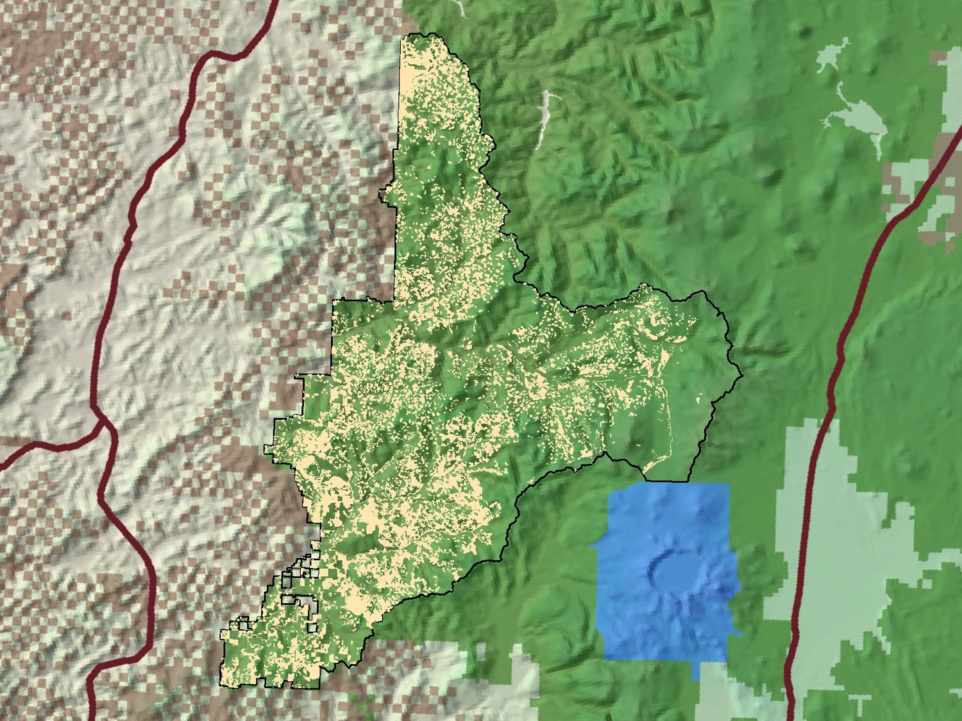
Notes:
silvicultural treatments (commercial thinning and fuels treatments) designed to develop structurally complex stands and landscape structure as well as a more diverse species composition within second-growth stands that originated following even-aged management and subsequent planting in the 1950s through the 1970s.

Slide 5
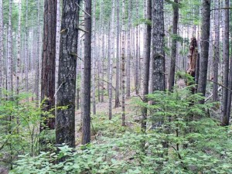
What we’ve been up to
Management in <80 year old managed stands
Allows for efficiencies for example:
Survey and Manage exemptions
D x D marking (designation) on the implementation side.
Notes:
Simple silvicultural prescriptions, more affordable planning and implementation, including sale administration

Slide 6
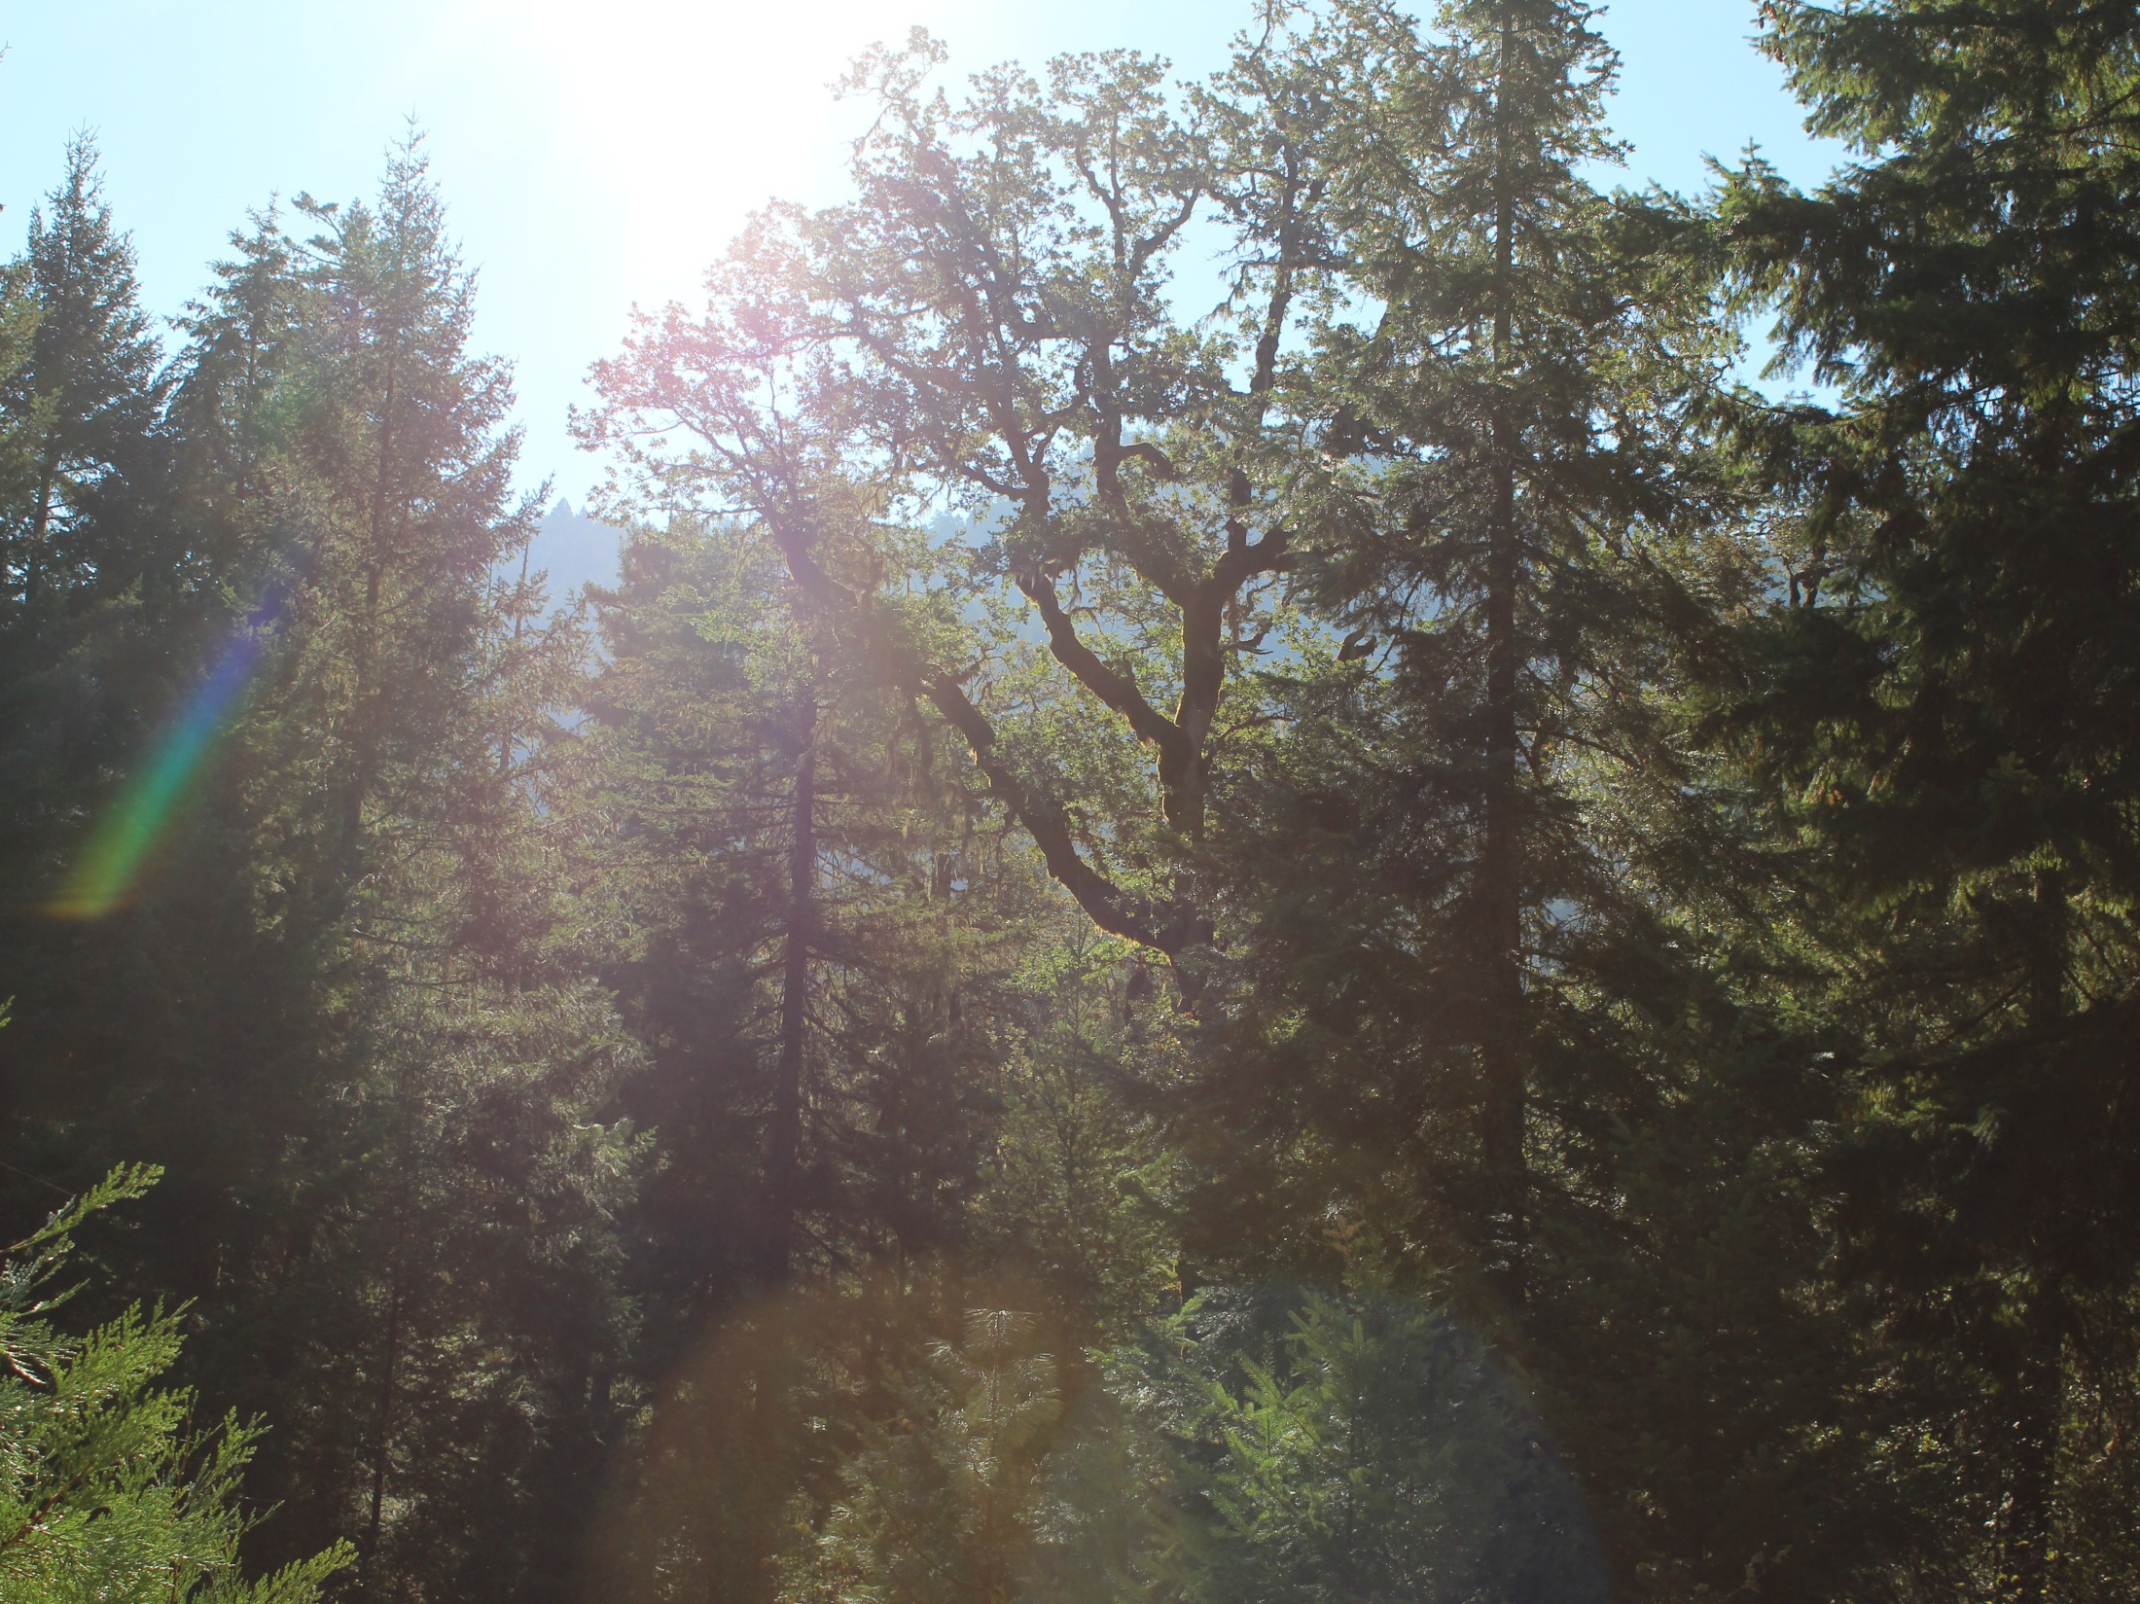
Recent Planning Acreage Reductions
Timber Sale | Starting Acres | Final Acres | % Reduction
Beaver | 2,736 | 1,873 | 32%
D-Bug | 12,000 | 5,497 | 54%
Little River | 5,000 | 1,609 | 68%
Parker Wyatt | 2,544 | 619 | 76%
Rail 2 | 2,654 | 2,000 | 25%
Loafer | 5,782 | 1,430 | 75%
Quartz | 1,975 | 1,026 | 52%
Lower Steamboat | 2,390 | 1,214 | 51%
Average Reduction |  |  | 54%
Little Oak Flats
Notes:
Reductions in acreage treated but we have been exploring ways to improve effecies.

Slide 7
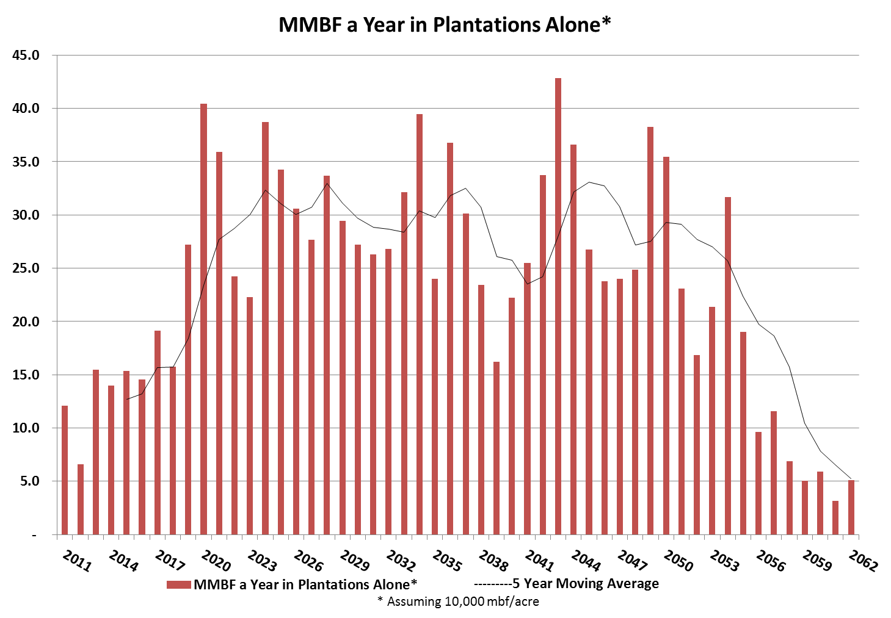
Umpqua National Forest Merchantable Plantation Age Structure
Current Target
Little Oak Flats
Notes:
Assumes 10000 board feet per acre
This slide does not have a spatial componant so these stands may or may not be juxtapositioned to facilitate timber sales
Many of these stands were harvested in ways that we can’t harvest now so access isn’t assured
And many of these stands are likely in CHU or LSR so remember the Purpose and need I described before

Slide 8
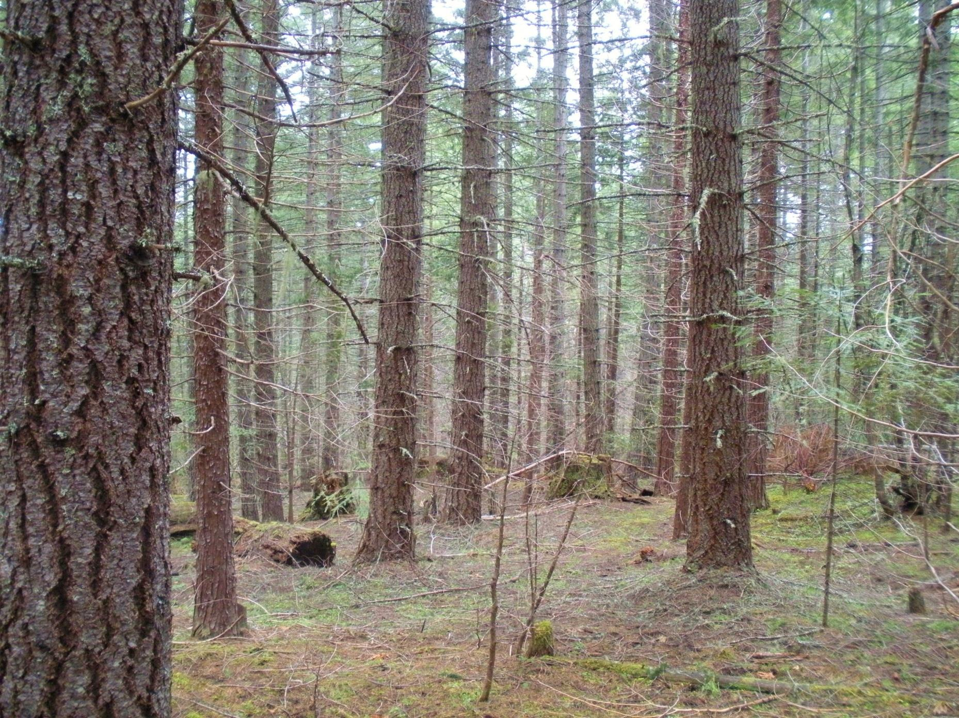
Unmanaged and managed stands greater than 80 year old
More complex analysis & prescriptions
Harder & more time consuming I
implementation.
Adding more complexity to prescriptions leads to D by P or marking the entire unit
.
Notes:
D

Slide 9
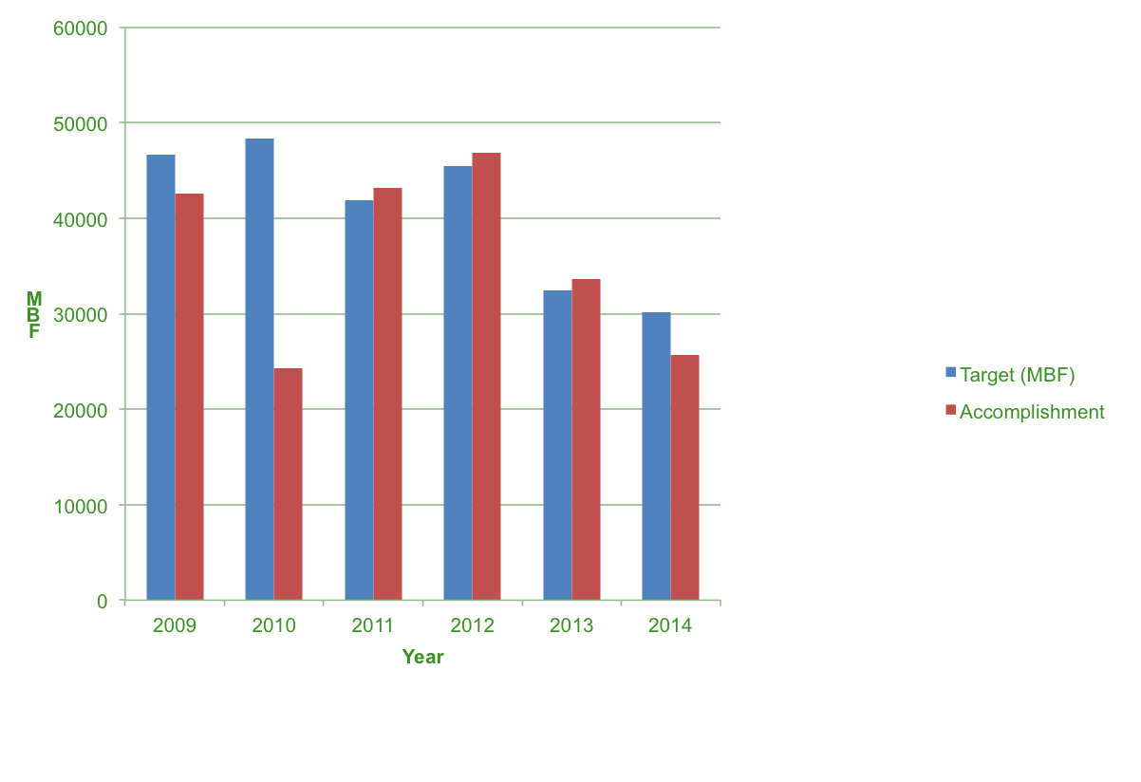
Target vs Accomplishment

Slide 10
Northwest Forest Plan Land Use Allocation | Critical Habitat (ac) 2013 | % of Land Use Allocation 2013 | Critical Habitat (ac) 2008 | % of Land Use Allocation 2008 | Total Umpqua NF Acres
Adaptive Management Area | 30,615 | 50% | 0 | 0% | 60,852
Administratively Withdrawn | 14,455 | 22% | 0 | 0% | 66,350
Congressionally Reserved | 0 | 0% | 0 | 0% | 71,819
Matrix | 268,233 | 65% | 0 | 0% | 411,983
Late Successional Reserves | 282,993 | 75% | 178,065 | 47% | 375,157
Totals | 596,296 | 60% | 178,065 | 18% | 986,160

Slide 11
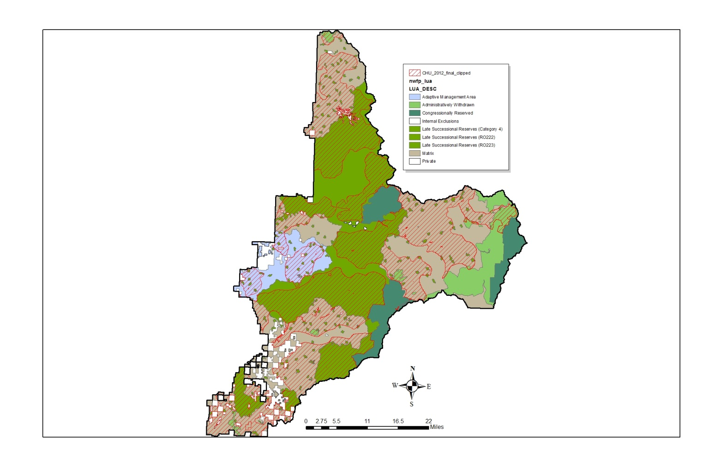
Critical Habitat, LSR, Matrix

Slide 12
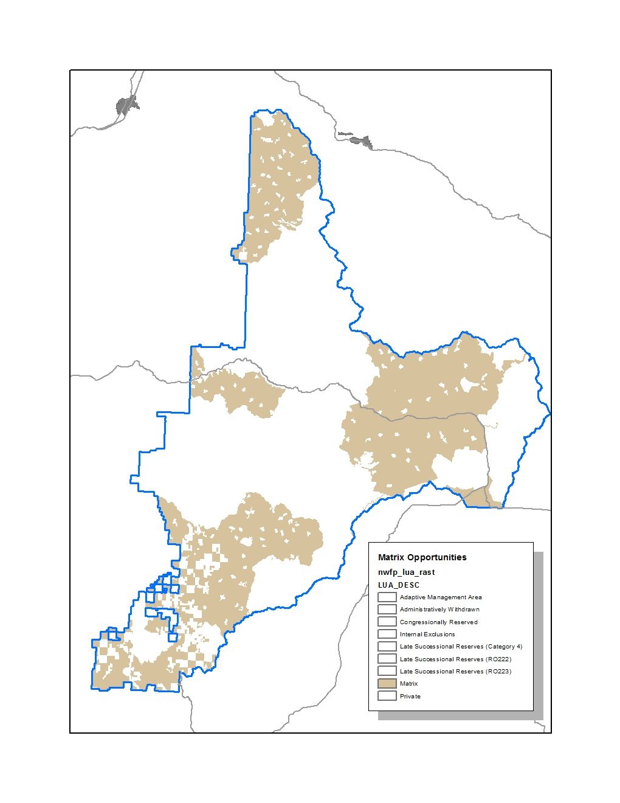
Matrix
Notes:
Matrix only

Slide 13
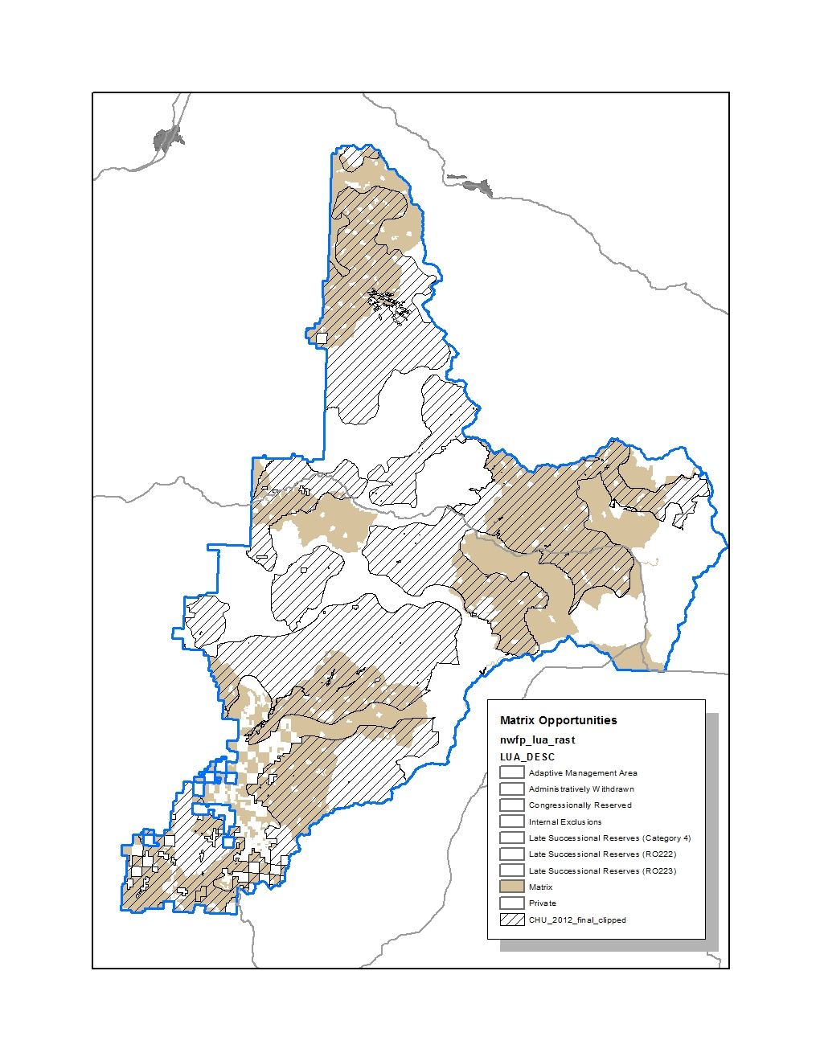
Not Critical Habitat
Notes:
Critical habitat (crosshatched) includes much of the Umpqua’s matrix allocation.

Slide 14
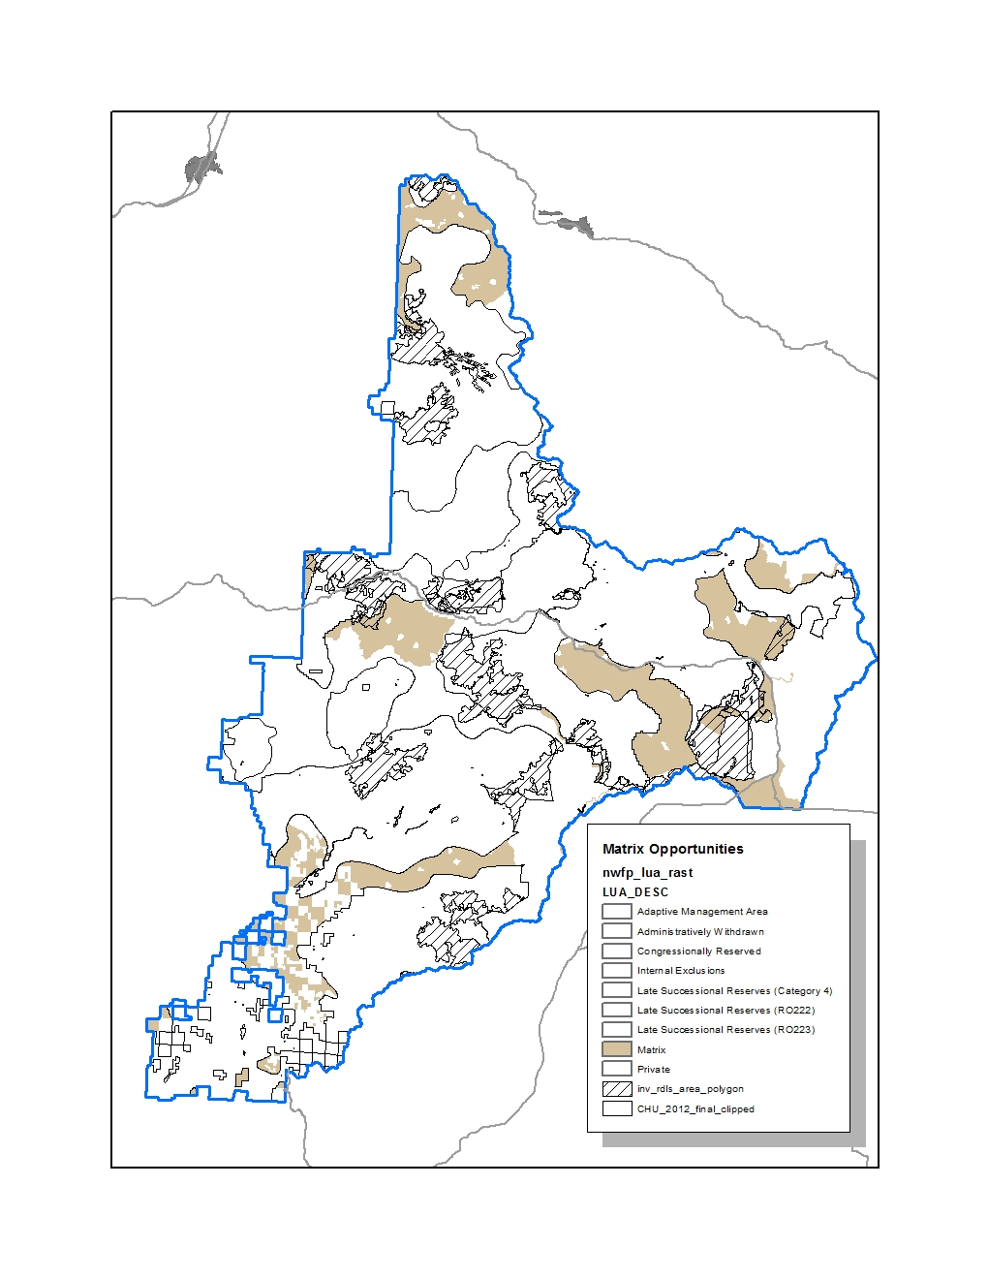
Not Inventoried Roadless Area
Notes:
Inventoried roadless areas nibble away a few more acres.

Slide 15
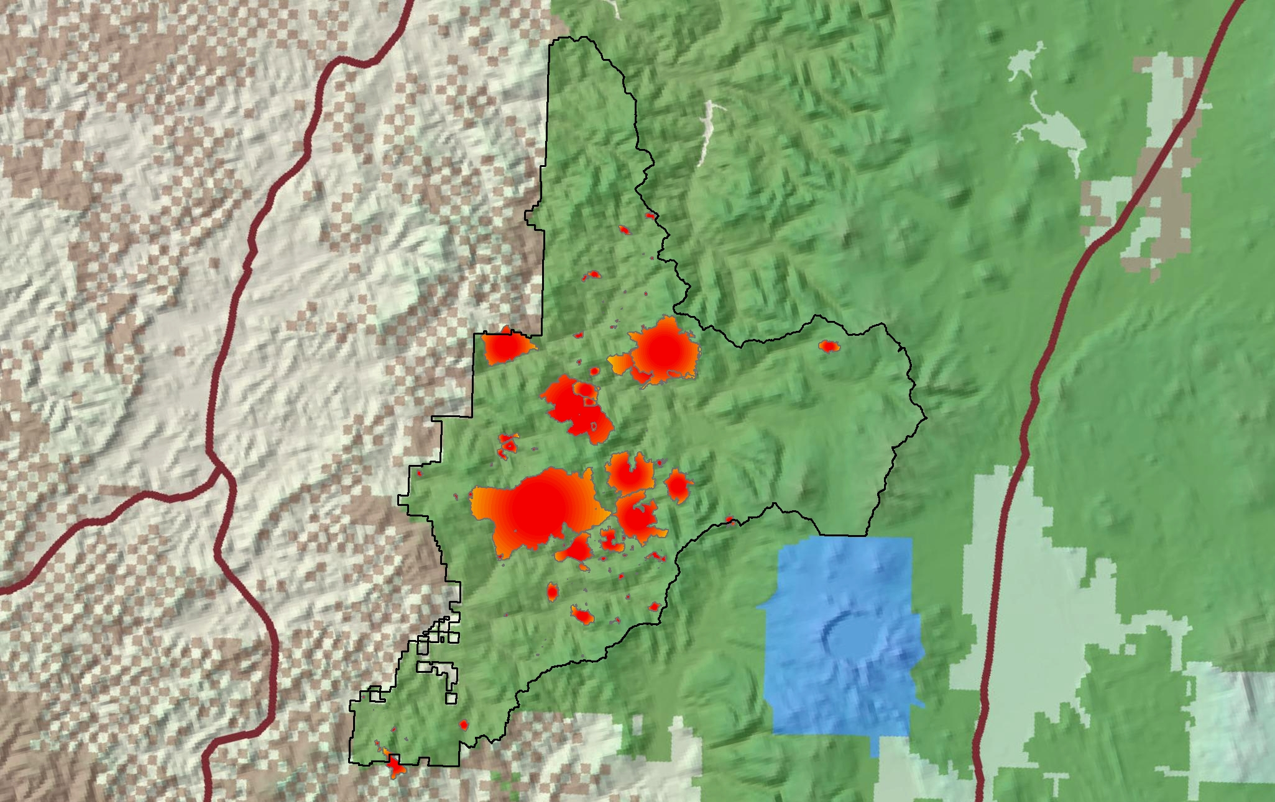
Map of recent large fires
Notes:
Fire history since late 1980s

Slide 16
Consequences
Expensive to plan
Expensive to implement
Challenging to administer
Controversial
Need for collaboration with unresolved issues around social license
Urgent: losing important habitat, species, resiliency to short-term effects and long-term effects ( fire now, climate change)

Slide 17
Any Questions?

