Slide 1
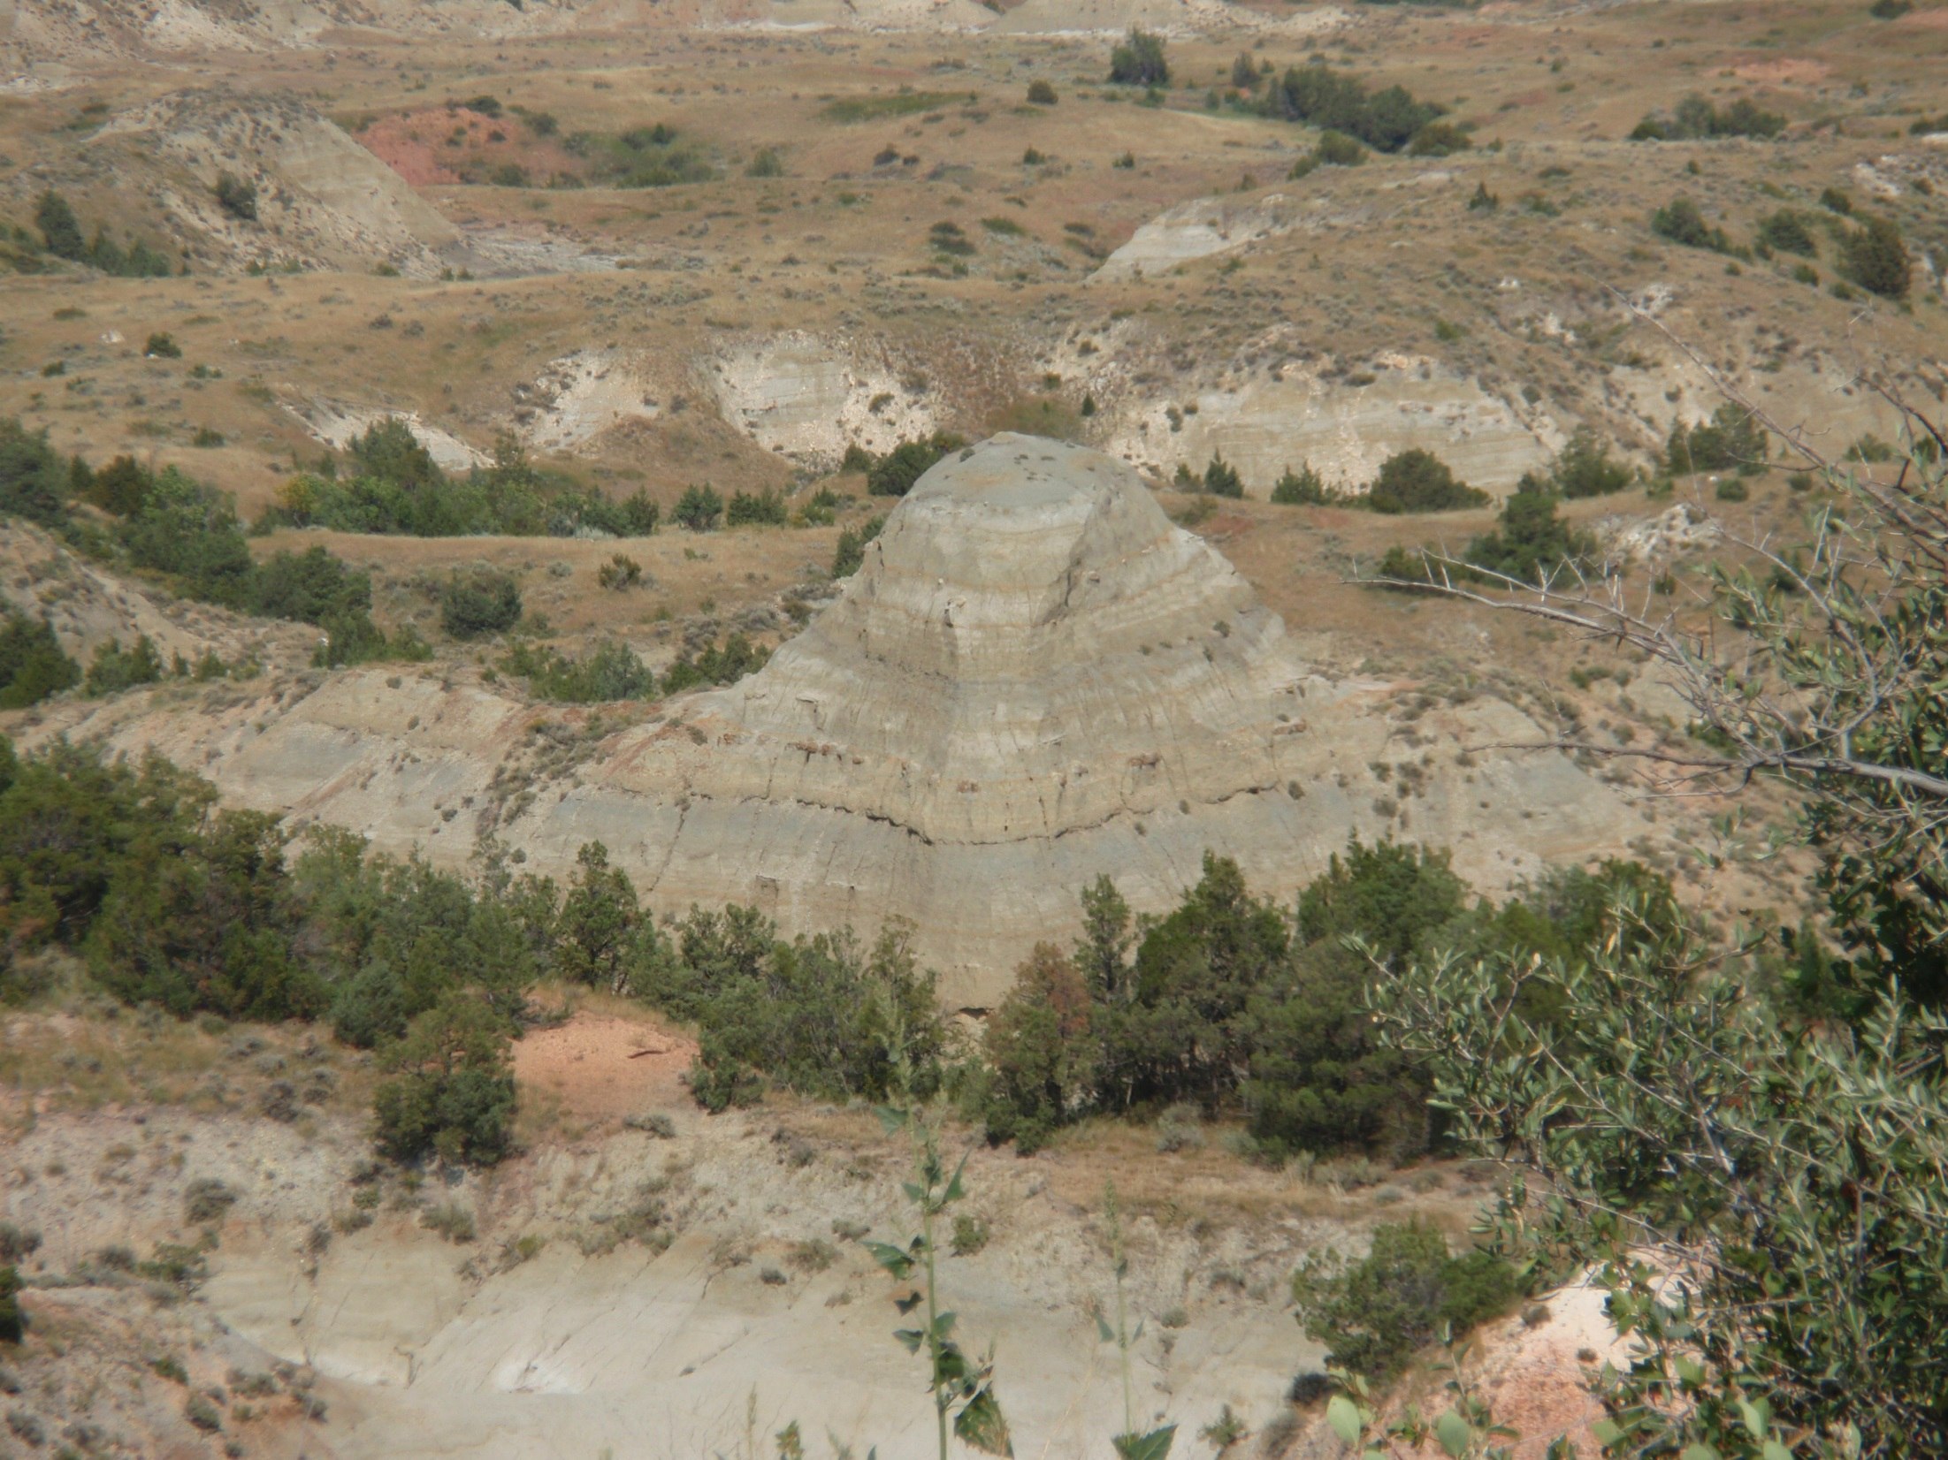
Why Forest Management is a “Social” enterprise: How We Assess Public Wants & Needs
Stanley T Asah
Associate Professor: Human Dimensions of Natural Resource Management
School of Environmental & Forest Sciences
College of the Environment
University of Washington

Slide 2
What is management?
The identification, mobilization, and deployment of resources to accomplish set goals/address identified problems
People
Identify problems
Identify, Mobilize, and Deploy resources
Set goals and determine goal attainment/problem solving
Set goals implicitly/explicitly relate to the life, welfare, and relations of human beings in a community or another social unit—the PNW, US, etc.
Human judgement/subjectivity
These, and especially science, drive management

Slide 3
Science & Scientism
People do science, according to certain:
Clearly specified procedures,
Assumptions, and
Analytical techniques
It is learned behavior; culture, that is
Some sciences are not done correctly

Slide 4
Science & Scientism
People/scientists interpret findings and suggest management actions
Assumptions and other caveats, are often inadequately elaborated upon
Or ignored, depending on who is interpreting and for what purpose—to serve what interests
E.g., Old growth 80-140 years: “Caveat”—depending on ecological contexts—“other factors”
Other factors are either ignored or emphasized depending on
Judge says 80 years—lets peculate on why the judge might have suggested 80 years as old growth

Slide 5
Science & Scientism
Scientific findings, within the same discipline, are sometimes:
Conflicting,
40 years ago—wolves should be killed; ecology
Today—wolves should be restored; ecology
Inconclusive or not very precise/nuanced—80-140 years
Criteria: 80-140, depending on….
Standard: 80, there is no dependencies/contingencies—the judge is not a scientist
Management based on standards (human judgment) not criteria (science)

Slide 6
Science & Scientism
So science is the basis for developing of management standards, not management decisions
Most importantly, people, the public, know that’s the case/they know about:
Conflicting findings
Uncertainty
So, leads to
Conflicting understandings tailored to align with specific interests
Conflict: even contesting science when there is misalignment

Slide 7
Assessing the social
Multitude of approaches; depends on what the issue is
You may want to understand public attitudes and potential behaviors pertinent to that issue
Public engagement and public representation/representative participation are two different things
Public procedural engagement pertains to the knowledgeable, and highly and directly invested
Representative participation pertains to the salience and prevalence of views, attitudes, stakes and issues across the entire population of interest

Slide 8
Assessing the social
Representative participation through social assessments can be a powerful leverage for procedural engagement
E.g., survey of a representative sample of people in the Deschutes county showed that the USFS is more trusted than some environmental groups
Same population “highly” belief that science rather than public opinion should drive management
Environmental groups are known, to some, for their judicious use of science
???????????????????????????????????????????????????

Slide 9
Assessing the social
Before decisions—run that by people
Ensuring the public uses their own expressions to articulate issues from their own frames of references can put the situation in more favorable light than managers would have ever thought of
E.g., volunteering in the Deschutes
Fortifies social desirability and acceptability
E.g., ESs focus group interviews—social appreciation for seeking public input via face-to-face conversations
Qualitative methods are very important

Slide 10
Assessing the social
Surveys are also very important and where relevant, could be informed by interviews
elucidate prevalence and salience of issues, attitudes, etc.
Illuminate contradictions
Ensure methods are proper for the issue at hand
Ensure relevant analysis beyond measures of central tendency are conducted
E.g., Asah & Blahna, 2012, Conservation Letters
Asah & Blahna, 2013, Conservation Biology

Slide 11
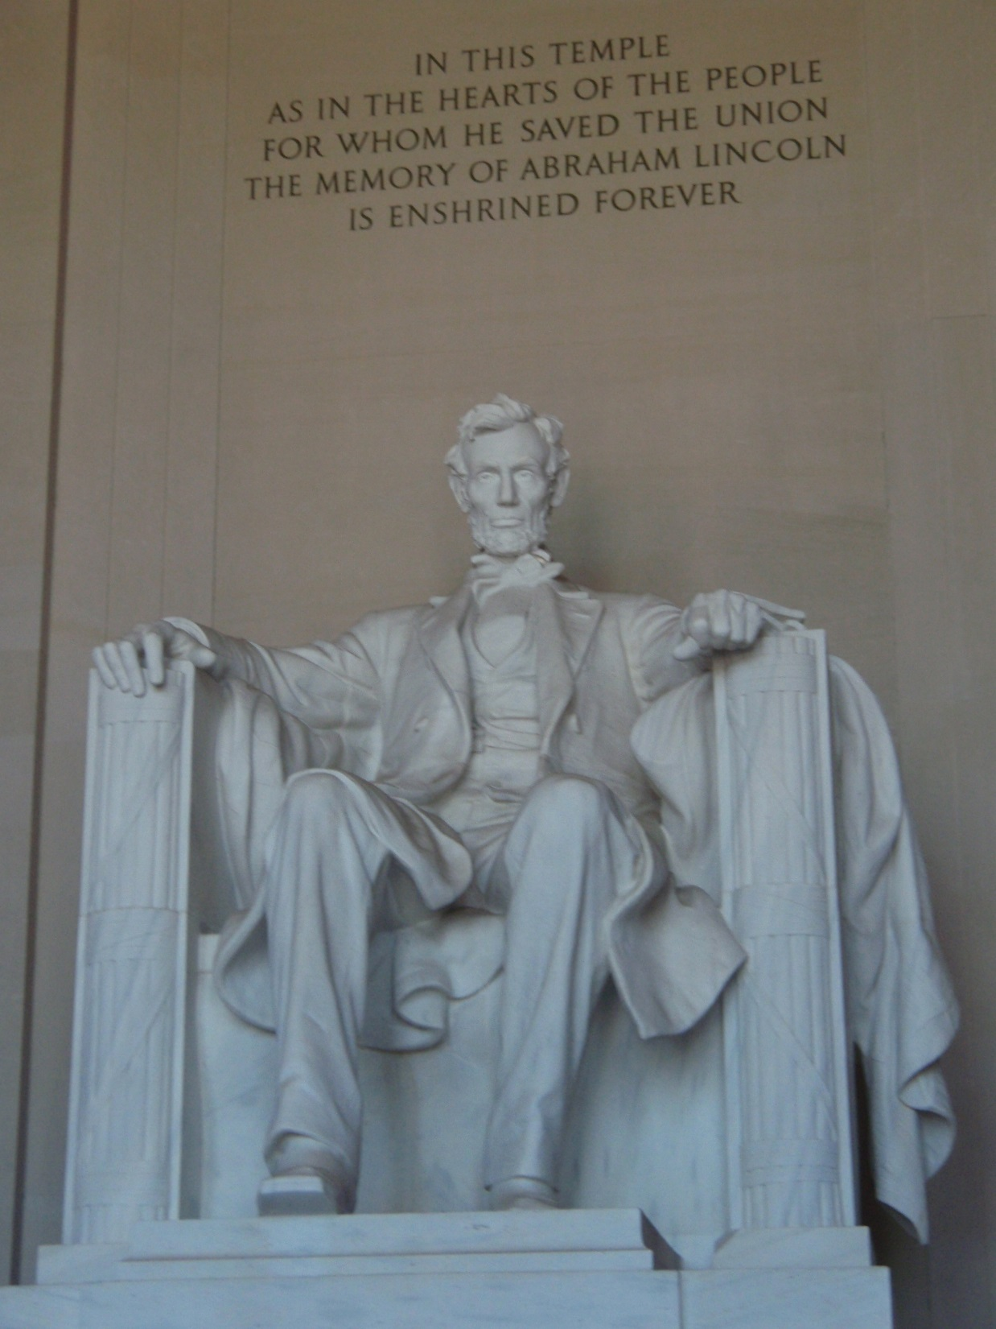

Slide 12
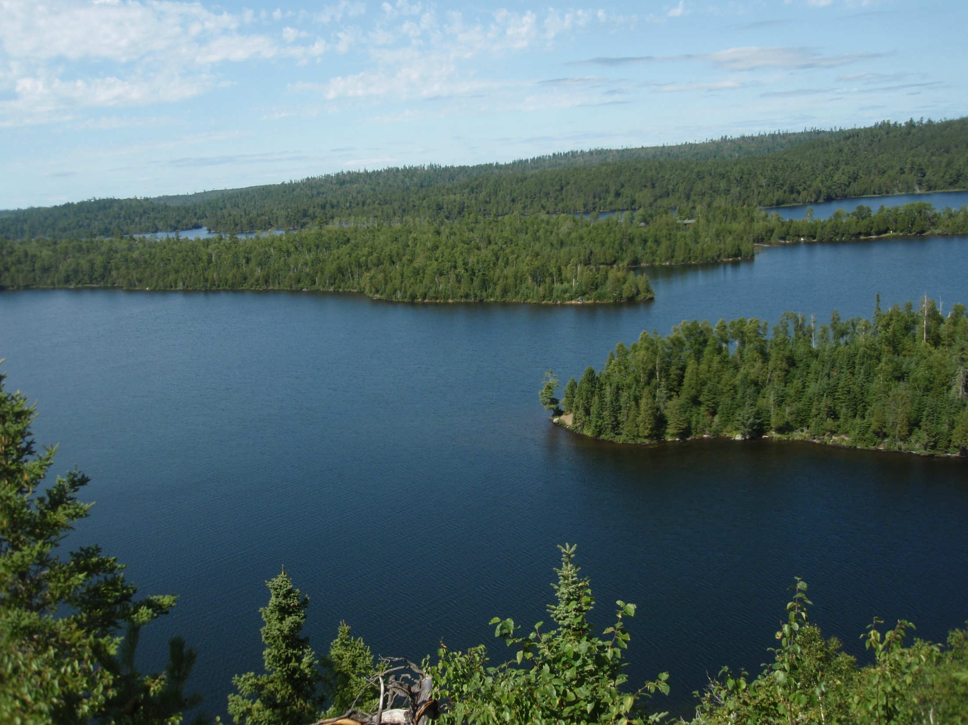
Thank you I am not Allergic to Questions or conversations/dialogue

