Slide 1
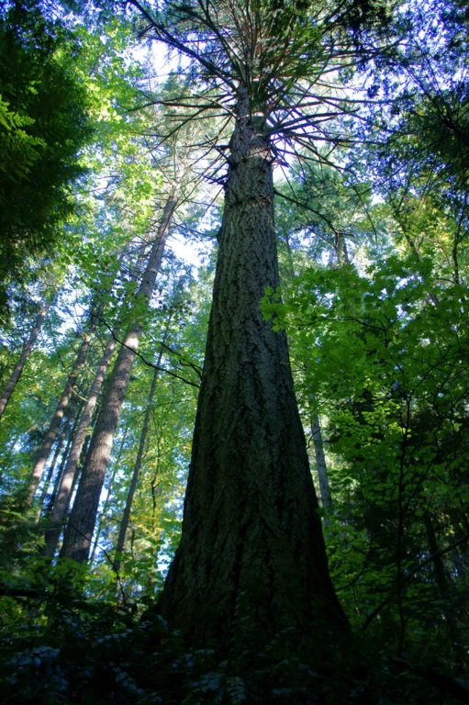
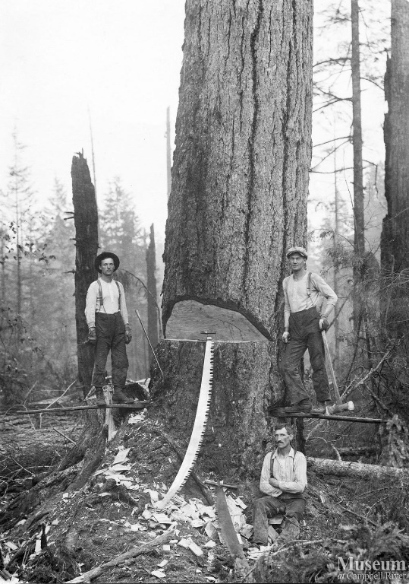
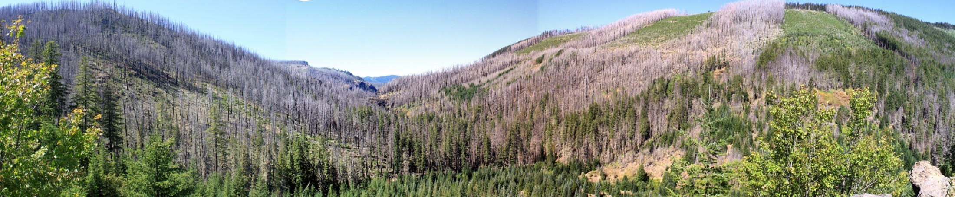
HISTORICAL AND CURRENT DYNAMICS
IN WEST-SIDE FORESTS
WHERE DID THEY COME FROM
AND WHERE ARE THEY GOING?
Jane Kertis and Matt Reilly

Slide 2
Presentation Outline
Where did these forests come from?
Where are they now?
Where are they going?

Slide 3
Where did they come from?
Vegetation Development concepts
Drivers of Historical vegetation
Vegetation pathways
20th century fire

Slide 4
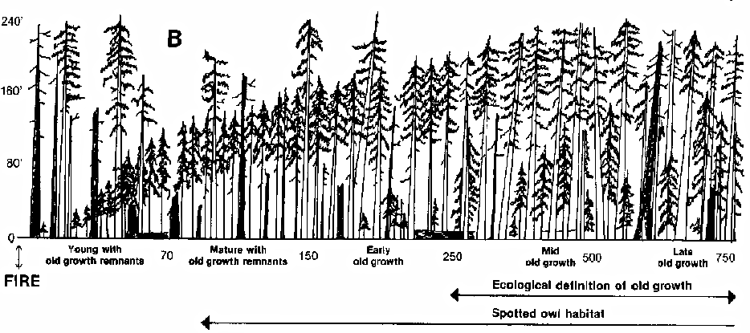
Forest Development
The gradual and orderly process of change brought about by the progressive replacement of one structural stage by another until a stable climax stage is established
Spies and Franklin. 1988. Natural Areas Journal.
Notes:
Classic successional defintion that also holds true for structural development is that after a disturbance forests move through designated stages and end up at a climax state.

Slide 5
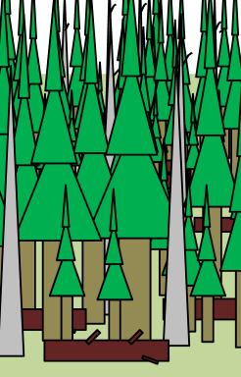
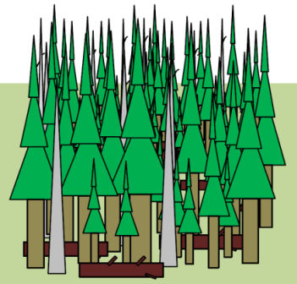
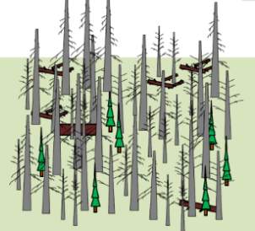
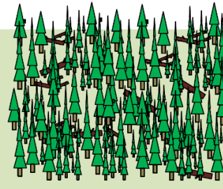
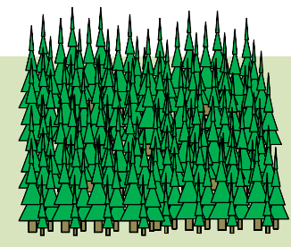
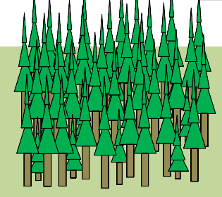

Stand Development Stages
Oliver and Larson (1990)
Stand initiation
Stem exclusion
Understory re-initiation
Old-growth
Biomass accum./ competitive exclusion
Franklin et al. (2002)
Disturbance and legacy
creation
Cohort establishment
Canopy closure
Maturation
Vertical and horizontal diversification
Age
(yrs) 0 20 30 80 150 300 800
From Franklin et al. 2002 For Ecol and Mngmt.
Notes:
Various efforts have classified forest development progression into discreet “stages” to better to describe the range of stand conditions occurring through time. Simple 4 stage to more complex. More or less follows a linear progression

Slide 6
Components Used to Describe Stand Development Stages
Canopy Cover
Live trees:
Size (by species) and density
Diversity of sizes
Dead wood (snags and down wood):
Size and density
Biomass
Cover
Notes:
Many of the classifications incorporate the basic components used to develop the OGSI such as canopy cover, live tree sizes and species, and snags and downwood biomass (similar to OGSI presented by Ray)

Slide 7
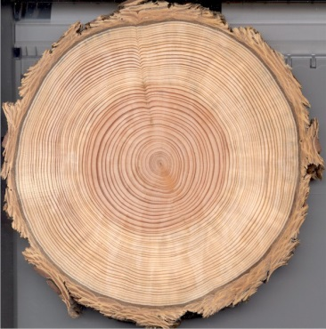
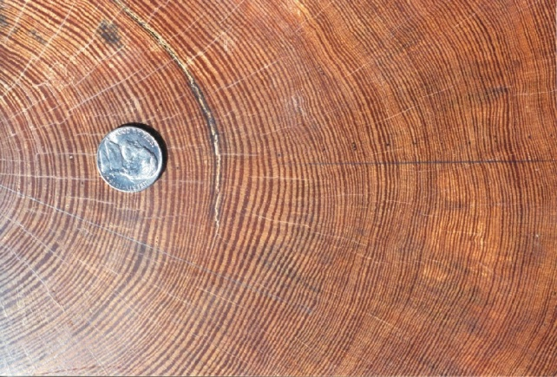
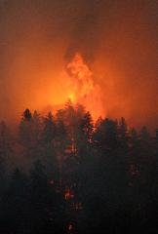
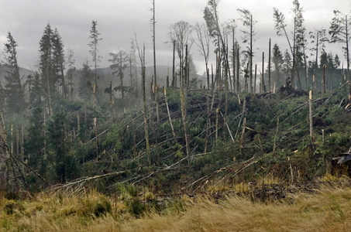
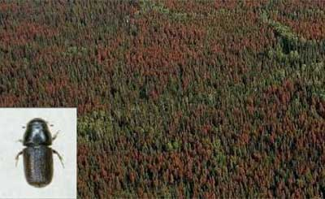
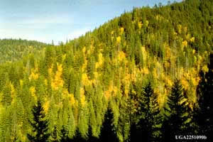
Processes affecting Development Pathways
Growth
Climate and environment
species composition
Mortality
Fire
Wind
Competition
Pathogens
Insects
Ronald F Billings, Texas Forest Service and USDA Forest Service, Region 2, Rocky Mountain Region Archive,
Notes:
Many processes affect the speed and direction that forest development follows in space and time. Climate and environment operate at broad spatial scales to affect distribution of species, productivity and growth. Mortality is driven by physical and biological processes. Competition for resources, insects, pathogens and wind operate at fine to moderate spatial scales . Fire operates at both landscape and fine scales to produce within stand and landscape scale diversity.

Slide 8
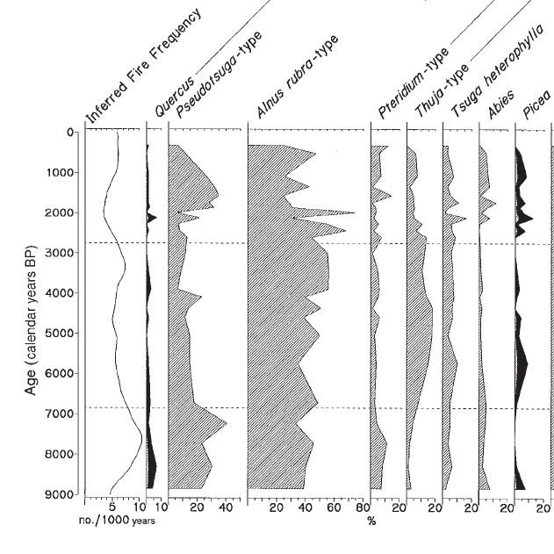
Paleoclimate and Vegetation Composition Little Lake, Oregon Coast Range
Cooler/more humid
Cool/Humid
Warm/Dry
Long et al Can J. For. Res. 1998
Notes:
There is a strong historical relationship between climate and vegetation. Pollen diagram from Long and colleagues work at Little Lake in the central Oregon Coast Range. X axis/Y axis. In this example an early Holocene warm, dry climate was related to communities of Oak, Douglas-fir, and a large component of bracken fern. As climate cooled and got wetter, shifts to communities of western hemlock and western redcedar occurred.

Slide 9
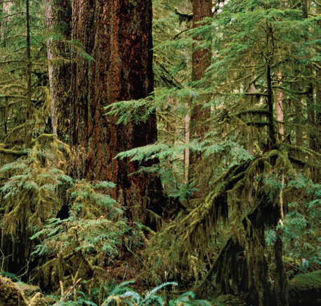
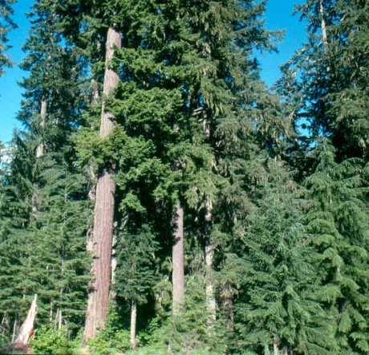
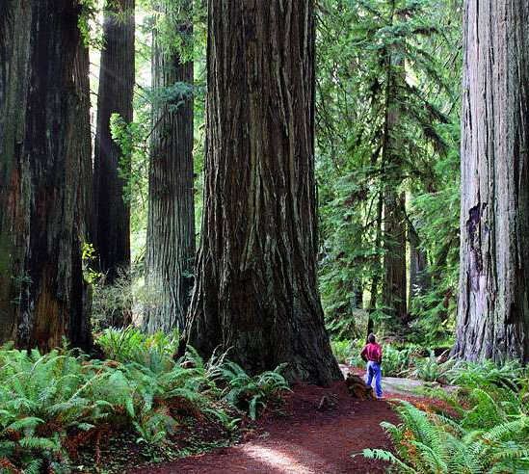
Potential Vegetation Zones
Notes:
Pattens of precipitation, temperature and soil/landform characteristics drive broad vegetation distribution . Potential vegetation zones are named for the “climax” dominant species that will grow there without disturbance.

Slide 10
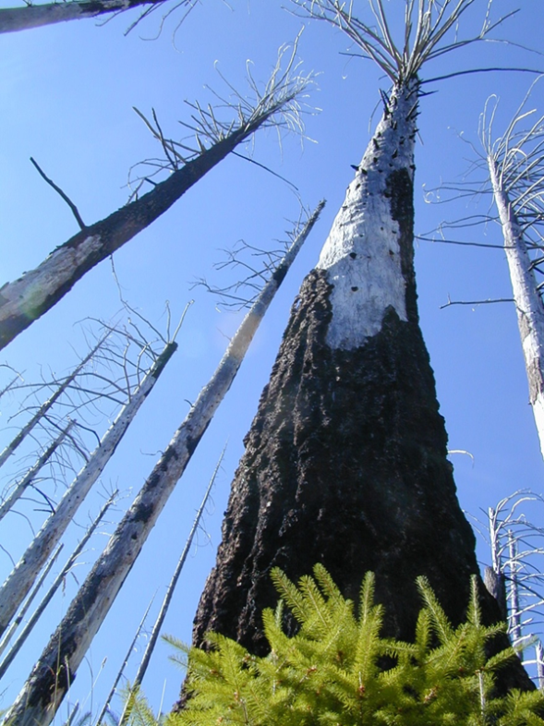
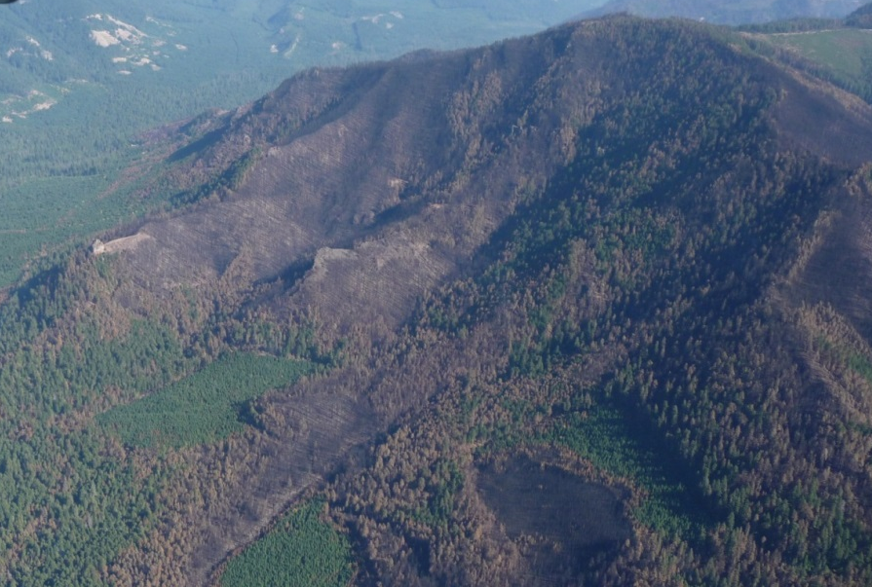
Fire
Dominant landscape process operating on variable temporal scales
Variable stand effects
Canopy Cover
Live tree species and size classes
Deadwood
Notes:
Fire is the dominant process that has historically shaped landscape pattern in westside forests. Fire has affected the types and distribution of vegetation stages across the landscape, and has affected vegetation development —supplying CWD, influencing species composition and size distributions in space and time

Slide 11
Paleoclimate, Vegetation and Fire Little Lake, Oregon Coast Range
Fire Frequency
Cooler/more humid
230 yrs
Cool/Humid
160 yrs
Warm/Dry
110 yrs
Long et al Can J. For. Res. 1998
Notes:
Long and colleagues also looked at fire history using charcoal in lake sediments. They found a direct link between climate, vegetation and fire

Slide 12
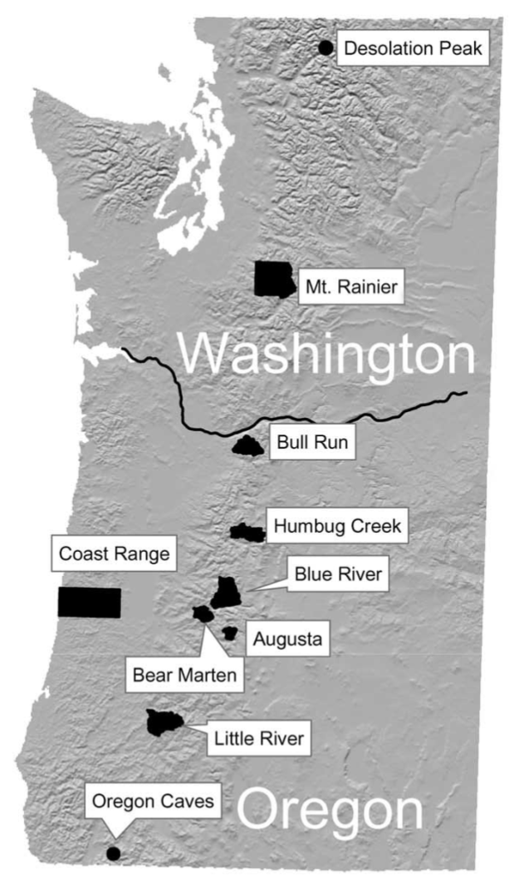
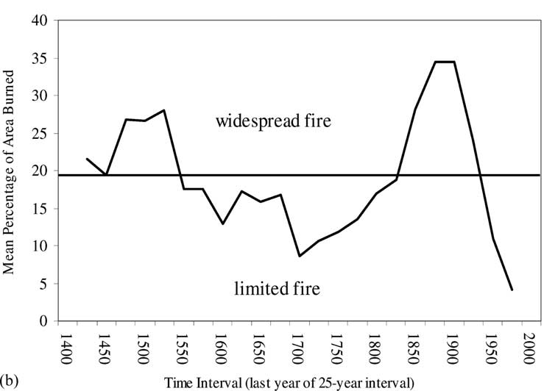
Fire History Studies: Westside Regional Signal
Warm break in Little Ice Age
Height of Little Ice Age
Weisberg & Swanson, 2003, For. Ecol. Manag.
Notes:
More recent history climate fluctuations that many of our older forests experienced we can see continued link with fire. Westside forests have a rich fire history databank to draw on. There are regional trends in fire activity, with the mid-1400s-mid 1500s and mid 1800s-early 1900s showing pulses of fire activity that is correlated with warmer climate, with the height of the Little Ice Age (1600-1850) cool weather linked with lower than average fire activity.

Slide 13
Fire Regimes
Infrequent High Severity
Large Extent
Frequency: How often
Severity: How much mortality
Extent: How large
Affects the composition, structural development and landscape pattern
Variable frequency
Mixed severity
Variable Extent
Frequent low severity
Perry et al. 2011, Forest Ecology and Management
Notes:
Fire history information has helped us characterize the broad role of historical fire into fire regime groups. Westside forests fall into 3 regimes: an infrequent, high severity or stand replacing regime, a complicated variable frequency mixed severity regime, and a high frequency, low severity group. Regimes were responsible for different vegetation development pathways…

Slide 14
Infrequent Stand Replacing Fire Regime
Infrequent High Severity
Large Extent
Dominated Coast Range ecoregion
Dominated northern West Cascade ecoregion
More localized further south
Perry et al. 2011, Forest Ecology and Management
Notes:
Fire history information has helped us characterize the broad role of historical fire into fire regime groups. Westside forests fall into 3 regimes: an infrequent, high severity or stand replacing regime, a complicated variable frequency mixed severity regime, and a high frequency, low severity group. Regimes were responsible for different vegetation development pathways…

Slide 15
Stand Development Pathways Stand Replacement Fire Regime
Long time between fires (> 200 years)

Slide 16
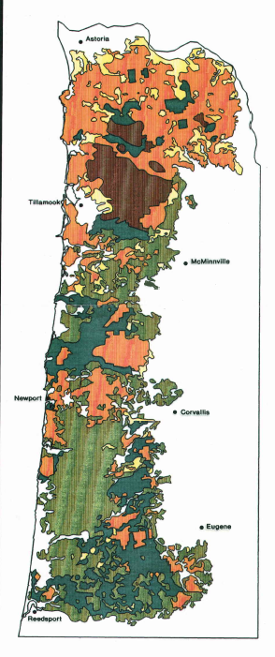
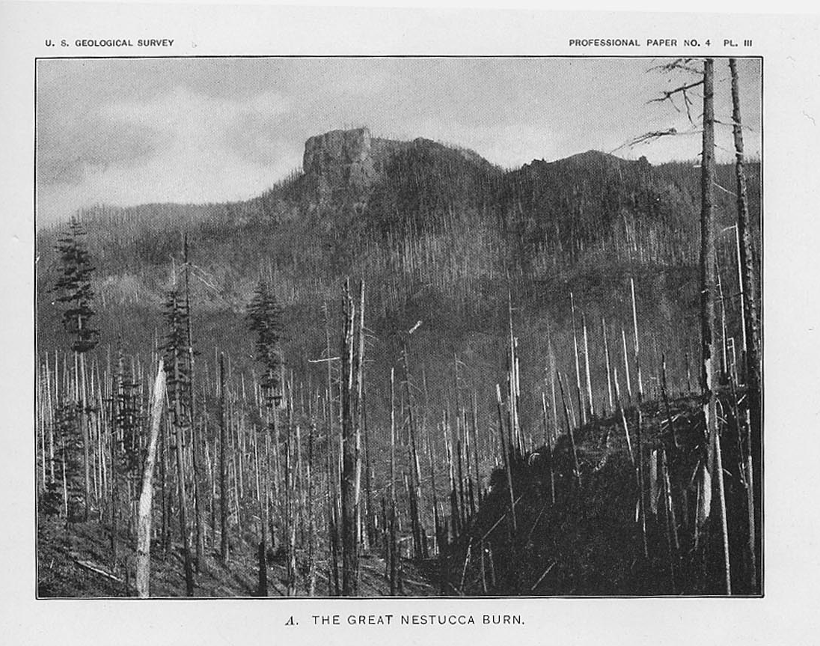
Oregon Coast Range 1940
Tillamook: 1933-1951;
4 fires
355,000 total acres
Nestucca: 1845/6/7
Repeated reburn by settlers;
300-375,000 total acres
Yaquina 1849;
450,000 total acres
Teensma et. al 1991
Notes:
The Oregon Coast Range is a good place to see an example of extent and pattern. As you can see in this historic map of 1940 Oregon Coast Range vegetation age classes where orange is recently burned and brown is forest < 50 years and dark green is 200+ yrs 3 large fires are evident, each affecting over 300, 000 acres. Even with high severity there may have been unburned islands or less severely burned patches within the fire perimeter. Reburning may create some seed source issues as might have been the case with western hemlock seed source availability after these fires.

Slide 17
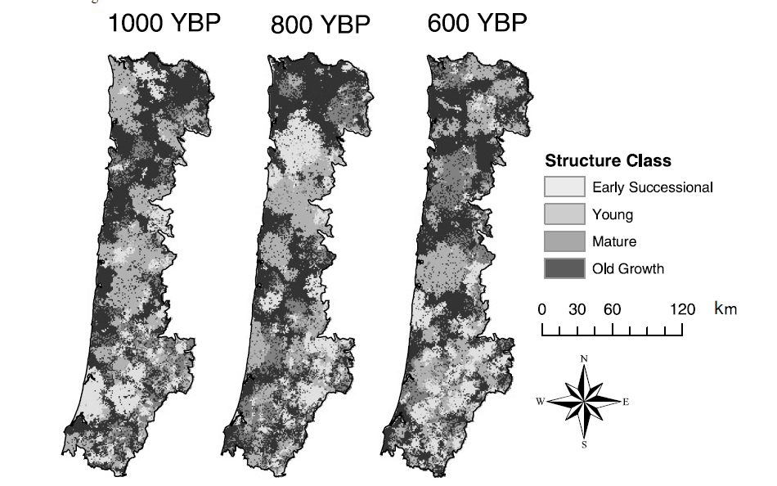
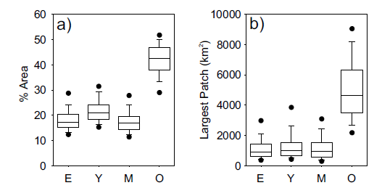
Historical distribution: Oregon Coast Range example
Spatial scale: Ecoregion
High proportion of area in large patches
Higher proportion in old growth
Wimberly, MC 2002 Can. J. For. Res
Notes:
To illustrate this fire regimes potential historical distribution are model results using historical fire history information from the Oregon Coast Range. A single model run result is shown here. You can see that large patches dominate the landscape. The results of multiple model runs show GO dominates the Coast Range ecoregion (30-50%), with early seral varying from 10-30%. that median largest patch sizes of most structure classes were ~ 250,000 acres, with the exception of OG which was ~100,000 acres—lots of variability!

Slide 18
Mixed Severity Fire Regimes
Dominated Valley margin
Dominated central/south West Cascades ecoregion
Found in mesic vegetation types in Klamath Mountain ecoregion
Variable frequency
Mixed severity
Variable Extent
Perry et al. 2011, Forest Ecology and Management

Slide 19
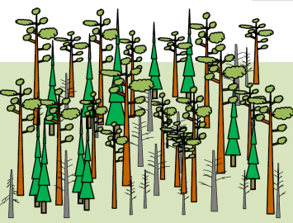
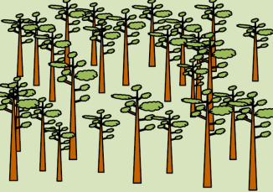
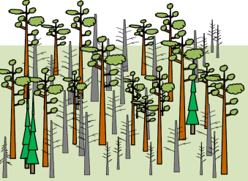

Stand Development Pathways Mixed Severity Fire Regime: It is Complicated!
Alternative pathway
Notes:
Stand development pathways in this regime are complicated. Post fire stand conditions and alternate pathways vary depending on the frequency and severity of fires, and may hasten or delay acquiring late successional structural components of large live trees and diverse tree sizes, and will provide pulsed of snags and down wood..

Slide 20
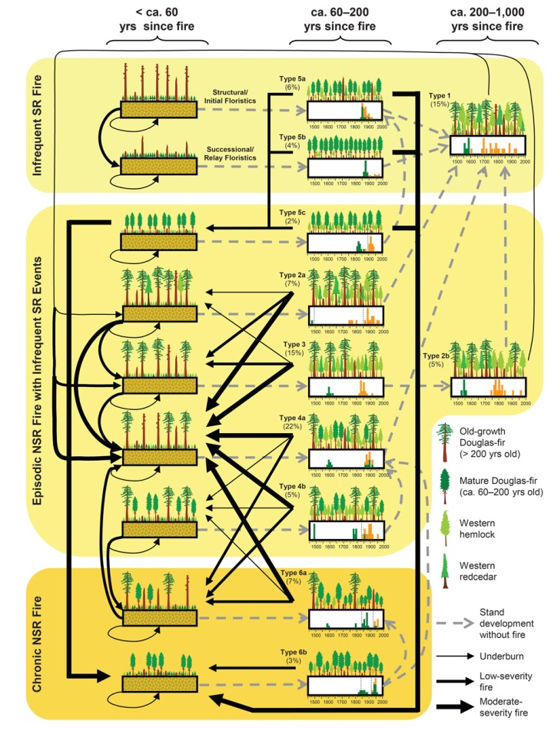
Low Frequency (200+yrs)
High Frequency (<30 yrs)
Tepley et al. 2013 Ecology
Notes:
And you thought the previous slide was confusing! This figure from Tepley and colleagues illustrates the complexity of forest development in mixed severity regimes, with multiple pathways possible given the frequency of fire on the landscape

Slide 21
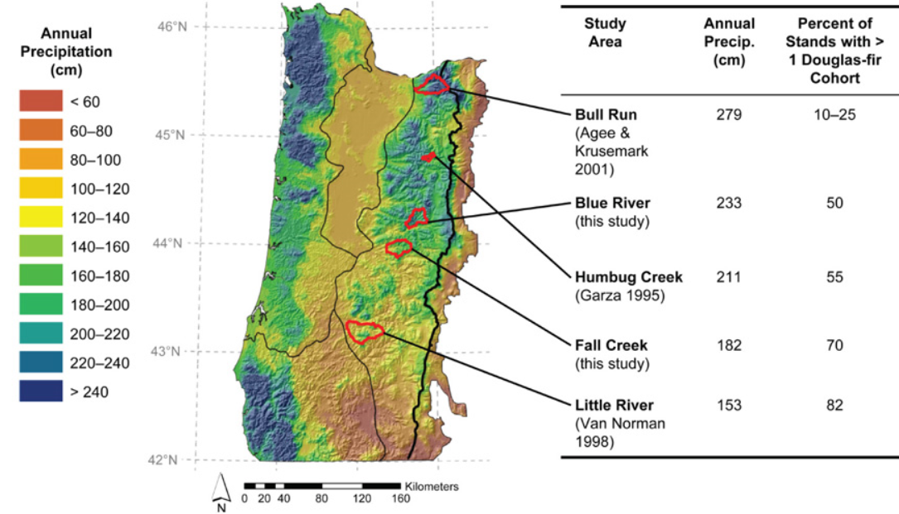
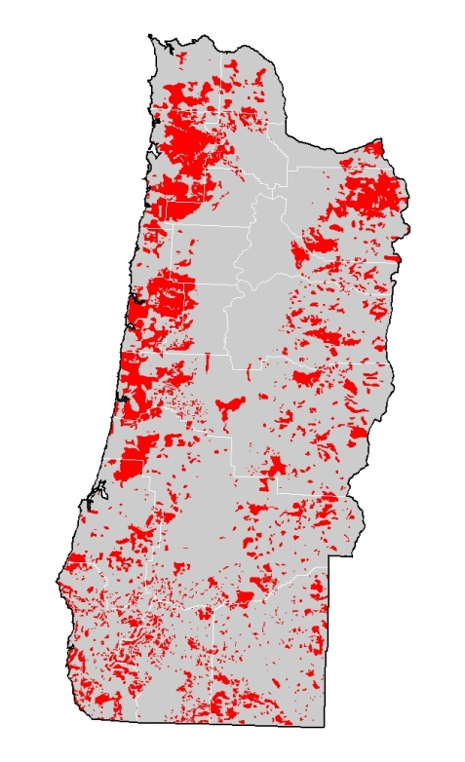
Precipitation, Topography and Mixed Severity Fires
Precipitation influences fire severity patterns
Effects of topography stronger with more limiting moisture.
Early 20th century high severity fires
Tepley et al. 2013 Ecology
Notes:
Precipitation coupled with topography influenced the frequency and distribution of high, moderate and low severity patches, especially as moisture became more limiting to the south. You can see this by the work of Tepley and colleagues. He found strong links between precipitation and fire effects. The lower the precip the > the % of stands with 2 or more PSME cohorts. This suggests a larger proportion of area covered by moderate severity patches. Aspect and slope position become important drivers of severity types as well. More protected toe slopes and north and east aspects experienced less fire and less severe fire than southern aspect and ridge tops (Taylor and Skinner) This pattern is nicely illustrated in the turn of the century high severity fire distribution, with patches decreasing in size from north to south, but more broadly distributed.

Slide 22
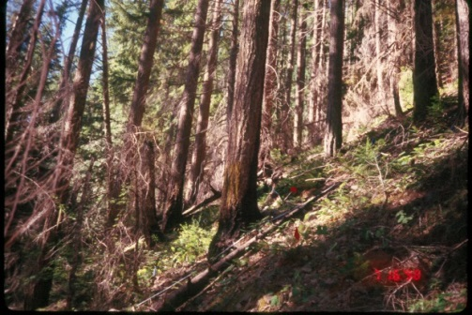
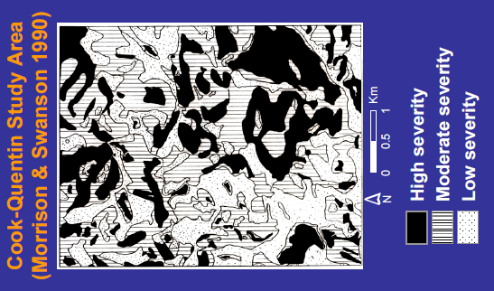
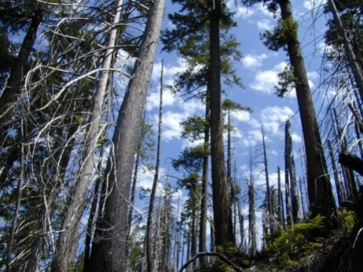
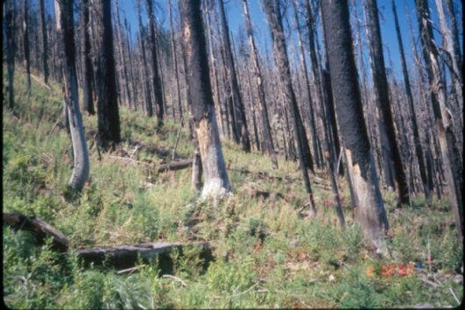
Historical Distribution of Mixed Severity patches: central west Oregon Cascades
9000 acre area
1800-1900 fires
Almost equal area occupied by each severity group
Most of high severity patches < 25 acres with 2 large patches (250 acres)
Low
Moderate
High
Notes:
< 30% Low severity
30-70 Mod
> 70% High

Slide 23
Frequent Low Severity Fire Regimes
Willamette Valley
Dry sites in south West Cascades and Klamath Mountains
Frequent low severity
Perry et al. 2011, Forest Ecology and Management
Notes:
Fire history information has helped us characterize the broad role of historical fire into fire regime groups. Westside forests fall into 3 regimes: a long fire return interval, high severity or stand replacing regime, a much more complicated variable frequency and severity regime, and a high frequency, low severity group. Regimes were responsible for different vegetation development pathways…

Slide 24
Stand Development Pathways Low Severity Fire Regime
5-25 year Fire return interval
Notes:
Repeated burning over short intervals supports open forests, with little CWD

Slide 25
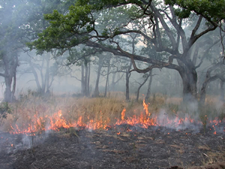
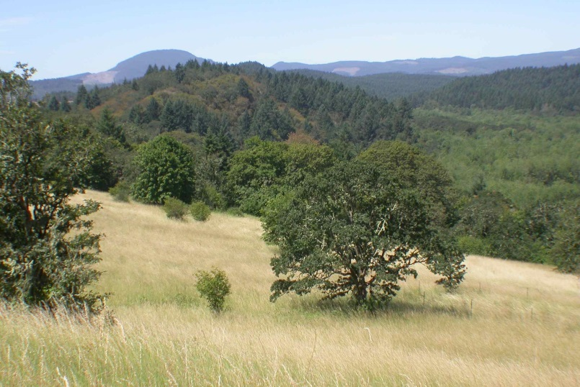
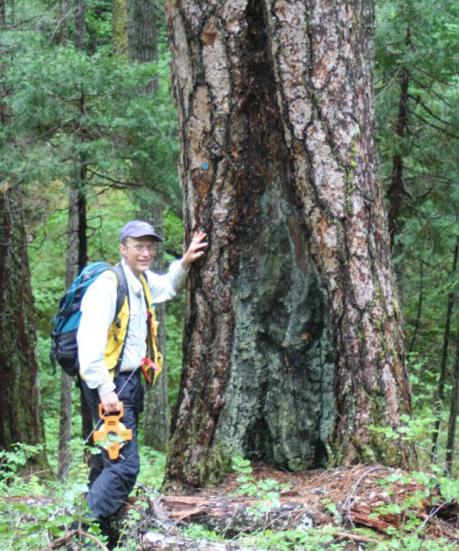
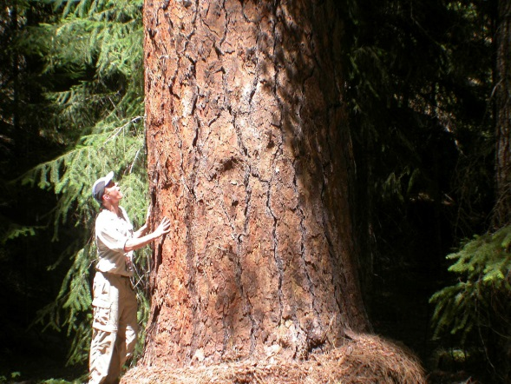
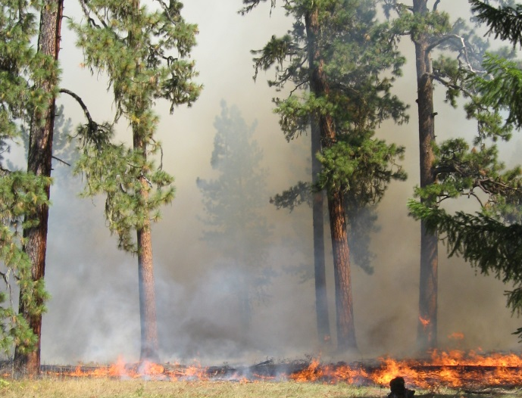
Oak forests and savannas
Mixed conifer/ Ponderosa pine

Slide 26
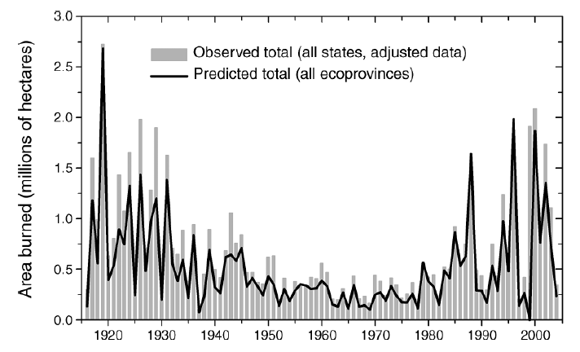

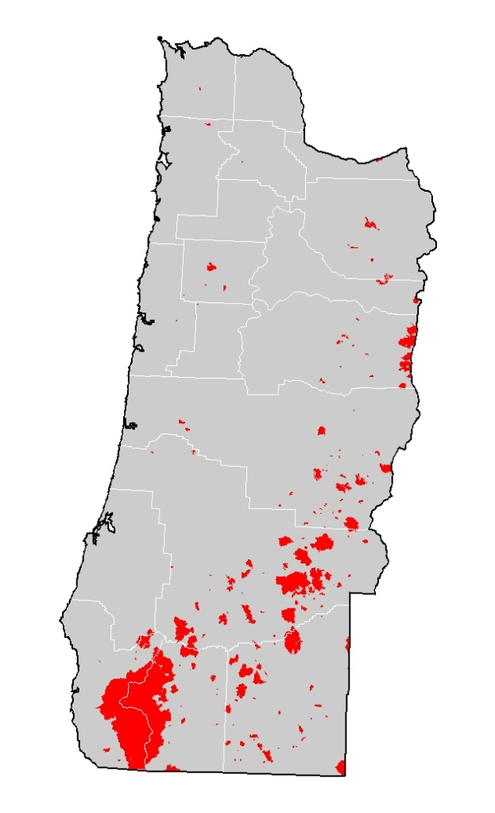
20th Century Fire Activity
1900-1946
1970-2014
Littell et al. 2009, Ecological Applications
Notes:
The Variable fire footprint in the recent past, with lots of fire until the 1930’s and a lack of fire until the 1970’ that Little and colleagues found when synthesizing data from 11 western states is mirrored in the pattern seen here for western Oregon.
Andrews, H.J.; Cowlin, R.W. 1940. Forest resources of the Douglas-fir region. Misc. Publ. 389. Washington, DC: U.S. Department of Agriculture, Forest Service, Pacific Northwest Research Station. 149 p.
Oregon State Board of Forestry. 1914. Map of the state of Oregon. Compiled by Theodore Rowland under the direction of F. A. Elliott, State Forester. Salem, Oregon, USA.

Slide 27
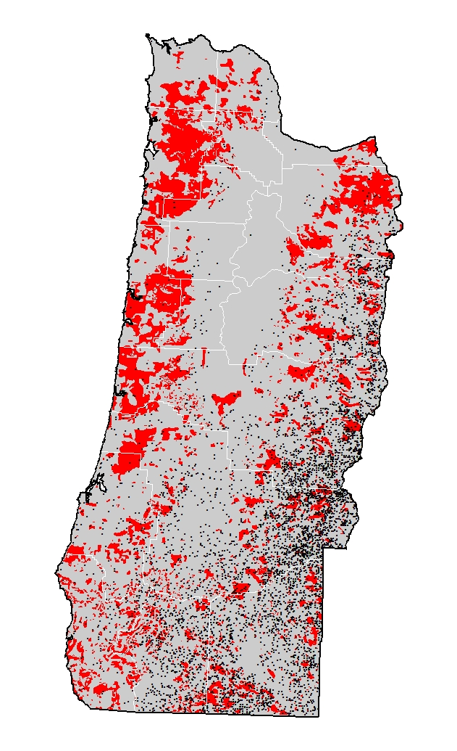
Lightning Fires 1990-2012 and early 20th Century Fires
Opportunities for mixed severity fires?
Notes:
Elliot

Slide 28
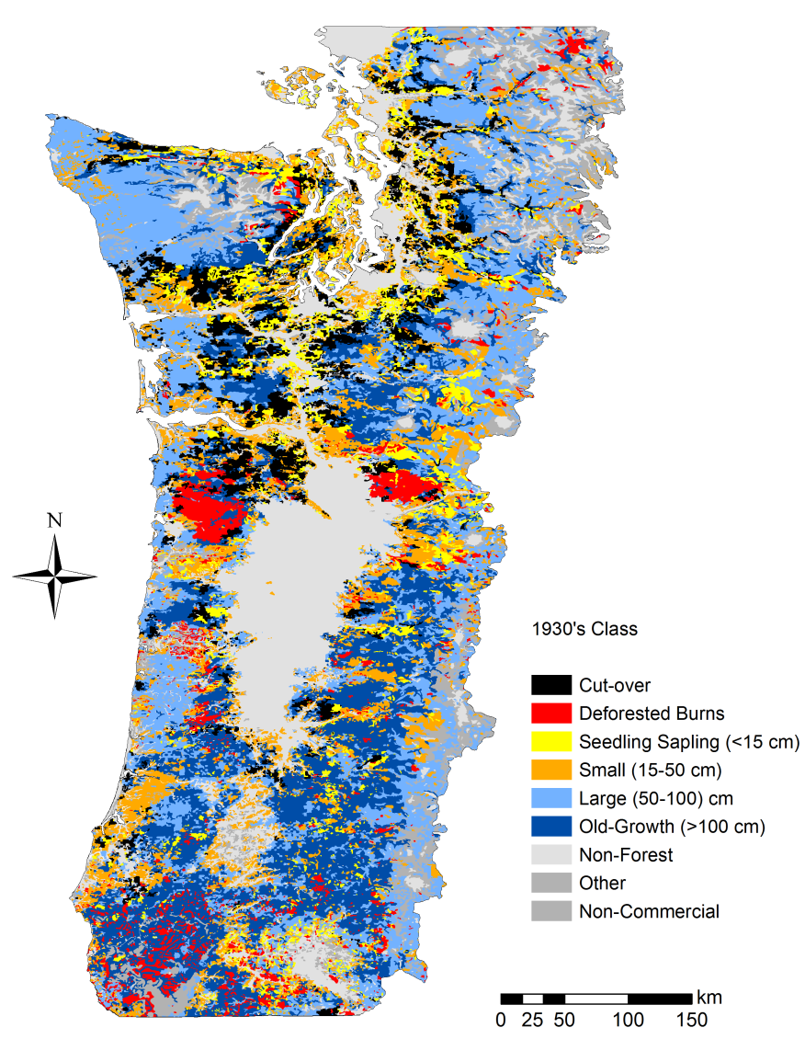
Where are we now?
Legacies of historical and wildfire and management
Describe a structure-based framework
Examine geographic distribution of different structural conditions and the role of productivity and disturbance history
compiled by C.A. Harrington

Slide 29
Age Class Distribution by Vegetation Zone

Slide 30
Age Class Distribution by Vegetation Zone
Is an age-based approach all we need?

Slide 31
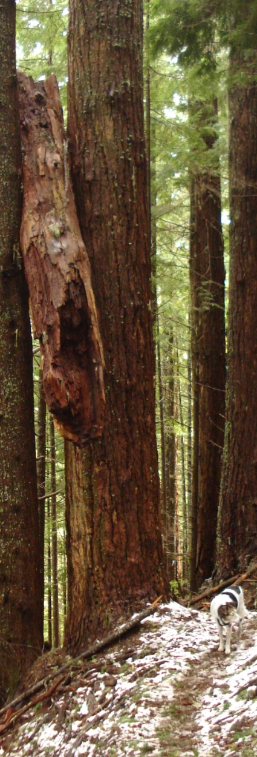
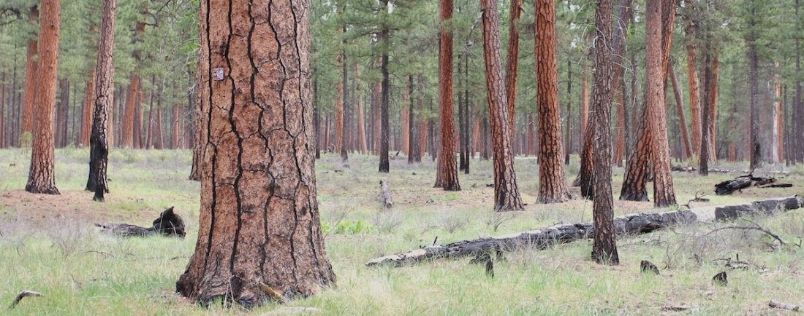
Multiple Components of Forest Structure
Traditional approaches based on biomass accumulation with age
Other dimensions of forest structure vary independently
Live tree density
Snags
Dead and downed wood
Understory vegetation
Notes:
Live trees size, biomass, density
Snags or standing dead trees
Dead wood
Understory layers
Important component of biodiversity and focus of policy

Slide 32
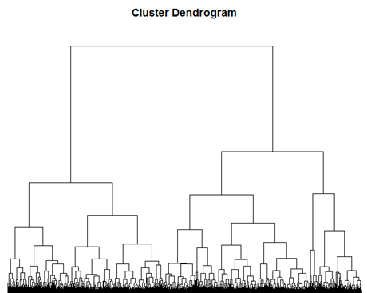
Structure-Based Framework
Hierarchical classification
Field Data from 11,091 FIA plots (2001-2010)
Structural Attributes:
1) Live trees – biomass, basal area, DDI, density, tree size
2) Snags – density and biomass
3) Dead/downed wood - biomass
4) Understory vegetation - cover

Slide 33
Approach
Hierarchical classification
Field Data from 11,091 FIA plots (2001-2010)
Structural Attributes:
1) Live trees – biomass, basal area, DDI, density, tree size
2) Snags – density and biomass
3) Dead/downed wood - biomass
4) Understory vegetation - cover
3 Groups
High Live
Biomass
Moderate Live
Biomass
Low Live
Biomass

Slide 34
Approach
Hierarchical classification
Field Data from 11,091 FIA plots (2001-2010)
Structural Attributes:
1) Live trees – biomass, basal area, DDI, density, tree size
2) Snags – density and biomass
3) Dead/downed wood - biomass
4) Understory vegetation - cover
11 Classes

Slide 35
Approach
Hierarchical classification
Field Data from 11,091 FIA plots (2001-2010)
Structural Attributes:
1) Live trees – biomass, basal area, DDI, density, tree size
2) Snags – density and biomass
3) Dead/downed wood - biomass
4) Understory vegetation - cover
25 Types

Slide 36








Regional Structural Classification
11 - Extremely High Live Biomass w/ Giant Trees
1.1 - Extremely Low Live Biomass Density w/ Snags
3 Groups
11 Classes
25 Types
3 - Low Live Biomass & High Density w/ Small Trees
9 - High Live Biomass & Very High Density
6.2 - Moderate Live Biomass & Density w/ Big Trees and Snags
4 - Moderate Live Biomass & Low Density w/ Big Trees
7 - Moderate Live Biomass & High Density
photo credit : Lea Condon
photo credit : James Johnston
Notes:
We can interpret patterns in structural conditions and start thinking about the processes that create them
Some are the result of

Slide 37
Regional Structural Classification
11 - Extremely High Live Biomass w/ Giant Trees
1.1 - Extremely Low Live Biomass Density w/ Snags
Where do stands >80 years old fall into this classification?
3 Groups
11 Classes
25 Types
3 - Low Live Biomass & High Density w/ Small Trees
9 - High Live Biomass & Very High Density
6.2 - Moderate Live Biomass & Density w/ Big Trees and Snags
4 - Moderate Live Biomass & Low Density w/ Big Trees
7 - Moderate Live Biomass & High Density
photo credit : Lea Condon
photo credit : James Johnston
Notes:
We can interpret patterns in structural conditions and start thinking about the processes that create them
Some are the result of

Slide 38
Distribution of >80 forests by structural class
Low Biomass
Moderate Biomass
High Biomass
Notes:
Tremendous diversity in biomass and density

Slide 39

Class 8: High Live Biomass & Density
Notes:
Processes growth

Slide 40

Type 8.2: High Live Biomass & Density w/ Very High Biomass of Dead and Downed Wood

Slide 41

Class 11: Extremely High Live Biomass w/ Giant Trees

Slide 42

Class 11: Extremely High Live Biomass w/ Giant Trees
High Density
Low Density

Slide 43

Class 6: Moderate Biomass & Density w/ Big Trees and Snags

Slide 44

Class 6: Moderate Biomass & Density w/ Big Trees and Snags
Low Density
High Snag Density
Ex. High Snag Density

Slide 45









Structural Class vs. Age
Class 4: Moderate Biomass w/ Low Density and Big Trees
Class 9: High Biomass & Very Density w/ Big Trees
120
100
80
Class 6: Moderate Biomass w/ Low Density and Big Trees & High Snag Density
Class 10: Very High Biomass & High Density w/ Large Trees
120
Class 11: Ex. High Biomass w/ Giant Trees
Class 8: High Biomass & Density w/ Big Trees
100
80
Low
Biomass
Moderate Biomass
High
Biomass

Slide 46

Interpreting Developmental Stages
Early: open canopies with small trees
Mid: closed canopies with medium trees
Mature: presence of big trees (>50 cm)
Late: >20 big trees
Old-growth: based on comparisons with published studies of current or historic structure
Notes:
Structure alone doesn’t give us enough to go on
We still need some concept of time, but
Not all structures mean the sam e

Slide 47
Review
Stands >80 years comprise about half the forested area in western Oregon and Washington
Most stands >80 have high biomass, but there’s tremendous diversity in the structure
Age may be indicative of structure in some vegetation zones but not in others
Legacies of past disturbance and productivity are strong

Slide 48

Where are we going?
Increased background mortality rates (van Mantgem et al. 2009)
Effects of disease, insects, and wildfire?
What are the cumulative effects of mortality and growth abundance on forests >80 years?
van Mantgem et al. 2009

Slide 49


Field Data
Current Vegetation Survey on USFS lands in Oregon and Washington
sampled from 1992-1997 and 1997 -2007
1,700 1 ha plots with no evidence if management during interval
~160,000 tagged trees >7.2 cm
4-10 yr intervals (average 7.5 yr)
Calculation of plot mortality rate (m)
m=1-[1-(N₀-N₁/N₀)]^{1/t}
Plot narratives on present conditions and past disturbance (PCPD) to document presence of disturbance agents

Slide 50
“Background” mortality on USFS lands mid-1990’s to mid-2000s
Western Hemlock
Douglas-fir – Grand Fir/White Fir
Early
Mid
Mature
Late/
Old-Growth
Notes:
Include effects of competition, pathogens, insects

Slide 51
Disturbance and Mortality in Stands >80 yrs
Notes:
Over 50% are >1%/yr
Most are associated with pathogens with some insects
Fire affected a small proportion of the plots (<2.5%)

Slide 52
Disturbance and Mortality in Stands >80 yrs
Notes:
Over 50% are >1%/yr
Most are associated with pathogens with insects playing a greater role
Fire affected a greater proportion of the plots (~10%)
~3% stand replacing, but most fire low and moderate severity

Slide 53



Framework for Assessing Structural Change
How do trajectories of structural change differ at different levels of mortality?
Expanding on an existing framework following Coomes et al. (2007)
Notes:
Is there any reason to think that similar levels of mortality will have similar effects on stand structure?

Slide 54



Trajectories of Structural Development
tree/ha (TPH)
mean tree size (QMD)

Slide 55


Trajectories of Structural Development
“Infilling”
+TPH -QMD
t₂
Densification, understory re-initiation, loss of big trees
t₁
tree/ha (TPH)
mean tree size (QMD)

Slide 56
Trajectories of Structural Development
“Infilling”
+TPH -QMD
“Aggrading”
+TPH +QMD
t₂
t₂
Infilling, understory re-initiation, loss of big trees
t₁
t₁
Growth and recruitment
tree/ha (TPH)
mean tree size (QMD)

Slide 57
Trajectories of Structural Development
“Infilling”
+TPH -QMD
“Aggrading”
+TPH +QMD
t₂
t₂
Infilling, understory re-initiation, loss of big trees
t₁
t₁
Growth and recruitment
tree/ha (TPH)
“Die-back”
-TPH -QMD
t₁
t₂
“Top down” mortality, stand initiation, release of advanced regeneration
mean tree size (QMD)

Slide 58
Trajectories of Structural Development
“Infilling”
+TPH -QMD
“Aggrading”
+TPH +QMD
t₂
t₂
Infilling, understory re-initiation, loss of big trees
t₁
t₁
Growth and recruitment
tree/ha (TPH)
“Die-back”
-TPH -QMD
t₁
t₁
“Self-thinning”
-TPH +QMD
t₂
t₂
“Top down” mortality, stand initiation, release of advanced regeneration
“Bottom up” mortality, asymmetric competition, low severity fire
mean tree size (QMD)

Slide 59

Western Hemlock
“Densifying”
+TPH -QMD
“Aggrading”
+TPH +QMD
t₂
t₂
16%
8%
Infilling, understory re-initiation, loss of big trees
t₁
t₁
Growth and recruitment
tree/ha (TPH)
“Die-back”
-TPH -QMD
t₁
t₁
“Self-thinning”
-TPH +QMD
2%
74%
t₂
t₂
“Top down” mortality, stand initiation, release of advanced regeneration
“Bottom up” mortality, asymmetric competition, low severity fire
mean tree size (QMD)

Slide 60

Douglas-fir - White Fir/Grand Fir
“Densifying”
+TPH -QMD
“Aggrading”
+TPH +QMD
t₂
t₂
23%
9%
Infilling, understory re-initiation, loss of big trees
t₁
t₁
Growth and recruitment
tree/ha (TPH)
“Die-back”
-TPH -QMD
t₁
t₁
“Self-thinning”
-TPH +QMD
6%
62%
t₂
t₂
“Top down” mortality, stand initiation, release of advanced regeneration
“Bottom up” mortality, asymmetric competition, low severity fire
mean tree size (QMD)

Slide 61

Trajectories of Structural Change

Slide 62
Trajectories of Structural Change

Slide 63
Review
Relatively high levels of mortality compared to published rates
Effects of fire are tremendously variable around the region
Region-wide thinning episode?
Future change will vary depending on the relative importance of background mortality and disturbance driven mortality

Slide 64
Acknowledgements
Funding from Northwest Forest Plan monitoring under a special agreement w/ USDA Forest Service Region 6 with Ray Davis
Landscape Ecology Modeling, Mapping, and Analysis (LEMMA) Team - Janet Ohmann, Matt Gregory, Heather Roberts
Tom Spies, Alan Tepley, Andy Gray, Catherine Ronnenberg

