Slide 1


What Makes Forest Management a ‘Social’ Issue?
Stanley Asah
University of Washington
Dale Blahna
USFS, PNW Research Station
June 3, 2015

Slide 2
Our Assigned Topics
What makes forest management a ‘social’ issue?
    What DOESN’T make forest management a social issue?
    “Forestry is a social science “ (Jerry Franklin)
How do we assess what the public wants?
    Agency initiatives (Blahna)
    Academic perspective (Asah)

Slide 3
Agency Perspective
Social Issue?
Increasing demands, decreasing capacity
All lands/all hands
Ecosystem services
Ecosystem management
Assess what public wants?
Context dependent
Public engagement and social assessment
Linking people to the land

Slide 4
Increasing Demand—Decreasing Capacity
Recreation’s value increasing
  161 million visitors/year
  Over half of USFS GDP contribution
  Sustainable Recreation Framework
  Connecting urban America & kids
Decreasing capacity
  Use patterns are changing
  ~2-3% of R&D budget on ANY social science (Cleaves, 2007)
  10% decline in budget last 10 years
  Volunteerism, partnerships new reality

Slide 5
A Broad Spectrum of Human Uses/Demands
Human Uses
Recreation
Subsistence
Stewardship
Culture & Heritage
Learning & Discovery
Healing & Therapy
Outdoor Work
Social & Family Ties

Slide 6
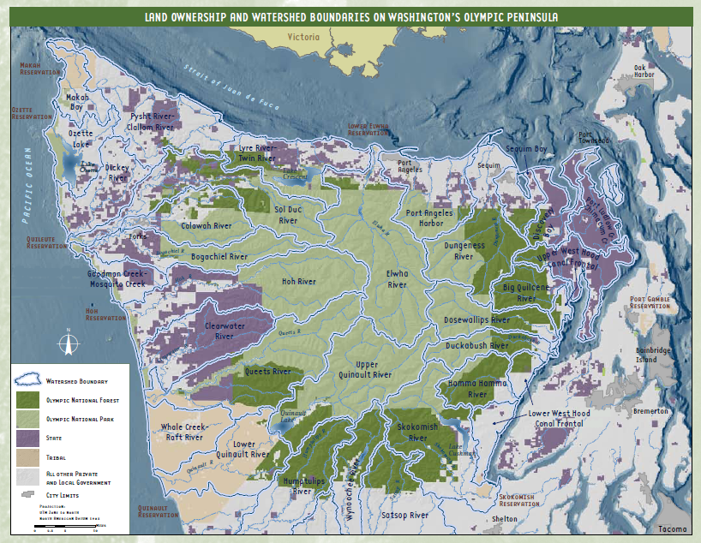
Olympic Peninsula
All Lands Approach
Pop. 234,772 (2010)
1.7 million hectares
Dispersed, rural communities
Changing economy and land use
Special Designation
  UN International Biosphere Reserve
  World Heritage Site
Multiple jurisdictions
  Olympic National Park
  Olympic National Forest
  8 recognized tribes
  State forests
  Private landowners (timber companies)
Rain shadow
Notes:
The Olympic Peninsula is an ideal place to start this project. This map is hard to read, perhaps, but you can see the array of land management agencies represented here. Light green is Park Service. Dark green is the USFS – which makes a doughnut around the park. Purple represents DNR lands and beige shows the tribal lands. There are 8 tribes on the Peninsula. In between the patchwork of purple and dark green are large private land-owners, timber companies mostly, which are especially prominent players on the westside.

Slide 7
Ecosystem Services
Milenium Assessment (2005)
“Any benefit that people obtain from nature”

Slide 8
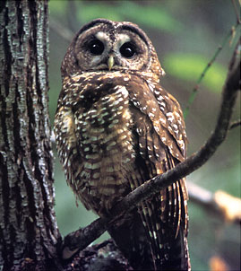
Ecosystem Services and the Forest Service
Embraced ecosystem services
    161 million visitors 2012
      $11B in spending
      194,000 jobs
    20% of nation’s freshwater
Key role in planning rule
    ES mentioned 7 times
    MA categorization
Emphasis on human well-being
    Multiple use mandate
    Common metric for decisions
    Internalize externalities
    Political, social support
    Funding (revenue replacement)

Slide 9
Ecosystem Management Criteria
Decisions can integrate (Keough & Blahna 2007)
Merge science and collaboration
Management implications often counter-intuitive
Little research
    How meet criteria?
    Measure success?
Ecologically sustainable
Economically
feasible
Socially acceptable

Slide 10
EM Criteria are Morphing
Ecologically sustainable
Economically
feasible
Socially acceptable
Environment
Economy
Society

Slide 11
New Ecosystem Management “Model”?
Source: 2010 RPA Assessment (USFS 2012)
Environment
Economy
Society
Environment
Society
Economy

Slide 12
Problems with new EM ‘model’
Environment focus
Describes descriptive reality . . .
    Inventory limitless–‘analysis paralysis’ (no ‘stopping rule’)
    Provides analyst no guidance
Not decision-making or ‘management’ reality
    Deemphasizes goals, purpose of NR/E?
    Criteria for success or failure?
Training of students & managers (everything?)

Slide 13
Management Drivers and ‘Fixes’ are all Human
Ecosystem degradation ‘footprint’
(Source: 2010 RPA)
    Population
    Urbanization
    Land use change
    Climate change
Stewardship ‘footprint’
    Agencies
    Environmental groups
    NGOs
    Restoration
    Ecosystem Services
    Natural resource management
Political/conflict ‘footprint’?
Environment
Society
Economy

Slide 14
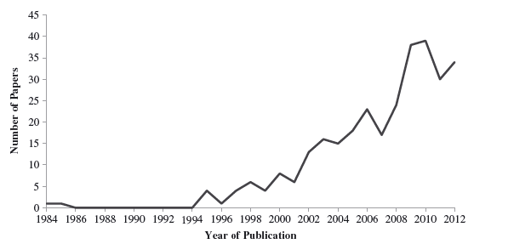
Evaluating Restoration Success
(Wortley et al. 2013)
Large increase in studies since 1994
Few include socioeconomic factors

Slide 15
Assessing what Public Wants
Context dependent
    Actions? Treatments? Scales? Sites/locations? Existing uses?
    Issue framing and data collection is key
Public engagement AND social assessment
    Two distinct reasons, for a reason
    Collaboration AND systematic representation of social environment
Linking people to the land
    Management preferences and value differences?
    We are still trying to conduct BASIC INVENTORY!
    Permit analysis, Human Ecology Mapping . . .

Slide 16
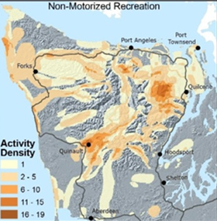
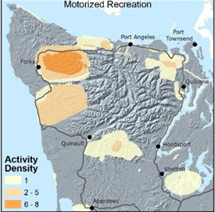
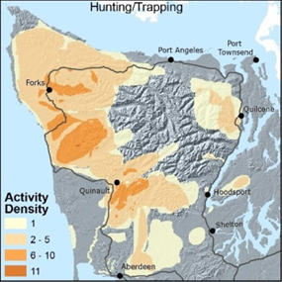
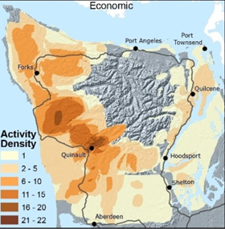
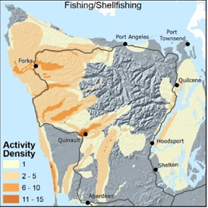
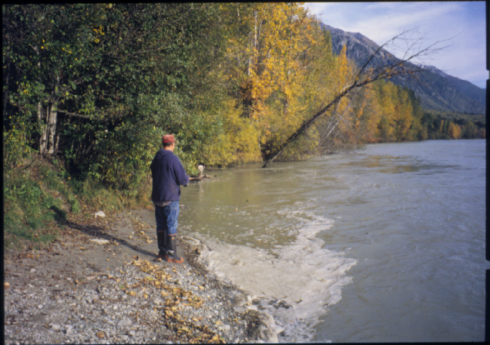
Non-motorized Recreation
Motorized Recreation
Hunting/trapping
Economic
Fishing/shell-fishing
Mapping reveals diversity in forest uses.

Slide 17
Stanley Asah, University of Washington . . .

Slide 18
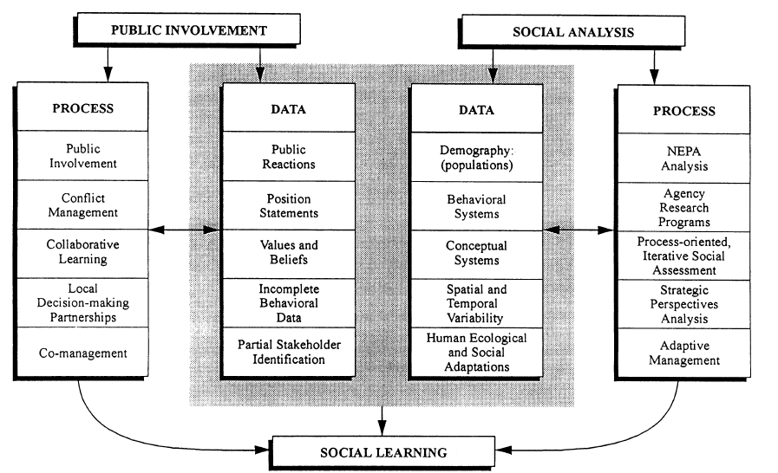
Public Engagement & Social Impact Analysis (SIA)

Slide 19
Assessing Preferences and Values
Context dependent—methods and results (like biological assessment)
    Management practices
    Place/ecosystem
    Existing uses, demands
    Scale
    Treatment options, etc.
Issue framing is key
Collaborative AND representative

Slide 20
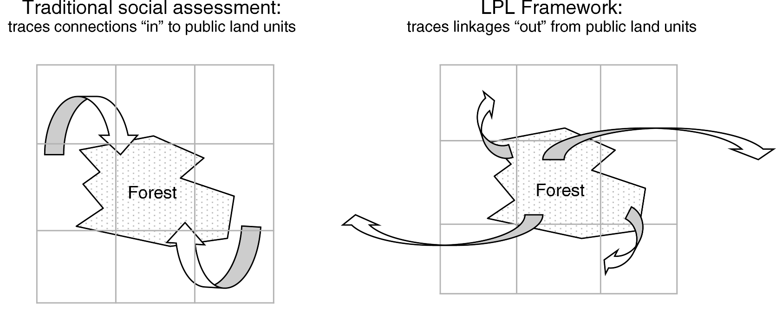
What are the Actual Public Linkages?

Slide 21
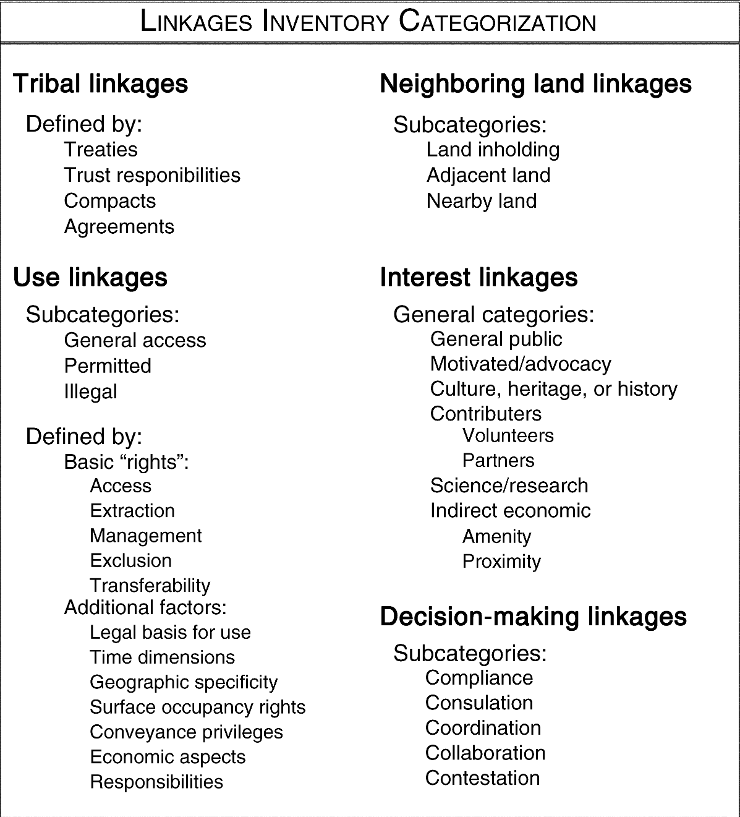
Linkages to Public Land Framework

Slide 22
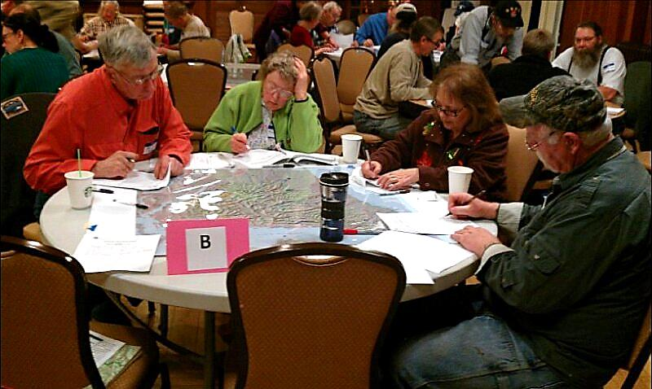
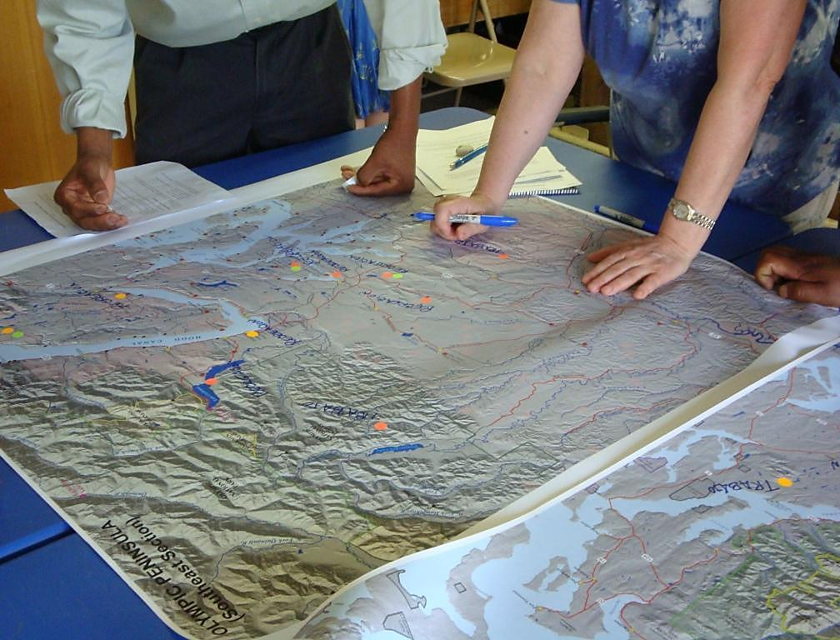
Human Ecology Mapping
Human ecology mapping gathers information about social values, human uses, and resource interactions using maps and other geo-spatial tools.
  Public meetings
  Websites/Internet
  Household survey
  Targeted stakeholders
  On-site (visitor ctr., trailhead)
  Special Events (fair, market)
Notes:
Human ecology mapping gathers information about social values, human uses, and resource interactions using maps and other geo-spatial tools.
HEM is a tool developed by social scientists and GIS specialists. HEM can be used to gather information from communities, stakeholders, tribes, landowners, public agencies, and special populations.

Slide 23
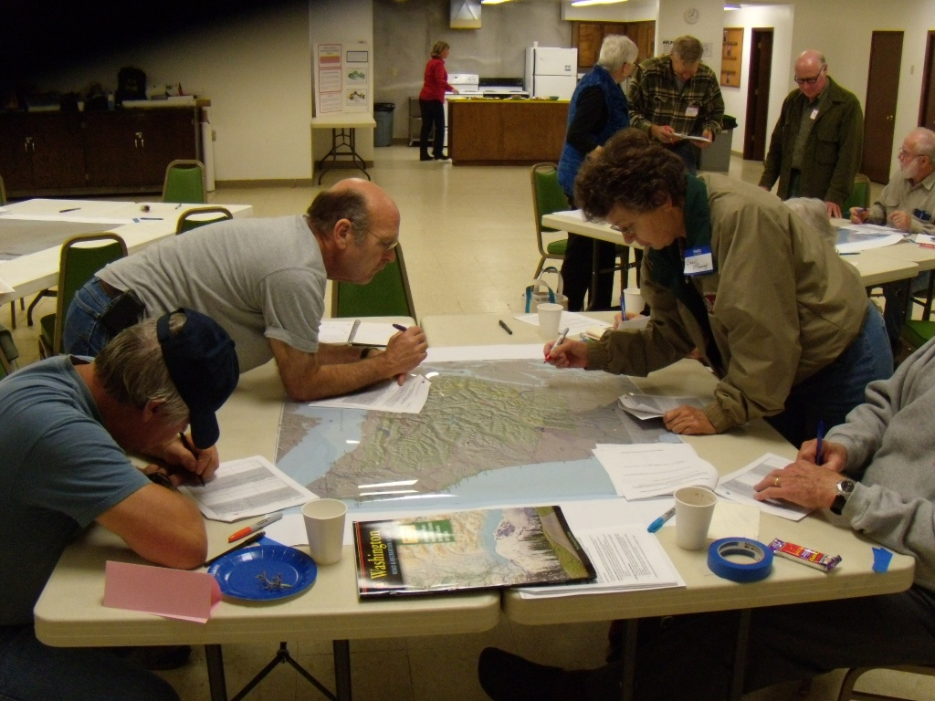
HEM: Olympic NF
Community Workshop | Number of Participants
Aberdeen | 17
Shelton | 17
Hoodsport | 17
Quilcene | 10
Port Townsend | 18
Port Angeles | 19
Forks | 32
Quinault | 39
TOTAL | 169
Exercise A. Social Values Map
“Pick 5 places important to you.”
Exercise B. Resource Interactions Map
“Pick 3 outdoor activities and tell us where you go to do them.”
Mapping Tables
4 to 6 participants per table
One 36x36” map per table
Points, lines, polygons
Worksheet – qualitative data
Notes:
For each workshop, we organized 4 to 6 people around tables with a 36 by 36” map in the middle. Maps were covered with mylar. Maps displayed general topographical features and landmarks, such as major roads, towns, and rivers, but we wanted to avoid lots of labels, such as names of campgrounds, which might bias what people choose to map.
Each participant had a workshop packet with prompts helping them along. We gave participants separate colors for marking their packets and their maps. We had reference materials available to help people find their places.
Workshops were 90 minutes and we had two major mapping exercises, which took 25 minutes each.

Slide 24
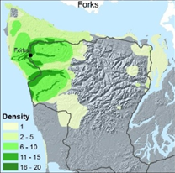
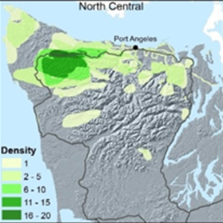
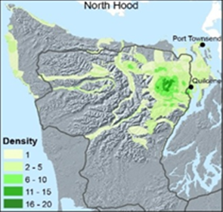
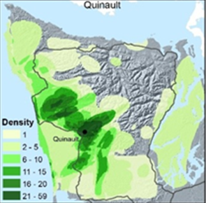
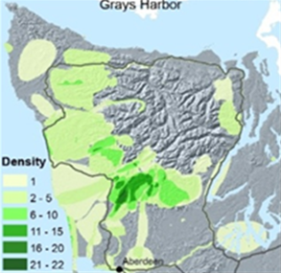
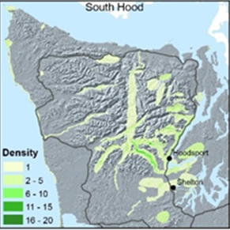
Forks
Port Angeles
North Hood Canal
Quinault
Grays Harbor
South Hood Canal
Mapping reveals information about community use.

