Slide 1
What forests are being actively managed, and what are being “deferred?” What are the consequences?
Kris Sexton, Natural Resources Staff Officer, Umpqua NF
Tim Lahey, Forest Products Program Manager, Willamette NF
June 2015

Slide 2
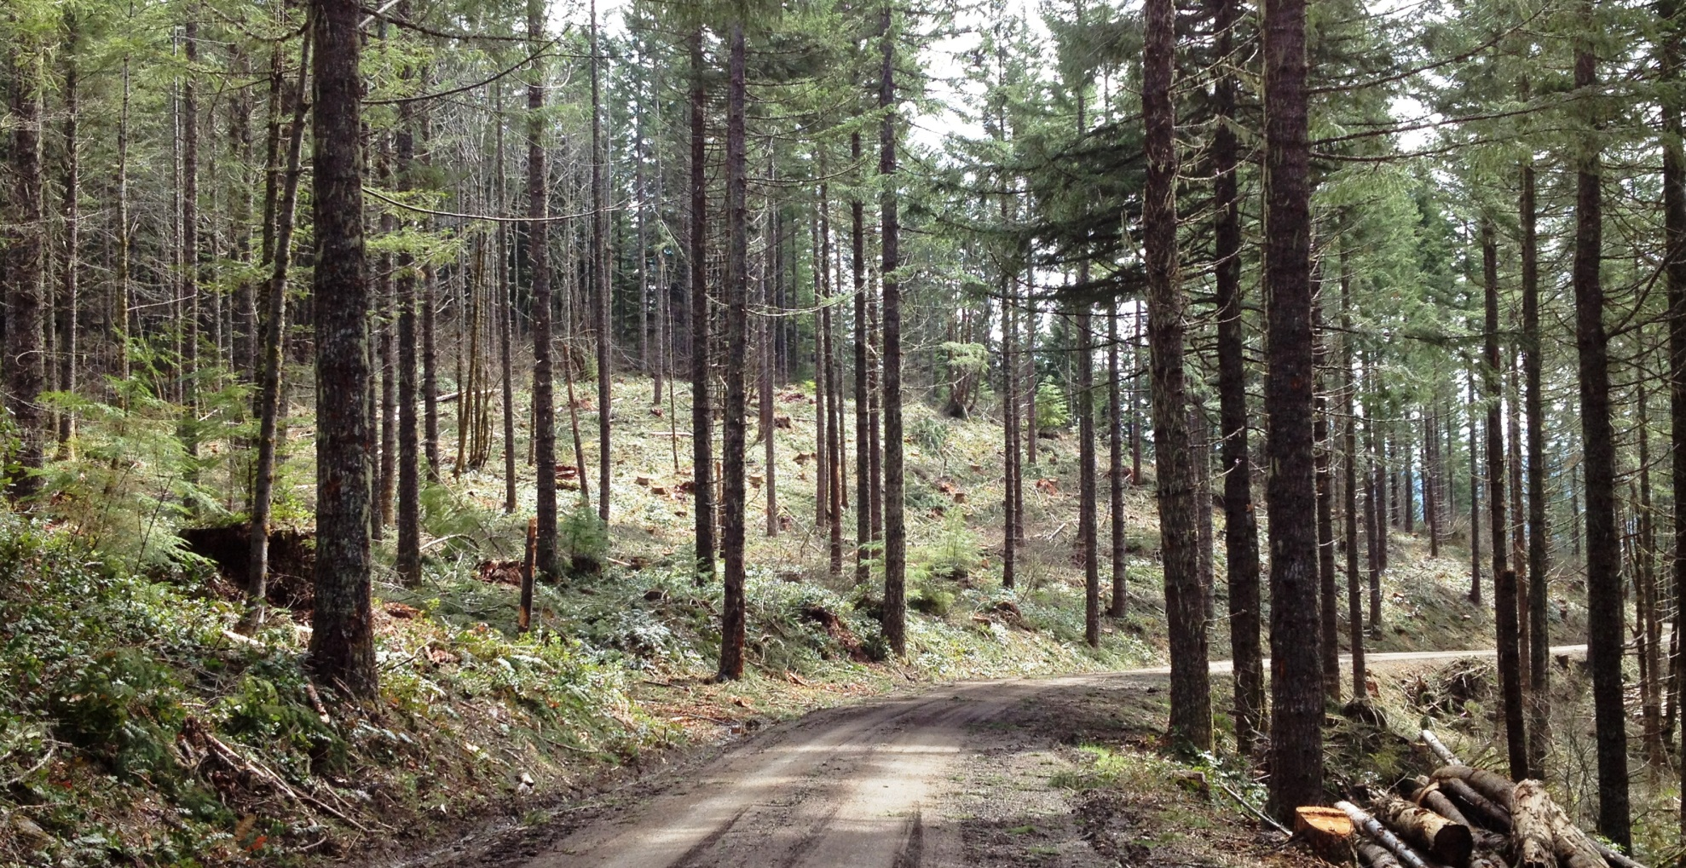
Willamette National Forest Timber Program – Past, Present and Future

Slide 3
Two Questions
Are the Willamette and Umpqua National Forest timber programs sustainable given the current management paradigm?
Answer:
No. Thank you, any questions?

Slide 4
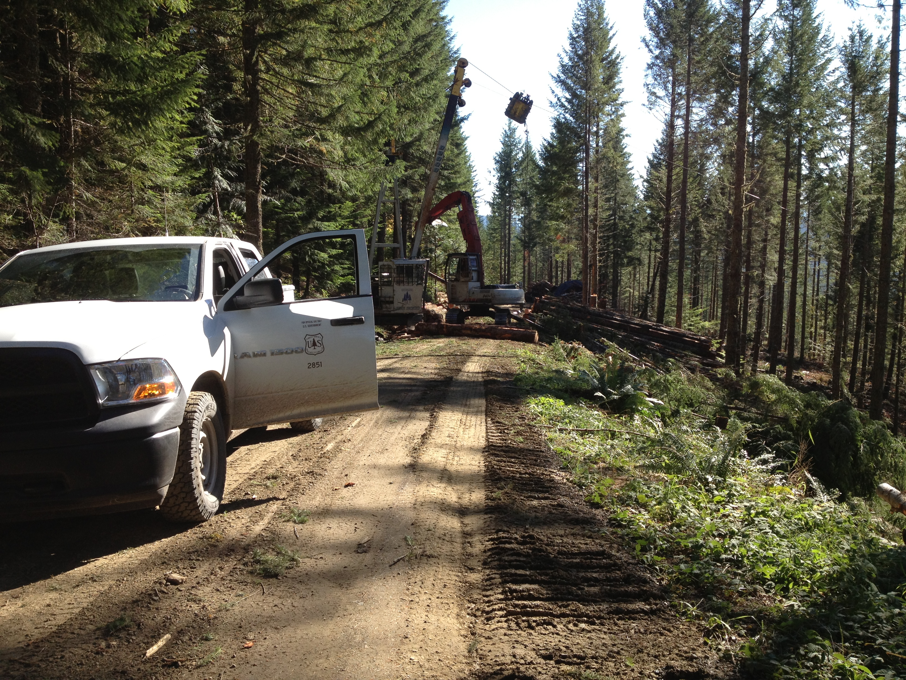
Questions, cont.
2. What are the economic consequences of continued less than 80 year old plantation thinning?

Slide 5
Willamette National Forest - Fast Facts
Forest – 1,700,000 acres
Matrix – 298,000 acres (17.5%)
Late Successional Reserves – 373,000 acres (22%)
Wilderness – 309,000 acres (18%)
Riparian Reserves – 143,000 acres (8.5%)
Adaptive Management Areas – 99,000 acres (6%)
Water, non-forest, roads - 161,000 acres (9%)
Other management designations – 320,000 acres (19%)
*all numbers are rounded

Slide 6
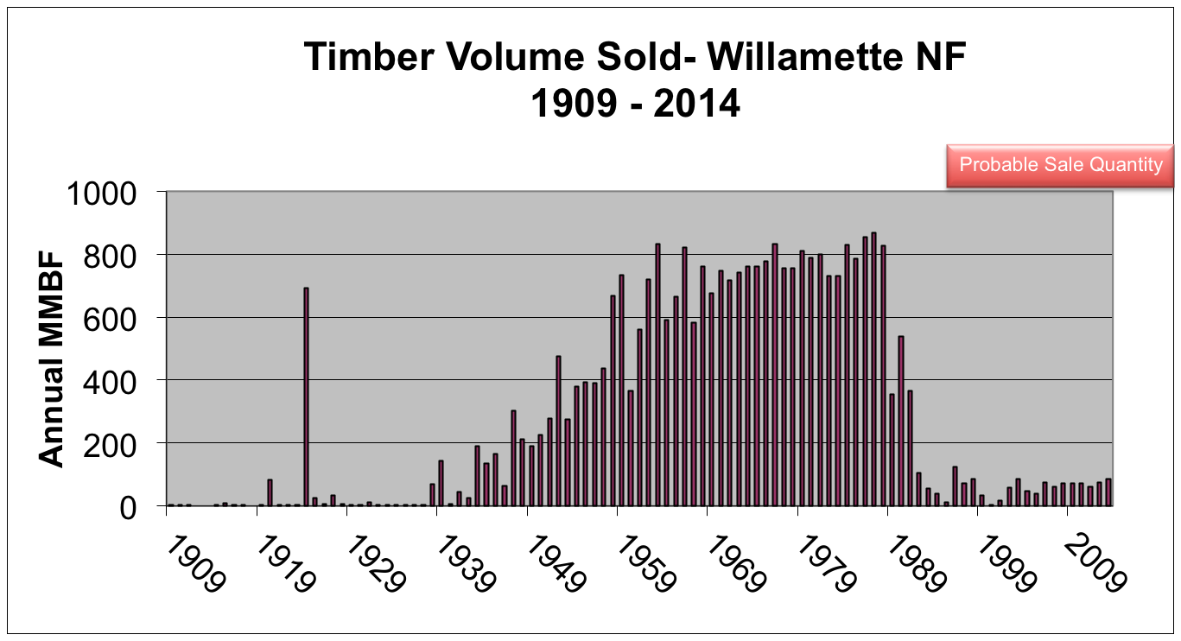
Willamette National Forest Timber Volume Sold – Where Have We Been?
116 MMBF

Slide 8
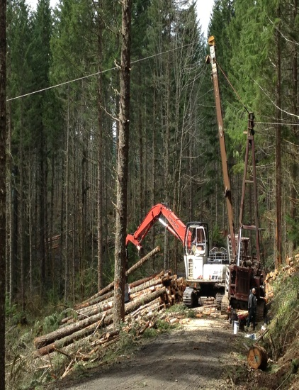
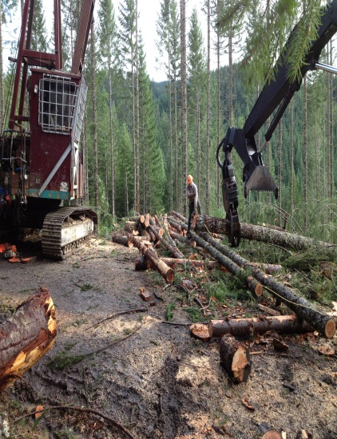
Willamette National Forest Timber Volume Sold –
Where Are We Now?
Year MMBF Sold National Ranking
2004 48.2 15th
2005 39.4 21st
2006 75.3 5th
2007 61.1 7th
2008 71.9 3rd
2009 70.8 5th
2010 72.6 5th
2011 61.5 8th
2012 74.1 3rd
2013 84.1 2nd
Average sawlog volume produced per year for ten year period – 66 Million Board Feet
Average timber revenue per year for ten year period – $5.6 Million
Average direct private forest sector jobs produced per year using a factor of 11 jobs per 1 MMBF – 726 Jobs

Slide 9
Past and Current Harvest in Acres
Past timber harvest (predominantly regeneration) ~350,000 acres or 21%
Current annual harvest (predominantly plantation thinning with small gaps) ~4,000 acres or 0.2% of Forest

Slide 10
Analysis Assumptions
Stands at 60 years old get thinned, with only one entry
Approximately 50% of previous harvest acres are unavailable for a variety of reasons
Approximately 34 CCF/acre is harvested with current thinning treatments

Slide 11
Conclusions
We can maintain our current strategy until approximately 2050
During the 2000’s and 2010’s we have been harvesting stands earlier, taking acres from subsequent years
Acreage available for harvest under this scenario is 10% of the 1.7 million acre Forest.
Some Districts on the Forest are already running out of plantations to thin to meet obligations, causing a shift in volume to other Districts

Slide 12
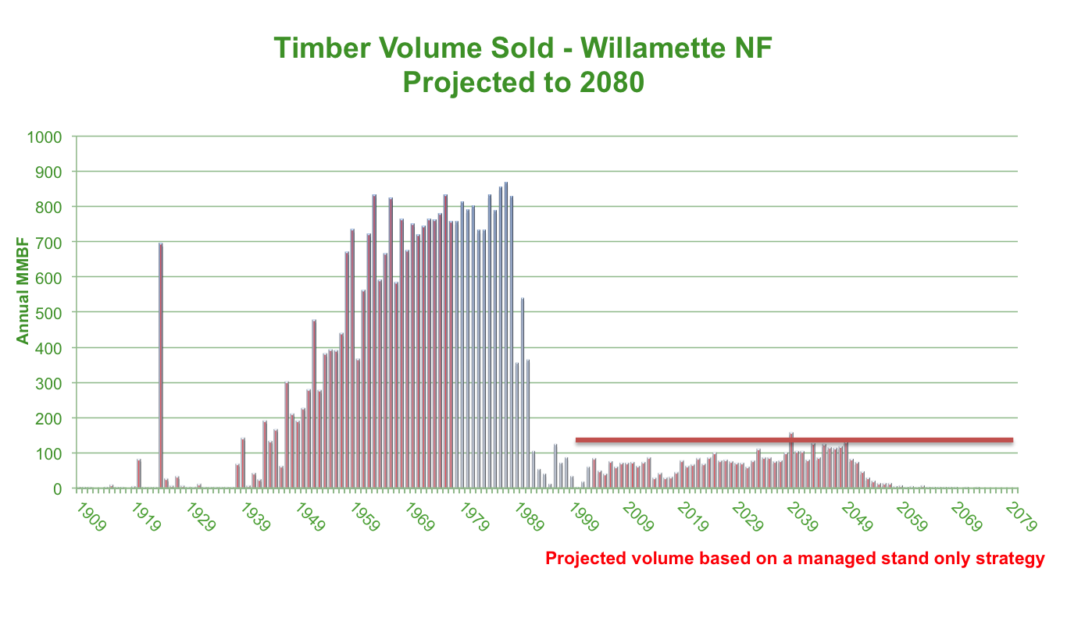

Willamette Timber Volume Sold – Where Are We Going?
116 MMBF PSQ

Slide 13
Economic Consequences
*Numbers courtesy of OFRI
Federal Forest in Oregon make up 60% of Oregon’s forests*
Federal forests account for 12% of statewide harvest*
In western Oregon, timber harvest on federal forests is 11% of annual growth*
In the central Willamette market area 5.9% of the region’s employment and 9.6% of the economic base is tied to the forest sector*
Forest Service employment in the forest management sector in Oregon accounts for 4,046 jobs and $191,293,085 in total income*

Slide 14
Economic Consequences, cont.
The Willamette National Forest currently has 250 million board feet under contract, ranging from 80 to 100 contracts at any given time.
Approximately 40% of the Willamette budget is tied directly to appropriated timber dollars or timber receipts.
After the downturn in volume sold in the early 90’s, employment on the Willamette was cut in half from over 800 employees to approximately 400.
Districts consolidated, resulting in a loss of relevance to local communities.
Forest Service employment in rural economies is often one of the highest paid sectors meaning those jobs are particularly important.

Slide 15
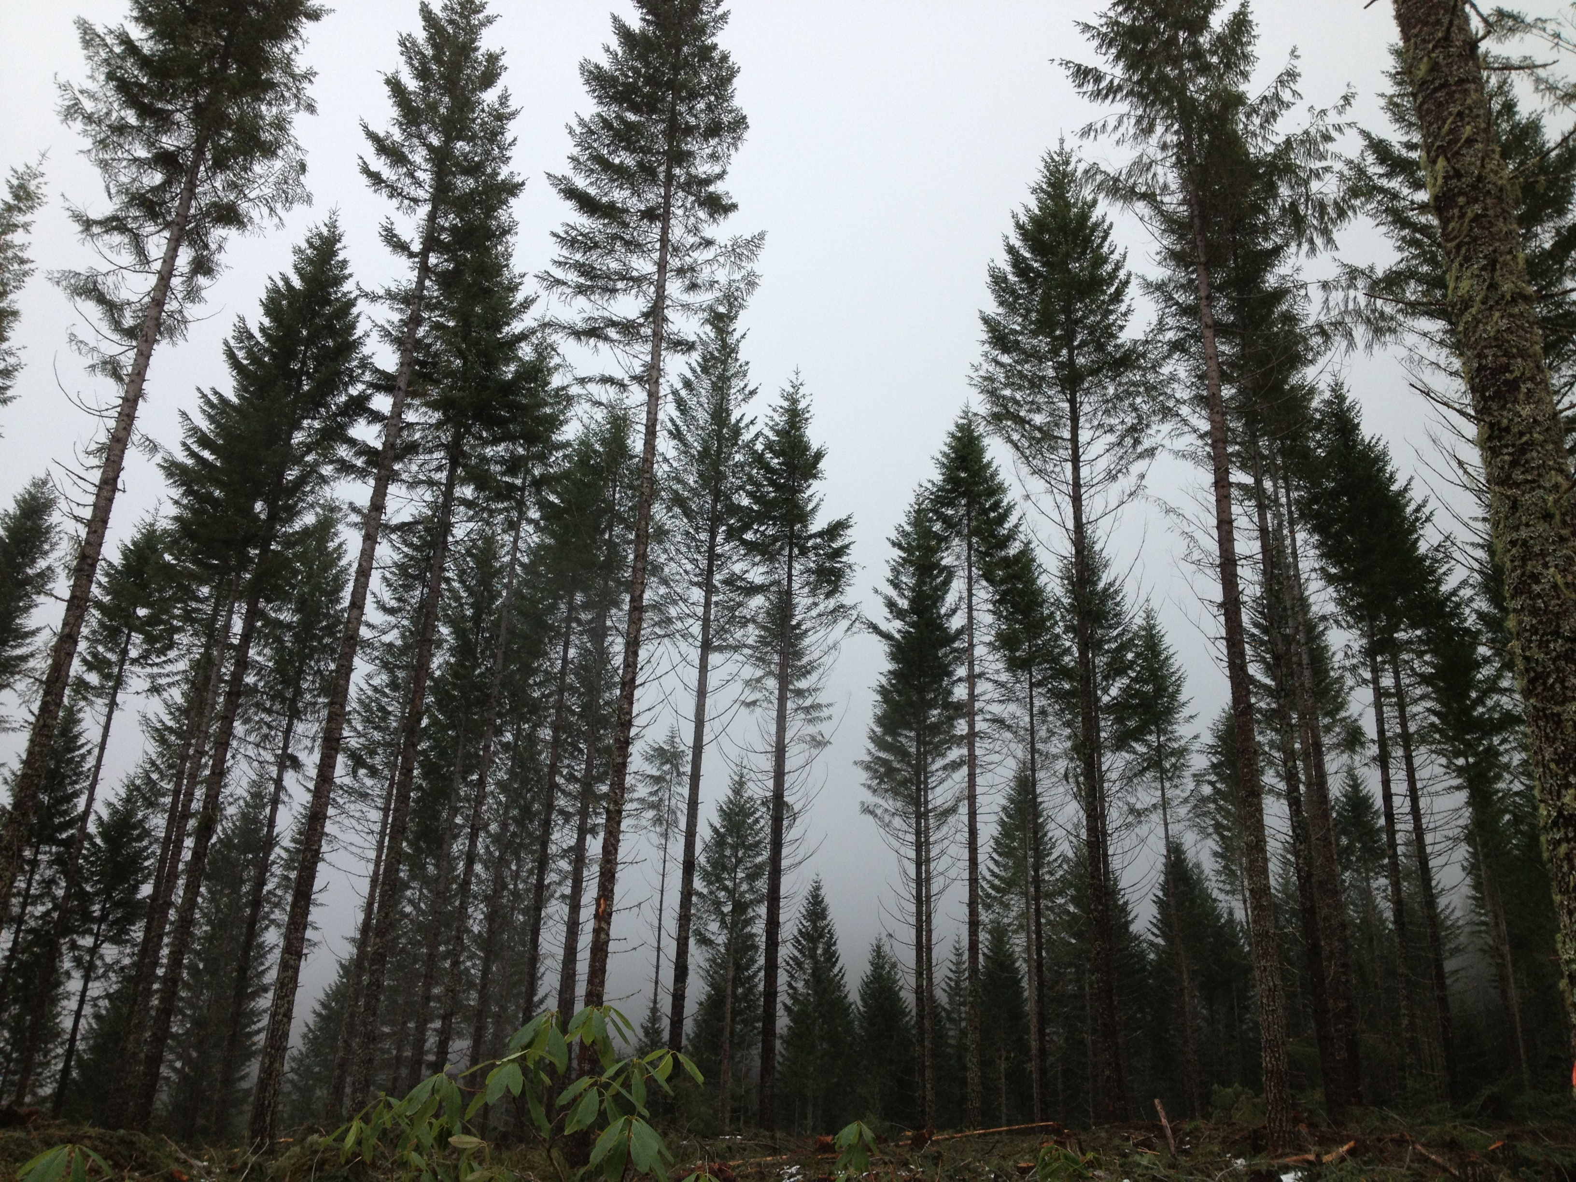
Conclusions
The NWFP has never been fully implemented on the Willamette National Forest in terms of timber output. The path we are on is not sustainable long term and provides no method to increase the pace and scale of restoration treatments.
We need to get out of the management box we have found ourselves in which means more than just plantation thinning must be on the table.

