Slide 1


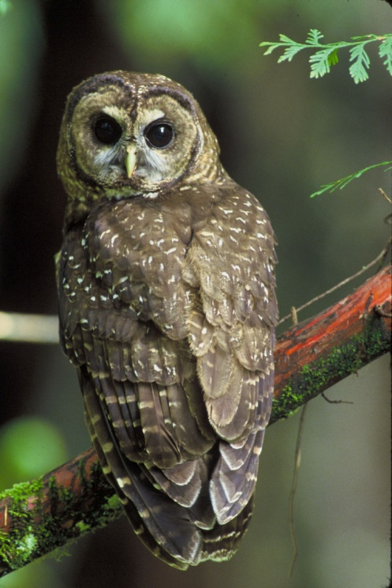
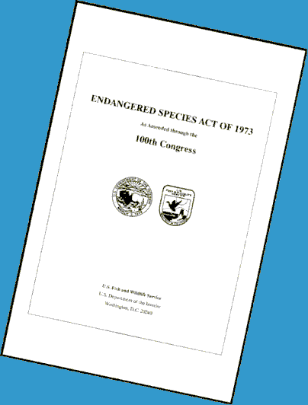
U.S. Fish and Wildlife Service
What Does it Mean When >80 Equals Spotted Owl Habitat?
Recovery Plan and Critical Habitat Designation: Stand and Landscape Considerations

Slide 2
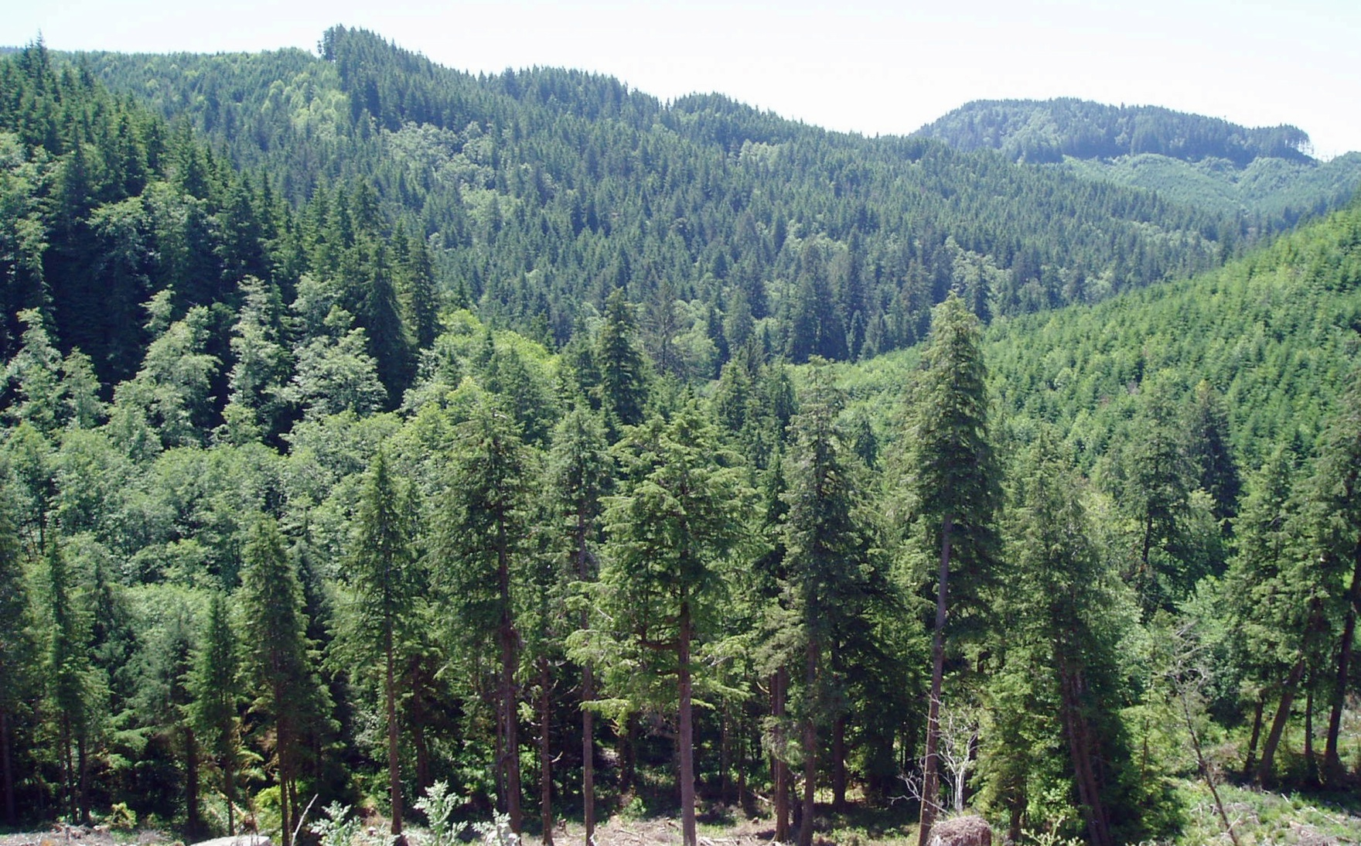
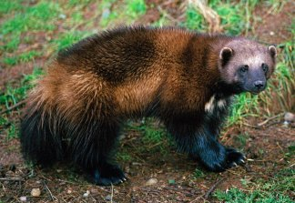
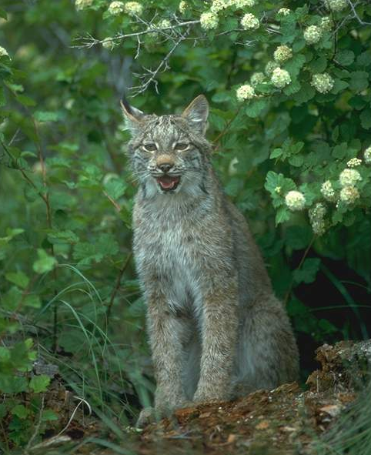
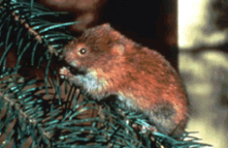
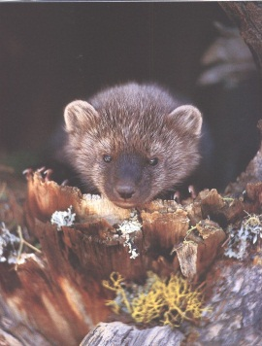
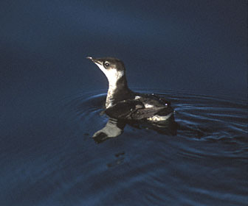
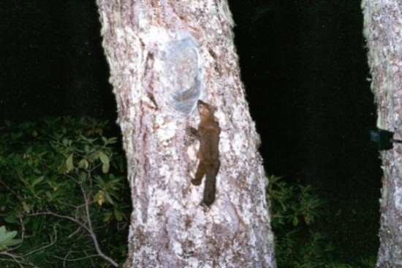
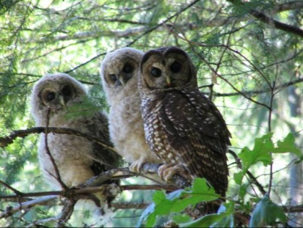
Purpose of Endangered Species Act (ESA): “Conserve the species and the ecosystems upon which they depend”

Slide 3

Northern Spotted Owl - Key Threats
1990
Widespread habitat loss across the species’ range
Inadequate regulatory mechanisms to conserve the owl/habitat
Low population sizes/declining populations
Limited habitat/declining habitat
Inadequate distribution/isolation of habitat and populations
Vulnerability to natural disturbance
Predation/competition (barred owls???)

Slide 4
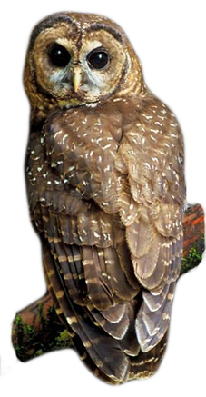
Northern Spotted Owl - Key Threats
2011
Past habitat loss
Current habitat loss
Barred owls
Disease
Climate change

Slide 5
Spotted Owl Habitat
Late Successional Forest
Large Home Ranges (> 1500 ha)
Complex Forest Structure
Central Place Forager
Forest composition varies across range
Small openings can be beneficial, particularly where there are woodrats

Slide 6

Northern Spotted Owl – Current Status: 1990-2008
Study Area | Fecundity | Survival | λ_{RJS} | Population change
CLE | Stable | Declining | 0.937 | Declining
RAI | Increasing | Declining | 0.929 | Declining
OLY | Stable | Declining | 0.957 | Declining
COA | Increasing | Declining since 1988 | 0.966 | Declining
HJA | Increasing | Declining | 0.997 | Declining
TYE | Stable | Declining since 2000 | 0.996 | Stationary
KLA | Declining | Stable | 0.990 | Stationary
CAS | Declining | Declining since 2000 | 0.982 | Stationary
NWC | Declining | Declining | 0.983 | Declining
HUP | Stable | Declining since 2004 | 0.989 | Stationaryy
GDR | Declining | Declining | 0.972 | Declining
Forsman et al. (2011).

Slide 8

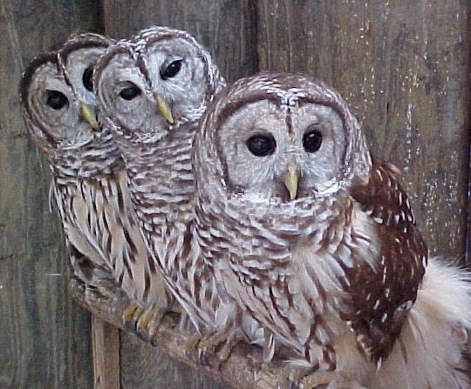
Spotted Owl – Barred Owl Interactions
Interference competition – aggressive interactions (Wiens et al. 2014)
Similar habitat preferences, but NSOs on steeper slopes, BO on more level areas w/more hardwoods (Wiens et al. 2014, Singleton 2013)
Prey Overlap (Gremel 2005, Wiens et al. 2014)
Higher survival of both NSOs and BOs in areas with more old (>120 yo) forest (Wiens et al. 2014)
Availability of old forest and associated prey species appeared to be most strongly limiting factors in competitive interactions between NSOs and BOs (Wiens et al. 2014)

Slide 9
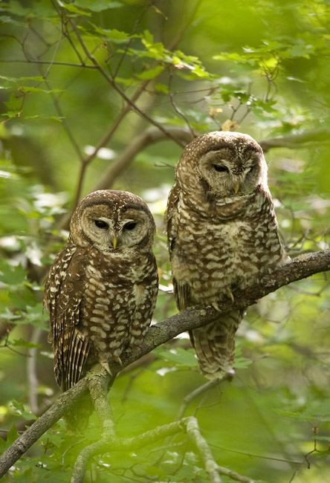
Recovery Objectives
Populations sufficiently large and distributed such that the species no longer requires listing.
Adequate habitat is available and will continue to exist to allow the species to persist without protection of the ESA.
Effects of threats have been reduced or eliminated such that populations are stable or increasing.

Slide 10
2011 Revised Recovery Plan / 2012 Critical Habitat Rule - Forest Management Goals
“to provide a means whereby the ecosystems upon which endangered and threatened species depend may be conserved.”
Consistent with the basic tenets of the Northwest Forest Plan.
Address multiple management goals in an integrated fashion.

Slide 11
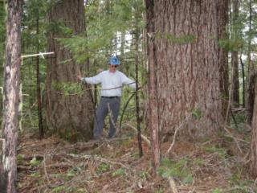

2011 Revised Recovery Plan
Recovery Action 10 – Conserve spotted owl sites and high value habitat to provide additional demographic support to the spotted owl population
Recovery Action 32 – Maintain/restore structurally-complex, multilayered conifer forest with large diameter trees, high amounts of canopy cover, downed wood, and legacy structures while allowing threats such as fire and insects to be addressed through restoration activities
Recovery Action 11 – When conducting vegetation management to restore or enhance NSO habitat, design/conduct experiments to better understand how these actions affect spotted owls

Slide 12
Critical Habitat
“..is a specific geographic area(s) that contains features essential for the conservation of a threatened or endangered species and that may require special management and protection.”

Slide 13
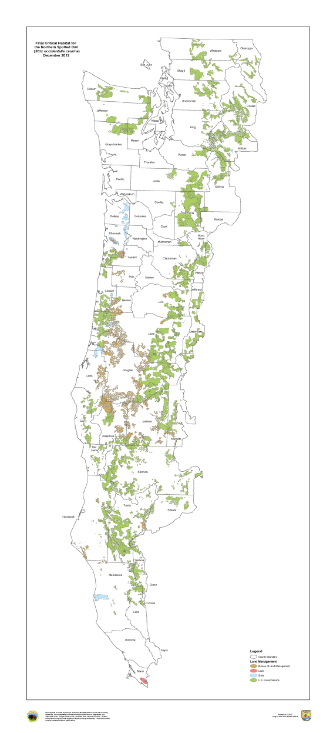
2012 Revised Critical Habitat
9.6 million acres
Sufficient habitat to support stable, healthy populations
Incorporate uncertainty – barred owls, climate change, wildfire
Recognition that barred owl threat needs to be addressed

Slide 14
Critical Habitat
Many areas of critical habitat do not need active management
Some areas not currently functioning as habitat
Encourage management actions that maintain and restore ecological function – where appropriate
Critical habitat is not a reserve
Disease/Insects/Fire
Ecological processes disrupted by human activity
Ecological processes disrupted by climate change
Actions that promote restoration at appropriate scales → consistent with spotted owl recovery

Slide 15
Critical Habitat and Forest Management
Recommendations for forest management in critical habitat:
Actions that do not turn habitat into non-habitat
Actions that maintain site occupancy/productivity
Not all critical habitat is occupied by spotted owls
Not all critical habitat >80 years is high quality NSO habitat
Critical habitat is not a reserve → Designated critical habitat does not prevent active management
Some areas need active management to maintain NSO habitat
Restoration forestry /ecological forestry

Slide 16
Special Management Considerations
Retain existing habitat and high quality habitat
Focus restoration on adapting to climate change and restoring habitats altered by past management
Emphasis on meeting NSO recovery and long-term ecosystem restoration

Slide 17
Special Management Considerations
4. Focus vegetation management outside of occupied sites and high-value habitat where consistent with overall landscape project goals
Design and implement restoration treatments at the landscape level (coordinated strategic effort)
Retain and restore key structural components and heterogeneity within and among forest stands

Slide 18
Summary
>80 years with structure that supports spotted owls = good owl habitat
Maintaining high quality older forest → essential for NSOs when barred owls are present
>80 years , but lacking conditions to support spotted owls → Restoration actions
Restoration activities also needed in <80 year old stands
Focus activities in unoccupied areas

