Slide 1
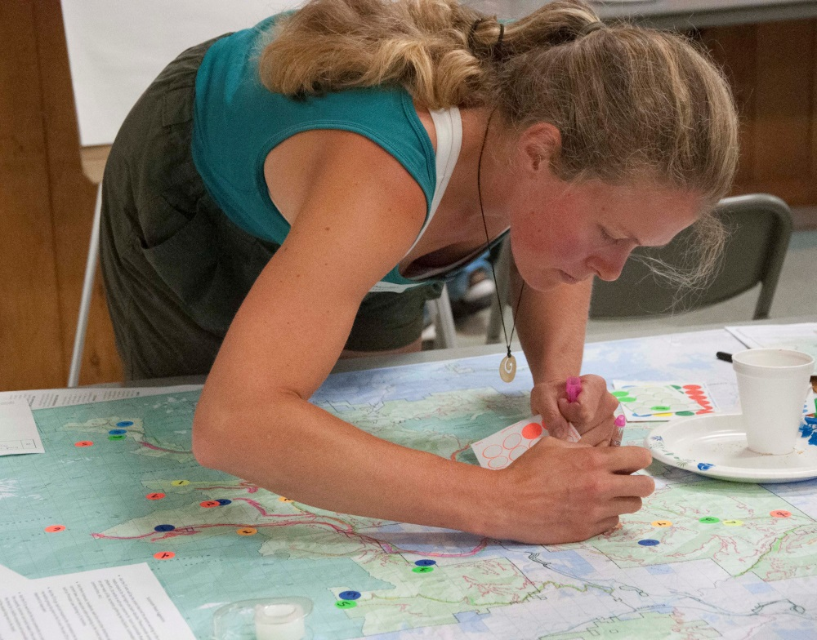
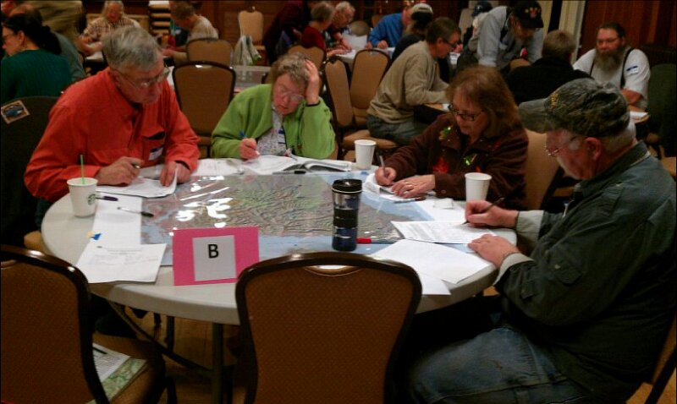



HUMAN ECOLOGY MAPPING:
A tool for incorporating social, ecological, and economic information in forest planning
Lis Grinspoon, Forest Service, R6 RO
Lee Cerveny, Forest Service, PNW
Diane Besser, PSU
June 3, 2025

Slide 2
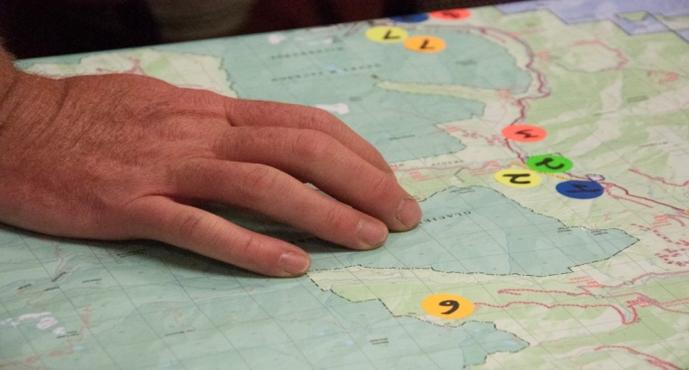
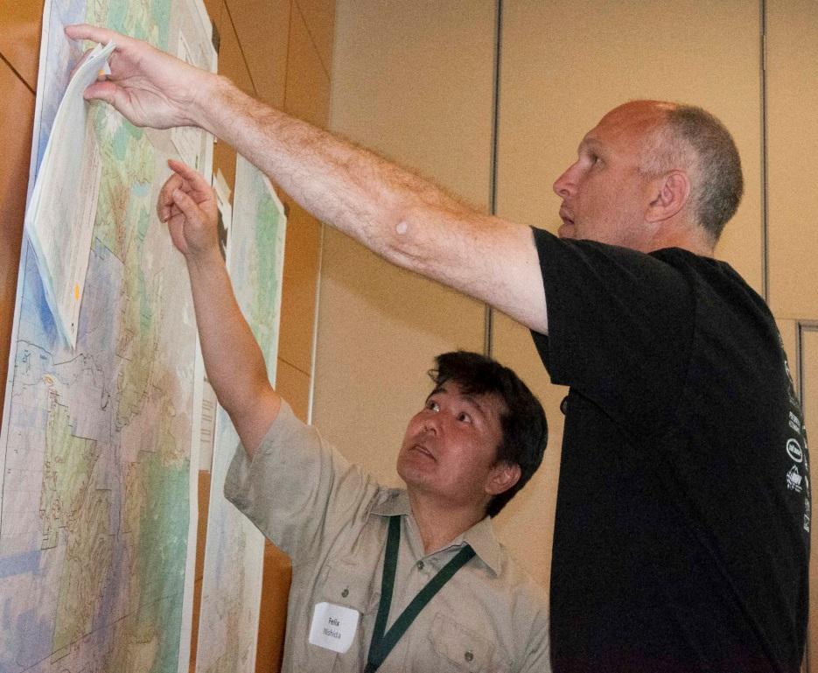
HUMAN ECOLOGY MAPPING (HEM)
HEM is a systematic public engagement approach that uses maps and other spatial tools to gather information about public values and forest uses to aid in planning using best available science.
What information can be captured on human ecology maps?
  Social and cultural values
  Ecosystems services
  Special places
  Historic and tribal land uses
  Harvest areas for fish, game, and other forest products
  Spatial identification of issues
Notes:
Human ecology mapping gathers information about social values, human uses, and resource interactions using maps and other geo-spatial tools.
HEM is a tool developed by social scientists and GIS specialists. HEM can be used to gather information from communities, stakeholders, tribes, landowners, public agencies, and special populations.
What can be mapped?
Places of social or biological value
“Hotspots” of intensive resource use
Special places & roads
Areas needing management attention
Treatment preferences
Desired forest outcomes or conditions
Values, attitudes, and beliefs about ecosystems and biodiversity
What approaches are used?
Public information sessions
Internet portals & on-line surveys
On-site (booth, district office)
Voluntary geographic info. (VGI)
Mail survey or questionnaire

Slide 3
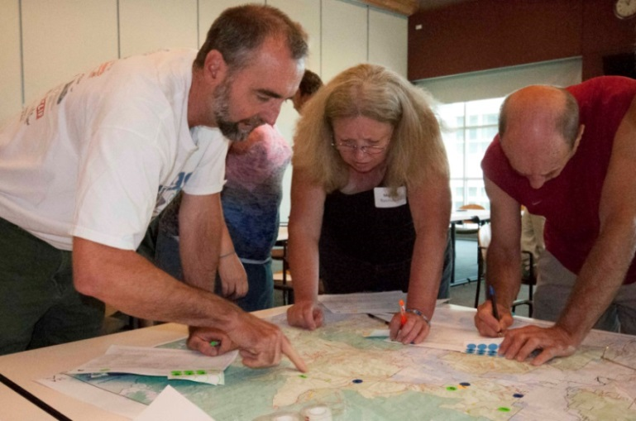
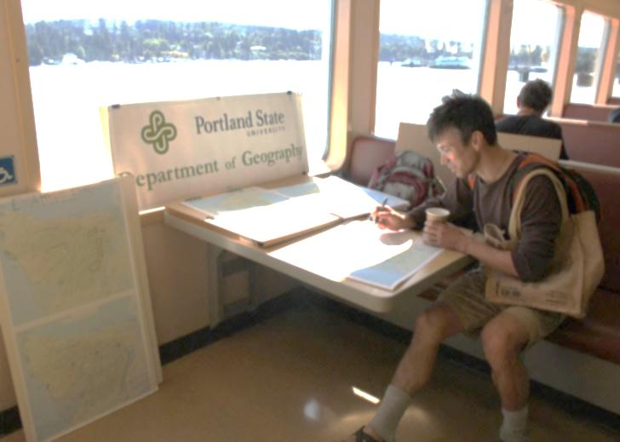
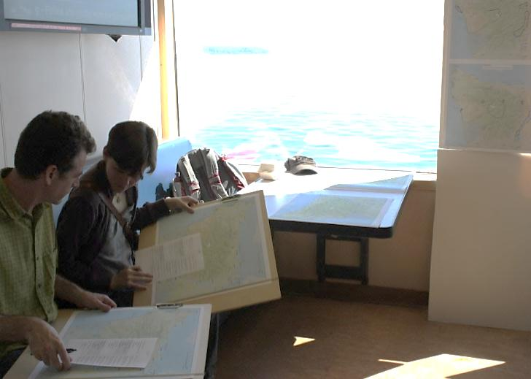
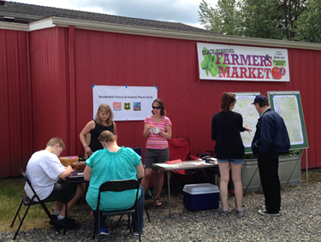
HUMAN ECOLOGY MAPPING:
A Strategy for Systematic Engagement
Multiple Approaches
  Public meetings
  Websites/on-line form
  Targeted stakeholder outreach
  On-site (trailheads, campgrounds)
  Special events (fairs, public markets)
  Stand-alone kiosk (ranger station, visitor ctr.)
Public meeting on travel management
Visitor intercept mapping on WA ferry
Farmer’s market, Seattle area
Notes:
HEM is a tool developed by social scientists and GIS specialists that can be adapted for use in landscape-scaleplanning. HEM can be used to gather information from communities, stakeholders, landowners, public agencies, and special populations.

Slide 4

HEM AS A PUBLIC ENGAGEMENT TOOL
Residents of local communities
  Youth, low-income, minority
Forest visitors (Portland, Eugene)
Forest stakeholders (COTA, BCH)
Private landowners
Tribes
County commissioners; political officials
Forest Service staff (District, SO)
Other federal & state agencies
Who can provide input?
The HEM approach selected will allow for different kinds of participation.

Slide 5
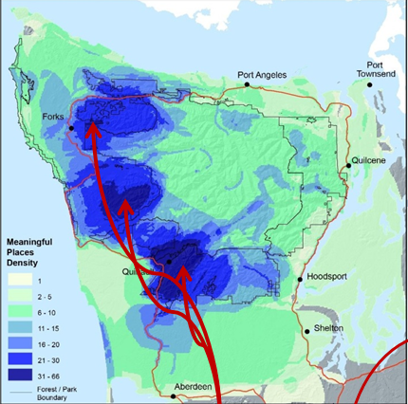
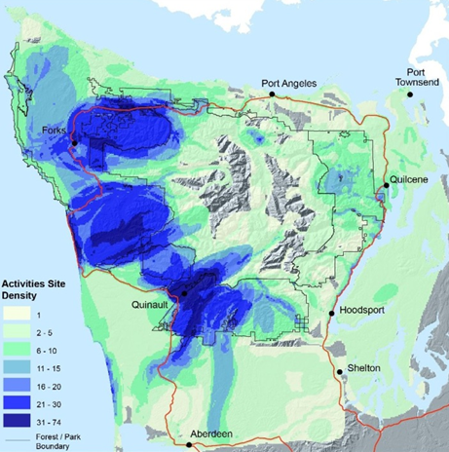
OLYMPIC HEM PROJECT:
Mapping Resident Values & Activities
Density of Social Values
Density of Resource Uses
Human ecological hot-spots

Slide 6
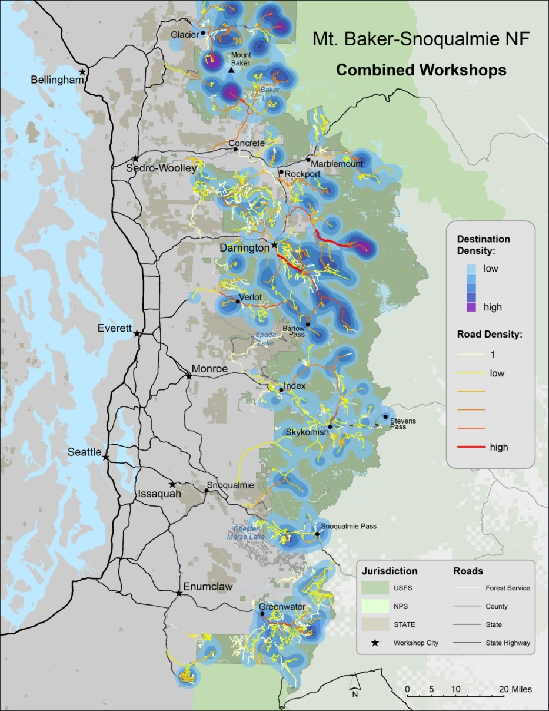
Mt. Baker-Snoqualmie National Forest
SUSTAINABLE ROADS STRATEGY
COLLABORATIVE ENGAGEMENT PROCESS
GOALS
Inform public about the Sustainable Roads Strategy
Public dialogue about what criteria should be used to decide which roads to prioritize.
Generate socio-spatial data about public uses of forest roads
Integrate with biophysical data in the strategic plan
Notes:
The Mt. Baker-Snoqualmie National Forest currently has approximately 2,500 miles of roads. We can afford to maintain about one quarter of them. 2012 we were funded to maintain 672 miles of roads. For 2013, they were funded to maintain 628 miles of roads. Of those roads, the MBS maintained 86 percent for passenger car use and 14 percent for high-clearance vehicles.

Slide 7
2012 RULE - PUBLIC PARTICIPATION
2012 RULE MINIMUM REQUIREMENTS [§ 219.4(a)(1)]
Engage the public in all stages of the planning process, including assessment, plan development and monitoring.
Engage interested parties (local, regional, national), private landowners, youth, minorities and low-income populations.
  TASK
  Develop a strategy to engage the public in meaningful and transparent ways.
Notes:
Develop a strategy to engage the public in meaningful and transparent ways that meet the FSH Directive’s objectives and principles of public participation
On the Deschutes NF, R6 Planning and Research can assist in the design of the Human Ecology Mapping (HEM) process in way similar to process used on Olympic Peninsula pilot project and MBS Roads Planning. Both of these projects used a participatory mapping workshop format that allowed for face-to-face contact between FS and local residents. Time was built into the process to allow for a dialogue between FS and participants on what people value about the forest. FS staff were able to answer questions about the forest planning process. In the MBS Roads Planning process, one of the “lessons learned” in the discussion was that participants prioritized “diversity” of use (over the expected “density” of use) when discussing how to make decisions about which roads to maintain.
Learning these types of lessons in the pre-assessment phase of the Deschutes Forest Plan Revision will enable use to better design the assessment phase and focus on issues uncovered in the HEM process.

Slide 8
GUIDANCE FOR PUBLIC PARTICIPATION
43.1 - Guidance for Public Participation
Public participation may be used to (1) identify or clarify issues, conflicts, constraints, values, beliefs, or expectations and (2) gather information…
  HEM techniques engage the public in a participatory data collection process.
  HEM produces baseline data on social, cultural and economic values associated with a forest.
  Data is used to develop plan components for social and cultural sustainability, ecosystem [cultural] services, and monitoring strategies.
Notes:
HEM is a double whammy! It is both a public participation tool and a data collection tool. Provide baseline data on social, cultural and economic values (e.g. cultural services) and the types of uses evident in the forest. This baseline data is a critical component of the assessment phase as it will inform the plan components (e.g. determining a “desired condition” statement for the social, cultural and economic plan components for sustainability, ecosystem services, and multiple use) and provide a way to develop indicators for monitoring and determine change over time.

Slide 9
DIRECTIVES – SOCIAL & CULTURAL
ASSESSING ECOSYSTEM SERVICES
13.2 - Assessing Benefits People Obtain from the NFS Plan Area
Include the condition and trend of key ecosystem services… identify those ecosystem services that are most important to people in the broader landscape and those that would be most affected by the land management plan.
  HEM techniques gather data about key cultural services directly from the public.
  Hotspots of values or uses assists in identifying key benefits to be incorporated and tracked.
  HEM processes can be used in collaborative efforts to resolve value or use conflicts.
Notes:
Cultural services, by definition, are those services deemed important by the interested public. What those key services are should be collected and/or vetted by the public.
BROADER LANDSCAPE implies at least making an attempt to capture data about local, regional and national values. This is connected to the All Lands Approach in which ecosystem services are supposed to be evaluated not just within the forest, but also how the forest connects to the wider landscape. In the “social/cultural” sphere, this means attending to that thankless task of trying to identify and reconcile local and regional interests.

Slide 10
Public Meetings & Events (Example)
Community Meetings
Bend
Redmond
Sisters
LaPine
Sun River
Crescent
Prineville
Madras/Warm Springs
Targeted Stakeholder Outreach
Tribes
Latino community
Tourism industry
Recreation guides/user groups
Ranchers
Forest products industry
Others?
2-3 FS staff
1-2 volunteers
3-4 FS staff
1 facilitator
3-4 volunteers
Online Survey
Non-local interests
Rural/remote
Public Events Booth (invisible middle)
Farmer’s markets, malls
County fairs, community events
Rodeos, OHV rallies , races
1 researcher
1-2 partners
Support from partners is needed to web-host the survey, expand outreach, assist with public meetings & events.
1-2 FS staff
1-2 volunteers

Slide 11
Tell us how you live, work, play, and learn in the national forest?
What benefits does the forest bring to you and your family?
Human
Health
Recreation
Food, Fuel, Provisions
Forest
Products
Ranching
Heritage
Learning
Appreciation
Spiritual
Cultural
Historic
Family
Outdoor leadership
Scenery
Tourism
Non-timber forest products
Camping
Motorized
Water-based
Winter
Religious
Nature appreciation
Nature education
Art
Sacred
Nature connection
Game
Fish
Forest foods
Shelter
Fuel
Community event
Economic
Tradition
Exercise,
fitness
Ecosystems
Habitat
Biodiversity
Ecological function
Water quality
Guiding, Interpretation
Home
Human-powered
Soils, hydrology
Therapeutic
Solitude
Clean air,
water
Social
Sport fishing; hunting
Place these dots on the map. Tell us where these activities and benefits occur?
HH
ECOL
ECON
REC
FFP
HER
APP
SPIR

Slide 12

TELL US HOW YOU BENEFIT FROM THE FOREST
I benefit from the Deschutes National Forest because…
Have the benefits you receive from the forest been changing over time?
YES, here’s why NO, here’s why Not sure???
PURPOSE: To identify the benefits people obtain from ecosystems (timber, recreation, soil stabilization, water filtration, aesthetic value, spiritual/cultural value, economic opportunity, etc.).
USEFUL FOR: Connection between benefits & ecological conditions; common objectives; trends over time.
U.S. Forest Service Deschutes National Forest

Slide 13
TELL US WHAT’S SPECIAL
TELL US WHAT YOU LIKE TO SEE
The Deschutes National Forest is the place I go to…
If I could take one picture of the forest it would be of…
PURPOSE: To identify unique and outstanding qualities & identify valued settings, scenery and special places.
USEFUL FOR: Distinctive roles & contributions of different places within the forests, recreation management or niche focus; scenery objectives.
U.S. Forest Service Deschutes National Forest

Slide 14
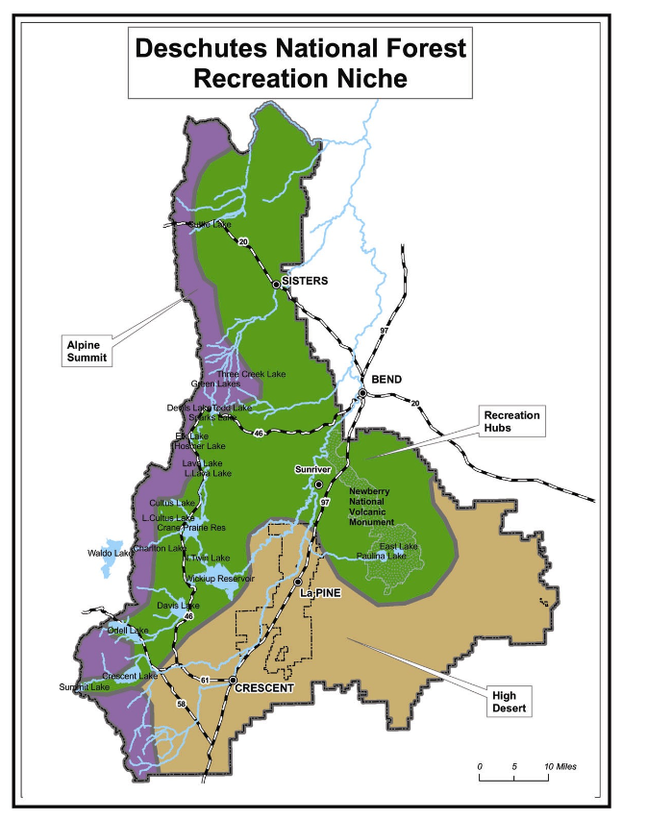
TELL US ABOUT YOUR FAVORITE PLACES
My favorite places on and near the forest are…
PURPOSE: Identify the location of special places on or near the forest.
USEFUL FOR: Public interests and activities; public value of different sites; how these special places connect with other areas within and outside the forests.
U.S. Forest Service Deschutes National Forest

Slide 15
TELL US WHAT YOU THINK
My visit to the Deschutes National Forest would be better if…
My use of the Deschutes National Forest would be greater if…
PURPOSE: Identification of ways to better connect people with the forests.
USEFUL FOR: Changes in management & offerings; compatibility or incompatibility of different activities and uses of the forests.
U.S. Forest Service Deschutes National Forest

Slide 16
HEM APPROACH TO ASSESSING SOCIAL, CULTURAL, AND ECONOMIC CONDITIONS
What are some ways you use or rely on the forest? OR What activities connect you to the forest? (SERVICES)
Why is this use/activity important to you? (VALUES)
What places are important to satisfy these needs or uses? (PLACES)
What particular assets do these places have that you need or use? (ASSETS)
What forest conditions do you require to maintain these activities or uses? (CONDITIONS)

Slide 17
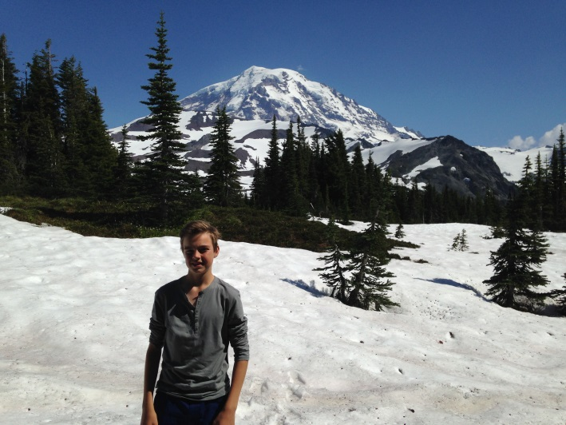
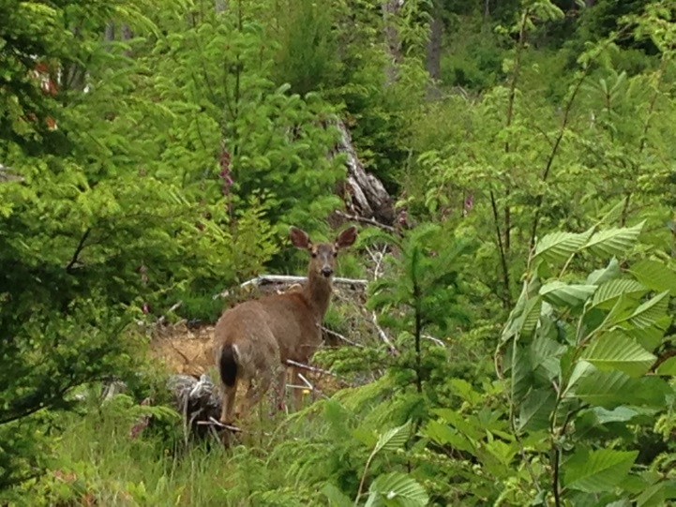
HEM FOR ECOSYSTEM SERVICES
Values-Threats Model
What places do you value in the national forest?
What natural asset do you value there? (water, land, air, biota)
What ecosystem service does that asset provide you?
Is there anything that could happen to threaten what you value?
Is there anything that could be done to protect what you value?
Raymond, et al. 2009. Mapping Community values for natural capital and ecosystem services. Ecological economics 1301-15.

Slide 18
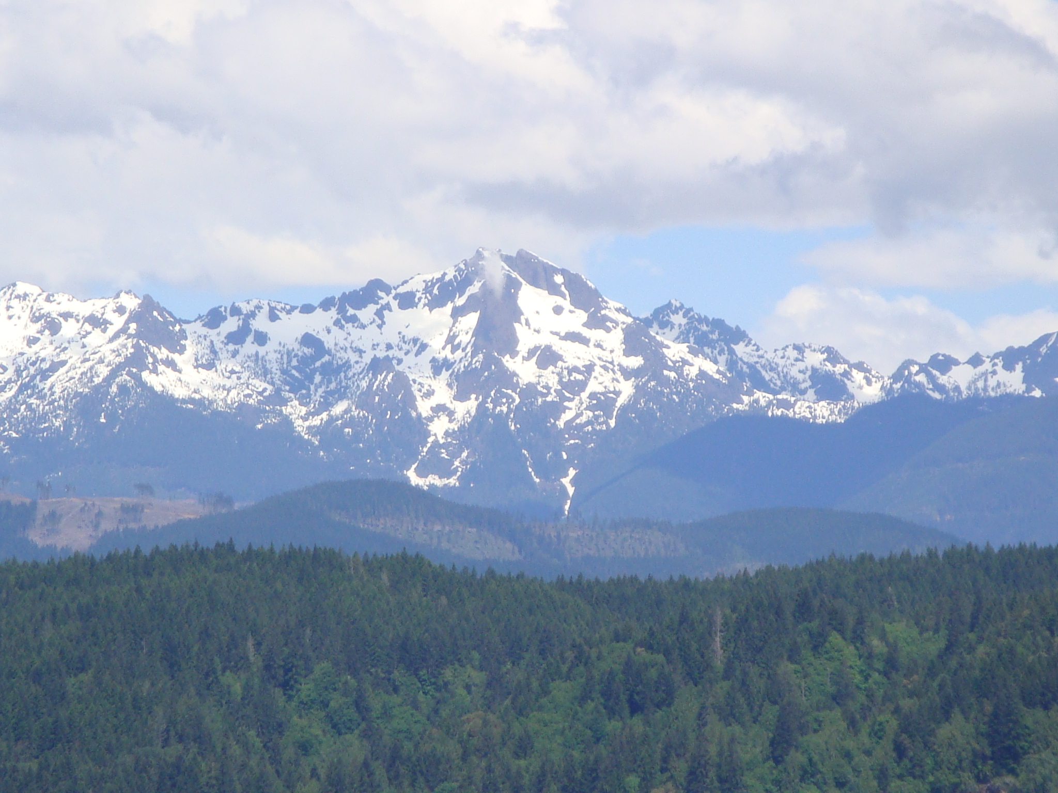

Questions

