Slide 1


Western Oregon BLM Draft RMP/EIS Concepts for Stands ≥ 80 years-old
Resource Management Plans for Western Oregon
BLM
June 03, 2015
Corvallis, Oregon
Abe Wheeler & Craig Kintop

Slide 2
Introduction
BLM manages approximately 2.5 million acres, primarily forested lands in western Oregon
Most lands interspersed in a checkerboard fashion with other ownerships
Broad ecological gradient from north (“moist” forest) to south (“dry” forest)
Substantial proportion of stands over 80-years-old

Slide 3
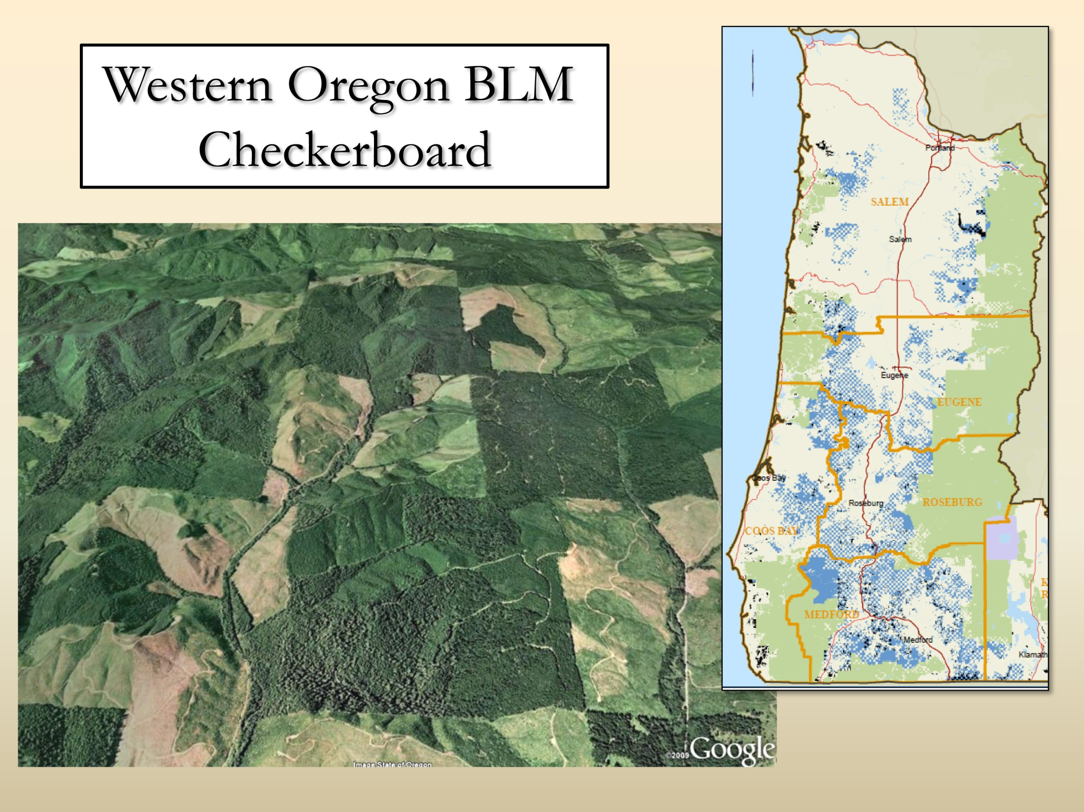

Slide 4
Acres by Age Class Coastal/North vs. Interior/South

Slide 5
Alternative Approaches to Older Forest Protection
Protected Older Forests, Outside of Large NSO Blocks
No Action Alternative; no special protection
Alt A; All stands >120
Alt B; District-specific structurally complex map
Sub-Alt B; District-specific structurally complex map
Alt C; All stands >160
Sub-Alt C; All stands >80
Alt D; All stands >120, 140, 160 on site class 1-2, 3-4, and 5, respectively.
Draft RMP/EIS pages 239 – 242 and chapter 2

Slide 6
Age vs. Structure

Slide 7
80-years-old & Greater Stands
A broad range of “older” aged stands with variable species composition and structures exist on BLM administered lands
Age is only one descriptive attribute of a forest stand and can be misleading in assumptions about the actual stand structural state

Slide 8
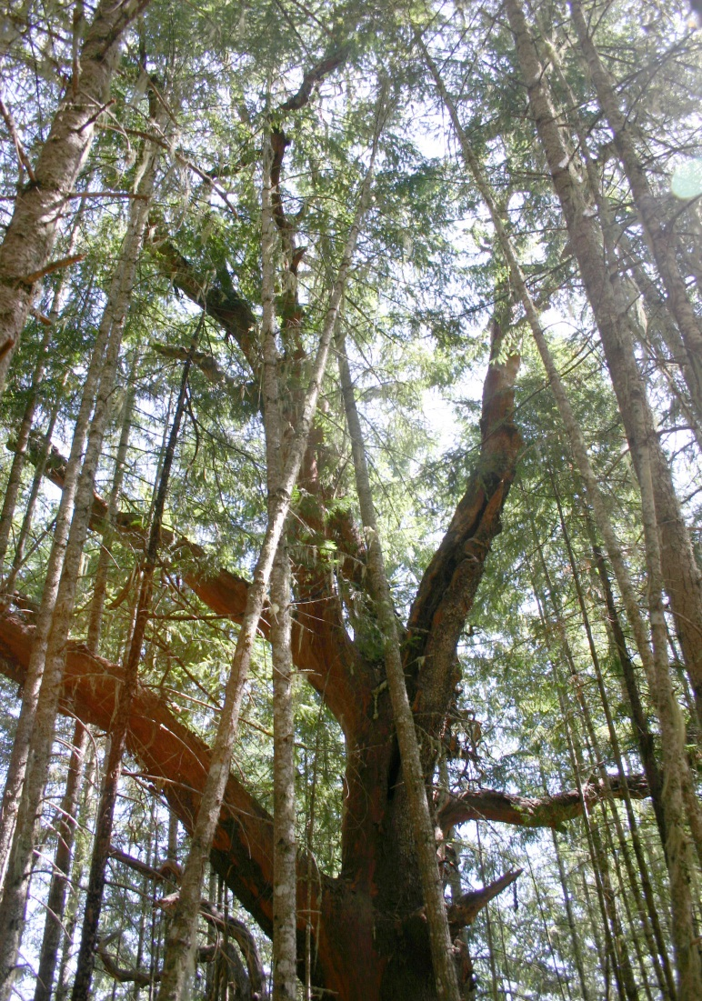
Dry Forest Legacy Tree Protection/Release in all Action Alternatives
Uneven-aged Timber Area, and Dry Forests in LSR and Owl Habitat Timber Area
Protect shade intolerant trees established prior to 1850, unless removal is necessary for safety or operational reasons.
Protect and develop these “legacy trees” on the landscape, by reducing competition.
Release “legacy trees” that originated prior to 1850 in order to improve vigor and resistance to fire, drought, disease and other disturbances.
Draft RMP/EIS pg. 919

Slide 9
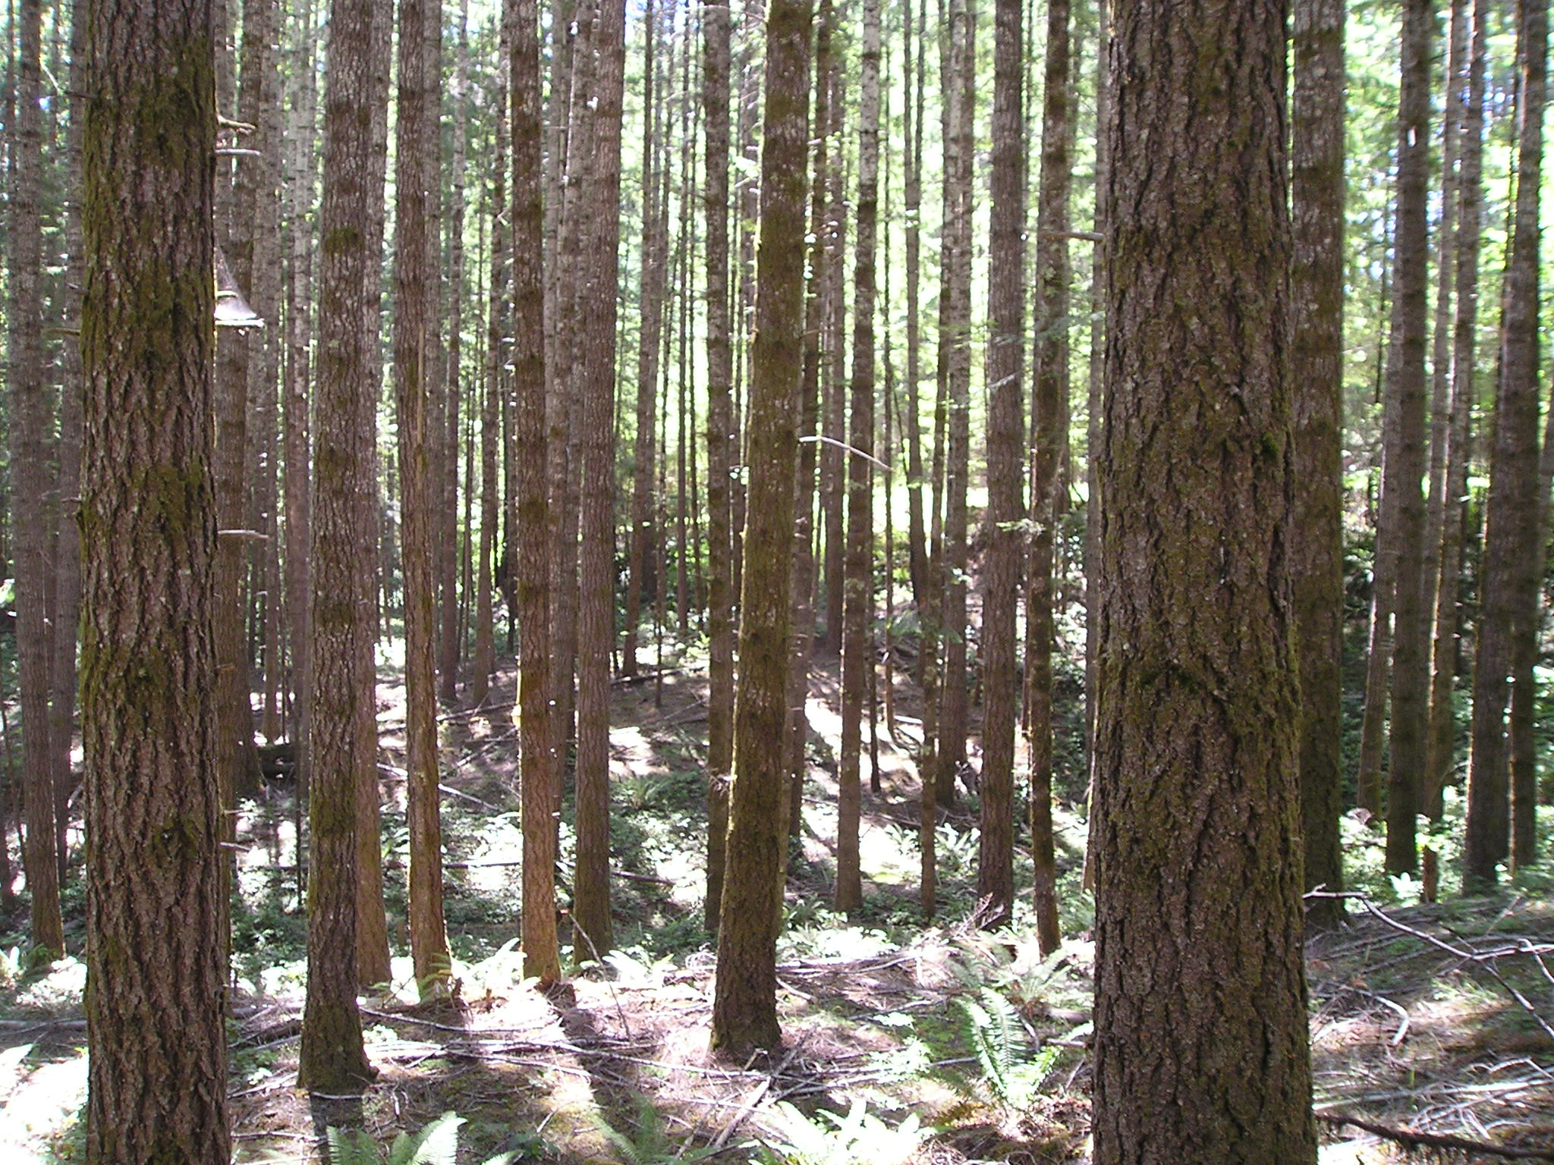
80 Years Old
Notes:
80 years-old

Slide 10
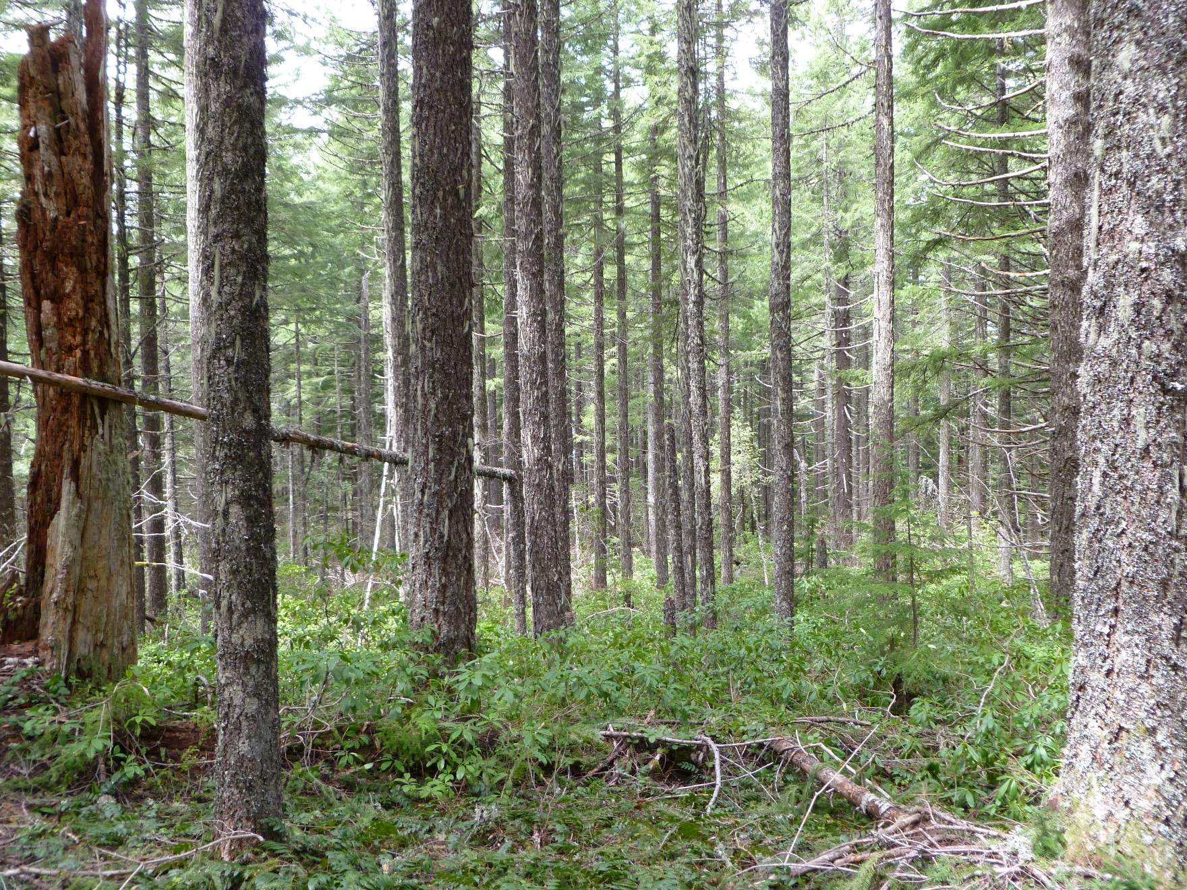
110 Years Old
Notes:
110

Slide 11
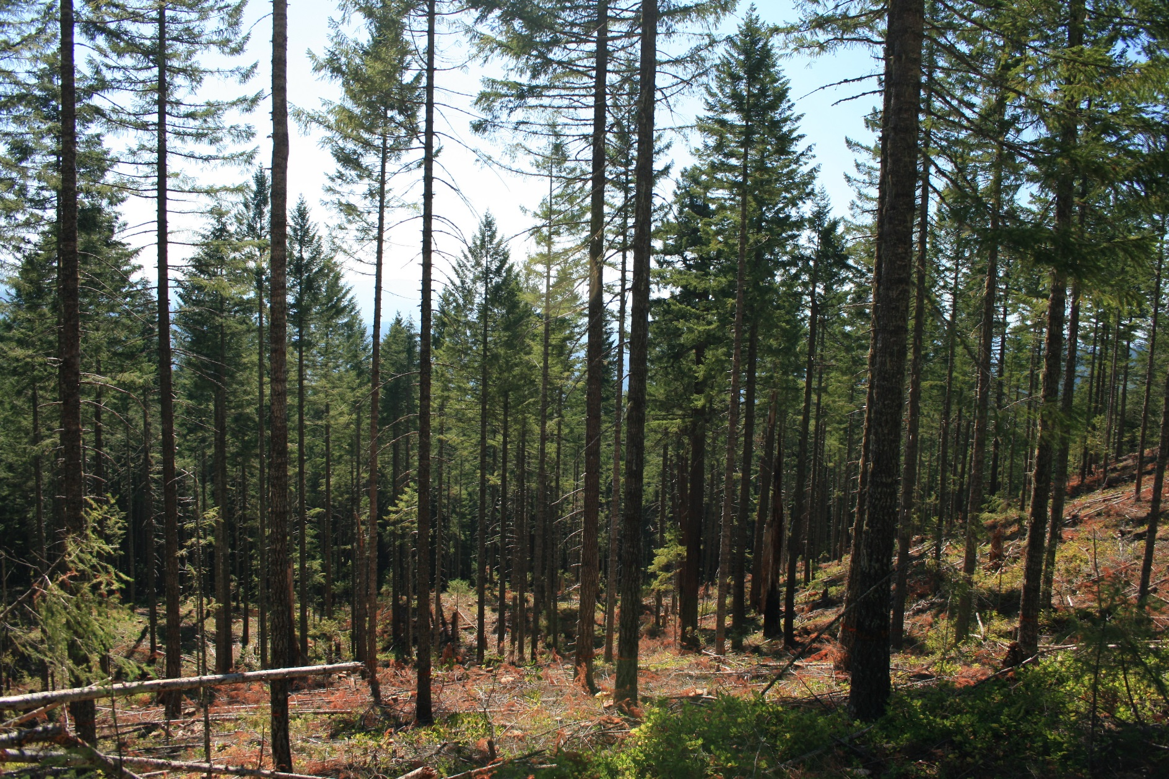
110 Years Old
Notes:
110

Slide 12
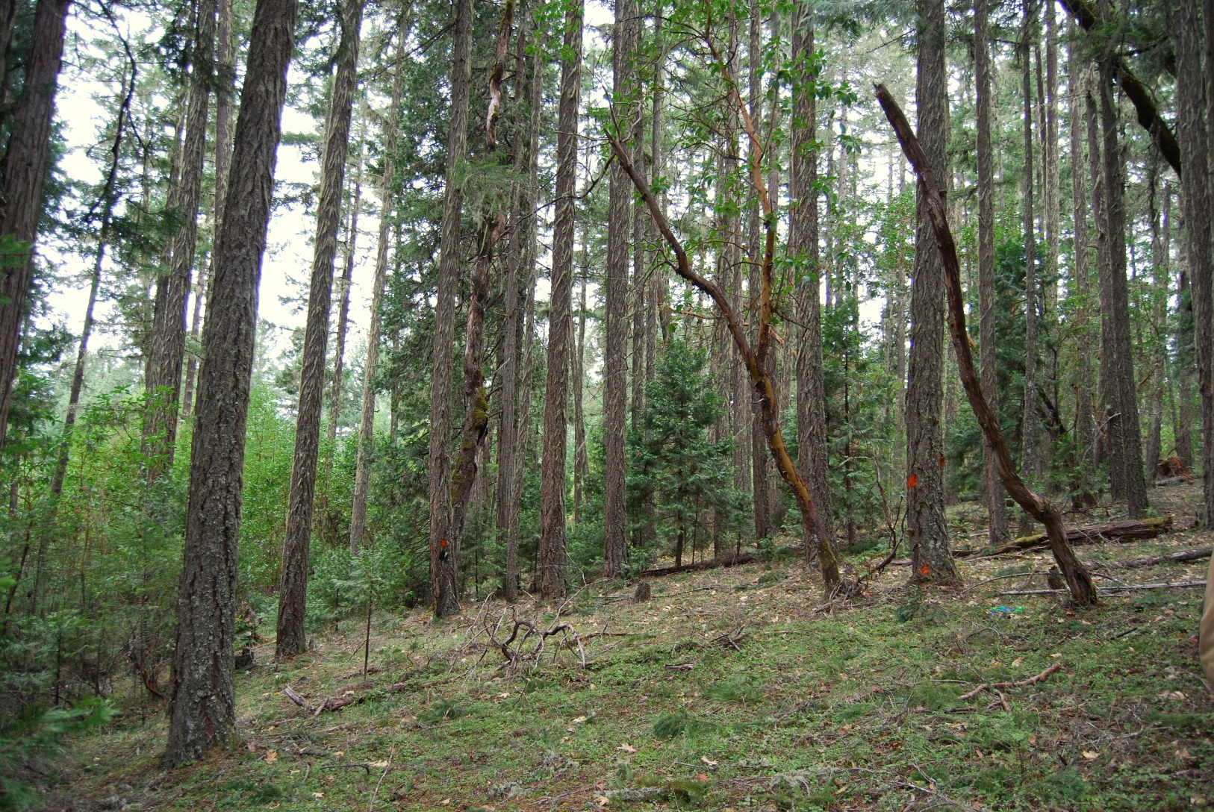
130 Years Old
Notes:
130

Slide 13
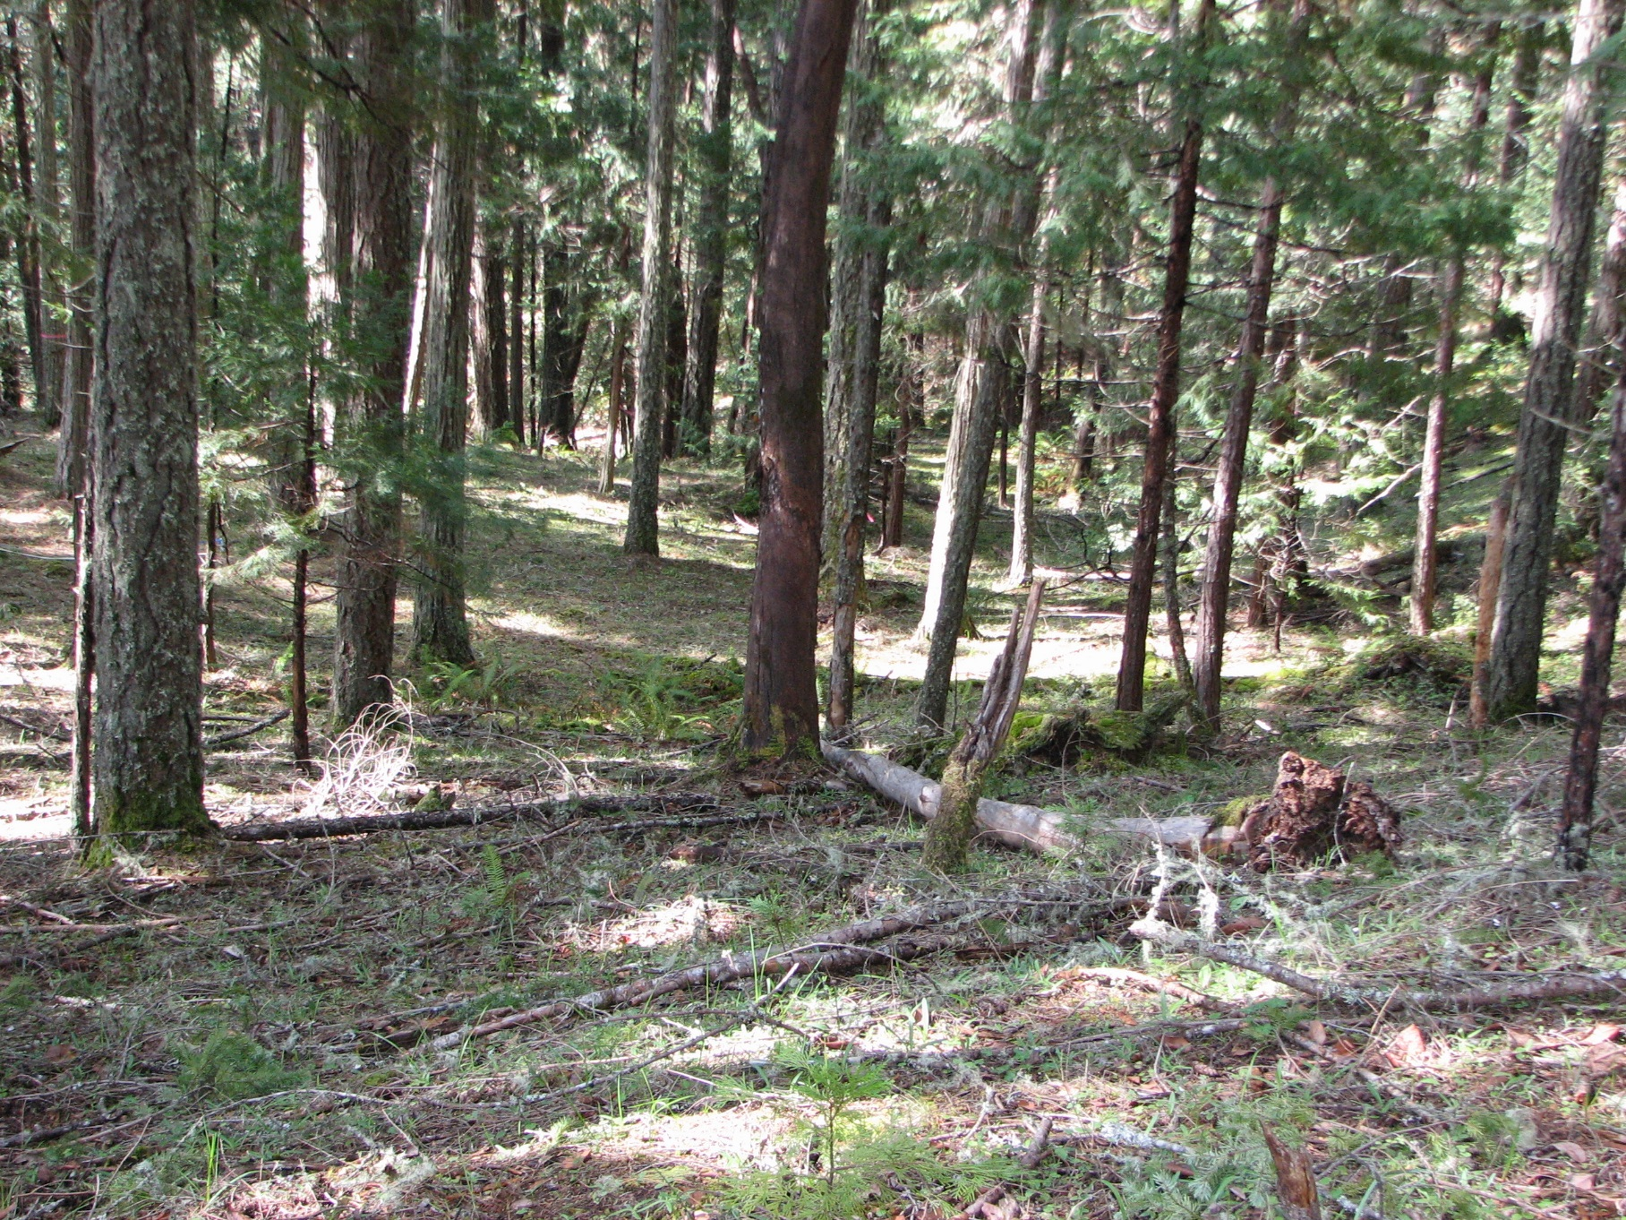
140 Years Old
Notes:
140

Slide 14
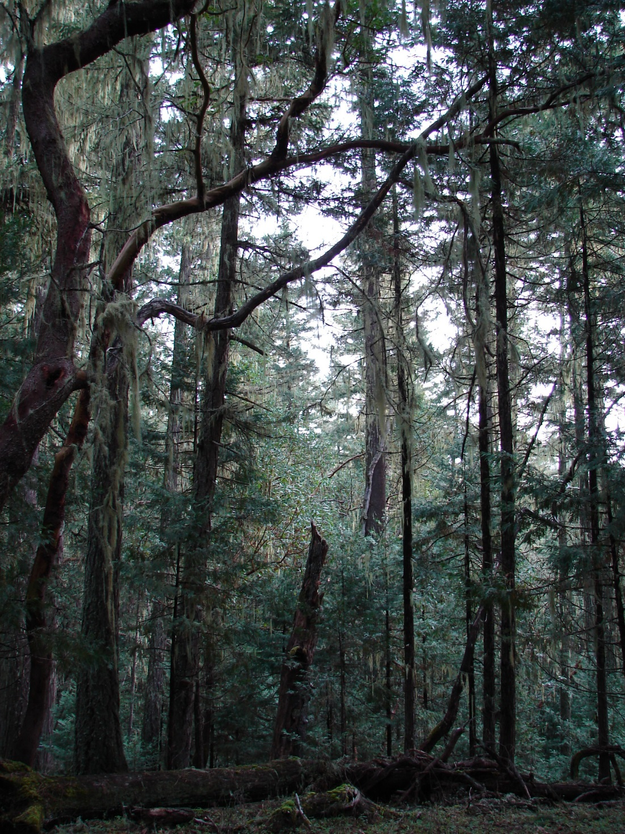
140 Years Old
Notes:
140

Slide 15
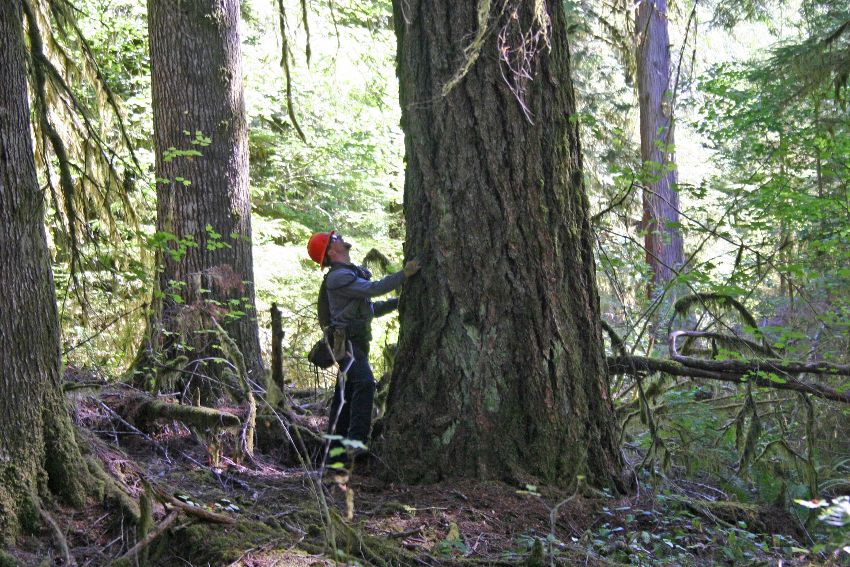
200+ Years Old
Notes:
200+

Slide 16
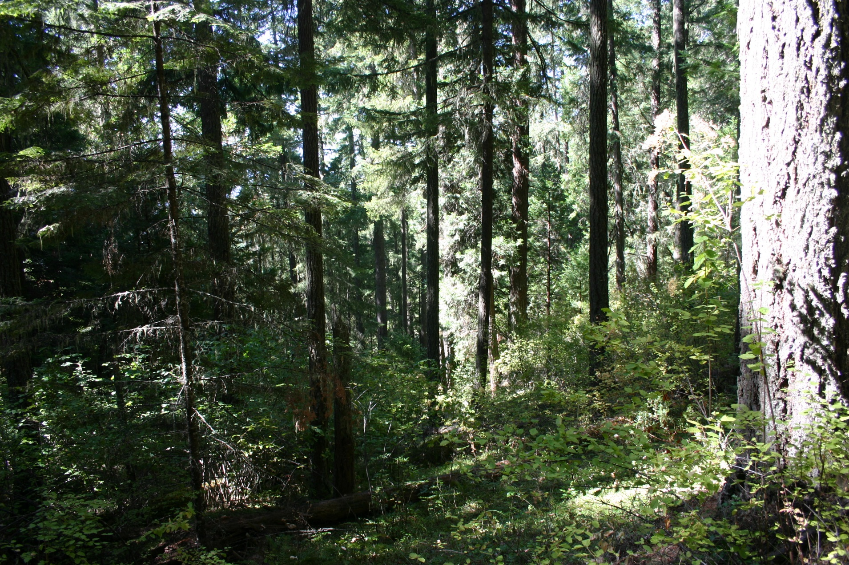
200+ Years Old
Notes:
200+

Slide 17
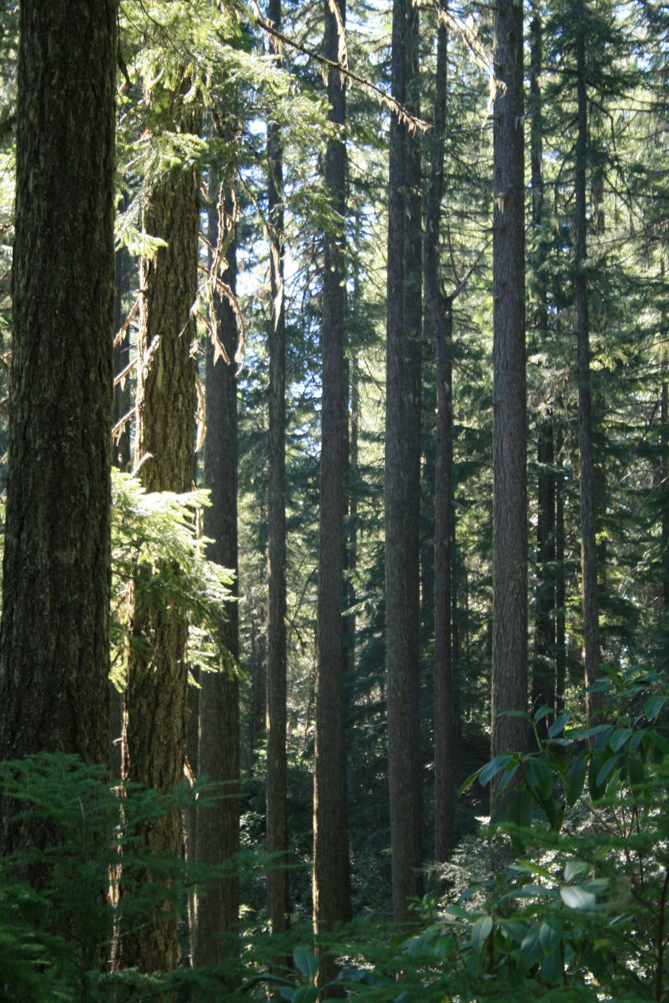
160 Years Old
Notes:
160

Slide 18
Action Alternatives
A range of silvicultural systems will be applied across a range of ages, including stands currently over 80-years-old
Maximum ages affected depends on land use objectives (allocation) and the definition of “older” stands by Alternative.

Slide 19
Silvicultural Systems
Even-aged [clearcut]
Two-aged
Low Retention
Moderate Retention
Uneven-aged
Owl Habitat
Forest Resistance/Resiliency

Slide 20
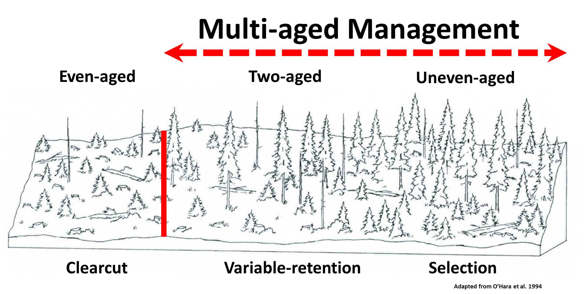
Silvicultural Systems
Range of possibilities

Slide 21
Intensity of Management
Land Use Allocation | Management Regime | Intensity Ranking
HLB-HITA, High Intensity Timber Area (ALT A and C) | Even-aged Management, Clearcuts, no retention trees, rapid reforestation | 7
HLB-MITA, Moderate Intensity Timber Area (Alt B and D), GFMA/NGFMA (NAA) | Two-aged Management, Variable-retention regeneration harvest, 5-15% retention VRH, delayed canopy closure in B/ prompt reforestation in D | 6
HLB-LITA, Low Intensity Timber Area (Alt B), SGFMA/CONN (NAA) | Two-aged Management, Variable-retention regeneration harvest, 15-30% retention VRH, delayed canopy closure, natural regeneration | 5
HLB-UTA, Uneven-aged Timber Area (Alts A, B, C, and D) | Uneven-aged Management, Selection Harvest,, reduced stand densities, increase fire resiliency/forest health, while producing timber. | 4
HLB-OHTA, Owl Habitat Timber Area (Alt D) | Uneven-aged Management, Selection Harvest,, promote and maintain owl habitat while producing timber. | 3
Reserves, Active Management (Alts A, B, C, and D) | Light to moderate intensity treatments; in moist forests tapering off to zero, in dry forests continuing on a regular cycle. | 2
Reserves, Passive Management (All Alternatives) | No Commercial Treatments. Uninterrupted forest successional pathways. | 1
8/4/2025

Slide 22

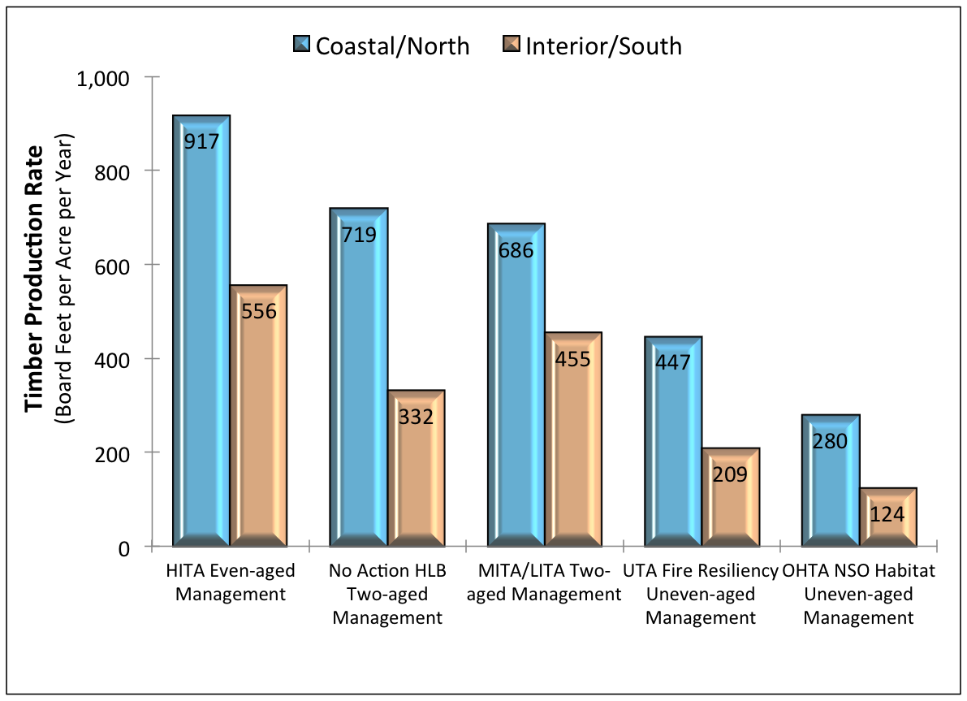
Analytical Results: Intensity of Management; contribution to ASQ timber harvest
Draft RMP/EIS pg. 263-265; Figure 3-72

Slide 23
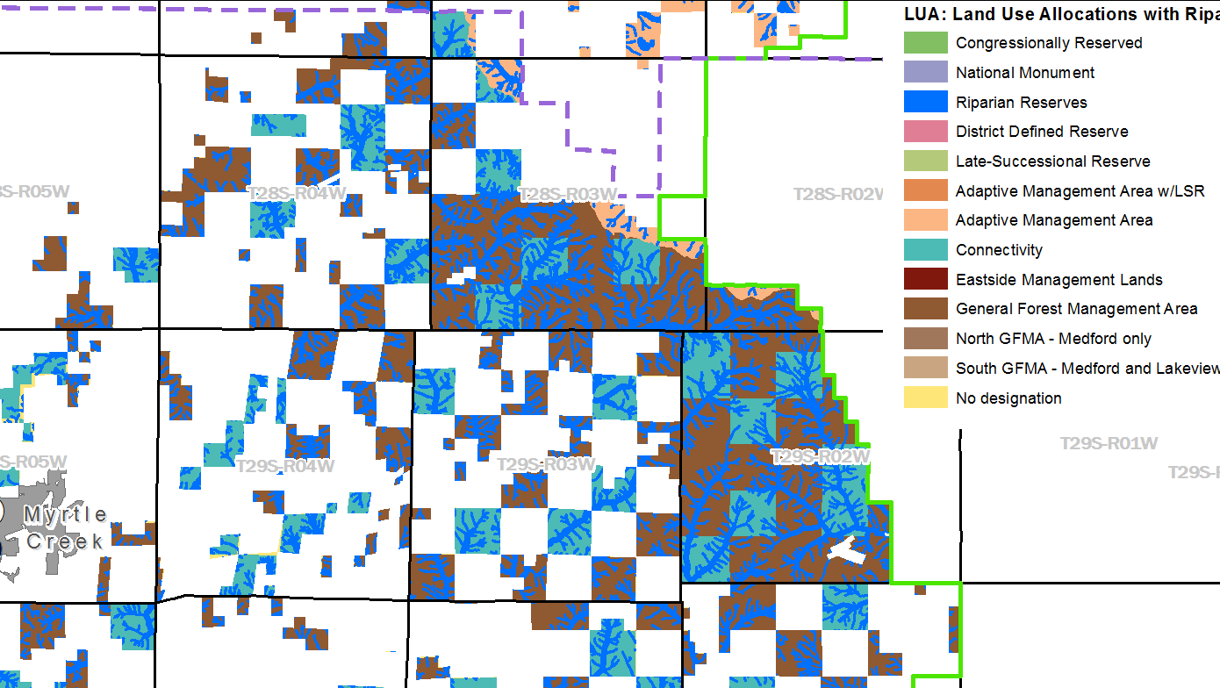
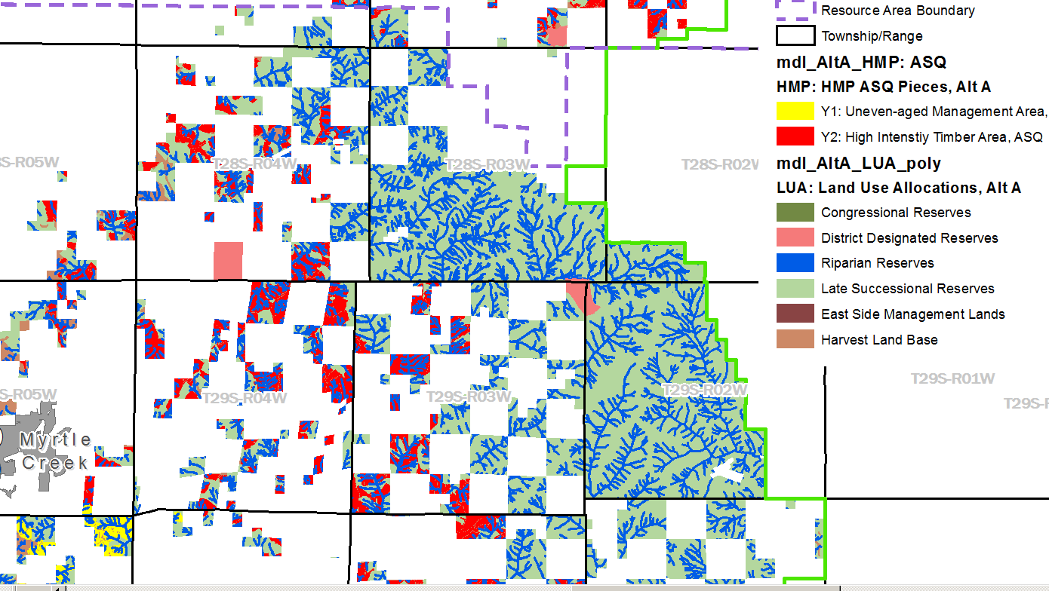
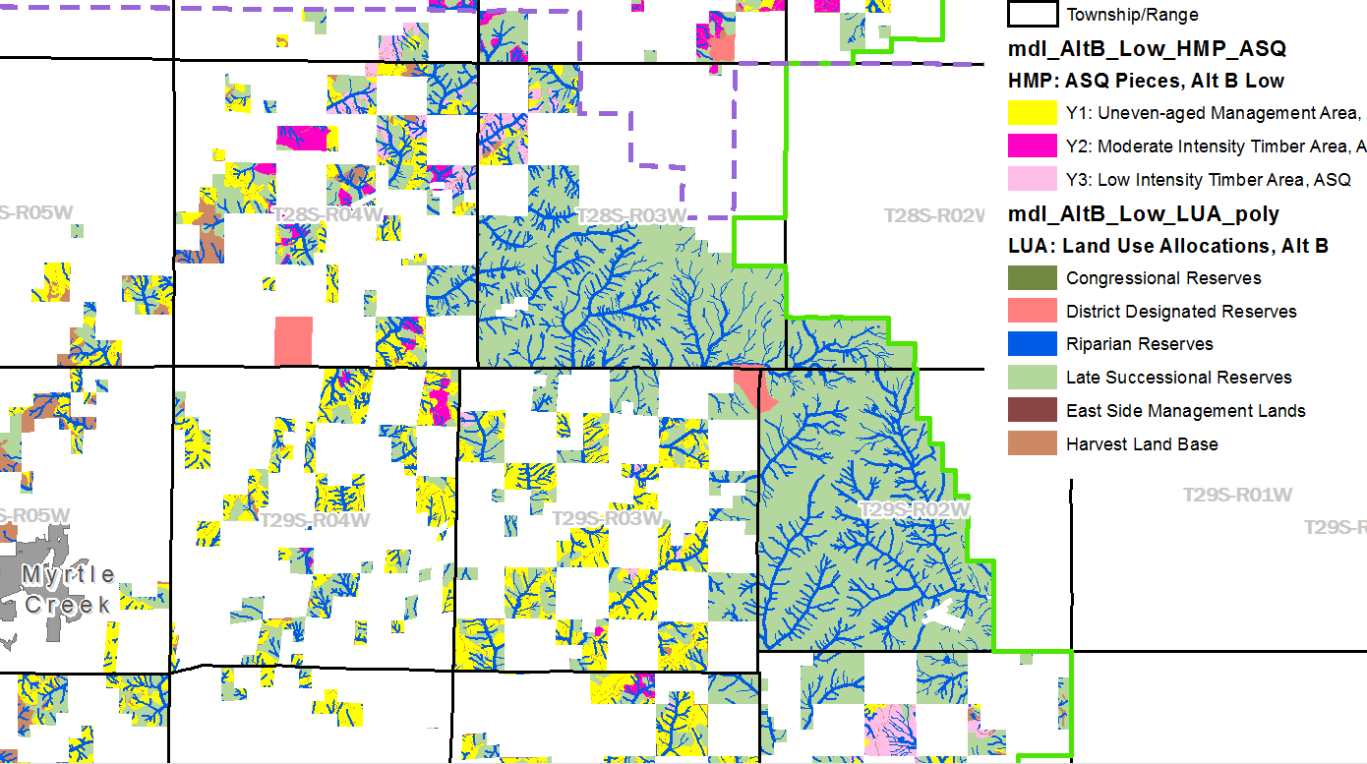
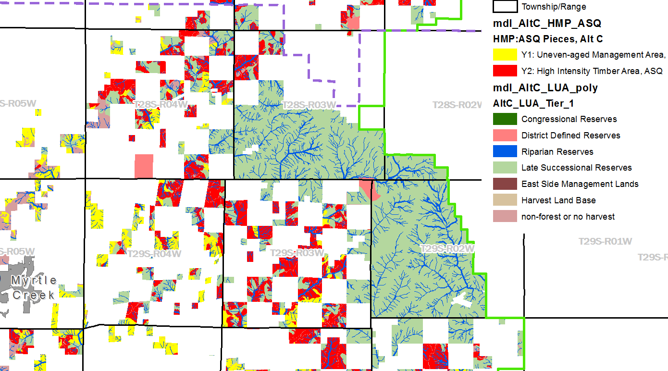
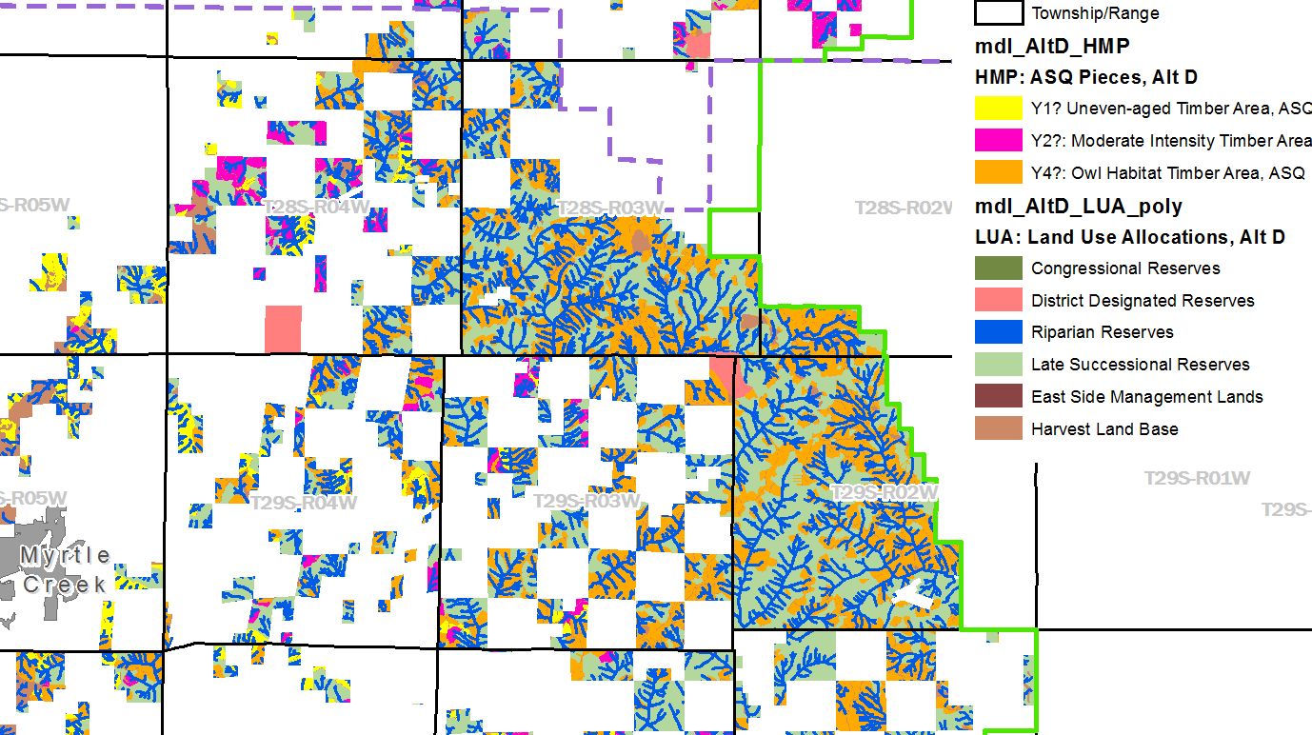
Mapped Land Use Allocations
Notes:
These allocations are mapped and fixed to achieve management certainty and predictability.

