Slide 1


Stand-Level Silviculture to meet Stand and landscape-level objectives in > 80-year-old stands
Matt Powers
Assistant Professor
Department of Forest Engineering,
Resources and Management
Oregon State University
Stephanie Wessell
Silviculturist
Marys Peak Resource Area
Salem District Office
Bureau of Land Management

Slide 2
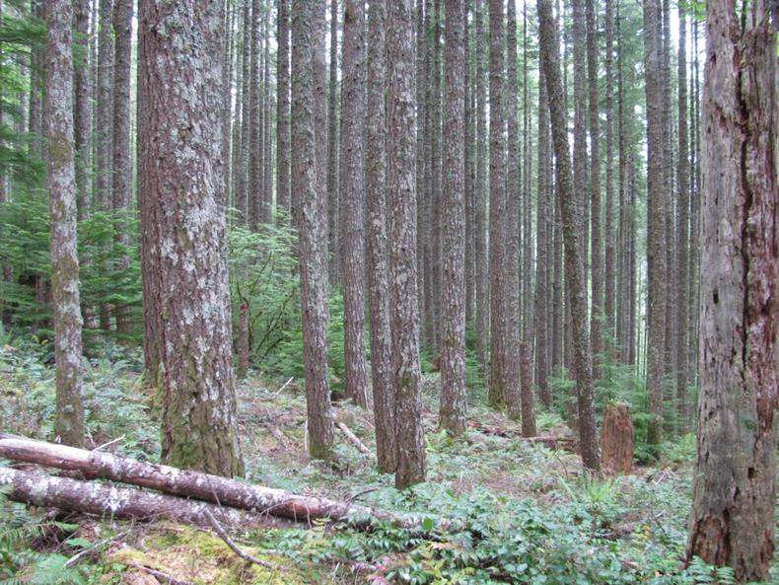
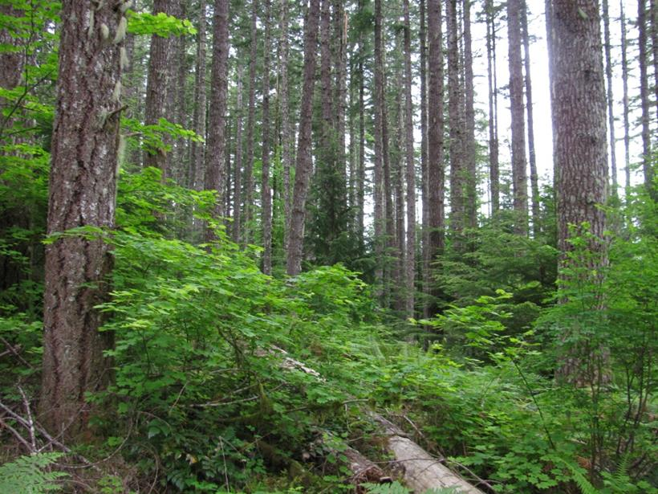
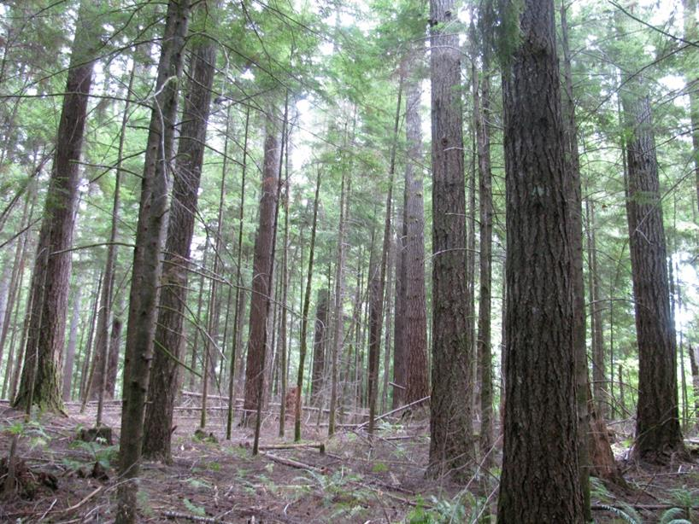
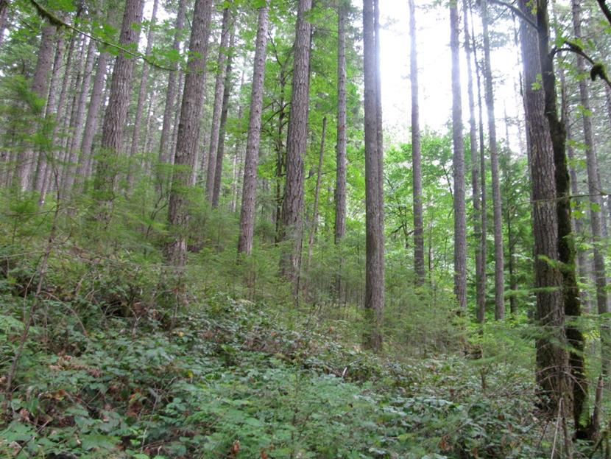
“Mature” Forests Are Structurally Variable
Notes:
“Mature” forests come in many different structural conditions. Take, for instance, this sequence of ~100-110 year-old stands.
Fairly dense stand with patchy areas of hemlock recruitment and other areas of limited understory development. Deadwood is largely absent.
Root rot gap in the same stand as previous image with abundant vine maple, hemlock, oceanspray, and huckleberry, and large-diameter deadwood.
40-50 TPA “Crop Tree” treatment at Black Rock with >30” diameter overstory trees, dense, self-thinning hemlock midstory, virtually no ground-layer vegetation, and lots of skinny deadwood.
Another thinning treatment at Black Rock after four entries with 125 TPA moderate understory development, and even pockets of suppressed PSME regeneration.

Slide 3
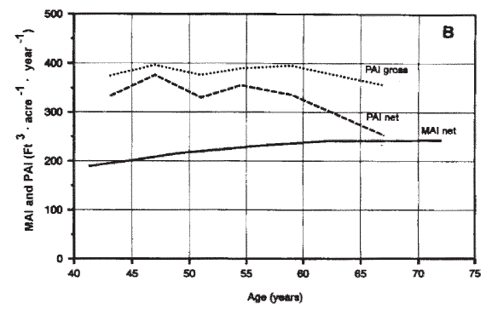
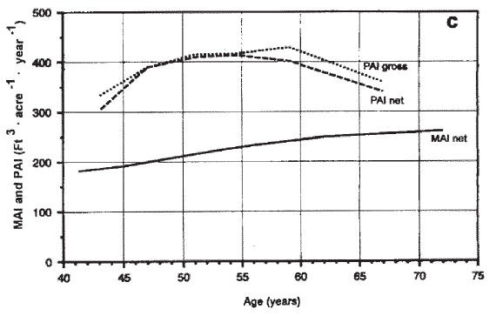
Management & Stand Productivity
Unmanaged Stand
The age at which the culmination of MAI (CMAI) occurs is variable.
Several factors influence the timing of CMAI:
Site quality
Initial stand densities
Disturbance history and severity (e.g., thinning regimes)
Thinned Stand
Curtis 1995
Notes:
-There is no single, magical value for the “biological rotation”.
-It is important to recognize that thinning (or any partial canopy disturbance) delays CMAI, so managing on longer rotations doesn’t necessarily result in a significant reduction in productivity.
-In west-side Douglas-fir, CMAI in stands that have been repeatedly thinned appears to culminate at ages >100-120 years with slow declines thereafter.

Slide 4
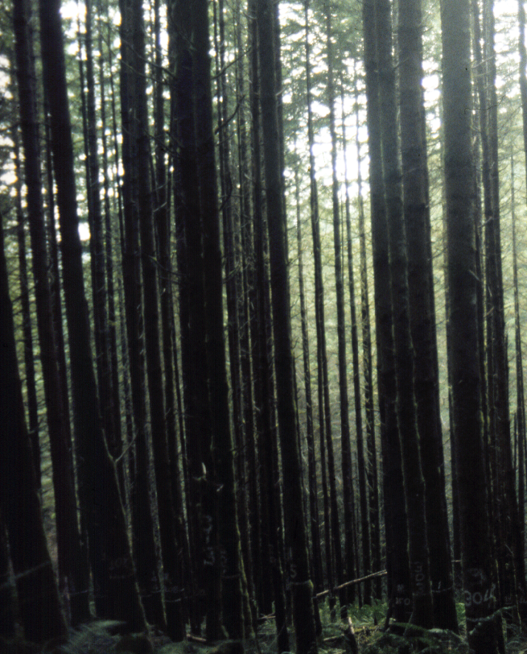
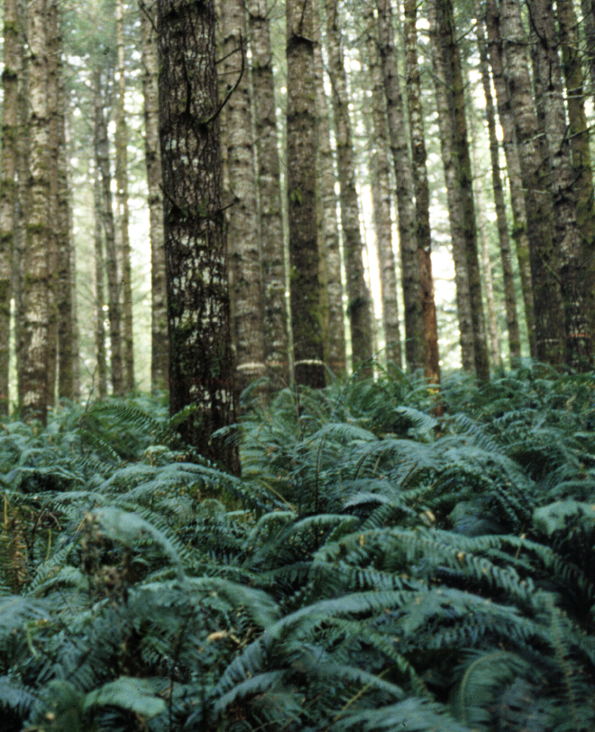
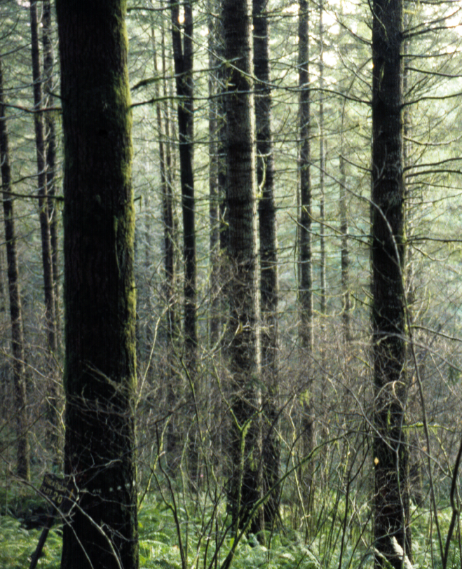
Structural Characteristics of Treatments in the Hoskins LOGS Study at Age 55
Photos: Tappeiner et al. 2015
Control (9)
Light Thin (7)
Heavy Thin (1)
Notes:
We know that thinning in younger (less than 80 year-old stands) can:
Promote understory diversity and accelerate development of LSOF understory veg communities.
Foster recruitment of shade tolerant tree species.
Delay crown recession, promote vertical layering, & accelerate development of (and retention of) large limbs.
Increase residual tree diameter growth (get big trees faster!).
On a downside, tends to slow deadwood recruitment, but also creates opportunities to generate larger-diameter deadwood silviculturally.

Slide 5
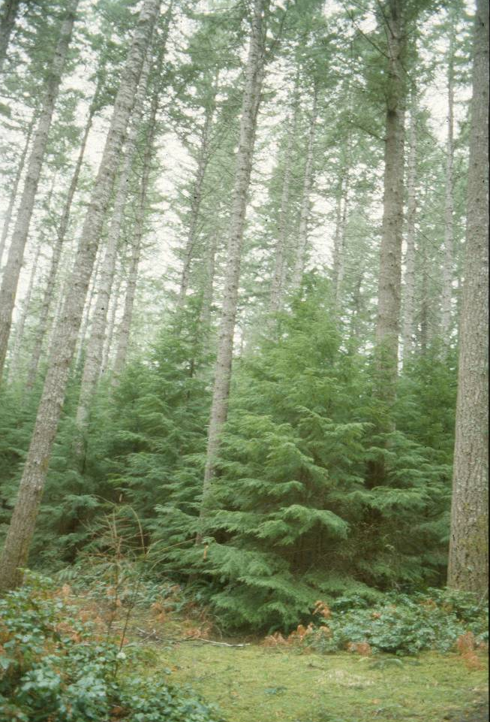

Issues with One-Entry Treatments
John Tappeiner
Circa 2005: 47-48 years after thinning and underplanting
2014: 56 years after thinning and underplanting
Notes:
-We also know that residual tree crown expansion can rapidly fill gaps created by light to moderate thinning, which limits understory development in these situations.
-Even after a single, heavy early thinning treatment (e.g., from 500 TPA down to 40-50 TPA at age 48), residual trees will gradually expand their crowns sufficiently to cause significant understory dieback without follow-up treatments or natural disturbances to further manage overstory stocking levels.
-The point is: repeated treatments are necessary to generate and tend a multi-cohort stand structure over time by managing growing space allocation across cohorts.

Slide 6
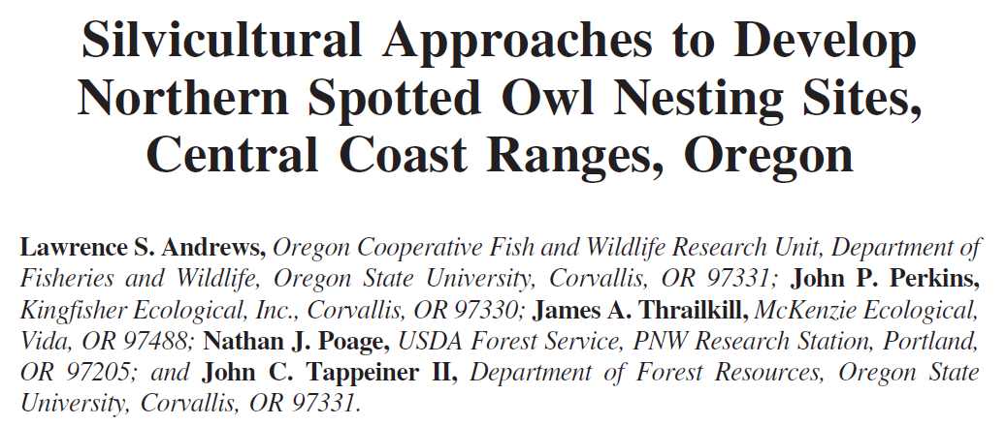
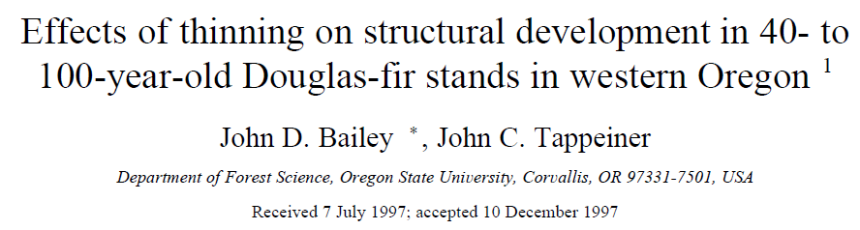
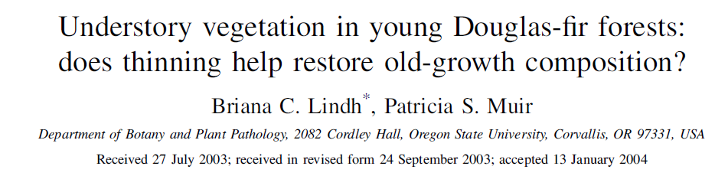
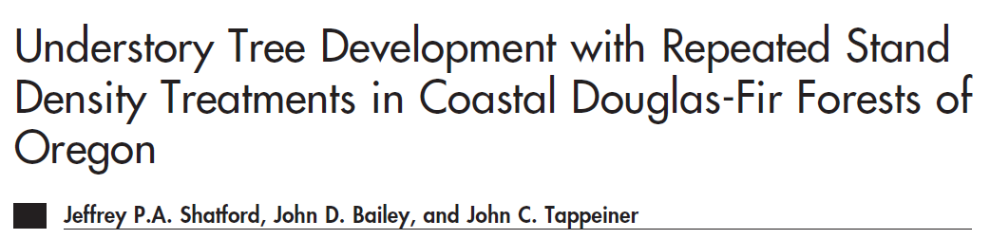
Multiple entries are likely needed to promote long-term growth of understory trees and shrubs.
Notes:
-Don’t base your information off a single case study though.
-There are many examples of studies that have reached similar conclusions based on well-replicated retrospective data or simulations.
-These are just a handful of examples.

Slide 7
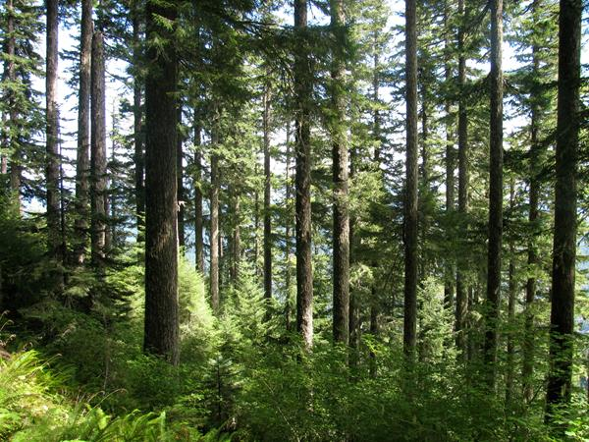
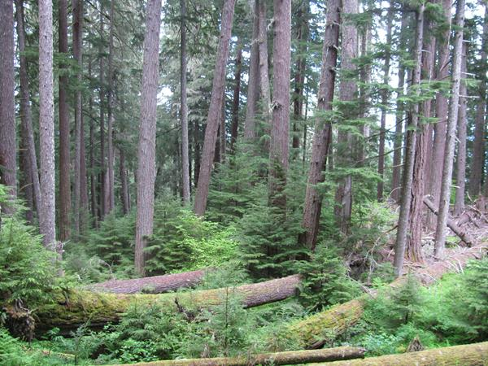
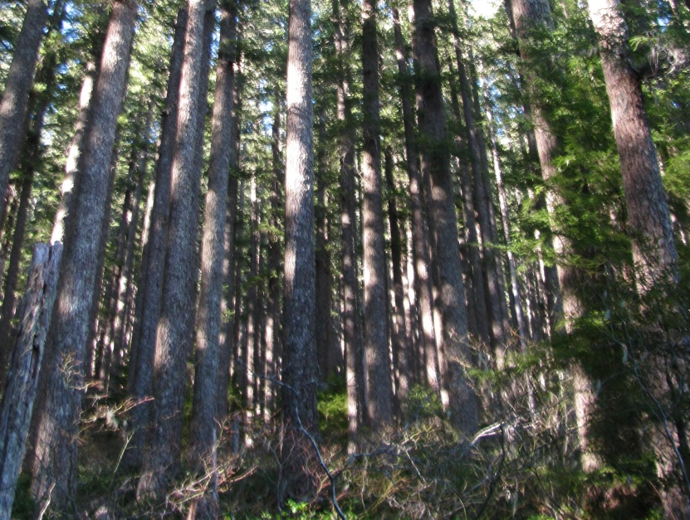
No Action Approaches
Notes:
No action approaches are most likely to produce LSOG stand structures by age 160 when repeated treatments at earlier ages or natural disturbances or low initial stand densities have already set the stand on a developmental trajectory that promotes characteristics like multi-cohort structures, large overstory trees, spatially variable structure, deep crowns, and an abundant, species rich shrub layer.
No action approaches have a low probability of producing LSOG structure if the current condition is a dense stand with limited understory development. These stands take a much longer, more torturous route to old-growth that involves a prolonged period of self-thinning in which shade tolerant trees establish in the understory until self-thinning eventually gives way to density-independent disturbance processes that release the shade tolerant cohorts in the understory from overhead competition. Although deadwood is generated during the long self-thinning process, it is generally smaller-diameter wood with more limited wildlife value until these stands reach very old ages.
Even dense stands with limited LSOG characteristics, however, may provide important ecosystem services like storing large amounts of C, providing NSO dispersal habitat, or red tree vole and flying squirrel habitat.

Slide 8
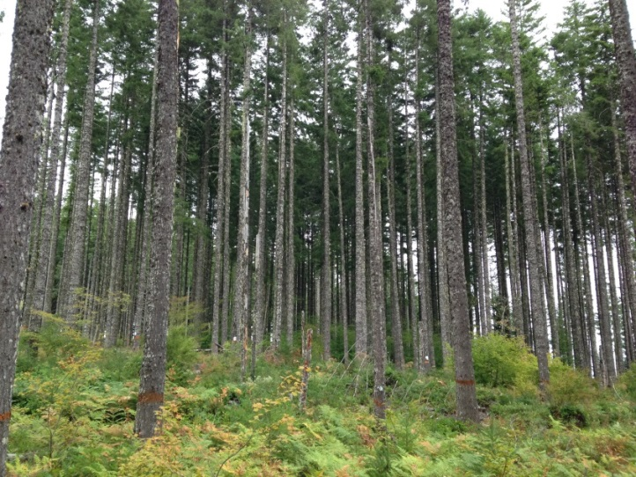
Commercial Thinning on Long Rotations
Pros:
Accelerates residual tree growth
Delays crown recession
Delays CMAI
Produces wood products to support local economies
Cons:
Slow understory development
Limited opportunities to recruit shade intolerant species
Prevents deadwood recruitment
Notes:
We are talking here about light-moderate intensity thinning treatments that would maintain stands within the range of what would generally be considered full stocking.
This may be most appropriate on matrix-type lands where broader management goals call for/allow for wood production and economic outcomes as drivers of management.

Slide 9
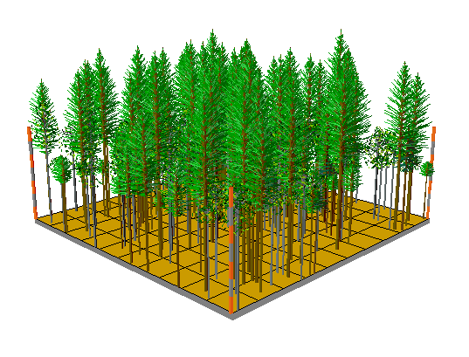
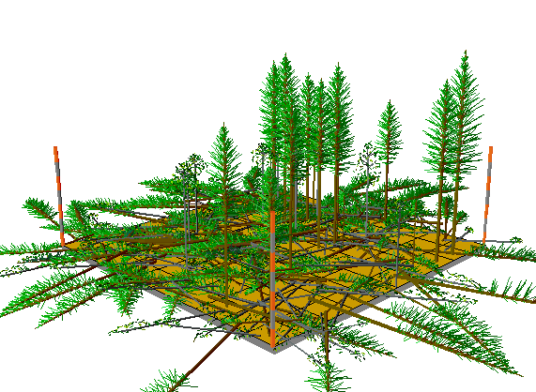
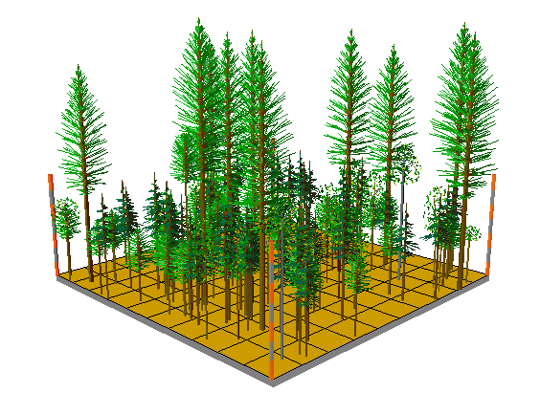
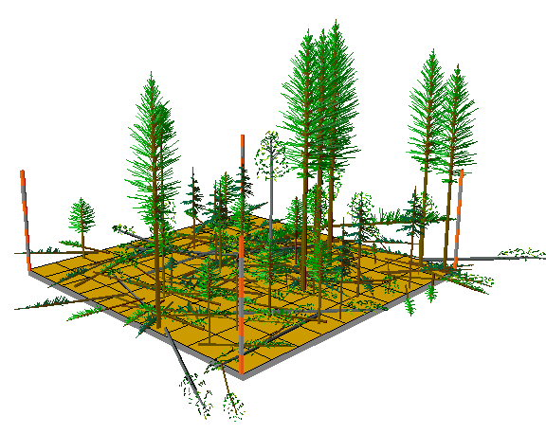
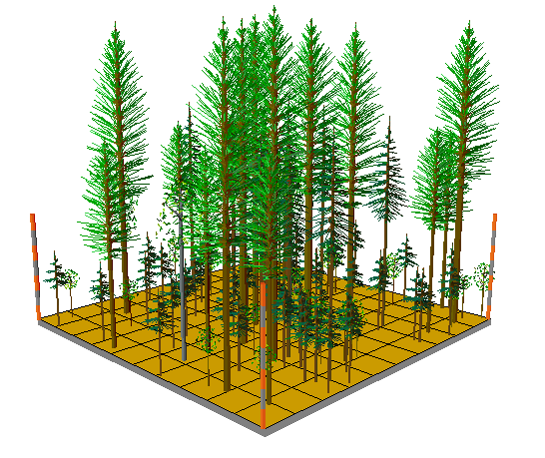
Two-Aged & Uneven-Aged Approaches
Pros:
Continues LSOG development following earlier thinning
Stewardship contracting
Cons:
Complex to implement
Tending multiple cohorts may require more frequent entries
Notes:
-This may be a good option to continue LSOG structural development in >80 stands that have received conventional thinning or gap-based VDT treatments earlier in their lives, but could also be applied to relatively uniform >80 stands to generate heterogeneity and/or build on existing patches of heterogeneity.
-Structural development responses will probably be more limited or gradual when dealing with dense, unthinned stands.
-Can theoretically be applied on matrix or LSR lands in the absence of age restrictions.

Slide 10
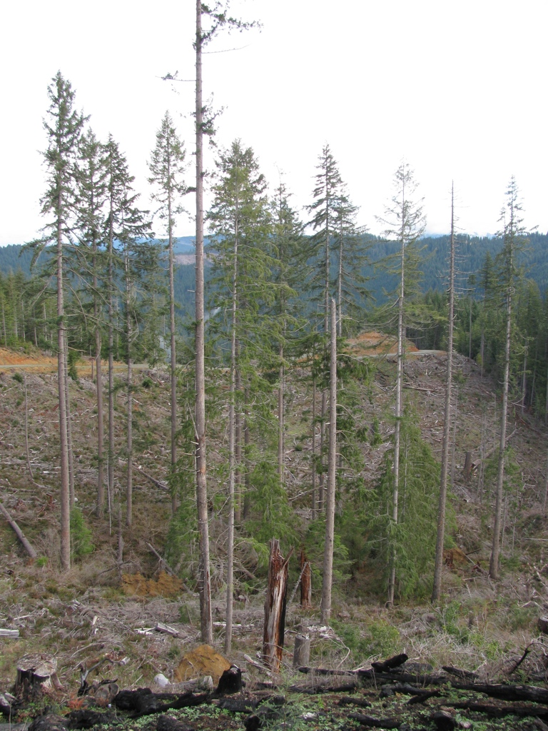
Even-Aged Regen in Older Stands
Dense, older stands with limited complexity may be good candidates:
Limited loss of current or potential future LSOG habitat
Few species are dependent on these stand structures
Generate economic stimulus, and early seral habitat with limited impact on LSOG
Notes:
Although we shouldn’t necessarily restrict even-aged regen methods to any given structural condition, or apply them too widely across any set of structural conditions, dense older stands seem like good candidates for a number of reasons.

Slide 11
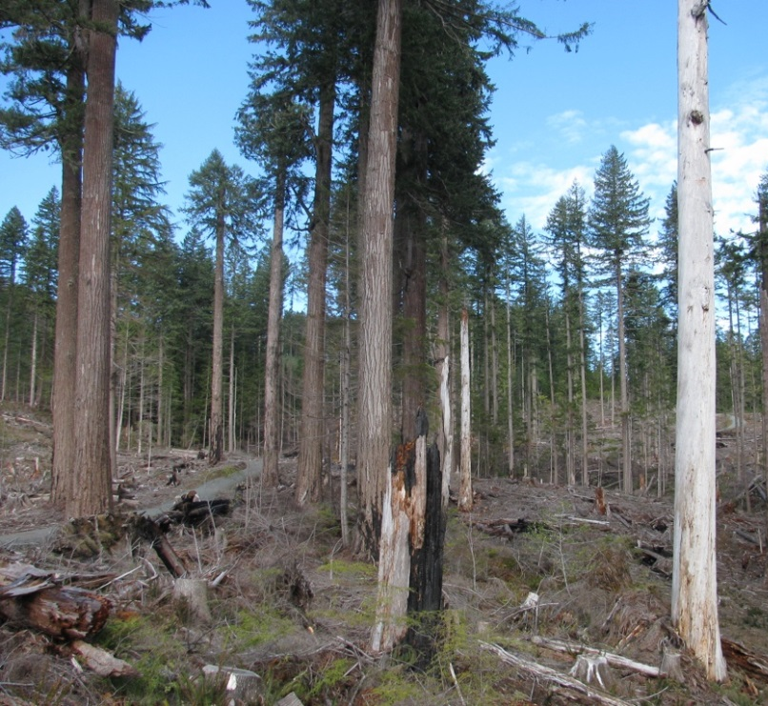
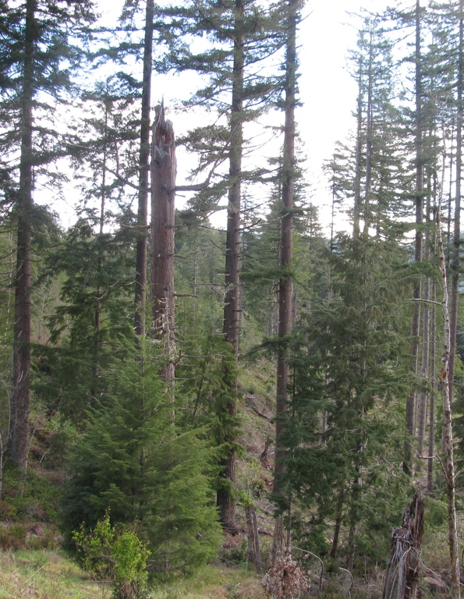
Legacies From Regen Cuts in Older Stands
Notes:
One benefit/rationale of doing even-aged management on longer rotations is that it creates opportunities to provide legacies in an early seral environment that simply can’t be generated by restricting even-aged regen treatments to younger stands.
Applying irregular shelterwood/variable retention harvest approaches that incorporate and build on existing variability and structural features offers a method for generating complex structures in regen harvests that address multiple objectives.
In these examples on the Coquille tribe’s forest, legacy retention included maintaining most representatives of an older (~200 year) 2nd cohort of very large trees with complex canopies along with pockets of deadwood and shade tolerant understory conifers.

Slide 12
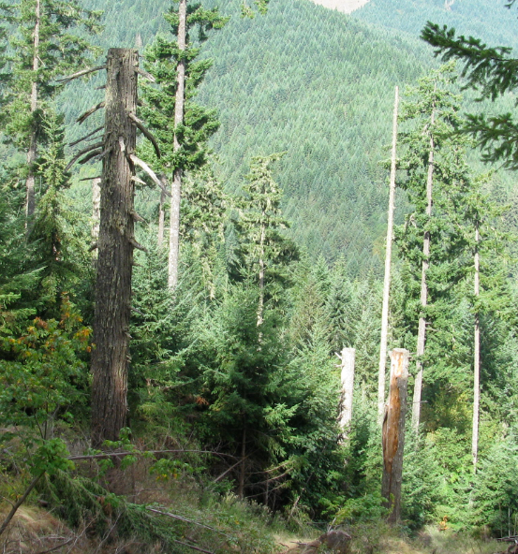
Deadwood Considerations
Deadwood creation is an important element of managing older stands, too!
Management limits deadwood recruitment
Generates large-diameter green trees faster
Opportunities for active deadwood creation
Notes:
The point is, we need to consider deadwood creation when developing silvicultural treatments in mature stands just as much as we do during regeneration harvests.
Silvicultural treatments grow bigger green trees more rapidly, but also reduce deadwood inputs by keeping stands below the self-thinning threshold.
However, we have opportunities to actively create long-lasting, large-diameter deadwood silviculturally at a faster pace than natural processes might generate.

Slide 13
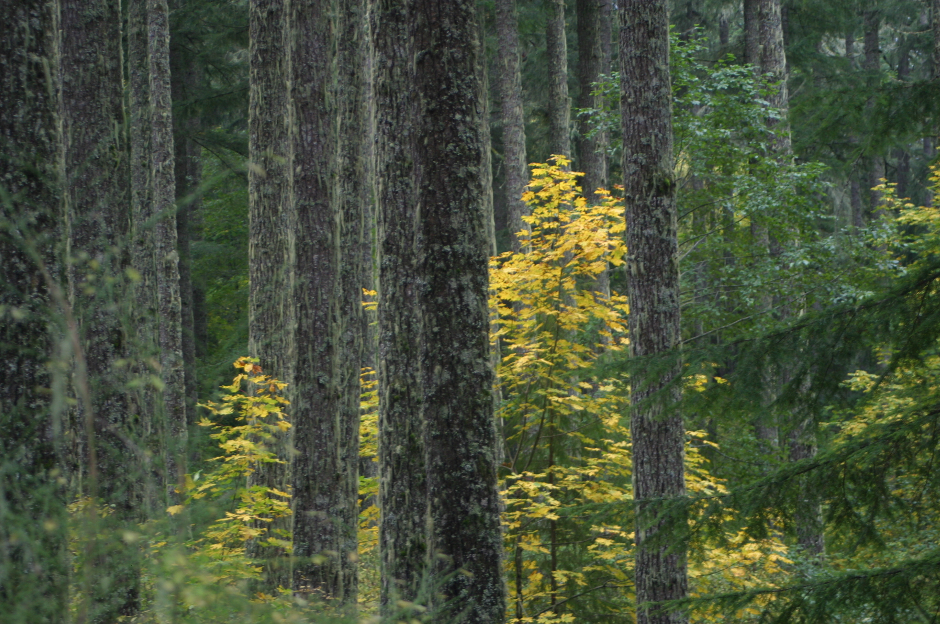
Management Considerations

Slide 14
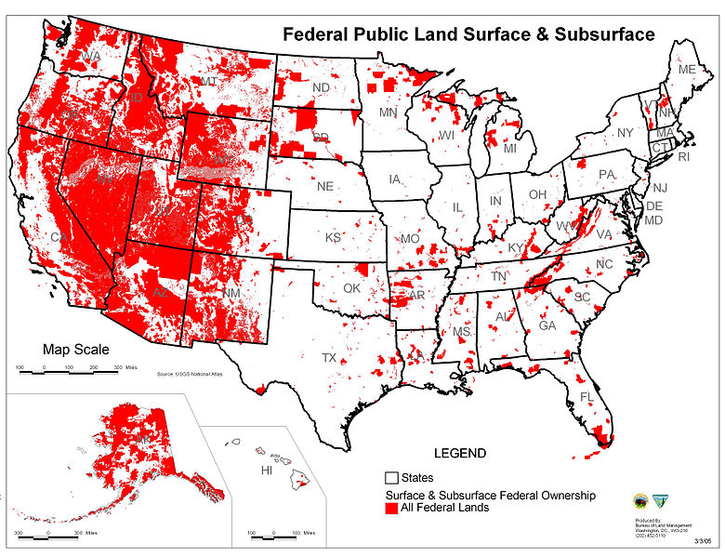
Federal Land Management Context

Slide 15
Federal Land Management Context
Right of Eminent Domain (1888)
Organic Administration Act (1897)
Transfer Act (1905)
Disposition of Receipts from National Forest Revenues (1907)
Weeks Law (1911)
Cooperative Funds (1914)
Brush Removal Fund (1916)
Minerals Resources on Weeks Lands (1917)
Migratory Bird Treaty Act (1918)
Mineral Leasing Act (1920)
General Exchange Act (1922)
Clarke-McNary Act (1924)
Facilitate and Simplify Work of Forest Service and to Promote Reforestation (1925)
Migratory Bird Conservation Act (1929)
Knutson-Vandenburg Act (1930)
Bankhead-Jones Farm Tenant Act (1937)
Domestic Water Supply (1940)
Bald and Golden Eagle Protection Act (1940)
Sustained-Yield Forest Management Act (1944)
Department of Agriculture Organic Act (1944)
Minerals Act (1947)
Federal Water Pollution Control Act (1948)
Ganger-Thye Act (1950)
Watershed Protection and Flood Prevention (1954)
Clean Air Act (1955)
Multiple Use Mining Act (1955)
Agriculture Organic Act (1956)
Forest Service Omnibus Act (1958)
Weeks Act Status of Certain Lands (1958)
Multiple-Use Sustained-Yield Act (1960)
Sikes Improvement Act (1960)
McIntyre-Stennis Act (1962)
Wilderness Act (1964)
Land and Water Conservation Fund (1964)
National Forest Roads and Trails Act (1964)
Federal Water Project Recreation Act (1965)
National Historic Preservation Act (1966)
Sisk Act (1967)
Wild and Scenic Rivers Act (1968)
National Trails System Act (1968)
National Environmental Policy Act (1969)
Federal Advisory Committee Act (1972)
Endangered Species Act (1973)
Preservation of Historical and Archeological Data (1974)
Federal Noxious Weed Act (1974)
Cooperative Funds and Deposits (1975)
Forest Ecosystems and Atmospheric Pollution Research Act (1976)
Federal Land Policy and Management Act (1976)
National Forest Management Policy Act (1976)
Department of Agriculture Advisory Committees (1977)
Soil and Water Resources Conservation Act (1977)
Renewable Resources Extension Act (1978)
Forest and Rangeland Renewable Resources Research Act (1978)
Cooperative Forestry Assistance Act (1978)
Public Rangelands Improvement Act (1978)
Archaeological Resources Protection Act (1979)
Reforestation Tax Incentives and Trust Fund (1980)
Alaska National Interest Lands Conservation Act (1980)
Forest and Rangeland Renewable Resources Planning Act (1980)
Forest Resources Conservation and Shortage Relief Act (1990)
National Forest Foundation Act (1990)
Native American Graves Protection and Repatriation Act (1990)
Food, Agriculture, Conservation, and Trade Act (1990)
National Indian Forest Resources Management Act (1990)
Department of the Interior and Related Agencies Appropriations Act, Forest Service Decisionmaking and Appeals Reform (1993)
Stewardship End Result Contracting Projects, Department of the Interior and Related Agencies Appropriations Act of Omnibus Consolidated and Emergency Supplemental Appropriations Act (1999)
Secure Rural Schools and Community Self-Determination Act (2000)
Healthy Forests Restoration Act (2003)
Evolving
Law, policy and regulatory framework

Slide 16
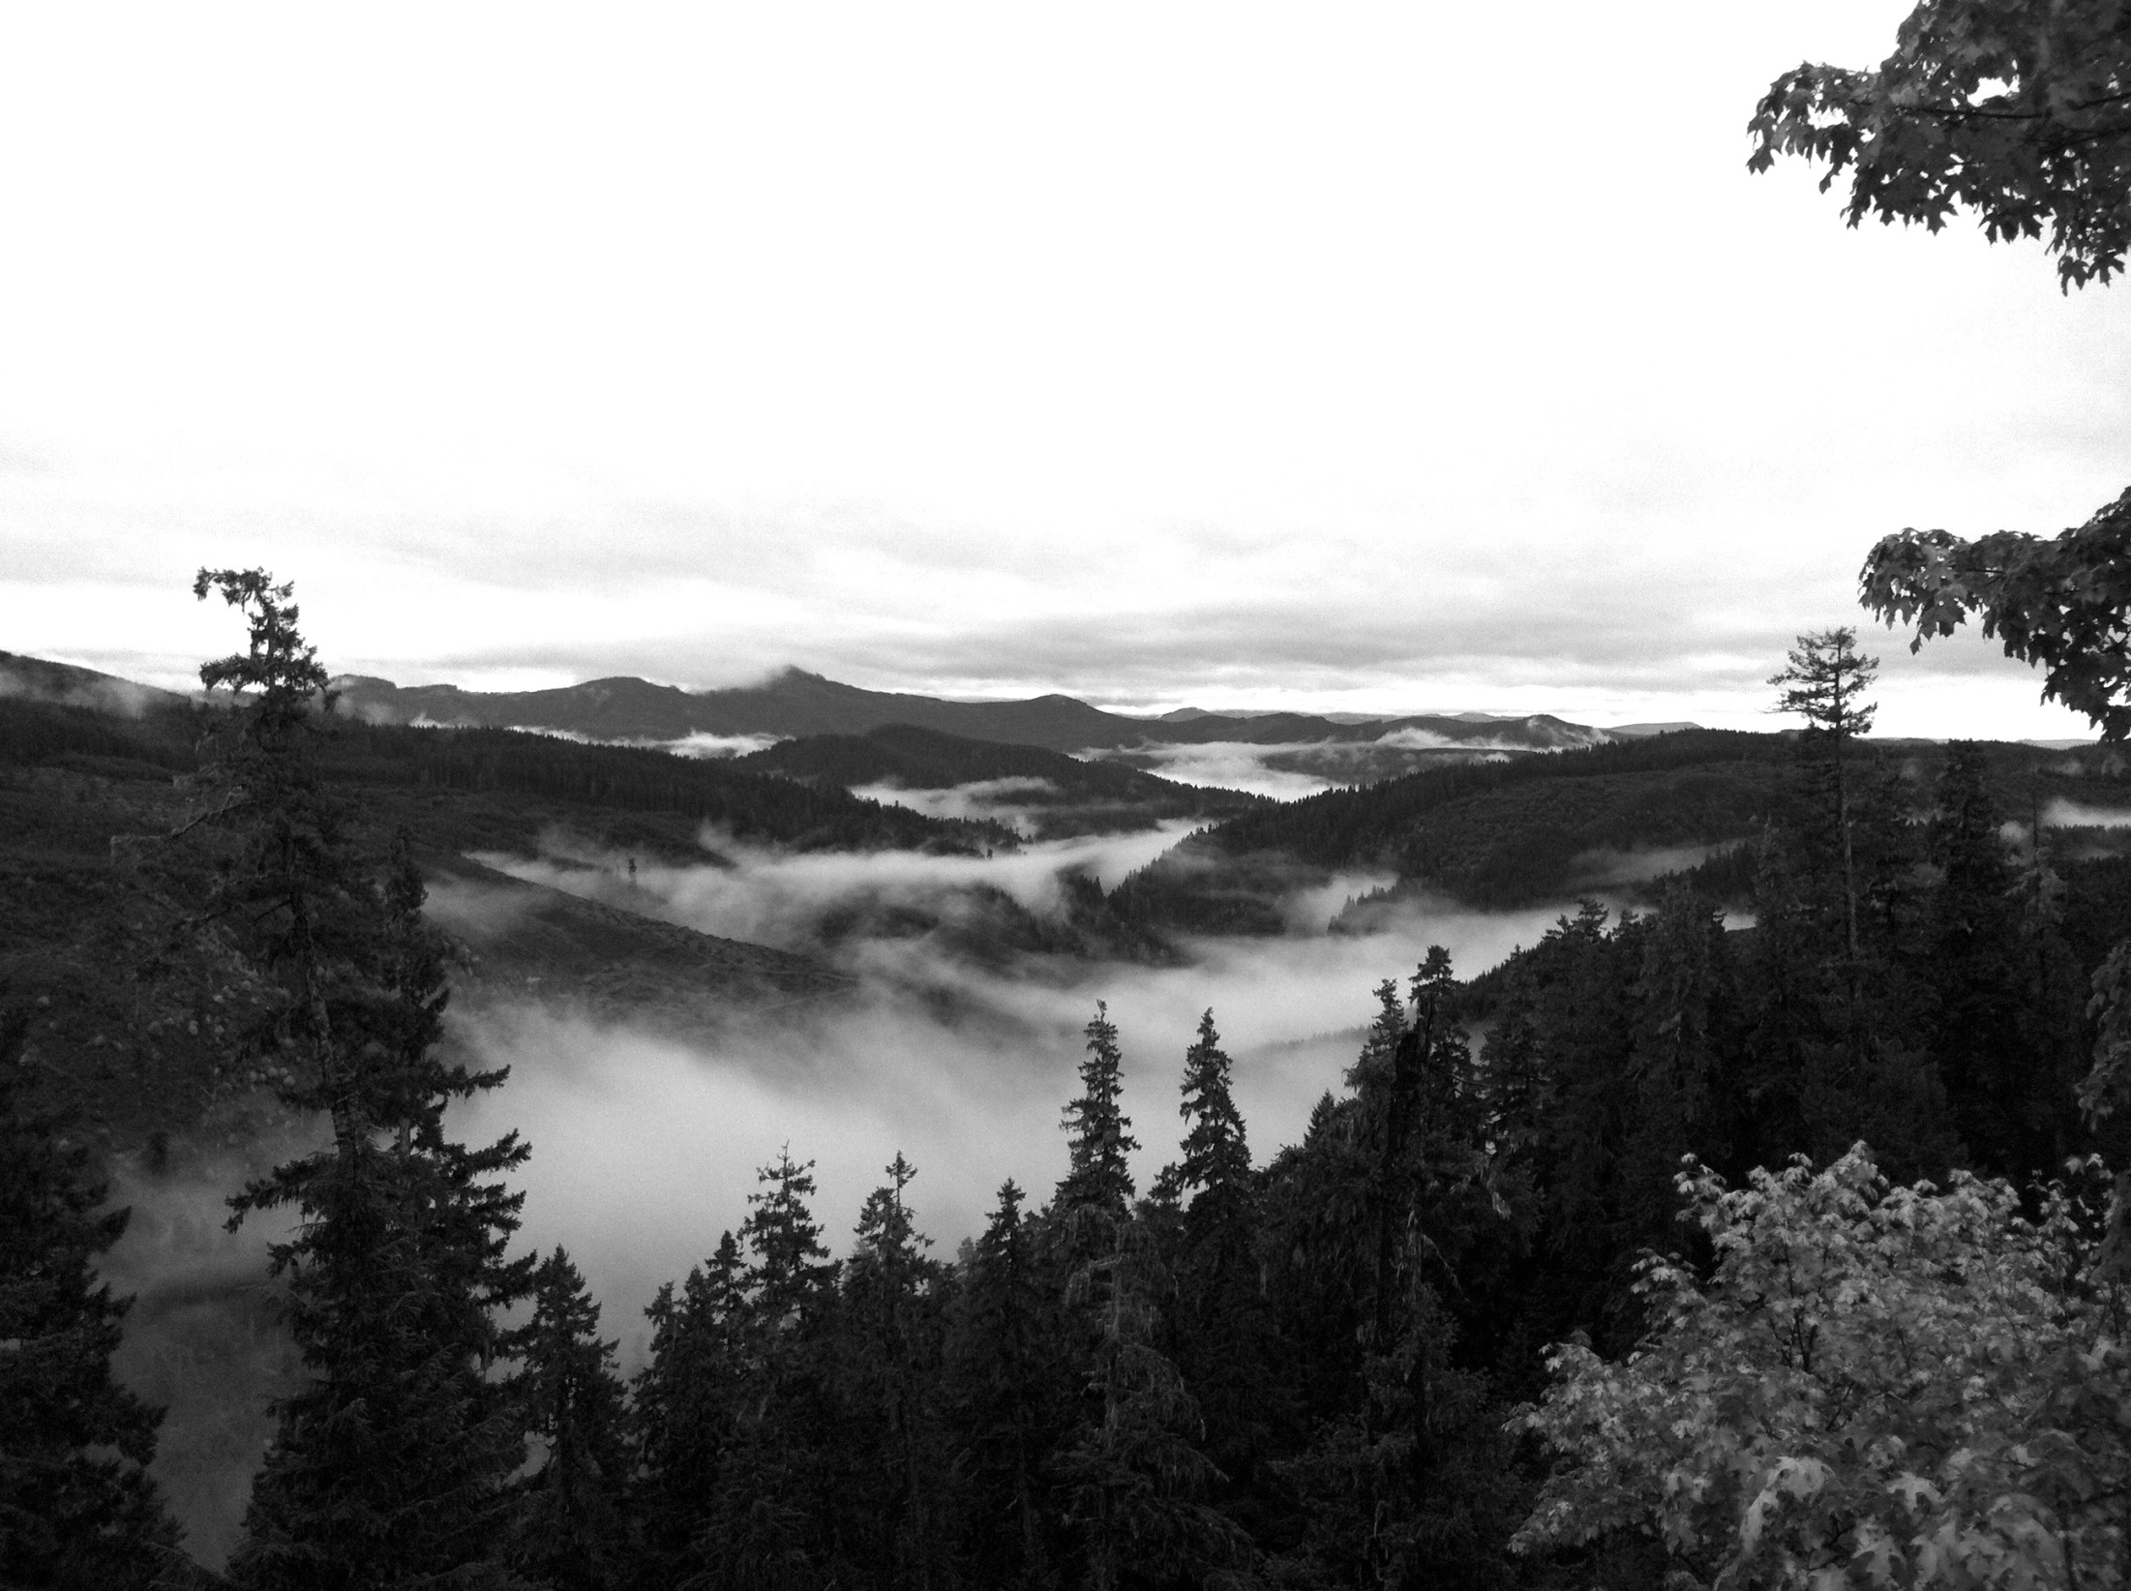
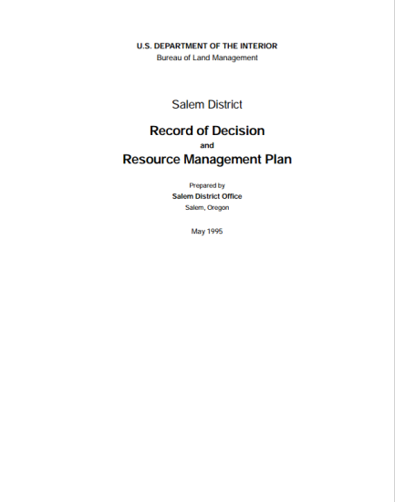
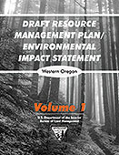
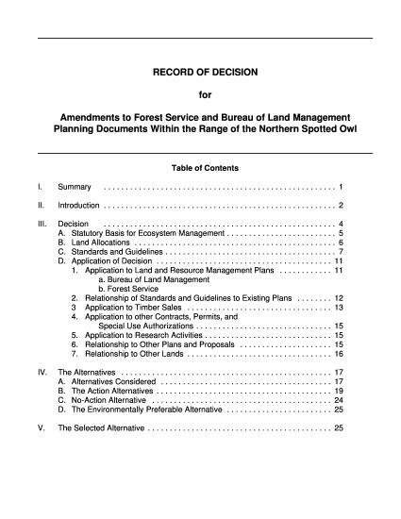
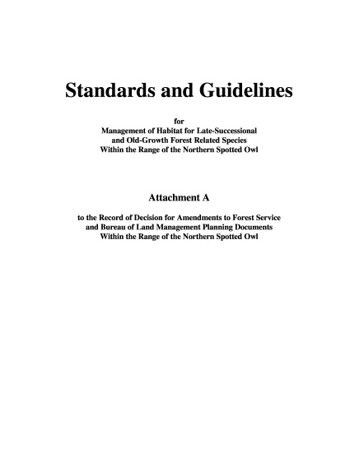
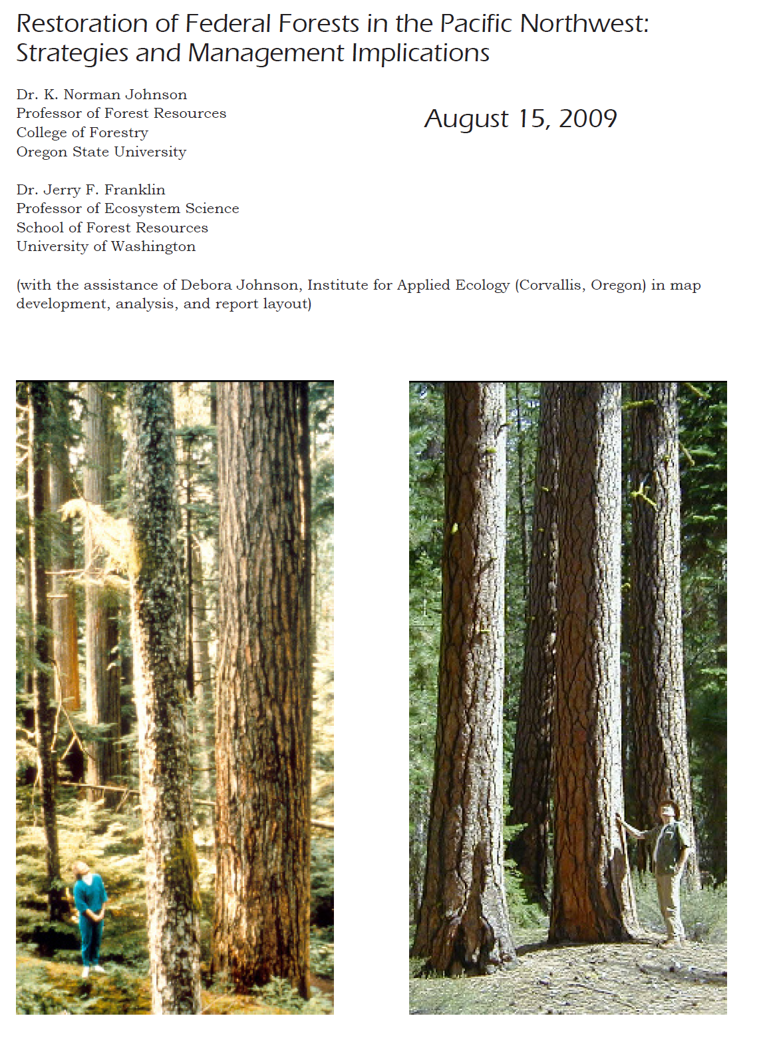
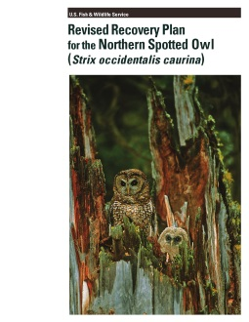
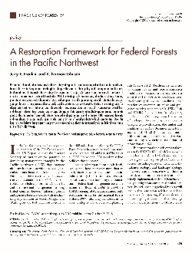
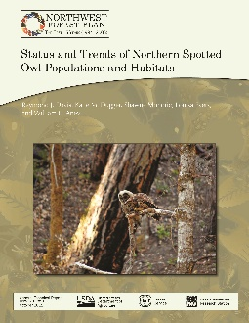
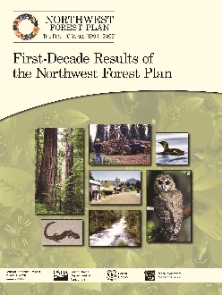
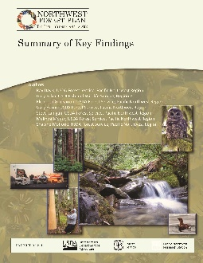
Federal Land Management Context
“The Northwest Forest Plan was not intended to be a static creation.
It was intended to evolve.”
-Pipkin, 1998

Slide 17
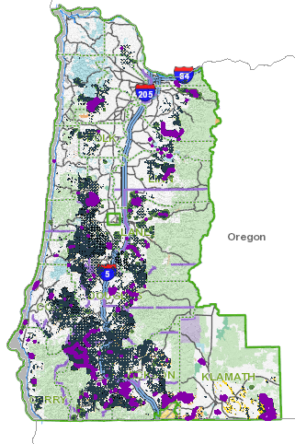
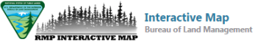
Western Oregon BLM Districts:
Draft Resource Management Plan/EIS
Western Oregon BLM Districts:
Coos Bay, Eugene, Medford, Roseburg, and Salem Districts and Lakeview District’s Klamath Falls Field Office
Purpose of RMP Revision:
Contribute to conservation and recovery of threatened and endangered species, including maintaining network of large blocks of forest to be managed for late-successional forests and maintaining older and more structurally complex multi-layered conifer forests
Provide sustained yield of timber
Provide clean water in watersheds
Restore fire-adapted ecosystems
Provide recreation opportunities
Coordinate management of lands surrounding the Coquille Forest with the Coquille Tribe
BLM RMP Interactive Map Viewer:
https://rmpwo.geocortex.com/Html5Viewer/Index.html?viewer=rmpwo

Slide 18
Western Oregon BLM Districts:
Draft Resource Management Plan/EIS
Alternative | Total Late-Successional Reserve (Acres) | Riparian Reserve (Total Width) | Riparian Reserve (Inner Zone Width) | Marbled Murrelet Survey and Protection | Protection of Structurally-Complex Forest
No Action | 478,860 | 2 SPTH on fish-bearing streams; 1 SPTH on non-fish-bearing streams | None specified | Survey in Zones 1&2; protect contiguous recruitment and existing habitat within ½-mile of sites | None specified
Alt. A | 1,147,527 | 1 SPTH on all streams | 120’ on perennial and fish-bearing streams; 50’ on non-fish-bearing intermittent streams | None | ≥ 120 years
Alt. B | 1,127,320 | 1 SPTH on perennial and fish-bearing streams; 100’ on debris-flow-prone non-fish-bearing intermittent streams; 50’ on other non-fish-bearing intermittent streams | 100’ on perennial and fish-bearing streams; 50’ on non-fish-bearing intermittent streams | Survey in Zone 1; protect contiguous habitat within 300’ of sites | District-defined map based on existing, district-specific information
Sub. B | 1,422,933
Alt. C | 949,279 | 150’ on fish-bearing streams; 50’ on non-fish-bearing streams | 60’ on fish-bearing streams; 50’ on non-fish-bearing streams | Survey stands >120 years; protect contiguous habitat within 300’ of sites | ≥ 160 years
Sub. C | 1,373,206 |  |  | None | ≥ 80 years
Alt. D | 714,292 | 1 SPTH on all streams | 120’ on all streams | Survey in Zones 1 and 2; protect habitat within ½-mile of sites | ≥ 120/140/160 years on high/moderate/low productivity sites

Slide 19
Western Oregon BLM Districts:
Draft Resource Management Plan/EIS
Alternative | Total Late-Successional Reserve (Acres) | Riparian Reserve (Total Width) | Riparian Reserve (Inner Zone Width) | Marbled Murrelet Survey and Protection | Protection of Structurally-Complex Forest
No Action | 478,860 | 2 SPTH on fish-bearing streams; 1 SPTH on non-fish-bearing streams | None specified | Survey in Zones 1&2; protect contiguous recruitment and existing habitat within ½-mile of sites | None specified
Alt. A | 1,147,527 | 1 SPTH on all streams | 120’ on perennial and fish-bearing streams; 50’ on non-fish-bearing intermittent streams | None | ≥ 120 years
Alt. B | 1,127,320 | 1 SPTH on perennial and fish-bearing streams; 100’ on debris-flow-prone non-fish-bearing intermittent streams; 50’ on other non-fish-bearing intermittent streams | 100’ on perennial and fish-bearing streams; 50’ on non-fish-bearing intermittent streams | Survey in Zone 1; protect contiguous habitat within 300’ of sites | District-defined map based on existing, district-specific information
Sub. B | 1,422,933
Alt. C | 949,279 | 150’ on fish-bearing streams; 50’ on non-fish-bearing streams | 60’ on fish-bearing streams; 50’ on non-fish-bearing streams | Survey stands >120 years; protect contiguous habitat within 300’ of sites | ≥ 160 years
Sub. C | 1,373,206 |  |  | None | ≥ 80 years
Alt. D | 714,292 | 1 SPTH on all streams | 120’ on all streams | Survey in Zones 1 and 2; protect habitat within ½-mile of sites | ≥ 120/140/160 years on high/moderate/low productivity sites

Slide 20
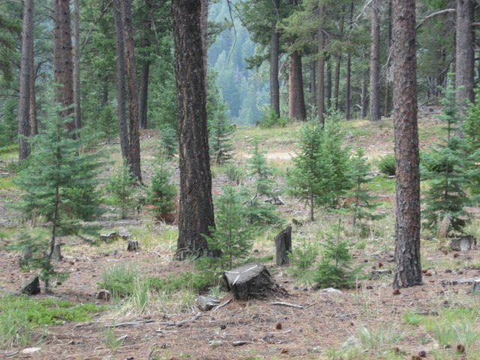
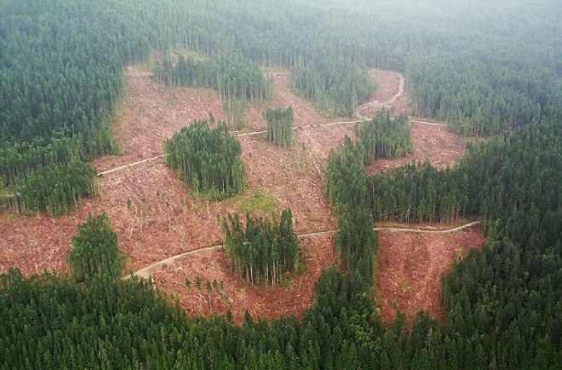
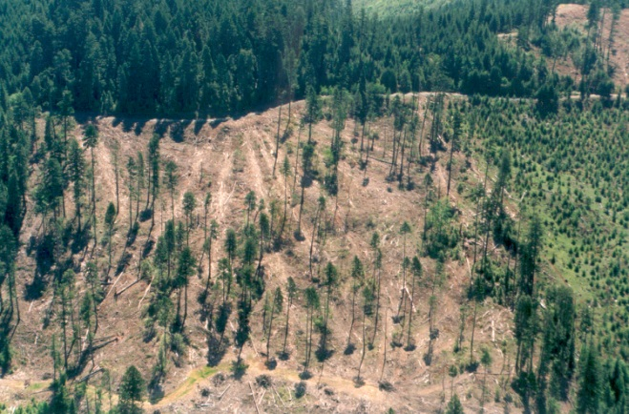
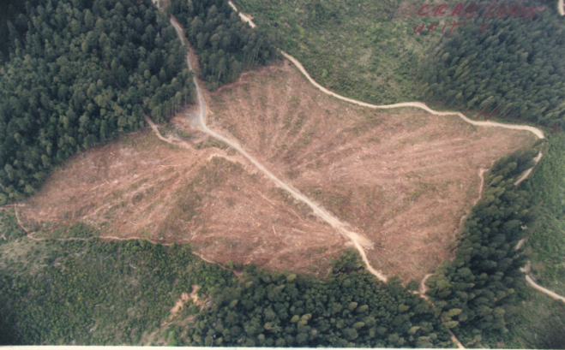
Silvicultural Toolbox
Low Intensity Timber Area: 15-30% retention
-Variable Retention
-Two-Aged (Emphasis on Aggregates)
Uneven-Aged and Owl Habitat Timber Areas:
-Group Selection
-Uneven-Aged
Moderate Intensity Timber Area: 5-15% retention
-Variable Retention
-Two-Aged (Emphasis on Dispersed Trees)
High IntensityTimber Area:
-Clearcut
-Even-Aged

Slide 21




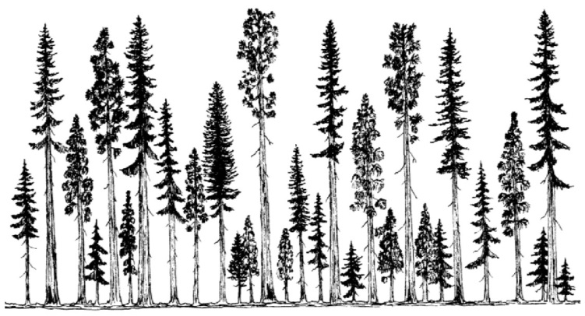
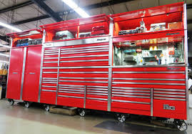
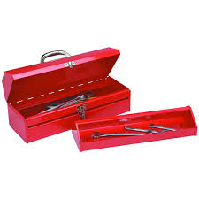
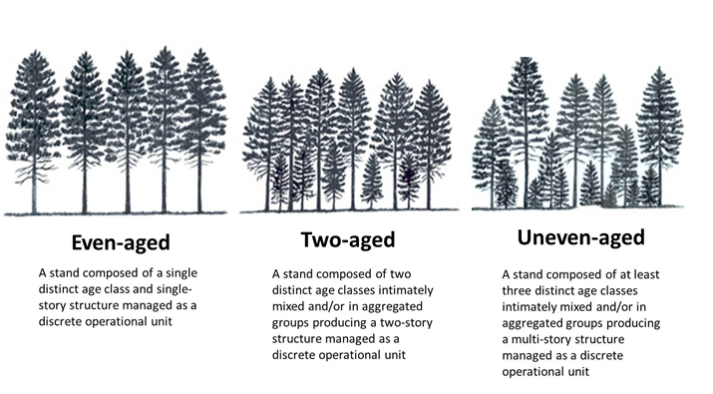
Silvicultural Toolbox

Slide 22

Management Tradeoffs:
Opportunities and Constraints
Ecological, economic and social implications:
  Management opportunities and constraints:
    Silvicultural “toolbox”
    Single vs. multiple entries and NEPA process
  Land Use Allocations
  Stand- and Landscape-Scale Resiliency
  Structural Variability
  Species Diversity
  Tree Vigor and Stand Productivity
  Coarse Wood Recruitment
  Wildlife Habitat
  Socioeconomic implications

Slide 23

Thank You

