Slide 1
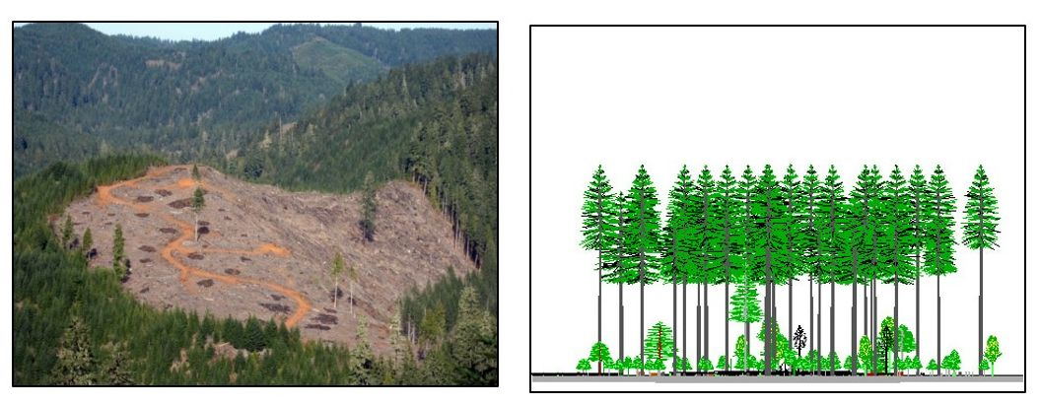
High intensity Timber Area (HITA) No retention = clearcut – Even-aged
Outside Large Blocks, Inside & Outside Critical Habitat
Management Hypothesis
Highest timber production yields.
Produces uniform stand conditions.
Shorter Rotations, Trend towards 60-90

Slide 2
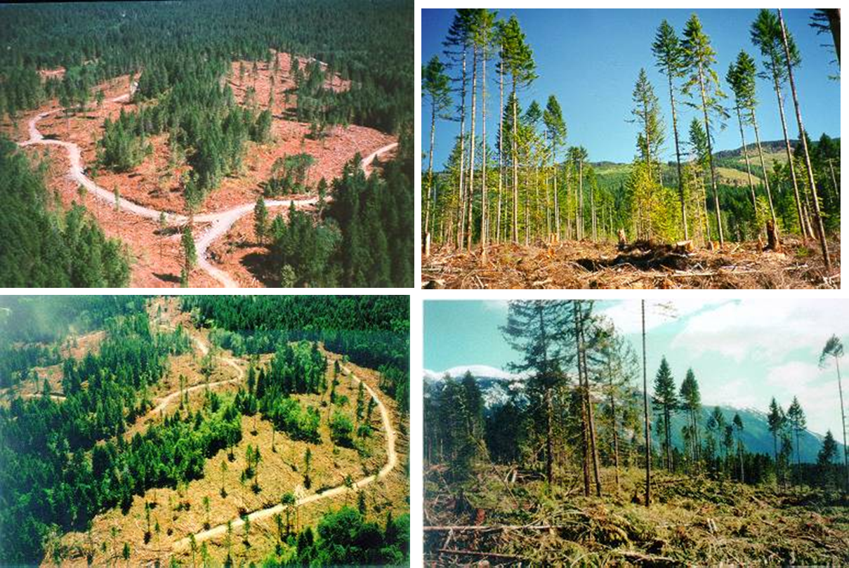
Two-aged — Variable-retention harvest
Two levels of retention proposed

Slide 3
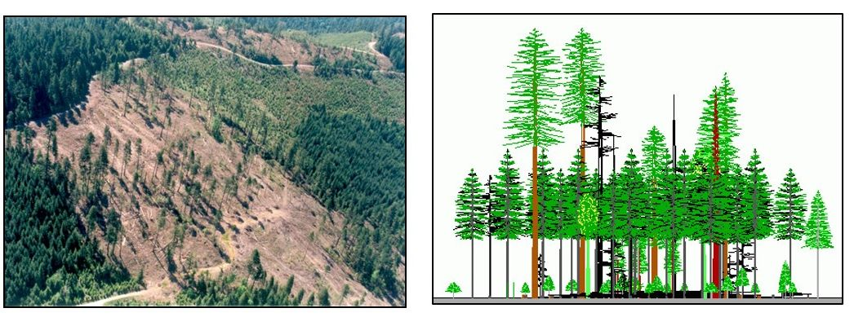
Moderate Intensity Timber Area (MITA) 5-15% Retention = Variable-retention Regeneration Harvest (VRH) – Two Aged Somewhat equivalent to GFMA/NGFMA in NAA
Outside Large Blocks, Outside Critical Habitat
Management Hypothesis:
Provides moderate timber production yields.
Produces compositionally/structurally complex stand conditions.
Longer Rotations, Trend towards 80-140
8/4/2025

Slide 4
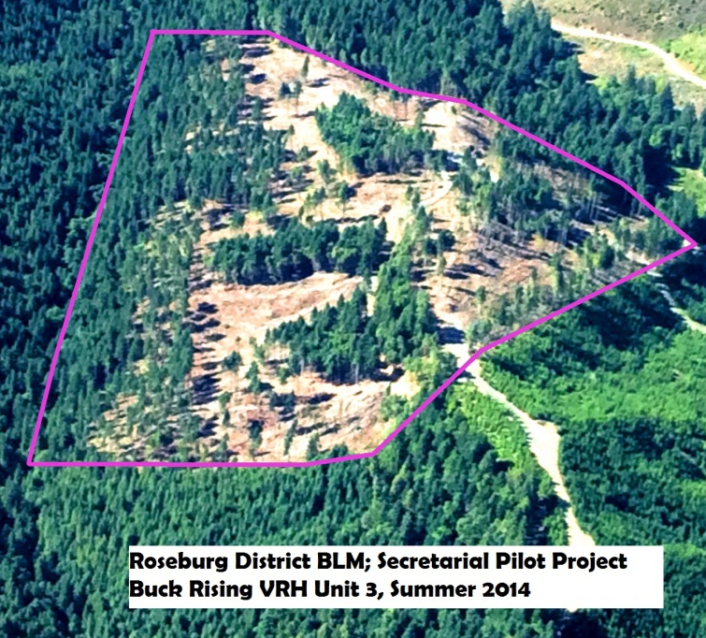
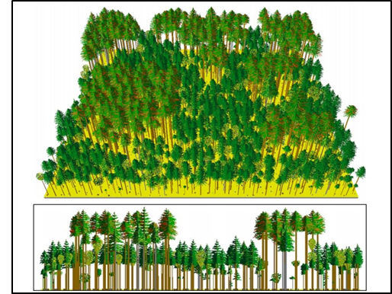
Low Intensity Timber Area (LITA) 15-30% Retention = Variable-retention Regeneration Harvest (VRH) - Two Aged Somewhat equivalent to Connectivity/SGFMA in NAA
Outside Large Blocks, Inside Critical Habitat
Management Hypothesis:
Provides moderate timber production yields.
Produces compositionally/structurally complex stand conditions.
Longest Rotations, Trend towards 100-160

Slide 5
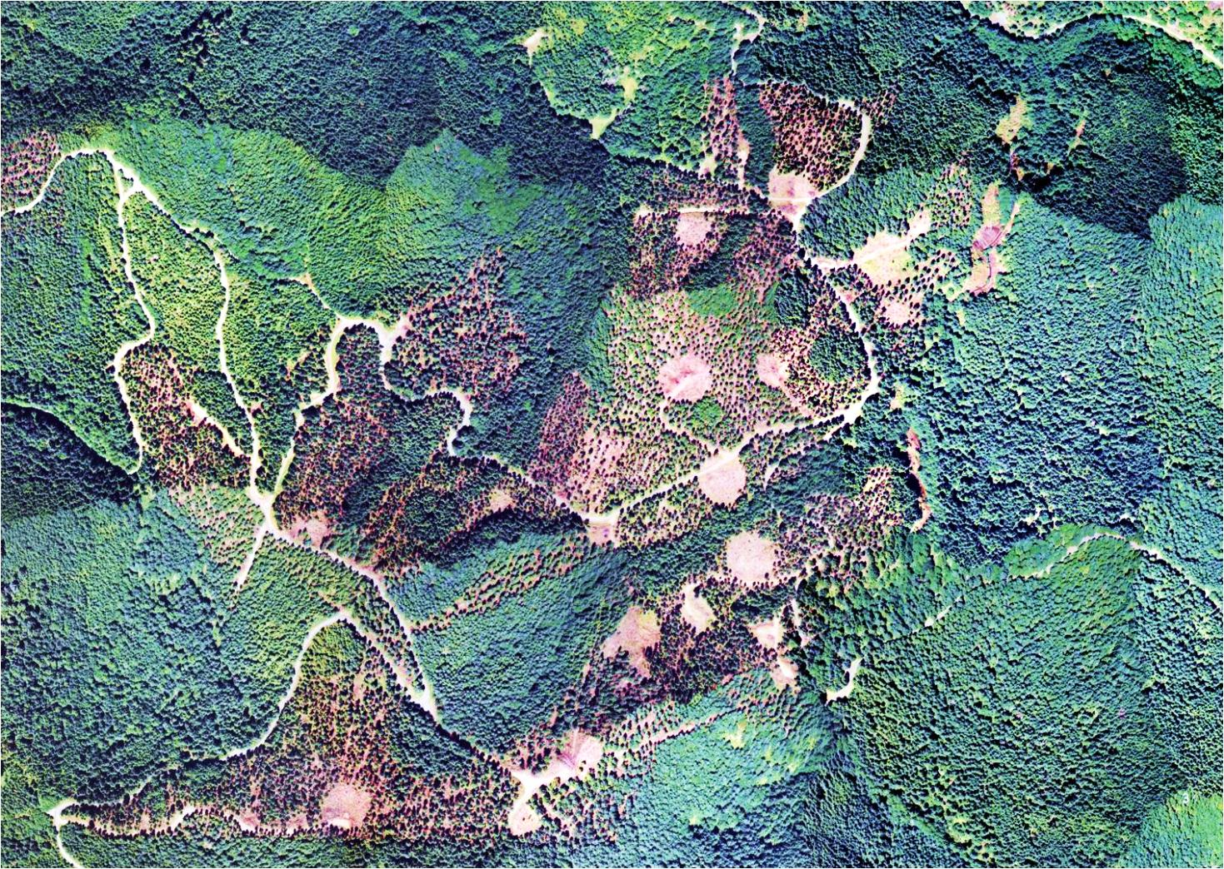
Uneven-aged Timber Area(UTA) – Fire/drought/insect resiliency focused
Owl Habitat Timber Area (OHTA) – Owl habitat focused
Uneven-aged Management:
Lowest long-term timber yields.
Creates and maintains complex late successional conditions.
No rotation age. Variable re-entry cycle.
Visually the approach would look similar in many respects to a complex variable-density thinning

Slide 6
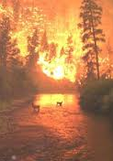


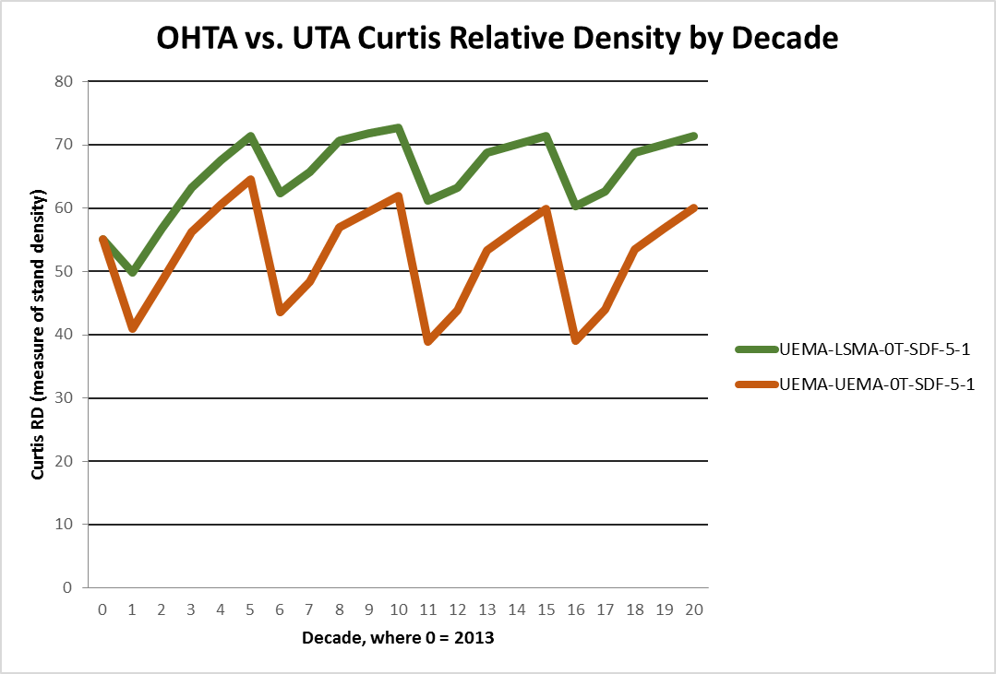
Uneven-aged Management
Owl Habitat Timber Area (OHTA)
Lighter touch treatments to restore/ maintain NSO habitat and produce wood.
Alt. D only.
Stand Density
Uneven-aged Timber Area (UTA)
Heavier treatments to reduce stand densities, increase fire resiliency/ forest health and produce wood.
Alts A, B, C, and D
Time in Decades
8/4/2025

Slide 7
Uneven-aged Management
Concept is a modified uneven-aged management technique
modified because a portion of the stand is permanently retained, i.e., green-tree retention with emphasis on aggregates that are not subject to group select (patch) cutting
permanent retention ≈ variable depending on whether fire resiliency or owls is the objective

Slide 8
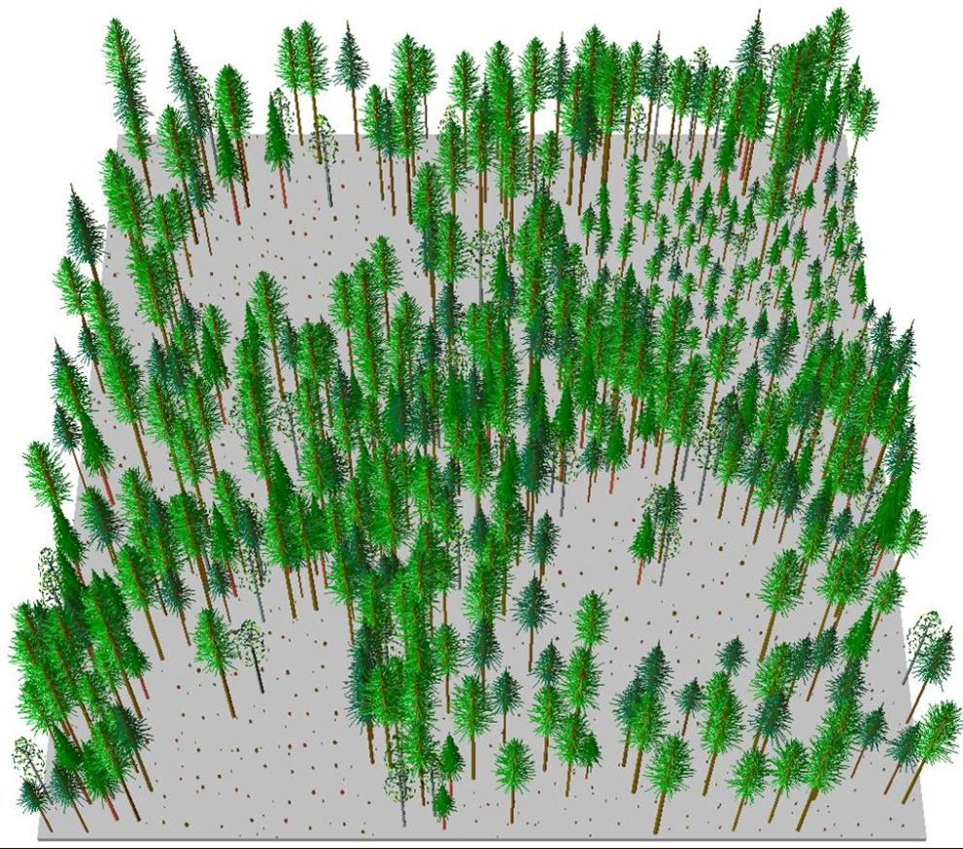
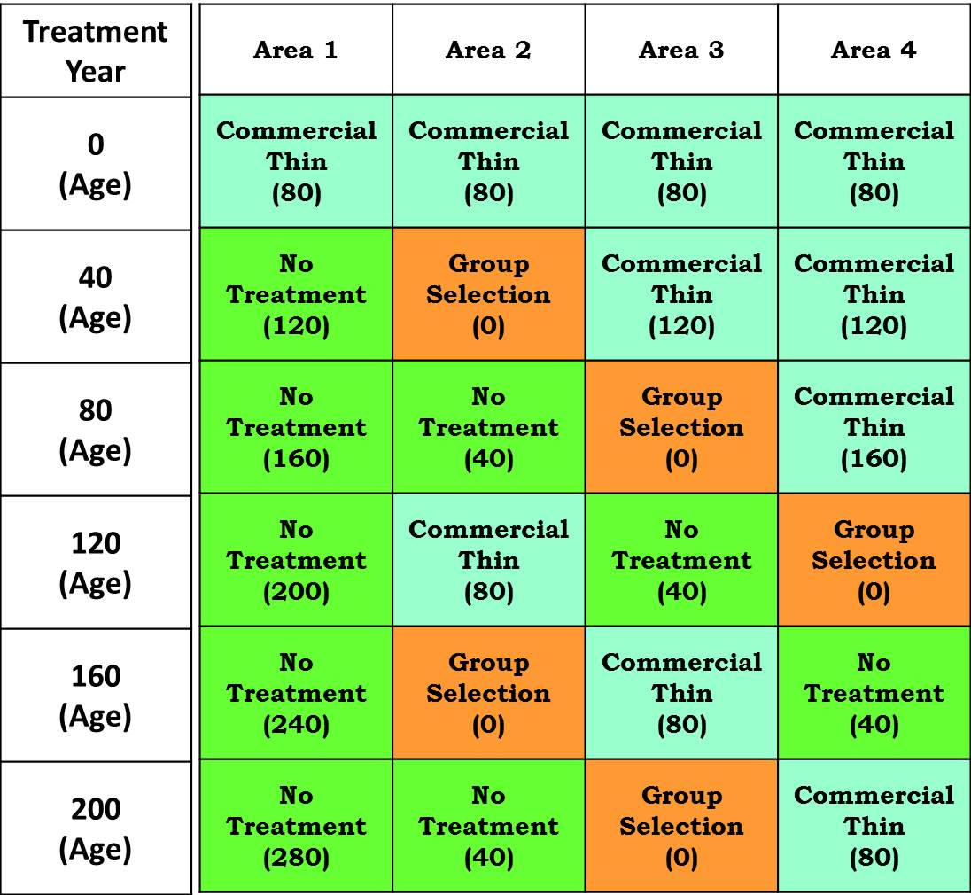
Uneven-aged Example
Harvest activities over a 100 year period starting at age 80 managed on a 40 year harvest cycle
Different treatments are applied to discreet areas depending on the stand prescription
Commercial and non-commercial activities may occur at the scheduled time or non-commercial activities at appropriate times

Slide 9
Uneven-aged Management
Harvest treatments may include varying amounts of:
thinning (intermediate cuts and/or single-tree selection)
group selections
may vary in size and shape
Objectives include:
Fire resistance/resilience
Old growth tree release and cultivation
Forest Health
Species and structural diversity
Timber production
Late successional habitat development

Slide 10
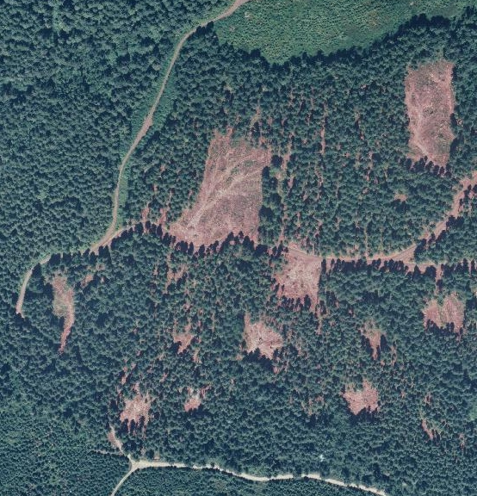
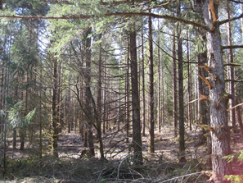
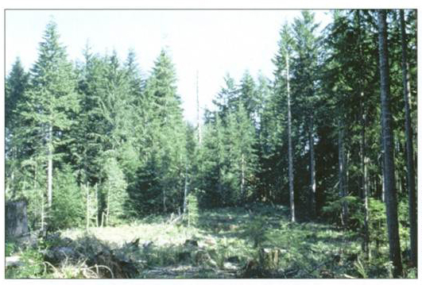
Uneven-aged Management

Slide 11
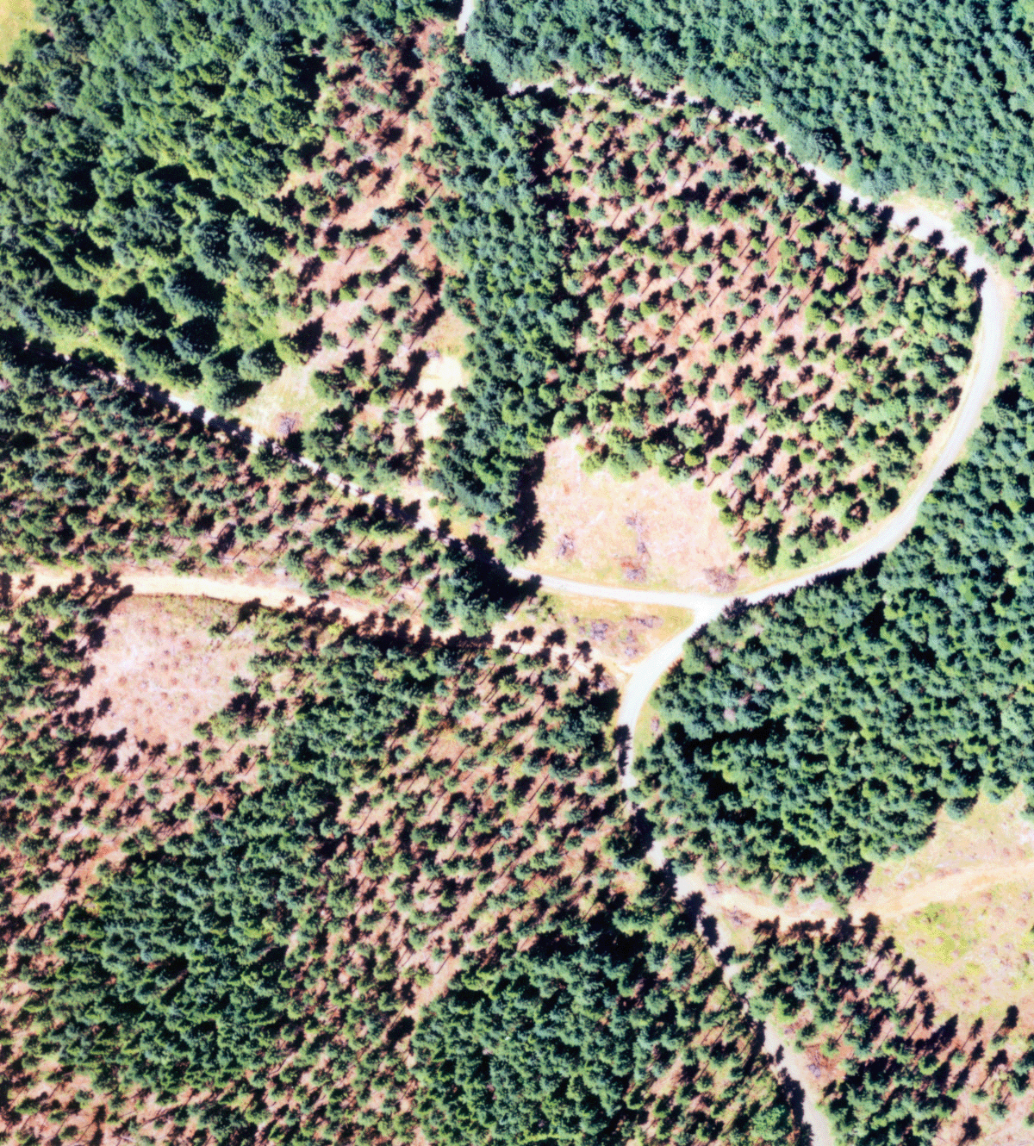
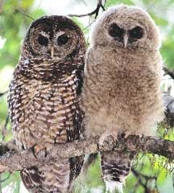
Uneven-aged management in Large Blocks (NSO)

Slide 12
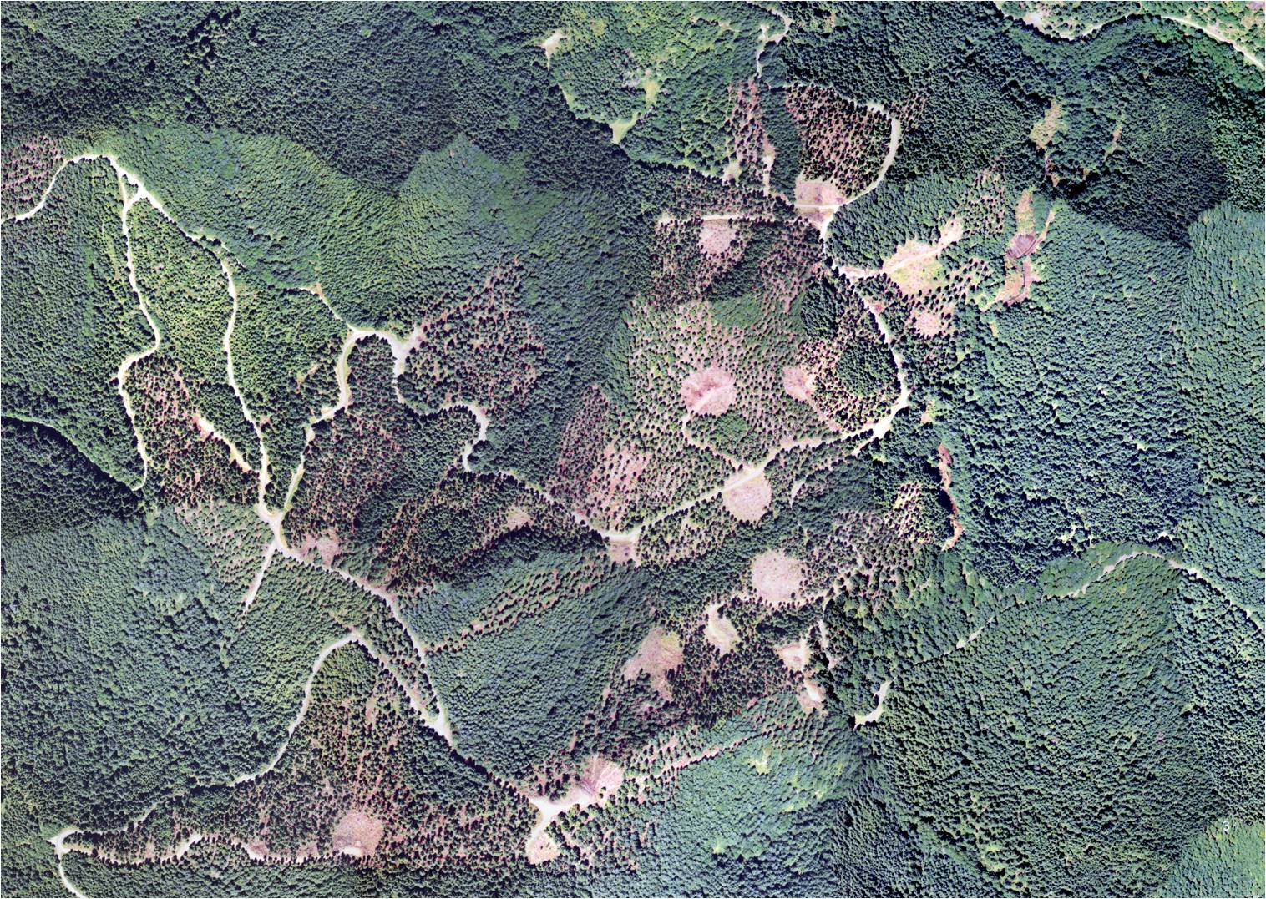
VDT or Uneven-aged Management?
Visually and operationally the Uneven-aged approach would look similar in many respects to a complex Variable-density thinning

Slide 13
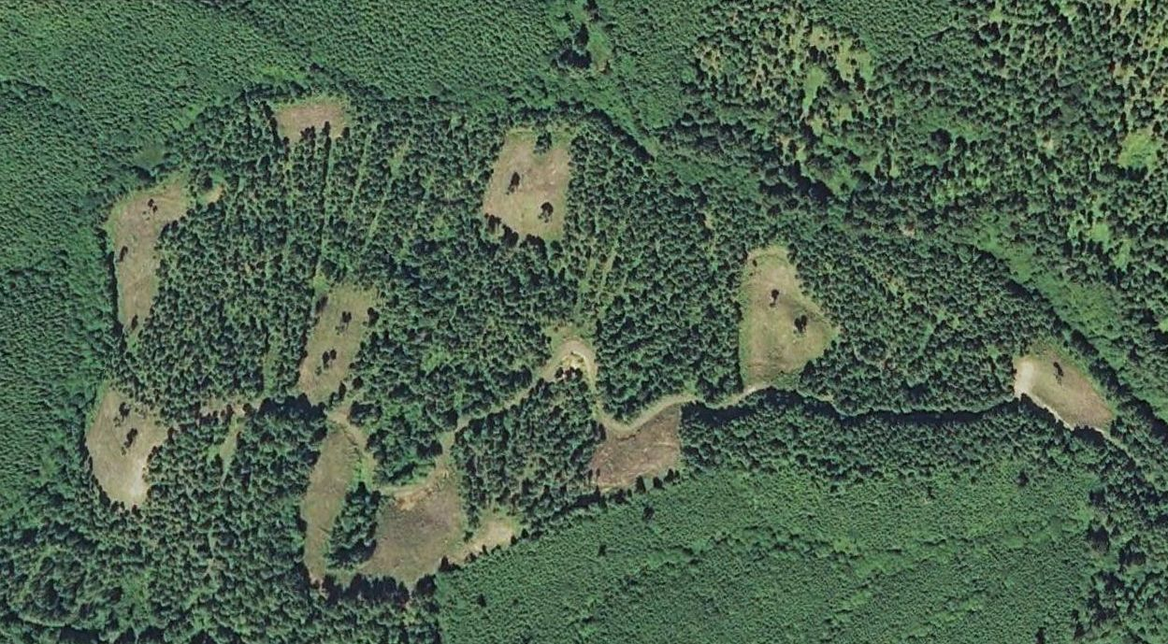
VDT or Uneven-aged Management?
Visually and operationally the Uneven-aged approach would look similar in many respects to a complex Variable-density thinning

Slide 14
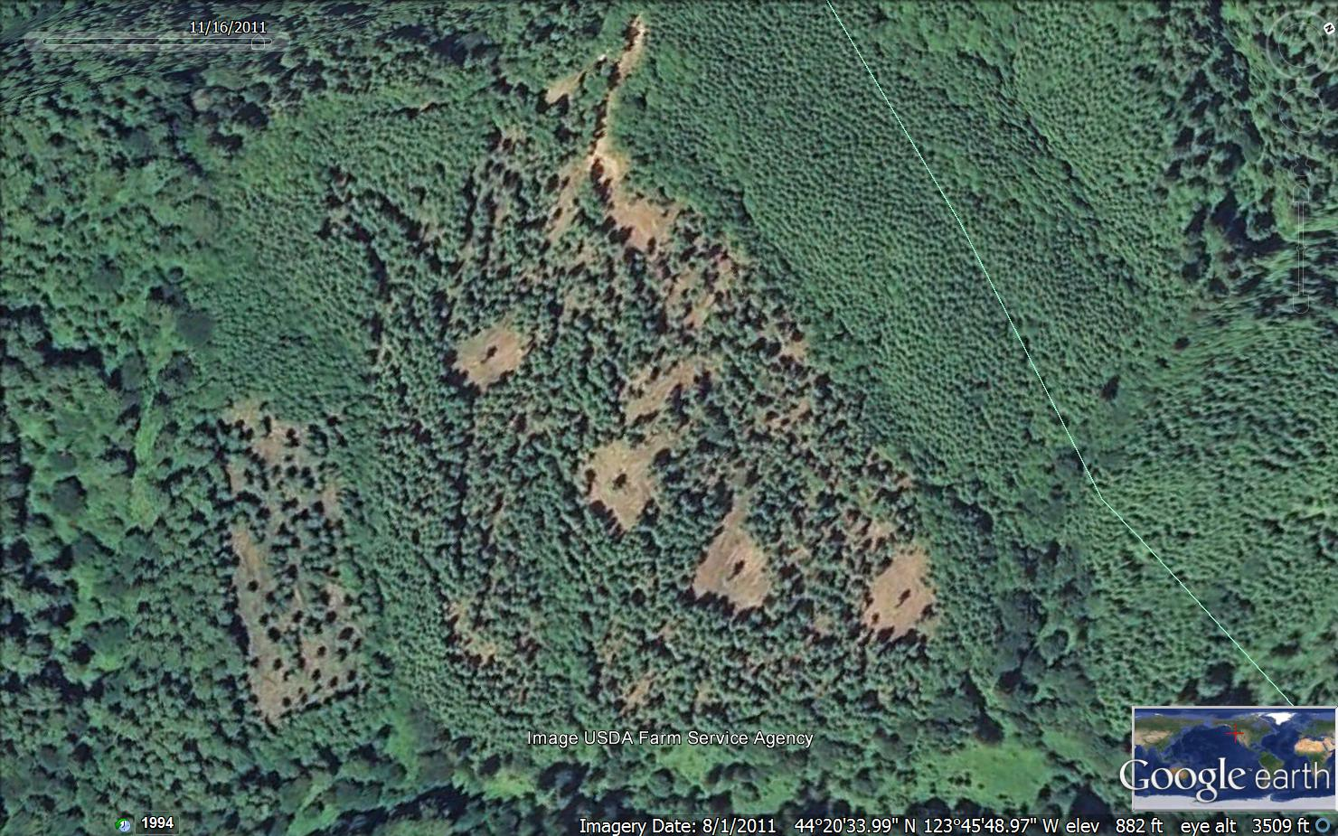
VDT or Uneven-aged Management?
Visually and operationally the Uneven-aged approach would look similar in many respects to a complex Variable-density thinning

Slide 15
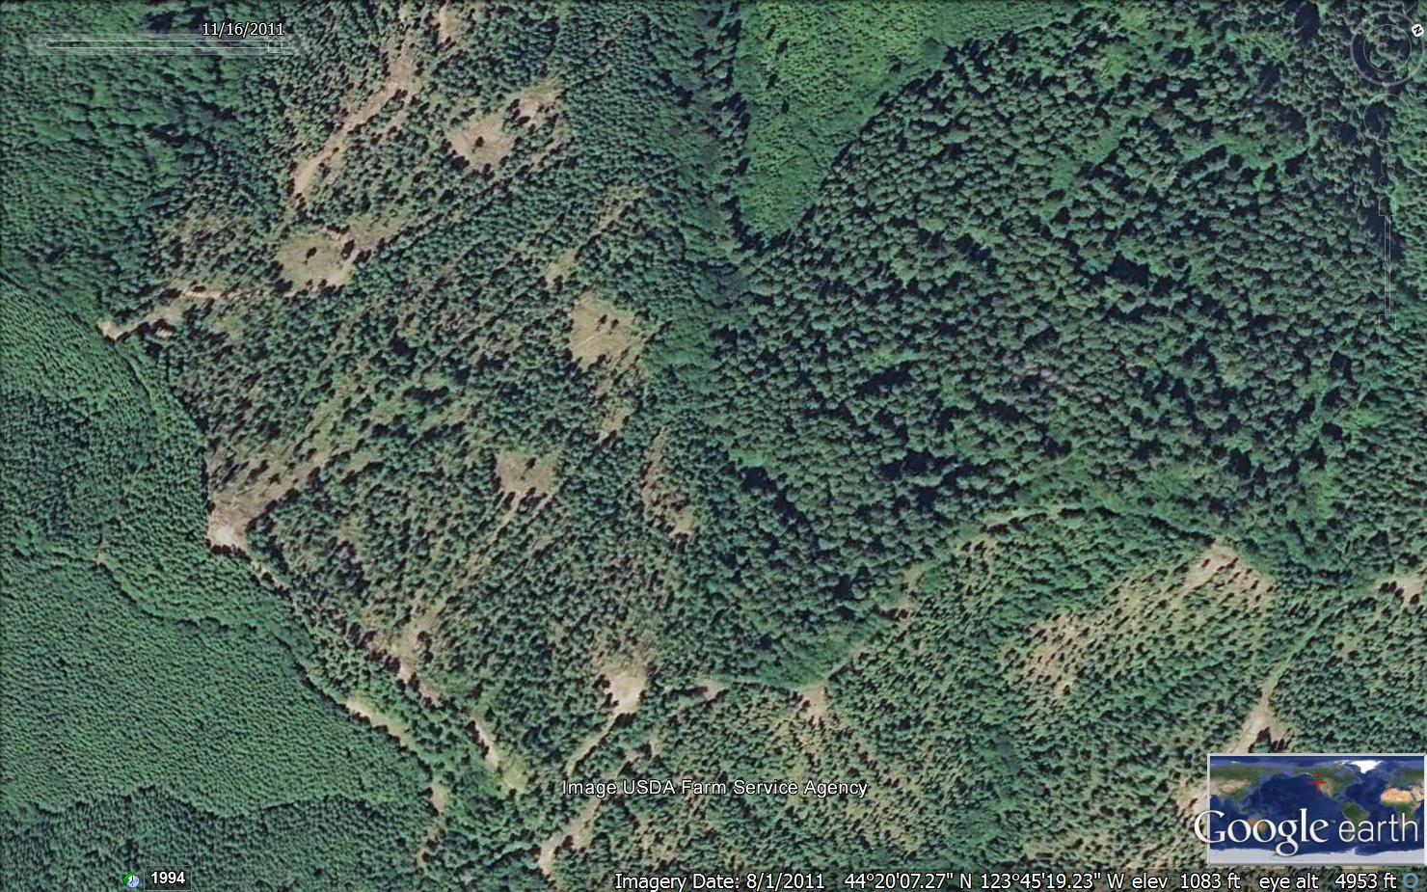
VDT or Uneven-aged Management?
Visually and operationally the Uneven-aged approach would look similar in many respects to a complex Variable-density thinning

Slide 16
Uneven-aged Management in “Young” Stands in NSO Habitat Blocks
In younger structurally-simple stands (dispersal habitat) apply silvicultural treatments to speed the develop-ment of structurally-complex forest or improve the quality of NSO habitat in the stand and adjacent stands
Do not preclude or delay by 20 years or more the development of northern spotted owl nesting-roosting habitat in the stand and in adjacent stands
In stands that are currently Nesting Roosting Habitat, maintain nesting-roosting habitat function regardless of northern spotted owl occupancy
Draft RMP/EIS pg. 957

Slide 17
Potential for Sustained Yield Harvest in Large Blocks for NSO
Concept derived from collaborative efforts and observations of current variable-density thinning (VDT) outcomes and research studies
Sustainable version of the “thinning only” approach.

Slide 18
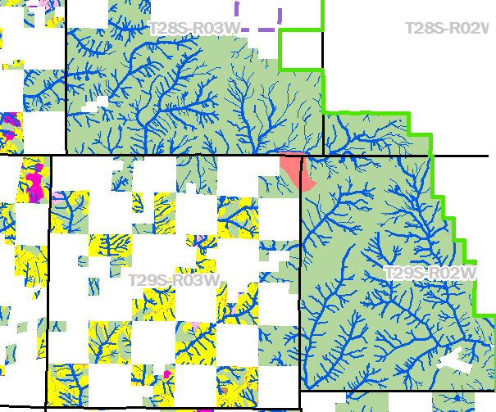
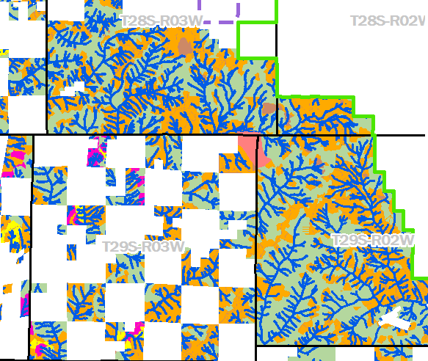
Owl Habitat Timber Area (ASQ) Orange
Contributes to function of the large block, but are not reserved from sustainable timber harvest.
Volume counts towards timber targets (ASQ).
Potentially Larger Harvest Land Base
Uneven-aged management = Habitat Creation and Maintenance
perpetual source of Timber, albeit at a relatively low level.
Notes:
Large amount of young stands in NSO large blocks (includes over 80 stands in some alternatives) might be managed on sustained yield basis without compromising objective of large block

Slide 19
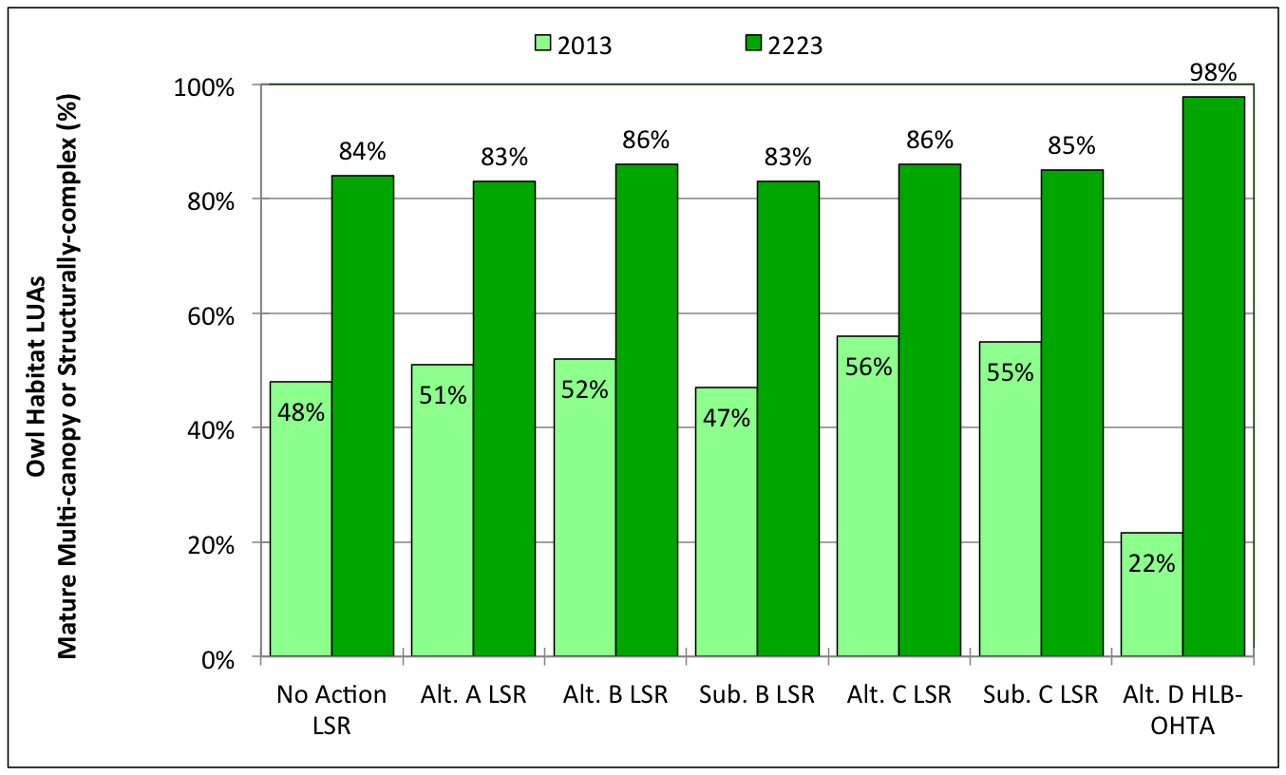
Analytical Results: Proportion of owl habitat management areas achieving Mature Multiple Canopy or Structurally Complex status
Strongly Selected For by NSO
Draft RMP/EIS pg. 254; Figure 3-68

Slide 20
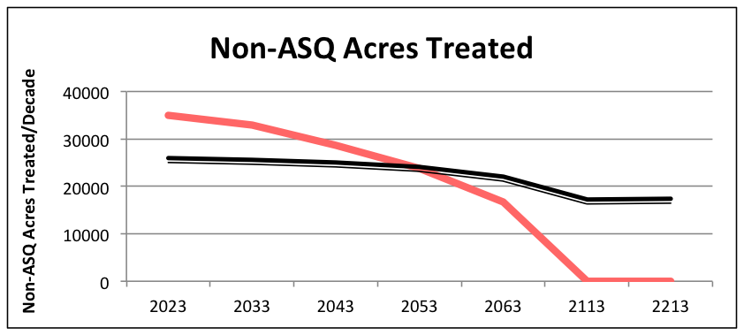
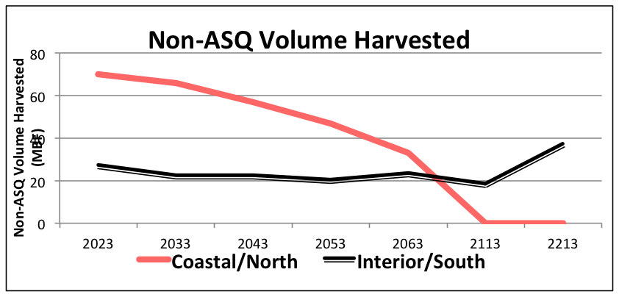
Analytical Results: Non-ASQ harvest flow; coastal/north vs. interior/south. Alternative B example
Strict age limits: (e.g. protect all current and future stands >80 years old):
leads to reduction in timber harvest to zero in time
Draft RMP/EIS pg. 273-274; Table 3-65

Slide 21

SUMMARY
The draft RMP/EIS alternatives:
Test a variety of approaches to protect older/structurally complex forests.
Test a variety of silvicultural systems to achieve sustained yield timber harvest and ecological objectives.
Stand Age
Is more reliable/useful in even-aged stands (moist forest) than uneven-aged stands (dry forest)
Strict age limits (e.g. protecting all current and future trees >80 years old) precludes long-term sustained yield timber harvest.

Slide 22
PUBLIC COMMENT
The public comment period goes through July 23, 2015:
RMPs for Western Oregon Bureau of Land Management P.O. Box 2965 Portland, Oregon 97208
Electronic mail (email): blm_or_rmpwo_comments@blm.gov

Slide 23

Questions?

