Slide 1
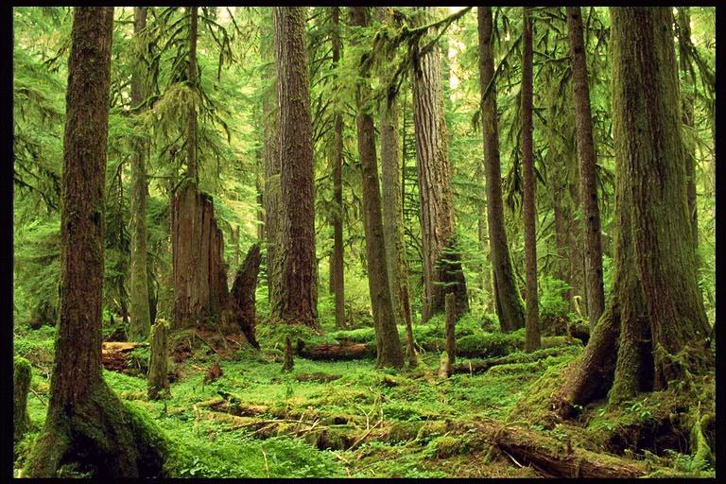
“Restoration”
Opportunities in “Over 80” on the
Mesic Westside

Slide 2
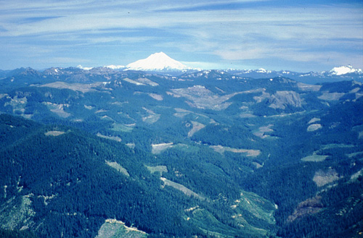
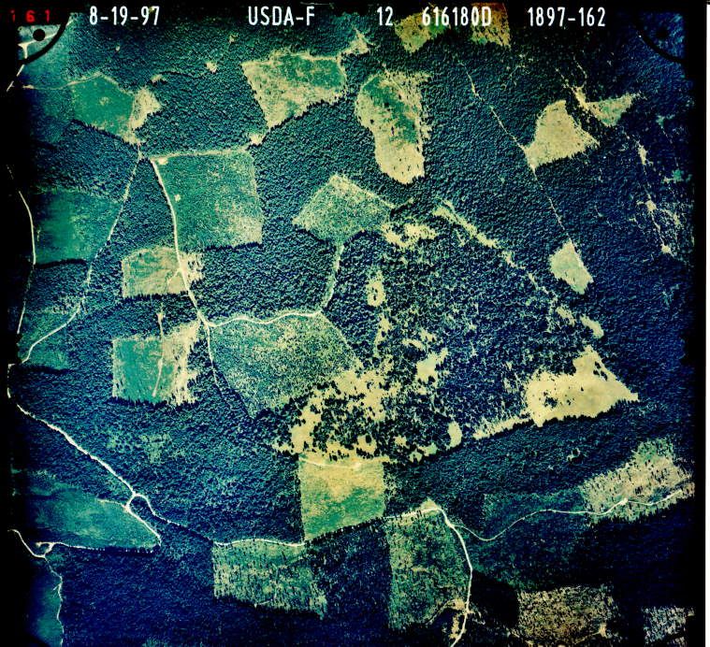
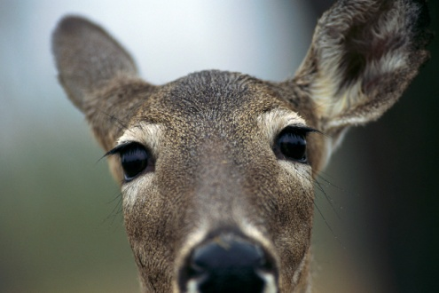

Legacy: harvest technique dominated by clearcutting + fire suppression
Staggered settings: good for big game and Doug-fir!

Slide 3
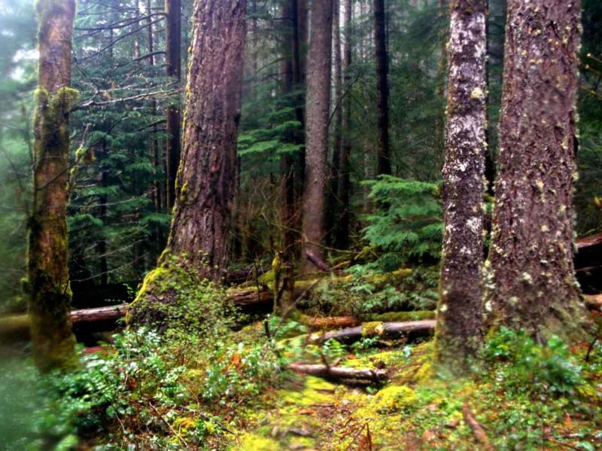
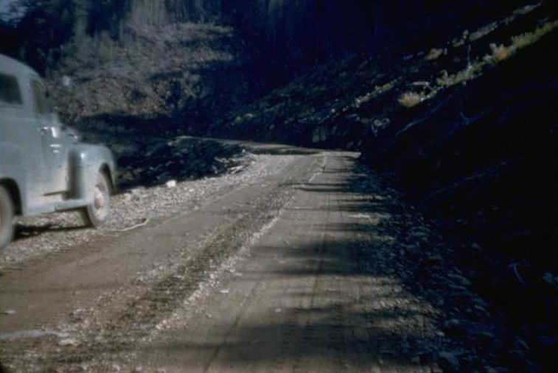
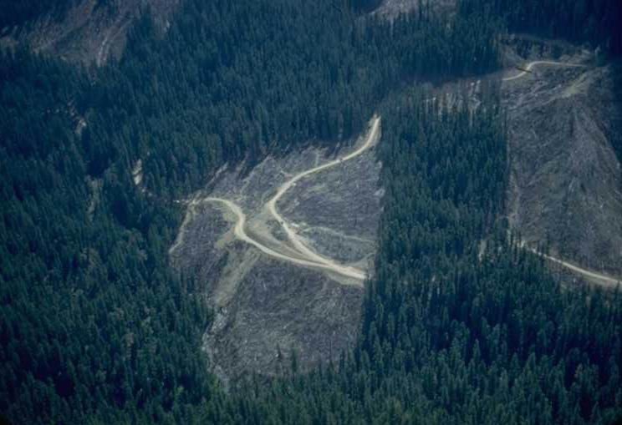
2 Drivers: Road Location Highest Volume/Acre
Model technology of the day: DFSIM and SNAP

Slide 4
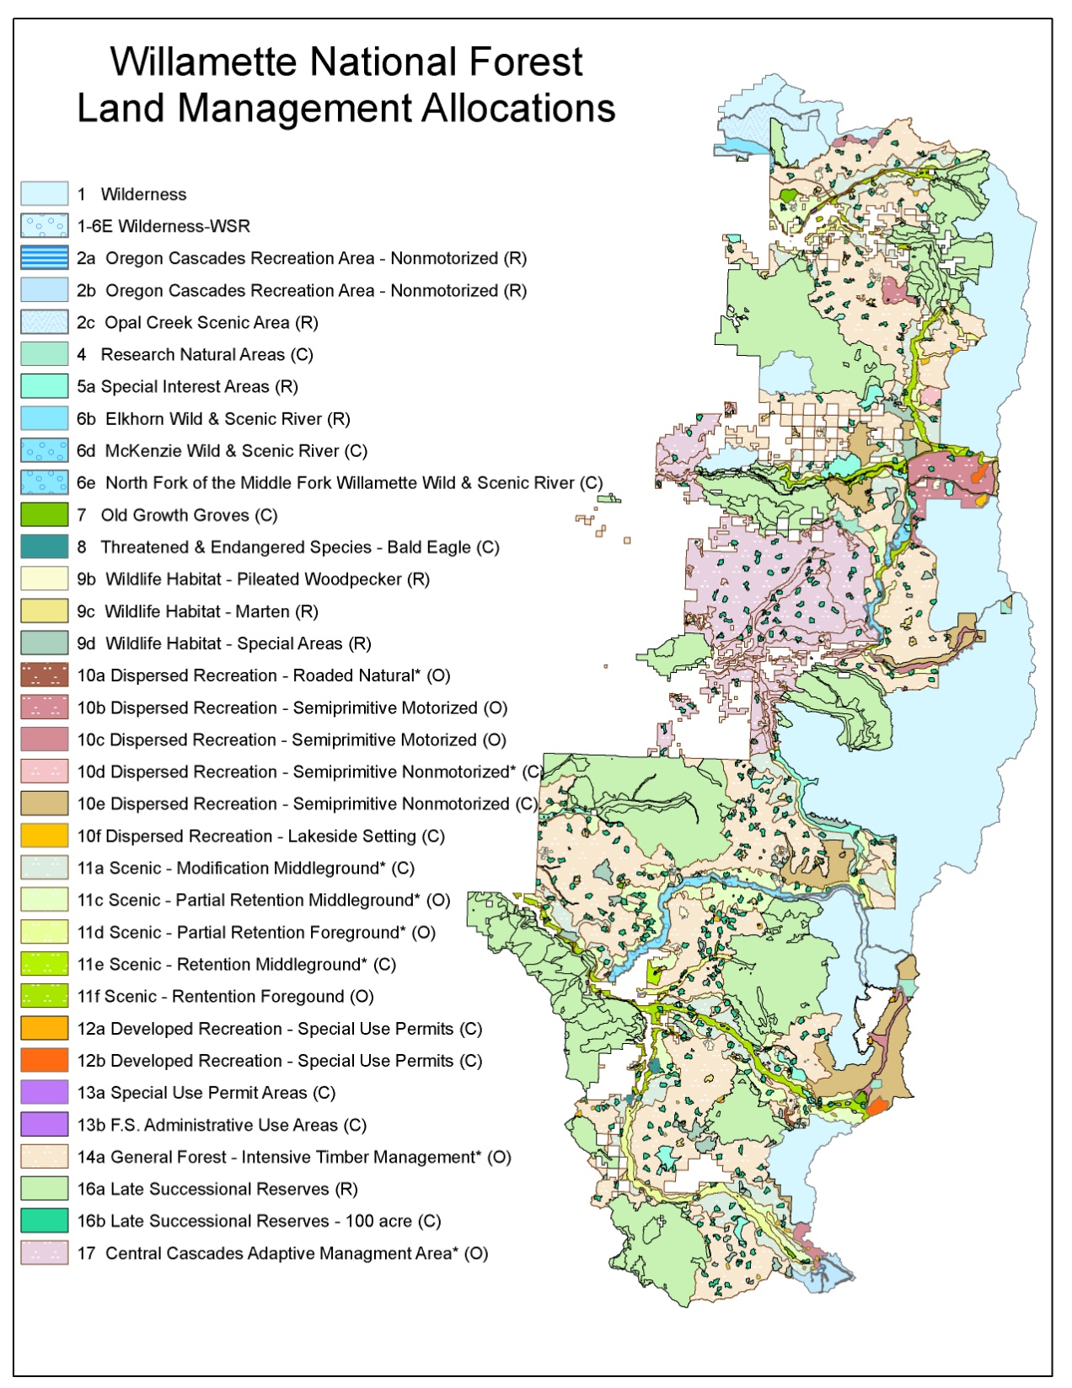
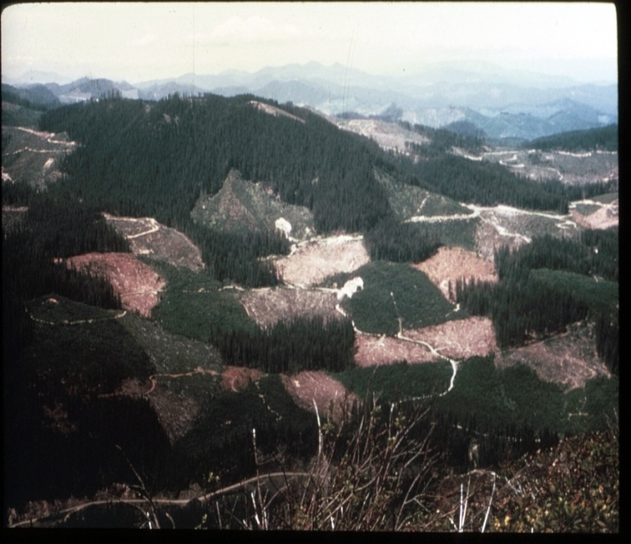
Obviously Much More Complicated Today
WNF Plan as amended by the NWFP

Slide 5
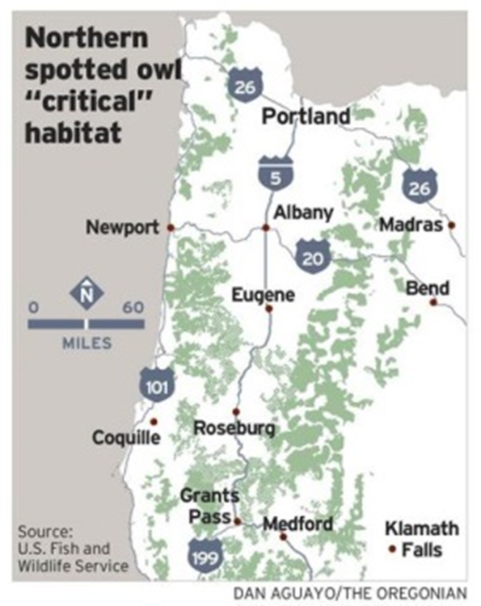
Spotted Owl Critical Habitat

Slide 6
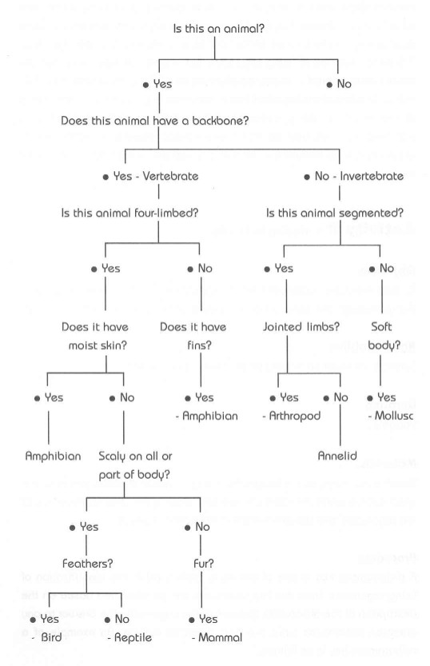
Zoologist answer to everything:
build a dichotomous key!

Slide 7

“Keys” assume there is only one correct answer.

Slide 8

One Answer: Highly Unlikely
multiple pathways and tradeoffs

Slide 9


“PAUSE POINTS”
for LANDSCAPE PLANNING
Assumes line officer has said let’s explore

Slide 10


Hierachical Approach Scale-Based (Admittedly Owl Centric)
CHU
Watershed
Owl Sites
Forest Restoration Opportunities
(Processes and Structures)

Slide 11
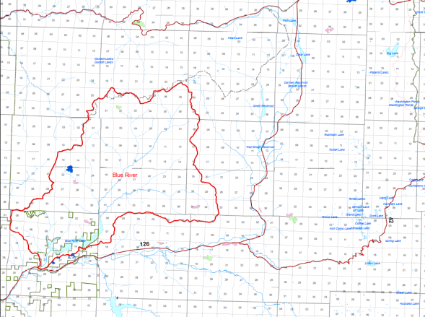
Case Study: Willamette NF Blue River Watershed within CCAMA

Slide 12
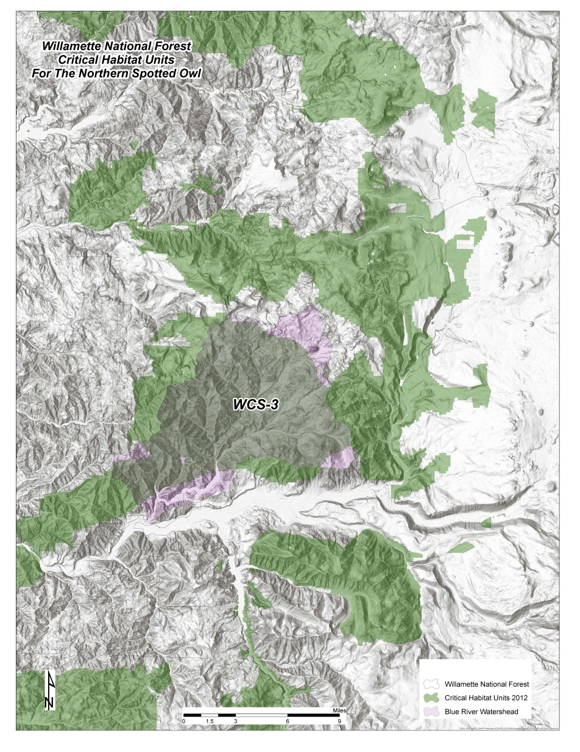
Critical Habitat Unit

Slide 13
CHU WCS-3
85% of area covered by owl home ranges
All unoccupied and likely occupied habitat essential for the conservation of the species to meet recovery.

Slide 14
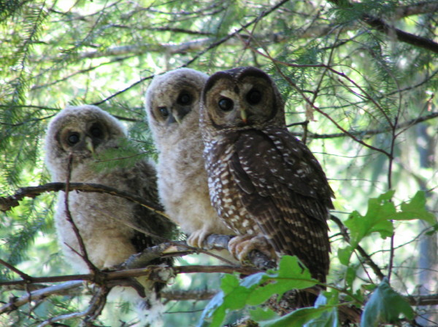
CHU Subunit WCS-3 Objectives
Function for demographic support to the overall population
Provide north south connectivity between subunits
Photo: David Roelofs, Medford BLM

Slide 15
Continue to maintain and recruit NSO habitat
Encourage management actions that will maintain and restore ecological function …
Focus active management in younger forest and lower quality owl habitat,
or where ecological conditions are most departed from the natural or desired range of variability.
We do not recommend actions in older forest stands or areas that currently contain owl habitat.

Slide 16
Watershed
Watershed position within CHU
Existing condition
Historic processes and condition

Slide 17
Watershed position w/in CHU
N / S
E / W
Connectivity

Slide 18
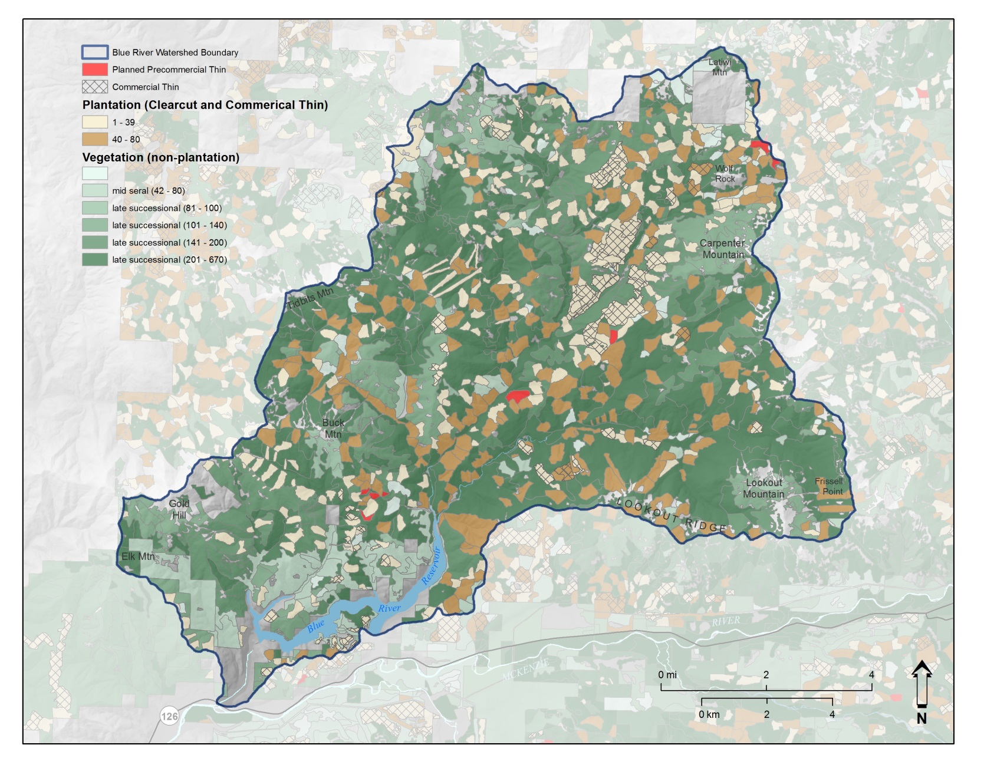
Current Vegetation
Notes:
Brown with no hatch: commercial thinning opportunities in plantations

Slide 19
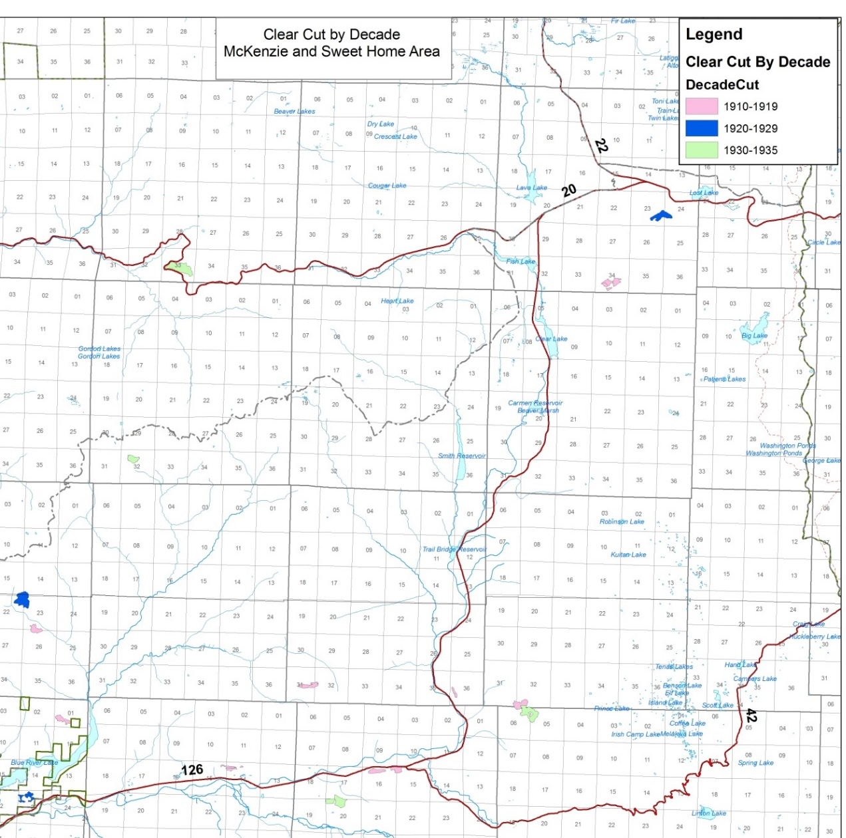

Very little clearcutting prior to 1935

Slide 20
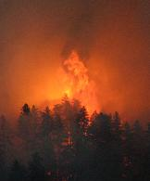
Historic Natural Processes

Slide 21
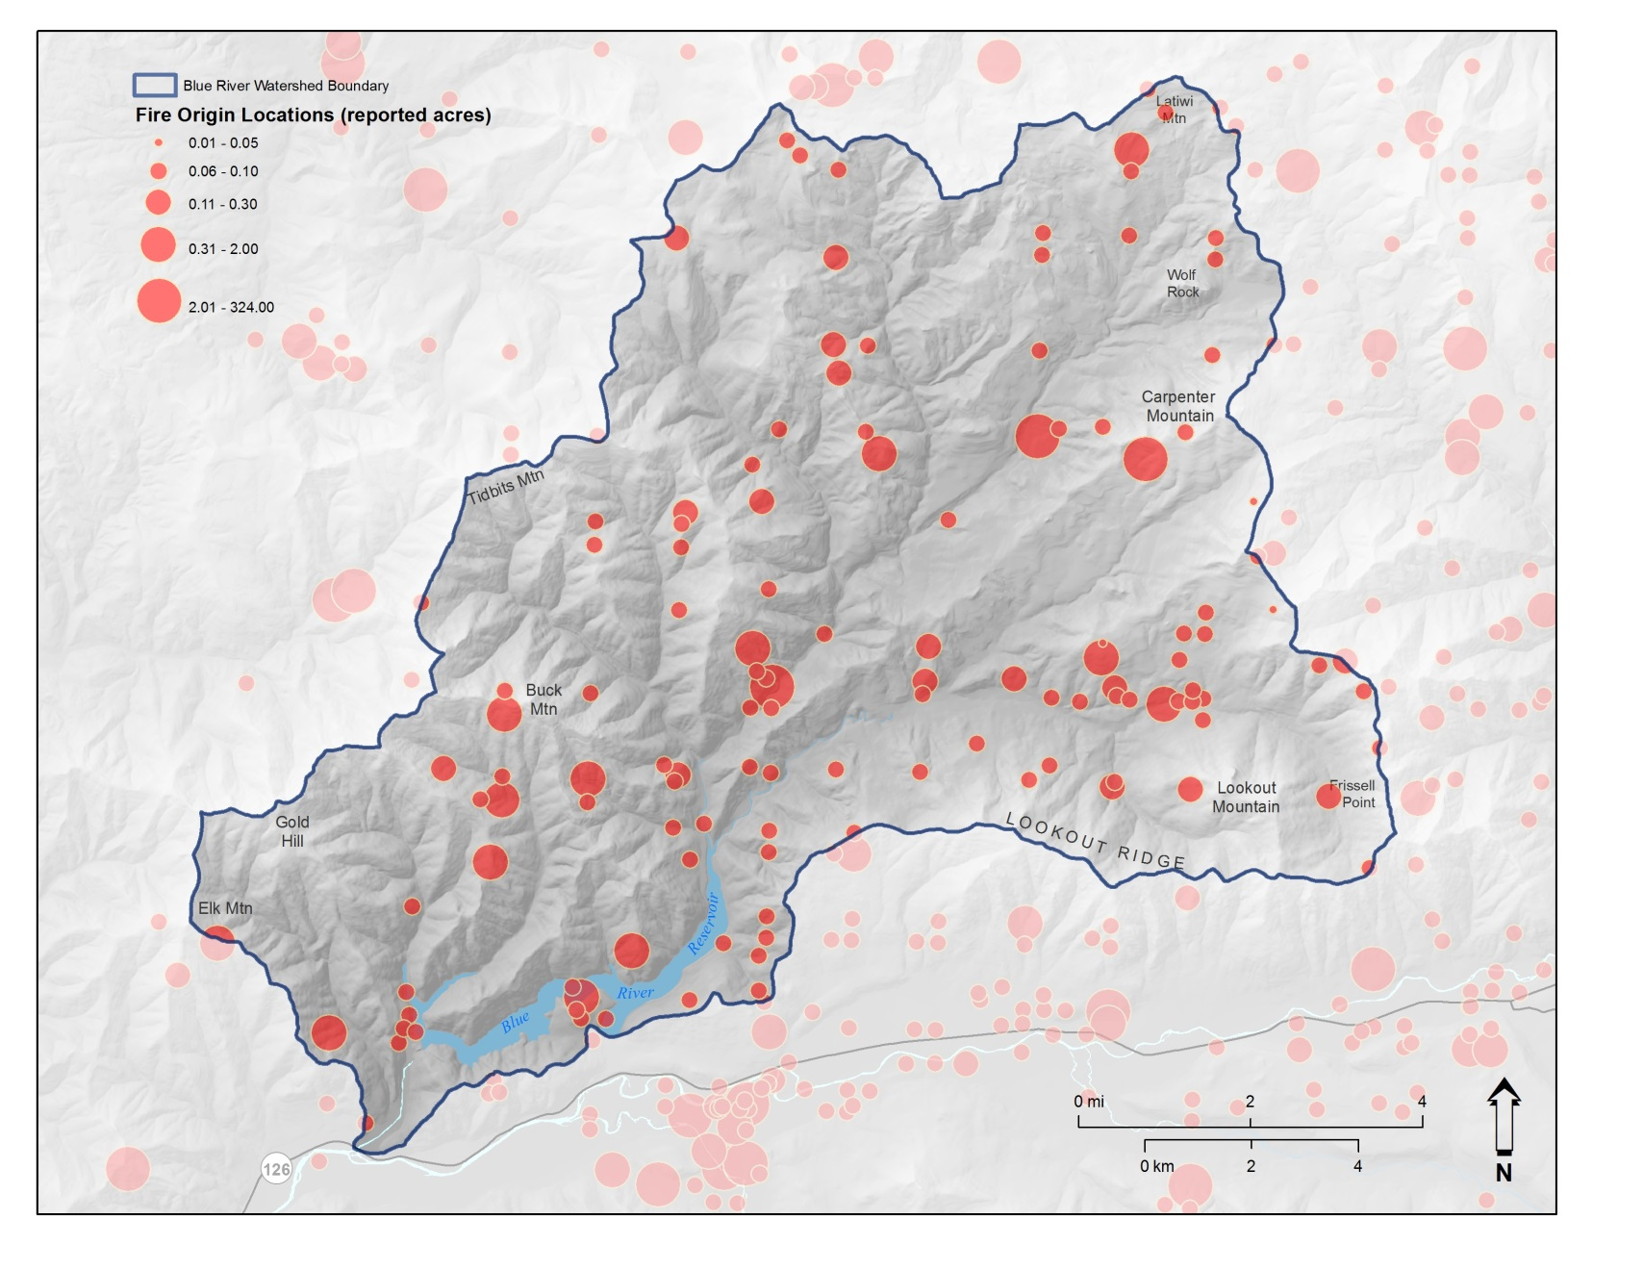
Fire Starts 1970- 2008
Notes:
1970-2008

Slide 22
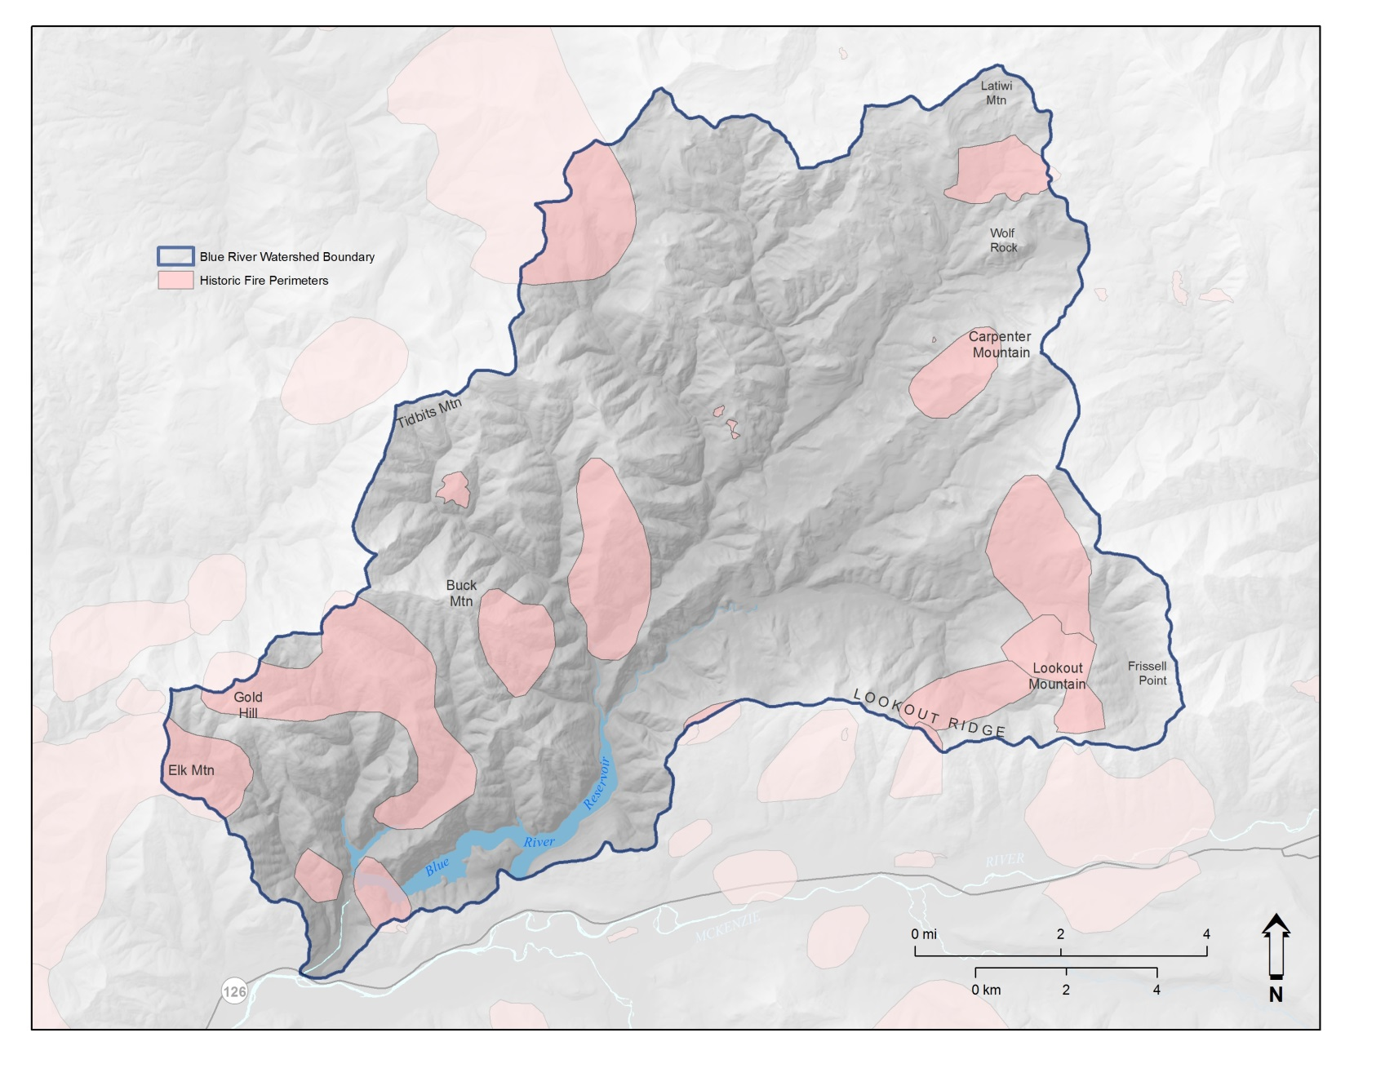
Early 20th Century Fires

Slide 23
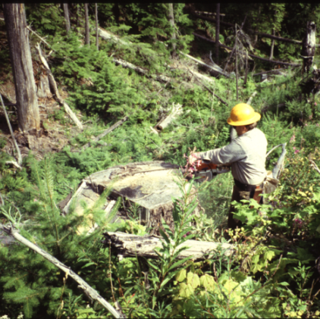
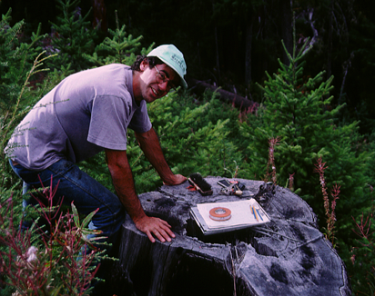
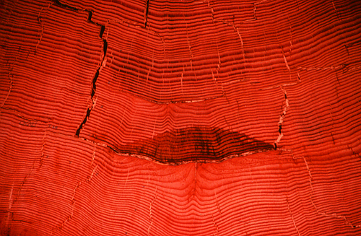
Fire History Studies
Sampled sites
Opportunistic sites

Slide 24
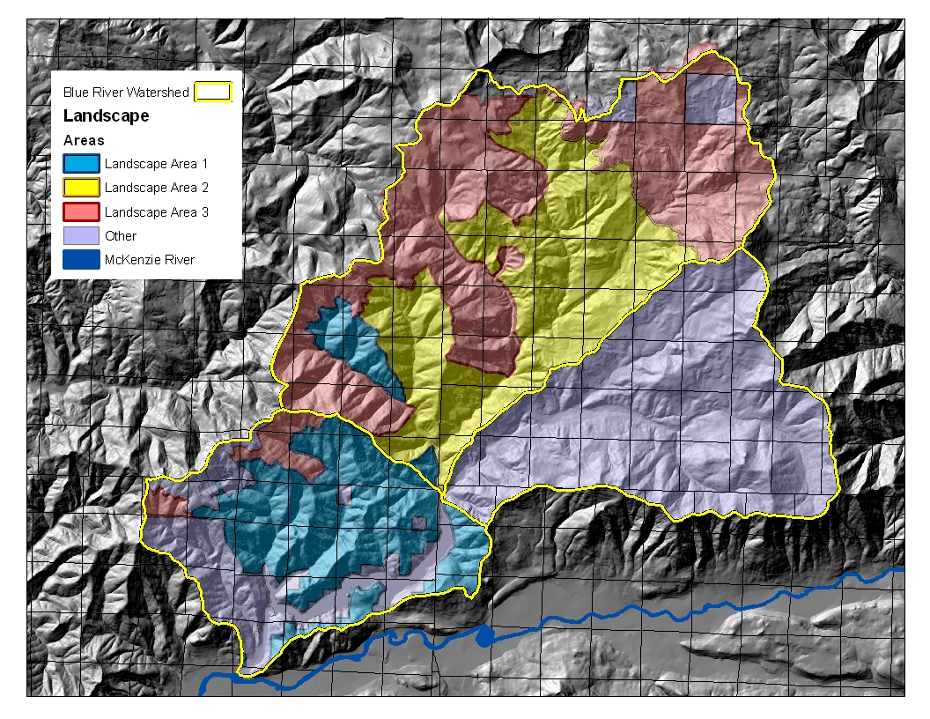
Stand Replacement
Blue: ~100
Yellow: ~180
Pink: ~260

Slide 25
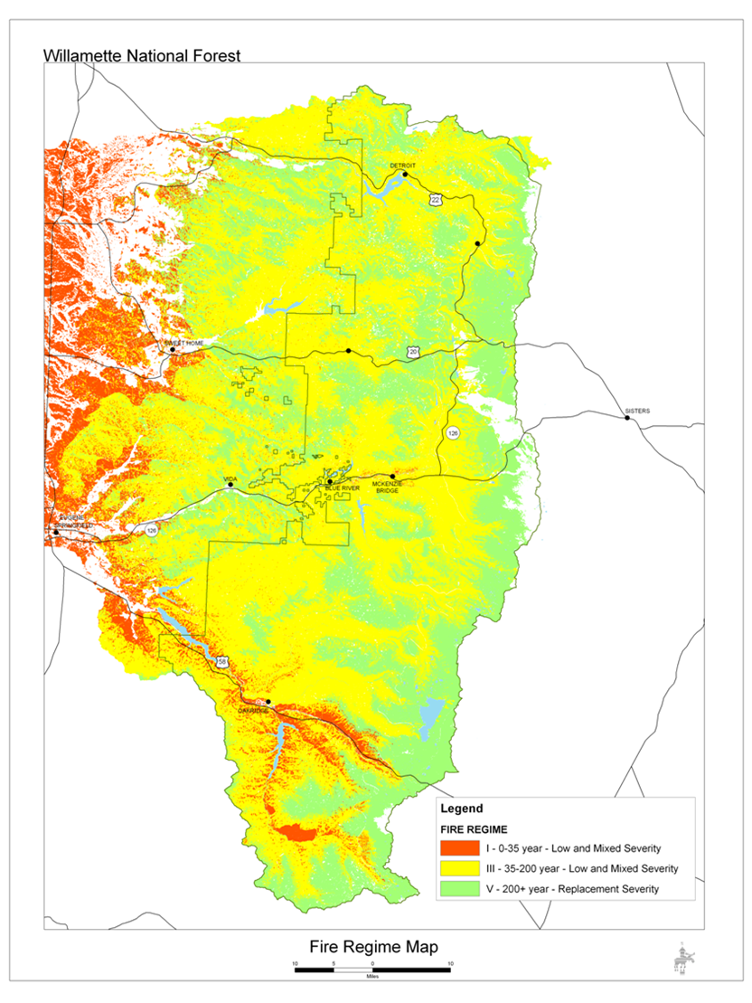
Mixed Severity Environment

Slide 26
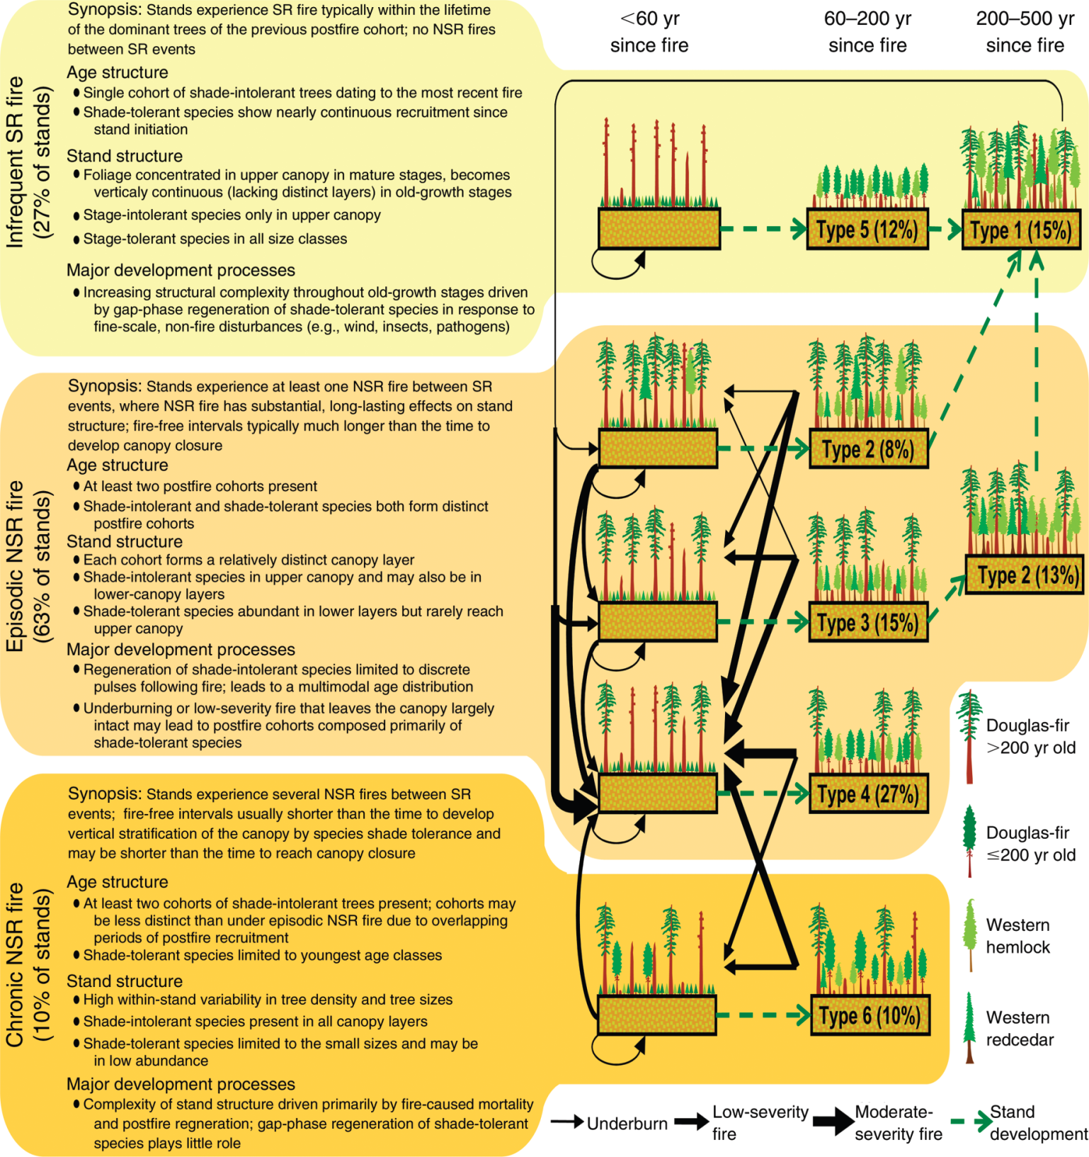
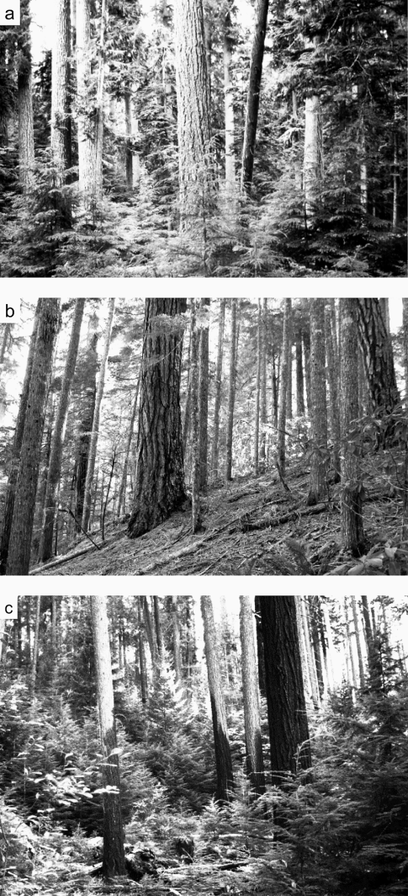
Chronic
Episodic
Infrequent

Slide 27
Ridgetops “Chronic Fires” .
Decrease in probability that multi-storied, diverse stands will persist

Slide 28
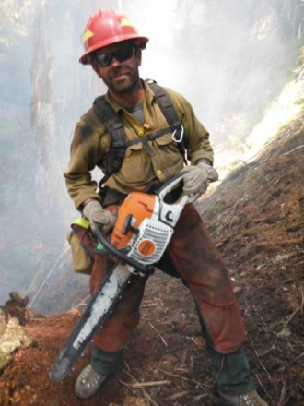

Mid-Slope “Episodic Fires” Mixed Severity Fire Effects we probably put vast majority of them out over the past 80 years.
Might mean some of these stands are less complex

Slide 29
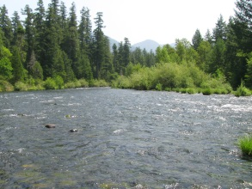
Valley bottoms and toe-slopes “Infrequent Fires” Increased probability that restored multi-storied, diverse habitat will persist Historically, time was the main process – J.Kertis

Slide 30
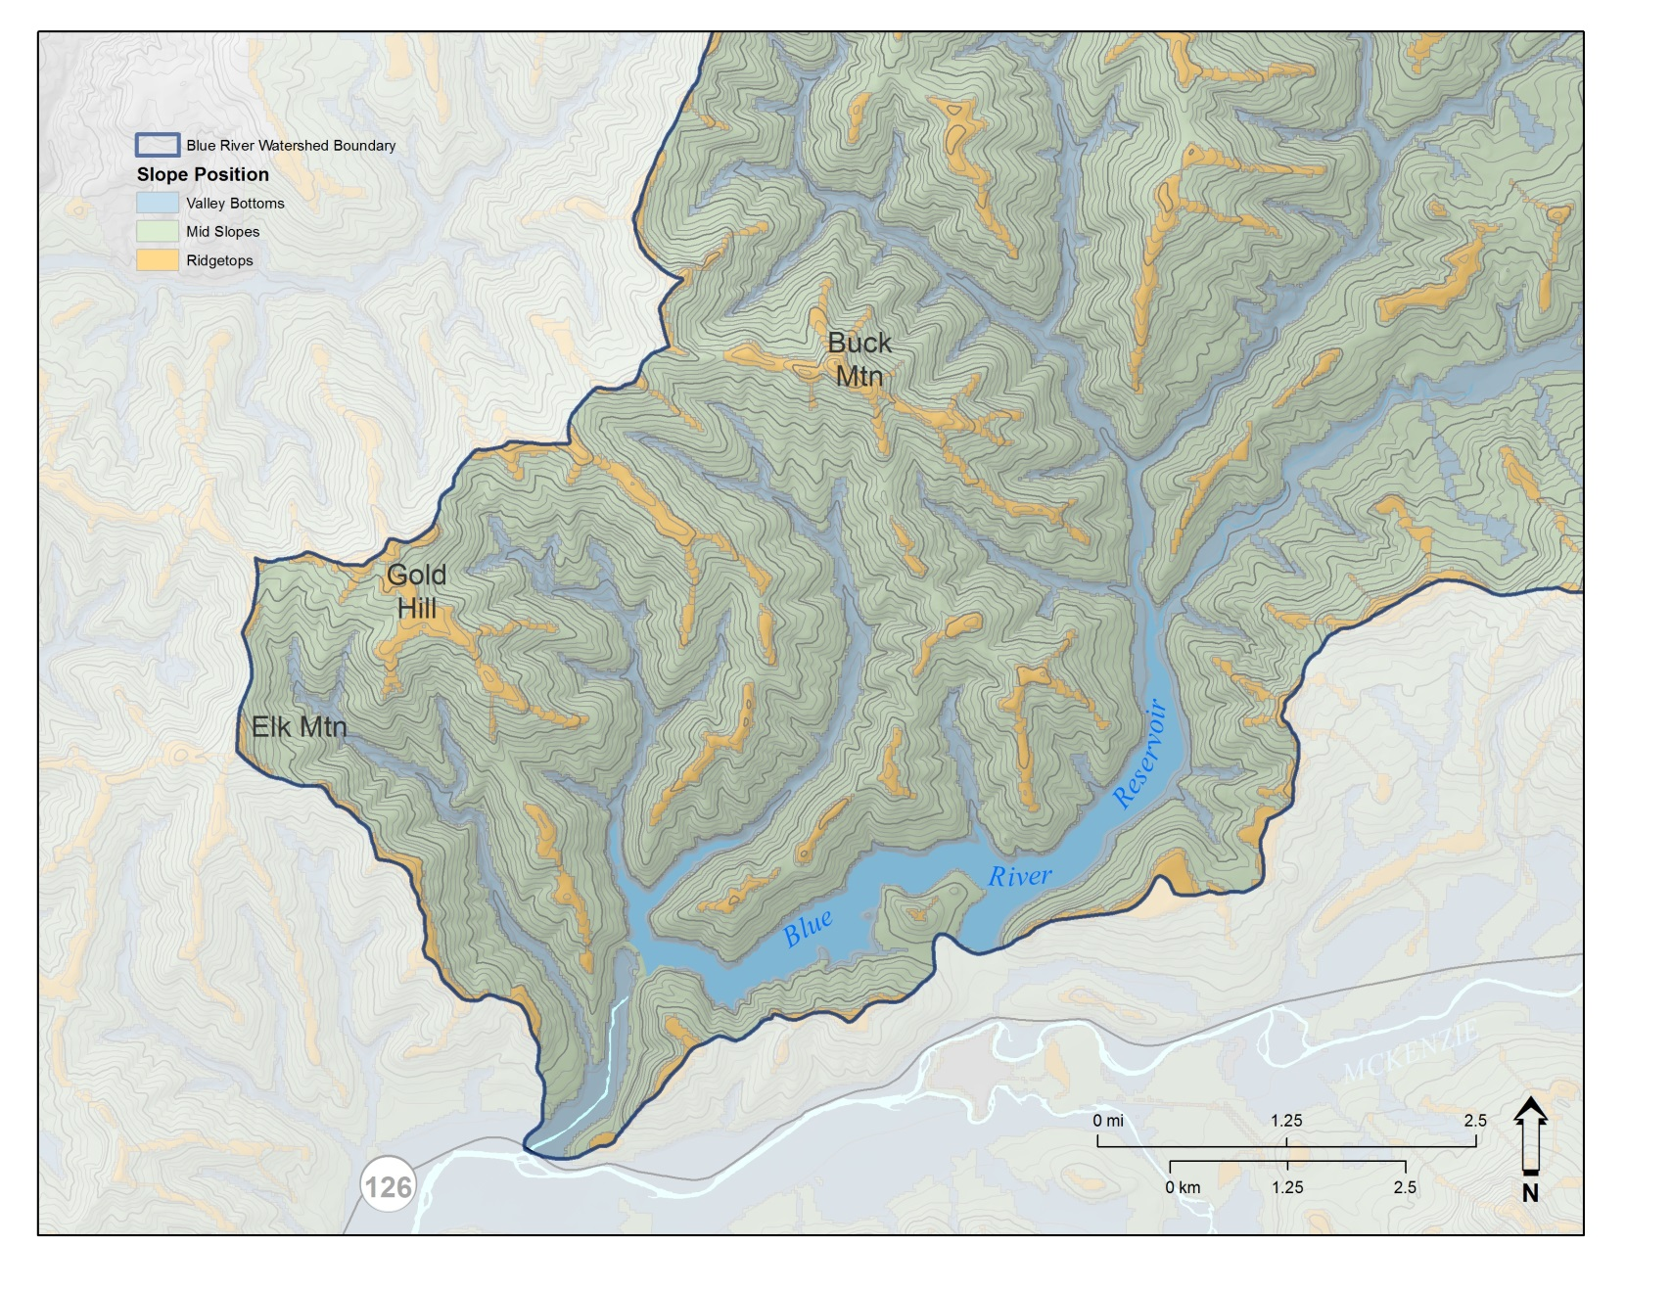
Toe-slope and drainages; mid-slope; ridgetops

Slide 31
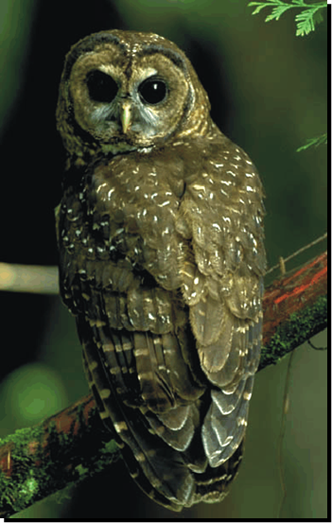
Spotted Owl Sites

Slide 32
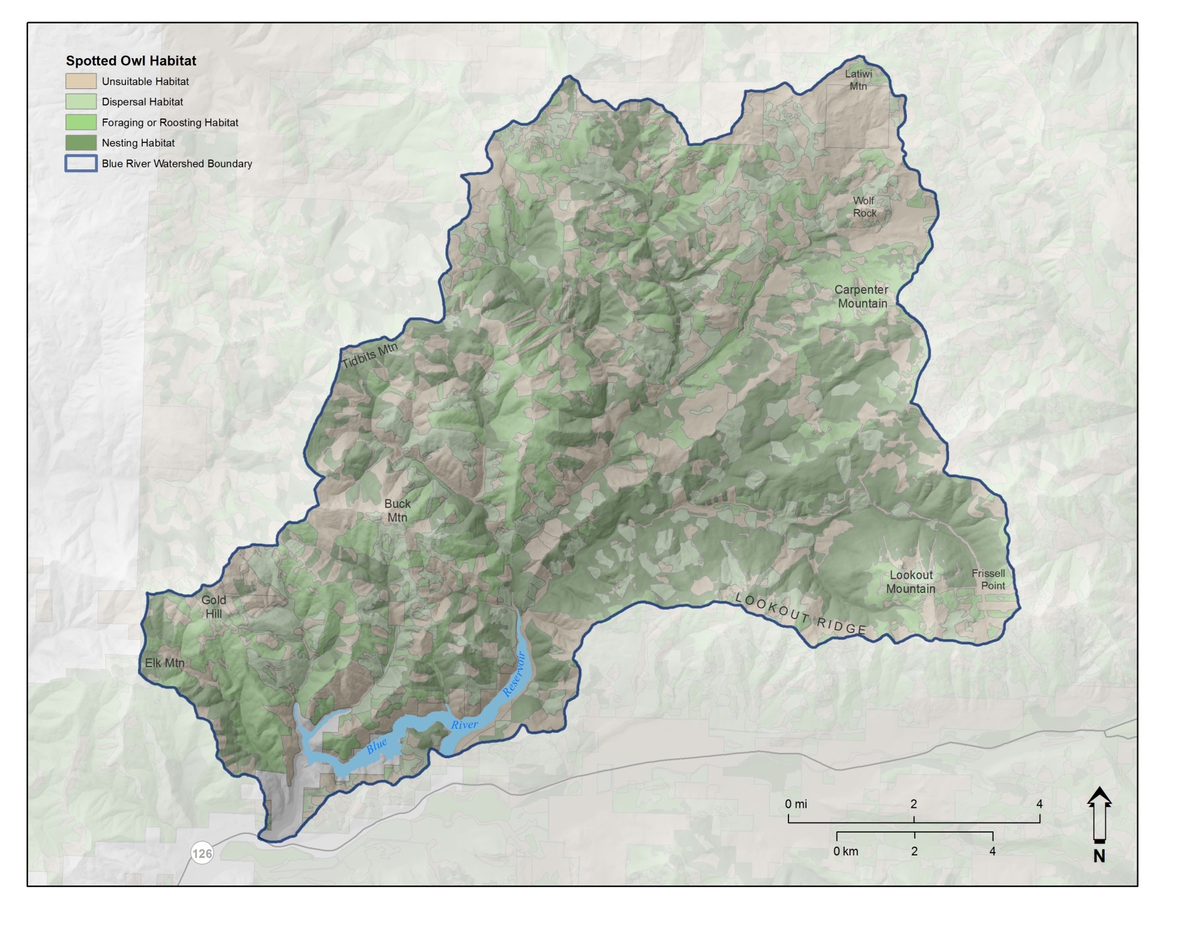
Spotted owl Habitat

Slide 33
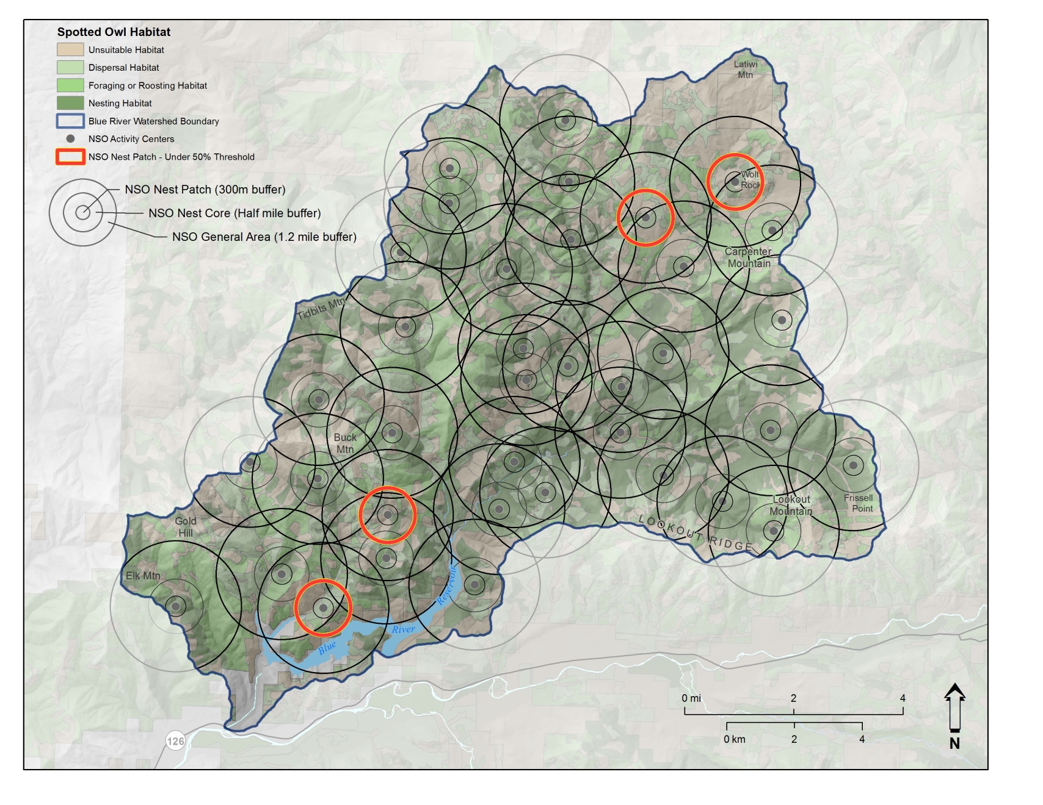
RA10

Slide 34
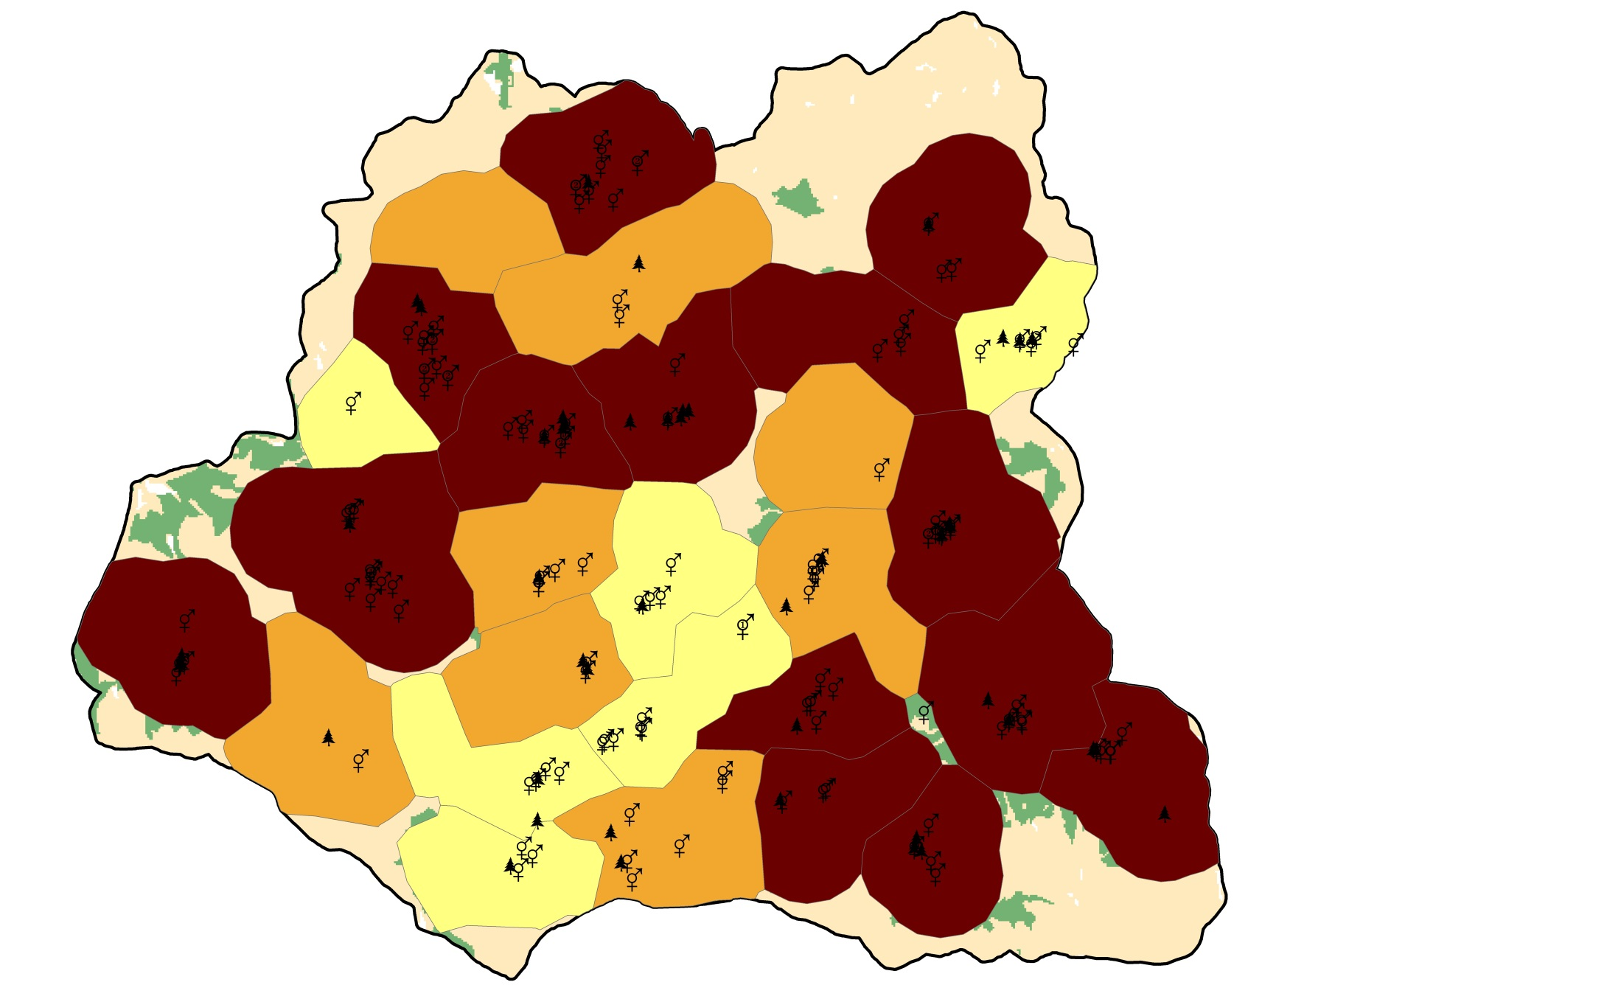
Conservation
Value --
Yellow = 0 Orange <= 10
Red > 10
Cons_Value = (Pair_occ) * (Succ_Repro + 1)

Slide 35
Red sites = high conservation value,
highly functioning in current state.
-- Not a high priority for
habitat restoration –
Yellow sites = low conservation value,
not functioning highly at present.
-- May be areas to focus restoration
of late successional OR early seral
habitat –

Slide 36
RA32
WCS-3:
“We do not recommend actions in older forest stands or areas that currently contain owl habitat”
Not a priority for restoration of
late successional habitat

Slide 37
Restoration Opportunities
Low diversity stands
Stands at high risk of disturbance
Stands lacking key components like standing and down wood
Stands to help buffer fire spread

Slide 38
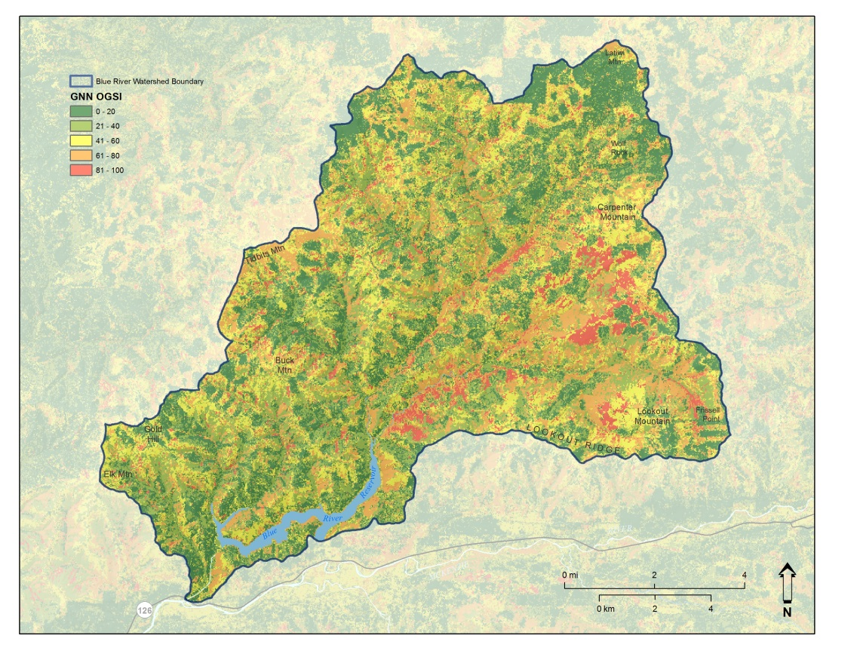
Finding Low Diversity Stands >80
OGSI Low (often originated from clearcutting or stand replacing fires with re-burns >80 years ago.
May also be in areas we have suppressed fire activity

Slide 39
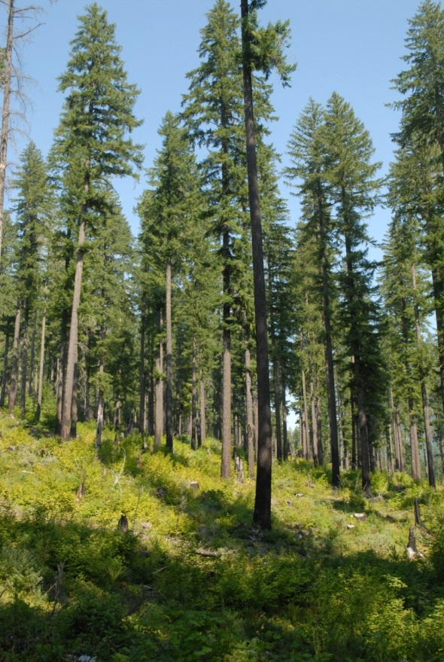
RX’s Low Diversity Stands >80
Thinning
Short Term: if now dispersal, may lose that function.
Long Term: may not succeed in
multi-storied restoration over time.

Slide 40
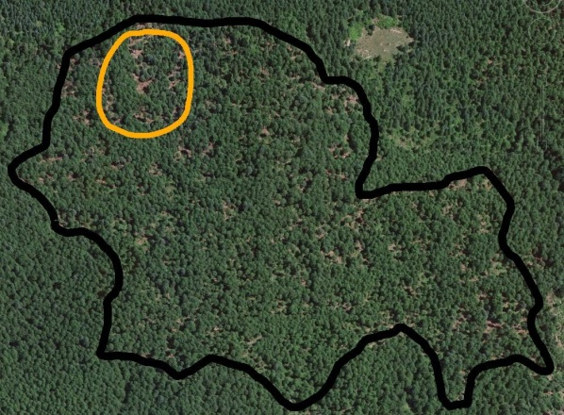
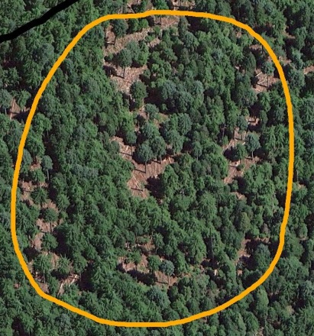
RX’s Low Diversity Stands >80
“Gapping”
Short Term: if now dispersal, may be able to retain that function. Gap size would have to be large enough to stimulate shade intolerants.
Long Term: may not succeed in multi-storied restoration over time.

Slide 41
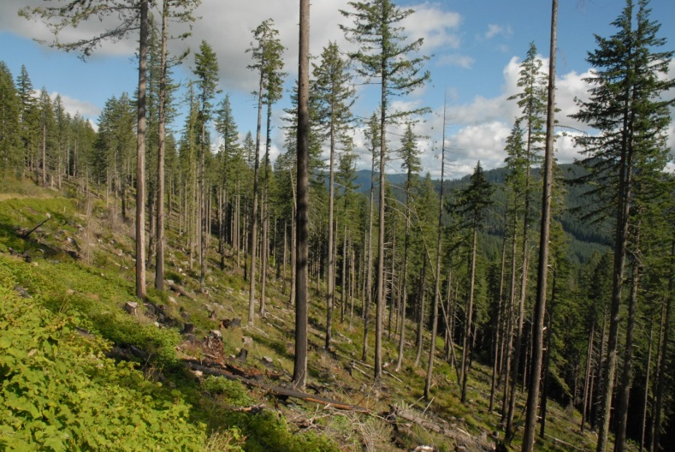
RX’s Low Diversity Stands >80
Restoring Early Seral Habitat:
Short term: would lose current function.
Long term: could create multi-storied stands
Restoring structure with multiple entries:
Short term: would lose current
dispersal function.
Long term: could create
multi-storied stands

Slide 42
RX’s Low Diversity Stands >80
Restoring Snag and down wood:
Short term: improve current function.
Long term: Won’t help meet multi-storied objectives.

Slide 43
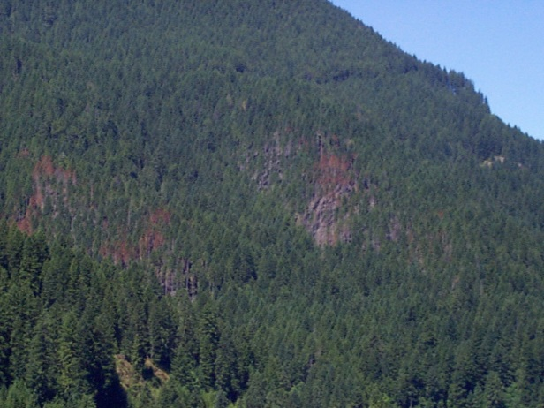
RX’s Low Diversity Stands >80
Restoring Fire
Short term: Could improve current function if creates some mortality.
Long term: May not help with multi-storied objectives
Could be part of a staged treatment coupled with other management tools

Slide 44
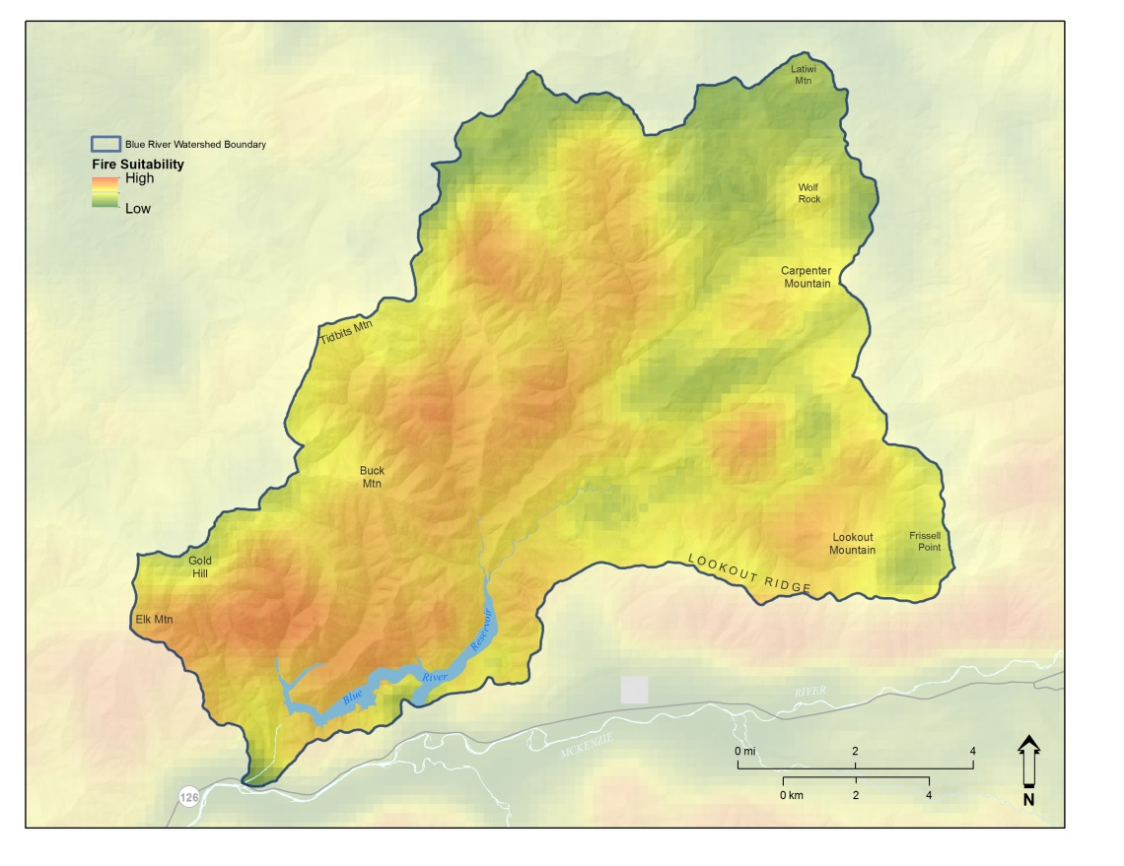
Finding stands at high risk of disturbance Fire Suitability Index
Treat to help buffer fire spread
Slope Position
Wind Patterns
Human Use

Slide 45
Example of Stand to Investigate Further

Slide 46
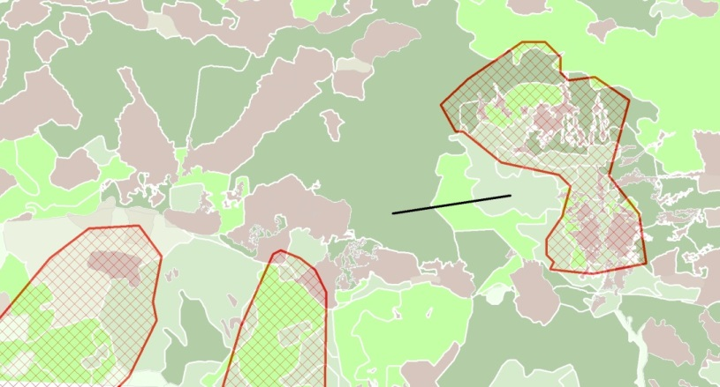
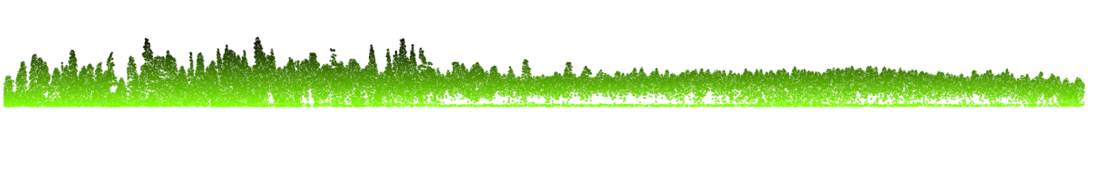
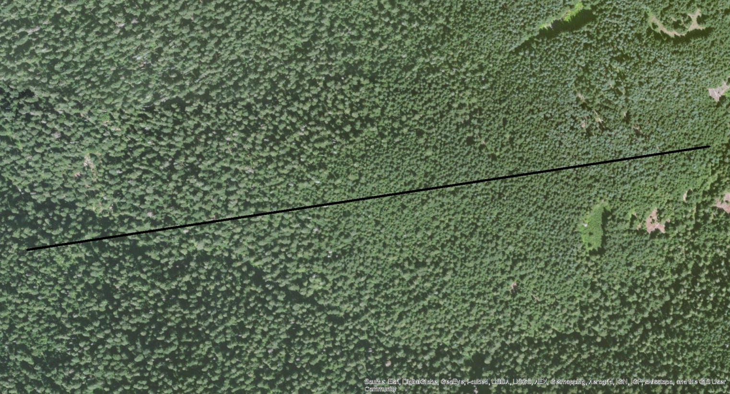
w / in low conservation value
owl site
1910 burn
Low OGSI

Slide 47
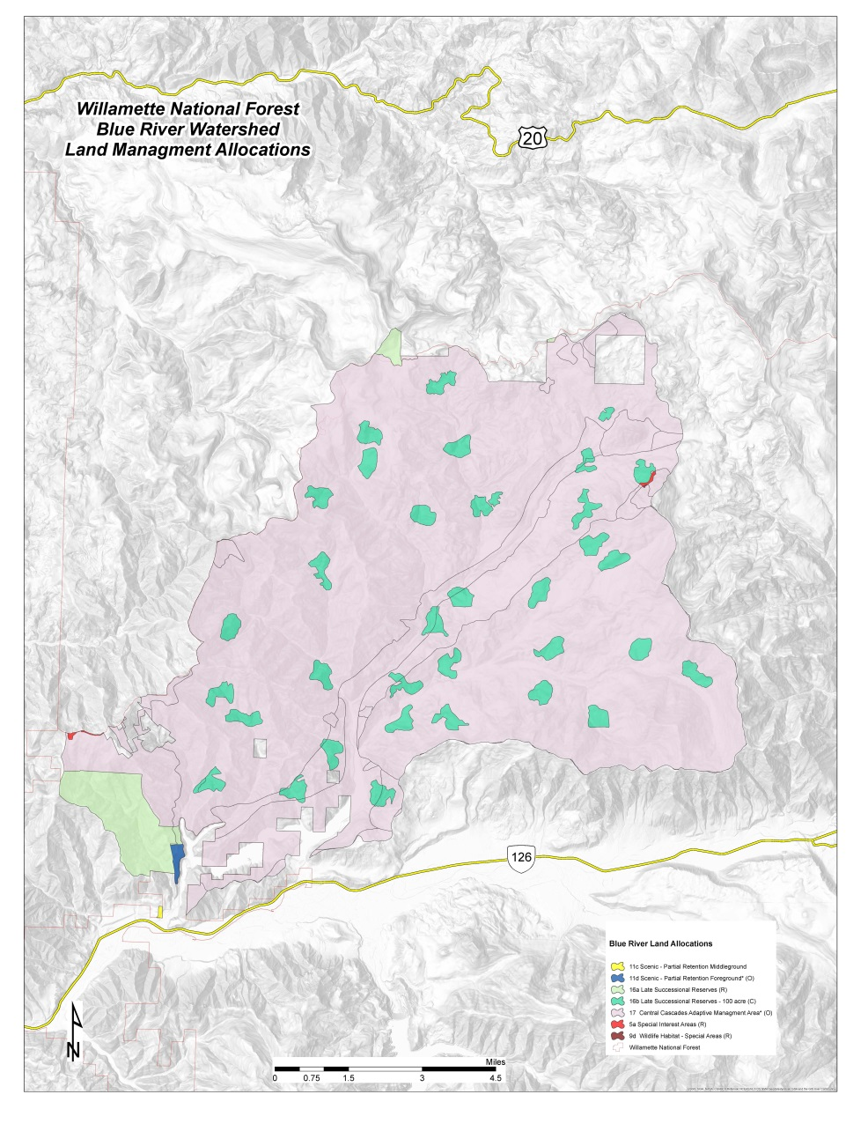
Other Land Allocation Considerations
AMA
Visuals
Special Interest Areas

Slide 48
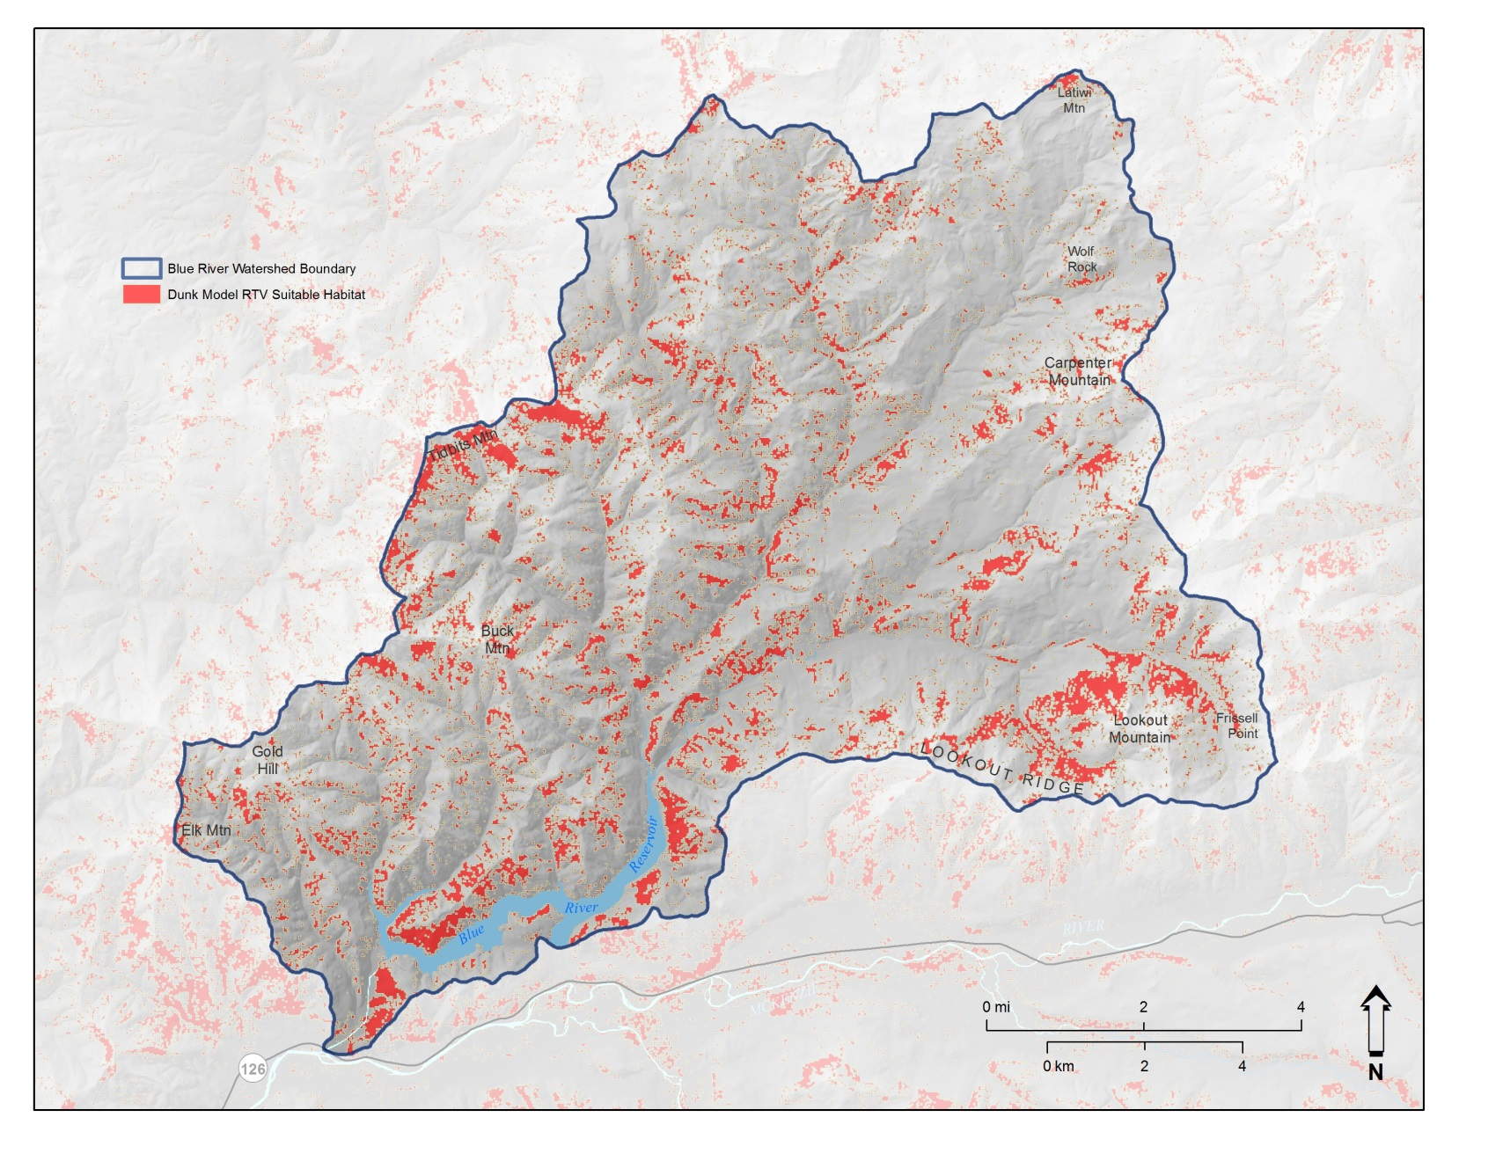
Survey and Manage RTV Megomphix

Slide 49
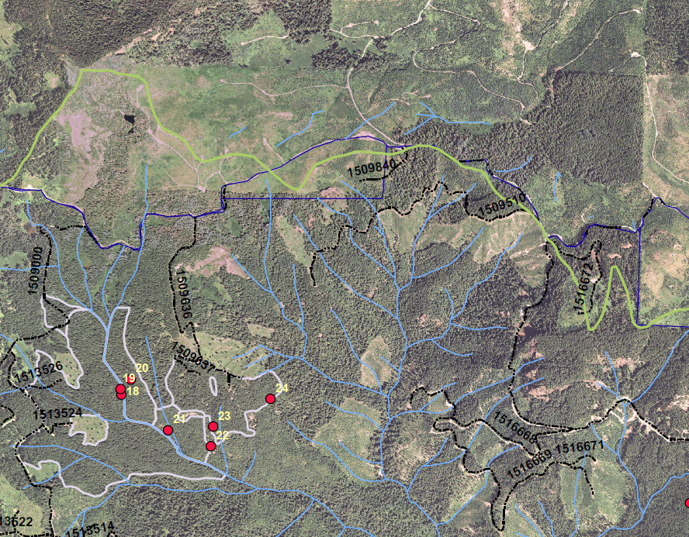

Survey and Manage: Axetail Slug
Riparian Reserves

Slide 50
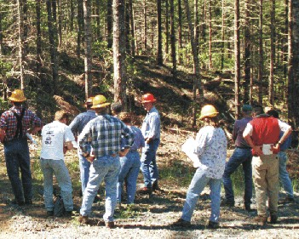
Rest of the IDT and Stakeholders
Why here, why now?

Slide 51
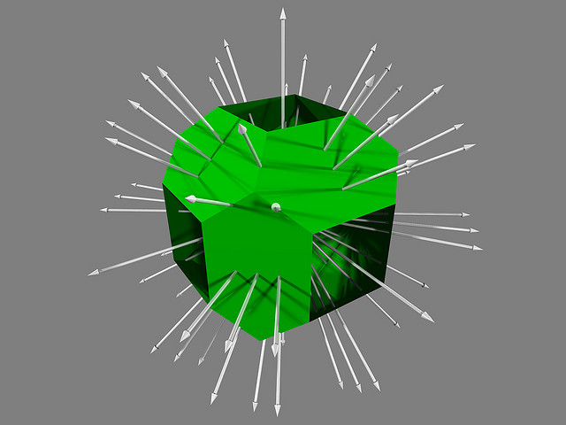

Tonan intersection of truncated cubes
Dichotomous key

Slide 52
Hierachical Approach Scale-Based
CHU
Watershed
Owl Sites
Forest Restoration Opportunities
(Processes and Structures)

Slide 53
CHU Squad/Scenario Playing
Joe Doerr, USFS
Steve Ackers, OSU
Josh Chapman, USFS
Bridgette Tueller, USFWS
Trish Wilson, USFS
Ruby Seitz, USFS
Shane Kamrath, USFS
Paul Bridges, USFWS
Lisa Helmig, SUFS
James Rudisill, USFS
Guenther Castillon, USFS
Jane Kertis, USFS
Ray Davis, USFS
Stephanie Wessell, BLM

