Slide 1
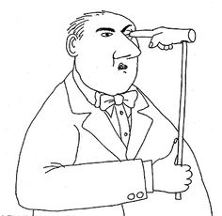
Actively Managing in Stands >80:
Using argument analysis to
poke a monster in the eye
Ecological, Economic, and Social Objectives
for Managing Stands “over 80”
Oregon State University
June 3, 2015
Michael Paul Nelson and Chelsea Batavia
Department of Forest Ecosystems and Society
Oregon State University

Slide 2
Do X
Justification for doing X
Evaluation of
Justification for doing X

Slide 3
What is the X we are proposing to do?
Should we actively manage in forests >80?
Should we think about actively managing in forests >80?
Should we actively manage some forests >80?, which and why?
Should we actively manage all forests >80?
Is 80 the right age cut off?
Are we talking about active management or logging/timber harvest?
Are we talking about >80, or LSOG forests?

Slide 4
ARGUMENTS:
P1. All birds have wings.
P2. Robins are birds.
Premises
Argument
Conclusion
C. Therefore, robins have wings.
Premises are like evidence, needed to support the conclusion.
Set of premises and resulting conclusion

Slide 5
ETHICAL ARGUMENTS:
EMPIRICAL PREMISES
Descriptions about the way the world is.
P1. Drunk driving endangers the lives of others.
P2. You should not endanger the lives of others.
C. Therefore, you should not drive drunk.
ETHICAL PREMISES
Value statement
CONCLUSION
can be expressed as,
“We should...”
MUST HAVE ONE OR MORE ETHICAL PREMISES.

Slide 6
CONSERVATION
“We should to use these water resources in this way, because...”
“We should to conserve this wildlife population, in this way, because...”
“We should engage in active management in stands >80, because…”
CONSERVATION IS
ENVIRONMENTAL ETHICS
IN ACTION

Slide 7
ARGUMENT ANALYSIS:
Criticizing an argument
In a formal sense, only two ways:
1) Mistake in premise
(Are the premises correct?)
2) Mistake in inference or missing premise
(Does the conclusion follow from the premises?)

Slide 8
ARGUMENT ANALYSIS:
Mistake in premise (example)
P1) All U.S. presidents live in the White House
P2) Lady Gaga is the president of the U.S.
C) Therefore, Lady Gaga lives in the White House

Slide 9
Is there a missing premise that would be necessary to arrive at the conclusion?
P1. Prostitution promotes economic development.
P2. We should promote economic development.
C. We should promote prostitution.

Slide 10
Is there a missing premise that would be necessary to arrive at the conclusion?
P1. Prostitution promotes economic development.
P2. We should do anything and everything that
promotes economic development.
C. We should promote prostitution.
Missing or misstated premises frequently hide critical flaws.

Slide 11
Set of all possible
arguments
Set of good
arguments
* Philosopher’s Diagram - Not drawn to scale

Slide 12
We should not AM in stands >80? | We should AM in stands >80?
* AM in stands >80 → AM in old growth | Mandate of NWFP (harvest 1 mil. Acres)
We can be trusted to maintain emergent properties in stands >80 | *AM will enhance fire resilience
* Will harm species dependent on mature and old growth stands | AM will encourage “true old growth”
Violates Land Ethic: “integrity, stability, and beauty of the biotic community” | Market niche for big logs (harvest)
Cannot trust those who would harvest to do it properly | Forests could be more financially productive (harvest)
Important values (carbon, aesthetic value) lost
Not needed, private lands taking care of need
* Mature forests on the right trajectory → OG
Harvesting mature/OG was wrong in the past still wrong

Slide 13
Enhancing Fire Resilience
P1. Historically, LSOG stands would not be as dense/fire prone as they are today due to fire exclusion.
P2. Dense fire-prone forests are a threat to human health and well being – especially in a warming, drying climate.
P3. Threats to human health and well being should be eliminated when it is possible and reasonable to do so.
P4. It is both possible and reasonable to reduce uncharacteristic fuel loadings by harvesting in select older stands, for the purpose of building fire resilience.
C. Therefore, we should harvest in older stands to build fire resilience.

Slide 14
We should not AM in stands >80? | We should AM in stands >80?
* AM in stands >80 → AM in old growth | Mandate of NWFP (harvest 1 mil. Acres)
We can be trusted to maintain emergent properties in stands >80 | *AM will enhance fire resilience
* Will harm species dependent on mature and old growth stands | AM will encourage “true old growth”
Violates Land Ethic: “integrity, stability, and beauty of the biotic community” | Market niche for big logs (harvest)
Cannot trust those who would harvest to do it properly | Forests could be more financially productive (harvest)
Important values (carbon, aesthetic value) lost
Not needed, private lands taking care of need
* Mature forests on the right trajectory → OG
Harvesting mature/OG was wrong in the past still wrong

Slide 15
Slippery slope (AM in stands >80 → AM in old growth)
P1. Federal forests >80 should not be actively managed without good reason.
P2. There are a small handful of good reasons for active management in federal forests >80.
P3. Allowing active management in federal forests >80 for any or all of those good reasons brings with it the risk that OG forests will be actively managed for the same reasons, causing significant harms to OG.
P4. The potential benefits of active management in federal forests >80 do not outweigh the potential risks to OG.
P5. Management practices whose potential risks outweigh its potential benefits should not be pursued.
C. Therefore, federal forests >80 should not be actively managed.

Slide 16
We should not AM in stands >80? | We should AM in stands >80?
* AM in stands >80 → AM in old growth | Mandate of NWFP (harvest 1 mil. Acres)
We can be trusted to maintain emergent properties in stands >80 | *AM will enhance fire resilience
* Will harm species dependent on mature and old growth stands | AM will encourage “true old growth”
Violates Land Ethic: “integrity, stability, and beauty of the biotic community” | Market niche for big logs (harvest)
Cannot trust those who would harvest to do it properly | Forests could be more financially productive (harvest)
Important values (carbon, aesthetic value) lost
Not needed, private lands taking care of need
* Mature forests on the right trajectory → OG
Harvesting mature/OG was wrong in the past still wrong

Slide 17
Future OG
P1. There is currently a critical shortage of LSOG forest on the landscape.
P2. Forests >80 on federal lands represent the most promising for recruitment into future LSOG in the shortest amount of time.
P3. Private lands currently sustain most of the timber industry in the region.
P4. Because private lands prioritize economic objectives, there must be a counterbalance on federal lands prioritizing ecological objectives.
C1. Therefore, restoration of LSOG should be prioritized over timber production on federal lands.
P5. Harvesting forests >80 would prioritize economic timber objectives over ecological LSOG restoration objectives.
C2. Therefore, forests >80 should not be harvested on federal lands.

Slide 18
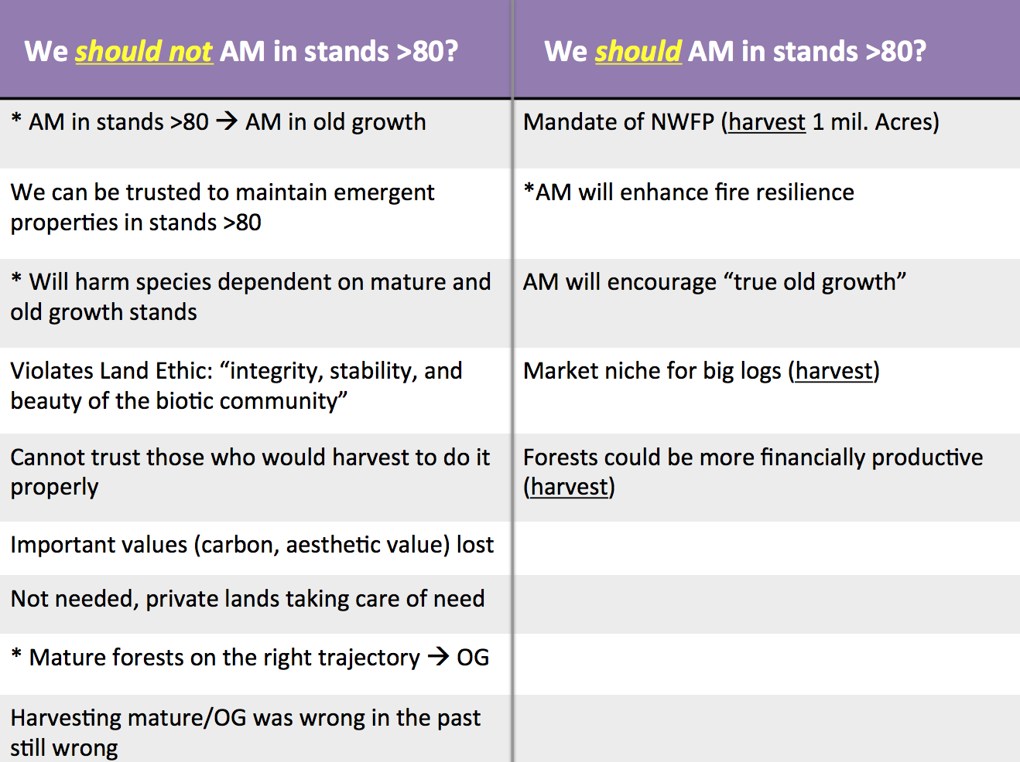
NWFP mandate (harvesting LSOG)
P1. NWFP mandates harvest of LSOG forest.
P2. ESA mandates protection of threatened/endangered species.
P3. Federal forest management should not break any relevant laws.
P4. Harvest of LSOG does not necessarily go against the ESA.
P5. Not harvesting LSOG does go against NWFP
C. Therefore, we ought to harvest LSOG.

Slide 19
NWFP moral
P1. NWFP committed us to supporting sustainable timber supply to local communities.
P2. It is wrong to renege on a commitment.
C1. Therefore, we ought to support a sustainable timber supply to local communities.
P3. By and large we have not supported a sustainable timber supply to local communities.
P4. Only by harvesting LSOG can we support a sustainable timber supply to local communities.
C2. Therefore, we ought to harvest LSOG.

Slide 20
Economic market niche
P1. There is a significant market for large diameter logs.
P2. Because harvest on federal lands is restricted to young forests and private lands we generate mostly small-diameter logs.
C1. Therefore, we are not capitalizing on a market niche on.
P3. By harvesting LSOG forests on federal lands, we can capitalize on this niche market.
P4. The benefit of capitalizing on this market niche outweighs any and all impacts of harvesting LSOG.
C2. Therefore, we should capitalize on the large log market by harvesting LSOG on federal lands.

Slide 21
Economic underperformance
P1. Large diameter logs represent a valuable source of revenue.
P2. By failing to harvest LSOG and produce large diameter logs, we are not capitalizing on the full economic potential of federal lands.
P3. Federal forests ought to be managed for maximum revenue.
P4. By harvesting LSOG, federal forests can meet their potential for maximum revenue.
C. Therefore, we ought to harvest LSOG on federal forests.

Slide 22
Economic legal
P1. Federal forests are mandated to create revenue.
P2. Currently federal forests are creating only a fraction of the revenue of which they are capable.
P3. The current amount of revenue being created by harvest on federal forests is insufficient to meet the legal mandate for which the USFS was formed.
P4. Federal agencies ought to meet their legal mandates.
C1. Therefore, federal forests ought to create revenue sufficient to meet their legal mandate.
P5. Only by harvesting LSOG can federal forests meet their legal mandate.
C2. Therefore, LSOG in federal forests ought to be harvested.

Slide 23
Unnatural OG clearcut version
P1. Some stands >80 originated from clearcuts.
P2. Even-aged stands originating from clearcuts do not provide the same structural features/habitat of natural OG.
P3. These stands could be actively managed for the same structural features/habitat associated with naturally created OG.
P4. The structural features/habitat of natural OG are more likely to support biodiversity than OG of clearcut origin.
P5. We ought to manage federal forests in whichever way is most likely to support biodiversity.
C. Therefore, we ought to actively manage stands >80 for the structural features/habitat of natural OG.

Slide 24
Unnatural OG structure fire version
P1. Prior to European settlement OG would have experienced a handful of small mix-severity fires, creating gaps that led to a mixture of size and age classes.
P2. Humans have largely suppressed fires for the past century, leaving some OG stands in unnatural even-aged conditions.
P3. OG forests ought to exist as they existed historically, prior to European settlement.
C1. Therefore, OG ought to have gaps, such as those created by small mixed-severity fires.
P4. The only way to create gaps is to use silviculture and actively manage these stands >80.
C2. Therefore, we ought to actively manage stands >80 to created gaps such as were historically created by small mixed-severity fires.

Slide 25
Unnatural OG composition fire version
P1. Under a natural fire regime, certain westside ecosystems would be dominated by various species (oak savannah, pine).
P2. Human fire suppression has shifted these ecosystems to dominance by Douglas fir.
P3. Ecosystems ought to exist as they exist naturally.
C1. Therefore, ecosystems currently but not historically dominated by Douglas fir ought to be dominated by whichever species dominated historically.
P4. Some of the Doug fir forests occurring where they did not historically occur are >80 years old.
P5. Restoring historic species compositions can only be accomplished by harvesting some of these older Doug fir forests.
P6. Restoring a natural species composition is more important than managing for LSOG forest.
C2. Therefore, we ought to harvest older Doug fir forests to restore historic species compositions.

Slide 26
Actively Managing in Stands >80:
Using argument analysis to
poke a monster in the eye
Ecological, Economic, and Social Objectives
for Managing Stands “over 80”
Oregon State University
June 3, 2015
Michael Paul Nelson and Chelsea Batavia
Department of Forest Ecosystems and Society
Oregon State University

