Slide 1
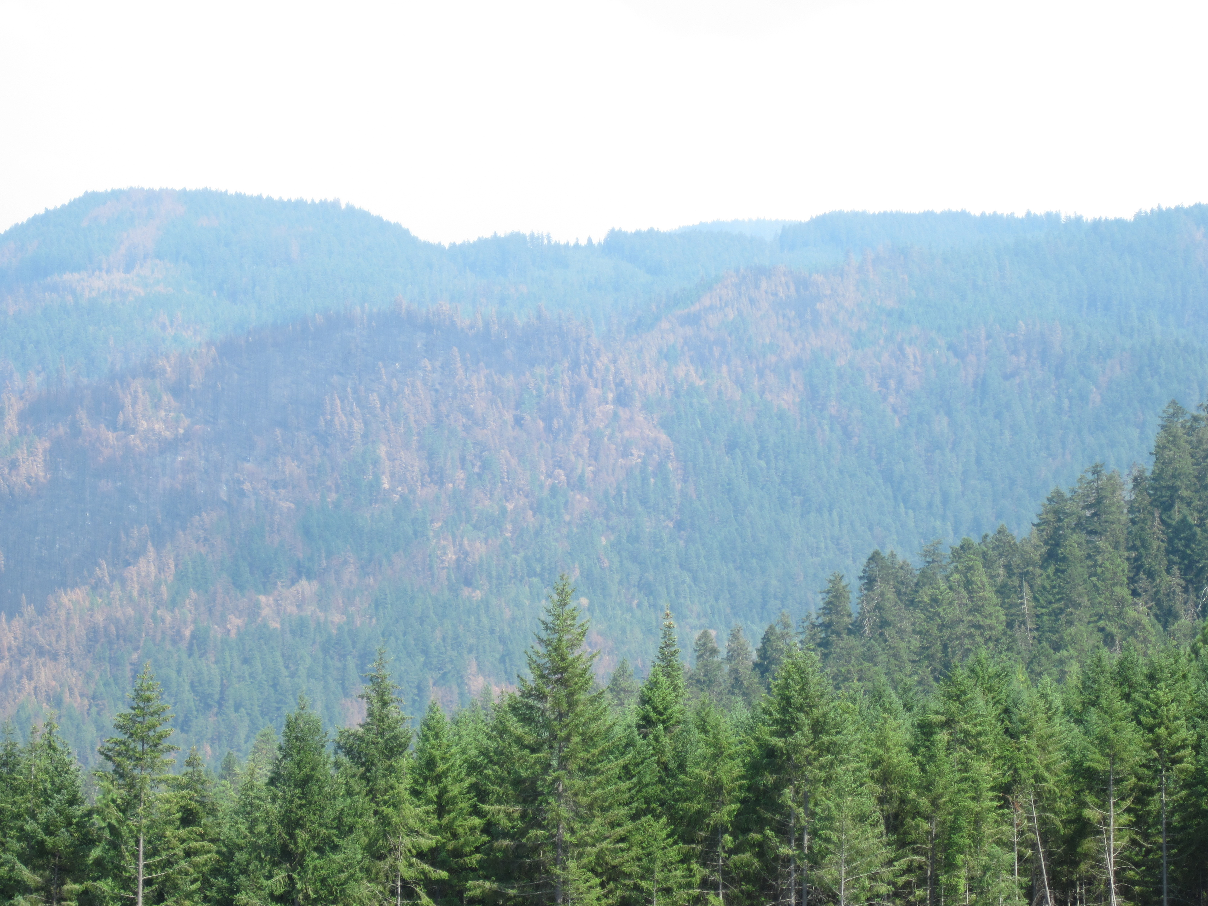
What’s left? An example of landscape restoration considerations on a drier West side forest
Josh Chapman
Forest Service Regional Wildlife Biologist with key input from Richard Helliwell Umpqua National Forest Botanist

Slide 2
Overview
Context of SW Oregon and the Umpqua
Northern spotted owl Considerations
Restoration opportunities in SW Oregon
Practical planning considerations

Slide 3
Notes:
Context of SW Oregon and where the Umpqua lays and the NWFP Physiographic Boundaries

Slide 4
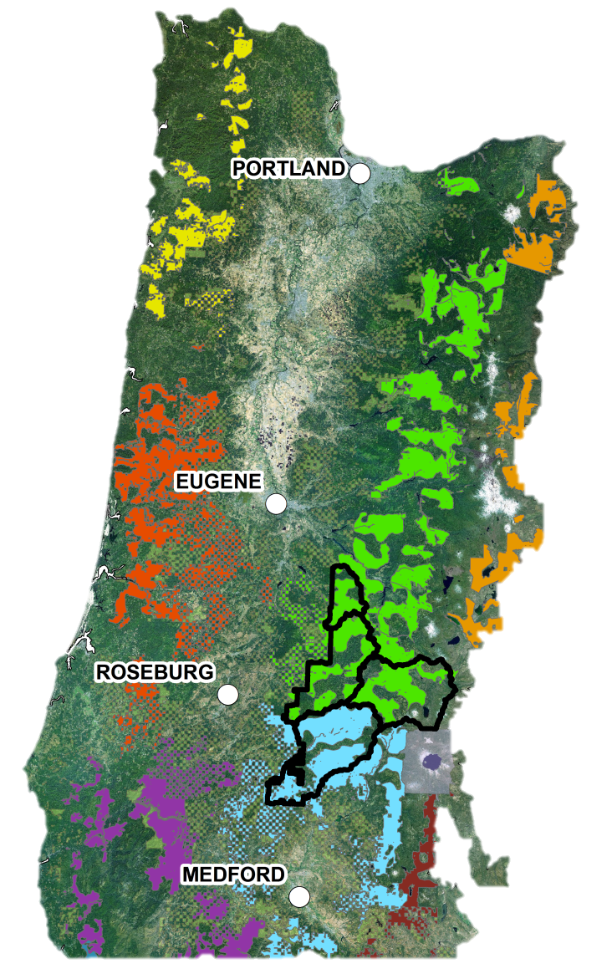
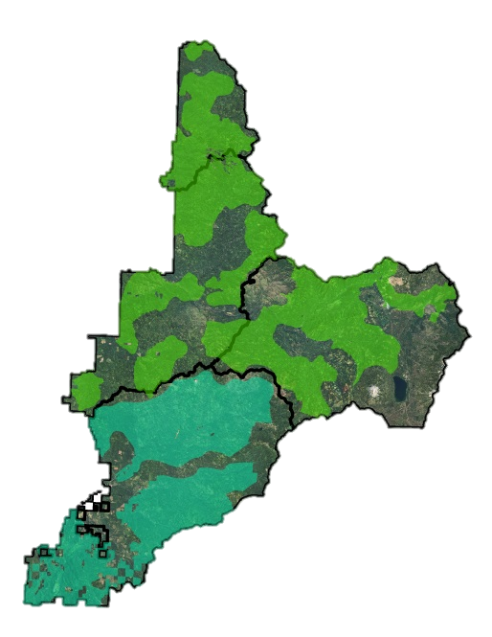
Critical Habitat in Oregon and on the Umpqua National Forest
Northwest Forest Plan Land Use Allocations on the Umpqua National Forest | Acres of Critical Habitat | % of Total Land Use Allocation | Total Umpqua NF Acres
Adaptive Management Area | 30,615 | 50% | 60,852
Administratively Withdrawn | 14,455 | 22% | 66,350
Congressionally Reserved | - | 0% | 71,819
Matrix | 268,233 | 65% | 411,983
Late Successional Reserves | 282,993 | 75% | 375,157
Totals | 596,296 | 60% | 986,160
Western Cascades
Subunit 5
Umpqua National Forest
Klamath East
Subunit 1
Notes:
Complex planning environment with a high percentage of forest in CHU

Slide 5
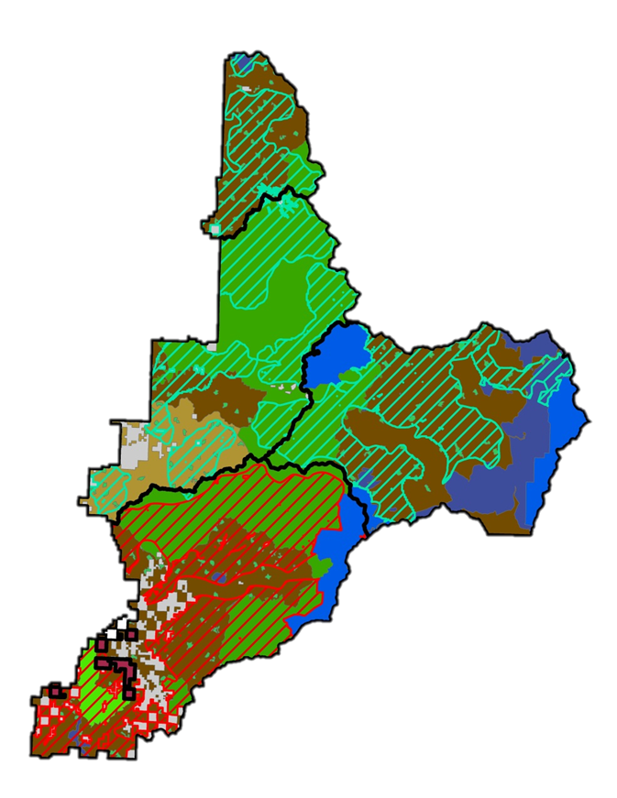
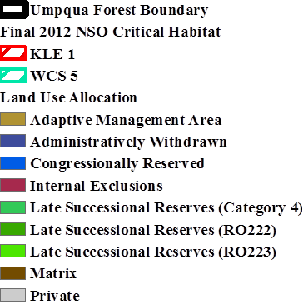
Critical Habitat Sub Units on the Umpqua
Notes:
Two different set of management recommendations for these two sub units.

Slide 6
Western Cascades South Subunit 5
Special management considerations:
Conserve older stands that contain the conditions to support northern spotted owl occupancy or high-value northern spotted owl habitat as described in Recovery Actions 10 and 32.
2. Management emphasis needs to be placed on meeting northern spotted owl recovery goals and long-term ecosystem restoration and conservation. When there is a conflict between these goals, actions that would disturb or remove the essential physical or biological features of northern spotted owl critical habitat need to be minimized and reconciled with long-term ecosystem restoration goals.

Slide 7
Western Cascades South Subunit 5
Special management considerations:
3. Continue to manage for large, continuous blocks of late-successional
Forest.
4. In areas that are not currently late seral forest or high-value habitat and where more traditional forest management might be conducted (e.g.matrix), these activities should consider applying ecological forestry prescriptions.

Slide 8
Klamath East Subunit 1
Special management considerations:
Combines the moist forest recommendations of the West Cascades Units and dry forest recommendations of the East Cascades.
Dry Forest Recommendations include:
Vegetation and fuels management in dry and mixed-dry forests may be appropriate both within and outside designated critical habitat where the
goal of such treatment is to conserve natural ecological processes or restore them (including fire) where they have been modified or suppressed.

Slide 9
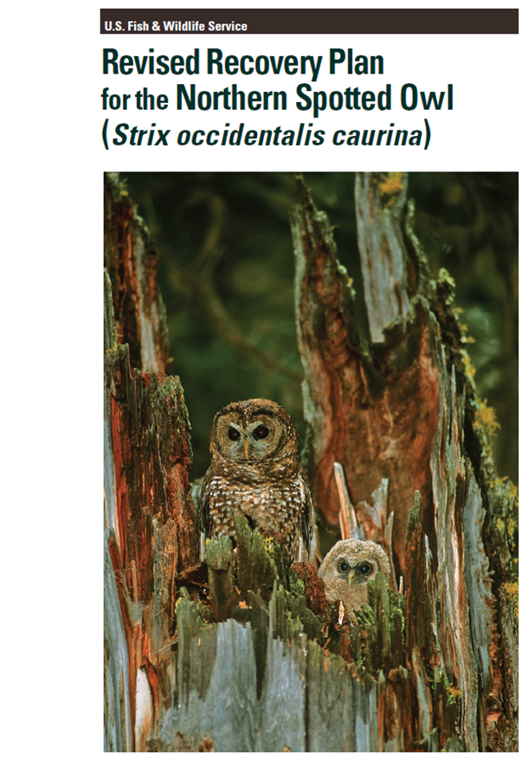
Recovery Action 32
Maintain and restore high-quality spotted owl habitat stands are characterized as having large diameter trees, high amounts of canopy cover, and decadence components such as broken-topped live trees, mistletoe, cavities, large snags, and fallen trees.
Notes:
Everything is not on the table. There are many areas, for a variety of reasons where we walk away from treatment. This is one key reason.

Slide 10
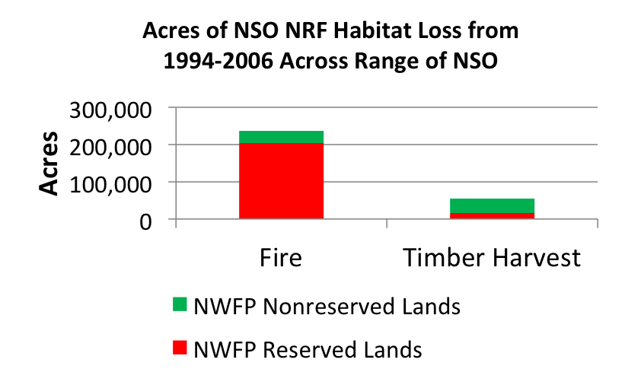
Fire History in SW Oregon
Over 900,000 acres of fire prone NSO habitat occurs in the Oregon Western Cascades, most in the southern portion, Davis 2011
Notes:
Loss of NSO habitat to wildfire exceeds loss by timber harvest on FS lands by a couple of orders of magnitudes.
Fires and habitat susceptible to habitat alteration increase in SW Oregon.

Slide 11
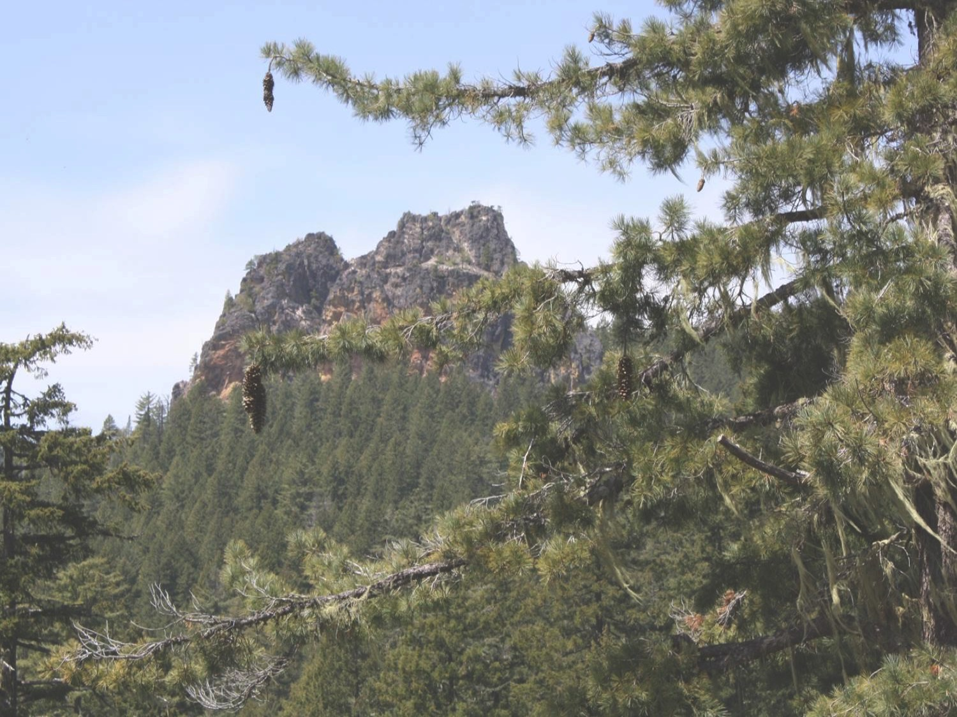
Vegetation Restoration Strategy Umpqua National Forest
Identify what restoration needs are most urgently needed
Identify where our most urgent restoration opportunities are
Identify where there are opportunities for stand-alone timber sales in matrix land allocations
Identify what vegetation management data needs are and how to acquire them
Limpy Rock
Notes:
The four principle objectives of the Vegetation Restoration Strategy.

Slide 12
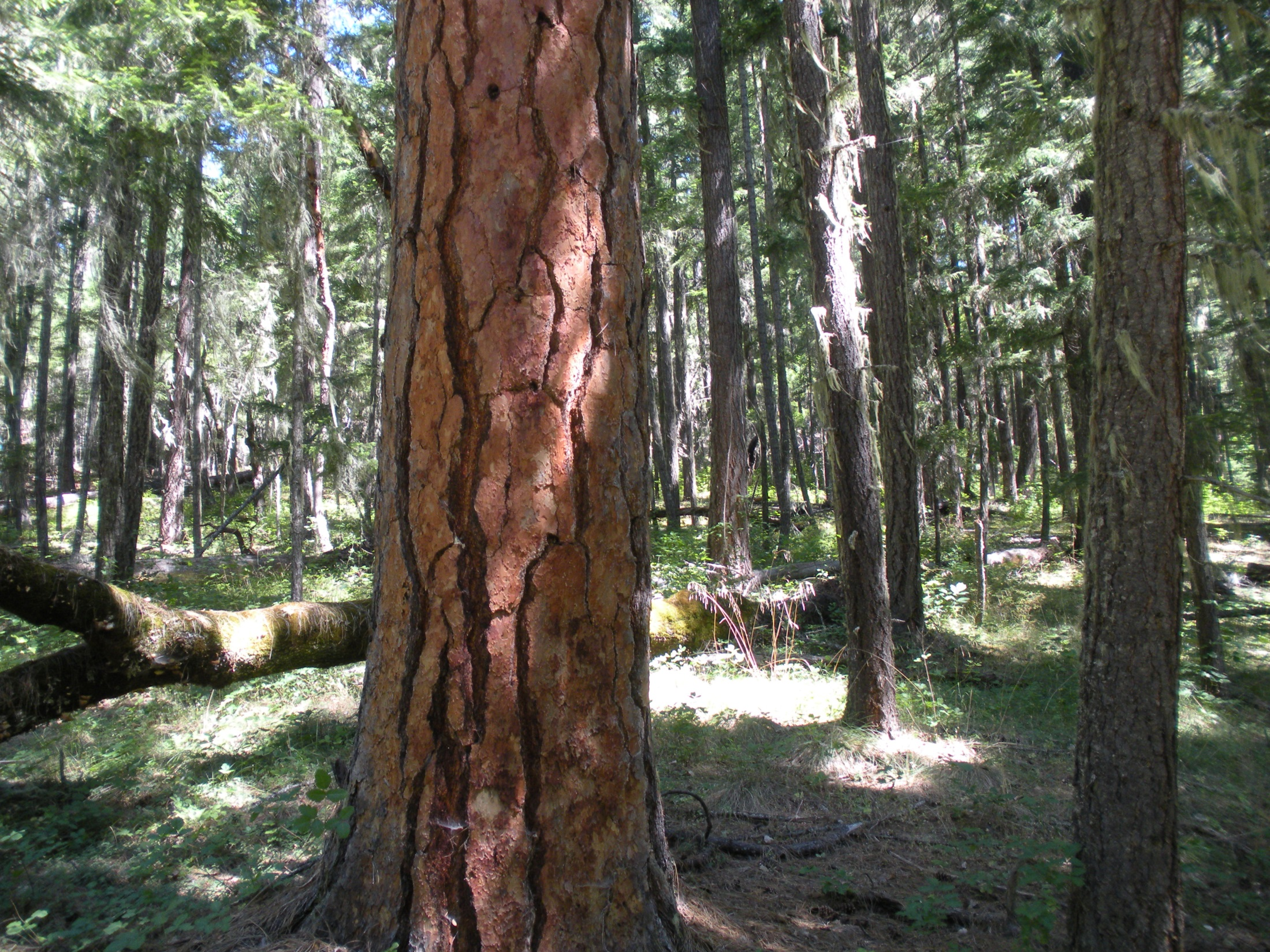
Vegetation Restoration Strategy Umpqua National Forest
Identify what restoration needs are most urgently needed
Identify where our most urgent restoration opportunities are
Elk Creek
Notes:
After first identifying what restoration opportunities were most urgent, we used these priorities to determine where first to target restoration management planning.
Photo of dead and declining ponderosa pine and oak in the Elk Creek watershed.

Slide 13
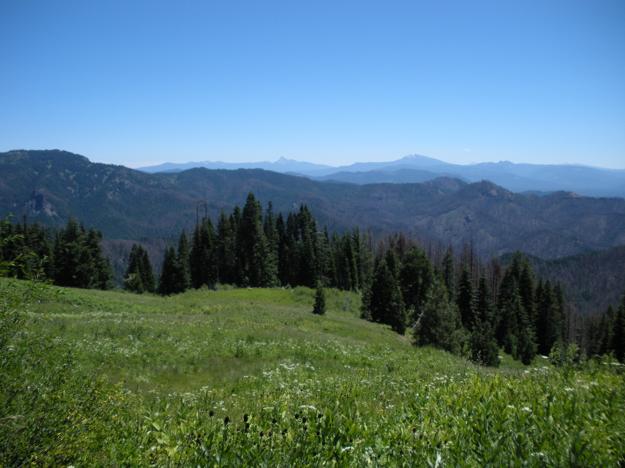
What are the Restoration Needs?
Young Stand Thinning to promote LSOG Characteristics
Riparian Thinning to promote Diverse Structure and Large Wood Recruitment
Fire Resiliency of LSOG/Spotted Owl Habitat
Oak/Hardwood Restoration
Pine Health
Meadow Encroachment (Mesic meadows)
Seral Stage Distribution/Extent (Departure from Reference Conditions)
Huckleberry/Traditional Use Species Enhancement
Off-site Conifer Plantation Rehabilitation
Pest/Pathogen Risk Abatement
Invasive Species Management
Soil Compaction Rehabilitation
Climate Change
Boulder Creek Wilderness
Notes:
This is the un-prioritized list of restoration opportunities.
There is broad overlap among some of these categories.
Photo of the Boulder Creek Wilderness Area from near the vicinity of Horse Prairie with Mt. Thielsen and Mt. Bailey in the background.

Slide 14

Pairwise Comparison Matrix
Assumptions:
Based on presumed critical, time-sensitive need
Scale independent
No consideration of cost
No consideration of timber outputs or other assigned targets
Methodology:
The relative value of each criterion are subjectively assigned in pair-wise fashion on a scale of 0.1-9
Values for each criterion are summed and the relative proportion of the total sum are computed
Only the red highlighted values should be edited; values below the grey diagonal line are the reciprocal values that are computed automatically
Notes:
Restoration opportunities were evaluated in pairwise fashion using a tool from a well established decision framework known as the Analytical Hierarchy Process. Each team member analyzed the opportunities individually. The individual results were tabulated and normalized and then summed into a consensus ranking.

Slide 15
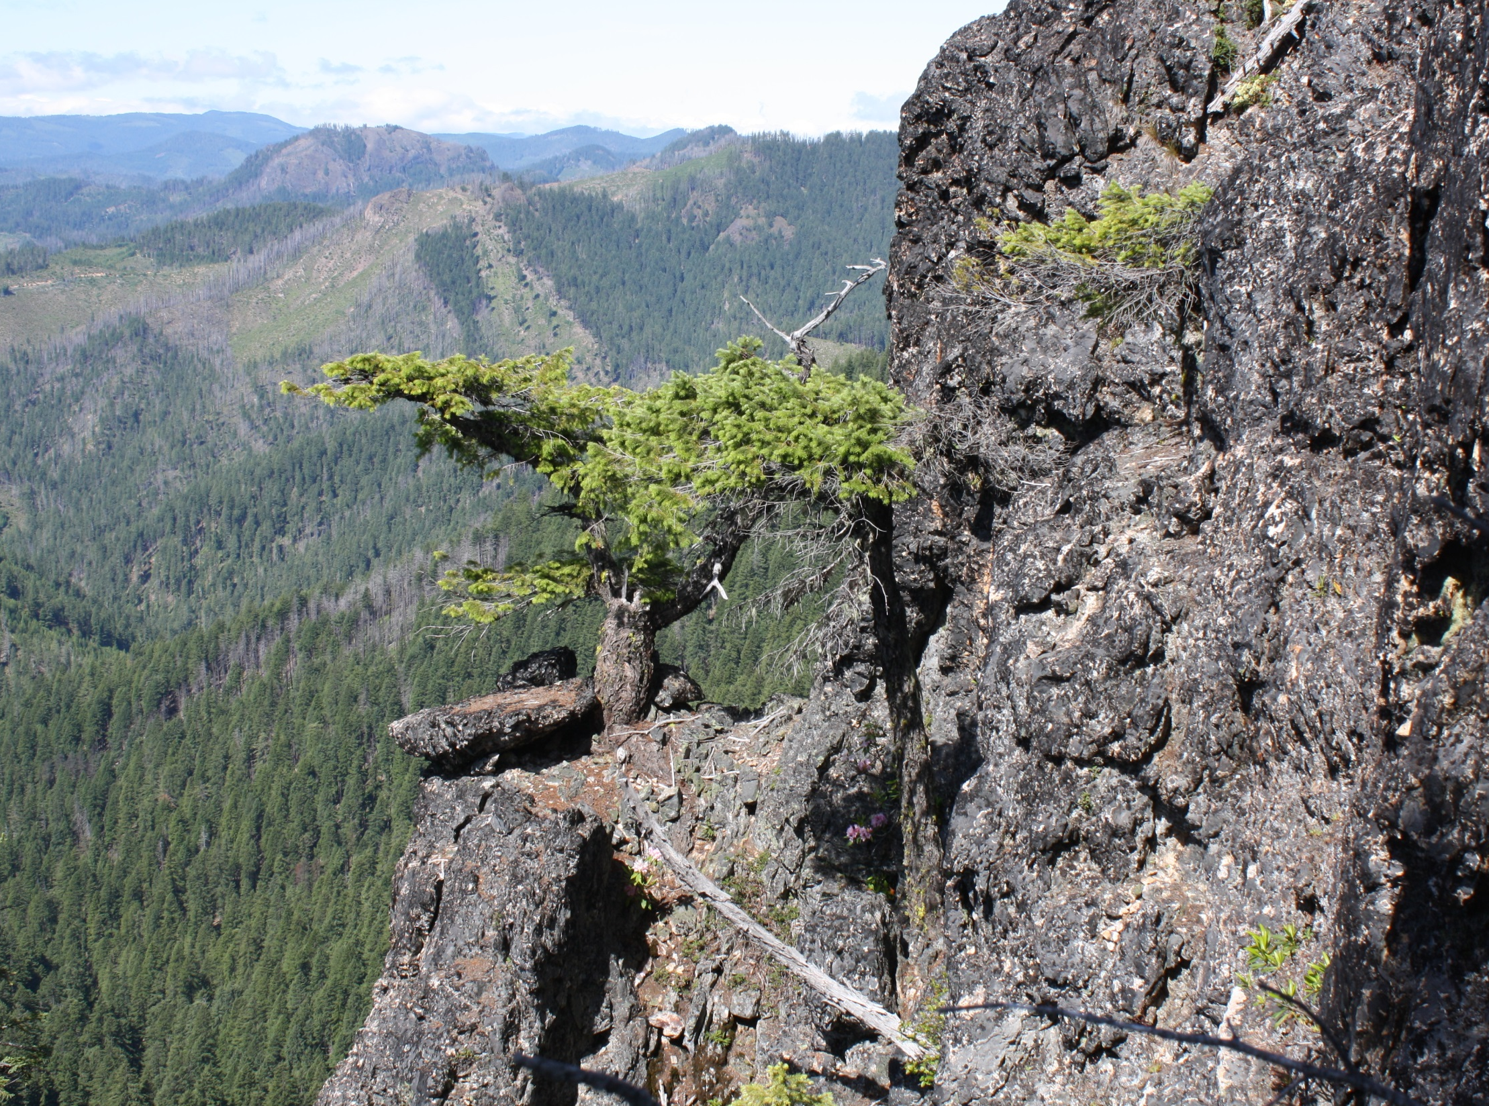
Pairwise Comparison Matrix Results
Fire Resiliency in Northern Spotted Owl Habitat
Sugar Pine and Western White Pine Health
Whitebark Pine Health
Oak Restoration
Ponderosa Pine Health
Riparian Thinning to promote Diverse Structure and Large Wood Recruitment
Jeffrey Pine Health in Serpentine Habitat
Meadow Encroachment
Seral Stage Distribution/Extent (Departure from Reference Conditions)
Young Stand Thinning to promote LSOG Characteristics
Invasive Species Management
Madrone/Chinquapin Restoration
Huckleberry/Traditional Use Species Enhancement
Pest/Pathogen Risk Abatement
Off-site Conifer Plantation Rehabilitation
Soil Compaction Rehabilitation
West of Quartz Mt.
Notes:
Here are the ordered results from bottom to top.
Photo is of a cliff on the west side of Quartz Mountain looking north towards Cavitt Mountain.

Slide 16

Where is the Highest Restoration Need?
Fire Resiliency in Owl Habitat
Pine Health
High Probability Large Fire Risk
Owl Habitat
Pine Presence
USFWS Model
NRF Habitat
PILA Model
ECOG_GNN
Aspect & Slope Model
Notes:
Using the top priority restoration categories for which we had suitable spatial data, we determined priority areas for restoration by intersecting presence of the high value features with likelihood of large fire.

Slide 17
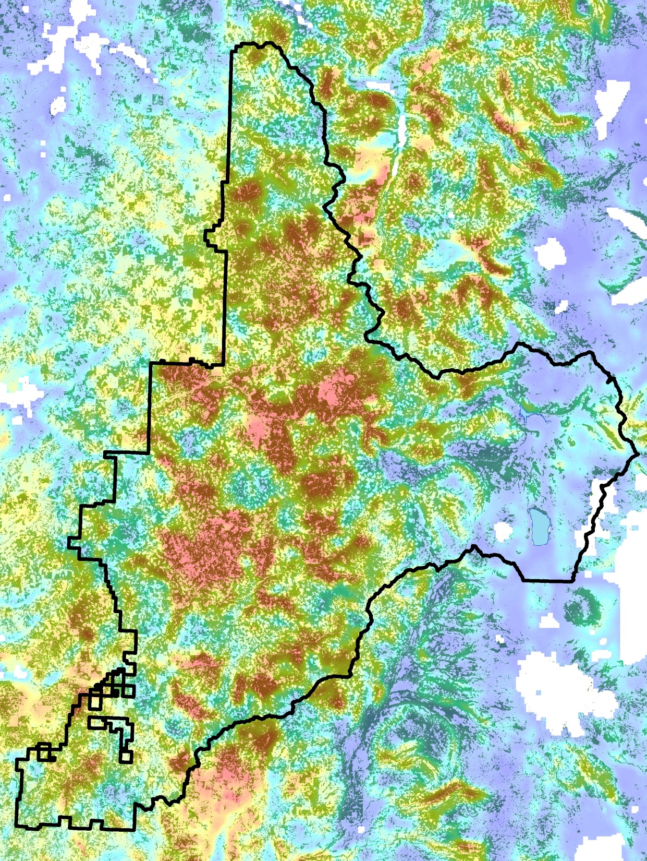
Large Fire Suitability and NRF Habitat Model (Davis 2011) Model Variables Included: August Max Temperature Slope Lightning Ignitions Distance to road* Elevation Summer Precipitation Solar Radiation *Use in conjunction with roads layers Trained by historic wildfire data 1970-2002, Useful at the 5th field watershed scale (or larger, approximately 20 square miles)

Slide 18
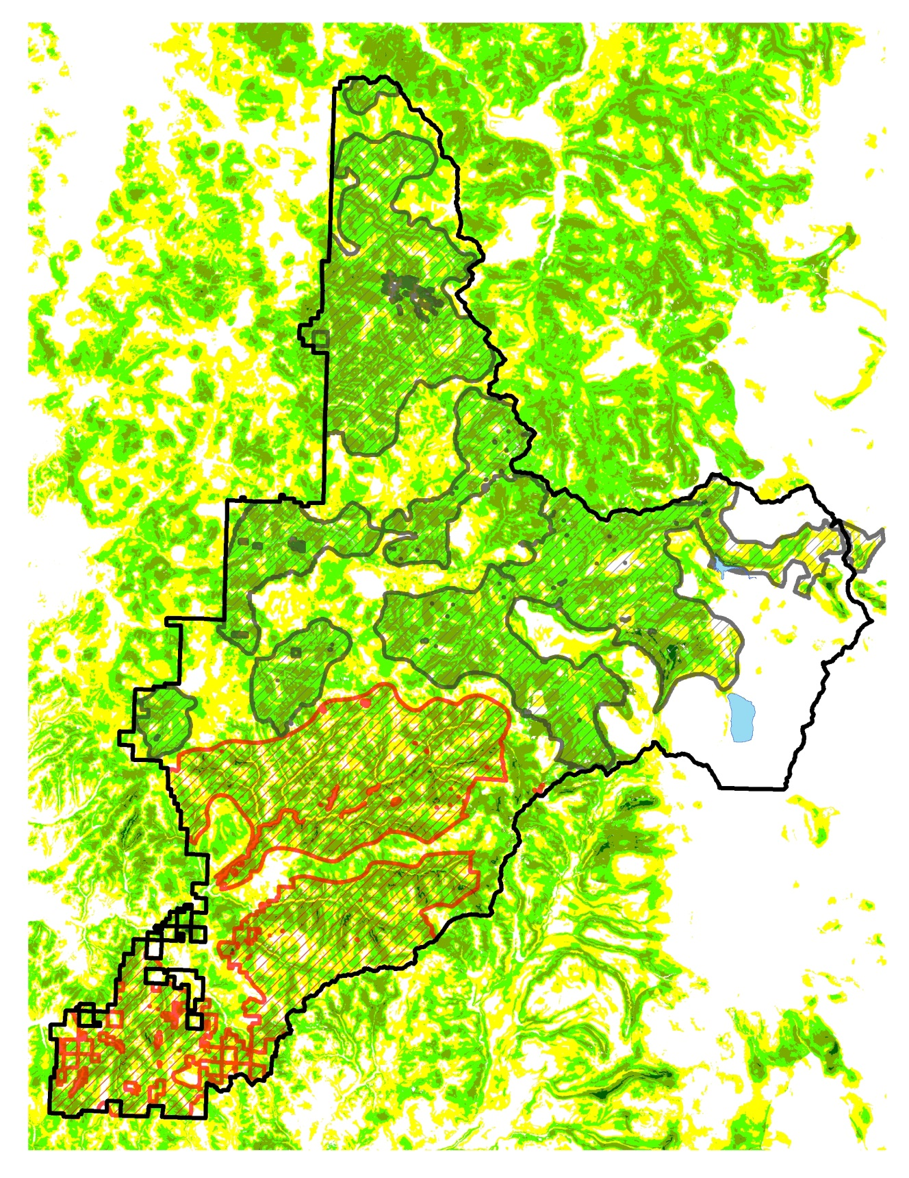
USFWS Relative Habitat Suitability Model Model Variables Included: Habitat Structure Variables Habitat pattern at Core and Edge of Nesting/Roosting habitat Species Composition Variables Topographic Position (Slope, Curvature, Insolation) Climate/Elevation Model was smoothed at 200 ha scale to simulate habitat at the core use area scale. These larger patches of highly suitable habitat are desirable to maintain where feasible

Slide 19
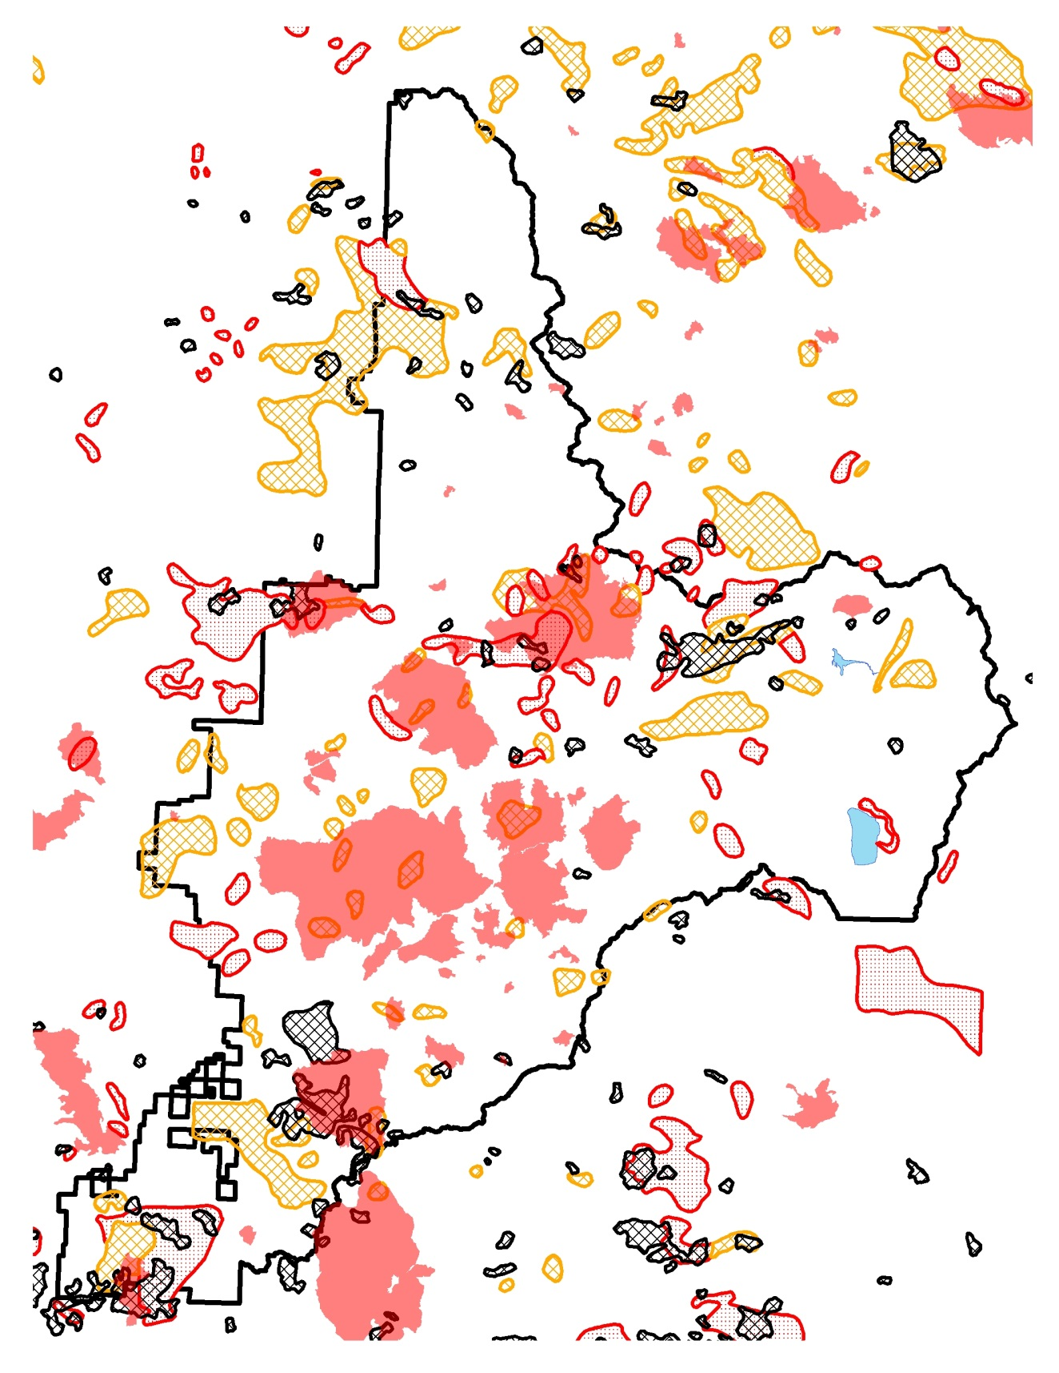
Fire History 1914-2014 Consideration of both recent and past fires can help identify landscape patterns of disturbance and areas that may more frequently burn.
Notes:
Historic fires whole perimeter not shown, just stand replacement patches. Can also show you areas of younger “over 80” stands that may have some density and structure concerns.

Slide 20
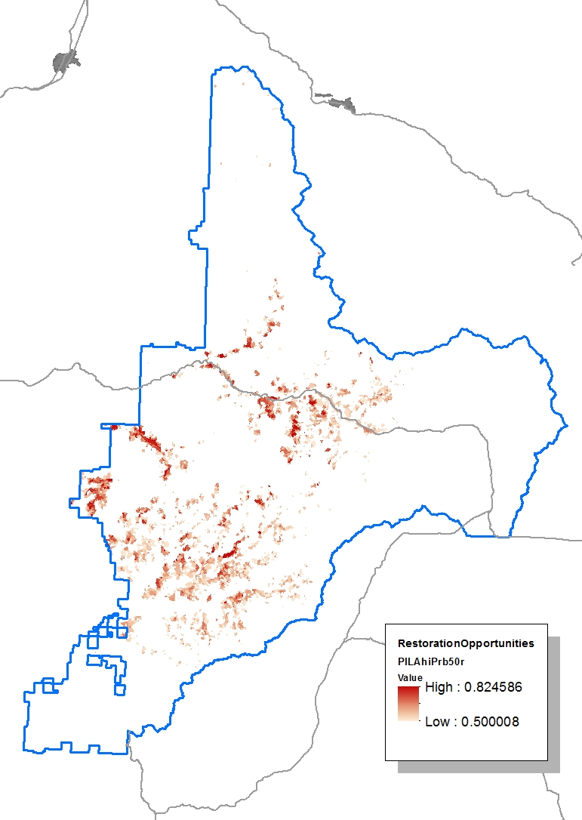
Sugar Pine Distribution Sugar Pine are a being crowded out of older stands due to lack of fire disturbance. Releasing the legacy sugar pines from encroachment and following up release with prescribed fire is a key restoration activity. Sugar Pine distribution was modeled by Richard Helliwell
Notes:
The GNN data was not robust enough to characterize sugar pine habitat on the Umpqua therefore habitat was modeled using known locations of sugar pine and the species distribution model Maxent. Likelihood of suitable habitat of 50% or more is displayed.

Slide 21
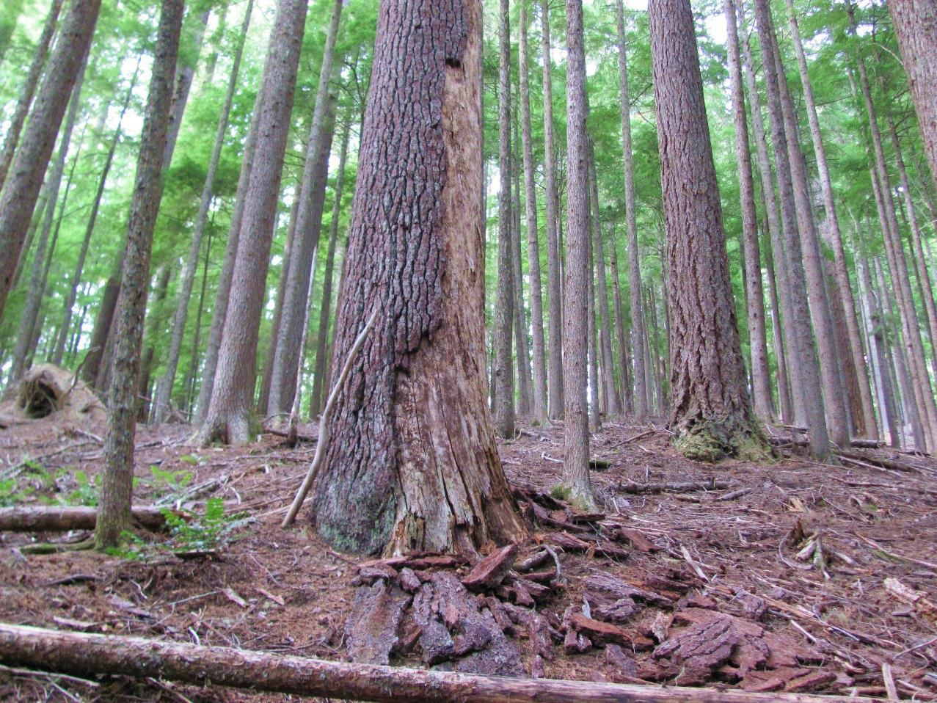
Sugar Pine and Western White Pine Health
Layng Creek
Notes:
Western white pine and, especially, sugar pine decline at stem densities in which Douglas-fir and true firs can still thrive. For this reason, mortality of these pines typically occurs even while their canopies are above the encroaching firs.
Both species are five-needle pines that are susceptible to white pine blister rust.
A dead sugar pine in a unit that was dropped from the Parker-Wyatt Timber Sale.

Slide 22
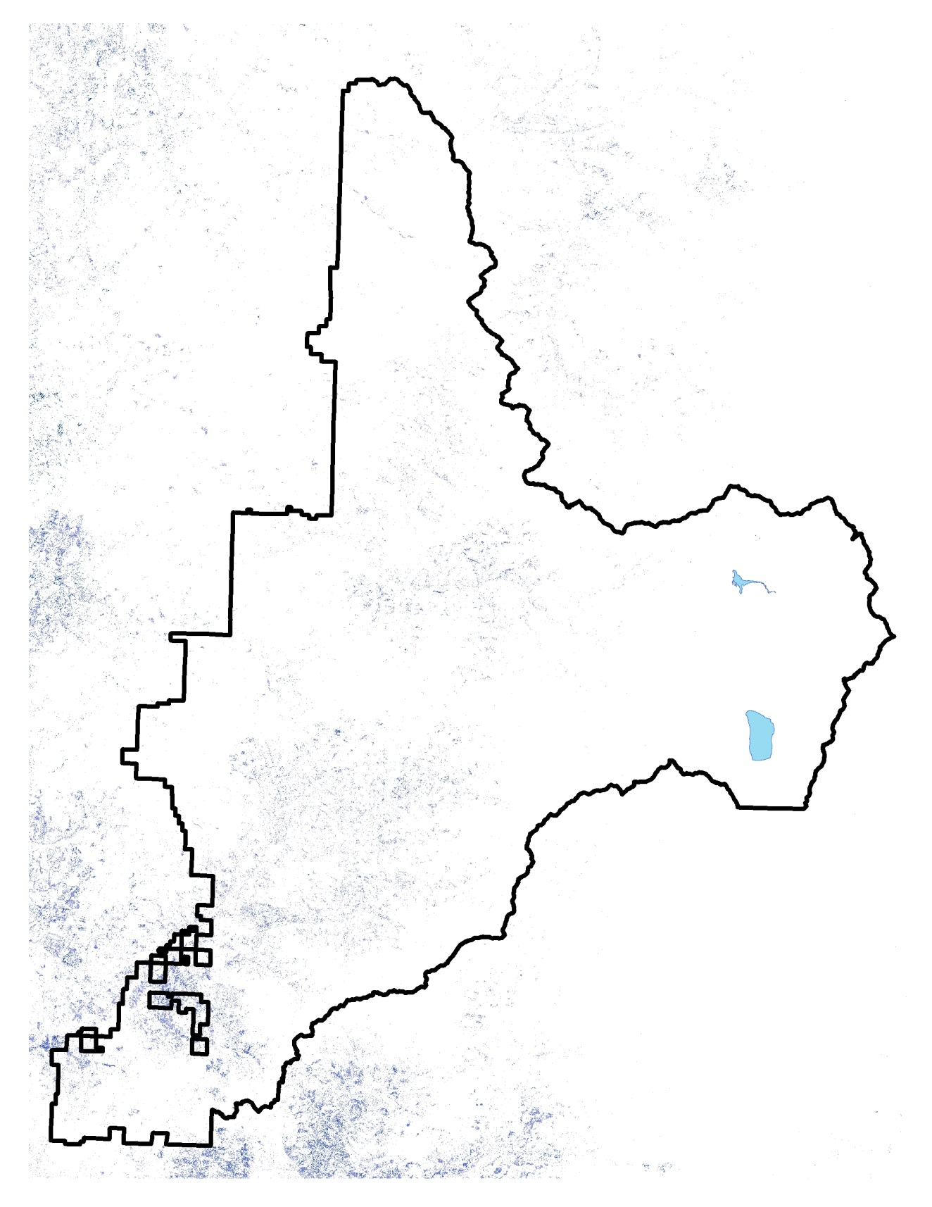
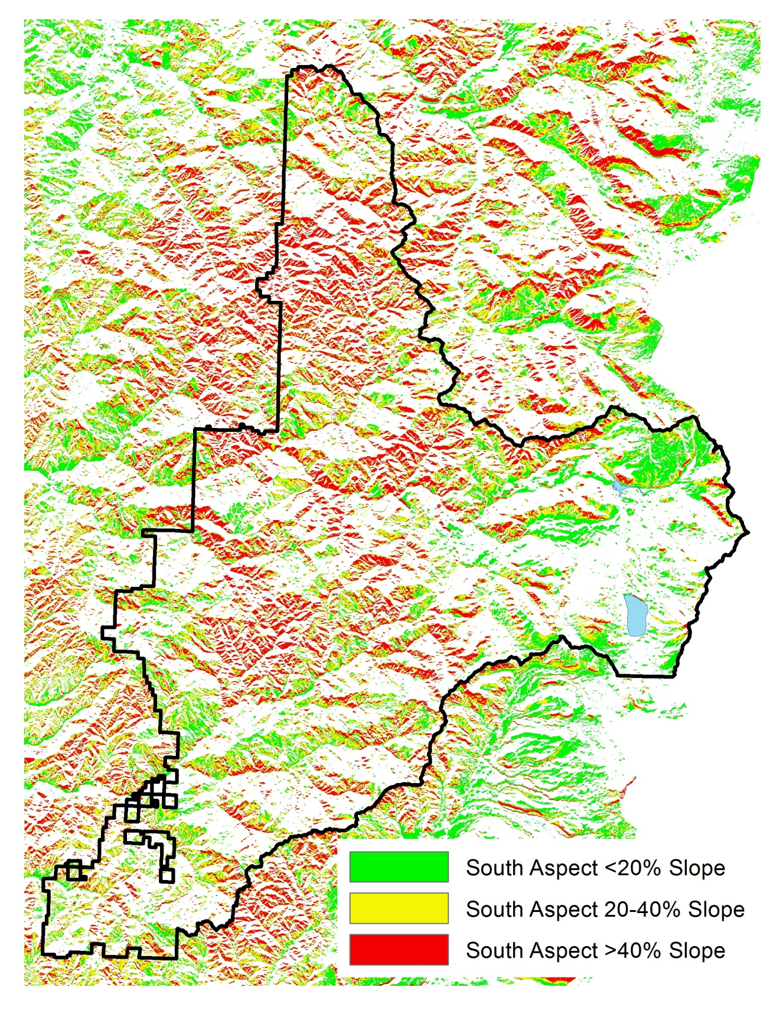
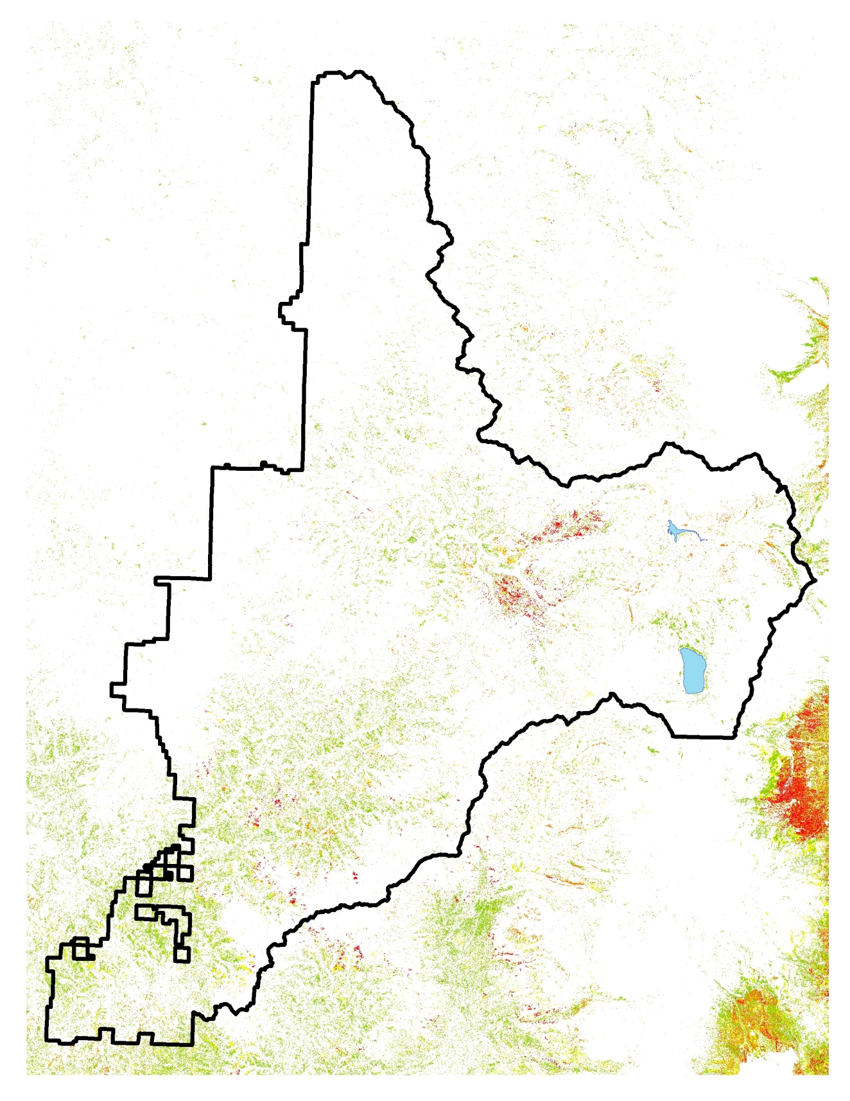
Oregon White Oak Distribution A more rare species on the Umpqua which in many areas are being encroached upon by conifers due to fire exclusion. They are an important piece of habitat diversity and represent a great opportunities for restoration objectives consistent with the critical habitat rule. Black oak also represents a key habitat feature that is prominent in some locations on the Tiller RD.

Slide 23
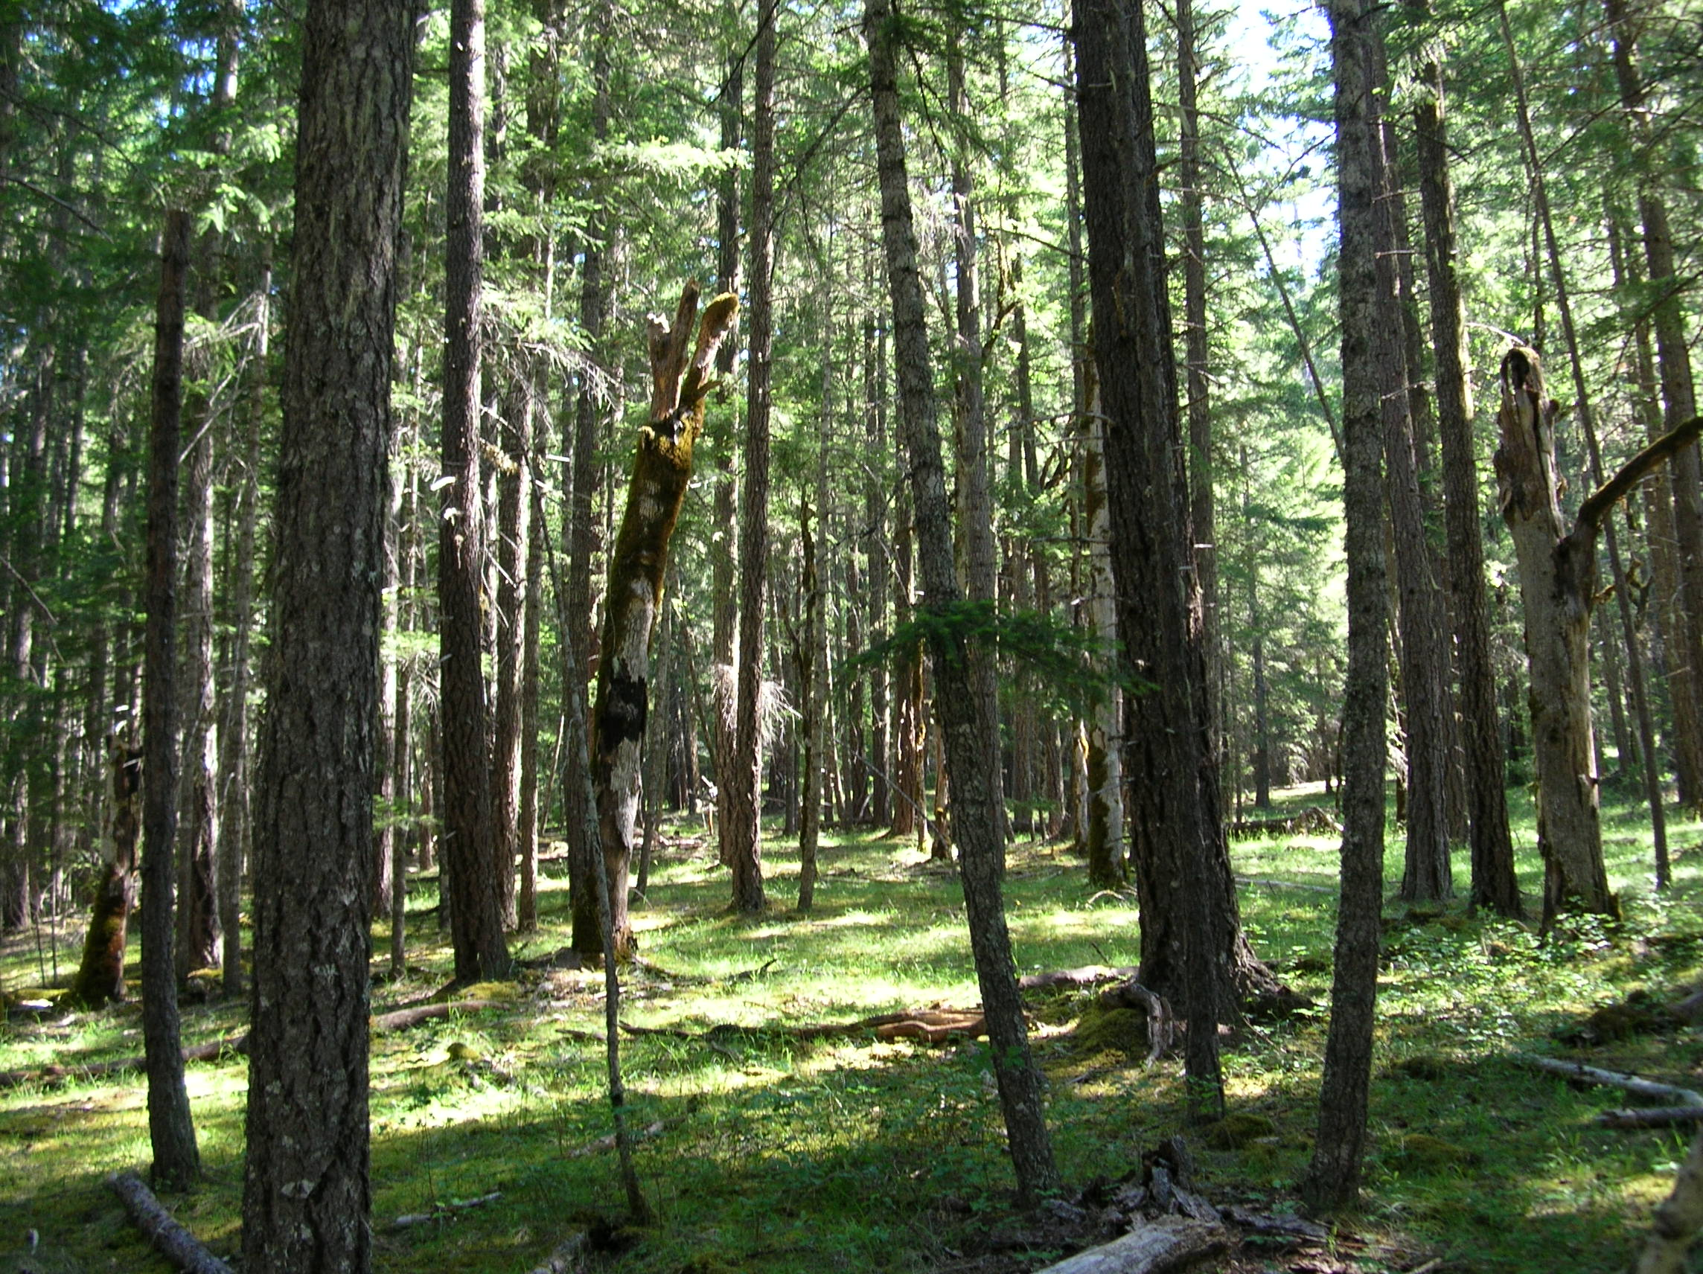
White Oak and Black Oak Habitat Restoration
Oak Flats
Notes:
Fire suppression has resulted in many stands of oaks being overtopped by conifers.
Even long suppressed oaks can respond through epicormic branching following conifer removal.
Black oak and white oak have different, albeit overlapping, habitat requirements.
At Oak Flat, old white oak snags under a 70-90 year-old Douglas-fir canopy provide a clear picture of what the stand formerly looked like.

Slide 24
Ponderosa Pine Distribution Ponderosa pine on the Umpqua present opportunities for restoration as many areas they are being encroached upon by other conifers where fire has been excluded. They are also evidence of more frequent fire return interval.

Slide 25
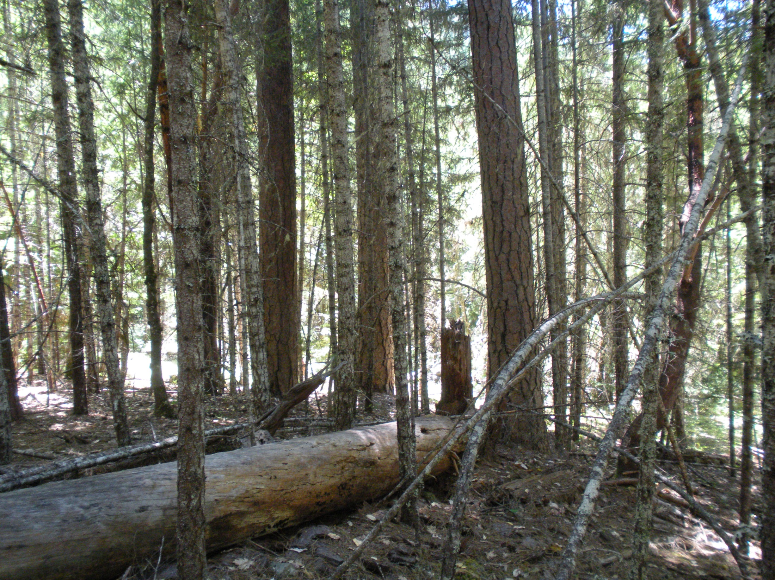
Ponderosa Pine Health
ElkCreek
Notes:
Ponderosa pine also declines at stem densities in which Douglas-fir and true firs can still thrive.
Widely planted across the forest because seedlings are more frost tolerant and drought tolerant than Douglas-fir.
Pre-1966 plantings are typically from off-site stock and prone to stagnation and significant deformities.
In this photo, three live ponderosa pine have been overrun by dog-hair Douglas-fir. A forth pine has already died.

Slide 26
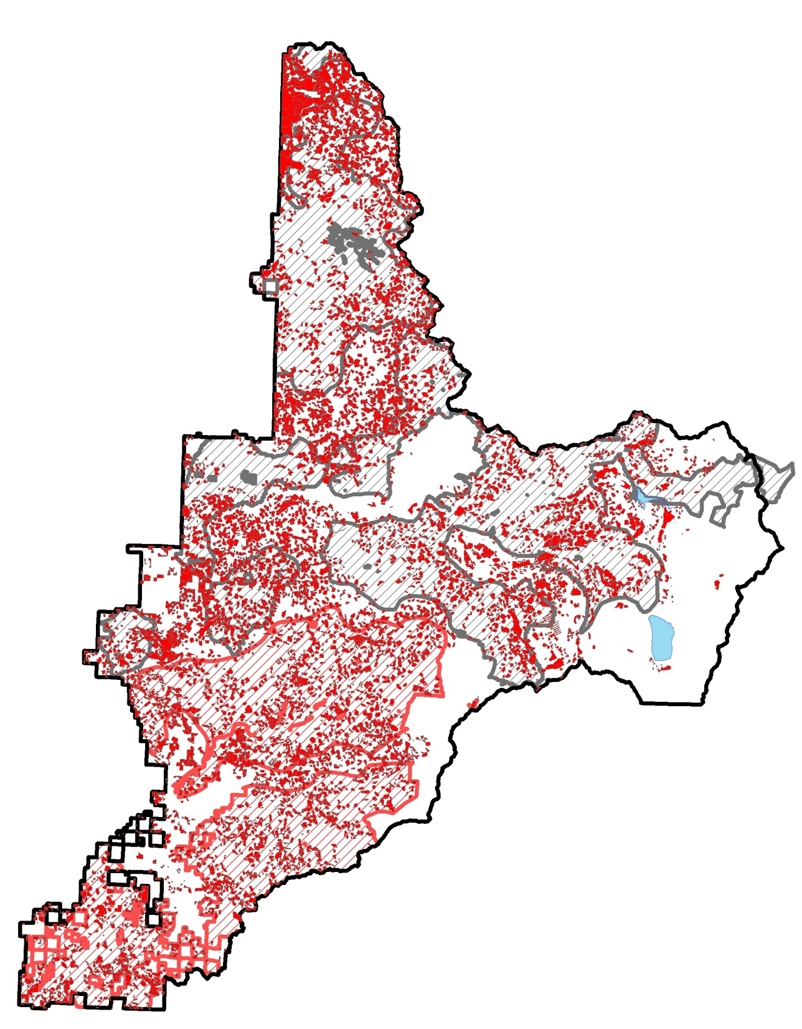
Umpqua National Forest Regeneration Harvest History 1913-2002 Consider proximity of older stands to younger stands and these younger stands provide an opportunity to manage for seral stage diversity at a landscape scale

Slide 27
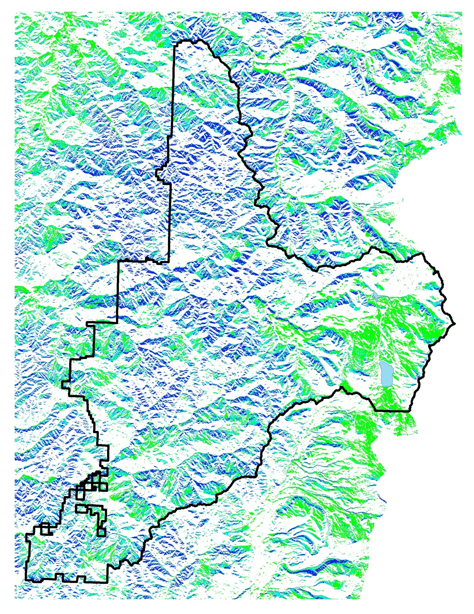
“Topography as a template for diversity”¹ North aspects and in particular North aspects with gentler slopes are areas less likely to burn at moderate to higher severities and are therefore places to consider treating younger stands to accelerate the development of late successional habitat characteristics. Existing habitat should be maintained as these are more likely to be retained in the face of future disturbances. 1. Stolen from a Tom Spies talk on moist conifer restoration

Slide 28
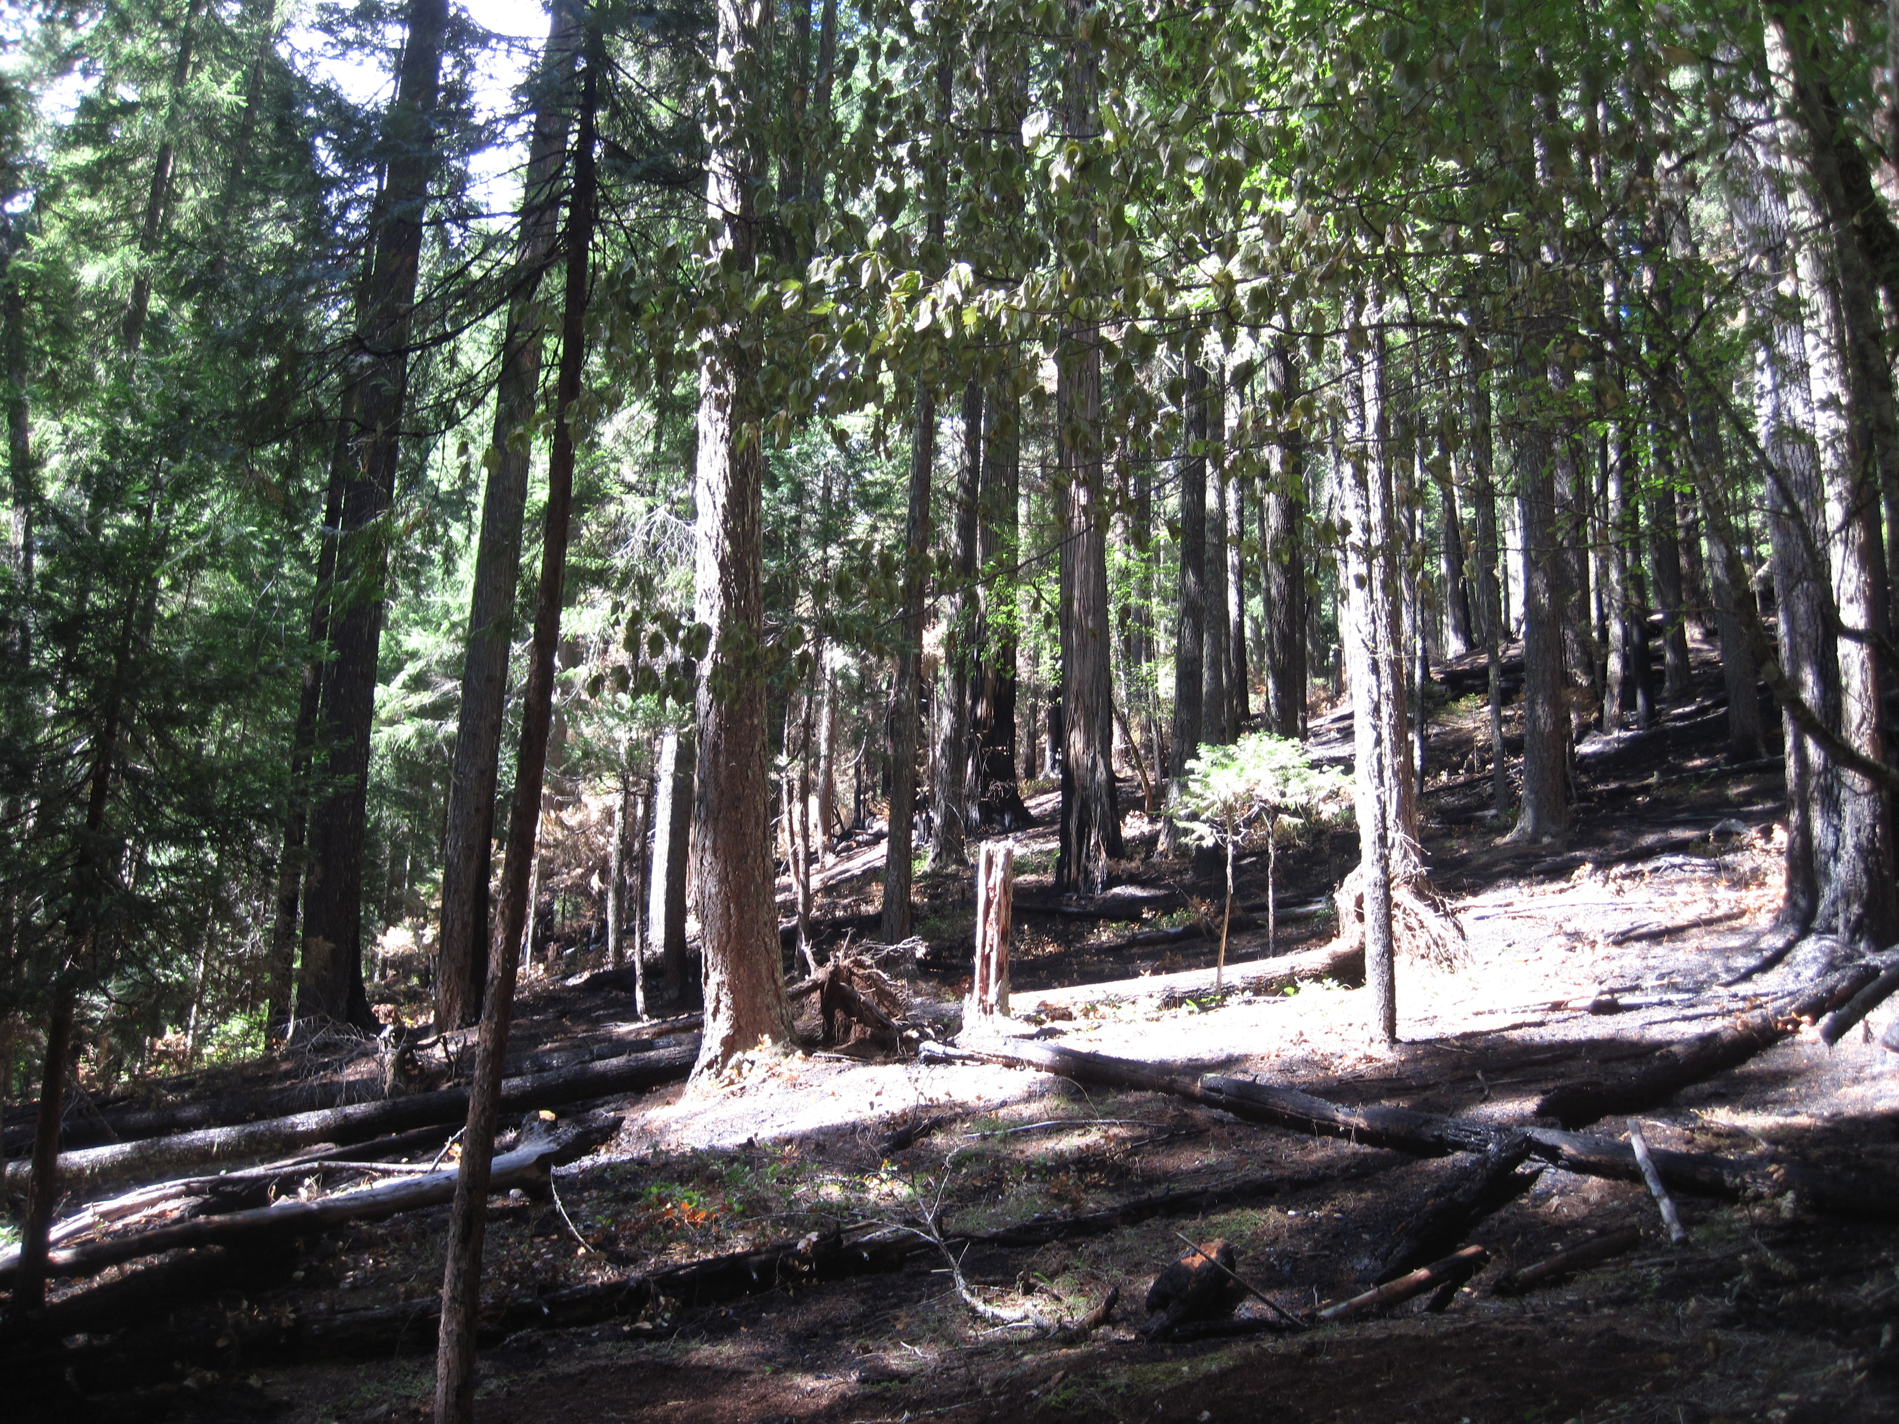
2013 Unnamed Fire
Notes:
Not everywhere needs to be treated, some areas are fine as is and can withstand natural fire on their own. To misquote Kenny Rodgers, “you need to know when to treat them and know when to walk away…”

Slide 29

Where is the Highest Restoration Need?
Fire Resiliency in Owl Habitat
Pine Health
High Probability Large Fire Risk
Owl Habitat
Pine Presence
USFWS Model
NRF Habitat
PILA Model
ECOG_GNN
Aspect & Slope Model
Notes:
Using the top priority restoration categories for which we had suitable spatial data, we determined priority areas for restoration by intersecting presence of the high value features with likelihood of large fire.

Slide 30
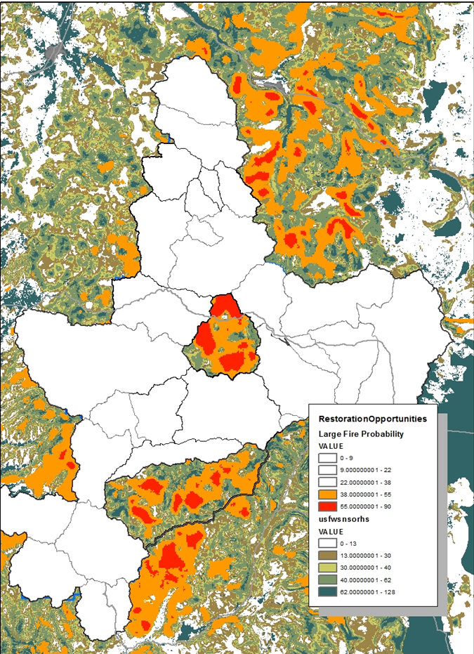

Working through the top restoration priorities, and around past fires and other projects these two watersheds jumped out as having large amounts of
large fire suitability areas with large amounts of NSO habitat along with a greater densities of Sugar and
Ponderosa Pines.
Jackson Creek Watershed
Calf & Copeland Watersheds

Slide 31
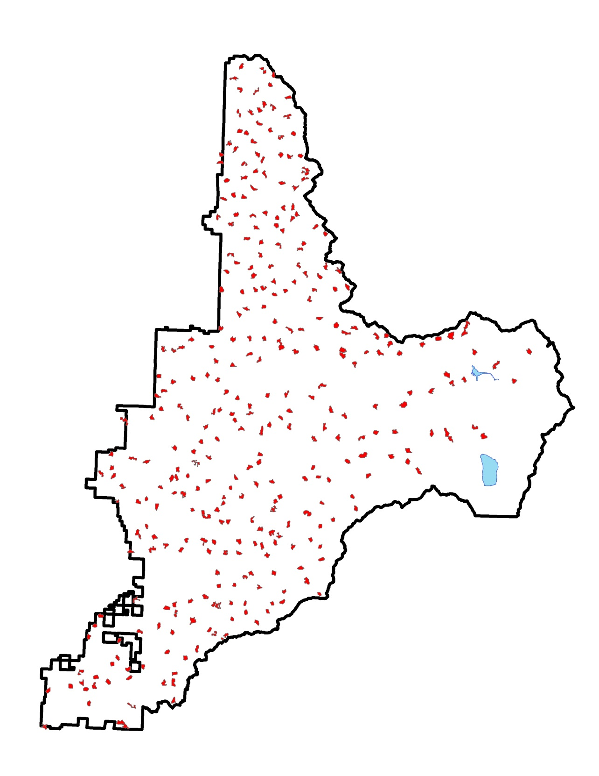
Recovery Action 10 Recovery Action 10 will likely play a larger role in landscape habitat management in the event of an uplisting of the NSO. Maintaining habitat around known sites with reproducing pairs and known sites with pairs will be critical to reducing potential take from restoration driven projects.

Slide 32
Other Key Planning Considerations
With NSO surveys, Survey and Manage Surveys and complex analyses, large landscape level projects in stands over 80 takes 3-4 years to plan
Red Tree Voles on the Umpqua are quite common in a wide variety of stand types under around 4,500 ft elevation. Non high priority site management or some other type of large scale habitat conservation plan will need to occur to make these projects feasible and ecologically meaningful to implement
Extensive work with partners and other interested publics is essential for successful planning and implementation of these types of projects.

Slide 33
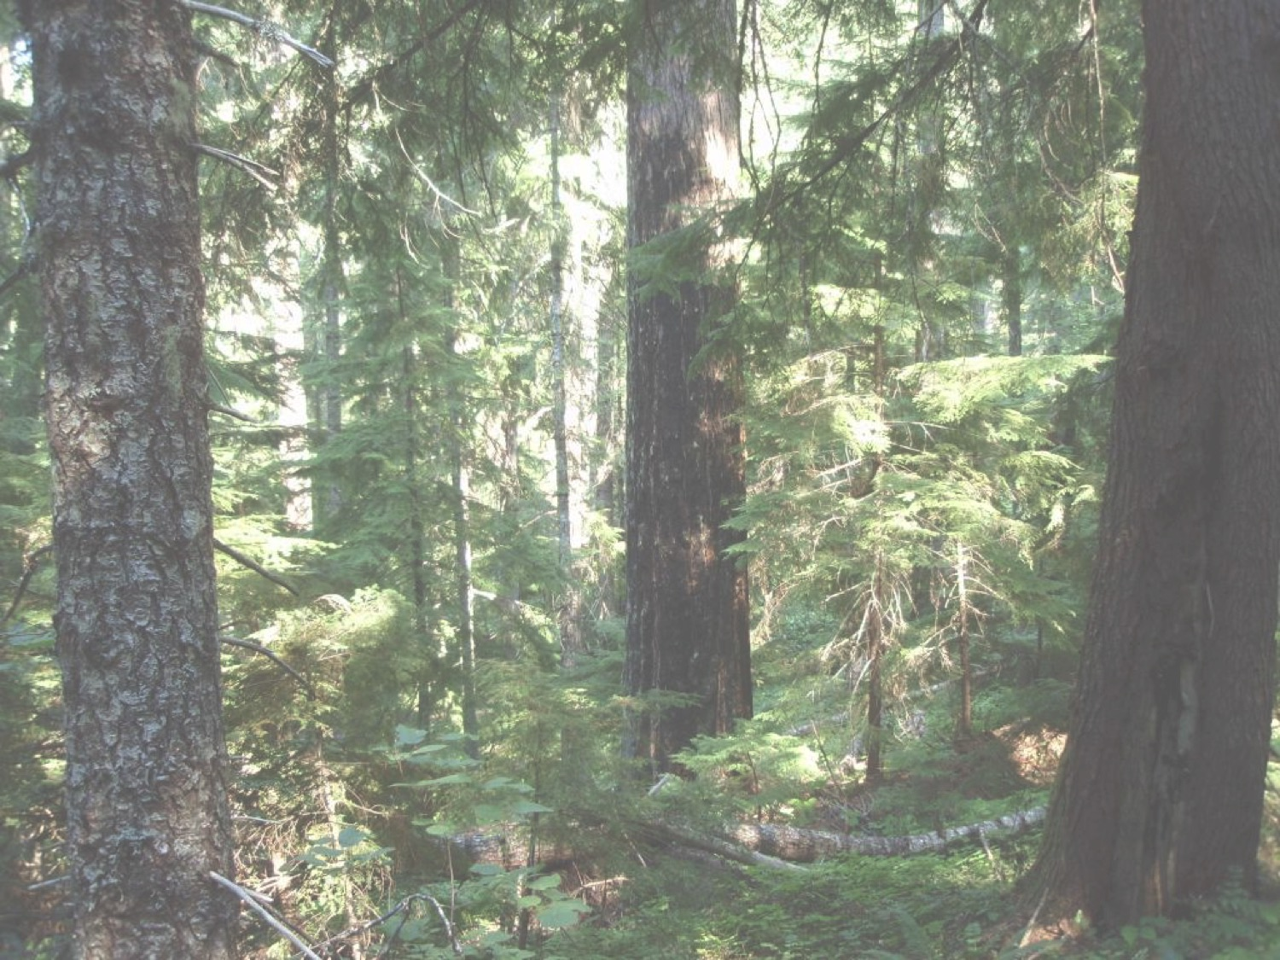
Questions?

