Slide 1

USING LIDAR TO INFORM NEPA
B L M
BLM’s LiDAR Strategy
The How, What, Where Strategy for LiDAR Data
Presenting:
Maria Fiorella
Remote Sensing Specialist
503-808-6271
mfiorell@blm.gov
More Info:
George McFadden
Oregon SO Silviculturist
503-808-6107
gmcfadde@blm.gov

Slide 2
USING LIDAR TO INFORM NEPA
B L M
BLM’s LiDAR Strategy
Acquire
BLM Cooperates with the Oregon LiDAR Consortium
Current Program Focused in Western Oregon
First LiDAR Acquisition 90+ percent complete
Install Ground Correlation Plots
Process
Currently Completed by Contractors
Will shift to Internal BLM Processing
Increased Need to Train BLM Staff
Inform
Data Currently Stored Off-Line
Will Shift to Greater Access
Will Require Increased IT Infrastructure

Slide 3
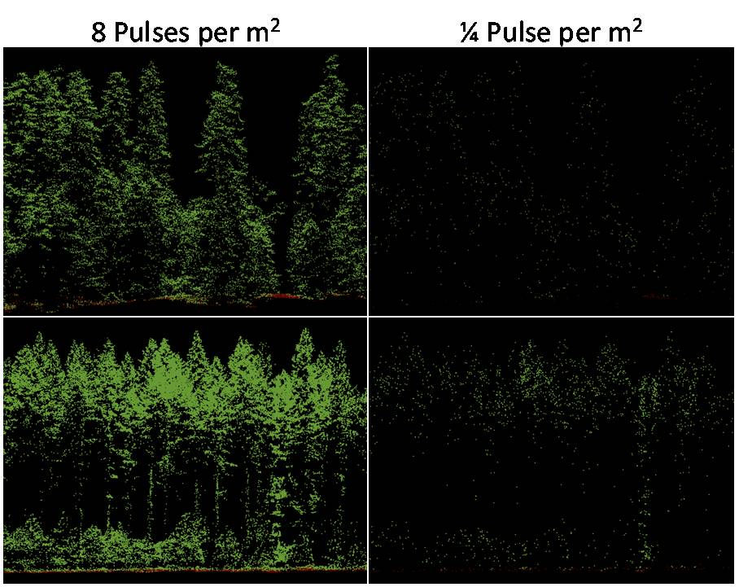
USING LIDAR TO INFORM NEPA
B L M
Data Acquisition

Slide 4
USING LIDAR TO INFORM NEPA
B L M
Common Forestry Specifications
High Pulse Density (>6 pulses/sq m.)
50% side-lap (reduced shadowing/more uniform pulse densities)
Narrow Field-of-View (≤ 30º)
High Relative Accuracy
Leaf-on/Leaf-off considerations
Normalized Intensities

Slide 5
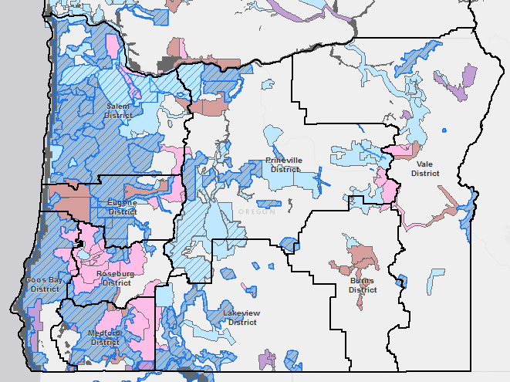
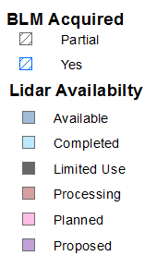
USING LIDAR TO INFORM NEPA
B L M
Acquisition Coverage
Coverage for All Lands in Western Oregon from Coast east to Forest Service Boundary in Cascade Mountains

Slide 6
USING LIDAR TO INFORM NEPA
B L M
Data Processing
Advanced commercial software tools available for analysis and visualization of LiDAR point cloud data.
Most high end software can now handle point cloud data (ArcGIS, ENVI, ERDAS, Ecognition)
Powerful software tools available at little or no cost:
USFS Fusion
LAS Tools
Open Source Libraries
Improved Processing Techniques for Vegetation Analysis.
Object Based Image Analysis
Voxel Approaches (volumetric analysis)
Ray Tracing Techniques (crown estimation)

Slide 7
USING LIDAR TO INFORM NEPA
B L M
Data Processing / Staff Training
Reliance on Contractors has Slowed Staff Skills Development
Many Needed Skills Will Be Developed Internally
Data Processing is a Custom BLM Operation
Training will Involve Internal and External Courses
Internal Training will Require BLM Instructors Teaching use of BLM Methodology

Slide 8
USING LIDAR TO INFORM NEPA
B L M
Inform / Data Storage and Retrieval
Raw LiDAR Data Stores as Log ASCII Standard (.LAS) Files
Approximately 50 TB of Raw Date for Western Oregon
Storage Access and Cost are Strong Considerations
IT Infrastructure Upgrade (Potential)
Dedicated LiDAR / Inventory Hard Drive
Process Data on the Cloud but Store Internally
Concentrate on Use of GIS to retrieve and Use Products Derived from LiDAR and Related Data, i.e. Ground Plots

Slide 9
USING LIDAR TO INFORM NEPA
B L M
Inform Managers / NEPA
Rely on GIS and Internal GIS Staff, i.e. BLM will not Hire LiDAR Specialists
LiDAR and LiDAR Derived Products Should Become Common GIS Available Products
Ultimately will Determine the Need / Use of Multi-temporal LiDAR Flights
Will Continue Research on the Use of LiDAR to Inform Multiple Resource Decisions

