Slide 1
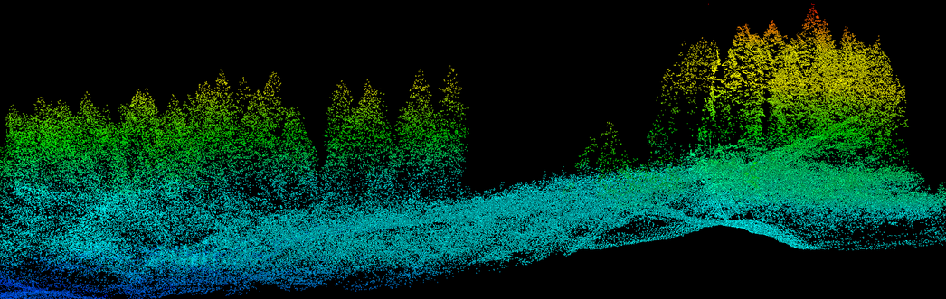

Lidar Strategy
Pacific Northwest Region
Using LiDAR to Inform NEPA
April 23, 2015
BLM Office | Salem, OR
Mark Riley
Remote Sensing Coordinator
US Forest Service, Region 6, Data Resources Management
Portland, OR

Slide 2
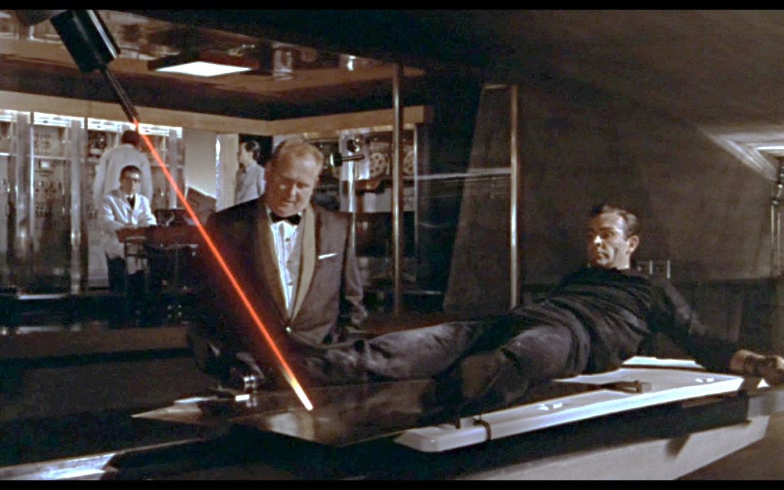
Lidar has evolved considerably in 50 years

Slide 3
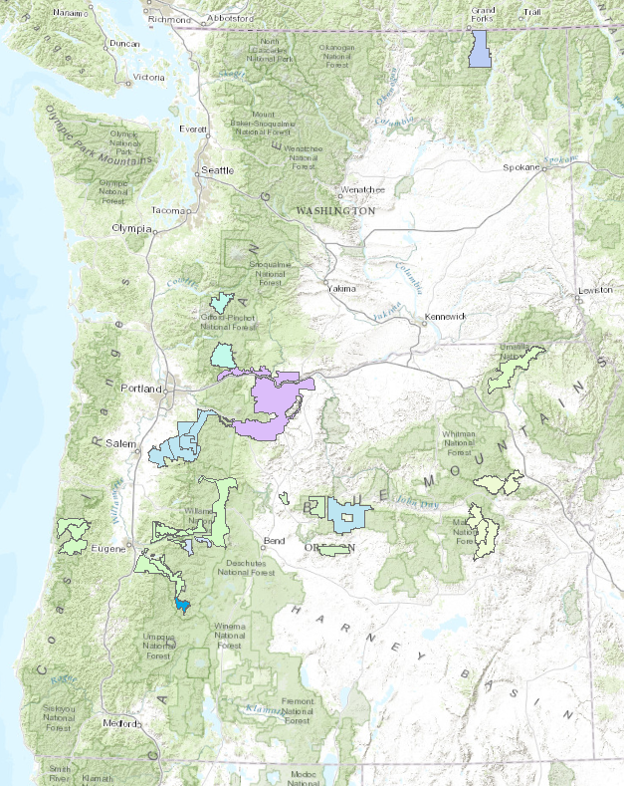
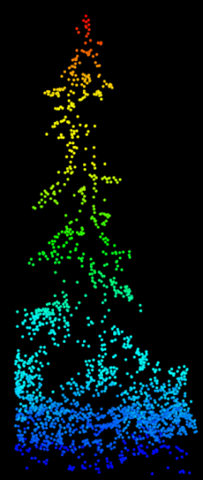
REGIONAL STRATEGY TEAM
Pete Heinzen, Data Resources Management
Brian Wing, Pacific Southwest Station
Tom DeMeo, Natural Resources
Leah Rathbun, NR
Kim Mellen-McLean, NR
Robyn Darbyshire, NR
Josh Chapman, NR
Dorothy Thomas, DRM
Mike Simpson, Deschutes NF
Mark Riley, DRM

Slide 4
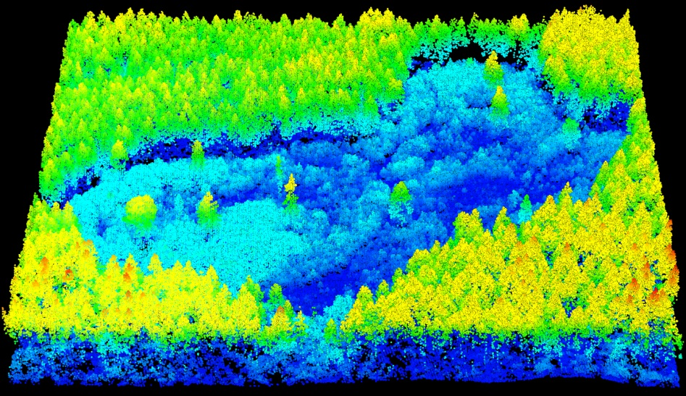
Lidar strategic framework
The Pacific Northwest Region has developed a strategic framework for acquiring, processing, and exploiting lidar effectively and efficiently. To create lidar continuity across the Region it is necessary to:
Explore new processing methods of lidar data
Identify new partnerships and leverage existing ones
Coordinate interdisciplinary efforts across the Region to assess existing natural resource conditions
Monitor outcomes of land management actions

Slide 5
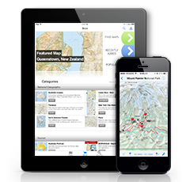
Lidar strategic framework
The R6 strategy provides recommendations for:
An efficient procurement processes
A protocol to prioritize lidar acquisition
A framework for modeling and analysis of lidar data to provide standardized outputs
Collecting in-situ field data to validate interpretation of lidar outputs
Easier, more consistent tablet-based collection
sUAS higher order field data collection

Slide 6
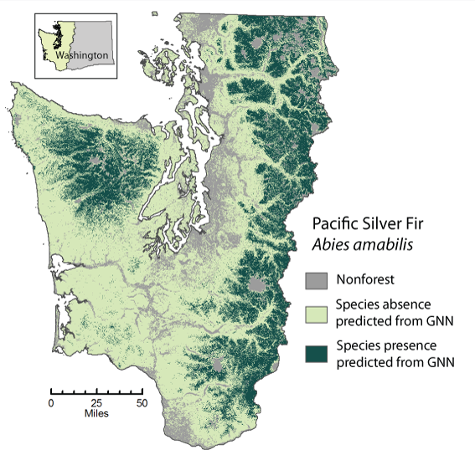
Lidar strategic framework
Integrating lidar with Gradient Nearest Neighbor (GNN) existing vegetation mapping
An effective approach for lidar data discovery and distribution
Training of interdisciplinary specialists and managers
Possible structural component or increase in classification accuracy
http://lemma.forestry.oregonstate.edu/methods/species-maps

Slide 7
Data discovery and distribution
New las tools (ArcGIS, Fugro, ERDAS) that will make point clouds less esoteric to a larger community
Huge files that are difficult to store and work with (las, derivatives, and other remotely sensed data sets)
Enterprise T: drive (ds.fs.fed.us\EFS) is a temporary, non-scalable solution
ArcGIS Pro and online
Image server options (remote rendering, remote processing)
OR archived at OSU and DOGAMI
OR and WA LiDAR archived on BLM and FS external hard drives in Portland

Slide 8
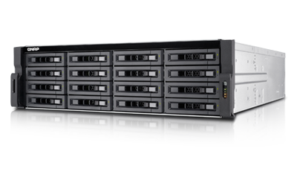
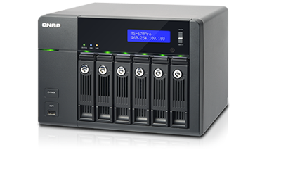
Data discovery and distribution
Cloud-based archiving
Network Access Storage (NAS)
Intranet access
Near-term, low-cost solution (48TB/$7,000; 4TB/$8,700; 96TB/$10,150 at RAID0)
Scalable
Smaller NAS at field office
16TB, $2,500

Slide 9
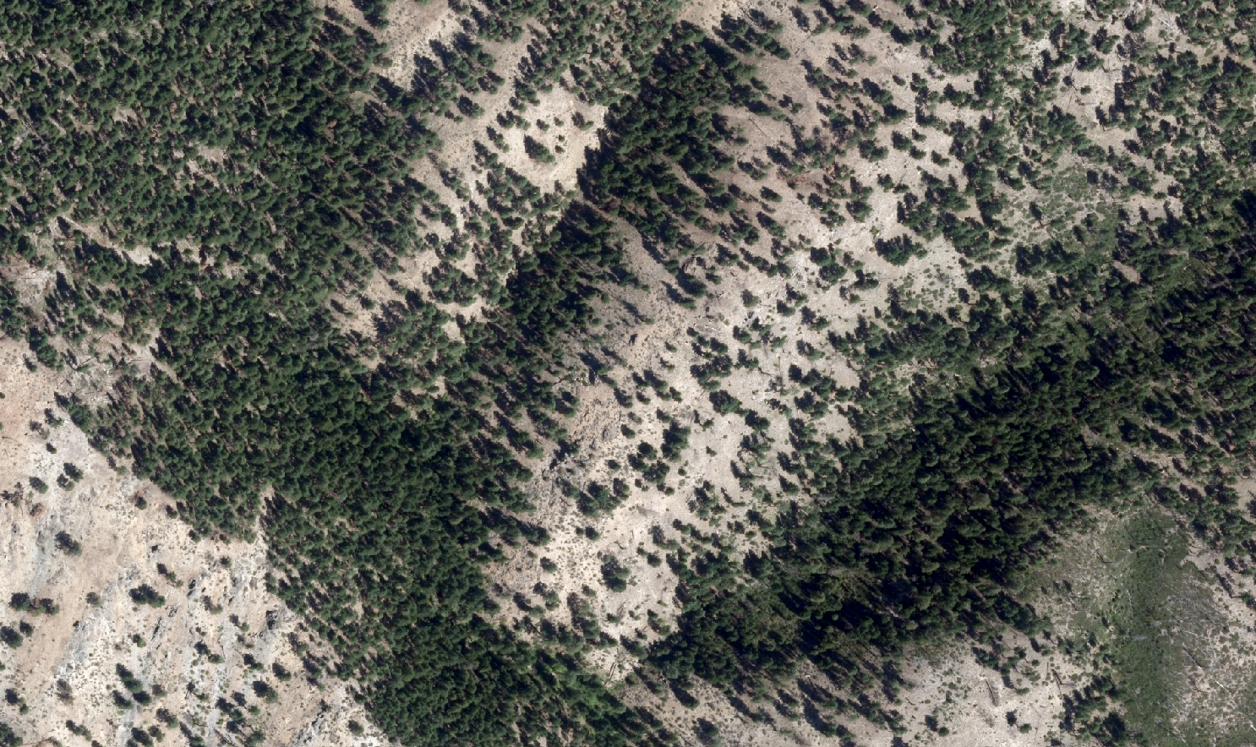
Mark Riley
Remote Sensing Coordinator
markriley@fs.fed.us
USDA Forest Service
Portland, OR

