Slide 1

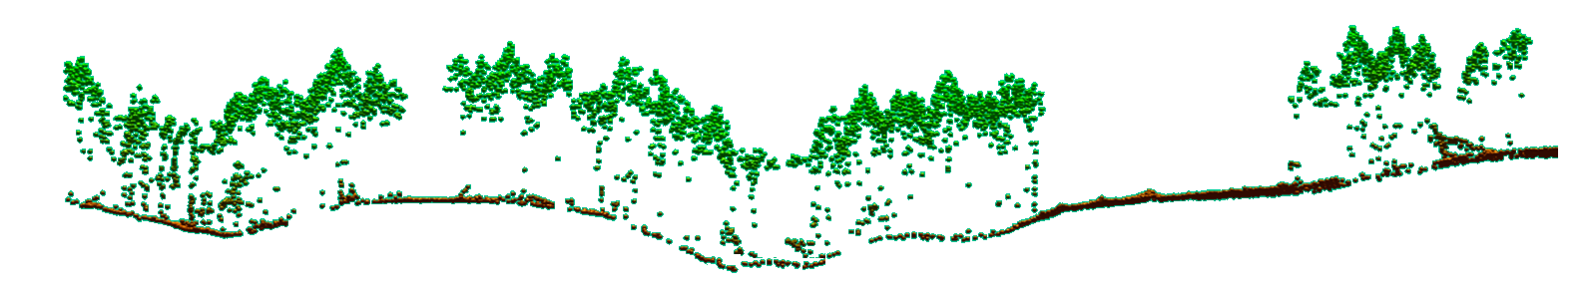
LiDAR-based assessment of sunlight distribution in forest ecosystems
Demetrios Gatziolis
USDA Forest Service
PNW Research Station
dgatziolis@fs.fed.us
http://pnwfia.info/dgatziolis
April 23, 2015
Notes:
By using precisely georeferenced and timed observations of direct sun illumination conditions, I managed to determine the accuracy of this approach in the Malheur NF. Please note that precise georeference, one foot or better, is a prerequisite for an unbiased assessment thanks to the high spatial variability of light mentioned earlier. Obtaining such georeferencing precision levels is a difficult and costly operation, especially in the western Cascades and the coastal mountains. As you can see, the fit is very good especially if the two outliers are removed. The first of the two points farther away from the red 1:1 line corresponds to a location where a defoliator appeared in the one growing season between LiDAR acquisition and field measurements. The second was near a stand profile exposed by thinning that occurred shortly before we went to the field.
Next slide please.

Slide 2
Motivation
Diurnal and seasonal distribution of sunlight
Influences tree growth, regeneration potential, wildlife habitat, stream temperature, and various other ecological processes
Difficult to assess precisely and without bias
Has management and policy implications
Proliferation of publicly available, high-density LiDAR data
90+% of Oregon forests scanned at least once
Potential for inexpensive, small area acquisitions (UAVs)

Slide 3
Current methods for assessing sunlight distribution
Developed for applications using bare earth representations
Degenerate 3D vegetation and terrain data into 2.5D
Consider trees opaque objects
Under canopy ground and lateral crown illumination are not defined
Incompatible with needs to determine which scene element(s) is responsible for shade on a particular location
Strongly biased (shade overestimation)

Slide 4
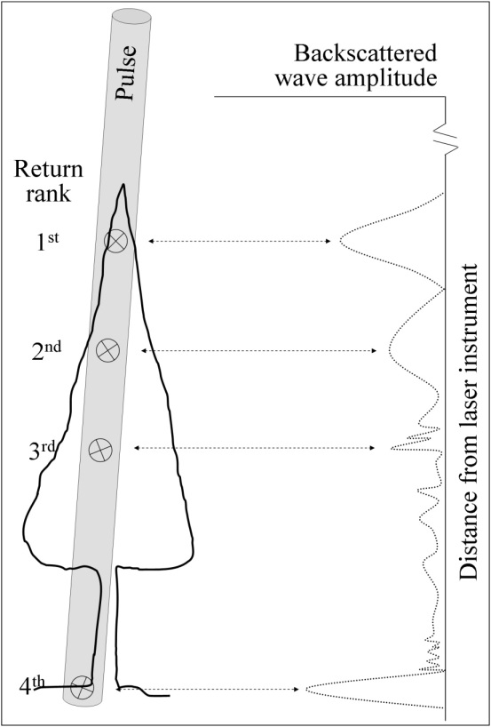
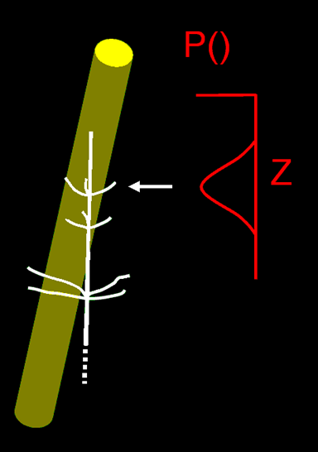
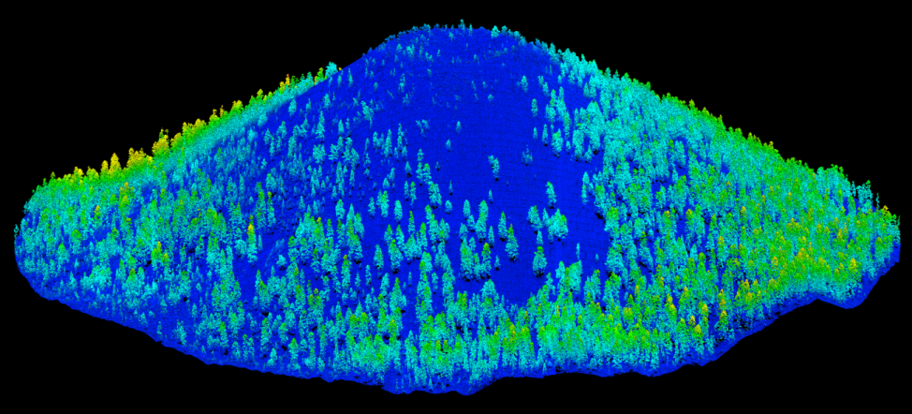
Elements of LiDAR technology
Volumetric pulse – object interaction

Slide 5
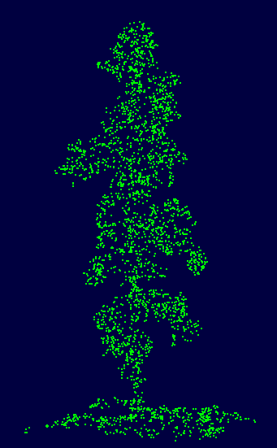
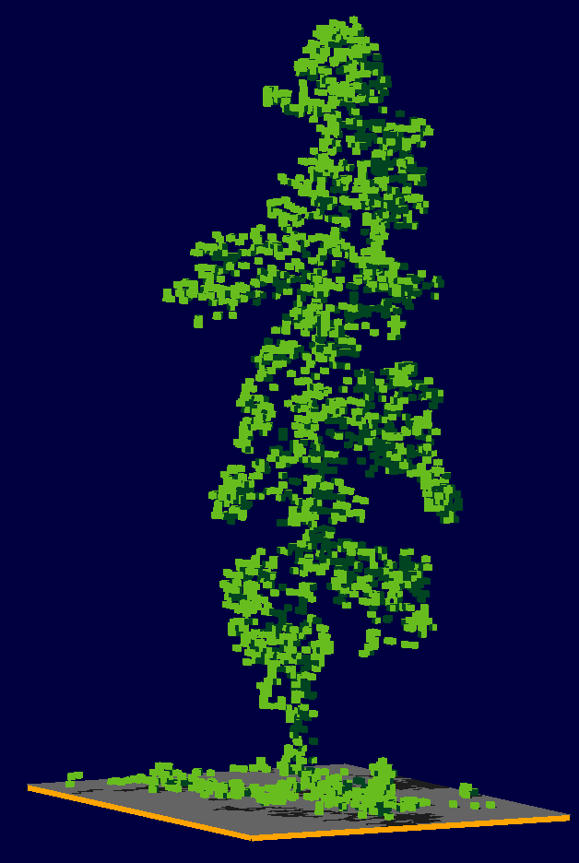
From point clouds to voxel space representation

Slide 6
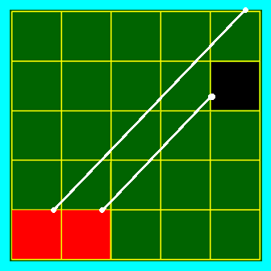
Ray tracing in voxel space
Determine voxel resolution
Generate voxel representation
Calculate ray azimuth and elevation angle
Compute the ray’s ‘voxel walk’
Stop if the ray intersects a ‘filled’ voxel
The process is computationally intensive and demanding of computer hardware resources (memory)
Efficient execution requires series of optimizations and execution in parallel (multithreading)

Slide 7
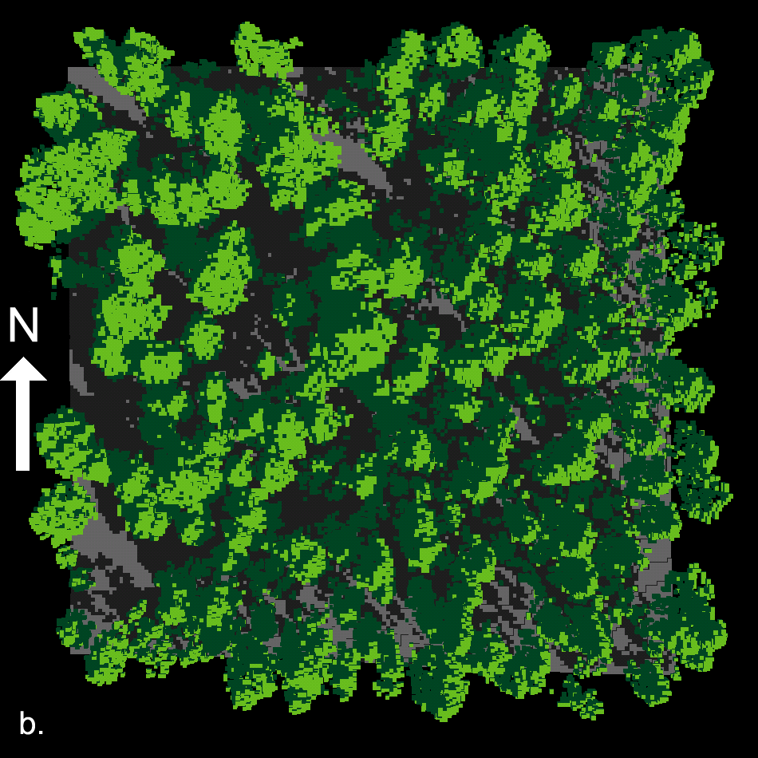
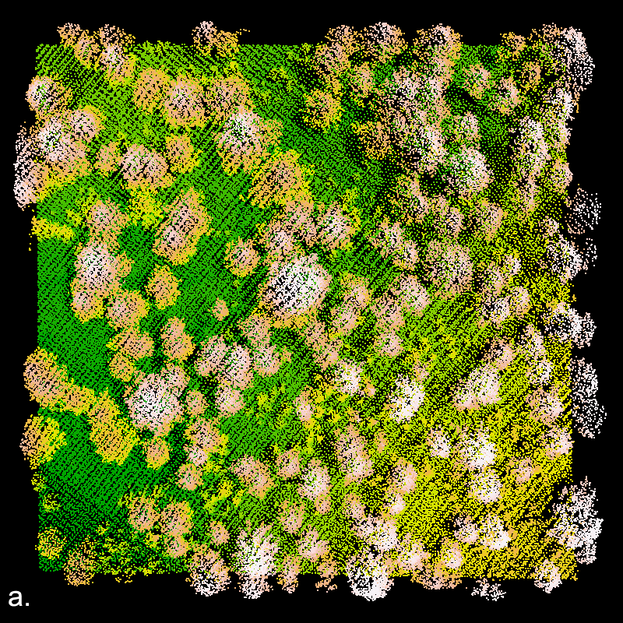
Point cloud to voxel space representation
to light assessment via ray tracing

Slide 8
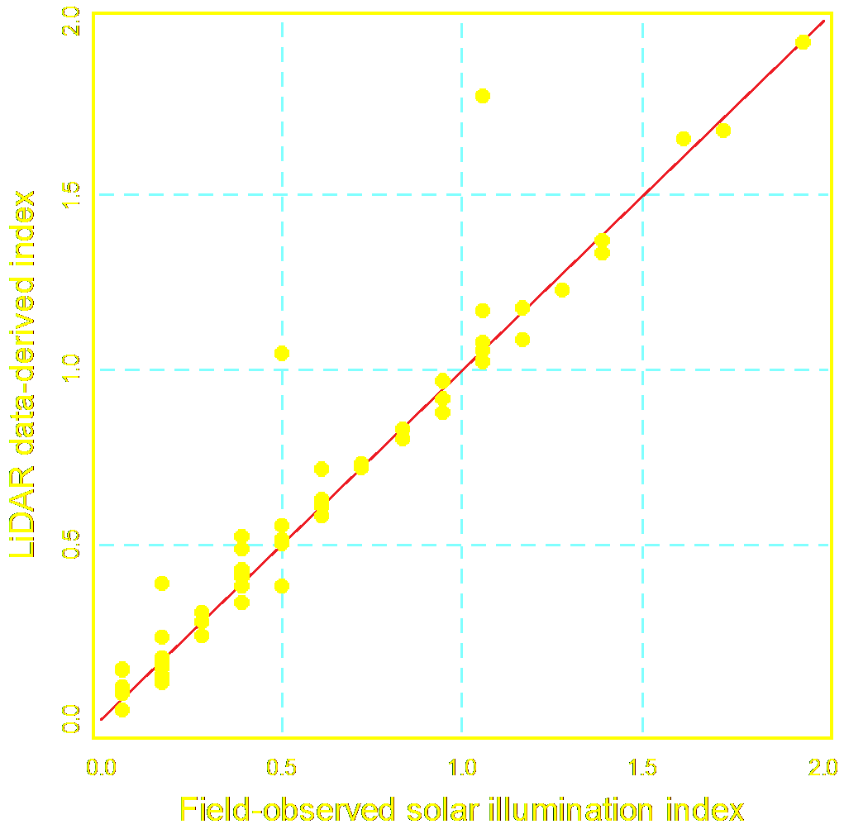
Prediction accuracy
N = 52
RMSD = 0.145 (7.25%)
R² = 0.92
If outliers are excluded:
N = 50
RMSD = 0.053 (2.65%)
R² = 0.98
Notes:
By using precisely georeferenced and timed observations of direct sun illumination conditions, I managed to determine the accuracy of this approach in the Malheur NF. Please note that precise georeference, one foot or better, is a prerequisite for an unbiased assessment thanks to the high spatial variability of light mentioned earlier. Obtaining such georeferencing precision levels is a difficult and costly operation, especially in the western Cascades and the coastal mountains. As you can see, the fit is very good especially if the two outliers are removed. The first of the two points farther away from the red 1:1 line corresponds to a location where a defoliator appeared in the one growing season between LiDAR acquisition and field measurements. The second was near a stand profile exposed by thinning that occurred shortly before we went to the field.
Next slide please.

Slide 9
Application capabilities
Shade/light assessment possible anywhere high-density LiDAR data are available
User can specify time span, over the day and year, and number of solar positions to be considered during processing
Generate illumination/shade summaries in tabular or georeferenced raster format
Assess shade/light regimes at ground surface, at any point or level in the canopy, or at a constant above-ground offset
Restrict computations within an AOI

Slide 10
Application capabilities (cont.)
3D visualizations of scene illumination conditions for a sequence of sun locations that can be assembled as an animation
Simulate the impact on shading of management activities such as harvest, relative to no-action alternatives
Delineate variable width buffers around stream reaches outside of which harvest won’t reduce shading by more than a specified threshold

Slide 11

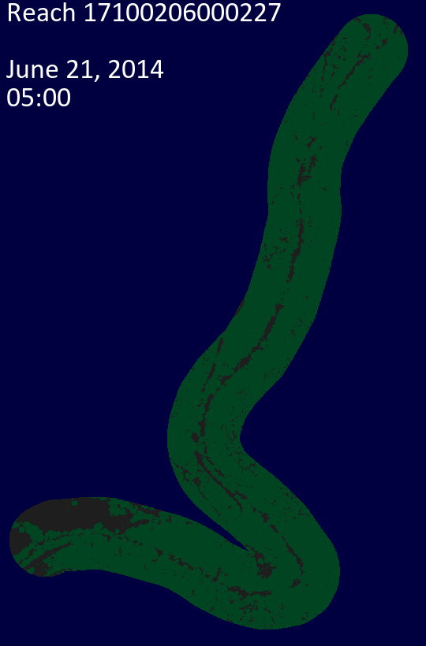
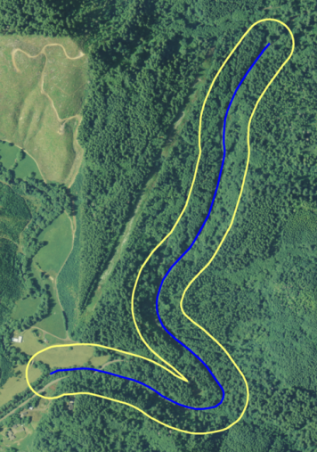
Rays cast
5am : 8pm
@ 12 min intervals
Direct illumination
of ground
Direct illumination
of ground and vegetation

Slide 12
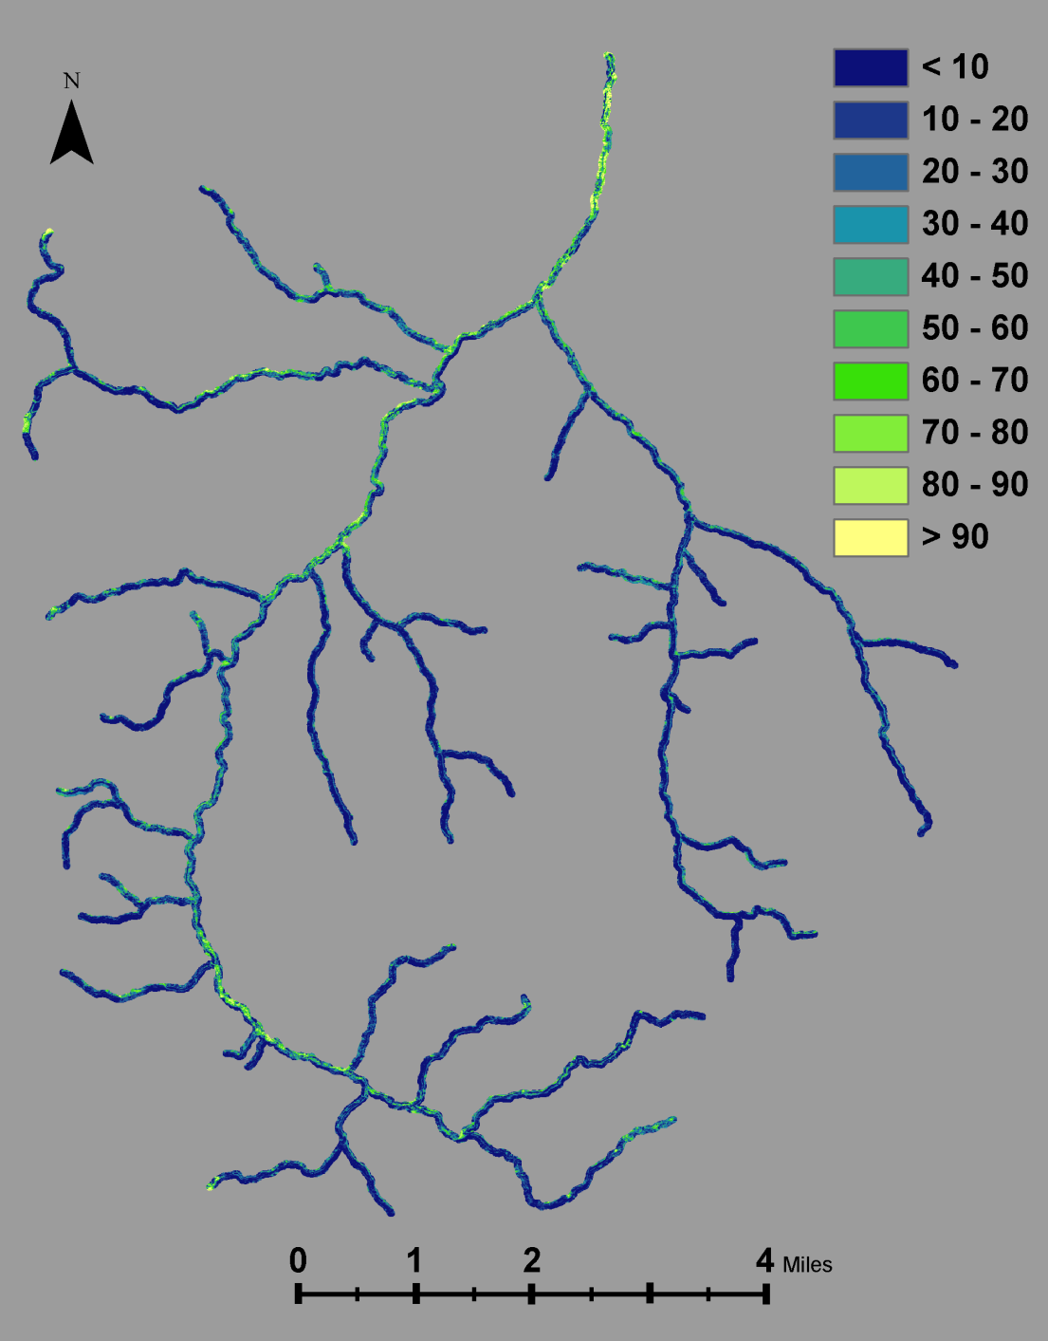
Mainstem CampLick, Malheur NF
Percent direct solar illumination of ground surfaces
25 ft resolution
6 days, 20 rays / day
2007 LiDAR acquisition
4,133 billion laser returns
Distribution moments:
Min: 0.0%
Mean: 19.8%
Max: 100.0%
SD: 19.4%
Stream layer from R. Hassmiller

Slide 13
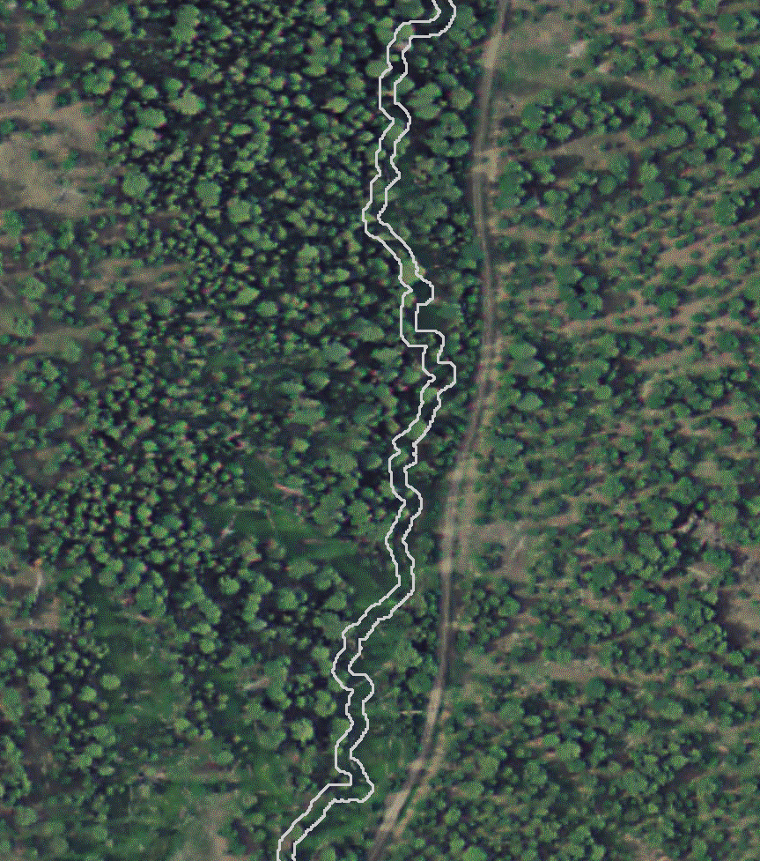
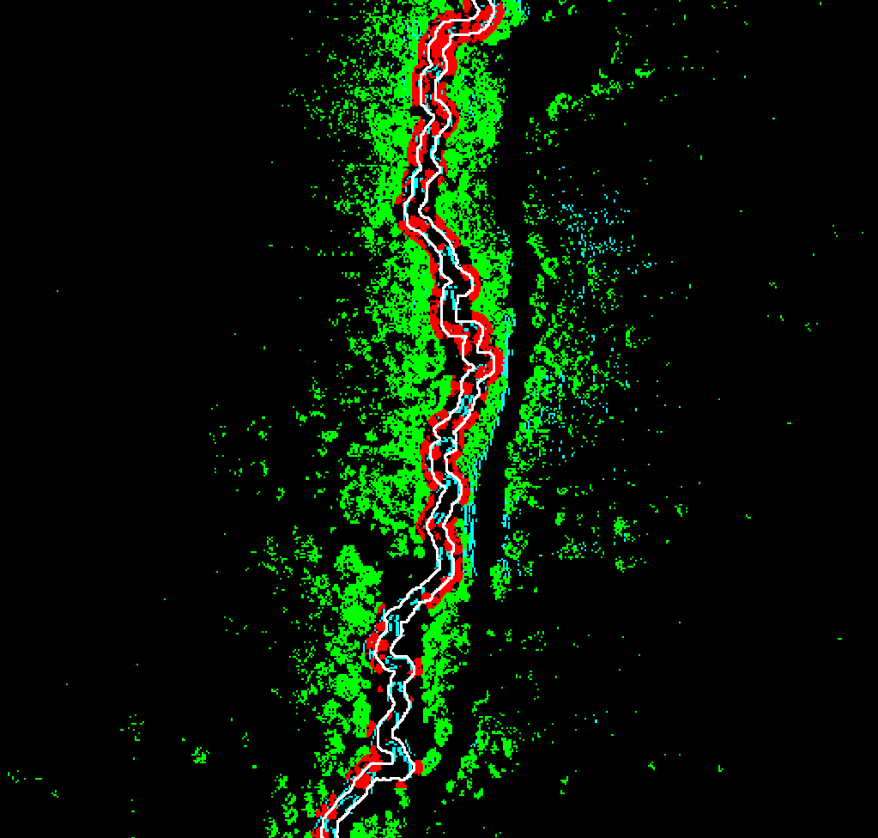
Shade management with variable-width harvesting buffer around a stream reach

Slide 14
Dynamic assessment of shade/sunlight in forest ecosystems using high-density LiDAR data
Demetrios Gatziolis
USDA Forest Service
PNW Research Station
dgatziolis@fs.fed.us
http://pnwfia.info/dgatziolis
April 23, 2015
Notes:
By using precisely georeferenced and timed observations of direct sun illumination conditions, I managed to determine the accuracy of this approach in the Malheur NF. Please note that precise georeference, one foot or better, is a prerequisite for an unbiased assessment thanks to the high spatial variability of light mentioned earlier. Obtaining such georeferencing precision levels is a difficult and costly operation, especially in the western Cascades and the coastal mountains. As you can see, the fit is very good especially if the two outliers are removed. The first of the two points farther away from the red 1:1 line corresponds to a location where a defoliator appeared in the one growing season between LiDAR acquisition and field measurements. The second was near a stand profile exposed by thinning that occurred shortly before we went to the field.
Next slide please.

