Slide 1
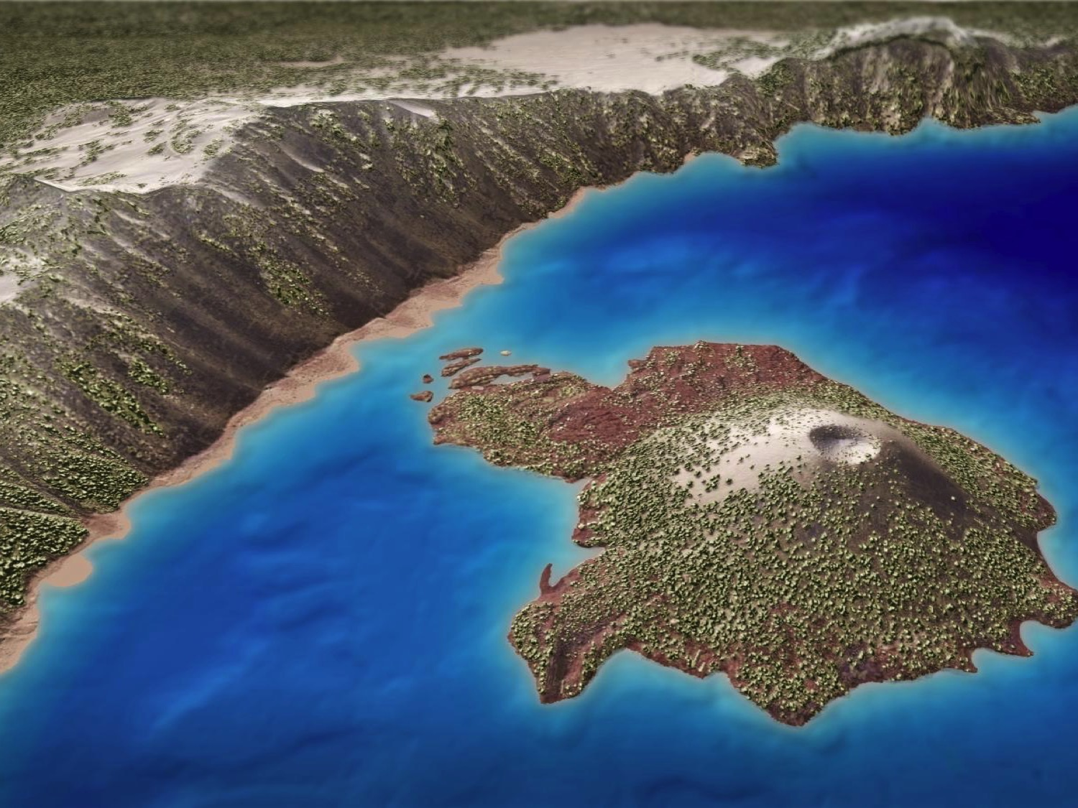

The Oregon Lidar Consortium
Jacob Edwards
LiDAR Coordinator
Oregon Dept. of Geology & Mineral Industries

Slide 2
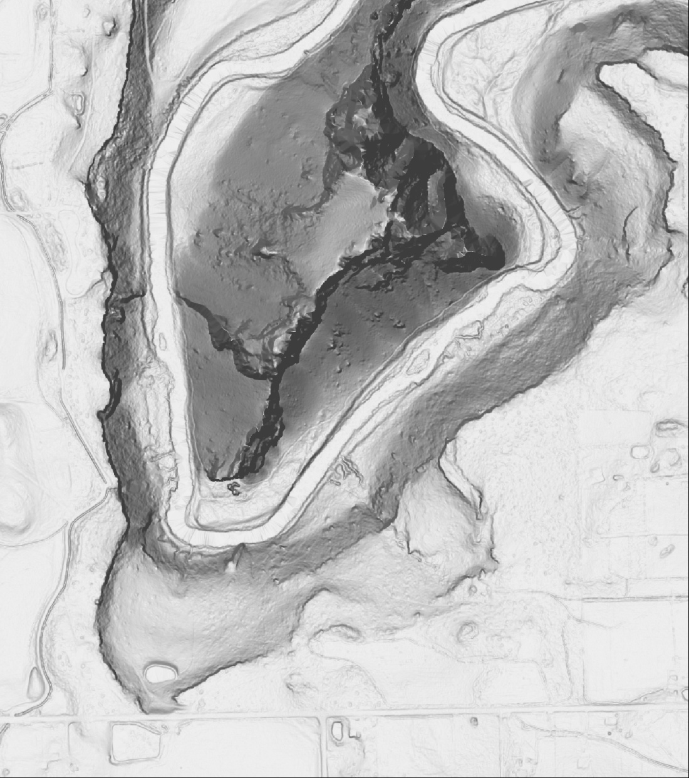
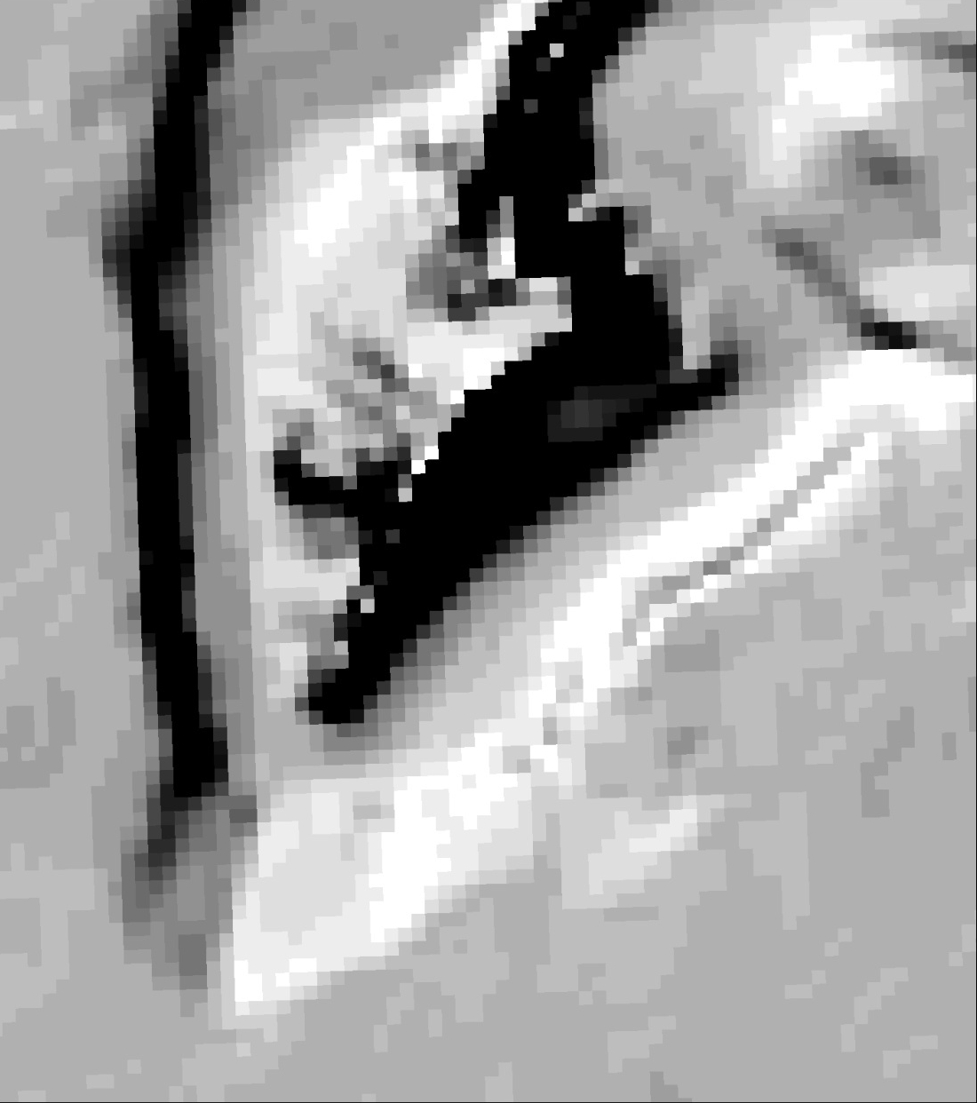
Significance of High Resolution Lidar
Variety of Partner Needs for Analysis
Ability to Create more Refined Mapping Products
Feature Resolution/Detection
Edge Detection (Channels, Buildings, Roads)
Vegetation Penetration (Ground point ratio)
Improved Accuracy (Horizontal)
Extended use of data
Smith Rocks, 1 m lidar DEM Smith Rocks, 10 m USGS DEM
Detroit Dam, lidar point cloud Detroit Dam, 2009 ortho

Slide 3

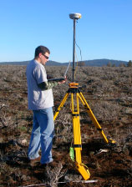

DOGAMI Selected a Vendor to Provide Lidar to the Consortium
A nationwide RFP led to the selection of Watershed Sciences Inc. of Corvallis Oregon as the lidar vendor for the consortium under Oregon Price Agreement # 8865.
Watershed Sciences
aka
Quantum Spatial

Slide 4
DOGAMI business plan for the OLC
Oregon Price Agreement # 8865 provides for a standard set of products with a pre-determined unit cost to DOGAMI based on the size of the project
Collection areas should be large and contiguous
Collection areas anchored by significant contribution from local funding partner
OLC builds on anchor funding by finding additional partners
Data in public domain

Slide 5
Advantages of the OLC Consortium Model
Consistent data quality
Large contiguous survey
Requires no expertise of participants
No contracting hassles for participants (No RFPs)
Lower cost for larger project areas
Particularly advantageous for partners with small areas of interest, or scattered parcels

Slide 6


























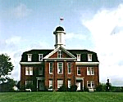

Since April 2008, DOGAMI has ordered 54 large lidar projects through agreements with over 60 different partners
The City of Turner
The City of Philomath
http://www.lincolncity.org/Portals/29/logo2.gif

Slide 7

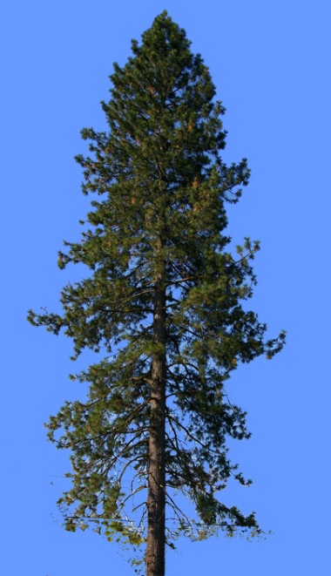
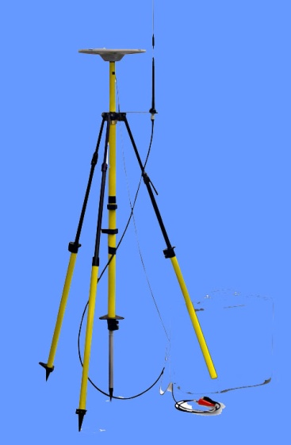

Millions of very precise laser range measurements are made from a precisely located aircraft, producing an accurate and detailed three-dimensional map of the earth’s surface, as a “point cloud”
OLC Lidar Data Collection Basics
Aircraft attitude is precisely measured by Inertial Motion Unit, so that the exact position and orientation of the laser rangefinder is always known
On-ground RTK-GPS base stations broadcast corrections to airborne GPS unit, locating the aircraft with an accuracy of a few centimeters
The rangefinder scans across the surface at 100,000 to 200,000 pulses per second, collecting millions or billions of precise distance measurements, which are converted to 3-D coordinates

Slide 8
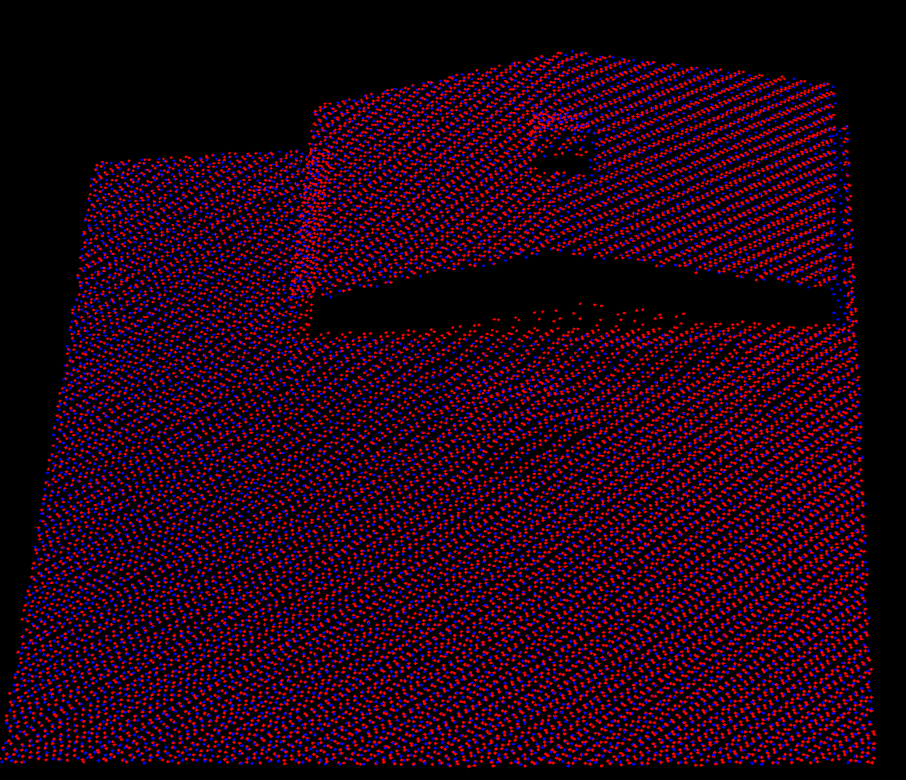
OLC Data Specifications
Laser spot size on ground 15 - 40cm
Aggregate pulse density > 8/m²
1m
Absolute accuracy of each point 20 cm horizontal and vertical
50% sidelap for complete double coverage
1m
Swath to swath consistency * 10 cm (4 inches) in the vertical
* Same point measured by adjacent swaths must have similar value
Point cloud image of field and building: red points are from one swath, blue from another

Slide 9
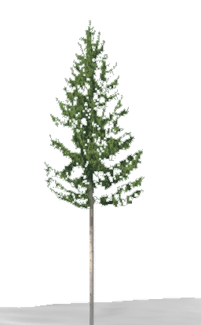
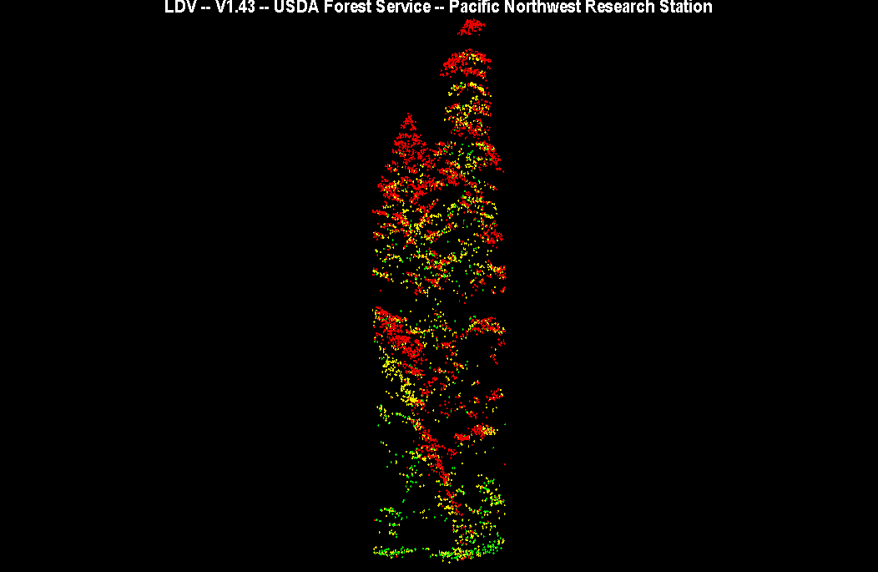
Why Collect Dense LIDAR DATA?
Oregon has one of the highest leaf-area indexes in the US.
First return, top of canopy
LiDAR Points colored by Return #
Second return, base of canopy
Third return, understory
Last return, ground

Slide 10
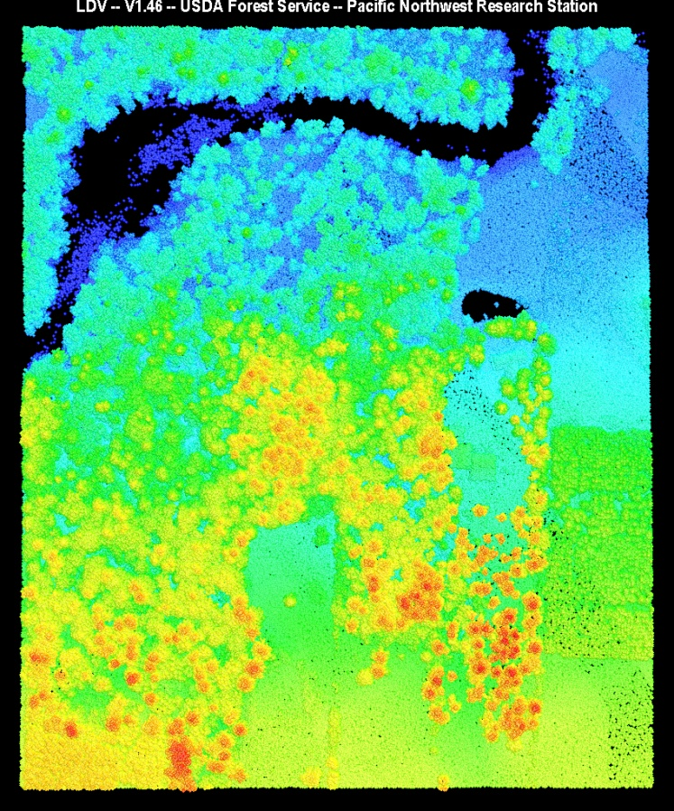
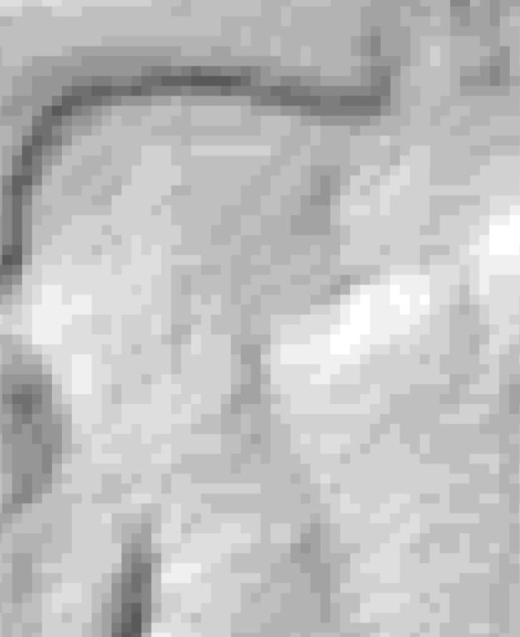
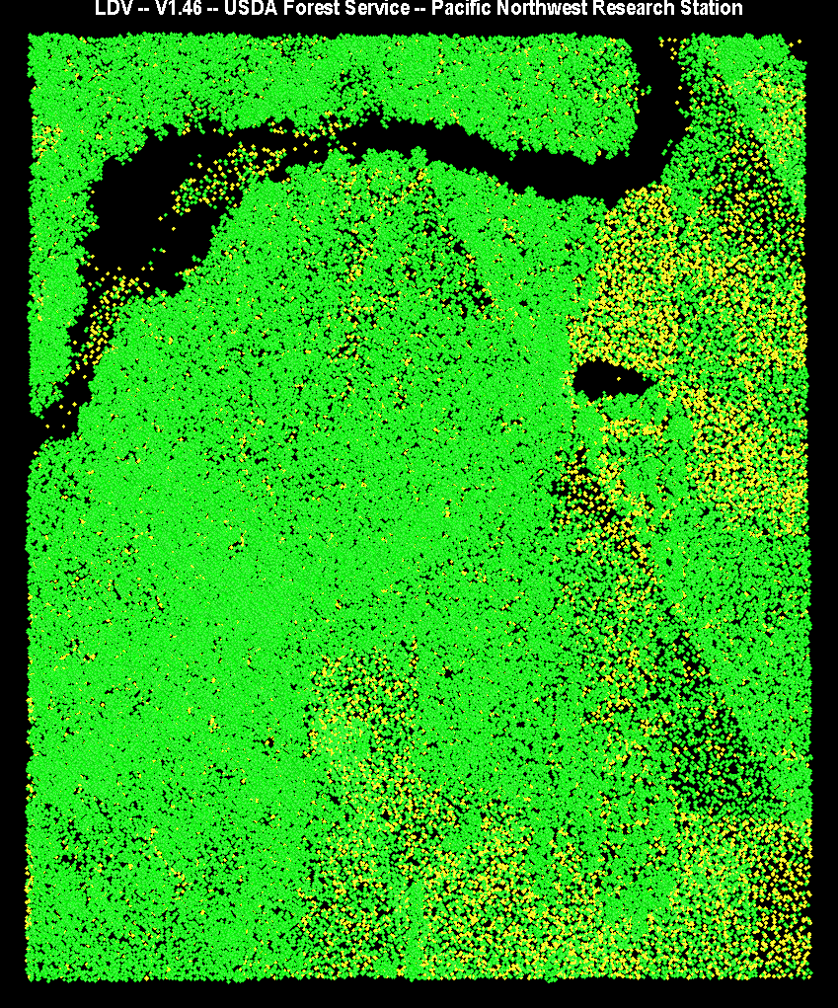
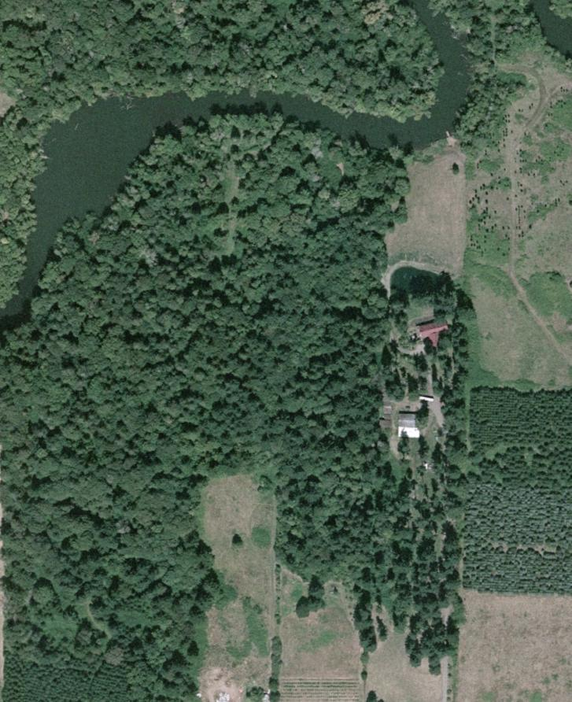
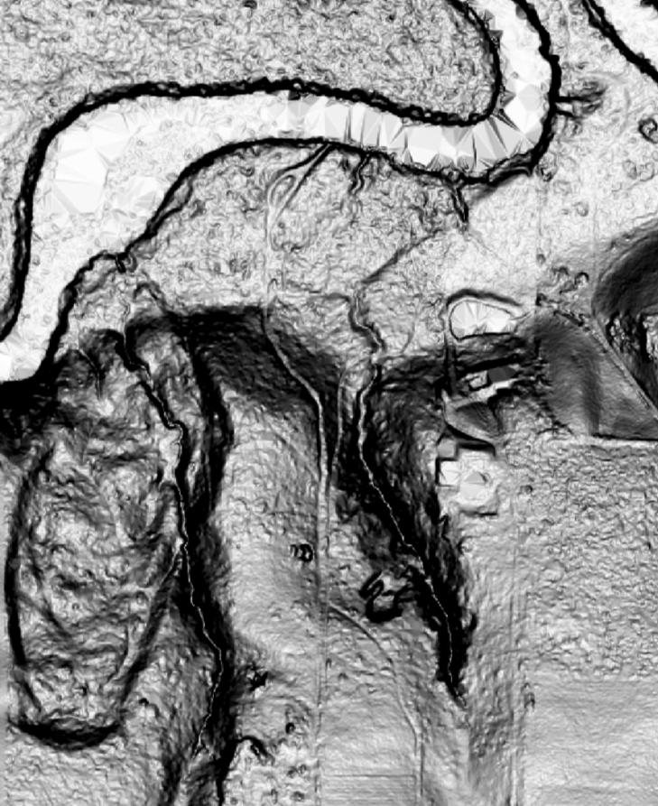
Very high point density means that even in heavily forested areas, it is still possible to get a large number of measurements of the ground.
Left image is an ortho-photo of the Tualatin River.
Right image is lidar point cloud with red points = high elevation, blue points = low elevation.
For comparison, the best previously available ground model is shown on the left. The 10 m USGS Digital Elevation Model shows only a crude representation of the real surface.
The lidar vendor uses a variety of software filters to choose the points out of the point cloud that measure the ground surface. In the image on the right, vegetation points are green and ground points yelllow. Even in thick forest there are numerous ground points.
Even if only one point in one hundred is a ground point, the huge number of points means that a smooth seamless ground model can be made. The image on the left is a bare earth digital elevation model, with 3 ft pixels, and reveals incredible detail of the terrain beneath the trees, including a hidden landslide.

Slide 11
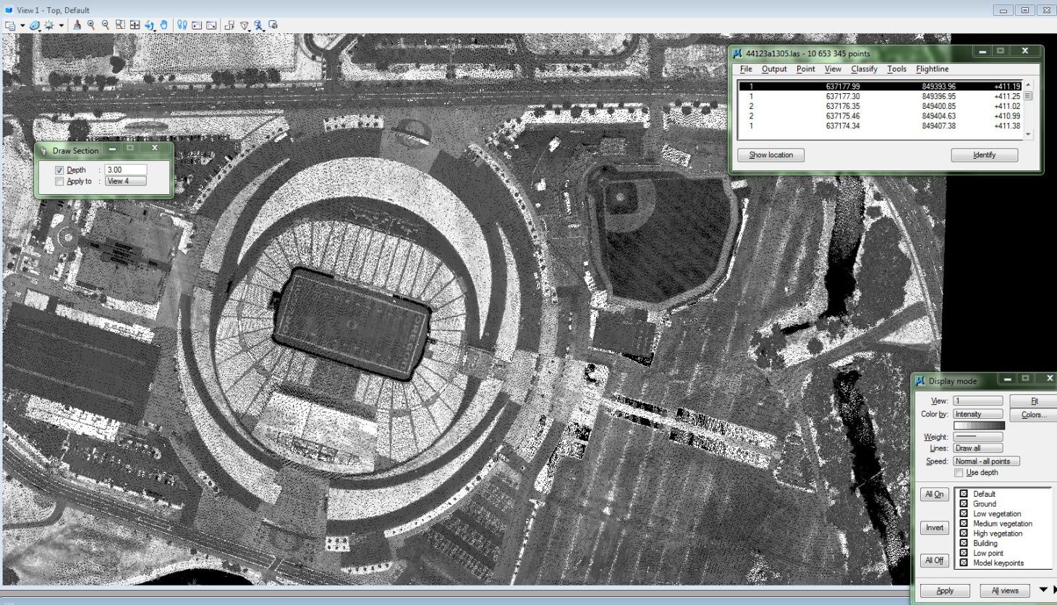
Dense Lidar data Yields Fine Scale Intensity Images

Slide 12
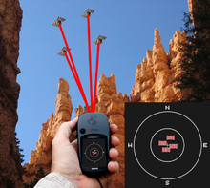
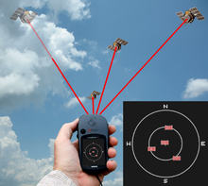
Lidar Data QA/QC :
Where Do Errors Come From?
Raw GPS Error = 1-3 meters
Post Processed GPS = 0.03 XY and 0.05 Z
Calibration Error = 0.05 – 0.07
Sensor Noise = 0.03 – 0.05 (AGL dependent)
PDOP = > 3
  Percent Dilution of Precision
  is an error indicator of the physical positioning the satellites have to triangulate the position being calculated

Slide 13
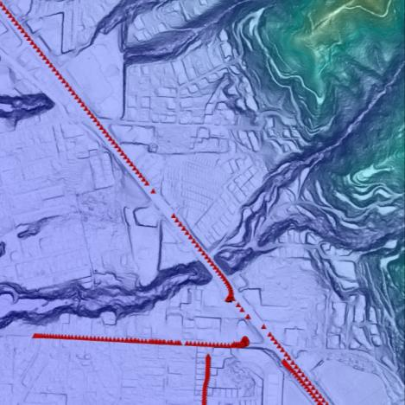
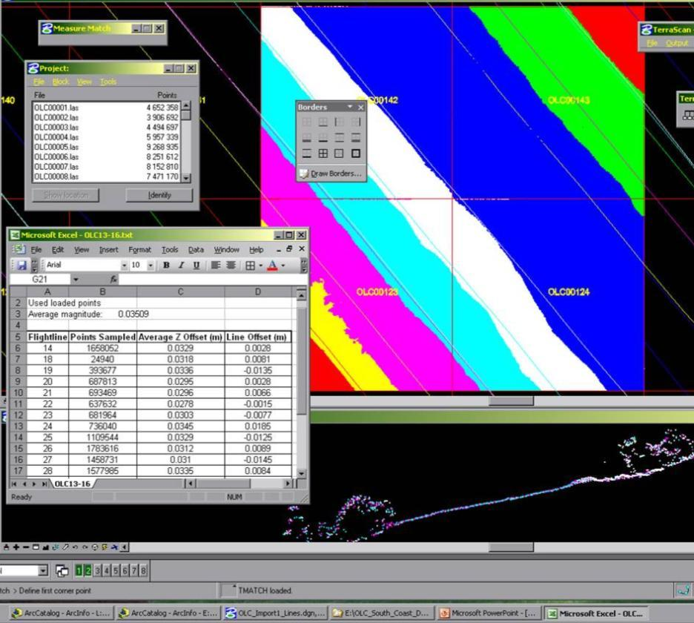

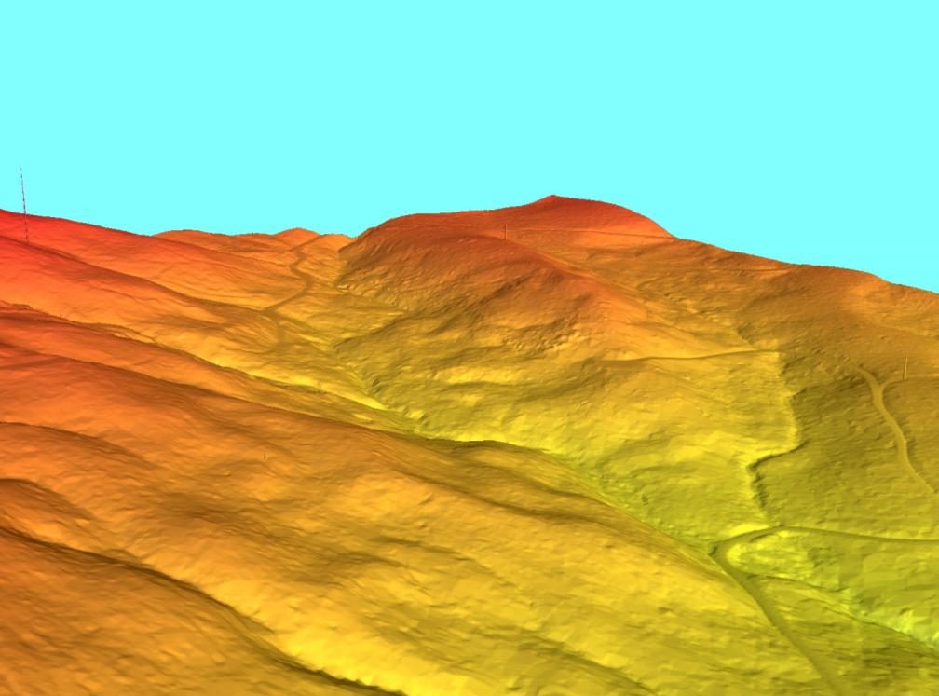

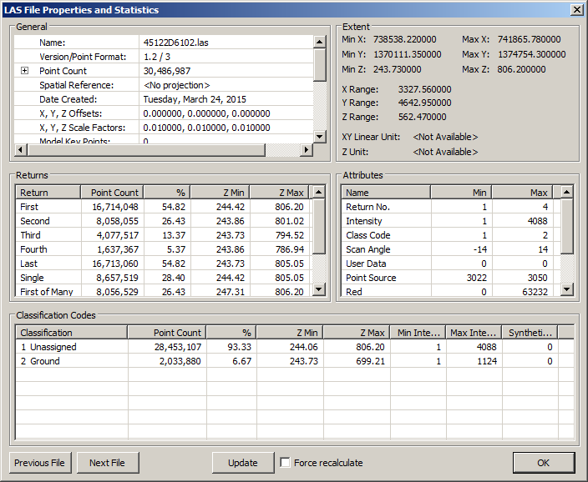

DOGAMI Lidar QA/QC Review:
Four-Part Process for Data Review
Compare accurately surveyed control points to the final lidar product to test absolute accuracy (+/- 9.25 cm)
OLC lidar image showing DOGAMI quality control points (red triangles) collected by RTK-GPS survey.
Colors indicate data from different swaths
Compare adjacent points from overlapping swaths to test consistency (+/- 10 cm)
“Bird” anomalies produce spikes in bare earth model
Use lidar to inspect bare earth models for artifacts and processing errors
GPS elevation = 50.40 m
Lidar elevation = 50.38 m
Error = 2 cm
Swath to swath differences, measured on hundreds of thousands of points per swath, average about 3 cm in this example
4. Ensure all products and are properly named, projected and delivery is complete

Slide 14
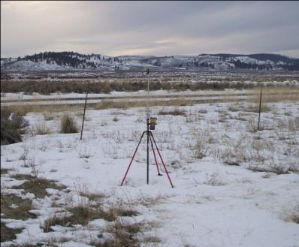
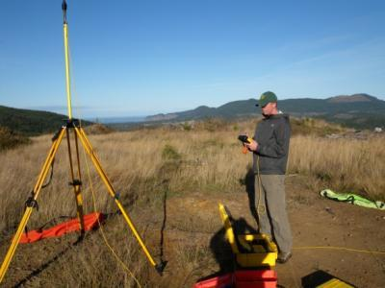
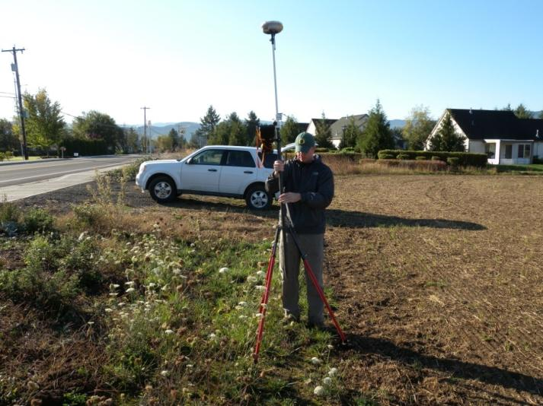
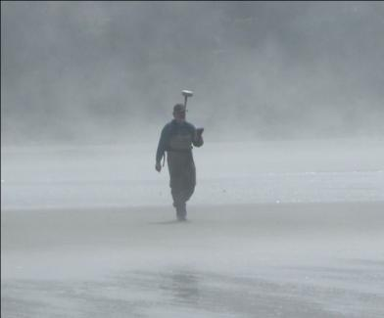
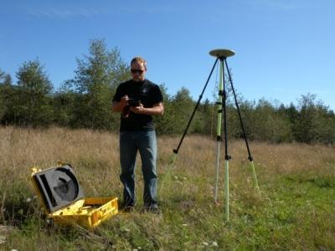
DOGAMI Absolute Accuracy Assessment Procedure
The lidar bare-earth DEM elevation is tested against hundreds of GPS RTK points collected by DOGAMI staff.
Average of over seven RTK points are collected per square mile

Slide 15
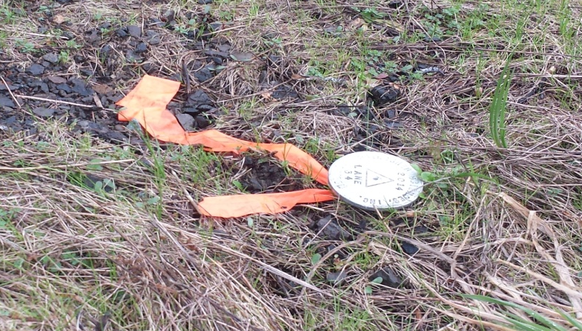
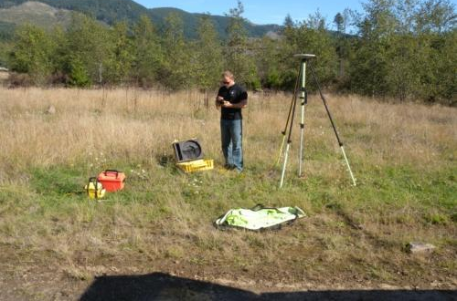
DOGAMI Performs a GPS check on Vendor Set Monuments
Watershed Sciences set their own monuments
  By occupying points with a GPS Base station for a minimum of 8hrs
Or use established NGS monuments
DOGAMI conducts 2 hour occupations on vendor monuments during RTK collections

Slide 16
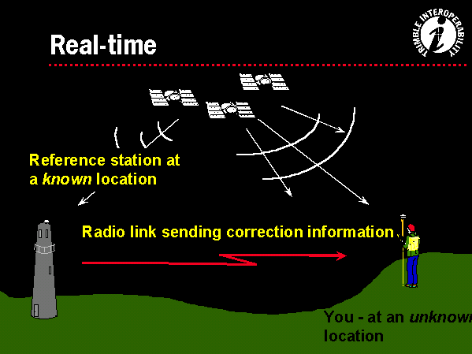
Real-Time Differential GPS
Differential correction techniques are used to enhance the quality of location data gathered using global positioning system (GPS) receivers.
  Differential correction can be applied in real-time directly in the field or when post processing data in the office
Real-time DGPS occurs when the base station calculates and broadcasts corrections for each satellite as it receives the data.
  The correction is received by the roving receiver via a radio signal if the source is land based or via a satellite signal if it is satellite based and applied to the position it is calculating.
  As a result, the position displayed and logged to the data file of the roving GPS receiver is a differentially corrected position

Slide 17
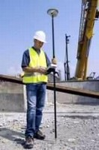
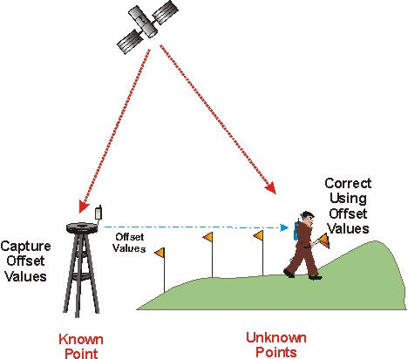
OLC Lidar Survey Collection Methods
RTK – preferred collection method
  a single reference station provides the real-time corrections, providing up to centimeter-level accuracy.
  Measurements on the carrier phase of GPS signals enable very precise position determination for real-time purposes
PPK
  post-processing kinematic
  When out of range of radio
  Position taken by a device that stores position data that can be adjusted using corrections from a reference station after the data has collected.

Slide 18
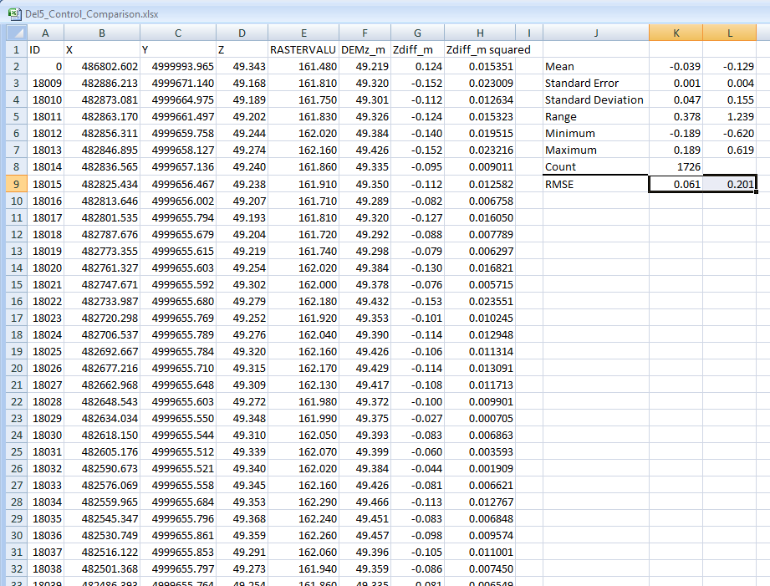
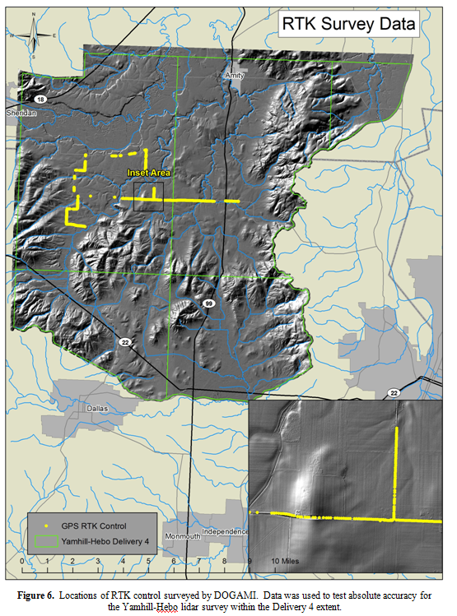
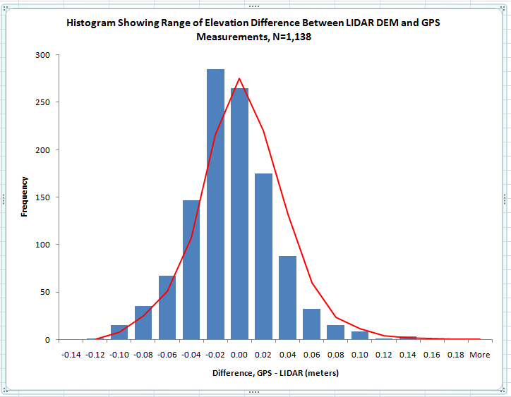
Vertical Accuracy Check

Slide 19
History of OLC Accuracy
OLC Project | Square Miles | Vendor Vertical Error (RMSE spec is 9.25cm) * | Vendor RTK GPS points used for vertical error test * | Vendor average pulse density (per m2)* | DOGAMI vertical error (RMSE spec is 9.25cm) | DOGAMI RTK GPS points used for vertical error test | DOGAMI swath to swath consistency (spec is 10cm)
Ontario | 261 | 3.00 | 2,175 | 6.80 | 6.80 | 100 | 2.50
Camp Creek | 319 | 4.60 | 1,452 | 8.10 | 6.70 | 116 | 4.00
Rogue Valley | 370 | 5.00 | 2661 | 7.79 | 6.10 | 201 | 2.70
South Coast | 2,504 | 5.20 | 23,291 | 8.93 | 6.17 | 9676 | 5.19
North Coast | 1,522 | 3.00 | 23935 | 8.15 | 5.10 | 7,950 | 4.86
Willamette Valley | 3106 | 3.70 | 38371 | 8.11 | 4.99 | 9135 | 3.82
Yambo | 1062 | 3.83 | 12390 | 9.24 | 4.81 | 4476 | 4.43
Deschutes | 2749 | 3.52 | 30867 | 9.40 | 4.57 | 13035 | 3.81
SW Washington | 464 | 5.00 | 9187 | 9.70 | 6.20 | 9932 | 3.70
Crater Lake | 282 | 5.00 | 1512 | 8.40 | 4.40 | 57 | 3.70
Newberry | 500 | 3.60 | 3835 | 8.50 | 5.37 | 3216 | 3.43
Shasta | 471 | 4.00 | 3236 | 10.18 | 4.40 | 1109 | 3.90
Burns | 76 | 3.00 | 594 | 8.25 | 4.10 | 2670 | 2.60
Umatilla | 415 | 3.80 | 2728 | 8.91 | 5.10 | 6200 | 2.35
Eagle Point | 202 | 3.00 | 3595 | 8.08 | 3.60 | 1670 | 2.40
Pine Creek | 160 | 3.00 | 2817 | 8.89 | 5.10 | 3228 | 3.30
Panther Creek | 10 | 3.00 | 1426 | 10.18 | 5.60 | 181 | 3.70
Klamath | 1052 | 3.08 | 6800 | 8.61 | 5.43 | 2644 | 2.73
Malheur | 399 | 3.00 | 1,619 | 7.90 | 9.40 | 98 | 4.90
DOGAMI tests calibration and vertical accuracy for every data delivery.
Delivered data routinely exceeds specs.
Total Square Miles | Avg. Vendor Vertical Error | Total Vendor RTK GPS | Avg. Vendor average pulse density | Avg. DOGAMI vertical error | Total DOGAMI RTK GPS points | Avg. DOGAMI swath to swath consistency
15,924 | 3.75 | 172,491 | 8.64 | 5.47 | 75,694 | 3.58

Slide 20
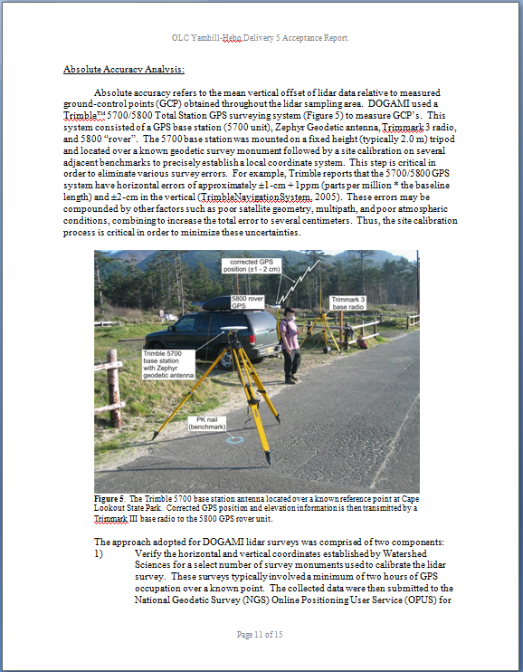
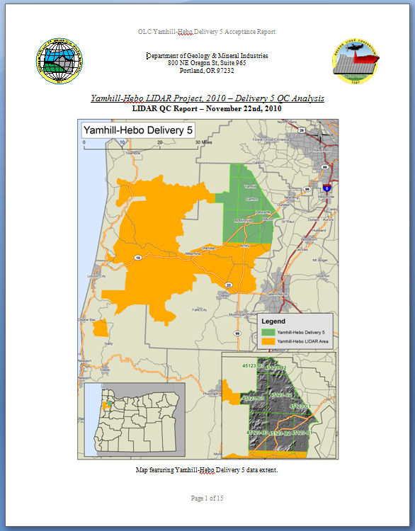
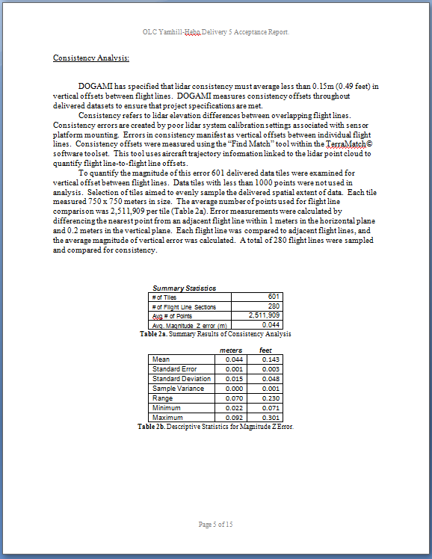

Acceptance Report

Slide 21
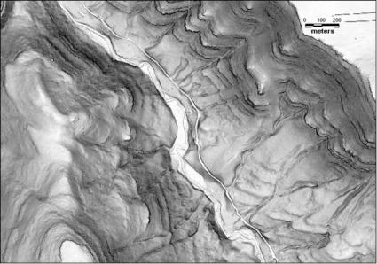
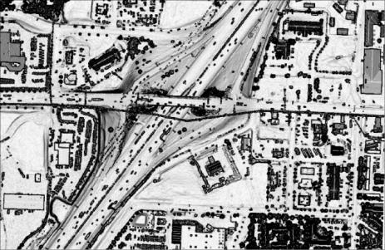
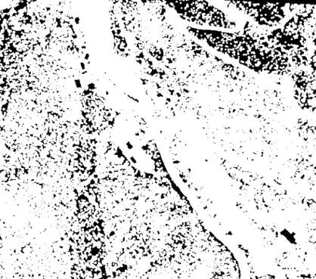
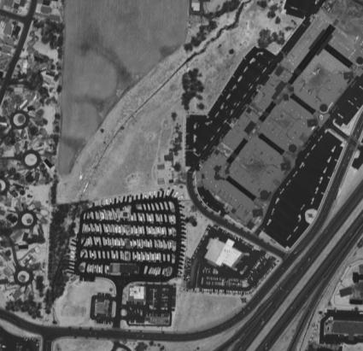
OLC Data Delivered to Customers
3 ft pixel bare earth DEM ESRI format (quad tiles)
3 ft pixel first return DEM ESRI format (quad tiles)
Point cloud, LAS format 1/100 quad tiles
Classified All- Return Points
1 ft pixel intensity images (tiled by ¹/₁₀₀th quad⁾
Ground point density grid
Aircraft Trajectories and date-stamped flightlines
Report and metadata !!

Slide 22
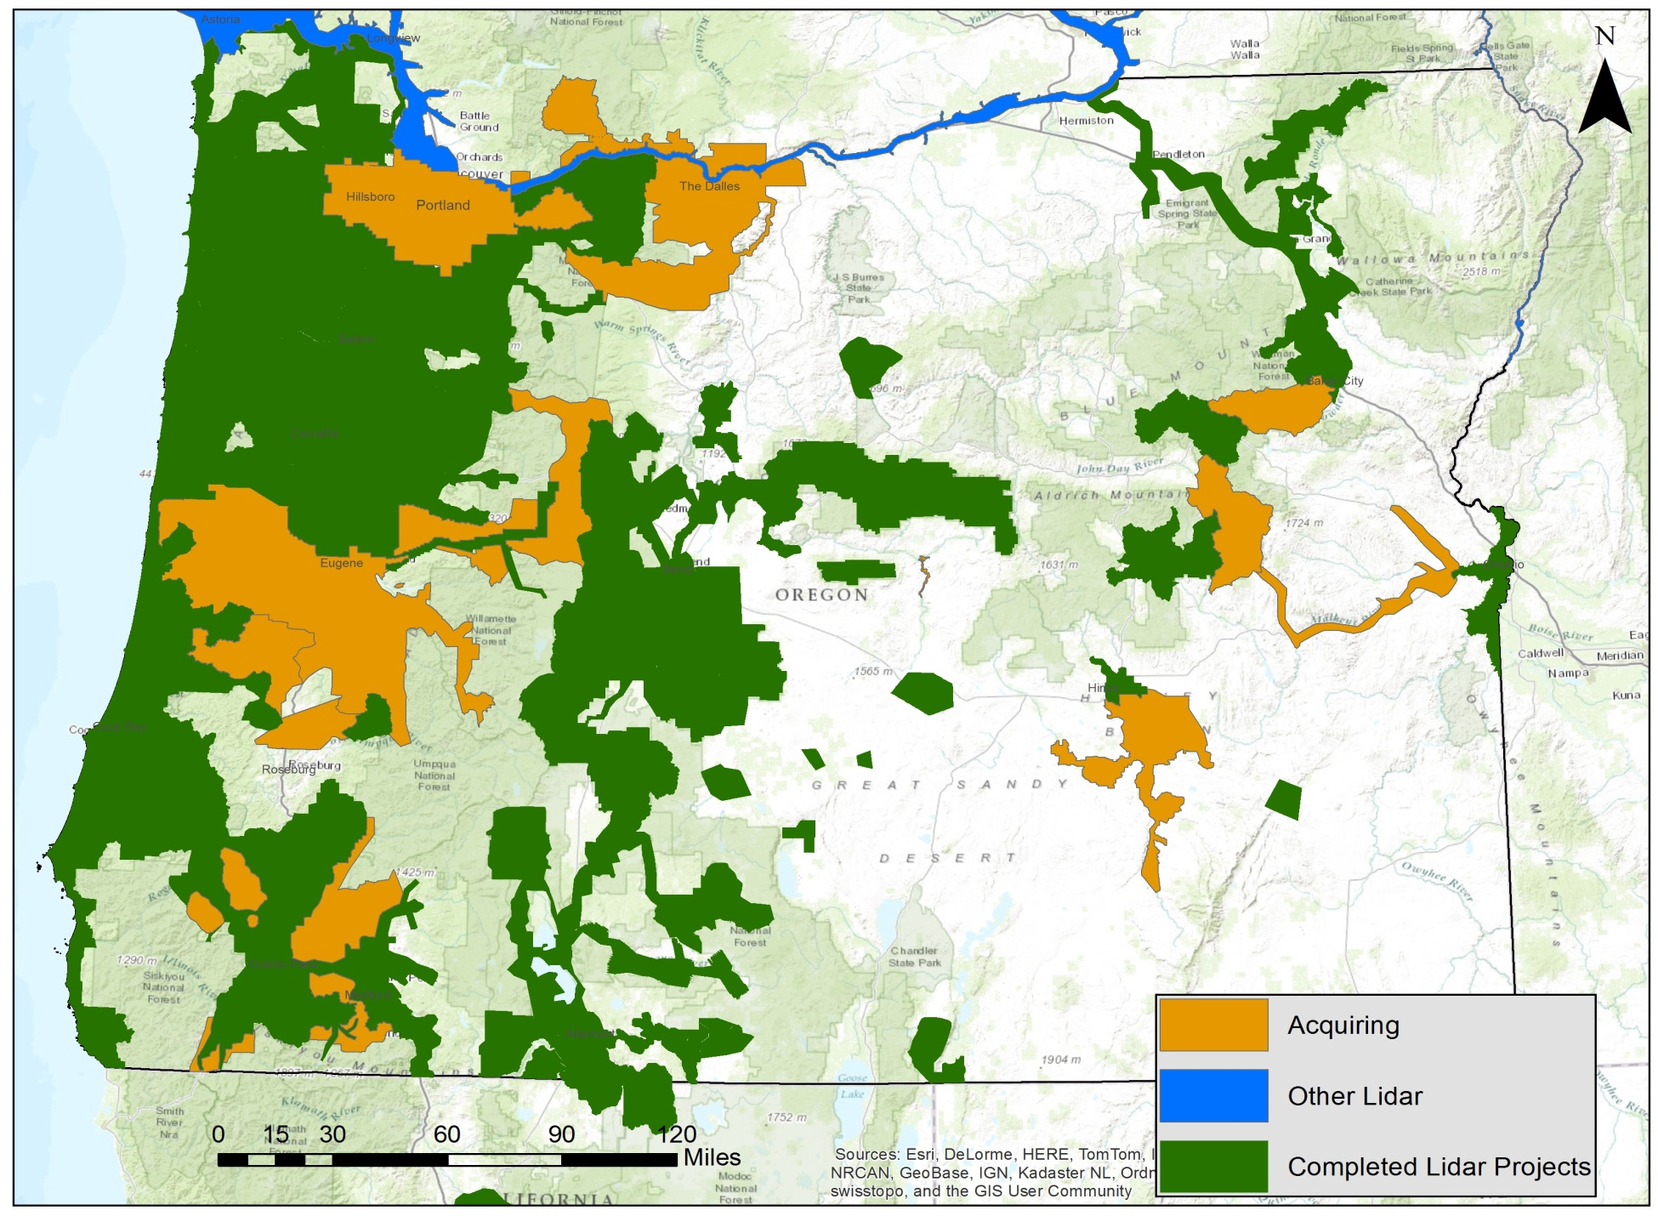
Current Lidar Coverage: Complete, Acquiring or Funded

Slide 23
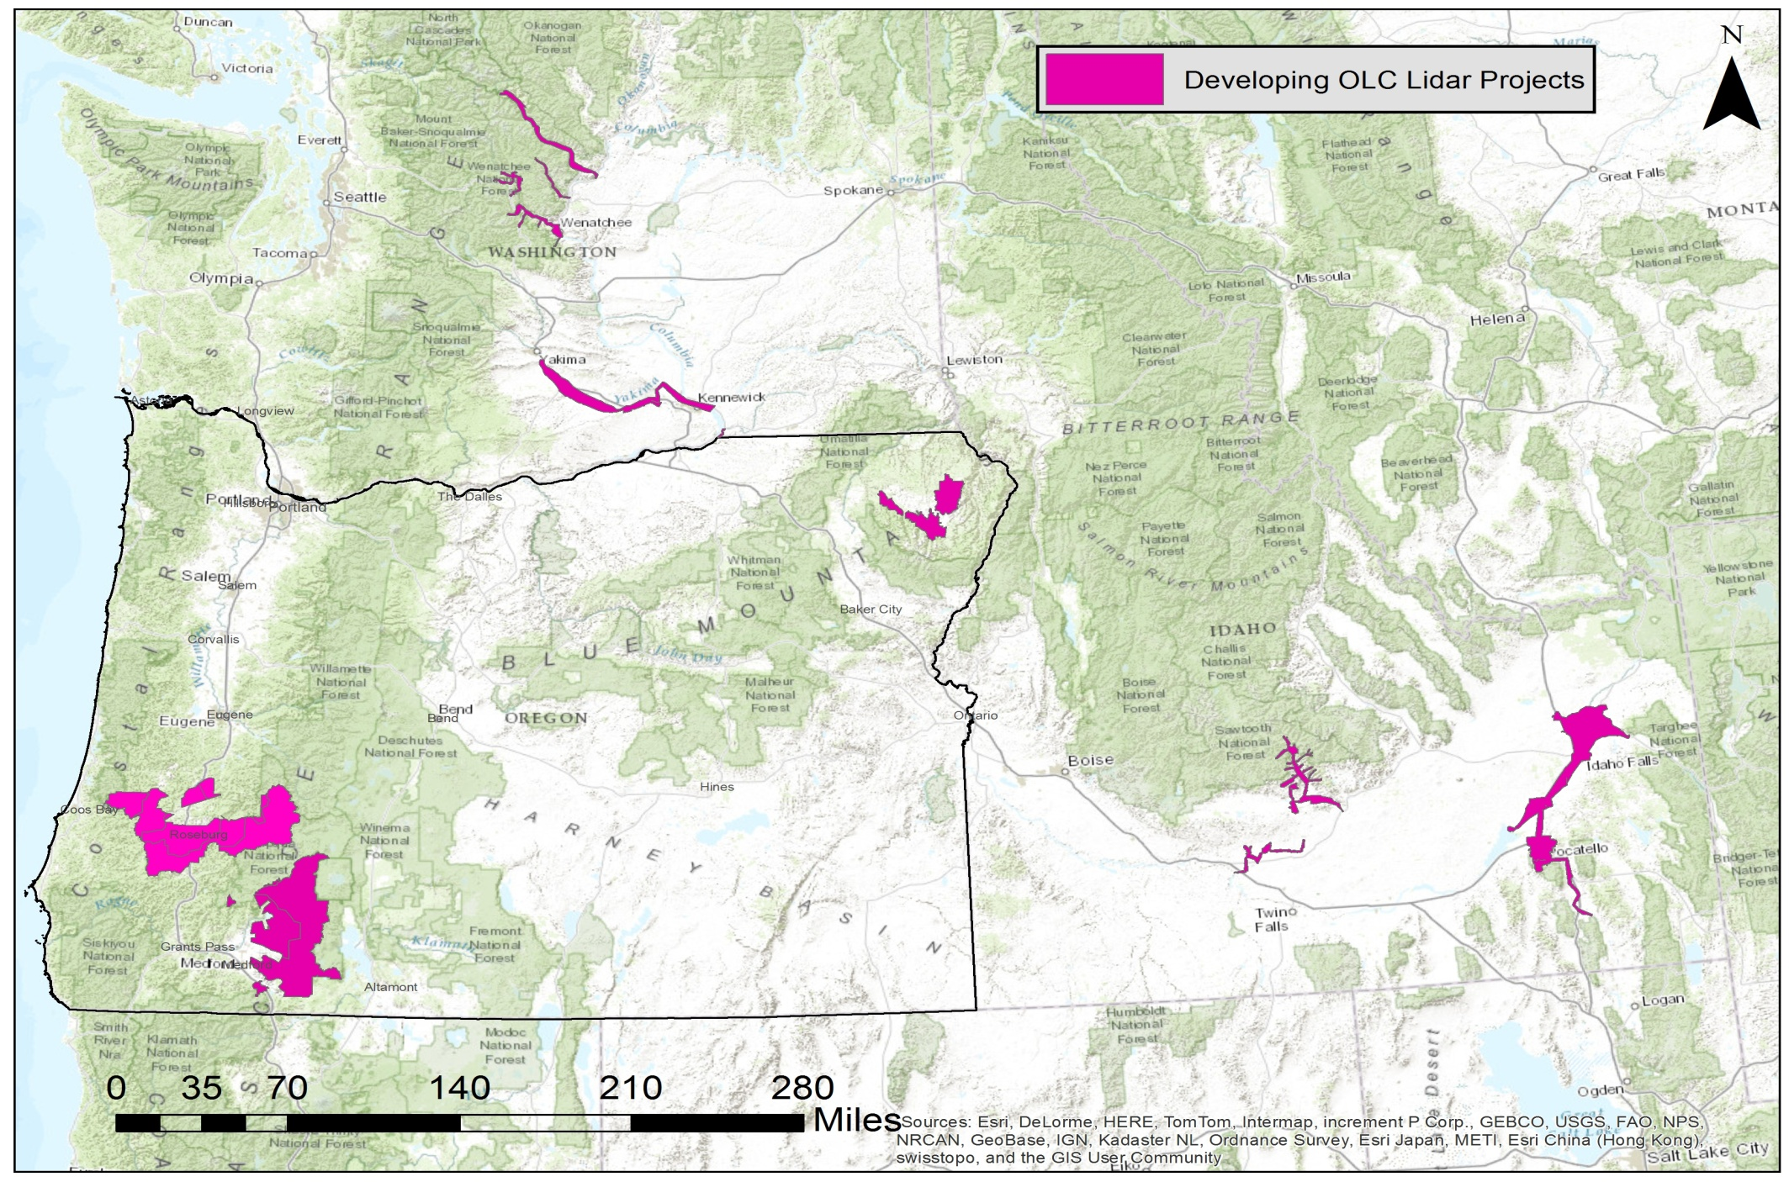
OLC Lidar Collections Currently Developing

Slide 24
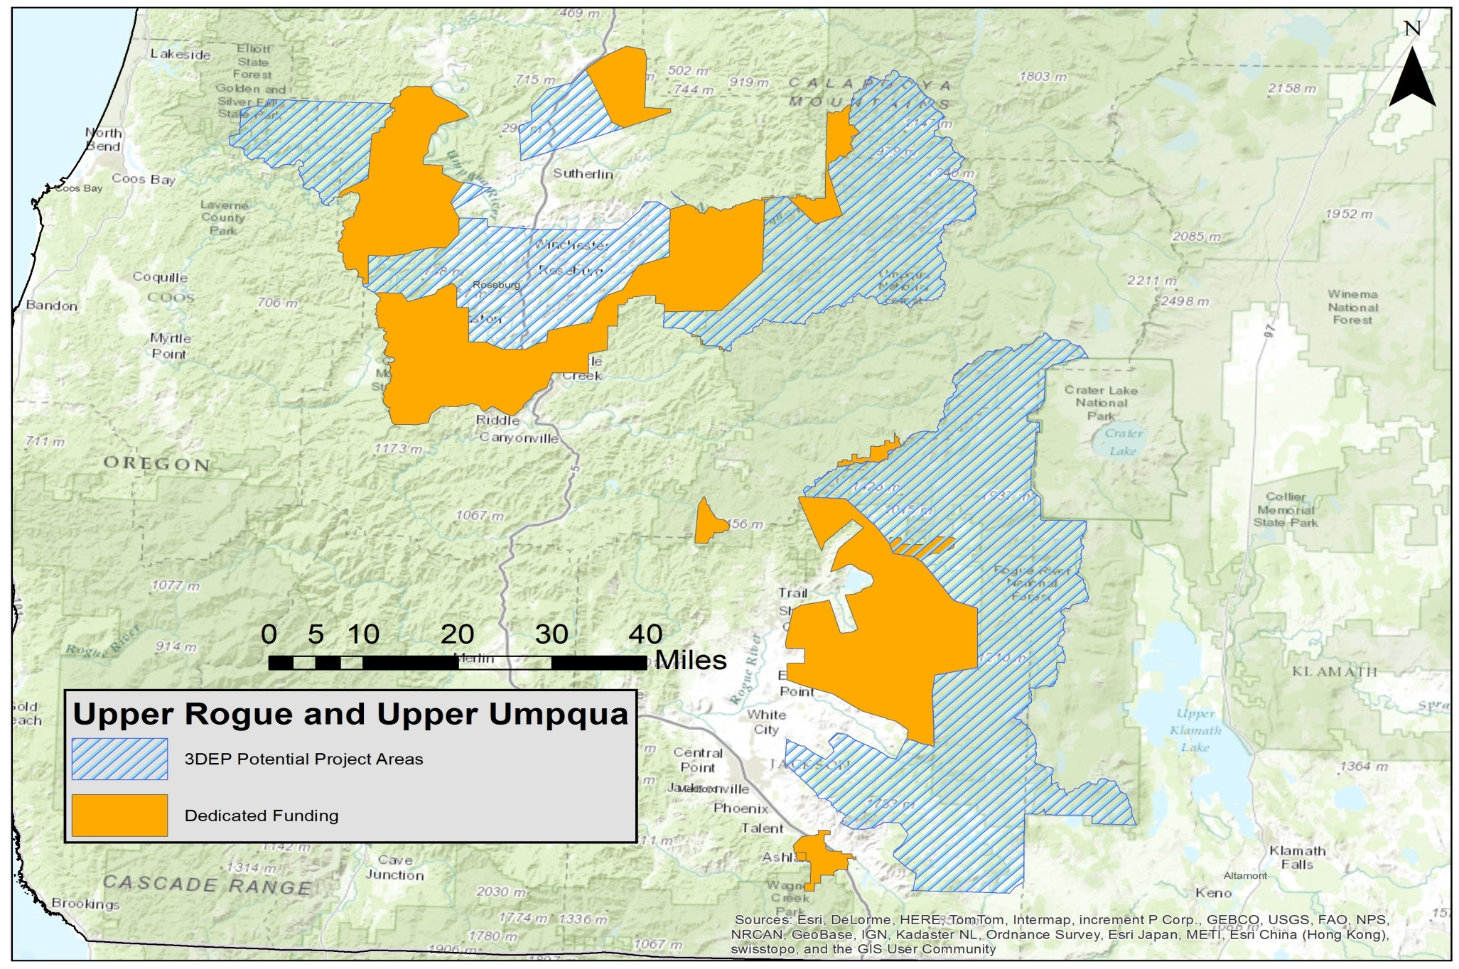
3DEP Funding for Upper Rogue and Upper Umpqua Lidar Projects

Slide 25
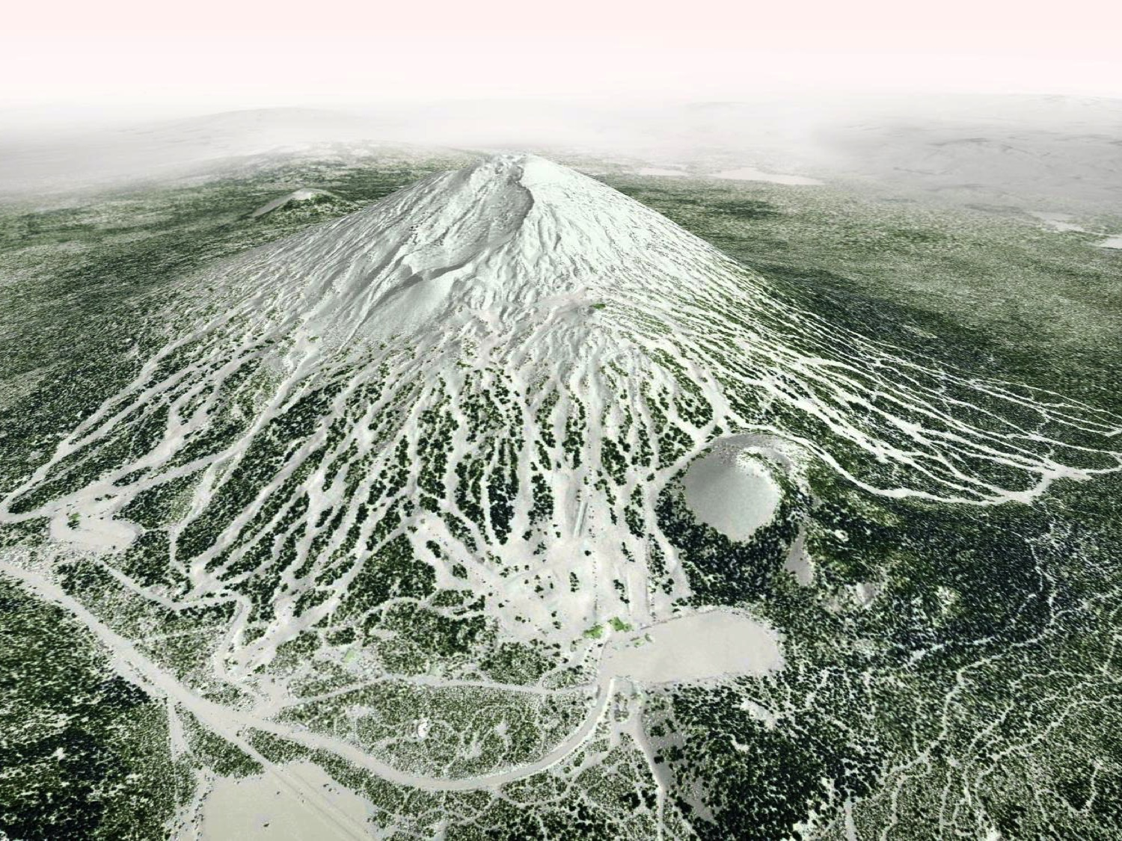
Lidar Applications

Slide 26
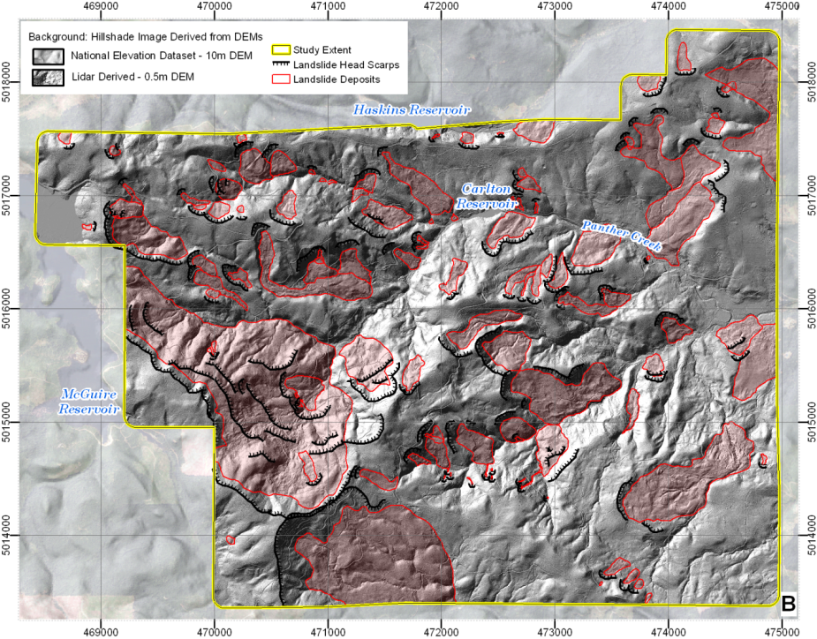
Landslide Inventory Maps
USGS map, 1994: 7 landslides
Landslide Inventory Map from lidar: 93 landslides

Slide 27
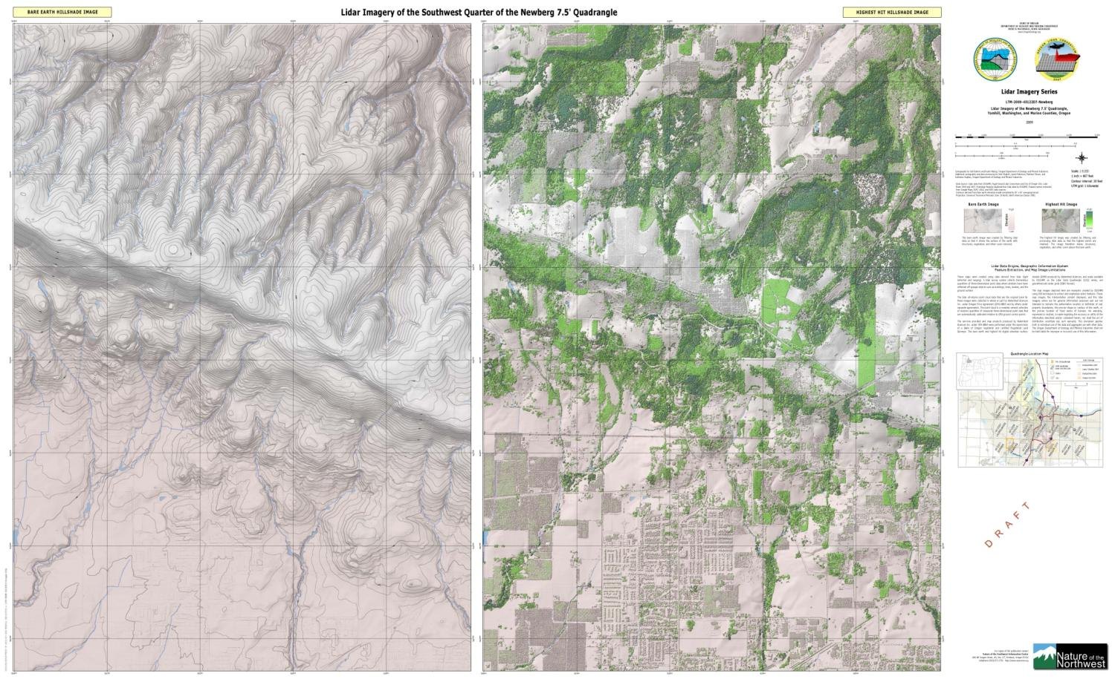
Developing New Base Maps

Slide 28
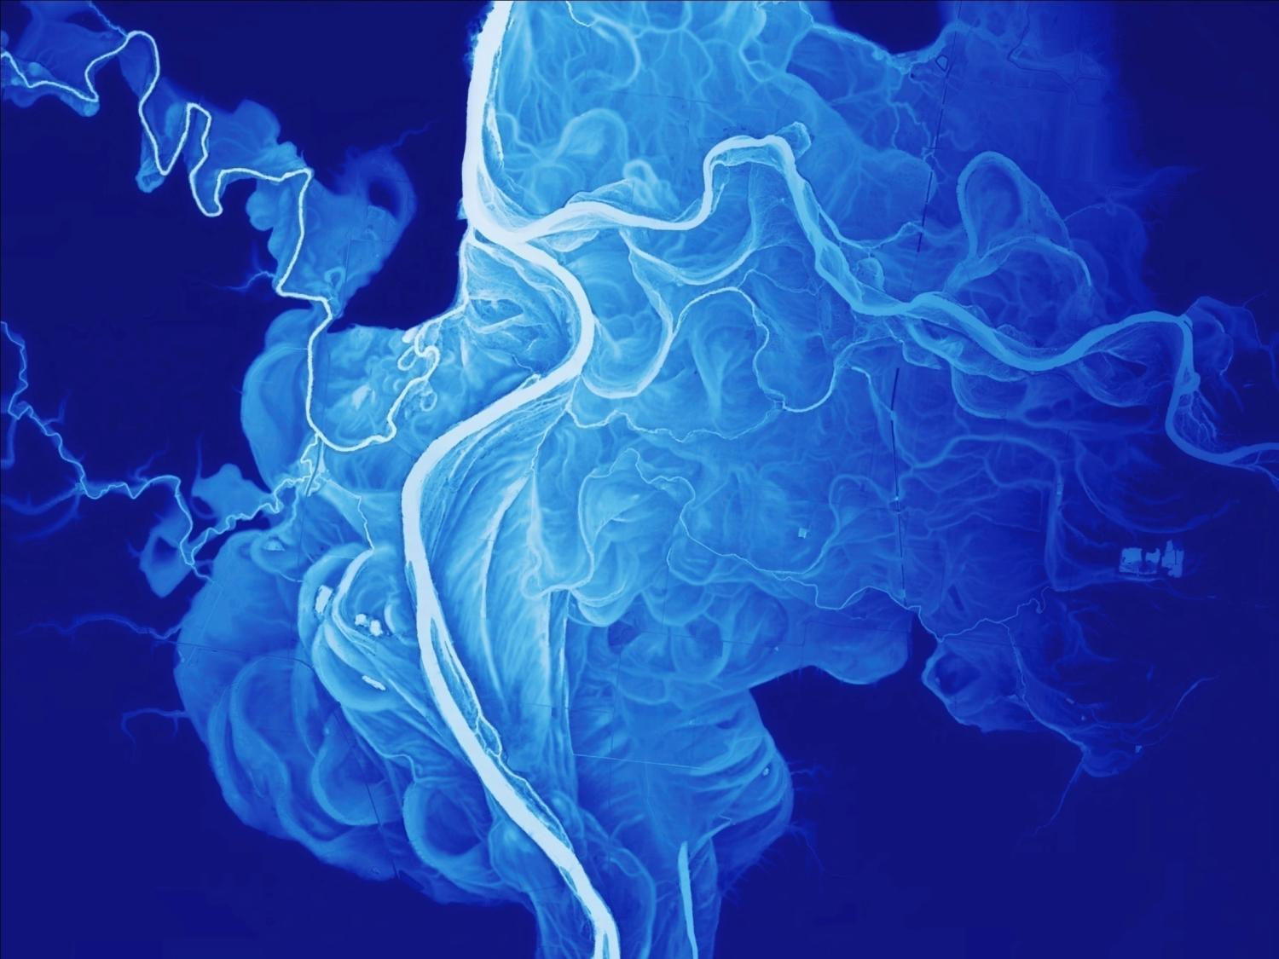
Questions?

