Slide 2

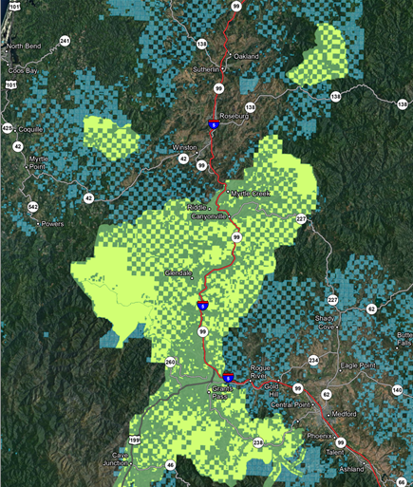
Rogue
Valley
LiDAR
Derived
Stand
Metrics

Slide 3
Rogue Valley LiDAR
Mid Rogue River, South Roseburg, Rock Cr,
Upper Coquille
Flown in 2012
~1.4 Million Acres
~650K BLM/ODF

Slide 4
LiDAR Source Reference Material
Rogue Valley BLM Stratified LIDAR
Sample Plot Methodology, March, 2013
Rogue Valley LIDAR Inventory
Plot Establishment, February 24, 2014
Notes:
LiDAR Source Reference Material
The details are in reference documents. Cheryl Friesen made copies.

Slide 5

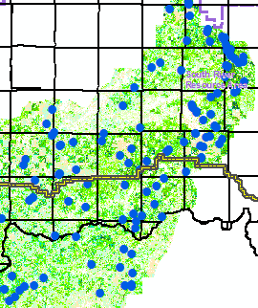
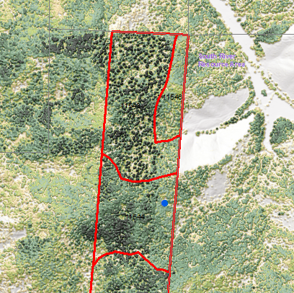
Components to
Derive Stand Metrics
LiDAR Bins
Pixelated to 75 Feet
Correlation Plot Tree Data
BLM FOI-VEG
Classified Forest Stands

Slide 6
Principle Components Analysis
Bin Development by Significance
1st Component
80TH Percentile Height
80% of LiDAR height returns below this point.
Six fixed width (30 ft) classes
Highly accurate for height prediction.
Cover %
Three equal-width density classes
Low (1), Moderate (2), High (3)

Slide 7
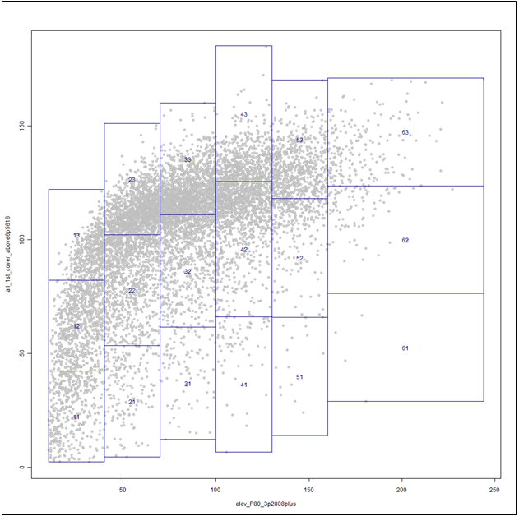
18 Bins (Strata)

Slide 8
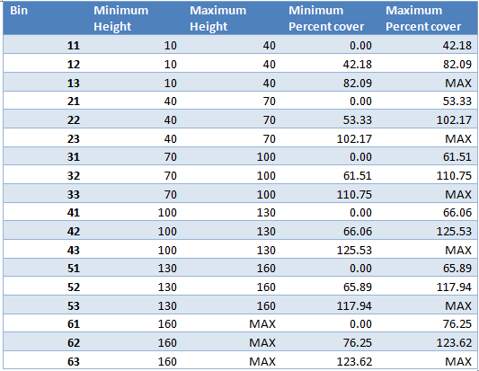
18 Bins (Strata)
Notes:
For the bins
[click] the first number represents the height classes. As you can see there are six.
[click] the second number represents the percent cover classes represented by 1-3 or Low, Mod, High.
Combined it gives a total of 18 bins.

Slide 9
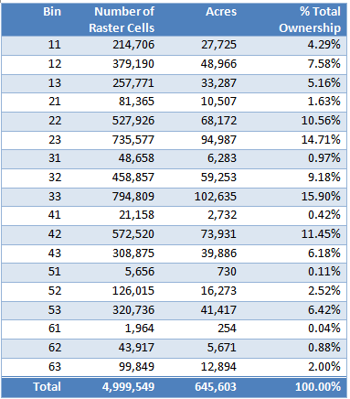
Bin Statistics

Slide 10
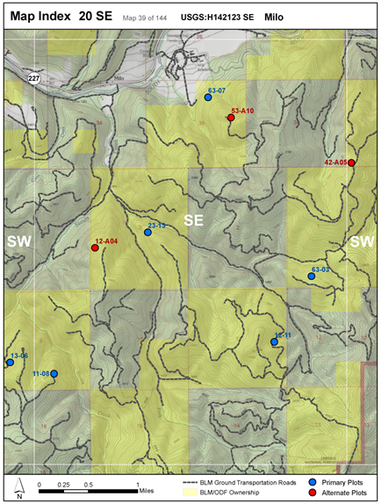
Correlation Plots
Primary
Plots
(blue)
Alternate
Plots
(red)

Slide 11
Correlation Plot Tree Data
2ND Component
240 Plots
~13 Plots per Bin
Tree List Generated per Bin
Notes:
Correlation Plot Data – 2nd Component
Tree lists were generated for each bin from the 13 plots.

Slide 12
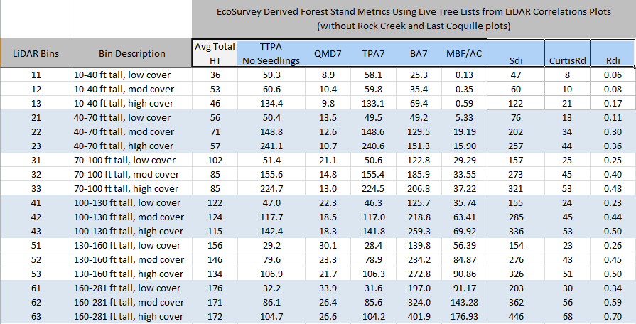
Correlation Plot Data
EcoSurvey Avg Stand Metrics per Bin
Notes:
EcoSurvey Avg Stand Metrics per Bin
The tree lists for each bin were run through BLM’s EcoSurvey program (probably similar to FS-VEG) to generate average stand metrics per bin as you see here.
[click] Unfortunately seedling counts were pulled from the correlation plot contract due to budget constraints.
[click] Also notice for these stand averages, I took out the Rock Creek and East Fork Coquille plot data because they are so different from the SW Oregon drier forest stands.

Slide 13
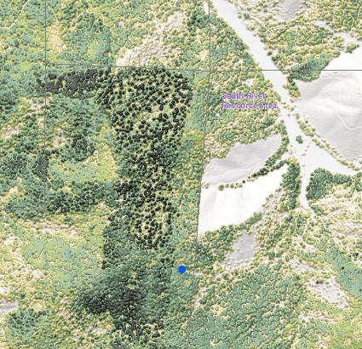
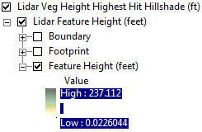
LiDAR Veg Height Color Blend
Provides Visual Contrast
One Meter Pixels

Slide 14
LiDAR & BLM FOI-VEG Polygons
3rd Component
BLM
Forest Stand
Polygons
Notes:
LiDAR & BLM FOI-VEG Polygons – 3rd Component
The third component involves using BLM’s FOI-VEG forest stand polygons. This picture reflects the checkerboard ownership of BLM lands These provide the backbone of BLM’s forest inventory of like kind forest stands.

Slide 15
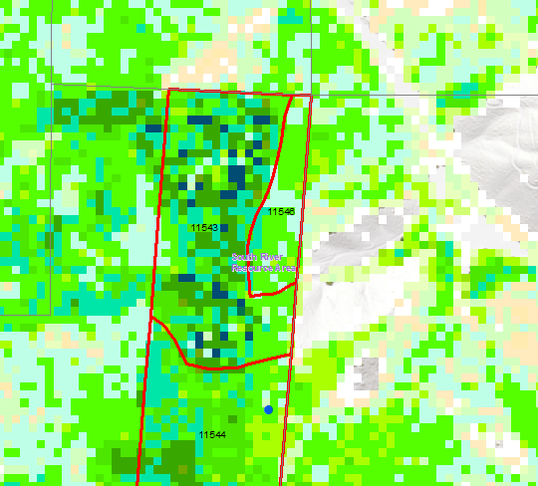
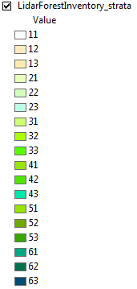
LiDAR & BLM FOI-VEG Polygons
Bin Pixels Intersected with Forest Stand
Notes:
LiDAR & BLM FOI-VEG Polygons – 3rd Component
Within each FOI-VEG polygons a weighted average of bins can be developed by intersecting in GIS the FOI-VEG polygons with the bins.

Slide 16
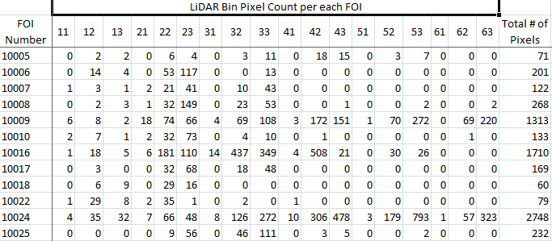
LiDAR & BLM FOI-VEG Polygons
Bin Weighted Avg per Forest Stand
Notes:
LiDAR & BLM FOI-VEG Polygons
Once intersected the number of pixels per bin and total number of intersected pixels per FOI-VEG polygon is given as shown in this partial spreadsheet.

Slide 17
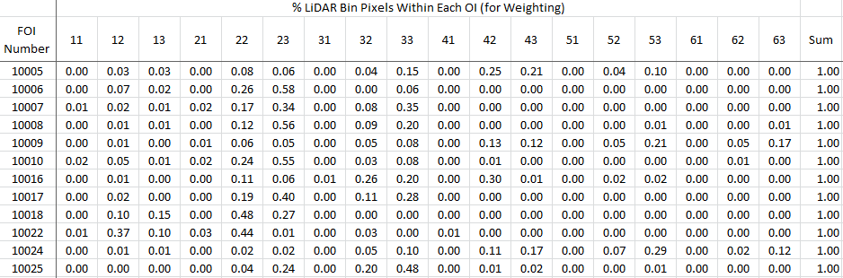
LiDAR & BLM FOI-VEG Polygons
Bin Weighted Avg per Forest Stand
Notes:
LiDAR & BLM FOI-VEG Polygons
Using the number of pixels per bin and total per FOI-VEG forest stand polygon, a weighted average for each bin is calculated as shown in this partial spreadsheet.

Slide 18
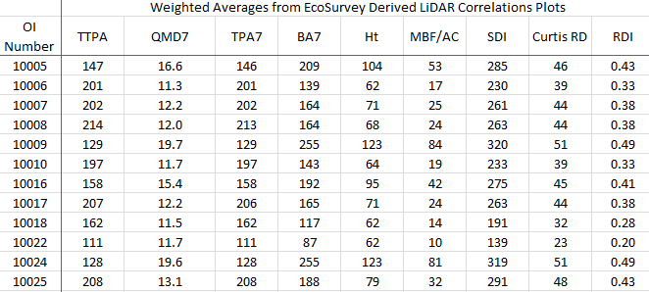
LiDAR Derived Stand Metrics
Weighted Average of the Averages
Notes:
LiDAR Derived Stand Metrics
Those weighted averages are then multiplied by the averages for each bin generated tree list and added together for each FOI-VEG forest stand to get the weighted average stand metrics.

Slide 19
LiDAR Derived Stand Metrics
Does not Give Species Mix,
Only Stand Metrics
Species Already Part of BLM’s Forest
Stand Description
Initial Quick Guide for the Field Forester
Notes:
LiDAR Derived Stand Metrics

Slide 20
Comparisons with Stand Exams
Preliminary comparisons on 80 stands
Inconclusive at this point
Need more testing & refinement

Slide 21
GIS Tools to Summarize
Stand Metrics by Unit
John Guetterman
GIS Lead Coos Bay BLM

Slide 22
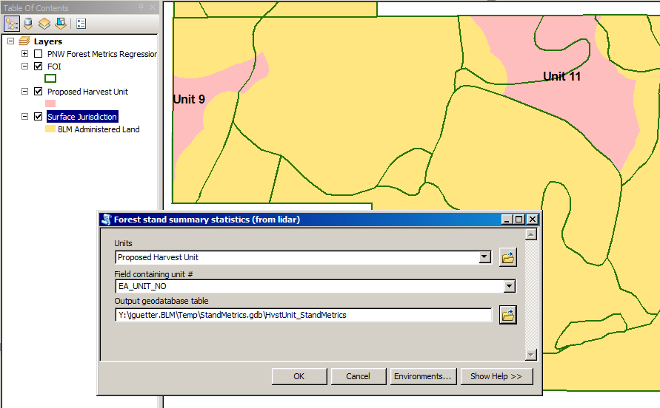
Summarizing Stand Metrics by Unit

Slide 23
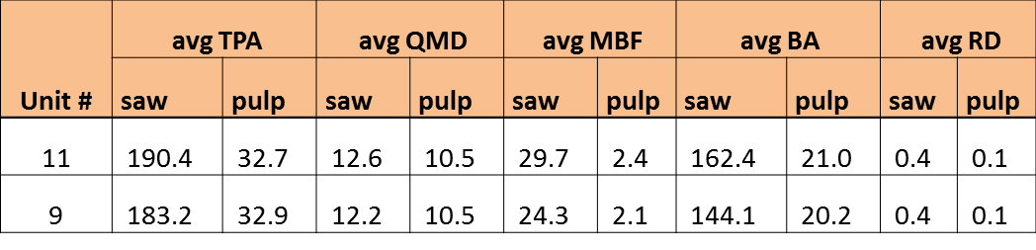
Summarizing Stand Metrics by Unit
Output = Area-weighted average by polygon
(harvest unit or whatever?)

Slide 24
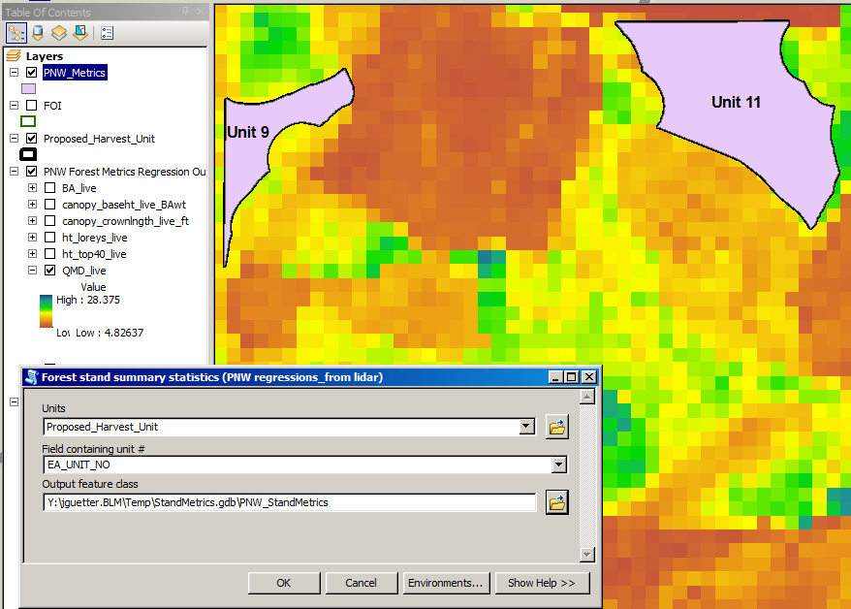
Summarizing PNW Stand Metrics by Unit

Slide 25
Summarizing PNW Stand Metrics by Unit
Output = Area-weighted average by polygon
(harvest unit or whatever?)
 | Area-weighted Averages
Unit # | BA | CanopyBaseHt | CrownLen | HtLoreysLive | HtTop40 | QMD | TPA | VolCuft
11 | 168.0 | 49.1 | 42.2 | 87.2 | 97.5 | 14.6 | 192.5 | 6,458
9 | 146.9 | 42.9 | 40.7 | 81.6 | 88.0 | 13.6 | 189.1 | 5,230

Slide 26
LiDAR
Stand Metrics
QUESTIONS?

